Slide 1
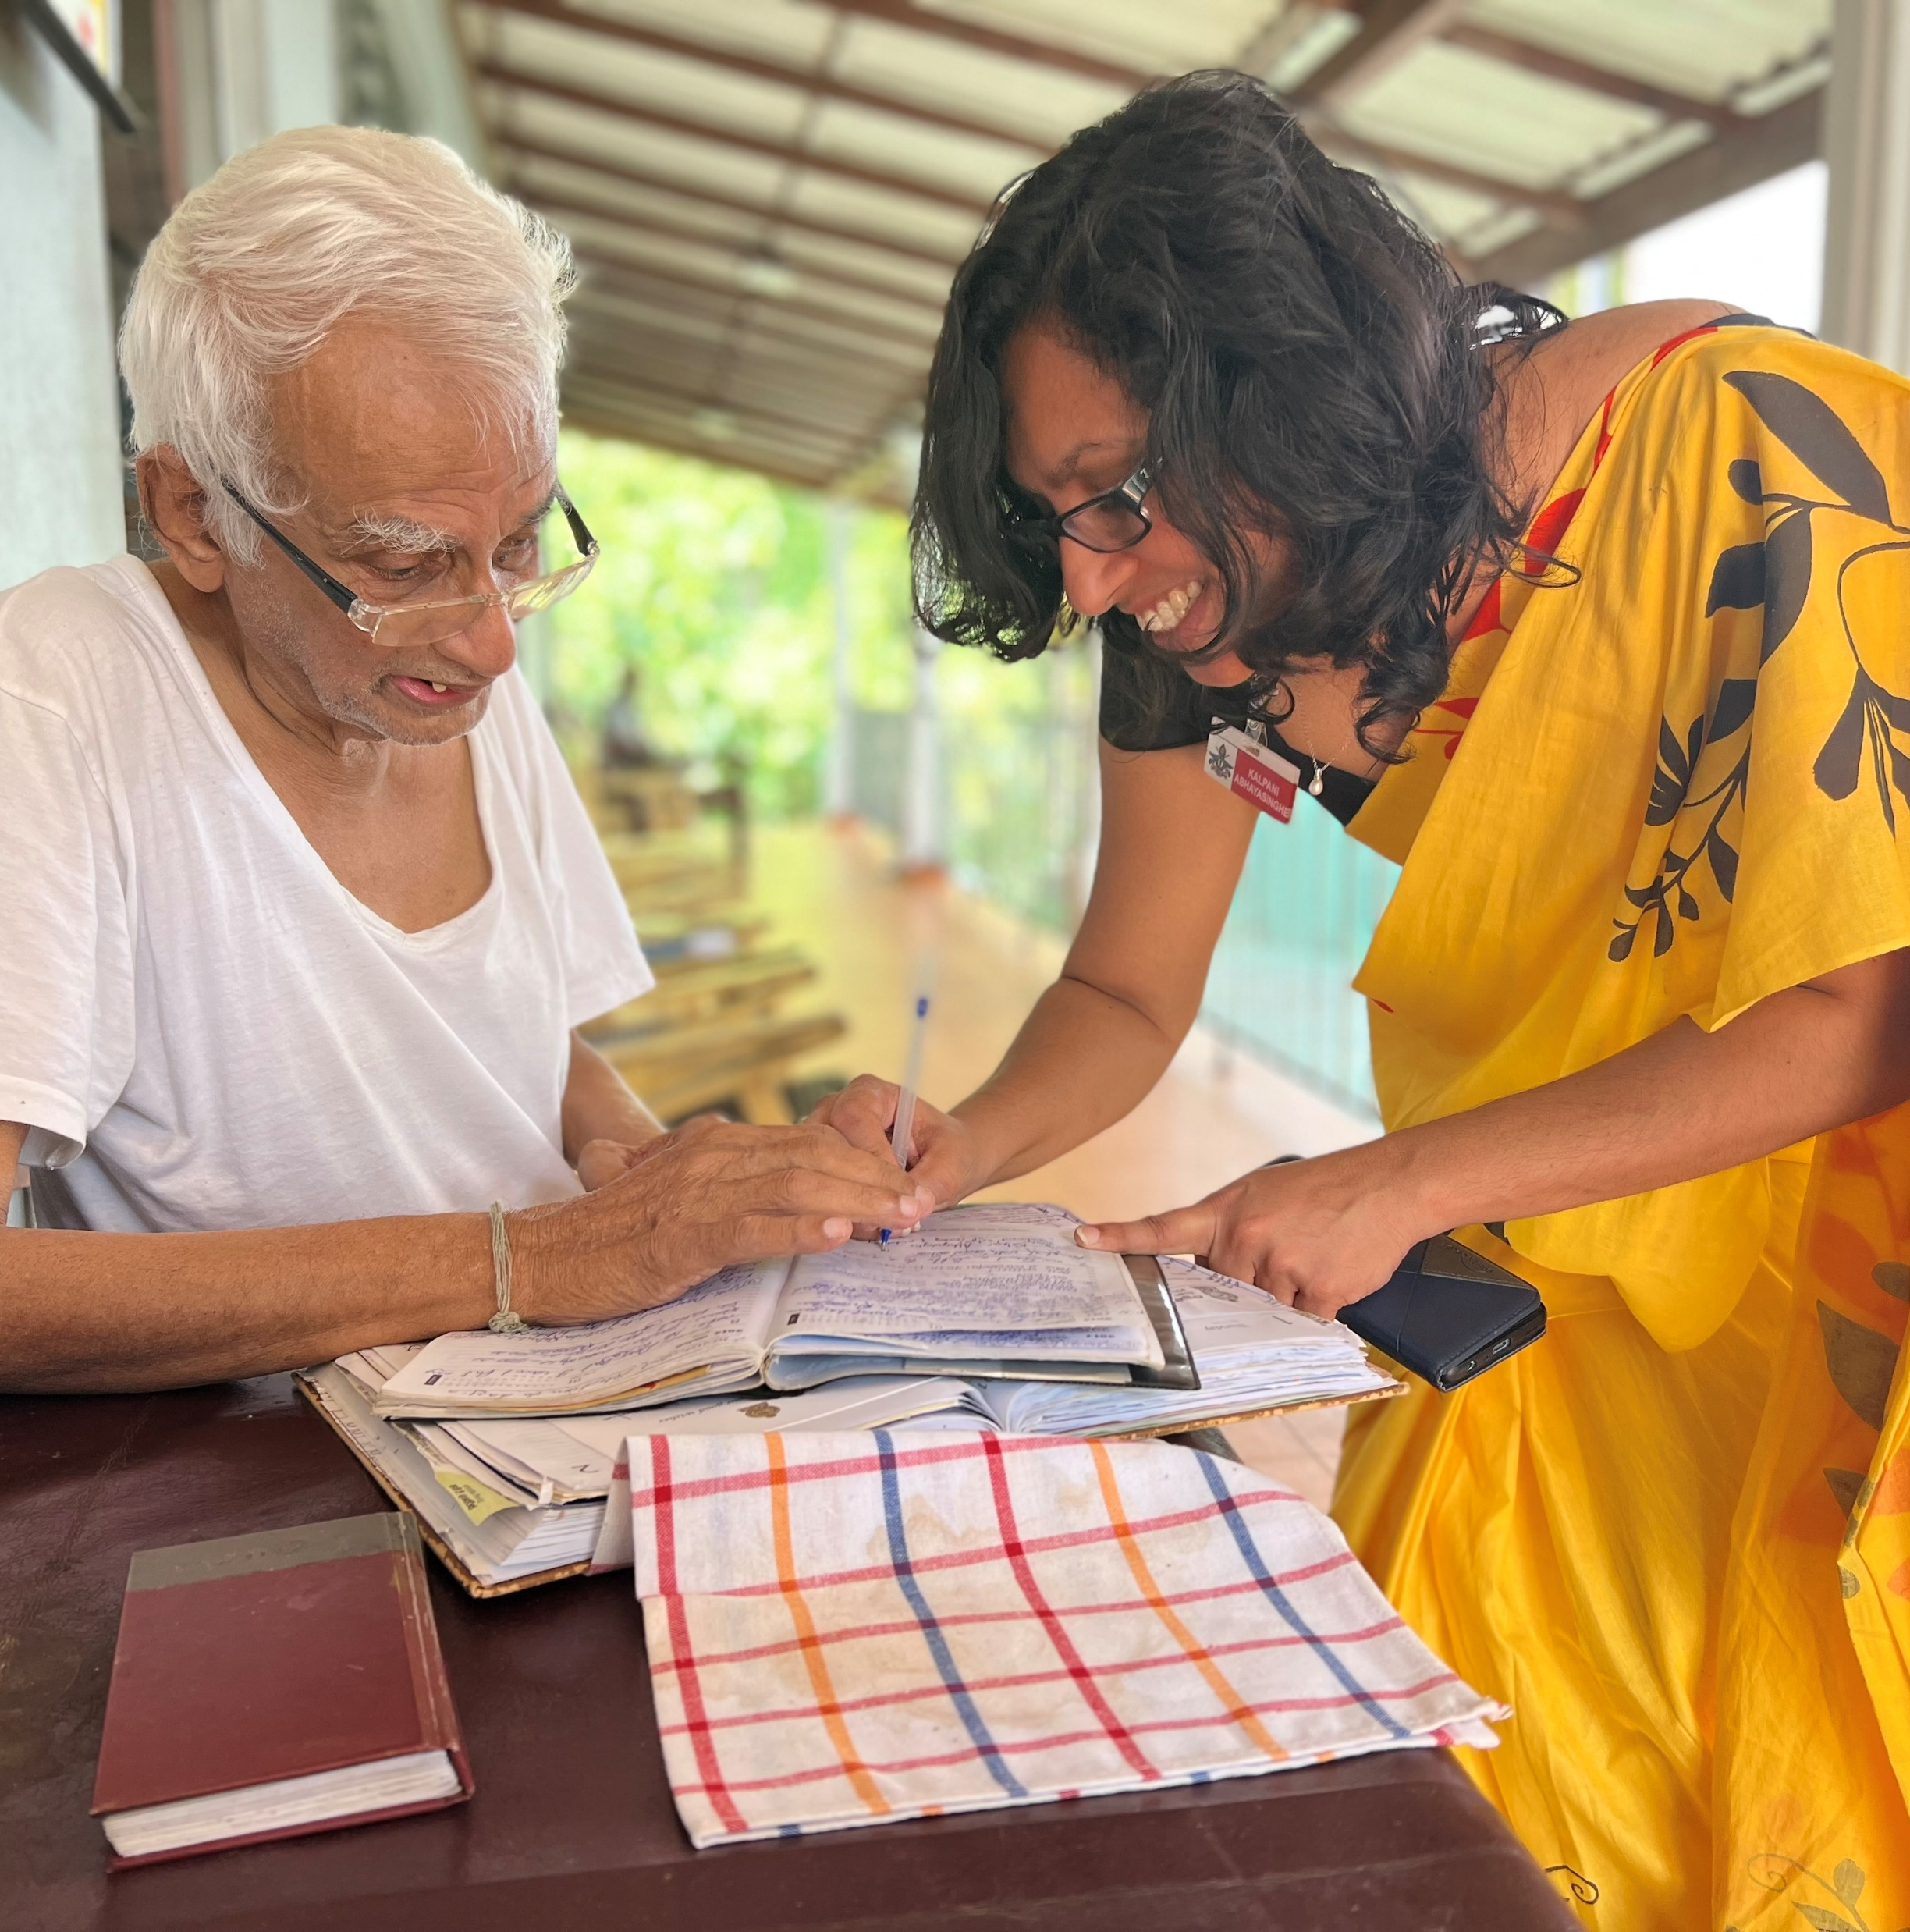


PERSON-CENTERED CARE INTRODUCTION
Reference number: 618596-EPP-1-2020-1-SE-EPPKA2-CBHE-JP This publication [communication] reflects the views only of the authors, and the Commission cannot be held responsible for any use, which may be made of the information contained therein.

Slide 2
Person-centered Care
Person centred care is about care approaches and practices that see the person as a whole with many levels of needs and goals with these needs coming from their own personal social determinants of health.
Hence, to be ‘person-centred’ means being responsive to holistic needs and to tailor care to individuals’ or group’s specific characteristics and potential

Slide 3
Course Title | : Person Centred Care
Course No | :
Credits | : 02
Core/Optional | :Core
Prerequisite | :None
Aim(s): to provide knowledge and skills related to person centred care

Slide 4
Intended Learning Outcomes
On successful completion of the course, the students will be able to:
explain the concepts of Person-centered care (PCC);
describe the principles and models of PCC;
discuss ethical and legal considerations in meeting the caring needs of persons with NDD;
compare between the local and global perspectives of PCC;
analyze PCC approach in clinical practice;
apply PCC approach in clinical practice.

Slide 5
Time Allocation (Hours)
Lectures: 18
Practical: 24
Independent learning : 58

Slide 6
Course Content
Introduction to PCC
Principles of PCC
Models of PCC (Ekman, Kitwood, McCormack & McCance)
Local and global perspectives of PCC
Ethical and legal considerations meeting the caring needs for persons with Neurodegenerative disorders (NDD)
Application of PCC in formal- and informal settings

Slide 7
Teaching /Learning Methods
Flipped classroom
Self-learning
Lectures Discussions/Role play/Study circles

Slide 8
Assessment
Continuous assessment 40%
End course assessment 60%

Slide 9
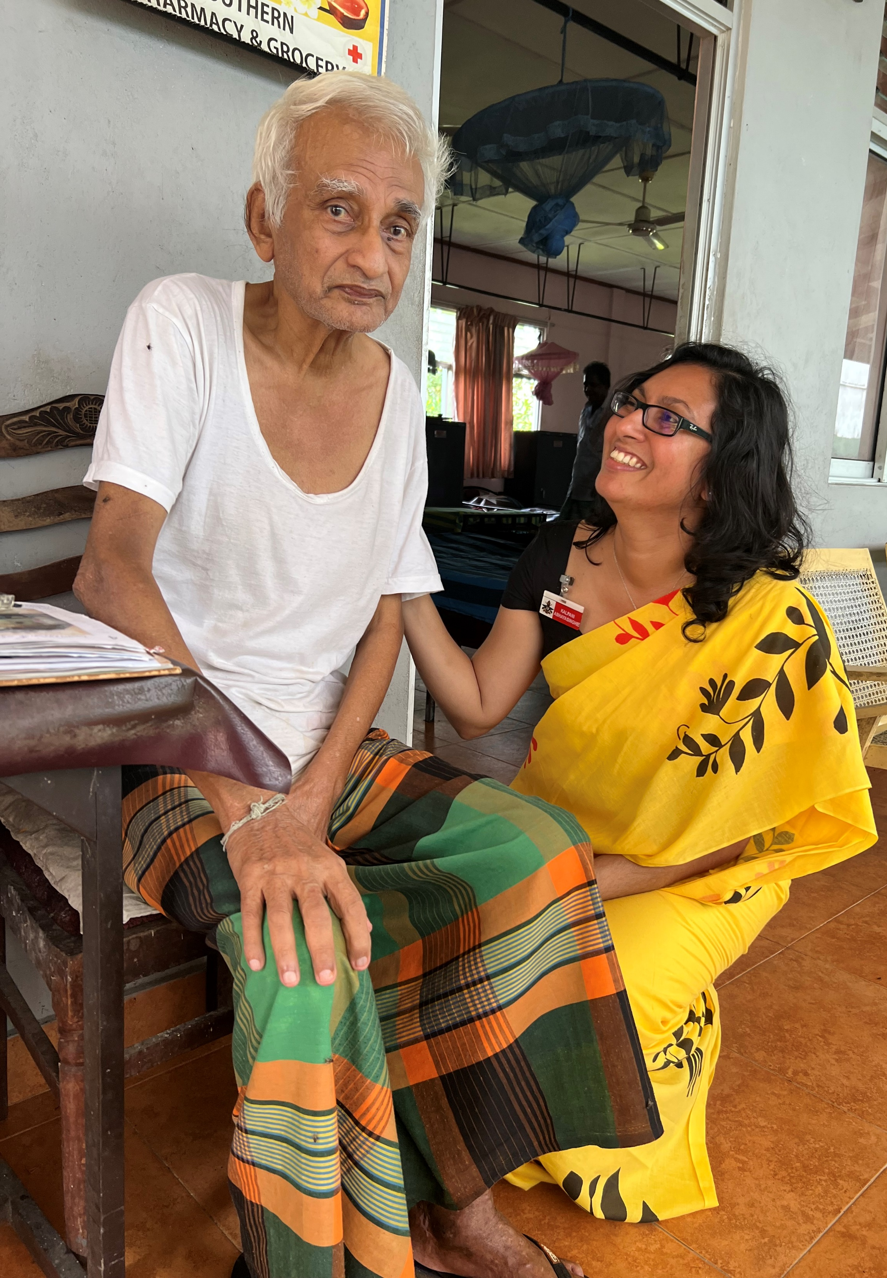
Thank you for listening!
Reference number: 618596-EPP-1-2020-1-SE-EPPKA2-CBHE-JP This publication [communication] reflects the views only of the authors, and the Commission cannot be held responsible for any use, which may be made of the information contained therein.

