Slide 1
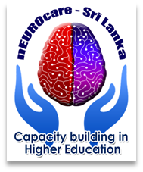

Look Back-Move Forward
Module: Implementation and Evaluation
Dr. Prasanna Herath
General Sir John Kotelawala Defence University

Slide 2
Objectives
Summarize the problems affecting the health and economy of Sri Lanka
Discuss Sri Lanka’s Health History
Explain innovation and the importance of innovation
Discuss the current health challenges of the country
Outline barriers and issues in overcoming health challenges
Explain implementation and evaluation based on the local perspective

Slide 3

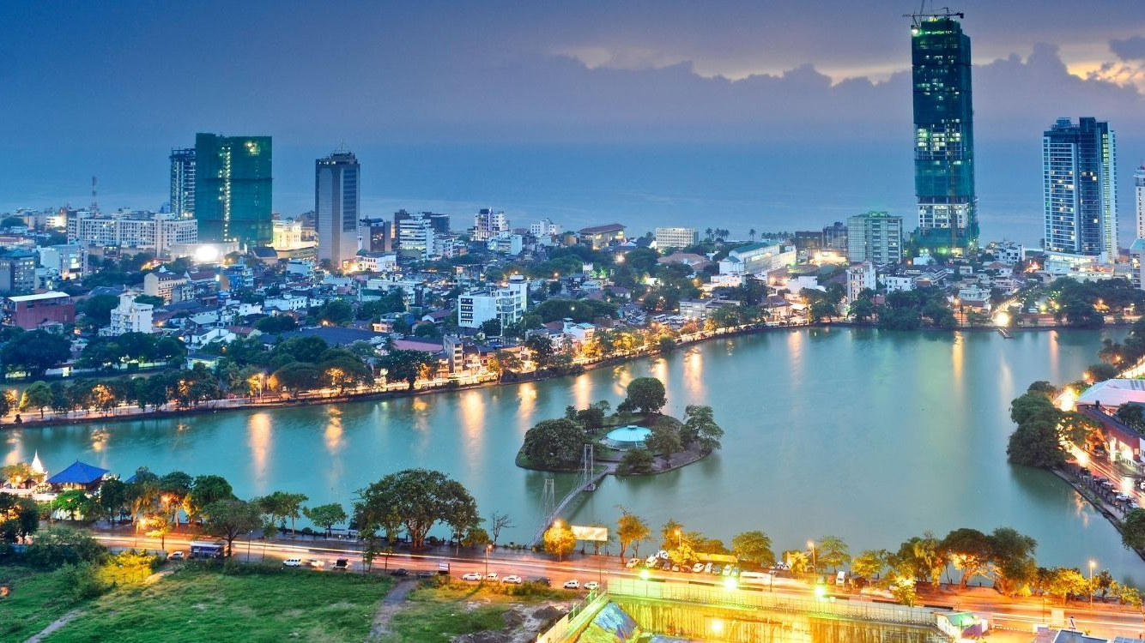




Sri Lanka
Notes:
Despite being a relatively small island, Sri Lanka is endowed with a diverse collection of landscapes, climates and natural features.
The country has no shortage of beautiful awe-inspiring spots, natural, historic and cultural, each more is-perfect than the next

Slide 4
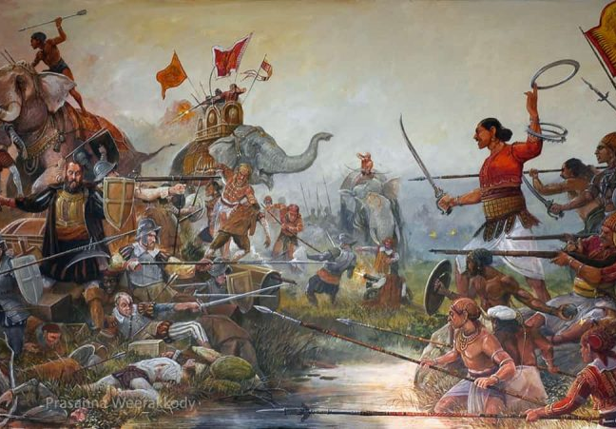
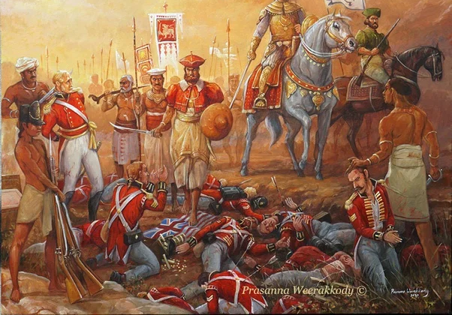
Old Sri Lanka
Notes:
I want to draw your attention-Occupied by the Portuguese in the 16th century and by the Dutch in the 17th century, became a crown colony in 1802, and was united under British rule by 1815 as Ceylon. It became independent in 1948; its name was changed to Sri Lanka in 1972.

Slide 5
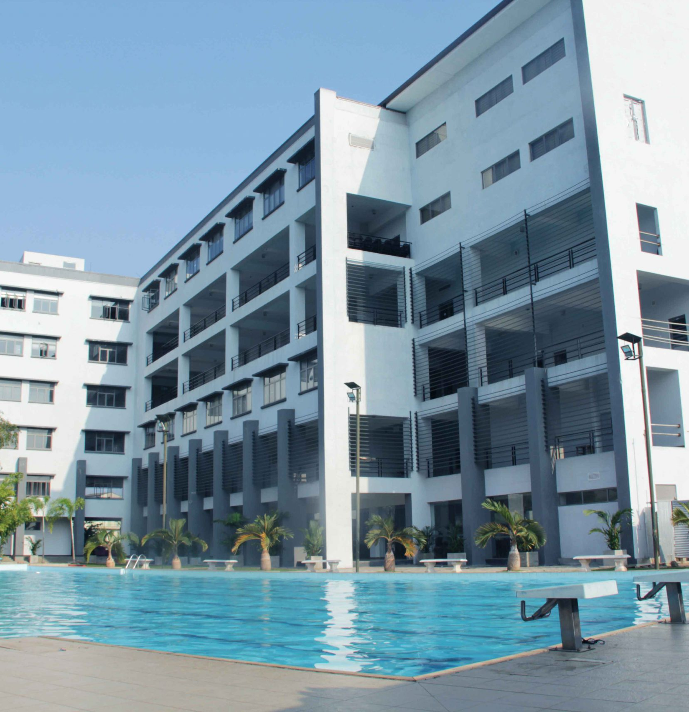
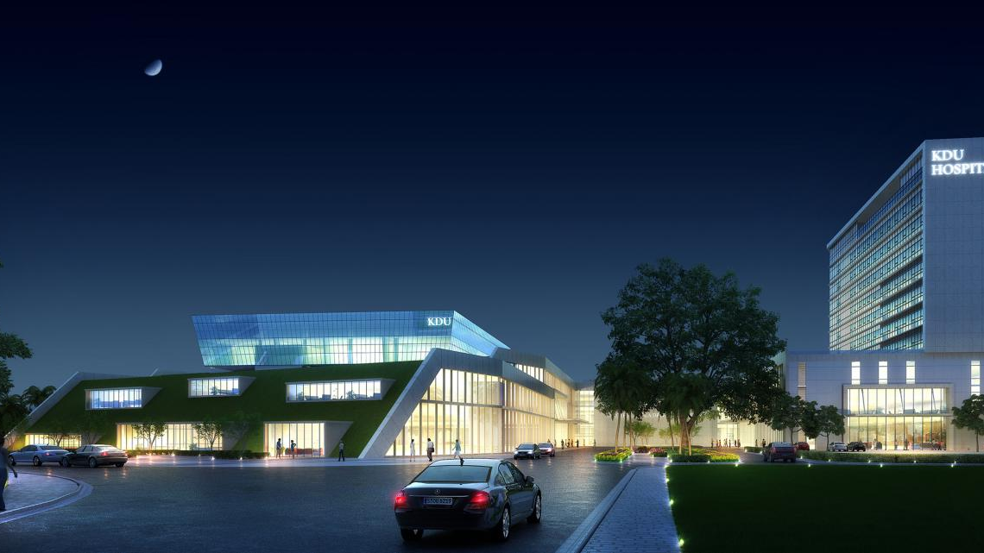

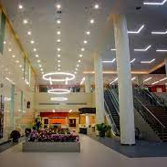
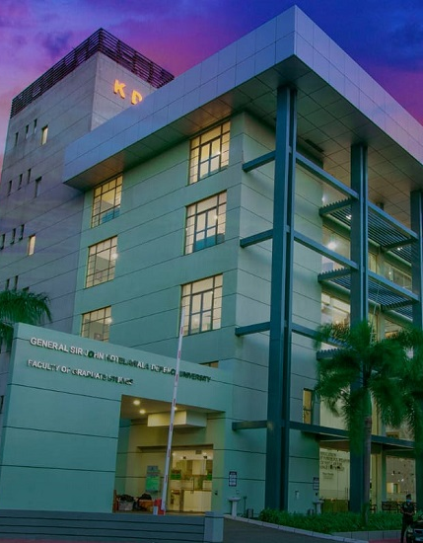
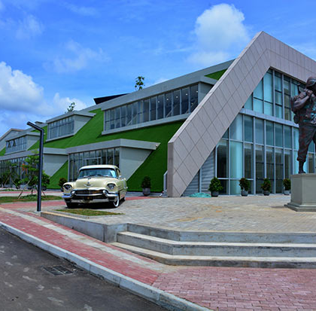
KDU
Kotelawala Defence University
Notes:
Initially established as the Kotelawala Defence Academy on 11 October 1980.
In 1986 the Board of Management of the KDA decided to elevate the Academy to the status of a University, Consequently, the Act of Parliament No. 27 of 1988 elevated the Academy to University status and its first convocation was held in 1991.

Slide 6
Socio-demography of Sri Lanka
Total population 22.16 million
Sri Lanka is a developing country, ranking 73rd on the Human Development Index.
Sri Lankans have a life expectancy of 75.5 years at birth, which is 10% higher than the world average.
Sri Lanka ranks first among southeast Asian countries with respect to deaths by suicide, with 33 deaths per 100,000 persons ¹.
The life expectancy for Sri Lanka in 2022 was 77.39 years, a 0.22% increase from 2021
Notes:
According to the Department of Census and Statistics, poverty, destructive pastimes, and inability to cope with stressful situations are the main causes behind the high suicide rates,

Slide 7
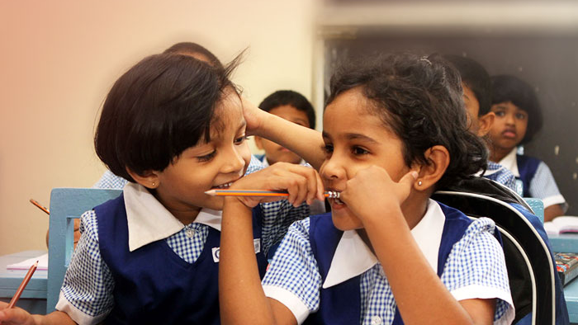
Major Problems affected the Health and Economy of Sri Lanka

Slide 8
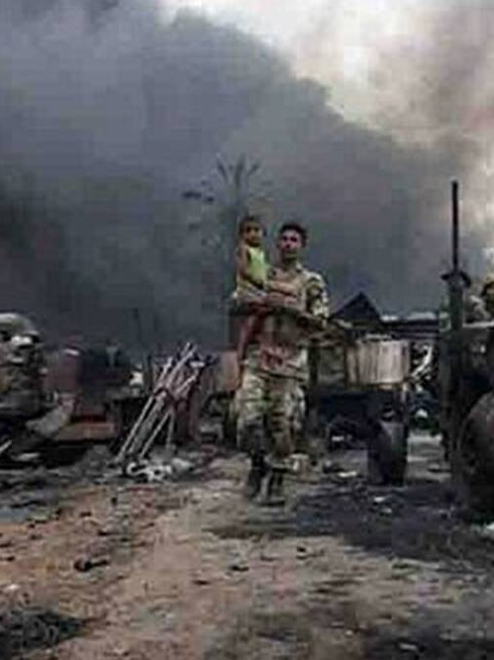
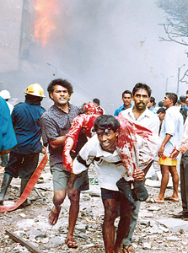
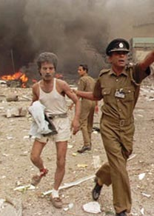
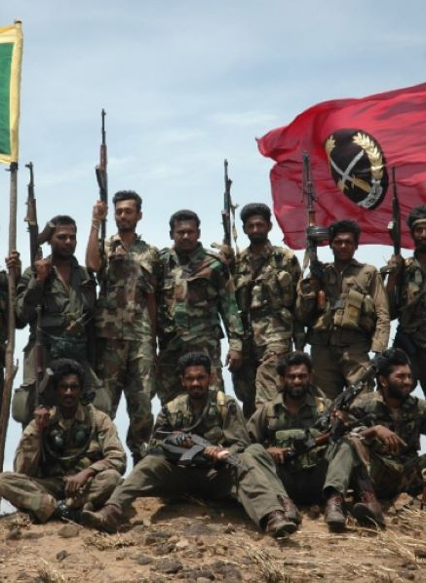
The Sri Lankan Civil War (1983 -2009))
Notes:
The war was mainly a clash between the Sinhalese-dominated Sri Lankan government and the Liberation Tigers of Tamil Eelam (LTTE) insurgent group ...
The Sri Lankan Civil War erupted in 1983 and dragged on until 2009. -80,000 died
Altered Physical health impact/Mental health impact/Collective trauma/ Combatant mental health/ Child and adolescent mental health/ Forced internal displacement were the results.

Slide 9
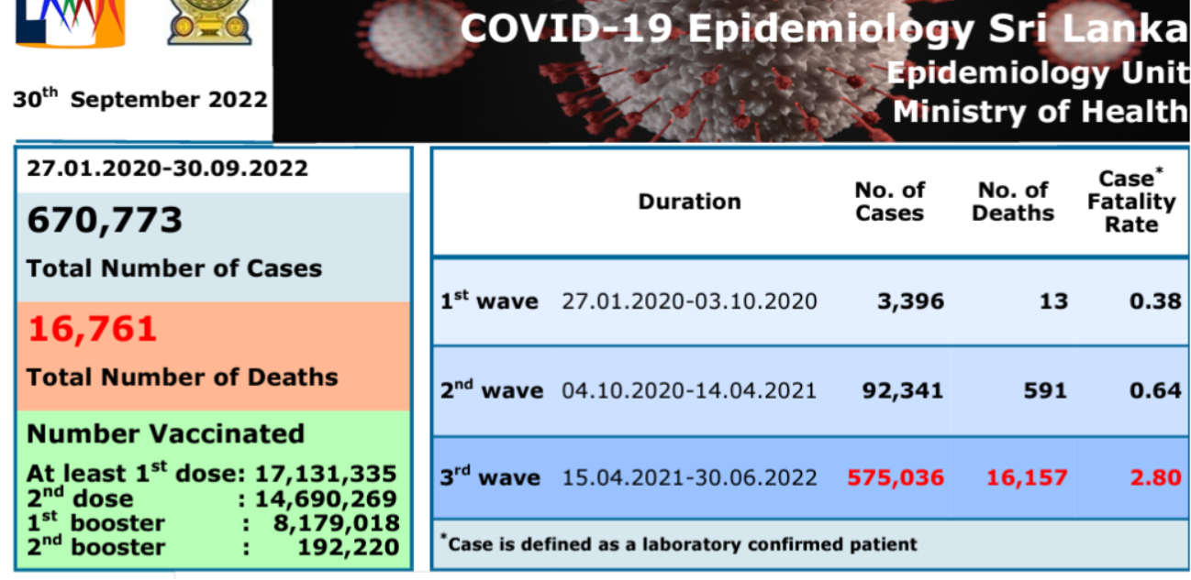
COVID-19 Pandemic
Notes:
It is not a secret that Sri Lanka was severely impacted by the global economic shifts brought about by the covid 19 pandemic.

Slide 10
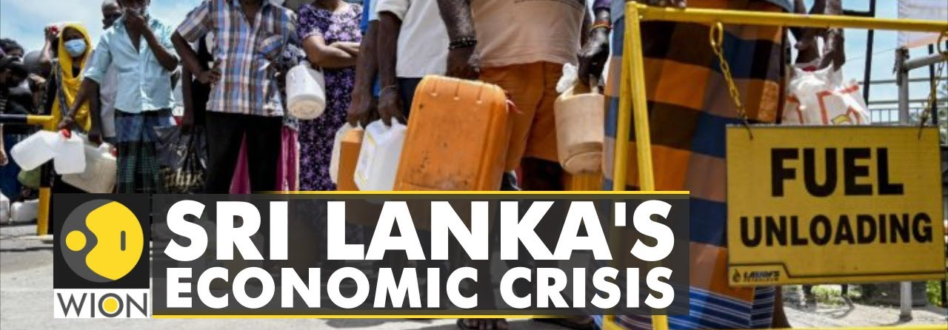
Sri Lanka’s sudden economic collapse
Threats to health from an economic crisis are multifold.
Stress and lack of health care can increase cardiovascular morbidities.
Malnutrition can affect generations of children.
Communicable diseases can increase due to rising costs of amenities
Notes:
The pandemic—and the subsequent collapse of tourism—is one reason
critics also cite mismanagement, such as a series of tax cuts that have left the government short of funds. Inflation hit 30%,
Communicable diseases can increase due to rising costs of amenities and the weakening of preventive and control measures

Slide 11
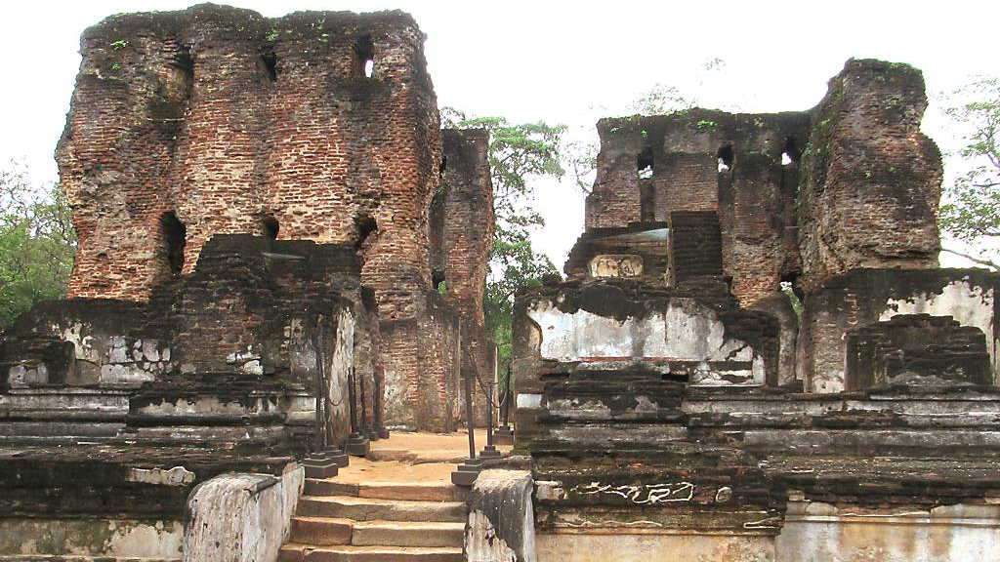
History of Health , Sri Lanka

Slide 12
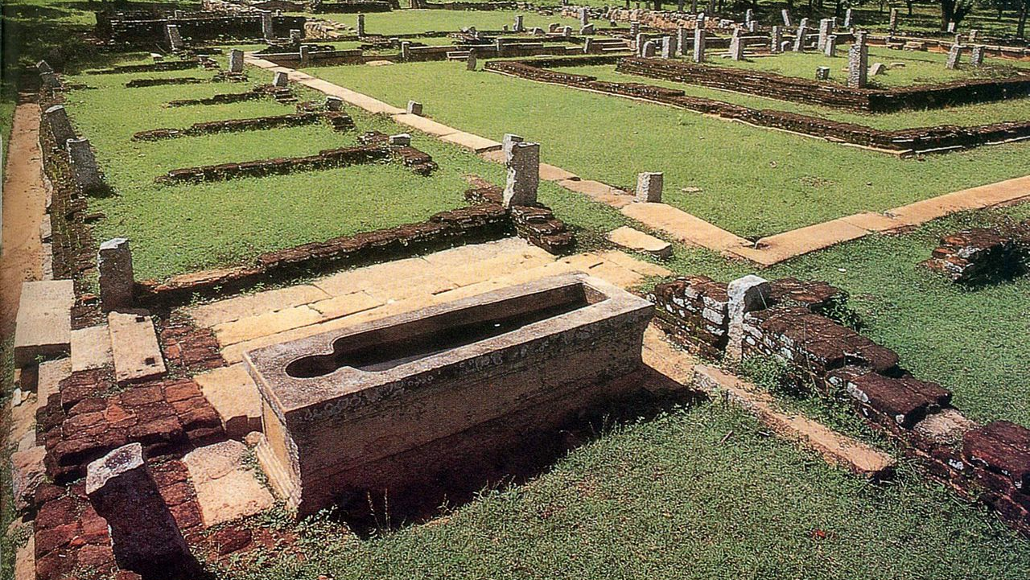
Ruins of a 2,000-year-old Mihintale hospital in the historical city of Anuradhapura³
Notes:
The history of Sri Lanka is intertwined with the history of the broader Indian subcontinent and the surrounding regions, comprising the areas of South Asia, Southeast Asia and Indian Ocean.
The early human remains found on the island of Sri Lanka date to about 38,000 years ago (Balangoda Man).
The historical period begins roughly in the 3rd century, based on Pali chronicles like the Mahavansa, Deepavansa, and the Choolavansa. They describe the history since the arrival of Prince Vijaya from Northern India.The earliest documents of settlement in the Island are found in these chronicles
Ruins of a hospital in Mihintale which was built by King Sena that dates back to the 9th century has been discovered and it is considered one of the world's oldest hospitals.

Slide 13

Health History-Sri Lanka
The surgical skills of King Buddhadasa (337-365 A.D.) to whom the authorship of the well-known medical book Sararthasangraha, are illustrated in the legendary tales found in the chronicle.
The fifth-century commentary Visuddhimagga of Buddhaghosa states that a “skilled student who has developed concentration of mind uses the scalpel on a lotus leaf in a dish of water and leaves the scalpel mark without the leaf being pushed underwater”.
Notes:
Next want to draw your attention for the history

Slide 14
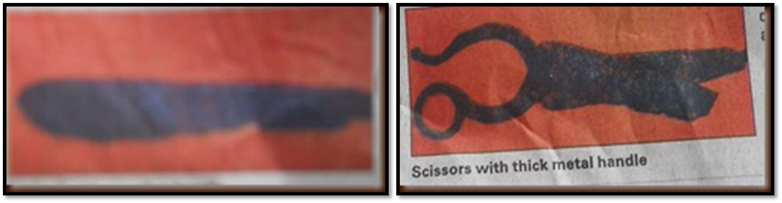
History of Health , SriLanka
A Sinhala text datable to a period between the eleventh and the thirteenth century, the Karmavibhaga, contains a clear reference to foetology.
While describing the sufferings a human being has to undergo at birth, this text states that “the foetus will be torn to pieces with sharp instruments if it assumes a transverse position at the time of birth”.
Notes:
These textual references to surgery have been confirmed by the discovery of probes, forceps, scissors, scalpels and a lance at the Polonnaruwa datable to the twelfth century.
They have been made out of bronze or iron with a small percentage of steel.

Slide 15
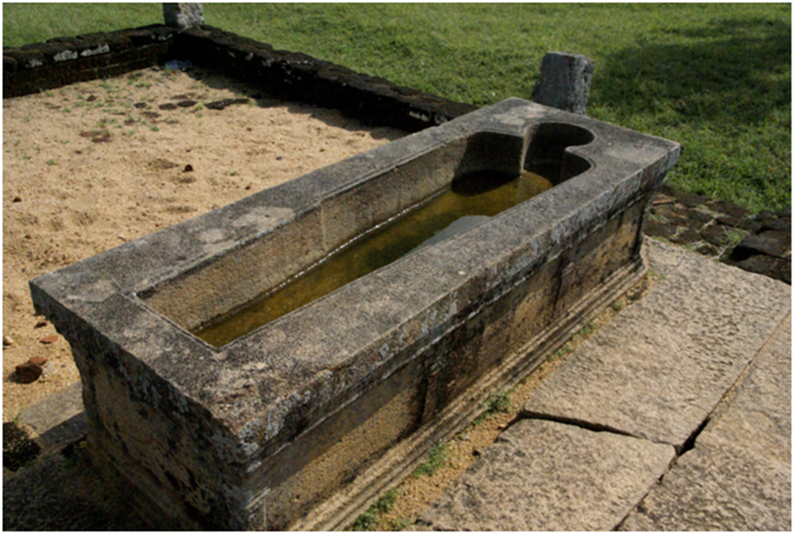
Why care about the history
“You have to know who you are and where you come from.
If you don’t know where you come from, how do you know where you are going?”
F. Fleisher, The Jazz Singer-1980

Slide 16

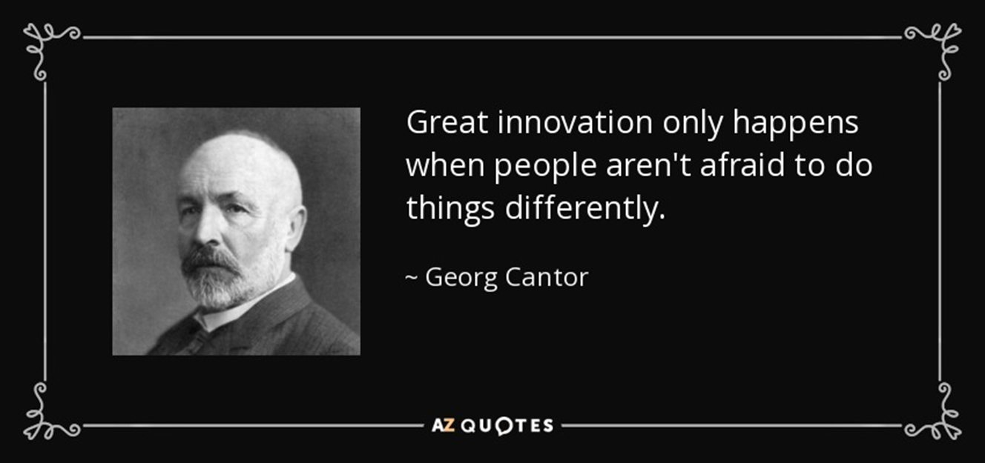
History & Innovation

Slide 17
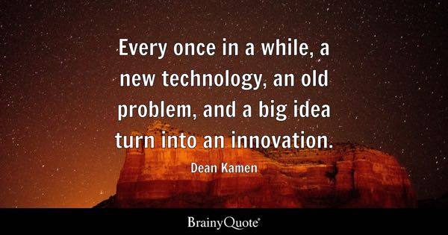

Slide 18
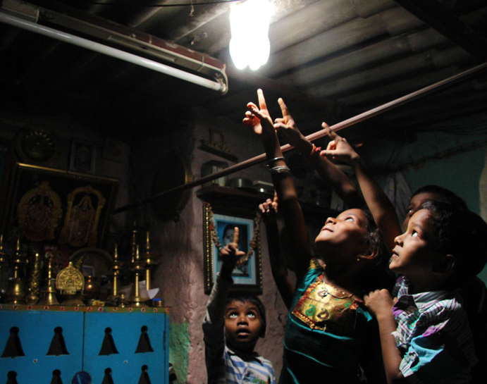
Innovations
The Solar Bottle Bulb
Notes:
The water inside the bottle refracts sunlight, creating an artificial light that can emit the equivalent of a 55-watt electric lamp.-Philippines

Slide 19
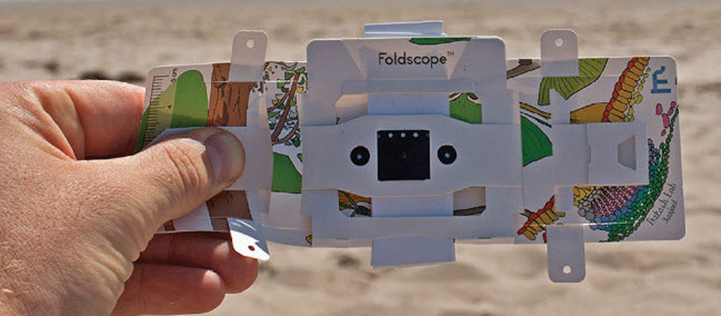
1 dollar microscope
Notes:
Foldscope is a paper microscope inspired by origami. It costs less than one U.S. dollar and fits easily in a pocket, yet is powerful enough to reveal blood cells and bacteria. Foldscope could prove invaluable for medical use or educational institutions in remote or resource-scare areas.
The WIPO Re:Search initiative to fight against neglected tropical diseases has supported field studies with the University of Lagos, to use Foldscope as a diagnostic tool in treating malaria.

Slide 20
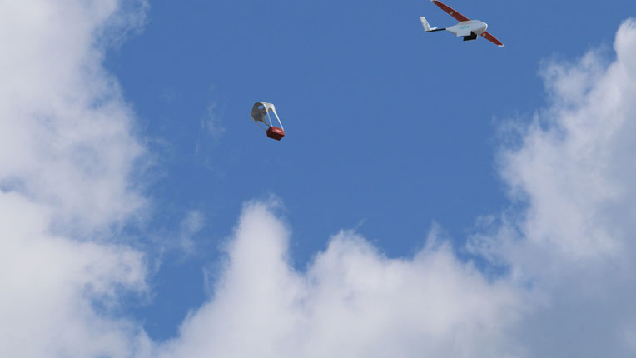
Medical drones
Notes:
Medical delivery drones are used to deliver vital medical supplies to patients living in difficult-to-reach parts of Rwanda. The drones, called Zips, can carry vaccines, medicines or blood to patients. Health workers simply text an order for the medical supplies they need to a central distribution center. Within minutes a Zip is loaded and launches, travelling at around 100 km/h to its destination, where the supplies are dropped with a paper parachute.

Slide 21

What is innovation in healthcare?
WHO defines health innovation as a new or improved solution with the transformative ability to accelerate positive health impact³. (WHO2023)

Slide 22
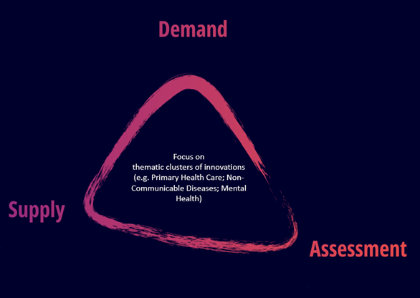
Innovation in healthcare
WHO’s Innovation Scaling Framework illustrates the multi-partner collaborative approach. WHO is taking to scaling innovation by linking three dimensions of innovation scaling:
  1) the health demands and priorities of countries
  2) the supply of ready-to-scale innovations
  3) assessment throughout from incubating (through partners) to implementing and sustaining innovations.

Slide 23
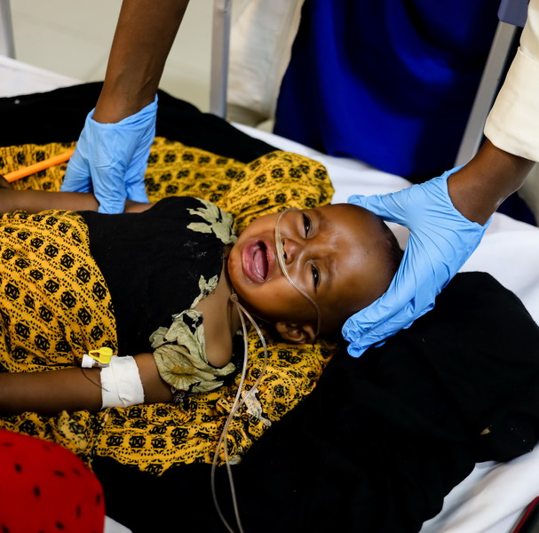
Innovation for health in action
1. Solar-Powered Oxygen:
Saving Lives with the WHO Innovation Scaling Framework.
This child is receiving oxygen through a solar-powered concentrator – an innovative solution that can save lives in places with frequent power shortages.
Notes:
Pneumonia accounts for 800 000 deaths per year of which 20-40 % could be saved with oxygen, and COVID-19 has accelerated global demand for medical oxygen.
Between February and March 2021, solar-powered oxygen concentrators were installed in a regional children’s hospital in Galmudug state, Somalia. This innovation pilot has already saved many lives (and counting).

Slide 24
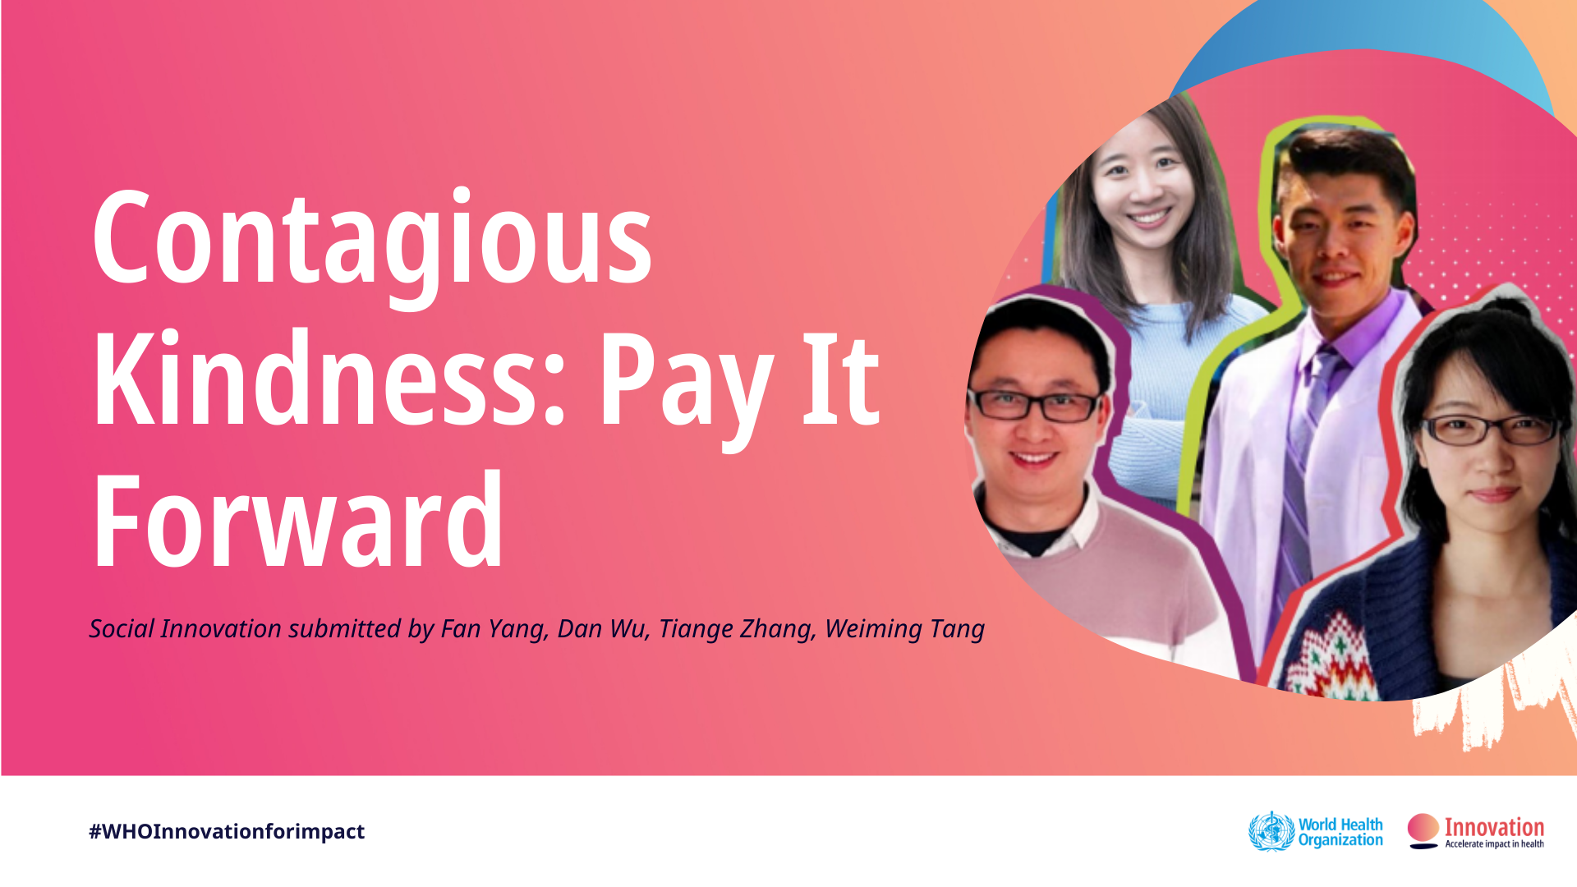
Innovation for health in action
2. Contagious Kindness - Pay It Forward
The team behind Contagious Kindness have developed an innovative approach, which empowers individuals and builds community support by offering young men at risk a free point-of-care test for gonorrhea and chlamydia, along with the opportunity to donate a free test to another young man.
Notes:
This includes a lack of screenings for many sexually transmitted infections, such as Gonorrhea and Chlamydia infections. In many countries, STI testing is not subsidized, meaning many young people are faced with financial barriers, a lack of community support and a subsequent increased likelihood of contracting STIs.

Slide 25

Innovation for health in action
3. RX Radio - Children’s Voices
RX Radio is a radio station that is run by and for children at the Red Cross Children’s Hospital in Cape Town.
Notes:
With the outbreak of COVID-19, reporters began utilising WhatsApp voice-notes and other remote recording methods to gather content about the pandemic and act as an educational, informational and entertainment tool for audiences and their families.
Children are also given the opportunity to work as young reporters, creating clear, helpful PSAs in various languages to educate fellow children and their families on COVID-19.

Slide 26
Innovation for health
This term covers any breakthroughs, no matter how simple or advanced, that result in better medical courses of action and experiences for patients, including new and better:
  Healthcare procedures
  Processes
  Commodities
  Solutions
  Distribution channels
  Regulations
  Strategies
  Products

Slide 27
Why is healthcare innovation important?
lead to better patient care, improved population health, and lower healthcare costs.
Improve patient outcomes by providing new and better treatment options, making it easier for patients to access care.
Lead to improvements in population health by making it easier for people to live healthy lifestyles and by providing new tools to detect and prevent the early onset of diseases.
an help to lower healthcare costs by improving the efficiency of care delivery and by providing new and less expensive treatment.
In essence, these innovations are important because they will require healthcare companies to come up with better tools to address health issues on a greater scale.

Slide 28
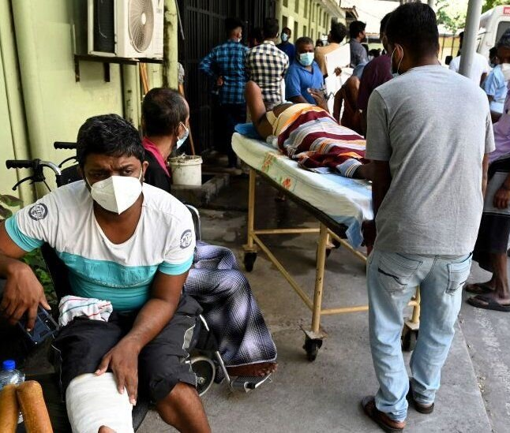
Health Facilities
Medical Officers per 100,000 population 93.5
Nurses per 100,000 population 214.8
Number of Hospital beds per 1,000 population 4.0
Nmber of hospitals 643
Percentage of elderly population has almost doubled during the period from 1981 to 2019
Notes:
Sri Lanka has a universal health care system that extends free[clarification needed] healthcare to all citizens, which has been a national priority.
OPD facilities are readily available in public (general) hospitals situated in major towns and cities, with laboratory and radiology facilities common in most. But most illnesses can be treated in teaching hospitals in Colombo, Colombo South, Colombo North, Kandy/Peradeniya, Galle (Karapitiya Hospital), Anuradhapura and Jaffna.

Slide 29
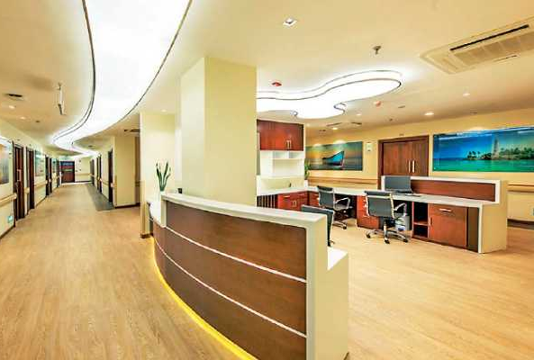
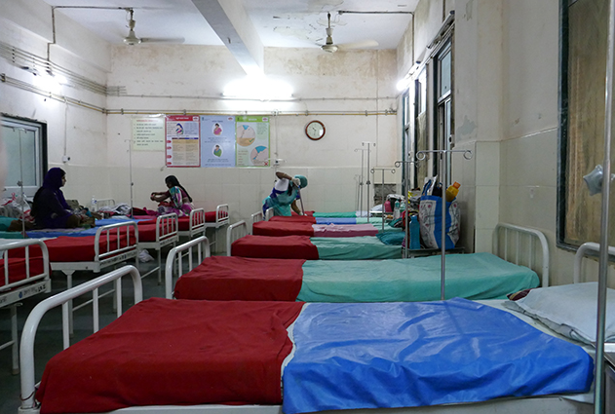
Sri Lankan Health Sector
The private sector provides access to almost all types of care at a cost while the public sector provides free health services at the point of care.
Notes:
The Sri Lankan health system comprises of different systems of medicine,
Western medicine is the leading sector
Western medicine is provided through both public and private sectors, but the share of care differs for inpatients and outpatients.
The public health sector is organized into two parallel streams as community health services and curative care services

Slide 30
Current Health Challenges of the Country
Non-Communicable Diseases
Nutrition challenges
Elderly / Ageing Population
Mental Health
Road Traffic accidents/Natural disasters
Suicide
Drug abuse
Food safety
Plantation Health
Cancer

Slide 31

Implementation
Implementation refers to the concrete activities and interventions undertaken to turn policy objectives into desired outcomes (Pressman and Wildavsky, 1973)

Slide 32

Barriers & Issues- Client perspective
Lack of responsiveness
Inequities in access to preventive health services
The Public has less access to information on Preventive Health
Inadequate public demand for preventive health services

Slide 33
Barriers &Issues - Stewardship
Poor Inter sectoral coordination among different preventive programs at the district, provincial & national level
Poor Inter-ministerial coordination e.g., Ministry of Education
Provincial level managers & central government communication issues
Certain preventive programs do not have policies
Issues in governance systems
Poor private sector in the involvement of preventive health service delivery
Lack of a coordinated mechanism on Global health issues

Slide 34

Other Barriers &Issues
Lack of efficiency in information flow
Lack of focused research and operationalizing of research findings
Lack of information flow from private and civil society agencies
Financial issues in investments
Lack of professionals and expertise
Technological deficiencies

Slide 35
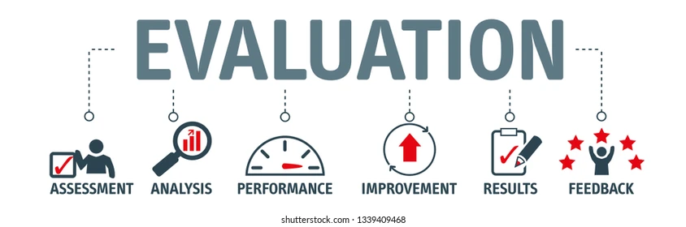
Barriers &Issues- Evaluation
The purpose of evaluation is to determine what outcomes—both desired and undesired, anticipated and unanticipated—have occurred as a result of a policy or program (Suchman, 1967).

Slide 36

Barriers &Issues- Monitoring & Evaluation
All Public health programs do not receive the same attention for monitoring and evaluation
Program objectives, targets, and indicators are ill-defined
Several public health programs are not results driven – Results based plans to be adopted
Lack of proper systems for validation of procedures
Lack of system for accreditation of public health services

Slide 37
Strategies/ Activities-Evaluation
Strengthening the monitoring and evaluation mechanism
Establish Specific Measurable Attainable Realistic and Time bound ( SMART ) programe objectives , targets and indicators for all preventive health programmes
Results Based Monitoring ( RBM ) should be incorporated to all preventive health programmes

Slide 38
REFERENCES
Knipe DW, Metcalfe C, Fernando R, Pearson M, Konradsen F, Eddleston M, Gunnell D: Suicide in Sri Lanka 1975-2012: age, period and cohort analysis of police and hospital data. BMC Public Health.
3. https://www.who.int/teams/digital-health-and-innovation/health-innovation-for-impact
."Surgery in an ancient kingdom". www.SundayTimes.lk. Retrieved 15 June 2017

Slide 39

Thank you

