Slide 1
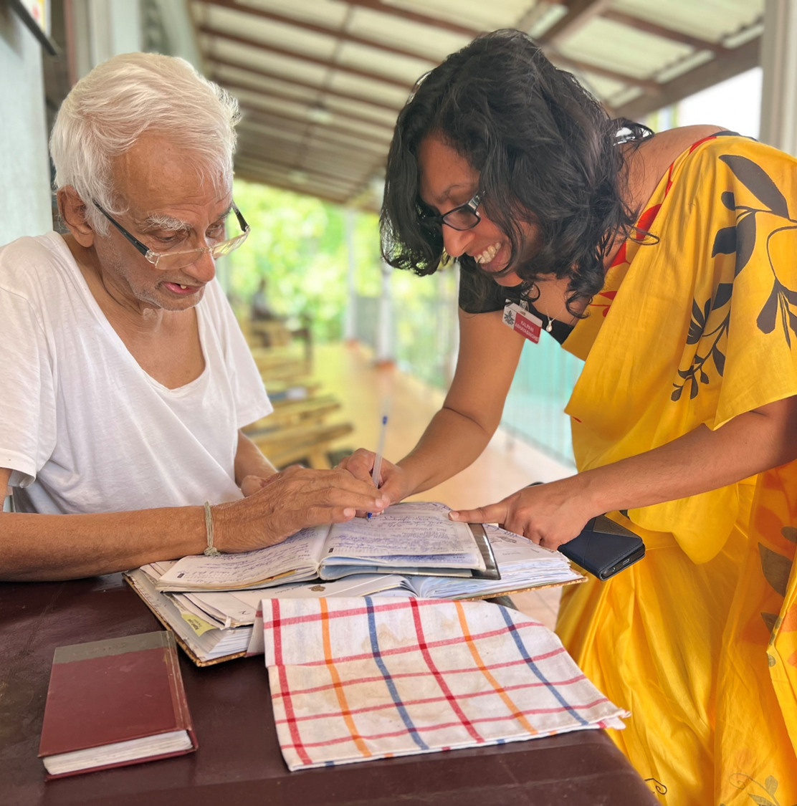



PERSON-CENTERED CARE
IMPLEMENTATION
PART II
Reference number: 618596-EPP-1-2020-1-SE-EPPKA2-CBHE-JP
This publication [communication] reflects the views only of the authors, and the Commission cannot be held responsible for any use, which may be made of the information contained therein.

Slide 2
Intended learning Outcome
After completion of the lecture, students will be able to
  Describe ‘what is implementation?’.
  Explain various types of interventions related to Person Centered Care.
  Explain challenges of interventions related to Person Centered Care.
  Describe outcomes of interventions related to Person Centered Care.
  Explain models of implementations related to Person Centered Care
  Apply various types of interventions related to Person Centered Care.

Slide 3

Frameworks for implementation of PCC

Slide 4
WE-CARE Roadmap framework
WE-CARE Roadmap framework -identified the implementation of Person-Centered Care (PCC) as a vehicle to improve quality and contain the increase of costs in healthcare , thus improving accessibility and affordability of future health care for all (Lewandowski et al, 2021)

Slide 5
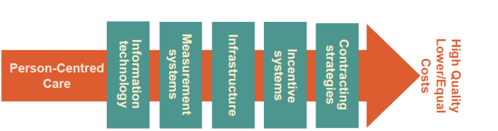
Dimensions WE-CARE Roadmap

Slide 6
Dimensions WE-CARE Roadmap
1. Information Technology (IT) might include IT solutions for communication or wearable devices for monitoring.
2. Infrastructure relates to the necessary resources and structures empowering the delivery of PCC (e.g., hospital organization, home care and their interaction).
3. Incentive systems include all conceivable means which could motivate both patients and professionals to engage in behaviors congruent with PCC.
4. Contracting strategies includes financial solutions and mutual agreements regulating commitments and deliverables.
5. Measurement systems to capture all necessary aspects of the implementation process and its outcome.

Slide 7
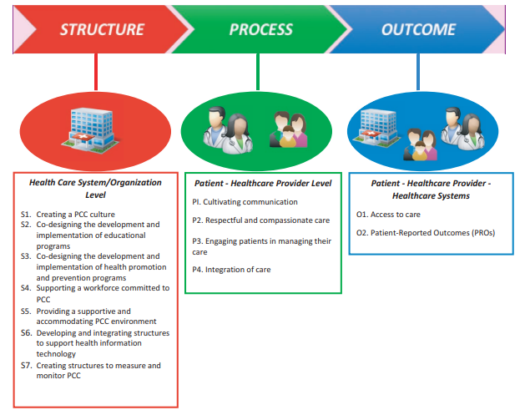
Comprehensive structure-level implementation guidance (Donabedian model)
Santana et al, 2017

Slide 8
Structure domains
S1. Creating a PCC culture
S2. Co-designing the development and implementation of educational programs
S3. Co-designing the development and implementation of health promotion and prevention programs
S4. Supporting a workforce committed to PCC
S5. Providing a supportive and accommodating PCC environment
S6. Developing and integrating structures to support health information technology
S7. Creating structures to measure and monitor PCC performance

Slide 9
Process domains
P1. Cultivating communication
P2. Respectful and compassionate care
P3. Engaging patients in managing their care
P4. Integration of care

Slide 10
Outcome domains
O1. Access to care
O2. Patient-Reported Outcomes (PROs)

Slide 11
References
Lewandowski RA, Lewandowski JB, Ekman I, Swedberg K, Törnell J, Rogers HL. Implementation of Person-Centered Care: A Feasibility Study Using the WE-CARE Roadmap. Int J Environ Res Public Health. 2021 Feb 24;18(5):2205. doi: 10.3390/ijerph18052205. PMID: 33668083; PMCID: PMC7956736.
Nkhoma KB, Cook A, Giusti A, Farrant L, Petrus R, Petersen I, Gwyther L, Venkatapuram S, Harding R. A systematic review of impact of person-centred interventions for serious physical illness in terms of outcomes and costs. BMJ Open. 2022 Jul 13;12(7):e054386. doi: 10.1136/bmjopen-2021-054386. PMID: 35831052; PMCID: PMC9280891.
Santana MJ, Manalili K, Jolley RJ, Zelinsky S, Quan H, Lu M. How to practice person-centred care: A conceptual framework. Health Expect. 2018 Apr;21(2):429-440. doi: 10.1111/hex.12640. Epub 2017 Nov 19. PMID: 29151269; PMCID: PMC5867327.

Slide 12
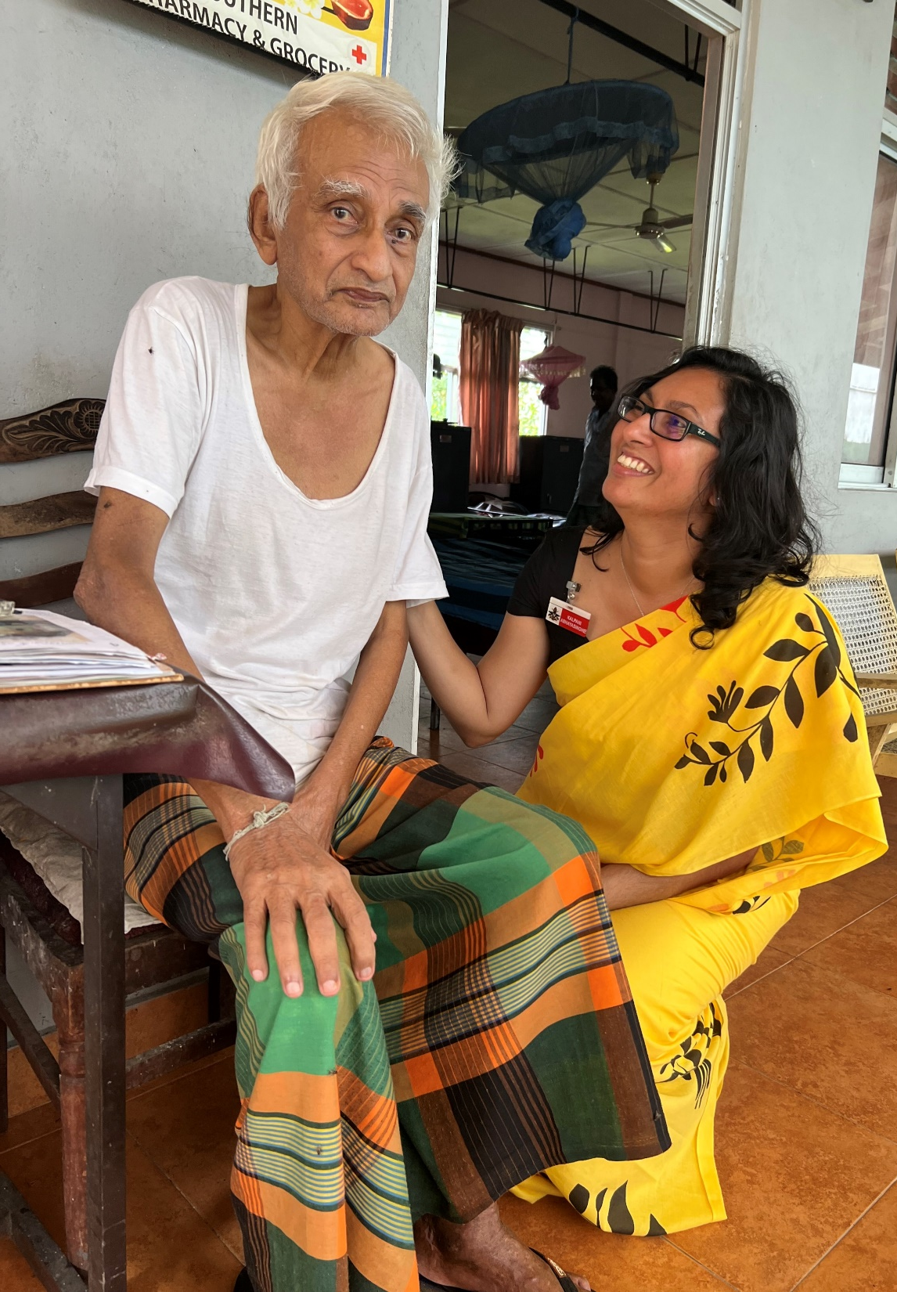
Thank you for listening!
Reference number: 618596-EPP-1-2020-1-SE-EPPKA2-CBHE-JP
This publication [communication] reflects the views only of the authors, and the Commission cannot be held responsible for any use, which may be made of the information contained therein.

