Slide 1
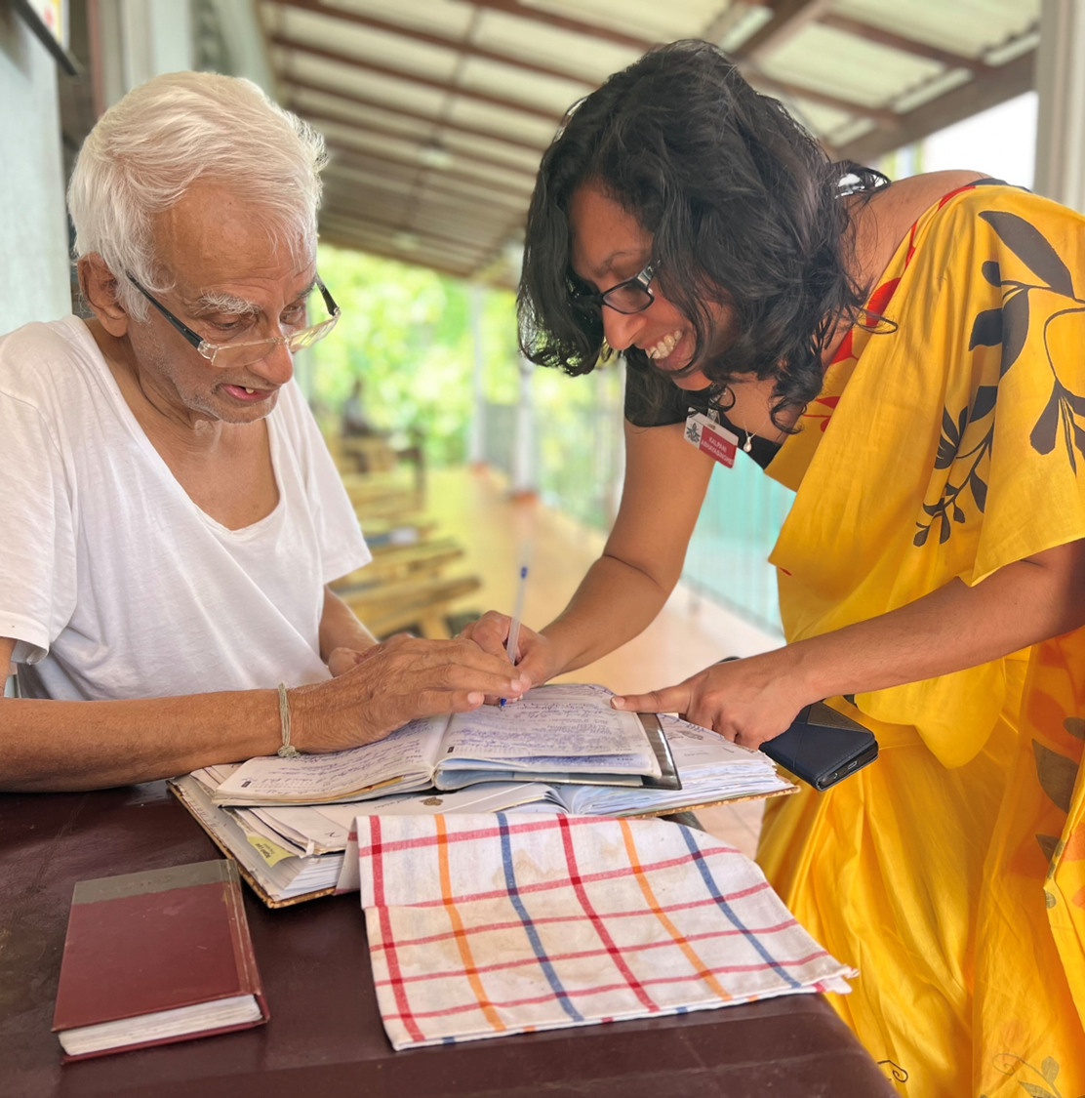



PERSON-CENTERED CARE
IMPLEMENTATION
PART I
Reference number: 618596-EPP-1-2020-1-SE-EPPKA2-CBHE-JP
This publication [communication] reflects the views only of the authors, and the Commission cannot be held responsible for any use, which may be made of the information contained therein.

Slide 2
Intended learning Outcome
After completion of the lecture, students will be able to
  Describe ‘what is implementation?’.
  Explain various types of interventions related to Person Centered Care.
  Explain challenges of interventions related to Person Centered Care.
  Describe outcomes of interventions related to Person Centered Care.
  Explain models of implementations related to Person Centered Care
  Apply various types of interventions related to Person Centered Care.

Slide 3
Implementation of Person Centered Care
Health and social care systems, organisations and providers are under pressure to organise care around patients’ needs with constrained resources
Person-Centered Care (PCC) is a promising approach towards improved quality of care and cost containment within health systems

Slide 4
Implementation
Interventions
Challenges

Slide 5
Interventions
Nurse-led
Nurse and physiotherapist-led
Nurse, physician and social worker-led

Slide 6
Interventions
individualised and delivered face-to-face
delivered in groups

Slide 7
Intervention components and delivery
Interventions comprising a self-management component
Technology-based interventions
  Training,
  Mentorship and support through lecturers,
  Seminars and/or workshops in the philosophy and delivery of PCC
    clinical consultations using person-centred approach,
    person-centred communication

Slide 8
Interventions Delivery
Nursing home
Primary care/outpatient
Surgical departments
Inpatient facilities
In home and/or community settings

Slide 9
Interventions Delivery
Using mobile technology
Mobile app to contact patients at home
Web-based eHealth tool pre-installed or downloaded it to use on their own mobile or a tablet computer to self-monitor blood glucose and blood pressure,
A web-based patient decision aid to populate their cardio metabolic and psychosocial profiles and general care priorities
To complete self-assessments using a computer touch screen and to develop a self-management action plan

Slide 10
Mechanism of action of the interventions
Initiation of partnership between the patient/ caregiver and healthcare professional
Implementing the partnership
Documenting/safeguarding the partnership

Slide 11
Outcomes of interventions
Caregiver outcomes
  Quality of life among caregivers
  Improve caregiver perceived burden among family caregivers of older people in geriatric practice
Healthcare professional outcomes
  Improve behavioural domains: transition to palliative care, general communication and involving significant others
Clinical outcomes
Costs of care and healthcare utilisation
  Decrease hospital appointments
  Reduce mortality

Slide 12
Challenges
Organizational factors
Individual factors

Slide 13
Challenges
Organizational factors
  Inadequate management support
  Insufficient opportunities for further training
  Work overload and time constraints
Individual factors
  Health personnel readiness to use PCC
  Dearth enthusiasm for change
  Poor nurses’ accountability

Slide 14
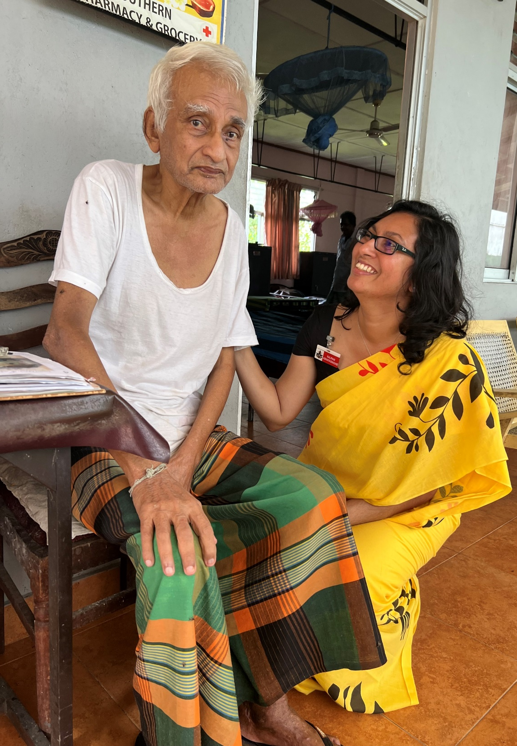
Thank you for listening!
Reference number: 618596-EPP-1-2020-1-SE-EPPKA2-CBHE-JP
This publication [communication] reflects the views only of the authors, and the Commission cannot be held responsible for any use, which may be made of the information contained therein.

