Slide 1
Global and Local Perspectives of Person Centered Care
Person Centered Care
Dr Kalpani Abhayasinghe
General Sir John Kotelawala Defence University

Slide 2
Learning Objectives
At the end of this session the student should be able to;
Explain global and local perspectives of PCC
Compare global and local perspectives of PCC

Slide 3
Content:
Policy perspectives
Relevance in different cultures and contexts
PCC practice
PCC research
Strengths and barriers

Slide 4
Global aspect of PCC
A dimension of high quality health care
Promoted as a core competency of health workers
A key component of primary care
Essential to achieving universal health coverage goals
Advocated by national governments, international organisations and patient and health policy groups.
An approach that evolved in high-income countries
Limited information from low-income and middle-income countries
(Giusti et al., 2022)

Slide 5
Comparison of global and local perspectives of PCC
Global
Definition of Ageing
65 years and above
Care Settings
Hospital, Care homes, Home-based care
Local
60 years and above (by United Nations)
Hospital, Care homes, Elderly homes, Homes

Slide 6
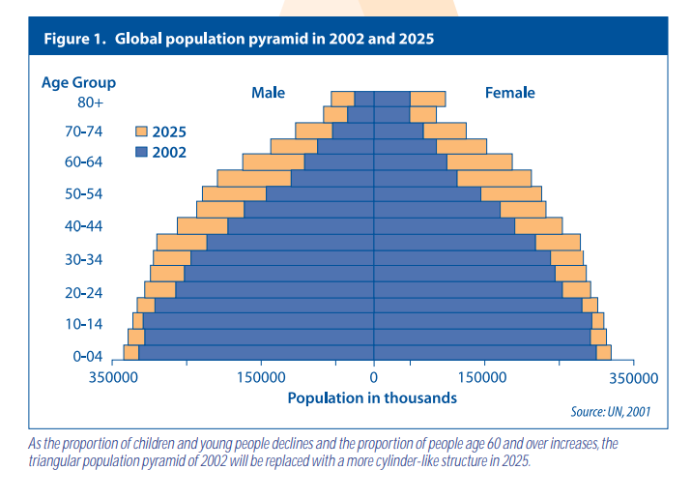
Comparison of global and local perspectives of PCC
Commonly in both Global and local settings
Population Ageing is a challenge
In UK, number of people aged 85 years+ projected to rise from 1.4 million in 2012 to 5 million by 2050
rising numbers of older people surviving with disability and multiple health conditions.

Slide 7
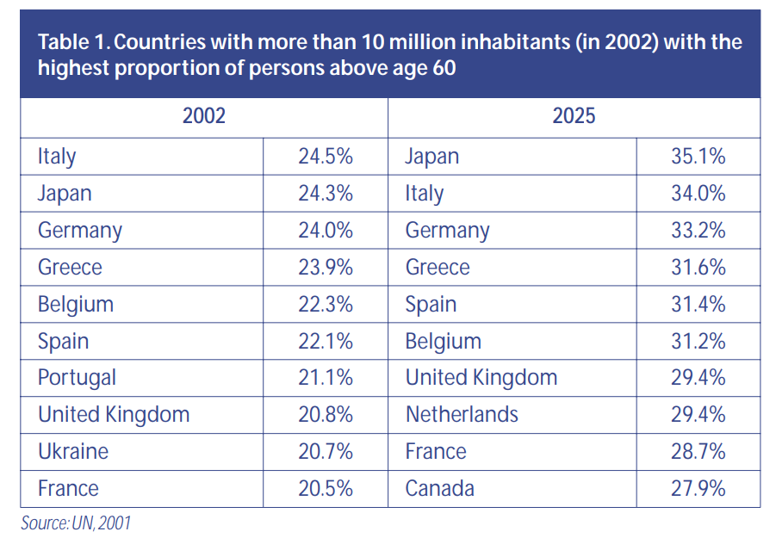

Slide 8
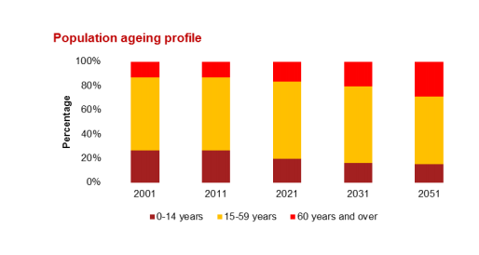
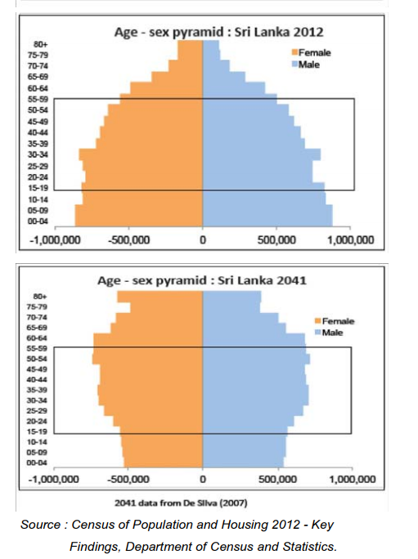
Ageing population in Sri Lanka
Source: Embassy of the Kingdom of the Netherlands. (2014). The health Sector of Sri Lanka. PWC
Source: Annual Health Bulletin 2015 Sri Lanka, Medical Statistics Unit Ministry of Health, Nutrition and Indigenous Medicine

Slide 9
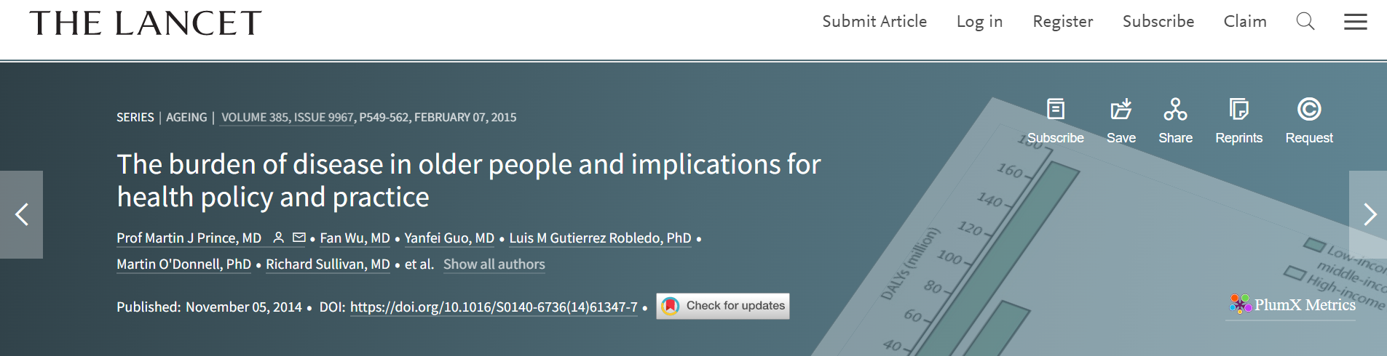
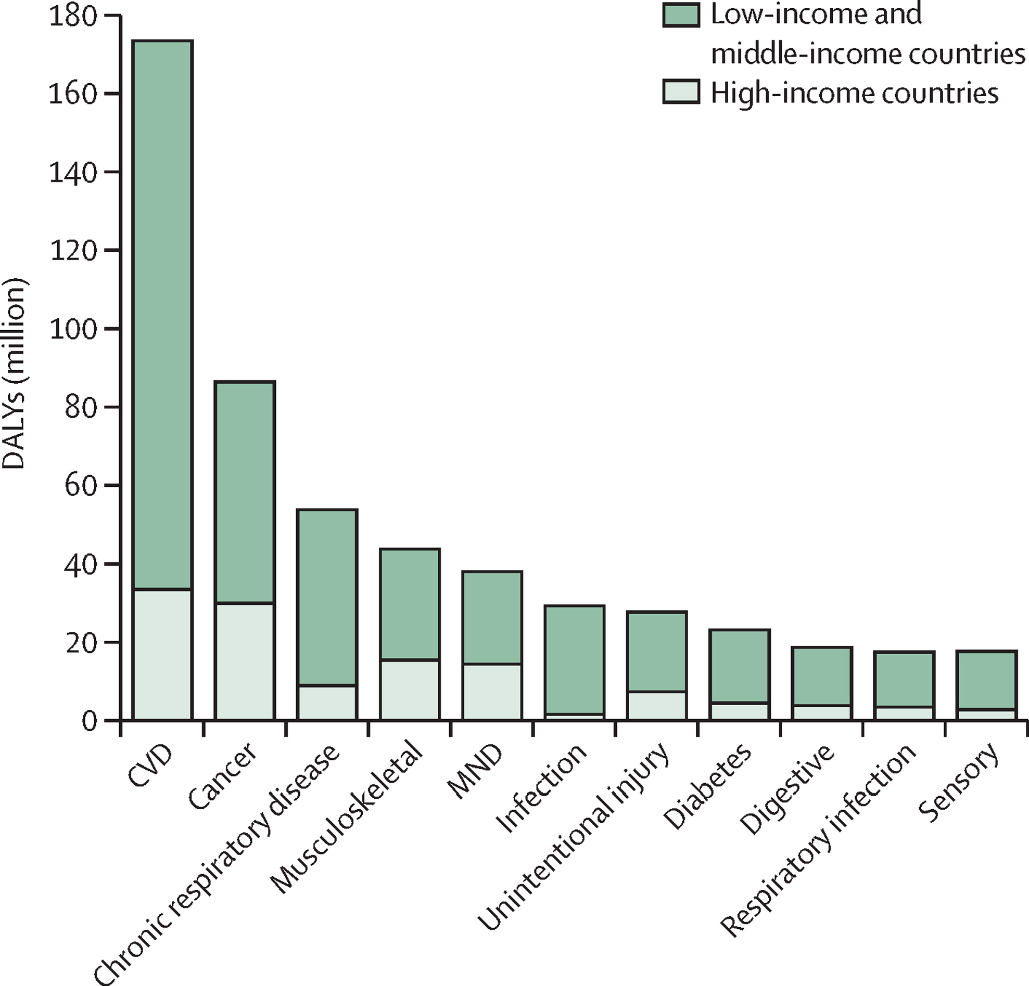
High risk in LMIC

Slide 10
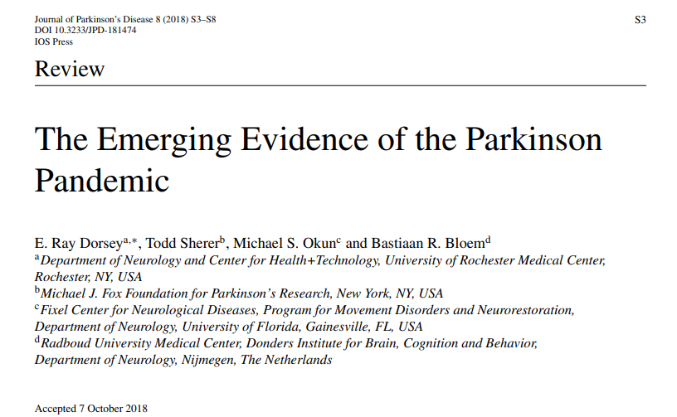
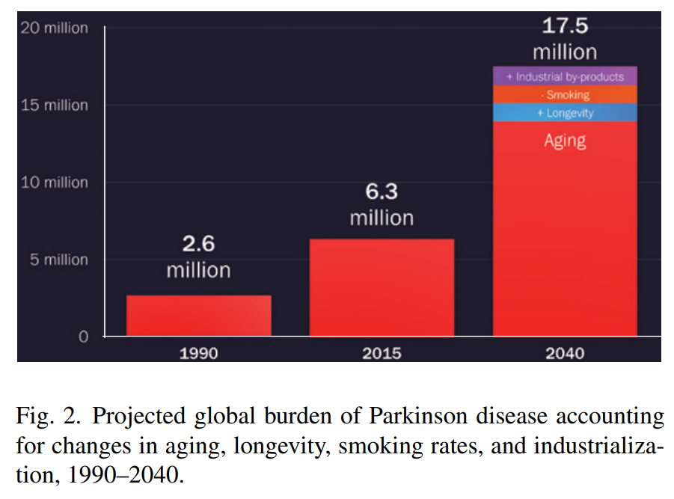

Slide 11
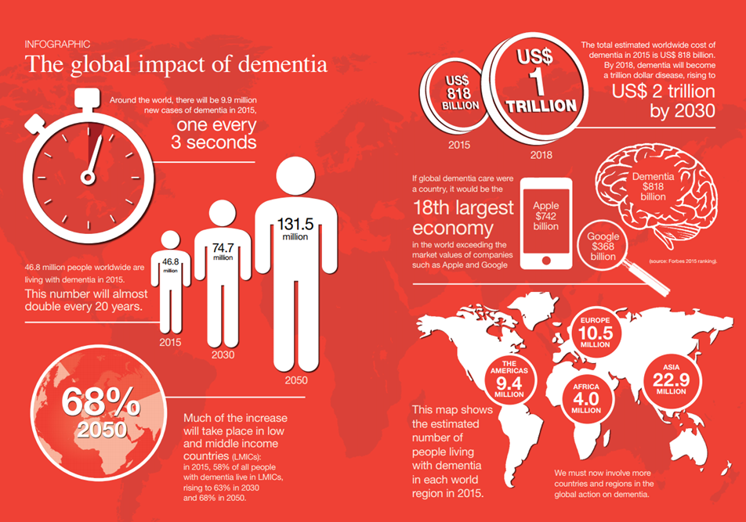
Alzheimer’s Disease International (2015). World Alzheimer Report 2015: The Global Impact of Dementia: An analysis of prevalence, incidence, cost and trends.

Slide 12
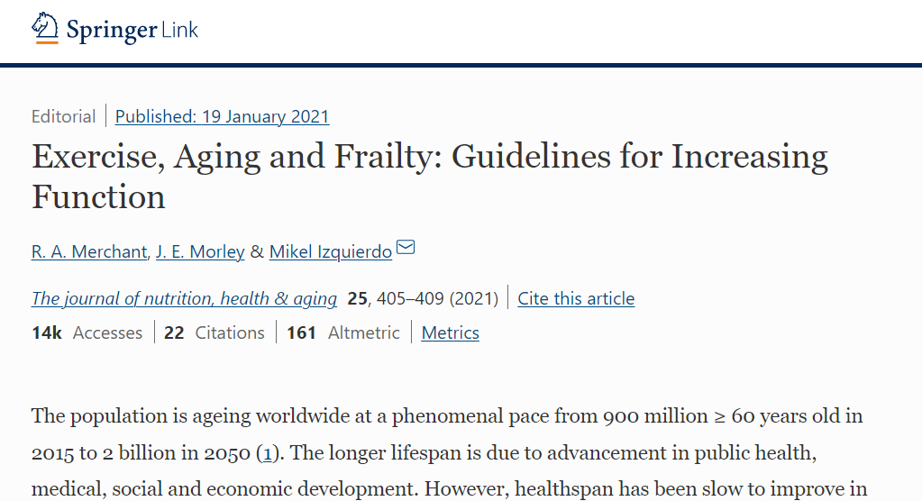
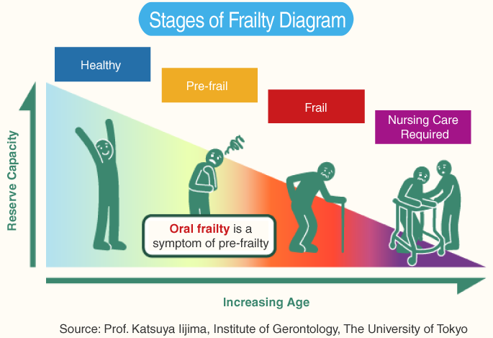
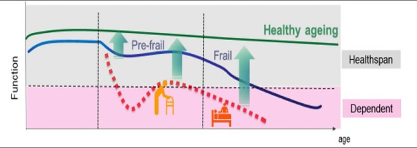
Ageing and frailty
Many older people may become frail
Features of frailty:
  lack of energy,
  loss of appetite & weight,
  ‘slowed up’,
  slow walking speed,
  slower (or incomplete) recovery from illness

Slide 13
Global
Local
Challenges of Ethnic minority groups
cultural barriers, belief systems
language
Legal and ethical framework
  Government funds/ services
  Social services
  Autonomy/ dignity related facts
  Advance directives )patients bill of rights)
  End of life care (DNR/ Euthenasia)
Trends of
  Family constitution
  Migration (local and abroad)
Socio-cultural influence
  Stigma relating to institutional care
  Religious beliefs
  Family/ social values
Legal and ethical framework (less awareness among people)
  No standard practice on advance directives (patients bill of rights, End of life care (DNR/ Euthenasia)

Slide 14
Global
Local
Institutionalised care
  Formal/ professional carers
  Well trained
  Illness awareness is good
  Facilities
  Dementia friendly
Home based care is encouraged
  Functional nursing practice in hospital settings
  Informal caregivers
  Lacks training/ knowledge
  No age friendly wards
  More general care rather than PCC

Slide 15
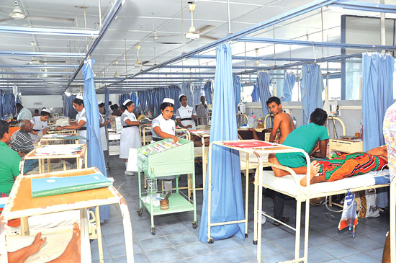
What this picture tells you about PPC?

Slide 16
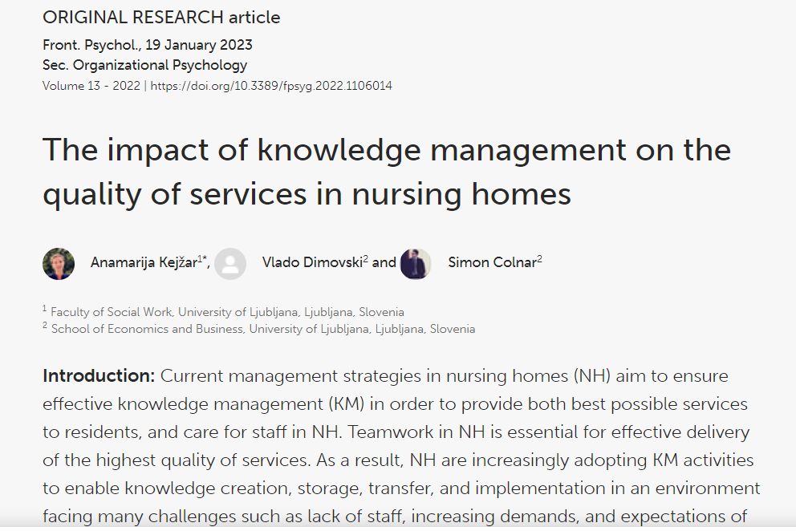
Global Perspective – Some examples/ evidence
More Dementia/ elderly friendly
Formal caregivers
Better provision of PCC

Slide 17
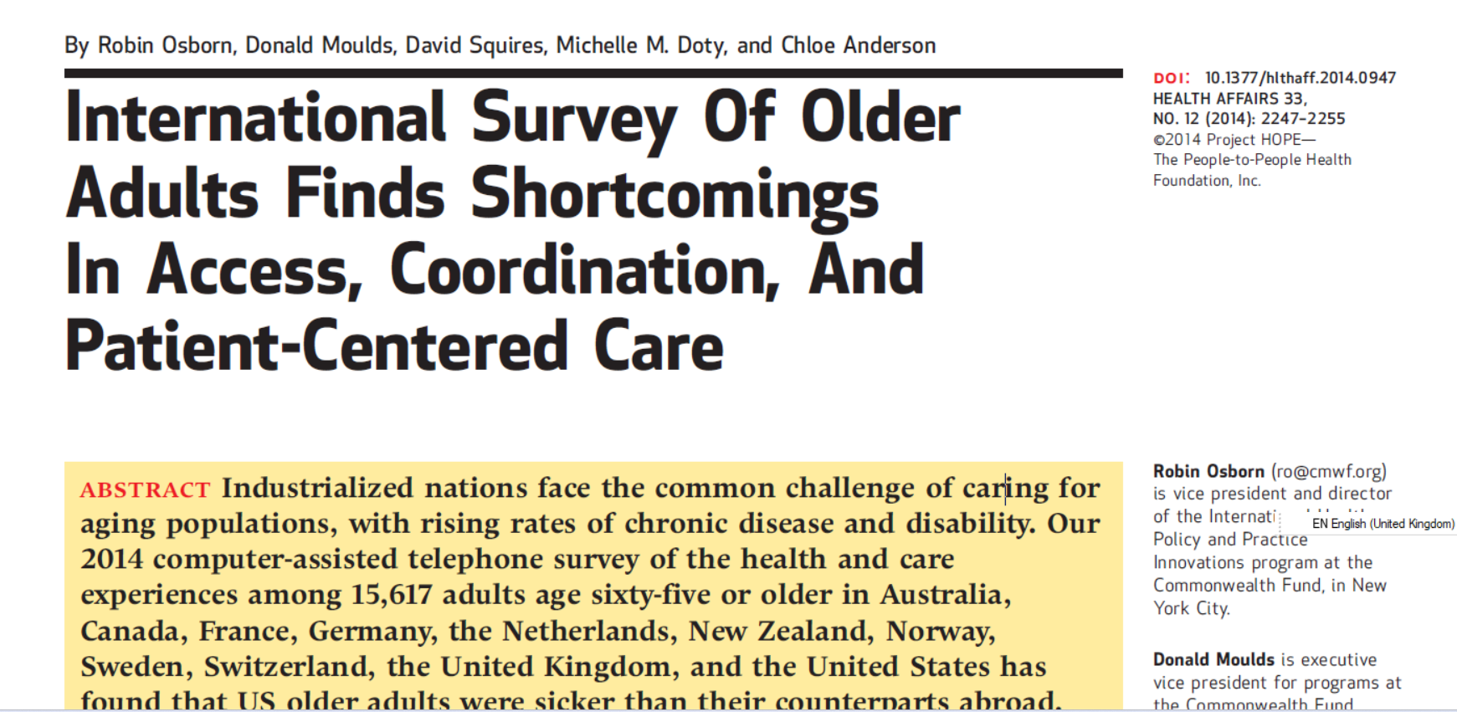

Slide 18
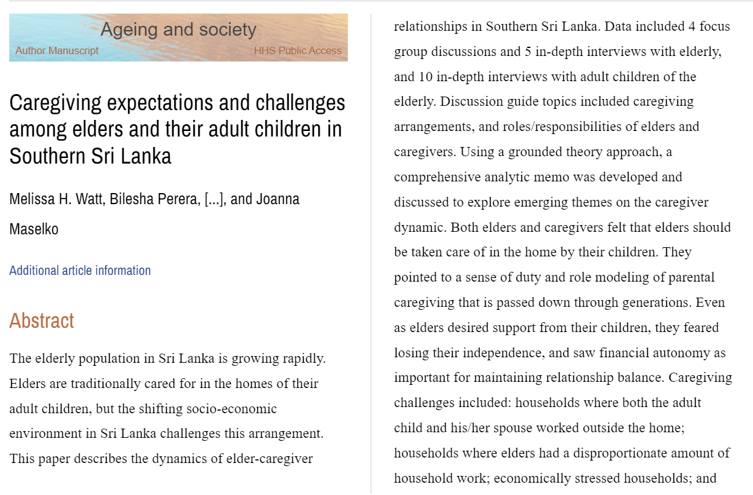
Local Perspectives – Care homes
Parents should be cared at home
Fear of losing independence, financial autonomy
Caregiving challenges
  Work-life balance of informal caregiver
  Communication issues
  Caregiver burden

Slide 19
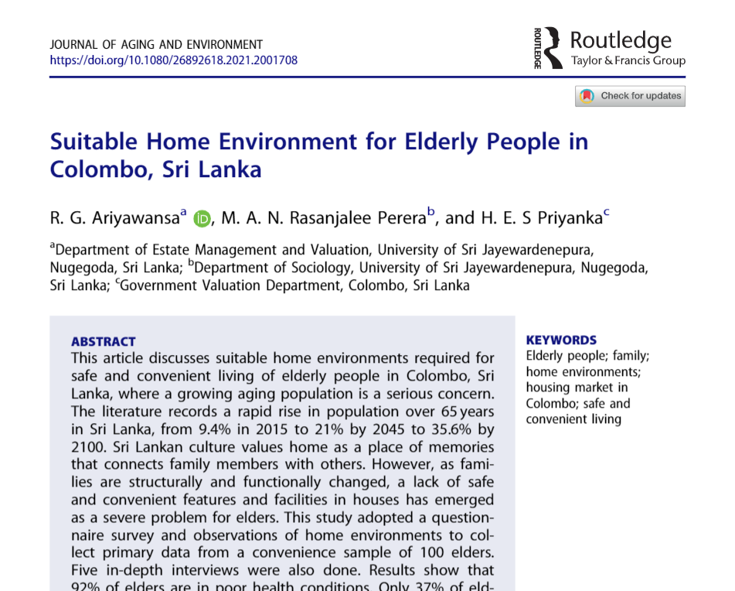
92% of elders are in poor health conditions.
37% of elders are satisfied with their home environments.
Suitable home facilities are not available in more than 50% of homes owned by elders.
Most elders indicated a strong desire to stay in their own homes.

Slide 20
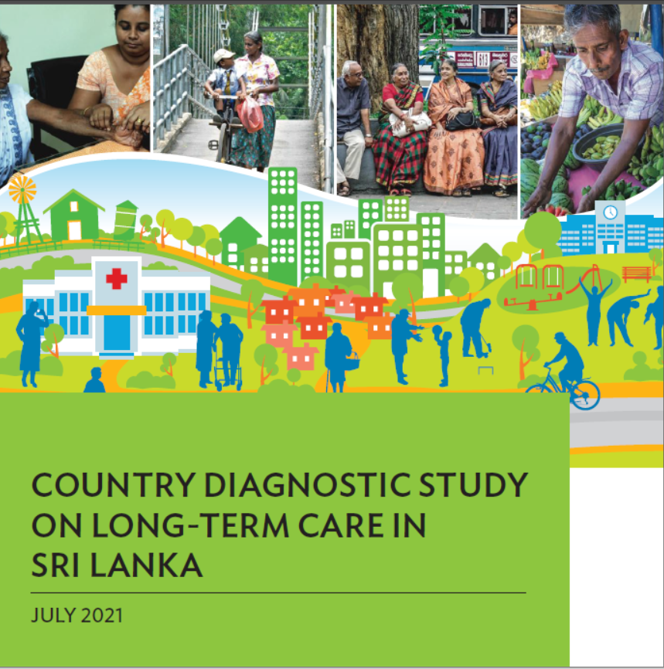
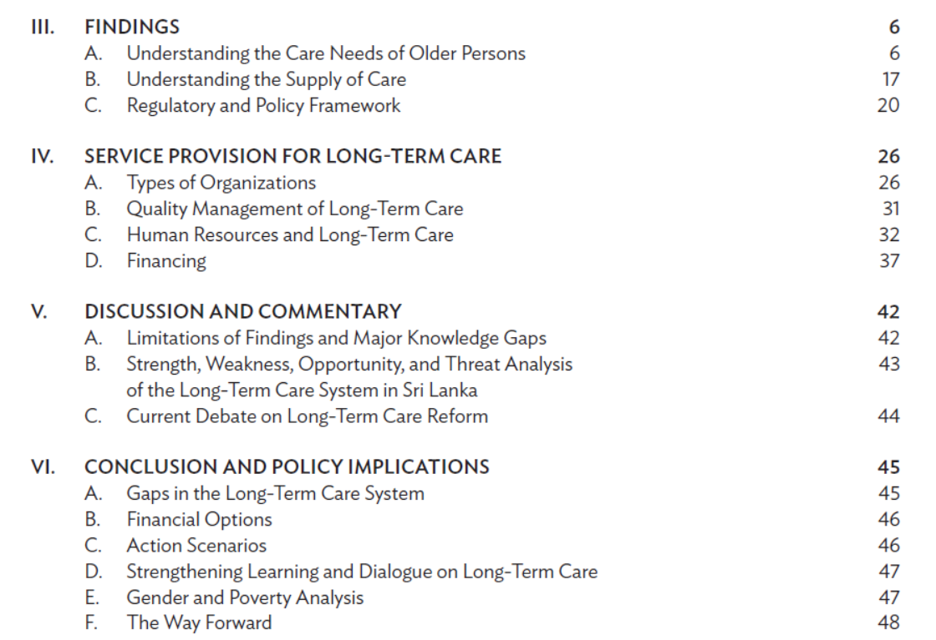
ADB (2021) DOI: http://dx.doi.org/10.22617/TCS210218-2

Slide 21
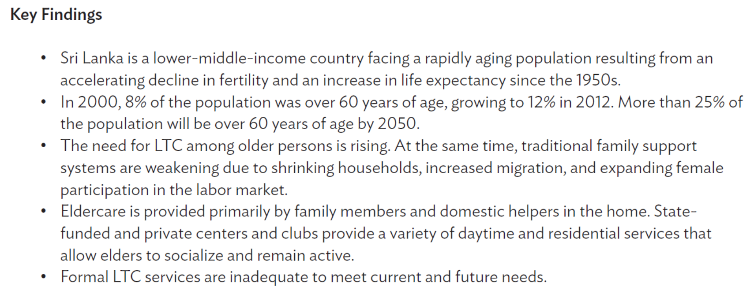
LTC – Long-Term Care

Slide 22
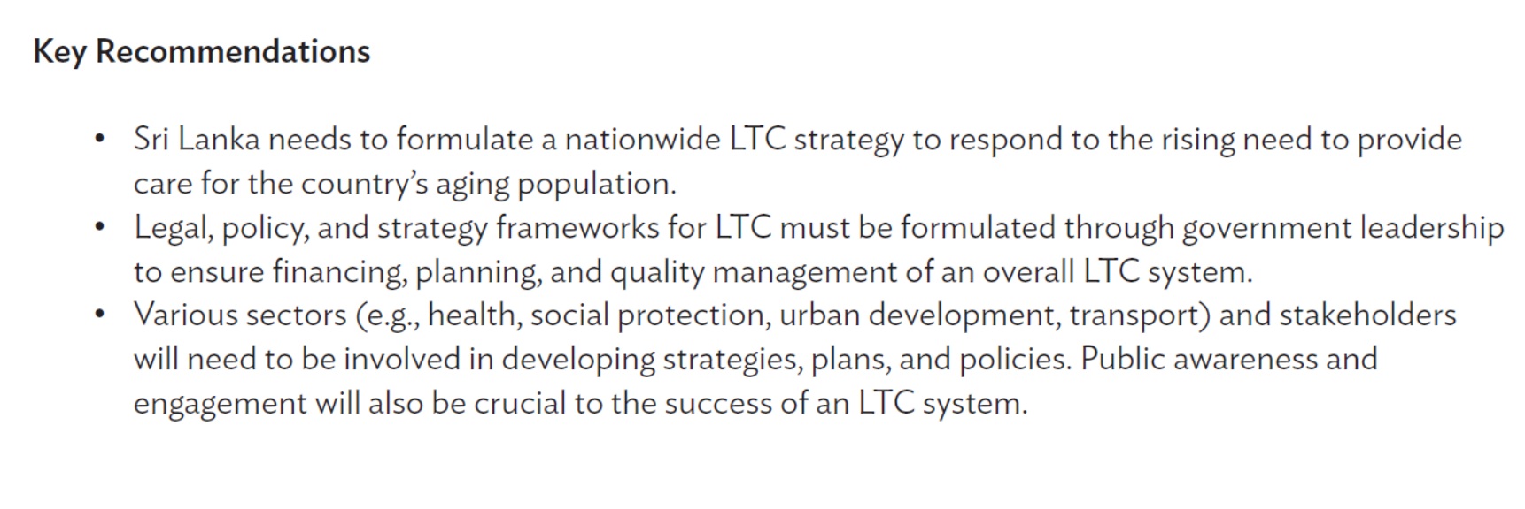
ADB (2021) DOI: http://dx.doi.org/10.22617/TCS210218-2

Slide 23
cross-national domains of person-centredness
Interdependency and collectivism
Bringing care into the home and community
Equity and non-discrimination
Addressing health and illness within the context of limited resources
Workforce well-being.
(Giusti et al., 2022)
Notes:
PCC frameworks must accommodate a collectivist worldview, promoting
activities that enable people to support each other and placing
focus on community-based
and home-based
care.
⇒⇒ PCC must consider and go some way to address the social determinants
of health and disease, healthcare access and health inequities
and should aim to give persons the genuine opportunity to do
the things that matter to them.
⇒⇒ PCC must centre around a shared set of human values, including
compassion, non-judgementalism,
equity and non-discrimination
and promote these values in workforce recruitment, training and
performance assessment.

Slide 24

Discussion:
How do we help people remain independent and active as they age?
How can we strengthen health promotion and prevention policies directed to older people?
As people are living longer, how can the quality of life in old age be improved?
Will large numbers of older people bankrupt our health care and social security systems?
How do we best manage the care needs as they grow older?
How do we acknowledge and support the major role that people play as they age in caring for others?

Slide 25

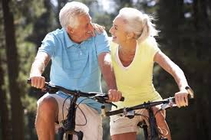



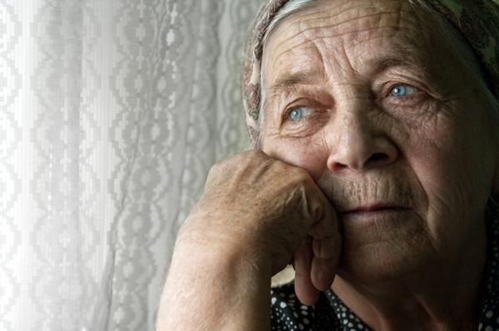
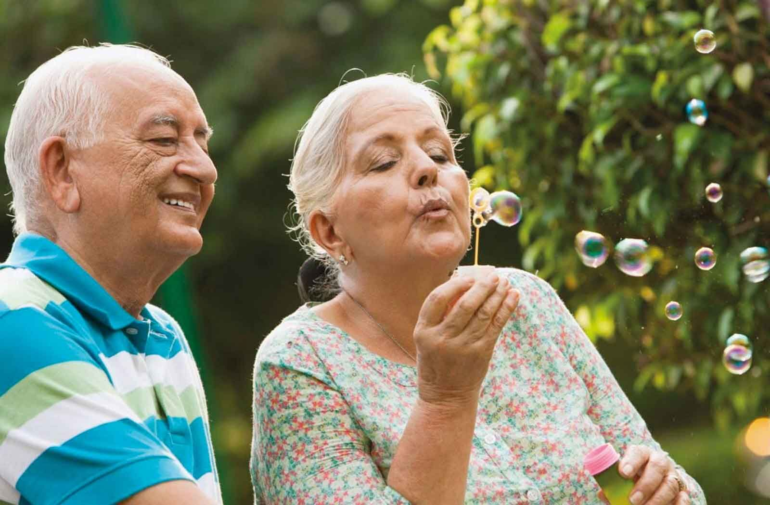

Slide 26
How appropriate are these interventions/ research to an older Sri Lankan population?
What else should be considered?

Slide 27


