Slide 1

LIVING WITH NDD
Module FAMILY & SOCIETAL PERSPECTIVES

Slide 2

Aim of the lecture
Outline the important aspects of educating caregivers on NDDs
Describe different aspects of care and well-being for individuals with NDDs,
Outline the role of the caregiver in the shared decision making process,
Explain the need for institutional help in care for individuals with NDDs
Discuss the importance of ‘caring for the caregiver’
Outline strategies to recognize and prevent abuse

Slide 3
Content of the lecture
Step by step education for person with NDD and care-giver
Personal plan of care with shared decision making
Dynamic adaptation of plan – living document, new family roles
Teaching relatives/informal care givers, how to deal with aspects of care
When to seek institutionalized help
Caring for the caregivers – respite care, prevention of burn out
Recognizing and preventing abuse

Slide 4

Why and how to educate caregiver?
Importance of timely diagnosis
Adequate communication – timely, accurate, not too
Importance of support at and after diagnosis
Where can a person with NDD and close help get?
How to prepare for life with NDD in the family?

Slide 5
Care planning
We plan together with the individual and his loved ones
We are looking for sources of power:
In the individual
In the family
In a social environment
We investigate the needs and wishes of the individual with the NDD

Slide 6
The diagnosis of a neurodegenerative disease (ND) produces profound changes in the quality of life of the affected families. Despite the vital importance of these processes, the scientific literature has addressed this topic almost exclusively relating to the main caregiver or using limited approaches.
The family is a major determinant of positive outcomes in people with ND. It provides emotional and practical support, social care, and assistance in the basic and instrumental activities of daily life
(Aza A, Gómez-Vela M, Badia M, Begoña Orgaz M, González-Ortega E, Vicario-Molina I, Montes-López E. Listening to families with a person with neurodegenerative disease talk about their quality of life: integrating quantitative and qualitative approaches. Health Qual Life Outcomes. 2022 May 7;20(1):76. doi: 10.1186/s12955-022-01977-z. PMID: 35525943; PMCID: PMC9077340.)

Slide 7
What changes can we expect?
What is the predicted timeline of the disease?
Are there medicines and what is their effect?
How do we adjust the environment at home to be as friendly as possible to the person with NDD?
What resources of assistance exist in the community and how should we organise aid?
Resources needed

Slide 8

Resources needed
Material: money to help care for a person with NDD, environmental adjustment
Intangible: help from the community, help for the community
what kind of help can I expect and where?
How to take care of carers' health?

Slide 9
Personal service planning – gold standard
The basic concern of the planner is to ensure the influence of the user at all points of the planning.
From the beginning of the design to the approval of the plan and further implementation, the person with NDD must be able to influence all aspects of the design and implementation of the plan. He's got to have control over what's going on. If possible, the person with NDD must be present everywhere.

Slide 10

Help for caregivers
Educating:
Giving basic information about NDD on example of dementia:
  What is p.e. dementia?
  What causes dementia?
  Explain progression of dementia
  Are there treatments for dementia?

Slide 11

Living with and caring for a person with NDD
Establish routines but keep things normal
Support the person‘s independence
Help the person maintain dignity
Avoid confrontation
Simplify tasks
Make safety important, but also maintaining autonomy
Encourage different activities
Maintatin communication

Slide 12
The journey of dementia caregivers
Onset of illness
Diagnosis of Dementia
Death of the Patient and after
Post Diagnosis/ Continuation of Caregiving

Slide 13
Onset of illness
Lack of Awareness / Negligence of Symptoms
Beliefs/ Assumptions and Illness Perception
Struggle with behavioural Changes/ Challenges of Care
Family Conflicts/ denial of illness
Shame/ Stigma/ Fear/ Anger
Blame/ Disapproval of the behaviour/ Punishment/ Giving up on Patient/ elder abuse
Need to Seek medical/ Alternative/ Complementary Treatments

Slide 14
Diagnosis of Dementia
Increase Awareness
Seek medical advice/diagnosis
Acceptance of illness
Start treatments
Caregiving improves
Connectedness with patient improves
Engagement with family and relatives in care

Slide 15
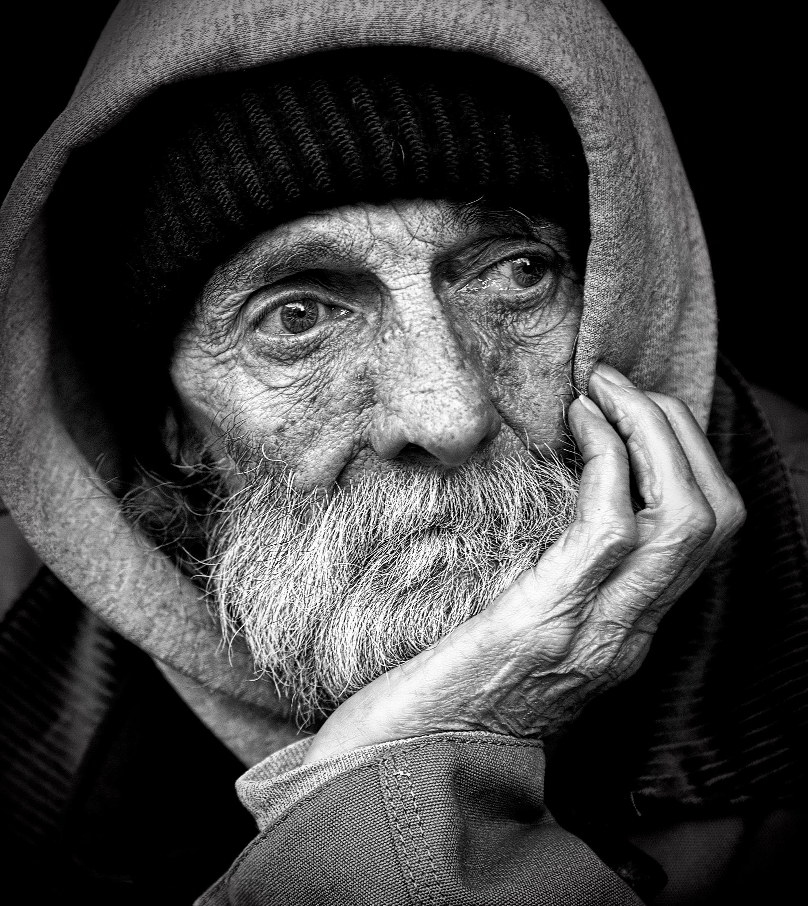
Continuation of Care
Changes in Care over time(+ve and –ve aspects
  Engagement (Support/Neglect/ Giving up),
  Dependency (Sense of Burden, Commitment)
  Relationships (Positive/ Negative)
Caregiving Experience
  Positive (Satisfaction/ happiness) or
  Negative ( Grief/ Guilt/ Frustration/etc)
Changes in family relationships
  conflicts of care (Decision making, Support)
Challenges of Care Vs Coping
Autonomy of the Patient Vs Safety
Socio cultural influence on caregiving
  Stigma

Slide 16

Continuation of Care (Cont.)
Illness progression
  behaviour and personality changes of the person with NDD
  functional deterioration of the affected individual
Poor Prognosis
  Side effects of medication and other treatments
  Poor compliance
  Giving up on medication/ Treatments
  Failure of treatment
  Losing Trust on current treatment
  Seek alternative Therapies
Burden of Care
  Neglegence
  Guilt
  Frustration
  Regrets
  Self blame

Slide 17
Risk factors for caregivers
Risk factors for caregiver stress include:
Being female
Having fewer years of formal education
Living with the person you are caring for
Social isolation
Having depression
Financial difficulties
Higher number of hours spent caregiving
Lack of coping skills and difficulty solving problems
Lack of choice in being a caregiver
(Mayo clinic, 2023)

Slide 18
Caring for caregiver / yourself
Finding sources of power and help (family, friends)
Share your problems, discuss them
Make time for yourself
Know your limits
Don‘t blame yourself
Take and seek advice
Take breaks from caring
Regular health checks for the carer

Slide 19

Institutionalised help
When to seek for living in institution?
How to keep family ties while person with NDD lives in institution?
What can we expect from the institution and what not?
Whose decision is to go?

Slide 20

Death of the person with NDD and after
Based on the nature of overall caregiving process family members may experience
Grief and Bereavement
Relief
Satisfaction Vs Guilt
Frustration
Regrets
Self-Blame
Acceptance
Depression

Slide 21

It’s a Journey Through… challenges
Beliefs, Thoughts, Assumptions, values and behaviour
Unknown to Known
Trust vs Experience
Changing the meaning of life/ caregiving
Independence/ Autonomy vs. Dependency/ Safety
Change of relationship status – power/ emotions/ interpersonal/ social/ etc.
Support vs. burden
Togetherness vs. isolation
Love vs. burden/duty

Slide 22
Questions to answer:
Why and how to make a care plane for person with NDD?
How to deal with the disesase – how would you describe help for the person with NDD and help for the caregiver?
Further reading:
  Mali, J., & Kejžar, A. (2019). A model of integrated care of residents with dementia – a case of innovation in long-term care with accommodation in Slovenia. Ljetopis Socijalnog Rada, 26(3), 447–469. https://doi.org/10.3935/LJSR.V26I3.282
  Hay, H. (2009). Lifestyle and Future Wishes. In H. May, P. Edwards, & D. Brooker (Eds.), Enriched Care Planning for People with Dementia (pp. 38–55). Jessica Kingsley Publishers.
  Kejžar, A., Rihter, L., Sajovic, J., & Drevenšek, G. (2022). Nutrition and congruent care improve wellbeing of residents with dementia in Slovenian care homes. Frontiers in Nutrition, 0, 277. https://doi.org/10.3389/FNUT.2022.796031
  Salvatore R, Cianciulli A, Calvello R and Panaro MA. Family Caregivers of Patients with Neurodegenerative Diseases: Life Challenge. J Fam Med. 2015;2(4): 1032.​
  Gozzoli C, Gazzaroli D and D’Angelo C (2018) Who Cares for Those Who Take Care? Risks and Resources of Work in Care Homes. Front. Psychol. 9:314. doi: 10.3389/fpsyg.2018.00314

