Slide 1


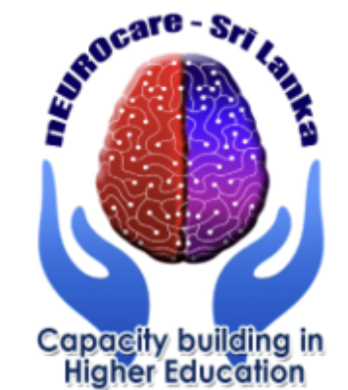
Sleep physiology
Heisl Vaher MD
Somnologist
ENT specialist

Slide 2
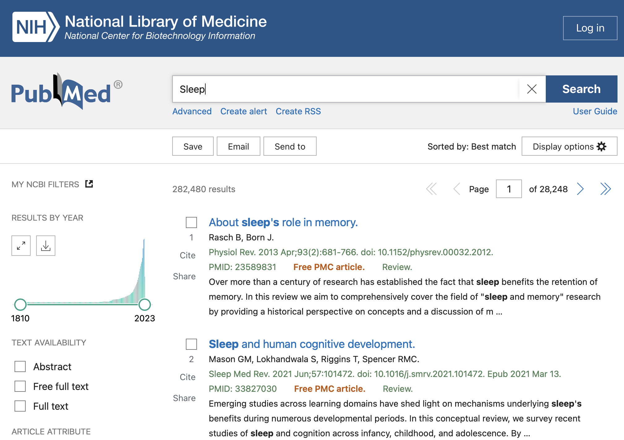


Pre-lecture preparation
How sleep works?
https://www.sleepfoundation.org/how-sleep-works
2. Mechanisms linking circadian clocks, sleep, and neurodegeneration.
https://pubmed.ncbi.nlm.nih.gov/27885006/

Slide 3
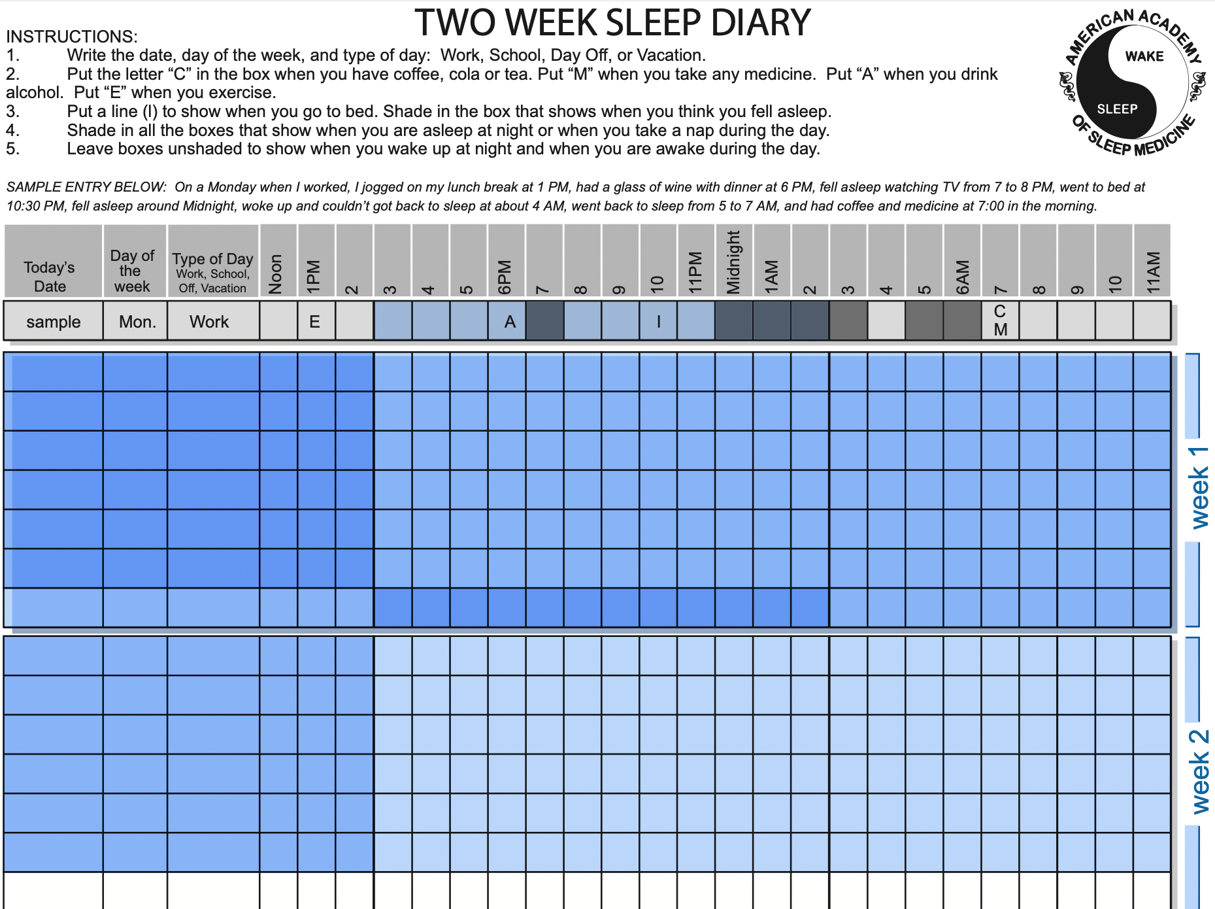
Pre-lecture preparation (sleep diary fill-in for 2 weeks)
Sleep diary:
https://www.uclahealth.org/sites/default/files/documents/sleepdiary.pdf

Slide 4
Lecture content
Pacemaker, zeitgeber
Nucleus suprachiasmaticus (SCN)
NonREM sleep, Slow Wave Sleep, REM sleep
Cortisol, adenosin, melatonin, ghrelin, leptin
Cirdadian rhythm
Clock genes, chronotype
Sleep deprivation
Glymphatic system
Anatomy of structures responsible for sleep. Neurohormonal signaling
External and internal pacemakers
Human sleep clock system - genetics; sleep wake rhythm
In lecture group discussion: What is each participant's sleep need?
Restorative functions of sleep
Effects of hypnotics

Slide 5
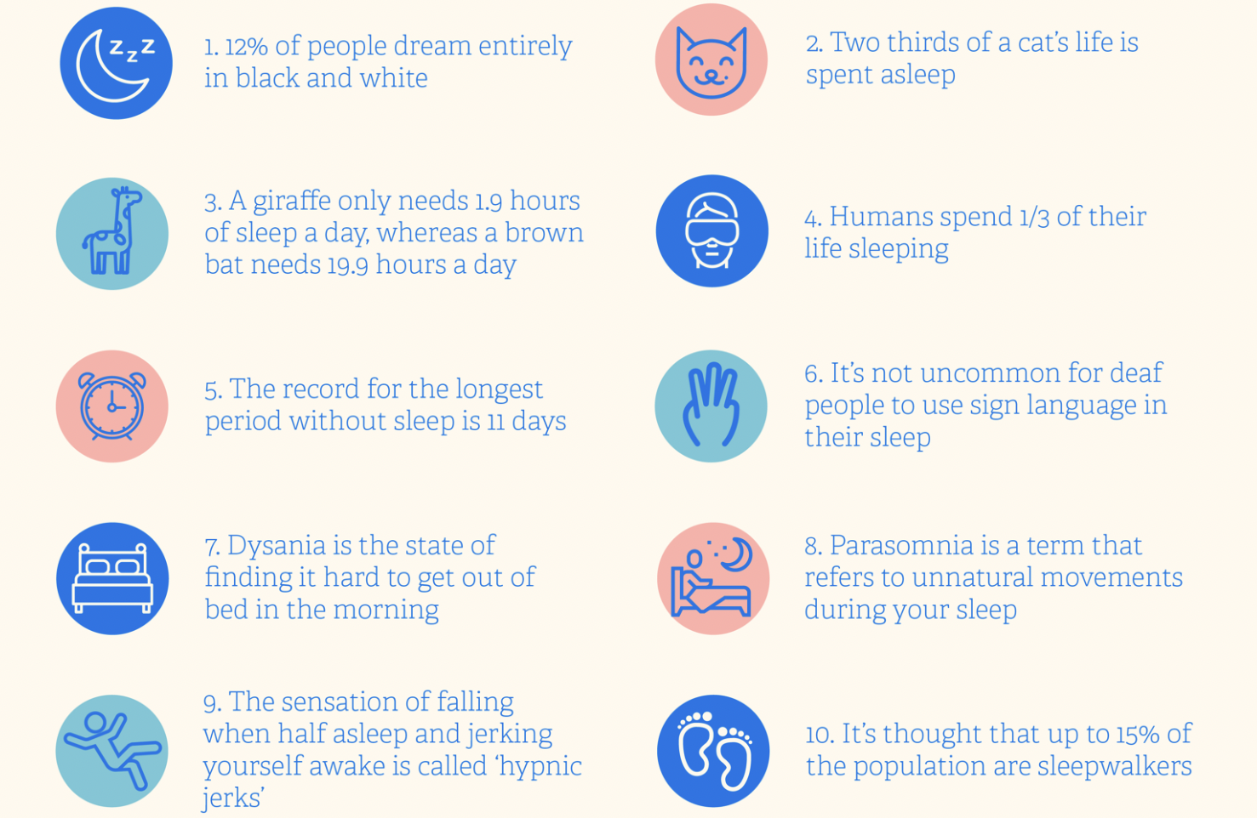
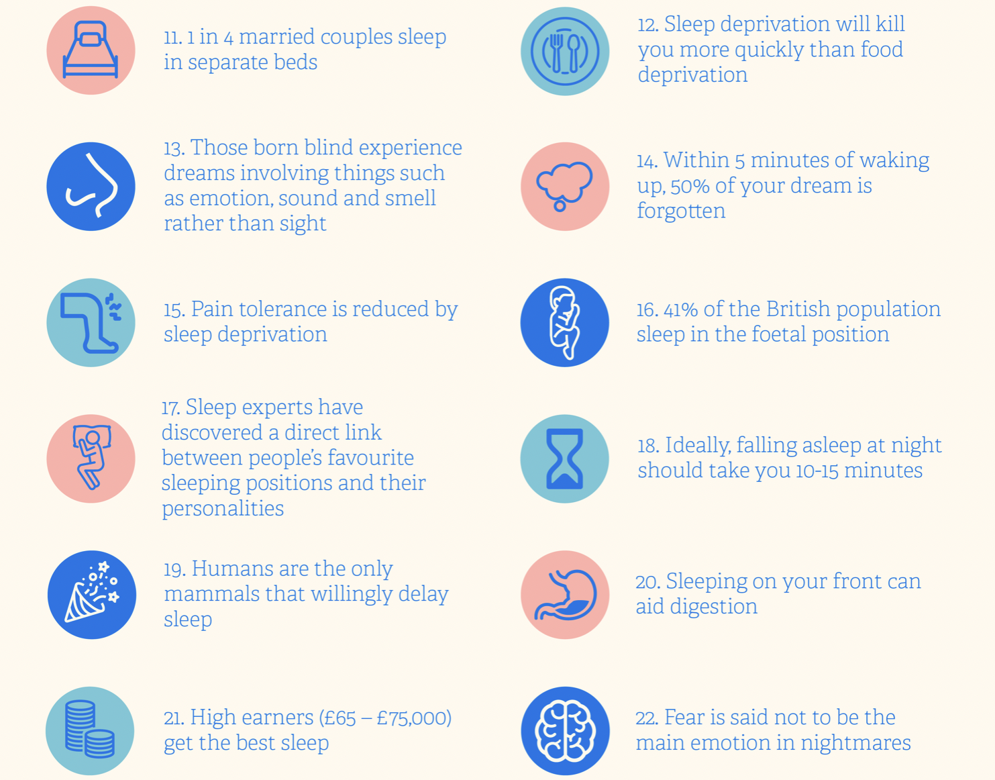
Fun facts about sleep

Slide 6
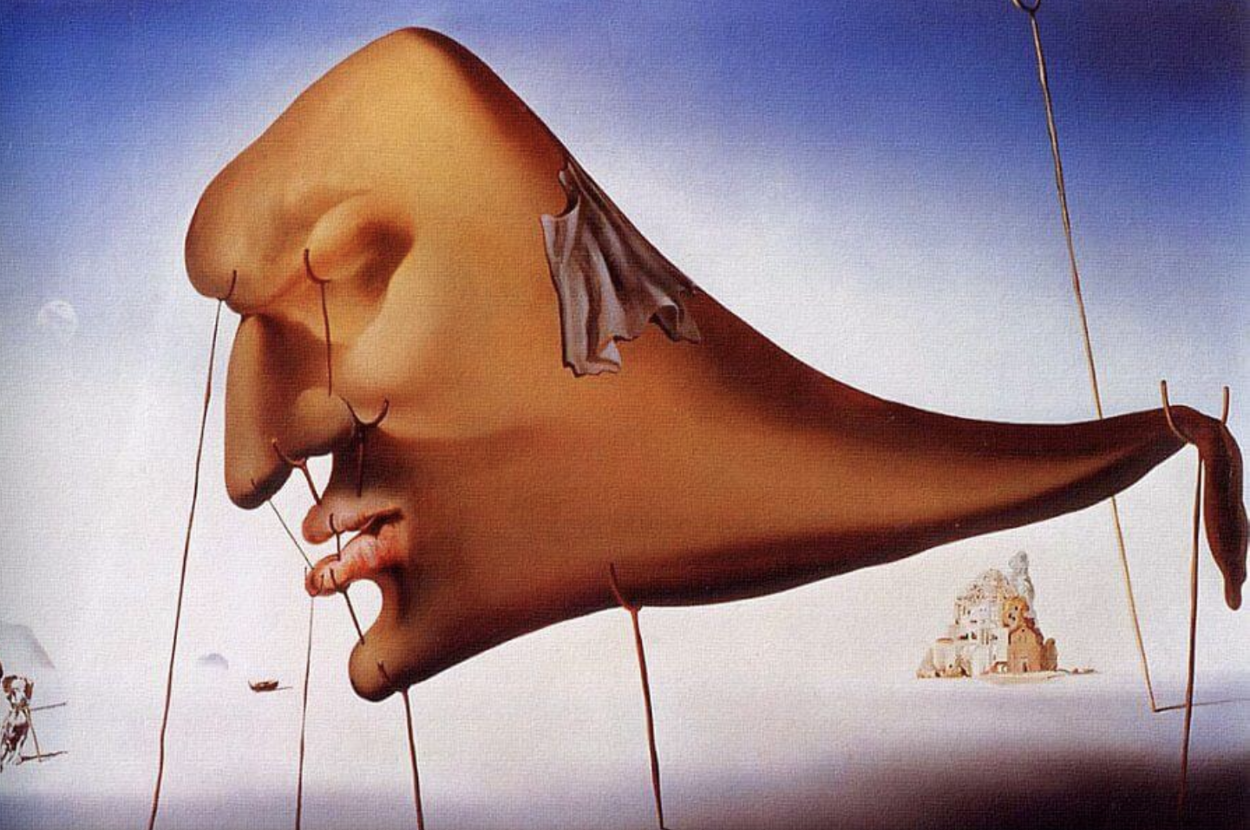
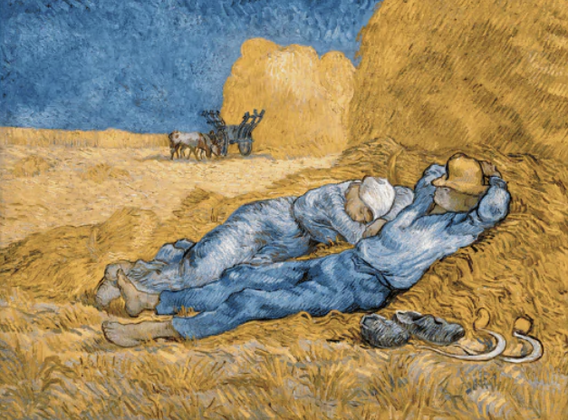
What is sleep?
Sleep is typically described as postural recumbence, behavioral quiescence, closed eyes
At times, behaviors typically associated with wake can occur during sleep:
Sleepwalking, sleeptalking, teeth grinding
The converse is also true: intrusions of sleep-related processes may occur when awake (muscle atonia, dream imagery, and even microsleep episodes). (1)

Slide 7
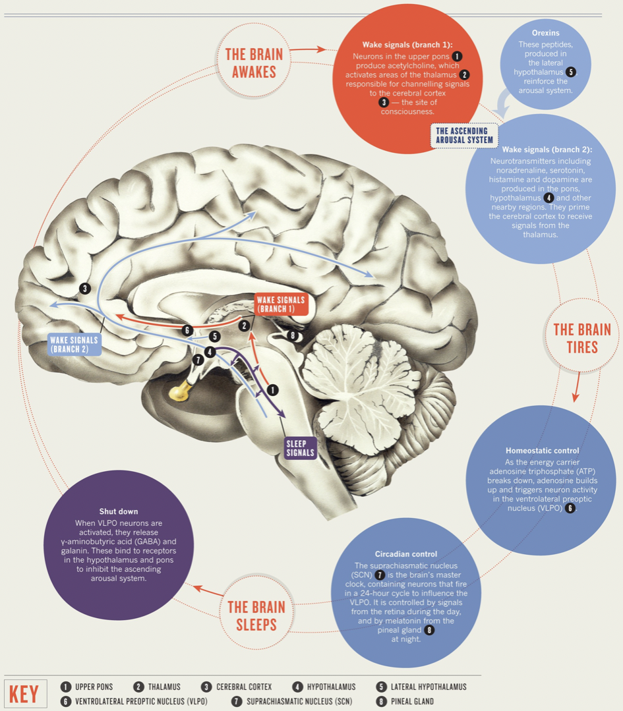
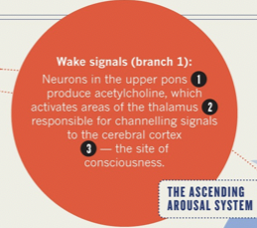
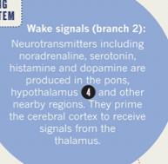
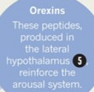
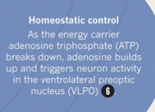
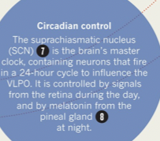
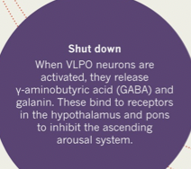
(3)

Slide 8
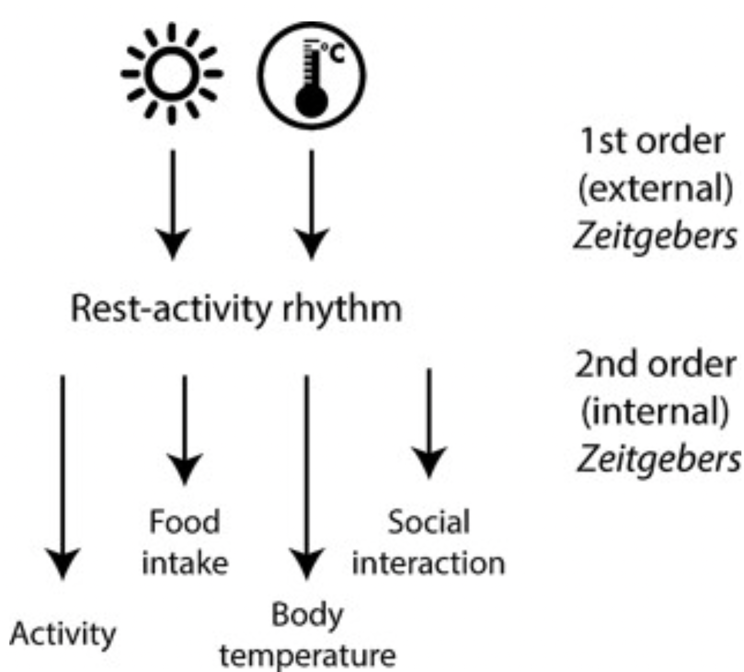
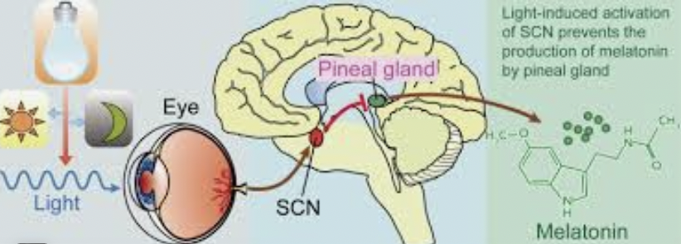
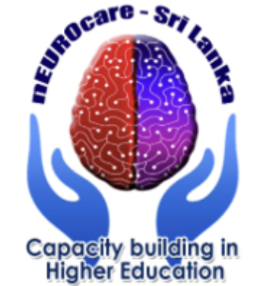
Sleep happens because:
Intrinsic pacemakers: circadian rythms (>200), build up of sleep pressure
Extrinsic zeitgebers: light, social cues
A master clock inside the body, the suprachiasmatic nucleus (SCN), keeps circadian rhythms organized. (2)

Slide 9
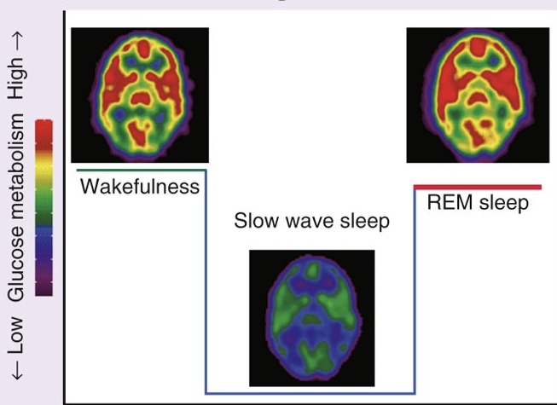
Sleep in numbers
Sleep is entered through NREM sleep. NREM sleep and REM sleep alternate (90 minute periods)
Wakefulness in sleep accounts for less than 5% of the night
Stage-1: 2%- 5% of sleep. Stage-2: 45%- 55% of sleep; stage-3: 3% - 8%; stage-4: 10%- 15%
5. NREM sleep 75% - 80% of sleep
6. REM 20% - 25% of sleep
7. Brief arousals may occur during
sleep
(does not indicate abnormality) (1)

Slide 10
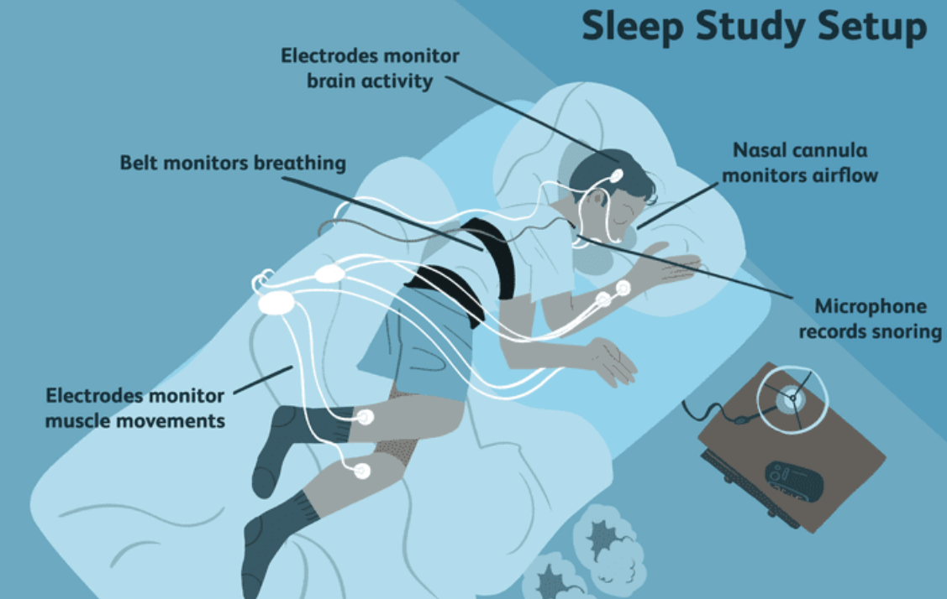
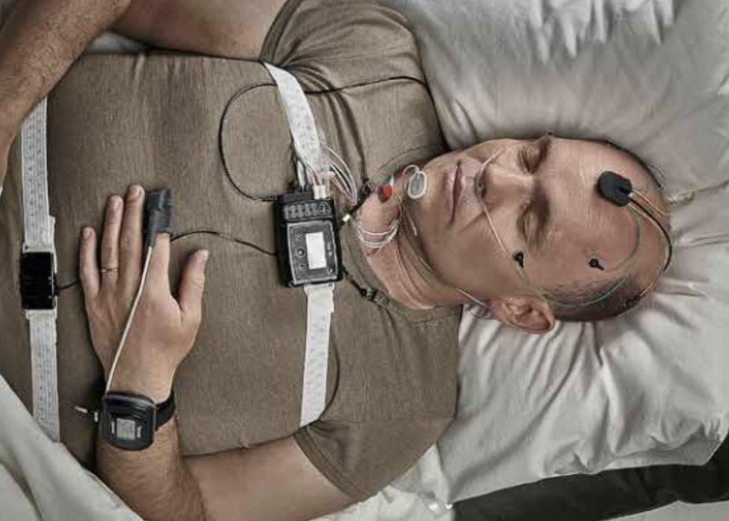
How to measure sleep
Brain waves
Eye movements
Heart rate
Breathing pattern
Blood oxygen level
Body position
Chest and abdominal movement
Limb movement
Snoring and other noises
Notes:
How to measure sleep and calculate the times, to estimate if sleep is normal or there are hints of disorder. You can see here how sleep study looks like and in the left window are listed variables of interest in sleep study. Sleep studies are of different extent, measuring up to 20-30 channels.

Slide 11
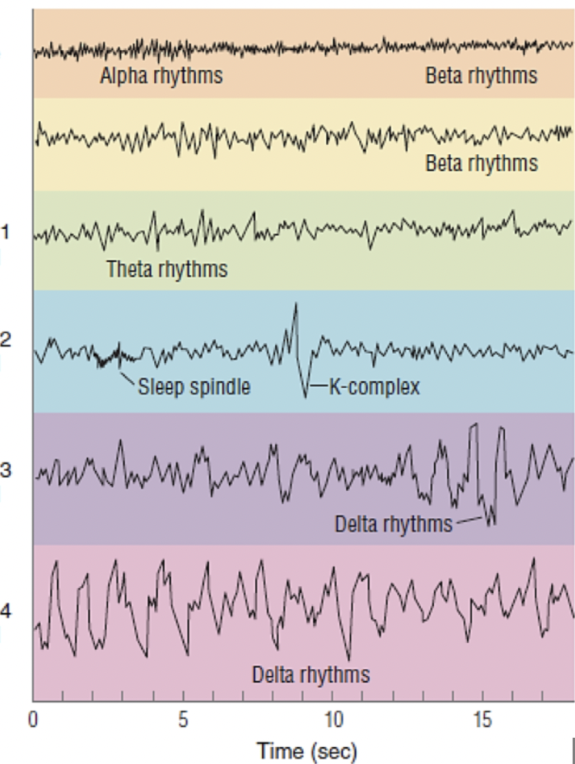
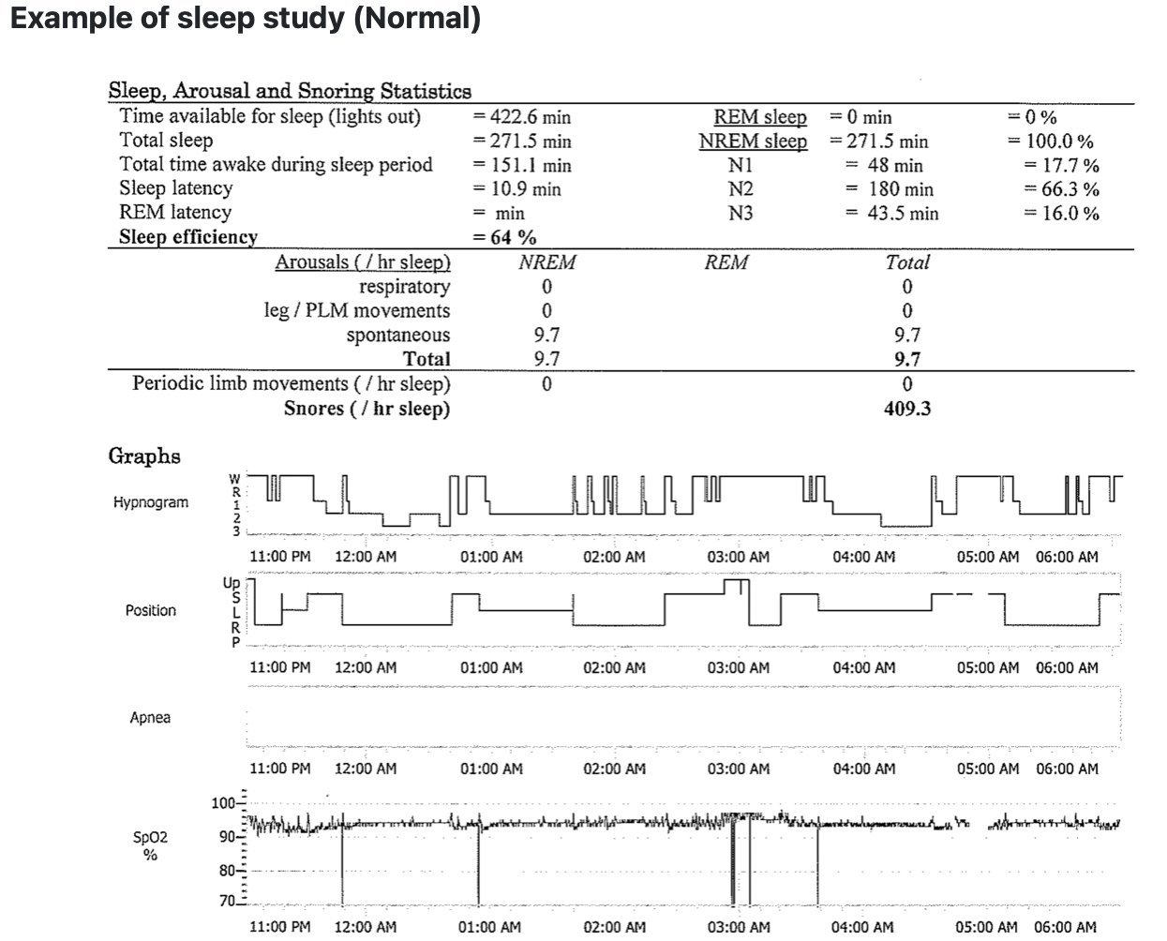
Sleep study graphics
Notes:
On the left is an example of normal sleep study - polysomnography - listed are general sleep estimates, arousals, snoring etc. It is always good to have a picture for the patient when explaining the results. Hypnogram - presents the sleep phase buildup through the study. On the colorful plate you can see how brain activity looks like and numbers 1-4 present sleep phases from light to deep. REM sleep is not presented here. Typical findings like sleep spindles and K-complexes immerge when patient has reached the second sleep phase. In lighter sleep phases the frequency is high and amplitude low, in deep sleep phases

Slide 12
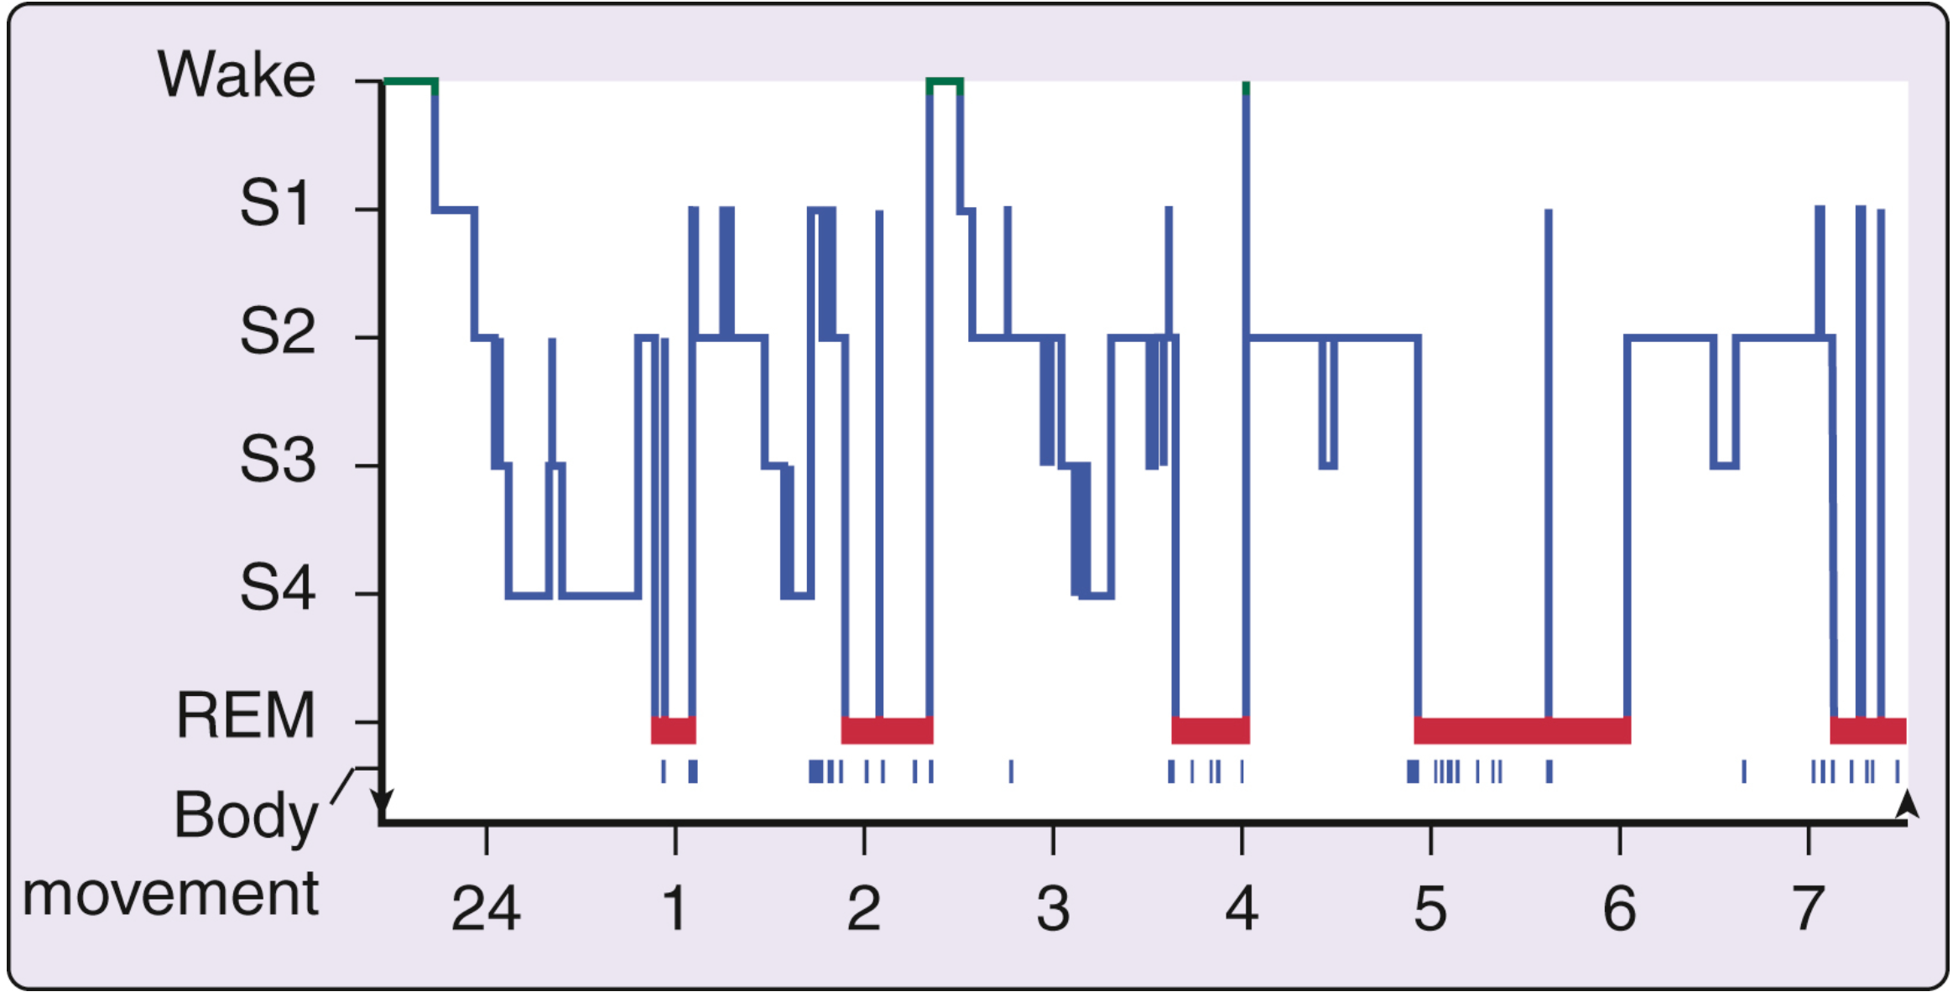
Normal sleep anatomy in perspective of natural aging
Age-related changes in sleep: newborn humans enter REM sleep (active sleep) before NREM (quiet sleep)
At birth, active sleep is about 50% of total sleep and declines over the first 2 years to about 20% to 25%
NREM sleep slow waves not present at birth, emerge in the first 2 years.
SWS decreases across adolescence (40%) from preteen years, declines into old age, particularly in men, less in women
REM sleep as a percentage of total sleep is relatively stable at about 20% to 25% across childhood, adolescence, adulthood, and into old age, except in dementia (3)
Normal human sleep: nonREM sleep and REM sleep. HYPNOGRAM:
Notes:
Normal sleep looks like walking down the stairs - initially when one falls asleep. After first, second, third and fourth stages of nonREM sleep REM phase (marked with red) is marked. Sleep changes through the course of life...
SWS marks the 3-4 sleep phase - which is deep sleep.

Slide 13
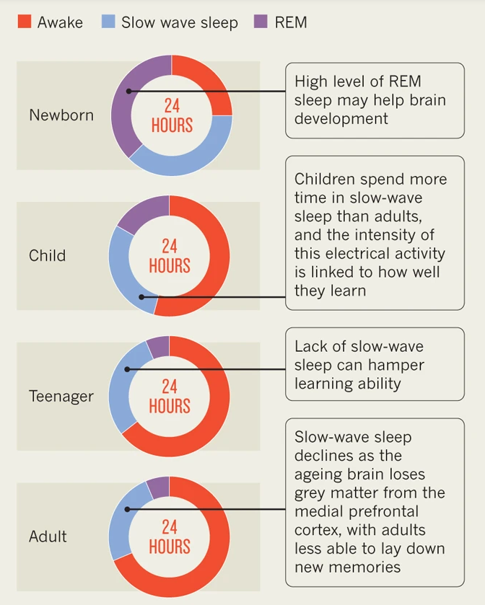
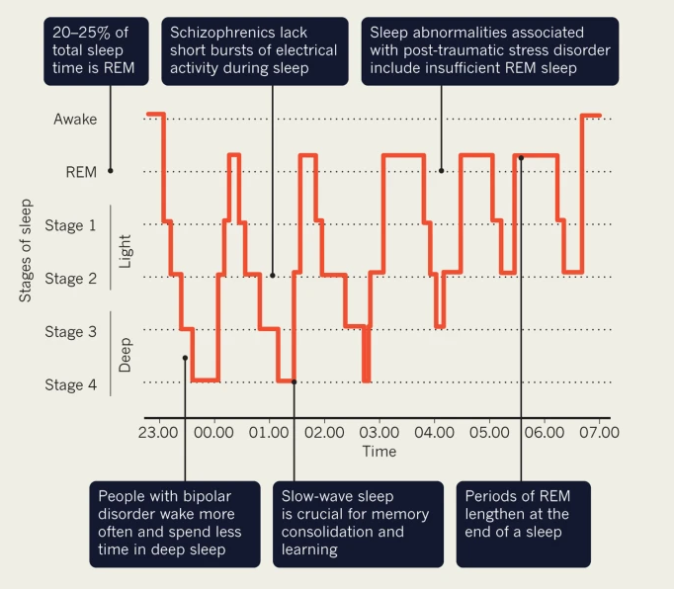
Sleep in different age groups and populations
Notes:
Through lifespan sleep has different clinical meaning. It is considered that newborns... Another illustration of hypnogram explains already few sleep disorders and facts.

Slide 14
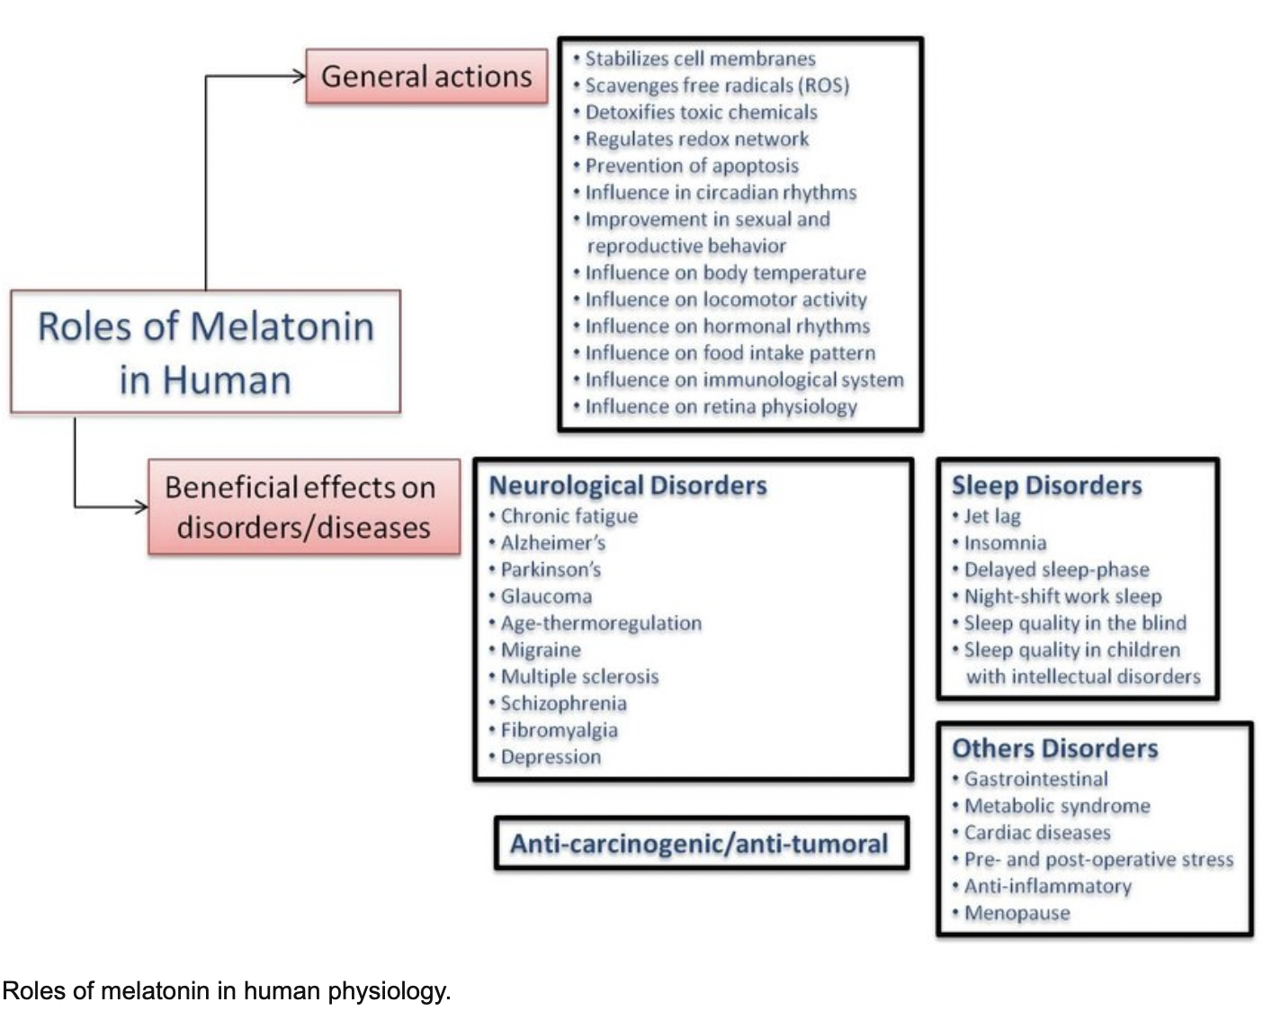
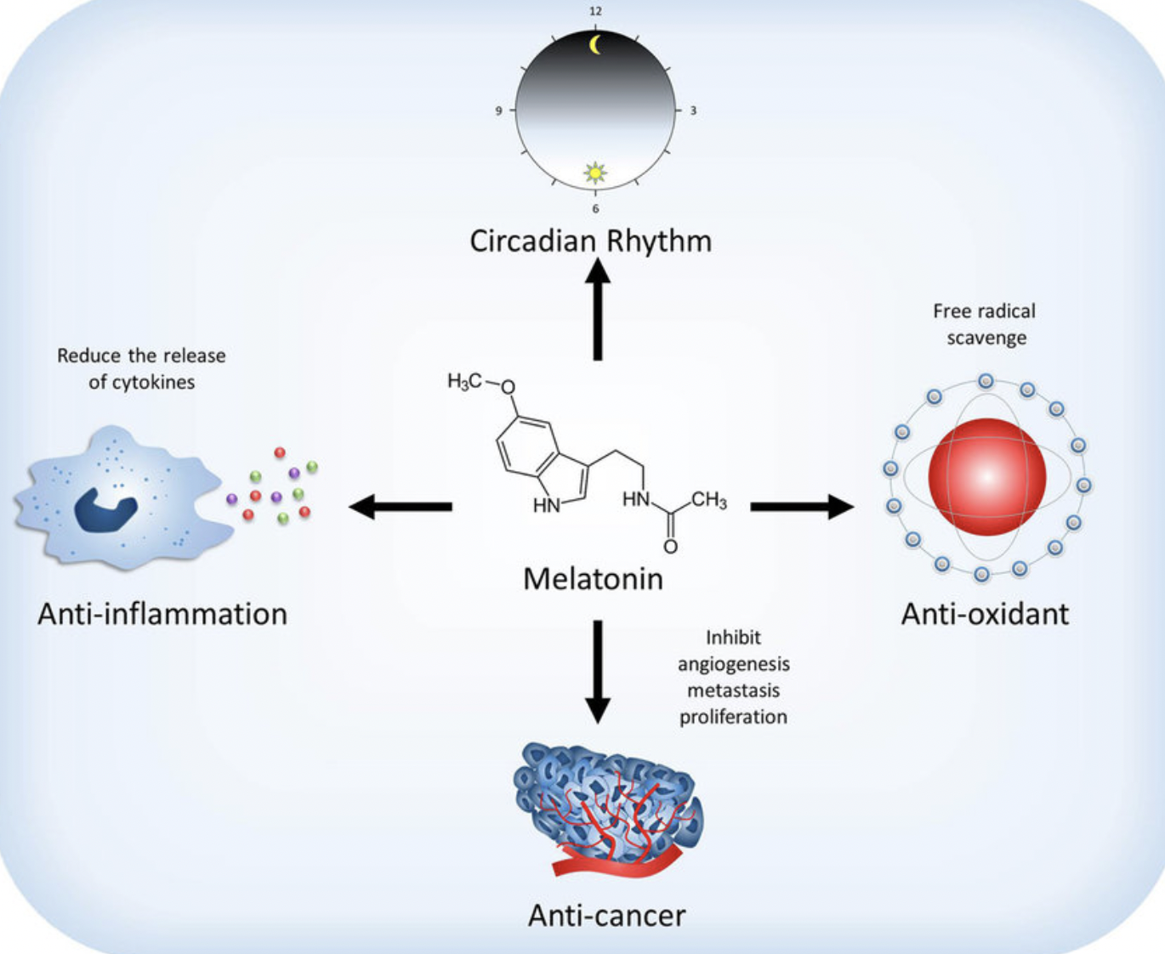
Melatonin is a hormone made by the pineal gland. Melatonin helps control the body’s sleep cycle, and is an antioxidant.
Notes:
Melatonin is called also a dark hormone. Because light supresses it and darkness increases release.

Slide 15
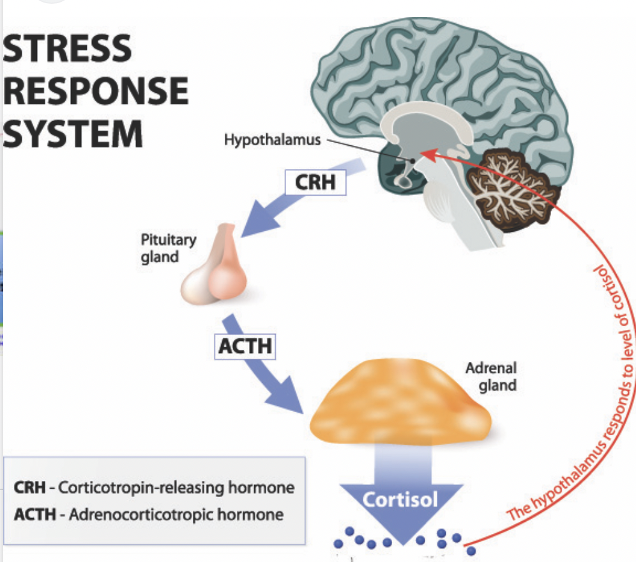
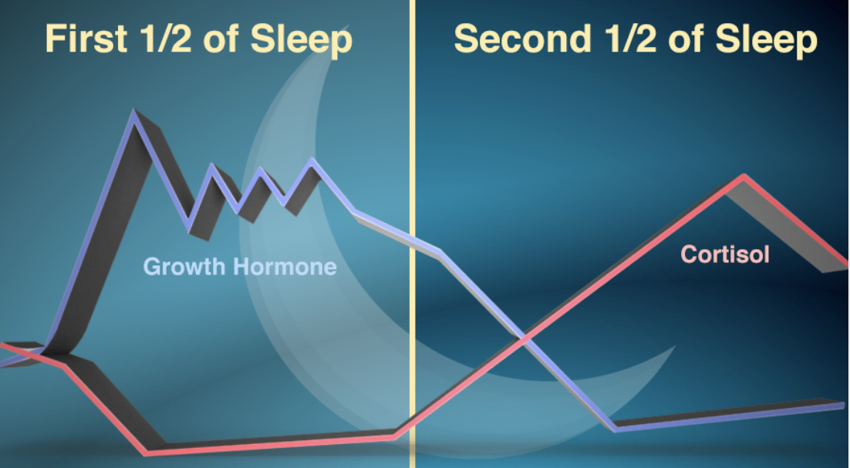
Cortisol is a steroid hormone, in the glucocorticoid class of hormones. It is produced mainly by the zona fasciculata of the adrenal cortex in the adrenal gland.
(4)
Notes:
Cortisol strikes in in the morning prior waking up. In a way it switches places with growth hormone.

Slide 16

Cortisol
Cortisol prepares to fight, to freeze, or run. It also:
affects mood, influence digestion and metabolism, helps immune system function in response to illness or injury
Cortisol levels are highest in the morning
When there is ongoing long stress (mental, disease-caused), the effects on HPA axis and cortisol levels can last a long time causing:
fragmented sleep
insomnia
shortened overall sleep time (4)
There is relationship between sleep and metabolism through hypothalamic–pituitary–adrenal (HPA) axis activation
Sleep deprivation and sleep disorders are associated with maladaptive changes in the HPA axis, leading to neuroendocrine dysregulation
Cells all over the body are studded with cortisol receptors, so this hormone can trigger:
rapid heart rate, spike in blood sugar rapid breathing, sharpened senses
Notes:
Cortisol has many roles among regulating wakefullness. Hypothalamic- pituitary adrenal axes is relevant in this metabolic route.

Slide 17
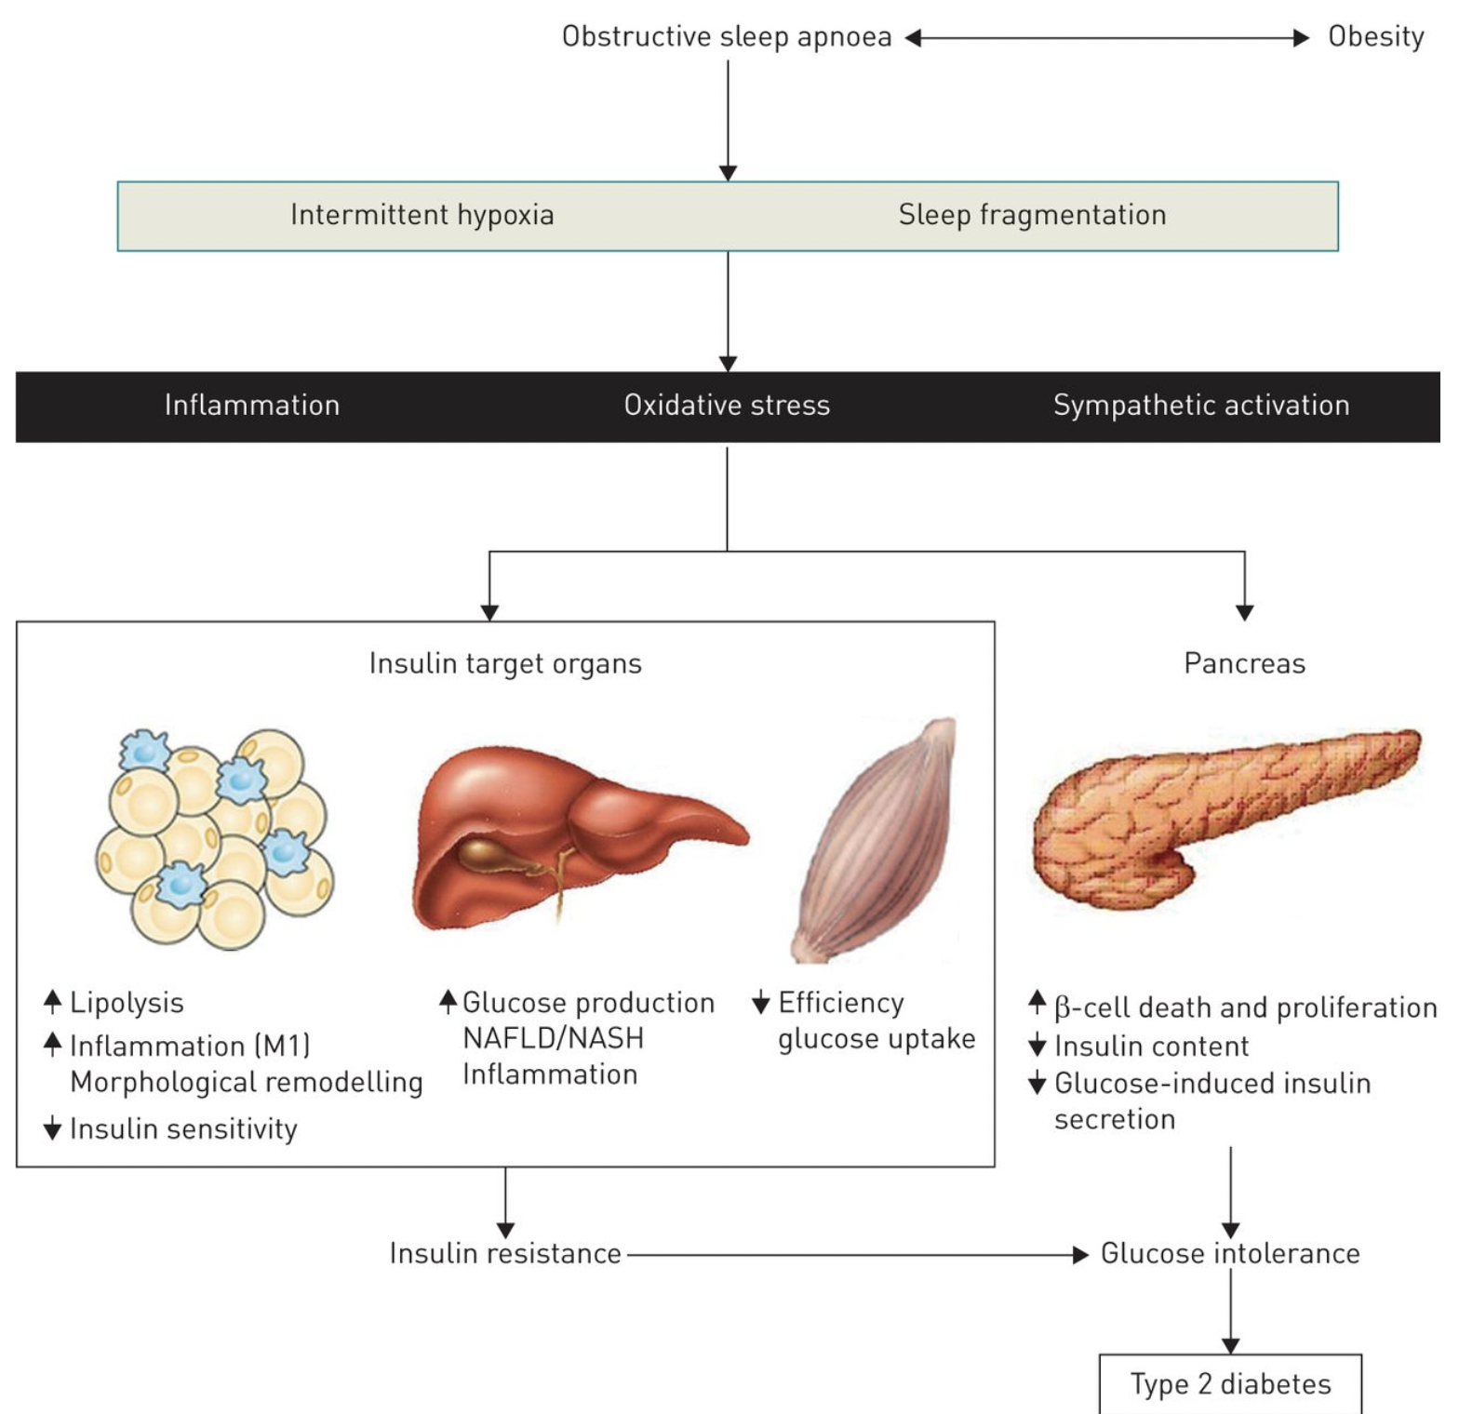
Insulin is a hormone made by the islet cells of the pancreas. Insulin controls the amount of sugar in the blood by moving it into the cells, where it can be used by the body for energy.
Notes:
When cortisol metabolism is affected, sleep is disrupted - usually insulin metabolism is also influenced. In this picture you can follow that sleep fragmentation plays big role in development on insulin resistance and development of diabetes.

Slide 18
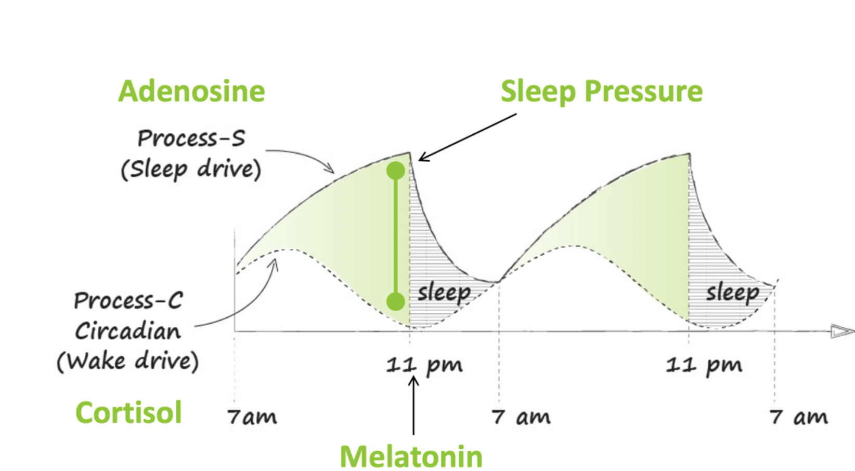
Adenosine has a multiplicity of effects on mammalian tissue acting as a homeostatic mediator to restore normal tissue function following stress and trauma. It also appears to be the key mediator of sleep, explaining why caffeine is the most widely used stimulant
Adenosine appears to subserve a number of diverse roles in normal physiology, which include promoting and/or maintaining sleep, regulating the general state of arousal as well as local neuronal excitability, and coupling cerebral blood flow to energy demand
During the day adenosine levels build up,
signalling fatigue
Adenosine is a byproduct of energy
expenditure – higher activity produces more adenosine producing more sleepiness
(13)
Notes:
Adenosine

Slide 19
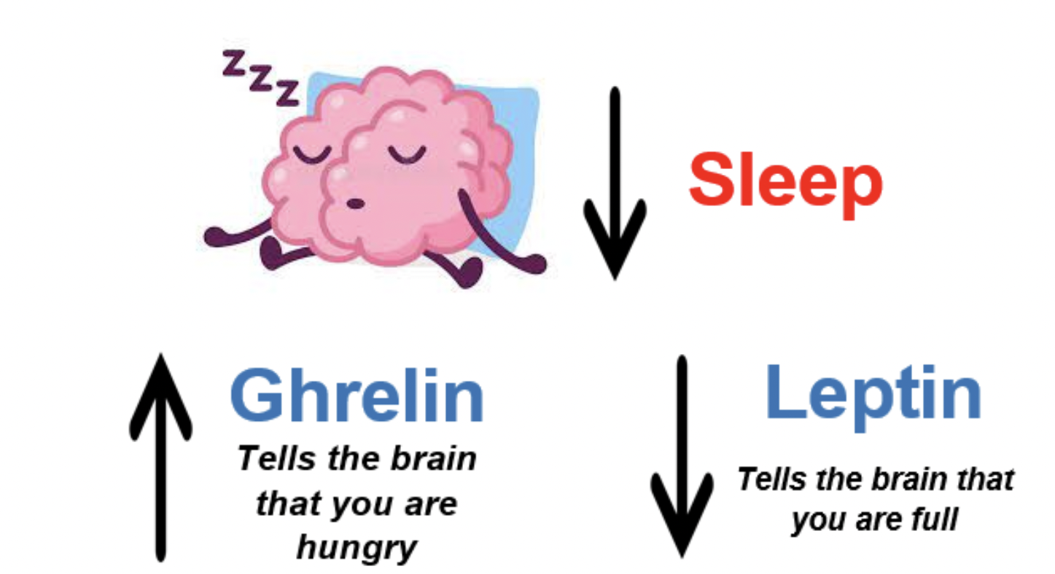
Ghrelin is a hormone produced by enteroendocrine cells of the gastrointestinal tract, especially the stomach, and is often called a "hunger hormone" because it increases the drive to eat.
Ghrelin levels rise primarily in response to acute sleep deprivation, while leptin levels fall with chronic sleeplessness.
A single night of poor sleep causes acute rises in ghrelin levels, but leptin concentrations remain essentially the same. (5)
Notes:
Ghrelin

Slide 20
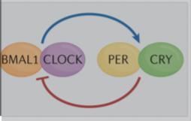
Human (gene) sleep clock system
Candidate Genes
The timing of the peaks and troughs of daytime alertness and the timing of nocturnal sleep (i.e., diurnal preference) are highly variable among healthy individuals.
Some go to sleep when others wake up. Self-rating scales: Horne-Östberg morningness-eveningness Questionnaire (MEQ) and the Munich Chronotype Questionnaire
Genes determine what is the chronotype
(1)
Notes:
Now we come to slides were three topics are mixed - genes orchestrate circadian rhythm and chronotype. Sleep need, length of sleep, timing to fall asleep and to wake up are orchestrated through genes. There are hundreds of candidate genes affecting sleep through switching in and out, most investigated ones are Clock and PER genes. You can find out about yourself – to what direction your genes push you by filling in questionnaires named here. At the moment we cannot yet offer laboratory testing for clinical use to understand what type your sleep might be.

Slide 21
Human (gene) sleep clock system
Large interindividual differences are observed in preferred time of day for completion of:
Distinct cognitive tasks, sleep timing
Majority of humans are not marginal in chronotype and usualy manage well some delineation regarding wake up- or bed times
Extreme early or late chronotypes do exist. Genetic variations have been identified leading to a short sleep phenotype in which individuals sleep only 4–6.5 h nightly.
Negative health consequences have been identified when individuals do not sleep at their ideal circadian timing or are sleep deprived relative to intrinsic sleep need.
(1,6)

Slide 22
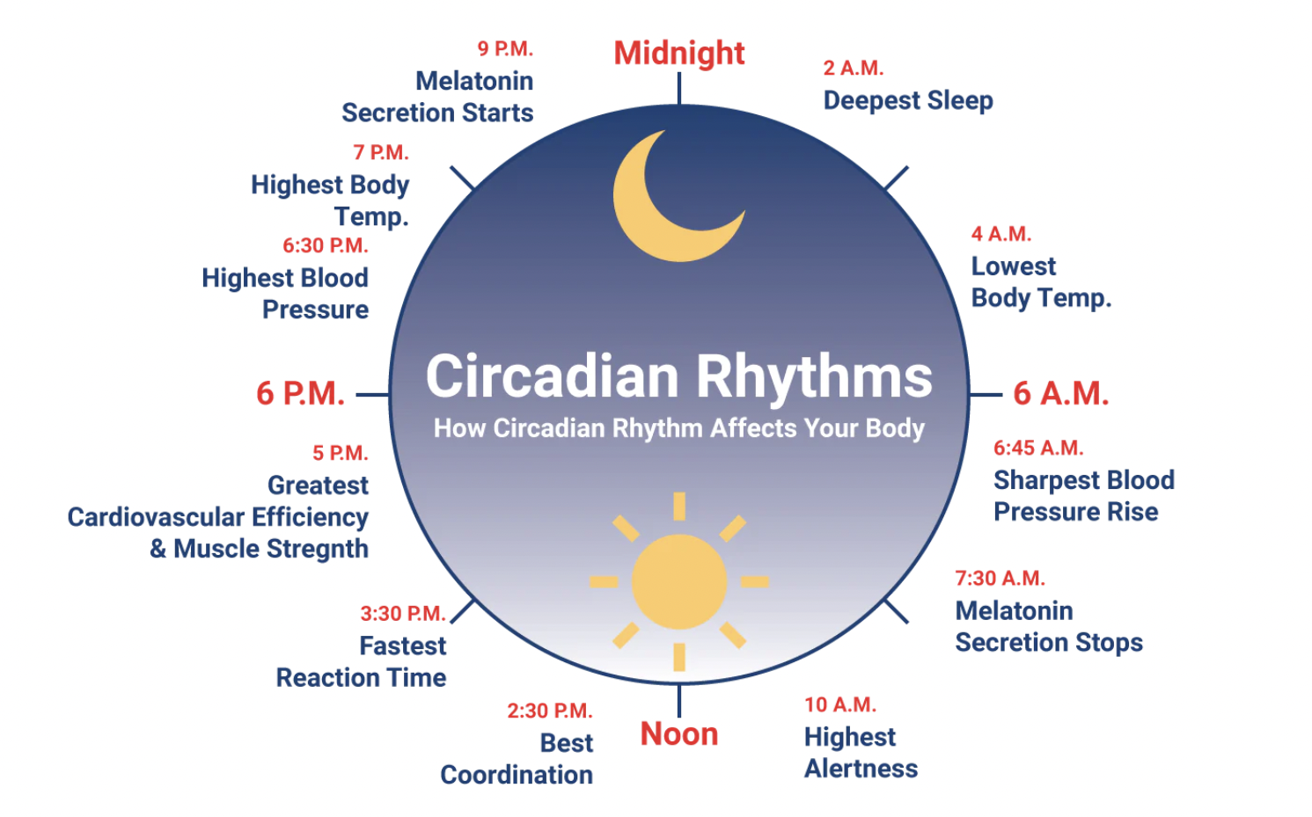
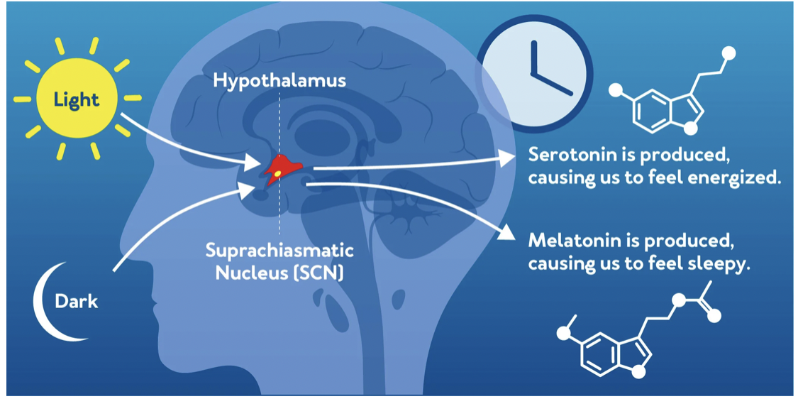
Circadian rythm <- chronotype <- genes LIGHT
The circadian pacemaker (or biologic clock) is endogenous rhythmicity with a period just slightly greater
than 24 hours, persists in the absence of periodic changes in
the external environment, and has timing or phase relative to the time of day that is genetically determined
and influenced by environmental synchronizers. (1)
Notes:
There are more than 200 circadian rhythms in human organism, interconnected. There is the best or suitable time window for every initiated action: different mental tasks, physical exercises, meal times and of course sleep times. This globe on right pictures possible timeline. Because different chronotypes have variable circadian prefernces it makes sense to get to know your chronotype and act accordinly.

Slide 23

Chronotype
Chronotype impacts the prevalence of diseases. Decreased well-being, shorter lifespan, and increase mortality in evening types have been noticed.
There are higher rates of a wide range of disorders including psychological disorders, diabetes, neurological, gastrointestinal, and respiratory in definite evening types compared with definite morning types.
Morning preference appears to have a protective effect against breast cancer (investigation of the impact of chronotype on breast cancer diagnosis in the UK Biobank). (6)
Notes:
Genes also have an input to our circadian rhythms as pointed out in the last slide. Circadian rhythm is strongly influenced by chronotype - morningness or eveningness or types in between.

Slide 24

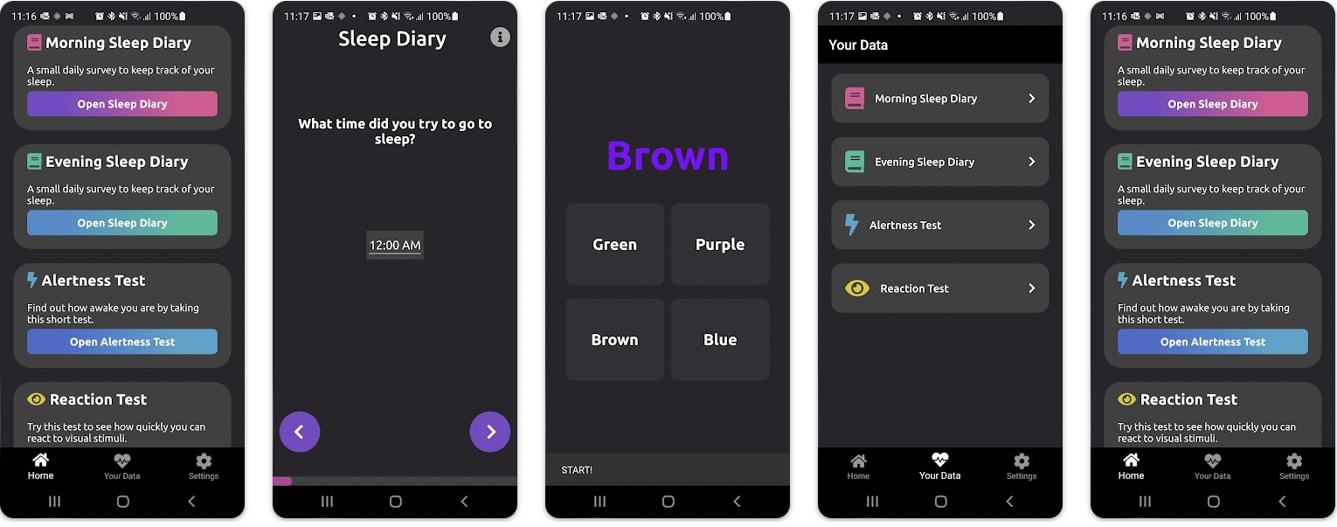
Sleep diary
Notes:
Sleep diary gives us lots of hints about circadian rhythms and chronotype. Paper- pen version versus digital and application versions are available.

Slide 25
GROUP DISCUSSION - individual sleep need
Based on subjective ideas and thoughts
Based on sleep diary results

Slide 26
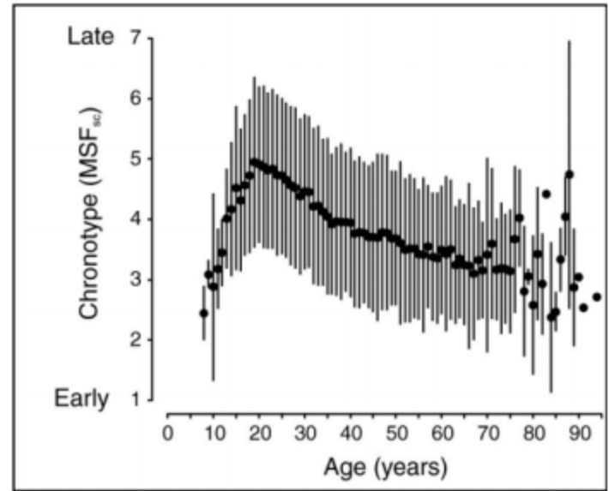
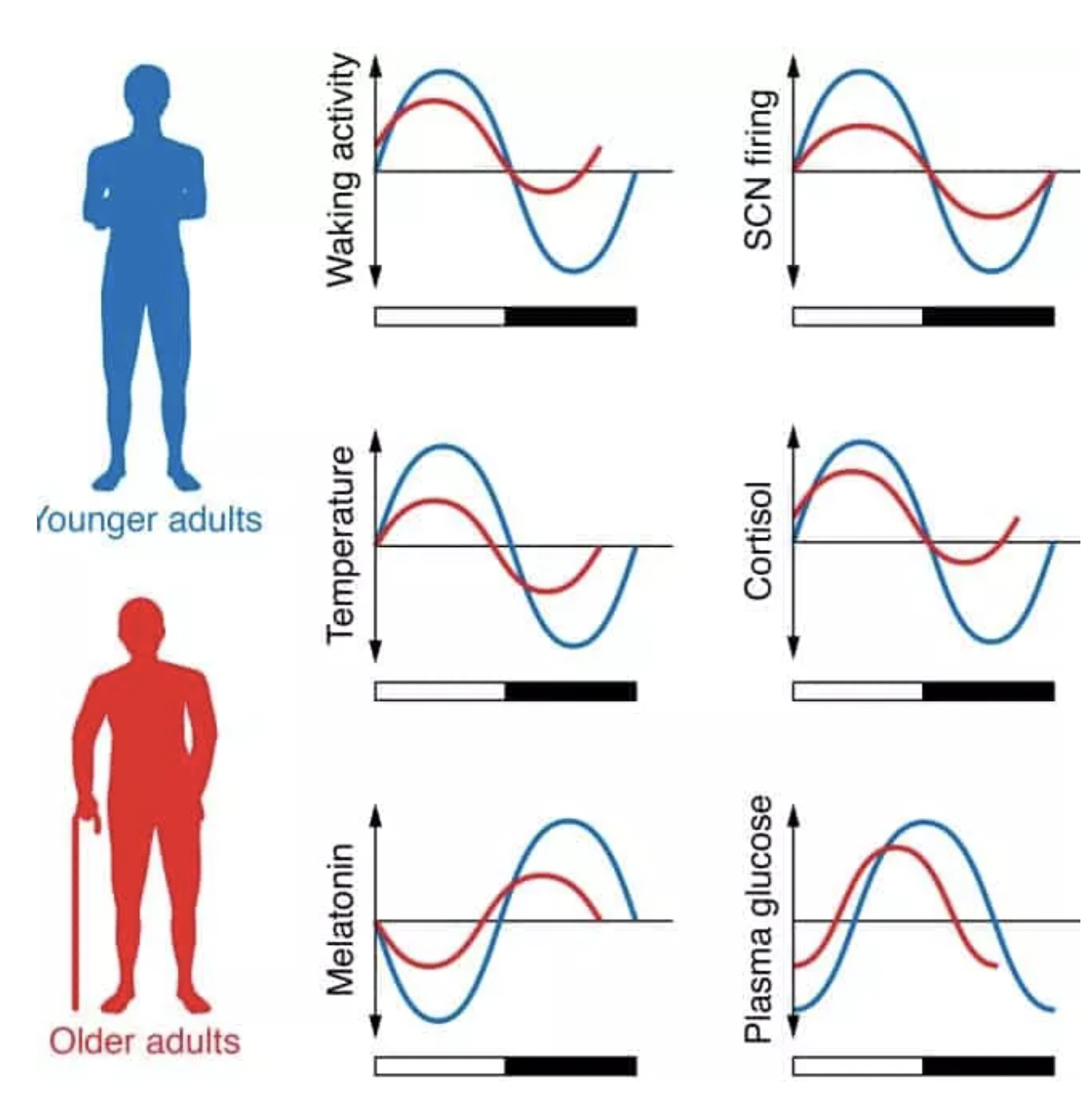
Chronotype, age
(7)
Notes:
There are changes through course of light in waking activity, body temperature and because melatonin physiology and temperature are interrelated then changes happen with both as you can see in these comparative picture of young and old.

Slide 27
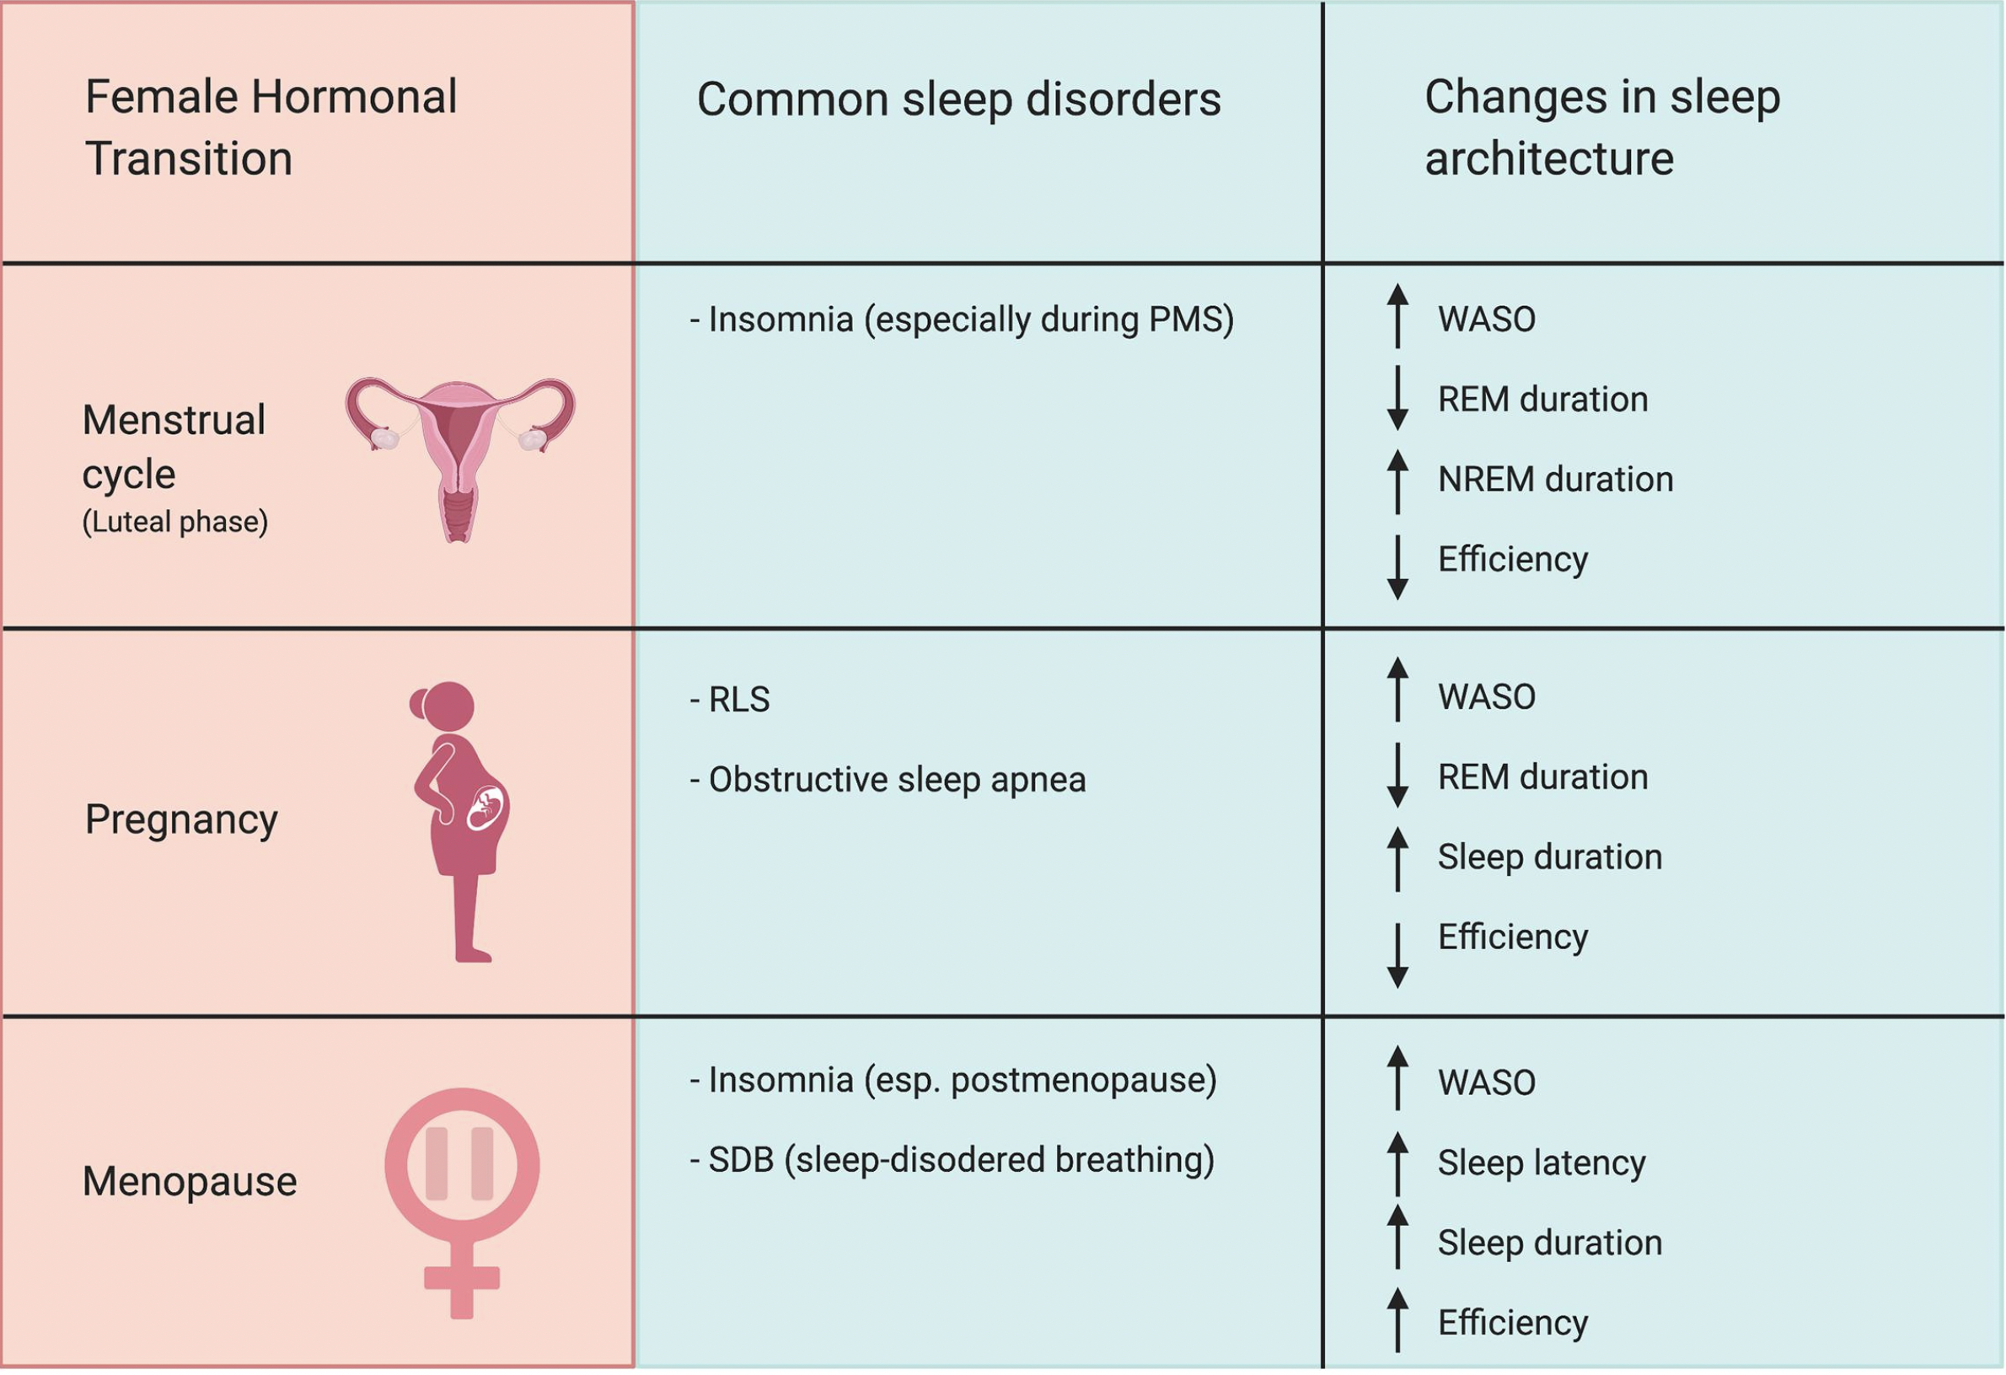
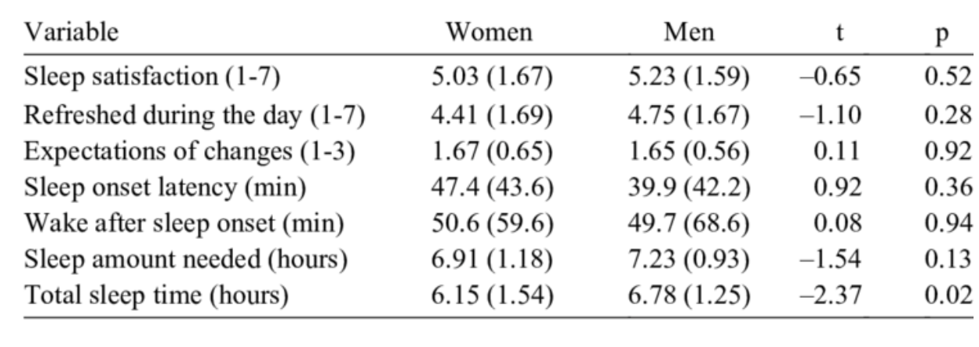
Gender differences in sleep characteristics
(8)
(9)
Notes:
There are some changes in sleep related times when comparing males females. But mostly female body is in constant change when it comes to hormones and there so is female sleep quality is more affected through life.

Slide 28
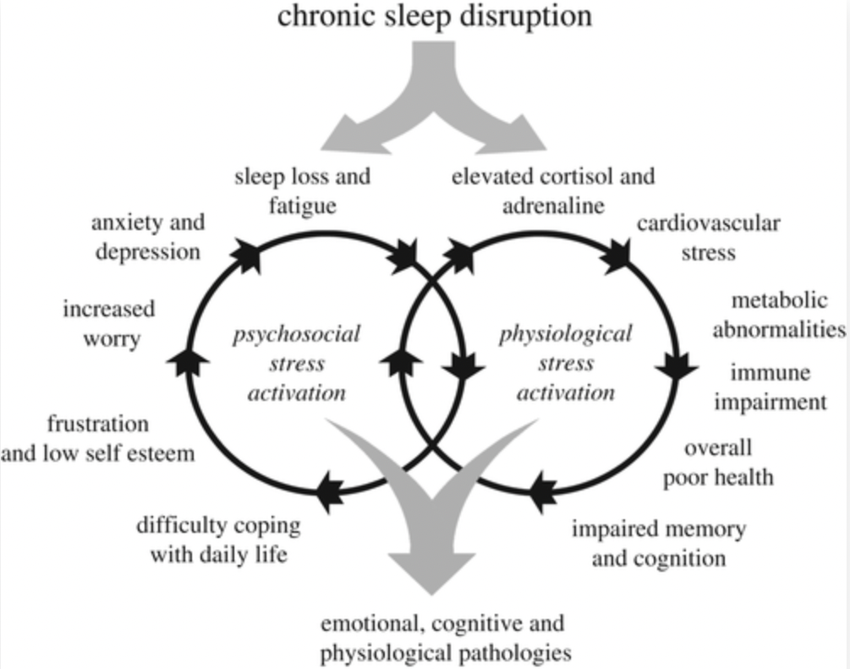
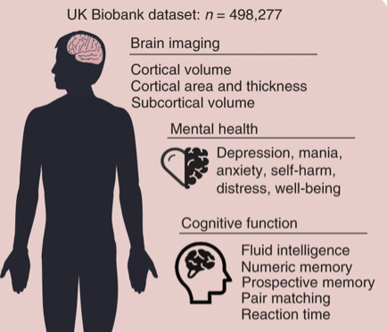
Sleep deprivation
Sleep deficiency leads to:
Chronic health problems
Heart disease
Kidney disease
High blood pressure, diabetes
Stroke
Obesity
Depression
Sleep deficiency is also linked to a higher chance of injury in all age groups
Slowed thinking, reduced attention span, worsened memory, poor or risky decision-making, lack of energy, mood changes, feelings of stress, anxiety, or irritability
(10)
Notes:
Sleep deprivation either acute or chronic is dangerous. It affects as you can see on the pink picture mental health and cognitive functions, if lasting long there are changes in brains anatomy influencing:

Slide 29
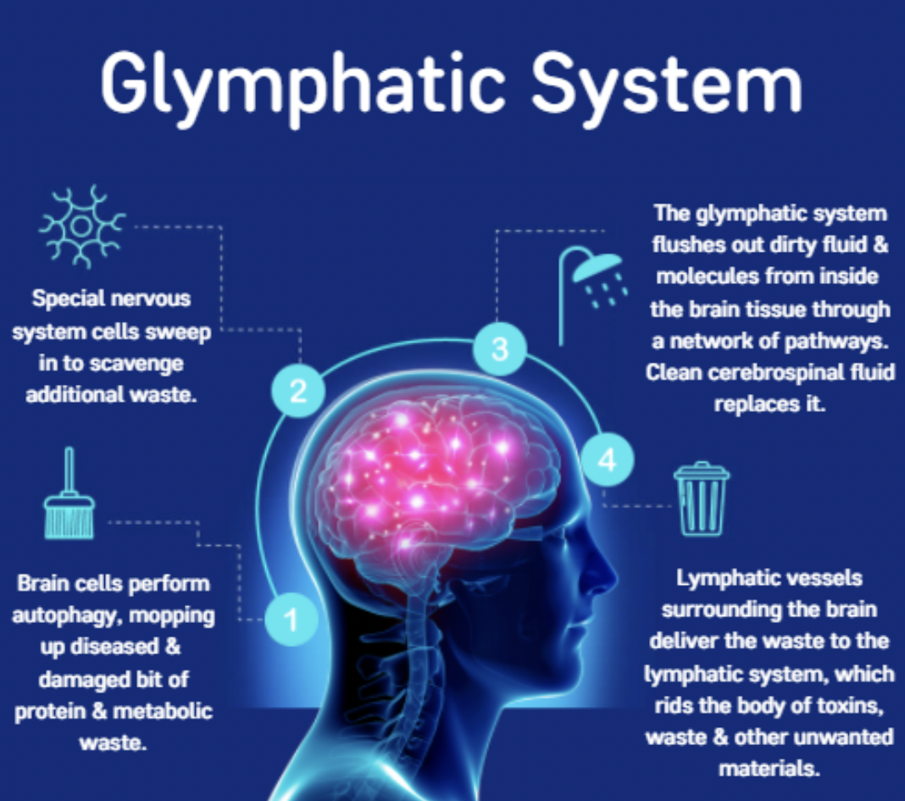

Glymphatic system
The glymphatic system is a recently discovered macroscopic waste clearance system in the brain
Utilizes a unique system of perivascular channels, formed by astroglial cells, to promote efficient elimination of soluble proteins and metabolites from the central nervous system
Distributes non-waste compounds, such as glucose, lipids, amino acids, and neurotransmitters in the brain
Intriguingly, the glymphatic system function mainly during sleep

Slide 30
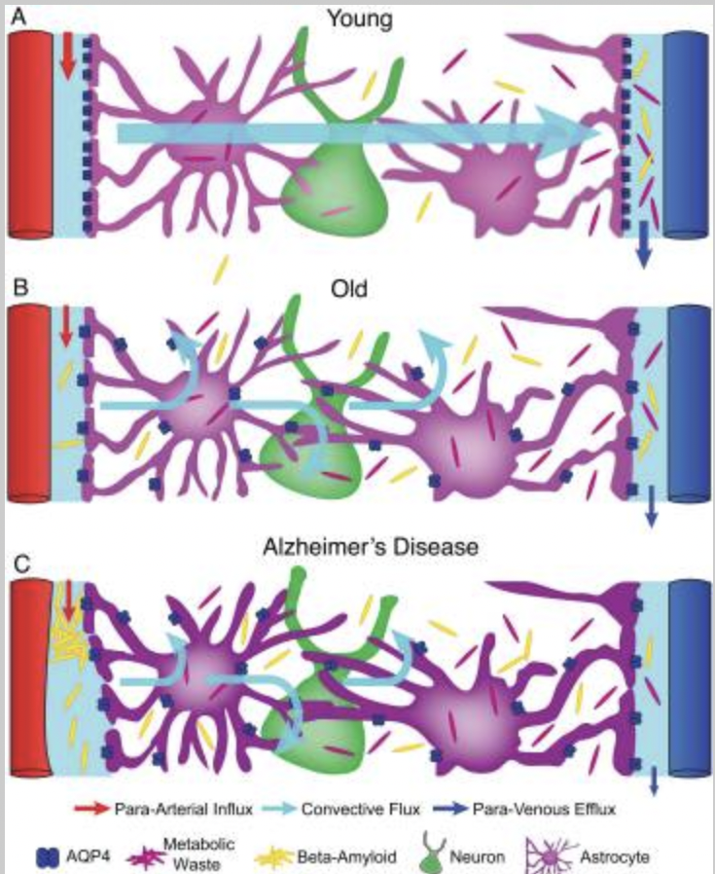
Glymphatic system 2
The brain must enter a state of
activity that enables elimination of
potentially neurotoxic waste
products, including β-amyloid
Glymphatic function is suppressed
in various diseases and failure of
glymphatic function in turn might
contribute to pathology in
neurodegenerative disorders,
traumatic brain injury and stroke
(11)
Notes:
In neurodegenrative disease glymphatic system might be compromised.

Slide 31
Sleep and neurodegeneration
Sleep abnormalities are clearly recognized as a distinct clinical symptom in neurodegenerative disorders.
Appropriate management of sleep-related symptoms has a positive impact on quality of life in patients with neurodegenerative disorders.
Sleep changes may also serve as markers to identify patients in the preclinical stage of some neurodegenerative disorders.
Specific sleep abnormalities in younger age groups could be a surrogate marker to neurodegenerative disorders.
It is yet unclear if sleep disturbance directly impacts neurodegenerative
processes or is a secondary outcome of neurodegeneration. (1)

Slide 32
Hypnotics, sleep aid pills
The distribution of sleep states and stages is affected by many common drugs, including those typically prescribed in the treatment of sleep disorders
Social or recreational drugs
A number of generalizations regarding the effects of certain of the more commonly used compounds on sleep stage distribution can be made:
Benzodiazepines tend to suppress SWS and have no consistent effect on REM sleep.

Slide 33
Hypnotics, sleep aid pills
Tricyclic antidepressants, monoamine oxidase inhibitors, certain selective serotonin reuptake inhibitors tend to
suppress REM sleep.
An increased level of motor activity during sleep occurs with certain
of these compounds, leading to a pattern of REM sleep without motor inhibition or an increased
incidence of PLMS.
Fluoxetine is also associated with rapid eye movements across all
sleep stages (“Prozac eyes”).
Withdrawal from drugs that selectively suppress a stage
of sleep tends to be associated with a
rebound of that sleep stage.
Thus acute withdrawal from a benzodiazepine compound
is likely to produce an increase of SWS;
acute withdrawal from a tricyclic antidepressant or
monoamine oxidase inhibitor is likely to produce an increase of REM sleep.

Slide 34
Hypnotics, sleep-aid pills
Consider signs of sleeping pill addiction:
requiring bigger doses in order to be able to fall asleep
becoming isolated from your loved ones while continuing to use sleeping pills
craving sleeping pills if you try to go without them
attempting to stop using sleeping pills unsuccessfully
behaving in unsafe ways while you’re under the influence of sleeping pills
running out of your sleeping pill prescription early due to taking larger dosages
taking sleeping pills without any intention of going to sleep, such as taking them during the day
Two main types of sedative-hypnotics – benzodiazepines and Z-drugs.
Common benzodiazepines:
Xanax (alprazolam), Valium (diazepam), Ativan (lorazepam)
Common Z-drugs:
Ambien (zolpidem), Lunesta (eszopiclone), Sonata (zaleplon).
Often prescribed for patients with anxiety and difficulty sleeping
Simultaneous use of alcohol, drugs.

Slide 35
Hypnotics, sleep aid pills
Acute presleep alcohol intake can produce an increase in SWS and suppression of REM sleep early in the night, which can be followed by REM sleep rebound in the latter portion of the night as the alcohol is metabolized
Low doses of alcohol have minimal effects on sleep stages, but they can increase sleepiness in the
late evening
Acute effects of marijuana (tetrahydrocannabinol [THC]) include minimal sleep
disruption, characterized by a slight reduction of REM sleep
Chronic ingestion of THC produces a long-term suppression of SWS (1)

Slide 36
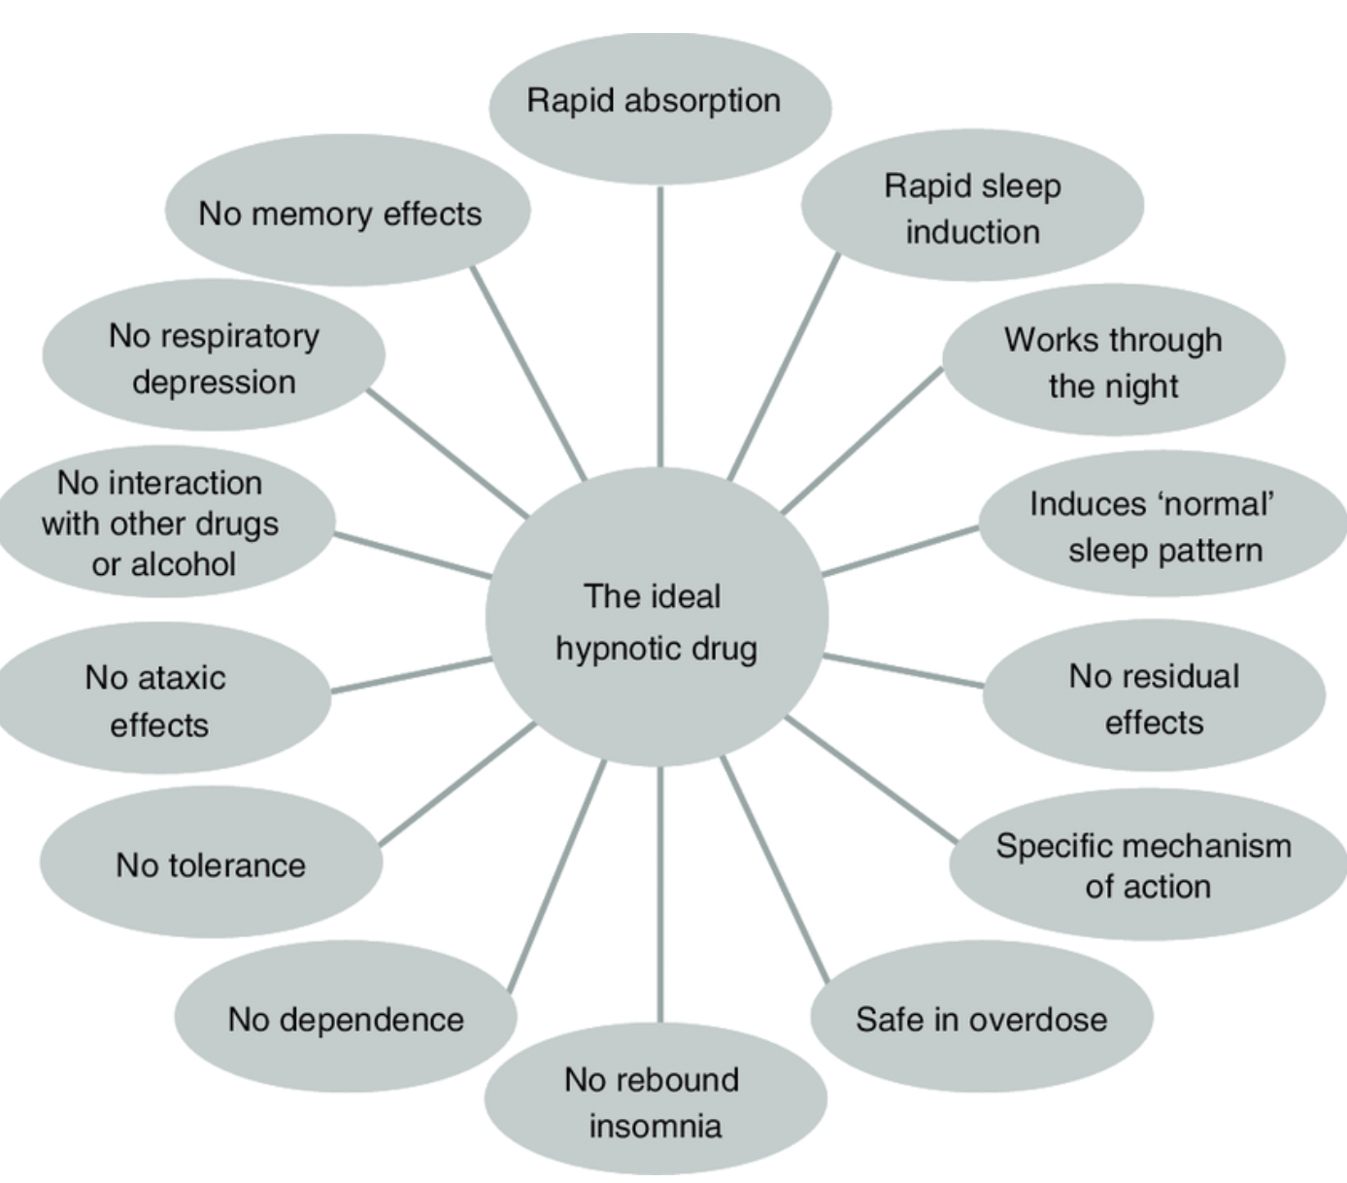
There is no perfect
sleep drug
(12)

Slide 37
Take home messages
Sleep is regulated by genes /hereditarity/
Light has major influence on sleep-wake system
In healthy individual sleep is quite stable, especially in young age
Normal sleep cannot be maintained with the help of long term medication and subtance use
5. Disease burden influences sleep quality and quantity

Slide 38
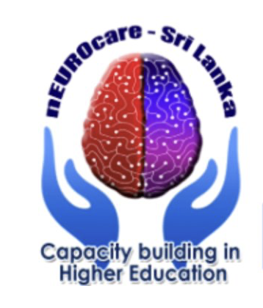
Literature
Kryger, M., Roth, T. and Goldstein, C. (2022). Kryger's Principles and Practice of Sleep Medicine. 7th Edition. [Insert Publisher Location]: Elsevier - OHCE.
Husse et al.(2015). Synchronization of the mammalian circadian timing system: Light can control peripheral clocks independently of the SCN clock. BioEssays : news and reviews in molecular, cellular and developmental biology.
Peplow M. Structure: the anatomy of sleep. Nature. 2013 May 23;497(7450)
Hirotsu C, Tufik S, Andersen ML. Interactions between sleep, stress, and metabolism: From physiological to pathological conditions. Sleep Sci. 2015 Nov;8(3):143-52.
Schmid SM, Hallschmid M, Jauch-Chara K, Born J, Schultes B. A single night of sleep deprivation increases ghrelin levels and feelings of hunger in normal-weight healthy men. J Sleep Res. 2008 Sep;17(3):331-4.
https://rdcu.be/db43z
https://www.sleepfoundation.org/how-sleep-works/chronotypes
Pallesen, Ståle & Nordhus, Inger & Nielsen, Geir. (2009). Perception of sleep in the elderly. Norsk Epidemiologi.
https://www.frontiersin.org/articles/10.3389/fnins.2020.625397/full
https://www.sleepfoundation.org/sleep-deprivation
Jessen NA, Munk AS, Lundgaard I, Nedergaard M. The Glymphatic System: A Beginner's Guide. Neurochem Res. 2015 Dec;40(12):2583-99.
Wilson, S.J et al. (2010). British Association for Psychopharmacology consensus statement on evidence-based treatment of insomnia, parasomnias and circadian rhythm disorders. Journal of psychopharmacology (Oxford, England). 24. 1577-601.
https://www.wellnessgarage.ca/better-blog/how-to-improve-your-sleep

