Slide 1

Implementation and Evaluation
An introduction
Martin Persson
Kristianstad University
Notes:
In the vast realm of healthcare, healthcare professionals often encounter a plethora of complex procedures, treatments, and interventions. Yet, amidst this myriad of activities, one foundational principle remains pivotal: evaluation. But why is evaluation so indispensable in the healthcare sector?
At its core, healthcare seeks to alleviate suffering, enhance the quality of life, and promote longevity. To achieve these objectives, healthcare professionals must ensure that their actions not only achieve the desired outcomes but also meet established standards of safety, efficiency, and ethics. This is where the role of evaluation becomes critical.

Slide 2
Ensuring Quality of Care: Every patient expects and deserves the highest standard of care. Evaluation, be it of clinical practices, surgical procedures, or novel treatments, helps maintain and elevate these standards. By regularly assessing the effectiveness and safety of interventions, healthcare providers can refine their practices, ensuring that patients always receive the best possible care.
Facilitating Continuous Improvement: The field of medicine is dynamic, with new research, technologies, and practices emerging continually. Evaluation serves as a feedback loop, allowing professionals to understand what works and what doesn’t, paving the way for innovation and improvement.

Slide 3
Accountability and Transparency: Healthcare practitioners hold immense responsibility. They make decisions that can profoundly impact lives. Through evaluation, they demonstrate accountability for their actions, ensuring that they remain transparent to patients, their families, peers, and regulatory bodies.
Optimizing Resources: Healthcare often grapples with resource constraints, whether financial, human, or material. Evaluating interventions ensures that resources are utilized optimally, preventing waste and ensuring maximum benefit for every dollar spent or every hour invested.

Slide 4
Informed Decision Making: Proper evaluation provides evidence, and evidence forms the backbone of informed decision-making in healthcare. Whether choosing a treatment protocol, implementing a public health intervention, or deciding on hospital policies, evaluations offer insights that drive sound, evidence-based choices.
Notes:
In essence, you will soon realize that evaluation isn't just a routine or administrative task; it's the compass that guides the healthcare ship. As you progress in your studies and professional journey, embracing a culture of consistent evaluation will not only make you a better healthcare provider but also ensure the betterment of the entire healthcare system.

Slide 5
Learning Objectives
Define
implementation
Explain why
evaluation is important
Summarise the
theory of change model

Slide 6

Implementation
This Photo by Unknown Author is licensed under CC BY-NC

Slide 7

‘Change is not made without inconvenience, even from worse to better.’
Richard Hooker, 1554–1600
“no copyright infringement is intended”

Slide 8

Only a small percentage of efforts to change or scale up a practice meet expectations.
Studies have shown that change efforts fail more often than they succeed.
World Health Organization. Guide to fostering change to scale up effective health services 2013.
Kotter JP. Leading change: Why transformation efforts fail. Harvard Business Review 2007.

Slide 9
Scenario
You are a team leader or member of the team
  You are tasked to implement an improved version of Neurodegenerative care
    The team consists of 15 individuals
  Limited resource allocation
  It will add to the work burden for the team initially.
    Learning new knowledge
    Change of routine

Slide 10
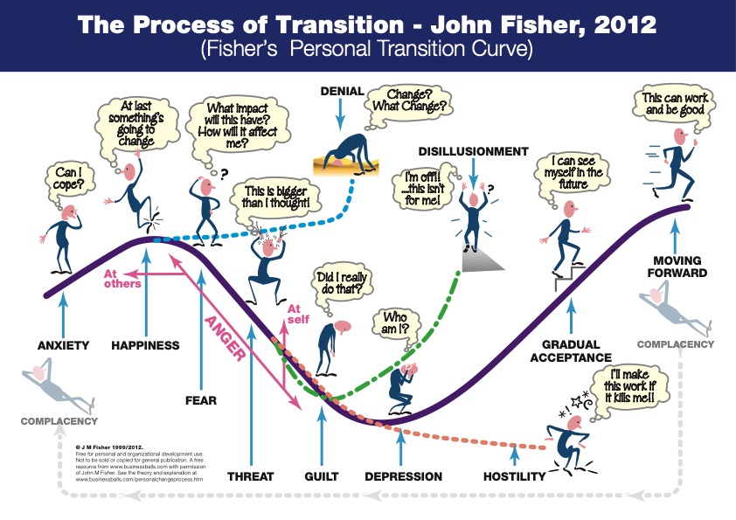

Slide 11
“To help people move through the transition effectively, we need to understand their perception of the past, present and future. For example, what is their past experience of change, and how has it impacted them? How did they cope? Also, what will they lose as part of the change, and what will they gain?
Therefore the goal of the 'manager'/change agent is to help make the transition as effective and painless as possible. By providing education, information, support, etc. we can help people transition through the curve and emerge on the other side.”
https://www.businessballs.com/change-management/personal-change-stages-john-fisher/

Slide 12




The Four Step Model of Change
NO COMMITMENT COMMITMENT
ADOPTION
How do we ensure staff will use it on a daily basis?
TRIAL
INTEREST
How do we get them involved in the implementation?
How do we get staff interested?
AWARENESS
HOW DO WE ACHIEVE ADOPTION?
How do we raise awareness?

Slide 13

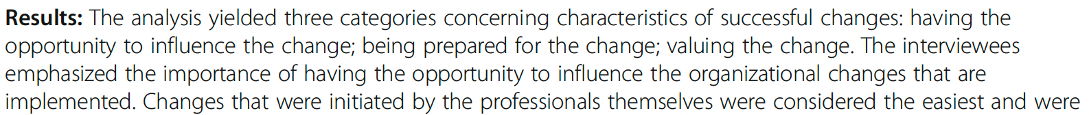

This Photo by Unknown Author is licensed under CC BY-SA-NC

Slide 14
4 phases of implementation
The first phase involve identifying the need for change of working routine
The second phase is about implementing the new method.
In the third phase the new method is applied in clinical practice.
In the fourth and last phase is considered implemented if the method is used of more than 50% of the staff and after 1-2 years the new method is the routine
Damschroder, L. J., Aron, D. C., Keith, R. E., Kirsh, S. R., Alexander, J. A., & Lowery, J. C. (2009). Fostering implementation of health services research findings into practice: a consolidated framework for advancing implementation science. Implementation science, 4, doi:10.1186/1748-5908-4-50.

Slide 15

Theory of change
Notes:
The "Theory of Change" (ToC) is a specific type of methodology used primarily in the planning, monitoring, and evaluation of projects and programs, especially within the fields of development, healthcare, social interventions, and community-building initiatives. Its primary purpose is to specify and visualize the causal relationships and pathways by which a given intervention (or set of interventions) is believed to achieve its intended outcomes.

Slide 16
Theory of change
A theory of change is a narrative that explains the links between program strategies or activities and outcomes and how and why the desired change is expected to come about.
W K Kellogg Foundation. The Step-by-Step Guide to Evaluation: How to Become Savvy Evaluation Consumers. 2017.
Notes:
Definition: The ToC describes the process of change by outlining causal linkages in an initiative, namely its inputs, processes, outputs, outcomes, and impacts. Essentially, it provides a roadmap that illustrates how a project or program will achieve its desired long-term goals.
Components of ToC:
Inputs: The resources that are invested in a project or program, such as time, money, staff, and equipment.
Activities: The actions or steps that are undertaken using the inputs.
Outputs: The immediate, tangible products or services resulting from the activities.
Outcomes: The short to medium-term changes resulting from the outputs.
Impacts: The long-term, overarching changes or goals that the program or project seeks to achieve.
Assumptions: Central to any Theory of Change are the assumptions that underpin the causal linkages. These are the beliefs we have about the context, the way change happens, and the reasons we think certain activities will lead to desired outcomes. By making these assumptions explicit, they can be tested, debated, and refined.
Indicators: These are used to measure and demonstrate whether expected outcomes and impacts are being achieved.
Visual Representation: Often, a ToC is visually represented in a flowchart to show the relationships between inputs, activities, outputs, outcomes, and impacts.
Benefits of Using a ToC:
Clarity and Consensus: It provides a clear, shared understanding of the program's logic, ensuring that stakeholders are on the same page.
Guided Implementation: It offers a roadmap for implementation and can highlight where adjustments might be needed.
Monitoring and Evaluation: By establishing clear outcomes and indicators, a ToC facilitates the collection of relevant data for monitoring and evaluation.
Communication: A visual ToC can be a powerful tool to communicate to funders, participants, or other stakeholders about how a project or program is intended to work.
Development of a ToC: This often involves several steps, starting from defining the long-term goal and working backward to specify intermediate outcomes, outputs, and activities. Engaging a broad range of stakeholders in the process can enrich the ToC, making it more comprehensive and contextually relevant.
In summary, the Theory of Change is a comprehensive and visual depiction of how and why a desired change is expected to occur in a particular context. It's a tool that provides clarity about the steps, resources, and strategies necessary to achieve desired goals and brings transparency to the underlying assumptions.

Slide 17
STRATEGIES
ASSUMPTIONS
5
6
INFLUENCIAL FACTORS
PROBLEM OR ISSUE
DESIRED RESULTS
(OUTPUTS, OUTCOMES, IMPACT)
1
4
3
NEEDS/ASSETS
2
Adapted from W K Kellogg Foundation. (2004). W.K. Kellogg Foundation Logic Model Development Guide. Page 31

Slide 18
1
Problem or Issue
  Describe what it is your program/intervention trying to solve
Patient Needs
  Specify the needs of your target group
Desired results
  Identify your desired results
    Outputs (immediate results)
    Outcomes (intermediate results)
    Impact (long-term results)
Influential factors
  Protective factors or resources could include funding, potential collaborating partners, staff and volunteers, time, facilities, equipment, and supplies.
  Risk factors or barriers might include such things as attitudes, lack of resources, policies, laws, regulations, and geography.
Strategies
  Identify “best practises” and/or research that supports why this will succeed
Assumptions
  State the assumption behind how and why the identified change strategies will work in your setting (e.g. principles, ideas, beliefs).
2
3
4
5
6
Adapted from W K Kellogg Foundation. (2004). W.K. Kellogg Foundation Logic Model Development Guide. Page 31

Slide 19
STRATEGIES
ASSUMPTIONS
5
6
INFLUENCIAL FACTORS
PROBLEM OR ISSUE
DESIRED RESULTS
(OUTPUTS, OUTCOMES, IMPACT)
1
4
3
NEEDS/ASSETS
2
Adapted from W K Kellogg Foundation. (2004). W.K. Kellogg Foundation Logic Model Development Guide. Page 31

Slide 20

Measuring change
“no copyright infringement is intended”
Notes:
Measuring change in evaluation or within the framework of a Theory of Change (ToC) is of paramount importance for a multitude of reasons:
Verification of Assumptions: At the heart of any ToC lie assumptions about how and why certain actions will lead to desired outcomes. By measuring change, these assumptions can be tested, verified, or refuted, leading to a more grounded and realistic understanding of how interventions work in particular contexts.
Accountability: Funders, stakeholders, and beneficiaries want to know if an intervention has achieved its intended goals. By measuring change, organizations demonstrate their accountability, showcasing the results of their efforts and justifying the resources that have been invested.
Informed Decision Making: Continuous measurement provides feedback on the progress of an intervention. If an initiative isn't resulting in the expected change, adjustments can be made. This iterative process, informed by real data, leads to more efficient and effective interventions.
Learning and Improvement: Measuring change contributes to organizational and sector-wide learning. When we know what works and what doesn't, future interventions can be designed more effectively. This cycle of "implement, measure, learn, and adjust" leads to continuous improvement.
Resource Allocation: Resources, be they financial, human, or material, are often limited. By measuring change, organizations can determine which activities are most impactful, allowing for smarter resource allocation in the future.
Building Credibility and Trust: Demonstrating evidence of change can significantly bolster an organization's credibility. Beneficiaries, communities, stakeholders, and funders are more likely to trust and support organizations that can transparently showcase the results of their interventions.
Communication and Advocacy: Concrete data about change can be a powerful tool for communication and advocacy. Whether it's convincing policymakers, attracting donors, or raising awareness about an issue, evidence-based narratives are more compelling.
Understanding Unintended Consequences: Not all changes resulting from an intervention are anticipated. Measuring change holistically can help in capturing unintended positive or negative outcomes, providing a fuller picture of an intervention's impact.
Replication and Scaling: For successful interventions that might be replicated or scaled in different contexts, understanding and measuring the exact nature of change is crucial. It provides a blueprint for what might work elsewhere and under what conditions.
Building a Knowledge Base: Consistently measuring and documenting change contributes to a broader knowledge base in a field or sector. This accumulated knowledge can inform best practices, guiding principles, and the design of future interventions.
In essence, measuring change is not just about numbers or ticking boxes; it's about understanding the dynamics of interventions, maximizing their impact, ensuring accountability, and constantly refining approaches for better results.

Slide 21
YOU CANNOT MANAGE SOMETHING YOU CANNOT CONTROL.
YOU CANNOT CONTROL SOMETHING YOU CANNOT MEASURE.

Slide 22
Utilisation–Focused
Outcomes Framework
A specific participant or client target group
The desired outcome(s) for that target group
One or more indicators for each desired outcome
Performance targets
Details of data collection
How will the results be used
Patton, M. Q. (2008). Utilization-focused evaluation (4th ed.). Thousand Oaks: Sage Publications. Page 243

Slide 23

Measurable
A measurable goal will usually answer questions such as:
  How much?
  How many?
  How will I know when it is accomplished?
  Indicators should be quantifiable.

Slide 24

Barriers
“no copyright infringement is intended”
Notes:
Evaluation, especially in complex fields like development, education, healthcare, and social programs, is an essential process to determine the effectiveness of interventions and derive learnings. However, the evaluation process can face multiple barriers that can challenge its accuracy, efficiency, and utility. Some common barriers in evaluation include:
Lack of Clear Objectives: If a project or program doesn't have clearly defined objectives from the outset, it can be challenging to evaluate its success or impact accurately.
Resource Constraints: Adequate evaluation often requires funds, skilled personnel, time, and tools. In the absence of these resources, the quality and depth of evaluation can be compromised.
Insufficient Data: Successful evaluations rely on accurate, comprehensive, and timely data. Barriers to data collection, such as accessibility issues, non-responsive participants, or lack of proper tools, can hinder effective evaluation.
Cultural and Social Barriers: Cultural norms, beliefs, and social structures can affect participation in evaluations, the honesty of responses, and the interpretation of findings.
Lack of Technical Expertise: Evaluation often requires specialized skills – from designing tools to analyzing data. A lack of expertise can affect the reliability and validity of the evaluation findings.
Political and Organizational Interference: Sometimes, there might be pressure from stakeholders, funders, or organizational leaders to present results in a particular light, leading to biased evaluations.
Poorly Defined Indicators: Without clearly defined and measurable indicators, it's challenging to gauge progress or impact.
Complexity of Interventions: Some programs are multifaceted and operate in dynamic environments. This complexity can make it difficult to attribute observed changes directly to the intervention.
Short-Term Focus: Some evaluations only focus on immediate outputs rather than long-term outcomes or impacts, thus offering a limited view of a program's effectiveness.
Lack of Stakeholder Engagement: For evaluations to be useful and accurate, they often need input and participation from various stakeholders – from beneficiaries to implementing staff. Lack of this engagement can hinder comprehensive understanding and acceptance of findings.
Expectations of Positive Results: There might be an implicit expectation that evaluations should always show positive results, leading to potential biases in data collection, analysis, or reporting.
Challenges in Generalizing Findings: Findings from one context or group may not necessarily apply to another, limiting the ability to generalize outcomes and impacts.
Rapidly Changing Environments: In fast-changing contexts, like crises or technological innovations, the results of an intervention can quickly become outdated, making evaluations challenging to conduct meaningfully.
Overcoming these barriers often requires a blend of technical expertise, stakeholder engagement, clear communication, and an organizational culture that values learning and transparency. By acknowledging and addressing these barriers, organizations can enhance the accuracy and utility of their evaluations, leading to more effective and impactful programs.

Slide 25
Barriers
There is an agreement among several researchers on the importance of addressing barriers and facilitators of implementation.
Damschroder, L. J., Aron, D. C., Keith, R. E., Kirsh, S. R., Alexander, J. A., & Lowery, J. C. (2009). Fostering implementation of health services research findings into practice: a consolidated framework for advancing implementation science. Implementation science, 4, doi:10.1186/1748-5908-4-50.
Durlak, J. A. & DuPre, E. P. (2008). Implementation matters: a review of research on the influence of implementation on program outcomes and the factors affecting implementation. Am J Community Psychol 41, 327–350.
Greenhalgh, T., Robert, G., Macfarlane, F., Bate, P. & Kyriakidou, O. (2004). Diffusion of innovations in service organisations. Systematic review and recommendations. The Milbank Quarterly, 82, 581–629.
Nilsen, P. (2015). Making sense of implementation theories, models and frameworks. Implementation Science, 10, 53 https://doi.org/10.1186/s13012-015-0242-0

Slide 26
Barriers
During the third phase, when the new method is implemented, most projects fail because the professionals feel uncomfortable and uncertain.
There is an evident risk that the professional, rather than using the method as intended, changes and adjusts it.
Thus, an integrated and ongoing supervision of the new method in ordinary activities could prevent this from happening.
  Formative evaluation
Damschroder, L. J., Aron, D. C., Keith, R. E., Kirsh, S. R., Alexander, J. A., & Lowery, J. C. (2009). Fostering implementation of health services research findings into practice: a consolidated framework for advancing implementation science. Implementation science, 4, doi:10.1186/1748-5908-4-50.

Slide 27

Evaluation

Slide 28

Evaluate
Feedback to the team
  What is good
  What could be changed (if needed)

Slide 29
Re-evaluate
Evaluation has to be a continuous process.
In order to:
  Feedback
  Ensure everything goes according to plan
  Change is the only constant aspect; hence the evaluation ensures that the delivery is consistent over time.

Slide 30
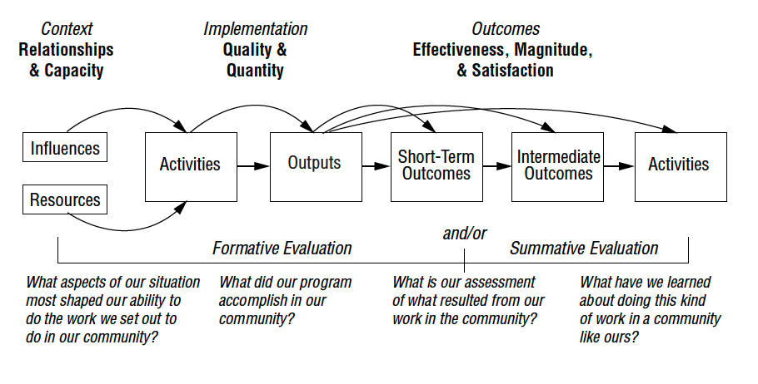
W.K. Kellogg Foundation Logic Model Development Guide (2004), page 36

Slide 31
W.K. Kellogg Foundation Logic Model Development Guide (2004), page 36

Slide 32
Learning Objectives
Define
implementation
Explain why
evaluation is important
Summarise the
theory of change model

Slide 33
Thank you

