Slide 1




PERSON-CENTERED CARE
ETHICAL AND LEGAL ASPECTS FOR PCC
IN RELATION TO NDDS
PART II
Reference number: 618596-EPP-1-2020-1-SE-EPPKA2-CBHE-JP
This publication [communication] reflects the views only of the authors, and the Commission cannot be held responsible for any use, which may be made of the information contained therein.
D.A.R.K. Dasanayaka, Dept. of Physiotherapy, FAHS, UoP

Slide 2


INTENDED LEARNING OUTCOMES
At the completion of this lecture, the students will be able to:
discuss ethical principles related to PCC
discuss legal considerations in local and global perspectives in meeting the caring needs of persons with NDDs
discuss the approaches of resolving ethical dilemmas

Slide 3
Ethical principles in PCC
Person-centered care is based on a view of humanity based on four ethical principles;
1. Autonomy – Each person’s right to choose their own path in life
2. Dignity – Self-esteem. An expression of respect for other people with the same rights and obligations like myself
3. Integrity – Not to hurt, harm, destroy or change other people’s lives, but to respect and protect the person’s wholeness and unity, the person’s life context and life history
4. Vulnerability – Vulnerability makes us human. It is not a defect but an important part of the human condition
These principles are mutually related to each other

Slide 4
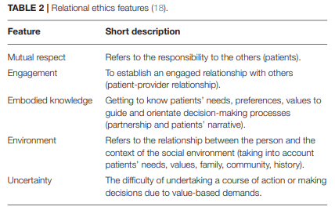
PCC and Relational Ethical Features
(Gianpaolo and Buttigieg, 2020)
Gianpaolo Tomaselli, Sandra C. Buttigieg

Slide 5
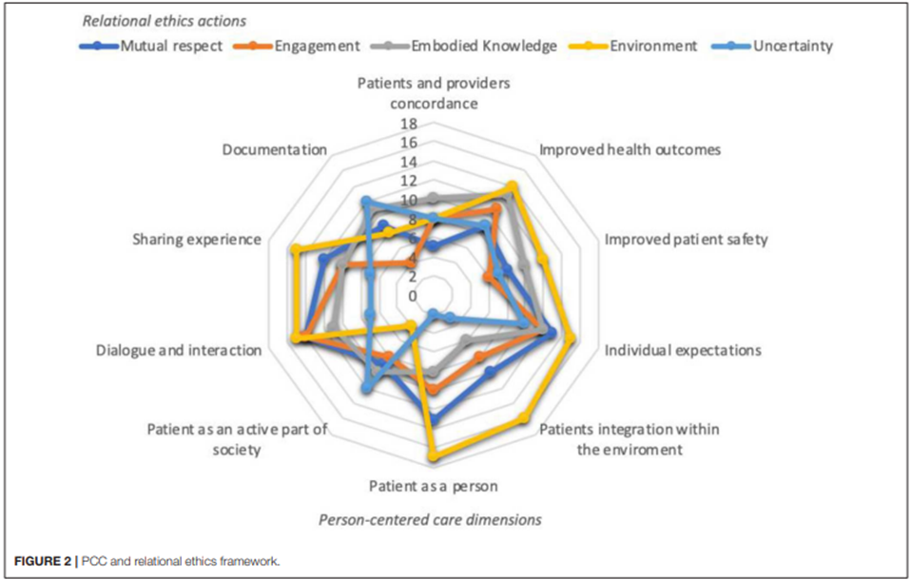
(Gianpaolo and Buttigieg, 2020)

Slide 6

Legal considerations in local and global perspectives

Slide 7
Global legal background
The Patient Self-Determination Act of 1990 requires hospitals, nursing homes, hospices, and home health agencies to inform patients at the time of admission of their right to make healthcare decisions, including the right to either accept or refuse treatment (Nurse Practice Act; the American Nurses Association)
Portability and Accountability Act (HIPAA). HIPAA was enacted in 1996 and was prompted by the need to ensure privacy and protection of personal health records and data in an environment of electronic medical records and third-party insurance payers.

Slide 8
Common HIPAA Violations
  Gossiping in the hallways or otherwise talking about patients where other people can hear you
  Mishandling medical records or leaving medical records unsecured
  Illegally or unauthorized accessing of patient files
  Sharing information with unauthorized people
  Texting or e-mailing patient information on an unencrypted device
  Sharing information on social media
The legality of euthanasia varies depending on the country. But legally not approved in Sri Lanka

Slide 9
Sri Lankan legal background
Protection of the Rights of Persons with Disabilities Act No. 28 of 1996:
  No person with a disability shall be discriminated against on the ground of such disability in recruitment for any employment or office or admission to any educational institution
  No person with a disability shall, on the ground of such disability, be subject to any liability, restriction or condition with regard to access to, or use of, any building or place which any other member of the public has access to or is entitled to use, whether on the payment of any fee or not
  Established the National Council for Persons with Disabilities
  The Disability Rights Bill was drafted in 2006 to add provisions to safeguard the rights of persons with disabilities but it has not been adopted by parliament

Slide 10
The Protection of the Rights of Elders Act, No. 9 of 2000 (Sri Lanka)
PROTECTION OF THE RIGHTS OF ELDERS(AMENDMENT) ACT, No. 5 OF 2011
  Elders should be benefited all the facilities, services and rights without considering there age
  Have elderly people committee in each Grama Niladhari Division
  Have elderly ID cards

Slide 11

Resolving of Ethical Dilemmas

Slide 12
What is an ethical dilemma in PCC
An ethical dilemma is a paradox that comes up when there are two or more options, but neither of them are the best ethical or moral option
The diagnosis of a neurodegenerative condition signifies a life event that changes the patient’s world completely
To many, it is viewed as a calamity that heralds the start of a long, progressive course towards the loss of the person’s independence, dignity and, eventually, life itself
Neurodegenerative diseases exact a heavy burden and toll on patients, families, caregivers as well as society
They contribute to increased healthcare cost and give rise to numerous ethical and moral dilemmas, especially towards the end of life

Slide 13
Ethical Dilemmas that may arise at the Different Stages of the NDDs
Early Stage
Carers conspire with the healthcare team to hide a diagnosis from the patient- deprives the patient of his autonomy and right to self-determination
The physician owes a duty of care to the patient and has to remain faithful and loyal to the patient whatever the circumstances may be
The duty of the physician does not end with the disclosure but continues beyond, to support and counsel the patient and family as necessary
Medical confidentiality should also be observed to protect the privacy of the patient and safeguard him from discrimination and stigmatization

Slide 14
Early Stage cont..
Areas of genetic testing and testing for biomarkers of the preclinical stages of neurodegenerative illnesses such as Alzheimer’s and Huntington’s dementia - these tests pose serious ethical dilemmas for the individual who, although not yet a patient but having been identified as high risk for developing the illness, is likely to be discriminated against in terms of his employment opportunities and insurance coverage
Informed consent must be obtained to carry out such tests and the approach taken when disclosing positive results of genetic and biomarker testing for their relatives

Slide 15
There is a gradual loss of mental capacity and decisional-making ability as the patient’s cognition and executive function deteriorate- therefore be in the interest of persons with neurodegenerative diseases to plan ahead in anticipation of this eventuality by making an advance medical directive (AMD), advance care plan (ACP) or lasting power of attorney (LPA), to predetermine end-of-life healthcare, financial and general welfare matters, respectively which help the patient exercise his or her autonomy

Slide 16
Ethical Dilemmas that may arise at the Different Stages of the NDDs
Intermediate Stage
As the disease progresses, the patient gradually loses various modalities of his function
All these act to impair the ability of the patient to communicate clearly and coherently, deleteriously affecting the patient’s mental capacity and autonomy
At this stage, it may be necessary to assess mental capacity for those who missed the opportunity earlier to make their ACP or LPA
There are statutes governing the making of an LPA and appointing a deputy

Slide 17
Intermediate Stage cont..
As the disease progresses, the patient gradually loses various modalities of his function
All these act to impair the ability of the patient to communicate clearly and coherently, deleteriously affecting the patient’s mental capacity and autonomy
At this stage, it may be necessary to assess mental capacity for those who missed the opportunity earlier to make their ACP or LPA

Slide 18
Ethical Dilemmas that may arise at the Different Stages of the NDDs
Late Stage
Dilemmas related to withholding or withdrawing treatment near the end of life are some of the most common reasons patients are referred to hospital ethics committees
There are occasions when a patient refuses to take his or her medications and the temptation is to ‘conceal’ the medication in the former’s food and drinks, alluding to the practice of covert medication use
This practice goes against the patient’s autonomy, is deceptive and undermines the principles of fidelity and truthfulness

Slide 19
Late Stage cont…
Food refusal and dysphagia are common late complications of neurodegenerative conditions and are vexing ethical dilemmas for clinicians caring for the elderly. The decision on whether to insert a feeding tube or provide other artificial means of nutritional support is a complex one and will require a multidimensional approach to decision-making.
An example of such an approach would be the Jonsen’s 4-topic approach to resolving ethical dilemmas in the clinical context

Slide 20
Jonsen’s 4-Topic Approach to Resolving Ethical Dilemmas
This is a practical approach and framework used by many hospital ethics committees to resolve clinical ethical dilemmas.
It categorizes the information, facts and details to be considered and weighed into four main themes;
  Medical Indication
  Patient Preference
  Quality of Life
  Contextual Features

Slide 21
1. Medical Indication
  The physician must consider the disease and its natural history, whether it is reversible with treatment and the prognosis of the disease if left untreated
  One also weighs the risk–benefit ratio of providing versus withholding a treatment or intervention, taking into account, the probability of success, the complication rates, etc
2. Patient Preference
  This serves to recognize the patient’s autonomy and right to self-determination.
  For situations where there is lack of mental capacity, as in patients with neurodegenerative conditions, the advance medical directive(AMD), advance care plan (ACP) or lasting power of attorney (LPA) would apply, and the substitute decision maker could help in the decision-making process

Slide 22
3. Quality of Life
  The merits of a treatment or intervention cannot be measured solely with a quantitative matrix
  One should also consider how it will impact the present and future quality of life of the patient
  What would be the opportunity cost of prolonging life temporally and temporarily but at a great cost, burden and suffering to a patient who does not have long to live anyway?
  What does ‘quality of life’ mean to a patient at different stages of the illness and of his life? Quality of life seen from the various dimensions of the human is complex, unique to each individual and a subjective phenomenon that may not be adequately understood even with substitute judgment of family members

Slide 23
4. Contextual Features
  The complexity of clinical ethical dilemmas is exacerbated by social, cultural, religious, ethnic and legal considerations
  Health economics and organizational practices also have a bearing on the Geriatrics 2017, 2, 8 6 of 7 decision-making process
  Utilitarianism and distributive justice are some of the ethical principles that are applied in this quadrant of the window.
  The above framework affords a cogent and systematic approach to solving clinical ethical dilemmas that crop up frequently in the care and management of patients with advanced neurodegenerative conditions

Slide 24
References
Beauchamp, T.L. and Childress, J.F. (2001) Principles of biomedical ethics. 5th Edition, Oxford University Press, Oxford, 59
Bjoern Schmitz-Luhn,Jennifer Chandl, erEthical and Legal Aspects of Technology-Assisted Care in Neurodegenerative Disease, 2022, 12, 1011. https://doi.org/10.3390/jpm12061011
David M. Sine and Virginia A. Sharpe, Ethics, risk, and patient-centered care: How collaboration between clinical ethicists and risk management leads to respectful patient care
Gianpaolo Tomaselli, Sandra C. Buttigieg, Aldo Rosano, Maria Cassar and George Grima, Person-Centered Care From a Relational Ethics Perspective for the Delivery of High Quality and Safe Healthcare: A Scoping Review
James Alvin Low, and Esther Ho, Managing Ethical Dilemmas in End-Stage Neurodegenerative Diseases, 2017, 2, 8; doi:10.3390/geriatrics2010008
PCC Ethical Good Practice Framework, https://apccs.police.uk/media/6000/pccs-ethical-framework2014.pdf
Protection of The Rights of Elders (Amendment) Act, No. 5 Of 2011, Parliament of The Democratic Socialist Republic of Sri Lanka
Summers, J. (2013). Principles of healthcare ethics. Available at: https://studylib.net/doc/18369976/principles-of-healthcare-ethics
To change perspective – a study circle about person-centered care (nEUROcare - PCC study circle)

Slide 25
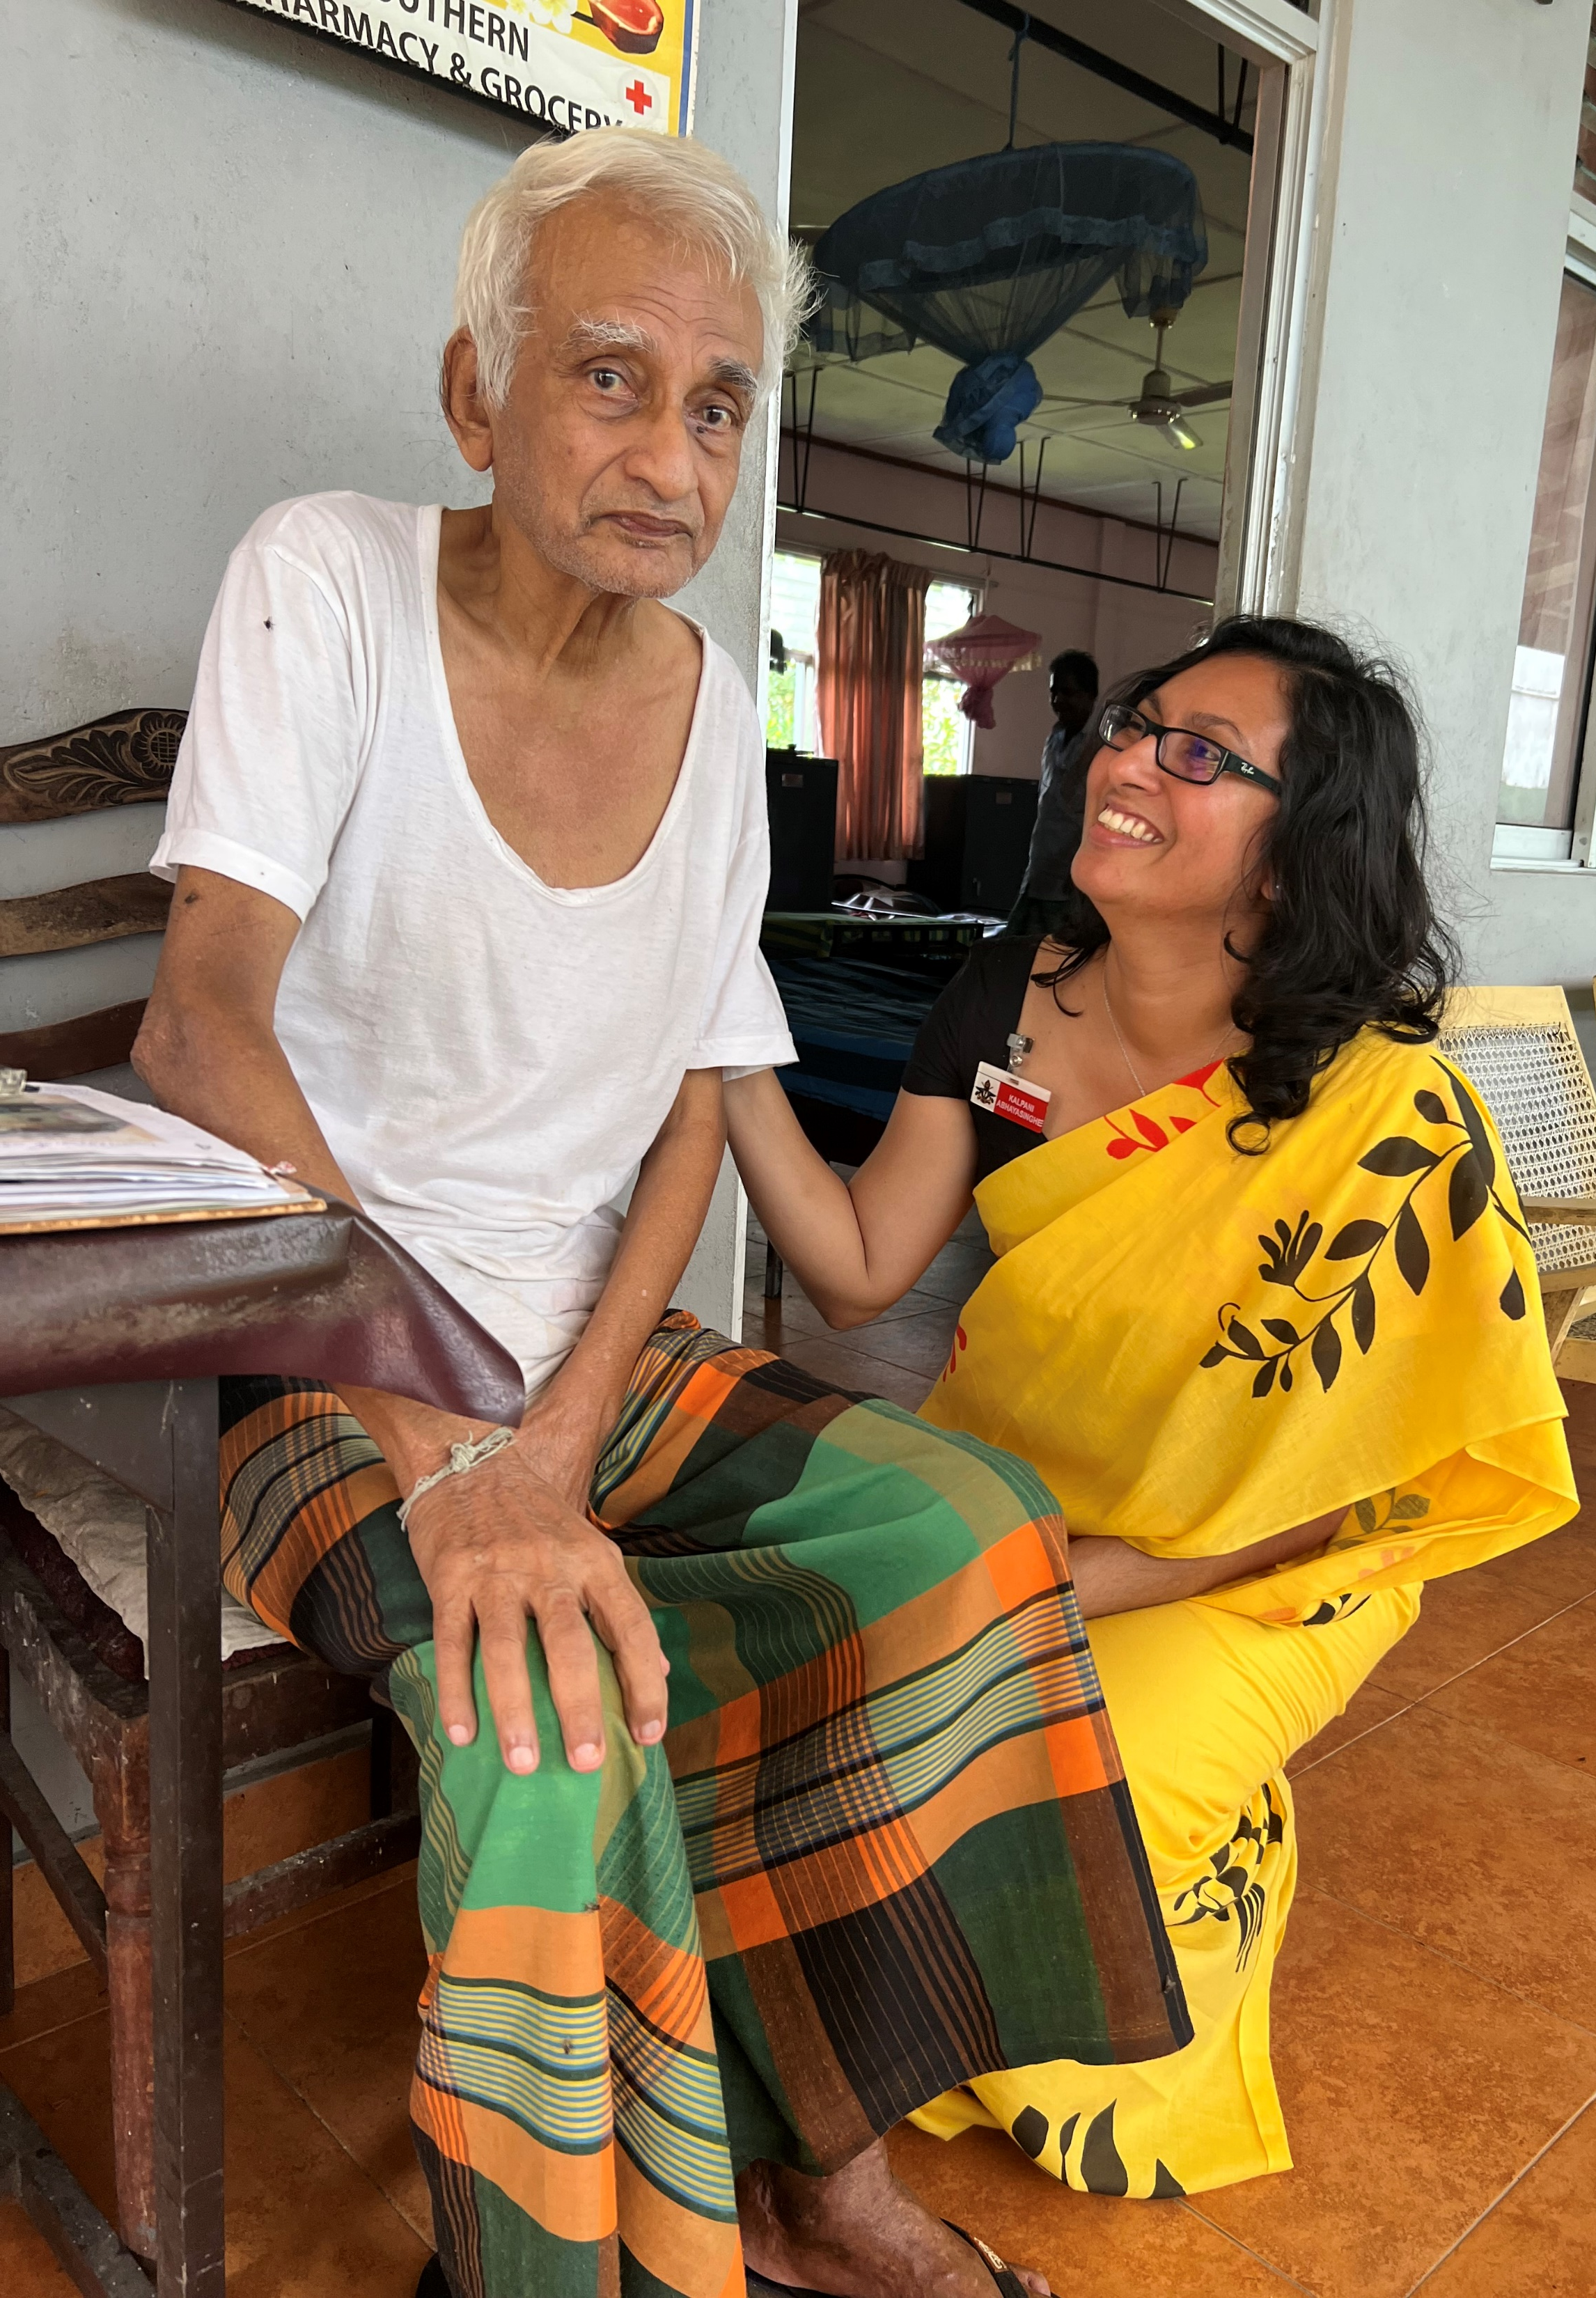
Thank you for listening!
Reference number: 618596-EPP-1-2020-1-SE-EPPKA2-CBHE-JP
This publication [communication] reflects the views only of the authors, and the Commission cannot be held responsible for any use, which may be made of the information contained therein.

