Slide 1




PERSON-CENTERED CARE ETHICAL AND LEGAL ASPECTS FOR PCC IN RELATION TO NDDS PART I
Reference number: 618596-EPP-1-2020-1-SE-EPPKA2-CBHE-JP This publication [communication] reflects the views only of the authors, and the Commission cannot be held responsible for any use, which may be made of the information contained therein.

Slide 2


INTENDED LEARNING OUTCOMES
At the completion of this session, the students will be able to:
Identify the major ethical principles.
Discuss the essence of major ethical principles.
Identify the relational ethics in PCC.

Slide 3

Introduction
The term ‘ethics’ simply means “moral principles that govern a person’s or a group’s behavior”
An ‘ethical principle’ is a sort of “rule of thumb” on how one should or shouldn’t behave. It’s like a general rule that defines good or bad behavior.
An ‘ethical principle’ is the foundation thought or idea makes an ethical standard correct.
Ethical principles guide to moral decision making and moral action and center on the formation of moral judgment in professional practice (Beauchamp and Childress, 2001)

Slide 4

Origin of ethics
The word Ethics is derived from Latin word ‘Ethicus’ and the Greek word ‘Ethikos’.
Ethics are an arrangement of decent principles and a branch of attitude which defines what is good for individuals and society.
There are many well known figures in the history of ethics. Greek philosophers; Socrates, Plato and Aristotle.
Modern influences include people such as Immanuel Kant, Jeremy Benthem, John Stuart Mill, D.W. Ross, C.L. Stevensons, Alasdair Maclntyre and John Rawls.

Slide 5
Origin of ethics cont…
Socrates was the first to recognize the importance of analyzing the meaning of good, right, just, and virtuous, and of articulating the standards for ascribing these properties.
‘Good’, for Plato, means resemblance to the pure form, or universal model of goodness, which serves as the standard for all value judgments.
Actions are right, laws are just, and people are virtuous to the degree to which they conform to the ideal model.
For Aristotle, ‘good’ means the achievement of the goals at which human beings naturally aim, the balanced and rational satisfaction of desires to which he gives the name "happiness."
Right action, just laws, and virtuous character are the means of achieving individual and social well-being.
All three philosophers agree in identifying individual good with social good and in defining moral concepts such as justice and virtue in terms of the achievement of good.

Slide 6
Ethical Principles
When making clinical judgments, healthcare workers base their decisions on consideration of consequences and of universal moral principles.
These moral principles both direct and justify our actions.
The most fundamental of these principles is respect for persons.
The other principles stemming from this basic principle are;
Autonomy
Beneficence
Non-maleficence
Justice
Confidentiality
Veracity and
Fidelity

Slide 7
Autonomy
Autonomy means to make a decision for the self without the control of others and a person can make meaning choices having sufficient level of understanding.
In other words, that individuals are able to act for themselves to the level of their capacity.
Autonomy as a concept means that the person is self-ruling.
The term “auto” is from the Greek, and means “self”.
The rest of the term comes from the Greek, “nomos” which means “rule” or “law”.
Thus, one can understand autonomy as self-rule.
Underlying the concept of autonomy is the idea that we are
to respect others for who they are.

Slide 8

Autonomy cont…
In medicine, autonomy refers to the right of the patient to retain control over his or her body.
A health care professional can suggest or advise, but any actions that attempt to persuade or coerce the patient into making a choice are violations of this principle.
Patient has freedom of thought, intention and action when making decisions regarding health care procedures.
Therefore, always respect the autonomy of the patient - then the particular patient is free to choose.
But, it is important to remember that patients are not fully autonomous and can’t act solely for their own purposes.

Slide 9

Autonomy cont…
Informed consent is a method that promotes and respects a person’s autonomy.
For a patient to make a fully informed decision, she/he must understand all risks and benefits of the procedure and the likelihood of success.
The patient must be informed clearly the consequences of his action that may affect him adversely and must be free of internal and external influences so that they can act.
The healthcare worker has a duty to respect the autonomous choice of the patient, as well as a duty to avoid harm and to provide a medical benefit.
Autonomy is not simply the ability to make rational decisions.
For someone with dementia, autonomy means fostering important relationships, maintaining a sense of self, and having a way to express values.

Slide 10
Autonomy cont…
Respect for autonomy must be acknowledged when the patient disagrees with health care professionals, as well as when the patient agrees with the recommendations of the health care team.
Respect for autonomy does not apply when patients are unconscious. Patients must be able to participate in decision making.
If unconscious or seriously ill, sometimes patients have made their wishes known to family members or has written advance directives.
Respect for autonomy requires that members of the health care team follow these directives.
The advance directives include a living will or appointing someone to speak for them through a durable power of attorney for health care.

Slide 11
Autonomy cont…
Obligations related to respect for autonomy include;
- Assist and promote client decision making.
- Make decisions when client’s choice poses harm.
- Support clients’ rights to informed consent.
- Follow the advance directives that clients provide.
- Support competent clients’ decisions.

Slide 12
Autonomy and paternalism
Ethical principle whereby the choices of an individual are overridden by another person in authority in order to benefit or avoid harm to that individual.
Paternalism is doing what the health professional believes is in the client’s best interests regardless the client’s own determinations.
Frequently the principles of respect for autonomy and beneficence (the duty to do good) conflict.

Slide 13
Beneficence
This principle states that healthcare professionals must do good for their patients in every situation.
What has to be considered is what is good for that patient and not what is good for the healthcare professional.
Simply, it is the principle of acting to achieve a greater good than harm.
All procedures and treatments recommended must be with the intention to do the most good for the patient.

Slide 14

Beneficence cont…
To ensure beneficence, a healthcare worker must;
- develop and maintain a high level of skills and knowledge
- make sure that they are trained in the most current and best practices
- must take their patients’ individual circumstances into account.
What is good for one patient will not necessarily benefit another.
Because, beneficence is a fundamental ethical principle, ethical egoism is disconnected from health care.
This is true, because most of people enter healthcare as a profession because they want to help people.

Slide 15
Beneficence cont…
Also, act of kindness and courtesy not expected by typical strangers are expected of health care workers.
Beauchamp and Childress (2001) explicate two types of beneficence: positive and utility.
Positive beneficence means that client should provide with benefit, while utility beneficence means to weigh risk and benefits and decide on the best result. Though, no one can weigh what is good for patient except patient her/himself.

Slide 16
Beneficence cont…
Beneficence requires the balancing of harms and benefits.
Benefits promote the client’s welfare and health, whereas harms or risks detract from the client’s health and welfare.
Patients, and healthcare providers consider the risks and benefits when making decisions related to treatment and research.
Obligations related to beneficence include;
- Provide health benefits to client.
- Balance benefits against harm in situations where a choice must be made.
- Determine the best way to assist the client.

Slide 17
Non-maleficence
The principle of ‘doing no harm’.
In the clinical setting, harm is that which worsens the condition of the patient.
Much of health care involves physical harm; pain, discomfort, inconvenience, and perhaps even disfigurement and disability.
However, harm can occur in other ways;
- health care managers can cause harm by failing to supervise effectively.
- disposal of hazardous materials without taking proper precautions.
- harm as negligence (omission) – failure to follow protocols, malpractice
- harm as violation of autonomy

Slide 18
Non-maleficence cont…
Care providers must consider whether the patient could be harmed by a decision made, even if it is made for the benefit of the patient.
When interventions undertaken by physicians create a positive outcome while also potentially doing harm it is known as the "double effect."
Eg: The use of morphine in the dying patient eases pain and suffering while hastening the demise through suppression of the respiratory drive.
Physicians are obligated to not prescribe medications they know to be harmful.
Violation of non-maleficence is the subject of medical malpractice litigation.

Slide 19
Non-maleficence cont…
Malpractice - an act or omission by a health care provider that deviates from accepted standards of practice in the medical community which causes injury to the patient.
Obligations related to non-maleficence include;
- Avoid deliberate harm, risk of harm, and harm that occurs during performance of care interventions
- Consider degree of risk permissible
- Determine whether use of technological advances provides benefits that outweigh risks

Slide 20
Justice
The literal meaning of justice is equity and fairness.
In health care industry, justice refers to the fair and equal distribution of scarce health resources, and the decision of who gets what treatment.
It is believed that all individuals have equal rights in terms of seeking healthcare and to participate in their plan of care.
The burdens and benefits of new or experimental treatments must be distributed equally among all groups in society.
The four main areas that health care provider must consider when evaluating justice.
1. Fair distribution of scarce resources
2. Competing needs
3. Rights and obligations
4. Potential conflicts with established legislations

Slide 21
Justice cont…
Justice and duty are the underlying moral principles to follow in making any ethical decision.
Telling truth and giving full information is a healthcare worker’s duty to follow therefore, by deceiving patient’s information and giving false hopes is the violation of the duty.
Moreover, the principle of justice also requires a care provider to provide adequate health care.
This includes providing right information to patient while refusing to tell patient about a prognosis, a care provider is violating the principle of justice and disrespecting patient’s right.

Slide 22
Justice cont…
Justice usually comes in 2 major categories; procedural and distributive
Procedural justice asks “were fair procedures in place, and were those procedures followed?”
Distributive justice is concerned with the allocation of resources.
The following problems complicate the application of distributive justice;
Not everyone is equal in every way. Sometimes there are situations in which it seems that one person should receive a greater or lesser share than another.
Resources are limited. There is not always enough for each person to receive an equal share.

Slide 23
Justice cont…
Suggestions to aid equal distribution include; contracts, individual need, individual effort, ability to pay, social contribution and merit.
The distribution of care is determined by the individual needs of the client.
Certain clients require skilled care more than others. To live and avoid permanent disability, these clients require immediate intervention.
The criteria of need, added with the client’s prognosis, is basic to the practice of triage, which is used by the nurses when resources are in short supply.
Unequal treatment to clients always requires justification.

Slide 24
Justice cont…
Obligations related to justice include;
- Ensure fair allocation of resources, such as appropriate staffing or mix of staff to all clients.
- Determine order in which clients should be treated (eg: priority treatment for clients in pain).
Given the vulnerability of people with dementia, the allocation of resources should supports dementia care
A fair distribution of benefits and burdens should promote and sustain the person with dementia throughout the course of their dementia and help them maintain their autonomy as much as possible.

Slide 25
Secondary ethical principles
Confidentiality
- Duty to respect privileged information.
- Only sharing private information on a ‘need to know basis’.
Veracity
- Duty to tell the truth.
- Eg: Informed consent
Fidelity
- Duty to keep promises.

Slide 26
Ethical principles in PCC
Person-centered care is based on a view of humanity based on four ethical principles;
1. Autonomy – Each person’s right to choose their own path in life
2. Dignity – Self-esteem. An expression of respect for other people with the same rights and obligations like myself.
3. Integrity – Not to hurt, harm, destroy or change other people’s lives, but to respect and protect the person’s wholeness and unity, the person’s life context and life history.
4. Vulnerability – Vulnerability makes us human. It is not a defect but an important part of the human condition.
These principles are mutually related to each other.

Slide 27
Relational ethics in PCC
Relational ethics refers to those relationships, which are considered better than others and aim at stimulating growth, healing, and health (Pollard, 2015; Bergum and Dossetor, 2005).
Relational ethics is defined as an action ethics that is placed within the interpersonal relationships (Evans, 2004).
The action ethics includes engagement, mutual respect, embodiment, and interdependent environment.
The leading principle is that ethical decisions and actions should be made in the context of relationships.

Slide 28
Relational ethics in PCC
According to this perspective, the focus of relational ethics is not the action itself but the relationship.
Thus, the relational ethics framework includes the following actions: mutual respect; engagement; embodied knowledge; environment; and uncertainty.
These parameters should ensure that relations are established in the right way and lead to ethical decisions and actions.

Slide 29
References
Beauchamp, T.L. and Childress, J.F. (2001) Principles of biomedical ethics. 5th Edition, Oxford University Press, Oxford, 59
To change perspective – a study circle about person-centered care (nEUROcare - PCC study circle)
Summers, J. (2013). Principles of healthcare ethics. Available at: https://studylib.net/doc/18369976/principles-of-healthcare-ethics
PCC Ethical Good Practice Framework, https://apccs.police.uk/media/6000/pccs-ethical-framework2014.pdf
David M. Sine and Virginia A. Sharpe, Ethics, risk, and patient-centered care: How collaboration between clinical ethicists and risk management leads to respectful patient care
Bjoern Schmitz-Luhn,Jennifer Chandl, Ethical and Legal Aspects of Technology-Assisted Care in Neurodegenerative Disease, 2022, 12, 1011. https://doi.org/10.3390/jpm12061011
Bergum V, Dossetor JB. Relational Ethics: The Full Meaning of Respect. Hagerstown, MD: University Publishing Group; (2005). p. 165–96.
Pollard CL. What is the right thing to do: use of a relational ethic framework to guide clinical decision-making. Int J Caring Sci. (2015) 8:362–8.
Evans DT. Behind the headlines: sexual health implications for nursing ethics and practice. Prim Health Care. (2004) 14:40–50. 10.7748/phc2004.10.14.8.40.c525
Tomaselli G, Buttigieg SC, Rosano A, Cassar M, Grima G. Person-Centered Care From a Relational Ethics Perspective for the Delivery of High Quality and Safe Healthcare: A Scoping Review. Front Public Health. 2020 Mar 6;8:44. doi: 10.3389/fpubh.2020.00044. PMID: 32211362; PMCID: PMC7067745.

Slide 30
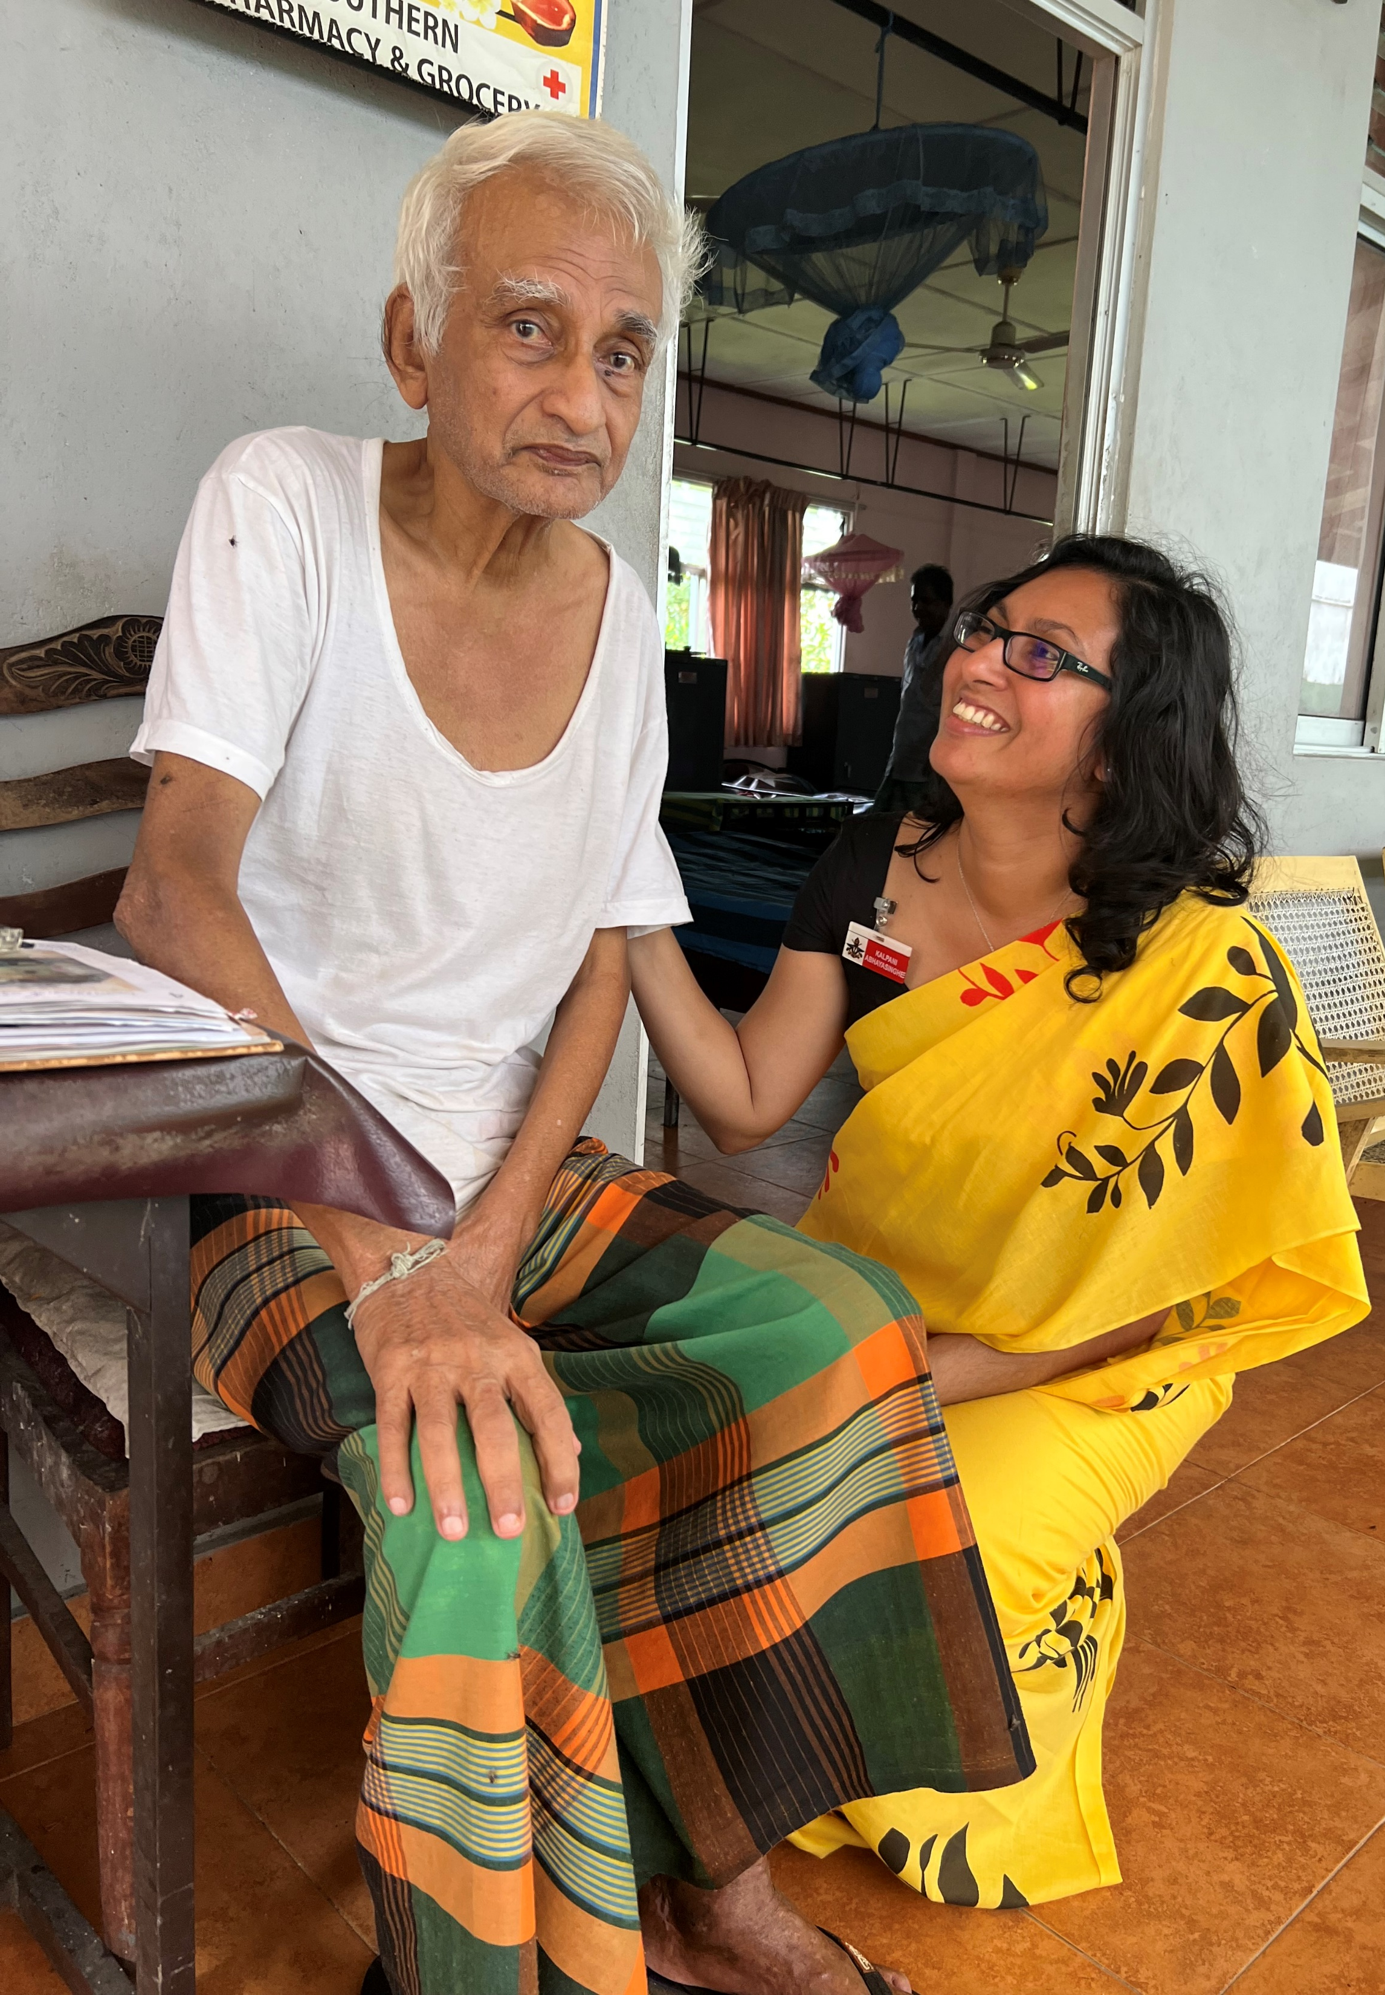
Thank you for listening!
Reference number: 618596-EPP-1-2020-1-SE-EPPKA2-CBHE-JP This publication [communication] reflects the views only of the authors, and the Commission cannot be held responsible for any use, which may be made of the information contained therein.

