Slide 1
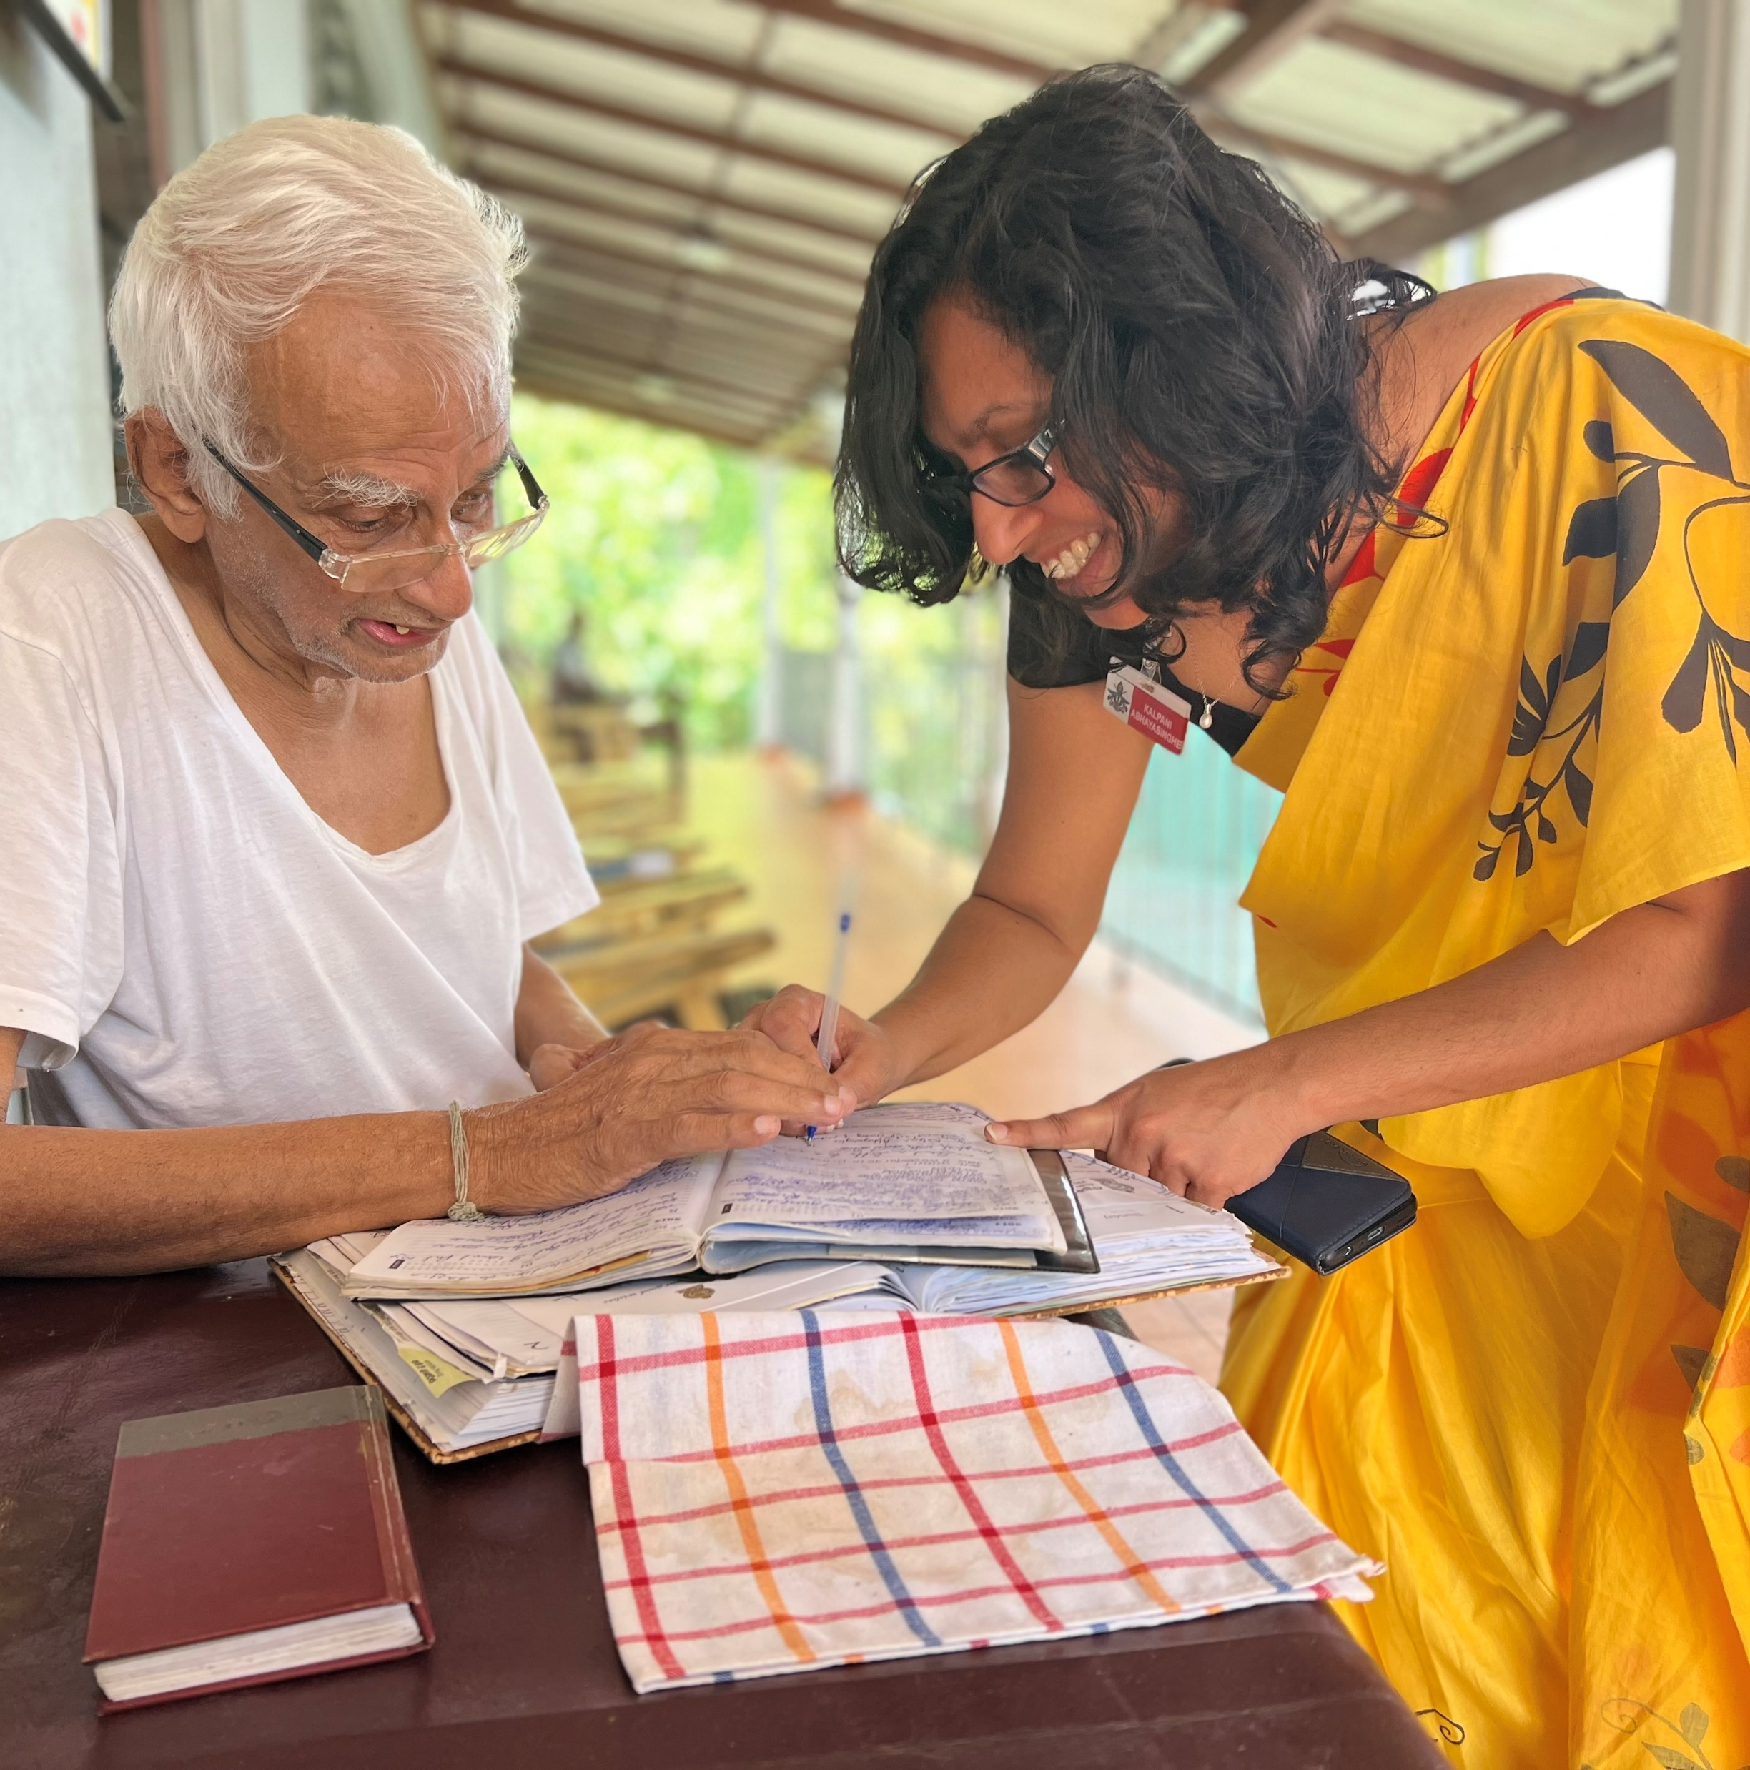
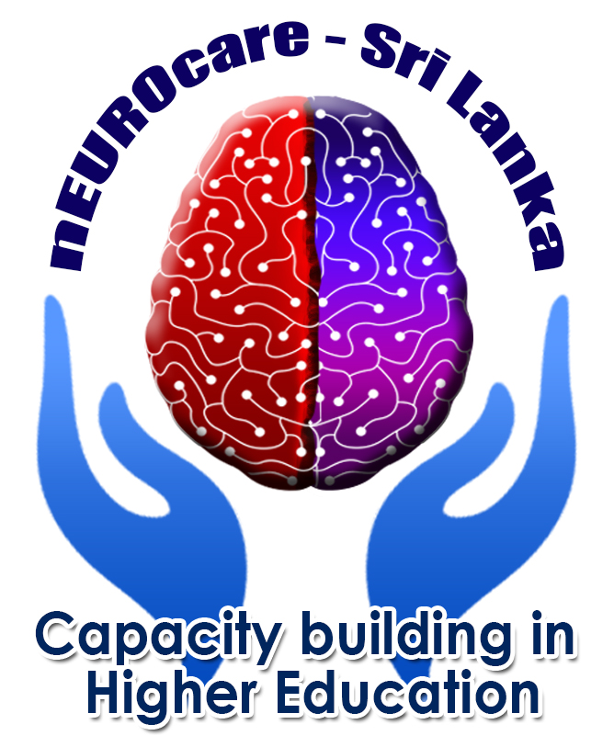
PERSON-CENTERED CARE ekman
EMMA EDBERG MATEI
Notes:
Hi and welcome to this lecture about Personcentered care and Elkmans model! My name is Emma Edberg Matei and I am a nurse specialised in psychiatric care. Im a lecturer in Kristianstad University Sweden . In this lecture I am going to give a brief introduction to the topic PCC.

Slide 2
INTENDED LEARNING OUTCOMES
describe Ekman´s model of person-centered care
At the completion of this lecture you will be able to:

Slide 3
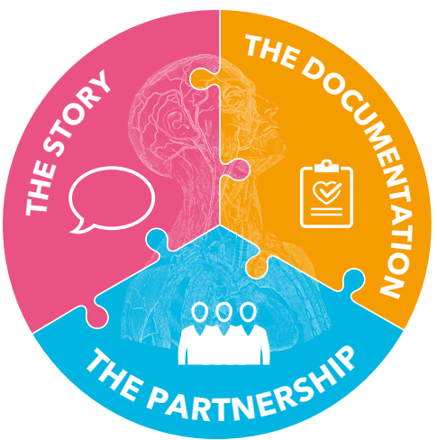
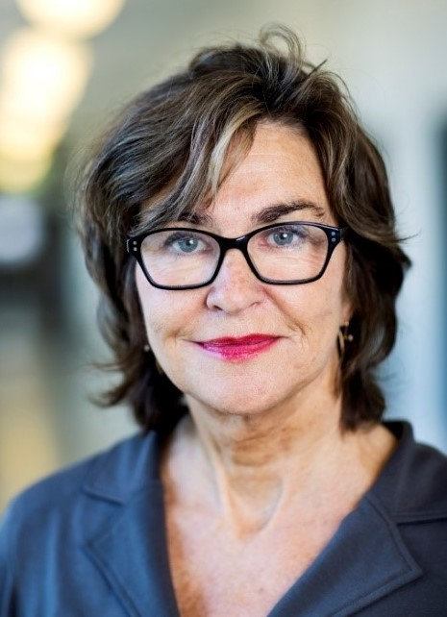
Ekman´s model
Notes:
Person-centered care according to Ekman et al. is based on three basic parts: the story, the partnership, and the documentation. It is only when a person tells a story that they fully emerge as a person with their own resources and needs.

Slide 4
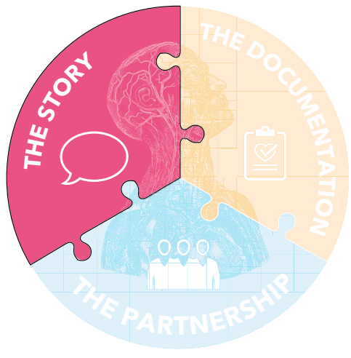
The story

Slide 5


The story – Time for the meeting
Notes:
The prerequisite for person-centered care is the person’s own story. Often, close relatives can contribute to the story. The story gives a picture of the whole life situation and captures the person’s own driving forces, resources, and abilities as well as emotional, social, and practical needs. The story becomes the basis for how the care is planned and implemented. Listening to the patient and their relatives is also important in short meetings. It increases security and makes it easier to take advantage of the person’s own capacity. The healthcare staf listens actively and responsively to sometimes short fragments, and sometimes to longer and more coherent descriptions. Today, time is seen as a negative cost in healthcare. Therefore, the time available for the meeting is often very limited. Today, it is also us – the healthcare staf – who set the agenda for what the patient must tell. Person-centered care means that we must change our perspective. The meeting with the person needs to be systematized and given time. In the story, there is the person and not just the patient. In the story, the person has the opportunity to describe their life situation and living conditions and not just their illness and diagnosis. ”Who are you and what is important to you?”We could, by these questions, receive important information for the care process.

Slide 6
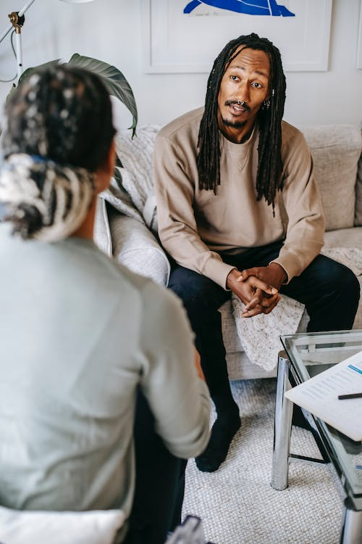


Create meaning and context
Notes:
Person-centered care is not a therapy. At the same time, one must not neglect the efect it has when a person gets an opportunity to tell their story and, in that way, gain more knowledge about their own situation. In the conversation, we give the person support to see and refect on their life situation. If we ask the right questions, we can contribute further to the person becoming aware of their own abilities and resources. The narrative does not only have the function of handing over information. The story is part of the care where the person receives support in creating meaning and context. These are important components of the road to recovery. If recovery is not possible, the need to create meaning and context may be even greater. The challenge with the story is to give the person time to express themselves, while limiting the conversation to the current care situation.

Slide 7
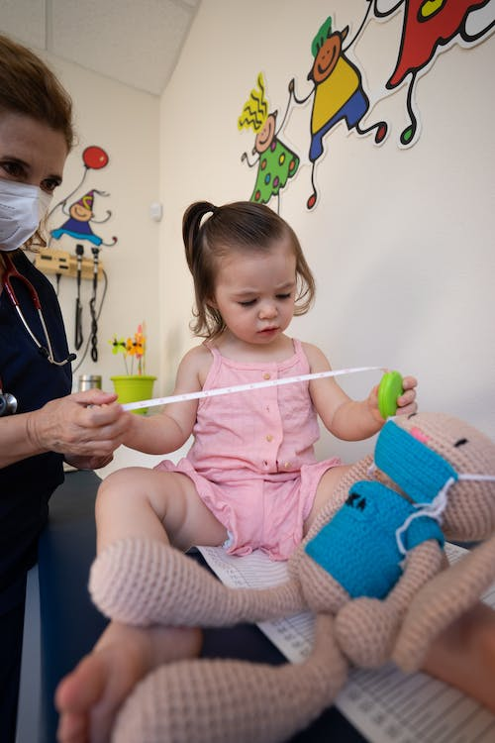

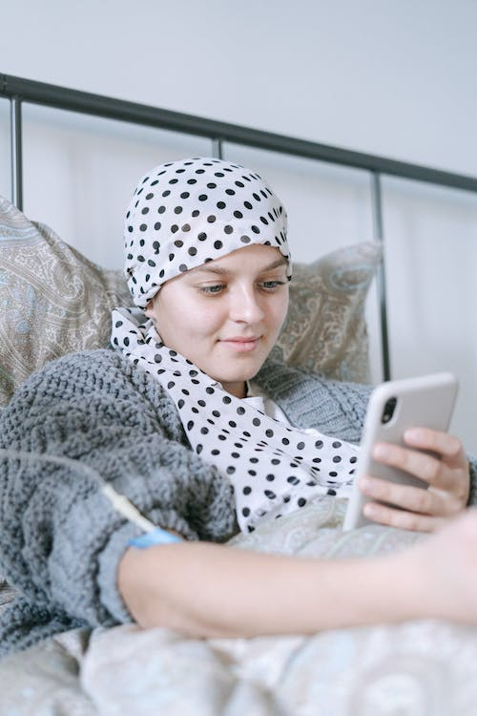
The importance of getting to know the person’s resources, driving forces and abilities
Notes:
An ability can be a physical, mental, or social strength that supports or drives the person’s health. It can be the desire to achieve a level of physical activity, for example, to be able to run, to be able to fetch wood or water for the cabin, or being able to stand up in order to facilitate personal care. An ability can also be more abstract or ”soft”. The love for one’s grandchildren can be a driving force. Being able to pick up the grandchildren from preschool can be a very concrete goal in the health plan that can be created using the story. We are not always aware of our own abilities. It is in the conversations – the story – that the healthcare staf should be curious and ask questions to fnd out what could be this person’s driving force and this particular person’s resources and abilities.

Slide 8
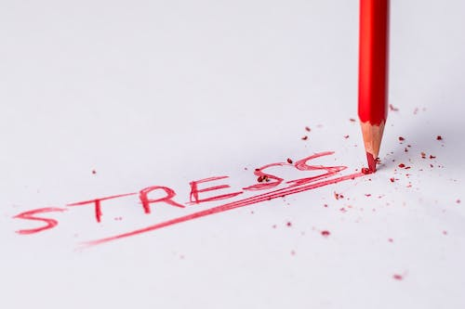

To be enough
Notes:
As healthcare professionals, we want to do our very best for the people we meet. We want the person to receive good and safe care and feel safe and respected based on their situation and their needs, regardless of background, health status, and care needs. Therefore, we begin by listening to the story which gives us the conditions to work person-centered. Sometimes, we feel that time is not enough. Sometimes, there are other shortcomings that give us poor conditions to do a good job. This can give us a feeling of inadequacy. This feeling of inadequacy can lead to stress of conscience. Stress of conscience is the stress that we can experience when we cannot do what we feel we should do. We know today that those who have converted to a person-centered working method describe that the stress of conscience has decreased, and that job satisfaction increased. We are now also beginning to see the results of research studies that confrm this. Working person-centered frees up resources that can be used to create a healthier care environment. How can we organize work so that we can listen to the story? What resources are needed to do the transition? There is no clear answer to this. But you can test how it feels to you as a professional to listen to the story and how it afects your experience of stress of conscience.

Slide 9
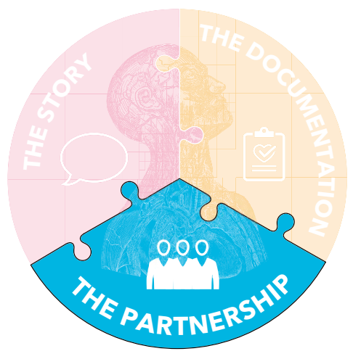
The partnership
Notes:
Person-centered care is based on three basic parts: the story, the partnership, and the documentation. At this meeting, we will immerse ourselves in the story. It is only when a person tells a story that they fully emerge as a person with their own resources and needs.

Slide 10

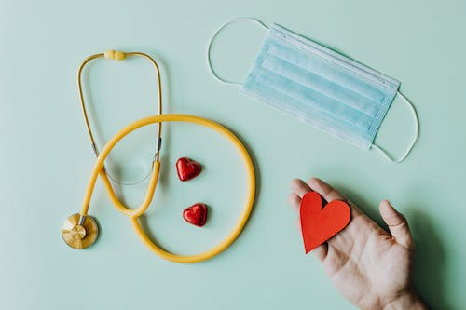
Real teamwork
Notes:
Working in teams is nothing new in healthcare. But what happens when the patient becomes part of the team for real? And how do the relationships between the professionals change when we work in partnership in a team that is put together and can be changed based on the person’s needs and abilities?

Slide 11

The collective knowledge of the team – a partnership
Notes:
The partnership is the second of the three fundamental elements of person-centered care. The partnership is founded initially in the story and listening to it. Based on the person’s story and the common picture of needs, resources, and abilities the team is put together. The patient is the starting point for the composition of the team and is of course a big part in the team. Relatives can also be part of the team. The healthcare staf in the team can come from diferent units and diferent healthcare providers. Together in the team, an agreement is made on how care should be planned and carried out. It is documented in a personal plan. In person-centered care, the patient is given both rights and responsibilities regarding their own care. This means that the person is seen as an active partner. The role of the healthcare staf is to contribute with their professional knowledge to the partnership and to engage the patient in a dialogue. The partnership is about respect for each other’s knowledge; on the one hand, the person’s knowledge of themselves, their health problems, or what it’s like to live with the disease, on the other hand the healthcare staf’s knowledge of the disease, diagnostics, care, treatment, and rehabilitation.

Slide 12

Asymmetric encounters – patient authority and disadvantage
• Institutional disadvantage: The person is in a healthcare organization that is strongly hierarchical. The person is suddenly either at the bottom or almost at the bottom of the hierarchy.
• Existential disadvantage: The existential disadvantage is based on the vulnerability that is associated with being a patient, due to the sense of failing health, exposure, and vulnerability.
• Cognitive disadvantage: In the role of patient, one finds themselves in an unavoidable state of disadvantage of knowledge in regards to the healthcare staff. They have a professional knowledge that I, as a patient, do not have.
Notes:
The patient is an authority based on knowledge of themselves. The patient’s own story and active participation are basic prerequisites for care and treatment. So, for a consensus and an interaction to become a reality in the care meeting, the patient’s authority must be self-evident. Person-centered care is based on a partnership between the various healthcare professions and the patient as a person. To become aware of what the conditions look like for a partnership between the health care staf and the person, we may need reminding that such a relationship cannot be completely equal in the context of care. The relationship between patient and healthcare staf is asymmetrical – uneven. The professional knowledge means a knowledge superiority, more power and thus more responsibility. The patient’s disadvantage can be described from three perspectives:
• Institutional disadvantage: The person is in a healthcare organization that is strongly hierarchical. The person is suddenly either at the bottom or almost at the bottom of the hierarchy.
• Existential disadvantage: The existential disadvantage is based on the vulnerability that is associated with being a patient, due to the sense of failing health, exposure, and vulnerability.
• Cognitive disadvantage: In the role of patient, one fnds themselves in an unavoidable state of disadvantage of knowledge in regards to the healthcare staf. They have a professional knowledge that I, as a patient, do not have.
The asymmetry is part of the conditions for the relationships between all people in care. It is further reinforced by the strong hierarchy that exists in the care team between diferent professional groups. I
n person-centered care, the asymmetrical disadvantage is constantly balanced against each person’s right to autonomy and dignity, with respect for the person’s integrity and vulnerability.

Slide 13
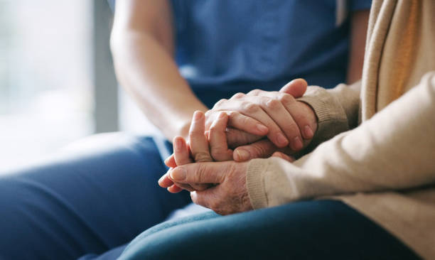
Challenges in the partnership
Notes:
In the partnership, the professional must not deviate from his professional responsibility. To enter a partnership can be a challenge. Entering a partnership with the patient requires surrendering power and control. Entering partnerships with other professions requires understanding, respect, and flexibility. A partnership must be open and respectful of what both parties can bring to the relationship.

Slide 14

Seamless care
Notes:
Traditional care takes its starting point in diferent medical disciplines, the diferent professions of care, diferent houses, and organizational boundaries. When care is person-centered, it must be planned so that it is held together for every person. The care should be experienced as seamless even though the person needs interventions from diferent parts of the care; from inpatient care, outpatient care, or care at home. The personal plan agreed upon in the team can support the transitions between the diferent parts of care.

Slide 15
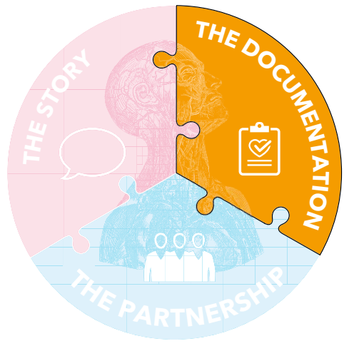
The documentation

Slide 16

Personal plan for context
Notes:
It is important that there is a unifed documentation that is fully accessible across care provider boundaries. But what role does documentation play in achieving person-centered care? Why is an agreement and a personal plan needed? That is the theme of today’s meeting.

Slide 17

A consolidated documentation
Notes:
The third part in person-centered care is the documented agreement. A personal plan that is based on the person’s story and is accessible across caregiver boundaries is an important basis for a good, safe, and seamless care. In a person-centered care, it becomes obvious that the patient should have access to all their information and documentation. The documentation must include all record keeping, the person’s own notes and self-registration of one’s health status, as well as a personal plan.

Slide 18

The agreement
Notes:
In person-centered care, it is important that the planning of the care is done together in the team where goals, strategies, and follow-up for care is determined. The agreement is documented and becomes a jointly decided personal plan. The agreement makes clear the responsibilities of each member of the team. Also, the patient’s own role and responsibility are made clear. It ensures that care, treatment, and rehabilitation are carried out as planned and that the care becomes coherent.

Slide 19

Why is a personal plan needed?
Notes:
The plan involves shared responsibility in the partnership for the entire team. The value of the plan is that everyone in the team has a common documentation with a common goal and common decisions to discuss and follow up.

Slide 20

Some ideas on how to create a personal plan
Notes:
The agreed upon plan must be based on the story and contain the planning for care, treatment, and rehabilitation. The plan is made jointly in the team and should contain three parts:
• The story – prerequisites for a partnership.
• The agreement – the partnership becomes concrete and leads to a personal plan.
• The documentation of the agreement found in the patient’s medical record.
The patient’s symptoms and resources are found in the story. The agreement contains all common information such as resources, barriers, risks, and the medical and nursing assessment. This is specifed in the personal plan.

Slide 21
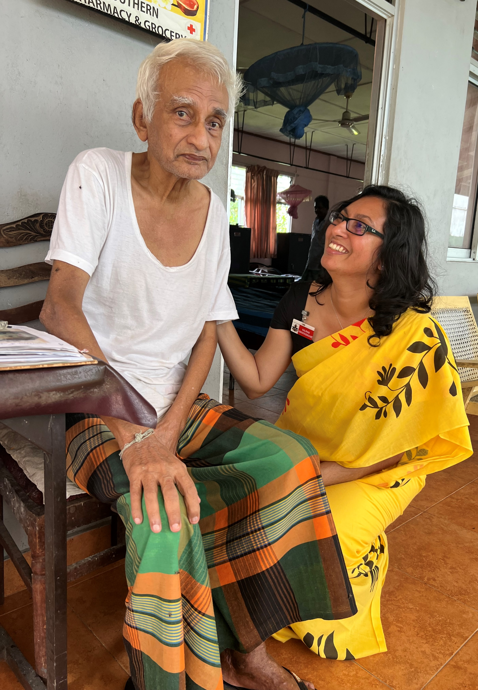

Thank you for listening!
Reference number: 618596-EPP-1-2020-1-SE-EPPKA2-CBHE-JP
This publication [communication] reflects the views only of the authors, and the Commission cannot be held responsible for any use, which may be made of the information contained therein.

