Slide 1


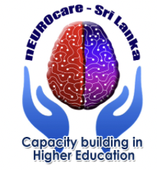

Communication and Swallowing Disorders and Care for Neurodegenerative Diseases
Andres Köster
Speech and Language Pathologist
North Estonia Medical Centre
PhD student of Medical Department
University of Tartu

Slide 2

Learning objectives:
At the completion of this course the student will be able to:
understand the physiology of swallowing, voice and speech;
know what unnoticed dysphagia can cause for NDD patients
assess the presence of dysphagia and be able to deal with it
understand the mechanisms of voice and speech and is able to provide basic practical advice to NDD patients or their caregivers

Slide 3
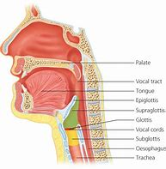
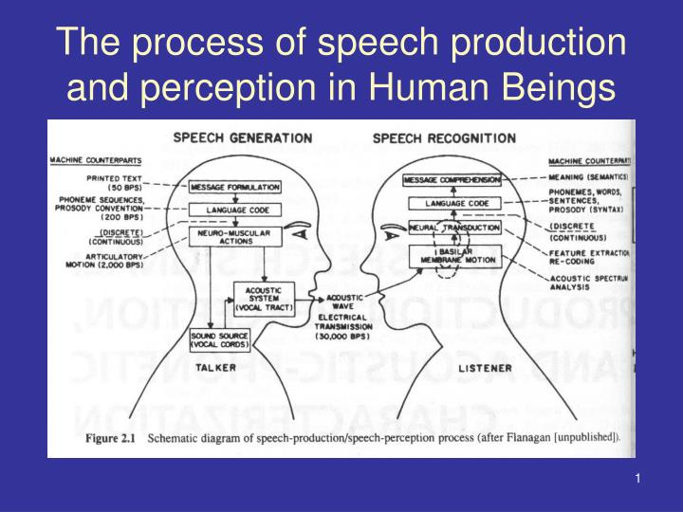
Introduction:
mechanism of speech and voice
https://www.bing.com/images/search?view=detailV2&ccid=GDhLiORE&id=516839F9635F8BF634D0A0A88154F087B19D6191&thid=OIP.GDhLiOREFis0FMCZw937GQAAAA&mediaurl=https%3a%2f%2fentokey.com%2fwp-content%2fuploads%2f2016%2f06%2fc17f001.jpg&cdnurl=https%3a%2f%2fth.bing.com%2fth%2fid%2fR.18384b88e444162b3414c099c3ddfb19%3frik%3dkWGdsYfwVIGooA%26pid%3dImgRaw%26r%3d0&exph=432&expw=424&q=Vocal+Tract+Anatomy&simid=608034582087155920&FORM=IRPRST&ck=BBC32EFC27AB4237F48384D2C866AC78&selectedIndex=16&mode=overlay
PPT - The process of speech production and perception in Human Beings PowerPoint Presentation - ID:5084456 (slideserve.com)

Slide 4
Speech and voice disorders in patients with NDD
Global estimates from the World Health Organization showed more than 8.5 million people with Parkinson's disease in 2019.
People with PD commonly have speech and vocal problems , including dysphonic speech, reduced loudness, and loss of articulation, which limit their ability to participate in spoken communication and social interactions (Xu et al., 2020)

Slide 5
Etiology of speech and language disorders in people with neurodegenerative disorders
Neurological oral/face/throat muscles discoordination:
Dysarthria
Apraxia
Aphasia: damage to portions of the brain that are responsible for language
cognitive-communicative disorder

Slide 6
Speech and language therapy
Dysarthria/ Apraxia:
isotonic and isometric exercises for articulation muscles
Aphasia
depending on the type of aphasia (speech and language therapy)

Slide 7
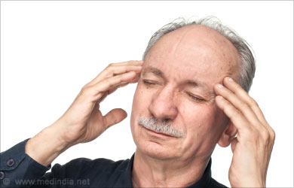
Etiology voice disorders in people with neurodegenerative disorders
Organic voice disorders:
Tremor, speech breathing impairment, quality of voice reduction
Voice Disorders | Problems in Voice Production - Causes Symptoms Types (medindia.net)

Slide 8
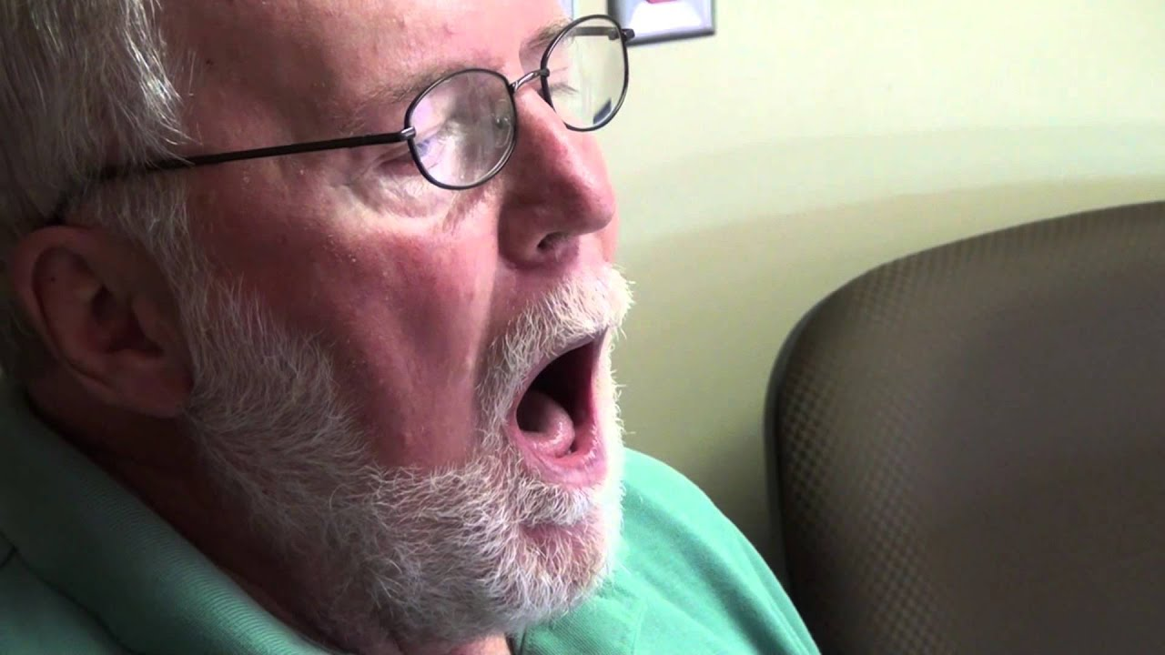
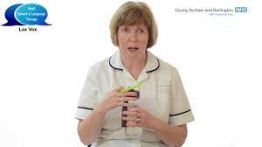
Voice Therapy
vocal cord adduction improvement
speech breathing exercises
resonance therapy
https://www.youtube.com/watch?v=dfltqJ95kXY
Local hospitals use Lee Silverman Voice Treatment for Parkinson's patients - YouTube

Slide 9
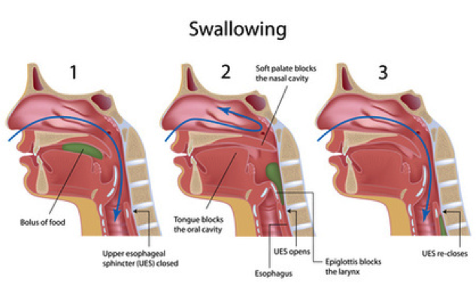
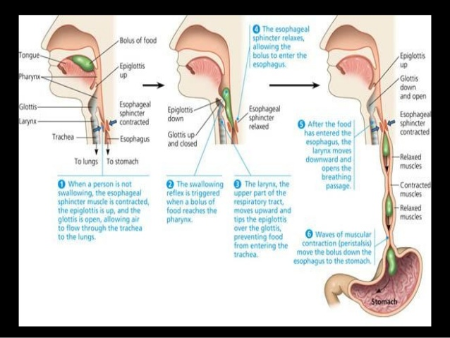
Mechanism of swallowing
Feeding and the Swallow Mechanism - Physiopedia (physio-pedia.com)
deglutition – Liberal Dictionary (tekportal.net)
deglutition

Slide 10
Swallowing disorders in people with neurodegenerative diseases
Malnutrition and aspiration pneumonia are the most common and troublesome consequences of dysphagia, with increased risk of death in elderly and debilitated patients. Especially, aspiration pneumonia is the most common cause of mortality in patients with neurological disease associated to dysphagia. ( Panebianco et al., 2020)

Slide 11
Prevalence of dysphagia in people with NDD
In Parkinson’s disease (PD), dysphagia occurs approximately in 50%.
Dysphagia in multiple sclerosis (MS) occurs in 31.3%.
Dysphagia is common in dementia with prevalence rates varying from 13 to 57%.
Dysphagia is reported to be prevalent in 30–100% of individuals depending on type of Amyotrophic lateral sclerosis (ALS) and the stage of disease affecting all individuals in the later stages of the disease. ( Panebianco et al., 2020)

Slide 12
Swallowing Disorder Dysphagia
Dysphagia is defined as an objective impairment or having difficulty with swallowing, resulting in an abnormal delay in the transit of a liquid or solid bolus (Speyer et al, 2022)
Dysphagia affects up to 35% of older adults living in the community and is considered a significant risk factor for malnutrition and aspiration (Werstuck. et al, 2021)
Dysphagia occurs when there is a problem with the neural control or the structures involved in any part of the swallowing process. Weak tongue or cheek muscles may make it hard to chew and move food around the mouth (Bhattacharyya, 2014)

Slide 13
Swallowing disorders clinical symptoms
Pain while swallowing
Inability to swallow
A sensation of food getting stuck in the throat or chest or behind the breastbone (sternum)
Drooling
Hoarseness
Food coming back up (regurgitation)
Frequent heartburn
Food or stomach acid backing up into the throat
Weight loss
Coughing or gagging when swallowing

Slide 14
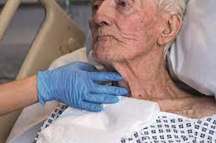
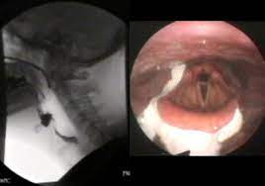
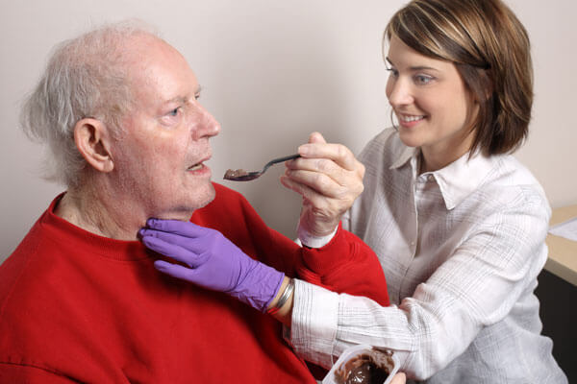
Evaluation of Dysphagia
Clinical evaluation:
cognition, health condition, cranial nerve function related to swallowing
face, oral and neck muscle function during eating How to tailor medication formulations for patients with dysphagia - The Pharmaceutical Journal)
h
Inpatient Rehabilitation | Johns Hopkins Bayview Medical Center (hopkinsmedicine.org)
What is Pharynx? 25 Amazing Facts about Pharynx Parts, Function & Anatomy (organsofthebody.com)

Slide 15
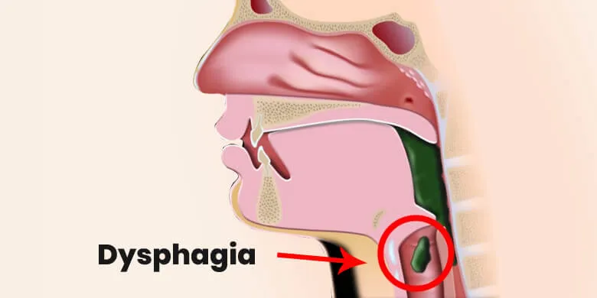
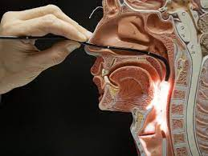
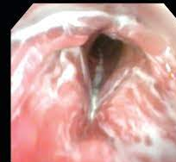
Evaluation of Dysphagia
Instrumental evaluation:
Flexible endoscopic evaluation of swallowing (FEES)
The modified barium swallow study (MBSS)
https://newenglandent.com/dysphagia/
https://healthjade.com/dysphagia/
https://www.wydysphagiadiagnostics.com/fees-vs-mbs
https://www.floridaswallowing.com/fees

Slide 16
Therapy of Dysphagia
Requirements for the patient
The patient must be able to cooperate:
actively participate in the therapy process (awake, without deep disturbance of consciousness, motivated, patient awareness); understanding the orders given to the patient
A prerequisite for direct swallowing therapy is the presence of a cough
reflex (so that the person can expel the aspirated fluid/food from the
respiratory tract)!

Slide 17
THANK YOU!!!

Slide 18
Sources
http://96.126.98.199/index.php/joghr/article/view/883
PDF] Oropharyngeal dysphagia: An overview
[HTML] Dysphagia in Parkinson's disease
[HTML] An overview of the molecular mechanisms and novel roles of Nrf2
in neurodegenerative disorders
The management of dysphagia in neurodegenerative disorders: Hospice
caregivers' perceptions and practices

