Slide 1
Quality assurance of clinical outcome assessment instruments
Clinical assessment and outcome measurement

Slide 2
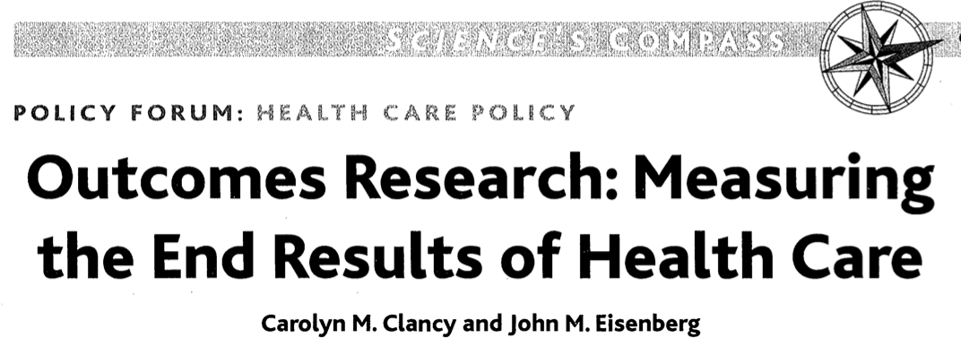
Outcomes research
Purpose
Provide evidence about benefits, risks, and results of therapies and interventions so clinicians and patients can make more informed decisions
Process
Identifying, assessing and measuring effects of care
Results
Guide health care decision makers (including patients and health care professionals) in selecting the most effective intervention or strategy, or improve current practice
the study of the end results of health services that takes patients' experiences, preferences, and values into account
Clancy & Eisenberg. Science 1998; 282(5387): 245-246.

Slide 3
Types of outcomes in outcomes research
Humanistic
  Patient-reported outcomes (health status, symptoms, well-being, etc.)
  Functional status
  Satisfaction with and quality of care
  Preferences
Clinical
  Effectiveness
  Symptom/disease severity
  Biomarkers
  Survival
(Health) Economic
  Costs (direct, indirect, intagible)
  Utilities (health value; typically based on patient report)
Rating scales and questionnaires dominate outcome assessments
Quality assurance of rating scales and questionnaires is a major field of outcomes research

Slide 4
Categorizing instruments according to their use
Patient-reported outcomes (PROs/PROMs)
Patient-reported experience measures (PREMs)
Clinician-reported outcomes (ClinROs)
Observer-reported outcomes (ObsROs)
Performance outcomes (PerfOs)
  Intended to produce a score representing the (outcome) variable of interest
  Typically developed to be useful for outcome measurement
Checklists
  Inventories
  Item-level use
Utlilities
  Valuation of health states
Classification tools (single-items)
  Coarse indicators
  Stages of disease, etc.
Screening tools
  Detect a potential problem or risk
May be patient-, clinician-, observer- reported, or performance based

Slide 5

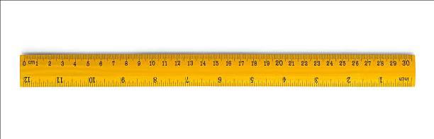
0 1 2 3 4 5 6 7 8 9
Outcome assessments and measurements produce numbers
The meaning and use of numbers differ depending on what they represent
Numerical data ≠ quantitative data
  Nominal, ordinal = Qualitative data; categorizations, assessments
  Interval, ratio = Quantitative (linear) data; measurement

Slide 6



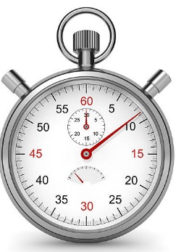
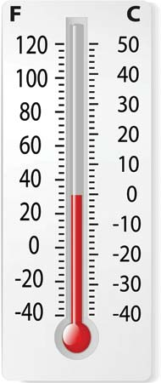
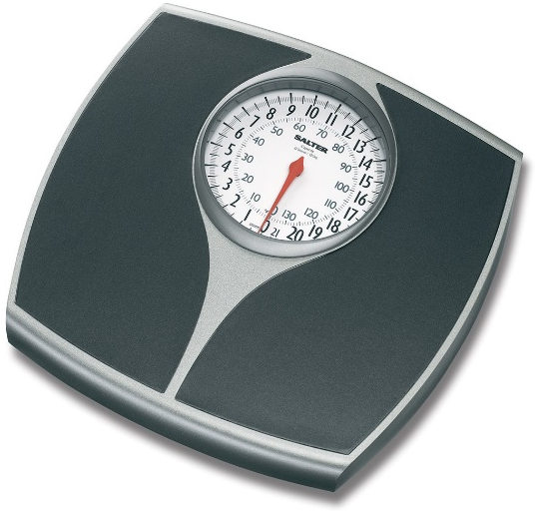
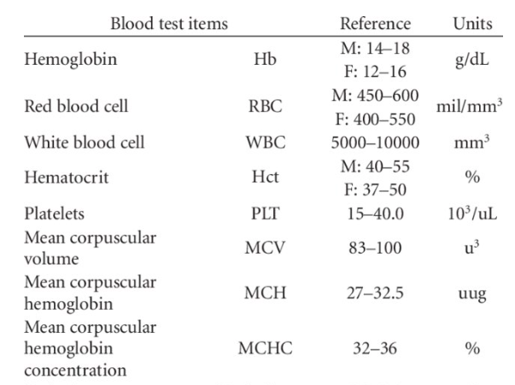
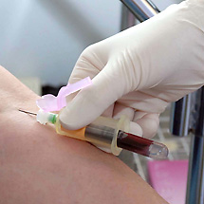

Slide 7
Metrology:
The Science of Measurement
  Calibration and quality assurance of physical and chemical measures (e.g., length, weight, time, temperature)
  Basic quality aspects:
  Measurement uncertainty:
  Known precision and risk of erroneous results/decisions/inference; allowed to vary to different degrees depending on purpose/context ("fit for purpose")
  Traceability:
  Comparable measures, with known measurement uncertainty

Slide 8
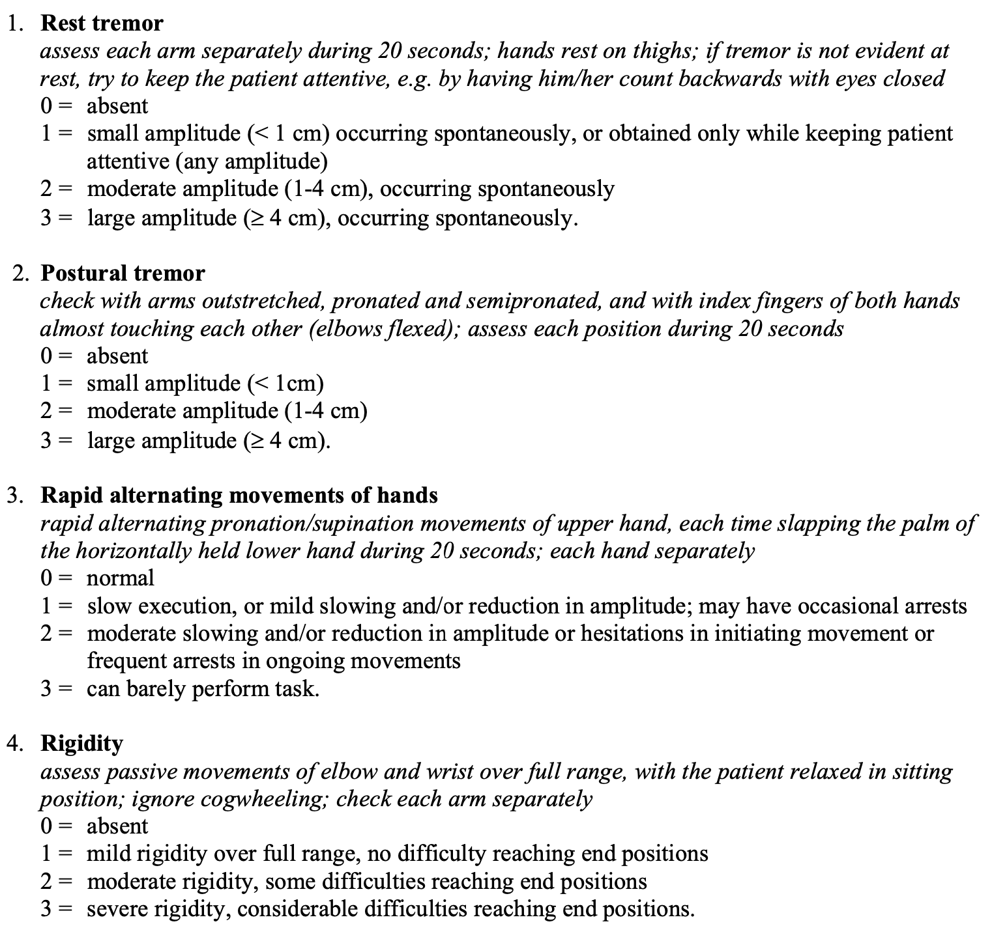
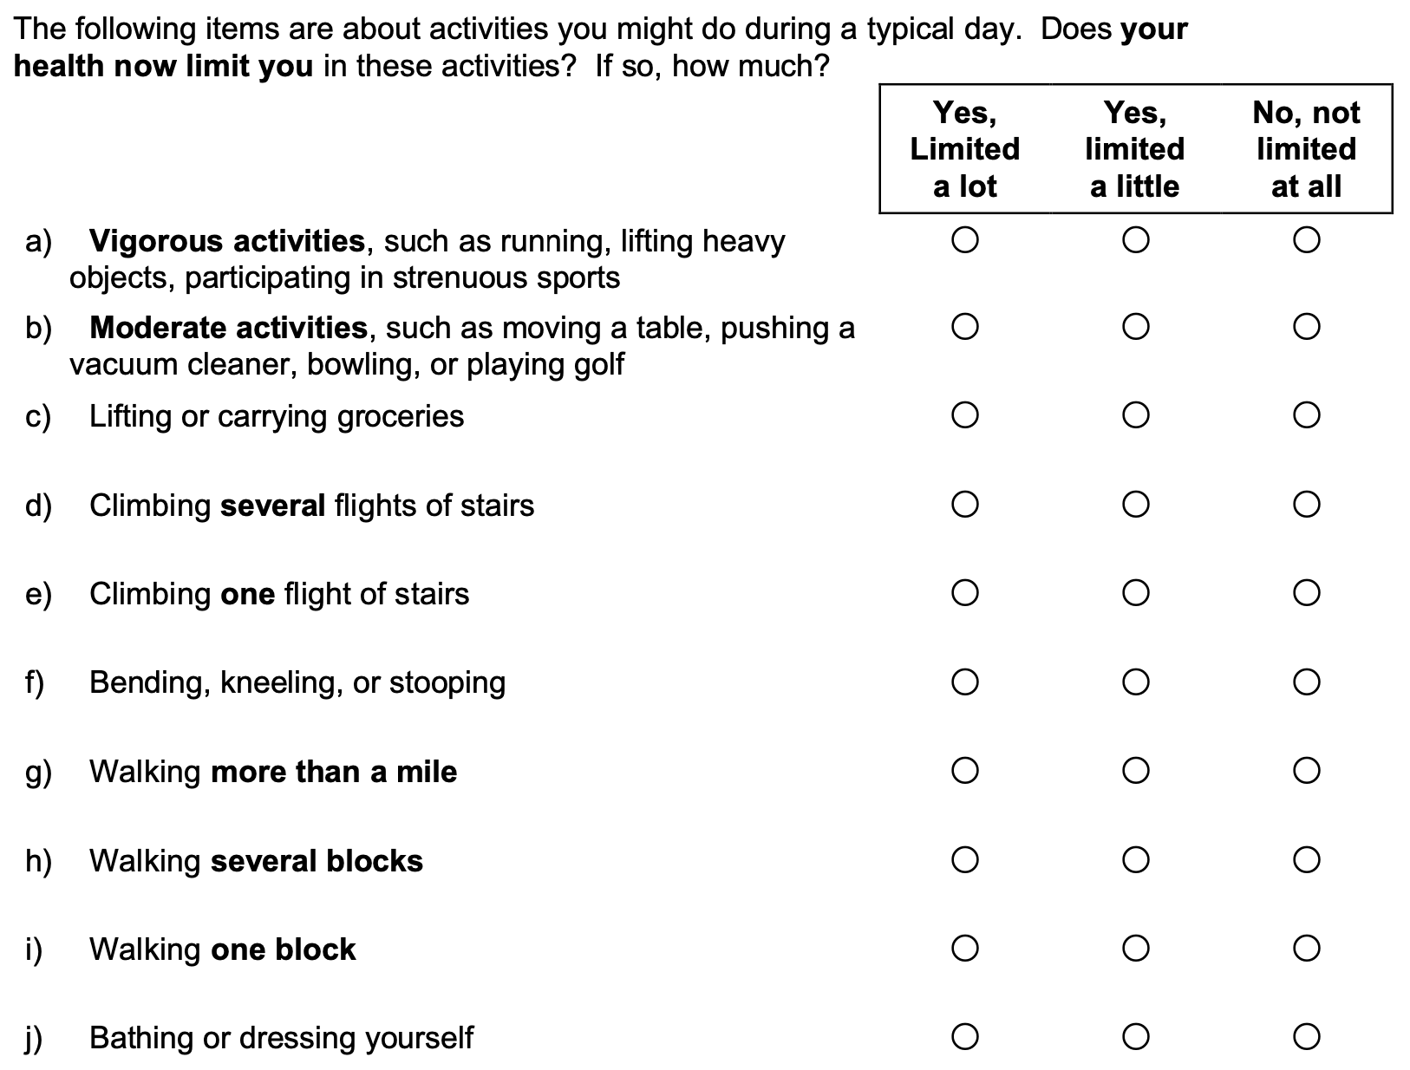
Observations
Assessments – Qualitative
Nominal/
ordinal

Slide 9
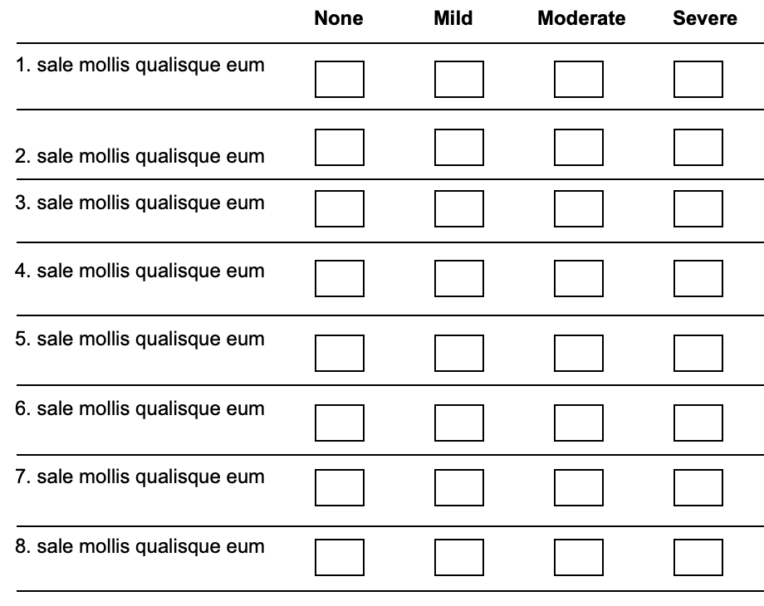
Rating scales provide the raw data (observations) for measurement. Measurement requires these raw data to be processed using methods of quantification (a measurement mechanism) for them to represent linear measures.

Slide 10
Need for methods to turn qualitative observations into quantitative measures
Less
More

Slide 11
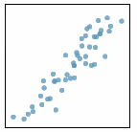
Classical Test Theory (CTT)
O = T + E
O = Observed score
T = True score
E = Error score
Assumptions
T = mean of repeated simultaneous independent observations of the same person
T and E are uncorrelated
E are uncorrelated
Largely correlational
Notes:
11

Slide 12
Likert scaling
Method of summated ratings
Ordered response categories with equally spaced integral scale values
  strongly disagree
  disagree
  neither agree nor disagree
  agree
  strongly agree
Can legitimitely be summed if:
  Items are unidimensional
  Items are approximately parallel (similar means and standard deviations)
  Items contribute about the same amount of information

Slide 13
✗
0
1
2
3
0
1
✗
3
2
0
1
✗
2
3
Σ
✗
1
0
2
3
✗
0
1
2
3
0
1
✗
2
3
0
1
✗
3
2
✗
1
0
2
3
TOTAL
SCORE
Ordinal
Non-linear








Less






More

Slide 14
Challenges
Latent variables
Turning qualitative observations into quantitative measures
Validity:
  The extent to which scores represent the variable they intend to represent
Reliability:
  The extent to which scores are free from error
  Range, 0-1; 1 = perfect reliability
Responsiveness:
  The ability of scores to reflect changes
  A function of validity and reliability
Psychometrics

Slide 15
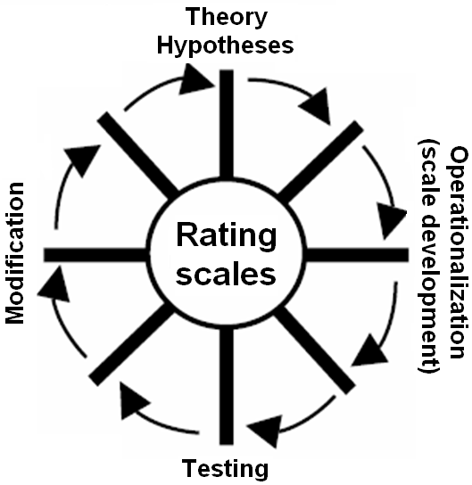
A rating scale can be seen as an hypothesis about a variable and how it can be quantified
Requires variable definition
Requires explicit operationalization - what characterizes the variable as it varies from "less" to "more" and how is this variation expressed in words (i.e., rating scale items and response categories)?
Latent variable
Uncertainty
To what extent and with what precision do empirical observations (responses to items) reflect the variable they intend to represent?
Notes:
15

Slide 16

Rating scale quality aspects
To what extent is the legitimacy of combining items into scales met?
To what extent can scores be interpreted as representations of the intended variable?
To what extent are scores useful for their intended purpose?
To what extent are scores free from measurement error?
To what extent do scores reflect differences and changes?
Can scores serve as a basis for linear measurement?

Slide 17
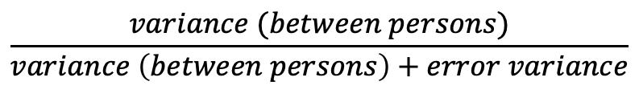
Reliability
True score (T)
True score (T) + Error score (E)
Reliability (r_{xx} ) =
  Little measurement error → High reliability
  Much measurement error → Low reliability
  Rules of thumb for acceptable reliability:
    ≥0.7, preferably ≥0.8 (group level)
    ≥0.9 (individual level)
Single administration
Internal consistency
  Coefficient alpha
Repeated administrations
Test-retest
Intra-rater
Inter-rater
  Intraclass correlation (ICC)
  Kappa, weighted Kappa
$$\frac{variance (between persons)}{variance \left(between persons\right)+error variance}$$

Slide 18
Standard Error of Measurement (SEM)
Precision (estimated deviation/variation) relative to the true score
Average value over the full sample/outcome space
±1.96SEM = 95% CI
Suggested rule of thumb: ≤½ SD
Expressed in the same unit as the scale scores - less abstract than reliability coefficients
Average value - relevance to individual observations?

Slide 19
Validity
Does the instrument represent the variable that it intends to represent?
Many different names (”types of validity”)
Main traditional types of evaluations
  Internal psychometric properties
  Content validity
  Criterion-related validity
  Construct validity
Rarely/never "proven" – supporting evidence accumulates
Internal validity
External validity

Slide 20
Internal validity
Do item scores appear to work together to yield a valid total score?
According to CTT/Likert scaling
Legitimacy of summing items into total scores
Scale unidimensionality (items should represent one common variable)
Score distribution; floor/ceiling effects (no excess skewness)
Reliability (internal consistency)

Slide 21
Content validity
Does the instrument contain representative manifestations/ aspects (items, response categories) of the target variable?
Does the instrument contain manifestations/aspects that are not representative of the target variable?
Evaluation:
How was the instrument developed?
Qualitative/theoretical/clinical considerations
Cognitive interviews
Evaluation by experts/respondents
  Content Validity Index (CVI)

Slide 22
External validity
Associations with other variables or scores, external to the instrument being tested
Criterion-related validity
  Concurrent use of another instrument ("gold standard") that represents the same thing
Construct validity
  Do scores ”behave" as expected?
    Between groups of people (differences)
    In relation to other variables (correlations)
  Expected results support validity
  Requires a priori hypothesis/theory

Slide 23
Responsiveness and sensitivity
Responsiveness
  Ability to capture differences over time, e.g., intervention effects
Sensitivity:
  Ability to capture differences between groups, e.g., stages of disease
A function of reliability and validity

Slide 24
Interpreting change
What does a particular change in scores mean?
What is the minimal meaningful difference?
Minimally Important Difference (MID)
  The smallest difference in a score that patients/clinicians perceive to be beneficial/meaningful
Approaches to estimate MID
  Anchor based
  Distribution based
Anchor based MID-estimations, e.g.,
  Have you experienced a change?
  If so, how large is the change? (small – moderate – large)
  Mean change from baseline for those with ”small” changes = Estimated MID
Distribution based MID-estimations: change scores corresponding to, e.g.,
  A ”small” to ”moderate” effect size (i.e., 0.2-0.5)
  Half a standard deviation
  One Standard Error of Measurement (SEM)

Slide 25
Ordinal scores vs. linear measures
Ordinal scores
Linear measures

Slide 26
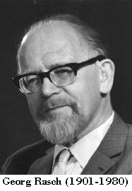
The Rasch Measurement Theory
Developed by Danish mathematician Georg Rasch (1960)
Basic logic of the model:
”A person having a greater ability than another should have the greater probability of solving any item of the type in question, and similarly, one item being more difficult than another one means that for any person the probability of solving the second item correctly is the greater one”
Rasch G. Probabilistic models for some intelligence and attainment tests. (p. 117)
Danish Institute for Educational Research, Copenhagen, Denmark, 1960.

Slide 27
The Rasch Measurement Theory
Not correlational
Probabilistic
Based on measurement principles in the physical sciences

Slide 28
Data requirements for measurement

Slide 29
The Rasch Measurement Theory
Measures in logits (log-odd units) – Logarithmic scale
Linear at the interval level
Persons and items are located (measured) independently of each other on the same scale, with known measurement uncertainties
Mean item location is set to 0

Slide 30
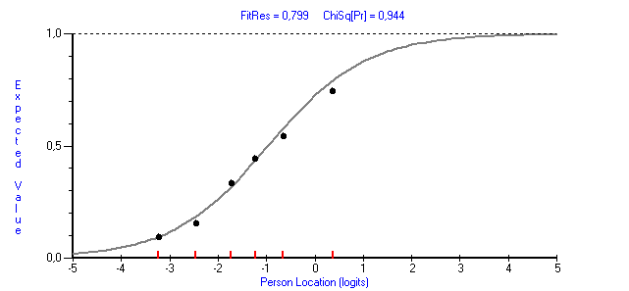
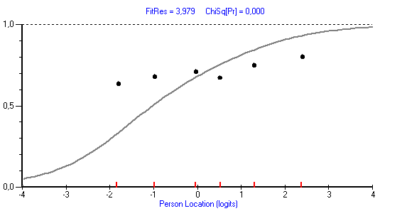
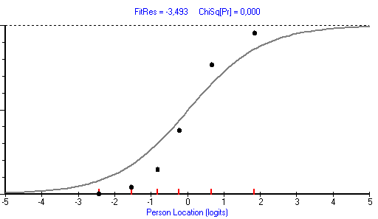
Assessment of how well items form a scale for measurement
Expected responses (grey curve)
Empirical responses (black dots)
Good working item
Problematic item
(potential multidimensionality)
Problematic item
(potential redundancy)

Slide 31
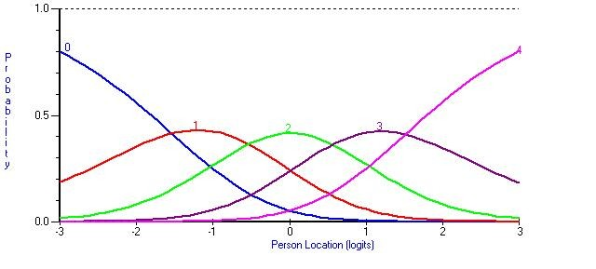
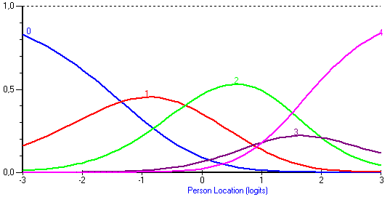
Assessment of response category functioning
Probability of response
0 = Definitely true
1 = Mostly true
2 = Don’t know
3 = Mostly false
4 = Definitely false
Not working as intended

Slide 32
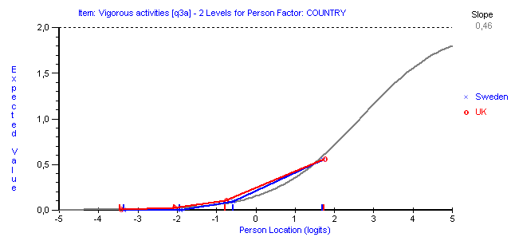
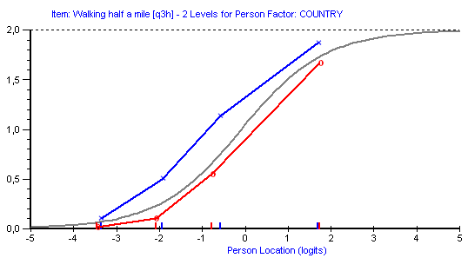
Assessment of measurement invariance (DIF, differential item functioning):
Do items work the same way in different groups?
No DIF: Invariant measurement
DIF: Item works differently for people
from Sweden and the UK

Slide 33
Raw scores-to-linear measures

Slide 34
Raw scores-to-linear measures with known uncertainties

Slide 35
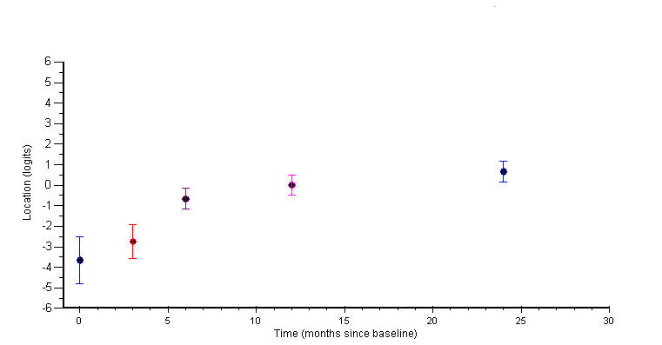
Person-centred measurement:
Known measurement uncertainties at the individual person level
1: No change given measurement uncertainty (error)
2: Change beyond measurement uncertainty (error)
2
1

Slide 36
Take home messages
Beware the meaning of numbers before you use and interpret them
Beware of the quality of rating scales and questionnaires before you use them and interpret scores
If we are serious about our patients and the care we provide, we must be serious about our assessment and measurement instruments (e.g., rating scales)
The quality of data, study results and conclusions are dependent on the quality of the instruments (e.g., rating scales) used to produce data

Slide 37
Recommended reading
Cano SJ, Hobart JC. The problem with health measurement. Patient Preference and Adherence 2011; 5: 279-290.
Available from: https://doi.org/10.2147/PPA.S14399
EuroTEQ Theoretical Report Part I – Research Basics.
Available from: https://euroteq.nu/resources
Hagell P. Measuring Activities of Daily Living in Parkinson's disease: On a road to nowhere and back again? Measurement 2019; 132: 109-124.
Available from: https://doi.org/10.1016/j.measurement.2018.09.050 (https://www.hkr.se/globalassets/transfer/hagell-msrmnt-2019_accepted_ms.pdf)
Hobart J. Rating scales for neurologists. Journal of Neurology Neurosurgery & Psychiatry 2003; 74(Suppl 4): iv22-iv26.
Available from: http://dx.doi.org/10.1136/jnnp.74.suppl_4.iv22
Hobart J, Cano S. Improving the evaluation of therapeutic interventions in multiple sclerosis: the role of new psychometric methods. Health Technology Assessment 2009; 13(12).
Available from: https://doi.org/10.3310/hta13120
Tesio L, Caronni A, Hassan S, Kumbhare D, Caronni A. Why Questionnaire Scores Are Not Measures: A Question-Raising Article. American Journal of Physical Medicine & Rehabilitation 2023; 102(1): 75-82.
Available from: https://doi.org/10.1097/PHM.0000000000002028
Wright BD, Linacre J M. Observations are always ordinal; measurements, however, must be interval. Archives of Physical Medicine & Rehabilitation 1989; 70(12): 857-860.
Available from: https://www.rasch.org/memo44.htm

