Slide 1

Political Implications in evaluation
Dr HMP Herath
Senior lecturer Ph.D. (USJ), RN(SLNC), B.Sc. (Nursing) Hons(UPSL), CTHE (KDU) Department of Nursing & Midwifery FAHS, KDU

Slide 2

Objectives
Understanding the importance of unbiased evaluations in governance and public policy.
Recognizing the potential consequences of biased evaluations.
Understanding how political implications can influence the outcomes of evaluations.
Identifying the benefits of keeping political implications in check for governance and the public.
Analyzing specific case studies where political implications affected evaluation outcomes.
Analyzing lessons learned from these case studies and their implications for governance.

Slide 3

Different types of evaluations
Project management involves various types of evaluations to assess the progress, performance, and outcomes of a project. These evaluations help project managers make informed decisions and improve project success.
Here are some of the different types of evaluations in project management:
Project Initiation Evaluation
Project Feasibility Evaluation
Formative Evaluation
Summative Evaluation
Performance Evaluation
Process Evaluation
Cost-benefit analysis (CBA)
Risk Evaluation
Stakeholder Evaluation
Quality Evaluation
Notes:
Project Initiation Evaluation: This evaluation occurs at the beginning of a project and involves assessing the project's feasibility, alignment with organizational goals, and the potential return on investment. It helps in deciding whether to proceed with the project.
Project Feasibility Evaluation: Before committing resources, project managers evaluate the feasibility of the project. This includes examining technical, operational, economic, and scheduling feasibility to determine if the project is viable.
Formative Evaluation: This type of evaluation takes place during the project's development phase. It aims to identify issues and areas for improvement as the project progresses. Formative evaluations help project teams make necessary adjustments to stay on track.
Summative Evaluation: Summative evaluations occur at the end of a project to assess its overall success and impact. This evaluation helps determine if the project met its objectives and delivered the expected outcomes.
Performance Evaluation: Project managers continuously monitor and evaluate the performance of team members and the project as a whole throughout its lifecycle. This can involve assessing the quality, timeliness, and cost-effectiveness of work.
Process Evaluation: This evaluation focuses on the processes and methods used in the project. It helps identify inefficiencies, bottlenecks, and areas for improvement in the project management process.
Cost-Benefit Analysis (CBA): CBA is a financial evaluation that assesses the costs incurred during the project against the expected benefits and returns. It helps determine if the project is financially viable and justifiable.
Risk Evaluation: Identifying, assessing, and managing risks is a crucial part of project management. Risk evaluations involve analyzing potential risks, their impact, and the likelihood of occurrence, as well as developing risk mitigation strategies.
Stakeholder Evaluation: It involves assessing the satisfaction, engagement, and communication with project stakeholders, such as clients, team members, and sponsors. The aim is to ensure that stakeholders' expectations are met and their concerns are addressed.
Quality Evaluation: This evaluation focuses on the quality of deliverables and whether they meet predefined standards and specifications. It often involves quality control and quality assurance processes.
Post-Implementation Evaluation: After project completion, this evaluation assesses the long-term impact of the project on the organization or its intended beneficiaries. It helps to identify whether the expected benefits are realized.
Lessons Learned Evaluation: A retrospective assessment that identifies what went well and what didn't during the project. Lessons learned evaluations provide insights for future projects and help in continuous improvement.
Benchmarking: Comparing the project's performance and outcomes to industry standards or best practices to identify areas for improvement.
Customer Satisfaction Evaluation: For projects involving the delivery of products or services to external customers, this evaluation gauges the satisfaction of the end-users or customers with the project's results.
Environmental and Social Impact Assessment: For projects that have potential environmental or social impacts, this evaluation assesses the effects and helps ensure compliance with regulations and ethical standards.
These different types of evaluations in project management serve distinct purposes and are typically integrated throughout the project's life cycle to ensure that the project meets its goals, satisfies stakeholders, and delivers value.

Slide 4
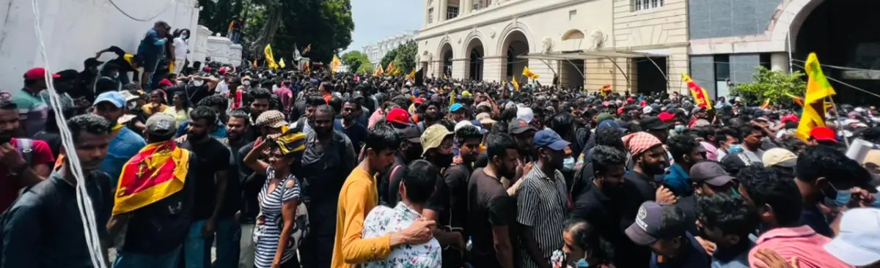
Benefits of effective evaluations for governments and public.
Effective evaluations play a crucial role in government and public sector organizations by providing a range of benefits.

Slide 5
Benefits of effective evaluations for governments and public.
1. Accountability and Transparency: Effective evaluations promote accountability by assessing the performance and outcomes of government programs and policies. They help identify whether public funds are being used efficiently and whether public officials are delivering on their promises. Transparent evaluation results can build trust between the government and its citizens.
2. Improved Decision-Making: Evaluations provide data and evidence that can inform decision-making processes. By understanding what works and what doesn't, governments can allocate resources more effectively, make informed policy choices, and adjust programs to achieve better outcomes.
3. Resource Allocation: Evaluation results help governments allocate resources where they are most needed. By identifying successful programs and initiatives, funding can be directed to those areas, while underperforming or inefficient programs can be adjusted or discontinued.

Slide 6
Benefits of effective evaluations for governments and public.
4. Enhanced Efficiency: Effective evaluations identify inefficiencies and wasteful practices in government programs. This leads to improved processes, reduced bureaucracy, and cost savings, allowing governments to do more with less.
5. Policy Development: Evaluations can inform the development of evidence-based policies. By examining the impact of existing policies, governments can refine and adapt them to better address the needs and challenges of society.
6. Program Improvement: Public programs and services can be enhanced and tailored to better meet the needs of citizens. Evaluation feedback can help program managers identify areas for improvement, leading to more effective and responsive services.

Slide 7
Benefits of effective evaluations for governments and public.
7. Learning and Knowledge Sharing: The evaluation process encourages learning and the exchange of best practices within government agencies. It helps public servants and policymakers understand what works in different contexts and apply those lessons to new initiatives.
8. Public Engagement: Evaluation results can be shared with the public to inform citizens about the effectiveness of government programs. This transparency can foster public engagement and encourage citizen participation in decision-making processes.
9. Prevention of Fraud and Corruption: Evaluations can uncover irregularities, fraud, or corruption within government programs. Identifying and addressing these issues can help maintain the integrity of public institutions and protect public funds.
10. Risk Management: Evaluations can help government agencies identify and mitigate risks associated with various programs and policies, ensuring that potential problems are addressed proactively.

Slide 8
Benefits of effective evaluations for governments and public.
11. Sustainable Development: Evaluations can assess the environmental and social impact of government actions, ensuring that policies and programs are aligned with sustainability goals and the well-being of future generations.
12. Economic Development: By assessing the economic impact of government programs and investments, evaluations can help governments stimulate economic growth and job creation in the public and private sectors.
13. Legal Compliance: Ensuring that government actions are in compliance with laws and regulations is a critical benefit of evaluations. It helps avoid legal challenges and ensures the government operates within the bounds of the law.
Overall, effective evaluations are essential for ensuring that government and public sector organizations operate efficiently, responsibly, and in the best interests of their citizens. They contribute to better governance, improved public services, and the achievement of societal goals.

Slide 9
Political Influences in Evaluation
Political agendas can significantly influence the goals of an evaluation in several ways.
While evaluations ideally aim to provide objective and evidence-based assessments of policies, programs, or projects, political considerations can impact the objectives, scope, and outcomes of the evaluation.
It's important to recognize that while political agendas can influence evaluations, there is also a need for independence and integrity in the evaluation process.
Independent evaluations, conducted with impartiality and adherence to recognized evaluation standards, are essential for ensuring that the results accurately reflect the impact of policies and programs, regardless of political influences.
However, achieving this independence can be challenging in politically charged environments.

Slide 10

How political agendas can influence the goals of an evaluation
Defining the Scope: Political agendas can influence what issues, policies, or programs are subject to evaluation. Government officials or leaders may prioritize evaluations of programs or policies that align with their political priorities or campaign promises.
Setting Objectives: Political considerations can affect the specific objectives of an evaluation. For example, an evaluation might be framed in a way that seeks to highlight the positive aspects of a policy or program that a particular political group supports.
Data Collection and Methodology: There may be pressure to collect data that supports a preconceived narrative or to employ methods that are less likely to reveal negative outcomes.
Influence on the Choice of Evaluator: Political leaders may select evaluators or agencies Supporting a preconceived narrative or to employ methods

Slide 11

How political agendas can influence the goals of an evaluation
Interpreting Findings: Different stakeholders may view the same results in a way that aligns with their political positions. Findings may be selectively emphasized or downplayed to support a particular agenda.
Timing of Evaluations: The timing of evaluations can be politically motivated. Politicians may choose to conduct evaluations closer to an election.
Funding and Resources: Programs or policies aligned with a political agenda may receive more funding for evaluations, while those in opposition to the agenda might not.
Suppression or Alteration of Results: In extreme cases, political agendas can lead to the suppression or alteration of evaluation results.
Selective Release of Information: Only the findings that support a particular agenda may be made public, while unfavorable findings might be kept confidential.

Slide 12
The role of stakeholders and power dynamics in political implications
Stakeholders and power dynamics play a crucial role in shaping and being shaped by political influences in various contexts, particularly in government decision-making, policy development, and implementation.
To navigate these complex power dynamics and political influences, it is crucial for policymakers, evaluators, and the public to be aware of the interests and power dynamics at play.
Efforts should be made to ensure transparency, accountability, and equity in the decision-making process, and evaluations should be conducted independently to provide an objective assessment of policies and programs.
Public engagement and the inclusion of diverse perspectives are also important for mitigating the disproportionate influence of powerful stakeholders.

Slide 13
The role of stakeholders and power dynamics in political implications
Identification of Stakeholders: Identifying stakeholders is the first step in any political process. Stakeholders are individuals, groups, organizations, or communities. These stakeholders can include government agencies, interest groups, businesses, advocacy organizations, and the general public.
Stakeholder Interests and Goals: Stakeholders often have divergent interests and goals. For example, a government agency may be interested in demonstrating the success of its programs, while an advocacy group may seek to expose flaws and advocate for changes. Understanding these interests is key to recognizing potential political influences.
Power Imbalance: Power dynamics play a significant role in political influence. Some stakeholders may possess more power and resources than others.

Slide 14
The role of stakeholders and power dynamics in political implications
Lobbying and Advocacy: Stakeholders often engage in lobbying and advocacy efforts to influence political decisions. They may use financial contributions, public relations campaigns, or legal actions to promote their interests.
Access to Decision-Makers: Access to decision-makers is a critical factor in political influence. Stakeholders with close relationships with policymakers or government officials may have more influence on policy decisions. This can be due to campaign donations, personal relationships, or professional networks.
Public Opinion: Stakeholders can attempt to shape public opinion through various means, including media campaigns, grassroots organizing, and public relations efforts. Public support or opposition can have a significant impact on political decisions, and this dynamic can be influenced by the resources and strategies of various stakeholders.

Slide 15
The role of stakeholders and power dynamics in political implications
Regulatory Capture: In some cases, stakeholders with significant power and resources can exert undue influence over regulatory agencies, leading to what is known as regulatory capture. This can result in policies and regulations that primarily serve the interests of these powerful stakeholders rather than the public.
Coalitions and Alliances: Stakeholders often form alliances or coalitions to pool their resources and amplify their influence. These alliances can help smaller stakeholders leverage their power and achieve their policy objectives.
Public Scrutiny: The role of the public and the media is essential in holding stakeholders and decision-makers accountable. Transparency and open debate can help to mitigate the undue influence of powerful stakeholders and balance the interests of different groups.

Slide 16
External pressures like media, public opinion, and donor requirements.
External pressures from sources like the media, public opinion, and donor requirements can influence political decision-making, policy development, and implementation.
These pressures can either act as checks and balances on government actions or, in some cases, exacerbate political agendas.
Balancing the influence of external pressures with democratic processes and the needs of the population is a complex challenge.
It requires vigilance, transparency, and public participation to ensure that external pressures do not distort the policymaking process.
Effective governance includes the ability to navigate these external forces while remaining accountable to the public.

Slide 17
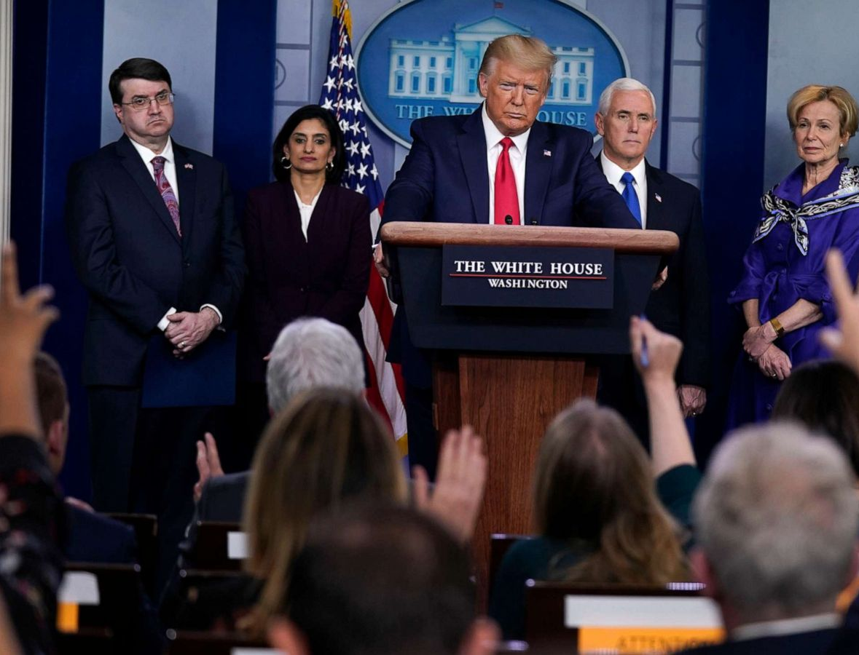
Here's how these external factors can exert influence:
Media Influence:
Agenda-Setting: Media plays a crucial role in setting the public agenda by deciding which issues to cover and how to frame them. Policymakers often respond to media coverage and public attention.
Information Dissemination: The media provides information on government actions, policies, and their outcomes, shaping public perception and knowledge. Positive or negative media coverage can impact how policies are viewed.
Investigative Reporting: In-depth investigative reporting can uncover government failures, corruption, or injustices, leading to public outrage and pressure for change.

Slide 18

Here's how these external factors can exert influence:influence:
Public Opinion:
Election Outcomes: Politicians are often responsive to public opinion, as elections can hinge on public approval. Public support or opposition can influence the decision-making process.
Protests and Activism: When public opinion coalesces around a particular issue, it can lead to grassroots activism, protests, and social movements that demand policy changes.
Policy Priorities: Public opinion can shape the priorities of government leaders, who may align their policies with popular demands to maintain their political viability.

Slide 19
Here's how these external factors can exert influence:
Donor Requirements:
International Aid and Development: Donor countries and organizations often provide financial assistance to governments, and their requirements can influence policy decisions. Donors may insist on specific conditions or reforms in exchange for funding.
Non-Governmental Organizations (NGOs): NGOs that receive donor support may also influence policies and programs based on their funding agreements and priorities.
Advocacy and Lobbying:
Organizations and interest groups can actively lobby and advocate for their positions. They may use media campaigns, public opinion polling, and donor funding to amplify their influence on decision-makers.
Transparency and Accountability:
External pressures, especially from media and public opinion, can promote transparency and accountability in government actions. They can encourage officials to be more responsive to the needs and expectations of their constituents

Slide 20
Implications and Consequences of Political Influences in Evaluation.
The implications and consequences of biased findings and misleading conclusions in evaluations, misallocation of resources, and the potential harm to targeted populations, as well as the erosion of trust in governance and institutions, are significant and far-reaching.
To avoid these repercussions and maintain evaluation integrity, transparency, independence, and objectivity must be maintained.
Independent assessment bodies, non-partisan specialists, and diverse stakeholders should plan, conduct, and interpret evaluations. Evaluation outcomes should be clearly reported and made public for examination and accountability.
In addition, oversight mechanisms, such as governmental audit offices and legislative bodies, can play a vital role in holding policymakers accountable for their decisions and the allocation of resources. Building a culture of evidence-based decision-making and public participation can also contribute to more effective governance and better policy outcomes.

Slide 21
Implications and Consequences of Political Influences in Evaluation: Here is how:
1. Biased Findings and Misleading Conclusions:
Policy Ineffectiveness: Biased or misleading evaluation findings can lead to the adoption of policies and programs that do not effectively address the intended issues or achieve desired outcomes.
Wasted Resources: Resources may be wasted on initiatives based on inaccurate findings, diverting valuable funds from more productive and impactful endeavors.
Distorted Understanding: Policymakers and the public may develop a distorted understanding of what works and what doesn't, undermining the potential for evidence-based decision-making.

Slide 22
Implications and Consequences of Political Influences in Evaluation: Here is how:
2. Misallocation of Resources:
Resource Diversion: Misallocation of resources can lead to the diversion of public funds away from programs that genuinely benefit the population or communities in need.
Inequities: Misallocation can exacerbate social and economic inequities, as funds may disproportionately benefit certain groups or areas at the expense of others.
Inefficient Spending: When resources are not allocated efficiently, government spending becomes less effective, reducing the overall impact of public policies

Slide 23
Implications and Consequences of Political Influences in Evaluation: Here is how:
3. Harm to Targeted Populations:
Vulnerable Populations: Flawed evaluations may result in policies or programs that unintentionally harm vulnerable or marginalized populations, as they are often the most affected by government decisions.
Negative Consequences: Harm can manifest in various forms, including decreased access to services, increased economic disparities, or violations of individual rights.
4. Erosion of Trust in Governance and Institutions:
Public Distrust: Biased or misleading evaluation findings can erode public trust in government institutions, as people may perceive decision-makers as unresponsive, unaccountable, or more concerned with political interests than the public welfare.
Reduced Participation: A lack of trust in governance can reduce civic engagement and participation, diminishing the effectiveness of democratic processes.
Political Instability: Pervasive mistrust in institutions can lead to political instability, protests, and even regime changes in extreme cases.

Slide 24
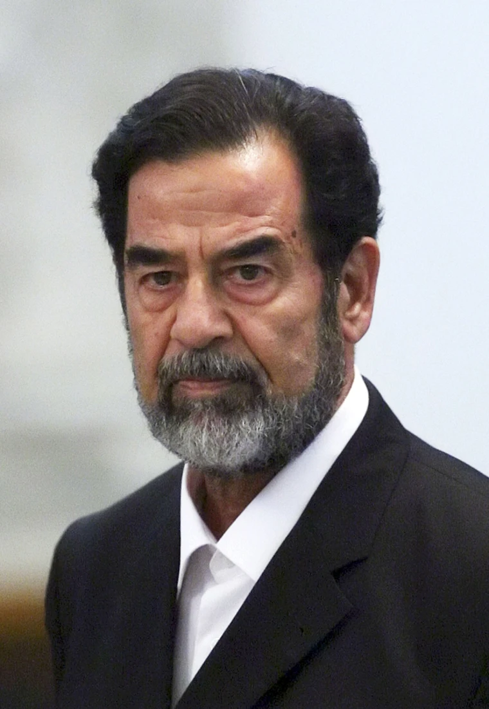
Real-life instances where political implications affected the outcome of evaluations. - Lessons learned from each case.
Certainly, there have been many real-life instances where political implications affected the outcome of evaluations. Here are a few case studies with lessons learned from each:
1. Iraq War and Intelligence Assessment:
Case Study: In the lead-up to the 2003 invasion of Iraq, the U.S. government relied on intelligence assessments that claimed Iraq possessed weapons of mass destruction (WMDs). These assessments were a significant part of the justification for the war. However, after the invasion, it was revealed that these assessments were flawed, and no WMDs were found.
Lessons Learned:
Political pressure can lead to biased intelligence assessments, which can have severe consequences when used to justify military actions.
The need for independent and objective evaluation of intelligence data is crucial to prevent policy decisions based on flawed or politically motivated information.

Slide 25

Real-life instances where political implications affected the outcome of evaluations.
2. No Child Left Behind Act:
Case Study: The No Child Left Behind (NCLB) Act, signed into law in 2002, introduced a system of standardized testing in U.S. schools to measure student progress. However, the policy led to criticisms that schools focused excessively on test scores and "teaching to the test," which limited the quality of education.
Lessons Learned:
Political pressure to demonstrate progress can lead to a narrow focus on specific indicators, potentially distorting the educational system's overall goals.
Evaluations should consider unintended consequences and be adaptable to evolving needs.

Slide 26
Real-life instances where political implications affected the outcome of evaluations.
3. World Bank's Economic and Structural Adjustment Programs:
Case Study: The World Bank's Structural Adjustment Programs (SAPs) in the 1980s and 1990s faced criticism for their social and economic impact in developing countries. Critics argued that these programs were influenced by political and ideological agendas, leading to negative consequences in recipient countries.
Lessons Learned:
Evaluations of international development programs should consider their impact on the target population rather than simply meeting economic and political goals.
The importance of feedback and accountability in shaping international policies and development programs.
These case studies illustrate the significant impact that political pressures and agendas can have on the outcomes of evaluations. They underscore the importance of maintaining independence and objectivity in evaluation processes and ensuring that evaluations are used to inform policy decisions rather than justify preconceived political positions. Transparency and open communication of findings are also essential to prevent the manipulation of evaluation outcomes for political purposes.

Slide 27
Conclusion-importance of unbiased evaluations
In conclusion, unbiased evaluations are of paramount importance in the realm of governance and public policy. They serve as a critical tool for assessing the effectiveness and impact of policies, programs, and decisions. The benefits of keeping political implications at bay in the evaluation process are numerous and essential for the betterment of governance and the well-being of the public.
Objective Decision-Making: Unbiased evaluations provide decision-makers with accurate and reliable information on which to base their choices. When political agendas are kept in check, policies and programs can be designed to address real needs rather than political expediency.
Effective Resource Allocation: Unbiased evaluations ensure that resources are allocated efficiently and to where they are needed the most. This reduces the risk of misallocation and wasted public funds, contributing to a more equitable and productive society.
Protection of Vulnerable Populations: By focusing on objective evaluation, policymakers can better safeguard the interests of vulnerable and marginalized populations. They are less likely to be adversely affected by policies influenced by political considerations.

Slide 28
Conclusion-importance of unbiased evaluations
Trust in Governance: When evaluations are conducted with integrity and independence, public trust in government institutions and decision-makers is bolstered. This trust is the cornerstone of effective governance and democratic stability.
Objective Decision-Making: Unbiased evaluations provide decision-makers with accurate and reliable information on which to base their choices. When political agendas are kept in check, policies and programs can be designed to address real needs rather than political expediency.
Effective Resource Allocation: Unbiased evaluations ensure that resources are allocated efficiently and to where they are needed the most. This reduces the risk of misallocation and wasted public funds, contributing to a more equitable and productive society.
Protection of Vulnerable Populations: By focusing on objective evaluation, policymakers can better safeguard the interests of vulnerable and marginalized populations. They are less likely to be adversely affected by policies influenced by political considerations.
Trust in Governance: When evaluations are conducted with integrity and independence, public trust in government institutions and decision-makers is bolstered. This trust is the cornerstone of effective governance and democratic stability.
Accountability: Unbiased evaluations promote accountability among government officials, as the results of evaluations provide a basis for holding them responsible for their decisions. This encourages transparency and fosters a culture of public service.

Slide 29
Conclusion-importance of unbiased evaluations
Learning and Adaptation: Objective evaluations enable governments to learn from past experiences and adapt policies to better meet the evolving needs of the public. This flexibility is crucial in an ever-changing world.
Long-term Success: Policies and programs founded on unbiased evaluations are more likely to yield long-term success. They stand a greater chance of addressing complex challenges and delivering sustainable, positive outcomes.
Evidence-Based Policymaking: Sound evaluations promote evidence-based policymaking, which enhances the likelihood of successful and effective governance. Decisions driven by data and evidence tend to produce better results for the public.
In a democratic society, the pursuit of unbiased evaluations is a fundamental commitment to the welfare of the people and the integrity of governance. While political considerations will always play a role in decision-making, they should never compromise the essential task of conducting evaluations in an objective, transparent, and independent manner.
In doing so, we prioritize the needs of the public, foster trust in our institutions, and work toward a more equitable and prosperous society for all.

Slide 30
References
Azzam, T., Wanzer, D.L., Knight, C., Codd, H., 2021. The manifestations of politics in evaluation: An exploratory study across the evaluation process. Evaluation and Program Planning 88, 101947. https://doi.org/10.1016/j.evalprogplan.2021.101947
Governance - Organisation for Economic Co-operation and Development [WWW Document], n.d. URL https://www.oecd.org/mena/governance/promoting-access-to-information.htm (accessed 10.14.23).
OECD, 2020. Improving Governance with Policy Evaluation: Lessons From Country Experience, OECD Public Governance Reviews. OECD. https://doi.org/10.1787/89b1577d-en
The politics of evaluation: Participation and policy implementation on JSTOR [WWW Document], n.d. URL https://www.jstor.org/stable/j.ctt9qgmph (accessed 10.14.23).

Slide 31

Thank you

