Slide 1

Mental health related needs in ageing

Slide 2

Aim of the lecture
At the end of this lecture, students should be able to:
Understand what are the modifiable and non-modifiable factors of wellbeing in the older population
Understand the mind and body connection in the scope of wellbeing and mental health
Understand the importance of subjective experience of aging for mental health and wellbeing
Understand the important needs of the older population for mental health and well being

Slide 3
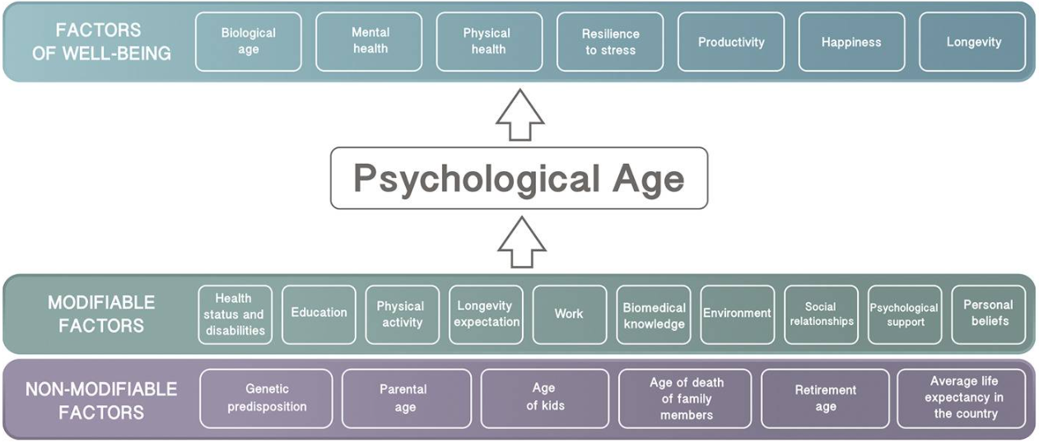
The content of the lecture in abstract
Modifiable and non-modifiable factors of wellbeing

Slide 4
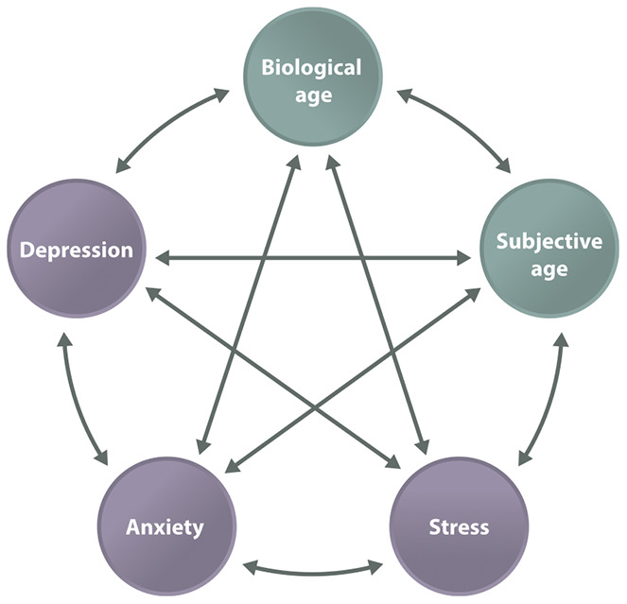
The content of the lecture in abstract
The mind and body connection in the scope of wellbeing, the interplay of various factors that affect mental health in later life periods

Slide 5
The content of the lecture in abstract
The importance of subjectivity in wellbeing, the ties to the topic of with mind and body connection and the modifiable factors of wellbeing
Main contents;
  subjective age,
  age identity,
  the aging self,
  attitudes toward one’s own aging,
  self-perceptions of aging,
  satisfaction with aging.

Slide 6
The content of the lecture in abstract
Elaboration on important needs of the older population for wellbeing and possible psychotherapeutic interventions
  Congruence and genuinity in interactions
  Understanding of the effects of the accumulation of psychological issues due to time
  Importance of sleep and physical activity
  Importance of the managment of physical issues and managing fears and shame arising from that

Slide 7
Methods of learning
Ex-catedra

Slide 8
Sources
Mandatory
Talarska, D., Tobis, S., Kotkowiak, M., Strugała, M., Stanisławska, J., & Wieczorowska-Tobis, K. (2018). Determinants of Quality of Life and the Need for Support for the Elderly with Good Physical and Mental Functioning. Medical Science Monitor : International Medical Journal of Experimental and Clinical Research, 24, 1604. https://doi.org/10.12659/MSM.907032
Mitina, M., Young, S., & Zhavoronkov, A. (2020). Psychological aging, depression, and well-being. Aging (Albany NY), 12(18), 18765. https://doi.org/10.18632/AGING.103880
Kornadt, A. E., Siebert, J. S., & Wahl, H. W. (2019). The interplay of personality and attitudes toward own aging across two decades of later life. PLOS ONE, 14(10), e0223622. https://doi.org/10.1371/JOURNAL.PONE.0223622
Additional
Harper, S. (2019). Living Longer within Ageing Societies. Journal of Population Ageing 2019 12:2, 12(2), 133–136. https://doi.org/10.1007/S12062-019-09248-4
Muñoz, E. (2021). Challenges and Opportunities During a “New Normal” of Psychological Aging Research. The Journals of Gerontology: Series B, 76(9), 1697–1699. https://doi.org/10.1093/GERONB/GBAB174

