Slide 1
Nutrition, supplements and weight related approaches
GP1-Neurology and medical care of neurodegenerative disorders
1.5. Lifestyle modification
Gorazd Drevenšek University of Ljubljana
Manuel Ramanović

Slide 2
Learning Objectives
To understand the role of nutrition in brain nutrition
To understand the changes in nutritional needs due to NDD
To understand inflammation processes during NDDs
To understand the protective role of nutrition and supplementation in NDDs
To discuss scientific evidence supporting the role of diet in the pathogenesis (and therefore prevention), or modifying the course of the NDD
To know the food that fits to individual needs

Slide 3
Contents of the lecture
A brief overview of brain aging and neurodegeneration
Role of nutrients in brain structure and function
Energy status and brain health
Nutrients related to cognitive function
Foods with antioxidant activity
Neuroactive substances
Potential positive and negative health effects of neuroactive compounds
Needs for healthy foods, food supplements (vitamins, minerals, fatty acids etc.) in NDDs
Biological pathways mediating the relationship of the diet with cognition
Bioactive compounds from food with effects on NDD
Malnutrition and dementia
Mediterranean Diet (MD) in Preventing Neurodegenerative Diseases
Pyramid for a Sustainable Mediterranean Diet
A practical guide to the Mediterranean diet
The MIND diet
Other clinically important supplements
Glutathione and glutathione supplementation
Melatonin
Ubiquinone
What is microbiota?
The importance of microbiota
Dysbiosis
Blood-brain barrier and microbiota
»Gut – brain« axis
How pathogens affects brain?
New insights: how the diet and intestinal microbiome affect the brain
Prevention of Dementia using Mobile phone applications (PRODEMOS)
New opportunities to modulate the gut microbiota by nutrition
Relationship between diabetes mellitus and NDD
Mechanisms connecting Alzheimer's disease and diabetes
Neuromodulatory effects of anti-diabetes medications
Study designs to nutrition-based interventions for dementia prevention

Slide 4
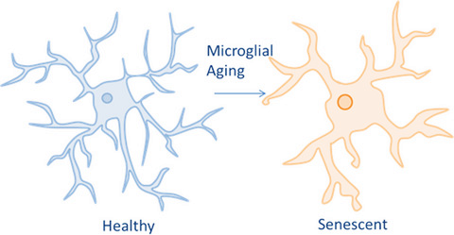
Brain Aging and Neurodegeneration
Microglia from aging or degenerated brains:
Exaggerated inflammatory response to secondary and sub threshold challenges
Higher percentage are "stuck" in the inflammatory phenotype
Produce significantly more pro-inflammatory cytokines (IL-I, IL-6, TNF)
Produce significantly less anti-inflammatory mediators (IL-10, BNDF, inhibitor of NF-kB)
Notes:
Microglia in the brain. Healthy microglial cells play a myriad of supportive roles in the brain including sensing, intercellular communication, promotion of inflammation, degradation, and repair.
Senescent can also imply different states. Originally derived from the study of cancer cells, cellular senescence implied a loss of the ability to divide (Campisi 2013). However, more recently this has come to imply an age-related change in the secretory profile, as in the senescence-associated secretory phenotype (SASP) (Coppe et al. 2008; Chinta et al. 2015).

Slide 5
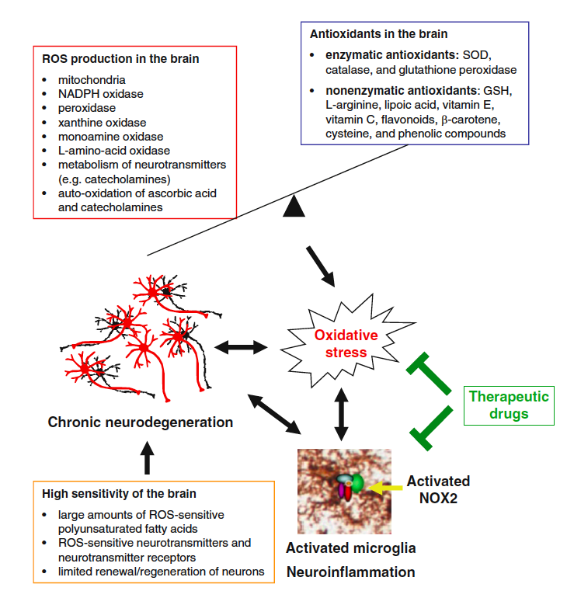
The Brain Is Highly Sensitive to Oxidative Stress
The brain derives its energy almost exclusively from oxidative metabolism of the mitochondrial respiratory chain
The “leakage” of high-energy electrons along the mitochondrial electron transport chain generates superoxide free radical and hydrogen peroxide (a non- radical oxidant)
"There is a strong correlation between brain aging and neurodegeneration and redox imbalance, as well as chronic low grade inflammation” (Rojo et al., 2014)
A vicious cycle among neuroinflammation, oxidative stress, and neurodegeneration drives chronic neurodegeneration
Gao, HM., Zhou, H., Hong, JS. (2014). Oxidative Stress, Neuroinflammation, and Neurodegeneration. In: Peterson, P., Toborek, M. (eds) Neuroinflammation and Neurodegeneration. Springer, New York, NY.
Notes:
A vicious cycle among neuroinfl ammation, oxidative stress, and neurodegeneration drives
chronic neurodegeneration. Oxidative phosphorylation in mitochondria, activation of oxidase enzymes
(e.g., NADPH oxidase, peroxidase, xanthine oxidase, monoamine oxidase, and L -AMINO- ACID oxidase),
metabolism of neurotransmitters (e.g., catecholamines), and auto-oxidation of ascorbic acid and catecholamines
in the brain generate reactive oxygen species (ROS). Mitochondrial dysfunction, increased
activity of oxidase enzymes, and oxidative metabolism of neurotransmitters, combined with the high
oxygen consumption and the high energy demand, lead to high production of ROS in the brain. Both
enzymatic antioxidants (e.g., SOD, catalase, and glutathione peroxidase) and nonenzymatic antioxidants
(e.g., GSH, L -arginine, lipoic acid, vitamin E, vitamin C, fl avonoids, β-carotene, cysteine, and
phenolic compounds) are essential for redox balance in the brain. Insuffi cient antioxidant defense also
leads to excessive amounts of ROS. Thus, when excessive amount ROS overwhelms the antioxidant
defense system, the resultant oxidative stress induces chronic neurodegeneration and brain dysfunction,
which in turn can exaggerate oxidative stress. Dysregulated chronic neuroinfl ammation can mediate
progressive neurodegeneration. Oxidative stress and chronic neuroinfl ammation are two intertwined
key pathologic factors in neurodegenerative diseases; one can be a result of the other. The brain is
highly sensitive to oxidative stress and neuroinfl ammation because of its large amounts of ROSsensitive
polyunsaturated fatty acids, neurotransmitters and neurotransmitter receptors, and the limited
renewal/regeneration of neurons. A vicious cycle among neuroinfl ammation, oxidative stress, and neurodegeneration
may drive chronic neurodegenerative process. Therefore, suppression of ROS production
may dampen neuroinfl ammation and vice versa. Over-activated NOX2 is a major contributor to
infl ammation- mediated oxidative stress and chronic neurodegeneration. Blockade of the crossroad of
neuroinfl ammation and oxidative stress, especially NOX2, may have greater effi cacy in the treatment
for neurodegenerative diseases. SOD, superoxide dismutase; GSH, glutathione

Slide 6
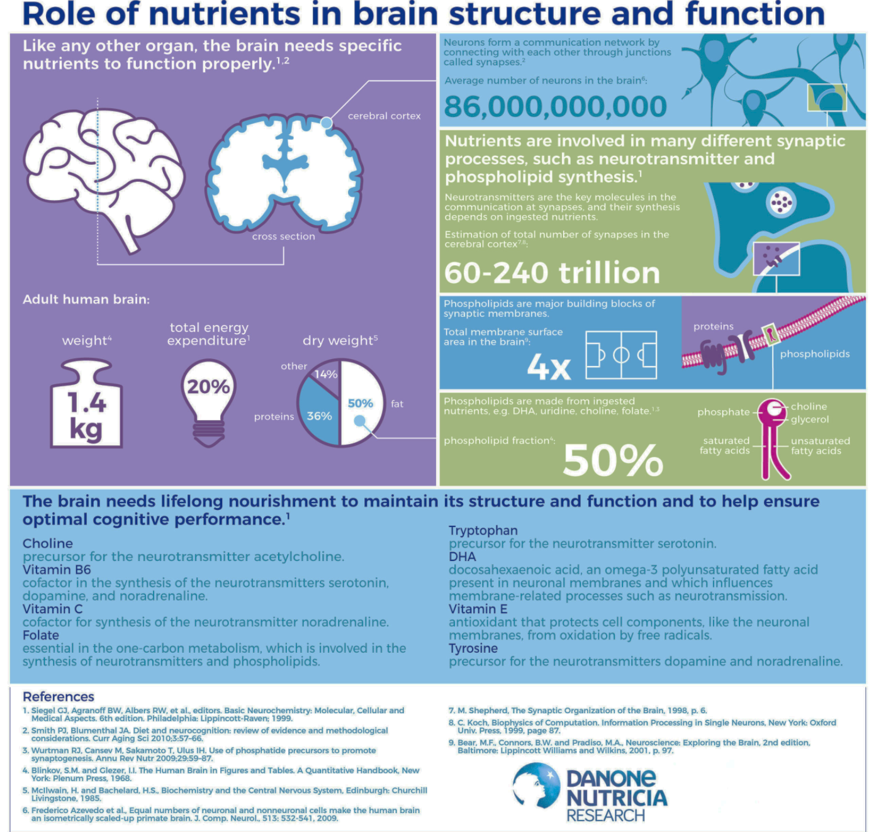
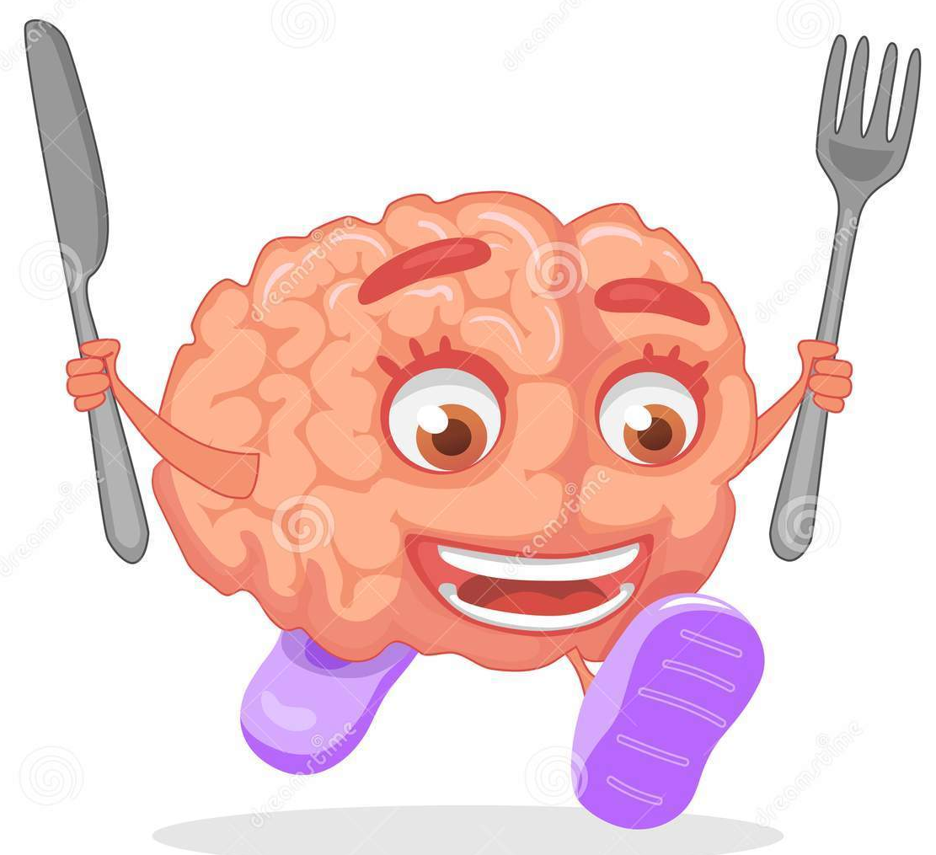
Role of nutrients in brain structure and function
¹Siegel CJ. et al. Basic Neurochemistry: Molecular, Cellular and Medical Aspects. 6th edition. Philadelphia: Lippincott-Raven; 1999.
²Smith PJ and Blumenthal JA. Diet and neurocognition: review of evidence and methodological considerations. Curr Aging Sci 207 0;3:57-66.
³Wurtman RJ, et al. Use of phosphatide precursors to promote synaptogenesis. Annu Rev Nutr 2009;29:59-87.
⁴Blinkov, S.M. and Glezer. I.I. The Human Brain in Figures and Tables. A Quantitative Handbook, New York: Plenum Press. 1968.
⁵Mcllwain, H. and Bachelard, H.S. Biochemistry and the Central Nervous System, Edinburgh: Churchill
Image source: https://www.nutriciaresearch.com
https://dreamstime.com

Slide 7
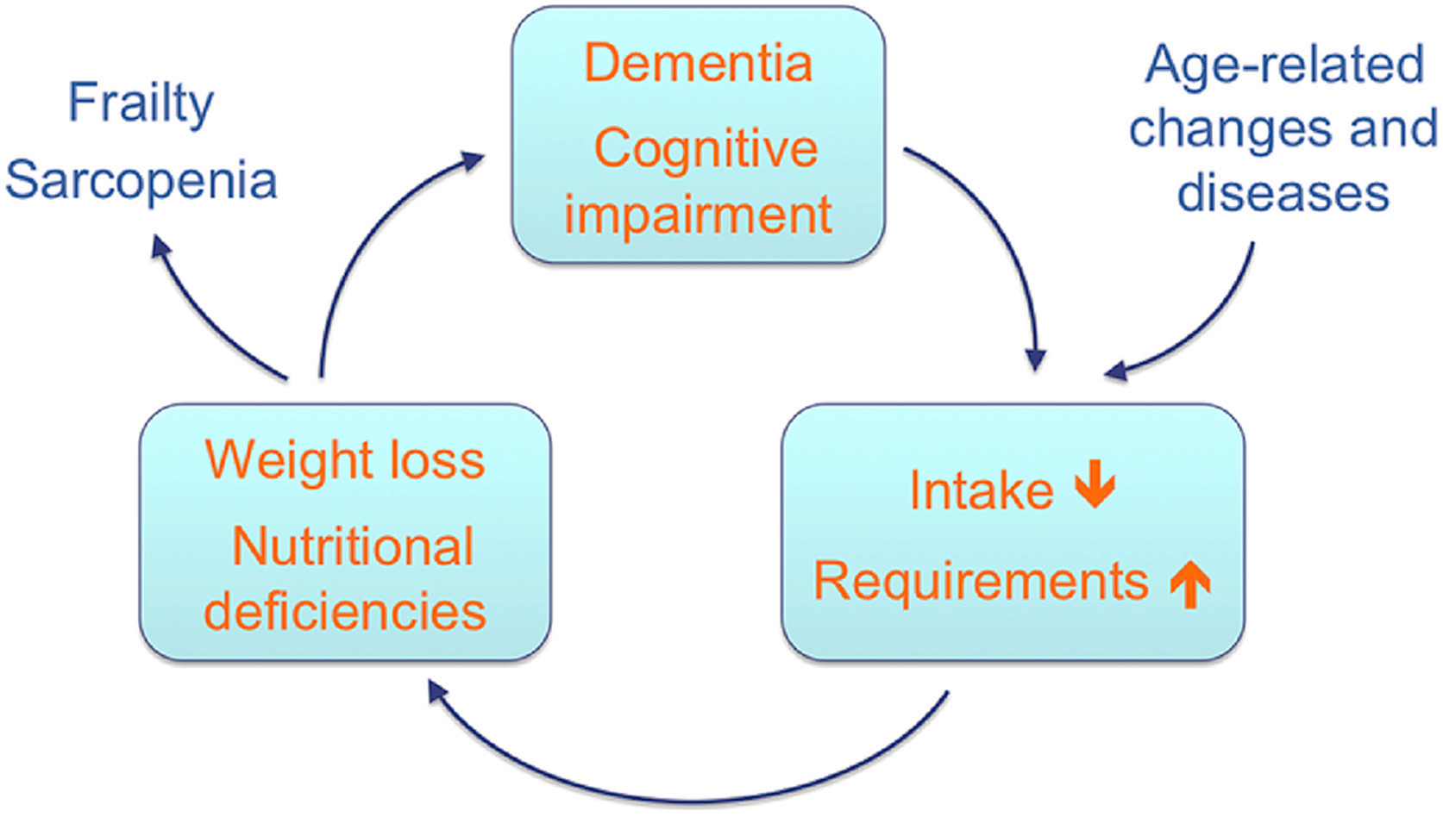
Role of nutrients in brain structure and function
Energy status and brain health
Brain health¹
Vicious circle of malnutrition and dementia
“a state of well-being in which the person can realize their potential, cope with normal stresses of life, work productively and fruitfully and contribute to the community.”
Energy status = critical element of brain health and well- being
energy intake
physical activity
energy metabolism
Suboptimal energy status (undernutrition and overnutrition) is linked with mental and neurological disorders (depression, schizophrenia, dementia, Alzheimer’s disease)²
¹https://www.who.int/features/factfiles/mental_health/en/
²ESPEN guidelines on nutrition in dementia, Clinical Nutrition, 2015
Notes:
Brain health has been defined as, “a state of well-being in
which the person can realize their potential, cope with
normal stresses of life, work productively and fruitfully and
contribute to the community.” In addition to cultural, economic,
social, and environmental factors, energy status has
been identified as holding a critical role in brain health and
well-being. The term energy status mentioned here includes
energy intake, physical activity, and energy metabolism.
Considerable evidence links physical activity and optimal
energy intake with improved mood and cognitive function,
while both underweight and obesity are associated with
impaired cognitive performance. Suboptimal energy status,
including undernutrition and overnutrition, is linked with
mental and neurological disorders such as depression,
schizophrenia, dementia, and Alzheimer’s disease (AD).

Slide 8
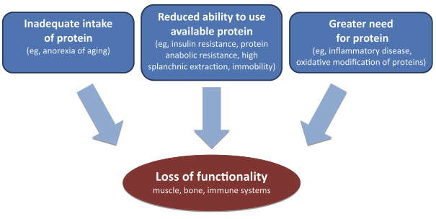
Role of nutrients in brain structure and function
Energy status and brain health
Dietary intake to prevent malnutrition in older populations^{1,2}
At least 1.0 to 1.2 g/kg body weight/day
in case of present acute or chronic disease 1.2 - 1.5 g/kg body weight /d
severe illness or injury or with marked malnutrition: 2.0 g/kg body weight /d
PROT-AGE Study Group. J Am Med Dir Assoc. 2013
Older people with severe kidney disease are an exception to the high-protein rule
¹ESPEN guidelines on nutrition in dementia, Clinical Nutrition, 2015
²PROT-AGE Study Group. J Am Med Dir Assoc. 2013
Notes:
Brain health has been defined as, “a state of well-being in
which the person can realize their potential, cope with
normal stresses of life, work productively and fruitfully and
contribute to the community.” In addition to cultural, economic,
social, and environmental factors, energy status has
been identified as holding a critical role in brain health and
well-being. The term energy status mentioned here includes
energy intake, physical activity, and energy metabolism.
Considerable evidence links physical activity and optimal
energy intake with improved mood and cognitive function,
while both underweight and obesity are associated with
impaired cognitive performance. Suboptimal energy status,
including undernutrition and overnutrition, is linked with
mental and neurological disorders such as depression,
schizophrenia, dementia, and Alzheimer’s disease (AD).

Slide 9
Nutrients related to cognitive function
The brain needs lifelong nourishment to maintain its structure and function and to help ensure optimal cognitive performance
B vitamins | Major Dietary sources
B6 | Grains (wholegrain corn or maize, brown rice, sorghum, quinoa, and wheat germ), pulses, nuts and seeds, meat, liver and meat products, and fish
B12 | Animal products (dairy products, eggs, meats, fish, and liver), foods that contain yeast or have been exposed to microbial fermentation (eg, beer), and fortified foods ( eg, ready-to-eat cereals)
Folate | Dark-green leafy vegetables, legumes, oranges and grapefruit, peanuts and almonds, offal (liver and kidney), and baker's yeast
Nikolaos Scarmeas, Costas A Anastasiou, Mary Yannakoulia, Nutrition and prevention of cognitive impairment,The Lancet Neurology, 2018

Slide 10
Nutrients related to cognitive function
The brain needs lifelong nourishment to maintain its structure and function and to help ensure optimal cognitive performance
Antioxidants | Major Dietary sources
Vitamin C | Fruits (berries, citrus fruits, kiwis, lychees, and papayas), vegetables (Brussels sprouts, cauliflowers, cabbages, sweet peppers, and tomatoes), and herbs and spices (parsley, sorrel, and chives)
Vitamin E | Vegetable oils and fat spreads from vegetable oils, nuts and seeds, some fatty fish (eg, sardines, salmon, herring, swordfish, and trout), egg yolk, and wholegrain cereals
Carotenes | Yellow or orange vegetables (sweet potatoes, carrots, and pumpkins), dark leafy vegetables (spinach, broccoli, and endives), and yellow or orange fruits (apricots, peaches, mangoes, and melons)
Flavonoids | Fruits (mainly citrus fruits, bananas, and berries), vegetables (parsley and onions), tea (black and brewed)
Vitamin D | Fish (especially fatty fish) and fish liver, full-fat dairy products (or fortified low-fat ones), egg yolk, meat and meat products, and offal (particularly liver)
n-3 fatty acids | Fish (for eicosapentaenoic acid and docosahexaenoic acid) and some vegetable oils and nuts (eg, linseeds, rapeseed oil, and walnuts for alpha-linolenic acid)
Nikolaos Scarmeas, Costas A Anastasiou, Mary Yannakoulia, Nutrition and prevention of cognitive impairment,The Lancet Neurology, 2018
Notes:
Lahko pustimo samo “bold”-ovani tekst, ker pol imamo dodatni slajd z antioksidanti

Slide 11
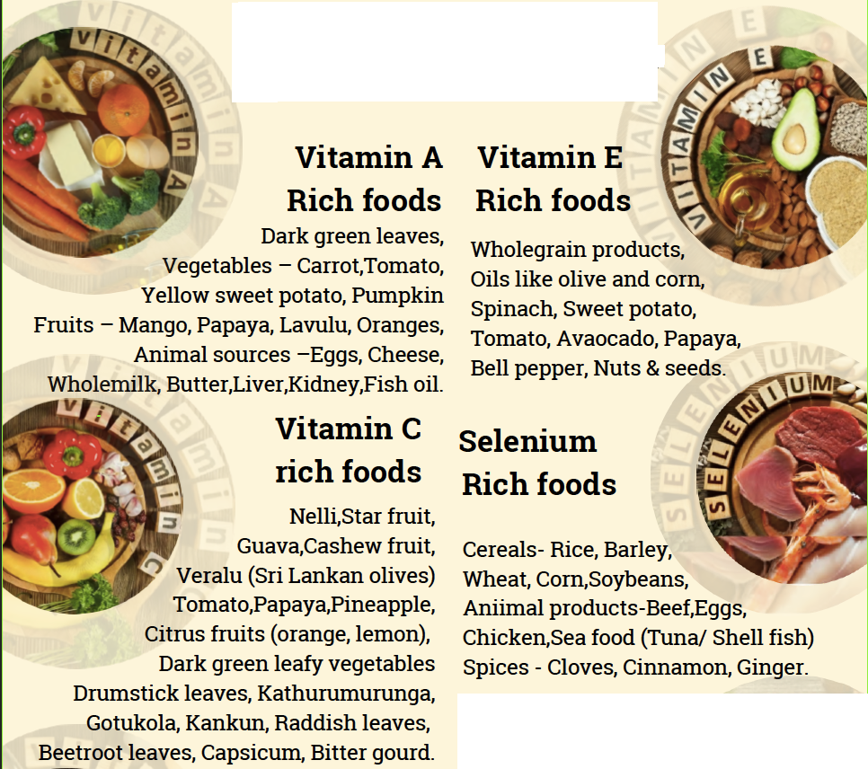
Foods with antioxidant activity
Sri Lanka Medical Nutrition Association
https://slmna.lk

Slide 12
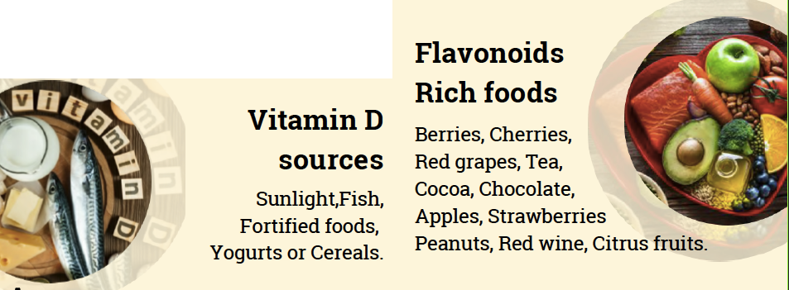
Foods with antioxidant activity
Sri Lanka Medical Nutrition Association
https://slmna.lk

Slide 13
Nutrients related to cognitive function
The brain needs lifelong nourishment to maintain its structure and function and to help ensure optimal cognitive performance
neuroactive substance
chemical agent synthesized by a neuron, which affects the properties of other neurons and muscle cells
many neuroactive compounds have significant roles as neurotransmitters, neuromodulators, and neurohormones
plants and microorganisms can synthetize them
PRESENT IN FOOD
gammaaminobutyric acid (GABA)
serotonin,
melatonin, kynurenine, kynurenic acid
dopamine,
norepinephrine,
histamine,
tryptamine,
tyramine,
beta-phenylethylamine
Siegel CJ. et al. Basic Neurochemistry: Molecular, Cellular and Medical Aspects. 6th edition. Philadelphia: Lippincott-Raven; 1999.

Slide 14
Potential positive and negative health effects of neuroactive compounds
Neuroactive compounds | Health effects
GABA | Reducing psychological and physical fatigue and stress
 | Reducing sleep latency and increasing total nonrapid eye movement sleep time
 | Blood pressure regulation
Melatonin | Protection from oxidative stress
 | Decreasing blood pressure
 | Reducing jet lag and sleep problems
 | Decreasing glucose tolerance and insulin sensitivity
Histamine | Managing hypotension, flushing, headache, abdominal cramps, diarrhea, and vomiting
Tryptamine beta-phenylethylamine | Managing hypertension, headaches, vomiting, and perspiration
L-Dopa | Increasing dopamine concentrations in treatment of Parkinson’s disease
5-Hydroxytryptophan | Antidepressant effect
Siegel CJ. et al. Basic Neurochemistry: Molecular, Cellular and Medical Aspects. 6th edition. Philadelphia: Lippincott-Raven; 1999.

Slide 15
Presence of neuroactive compounds in certain nonfermented foods
Compound |  | (µg/g)
Serotonin | Tomato | 221.9
 | Spinach | 34.4
 | Banana | 11.5
 | Kiwi | 9.5
 | Pecan | 13.6
 | Walnut | 155
 | Chocolate | 6.1
 | Green coffee | 1800-3200
Compound |  | (µg/g)
Dopamine | Orange | 1.96
 | Banana | 6.4
 | Chocolate | 18.6
Compound |  | (µg/g)
Norepinephrine | Banana | 6.07
 | Pineapple | 0.86
 | Fish | 0.1-2.9
Compound |  | (µg/g)
Melatonin | Tart cherry | 21-0.0135
 | Pistachio | 226-233
 | Wheat | 0.1
 | Cow milk | 0.000024
 | Green coffee | 0.00004
Yılmaz C, Food Res Int 2020

Slide 16
Presence of neuroactive compounds in certain nonfermented foods
Compound |  | (µg/g)
GABA | Sesame | 90.7
 | Wheat germ | 1000
 | Yellow soybean | 120
 | Black soybean | 370
 | Mung bean | 132
 | Wheat bran | 200
 | Spinach | 42.7
 | White tea | 240-2070
 | Oolong tea | 90-970
 | Chocolate | 111-325
Compound |  | (µg/g)
Histamine | Spinach | 27.2
 | Green coffee | 212-793
 | Fish | 0.1-41.1
 | Salami | 8.54
Tryptamine | Tomato | 147.1
 | Strawberry | 57.0
 | Paprika | 6.8
 | Spinach | 6.5
b-phenylethylamine | Chocolate | 2.67
 | Fish | 0.2-2.4
 | Salami | 3.2
Yılmaz C, Food Res Int 2020

Slide 17
Nutritional needs in NDD
There is a growing evidence that diet plays an important role in the pathogenesis of neurodegenerative diseases*
There are many methodological problems in investigating the relationship between diet and neurodegeneration
long preclinical period and very slow evolution - prospective studies are very complex to design
very difficult to establish causality in epidemiological studies since the disease itself can vary both nutritional requirements and dietary habits even in the preclinical period
difficulty of measuring nutrients in a comprehensive and reliable form retrospectively
*ESPEN. Nutrition in the Prevention of Neurological Diseases. 2015

Slide 18
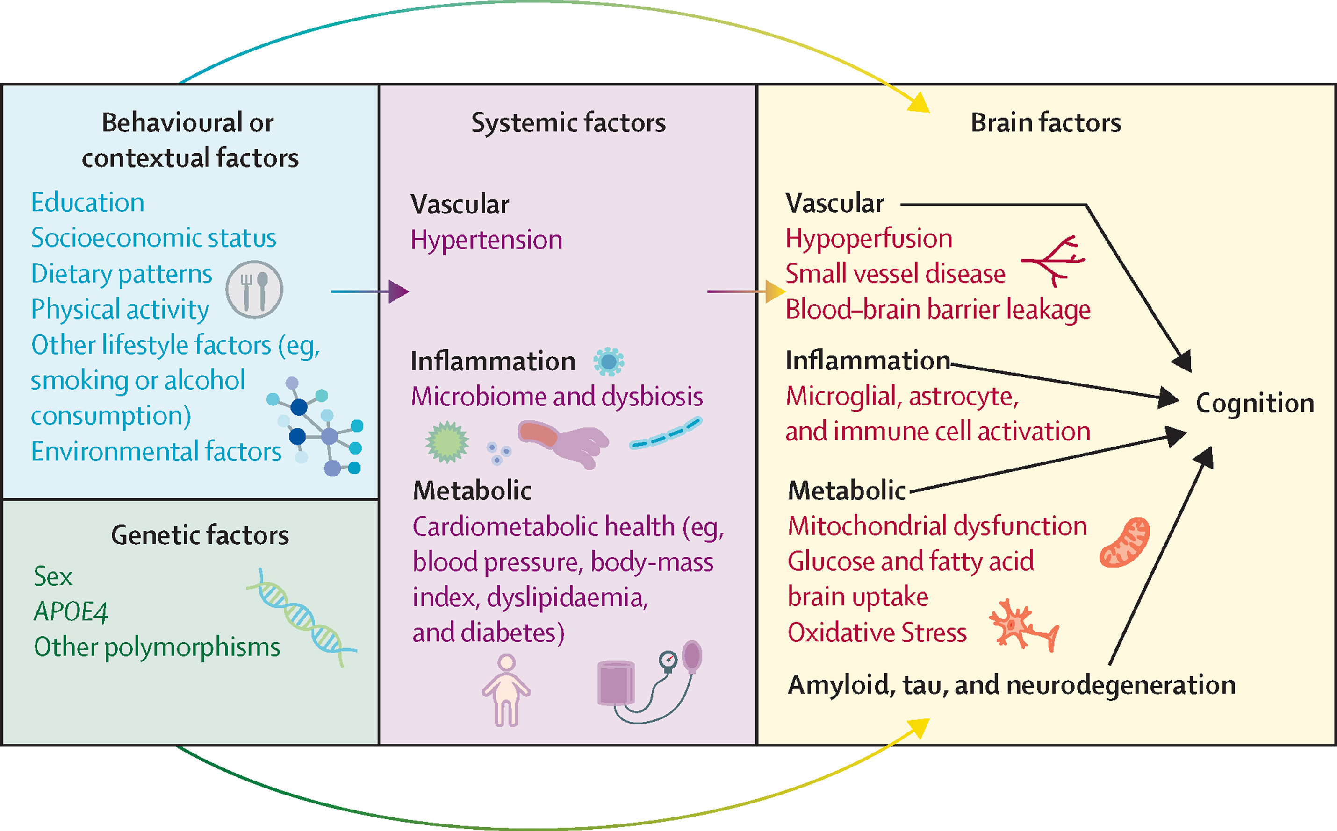
Biological pathways mediating the relationship of the diet with cognition
Hussein NY, et al. Nutrition state of science and dementia prevention: recommendations of the Nutrition for Dementia Prevention Working Group. The Lancet Healthy Longevity. 2022
Copyright © 2022 The Author(s). Published by Elsevier Ltd.
Notes:
The issue of whether the effects of nutrition on the brain are independent or correlates of other healthy behaviours remains open to debate. The biological pathways mediating the relationship between diet and cognition involve both direct and indirect effects on the brain (figure 1).
The effect of the diet on cognition involves complex interactions that include behavioural, genetic, systemic, and brain factors. The diet can affect the brain directly or indirectly through chronic diseases (dementia risk factors). The blood-brain barrier has pleiotropic functions that include nutrient brain delivery, and a leaky blood-brain barrier in Alzheimer’s disease is associated with brain glucose hypometabolism.
Although important from a public health point of view, interventions of diet since 2010, along with other lifestyle changes,^{5,} ^{6,} ⁷ have not addressed whether the effects are independent or correlates. Previous epidemiological observations examining diet in relation to physical activity has reported independent effects.⁸

Slide 19
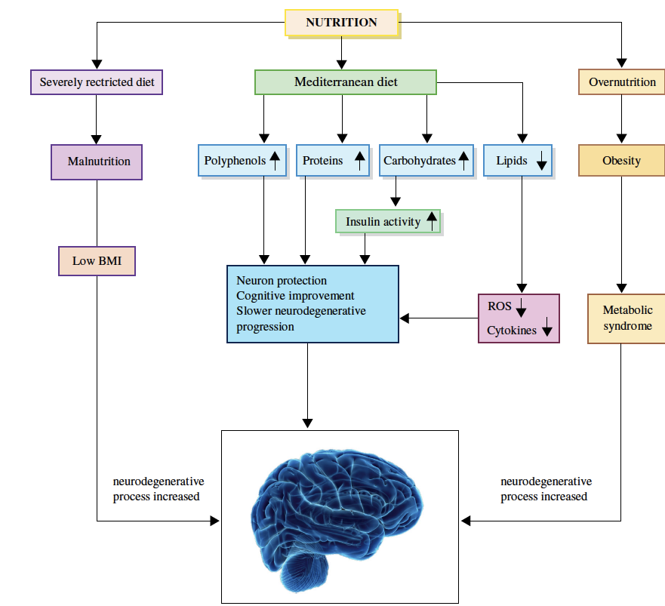
Nutrition = important strategy to prevent the neuronal and cognitive decline in NDD
Bianchi VE, et al. Effect of nutrition on neurodegenerative diseases. A systematic review. Nutr Neurosci. 2021
Notes:
Nutrition can affect brain function and neurodegenerative process profoundly. Low intake of nutrients induces a malnutritional
condition, with low BMI increasing the neurodegenerative process. Differently, overnutrition can generate obesity and metabolic
syndrome, which is also responsible of neurodegeneration due to insulin resistance and inflammatory markers. Mediterranean diet, due
to the controlled caloric intake, polyphenol and flavonoids (fruit, vegetables, olive oil, red wine) plus a regular intake of protein (fish and
meets) and carbohydrates (cereals) reduces the insulin resistance and the pro-inflammatory cytokines level determining neuronal protection
and slowering neuorodegenerative progression.

Slide 20
Nutritional needs in NDD
Bioactive compounds from food with effects on NDD
Food | Compound | Action | Role in NDD
Nuts | Ellagic acids | Inhibit HATs; Activate HDACs | Reverse brain atrophy in AD
Fish oil | ω-3 PUFA | Activates or inhibits DNMTs in different cells | Prevents age-associated cognitive decline
Olive oil | Gallic acid | Inhibits HATs | Potential prevention of AD
Red wine | Resveratrol | Activates HATs; Inhibits DNMTs and HDACs | Reduces the risk of AD
Berries | Gallic and ellagic acids | Inhibit HATs; Activate HDACs and DNMTs | Delay the development of age-related cognitive decline
Tea | Epigallocatechin-3-gallate | Inhibits DNMTs and HATs | Low prevalence of AD
Turmeric | Curcumin | Activates HDACs; Inhibits HATs, DNMTs, and miRNA | Corrects the dysregulation of several pathways in NDD
 |  | Alters the relative abundances of bacterial species | Gut microbiota produces neuroprotective metabolites from curcumin
Cocoa | Epicatechin | Inhibits HATs; Activates HDACs; Increases the presence of “healthy” bacteria | Decreases cerebral inflammation
Pomegranate | Ellagitannins | Inhibits HATs | Protective effects against AD
Morinda officinalis | Oligosaccharides | Not determined | Regulates the synthesis and secretion of neurotransmitters in rats
Algae | Oligomannate | Not determined | Inhibits AD progression in AD mouse models
AD, Alzheimer’s disease; NDD, neurodegenerative disease; HATs, histone acetyltransferases; HDACs, histone deacetylases; HMTs, histone methyltransferases; miRNA, microRNA.
Milošević M, et al. Memorable Food: Fighting Age-Related Neurodegeneration by Precision Nutrition. Front Nutr. 2021 doi: 10.3389/fnut.2021.688086.

Slide 21
Nutritional needs in NDD
Effect of nutritional supplements and nutritional education on neurodegenerative diseases.
Patients | Supplements | Duration | Clinical outcomes
60 PD | selenium (200 mug/day) plus probiotic (Lactobacillus acidophilus, Bifidobacterium bifidum, and Bifidobacterium longum) | 3 months | Significant reduction in insulin and CRP level and improvement in MDS-UPDRS
60 MS | Probiotic (Lactobacillus acidophilus, Lactobacillus casei, Bifidobacterium bifidum and Lactobacillus fermentum) | 12 weeks | Improvement in EDSS and depression; reduction in insulin and CRP level.
60 AD | 200 ml/day probiotic milk * | 12 weeks | significant improvement in the MMSE, no effect on inflammatory markers
65 frail or pre frail | Protein 30 g/day | 24 weeks | Protein supplementation improved reaction time
78 AD | < 1.2 g/bodyweight of protein | 12 months | Improves nutrition and HRQoL, and may prevent falls among AD people.
53 AD | Lyophilized foods and nutritional advice | 3 months | Positive impact on nutritional status, body weight increased, no improvement in cognitive function.
91 AD | Nutritional supplements | 3 months | A significant increase in weight and fat-free mass, but no changes in cognitive function.
99 AD | Nutritional supplements | 12 months | Nutritional supplements applied to a group of patients with AD living in nursing-homes can reduce morbidity and mortality.
151 AD | Nutritional intervention | 12 months | Nutritional educational program in AD patients could have a positive effect on patients’ weight and cognitive function.
*Lactobacillus acidophilus, Lactobacillus casei, Bifidobacterium bifidum, and Lactobacillus fermentum
MDS-UPDRS=Movement Disorders Society-Unified Parkinson's Disease Rating Scale; EDSS = Expanded disability status scale; MMSE= Mini-mental state examination;
Bianchi VE, et al. Effect of nutrition on neurodegenerative diseases. A systematic review. Nutr Neurosci. 2021

Slide 22
Nutritional needs in NDD
Effect of vitamins supplementation on neurodegenerative diseases
Patients | Age (average) | Vitamin supplementation | duration | Clinical outcomes
24 AD | 75 | Folate, alpha-tocopherol, B12, S-adenosyl methioinine, N-acetyl cysteine, acetyl-L-carnitine | 1 year | Improvement in cognitive performance.
121 AD | 60 | Folic acid (1.25 mg/d) | 6 months | Folic acid is beneficial in patients with AD with a slight improvement in mental test.
201 older with low vit. B12 | 80 | Vitamin B12 1 mg | 11 year | No effects on peripheral nerve and cognitive function.
168 mild cognitive impairment | 70 | High-dose B vitamin supplementation (folic acid, 0.8 mg; vitamin B-6, 20 mg; vitamin B-12, 0.5 mg) | 2 years | Vitamin B treatment is effective on reducing brain atrophy in subjects with high plasma omega-3 fatty acids.
613 mild to moderate AD | 65 | Vitamin E 2 gr/day | 5.2 months | Alpha tocopherol slowed functional decline in mild to moderate AD.
340 AD and mild AD | 75 | 5 mg/d of folate, 25 mg/d of vitamin B(6), 1 mg/d of vitamin B12 | 3.5 years | High-dose B vitamin supplements does not slow cognitive decline in individuals with mild to moderate AD.
616 non-demented | 73 | Vitamin C and/or Vitamin E | 14 years | Vitamins C and/or E did not delay the incidence of dementia or AD.
957.740 healthy | 64 | Vitamin E | 10 years | Regular use of vitamin E supplements was associated with a lower risk of dying of ALS.
Hcy = homocisteine
Bianchi VE, et al. Effect of nutrition on neurodegenerative diseases. A systematic review. Nutr Neurosci. 2021
Notes:
Thirteen studies investigated the effect of vitamins supplementation on cognitive performance and dementia [51,86,116,119–128] and summarized in Table 4. Most of the studies showed no effect of vitamins and mineral supplementation on cognitive function and AD progression. A few found that a high-dose of B vitamin supplementation was beneficial in patients with cognitive dysfunction [52,116,123,126,128]. Ascherio et al. [128] in a large population study found that vitamin E supplementation lowered the risk of ALS, but not among the user of other vitamins. A recent meta-analysis confirmed that vitamin E seems to have also some beneficial effect in preventing AD [129]. However, other studies did not find any positive impact mediated by vitamins supplementation on cognitive function [51,119,122,124,125].
The efficacy of vitamins supplementation remains to be demonstrated, though they can have some positive influence on the progression of cognitive impairment and AD, their impact seems related to other metabolic condition.
Although in patients with AD, a low plasma level of vitamin C was found [131], but the beneficial effect of vitamin C administration in the prevention and treatment of AD is still lacking
Folic acid in patients with AD caused a reduction of inflammatory markers (IL-6, TNF-α) and a slight cognitive improvement

Slide 23
Nutritional needs in NDD
Effect of EPA and DHA supplementation on cognitive impairment
Patients | Age | Supplementation | Duration | Clinical outcomes
99 elderly, CI and MCI | 86.9 | DHA 250 mg, EPA 40 mg, vitamin E 5 mg, phosphatidylserine 15 mg, tryptophan 95 mg, vitamin B 12 5 mikrog, folate 250 mikrog and ginkgo biloba 60 mg | 1 year | No improvement in the global cognitive function in elderly people without CI or with MCI.
1680 Cognitive normal | 70 | 800 mg docosahexaenoic acid and 225 mg eicosapentaenoic acid | 3 years | No significant effects of polyunsaturated fatty acids on cognitive decline.
92 cognitive healthy | 61.7 | n-3 PUFA (1.9 gr/day) | 3 months | No improvement of depressive and cognitive symptoms.
240 Mild cognitive impairment | 65 | DHA 2 g/day | 1 year | Significantly improvement in cognitive function and slow the progression of hippocampal atrophy.
44 cognitive healthy | 59.6 | n-3 PUFA 2.2 gr/day | 6.5 months | Positive effects on memory functions in healthy older adults.
174 AD | 74 | 2.3 g omega-3 FA | 6 months | Significative improvement of cognitive impairment with a dose-response relationship.
3073 risk of mavular degenration. Cognitive healthy | 72.7 | n-3 PUFA 1 gr and/or lutein (10 mg)/zeaxanthin (2 mg). | 5 years | No cognitive improvement
57 cognitive impairment19 AD | 71.1 | EPA mg. 600 +DHA mg. 625/day | 4 months | No significant effect on cognitive impairment and dementia
138 cognitive healthy | 51 | 1.25 gr/day n-3PUFA2.50 gr/day n-3 PUFAplacebo | 4 months | Attenuation of loneliness-related verbal episodic memory declines over time.
65 cognitive healthy | 63.9 | n-3 PUFA (1320 mg EPA + 880 mg DHA)placebo | 6.5 months | Improvement of cognitive performance, structural neuroimaging, vascular markers.
199 normal or moderate cognition impairment | >65 | 180 mg of DHA + 120 mg. of EPA | 6 months | No cognitive improvement.
2911 CD, cognitive healthy | 60-80 | EPA-DHA, 2 g/d | 40 months | No effect of dietary doses of n-3 fatty acids on global cognitive decline.
485 healthy | ≥55 | 900 mg/d of DHA | 6 months | Improved learning and memory function with DHA.
302 cognitive healthy | 70 | 1,800 mg/d EPA-DHA, 400 mg/d EPA-DHA, | 6.5 months | No effect of EPA and DHA supplementation on cognitive performance.
204 AD | 74 | DHA 1.7 g/day EPA 0.6 g/day | 6 months | No effect on the delay of cognitive decline.
The administration of polyunsaturated fatty acids, either alone or in combination, had no significant effects on cognitive decline
PA = eicosapentaenoic acid; DHA = docosahexaenoic acid; CI = cognitive impairment; MCI = mild cognitive impairment; CD = coronary disease;
Bianchi VE, et al. Effect of nutrition on neurodegenerative diseases. A systematic review. Nutr Neurosci. 2021
Notes:
Predlagam da to pustimo v enem slajdu da se pokaže število studij ki so raziskale ker je zakljucek da EPA in DHA nimajo pozitiven učinek oz. ni dokazov za uporabo v NDD

Slide 24
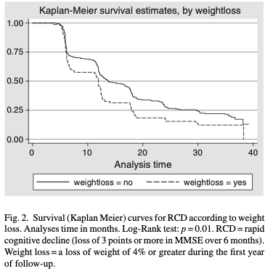
Malnutrition and dementia
Older patients with dementia
Weight loss^{1,2,3}
disease severity
BMI^{4,5}
In patients with very mild Alzheimer's disease a poorer nutritional status was found as predictor of disease progression after 1 year
Malnutition increases caregiver burden, which in turn may aggravate nutritional problems.
¹Albanese E. Alzheimers Dement 2013
²White H. J Am Geriatr Soc 1998
³Orsitto G. Clin Nutr 2009
⁴ Coin A, et al. J Nutr Health Aging 2012
⁵Wirth R, et al. J Am Med Dir Assoc 2012
Soto ME, Secher M, Gillette-Guyonnet S, Abellan van Kan G, Andrieu S, Nourhashemi F, Rolland Y, Vellas B. Weight loss and rapid cognitive decline in community-dwelling patients with Alzheimer's disease. J Alzheimers Dis. 2012
Volkert D, et al., ESPEN guidelines on nutrition in dementia, Clinical Nutrition (2015), http://dx.doi.org/ 10.1016/j.clnu.2015.09.004
Notes:
hus, in a cohort of 414 community-dwelling ambulatory patients with a diagnosis of probable Alzheimer's disease, weight loss of 4% body weight or more during the first year of follow up was independently predictive for rapid cognitive decline (loss of 3 points or more in MMSE over 6 months) during the following 3 years in a multivariate cox-proportional model (HR 1⁄4 1.5, 95%-CI 1.0e2.2) [58].

Slide 25
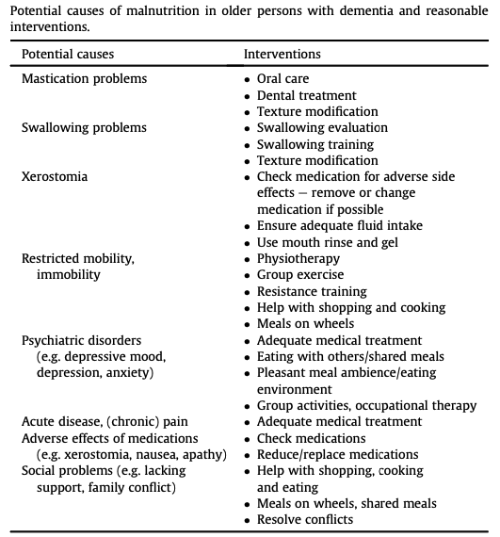
Malnutrition and dementia
Volkert D, et al., ESPEN guidelines on nutrition in dementia, Clinical Nutrition (2015)
Notes:
hus, in a cohort of 414 community-dwelling ambulatory patients with a diagnosis of probable Alzheimer's disease, weight loss of 4% body weight or more during the first year of follow up was independently predictive for rapid cognitive decline (loss of 3 points or more in MMSE over 6 months) during the following 3 years in a multivariate cox-proportional model (HR 1⁄4 1.5, 95%-CI 1.0e2.2) [58].

Slide 26
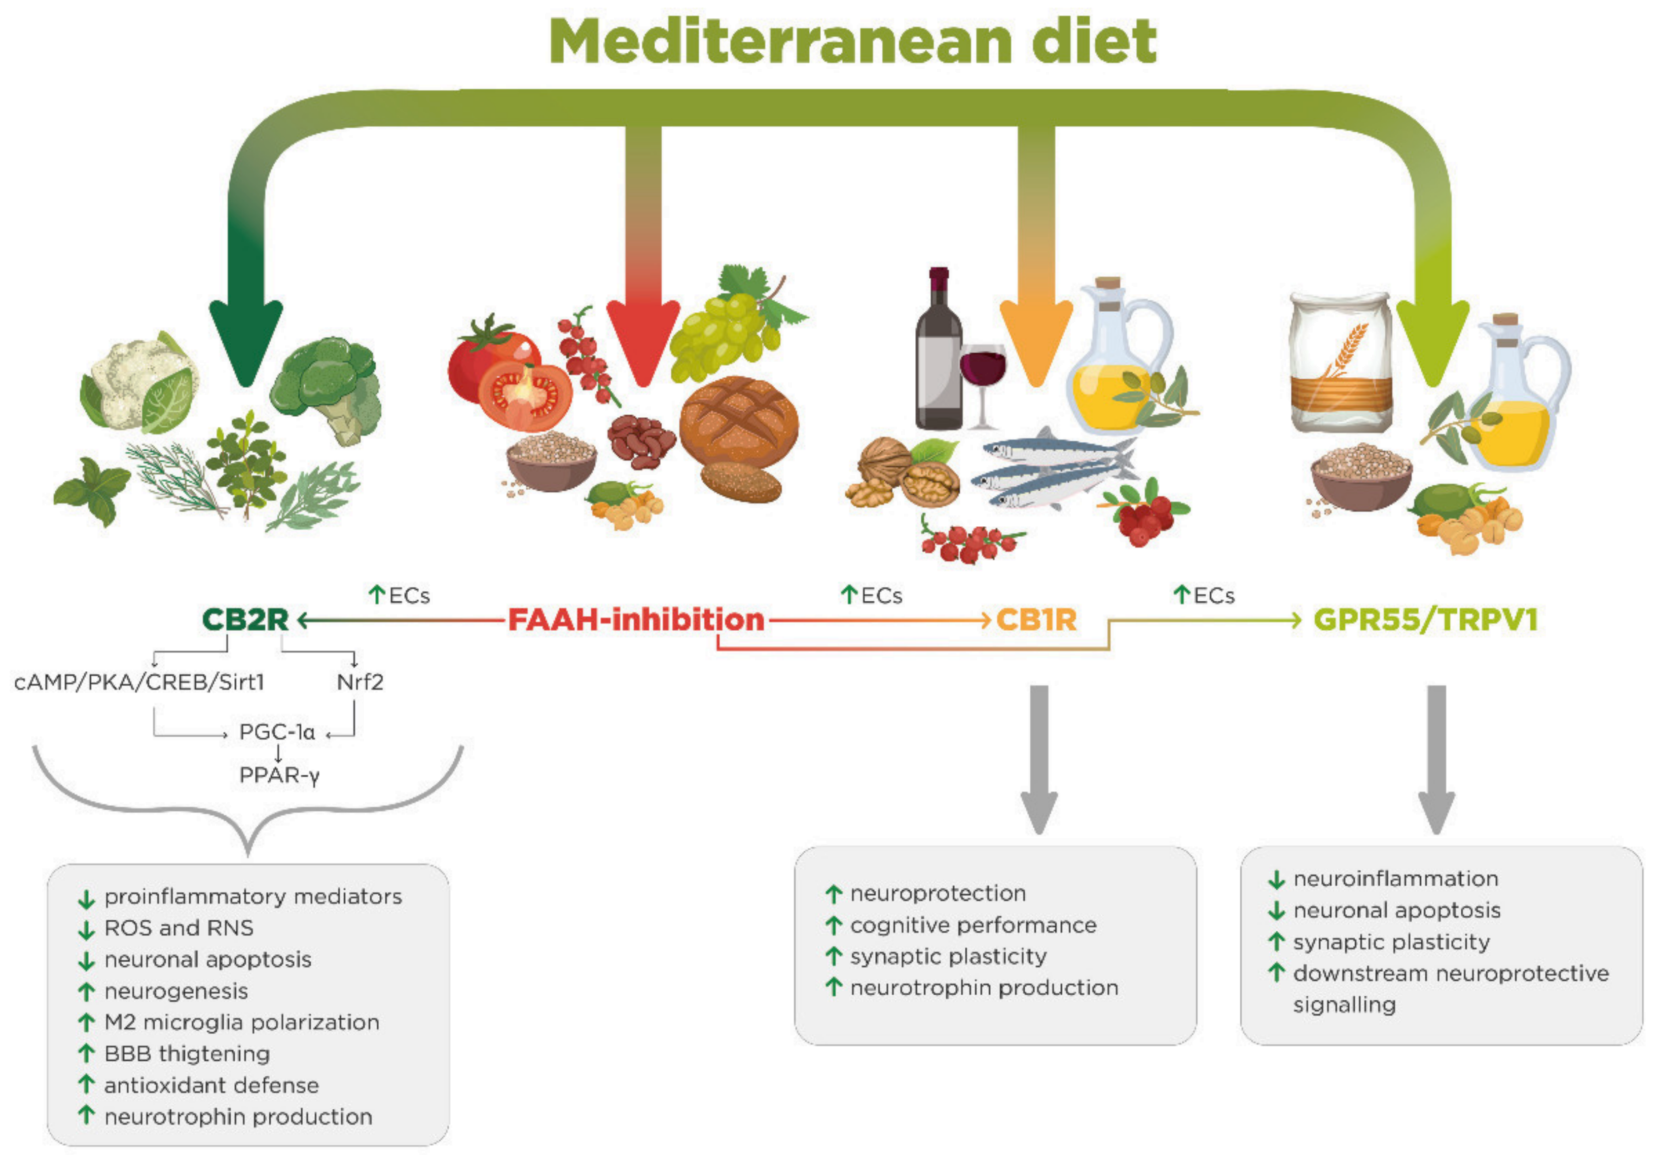
Mediterranean Diet (MD) in Preventing Neurodegenerative Diseases
Mediterranean diet activity on endocannabinoid receptors (CB1R, CB2R, GPR55/TRPV1) and on FAAH inhibition.
The MD reflects the dietary habits common among populations bordering the Mediterranean Sea
relatively high intake
fruits
vegetables
monounsaturated fat
fish
whole grains
legumes and nuts
moderate
alcohol consumption
low intake
red meat
dairy
saturated fat
refined grains
No prescribed cutpoints or recommended levels of the MD components.
CBR: cannabinoid receptor (1 and 2)
FAAH Inhibitors: Flavonoids
Armeli F, et al. Mediterranean Diet and Neurodegenerative Diseases: The Neglected Role of Nutrition in the Modulation of the Endocannabinoid System. Biomolecules. 2021

Slide 27
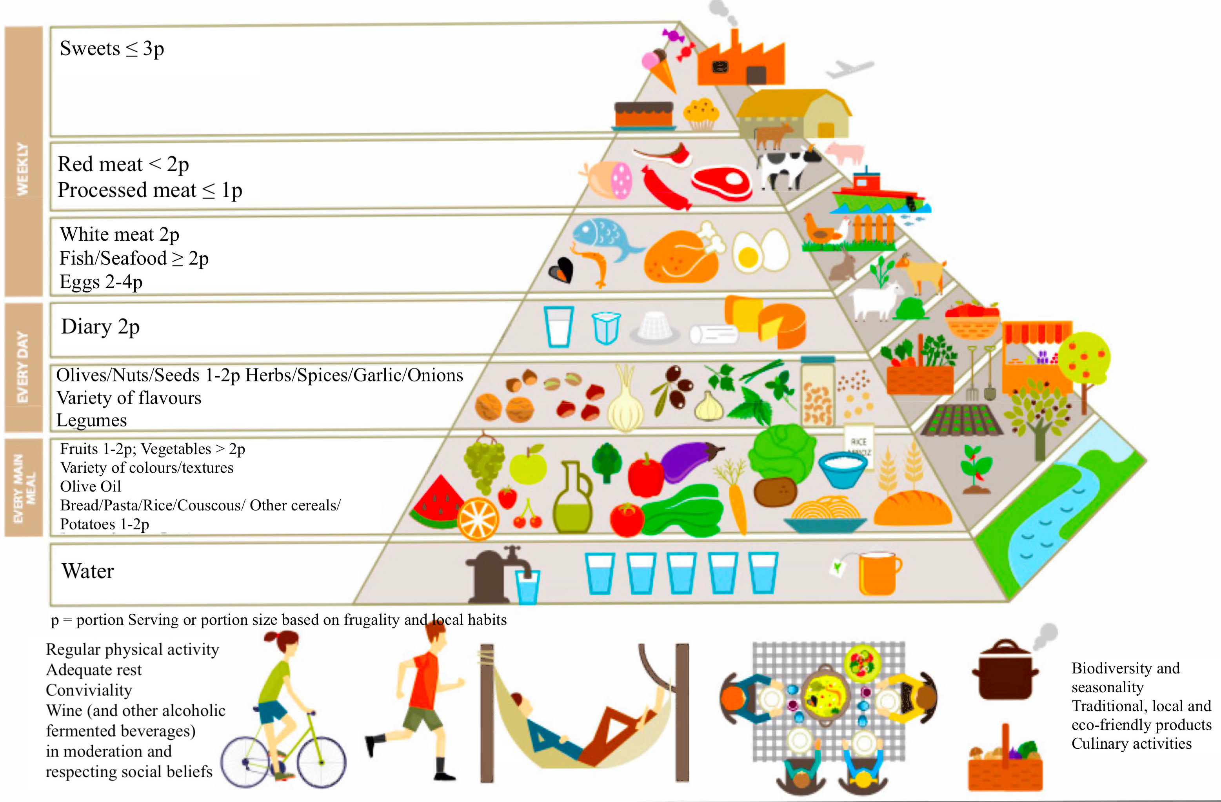
Pyramid for a Sustainable Mediterranean Diet
Specific foods and nutrients emphasized in the Mediterranean diet, such as olive oil, nuts, omega-3s, and carotenoids, have shown promise in improving AD patient outcomes
(Nolan JM. J Alzheimers Dis. 2018; Power R. J Alzheimers Dis. 2018)
Armeli F, et al. Mediterranean Diet and Neurodegenerative Diseases: The Neglected Role of Nutrition in the Modulation of the Endocannabinoid System. Biomolecules. 2021

Slide 28
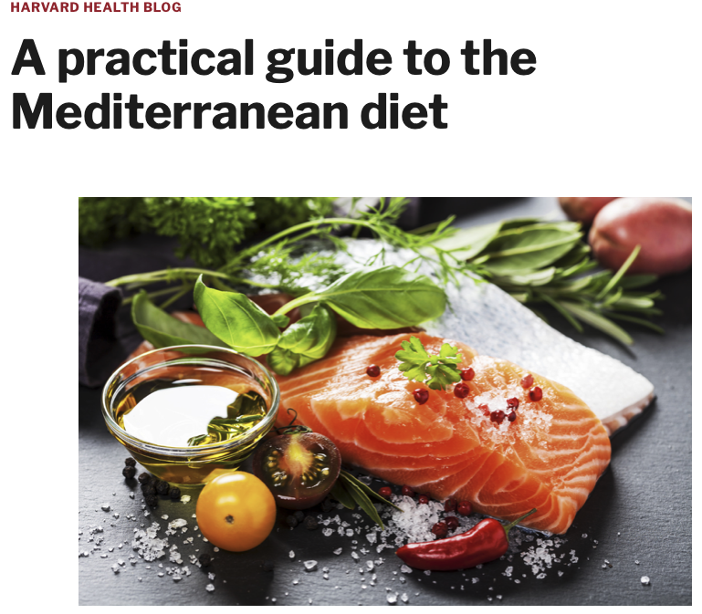
https://www.health.harvard.edu/blog/a-practical-guide-to-the-mediterranean-diet-2019032116194

Slide 29
The MIND diet
Mediterranean diet in combination with the Dietary Approaches to Stop Hypertension (DASH) diet
suggested to prevent neurodegeneration
(Gratwicke J, et al. Brain.2015; Bohnen NI, et al. Arch Neurol.2003)
associated with less cognitive decline and lowered risk for Alzheimer's dementia (van den Brink AC. Adv Nutr. 2019)
The effect of the MIND diet on cognitive function is now being tested in a randomised trial (Liu X,et al.Contemp Clin Trials. 2021) and as a component of US Protect Brain Health through Lifestyle Intervention to Reduce Risk (known as POINTER) study (Baker LD, et al. Alzheimers Dement. 2020)
Notes:
The MIND diet features the consumption of vegetables (particularly, green leafy vegetables), berries, extra-virgin olive oil, nuts, whole grains, and low-fat sources of protein. Previous observational studies showed that greater adherence to the MIND diet was related to a lower risk of AD [31,32] and slower cognitive decline [33]. However, evidence from a large-scale, randomized controlled trial to test the causal relationship between the MIND diet and protection from cognitive decline is lacking. This paper describes the MIND intervention trial, which is designed to test the effects of a 3-year MIND dietary counseling intervention (plus mild caloric restriction for weight loss) versus a usual diet (plus mild caloric restriction for weight loss) on cognitive decline among cognitively unimpaired and overweight older adults with suboptimal diets.

Slide 30
GLUTATHIONE (GSH)
Other clinically important supplements
GSH is the main antioxidant in the CNS and it has a crucial role in maintaining redox balance, particularly in astrocytes and microglia
GSH is essential for mitochondrial survival
GSH level decrease with aging
Crucial role in cellular signalling and antioxidant defences
Most abundant of the endogenous antioxidants
Detoxification of ROS and RNS
Detoxification of electrophiles produced by Xenobiotic
Optimal functioning of the immune system
CNS antioxidant, neuromodulator, neurotransmitter
Depletion/dysfunction plays an important role during the onset and progression of neuropsychiatric and
neurodegenerative diseases.
Neuroimmune disorders:
Depression
Parkinson's
ME/CFS
Fibromyalgia
PMID: 24752591 PMID: 26233704 PMID: 24145751PMID: 11111154

Slide 31
GSH Supplementation
Oral Supplementation
Intravenous Supplementation
Generally poorly absorbed and poor bioavailability
Oral GSH at 250 mg per day x 6 months
30-35% increase in erythrocytes, plasma and lymphocytes
260% increase in buccal cells
Oral GSH at 1000 mg a day > 2X increase in natural killer cytotoxicity
"prevents renal oxidative stress after coronary angiography " (Saitoh et al., 2011).
Randomized, double-blind, pilot evaluation of intravenous glutathione in Parkinson's disease - possibility of a mild symptomatic effect (Hauser et al., 2009).
PMID: 24752591 PMID: 26233704 PMID: 2414575 I PMID: 1111154

Slide 32
GSH Supplementation
Sublingual Supplementation
Liposomal Supplementation
A 2015 study demonstrate the significant superiority of a new sublingual form of GSH over the oral form, both in terms of bioavailability and positive effects on oxidative stress.
" restores Th1 cytokine response to Mycobacterium tuberculosis infection in HIV-infected individuals" (Ly et al., 2015).
PMID: 24752591 PMID: 26233704 PMID: 2414575 I PMID: 1111154

Slide 33
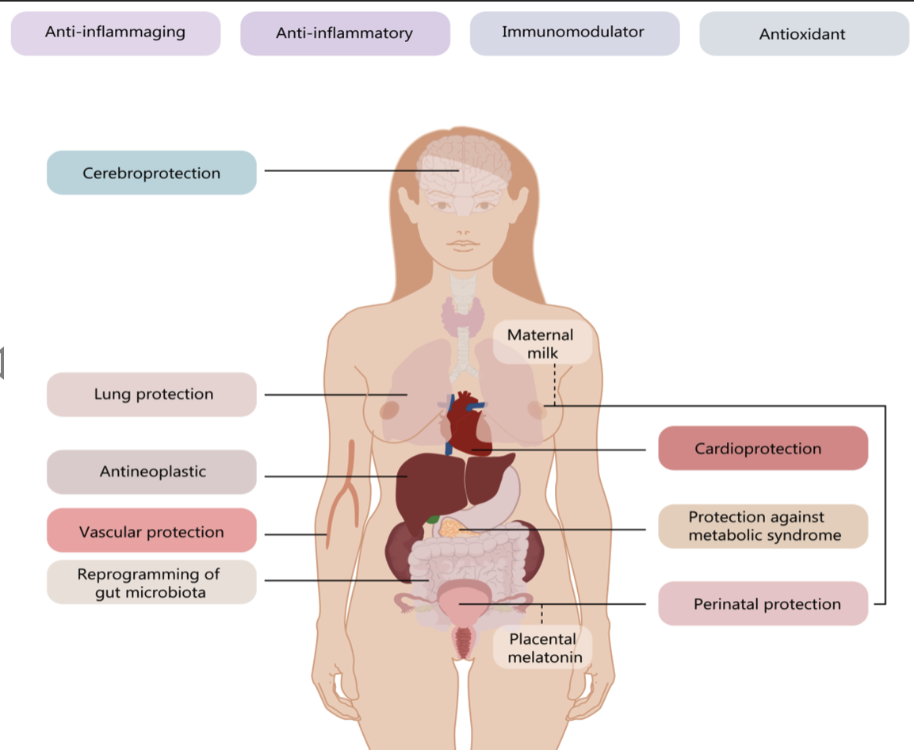
Other clinically important supplements
Efficiently protects neuronal cells from A𝝱-­mediated toxicity via antioxidant and anti-amyloid properties
It is suggested that melatonin attenuates the release of pro-inflammatory cytokines from microglia and the development of neuropathic pain through the inhibition of Ca²⁺ influx-mediated microglial activation
Melatonin
reduction of neuroinflammatory factors
neuroprotection
Dosage: 1 mg– 100, usually 3-5 mg
The widespread effects of melatonin at organ and system level
Chitimus DM, et al.Melatonin's Impact on Antioxidative and Anti-Inflammatory Reprogramming in Homeostasis and Disease. Biomolecules. 2020
PMC3593297. PMID 25012620 PMC3354573 PMC4 I I 958 I PMC3949259, PMID: 25052847

Slide 34
Other clinically important supplements
Ubiquinone (CoQ10)
Essential for mitochondrial respiratory chain efficiency; suggested that levels can be useful as biological marker of mitochondrial function
Deficiency predisposes to apoptosis
Anti-inflammatory
Neuro-protective
Regulates gene expression
CoQ10 Deficiencies
Autosomal recessive mutations
Aging related oxidative stress
Carcinogenesis processes
Statin treatment
Beta Blockers
TCA
CoQ10 Dosage
300 mg/day, divided in 3 doses (Fibromyalgia patients)
•300 mg - 2,400 mg /day in Parkinson's dx
Yang X, et al. Neuroprotection of Coenzyme Q10 in Neurodegenerative Diseases. Curr Top Med Chem. 2016.

Slide 35
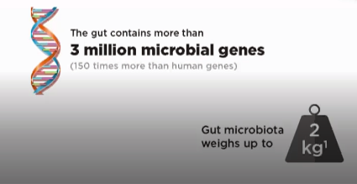
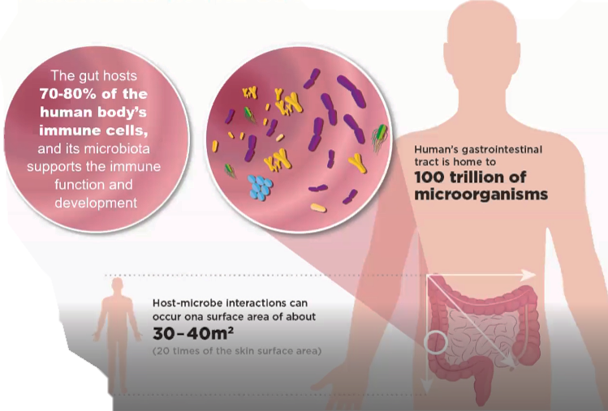
What is microbiota?
Gut microbiome
and gut microbiota
describe either the
collective genomes of
the microorganisms
that resides in the gut,
or the microorganisms
themselves
Microbiota are all microorganisms that normally inhabit an environment, such as the soil or a body of water, i.e.gut microbiota: bacteries, archaebacteria, viruses in single-cell Eukaryota.
A microbiome is the genomic composition of the entire microbiota in the host.
It occurs at any contact with the external environment: all mucous membranes, skin surface, intestines. The microbiome is even labeled a supporting organ because it plays so many key roles in promoting the smooth daily operations of the human body.
The microbiota is mostly present in the colon and less in the beginning of the digestive tube!
Source: https://www.nutriciaresearch.com

Slide 36
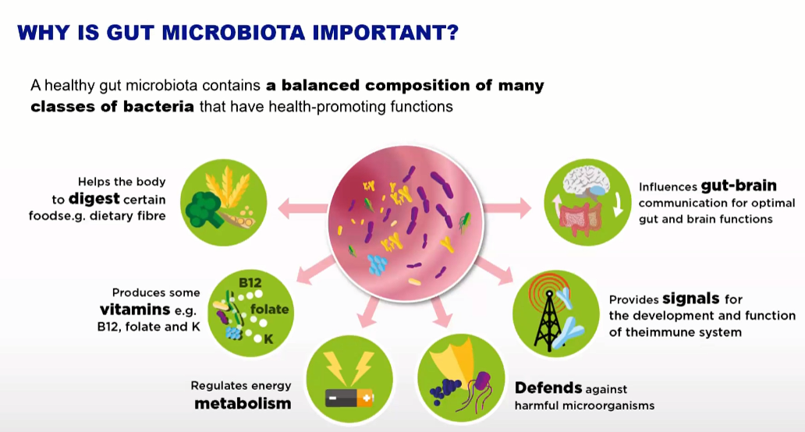
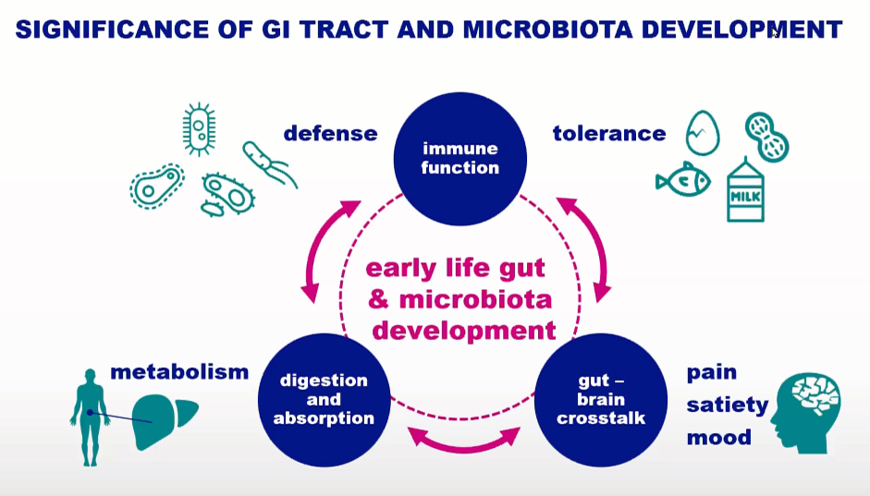
The importance of microbiota
Source: https://www.nutriciaresearch.com

Slide 37
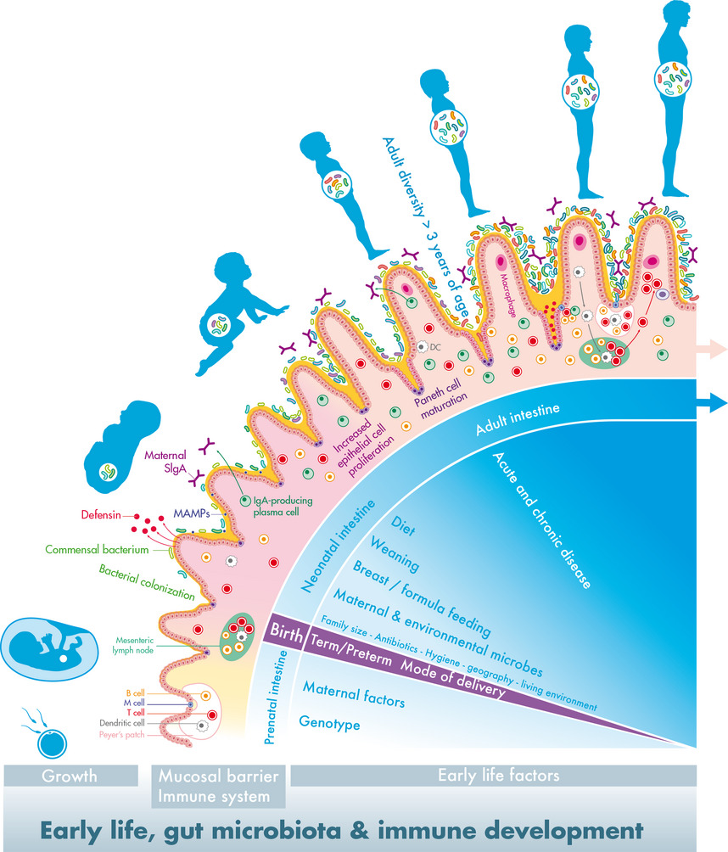
The first thousand days – intestinal microbiology of early life: establishing a symbiosis
Pediatric Allergy Immunology, Volume: 25, Issue: 5, Pages: 428-438, First published: 05 June 2014
Notes:
Early life, gut microbiota and immune development – establishing a symbiosis. The establishment of the intestinal host–microbiota symbiosis is driven by both developmental and environmental signals especially in early life, profoundly influencing health throughout life. The prenatal intestine is thought to be sterile, and development depends most importantly on genotype as well as on maternal factors, including nutrition and health status. The cryptopatches and lymphoid tissues (mesenteric lymph nodes and Peyer's patches) with dendritic, T and B cells develop in preparation of the exposure to the extrauterine world. During birth, infants are inoculated with maternal and environmental microbes, and the type and patterns strongly depend on birth mode and gestational age. The gut microbial development in the neonatal period is influenced by several early‐life factors and especially diet (type, composition and timing) drives the further diversification towards an adult complexity, which is reached around 3 years of age. This postnatal colonization process provides several signals, known as microbe‐associated molecular patterns (MAMPs), affecting the maturation of the immune system and the mucosal barrier, accompanied with increased mucus secretion. These signals also result in the proliferation of intestinal epithelial cells in crypts and the cryptlocated Paneth cells, resulting in their increased depth and the production of antimicrobial peptides (defensins), respectively. Specialized epithelial cells (M cells) reside above Peyer's patches and facilitate direct interaction of the luminal content with the underlying lymphoid cells to stimulate mucosal immunity. SIgA is the most abundant immunoglobulin on mucosal surfaces, and maternal SIgA is provided by human milk during the early postnatal period along with the initiation of the infants own SIgA.
IF THIS IMAGE HAS BEEN PROVIDED BY OR IS OWNED BY A THIRD PARTY, AS INDICATED IN THE CAPTION LINE, THEN FURTHER PERMISSION MAY BE NEEDED BEFORE ANY FURTHER USE. PLEASE CONTACT WILEY'S PERMISSIONS DEPARTMENT ON PERMISSIONS@WILEY.COM OR USE THE RIGHTSLINK SERVICE BY CLICKING ON THE 'REQUEST PERMISSIONS' LINK ACCOMPANYING THIS ARTICLE. WILEY OR AUTHOR OWNED IMAGES MAY BE USED FOR NON-COMMERCIAL PURPOSES, SUBJECT TO PROPER CITATION OF THE ARTICLE, AUTHOR, AND PUBLISHER.

Slide 38
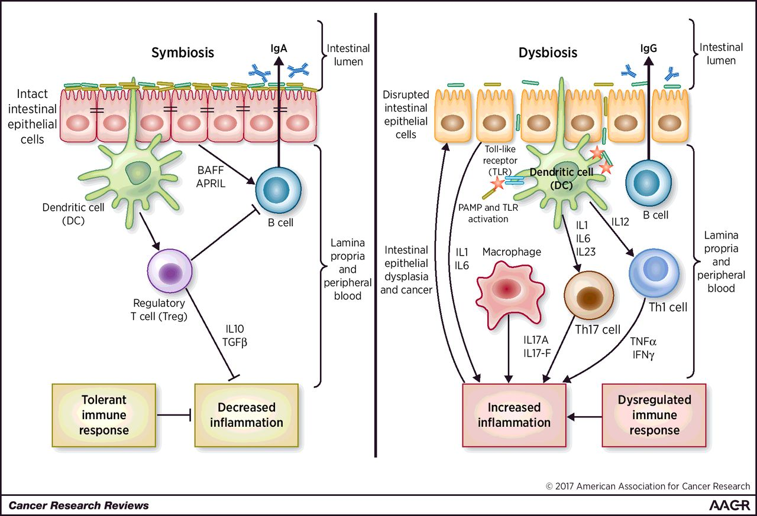

Dysbiosis: Altered immunological status due to pathogen colonization, resulting in excessive inflammation, dysplasia and tumorigenesis
Sunil Thomas et al. Cancer Res 2017;77:1783-1812
©2017 by American Association for Cancer Research
Notes:
Dysbiosis: an immunocompromised state characterized by pathobiont colonization that leads to hyperinflammation, dysplasia, and tumorigenesis. Symbiosis (left): a symbiotic gut microbiota operates under a functional intestinal epithelial cell barrier, with steady-state proportions of mucus, pattern recognition receptors, antimicrobial peptides, and secretory IgA, which in turn contain the microbiota in the intestinal lumen. Under tight control by intestinal epithelial cells, the intestinal immune system within the gut lamina propria becomes largely tolerant to the resident commensals. Signaling cascades that occur downstream of TLRs are used by intestinal epithelial cells to detect microbes through pattern recognition receptors. Upon LPS stimulation of TLRs, the MYD88 protein is recruited, activating the NF-κB pathway, leading to production of antimicrobial proteins and proinflammatory cytokines. In a symbiotic gut, intestinal epithelial cells are desensitized by repeated exposure to LPS or are attenuated by LPS-mediated downregulation of the IL1 receptor–associated kinase 1 (IRAK1), an activator of the NF-κB cascade. Exposure to LPS induces epithelial cells to secrete TGFβ, B-cell–activating factor of the TNF family (BAFF), and a proliferation-inducing ligand (APRIL), all of which promote the development of tolerogenic responses to the microbiota. CD103⁺ DCs support the development of Tregs to secrete IL10 and TGFβ, and together, they stimulate the production of commensal-specific IgA. Dysbiosis (right): increased intestinal exposure of diverse PAMPs, proinflammatory cytokines, apoptotic debris, and toxins leads to microbial dysbiosis and overgrowth of “pathobionts,” transformed symbiotic bacteria now under pathologic conditions. Pathobiont overgrowth leads to the loss of barrier integrity and a breach in the intestinal epithelial cell barrier. Translocation of bacteria and bacterial components triggers the intestinal immune system through TLR activation, resulting in potentially harmful effector T-cell responses set to clear invading bacteria. Ultimately, the secretion of IL1 and IL6 from intestinal epithelial cells fuels a Th1 and Th17 response by DCs and macrophages and leads to higher levels of commensal-specific IgG by B cells.

Slide 39
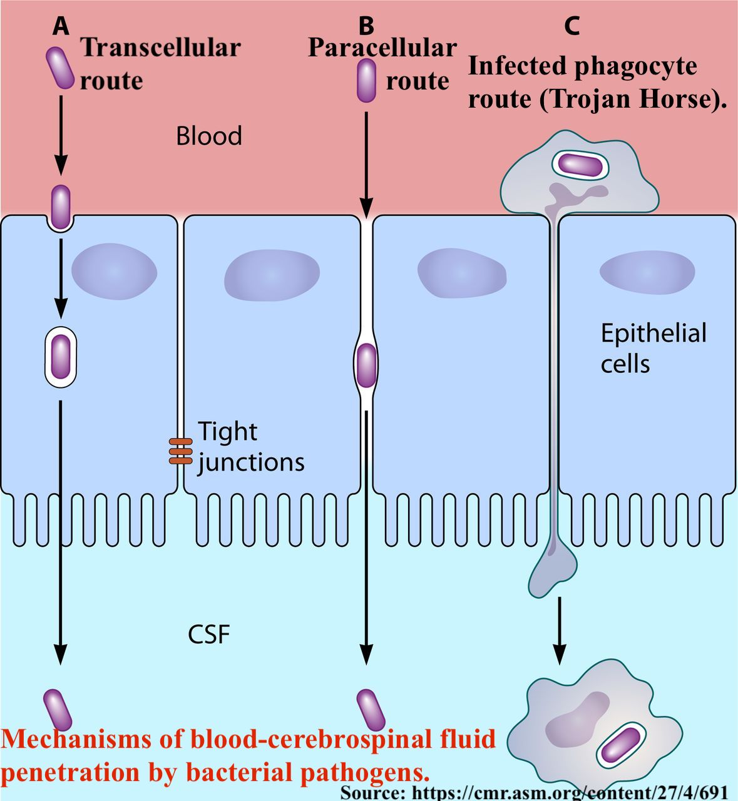
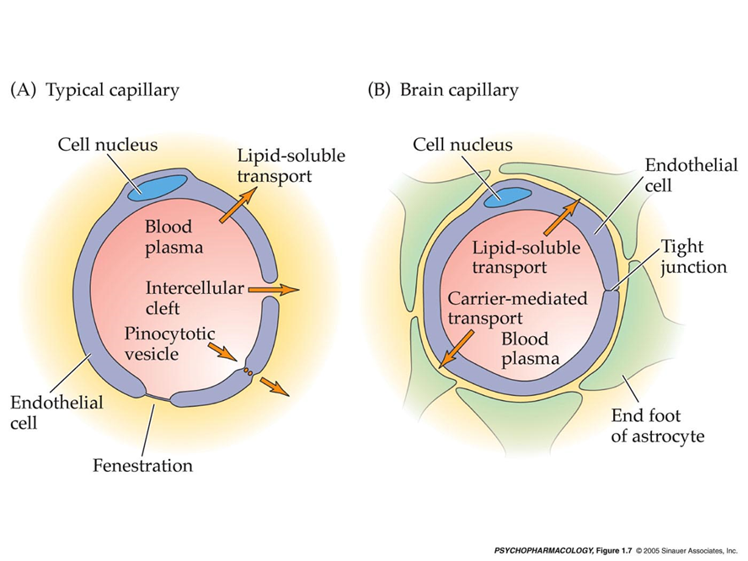
Blood-brain barrier and microbiota
Blood brain barrier -> protects brain against microorganisms, toxins and ionic disbalance
Microbiomic translocation: Bacteria and bacterial products can not enter into the brain, whereas can migrate to other organs
RNA of microorganisms can enter into the brain (CNS) and exists at the interface of blood vessels and interstitial fluid throughout the brain
Notes:
Blood-Brain Barrier (BBB) is a selectively permeable membrane regulates the passage of a multitude of large and small molecules into the microenvironment of the neurons. It achieves this feat by with the aid of multiple cellular transport channels scattered along the membrane

Slide 40
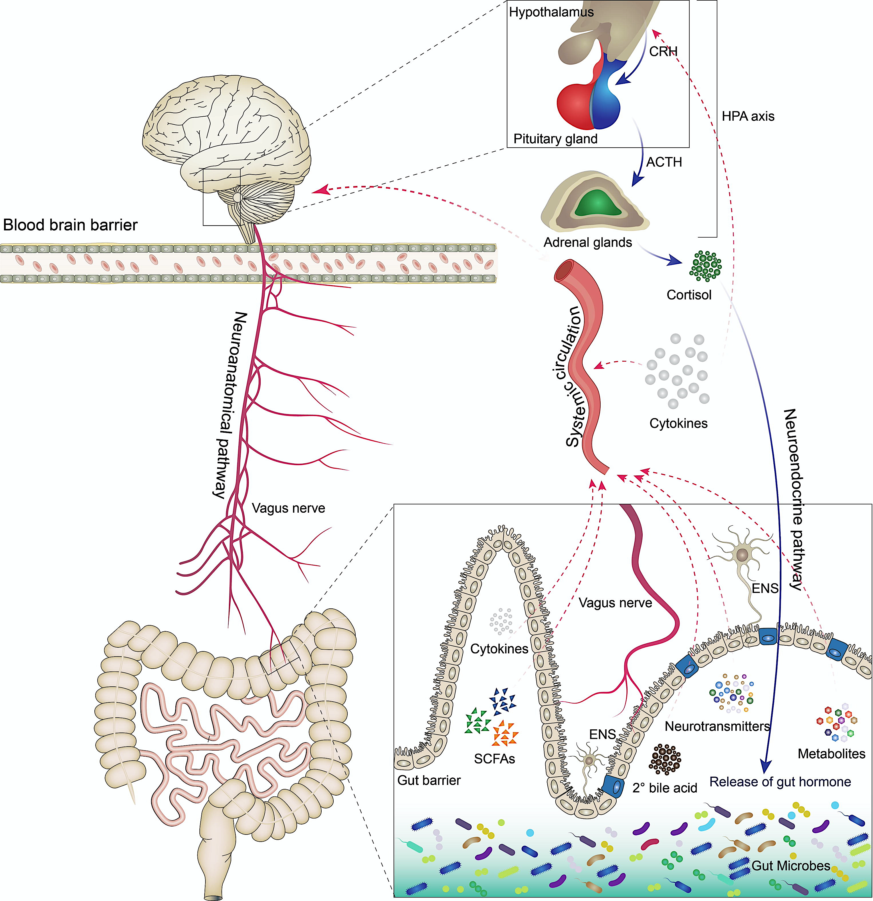
Relationship between the brain and gut microorganisms
„Gut – brain“ axis
Bidirectional communication between CNS and gastrointestinal tract
Autonomic nerve system (enteric nervous systems, vagus nerve) and (GABA, NA, 5-HT, DA, ACh)
Gut immune system (gut – associated lymphatic tissue)
Neuroendocrine system (hypothalamic–pituitary–adrenal (HPA) axis, neuropeptides)
Microbial metabolites (tryptophan metabolites, SCFA)
Notes:
A graphical representation of pathways involved in the bidirectional relationship between the brain and gut microorganisms. The communication routes between the brain and gut are regulated by multiple direct and indirect pathways. Evidence of the pathways presented in this illustration has been derived from several different animal studies. The gut-brain signaling pathways involve neuroanatomical, neuroendocrine, and immune pathways. The neuroanatomical pathway consists of the vagus nerve (afferent and efferent neurons) and the enteric nervous system. The hypothalamus–pituitary–adrenal (HPA) axis is part of the neuroendocrinal pathway. Several different inflammatory cytokines are involved in the immune pathway. In addition, several gut microbiota-derived metabolites, molecules, and neurotransmitters are involved in these pathways. The hypothalamus and pituitary glands modulate cortisol release from the adrenal gland, which regulates inflammatory cytokines and gut hormones. GM directly or indirectly modulate the release of various signaling molecules, short chain fatty acids (SCFAs such as acetate, butyrate, propionate), amino acids (tyramine, tryptophan), and neurotransmitters (γ-aminobutyric acid, dopamine, norepinephrine, serotonin) and convert bile acids into secondary bile acids. Other neuroactive bacterial metabolites that pass from the gut lumen through the gut barrier into the systemic circulation eventually enter the brain through the blood–brain barrier (BBB) to modulate brain function and cognitive behavior. The GM population and these metabolites also assist in maintaining the integrity of the gut barrier and BBB.

Slide 41
How pathogens affects brain?
Production of nerve transmitters, identical to humans!
 | Lactobacillus and Bifidobacterium | Escherichia coli, Bacillus and Saccharomices | Candida Albicans, Streptococcus, Escherichia coli and Enterococcus | Bacillus and Serratia
Biosynthetic metabolites | Gamma-Aminobutyric Acid (GABA) | Noradrenalin | Serotonin | Dopamin
Disease | Alzheimer's disease, depression, Synaptogenesis impairement | Depression and hyperactivity | Depression | Alzheimer's disease, Huntington’s disease, Parkinson's disease
Tivadar, 2019

Slide 42
New insights: how the diet and intestinal microbiome affect the brain
The Alzheimer’s Gut Microbiome Project is combining multiple nutritional trials including the MIND trial¹ the BEAT-AD trial of a modified ketogenic diet, and the US POINTER trial²
Detailed analysis of microbiota composition and function in these studies will be used to derive a comprehensive and mechanistic understanding of diet–microbiome–cognition–brain structure associations.
Scalable electronic-health interventions that are web-based are feasible for people older than 65 years³ although personal interaction or coaching is essential to connect with participants for motivation and adherence to a lifestyle intervention.
Prevention of Dementia using Mobile phone applications [PRODEMOS]⁴
The identification of key relationships between dietary intervention, specific gut microbiota, and cognition is essential as they will facilitate the testing of new hypotheses that might lead to new treatments.
¹Morris MC, et al. Alzheimers Dement. 2015
²Baker LD, et al. Alzheimers Dement. 2020
³Richard E, et al.Lancet Digit Health. 2019
⁴Eggink E, et al. BMJ Open. 2021

Slide 43
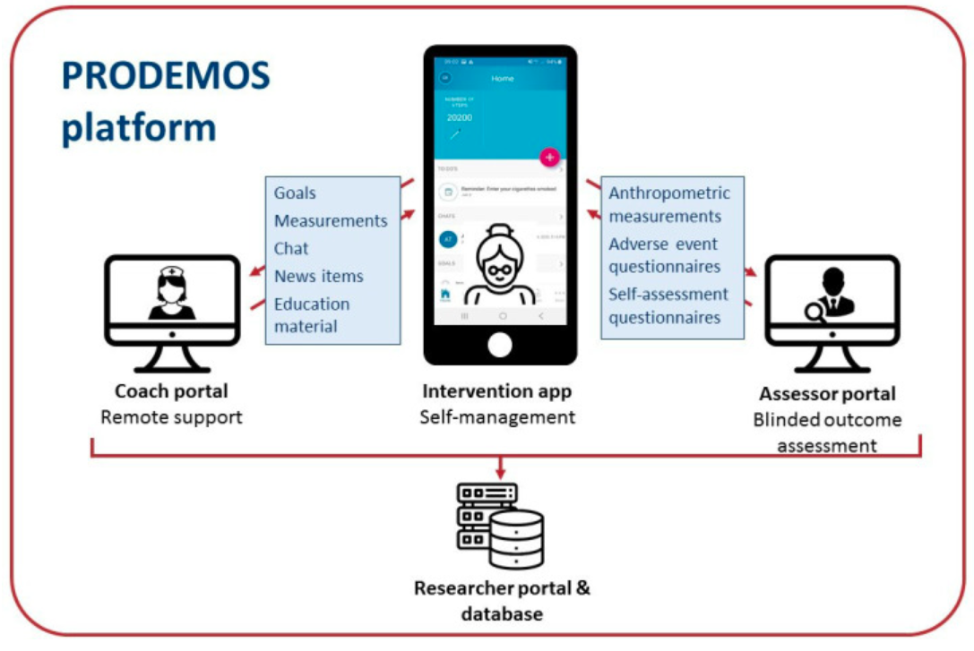
Prevention of Dementia using Mobile phone applications
(PRODEMOS)
A blended coach-supported health intervention in which participants can improve their dementia risk factors using a mobile health app to set and monitor goals)
Eggink E, et al. BMJ Open. 2021
Notes:
Overview of the prevention of dementia using mobile phone applications (PRODEMOS) platform and its functionalities. Main features of coach portal: viewing and adjusting details of goals and measurements; sending and receiving chat messages to and from the participants; sending education and news items. Main features of intervention app: setting and adjusting goals; entering measurements; sending and receiving chat messages to and from the coach; reading education and news items automatically pushed by platform or received from the coach; receiving periodic adverse event questionnaires and self-assessment questionnaires. Main features of assessor portal: blinded collection of participant data through electronic case report forms and questionnaires. The control application has similar connections with the assessor portal and the researcher portal/database, but is not connected to the coach portal.

Slide 44
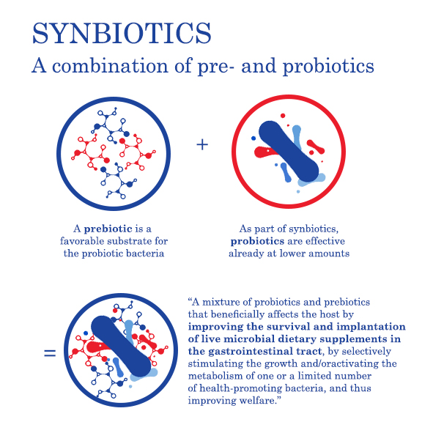
New opportunities to modulate the gut microbiota by nutrition
PROBIOTICS
live microorganisms that,
when administrated in adequate
amounts confer a health benefit on the host
Based on FAO/WHO definition (2001) and updated ISAPP (2014)
+
SYNBIOTICS
are combination of Pre and Probiotics
Pandey t al, 2015
Shamir, 2015
PREBIOTICS
substrates that are selectively utilized by host microorganisms conferring a health benefit
The International Scientific Association for Probiotics and Prebiotics (ISAPP) definition for prebiotics as published in a consensus statement from June 2017.
POSTBIOTICS
Are bioactive compounds produces by food-grade microorganisms in a fermentation process
Aguilar-Toala 2018
Klemashevish 2014

Slide 45
Relationship between diabetes mellitus and NDD
Metabolic disorders (i.e. type 2 diabetes and obesity) constitute major health problems worldwide <- unhealthy life style
Type 2 diabetes nearly doubles the risk of dementia
Potential association between diabetes and major depressive disorder to promote cognitive dysfunction and Alzheimer's disease
Elevated glycaemia in non-diabetic individuals increases the risk for dementia by 18%, and is associated with cognitive decline and reduction of hippocampal volume
Source: Ott, A., Stolk, R., Hofman, A. et al. Association of diabetes mellitus and dementia: The Rotterdam Study. Diabetologia 39, 1392–1397 (1996). https://doi.org/10.1007/s001250050588
Notes:
The global prevalence of diabetes mellitus (DM) is growing rapidly [1] with the result of increased morbidity and mortality from diabetic complications [2]. Diabetic complications are a major cause of disabilities with an increasing economic healthcare burden [2,3]. It has been shown that people with poor glycemic control are at higher risk of tissue dysfunction, age-related disorders as well as neuronal complications and cognitive problems compared to those without diabetes
Since initial epidemiological evidence from the Rotterdam study linking diabetes to dementia, two decades ago (Ott et al., 1999, Ott et al., 1996), accumulating evidence provided further support for an association between these two conditions. Type 2 diabetes nearly doubles the risk of dementia (Huang et al., 2014, Ohara et al., 2011). It has further been suggested an association between diabetes and major depressive disorder to promote cognitive dysfunction and AD (Cha et al., 2014). Elevated glycaemia in non-diabetic individuals increases the risk for dementia by 18%, and is associated with cognitive decline and reduction of hippocampal volume (Crane et al., 2013, Kerti et al., 2013). Moreover, AD incidence is positively correlated with hyperinsulinemia and hyperglycaemia (Baker et al., 2011, Matsuzaki et al., 2010). Conversely, AD patients have an increased risk of developing T2D (Janson et al., 2004, Matsuzaki et al., 2010). Despite substantial epidemiological evidence linking AD and diabetes, the molecular mechanisms underlying this connection remain elusive.

Slide 46
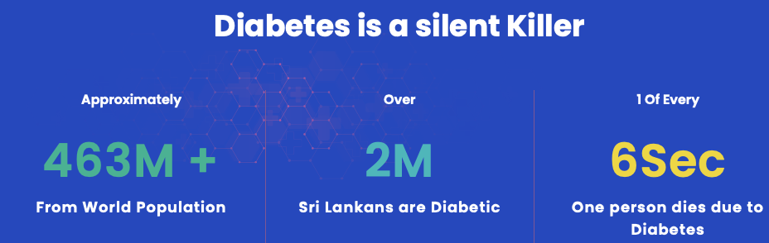
Relationship between diabetes mellitus and NDD
National Diabetes Center Sri Lanka. http://www.diabetessrilanka.org
537 M +
latest data from the International Diabetes Federation (https://www.diabetesatlas.org/)
783 M
estimation by 2045
Notes:
The global prevalence of diabetes mellitus (DM) is growing rapidly [1] with the result of increased morbidity and mortality from diabetic complications [2]. Diabetic complications are a major cause of disabilities with an increasing economic healthcare burden [2,3]. It has been shown that people with poor glycemic control are at higher risk of tissue dysfunction, age-related disorders as well as neuronal complications and cognitive problems compared to those without diabetes
Since initial epidemiological evidence from the Rotterdam study linking diabetes to dementia, two decades ago (Ott et al., 1999, Ott et al., 1996), accumulating evidence provided further support for an association between these two conditions. Type 2 diabetes nearly doubles the risk of dementia (Huang et al., 2014, Ohara et al., 2011). It has further been suggested an association between diabetes and major depressive disorder to promote cognitive dysfunction and AD (Cha et al., 2014). Elevated glycaemia in non-diabetic individuals increases the risk for dementia by 18%, and is associated with cognitive decline and reduction of hippocampal volume (Crane et al., 2013, Kerti et al., 2013). Moreover, AD incidence is positively correlated with hyperinsulinemia and hyperglycaemia (Baker et al., 2011, Matsuzaki et al., 2010). Conversely, AD patients have an increased risk of developing T2D (Janson et al., 2004, Matsuzaki et al., 2010). Despite substantial epidemiological evidence linking AD and diabetes, the molecular mechanisms underlying this connection remain elusive.

Slide 47
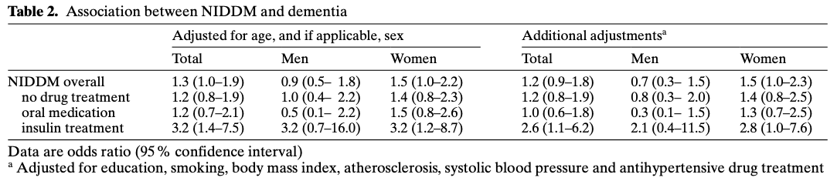
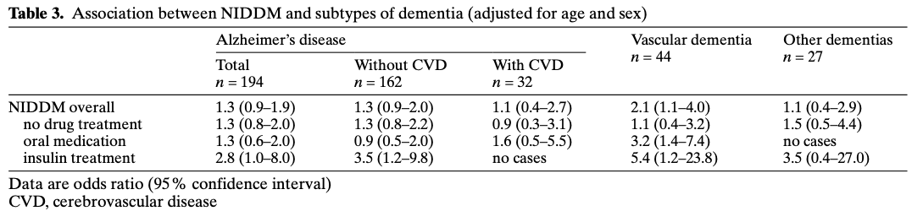
Relationship between diabetes mellitus and NDD
NIDDM = non-insulin-dependent diabetes mellitus
Source: Ott, A., Stolk, R., Hofman, A. et al. Association of diabetes mellitus and dementia: The Rotterdam Study. Diabetologia 39, 1392–1397 (1996). https://doi.org/10.1007/s001250050588
Notes:
The global prevalence of diabetes mellitus (DM) is growing rapidly [1] with the result of increased morbidity and mortality from diabetic complications [2]. Diabetic complications are a major cause of disabilities with an increasing economic healthcare burden [2,3]. It has been shown that people with poor glycemic control are at higher risk of tissue dysfunction, age-related disorders as well as neuronal complications and cognitive problems compared to those without diabetes

Slide 48
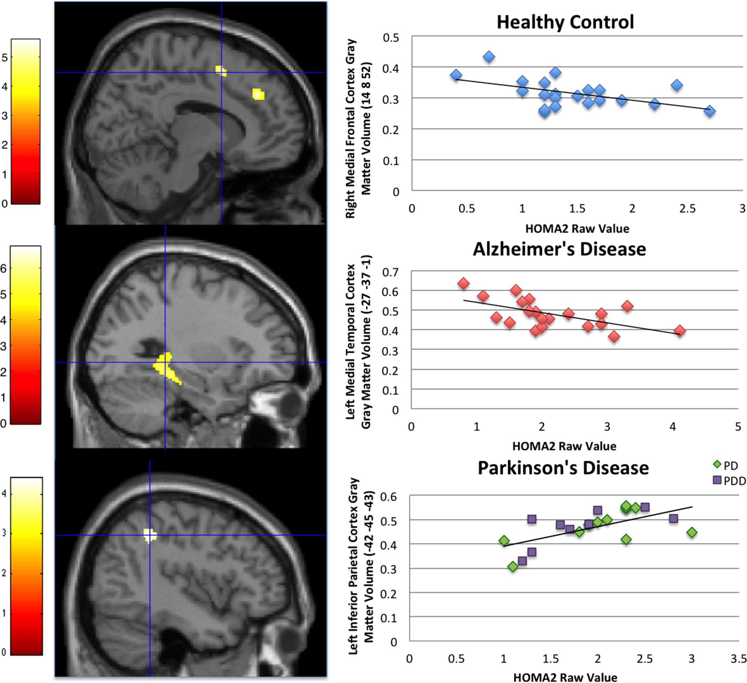
Insulin resistance and brain gray matter volume (GMV)
• Insulin resistance was increased in individuals with Alzheimer’s disease (AD) and Parkinson's disease (PD) compared to healthy elderly subjects.
• AD subjects exhibited more severe metabolic dysfunction than PD subjects.
• Within-group assessments showed a significant relationship between gray matter volume and insulin resistance.
• Both the brain region and directionality of the relationship between metabolism and brain volume was unique in each group.
HOMA2 = homeostasis model assessment of insulin resistance 2
J.K. Morris, E, et al. Insulin resistance and gray matter volume in neurodegenerative disease, Neuroscience, 2014,
Notes:
The study examined the Insulin resistance in aging and aging-related neurodegenerative diseases, and to determine the relationship between insulin resistance and gray matter volume (GMV) in each cohort using an unbiased, voxel-based approach
Relationship between higher HOMA2 and regional gray matter volume at cross-section in healthy control, AD, and PD individuals. The color bar represents t values. Statistical parametric maps are overlaid on a canonical brain image. Cross-hairs are on the most significant cluster from the HOMA2 regression. Significant clusters from these three analyses were extracted and plotted against raw HOMA2 values for visual purposes. The coordinates for our voxel-based morphometry results are presented in MNI space.

Slide 49
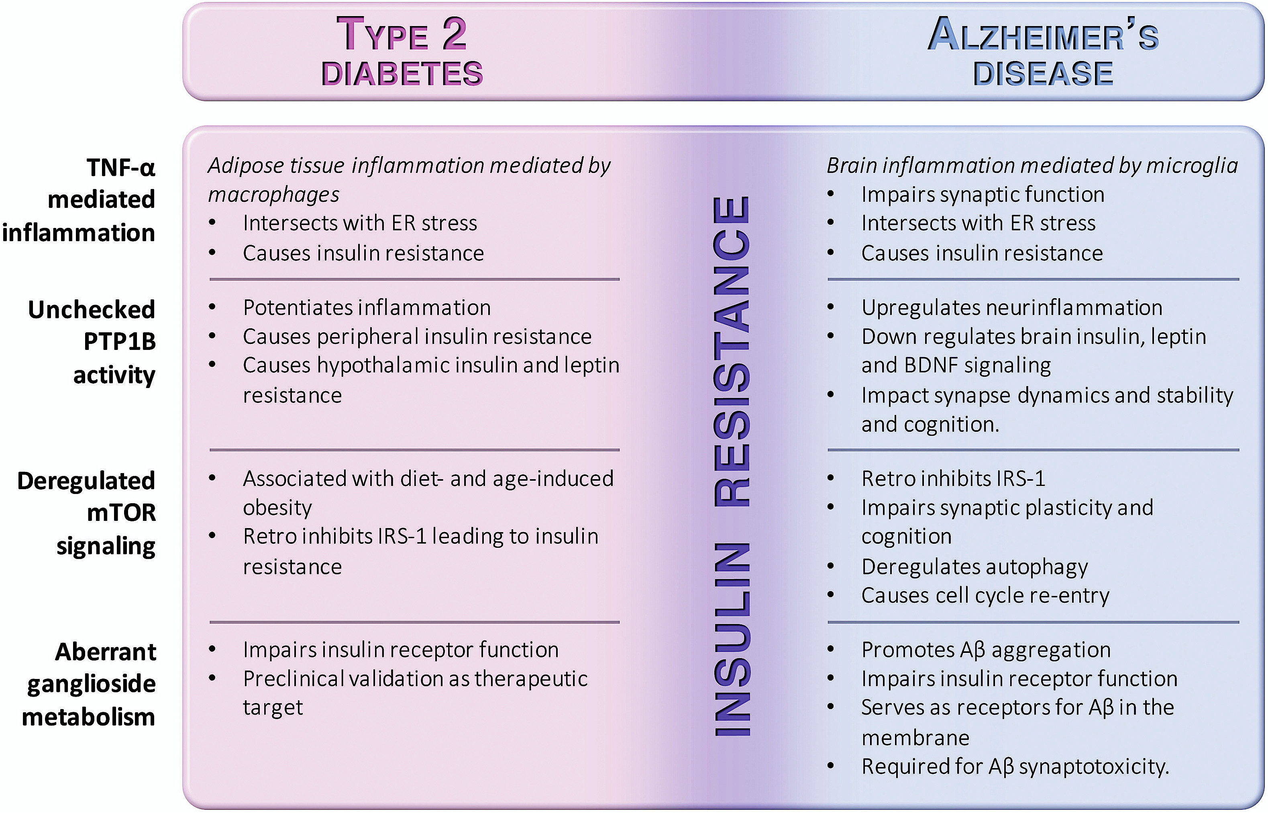
Mechanisms connecting Alzheimer's disease and diabetes
TNF-α = Tumor necrosis factor-alpha
ER = endoplasmic reticulum
PTP1B = protein tyrosine phosphatase 1B
BDNF = brain-derived neurotrophic factor
IRS-1 = insulin receptor substrate 1
mTOR = mammalian target of rapamycin
Aβ = amyloid beta
Source: Marcelo N.N, et al.Connecting Alzheimer's disease to diabetes: Underlying mechanisms and potential therapeutic targets, Neuropharmacology, Volume 136, Part B, 2018, https://doi.org/10.1016/j.neuropharm.2017.11.014.
Notes:
Mechanisms connecting AD and diabetes. The diagram highlights insulin resistance as a major intersection between Alzheimer's disease and type 2 diabetes. The selected mechanisms covered in this review are indicated in the left column. Potential physiopathological and therapeutical implications of those mechanisms to either type 2 diabetes (pink column) or Alzheimer's disease (blue column) are described.

Slide 50
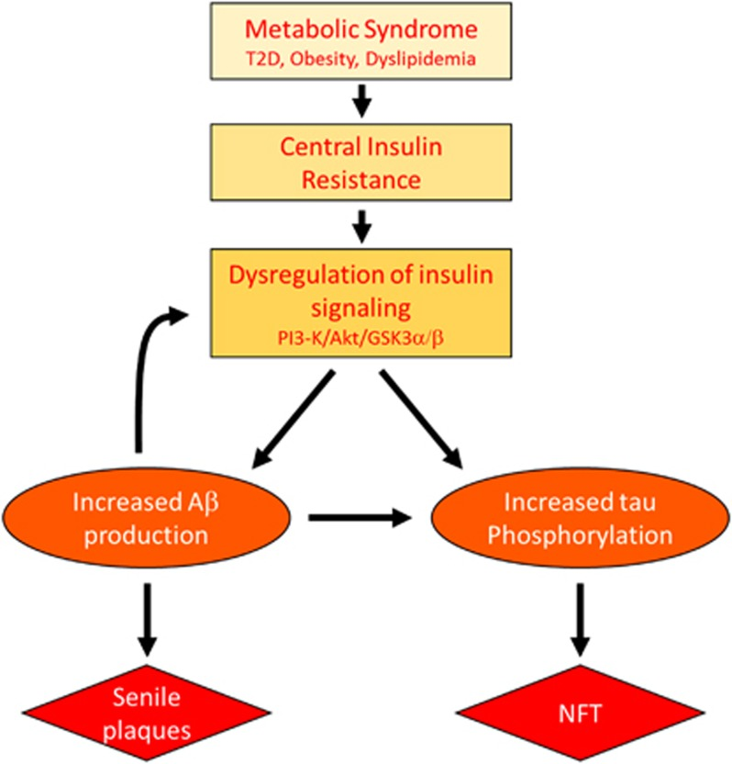
Alzheimer׳s disease (AD) and brain glucose starvation
80% of people with Alzheimer’s disease have insulin resistance or full-developed type 2 diabetes
AD could be regarded as a brain disorder that has composite features of Type 1 (insulin deficiency) and Type 2 (insulin resistance) diabetes.
T2D = Type 2 Diabetes
PI3 = phosphatidylinositol 3 kinase
Akt = serine/threonine kinase
Aβ = amyloid beta
GSK3α/β = Glycogen synthase kinase 3α/β (GSK3α/β), a serine/threonine kinase that plays a critical role in cancer.
NFT =neurofibrillary tangles
Metabolic syndrome and AD Aβ/tau pathology may act in a feed-forward mechanism to accelerate AD pathology in the presence of insulin resistence.
Kim B, Feldman EL. Insulin resistance as a key link for the increased risk of cognitive impairment in the metabolic syndrome. Exp Mol Med. 2015. doi: 10.1038/emm
Notes:
Over decades, the dominant hypothesis was that neurodegeneration is caused by one or two of the specific lesions that characterize AD, e.g. AβPP-Aβ accumulation, pTau aggregation, or neuro-inflammation. However, a stream of human and experimental studies has provided convincing evidence that AD is a metabolic disease whereby the brain loses its capacity to efficiently utilize glucose for energy production and respond to critical trophic factor signals due to insulin as well as insulin-like growth factor (IGF) resistance (Baker et al., 2010, Craft, 2007, Hoyer, 2002, Hoyer, 2004b, Krikorian et al., 2010, Luchsinger, 2010, Neumann et al., 2008, Rivera et al., 2005, Schubert et al., 2004, Steen et al., 2005, Talbot et al., 2012, Watson and Craft, 2006). The molecular and biochemical consequences of insulin and IGF resistance in the brain are similar to those in other organs and tissues; however, in brain, insulin signaling impairments compromise neuronal survival, energy production, gene expression, plasticity and white matter integrity (de la Monte, 2011, de la Monte et al., 2009a)
FIGURE: n summary, peripheral MetS induces central IR in the brain. The resulting impaired insulin signaling, which mainly impacts the PI3K/Akt pathway, then increases APP processing/Aβ levels and tau phosphorylation. Finally, increased Aβ further disrupts insulin signaling to exacerbate AD pathology and cognitive decline

Slide 51
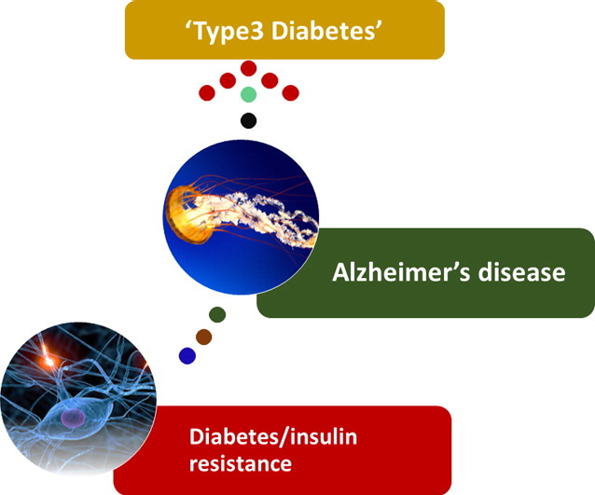
Alzheimer׳s disease (AD) and brain glucose starvation - The concept of type 3 diabetes -
To consolidate the type of glucose impairment in AD patients, Rivera et al., 2005, Steen et al., 2005 proposed that AD be referred to as, “Type 3 diabetes”.
Key features of “type 3 diabetes ”: brain insulin and IGF resistance and deficiency
*Type 3 diabetes is still a concept and not yet incorporated in official medical practice and terminology
Mittal, K. Type 3 Diabetes: Cross Talk between Differentially Regulated Proteins of Type 2 Diabetes Mellitus and Alzheimer’s Disease. Sci Rep 2016.
Kim B, Feldman EL. Insulin resistance as a key link for the increased risk of cognitive impairment in the metabolic syndrome. Exp Mol Med. 2015. doi: 10.1038/emm
Notes:
Over decades, the dominant hypothesis was that neurodegeneration is caused by one or two of the specific lesions that characterize AD, e.g. AβPP-Aβ accumulation, pTau aggregation, or neuro-inflammation. However, a stream of human and experimental studies has provided convincing evidence that AD is a metabolic disease whereby the brain loses its capacity to efficiently utilize glucose for energy production and respond to critical trophic factor signals due to insulin as well as insulin-like growth factor (IGF) resistance (Baker et al., 2010, Craft, 2007, Hoyer, 2002, Hoyer, 2004b, Krikorian et al., 2010, Luchsinger, 2010, Neumann et al., 2008, Rivera et al., 2005, Schubert et al., 2004, Steen et al., 2005, Talbot et al., 2012, Watson and Craft, 2006). The molecular and biochemical consequences of insulin and IGF resistance in the brain are similar to those in other organs and tissues; however, in brain, insulin signaling impairments compromise neuronal survival, energy production, gene expression, plasticity and white matter integrity (de la Monte, 2011, de la Monte et al., 2009a)
FIGURE: n summary, peripheral MetS induces central IR in the brain. The resulting impaired insulin signaling, which mainly impacts the PI3K/Akt pathway, then increases APP processing/Aβ levels and tau phosphorylation. Finally, increased Aβ further disrupts insulin signaling to exacerbate AD pathology and cognitive decline

Slide 52
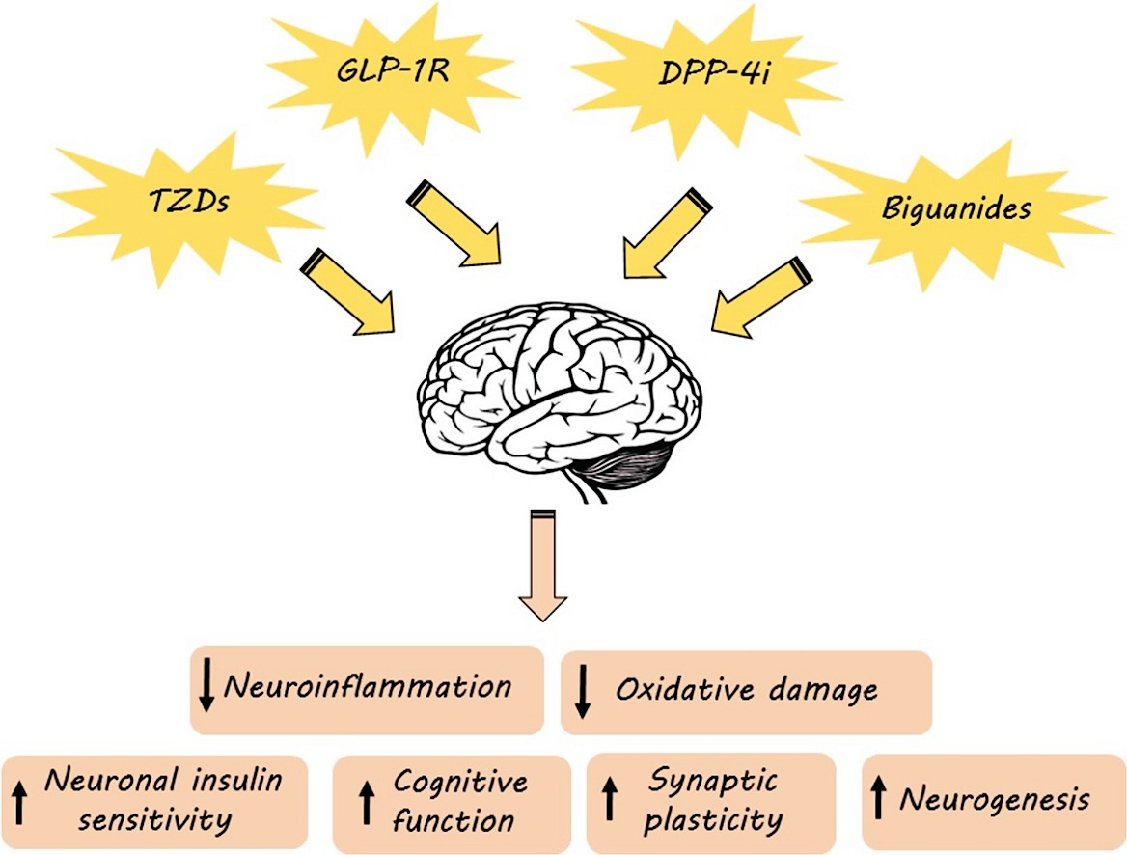
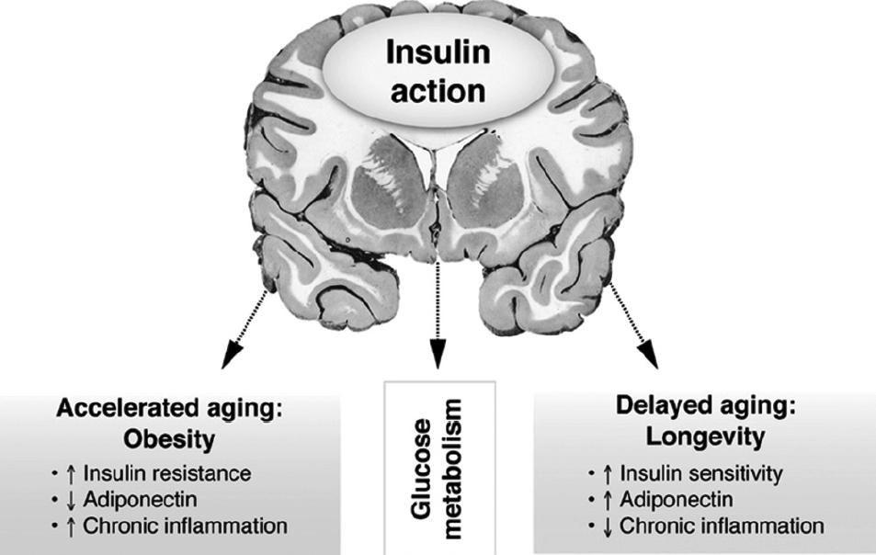
Neuromodulatory effects of anti-diabetes medications
influences learning and memory by modulating synaptic plasticity, synaptic density, synaptic transmission and neurogenesis
TZDs = Tiazolidins
GLP-1R = Glucagon-like peptide-1 receptor agonists
DPP-4i = Dipeptidyl peptidase 4 inhibitors
Source: Habib Y et al, Neuromodulatory effects of anti-diabetes medications: A mechanistic review, Pharmacological Research, Volume 152, 2020, https://doi.org/10.1016/j.phrs.2019.104611.
Notes:
The anti-diabetic medications which are used primarily to reduce blood glucose have other potentially beneficial effects including antioxidant, anti-inflammatory and anti-apoptotic effects which may enable them to play major protective roles in other conditions including neurodegenerative complications of diabetes and various neurological disorders
There is a high incidence of diabetes-induced neuronal complications in patients, which has a significant effect on their quality of life. The medications which are commonly used to manage hyperglycemia in diabetes have other potentially beneficial effects by suppressing the pathophysiological pathways associated with neurological morbidities such as oxidative damages, inflammatory responses, apoptotic processes, necrotic events, intracellular signaling, growth factors and transcriptional nuclear factors. Anti-diabetic medications can modulate neuronal function and we present a foundation on which to build our understanding of to how we can better manage diabetes-induced neuronal comorbidities and also neurodegenerative disorders in patients without diabetes.
Insulin, IGF-1, and IGF-2 have been reported to have inhibitory actions on apoptosis in brain neuronal cells through binding to insulin receptors. Neurobiological processes such as neuromodulation, neurotrophy, neuronal growth, and neuronal survival are largely controlled by insulin and IGFs, regulating the physiological, biochemical, cellular, molecular and behavioral activities (Steen et al., 2005).
Studies have also shown that insulin as well as IGF-1 regulates amyloid-β metabolism and its clearance (Carro et al., 2002; Logan et al., 2018). It has been revealed that insulin acts by inhibiting the degradation of amyloid-β. This effect was depicted through a protease namely insulin-degrading enzyme (IDE), involved in amyloid-β breakdown. Hence, AD pathology which majorly involves amyloid-β formation and its accumulation is directly or indirectly controlled by insulin and IGFs (Gasparini et al., 2001; Selkoe, 2001).
Interestingly, hyperinsulinaemia in brain has been demonstrated to augment amyloid-β level through insulin's competition with amyloid-β for insulin degrading enzyme (IDE) (Qiu and Folstein, 2006).

Slide 53
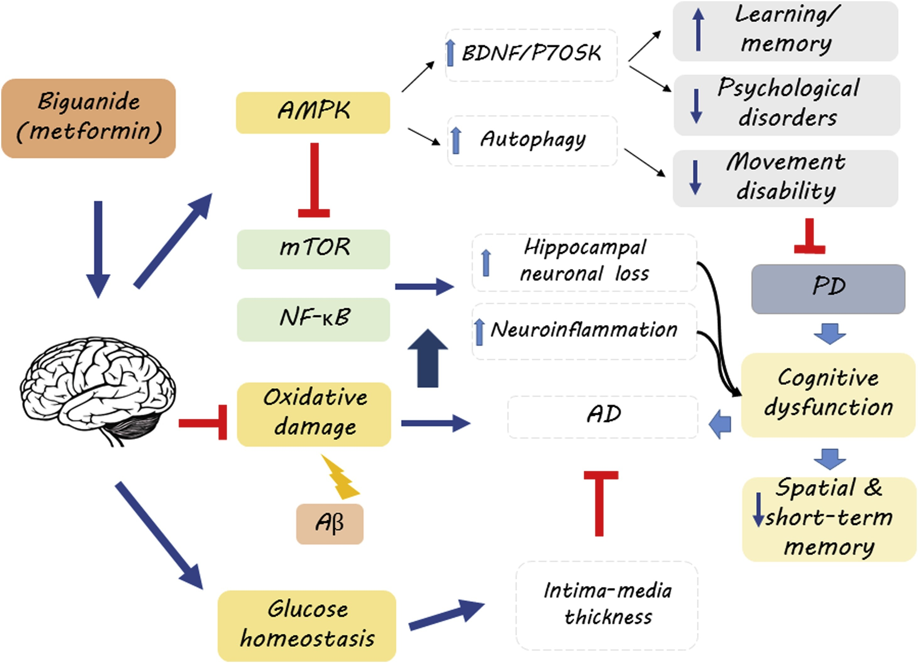
Molecular mechanisms underlying the neuromodulatory effects of GLP1 receptor agonists and DPP4 inhibitors.
AMPK = AMP-activated protein kinase)
mTOR = mammalian target of rapamycin
Nf-κB = nuclear factor kappa B
Aβ = amyloid beta
BDNF/P70SK = brain-derived neurotrophic factor/ Phospho-p70 S6 Kinase signalling pathway
PD = Parkinson's disease
AD = Alzheimer's disease
Source: Habib Y et al, Neuromodulatory effects of anti-diabetes medications: A mechanistic review, Pharmacological Research, Volume 152, 2020, https://doi.org/10.1016/j.phrs.2019.104611.

Slide 54
Likely molecular mechanisms by which GLP-1 analogues improve cognitive functions
Molecular mechanisms | Effects of GLP-1
Oxidative stress | Reduce oxidative damages in brain area related to cognition and memory
Neuroinflammation | Decline inflammatory responses included in cognitive disorders
Neuroapoptosis | Inhibit or reduce apoptotic death in neuronal structures involved in cognitive functions
Direct central area | Pass BBB and directly modulate central area involved in cognition and memory
Insulin signal transduction | Facilitate and promote insulin signaling leading to improvement in brain insulin function
Aβ and tau proteins' aggregation | Reduce or prevent Aβ and tau proteins' plaque aggregation in brain area related to cognition
Neurotoxicity | Decrease or suppress neurotoxicity
Neurogenesis | Induce neurogenesis and positively modulate synaptic plasticity
BBB = blood brain barrier
Aβ = amyloid beta
Source: Habib Y et al, GLP-1 mimetics and cognition, Life Sciences, 2021, https://doi.org/10.1016/j.lfs.2020.118645.
Notes:
GLP-1 mimetics could have dual benefits in patients with type 2 diabetes. In addition to improved glycemic control there is compelling experimental evidence to suggest that they may be associated with improved cognitive impairment in diabetes. Incretins can positively modulate cognitive function via at least eight molecular and cellular pathways including a reduction in oxidative damage, inflammation, neuroapoptosis, and Aβ or tau protein aggregation, or by improvements in neurogenesis and synaptic plasticity, neurotoxicity, and insulin signal transduction. Using one effective pleiotropic medication to address diabetes mellitus and related complications could result in a reduction in healthcare costs and a reduction in the medication burden. Further clinical evidence is needed to establish the impact of analogues on cognitive and memory functions in diabetic patients.

Slide 55
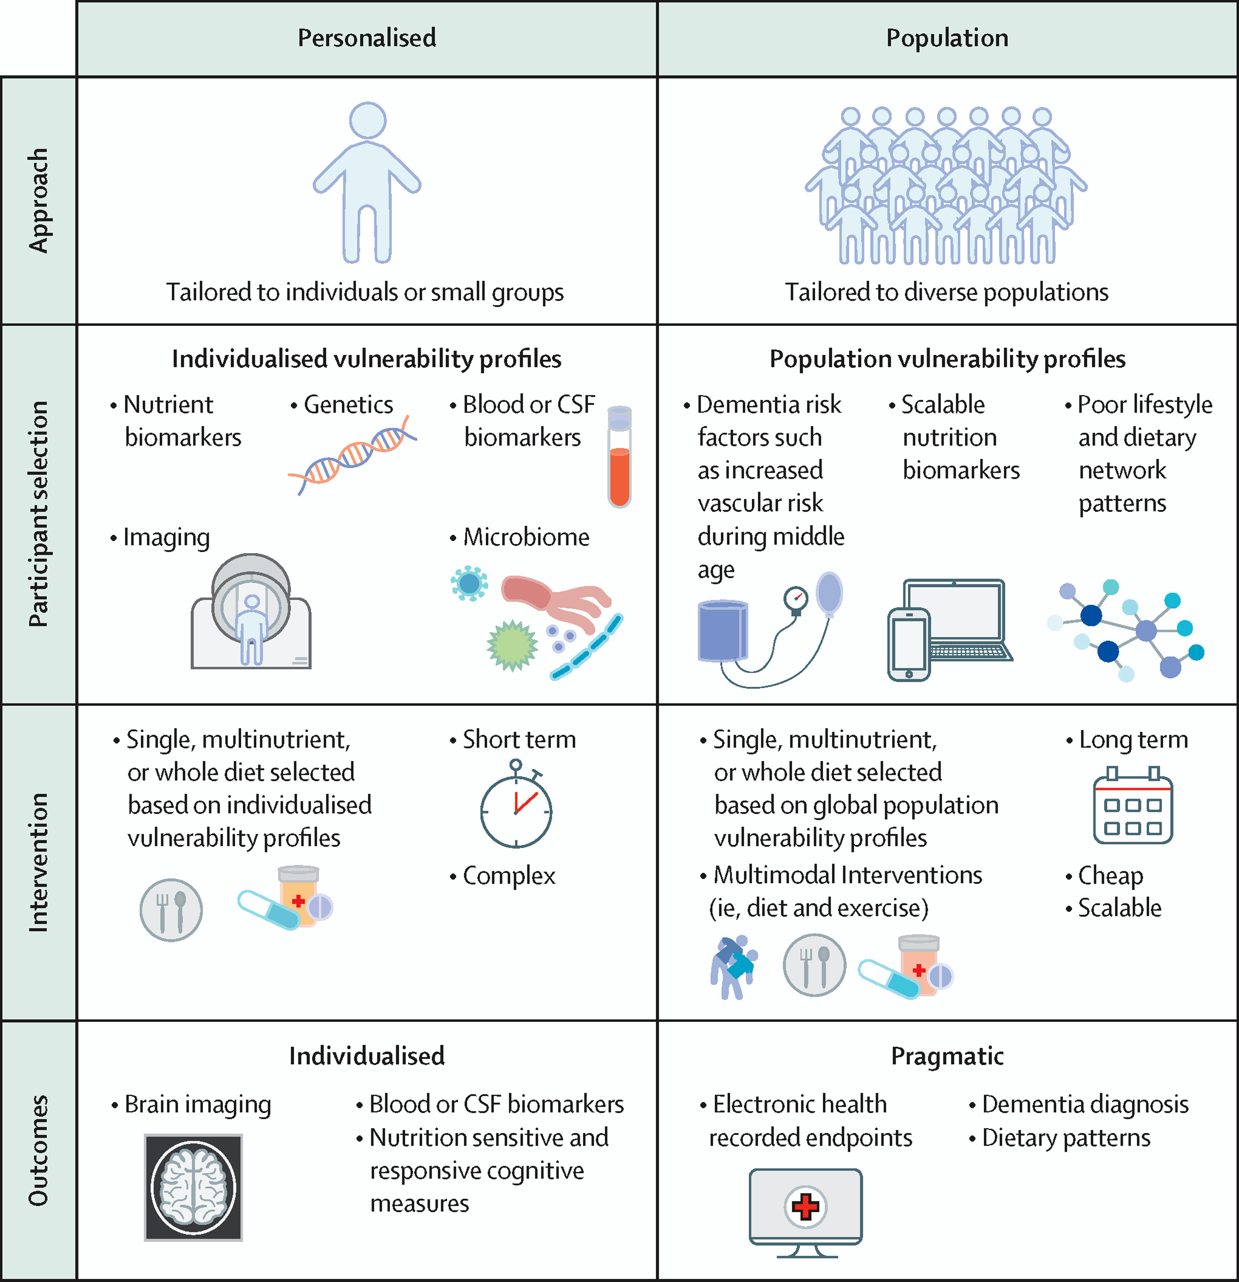
Figure 2
Hussein NY, et al. Nutrition state of science and dementia prevention: recommendations of the Nutrition for Dementia Prevention Working Group. The Lancet Healthy Longevity. 2022
Copyright © 2022 The Author(s). Published by Elsevier Ltd.
Notes:
Two contrasting study designs to nutrition-based interventions for dementia prevention
Two contrasting approaches to nutrition-based clinical trials are shown. The first column shows intensive and personalised interventions guided by biomarkers that capture brain functions. In the second column, interventions are tailored to a population level in groups at risk of dementia and uses pragmatic outcomes. Although certain trials will have to share elements from both approaches, clear study designs that match the intensity of the intervention with the outcome proposed promises to maximise the chances of finding effective therapies.

Slide 56
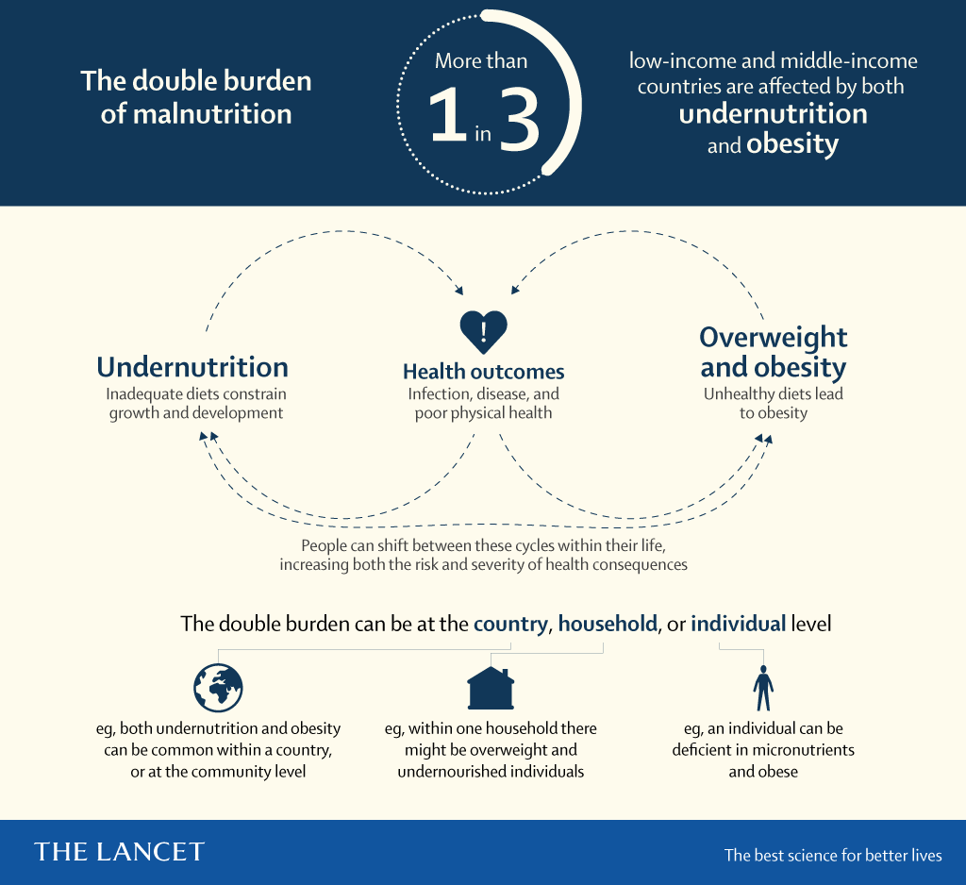

Slide 57
Literature
Mandatory:
Bianchi VE, et al. Effect of nutrition on neurodegenerative diseases. A systematic review. Nutr Neurosci. 2021
ESPEN. Nutrition in the Prevention of Neurological Diseases. 2015
Hussein NY, et al. Nutrition state of science and dementia prevention: recommendations of the Nutrition for Dementia Prevention Working Group. The Lancet Healthy Longevity. 2022
Ott, A., Stolk, R., Hofman, A. et al. Association of diabetes mellitus and dementia: The Rotterdam Study. Diabetologia 39, 1392–1397 (1996). https://doi.org/10.1007/s001250050588
Additional:
Nikolaos Scarmeas, Costas A Anastasiou, Mary Yannakoulia, Nutrition and prevention of cognitive impairment,The Lancet Neurology, 2018, https://doi.org/10.1016/S1474-4422(18)30338-7.
Gao, HM., Zhou, H., Hong, JS. (2014). Oxidative Stress, Neuroinflammation, and Neurodegeneration. In: Peterson, P., Toborek, M. (eds) Neuroinflammation and Neurodegeneration. Springer, New York, NY.
https://www.health.harvard.edu/blog/a-practical-guide-to-the-mediterranean-diet-2019032116194
Advanced:
Morris MC, et al. Alzheimers Dement. 2015
Baker LD, et al. Alzheimers Dement. 2020
Richard E, et al.Lancet Digit Health. 2019
Eggink E, et al. BMJ Open. 2021

