Slide 1

REGULATE AN EVALUATION OR AN EVALUATION SYSTEM
Dr HMP Herath
Senior lecturer
Ph.D. (USJ), RN(SLNC), B.Sc. (Nursing) Hons(UPSL), CTHE (KDU)
Department of Nursing & Midwifery
FAHS, KDU

Slide 2

Objectives
Define the evaluation concept and its role in assessing actions and policies.
Identify the resources required for an evaluation, including financial, management, analytical, policy, and delivery-related resources.
Summarize the significance of obtaining early agreement for an evaluation within the decision-making process.
Explain how data collection costs may vary based on the type of policy or intervention, particularly new policies and data collection.
Discuss the role of external researchers and experts in advising on evaluation design and quality assurance.
Describe the governance arrangements necessary for effective evaluation management.

Slide 3
Establishing the evaluation
Evaluations are best planned in an environment where all actions and policies are expected to be assessed.
When this is not the case, an agreement to an evaluation should be obtained as early in the process as possible.
At all levels of business planning, the assessment should be expressly considered, and resources included into the business case to cover both internal expertise and external spending.
Evaluation might necessitate significant resources, both monetary and from analysts and policymakers.

Slide 4
Resources required in an evaluation
Financial
Management
Analytical (including external researchers conducting the evaluation)
Policy
Delivery bodies
Wider stakeholders
Post-delivery resource

Slide 5
1. Financial Resources
The evaluation's scale is usually proportional to the policy's scale and ambition, although there is no standard proportion.
Evaluation will cost more for pilots, trials, and other new policies than for established ones.
New data collection generally comprises a major amount of evaluation costs.
Building data requirements into routine monitoring can significantly cut expenses.

Slide 6
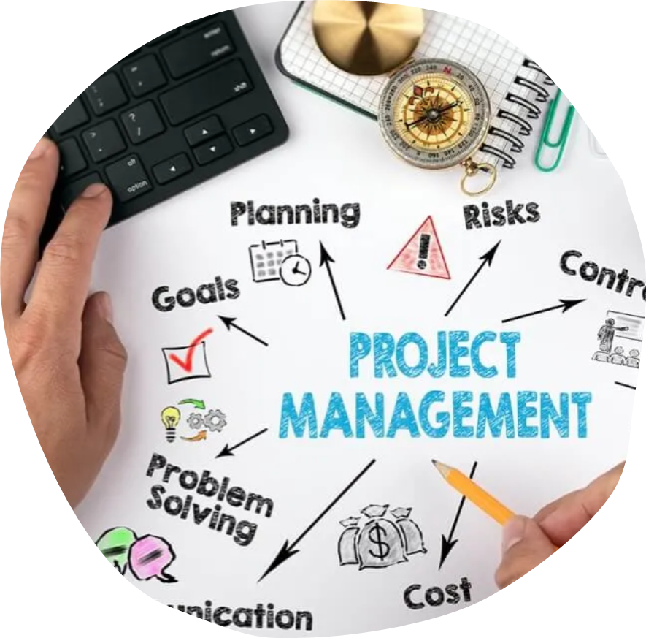
2. Management
The evaluation's scale is usually proportional to the policy's scale and ambition, although there is no standard proportion.
Evaluation will cost more for pilots, trials, and other new policies than for established ones.
New data collection generally comprises a major amount of evaluation costs.
Building data requirements into routine monitoring can significantly cut expenses.

Slide 7
3. Analytical (including external researchers conducting the evaluation)
Evaluation professionals, social researchers, statisticians, operational researchers, and economists may advise on its design and outputs.
Large or complex evaluations benefit from an evaluation professional. Complex and technological tasks go into evaluation design and execution.
Evaluation guidance and quality assurance benefit from multidisciplinary support.
External peer reviews are usually commissioned and require resources and a lead time.
External evaluation specialists often evaluate. They must grasp the evaluation standards, but sometimes it helps to preserve some independence from commissioners to build confidence in the evaluation results.

Slide 8
4. Policy
Engaging with the evaluation is essential for the policy or delivery team responsible for the intervention, and they should allocate resources accordingly.
This will include day-to-day engagement to ensure the . is focused and the findings are useful, and through discussions at policy/program boards where appropriate.

Slide 9
5. Delivery bodies
The engagement and collaboration of the organizations and persons engaged in delivering the intervention are frequently required for a successful evaluation.
It will be critical to earn their commitment and be clear about what feedback they will be asked to provide.
Evaluation fieldwork is frequently constructed around the delivery body's ability to participate and the time commitment that will be necessary.

Slide 10
6. Wider stakeholders
Other stakeholders are often involved; for example, those directly or indirectly affected by the policy.
Engagement of this group can be made through inviting them onto the steering group, informing them about the evaluation or including them as participants in the research.

Slide 11
7. Post-delivery resource
The engagement and collaboration of the organizations and persons engaged in delivering the intervention are frequently required for a successful evaluation.
It will be critical to earn their commitment and be clear about what feedback they will be asked to provide.
Evaluation fieldwork is frequently constructed around the delivery body's ability to participate and the time commitment that will be necessary.

Slide 12
Project management
Management of the assessment requires adequate time and experience to ensure it satisfies the needs of the policy and delivery team responsible for the intervention, is on time and within budget, and is of appropriate quality.
Managing the project will also help identify and resolve concerns promptly.
There are often shortcomings with intervention design, execution, or data collection that demand rapid evaluation design adjustments.
The topic of interest and evaluation design may change as new data emerge.
Notes:
Close management and collaboration ensure that data collection remains relevant to the learning needs of those running the evaluation and maximises the impact of useful findings. The evaluation manager does not necessarily need to be an evaluation specialist (although this is more efficient) but specialist input will be required.

Slide 13
Governance
Effective governance mechanisms must be established early in an examination. This helps with scoping, commissioning, and delivering the assessment.
When assessment plans must change over time and demand a more flexible evaluation design, it is crucial.
Key stakeholders can benefit from being informed and involved in an evaluation and seeing its conclusions early on.
Analysts including evaluators, social researchers, economists, operational researchers, and statisticians create and oversee evaluation.
Governance processes can clarify and manage stakeholder roles, duties, expectations, and conflicts.
Notes:
Evaluations are most successful when the design matches stakeholders' needs who will use the findings.

Slide 14

Governance arrangements involve the following
Policy program/project board
valuation steering group
Expert peer review

Slide 15
Governance - Policy programme/project board
Evaluations of government interventions require decision-maker buy-in and utilization of findings.
To do this, the policy team should own the evaluation and periodically report progress to the policy board.
The policy board can
  Shape and steer the evaluation
  Agree on resources
  Understand the evaluation's scope
  Adapt to changing circumstances (e.g., key decision points)
  Be aware of emerging findings; - Apply emerging findings.

Slide 16
Valuation steering group
A steering group exists to ensure the evaluation meets objectives and addresses new difficulties. Include all key stakeholders, such as evaluators, commissioners, and intervention policy team representatives.
For larger programs, it is recommended to incorporate intervention delivery personnel, participants, and independent expert examination and recommendations.
To truly steer development and address unexpected challenges, the steering group should convene throughout the evaluation, from design to completion, discussing and participating with the evaluation team.
Notes:
Its responsibilities include advising on evaluation design, and method feasibility, ensuring high-quality and policy-relevant evaluation, guiding on how to proceed if circumstances change, facilitating external evaluators, providing information and contacts, and quality-ensuring evaluation design and questions. Advise and quality ensure the analysis and interpretation of the evidence.

Slide 17
Expert peer review
Peer review is beneficial throughout the assessment process but is most prevalent during the design and reporting stages.
Independent specialists analyze the suitability of the intervention and its evaluation through peer review. This ensures that the questions, design, execution, and findings satisfy the stated objectives.
It also evaluates and ensures compliance with ethical, legal, and commercial processes. Peer review can be undertaken internally by unaffiliated individuals or externally by subject specialists
Notes:
External peer review is usually done by professionals in the evaluation method or subject area. They provide high-quality inspection and challenge, and their knowledge and independence can boost evaluation credibility and broaden perspectives. Use external advice with caution to avoid conflicts of interest.

Slide 18

Linking evaluation to the intervention design
The evidence requirements from the evaluation can usefully influence the design of the intervention to enhance the quality of the evidence generated and the resulting learning that can be achieved.
The plan for the evaluation should, therefore, be designed in tandem with that of the intervention.

Slide 19
How to Build evaluation data requirements into monitoring data collection.
Keyways the intervention can support the evaluation include:
Building evaluation data requirements into monitoring data collection.
Collecting contact details and consent.
Conducting a census of participants.
Piloting/testing
Targeted implementation to create comparison groups
Notes:
Building evaluation data requirements into monitoring data collection.
Simple adjustments to the collection of monitoring data can provide rich data that can be used by the evaluation. This is a cost-effective way collecting information, and can make a survey of participants either unnecessary or shorter.
Collecting contact details and consent. Alongside informed consent from participants agreeing to participate in the research, it is also necessary to obtain consent for any proposed data linking or for contact details to be held and used for follow-up research (In such cases, advice from GDPR experts should be obtained ).
Conducting a census of participants. A cost-effective way to collect data can be through a census or automatic survey of all participants. This could mean that:
o all participants are contacted and invited to take part in the survey;
o taking part in the survey is a mandatory requirement of the intervention (e.g. applicants for a grant are required to complete a survey). In this case, the requirement needs to be built into the intervention and clearly explained in any advertising.
Piloting/testing. Piloting and testing allow an intervention to be tried out on a smaller scale to understand (a) if it works (b) whether it can be modified to improve it and (c) how it is best delivered. This is essential if there is any uncertainty around the likely success of an intervention.
Targeted implementation to create comparison groups. some evaluation methods require both an intervention and comparison group to measure the impact of the intervention. The method of assigning individuals or groups to the intervention or comparison group is best built into the intervention design itself. Two of the most common ways to achieve this are:
o Randomised Control Trials (RCTs). Randomly assigning individuals or groups to the treatment or control group. This needs to be done as part of the intervention design.
o Phased implementation. One group is subject to the intervention before another to allow for a comparison between the two groups. This approach can work if it is expected that outcomes for the first group can be observed in the short term, before the second group receives the intervention.
It should be borne in mind that some data access or data collection can require legislation; for example, the automatic collection of specific details about participants in a national scheme. If this is the case, the data requirements need to be identified early and built into the intervention’s legislation. Without such data, identifying participants and obtaining data from them can be very difficult.

Slide 20
Specifying an evaluation
Departmental analytical professionals or specialist teams can evaluate.
Even in-house evaluations require external commissioning for specific tasks like primary data collection.
To choose a route, consider the capacity and capability of the in-house analytical team.
Independence need. This boosts findings credibility and trust.
Timeframes. Internal resources may vary throughout long-term evaluations. Overreliance on persons can be problematic.

Slide 21
Specifying an evaluation
When specifying an evaluation, it is important to include:
the purpose and intended use of the evaluation evidence
the timing of any decisions that will be informed by the evaluation
the recommended evaluation approach and/or methods where these exist
the data that already exist (the intervention’s own monitoring data or other available and relevant data)
any specific essential evaluation activities
an indicative publication strategy that sets out what will be published and when.
Notes:
It is useful to request bidders to provide a synthesis strategy: the plan for how the various research and data streams from the evaluation will be brought together into a clear narrative that answers the evaluation questions
The quality of the specification of the work will determine the quality of the ultimate evaluation. Time and expertise dedicated to preparing a well-thought through, clear and precise specification will be well spent. For complex evaluations, more information on specifications for commissioning can be found in the Supplementary Guidance on ‘Evaluating Complexity’

Slide 22
Commissioning an evaluation
If additional fieldwork is needed, other experts are often hired to evaluate.
Evaluation project managers should consult departmental commercial experts to determine the best commissioning approach.
Having a variety of external assessors ensures a steady supply of new ideas and supplier competition.
Notes:
Evaluation project managers should consult departmental commercial experts to determine the best commissioning approach. The most popular methods are departmental framework contracts, cross-government frameworks, the Crown Commercial Service research marketplace, and open competition.
Having a variety of external assessors ensures a steady supply of new ideas and supplier competition. Inviting bidders to create consortia can help ensure that one bid covers all evaluation skills. ‘Supplier Days’, where potential bidders learn about the intervention and evaluation needs, can boost evaluation interest and bring together potential consortia.

Slide 23

Commissioning an evaluation
If additional fieldwork is needed, other experts are often hired to evaluate.
Evaluation project managers should consult departmental commercial experts to determine the best commissioning approach.
The most popular methods are departmental framework contracts, cross-government frameworks, the Crown Commercial Service research marketplace, and open competition.
Notes:
Having a variety of external assessors ensures a steady supply of new ideas and supplier competition.
Inviting bidders to create consortia can help ensure that one bid covers all evaluation skills.
‘Supplier Days’, where potential bidders learn about the intervention and evaluation needs, can boost evaluation interest and bring together potential consortia.

Slide 24
Assessing bids
Project managers and at least two others will evaluate bids. These can be steering committee members, intervention design or delivery team members, or evaluation or analytical experts.
The Invitation to Tender specification must clearly state the assessment criteria, and the assessors must agree on what "good" is before receiving bids.
Cost information is usually separated from bids to assess quality only. After cost is assessed, quality bids are distinguished. Ideas from one bid cannot be shared with another.
Always allow enough time for commissioning. Obtaining stakeholder approval for the specification, procurement sign-off, bidder response time, bid review and agreement time, and contract awarding can take months.

Slide 25
Flexibility and consistency of evaluation
Evaluation design and management require a balance between consistency and flexibility. Experimental and quasi-experimental methods are consistent.
This allows comparisons between the intervention and the control group or between "before" and "after" samples, but both the intervention and evaluation must remain unchanged during delivery.
However, interventions can be challenging. Decisionmakers typically want to make ‘in-flight adjustments’ to enhance benefits.
It may also be difficult to predict which evaluation approaches will generate helpful results.
Notes:
Building flexibility early on will allow the evaluation to adjust to changes in intervention design, delivery modes, and data collection.
In novel or innovative intervention assessments, where the Theory of Change has not been tested and the intervention design is uncertain, this is crucial.
Evaluators and stakeholders must communicate to agree on evaluation design changes and understand their ramifications.
A thorough audit trail of modifications and decisions is needed. Governance processes can aid this.

Slide 26
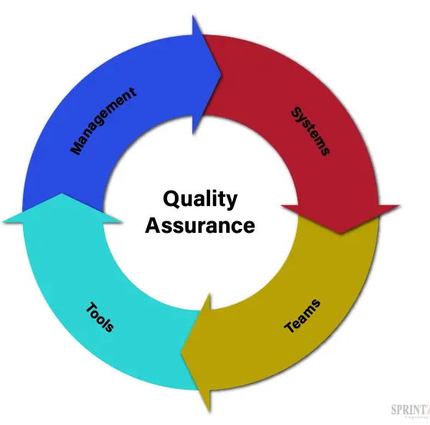
Quality assurance
All evaluations require quality assurance. Independent inspection, especially from many analytical perspectives, is helpful, but even without it, the project manager must take reasonable steps to assure quality design, implementation, and results.
Quality assurance is continual and must be prepared in advance. This ensures that evaluation design, execution (including fieldwork), analysis, and reporting are suitable and useful.

Slide 27
Quality assurance
Each level may include internal expert/inhouse peer review, steering group review, or external expert peer review for quality assurance. A blend of all three is typical.
Quality assurance ensures the findings are based on an objective and defensible interpretation of the results and relate to the evaluation objectives at the reporting stage.
Check all reported numbers wherever possible.
Observing data collection (e.g., listening to telephone interviews or focus groups), reviewing the analytical framework, or testing a sample of analytical results to ensure they can be reproduced from the raw data using contractor documentation are other checks.

Slide 28

References
HMT Magenta Book: Prudential standards in the Financial Services Bill: Policy statement, 2020. . HM Treasury, United Kingdom.

Slide 29


