Slide 1

4.8. ASSESING AND MEASURING IN PD, part 1

Slide 2
LEARNING OBJECTIVES
Learning objective 1: to understand clinical, paraclinical and metrological spectrum of assessments, evaluations and outcome measurements in PD
Learning objective 2: scales, assessments and questionaires for many Parkinson‘s disease (PD),
Learning objective 3: to master ??? UPDRS

Slide 3
ASSESSMENT AND MEASUREMENT IN PD
Clinical Assessment
Medical History
Neurological Examination:
  Motor Symptoms
  Non-Motor Symptoms:
Rating Scales
Unified Parkinson's Disease Rating Scale (UPDRS)
Hoehn and Yahr Scale
Parkinson's Disease Questionnaire-39 (PDQ-39)
Schwab and England Activities of Daily Living Scale
Neuroimaging
Magnetic Resonance Imaging (MRI):
Positron Emission Tomography (PET) and Single Photon Emission Computed Tomography (SPECT)
Laboratory Tests
Genetic Testing
Cerebrospinal Fluid (CSF) Analysis
Other Assessments
Neuropsychological Testing
Olfactory Testing:
Autonomic Function Tests

Slide 4
Comprehensive Medical History in Parkinsonism
Symptom Onset and Progression:
  Date of initial symptoms and their evolution over time.
  Initial and current severity of motor symptoms (e.g., tremor, bradykinesia, rigidity, postural instability).
  Development of non-motor symptoms (e.g., sleep disturbances, autonomic dysfunction, mood disorders).
Family History:
  Presence of Parkinson’s disease or related disorders in family members.
  Genetic predisposition and known mutations (e.g., LRRK2, PARK2).
Medication History:
  Current and past medications for PD and their effectiveness.
  History of treatments for other conditions and possible drug-induced parkinsonism.
Occupational and Environmental Exposures:
  Exposure to pesticides, heavy metals, or other neurotoxins.
  History of head trauma or significant injuries.

Slide 5
Comprehensive Medical History in Parkinsonism
Response to Therapy:
  Effectiveness and side effects of dopaminergic treatments (e.g., Levodopa).
  Changes in symptom severity with medication adjustments.
Non-Motor Symptoms:
  Cognitive changes: memory loss, executive dysfunction.
  Psychiatric symptoms: depression, anxiety, hallucinations.
  Sleep issues: REM sleep behavior disorder, insomnia.
  Autonomic symptoms: constipation, urinary problems, orthostatic hypotension.
Impact on Daily Living:
  Functional status and ability to perform activities of daily living (ADLs).
  Changes in work, social interactions, and hobbies.
Previous Medical Conditions:
  History of cerebrovascular disease, dementia, or other neurological conditions.
  Other chronic conditions that might affect symptom management

Slide 6
EXAMINATION FOCUS IN PATIENT WITH PD
Motor Symptoms Assessment
Non-Motor Symptoms Assessment
Bradykinesia: Slowness of movement; assessed through repetitive finger tapping, hand movements, and foot tapping.
Rigidity: Stiffness in limbs and neck; evaluated by passive movement of limbs.
Tremor: Resting tremor typically observed in the hands; assessed by observing hands at rest and during activities.
Postural Instability: Difficulty maintaining balance; tested through the "pull test" where the examiner gently pulls the patient backward to observe their ability to maintain balance
Cognitive Function: Evaluation of memory, attention, executive function, and visuospatial skills using tests like the MMSE or MoCA.
Mood and Psychiatric Symptoms: Screening for depression, anxiety, and psychosis.
Autonomic Dysfunction: Assessment of blood pressure regulation, heart rate variability, and gastrointestinal symptoms.
Sleep Disorders: Evaluation of sleep patterns, REM sleep behavior disorder, and excessive daytime sleepiness.

Slide 7
Unified Parkinson's Disease Rating Scale (UPDRS)
The UPDRS is a comprehensive tool used to measure the severity and progression of PD.
Developed to provide a standardized method for evaluating the clinical features of PD.
Widely used in both clinical practice and research.
Purpose and Importance of UPDRS
Assesses a wide range of motor and non-motor symptoms of PD.
Helps in tracking disease progression over time.
Useful for evaluating the efficacy of treatments and interventions.
Provides a common language for clinicians and researchers.

Slide 8
Structure of UPDRS
Divided into four main parts:
  Part I: Non-motor aspects of experiences of daily living (nM-EDL)
  Part II: Motor aspects of experiences of daily living (M-EDL)
  Part III: Motor examination
  Part IV: Motor complications
Each part addresses different aspects of PD symptoms and their impact on daily life.

Slide 9
Structure of UPDRS
Part I - Non-Motor Aspects
Part II - Motor Aspects
Focuses on non-motor symptoms such as:
  Cognitive impairment
  Mood disorders (depression, anxiety)
  Sleep disturbances
  Autonomic dysfunction
Assessed through patient and caregiver reports.
Evaluates the impact of motor symptoms on daily activities.
Includes items on speech, handwriting, dressing, hygiene, and walking.
Based on patient self-report or caregiver input.

Slide 10
Structure of UPDRS
Part III - Motor Examination
Part IV - Motor Complications
Objective assessment by a clinician
Evaluates motor function including:
  Tremor at rest
  Rigidity
  Finger taps
  Hand movements
  Rapid alternating movements of hands
  Leg agility
  Arising from chair
  Gait
  Postural stability
  Body bradykinesia and hypokinesia
Assesses motor complications such as:
  Dyskinesias (involuntary movements)
  Motor fluctuations (on-off phenomena)
  Duration and severity of dyskinesias
Based on patient and caregiver reports as well as clinical observation.

Slide 11
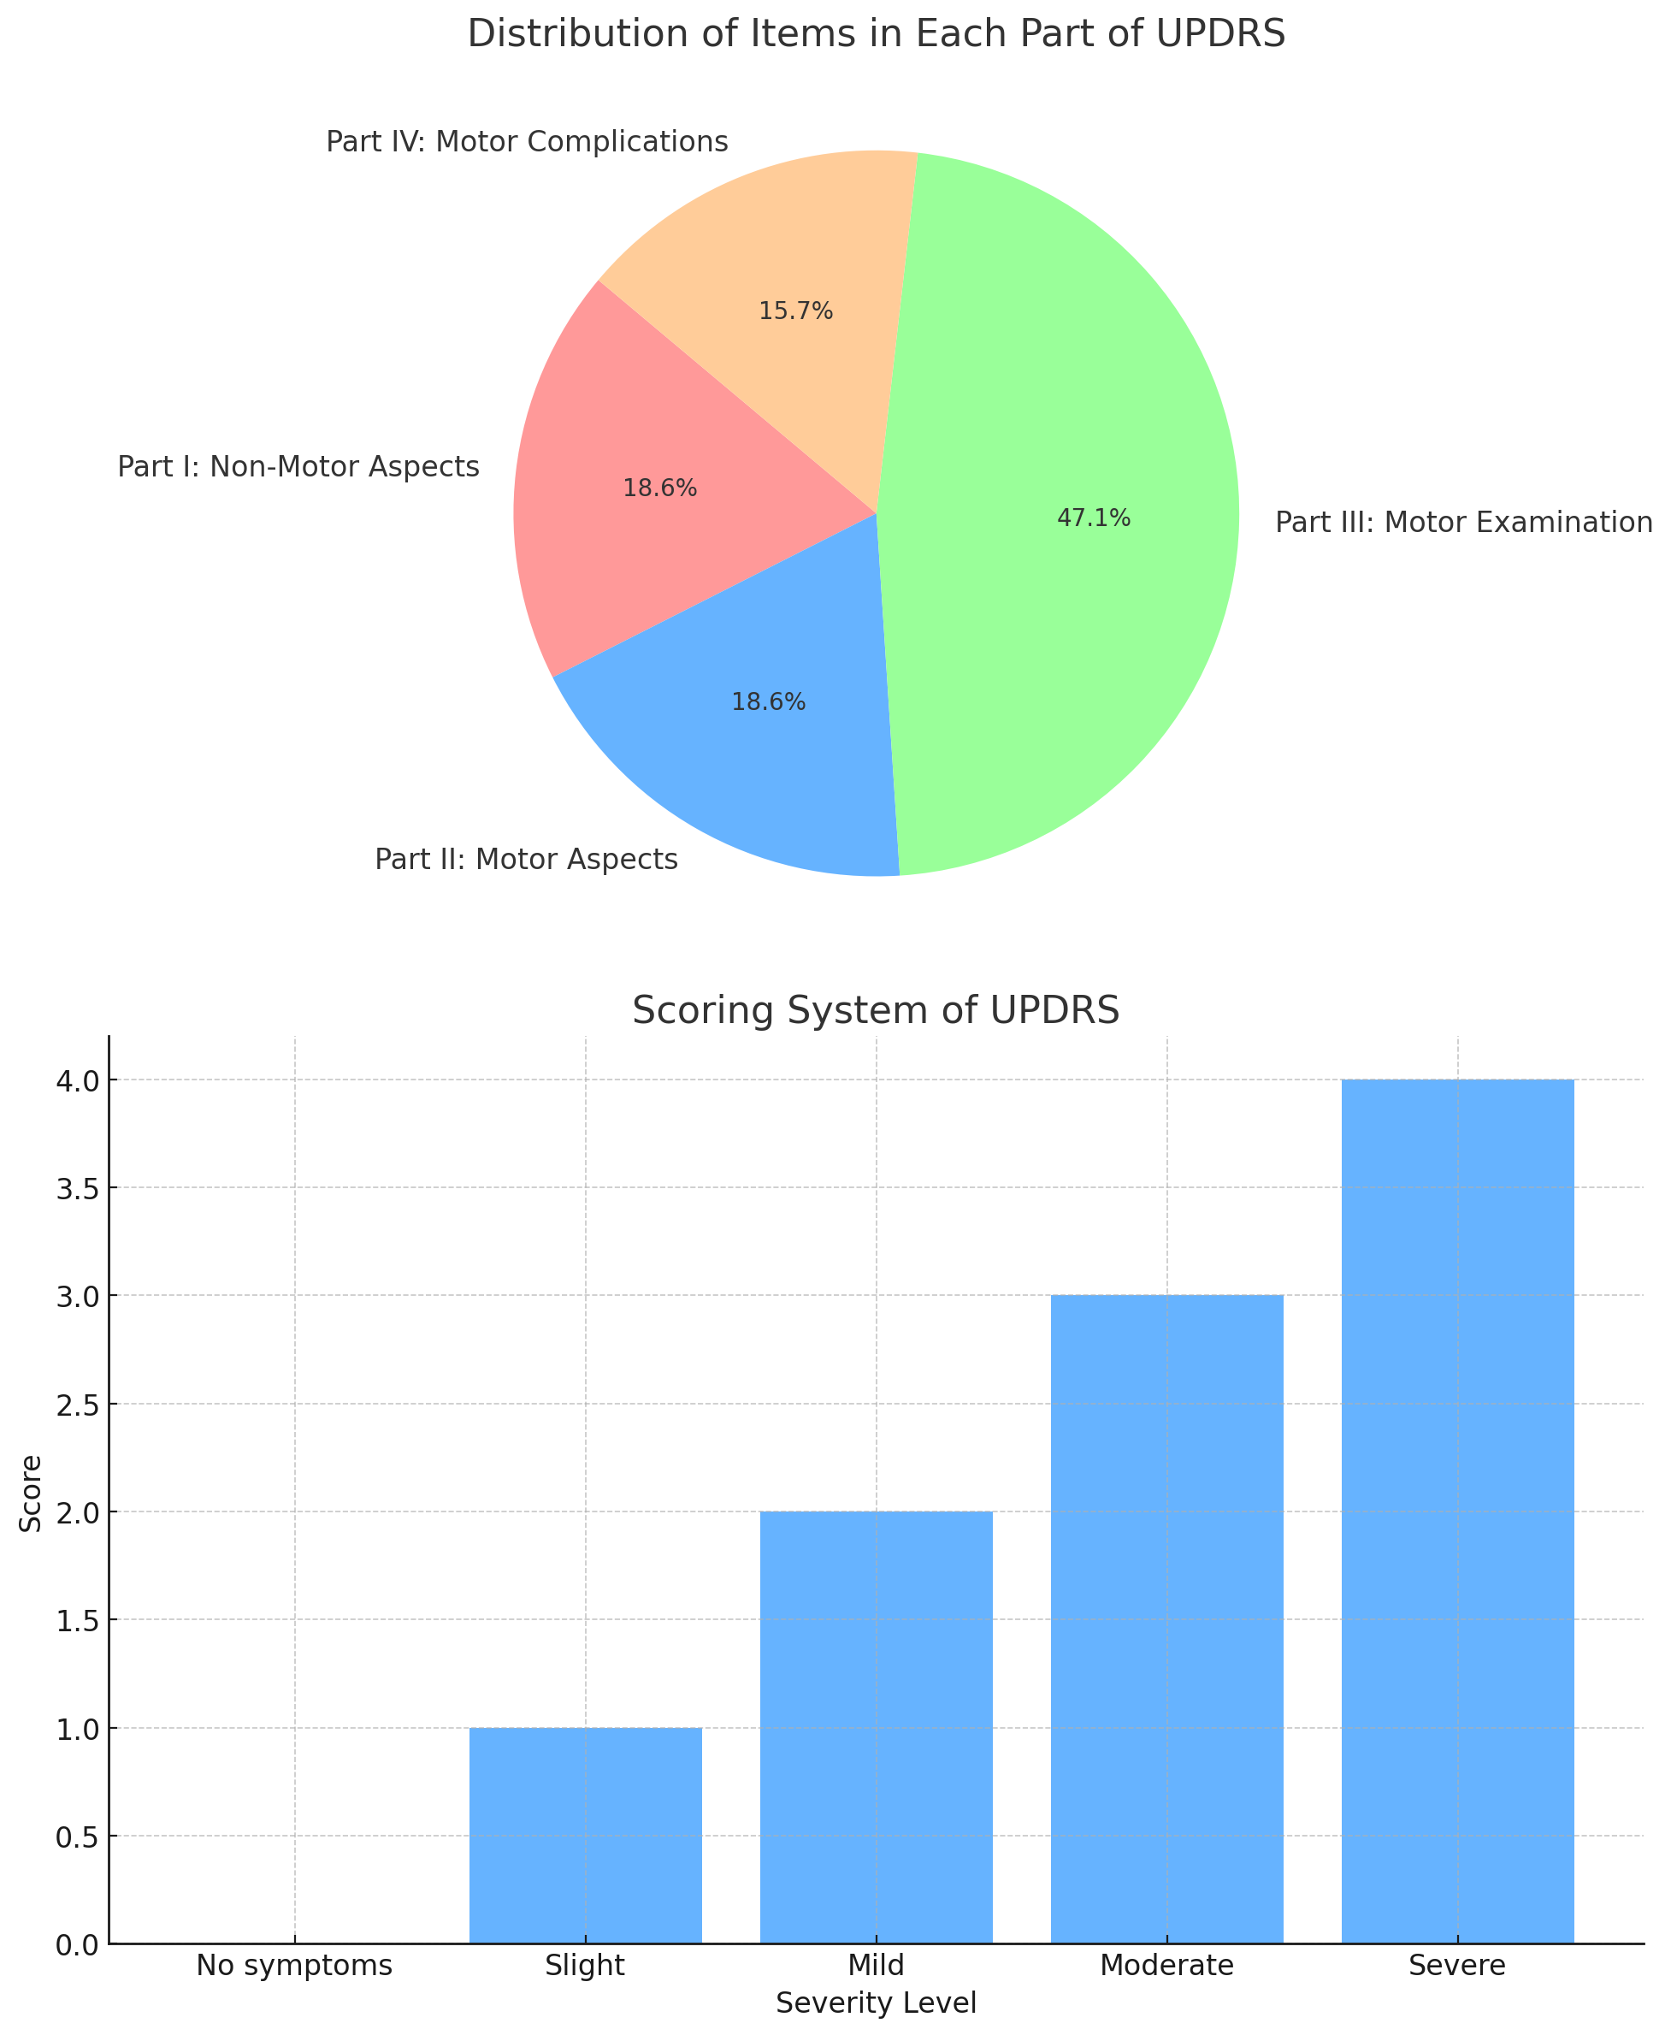

Slide 12
UPDRS LIMITATIONS
Inherent subjectivity
Requires specialized training to administer the test
Early and mild motor disability may not be detected with the UPDRS

Slide 13
Hoehn and Yahr Scale in Parkinson's Disease
It stages the severity of the disease from 1 to 5, based on motor symptoms and functional impairment.
Stage 1:
Unilateral symptoms only (one side of the body).
Mild symptoms, not disabling.
Tremor or other symptoms on one side.
Minimal or no functional impairment.
Stage 2:
Bilateral symptoms (both sides of the body).
No balance impairment.
Moderate symptoms, still not disabling.
Daily activities slightly affected.
Stage 3
Balance impairment.
Mild to moderate bilateral symptoms.
Significant slowing of movements.
Still independent but more noticeable impairment in daily activities.
Stage 4:
Severe disability.
Able to walk or stand unassisted but significantly impaired.
Daily activities highly compromised.
Requires assistance with some activities.
Stage 5:
Wheelchair-bound or bedridden unless assisted.
Severe motor impairment.
Requires constant nursing care.
Complete dependency.

Slide 14
SCHWAB AND ENGLAND ACTIVITIES OF DAILY LIVING SCALE
100% - Completely independent. Able to do all chores without slowness, difficulty, or impairment.
90% - Completely independent. Able to do all chores with some degree of slowness, difficulty, and impairment. Might take twice as long.
80% - Completely independent in most chores. Takes twice as long. Conscious of difficulty and slowness.
70% - Not completely independent. More difficulty with some chores. Three to four times as long in some chores.
60% - Some dependency. Can do most chores, but extremely slowly and with much effort. Errors and some impossibility.
50% - More dependent. Help with half of chores. Difficulty with everything.
40% - Very dependent. Can assist with all chores but few alone.
30% - Extremely dependent. Help with all chores and few alone.
20% - Severe disability. Help with most chores. Very few alone.
10% - Total disability. Can be a slight help.
0% - Vegetative functions. Bedridden.

Slide 15
MRI TECHNIQUES IN PARKINSON'S DISEASE
Structural MRI:
  Used to detect atrophy in specific brain regions.
  Helps in differentiating PD from other parkinsonian syndromes.
Diffusion Tensor Imaging (DTI):
  Measures the diffusion of water in brain tissue.
  Useful in assessing white matter integrity.
Functional MRI (fMRI):
  Monitors brain activity by detecting changes associated with blood flow.
  Helps in understanding the functional abnormalities in PD.

Slide 16
MRI Techniques in Parkinson's Disease
Diagnosis:
  MRI helps in ruling out other causes of parkinsonism.
  Specific MRI markers for PD are still being researched.
Monitoring Disease Progression:
  MRI can track changes in brain structure and function over time.
  Helps in assessing the effectiveness of therapeutic interventions.

Slide 17
MRI Techniques in Parkinson's Disease
Current Research:
  Development of new MRI biomarkers for early detection of PD.
  Studies on neuroplasticity and brain reorganization in PD.
Future Directions:
  Integration of MRI with other imaging modalities (e.g., PET, SPECT).
  Advanced MRI techniques like 7T MRI for higher resolution imaging.
  Personalized medicine approaches using MRI data.

Slide 18
Positron Emission Tomography in PD
  PET is an imaging technique that helps visualize metabolic processes in the body.
  It uses radiotracers to detect gamma rays emitted indirectly by a positron-emitting radionuclide.
  PET can assess the integrity of the dopaminergic system and monitor disease progression.
Radiotracers:
  Commonly used radiotracers: [^18F]-fluorodopa (FDOPA), [^11C]-raclopride.
  FDOPA: assesses dopamine synthesis capacity.
  Raclopride: measures dopamine receptor availability.
Imaging Process:
  Radiotracer is injected into the bloodstream.
  It accumulates in brain regions with high metabolic activity.
  PET scanner detects the gamma rays and constructs images.

Slide 19
Clinical Applications of PET in PD
Early Diagnosis:
  PET can detect dopaminergic deficits before clinical symptoms appear.
  Early intervention can be planned based on PET findings.
Monitoring Disease Progression:
  PET provides quantitative data on the extent of neuronal degeneration.
  Useful in tracking the effectiveness of therapeutic interventions.
Research Applications:
  Helps in understanding the pathophysiology of PD.
  Aids in the development of new treatment strategies.

Slide 20
Positron Emission Tomography in PD
Limitations:
  High cost and limited availability.
  Exposure to radiation, though minimal.
  Requires highly specialized equipment and personnel.
Future Directions:
  Development of new radiotracers for better specificity and sensitivity.
  Combining PET with other imaging modalities (e.g., MRI) for comprehensive analysis.
  Advancements in PET technology to reduce costs and improve accessibility.

Slide 21
Single Photon Emission Computed Tomography (SPECT) in PD
SPECT is a nuclear imaging technique that provides 3D images of blood flow and activity within the brain. It utilizes gamma-emitting radioisotopes to capture functional information.
Mechanism:
  Radiotracers (e.g., 123I-FP-CIT) bind to dopamine transporters in the brain.
  Gamma cameras detect emitted radiation, creating detailed images of the dopaminergic system.
Procedure:
  Patient preparation includes cessation of medications that may interfere with results.
  Intravenous injection of radiotracer followed by a waiting period (usually 3-4 hours) for optimal brain uptake.
  Scanning typically lasts 30-45 minutes.

Slide 22
Single Photon Emission Computed Tomography (SPECT) in PD
Limitations:
  Limited availability and high cost.
  Radiation exposure, though relatively low.
  May not distinguish between different causes of dopaminergic loss.
Future Directions:
  Development of new radiotracers with higher specificity and sensitivity.
  Combination with other imaging modalities (e.g., MRI) for comprehensive assessment.
  Integration with artificial intelligence for enhanced image analysis and diagnosis.

Slide 23
Clinical Applications of SPECT in PD
Diagnosis:
  Differentiates PD from other parkinsonian syndromes (e.g., essential tremor, vascular parkinsonism).
  Assists in early diagnosis by visualizing reduced dopaminergic activity.
Disease Progression:
  Monitors the progression of dopaminergic degeneration over time.
  Helps evaluate the efficacy of therapeutic interventions.
Research Applications:
  Used in clinical trials to measure treatment outcomes.
  Aids in understanding the pathophysiology of PD.

Slide 24
GENETIC TESTING IN PD
Why is it important to identify genetic mutations associated with Parkinson's Disease?.
  Early diagnosis and intervention.
  Personalized treatment plans.
  Familial risk assessment and genetic counseling.

Slide 25
Methods of Genetic Testing in Parkinson's Disease
Testing Techniques
Clinical Application
Single Gene Testing: Focuses on specific known mutations.
Panel Testing: Screens multiple genes simultaneously.
Whole Exome Sequencing (WES): Analyzes all coding regions in the genome.
Whole Genome Sequencing (WGS): Comprehensive analysis of the entire genome.
Diagnostic Testing: Confirms diagnosis in symptomatic individuals.
Predictive Testing: Identifies risk in asymptomatic individuals with family history.
Carrier Testing: Determines carrier status for recessive genes.

Slide 26
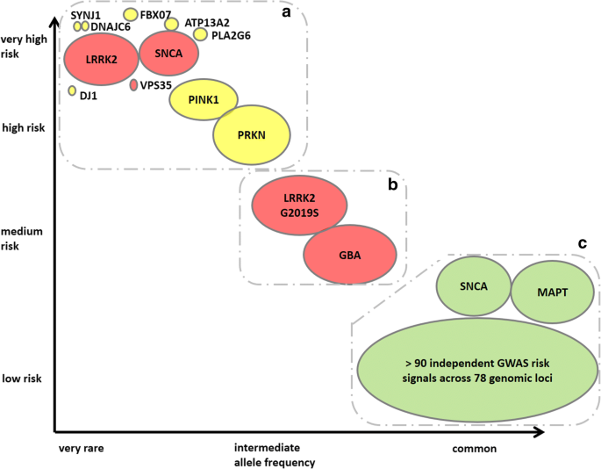
GENETIC TESTING IN PD
Common Genetic Mutations
Inheritance Patterns
SNCA (Alpha-Synuclein):
  Role: Involved in synaptic function.
  Mutations: A53T, A30P, E46K.
LRRK2 (Leucine-Rich Repeat Kinase 2):
  Role: Implicated in protein phosphorylation.
  Common Mutation: G2019S.
Parkin (PARK2):
  Role: E3 ubiquitin-protein ligase.
  Mutations: Various loss-of-function mutations.

Slide 27
GENETIC TESTING IN PD
Common Genetic Mutations
Inheritance Patterns
Autosomal Dominant:
  SNCA
  LRRK2.
Autosomal Recessive:
  Parkin,
  PINK1,
  DJ-1.

Slide 28
GENETIC TESTING IN PD
Ethical Considerations
Genetic Counseling: Essential before and after testing.
Privacy and Confidentiality: Protecting patient genetic information.
Informed Consent: Ensuring patients understand the implications of testing.

Slide 29
GENETIC TESTING IN PD
Future Directions
Gene Therapy: Exploring potential treatments targeting specific mutations.
Biomarker Development: Identifying early disease markers through genetic research.
Personalized Medicine: Tailoring treatments based on genetic profiles.

Slide 30
ROLE OF CEREBROSPINAL FLUID (CSF) IN PD
CSF is clear, colorless body fluid found in the brain and spinal cord. It provides mechanical protection, nutrient transport, and waste removal.
CSF in Neurodegenerative Diseases
Analysis can provide biomarkers for diagnosis and progression.
Helps in understanding disease mechanisms.
Significance in PD
Potential to identify PD-specific biomarkers.
Aids in differentiating PD from other neurodegenerative diseases.

Slide 31
KEY CSF BIOMARKERS IN PARKINSON'S DISEASE
Alpha-synuclein
Major component of Lewy bodies.
Total alpha-synuclein levels typically reduced in PD patients.
Tau Protein
Associated with microtubule stability.
Increased total tau and phosphorylated tau levels observed in PD.
Beta-amyloid 1-42
Fragment of amyloid precursor protein.
Lower levels in PD, similar to Alzheimer's disease.
Neurofilament Light Chain (NfL)
Marker of neuronal damage.
Elevated levels in PD and correlate with disease severity

Slide 32
CSF BIOMARKERS IN PARKINSON'S DISEASE
Diagnostic Utility
CSF biomarker profiles can improve diagnostic accuracy.
Early detection through CSF analysis may allow timely intervention.
Therapeutic Monitoring
Biomarkers can track disease progression and treatment response.
Research and Development
Ongoing studies to identify novel biomarkers.
Aim to enhance personalized medicine approaches.
Challenges
Standardization of CSF collection and analysis methods.
Need for large-scale longitudinal studies.

Slide 33
Neuropsychological Testing in Parkinson's Disease
Cognitive Impairment in PD
Cognitive impairment can range from mild cognitive impairment (MCI) to Parkinson's Disease Dementia (PDD).
Common cognitive deficits include executive dysfunction, memory problems, and visuospatial difficulties.

Slide 34
WHY IS NEUROPSYCHOLOGICAL TESTING IN PD CRUCIAL
Helps in diagnosing cognitive impairments early.
Assists in differentiating PD from other neurodegenerative diseases.
Guides treatment and management strategies.

Slide 35
COMPONENTS OF NEUROPSYCHOLOGICAL TESTING
Executive Function Tests: Wisconsin Card Sorting Test, Trail Making Test.
Memory Tests: Rey Auditory Verbal Learning Test, Wechsler Memory Scale.
Visuospatial Tests: Clock Drawing Test, Benton Visual Retention Test.
Language Tests: Boston Naming Test, Verbal Fluency Test.

Slide 36
EXECUTIVE FUNCTION IN PD
Patients with PD often exhibit deficits in planning, problem-solving, and multitasking.
Tests like the Stroop Test and the Wisconsin Card Sorting Test are commonly used.

Slide 37
MEMORY ASSESSMENT IN PD
Both short-term and long-term memory can be affected in PD.
The Rey Auditory Verbal Learning Test is useful for assessing verbal memory, while the Wechsler Memory Scale evaluates different memory domains.

Slide 38
VISUOSPATIAL ABILITIES IN PD
Difficulties in visual perception and spatial orientation are frequent.
The Clock Drawing Test and the Benton Visual Retention Test are standard tools.

Slide 39
LANGUAGE SKILLS IN PD
Language can be impacted, with issues in naming, fluency, and comprehension.
The Boston Naming Test and Verbal Fluency Test help in assessing these abilities.

Slide 40
Olfactory Testing in Parkinson's Disease
Early Indicator: Olfactory dysfunction often precedes motor symptoms by years, serving as an early indicator of PD.
Diagnostic Tool: Helps differentiate PD from other NDDs
Disease Monitoring: Assists in tracking disease progression and response to treatment.
Quality of Life: Affects patient's quality of life, as olfaction is linked to flavor perception and safety (e.g., detecting smoke).

Slide 41
OLFACTORY TESTING IN PARKINSON'S DISEASE
METHODS
Sniffin' Sticks Test: Commonly used method involving odor identification, discrimination, and threshold tests.
University of Pennsylvania Smell Identification Test (UPSIT): A standardized 40-item smell identification test.
Brief Smell Identification Test (B-SIT): A shorter version of UPSIT, useful in clinical settings.
Olfactory Threshold Test: Measures the lowest concentration of an odorant that a person can detect.

Slide 42
AUTONOMIC DYSFUNCTION IN PARKINSON'S DISEASE
Autonomic dysfunction is a common non-motor symptom in PD.
Early identification of autonomic dysfunction can improve patient management and quality of life.

Slide 43
AUTONOMIC DYSFUNCTION IN PARKINSON'S DISEASE
Cardiovascular Tests:
  Heart Rate Variability (HRV)
  Blood Pressure Response to Postural Changes
  Valsalva Maneuver
Sweat Tests:
  Quantitative Sudomotor Axon Reflex Test (QSART)
  Thermoregulatory Sweat Test
Gastrointestinal Tests:
  Gastric Emptying Studies
  Colonic Transit Time

