Slide 1

Pharmacotherapy for Alzheimer disease, novel approaches in treatment
Pille Taba, Ülle Krikmann

Slide 2
Aims of the lecture
By the end of this lecture the student should be able to understand and explain
the mechanisms of pharmacotherapy acetylcholinesterase inhibitors end memantine
The indications for treatment
Management with the adverse effects
Stoping the treatment

Slide 3
Content of lecture
  Alzheimer disease pharmacotherapy
    General overview treatment approach
    An acetylcholinesterase inhibitors pharmacological action mechanism, adverse effects,
    Memanatine action mechanism, adverse effects
    Add-on therapy

Slide 4
Methods of learning
Lecture 1 hour
Seminar: questions and discussion 1 hour

Slide 5
Literature
Mandatory:
Optional:

Slide 6
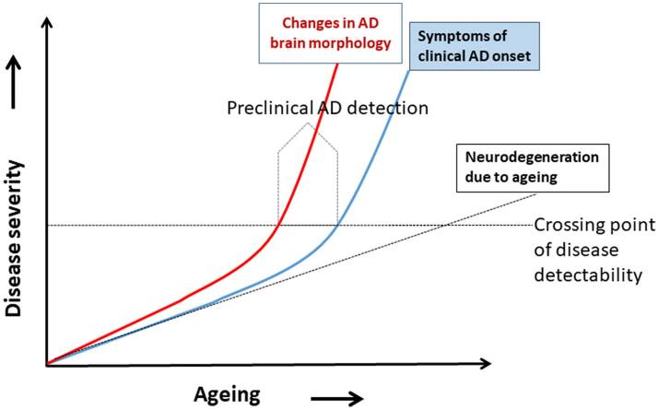
Treatment
An Algorithm for Preclinical Diagnosis of Alzheimer's Disease.

Slide 7
Evidence based interventions for cognitive
Evidence based pharmcological treatment
Alzheimer`s patient, care giver
Comorbidity treatment
Behavoir
Supporting caregiver

Slide 8
Donepesil
Reversible non-competitive acetylcholinesterase inhibitor
Oral immediate release
Initial dose 5 mg daily increase after 1 month to maintenance dose 10 mg daily
Oral sustained release 23 mg film-coated tablett
Protein binding: primarily proteinbound
Metabolism: hepatic, via CYP2D6 and CYP 3A4; 2 active and 2 inactive metabolites
Half-life: 70 hours
Adverse effects
Nausea, vomiting, loss of appetite, weight loss, diarrhea
Bradycardia, heart block, QT prolongation
Dizziness, syncope
Insomnia, abnormal dreams, fatigue, drowsiness
Headache
Muscle cramps, rare reports of
rhabdomyolysis and neuroleptic malignant
syndrome
Levels may be increased in patients with hepatic impairment, CYP2D6 slow metabolizers, and with concurrent CYP2D6 or CYP3A4 inhibitors such as sertraline

Slide 9
Rivastigmine
Acetylcholinesterase and butylcholinesterase inhibiitor
Oral
Initial dose 1.5 mg BID with meals, increase by 3 mg daily every 2 weeks to maintenance doose of 6 mg BID
Transdermal patch
Initial dose 4.6 mg patch to upper back daily increase no sooner than 4 weeks to 9.5 mg/day patch and then to maximum dose of 13.3 mg/day patch. Rotate patch site to reduce skin irritation
Protein binding: 40%
Metabolism: hydrolyzed in brain, then metabolite further processed in liver independent of CYP system then eliminated in urine
Half life: 1.5 hours (oral), 3 hours (after patch removal), but clinical effect ~10 hours due to pseudoirreversible nature of inhibition
Adverse effec
Nausea, vomiting, diarrhea, loss of appetite, abdominal pain, weight loss
Irritation at application site (patch)
Allergic dermatitis (both formulations)
Rare hypersensitivity reaction and Stevens-
Johnson syndrome
Bradycardia, heart block, dizziness, syncope, falls
Insomnia, fatigue
Headache
Tremor
Avoid with concurrent β blocker therapy. Clearance is increased in smokers and decreased in liver and moderate renal impairment but increased in severe renal impairment

Slide 10
Galantamine
Reversible, competitive acetylcholinesterase inhibiitor and modulator of nicotinic acetylcholine receptor
Oral immediate release
Initial dose 4 mg BID increase by 8 mg daily every 4 weeks to maintenance dose of 12 mg BID
Oral extended release
Initial dose 8 mg daily increase by 8 mg daily every 4 weeks to maintenance dose of 24 mg daily
Also available as oral solution
Protein binding: low
Metabolism: hepatic via CYP2D6
Half-life: 7 hours
Adverse effects
Nausea, vomiting, decreased appetite, weight loss, diarrhea, abdominal pain
Bradycardia, heart block, dizziness, syncope, falls
Rare hypersensitivity reactions, Stevens-Johnson syndrome and another rash
Levels increased in hepatic and renal impairment and in CYP2D6 slow metabolizers

Slide 11
Memantine
Non-competitive NMDA antagonist
Immediate release initial
titration
Week 1: 5 mg daily
Week 2: 5 mg BID
Week 3: 10 mg qam, 5 mg QHS
Week 4 and after: 10 mg BID
Sustained release Namenda XR
Initial dose: 7 mg daily, Increase weekly in increments of 7 mg to maintenance dose of 28 mg daily
Available in combination with donepezil
Protein binding: 45%
Metabolism: almost 50% excreted unchanged in urine; remainder undergoes hepatic metabolism
independent of CYP system
Half-life: 60-80 hours
Adverse effects
Generally well tolerated without consistent pattern of adverse effects; for example, package labeling includes
both hypertension and hypotension,
and constipation and diarrhea
Rare hypersensitivity reactions have been reported
Canadian package label recommends periodic eye exams due to worsening of corneal disease
Clearance is reduced by alkaline urine and by liver and renal impairment

Slide 12
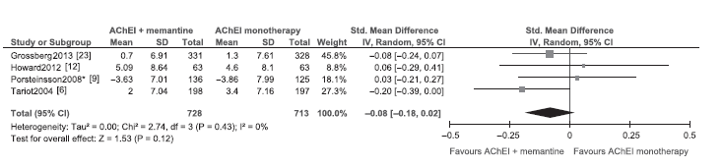
Add-on therapy: combination

