Slide 1
4.1 CLINICAL EXAMINATION
GP2 - Clinical assessment and outcome measurement
Zvezdan Pirtošek University of Ljubljana

Slide 2
LEARNING OBJECTIVES
Learning objective 1: to understand the value of neurological examination
Learning objective 2: to know the main structure and logic of neurological examination

Slide 3
CLINICAL ASSESSMENT – EXAMINATION
Mental status
Evaluation of the nerves of the brain.
Motor function and balance
Sensory exam
Gait
Deep tendon reflexes
Meningeal signs

Slide 4
ASSESSMENT OF MENTAL STATUS
begins during the interview giving a clinician a general feel of the patient's condition.
a quick mental status exam may involve asking for orientation to time, place, and person.
a healthy patient is recognized to be "awake," "alert" (responding appropriately), and "oriented" (aware of self, place, and time).
if disorientation or memory lapses are present, a mini-mental status examination should be done.
mood and affect also require assessment
Notes:
The mental status examination begins during the interview. Assessment of the patient's cognitive abilities such as language usage, chronology in the recollection of events, and significance of answers will give a clinician a general feel of the patient's condition. A quick mental status exam may involve asking for orientation to time, place, and person. A healthy patient is recognized to be "awake," "alert" (responding appropriately), and "oriented" (aware of self, place, and time). If disorientation or memory lapses (especially in the elderly) are present, a mini-mental status examination can be done. This will assess further the patient's orientation, registration, attention, recall, language, repetition, complex commands, and visuospatial function. Any abnormality in a specific function may warrant further investigation that is not covered by this article. Abnormalities in these areas can point to lesions in specific areas of the cortex (e.g., difficulty in repetition may involve the arcuate fasciculus of the dominant hemisphere—the pathway between Wernicke's area and Broca's area). Mood and affect also require assessment.
Norris D, Clark MS, Shipley S. The Mental Status Examination. Am Fam Physician. 2016 Oct 15;94(8):635-641.

Slide 5
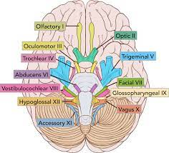
ASSESSMENT OF CRANIAL NERVES
CN I: Olfactory nerve
CN II: Optic nerve
CN III: Oculomotor nerve
CN IV: Trochlear nerve
CN V: Trigeminal nerve
CN VI: Abducens nerve
CN VII: Facial nerve
CN VIII: Vestibulocochlear nerve
CN IX: Glossopharyngeal nerve
CN X: Vagus nerve
CN XI: Spinal accessory nerve
CN XII: Hypoglossal nerve

Slide 6
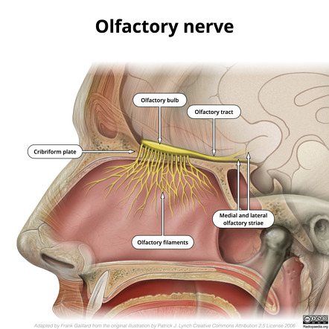
ASSESSMENT OF CRANIAL NERVE I
Smell
Very important in NDD
Ask the patient to close their eyes.
Present familiar, non-irritating odors (e.g., coffee, mint) one nostril at a time.
Ask the patient to identify the odor.
Repeat with different scents in each nostril.
Impaired or absent smell may indicate olfactory nerve dysfunction.
Notes:
Olfactory nerve (Cranial nerve I) - This is the least tested of cranial nerves in the clinical setting. To test function involves the assessment of the patient's sense of smell. Start with one nostril while covering the opposing nostril to allow for proper detection of any abnormal findings. Do this for both sides. The most common causes of anosmia, the loss of smell, are the following: infections, allergies, or nasal polyps. Other causes include trauma (fracture of the cribriform plate), Parkinson disease, lesions at the base of the skull (meningioma), or rare genetic conditions.[10]
Boesveldt S, Postma EM, Boak D, Welge-Luessen A, Schöpf V, Mainland JD, Martens J, Ngai J, Duffy VB. Anosmia-A Clinical Review. Chem Senses. 2017 Sep 01;42(7):513-523.

Slide 7
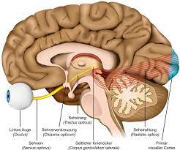
ASSESSMENT OF CRANIAL NERVE II
Assess visual acuity by asking the patient to read from an eye chart.
Examine the visual fields by using the confrontation test.
Evaluate the pupillary light reflex and the accommodation reflex to assess the function of the pupils and eye movement.
Inspect the optic disc and retina using an ophthalmoscope for signs of optic nerve and retinal abnormalities.
Notes:
Optic nerve (Cranial nerve II) – Assessment of the optic nerve function includes a test for visual acuity and visual fields. Each eye is tested separately. Most problems with visual acuity are ophthalmologic in origin; however, damage to this nerve, like pseudobulbar neuritis or pressure from a pituitary tumor, can present with monocular blindness and visual field cuts. The extent of involvement will depend on what they can see during the examination as compared to the baseline.[11] Furthermore, the pupillary light reflex can be tested by shining a light directly into the eye. The afferent limb of this reflex is found on the optic nerve; the sensory input. Shining a light on one eye should show a constriction of the pupils on both eyes. The failure of the pupils to constrict could indicate either an optic nerve lesion, a lesion of the efferent limb (oculomotor nerve), or any lesion along the pathway. A dilated pupil that is unresponsive to light may indicate a lesion on the efferent limb of the pathway, while a constricted pupil can point to a lesion on the cervical sympathetic chain. A fundoscopic examination is also done to visualize the optic disk. Abnormalities like papilledema or retinal hemorrhages are red flags that can point to life-threatening conditions like increased intracranial pressure and subarachnoid hemorrhage.[12]
Kniestedt C, Stamper RL. Visual acuity and its measurement. Ophthalmol Clin North Am. 2003 Jun;16(2):155-70
Dhoot R, Margolin E. StatPearls [Internet]. StatPearls Publishing; Treasure Island (FL): Aug 8, 2022. Papilledema.

Slide 8
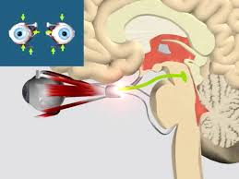
ASSESSMENT OF CRANIAL NERVE III
Eye Movements: Assess the patient's ability to move the eyes in different directions, including upward, downward, and inward.
Pupillary Response: Examine the size and reactivity of the pupils, looking for equal size and brisk reactions to light.
Notes:
Oculomotor, trochlear, and abducens nerves (Cranial nerve III, IV, and VI) are the nerves for extraocular muscle movement. Assessment involves drawing an invisible "H" in front of the patient and asking the patient to follow with their eyes. Abnormal findings present as disconjugate gaze or double vision. The involvement of the third cranial nerve by compression (aneurysm of the posterior communicating artery) leads to dilated pupil, ptosis, and eyes looking outward and downward. Lateral rectus palsy is due to the involvement of the sixth cranial nerve; it can be a false localizing sign in increased intracranial pressure (bilateral lateral rectus palsy). The involvement of the pathways in the brainstem (e.g., lacunar infarct, multiple sclerosis) can lead to internuclear ophthalmoplegia. This condition occurs when the medial longitudinal fasciculus (MLF), a heavily myelinated pathway that allows for coordinated horizontal gaze, is damaged.[13]
Virgo JD, Plant GT. Internuclear ophthalmoplegia. Pract Neurol. 2017 Apr;17(2):149-153.

Slide 9
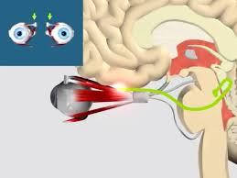
ASSESSMENT OF CRANIAL NERVE IV
Eye Movements: Evaluate the patient's ability to move one eye downward and inward.
Coordinated Movement: Check for coordinated movements of the eyes during this specific action.
Notes:
Oculomotor, trochlear, and abducens nerves (Cranial nerve III, IV, and VI) are the nerves for extraocular muscle movement. Assessment involves drawing an invisible "H" in front of the patient and asking the patient to follow with their eyes. Abnormal findings present as disconjugate gaze or double vision. The involvement of the third cranial nerve by compression (aneurysm of the posterior communicating artery) leads to dilated pupil, ptosis, and eyes looking outward and downward. Lateral rectus palsy is due to the involvement of the sixth cranial nerve; it can be a false localizing sign in increased intracranial pressure (bilateral lateral rectus palsy). The involvement of the pathways in the brainstem (e.g., lacunar infarct, multiple sclerosis) can lead to internuclear ophthalmoplegia. This condition occurs when the medial longitudinal fasciculus (MLF), a heavily myelinated pathway that allows for coordinated horizontal gaze, is damaged.[13]
Virgo JD, Plant GT. Internuclear ophthalmoplegia. Pract Neurol. 2017 Apr;17(2):149-153.

Slide 10
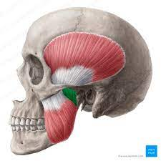
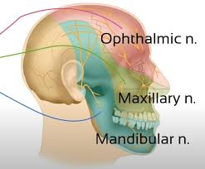
ASSESSMENT OF CRANIAL NERVE V
This nerve is responsible for
facial sensation: assess pain, touch, and temperature sensations on the face
motor control of the muscles used for chewing: checking for symmetrical jaw strength and reflexes.
Notes:
Trigeminal nerve (Cranial nerve V) – this nerve supplies the sensation to the face, the motor nucleus is responsible for biting and chewing. Assessment of this nerve involves asking the patient to clench their jaw and test for the sensation of the ophthalmic, maxillary, and mandibular branches. Therefore, a weakness of the muscle of mastication or sensory deficit on the ipsilateral side suggests its involvement. This is also the afferent pathway for the blink reflex (the efferent pathway being the facial nerve). A corneal reflex is usually performed in comatose patients to assess brainstem function. An absence in an awake patient may point to a localized lesion affecting either the trigeminal nerve the facial nerve or both.[14]
Walker HK. Cranial Nerve V: The Trigeminal Nerve. In: Walker HK, Hall WD, Hurst JW, editors. Clinical Methods: The History, Physical, and Laboratory Examinations. 3rd ed. Butterworths; Boston: 1990.

Slide 11
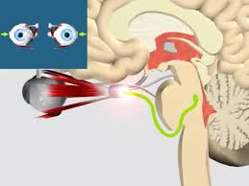
ASSESSMENT OF CRANIAL NERVE VI
Eye Movements: Test the ability to move one eye outward.
Coordination: Observe for coordinated lateral eye movements.
Notes:
Oculomotor, trochlear, and abducens nerves (Cranial nerve III, IV, and VI) are the nerves for extraocular muscle movement. Assessment involves drawing an invisible "H" in front of the patient and asking the patient to follow with their eyes. Abnormal findings present as disconjugate gaze or double vision. The involvement of the third cranial nerve by compression (aneurysm of the posterior communicating artery) leads to dilated pupil, ptosis, and eyes looking outward and downward. Lateral rectus palsy is due to the involvement of the sixth cranial nerve; it can be a false localizing sign in increased intracranial pressure (bilateral lateral rectus palsy). The involvement of the pathways in the brainstem (e.g., lacunar infarct, multiple sclerosis) can lead to internuclear ophthalmoplegia. This condition occurs when the medial longitudinal fasciculus (MLF), a heavily myelinated pathway that allows for coordinated horizontal gaze, is damaged.[13]
Virgo JD, Plant GT. Internuclear ophthalmoplegia. Pract Neurol. 2017 Apr;17(2):149-153.

Slide 12
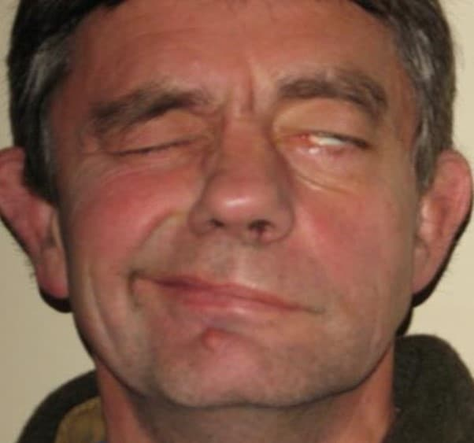
ASSESSMENT OF CRANIAL NERVE VII
assesses facial muscle strength, symmetry, and coordination
includes testing facial expressions, such as smiling, frowning, and raising eyebrows, and evaluating the patient's ability to close their eyes tightly and puff out their cheeks
the examination may also involve assessing taste on the anterior two-thirds of the tongue and sensitivity to sound in the ear.
Notes:
The facial nerve (Cranial nerve VII) supplies the muscles of facial expression, stapedius muscle, and taste to the anterior two- of the tongue. Assessment of this nerve involves asking the patient to move their facial muscles by asking them to raise their eyebrows, close their eyes tightly, smile, and blow up their cheeks. The location of weakness in facial muscles can differentiate between peripheral or central involvement. A weakness with the movement of the entire right side of the face is indicative of either a peripheral lesion or damage to the facial nucleus on the ipsilateral side, like in Bell's palsy or a pontine infarct. A weakness of the lower half of the face with sparing of the forehead is suggestive of a lesion above and contralateral to the facial nerve (stroke involving the motor cortex). This is because the forehead has innervation from both the left and right sides of the motor cortex. [15] Damage to the facial nerve can also present with hyperacusis and loss of taste to the anterior 2/3 of the tongue.
Sonne J, Lopez-Ojeda W. StatPearls [Internet]. StatPearls Publishing; Treasure Island (FL): Dec 9, 2022. Neuroanatomy, Cranial Nerve.

Slide 13
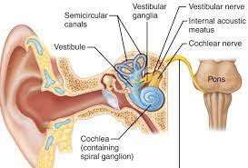
ASSESSMENT OF CRANIAL NERVE VIII
assesses hearing and balance
it typically includes clinical assessment of hearing or audiometry to evaluate hearing
the Romberg test to assess balance and coordination
Notes:
The vestibulocochlear nerve (Cranial nerve VIII) supplies functions in hearing and equilibrium. Gross assessment of function can be done by whispering words behind the patient, rubbing fingers or hair together close to the ear, and asking if the patient can hear. If a hearing deficit is established, doing a Weber and Rinne test can differentiate sensorineural from conductive hearing loss. A normal Rinne exam will exhibit air conduction (AC) greater than bone conduction (BC). A conductive hearing loss will show BC greater than AC. In patients with sensorineural hearing loss, AC will be greater than BC, but for a shorter duration when compared to a normal subject. A normal Weber test shows hearing the sound/vibration equally in both ears. A conductive hearing loss will lateralize the sound to the abnormal ear while a sensorineural hearing loss will lateralize to the normal ear.[16]
Kong EL, Fowler JB. StatPearls [Internet]. StatPearls Publishing; Treasure Island (FL): Jan 30, 2023. Rinne Test.

Slide 14
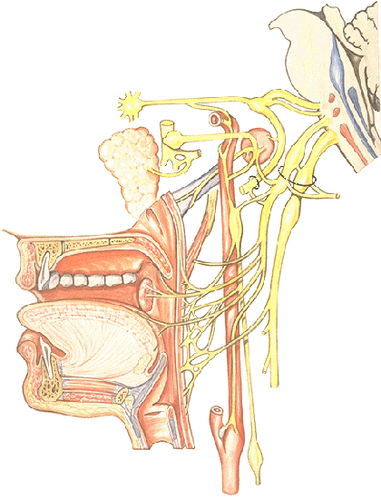
ASSESSMENT OF CRANIAL NERVE IX
assessing a patient's ability to swallow, taste in the posterior third of the tongue, and the gag reflex.
observe the movement of the soft palate, the elevation of the pharynx during swallowing,
assess taste sensation
Notes:
The glossopharyngeal and vagus nerves (Cranial nerve IX and X) innervate the pharynx and posterior third of the tongue. The vagus nerve innervates the pharynx, larynx, and gastrointestinal tract motility and function. Assessment of these nerves includes listening as the patient talks, watching out for hoarseness, or nasal speech. The patient can also be asked to swallow some water and observed for coughing or gurgling speech, which may indicate weakness of the muscles involving swallowing. Ask the patient to open the mouth and say "ah," and observe the palatal arch for asymmetry. The deviation of the uvula to one side indicates a vagal nerve lesion on the opposite side.[17]
Erman AB, Kejner AE, Hogikyan ND, Feldman EL. Disorders of cranial nerves IX and X. Semin Neurol. 2009 Feb;29(1):85-92

Slide 15
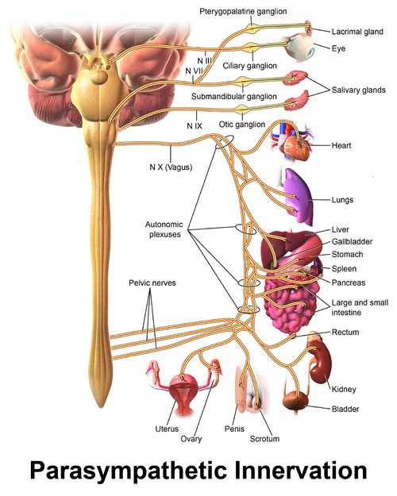
ASSESSMENT OF CRANIAL NERVE X
assessing its functions related to the throat, palate, and vocal cords
observing swallowing, speech, and the gag reflex
additionally, the vagus nerve's impact on heart rate and digestive functions may be evaluated through clinical tests.
Notes:
The glossopharyngeal and vagus nerves (Cranial nerve IX and X) innervate the pharynx and posterior third of the tongue. The vagus nerve innervates the pharynx, larynx, and gastrointestinal tract motility and function. Assessment of these nerves includes listening as the patient talks, watching out for hoarseness, or nasal speech. The patient can also be asked to swallow some water and observed for coughing or gurgling speech, which may indicate weakness of the muscles involving swallowing. Ask the patient to open the mouth and say "ah," and observe the palatal arch for asymmetry. The deviation of the uvula to one side indicates a vagal nerve lesion on the opposite side.[17]
Erman AB, Kejner AE, Hogikyan ND, Feldman EL. Disorders of cranial nerves IX and X. Semin Neurol. 2009 Feb;29(1):85-92

Slide 16
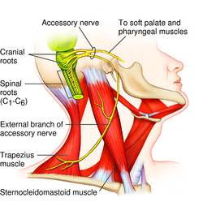
ASSESSMENT OF CRANIAL NERVE XI
examined for muscle strength and coordination in the neck and shoulder areas
assessing the ability to turn the head and shrug the shoulders against resistance.
Notes:
The spinal accessory nerve (Cranial nerve XI) innervates the muscles of the thorax, back, and shoulders. Assessment involves asking the patient to turn their head to the side against resistance and shrug their shoulders. The weakness of the sternocleidomastoid or atrophy of the trapezius muscle may indicate involvement.[18]
Bordoni B, Reed RR, Tadi P, Varacallo M. StatPearls [Internet]. StatPearls Publishing; Treasure Island (FL): Jul 18, 2022. Neuroanatomy, Cranial Nerve 11 (Accessory)

Slide 17
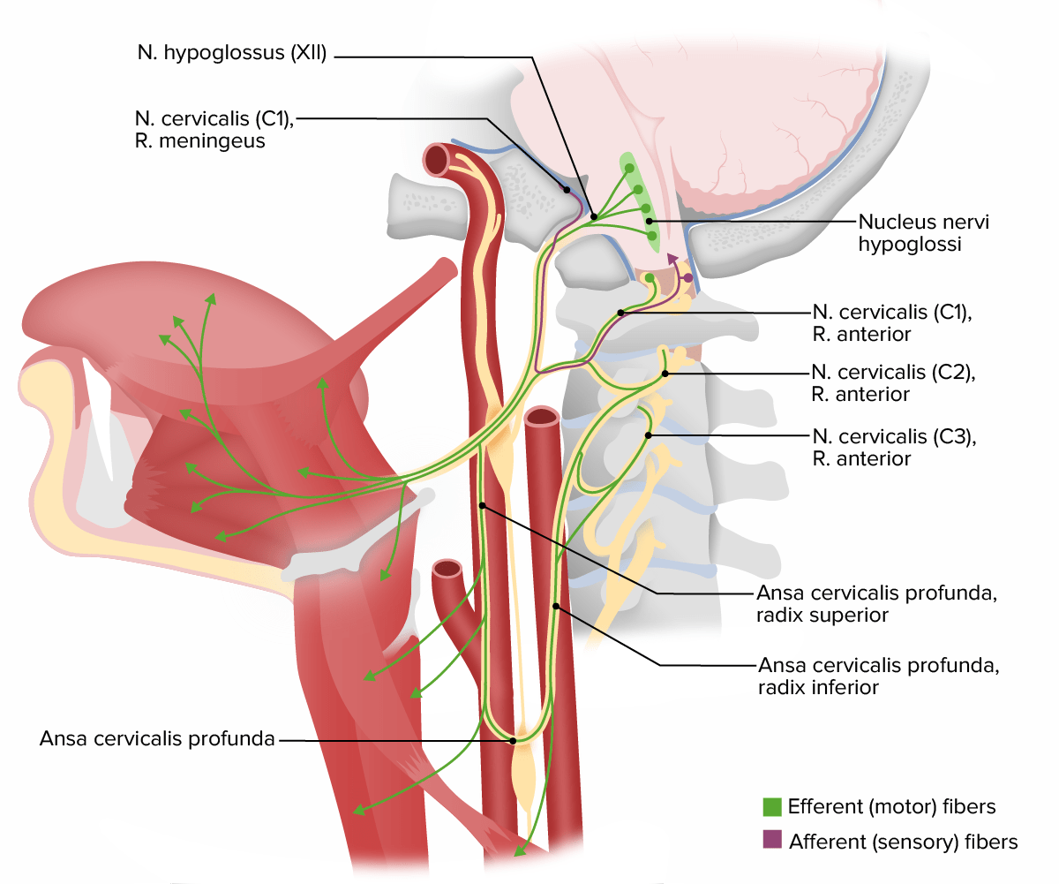
ASSESSMENT OF CRANIAL NERVE XII
Motor Function Assessment of tongue:
Observe tongue movement for symmetry and at rest.
Ask the patient to stick out their tongue.
Assess the ability to move the tongue side to side.
Request the patient to push their tongue against the inside of their cheek.
Evaluate the resistance and strength of the tongue movement.
Assess speech clarity and articulation,
Note any signs of atrophy, fasciculations, or weakness in the tongue muscles (ALS).
Notes:
The hypoglossal nerve (Cranial nerve XII) innervates the motor component of the tongue. Assessment involves inspection of the tongue in the relaxed position inside the mouth, the presence of increased corrugation and fasciculations may indicate a lower motor neuron involvement. Also, ask the patient to stick out the tongue, the deviation to one side is indicative of a lesion on the same side.[19]
Finsterer J, Grisold W. Disorders of the lower cranial nerves. J Neurosci Rural Pract. 2015 Jul-Sep;6(3):377-91

Slide 18
ASSESSMENT OF MOTOR SYSTEM
Notes:
In a neurological status examination, the motor examination is a crucial component that focuses on assessing the strength, coordination, and function of a patient's motor system. It is used to detect abnormalities in motor function and can provide important diagnostic information. The motor examination typically includes the following components:
Muscle Strength:
Assess muscle strength in various muscle groups using the Medical Research Council (MRC) scale or other standardized grading systems. The MRC scale typically ranges from 0 to 5, with 0 indicating no movement and 5 indicating normal strength.
Evaluate muscle strength bilaterally, comparing one side of the body to the other. Note any asymmetry.
Muscle Bulk and Tone:
Observe muscle bulk and assess for muscle atrophy (wasting) or hypertrophy (enlargement).
Evaluate muscle tone by passive range of motion. Look for increased tone (spasticity) or decreased tone (hypotonia).
Coordination:
Assess coordination and fine motor control with tests like finger-nose-finger, heel-shin, or finger tapping. Check for dysdiadochokinesia (difficulty with rapid alternating movements).
Perform tests of rapid alternating movements to evaluate the patient's ability to perform tasks like pronation/supination of the hands or rapid toe tapping.
Gait and Balance:
Observe the patient's gait (the way they walk) to detect abnormalities such as weakness, spasticity, ataxia (incoordination), or festination (shuffling gait).
Evaluate balance by asking the patient to stand with feet together (tandem gait) or to stand on one foot (Romberg test). Assess for any imbalance or swaying.
Reflexes (Deep Tendon Reflexes):
Test deep tendon reflexes (DTRs) using a reflex hammer. Common reflexes tested include the:
Biceps reflex (C5-C6)
Triceps reflex (C7)
Brachioradialis reflex (C5-C6)
Patellar reflex (L2-L4)
Achilles reflex (S1-S2)
Assess for the presence or absence of reflexes and any hyperreflexia or hyporeflexia.
Pathological Reflexes:
Check for the presence of pathological reflexes such as the Babinski sign (extensor plantar response) or the Hoffman sign. These reflexes can indicate upper motor neuron dysfunction.
Muscle Fasciculations and Fibrillations:
Observe for muscle fasciculations (spontaneous muscle twitches) and fibrillations (small, spontaneous muscle contractions) that can be indicative of lower motor neuron involvement.
Strength Patterns and Distribution:
Note the patterns of weakness and their distribution. Some neurological conditions exhibit characteristic patterns of muscle involvement.
Functional Testing:
Assess the patient's ability to perform functional tasks such as standing from a chair, walking, and other activities of daily living.
Pain and Sensory Complaints:
Inquire about any pain or sensory disturbances that may be related to motor function issues.
The motor examination is an essential part of the overall neurological assessment and helps the healthcare provider evaluate the integrity of the motor system, identify abnormalities, and guide further diagnostic and treatment decisions. It is typically performed in conjunction with other components of the neurological examination, including the assessment of sensory function, cranial nerves, and mental status.

Slide 19
MOTOR EXAMINATION – Assess by observation
begin by observing the patient's posture, gait, and overall body position for any asymmetry, or atrophy (muscle wasting),
look for any involuntary movements, such as fasciculations, (spontaneous muscle twitches) that can be indicative of lower motor neuron involvement
tremors (PD?)
chorea (HD?)

Slide 20
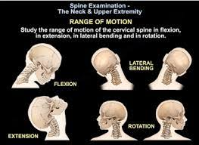
MOTOR EXAMINATION – Assess range of mobility

Slide 21
MOTOR EXAMINATION – Assess muscle tone
Muscle tone refers to the resistance of a muscle to passive stretch. It can be assessed by passive movements of the limbs.
Hypotonia: Reduced muscle tone may be observed in conditions such as cerebellar disorders, myopathies or neuropathies.
Hypertonia: Increased muscle tone may be seen in conditions such as spasticity (as in upper motor neuron lesions) or rigidity (as in Parkinson's disease). .

Slide 22
MOTOR EXAMINATION – Assess Muscle Strength
Assess muscle strength in various muscle groups using the Medical Research Council (MRC) scale or other standardized grading systems. The MRC scale typically ranges from 0 to 5, with 0 indicating no movement and 5 indicating normal strength.
Evaluate muscle strength bilaterally, comparing one side of the body to the other. Note any asymmetry.

Slide 23
MOTOR EXAMINATION – Assess Muscle Strength Patterns and Distribution
Note the patterns of weakness and their distribution. Some neurological conditions exhibit characteristic patterns of muscle involvement.

Slide 24
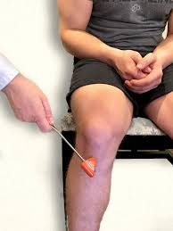
MOTOR EXAMINATION – Assess for Reflexes
Test deep tendon reflexes (DTRs) using a reflex hammer. Common reflexes tested include the:
Biceps reflex (C5-C6)
Triceps reflex (C7)
Brachioradialis reflex (C5-C6)
Patellar reflex (L2-L4)
Achilles reflex (S1-S2)
Assess for the presence or absence of reflexes and any hyperreflexia or hyporeflexia.

Slide 25
MOTOR EXAMINATION – Assess for Pathological Reflexes
Check for the presence of pathological reflexes such as
the Babinski sign (extensor plantar response)
the Hoffman sign.
These reflexes can indicate upper motor neuron dysfunction.

Slide 26
MOTOR EXAMINATION – Assess Coordination
Assess coordination and fine motor control with tests like finger-nose-finger, heel-shin, or finger tapping. Check for dysdiadochokinesia (difficulty with rapid alternating movements).
Perform tests of rapid alternating movements to evaluate the patient's ability to perform tasks like pronation/supination of the hands or rapid toe tapping.

Slide 27
Sensory Examination in the Neurological Exam
Sensory examination is a core component of the neurological exam, helping to evaluate the integrity of various sensory pathways.
It involves assessing different modalities such as touch, pain, vibration, and position sense.
Proper technique is crucial for detecting and localizing neurological lesions.
This presentation provides a systematic approach to the sensory examination.

Slide 28
Purpose of Sensory Examination
Sensory exams help detect deficits like numbness, tingling, or pain, which may indicate neurological damage.
By testing specific modalities, clinicians can identify which neural pathways or anatomical regions are affected.
Findings assist in localizing the lesion to the peripheral nerves, spinal cord, brainstem, or cortex.
Sensory examination is essential for diagnosing neurological disorders and planning treatment.

Slide 29
Anatomy of the Sensory System
Sensory signals start in peripheral nerves, which carry information to the central nervous system.
The dorsal columns of the spinal cord transmit vibration and proprioception, while the spinothalamic tract carries pain and temperature signals.
The brainstem relays sensory inputs to the thalamus for processing and integration.
The somatosensory cortex in the brain interprets these signals, creating conscious sensory perception.

Slide 30
Sensory Modalities
Superficial sensations include light touch, which assesses the integrity of the skin and underlying nerves.
Deep sensations like vibration and proprioception test the functionality of the dorsal columns.
Cortical sensations, such as stereognosis and graphesthesia, evaluate higher-order sensory processing in the parietal cortex.
Assessing these modalities helps identify both peripheral and central nervous system issues.

Slide 31
Tools for Sensory Testing
A cotton swab is used to assess light touch, ensuring the patient perceives gentle contact.
A pin or sharp object helps test pain sensation, distinguishing sharp from dull perceptions.
A 128 Hz tuning fork is ideal for vibration testing, applied to bony prominences to evaluate the dorsal columns.
Metal or temperature-controlled objects are used to assess hot and cold sensitivity, evaluating the spinothalamic tract.

Slide 32
Light Touch Testing
Use a cotton swab or fingertips to gently touch the skin, ensuring the patient perceives the contact.
Test symmetrical areas bilaterally, comparing responses to detect asymmetry or deficits.
Start distally and move proximally to identify length-dependent sensory loss.
Light touch testing primarily evaluates the dorsal columns and peripheral nerves.

Slide 33
Pain and Temperature Testing
For pain, lightly press a pin against the skin and ask the patient to differentiate sharp from dull sensations.
Use warm and cool objects to test temperature perception, focusing on specific dermatomes.
Compare responses on both sides of the body to identify asymmetries.
These tests assess the spinothalamic tract and its peripheral inputs.

Slide 34
Testing Vibration Sense
Strike a 128 Hz tuning fork and place it on bony prominences like the ankle or finger joints.
Ask the patient to report when vibration is felt and when it stops.
Test progressively proximally if deficits are noted distally.
This evaluates the integrity of the dorsal columns and is crucial in diagnosing neuropathy.

Slide 35
Proprioception Assessment
Hold the sides of the patient’s finger or toe and move it up or down.
Ask them to identify the direction of movement with their eyes closed.
Impaired proprioception suggests posterior column or peripheral nerve dysfunction.
This test is particularly useful in conditions like tabes dorsalis or peripheral neuropathy.

Slide 36
Cortical Sensory Tests
Stereognosis: Place an object like a coin or key in the patient’s hand and ask them to identify it by touch.
Graphesthesia: Draw a number or letter on the patient’s palm and ask them to recognize it.
These tests assess higher-order sensory processing in the parietal lobe.
Deficits in these tests can indicate cortical lesions or sensory integration disorders.

Slide 37
Dermatomes and Peripheral Nerves
Use a dermatomal map to guide testing, focusing on areas corresponding to spinal nerve roots.
For example, test the thumb (C6), middle finger (C7), or big toe (L5) for specific dermatomes.
Peripheral nerve testing focuses on localized regions, distinguishing from radiculopathy.
Comparing findings helps pinpoint the exact location of sensory deficits.

Slide 38
Integrating Sensory Findings
Combine sensory findings with motor and reflex results for a comprehensive diagnosis.
Patterns of sensory loss, like stocking-glove distribution, suggest peripheral neuropathy.
Central lesions often produce contralateral deficits, aiding in localization.
Integration ensures accurate identification of the affected pathways.

Slide 39
Common Sensory Pathologies
Peripheral neuropathy typically causes distal sensory loss in a stocking-glove pattern.
Spinal cord lesions may cause sensory loss below the lesion, with characteristic patterns like Brown-Séquard syndrome.
Stroke-related sensory deficits are contralateral to the lesion due to cortical involvement.
Recognizing these patterns aids in differential diagnosis and treatment planning.

Slide 40
Challenges in Sensory Exams
Patient responses can be subjective and inconsistent, making interpretation difficult.
Standardizing techniques and repeating tests increases reliability.
Comparing symmetrical areas helps identify subtle asymmetries.
Proper communication with the patient ensures accurate results.

Slide 41
MOTOR EXAMINATION – Assess Functional Testing
Assess the patient's ability to perform functional tasks such as standing from a chair, walking, and other activities of daily living.

Slide 42
MOTOR EXAMINATION – Assess Gait and Balance
Observe the patient's gait (the way they walk) to detect abnormalities such as weakness, spasticity, ataxia (incoordination), or festination (shuffling gait).
Evaluate balance by asking the patient to stand with feet together or to stand on one foot, with eyes opened and closed (Romberg test). Assess for any imbalance or swaying.

Slide 43
Gait Assessment in the Neurological Exam
Gait examination is a critical component of the neurological exam, helping to assess motor, sensory, and cerebellar function.
It provides key insights into disorders affecting the central and peripheral nervous systems.
This presentation highlights the systematic approach to gait assessment.

Slide 44
Normal Gait Characteristics
Rhythmic and symmetric stride length with smooth transitions.
Arms swing naturally opposite to leg movement for balance.
Proper heel-to-toe walking pattern is maintained.
Requires intact motor strength, sensory input, and coordination.

Slide 45
Abnormal Gait Patterns
Spastic Gait: Stiff, scissoring legs, often seen in upper motor neuron lesions.
Ataxic Gait: Wide-based, unsteady steps, typical of cerebellar disorders.
Shuffling Gait: Short steps with reduced arm swing, common in Parkinson’s disease.
Steppage Gait: Exaggerated lifting of the legs, associated with foot drop.

Slide 46
Gait Testing Techniques
Observe the patient walking a straight line and turning.
Perform tandem walking to evaluate balance and coordination.
Test walking on heels and toes to assess distal muscle strength.
Assess rising from a chair and initiating movement to detect bradykinesia.

Slide 47
Special Gait Tests
Romberg Test: Assess balance with eyes open and closed.
Tandem Gait: Heel-to-toe walking for cerebellar function.
Timed Up and Go (TUG) Test: Measures functional mobility and fall risk.
Observing dual-task walking for cognitive-motor interaction.

Slide 48
GAIT IN NDD
The commonest types of gait in NDD:
Parkinsonian
Apraxic
Choreatic
‘ALS gait‘

Slide 49
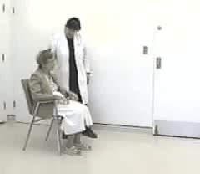
DESCRIBE THIS GAIT

Slide 50
WHERE IS THE LESION?
Cerebral cortex
Cerebellum
Peripheral nerves
White matter
Basal ganglia
Other
Notes:
CORRECT 5

Slide 51
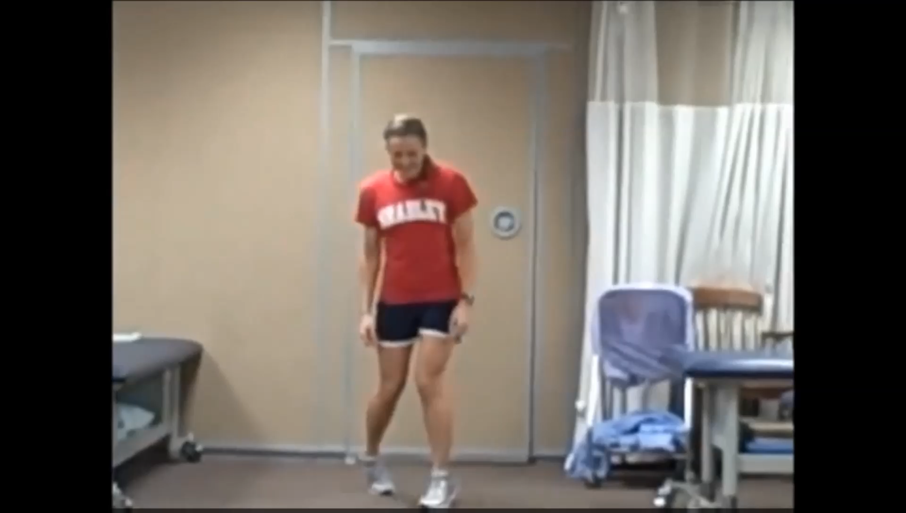
DESCRIBE THIS GAIT

Slide 52
WHAT GAIT?
Myopathic
Neuropathic
Atactic
Spastic
Hemiparetic
Parkinsonian
Notes:
CORRECT 4

Slide 53
ASSESS FOR MENINGEAL SIGNS
Neck Stiffness (Nuchal Rigidity): Resistance or discomfort during neck flexion, indicating meningeal irritation.
Kernig's Sign: Pain and resistance during knee extension with the hip flexed, suggesting meningeal irritation.
Brudzinski's Sign: Involuntary hip and knee flexion when neck flexed, indicating meningeal irritation.

Slide 54
MODIFIED NEUROLOGICAL EXAMINATION OF ELDERLY

Slide 55
EXAMINATION: SCREENING IN ELDERLY
Mental status Attention, executive functions, language, memory
Cranial nerves vision and hearing, eye movement, visual fields, facial symmetry
Motor skills: symmetry, coordination and speed of use of limbs; muscle tone, pronation test, involuntary movements
Reflexes pathological or asymmetric reflexes
Sensation: Joint position sense, dual simultaneous stimulation
Walking: getting up from a chair, casual, tandem

Slide 56
EXAMINATION: PARTICULARITIES IN ELDERLY
smaller pupil size and reduced reactivity reduced near vision (presbyopia)
smooth eye tracking is disrupted by saccadic intrusions
reduced upward gaze and convergence
hearing loss at high frequencies
a slight increase in muscle tone,
a decrease in muscle mass
a slight decrease in strength
reduced sense of vibration in the distal lower extremities
absence of Achilles reflexes
primitive reflexes present
slightly stooped and slower walking, reduced tandem ability

Slide 57
How to Assess Glasgow Coma Scale (GCS)
The GCS is a standardized tool for evaluating consciousness level in patients with altered mental status.
The GCS evaluates three domains: Eye Opening, Verbal Response, and Motor Response.
Widely used in critical care settings.
Helps monitor changes in neurological status.

Slide 58
Scoring Eye Opening
4: Spontaneous - Opens eyes without any external stimulation.
3: To speech - Opens eyes in response to verbal prompts.
2: To pain - Opens eyes only to painful stimuli.
1: None - Does not open eyes even to pain.

Slide 59
Scoring Verbal Response
5: Oriented - Can answer questions appropriately.
4: Confused - Responds but with disorientation or confusion.
3: Inappropriate - Produces words but without coherent meaning.
2: Incomprehensible - Makes sounds but no words.
1: None - No verbal response at all.

Slide 60
Scoring Motor Response
6: Obeys commands - Performs simple tasks upon request.
5: Localizes pain - Moves purposefully to painful stimuli.
4: Withdraws from pain - Flexion withdrawal to painful stimuli.
3: Abnormal flexion - Decorticate posturing to pain.
2: Abnormal extension - Decerebrate posturing to pain.
1: None - No motor response.

Slide 61
Calculating the Total Score
Add the scores from Eye Opening, Verbal Response, and Motor Response.
Minimum score: 3 (indicates deep coma or brain death).
Maximum score: 15 (fully awake and alert).
Helps classify severity: mild (13–15), moderate (9–12), severe (<8).

