Slide 1
Developing and designing scales
Clinical assessment and outcome measurement
Peter Hagell Kristianstad university

Slide 2
Learning Objectives
Describe the general process of developing outcome assessment instruments
Discuss design issues, including choice of response categories, when constructing instruments

Slide 3
Instrument development

Slide 4
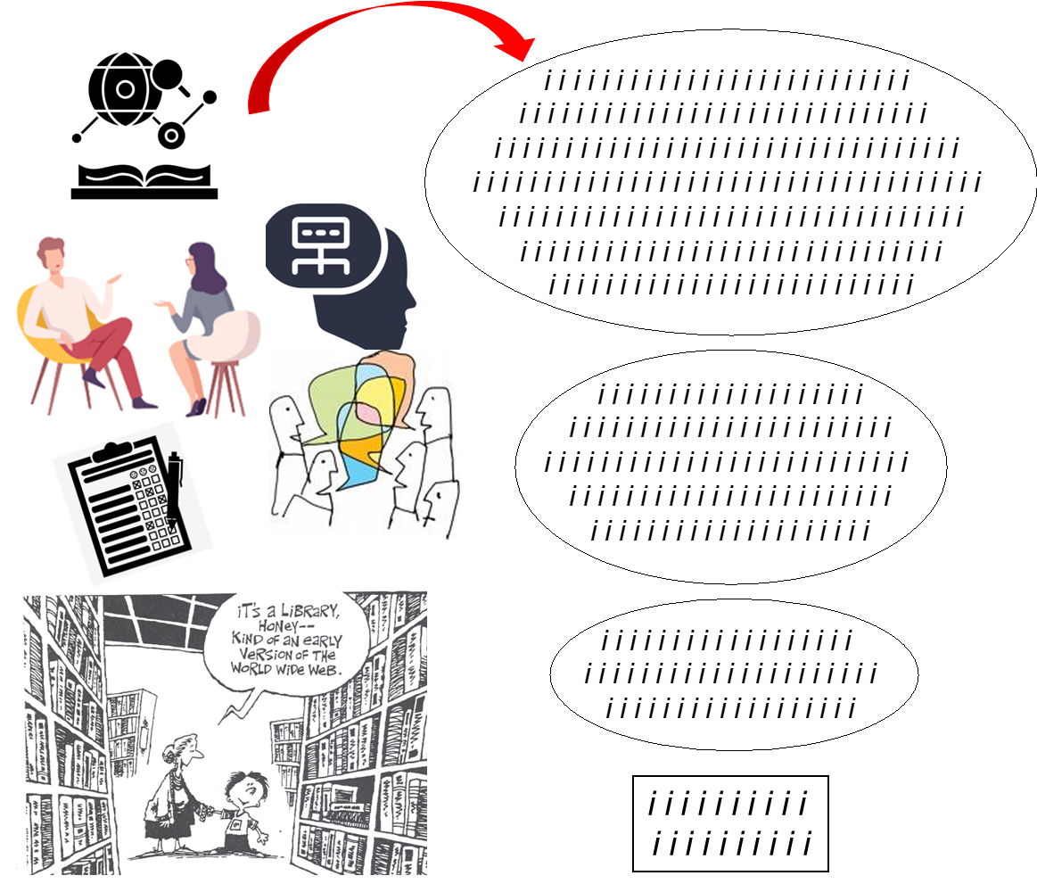

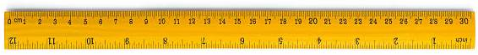
Qualitative:
Relevance
Formulations
Redundancy, etc.
Quantitative (statistics/psychometrics):
Descriptive statistics
CTT (correlations)
Item-total
Inter-item
Coefficient alpha
PCA/EFA
Test-retest, etc.
Rasch measurement theory

Slide 5
Developing an instrument for measurement
Define the target variable (what to measure) as specifically as possible!
What is the variable?
How does it vary, i.e., what expressions does it take as it varies from less to more?
Develop items and response categories that cover and operationalize variable manifestations
Basis for items depends on purpose and what to measure
Expert knowledge, literature
Qualitative interviews
Other instruments
Theory

Slide 6
Less
More
1
2
3
4
5
6
7
8
9
10
11
12
13
www.rasch.org/rmt/rmt221f.htm

Slide 7
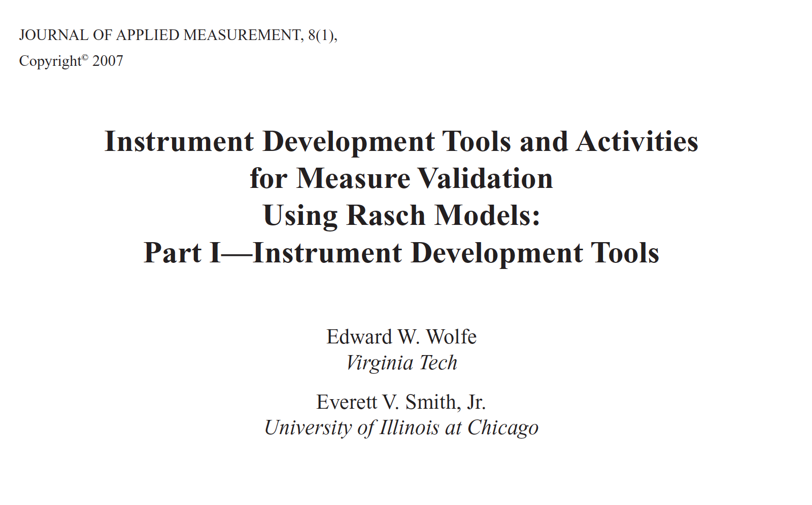
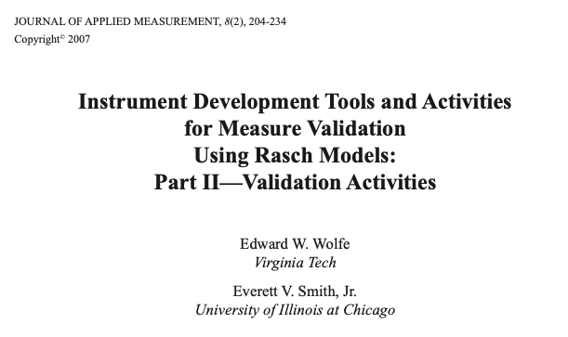
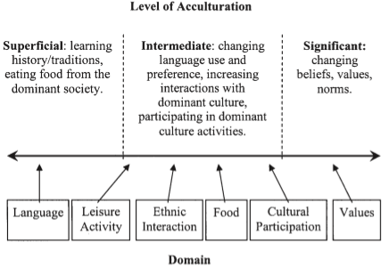
Example: Acculturation to the US culture of Chinese immigrants
Wolfe & Smith. J Appl Meas 2007

Slide 8
Instrument design
Some key aspects to consider when developing instruments and reviewing existing instruments

Slide 9
Be clear about the meaning and intention of each question/statement (and test how they are actually interpreted/understood)
Simple, clear and "plain" language - to the point
Note grammar, sentence structure, spelling, etc.
Consistent wording, etc.
Avoid negations - especially double negations (NOTE also in relation to response categories)
Logical response categories without overlap and with clear meaning
One question per question
Clear and simple instructions (possibly with some repetition through the questionnaire) - if at all needed...
Layout
Testing - modification

Slide 10
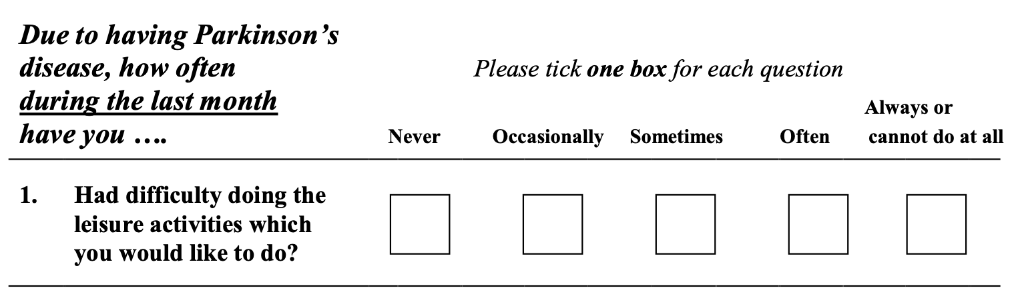
39-item Parkinson's Disease Questionnaire (PDQ-39)
Peto et al. Qual Life Res 1995; 4: 241-248.

Slide 11
Be clear about the meaning and intention of each question/statement (and test how they are actually interpreted/understood)
Simple, clear and "plain" language - to the point
Note grammar, sentence structure, spelling, etc.
Consistent wording, etc.
Avoid negations - especially double negations (NOTE also in relation to response categories)
Logical response categories without overlap and with clear meaning
One question per question
Clear and simple instructions (possibly with some repetition through the questionnaire) - if at all needed...
Layout
Testing - modification

Slide 12
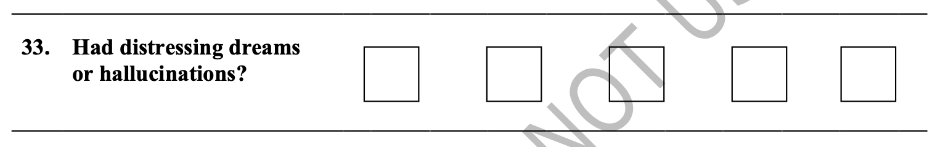
39-item Parkinson's Disease Questionnaire (PDQ-39)
Peto et al. Qual Life Res 1995; 4: 241-248.

Slide 13
Be clear about the meaning and intention of each question/statement (and test how they are actually interpreted/understood)
Simple, clear and "plain" language - to the point
Note grammar, sentence structure, spelling, etc.
Consistent wording, etc.
Avoid negations - especially double negations (NOTE also in relation to response categories)
Logical response categories without overlap and with clear meaning
One question per question
Clear and simple instructions (possibly with some repetition through the questionnaire) - if at all needed...
Layout
Testing - modification

Slide 14
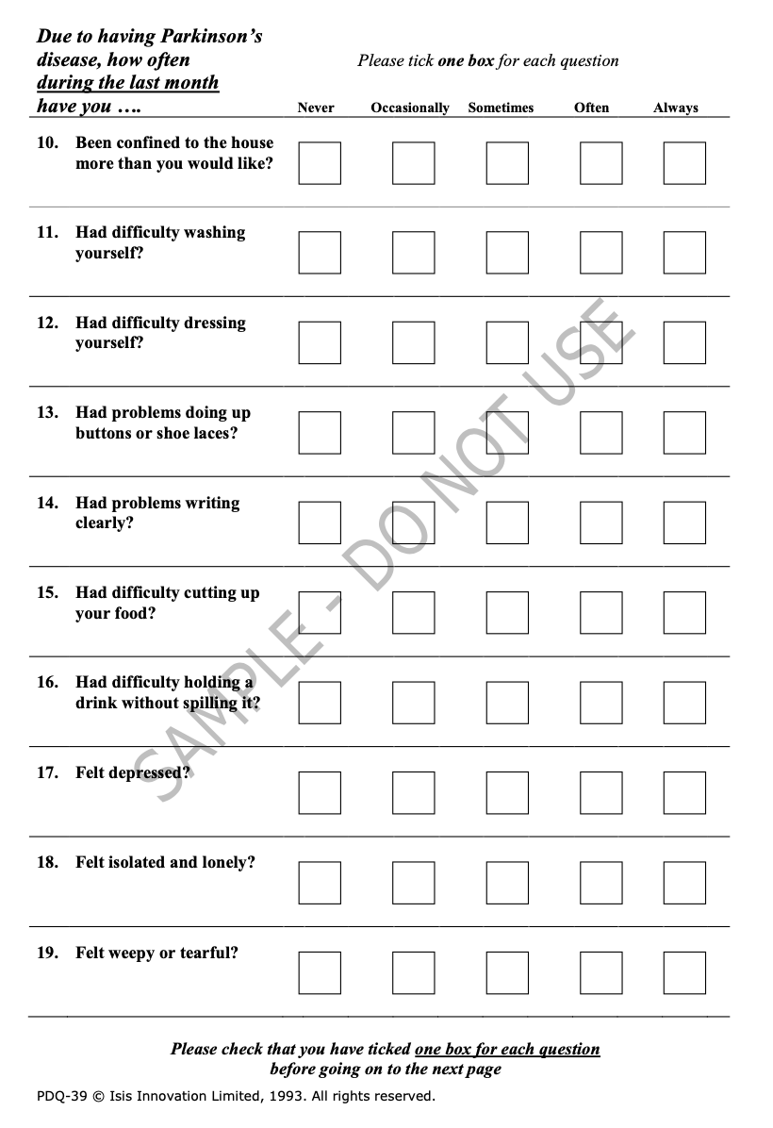
39-item Parkinson's Disease Questionnaire (PDQ-39)

Slide 15
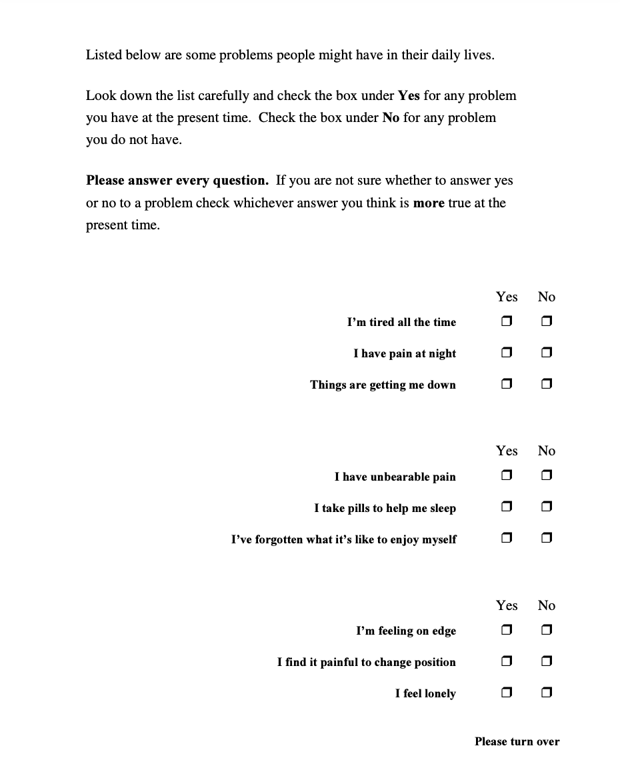
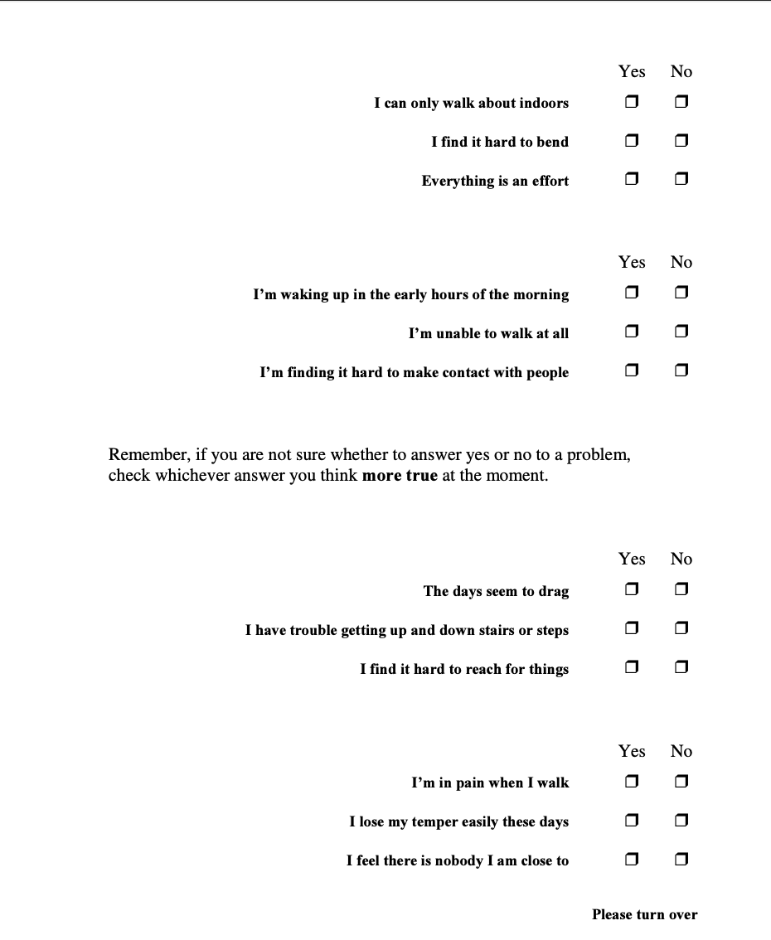
Nottingham Health Profile (NHP)
SAMPLE
DO NOT USE WITHOUT PERMISSION
SAMPLE
DO NOT USE WITHOUT PERMISSION
Hunt et al. J Epidemiol Community Health 1980; 34: 281

Slide 16
Be clear about the meaning and intention of each question/statement (and test how they are actually interpreted/understood)
Simple, clear and "plain" language - to the point
Note grammar, sentence structure, spelling, etc.
Consistent wording, etc.
Avoid negations - especially double negations (NOTE also in relation to response categories)
Logical response categories without overlap and with clear meaning
One question per question
Clear and simple instructions (possibly with some repetition through the questionnaire) - if at all needed...
Layout
Testing - modification

Slide 17
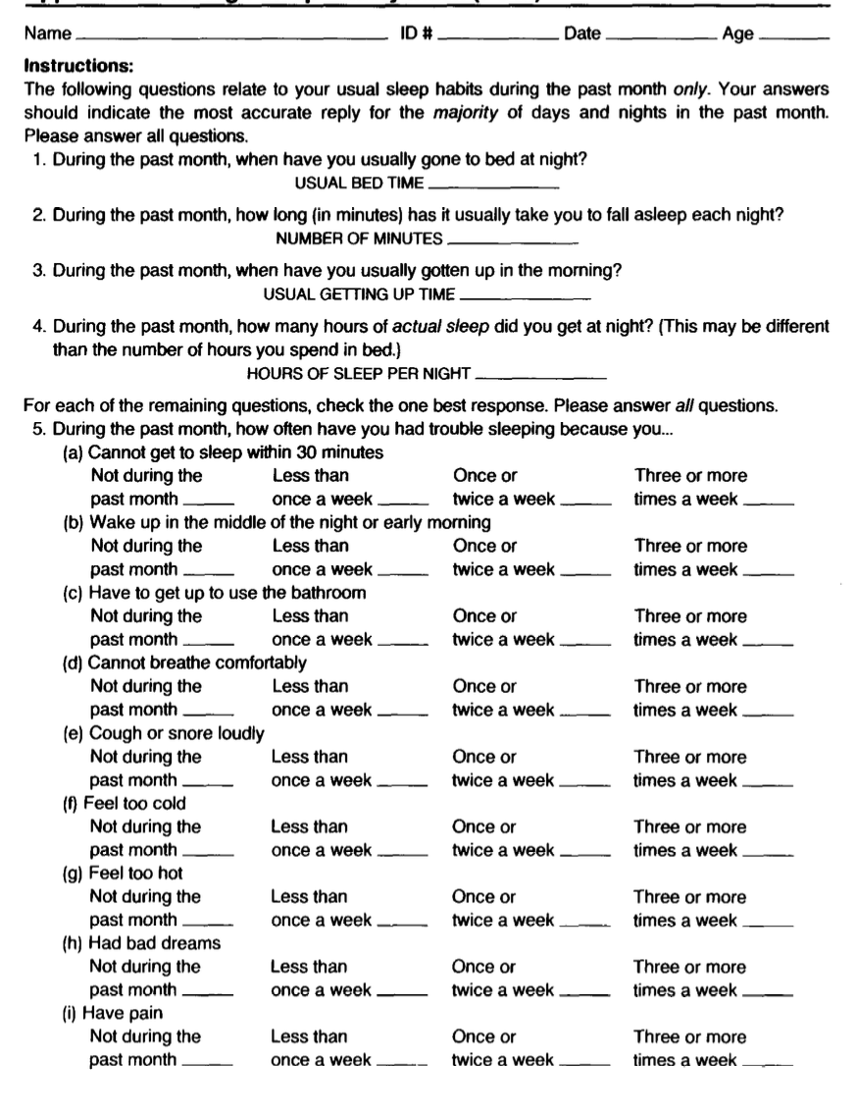
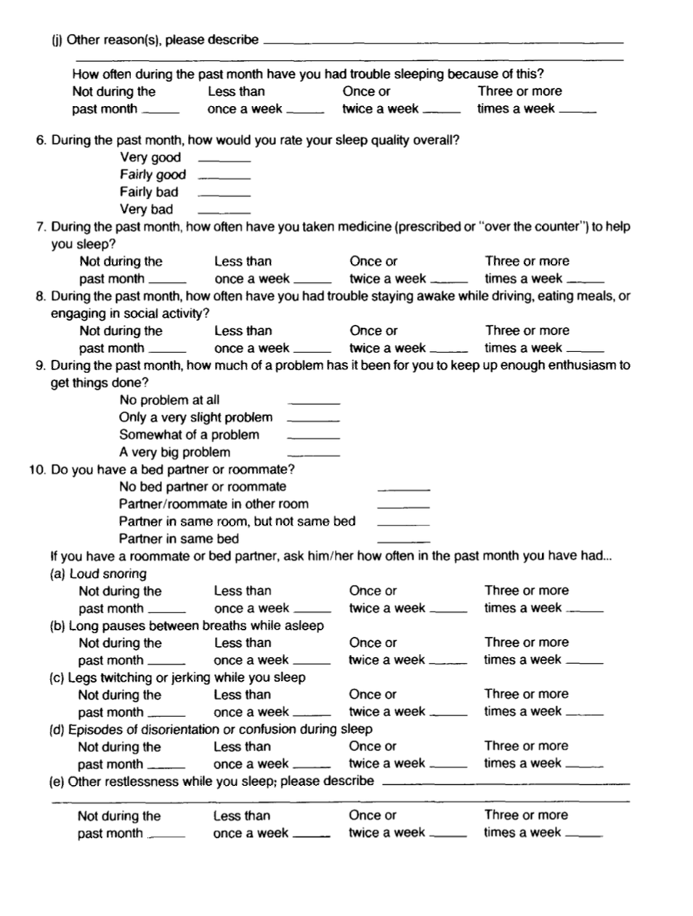
Pittsburgh Sleep Quality Index (PSQI)

Slide 19
Lang-Fahn ADL
Dyskinesia Scale
Arch Neurol 2001; 58: 1660

Slide 20
Be clear about the meaning and intention of each item (and test how they actually are interpreted/understood)
Simple, clear and "plain" language - to the point
Note grammar, sentence structure, spelling, etc.
Consistent wording, etc.
Avoid negations - especially double negations (NOTE also in relation to response categories)
Logical response categories without overlap and with clear meaning
One question per question
Clear and simple instructions (possibly with some repetition through the questionnaire) - if at all needed...
Layout
Testing - modification

Slide 21

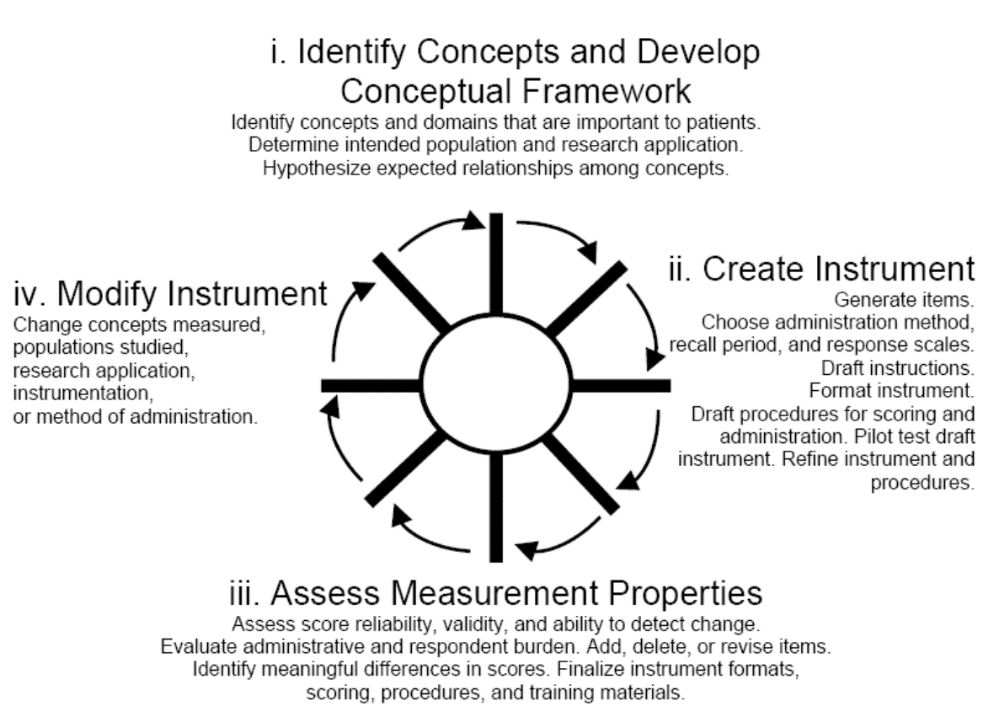

Slide 22
Response categories

Slide 23
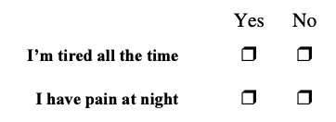
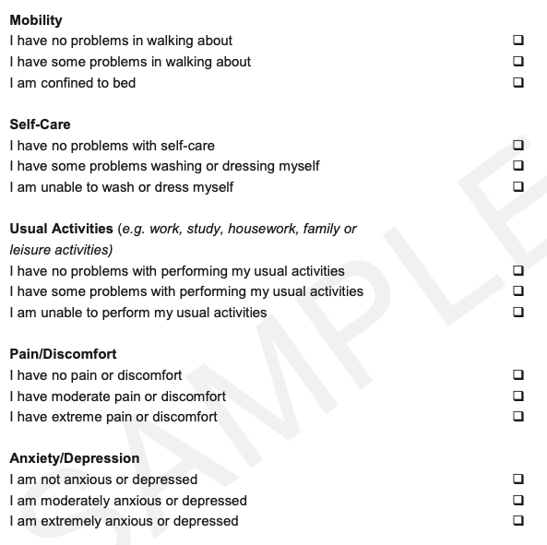
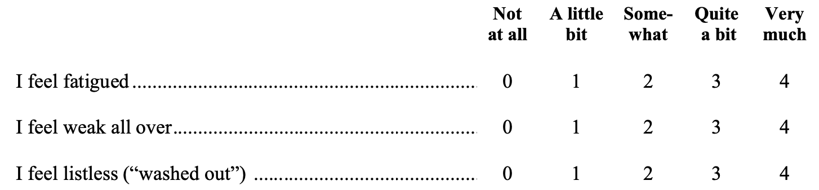
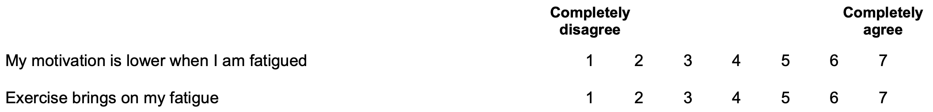
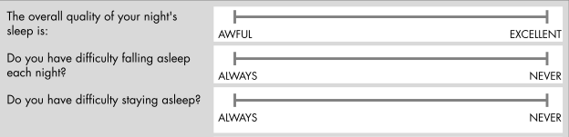
Dichotomous
(2 orderd categories)
Descriptive
Verbal rating scale/ "Likert-type"
Numerical rating scale
Visual analogue scale (VAS)
Polytomous (>2 ordered categories)

Slide 24
Response categories
Ordered (from less to more) - ordinal
Distinct, clear interpretations
Logical and meaningful in relation to item(s)
Numerical (integer) codes, e.g.,
Never=0; Rarely=1; Sometimes=2; Often=3; Always=4
Summation based on assumption of approximately equal differences
Evaluate in conjunction with cognitive interviews

Slide 25
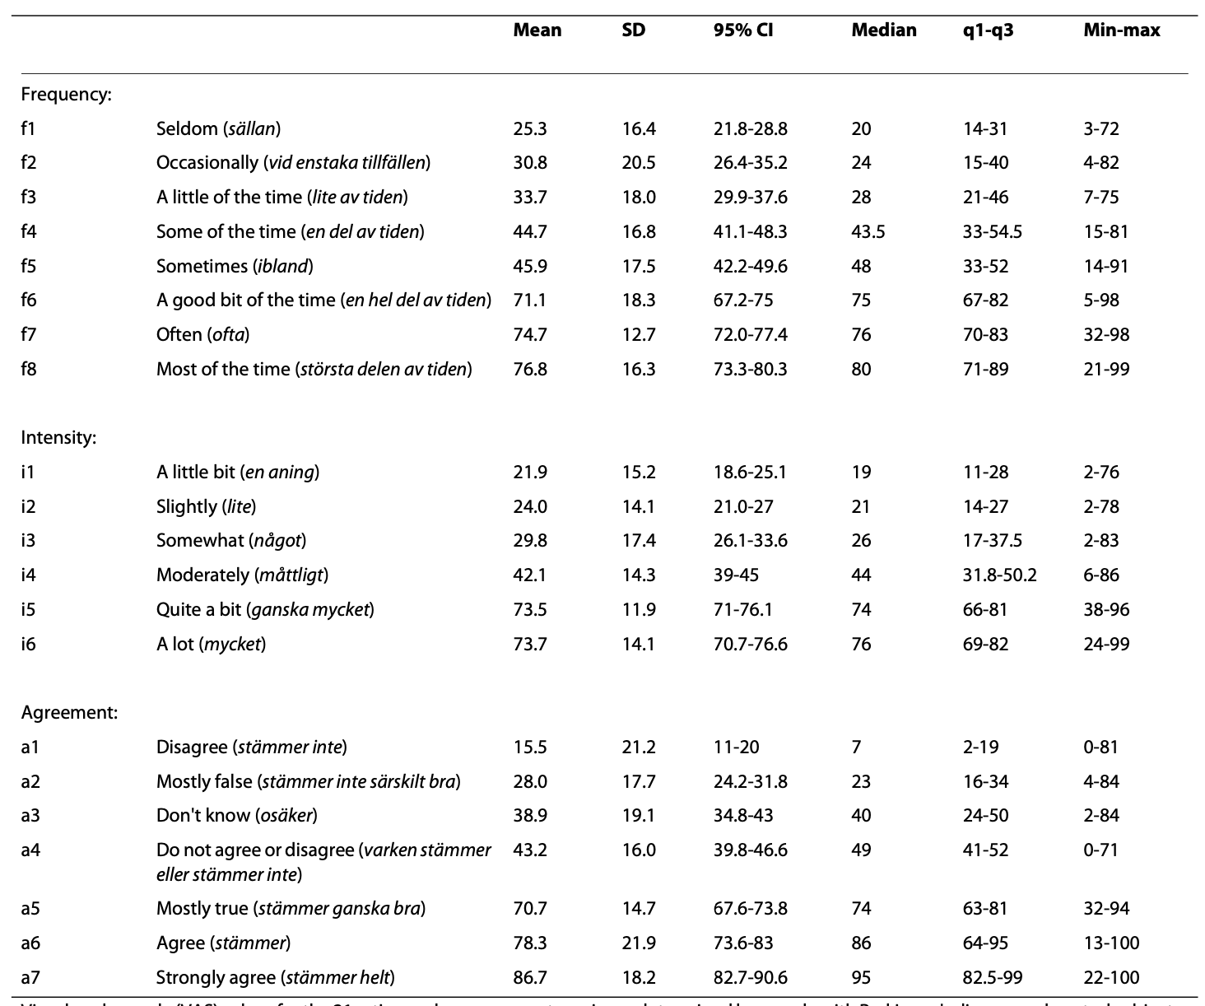
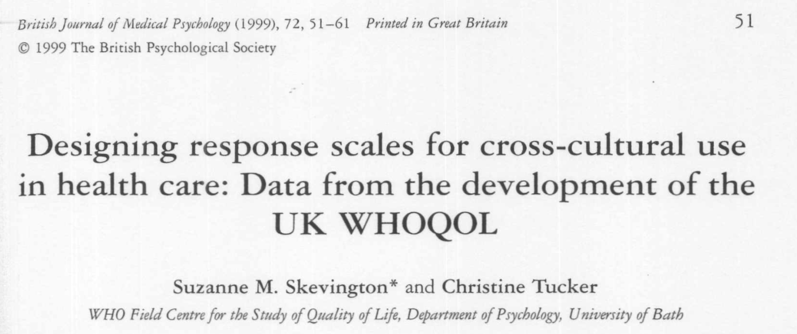


Slide 26
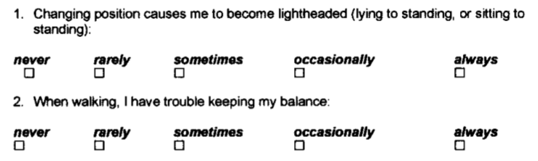
PDQ-39
PDQUALIF
Welsh et al. MDJ 2003; 18(6): 637-645.
Knutsson et al. HQLO 2010; 8: 61.

Slide 27
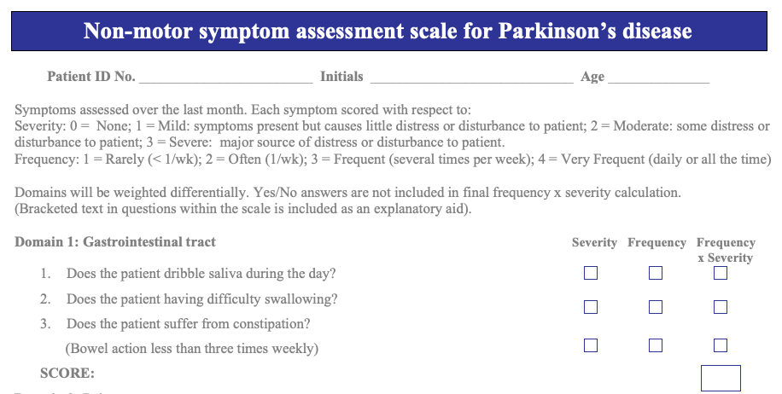
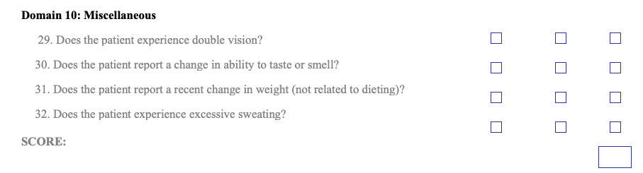

Slide 28

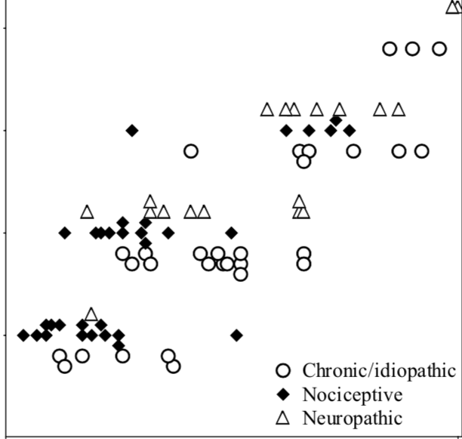
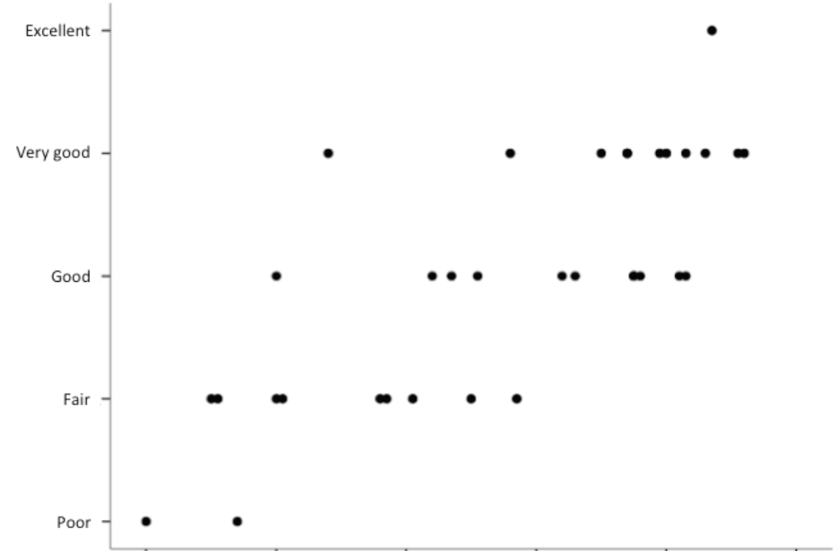
Visual Analogue Scale (VAS)
?
Pain
General health
Worst possible pain
Excellent
Severe pain
Very good
Verbal Rating Scale (VRS)
Moderate pain
Good
Mild pain
Fair
No pain
Poor
0
100
0
100
VAS (0=No pain; 100=Worst possible pain)
VAS (0=Poor; 100=Excellent)
Hagell & Knutsson QLR 2013
Lund et al. BMC Med Res Methodol 2005

Slide 29
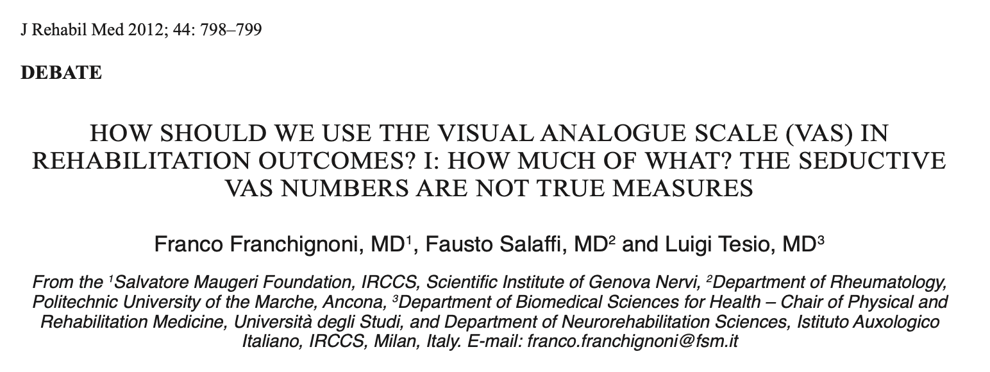
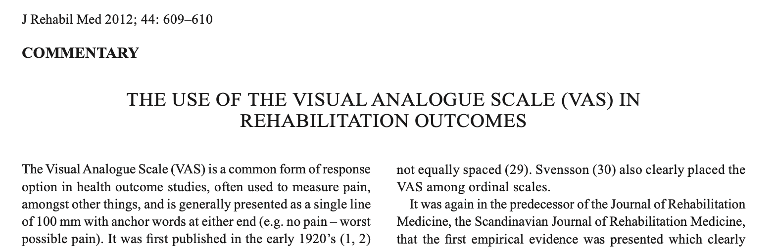
https://doi.org/10.2340/16501977-1030
https://labs.la.utexas.edu/gilden/files/2016/04/MagicNumberSeven-Miller1956.pdf
https://doi.org/10.2340/16501977-0999

Slide 30
Qualitative testing of instruments

Slide 31
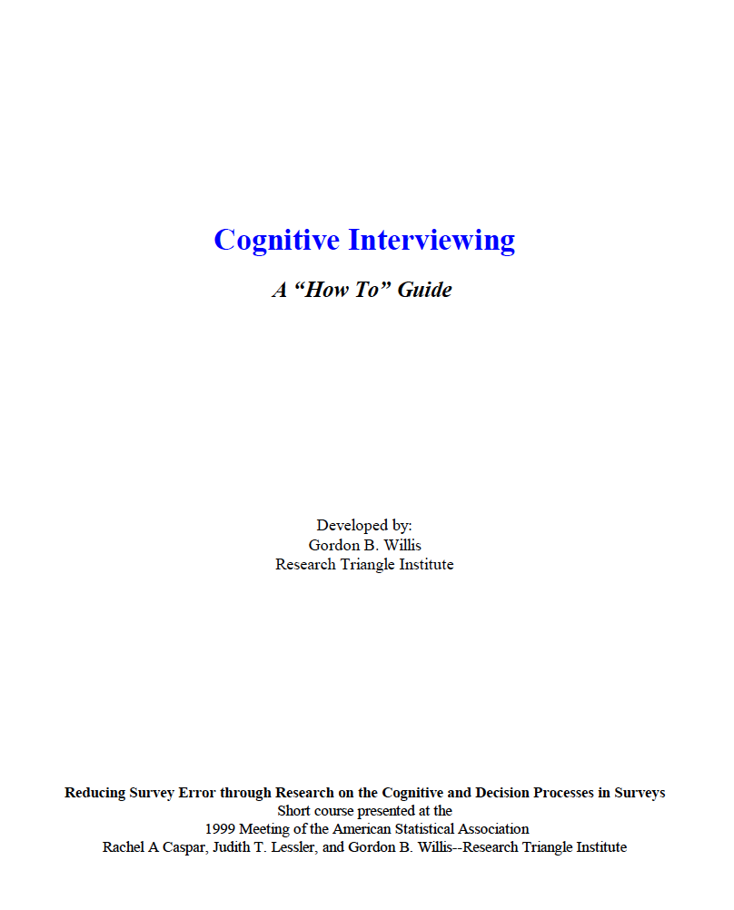
Qualitative testing
"The read-aloud method"
Focus groups
Content validity, relevance
Cognitive interviews
”Think aloud”
Retrospective questions (verbal probing)
https://www.hkr.se/contentassets/9ed7b1b3997e4bf4baa8d4eceed5cd87/gordonwillis.pdf

Slide 32
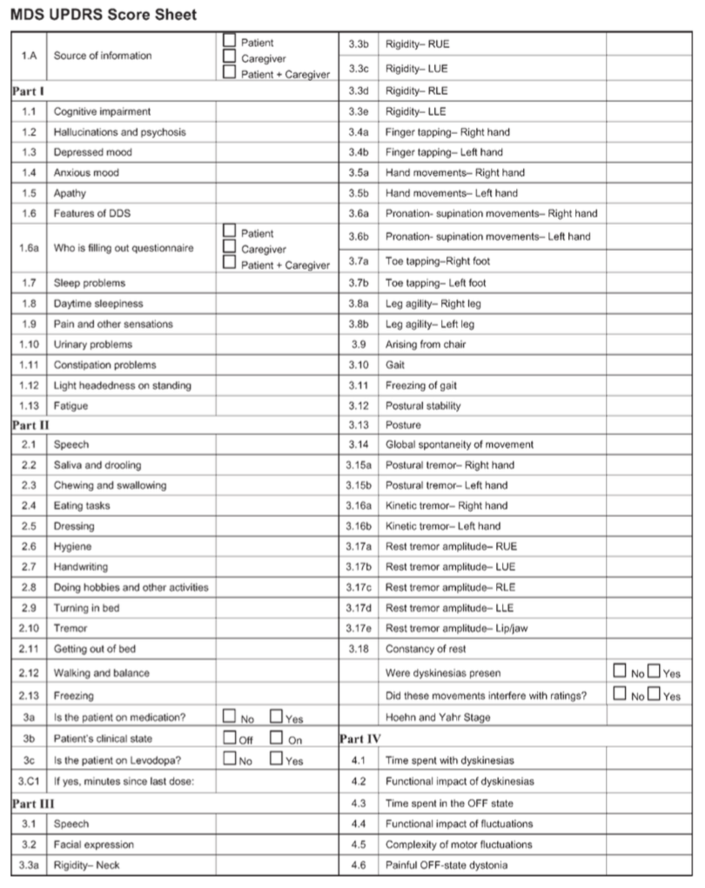
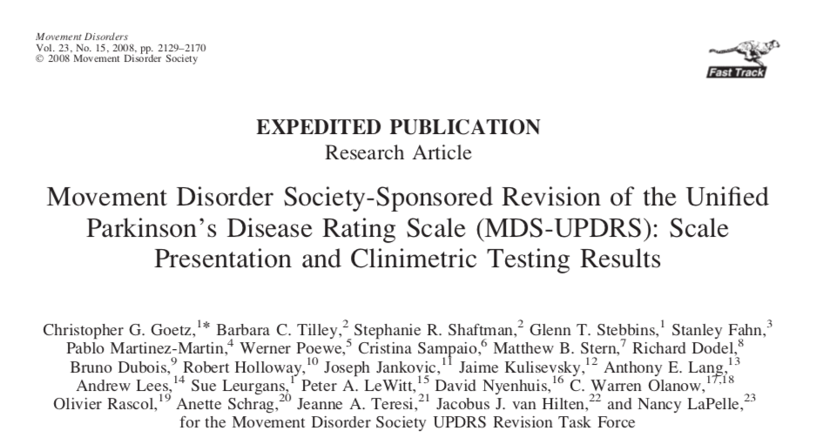
Example: MDS-UPDRS
Non-motor Aspects of Experiences of Daily Living (13 items)
History, patient-report
Motor Aspects of Experiences of Daily Living (13 items)
Patient report
Motor Examination (18/33 items)
Clinical examination
Motor Complications (6 items)
History

Slide 33
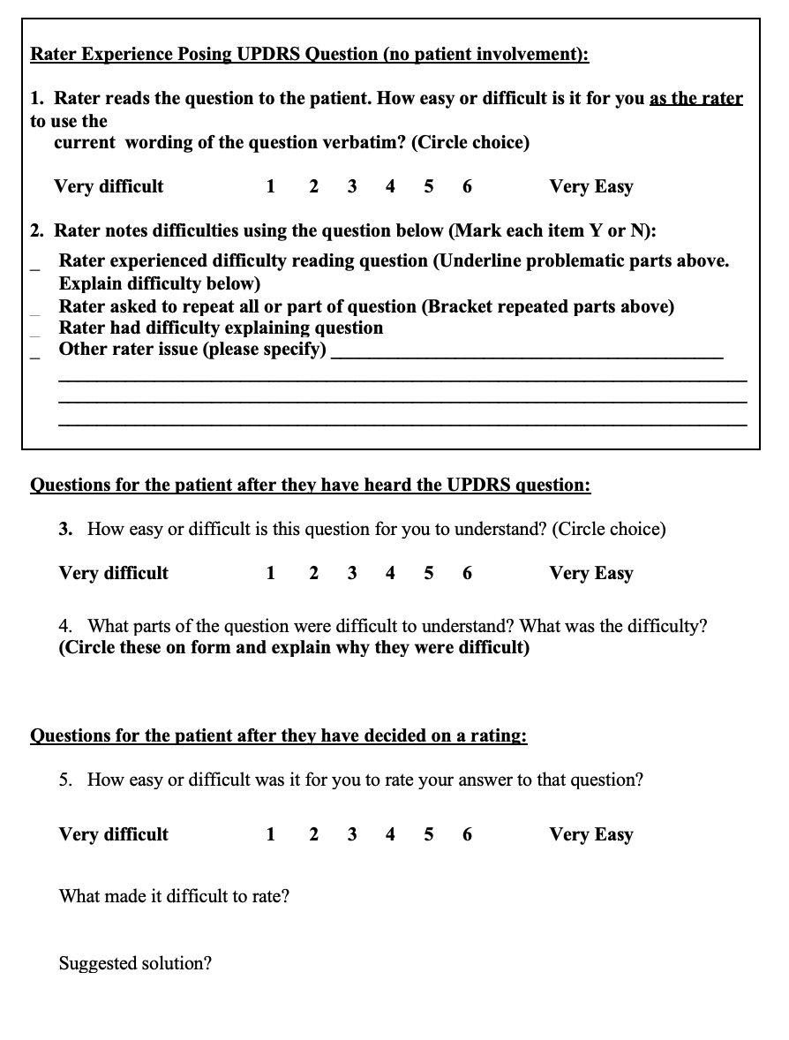
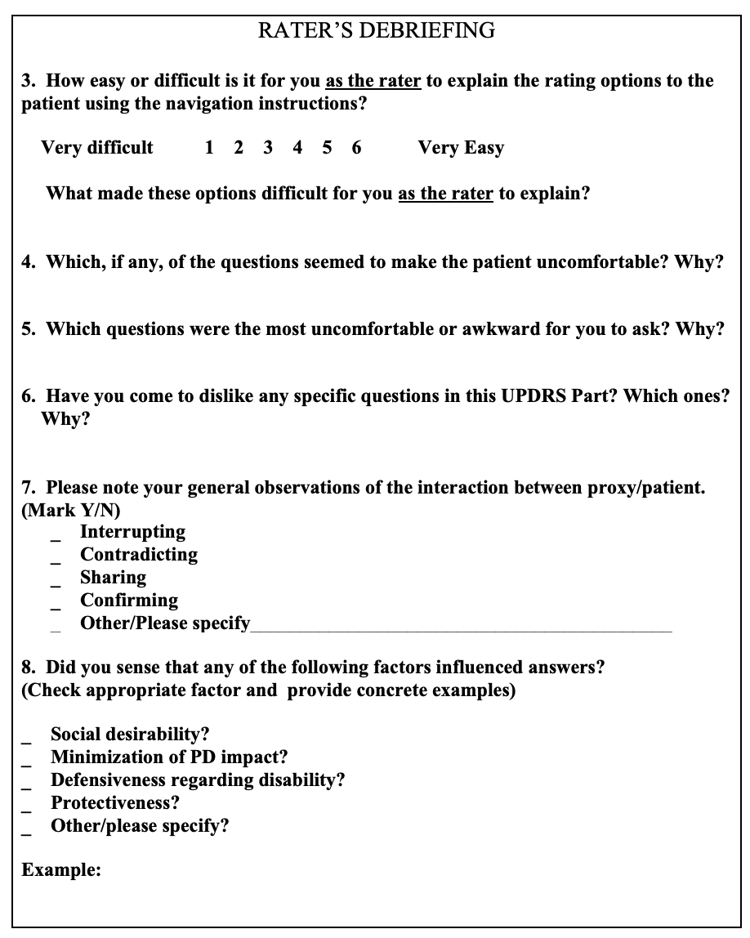
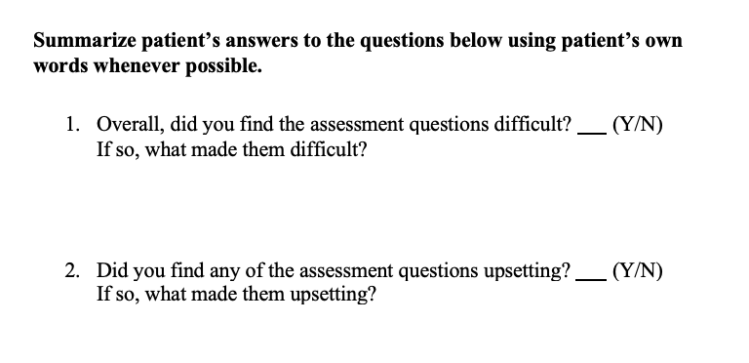
Part I: Non-Motor Aspects of Experiences of Daily Living (13 items)
Part II: Motor Aspects of Experiences of Daily Living (13 items)
Following each item:
For the whole section:
Tilley et al. JPD 2014; 4(3): 395-404.

Slide 34
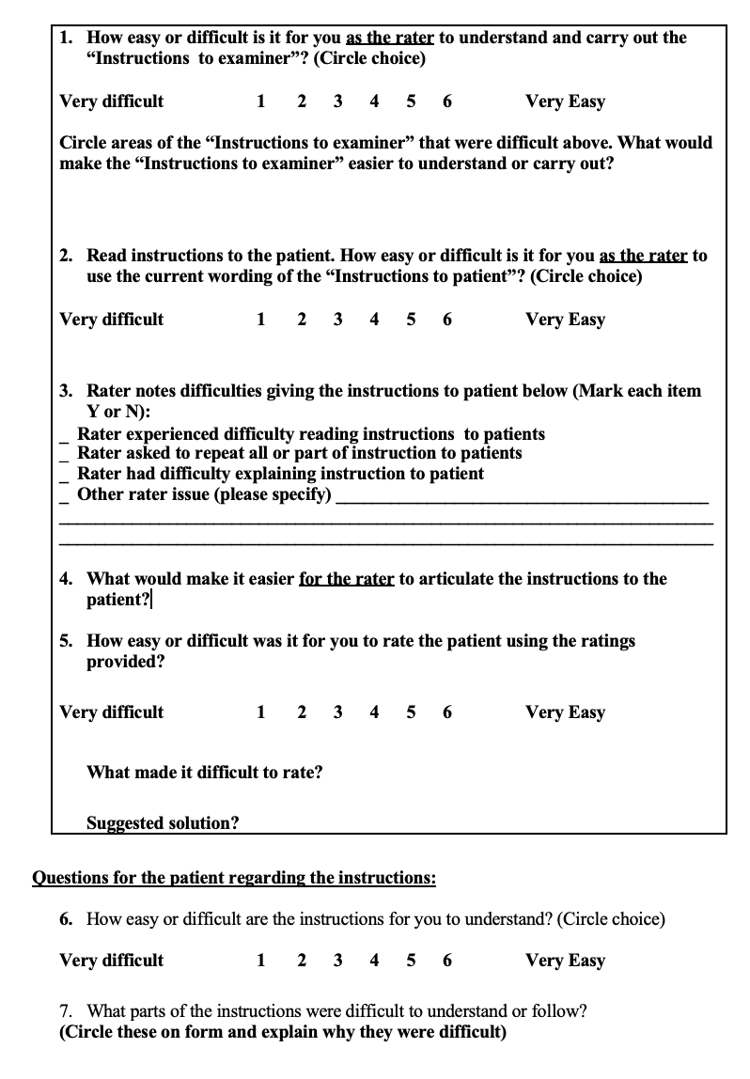
Part III: Motor Examination (18/33 items)
Following each item:
For the whole section:
Tilley et al. JPD 2014; 4(3): 395-404.

Slide 35
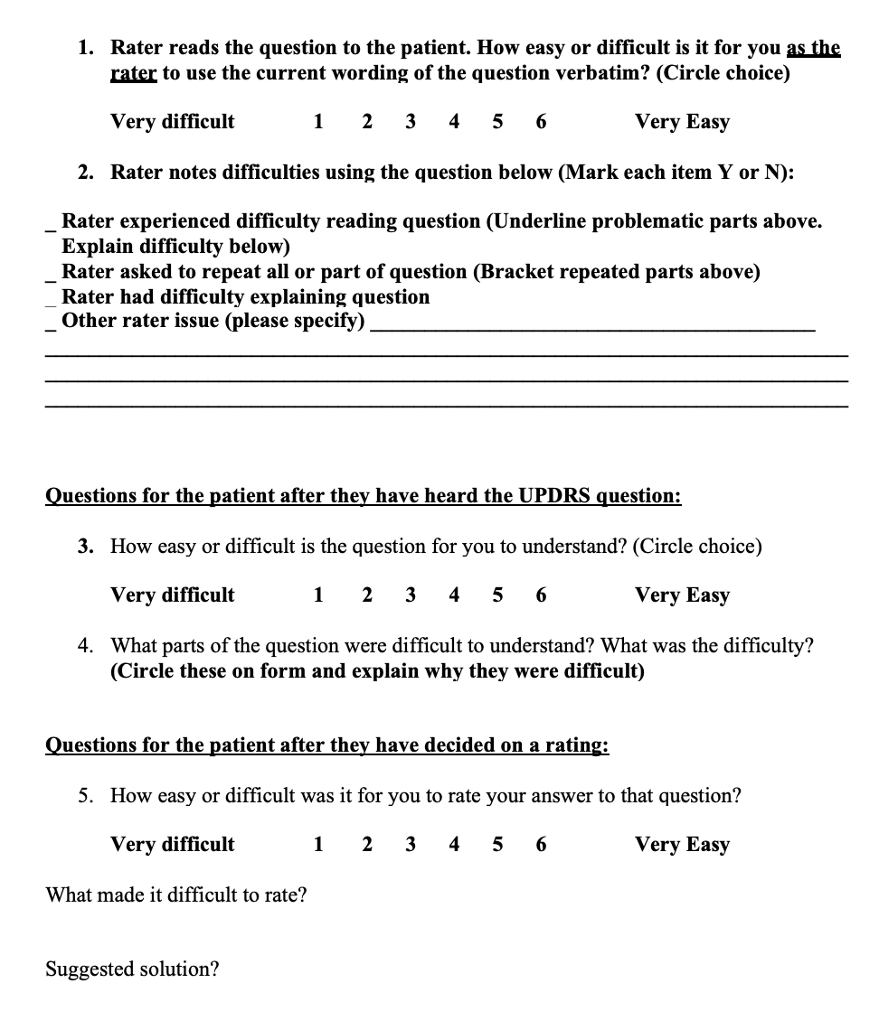
Part IV: Motor Complications (6 items)
Following each item:
For the whole section:
Tilley et al. JPD 2014; 4(3): 395-404.

Slide 36
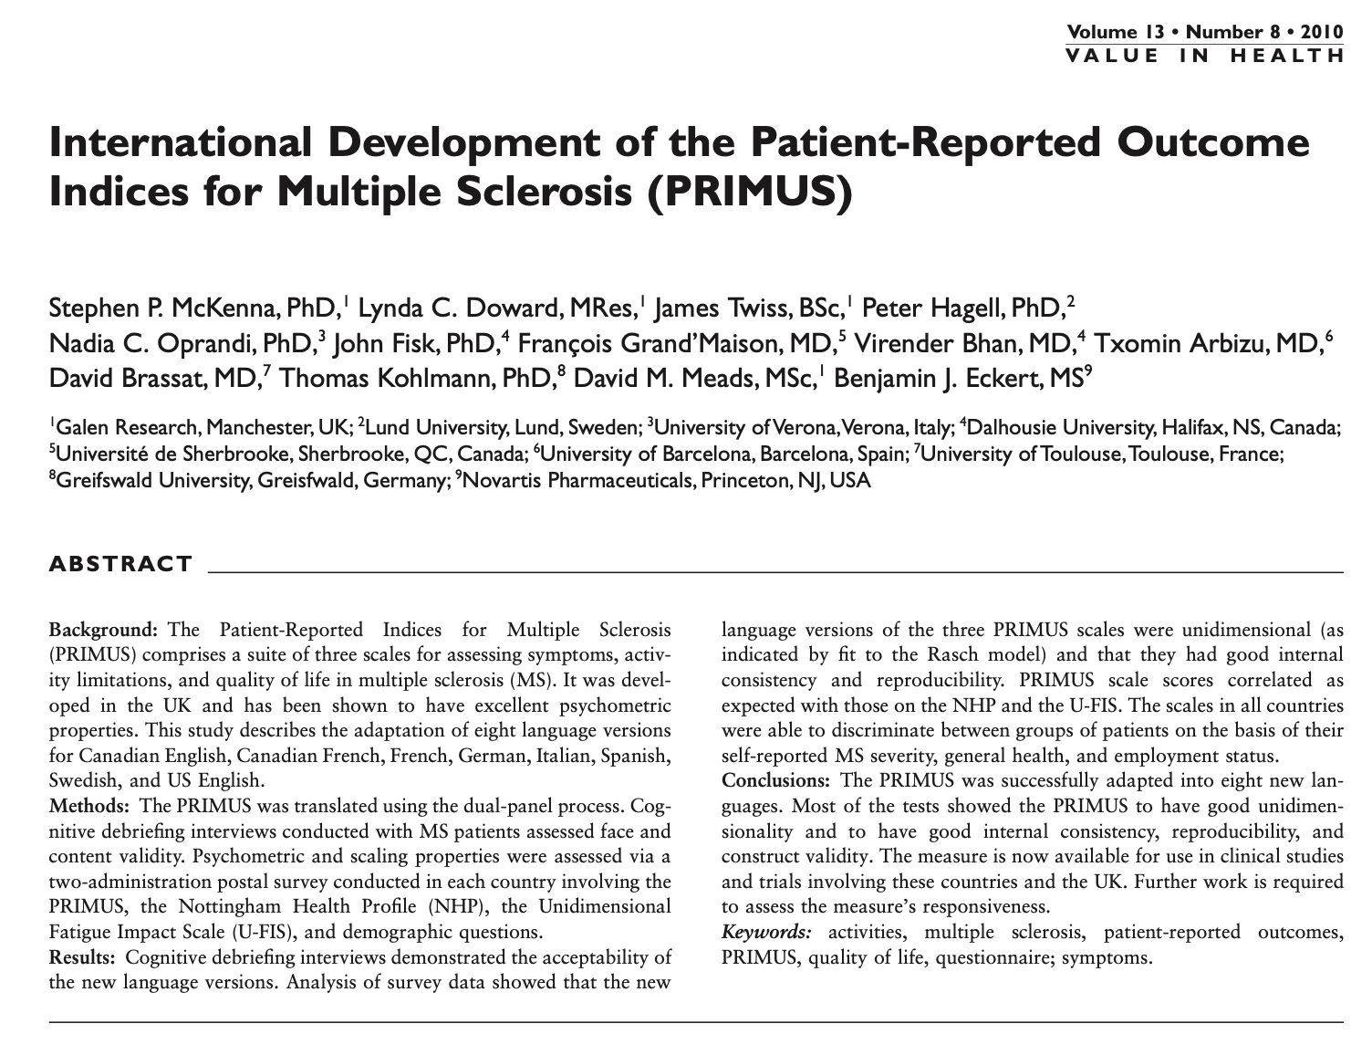
Example: PRIMUS
MS-specific PROM based on the ICF
Symptoms/functioning (22 items)
Activity limitations (15 items)
Needs-based quality of life (22 items)

Slide 37
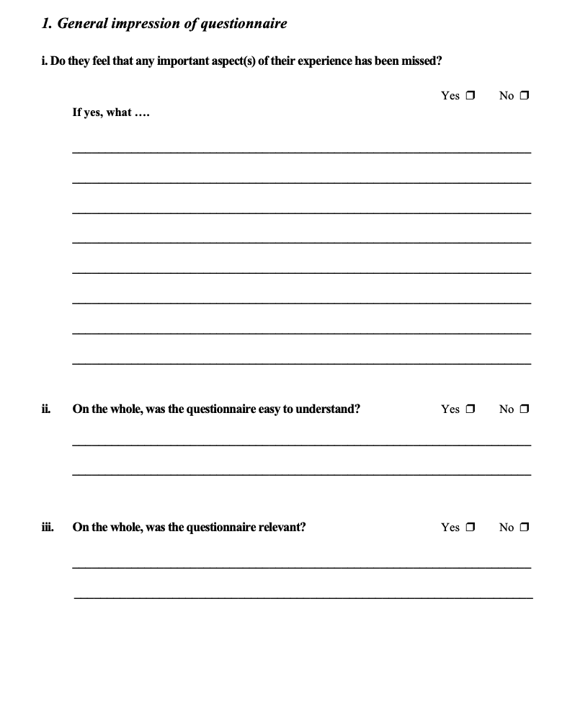

Example: PRIMUS
Open conversation regarding the instrument

Slide 39
References
Knutsson I, Rydstrom H, Reimer J, Nyberg P, Hagell P. (2010). Interpretation of response categories in patient-reported rating scales: a controlled study among people with Parkinson's disease. Health and Quality of Life Outcomes 2010; 8: 61. Available from: https://doi.org/10.1186/1477-7525-8-61
Lund I, Lundeberg T, Sandberg L, Norrbrink Budh C, Kowalski J, Svensson E. Lack of interchangeability between visual analogue and verbal rating pain scales: a cross sectional description of pain etiology groups. BMC Medical Research Methodology 2005; 5: 31 . Available from: https://doi.org/10.1186/1471-2288-5-31
McKenna SP, et al. International development of the Patient-Reported outcome Indices for Multiple Sclerosis (PRIMUS). Value in Health 2010; 13(8): 946-951. Available from: https://doi.org/10.1111/j.1524-4733.2010.00767.x
Skevington SM, Tucker C. Designing response scales for cross-cultural use in health care: Data from the development of the UK WHOQOL. British Journal of Medical Psychology 1999; 72: 51-61. Available from: https://doi.org/10.1348/000711299159817
Tilley BC, LaPelle NR, Goetz CG, Stebbins GT; MDS-UPDRS Task Force. Using cognitive pretesting in scale development for Parkinson's disease: the Movement Disorder Society Unified Parkinson's Disease Rating Scale (MDS-UPDRS) example. Journal of Parkinsons Disease 2014; 4(3): 395-404. Available from: https://www.ncbi.nlm.nih.gov/pmc/articles/PMC5086096/
Willis GB. Cognitive interviewing: A "how to" guide". Research Triangle Institute; 1999. Available from: https://www.hkr.se/contentassets/9ed7b1b3997e4bf4baa8d4eceed5cd87/gordonwillis.pdf
Willis GB. Cognitive interviewing: A tool for improving questionnaire design. Thousand Oaks, CA: Sage Publications; 2005. Available from: https://methods.sagepub.com/book/cognitive-interviewing

