Slide 1
Rating scale dimensionality (part 2)
Clinical assessment and outcome measurement
Peter Hagell
Kristianstad university

Slide 2
Learning Objectives
Understand the principles of factor analysis
Understand the principles of multitrait scaling analysis
Critically review the use of factor analysis

Slide 3
Outline
Part 1
Principal component analysis
Exploratory factor analysis
Part 2
Confirmatory factor analysis
Multi-trait scaling analysis

Slide 4
Confirmatory Factor Analysis (CFA)
"Hypothesis testing" factor analysis
Structure specified
Goodness-of-fit
Number of observations
  n ≥ approx 200
  10x number of estimated parameters (compared to 10x number of observations in, e.g., regression analysis and EFA)

Slide 5
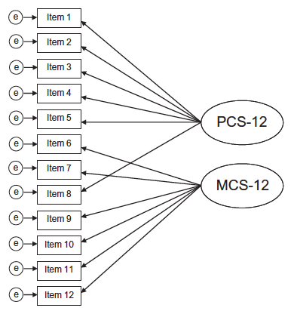
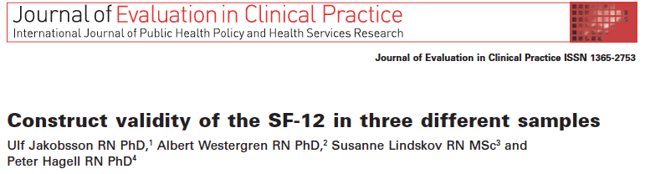
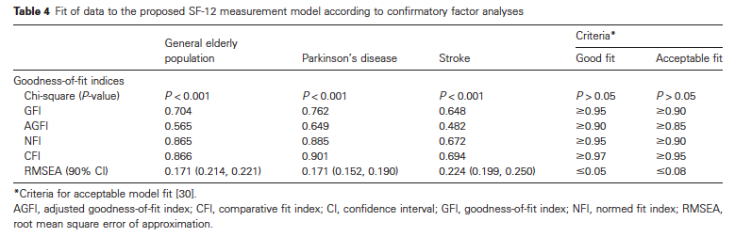

Slide 6
Multi-trait scaling:
An alternative to CFA

Slide 7
RAND-/SF-36 Health survey

Slide 8
Support for grouping items into scales?
  Corrected item-total correlations (>0.4)
  Multitrait scaling analysis

Slide 9
Corrected item-total correlations
Example 5-item instrument
The correlation between each item and the total score of all other items
Correction of overestimated correlation if the item is included in total score (in part correlated with itself)
Item | r | Total score
i1 | → | i2+i3+i4+i5
i2 | → | i1+i3+i4+i5
i3 | → | i1+i2+i4+i5
i4 | → | i1+i2+i3+i5
i5 | → | i1+i2+i3+i4

Slide 10
Multitrait scaling analysis
Items
Total scores
1
A
A
2
3
Scaling success
4
Scaling failure
5
Possible scaling failure
B
6
B
7
8

Slide 11
Hypothetical multitrait scaling matrix

Slide 13
Multitrait scaling:
The SF-36 in Parkinson’s disease
Hagell et al. J Neurol 2008; 255: 246-54.

Slide 14
RAND-/SF-36 Health survey

Slide 15
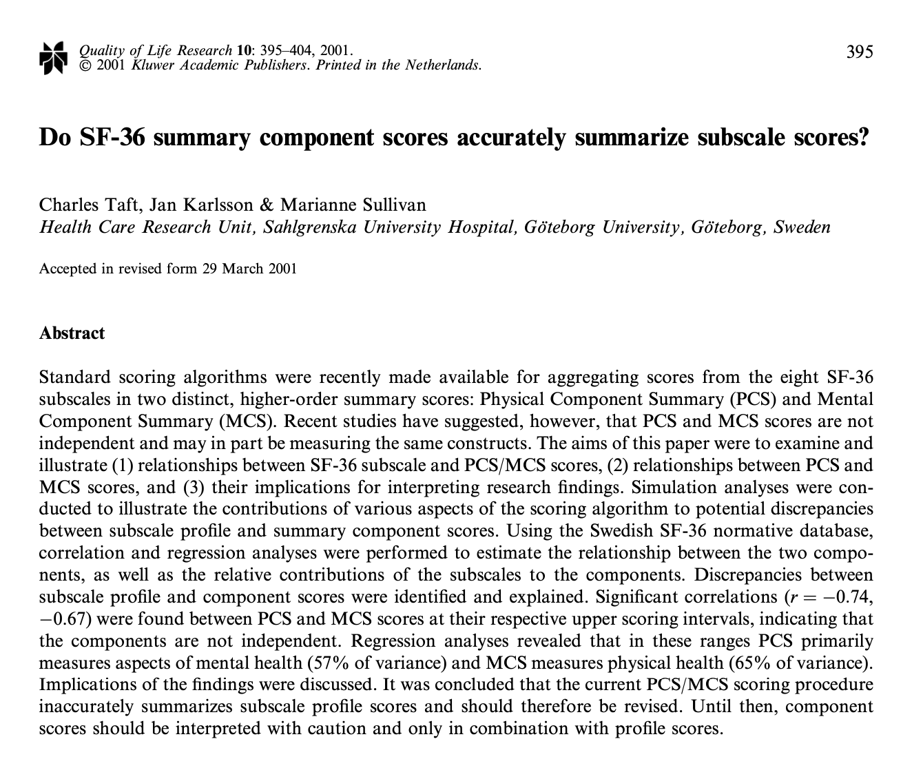
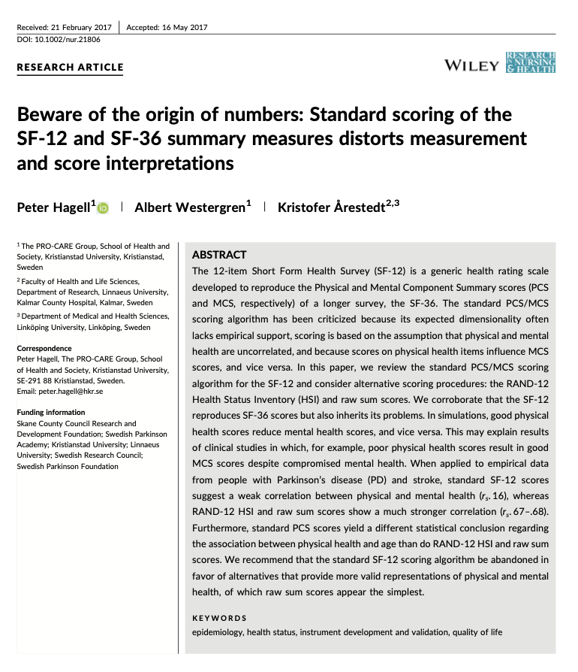
https://www.researchgate.net/publication/11595008
Standard scoring of the SF-36 Physical and Mental health summary scores
Scoring of the eight SF-36 scales into score ranges of 0–100 (100 = better health)
Scale score standardization (z- scores) by subtracting US general population scale mean score from individual scale scores and divide by US general population standard deviation
Compute “raw” PCS and MCS scores: Standardized z-scores from step 1 are multiplied by scale factor scores from orthogonally rotated PCA of US general population data
Compute PCS and MCS composite scores (t-scores): Multiply “raw” PCS and MCS scores (step 3) by 10 and add 50
https://www.researchgate.net/publication/318604811

Slide 16
Support for physical and mental summary scores?
  PCA with orthogonal rotation (varimax) of the 8 RAND-/SF-36 scale scores
  CFA of the 8 RAND-/SF-36 scale scores according to assumed scale-to-PCS/MCS structure

Slide 17
SF-36 Physical and Mental Health Components
Ware et al. 1994.
Sullivan et al. 1994.

Slide 18
SF-36 Physical and Mental Health Components in PD
Ware et al. 1994.
Hagell et al. 2008.

Slide 19
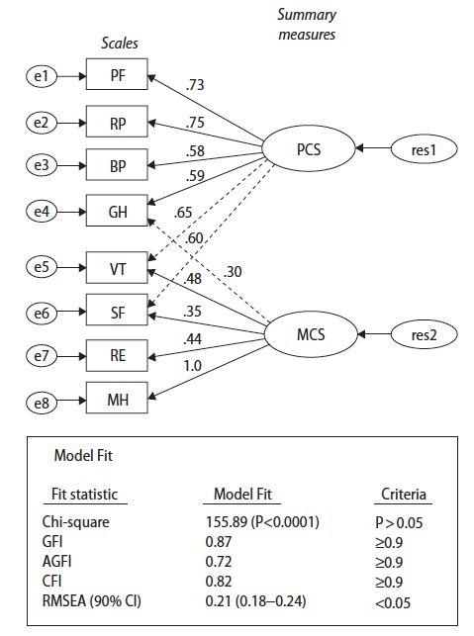
Confirmatory factor analysis
Hagell et al. 2008.

Slide 20
References
Baglin J. Improving your exploratory factor analysis for ordinal data: A demonstration using FACTOR. Practical Assessment, Research & Evaluation 2014; 19: 5.
Available from: https://doi.org/10.7275/dsep-4220
Costello AB, Osborne J. Best practices in exploratory factor analysis: four recommendations for getting the most from your analysis. Practical Assessment, Research & Evaluation 2005; 10: Article 7.
Available from: https://scholarworks.umass.edu/pare/vol10/iss1/7/
Hagell P, Tornqvist AL, Hobart J. Testing the SF-36 in Parkinson's disease. Implications for reporting rating scale data. Journal of Neurology 2008: 255(2): 246-254.
Available from: https://doi.org/10.1007/s00415-008-0708-y
Hagell P, Westergren A, Årestedt K. Beware of the origin of numbers: Standard scoring of the SF-12 and SF-36 summary measures distorts measurement and score interpretations. Research in Nursing and Health 2017; 40(4): 378-386.
Available from: https://www.researchgate.net/publication/318604811
Horn JL. A rationale and test for the number of factors in factor analysis. Psychometrika 1965; 30: 179–185.
Available from: https://doi.org/10.1007/BF02289447
Taft C, Karlsson J, Sullivan M. Do SF-36 summary component scores accurately summarize subscale scores? Quality of Life Research 2001; 10(5): 395-404.
Available from: https://www.researchgate.net/publication/11595008

