Slide 1
Rating scale dimensionality (part 1)
Clinical assessment and outcome measurement
Peter Hagell
Kristianstad university

Slide 2
Learning Objectives
Understand the principles of factor analysis
Understand the principles of multitrait scaling analysis
Critically review the use of factor analysis

Slide 3
Outline
Part 1
Principal component analysis
Exploratory factor analysis
Part 2
Confirmatory factor analysis
Multi-trait scaling analysis

Slide 4
Factor analysis
Objective
  Study and identify patterns among several variables
Part of a "family" of multivariate analysis methods
  Regression
  Principal Component Analysis (PCA)
  Exploratory factor analysis (EFA)
  Confirmatory factor analysis (CFA)
  "Path analysis"
  Structural Equation Models (SEM)

Slide 5
(1904)

Slide 7
Factor analysis
Assumption
  The variance among multiple variables can, due to their correlations, be explained by a smaller number of underlying latent (unobserved) variables ("factors"/"components")
Principle
  Correlation patterns between variables are studied
  Variables are grouped
  The groups are treated as new, latent, variables
Applications
  Reduce the number of variables
  Find patterns among many variables
  Generate or support hypotheses
  Instrument development/evaluation (dimensionality)

Slide 8
Why factor analysis in instrument development/testing?
Testing unidimensionality
Replication of previous results
Identify underlying latent variables

Slide 10
Exploratory factor analysis
Factor analysis (common factor analysis; several different estimation methods)
  Explains the common variance shared by the variables
Principal component analysis (PCA)
  Explains all variance in the data

Slide 11
1
2
F₁
+
F₃
3
F₄
4
F₅
5
F₆
F₂
F₇
6
F₈
7
8
F₁ = (weight₁ x X₁ ) + (weight₂ x X₂ ) + (weight₃ x X₃ ) + ... + (weight₈ x X₈ ) + e ₁
F₂ = (weight₁ x X₁ ) + (weight₂ x X₂ ) + (weight₃ x X₃ ) + ... + (weight₈ x X₈ ) + e₂
...
F₈ = (weight₁ x X₁ ) + (weight₂ x X₂ ) + (weight₃ x X₃ ) + ... + (weight₈ x X₈ ) + e₈
Weight = ”loadings" (correlations)

Slide 12
1
2
F₁
+
F₃
3
F₄
4
F₅
5
F₆
F₂
F₇
6
F₈
7
8
F₁ = (weight₁ x X₁ ) + (weight₂ x X₂ ) + (weight₃ x X₃ ) + ... + (weight₈ x X₈ ) + e ₁
F₂ = (weight₁ x X₁ ) + (weight₂ x X₂ ) + (weight₃ x X₃ ) + ... + (weight₈ x X₈ ) + e₂
...
F₈ = (weight₁ x X₁ ) + (weight₂ x X₂ ) + (weight₃ x X₃ ) + ... + (weight₈ x X₈ ) + e₈
Weight = ”loadings" (correlations)

Slide 13
Hospital Anxiety and Depression Scale (HADS)
A
D
A
D
A
D
A
D
A
D
A
D
A
D
1 | I feel tense or uptight
2 | I appreciate the same things as before
3 | I get a kind of feeling of fear as if something terrible is about to happen
4 | I can laugh and see things from the humorous side
5 | Worrying thoughts come to me
6 | I feel happy
7 | I can sit in peace and feel relaxed
8 | I feel like I went on "low gear"
9 | I get a kind of feeling of fear as if I had "butterflies in my stomach"
10 | I have lost interest in my appearance
11 | I feel restless as if I have to be on the go
12 | I look forward to things with joy
13 | I get sudden feelings of panic
14 | I can enjoy a good book, a good radio or TV programme
Zigmond & Snaith. Acta Psychiat Scand 1983;67:361-370.

Slide 14



Dimensionality:
How many factors/components?
Different methods/rules of thumb, e.g.
  Eigenvalue >1
  Scree plot
  ≥60-70% explained variance
  Parallel analysis

Slide 15
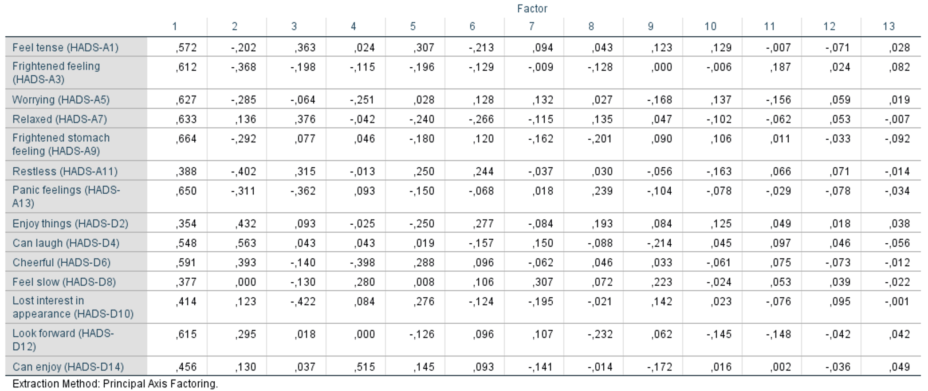
Eigenvalue
Sum of squared loadings for each factor
Indicates how much of the variance in the data that is explained by the factor (cf. R² )
Sum of eigenvalues = number of variables
Eigenvalue/number of variables x 100 = % explained variance

Slide 16
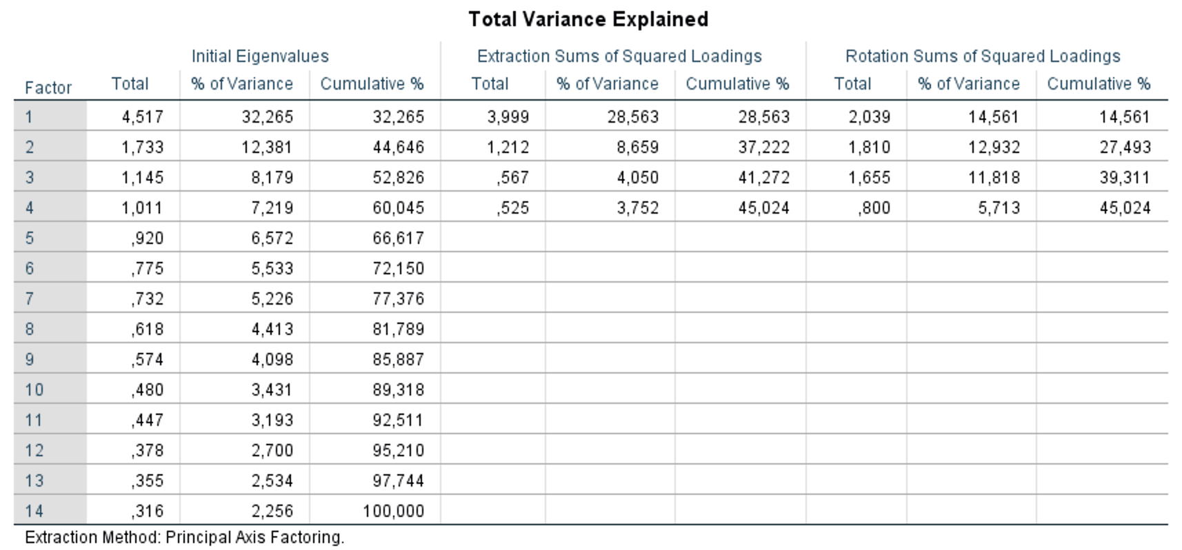
Eigenvalue >1
Sum of squared loadings for each factor
Indicates how much of the variance in the data that is explained by the factor (cf. R² )
Sum of eigenvalues = number of variables
Eigenvalue/number of variables x 100 = % explained variance

Slide 17
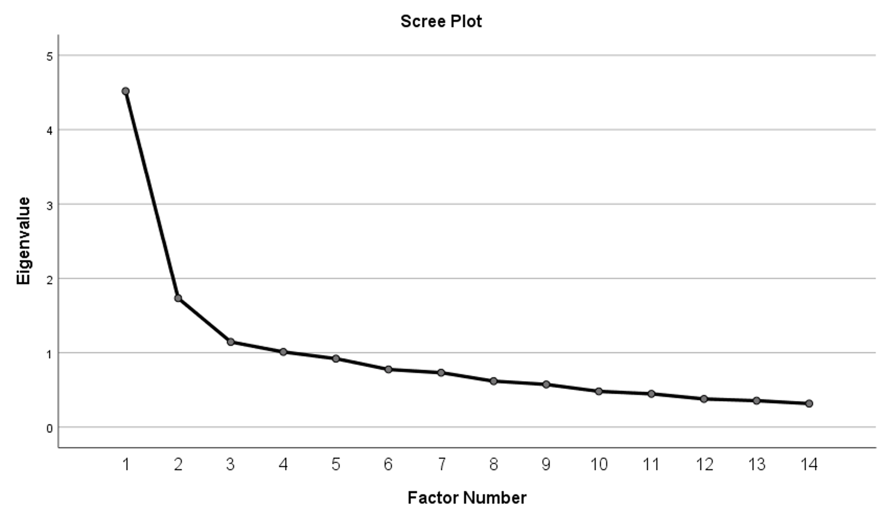
Scree Plot

Slide 18
≥60-70% explained variance

Slide 19
Parallel analysis
Calculate eigenvalues/explained variance from empirical data
Generate random data
Calculate eigenvalues/explained variance from random data
Compare eigenvalues/explained variance from empirical and random data
Empirical eigenvalues/explained variance > random = valid factor/component
Horn. Psychometrika 1965

Slide 20
Correlation matrices analyzed: Polychoric
Number of random correlation matrices: 500
Method to obtain random correlation matrices: Permutation of raw data
Variable Real-data Mean of random 95 percentile of random
% of variance % of variance % of variance
1 41.1** 15.4 17.6
2 14.3* 13.4 15.0
3 8.1 12.0 13.1
4 6.8 10.7 11.7
5 6.1 9.5 10.3
6 5.6 8.4 9.3
7 4.8 7.4 8.2
8 3.4 6.4 7.2
9 3.1 5.4 6.3
10 2.1 4.4 5.3
11 1.9 3.4 4.3
12 1.4 2.3 3.4
13 1.2 1.3 2.3
14 0.0 0.0 0.0
** Advised number of dimensions when 95 percentile is considered: 1
* Advised number of dimensions when mean is considered: 2
Notes:
20

Slide 21


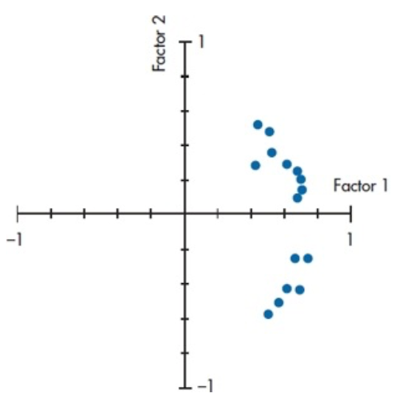
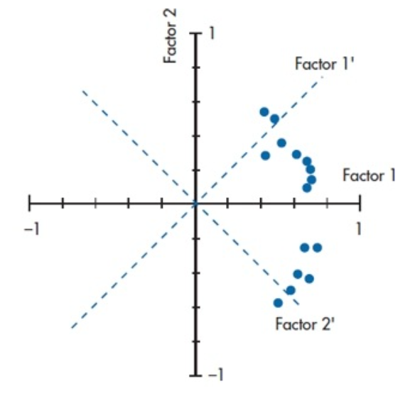
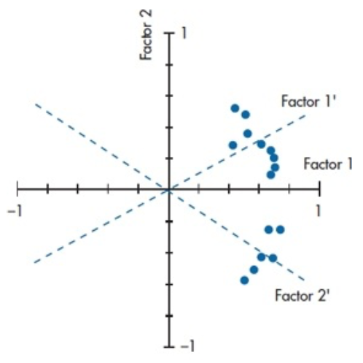
Rotation
Results (loadings) can be difficult to interpret; may be facilitated by rotation
  Orthogonal (e.g., varimax): factors are assumed to be uncorrelated
  Oblique (e.g., promax, oblimin, promin): factors are allowed to correlate
Ortogonal:
Oblique:
Unrotated
Ortogonal
Oblique

Slide 22
Where do variables belong?
Some rules of thumb
≥3-5 variables per component/factor
Each factor should contain some variable(s) that load almost exclusively in that factor
Variables should not load >0.3-0.4 in other factors

Slide 23
Assumptions
EFA assumes a reflective structure, i.e., observed variables express variations in (effects/consequences of) the latent variables/factors – NOT the other way around
1
1
2
2
3
3
4
4
Reflective
Formative

Slide 24
Assumptions
Number of observations
  n ≥100
  ≥10 observations (persons) per variable
Type of data/variables
  Linear
    Not dichotomous
    Caution with polytomous (but often considered ok if >7-10 categories)
  Not variables generated from other variables in the analysis
Linear relationships among variables
Multivariate normal distribution

Slide 25
Problems with item-level EFA/PCA
Item data...
are non-linear
are less reliable → lower correlations
are less valid
has narrower outcome space → poorer differentiation of individuals → weaker correlations
are more skewed → lower correlations
Compensated by use of appropriate correlations
  Tetrachoric (dichotomous items); Polychoric (polytomous items)
  Not (yet) incorporated in standard statistical packages (e.g., SPSS)

Slide 26
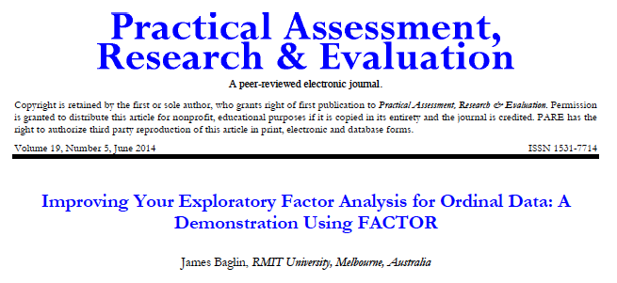
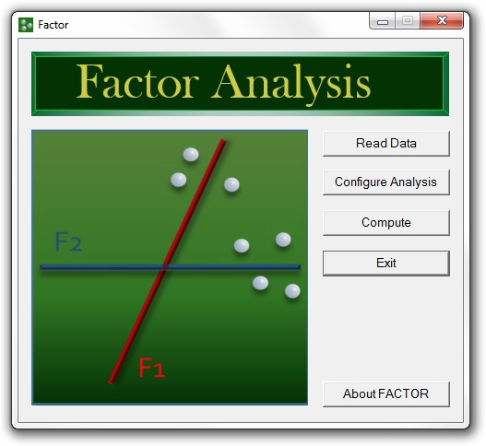
Specifically developed for item-level EFA
Uses tetrachoric/polychoric correlations
FACTOR is available from:
https://psico.fcep.urv.cat/utilitats/factor/

Slide 27
References
Baglin J. Improving your exploratory factor analysis for ordinal data: A demonstration using FACTOR. Practical Assessment, Research & Evaluation 2014; 19: 5.
Available from: https://doi.org/10.7275/dsep-4220
Costello AB, Osborne J. Best practices in exploratory factor analysis: four recommendations for getting the most from your analysis. Practical Assessment, Research & Evaluation 2005; 10: Article 7.
Available from: https://scholarworks.umass.edu/pare/vol10/iss1/7/
Hagell P, Tornqvist AL, Hobart J. Testing the SF-36 in Parkinson's disease. Implications for reporting rating scale data. Journal of Neurology 2008: 255(2): 246-254.
Available from: https://doi.org/10.1007/s00415-008-0708-y
Horn JL. A rationale and test for the number of factors in factor analysis. Psychometrika 1965; 30: 179–185.
Available from: https://doi.org/10.1007/BF02289447

