Slide 1
Differences and changes
Clinical assessment and outcome measurement
Peter Hagell Kristianstad university

Slide 2
Learning Objectives
Describe approaches to assess responsiveness and sensitivity
Describe the two main approaches to estimating a minimally important difference

Slide 3
Responsiveness and sensitivity
Responsiveness
Dependent observations (longitudinal, pretest-posttest)
Ability to capture differences over time, e.g., intervention effects
Sensitivity:
Independent observations (cross-sectional)
Ability to capture differences between groups, e.g., stages of disease
A function of reliability as well as validity

Slide 4
Why responsiveness and sensitivity
Interpreting data – are changes and differences clinically relevant?
Study design – sample size estimation
Statistical power: The probability of detecting an effect when there is an effect
Rule of thumb: ≥80% power
Determined by
Sample size (n)
Significance level (P-value)
Dispersion (SD)
Effect size (e.g., difference between groups – what difference is clinically relevant?)

Slide 5
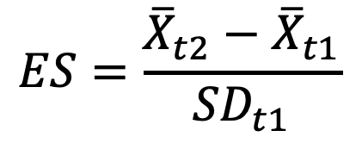
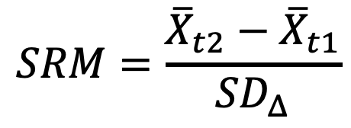
Responsiveness
Typically quantified based on
Variation at baseline (e.g., Cohen's Effect Size, ES)
Variation in change (e.g., Standardized Response Mean, SRM)
$$ES=\frac{{\overline{X}}_{t2}−{\overline{X}}_{t1}}{{SD}_{t1}}$$
$$SRM=\frac{{\overline{X}}_{t2}−{\overline{X}}_{t1}}{{SD}_{Δ}}$$
Norman et al. Qual Life Res 2007; 16: 815–822.

Slide 6
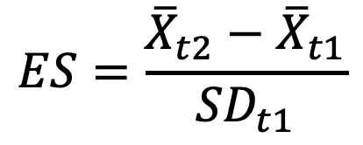
Responsiveness
Effect size (ES)
Standardised measure in SD units
High ES = large change relative to variation at baseline
Rule of thumb (Cohen 1992):
0.2: small
0.5: moderate
0.8: large
Different variants depending on the situation, see, e.g.,
Lakens. Front Psychol 2013; 4, 863.
Practical Meta-analysis Effect Size Calculator (https://campbellcollaboration.org/escalc/html/EffectSizeCalculator-Home.php)
$$ES=\frac{{\overline{X}}_{t2}−{\overline{X}}_{t1}}{{SD}_{t1}}$$
Cohen. Psychol Bull 1992; 112: 155.

Slide 7
Responsiveness
ES can often be calculated from published data
Different instruments, similar therapies and samples → Aid when selecting instruments

Slide 8
Sensitivity
Effect size (ES)
Relative efficiency (RE)
Relative ability to discriminate between groups (e.g. mild - moderate - severe disease) compared to other measures
Ratio of test statistics (e.g. t² or F-ratios)
Higher over lower (reference group)

Slide 9
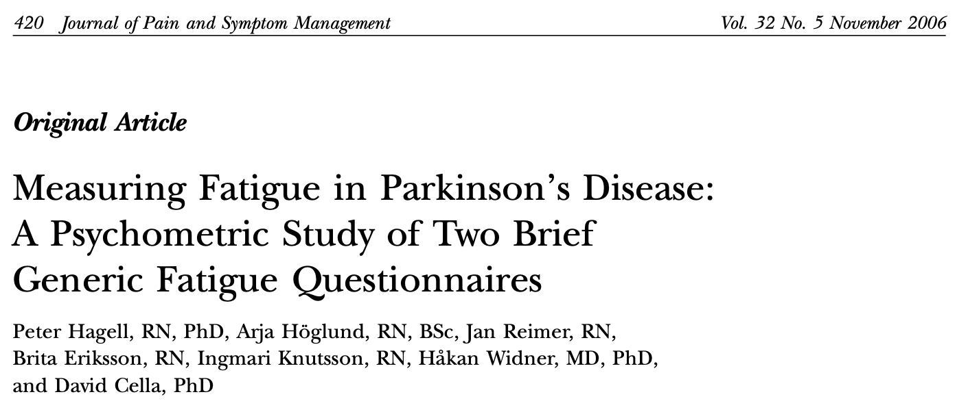
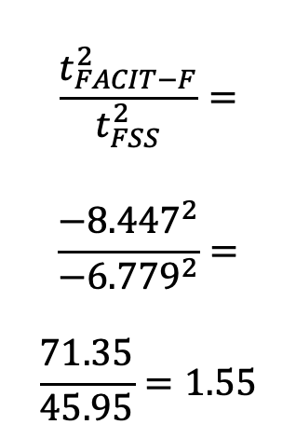
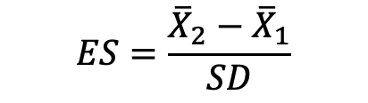
Example: Comparing two fatigue scales in Parkinson’s disease
95% CI of difference
(fatigued vs. non-fatigued)
Relative efficiency
(FACIT-F over FSS)
$$\frac{t_{FACIT−F}^{2}}{t_{FSS}^{2}}=$$
$$\frac{{−8.447}^{2}}{{−6.779}^{2}}=$$
$$\frac{71.35}{45.95}=1.55$$
Effect size
(fatigued vs non-fatigued)
$$ES=\frac{{\overline{X}}_{2}−{\overline{X}}_{1}}{SD}$$
FACIT-F: 1.23
FSS: 1.09

Slide 10
Interpreting change
What does a particular change mean?
What is the minimal meaningful difference?
Minimally Important Difference (MID) / Minimal Clinically Important Difference (MCID) / etc...
The smallest difference in a score that patients/clinicians perceive to be beneficial/meaningful
Two general approaches
Anchor based
Distribution based
King. ERPOR 2011; 11: 171.
Wyrwich et al. Qual Life Res 2005; 14: 285.
Wyrwich et al. Qual Life Res 2013; 22: 475.

Slide 11
Anchor based MID
Change in measure related to external criterion
Common criteria
Clinical indicators (biomarkers, therapy/care needs, level of function, etc.)
Cross-sectional assessment
Retrospective assessment

Slide 12
Anchor based MID
Basic principle
1. Change?
Worse About the same Better
2. If worse or better, how much?
7 Very much better/worse
6
5
4
3
2
1 Hardly any better/worse
3. Mean difference from baseline for those with ”small” changes
Large
Moderate
Small
Jaeschke et al. CCT 1989; 10: 407-415.

Slide 13
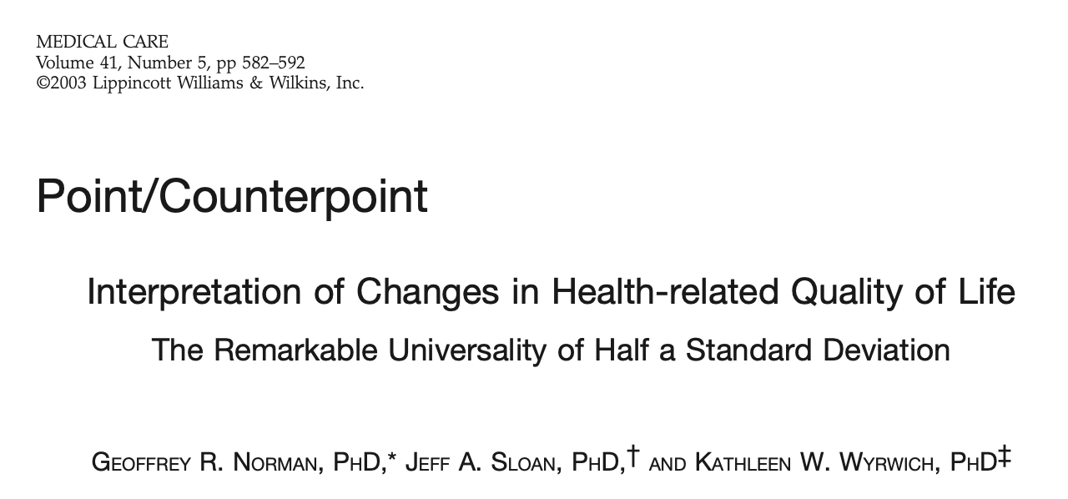
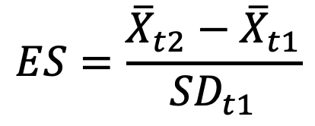
Distribution based MID
Effect size (ES)
0.2: small
0.5: moderate
0.8: large
Standard Error of Measurement (SEM)
0.5 SD
$$ES=\frac{{\overline{X}}_{t2}−{\overline{X}}_{t1}}{{SD}_{t1}}$$

Slide 14
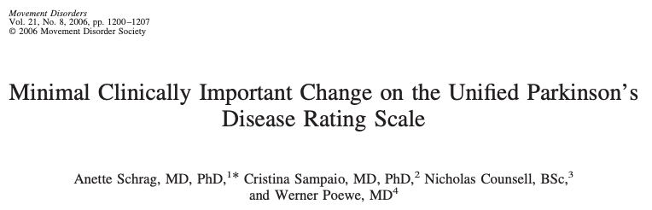
Data from 2 DA-agonist RCTs
De novo PD (n=(335+268)=603)
HY I (unilateral) to III (bilateral w/ impaired balance)
6 months follow-up
Anchor-based
Clinical Global Impression (Improvement)
7 (very much worse)
6 (much worse)
5 (minimally worse)
4 (no change)
3 (minimally improved)
2 (much improved)
1 (very much improved)
MCIC
Mean change from baseline among those judged to be ”minimally improved”
Baseline scores, mean (SD)
UPDRS II (ADL): 8.3 (4.76) 8.1 (4.87)
UPDRS III (motor): 23.1 (10.77) 21.5 (10.77)
Change scores (minimally improved), mean (ES)
UPDRS II (ADL): -2.2 (ES: 0.5) -1.8 (ES: 0.4)
UPDRS III (motor): -5 (ES: 0.5) -5.3 (ES: 0.5)
Suggested MCIC
UPDRS II (ADL): -2 (HY I-II); -3 (HY II.5-III)
UPDRS III (motor): -5 (HY I-III)

Slide 15
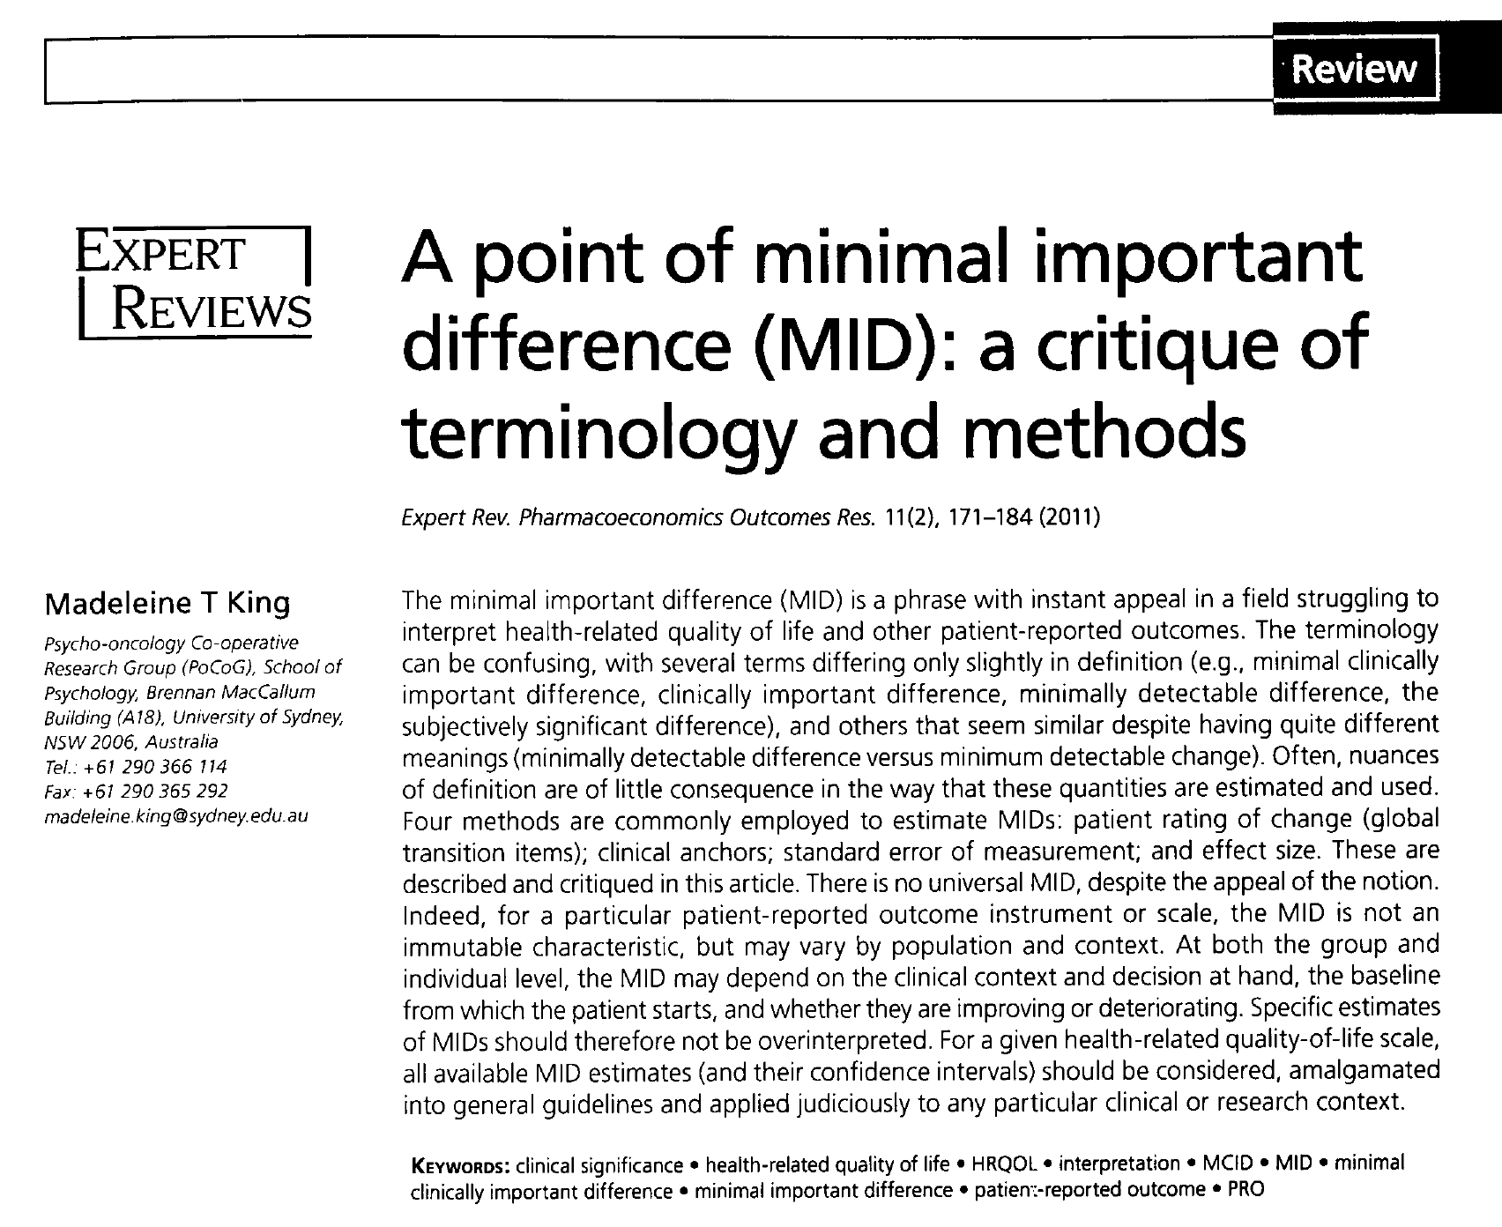
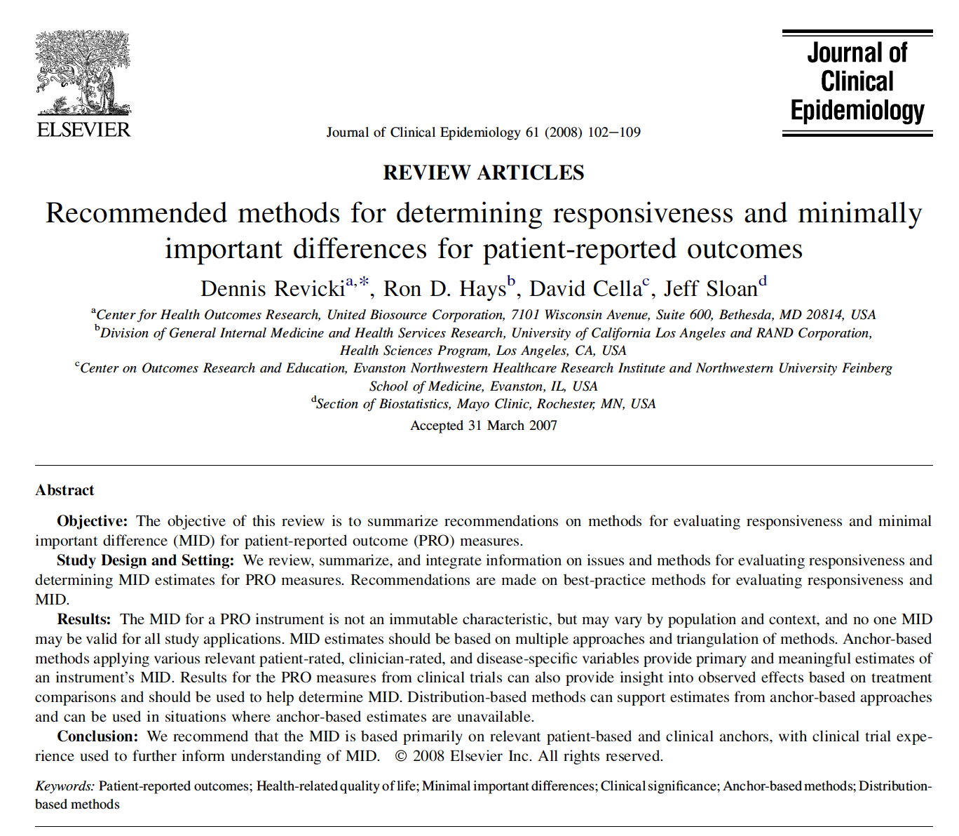


Slide 16
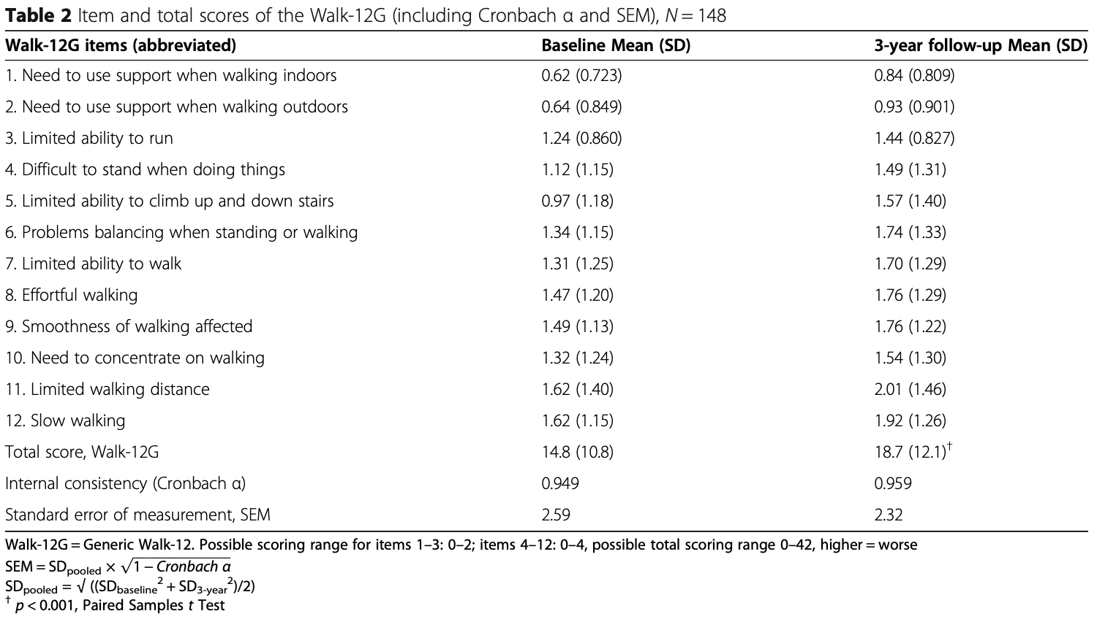
Exercise
These data are from a longitudinal study regarding perceived walking difficulties in Parkinson’s disease
Focus on the total Walk-12G scores and determine its effect size (ES) according to Cohen
Interpret and discuss the result (including the change score)
Lindh-Rengifo et al. BMC Geriatr 2021; 21: 221.
https://doi.org/10.1186/s12877-021-02113-0

Slide 17
Completion of the exercise

Slide 18
References
Cohen J. A power primer. Psychological Bulletin 1992; 112(1): 155-159. Available from: https://www2.psych.ubc.ca/~schaller/528Readings/Cohen1992.pdf
Hagell P, Hoglund A, Reimer J, Eriksson B, Knutsson I, Widner H, Cella D. Measuring fatigue in Parkinson's disease: a psychometric study of two brief generic fatigue questionnaires. Journal of Pain and Symptom Management 2006; 32(5): 420-432. Available from: https://lucris.lub.lu.se/ws/portalfiles/portal/2642368/625763.pdf
King MT. A point of minimal important difference (MID): a critique of terminology and methods. Expert Review of Pharmacoeconomics & Outcomes Research 2011; 11(2): 171-184. Available from: https://www.pocog.org.au/doc/QoL/King_MID%20Critique_ExpRevPharOutRes_2011.pdf
Lakens D. Calculating and reporting effect sizes to facilitate cumulative science: a practical primer for t-tests and ANOVAs. Frontiers in Psychology 2013; 4, 863. Available from: https://doi.org/10.3389/fpsyg.2013.00863
Lindh-Rengifo M, Jonasson SB, Ullén S, Mattsson-Carlgren N, Nilsson MH. Perceived walking difficulties in Parkinson’s disease – predictors and changes over time. BMC Geriatrics 2021; 21: 221. Available from: https://doi.org/10.1186/s12877-021-02113-0
Norman GR, Wyrwich KW, Patrick DL. The mathematical relationship among different forms of responsiveness coefficients. Quality of Life Research 2007; 16(5): 815-822. Available from: https://doi.org/10.1007/s11136-007-9180-x
Norman GR, Sloan JA, Wyrwich KW. Interpretation of changes in health-related quality of life: the remarkable universality of half a standard deviation. Medical Care 2003; 41(5), 582-592. Available from: https://doi.org/10.1097/01.MLR.0000062554.74615.4C

Slide 19
References
Revicki D, Hays RD, Cella D, Sloan J. Recommended methods for determining responsiveness and minimally important differences for patient-reported outcomes. Journal of Clinical Epidemiology 2008; 61(2): 102-109. Available from: https://www.researchgate.net/publication/5672094_Recommended_Methods_for_Determining_Responsiveness_and_Minimal_Important_Differences_for_Patient-Reported_Outcomes
Revicki DA, Cella D, Hays RD, Sloan JA, Lenderking WR, Aaronson NK. Responsiveness and minimal important differences for patient reported outcomes. Health and Quality of Life Outcomes 2006; 4(70). Available from: https://doi.org/10.1186/1477-7525-4-70
Schrag A, Sampaio C, Counsell N, Poewe W. Minimal clinically important change on the unified Parkinson's disease rating scale. Movement Disorders 2006; 21(8): 1200-1207. Available from: https://doi.org/10.1002/mds.20914
Wyrwich KW, Tierney WM, Wolinsky FD. Further evidence supporting an SEM-based criterion for identifying meaningful intra-individual changes in health-related quality of life. Journal of Clinical Epidemiology 1999; 52(9): 861-873. Available from: https://www.jclinepi.com/article/S0895-4356(99)00071-2/pdf
Wyrwich KW, Bullinger M, Aaronson N, et al. Estimating clinically significant differences in quality of life outcomes. Quality of Life Research 2005; 14(2): 285-295. Available from: https://doi.org/10.1007/s11136-004-0705-2
Wyrwich KW, Norquist JM, Lenderking WR, et al. Methods for interpreting change over time in patient-reported outcome measures. Quality of Life Research 2013; 22(3): 475-483. Available from: https://doi.org/10.1007/s11136-012-0175-x

