Slide 1
Validity
Clinical assessment and outcome measurement
Peter Hagell Kristianstad university

Slide 2
Learning Objectives
Describe the rationale behind tests of internal validity
Explain ways in which content validity can be assessed
Discuss different approaches to testing external validity

Slide 3
Validity
Does the instrument represent the variable that it intends to represent?
Mainly problematic with latent variables (e.g., emotions, experiences, attitudes) AND in the absence of explicit variable definition/theory
Many different names (”types of validity”)
Main traditional types of evaluations
Internal psychometric properties
Content validity
Criterion-related validity
Construct validity
Rarely/never "proven" – supporting evidence accumulates
Internal validity
External validity

Slide 4
Validity
Low
High
Latent target variable
Instrument

Slide 5
Internal validity
Do item scores appear to work together to yield a valid total score?
Testing relates to underpinning psychometric model/method
According to CTT/Likert scaling
Data quality
Legitimacy of summing items into total scores
Scale unidimensionality
Score distribution; floor/ceiling effects
Reliability (internal consistency)

Slide 6
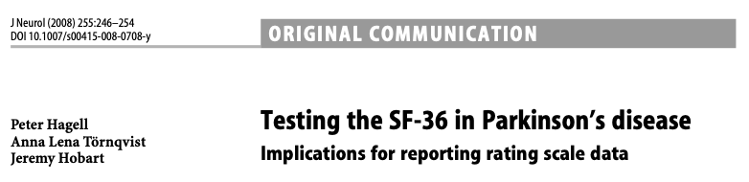
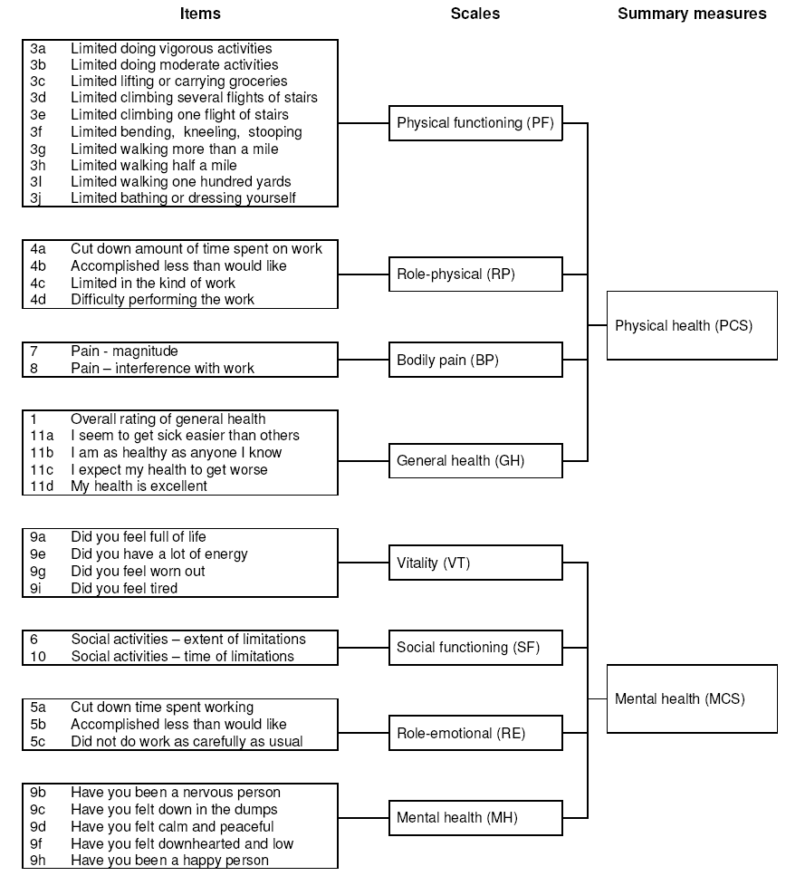
Data quality
% missing responses/item (<10% per item)
(% computable total scores)
Legitimacy of summing items into total score
Item level descriptive statistics (similar means, SDs)
Corrected item-total correlations (>0.3)
Scale unidimensionality
Corrected item-total correlations (>0.4)
Score distribution; floor/ceiling effects
Scores match the scale’s outcome range
No excessive floor/ceiling effects (<15-20%)
Reliability
Low levels of measurement error
Cronbach's coefficient alpha (≥0.7/0.8)

Slide 7
Corrected item-total correlations
The correlation between each item and the total score of other items in the same scale
Correction of overestimated correlation if the item is included in total score (in part correlated with itself)
Example 5-item instrument
Item | r | Total score
i1 | → | i2+i3+i4+i5
i2 | → | i1+i3+i4+i5
i3 | → | i1+i2+i4+i5
i4 | → | i1+i2+i3+i5
i5 | → | i1+i2+i3+i4
Indication of unidimensionality and the role of items in the total score

Slide 8
Floor/ceiling effects
Observed distribution
(floor effect)
Proportion (%) of persons with lowest (floor) and highest (ceiling) possible scores
Unknown locations
Cannot be compared with each other
Further improvement (ceiling) or deterioration (floor) is not reflected
Affects, e.g., clinical usefulness, correlations with other variables, and reliability
Rule of thumb: <15-20% (context dependent!)
Less
More
Possible score
Hypothetical true
distribution
Less
More

Slide 9
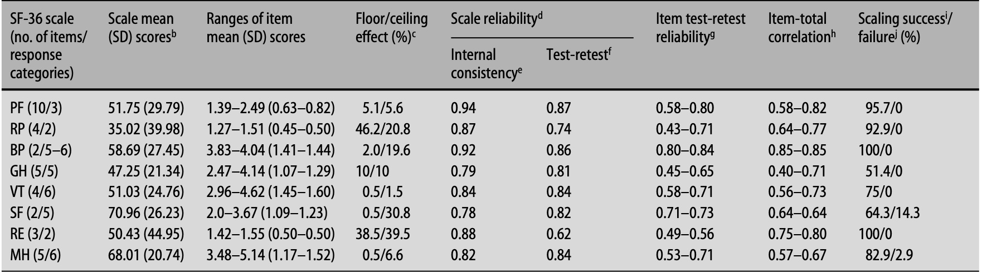
Data quality: 3% (0.5-5.9%) missing responses/item
Legitimacy of summing items into total score
Scale unidimensionality
Score distribution; floor/ceiling effects
Reliability

Slide 10
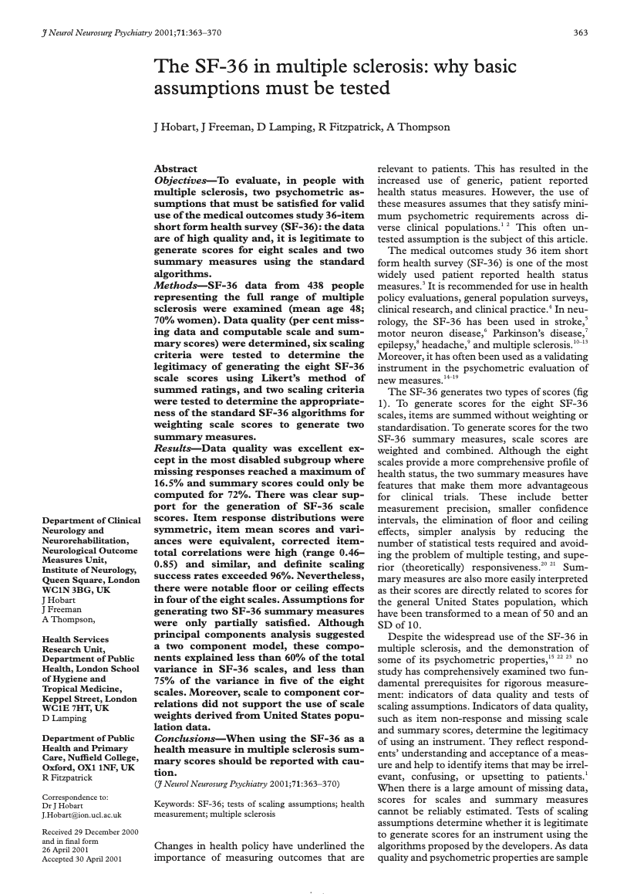
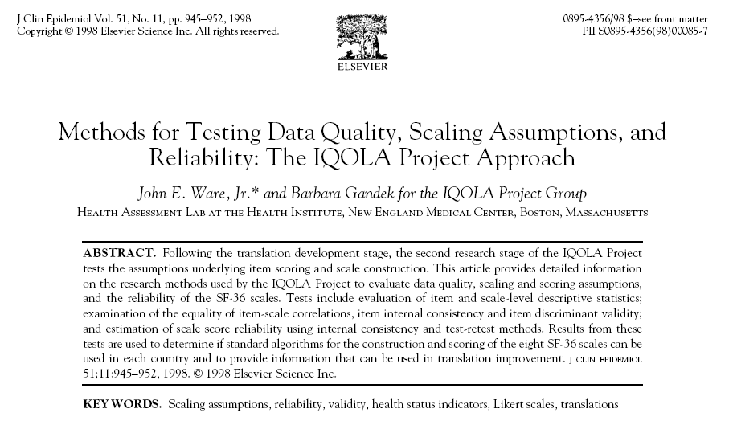

Slide 11
Content validity
Does the instrument contain representative manifestations/ aspects (items, response categories) of the target variable?
Does the instrument contain manifestations/aspects that are not representative of the target variable?
Evaluation:
How was the instrument developed?
Qualitative/theoretical/clinical considerations
Cognitive interviews
Evaluation by experts/respondents
Content Validity Index (CVI)
Almanasreh et al. RSAP 2019; 15: 214–221.
Willis. Cognitive interviewing: A "how to" guide. 1999.

Slide 12
Content Validity Index (CVI)
3-10 experts
But related to context, complexity of variable, etc.
Rating of item relevance
1 = not relevant
2 = somewhat relevant
3 = quite relevant
4 = highly relevant
CVI per item (I-CVI):
Proportion of 3/4 ratings
Recommendation: ≥0.78
CVI for the whole scale (S-CVI):
Mean I-CVI
Recommendation: ≥0.90
Polit & Beck. Res Nurs Health 2006; 29: 489-497.

Slide 13
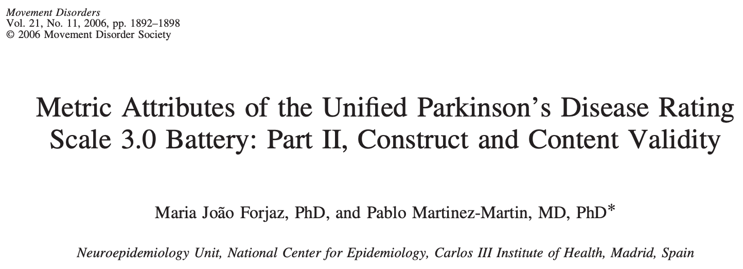
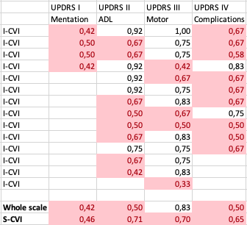
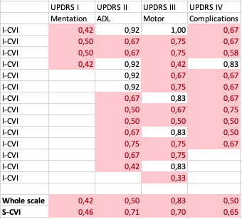
CVI: Unified Parkinson’s Disease Rating Scale (UPDRS)
Mentation, Behavior & Mood (4 items)
History, observation
Activities of Daily Living (13 items)
History
Motor Examination (14/27 items)
Clinical examination
Complications of Therapy (11 items)
History, observation
CVI:
12 international experts
Rating per item and for whole scales
I-CVI & S-CVI ≥0.75
I-CVI ≥0.78; S-CVI ≥0.90

Slide 14
External validity
Associations with other variables or scores, external to the instrument being tested
Criterion-related validity
Construct validity

Slide 15
Criterion-related validity
How do scores relate to an external criterion?
Evaluation:
Prediction of future events based on scores (predictive validity)
Concurrent use of another instrument ("gold standard") that represents the same thing (concurrent validity)

Slide 16
RAND-/SF-36
Health survey
Ware & Sherbourne.
Med Care 1992; 30: 473-483.

Slide 17
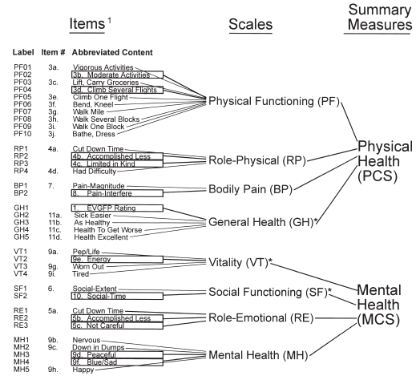
RAND-/SF-12
Health survey
Ware et al.
Med Care 1996; 34: 220-233.

Slide 18
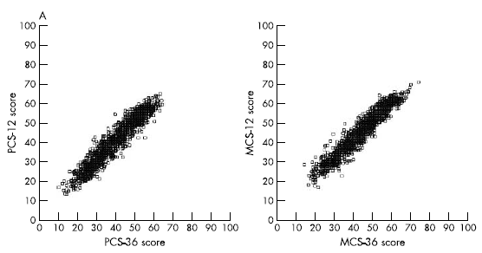
SF-12 vs SF-36 in coronary artery disease
Coronary artery disease
Parkinson’s disease
PCS-12, mean (SD): 37.7 (9.8)
PCS-36, mean (SD): 35.4 (10.6)
MCS-12, mean (SD): 46.2 (11.1)
MCS-36, mean (SD): 44.4 (11.2)
89% of PCS-36 scores reproduced by PCS-12
90% MCS-36 scores reproduced by MCS-12
~94% of the scores from SF-36 were reproduced by SF-12
Müller-Nordhorn et al. Heart 2004; 90: 523-527.
Hagell et al. Res Nurs Health 2017; 40: 378–386.

Slide 19
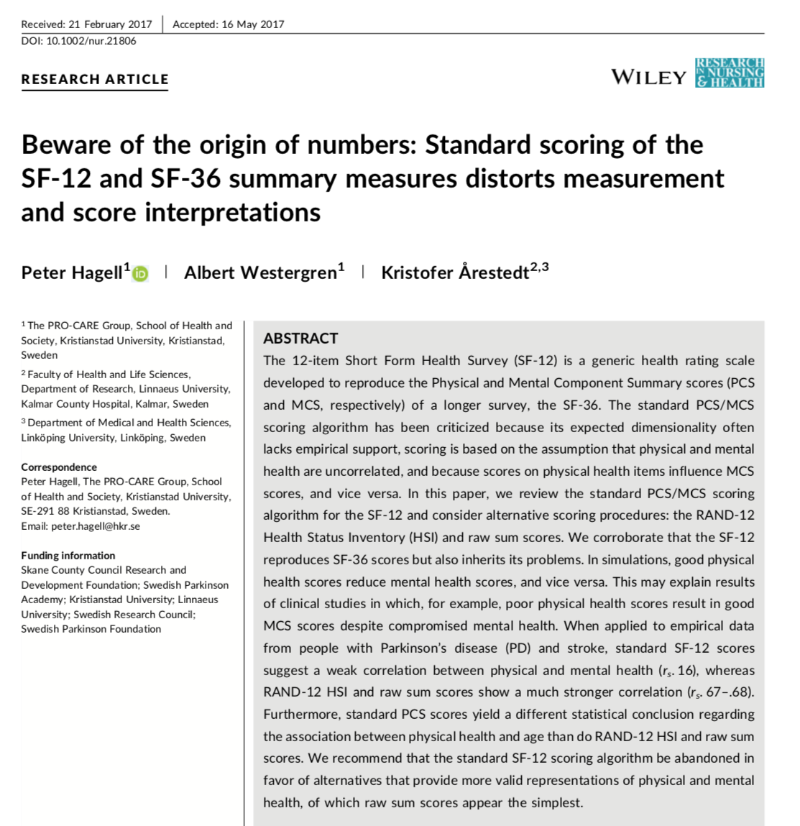
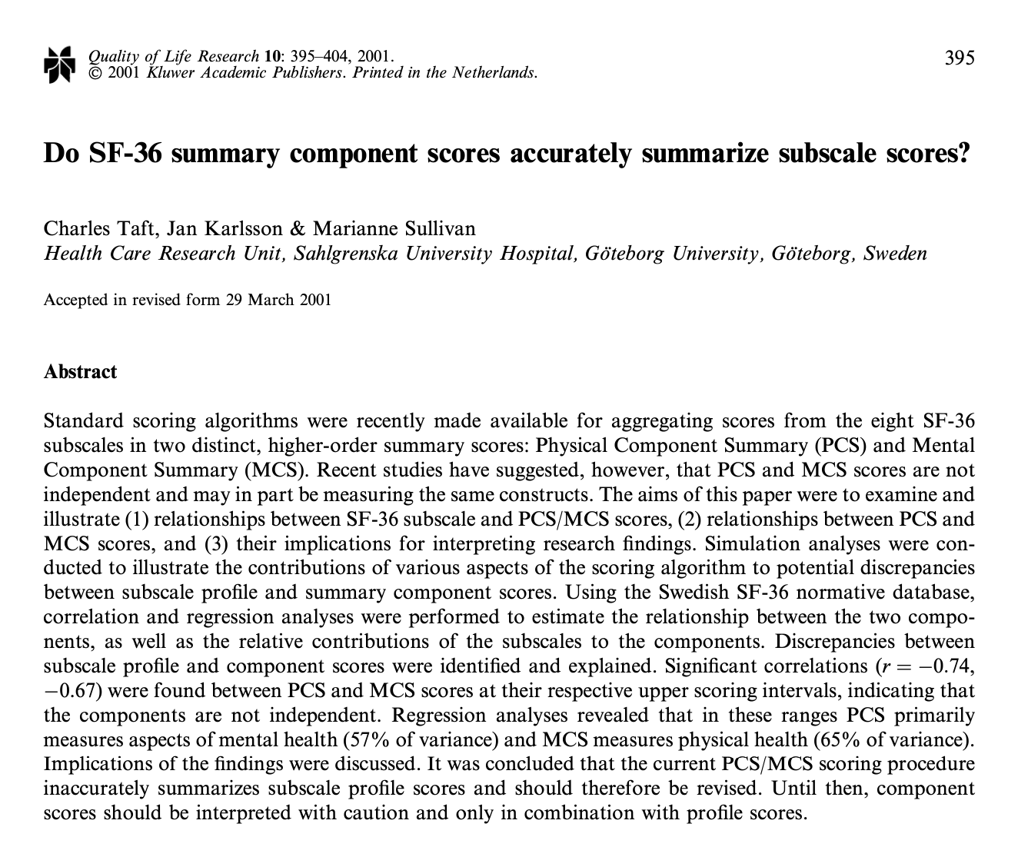
But says nothing about the quality of either...

Slide 20
Construct validity
Do scores represent the intended variable (construct)?
Do scores ”behave" as expected?
Between groups of people (differences - known-groups validity)
In relation to other variables (correlation - multitrait-multimethod; convergent/divergent)
Expected results support validity
Requires a priori hypothesis/theory

Slide 21
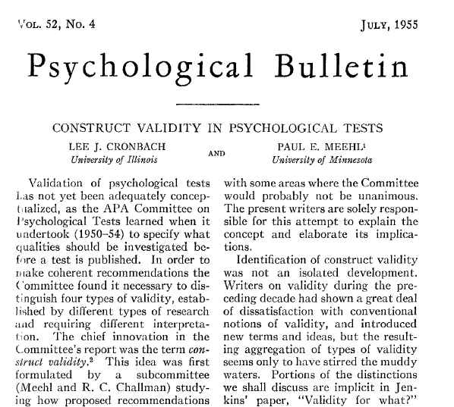
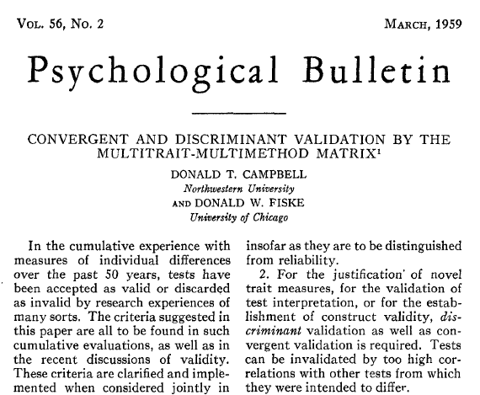

Slide 22
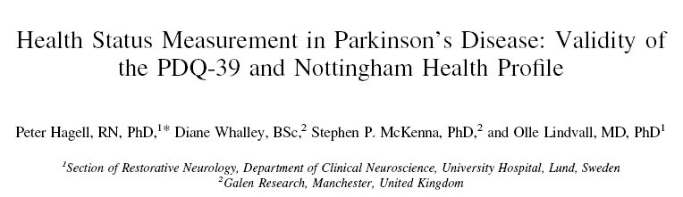
"Known-groups” based external construct validity
NHPD: NHP index of Distress
Based on the generic health status instrument Nottingham Health Profile (NHP)
Assessment of illness-related distress
Hypothesis:
Increased perceived disease severity → more "distress"
Higher NHPD scores (= more distress) among people with more severe perceived disease severity
100
P<0.001
(Kruskal-Wallis)
80
60
NHPD (0-100)
40
20
0
Mild
Moderate
Difficult
Perceived illness severity
Mov Disord 2003; 18: 773-783.

Slide 23
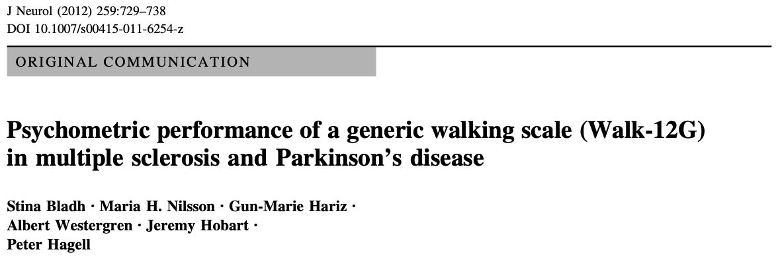
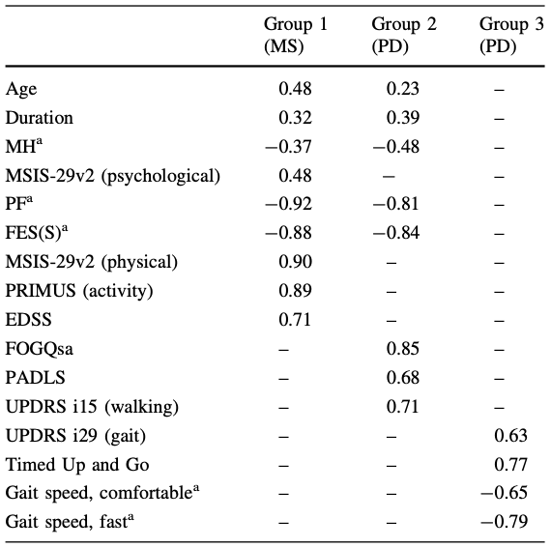
Convergent/divergent external construct validity
Walk-12G: 12-item generic walking scale
Walking difficulties in everyday life from the respondent’s perspective
12 items, 3-5 ordered response categories
Hypotheses:
Relatively strong correlations (≥0.6) with mobility, activity and physically related variables
Weaker correlations (<0.6) with mental and demographic aspects

Slide 24
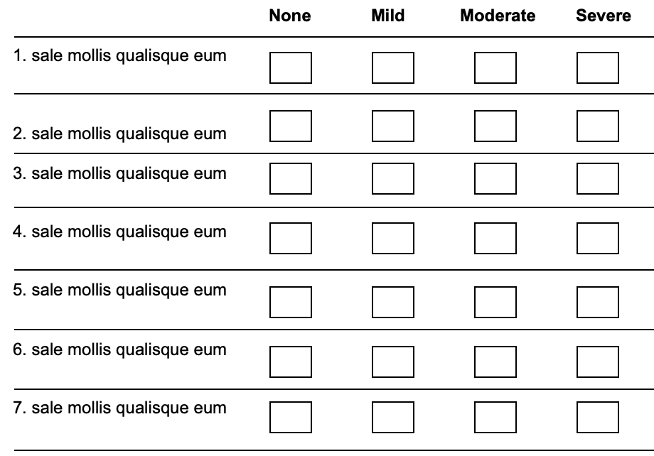
Unobservable latent variable
(e.g. mobility, fatigue, mental health,
depression, pain, well-being)
VALIDITY
Are observations interpretable
and meaningful representations
of variations in the latent variable
we are trying to quantify?
Descriptors of observable manifestations
Notes:
24

Slide 25
An example…
BUT...
What VARIABLE does it represent?
Meets traditional psychometric criteria
Has been used in clinical MS research since the 1990s
Translated into >25 languages
?
Cella et al. Neurology 1996; 47: 129-39.

Slide 26
Completion of the exercise

Slide 27
An example…
BUT...
What VARIABLE does it represent?
Meets traditional psychometric criteria
Has been used in clinical MS research since the 1990s
Translated into >25 languages
?
"MOBILITY"
Cella et al. Neurology 1996; 47: 129-39.

Slide 28
References
Almanasreh E, Moles R, Chen TF. Evaluation of methods used for estimating content validity. Research in Social and Administrative Pharmacy 2019; 15: 214–221. Available from: https://doi.org/10.1016/j.sapharm.2018.03.066
Campbell DT, Fiske DW. Convergent and discriminant validation by the multitrait-multimethod matrix. Psychological Bulletin 1959; 56(2): 81-105. Available from: https://users.cla.umn.edu/~nwaller/prelim/campbelfiskemtmm.pdf
Cronbach LJ, Meehl PE. Construct validity in psychological tests. Psychological Bulletin 1955; 52(4): 281-302. Available from: https://uopsych.github.io/psy611_2019/readings/Cronbach_Meehl_1955.pdf
Hagell P, Tornqvist AL, Hobart J. Testing the SF-36 in Parkinson's disease. Implications for reporting rating scale data. Journal of Neurology 2008: 255(2): 246-254. Available from: https://doi.org/10.1007/s00415-008-0708-y
Hagell P, Westergren A, Årestedt K. Beware of the origin of numbers: Standard scoring of the SF-12 and SF-36 summary measures distorts measurement and score interpretations. Research in Nursing & Health 2017; 40(4): 378-386. Available from: https://doi.org/10.1002/nur.21806
Hobart J, Freeman J, Lamping D, Fitzpatrick R, Thompson A. The SF-36 in multiple sclerosis: why basic assumptions must be tested. Journal of Neurology Neurosurgery & Psychiatry 2001; 71: 363–370. Available from: https://www.ncbi.nlm.nih.gov/pmc/articles/PMC1737568/pdf/v071p00363.pdf

Slide 29
References
Hobart JC, Riazi A, Lamping DL, Fitzpatrick R, Thompson AJ. Improving the evaluation of therapeutic interventions in multiple sclerosis: development of a patient-based measure of outcome. Health Technology Assessment 2004; 8(9). Available from: https://doi.org/10.3310/hta8090
Muller-Nordhorn J, Roll S, Willich SN. Comparison of the short form (SF)-12 health status instrument with the SF-36 in patients with coronary heart disease. Heart 2004; 90: 523–527. Available from: http://dx.doi.org/10.1136/hrt.2003.013995
Polit DF, Beck CT. The content validity index: are you sure you know what's being reported? Critique and recommendations. Research in Nursing and Health 2006; 29(5): 489-497. Available from: https://faculty.ksu.edu.sa/sites/default/files/the_content_validity_index_are_you_sure_1.pdf
Taft C, Karlsson J, Sullivan M. Do SF-36 summary component scores accurately summarize subscale scores? Quality of Life Research 2001; 10(5): 395-404. Available from: https://www.researchgate.net/publication/11595008
Ware JE Jr., Gandek B. Methods for testing data quality, scaling assumptions, and reliability: the IQOLA Project approach. Journal of Clinical Epidemiology 1998; 51(11): 945-952. Available from: https://www.researchgate.net/publication/13469790
Willis GB. Cognitive interviewing: A "how to" guide. Research Triangle Institute, 1999. Available from: https://www.hkr.se/contentassets/9ed7b1b3997e4bf4baa8d4eceed5cd87/gordonwillis.pdf

