Slide 1
Reliability
Clinical assessment and outcome measurement
Peter Hagell Kristianstad university

Slide 2
Learning Objectives
Understand the meaning of reliability
Describe methods to estimate internal consistency reliability
Describe methods to estimate agreement/test-retest reliability

Slide 3
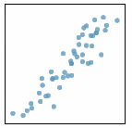
Classical Test Theory (CTT)
O = T + E
Largely correlational
O = Observed score
T = True score
E = Error score
Assumptions
T = mean of repeated independent observations of the same person at the same time
T and E are uncorrelated
E are uncorrelated
Notes:
3

Slide 4
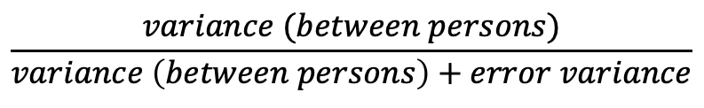
True score (T)
True score (T) + Error score (E)
Reliability (r_{xx} ) =
Little measurement error → High reliability
Much measurement error → Low reliability
Rules of thumb for acceptable reliability:
≥0.7, preferably ≥0.8 (group level)
≥0.9 (individual level)
$$\frac{variance (between persons)}{variance \left(between persons\right)+error variance}$$

Slide 5
Reliability
Split-half
Internal consistency
Test-retest
Intra-rater
Inter-rater

Slide 6
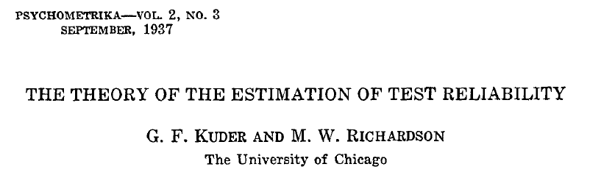
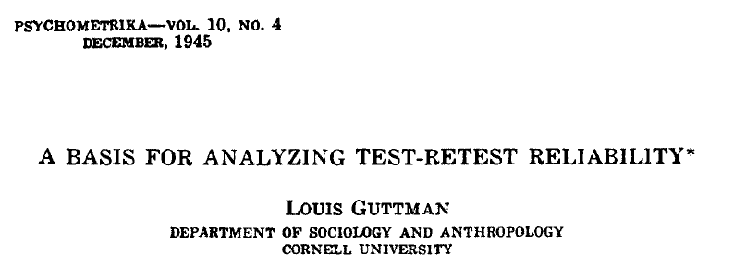
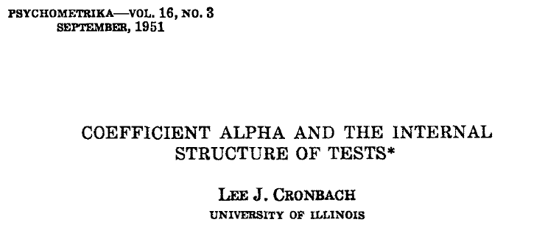
Internal consistency
Traditional estimates
Kuder-Richardson's formula 20 (KR-20)
Guttman's λ
Cronbach's coefficient alpha

Slide 7
Cronbach’s coefficient alpha
 | i1 | i2 | i3 | i4 | i5 | Total
n1 | 0 | 0 | 0 | 1 | 0 | 1
n2 | 1 | 0 | 0 | 0 | 1 | 2
n3 | 1 | 1 | 1 | 2 | 1 | 6
n4 | 1 | 1 | 2 | 2 | 2 | 8
n5 | 1 | 1 | 2 | 1 | 1 | 6
SUM | 4 | 3 | 5 | 6 | 5 | 23
Mean | 0.8 | 0.6 | 1.0 | 1.2 | 1.0 | 4.6
Var (s²) | 0.2 | 0.3 | 1.0 | 0.7 | 0.5 | 8.8

Slide 8
Cronbach’s coefficient alpha
Interpretation
Average of all possible split-half estimations
Estimation of reliability
Not a "test" of unidimensionality (alpha assumes unidimensionality)
Requires complete responses
Sensitive to, e.g.,
Number of items
Data distribution

Slide 9
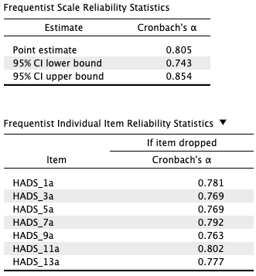
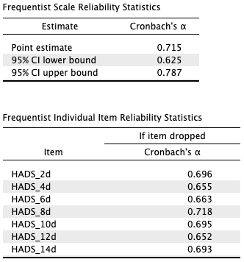
Alpha if item deleted
Alpha is expected to decrease with decreasing number of items
If alpha increases: Suggests problem
Conceptually
Dimensionality
Wording
other…?
Example: HADS in Parkinson’s disease
Anxiety
Depression

Slide 10
Assumptions (Cronbach’s coefficient alpha)
Unidimensionality
Equal item variances
Equal covariance (correlation) between items
Linear data
Dichotomous/polytomous items = ordinal
Unmet assumptions → Underestimation of reliability
Alternative methods:
Ordinal alpha
McDonald’s omega (𝞈)
Greatest Lower Bound (GLB)
Gadermann etal. PARE 2012; 17(3).
Trizano-Hermosilla & Alvarado FP 2016; 7: 1-8.
Xiao & Hau EPM 2022; 83: 5-27.

Slide 11
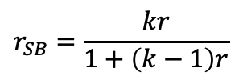
Additional methods
Homogeneity coefficient
Mean of all inter-item correlations
Should be >0.3
Spearman-Brown prophecy formula (r_{SB})
Developed as a complement for split-half reliability
Estimation of reliability if the number of items changes: (r = estimated reliability; k = factor by which the number of items changes)
$$r_{SB}=\frac{kr}{1+\left(k−1\right)r}$$
Trizano-Hermosilla & Alvarado FP 2016; 7: 1-8.
Xiao & Hau EPM 2022; 83: 5-27.

Slide 12
Agreement/stability; Test-retest reliability
Repeated testing/assessments
Same situation, same assessor, different occasions
Test-retest reliability (self-report/clinical assessments)
Intra-rater reliability (clinical assessments)
Same situation, different assessors
Inter-rater reliability (clinical assessments)

Slide 13
Agreement/stability; Test-retest reliability
Assumes that the target variable is stable
Otherwise results do not reflect stability of assessments
Time interval
Related to stability of the target variable
Too long: Risk of actual change
Too short: Recall bias
Common recommendation: 1-2 weeks
If possible, use external variable indicating stability
Latent target variable
Test 1
Test 2
Latent target variable
Test 1
Test 2

Slide 14
Agreement/stability; Test-retest reliability
Commonly used methods
Correlation (e.g., Pearson, Spearman)
Intra-class correlation (ICC)
Kappa, weighted Kappa

Slide 15
Correlation: Degree of linear covariation between two variables
Graphical: Scatterplots
Expressed as the correlation coefficient
Can range between -1 and 1
The extent to which observations (dots) follow a straight line
Does not represent non-linear (e.g., U-shaped) associations
The value (regardless of direction) indicates the strength
Close to 1 = strong positive correlation
Close to -1 = strong negative correlation
Positive
Negative

Slide 16
Correlation
r = 1.0
NOT recommended!
Does not reflect systematic changes
Time 2
Time 1

Slide 17
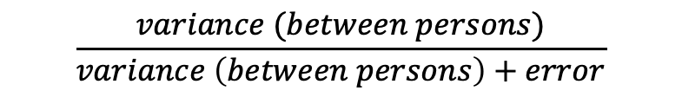
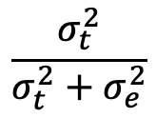
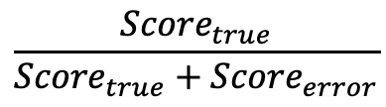
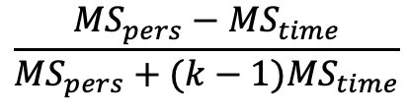
Intraclass correlation (ICC)
ANOVA-based method
Reliability:
$$\frac{{Score}_{true}}{{Score}_{true}+{Score}_{error}}$$
$$\frac{variance (between persons)}{variance \left(between persons\right)+error}$$
$$\frac{σ_{t}^{2}}{σ_{t}^{2}+σ_{e}^{2}}$$
ICC (one-way absolute agreement):
$$\frac{{MS}_{pers}−{MS}_{time}}{{MS}_{pers}+(k−1){MS}_{time}}$$

Slide 18
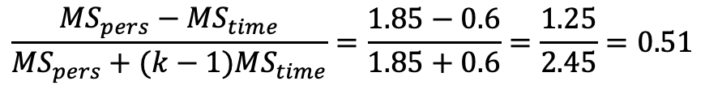
ICC (one-way absolute agreement)
Variance over time +
unexplained variance
Variance between
people
$$\frac{{MS}_{pers}−{MS}_{time}}{{MS}_{pers}+(k−1){MS}_{time}}=\frac{1.85−0.6}{1.85+0.6}=\frac{1.25}{2.45}=0.51$$

Slide 19
Intraclass correlation (ICC)
1-way random
Random sample of persons
Random selection of assessors
Different assessors for each person
2-way random
Random sample of persons
Random selection of specific type of assessors (e.g., training)
Same assessor for each person
2-way mixed
Random sample of persons
Specific assessor(s)
Same assessor for each person
X
Single measure:
One time point/rating
Average measure:
Mean of >1 time point/rating
Consistency (2-way):
Rank order
Agreement (1- & 2-way):
Absolute agreement
Assumptions
Same unit of measurement
Equal variances
X
X

Slide 20
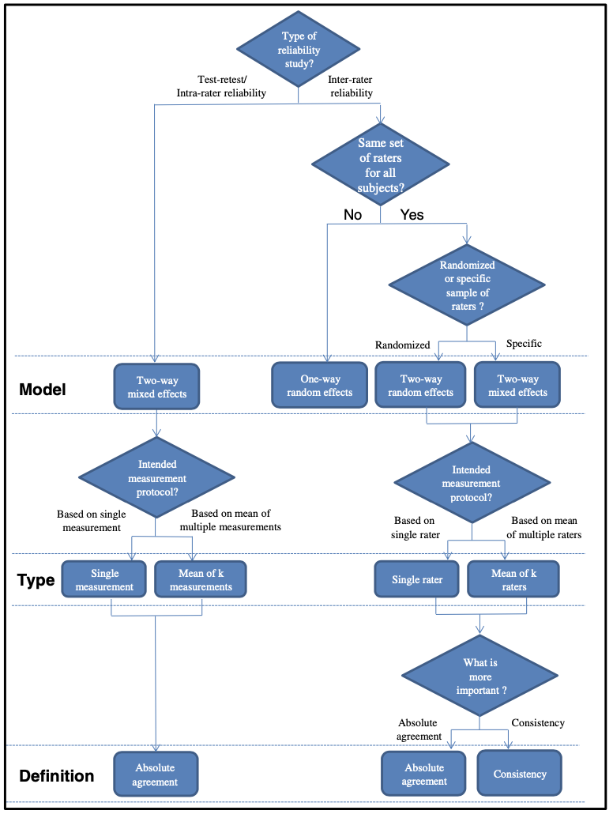
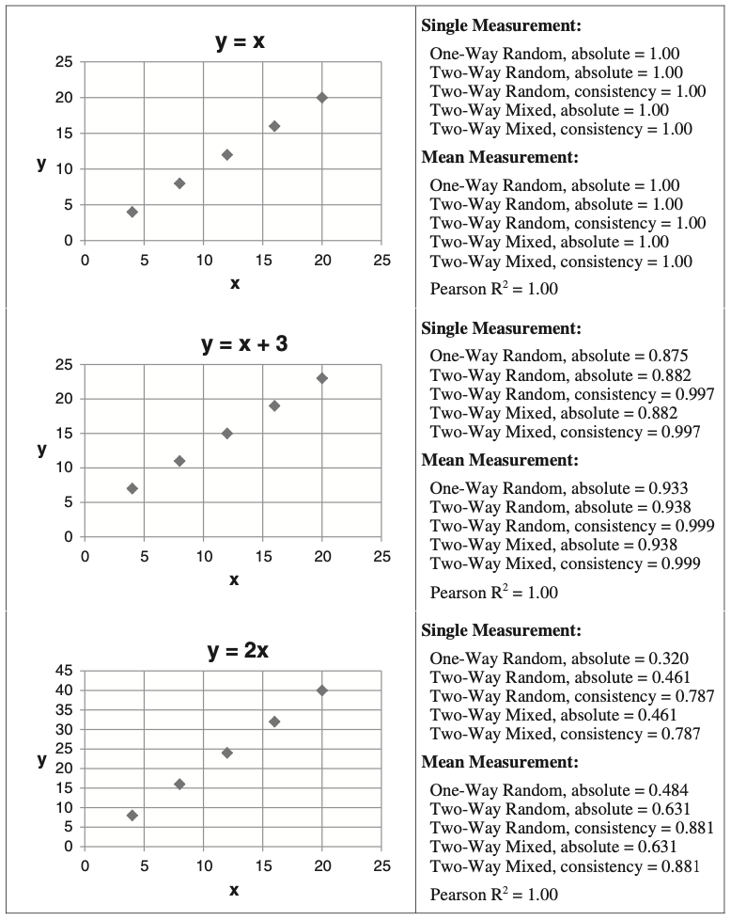
Koo & Li. JCM 2016; 15: 155-163.

Slide 21
Categorical variables: Kappa
% agreement (PA): 75/100 = 75%
Expected agreement (by chance):
a = 35 x 30 / 100 = 10.5
d = 65 x 70 / 100 = 45.5
Rules of thumb:
0.00-0.2: Slight
0.21-0.4: Fair
0.41-0.6: Moderate
0.61-0.8: Substantial
0.81-1.0: Almost perfect
Landis & Koch Biometrics 1977; 33: 159-174.
 | Yes | No
Yes | a | b
No | c | d
 | Yes | No | Total
Yes | 20 | 15 | 35
No | 10 | 55 | 65
Total | 30 | 70 | 100
P_{o} = Proportion observed
P_{e} = Proportion expected (by chance)

Slide 22
Categorical variables: weighted Kappa
Observed:
Expected:
 | 0 | 1 | 2 | 3 | Total
0 | 1 | 5 | 8 | 1 | 15
1 | 8 | 10 | 29 | 5 | 52
2 | 4 | 14 | 21 | 20 | 59
3 | 1 | 4 | 27 | 12 | 44
Total | 14 | 33 | 85 | 38 | 170
 | 0 | 1 | 2 | 3
0 |  | 2.91 | 6.61 | 4.23
1 | 4.28 |  | 26 | 11.62
2 | 4.85 | 11.45 |  | 16.65
3 | 3.62 | 8.54 | 19.41
Quadratic weights:
Quadratic weights (w):
Diagonal = 0
1 degree of disagreement = 1² = 1
2 degrees of disagreement = 2² = 4
3 degrees of disagreement = 3² = 9
 | 0 | 1 | 2 | 3
0 |  | 1 | 4 | 9
1 | 1 |  | 1 | 4
2 | 4 | 1 |  | 1
3 | 9 | 4 | 1
w = (quadratic) weight
P_{o} = Proportion observed
P_{e} = Proportion expected (by chance)

Slide 23
Kappa
Sensitive to cell distribution
Erroneously low/high values as an effect of cell distribution
Alternatives:
PABAK: Prevalence (cells a & d) And Bias (cells b & c) Adjusted Kappa
Replace cell values with averages (a & d are replaced by the average of a & d, corresponding for b & c)
Gwet's AC
Sim & Wright. Phys Ther 2005; 85(3): 257-268
Wongpakaran et al. BMC Med Res Methodol 2013; 13:61.

Slide 24
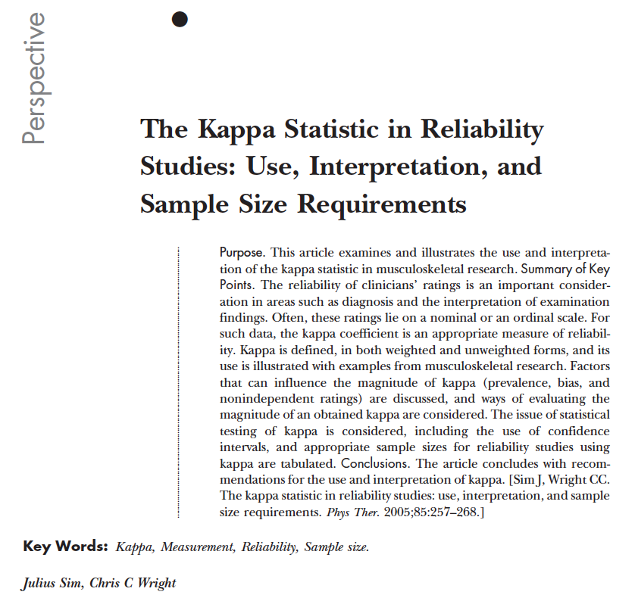
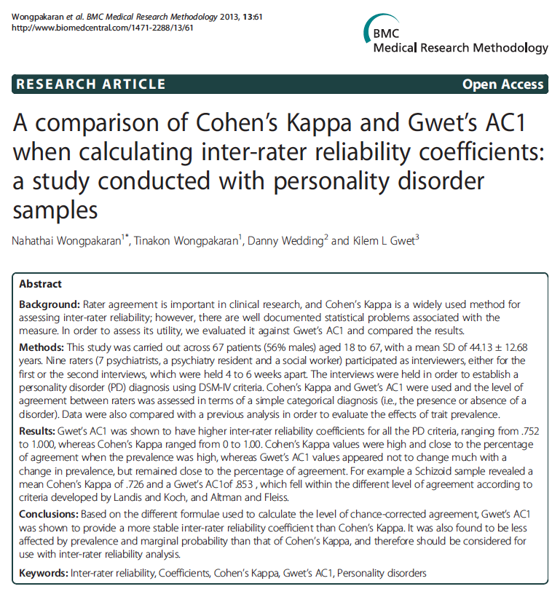

Slide 25
Reliability vs. agreement
Reliability:
the ratio of variability between subjects (e.g., patients) or objects (e.g., CT-scans) to the total variability of all measurements in the sample
the ability of a measurement to differentiate between subjects or objects
Agreement:
the degree to which scores or ratings are identical
Both concepts are important, because they provide information about the quality of measurements
Knotter et al. J Clin Epidemiol 2011; 64: 96-106.

Slide 26
Standard Error of Measurement (SEM)
Precision (estimated deviation/variation) relative to the true score
Average value over the full sample/outcome space
±1.96SEM = 95% CI
Suggested rule of thumb: ≤½ SD
Example
Physical Functioning scale (PF-10) from the SF-36 in Parkinson's disease:
Mean (SD): 51.75 (29.79)
Reliability: 0.94
SEM: 29.79√0.06 = 29.79 x 0.25 = 7.3 (95% CI: ±14.3)

Slide 27
Standard Error of Measurement (SEM)
Expressed in the same unit as the scale scores - less abstract than reliability coefficients
Average value - relevance to individual observations?
Varies across the outcome range

Slide 28
References
Cronbach LJ. Coefficient alpha and the internal structure of tests. Psychometrika 1951; 16(3): 297-334. Available from: http://cda.psych.uiuc.edu/psychometrika_highly_cited_articles/cronbach_1951.pdf
Gadermann AM, Guhn M, Zumbo BD. Estimating ordinal reliability for Likert-type and ordinal item response data: A conceptual, empirical, and practical guide. Practical Assessment, Research & Evaluation 2012; 17(3). Available from: https://doi.org/10.7275/n560-j767
Kottner J, Audigé L, Brorson S, Donner A, Gajeweski BJ, Hróbjartsson A, Robersts C, Shoukri M, Streiner DL. Guidelines for reporting reliability and agreement studies (GRRAS) were proposed. Journal of Clinical Epidemiology 2011; 64(1): 96-106. Available from: https://www.acilci.net/wp-content/uploads/2014/02/Guidelines-for-reporting-reliability-and-agreement-studies-GRRAS-were-proposed.pdf
Koo TK, Li MY. A guideline of selecting and reporting intraclass correlation coefficients for reliability research. Journal of Chiropractic Medicine 2016; 15: 155-163. Available from: https://www.ncbi.nlm.nih.gov/pmc/articles/PMC4913118/

Slide 29
References
Landis JR, Koch GG. The measurement of observer agreement for categorical data. Biometrics 1977; 33(1): 159-174. Available from: https://pdfs.semanticscholar.org/7e73/43a5608fff1c68c5259db0c77b9193f1546d.pdf
Sim J, Wright CC. The kappa statistic in reliability studies: use, interpretation, and sample size requirements. Physical Therapy 2005; 85(3): 257-68. Available from: https://doi.org/10.1093/ptj/85.3.257
Trizano-Hermosilla I, Alvarado JM. Best alternatives to Cronbach's alpha reliability in realistic conditions: Congeneric and asymmetrical measurements. Frontiers in Psychology 2016; 7: 769. Available from: https://doi.org/10.3389/fpsyg.2016.00769
Wongpakaran N, Wongpakaran T, Wedding D, Gwet KL. A comparison of Cohen's Kappa and Gwet's AC1 when calculating inter-rater reliability coefficients: a study conducted with personality disorder samples. BMC Medical Research Methodology 2013; 13: 61. Available from: https://doi.org/10.1186/1471-2288-13-61
Xiao L, Hau KT. Performance of coefficient alpha and its alternatives: Effects of different types of non-normality. Educational and Psychological Measurement 2022; 83(1): 5-27. Available from: https://doi.org/10.1177/00131644221088240

