Slide 1
Scoring and scaling (part 2)
Clinical assessment and outcome measurement
Peter Hagell
Kristianstad university

Slide 2
Learning Objectives
Identify common scaling methods
Understand the principles of various common scaling approaches
Discuss strengths and weaknesses of various scaling approaches

Slide 3
Weighting
Giving responses to different items different weights based on their ”importance”, ”severity”, etc.

Slide 4
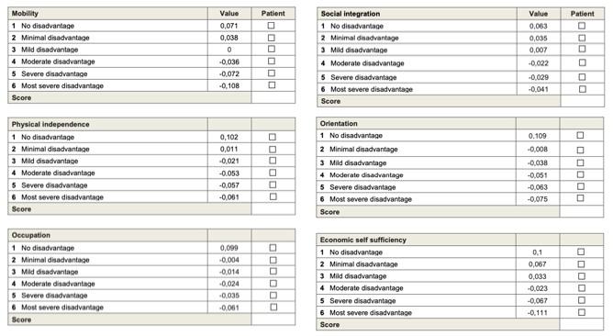
London Handicap Scale
LHS = Sum of all 6 weighted values + 0.456, where
The sum of all "no disadvantage" values is 0.544 (+0.456 = 1.00).
The sum of all "most severe disadvantage" values is –0.456 (+0.456 = 0.00).
Interpretation:
Minimum scale value: 0 (total disability)
Maximum scale value: 1.00 (normal function)

Slide 5
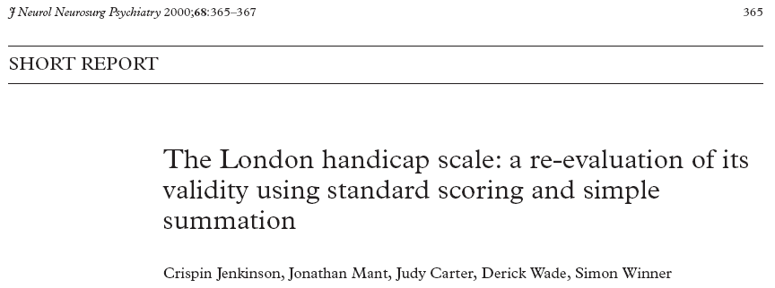
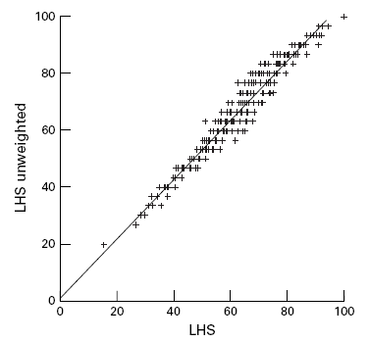
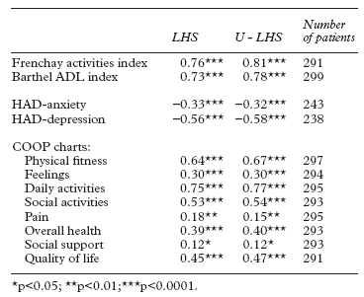
r_{s} = 0.98

Slide 6
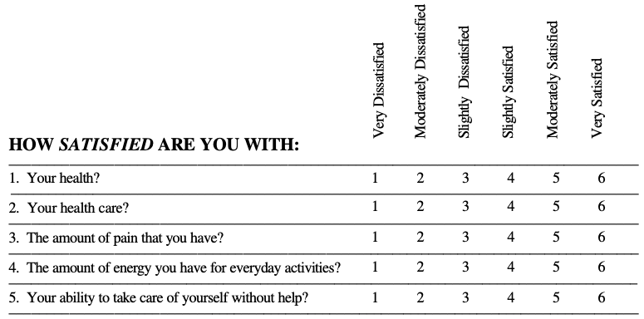
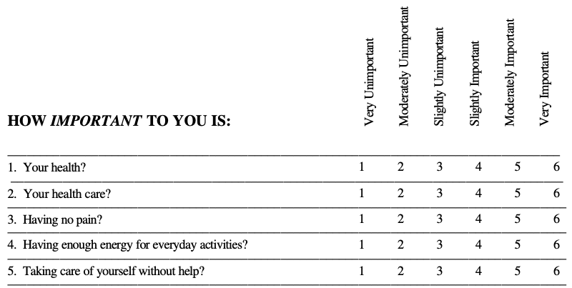
Ferrans & Powers' Quality of Life Index (QLI)
Weighted scoring; 2 x 34 items
  Satisfaction is weighted by how important each item is considered to be (satisfaction x importance)
1
2
Ferrans & Powers. Res Nurs Health 1992; 15: 29-38.

Slide 7
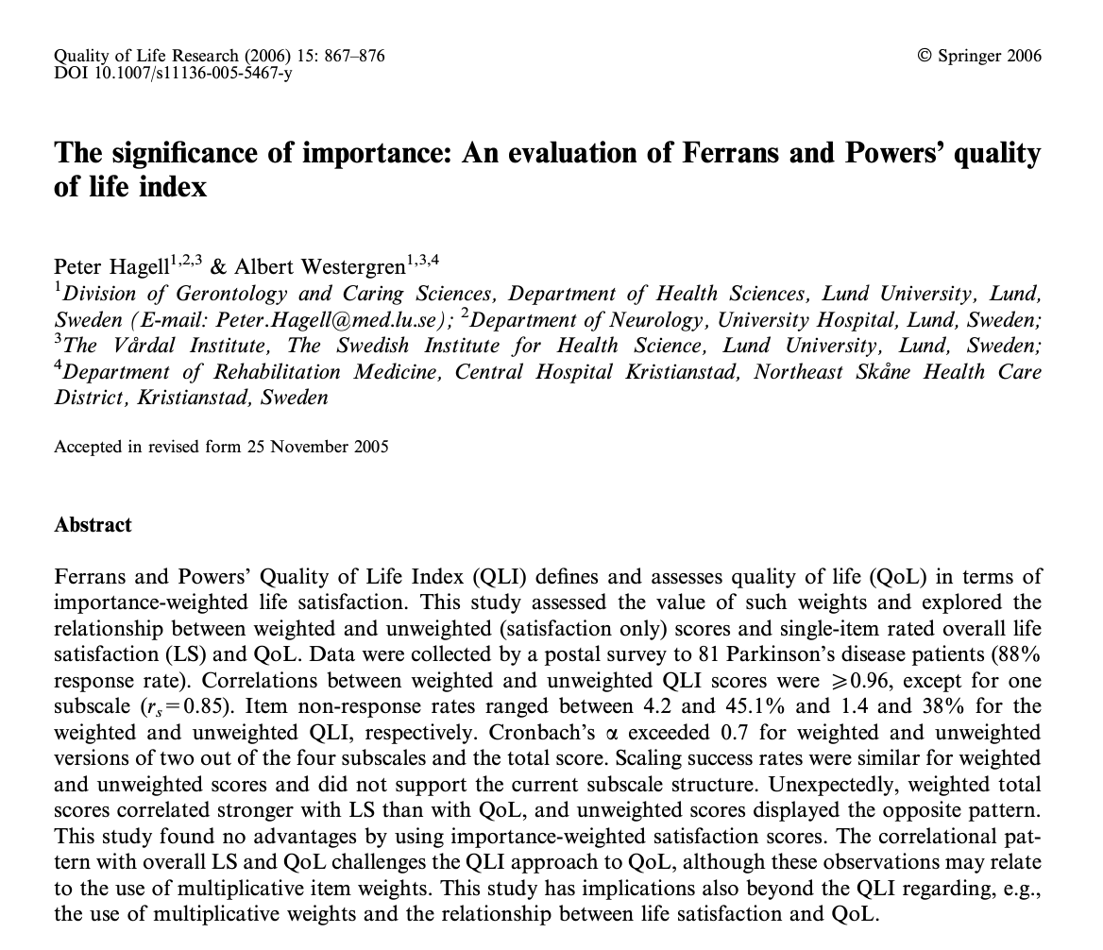
The QLI in Parkinson’s disease
Satisfaction
Ferrans & Powers. Res Nurs Health 1992; 15: 29-38.

Slide 8
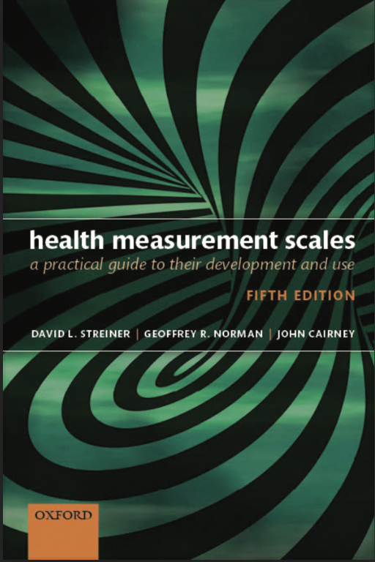
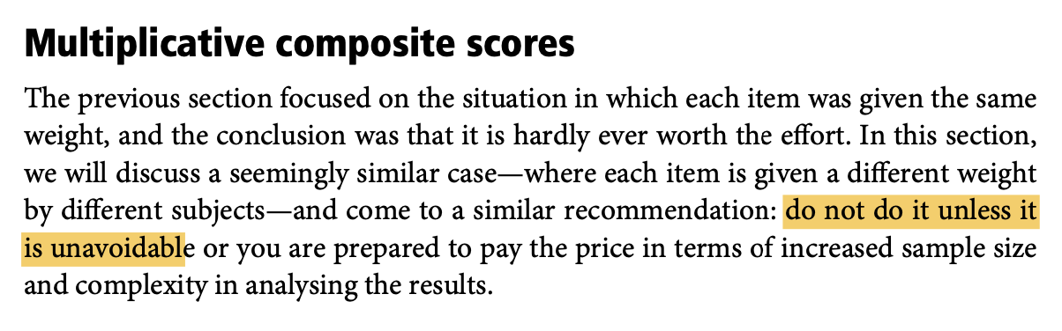
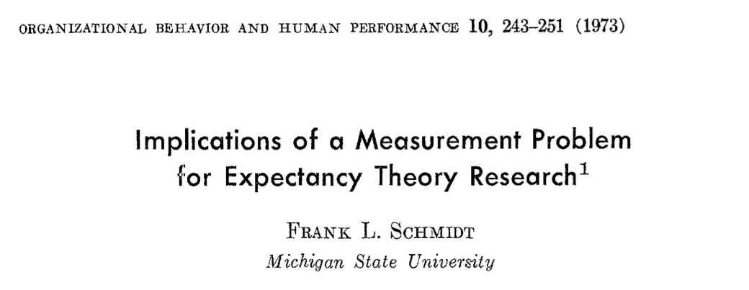
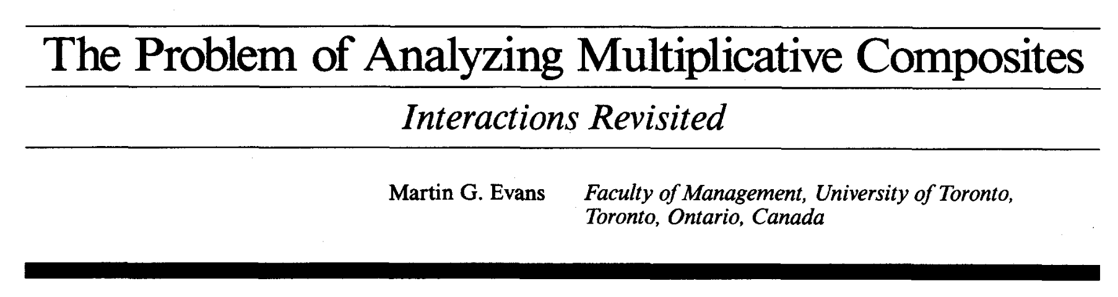
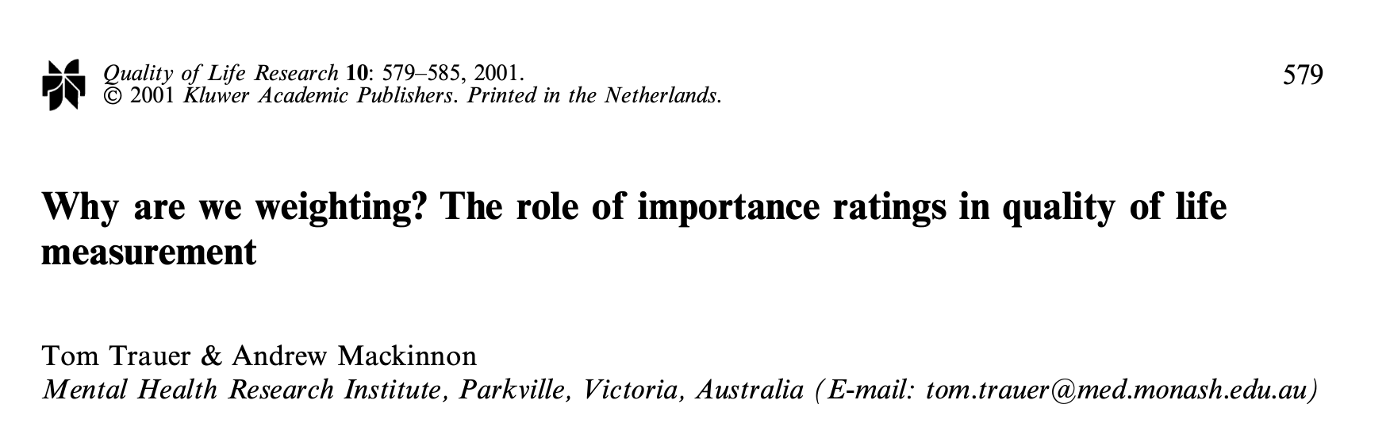
More fundamental issues with multiplicative weights
Streiner & Norman. Health Measurement Scales: A Practical Guide to Their Development and Use.

Slide 9
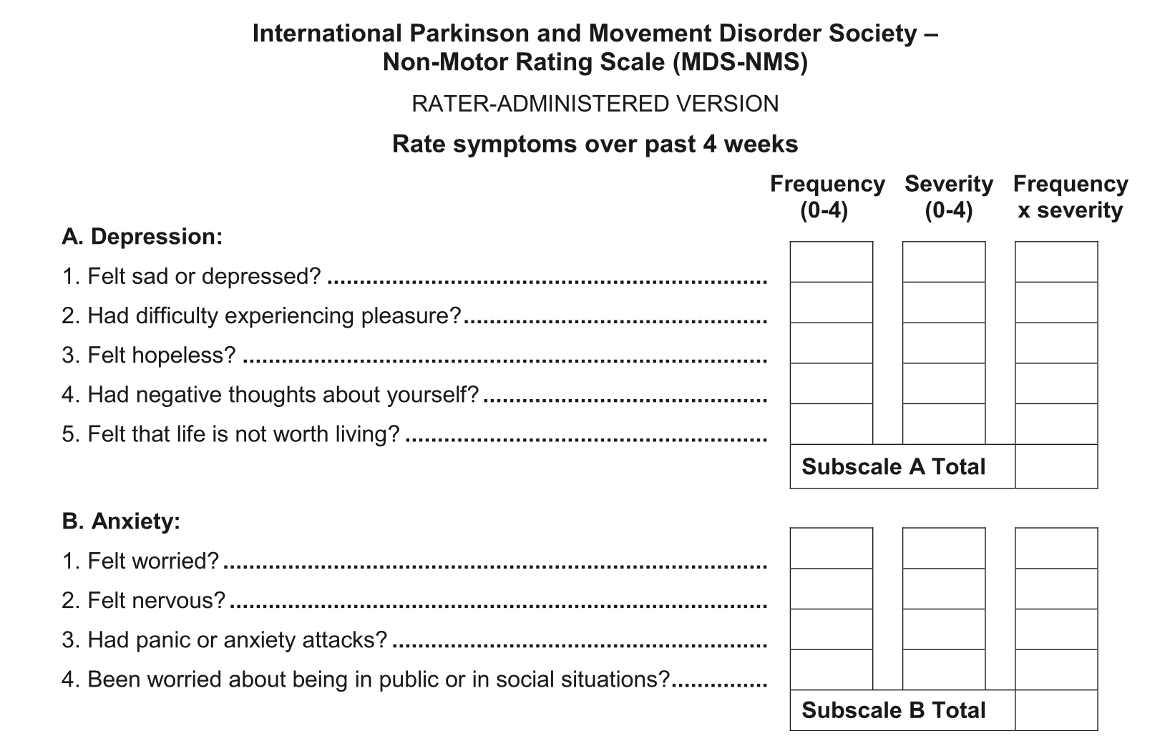
Chaudhuri et al. Mov Disord 2019.

Slide 10
Recommendation
Do not weight
Use separate scores, e.g., satisfaction & importance or frequency & severity, if
  Research: Part of study objectives
  Clinical practice: Aid in setting priorities
Item level use and interpretation, as with clinical checklists

Slide 11
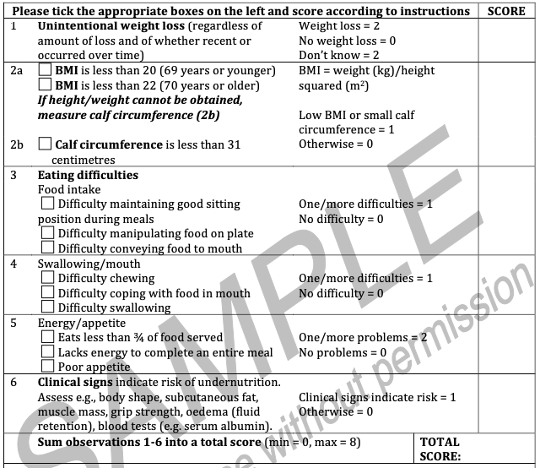
When may weights be useful?
Risk screening
If certain feature(s)/item(s) are known to be more important indicator(s) of risk

Slide 12
Health economic utilities
Valuation of health states

Slide 13
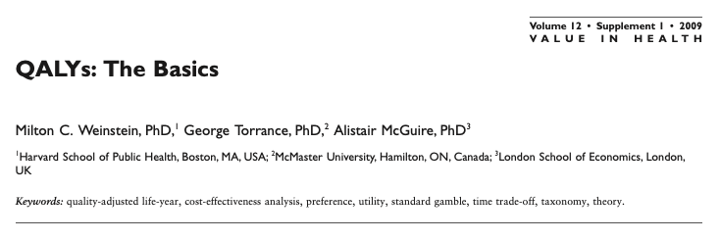
Utilities
https://pubmed.ncbi.nlm.nih.gov/19250132/
Assessment and valuation of health status
Based on estimates of normal population
  Standard Gamble: Certain health status for the rest of your life vs. therapy with 50% risk of death or immediate recovery
  Time Trade-Off: Certain health status for a certain time (t) followed by death vs. full health for a certain time (<t) followed by death
For calculation of "quality-adjusted life years" (QALYs) in health economic evaluations
1.0
Perfect health
0.0
Dead

Slide 14
Quality-adjusted life years (QALYs)
1.0
Perfect health
1 year with utility 1.0 = 1 QALY
1 year with utility 0.3 = 0.3 QALYs
3.3 years with utility 0.3 = (3.3 x 0.3) = 1 QALY
→ Estimation of cost per QALY
0.0
Dead

Slide 15
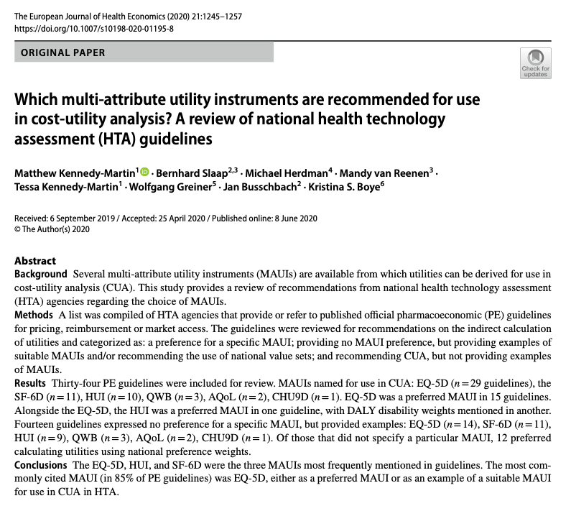
Instruments
EQ-5D
Short-Form 6-Dimension (SF-6D)
  Based on SF-/RAND-36 or SF-12
Health Utility Index (HUI)
15D
Assessment of Quality of Life (AQoL)
Quality of Well-Being (QWB) instrument
https://doi.org/10.1007/s10198-020-01195-8

Slide 16
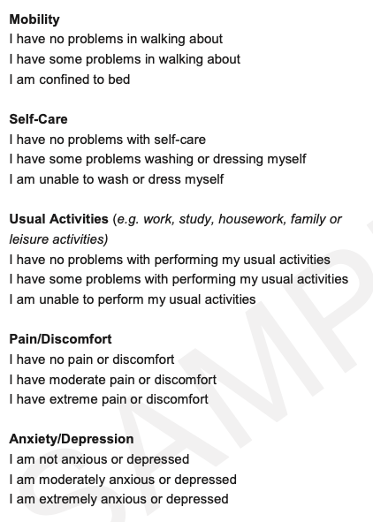
EQ-5D (TTO)
x
1.0
Perfect health
x
Valuation by general population
x
x
0.0
Dead
x

Slide 17
Bottom line
Beware of the purpose of scores and how scores are calculated
Scoring algorithms (calculation of scores) affect their interpretation and use
Review scoring and scaling, underlying assumptions and intentions of instruments before using them or (over)interpreting their scores

Slide 18
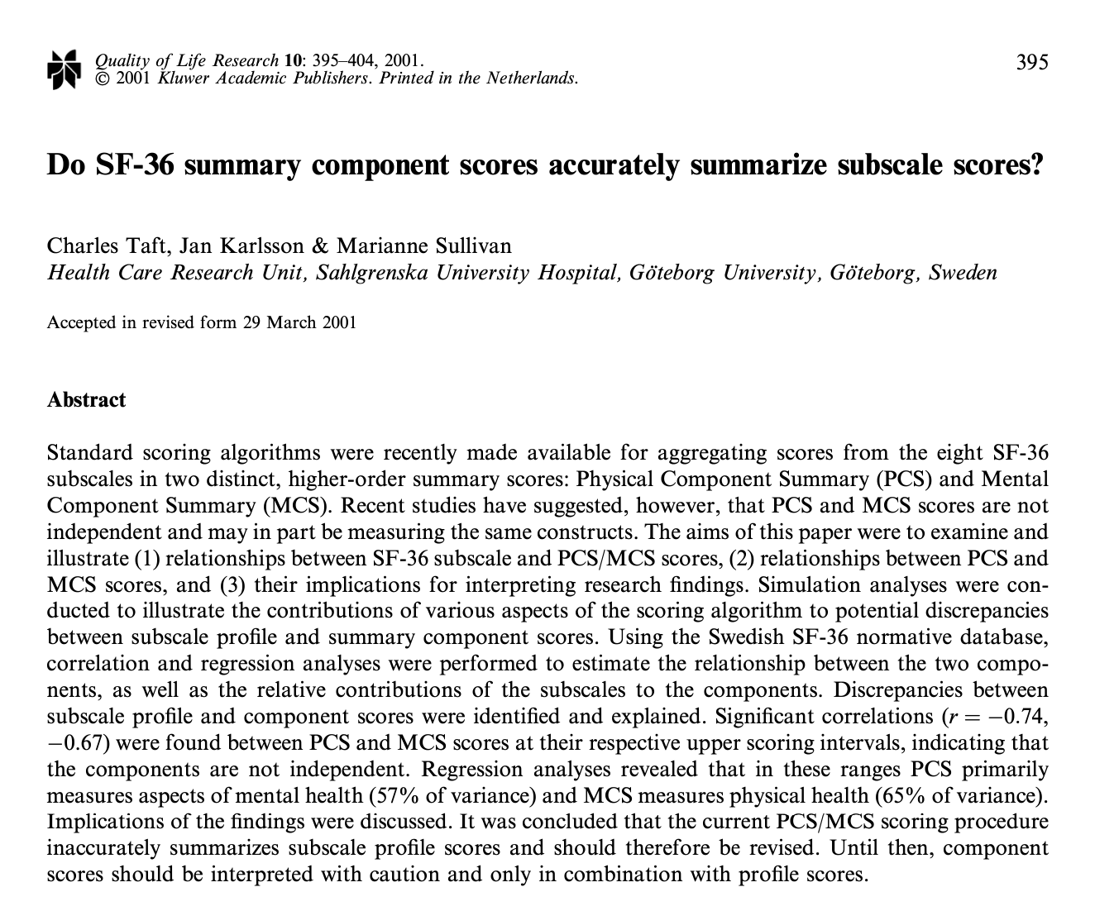
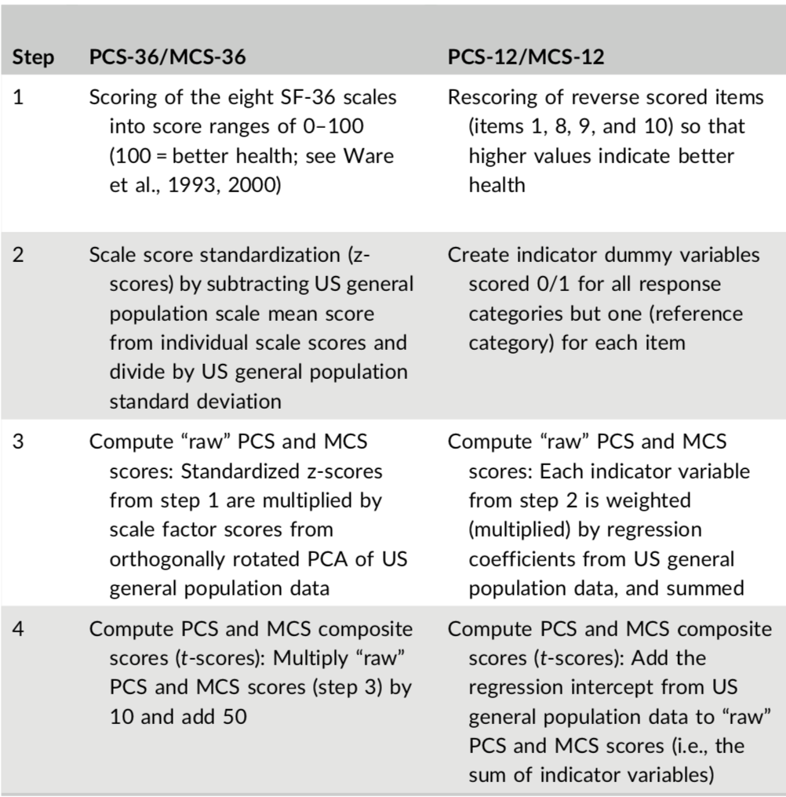
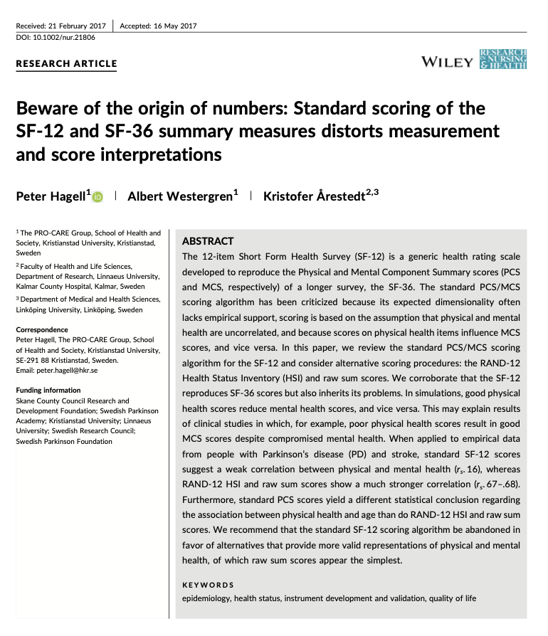
https://www.researchgate.net/publication/11595008
Example:
Standard scoring of the SF-36 and SF-12 Physical and Mental health summary measures
https://www.researchgate.net/publication/318604811

Slide 19
https://www.researchgate.net/publication/11595008
Example:
Standard scoring of the SF-36 and SF-12 Physical and Mental health summary measures
Based on the assumption that physical and mental health are uncorrelated
Physical health items influence mental health scores, and vice versa
Good physical health scores reduce mental health scores, and vice versa
Standard scoring yields a weak correlation between physical and mental health (r_{s}, 0.16), whereas alternative scoring methods do not (r_{s}, 0.67–0.68)
https://www.researchgate.net/publication/318604811

Slide 20
References
Abdi H. Guttman scaling. In: Salkind N (Ed.), Encyclopedia of research design. Thousand Oaks, CA: Sage, 2010.
Available from: https://personal.utdallas.edu/~herve/abdi-GuttmanScaling2010-pretty.pdf
Brook RH, Ware JE Jr, Davies-Avery A, Stewart AL, Donald CA, Rogers WH, et al. Overview of adult health status measures fielded in Rand’s Health Insurance Study. Medical Care 1979; 17(7 Suppl): 1-131.
Available from: https://www.researchgate.net/publication/22681856_Overview_of_Adult_Health_Status_Measures_Fielded_in_Rand%27s_Health_Insurance_Study
Brown RG, Dittner A, Findley L, Wessely SC. The Parkinson fatigue scale. Parkinsonism & Related Disorders 2005; 11(1): 49-55.
Available from: http://simonwessely.com/Downloads/Publications/Other_p/106.pdf
Chaudhuri KR, Schrag A, Weintraub D, Rizos A, Rodriguez-Blazquez C, Mamikonyan E, Martinez-Martin P. The movement disorder society nonmotor rating scale: Initial validation study. Movement Disorders 2020; 35(1): 116-133.
Available from: https://www.ncbi.nlm.nih.gov/pmc/articles/PMC7037759/
Collen FM, Wade DT, Robb GF, Bradshaw CM. The Rivermead Mobility Index: a further development of the Rivermead Motor Assessment. International Disability Studies 1991; 13(2): 50-54.
Available from: https://doi.org/10.3109/03790799109166684
Hagell P, Westergren A. The significance of importance: an evaluation of Ferrans and Powers' Quality of Life Index. Quality of Life Research 2006; 15(5): 867-876.
Available from: https://www.researchgate.net/publication/7060458_The_Significance_of_Importance_An_Evaluation_of_Ferrans_and_Powers%27_Quality_of_Life_Index

Slide 21
References
Hagell P, Westergren A, Årestedt K. Beware of the origin of numbers: Standard scoring of the SF-12 and SF-36 summary measures distorts measurement and score interpretations. Research in Nursing and Health 2017; 40(4): 378-386.
Available from: https://www.researchgate.net/publication/318604811
Hobart J, Lamping D, Fitzpatrick R, Riazi A, Thompson A. The Multiple Sclerosis Impact Scale (MSIS-29): a new patient-based outcome measure. Brain 2001;124: 962-973.
Available from: https://doi.org/10.1093/brain/124.5.962
Hobart JC, Riazi A, Lamping DL, Fitzpatrick R, Thompson AJ. Improving the evaluation of therapeutic interventions in multiple sclerosis: development of a patient-based measure of outcome. Health Technology Assessment 2004; 8(9): iii, 1-48.
Available from: https://doi.org/10.3310/hta8090
Jenkinson C, Mant J, Carter J, Wadec D, Winner S. The London handicap scale: a re-evaluation of its validity using standard scoring and simple summation. Journal of Neurology Neurosurgery & Psychiatry 2000; 68: 365-367.
Available from: http://dx.doi.org/10.1136/jnnp.68.3.365
Kennedy-Martin M, Slaap B, Herdman M, et al. Which multi-attribute utility instruments are recommended for use in cost-utility analysis? A review of national health technology assessment (HTA) guidelines. European Journal of Health Economics 2020; 21: 1245–1257.
Available from: https://doi.org/10.1007/s10198-020-01195-8
Likert R. A technique for the measurement of attitudes. Archives of Psychology; 140: 1-55.
Available from: https://legacy.voteview.com/pdf/Likert_1932.pdf

Slide 22
References
McKenna SP, Hunt SM, McEwen J. Weighting the seriousness of perceived health problems using Thurstone's method of paired comparisons. International Journal of Epidemiology 1981; 10(1): 93-97.
Available from: https://citeseerx.ist.psu.edu/viewdoc/download?doi=10.1.1.833.5428&rep=rep1&type=pdf
Schmidt FL. Implications of a measurement problem for expectancy theory research. Organizational Behavior and Human Performance 1973; 10: 243–251.
Available from: https://doi.org/10.1016/0030-5073(73)90016-0
Stouffer SA, Guttman L, Suchman EA, Lazarsfeld PF, Star SA, Clausen JA. Measurement and prediction (Studies in Social Psychology in World War II, Volume IV). Princeton, NJ: Princeton University Press, 1950.
Available from: https://gwern.net/doc/psychology/1950-stouffer-theamericansoldier-v4-measurementandprediction.pdf
Streiner DL, Norman GR. Health Measurement Scales: A Practical Guide to Their Development and Use. 5th edition. Oxford: Oxford University Press, 2014.
Available from: https://doi.org/10.1093/med/9780199685219.001.0001
Taft C, Karlsson J, Sullivan M. Do SF-36 summary component scores accurately summarize subscale scores? Quality of Life Research 2001; 10(5): 395-404.
Available from: https://www.researchgate.net/publication/11595008

Slide 23
References
Thurstone LL. A law of comparative judgment. Psychological Review 1927; 34(4): 273–286.
Available from: https://parsmodir.com/wp-content/uploads/2013/02/thurstone1927.pdf
Trauer T, Mackinnon A. Why are we weighting? The role of importance ratings in quality of life measurement. Quality of Life Research 2001; 10: 579–585.
Available from: https://doi.org/10.1023/A:1013159414364
Ware JE Jr., Gandek B. Methods for testing data quality, scaling assumptions, and reliability: the IQOLA Project approach. International Quality of Life Assessment. Journal of Clinical Epidemiology 1998; 51(11): 945-952.
Available from: https://www.researchgate.net/publication/13469790_Methods_for_testing_data_quality_scaling_assumptions_and_reliability_the_IQOLA_Project_approach_International_Quality_of_Life_Assessment
Weinstein MC, Torrance G, McGuire A. QALYs: The basics. Value in Health 2009; 12(Suppl 1): S5-S9.
Available from: https://pubmed.ncbi.nlm.nih.gov/19250132/

