Slide 1
Scoring and scaling (part 1)
Clinical assessment and outcome measurement
Peter Hagell
Kristianstad university

Slide 2
Learning Objectives
Identify common scaling methods
Understand the principles of various common scaling approaches
Discuss strengths and weaknesses of various scaling approaches

Slide 3
Definitions
Scoring
  the application of an answer key to a test or survey for the purpose of obtaining a value (score) that reflects an individual’s position on an underlying construct. The answer key would typically indicate individual scores for the different responses on each item
  i.e., the assignment of numerical codes to response categories
Scaling
  the process of constructing an instrument to measure, assess, and order some quantity or characteristic
  i.e., how total scores are computed
APA Dictionary of Psychology
https://dictionary.apa.org

Slide 4
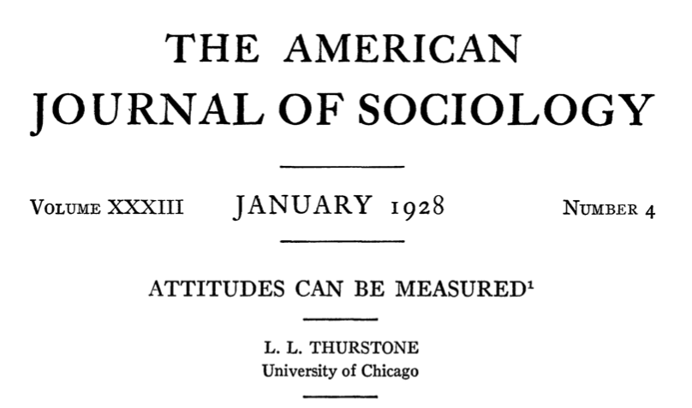
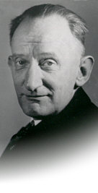
1920s:
Louis Leon Thurstone

Slide 5
1920s:
Louis Leon Thurstone
Three approaches:
  the method of equal-appearing intervals
  the method of successive intervals
  the method of paired comparisons
Differs in how scale values for items are constructed
Unidimensional
Resulting instruments ”look” the same

Slide 6
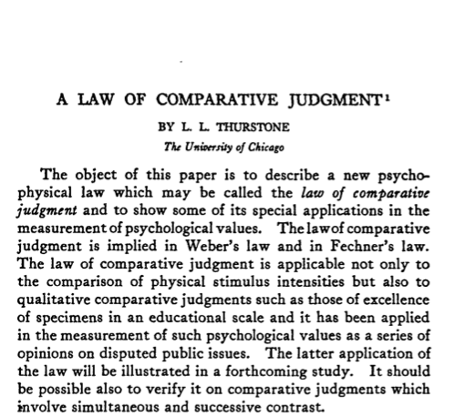
1920s:
Louis Leon Thurstone
The method of paired comparison
  Law of comparative judgement
Items define a unidimensional continum
Items are presented in pairs to a number of people who judge which one represents "more” of the variable
Less
More
Items

Slide 7
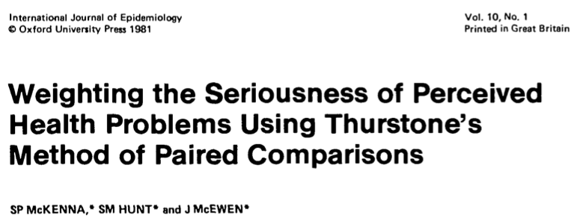
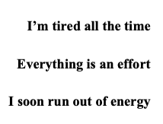
1920s:
Louis Leon Thurstone
Example:
Nottingham Health Profile (NHP)
Less
More
Items
McKenna et al. IJE 1981

Slide 8
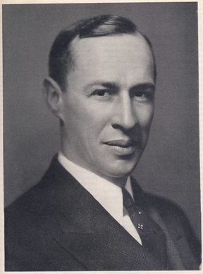
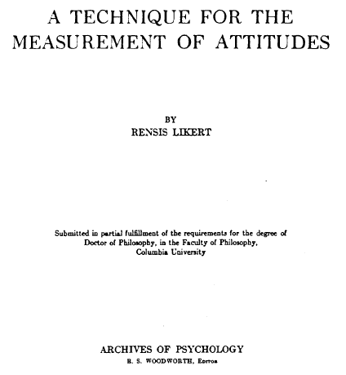

Slide 9
1930s:
Rensis Likert
Attitudes
Method of summated ratings
Ordered response categories with equally spaced integral scale values
  strongly disagree
  disagree
  neither agree nor disagree
  agree
  strongly agree

Slide 10
1930s:
Rensis Likert
Can legitimitely be summed if:
  Items are unidimensional
  Items are approximately parallel (similar means and standard deviations)
  Items contribute about the same amount of information

Slide 11
1930s:
Rensis Likert

Slide 12
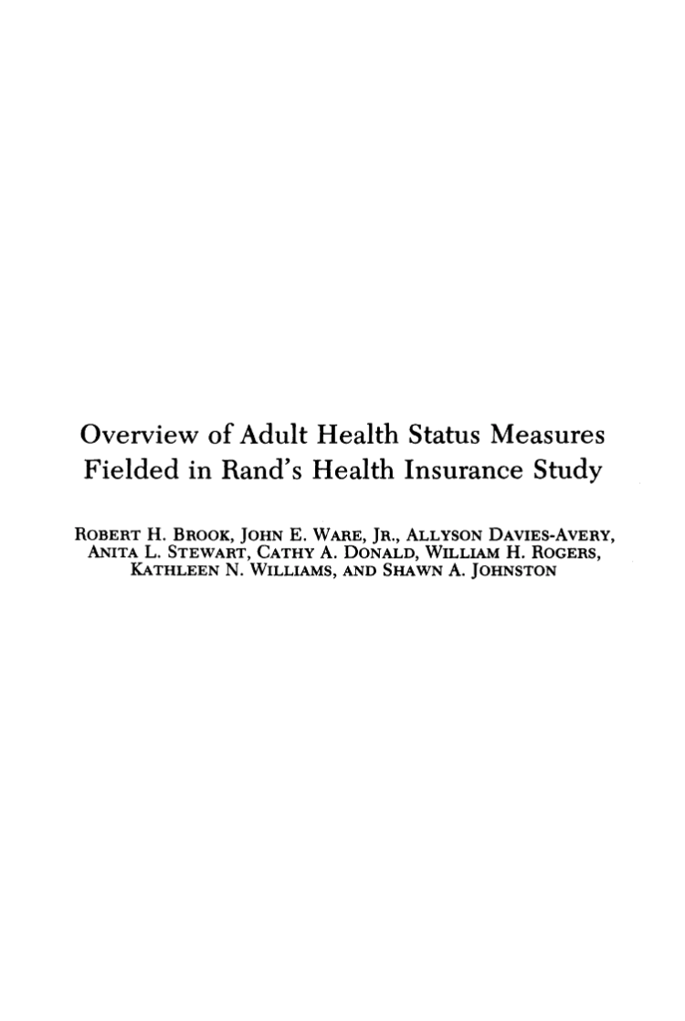
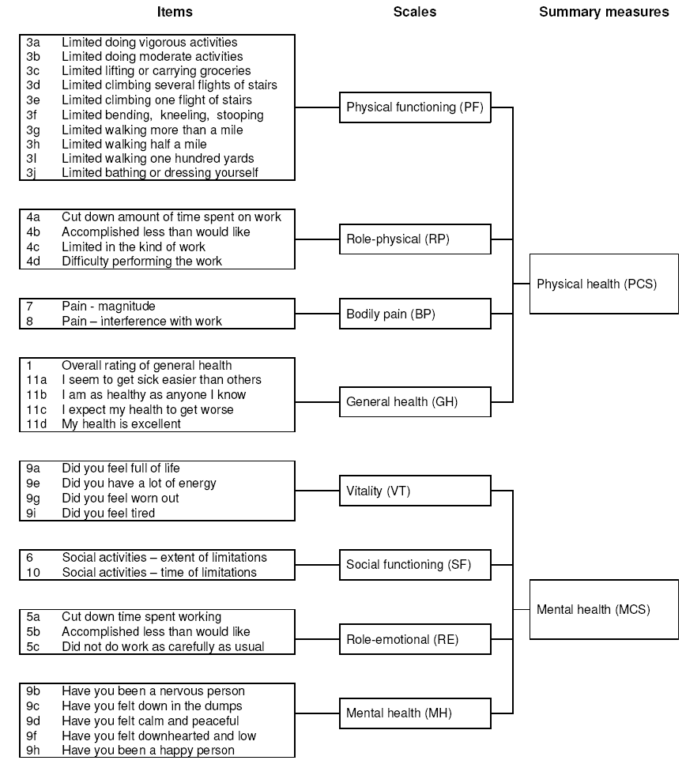
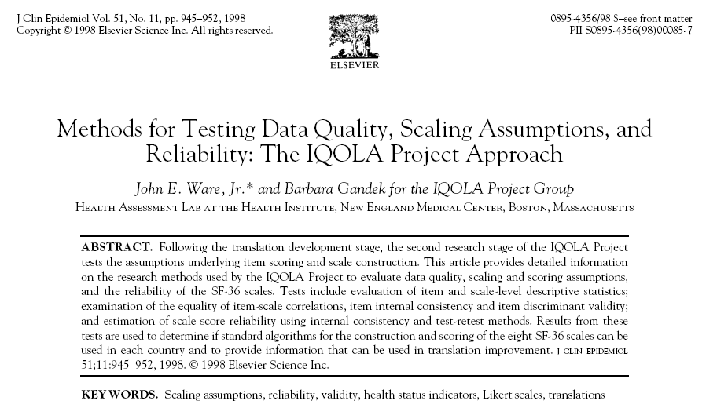
RAND-/SF-36 Health survey
Brook et al. Med Care 1979.
Ware & Sherbourne. Med Care 1992.
Hays et al. Health Econ 1993.
Ware & Gandek. JCE 1998.

Slide 13
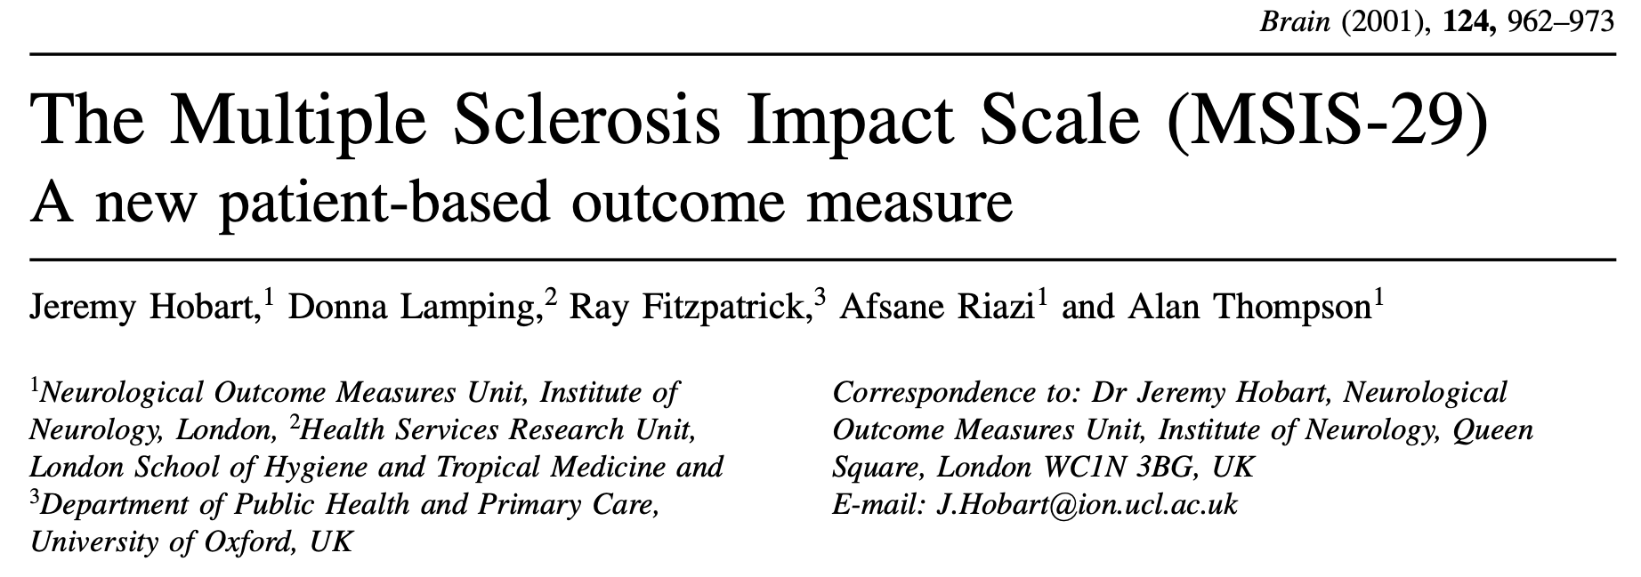
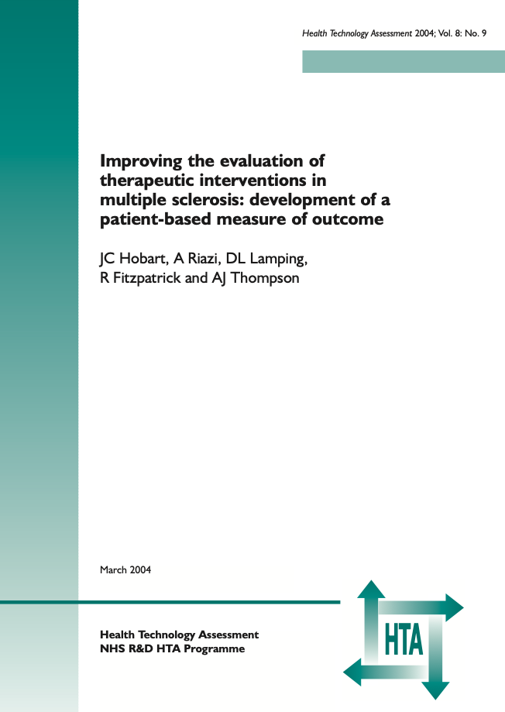
Example: The 29-item Multiple Sclerosis Impact Scale (MSIS-29)

Slide 14
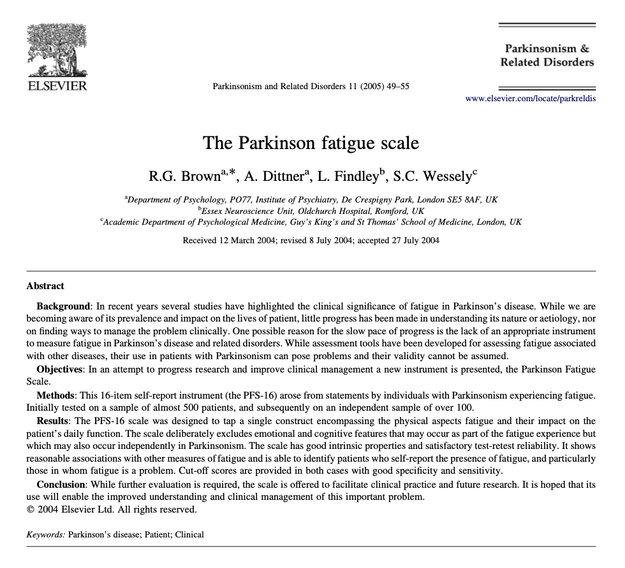
Example: The 16-item Parkinson Fatigue Scale (PFS-16)

Slide 15
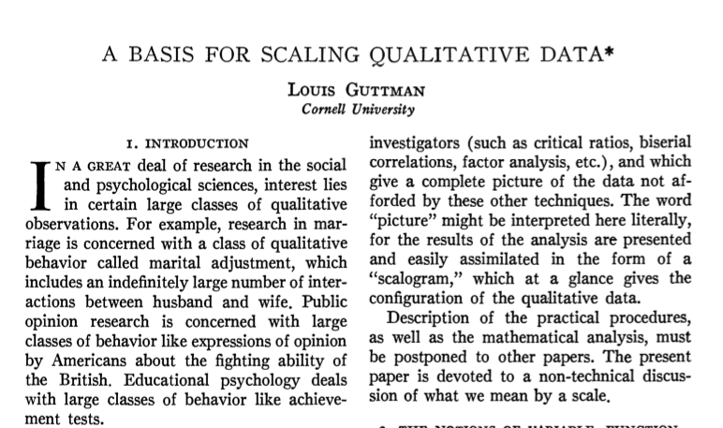
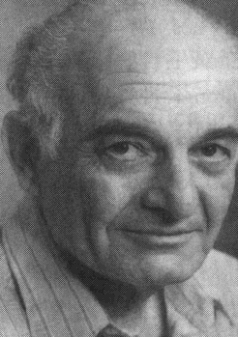
1940s:
Louis Guttman
”If person A has a greater total score than person B on a test, then person A should have answered all the items correctly that person B has answered correctly, and in addition, some other items that are more difficult.”
Guttman 1950 (in Stouffer et al. Measurement and Prediction)

Slide 16
1940s:
Louis Guttman
A
B
C
D
Scalogram analysis
Total score determines response pattern
Hierarchical, unidimensional, deterministic
Coefficient of reproducibility (CR): How well the responses follow a perfect pattern (≥0.90)
Coefficient of scalability (CS): Proportion of responses that can be predicted from total scores (≥0.60)
Abdi 2010.

Slide 17
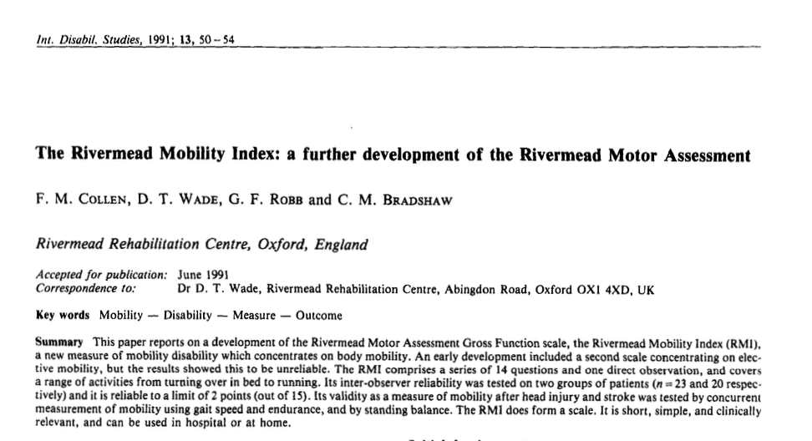
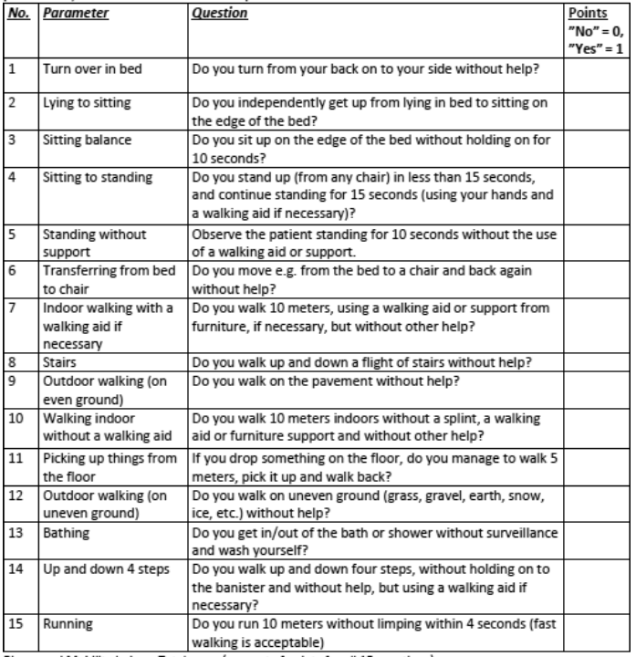
Example: The Rivermead Mobility Index
Coefficient of reproducibility (CR): 0.93
Coefficient of scalability (CS): 0.79
Collen et al. IDS 1991.

Slide 18
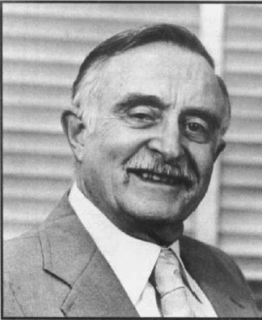

1950s:
"Modern" test theory
Rasch Measurement Theory
Item Response Theory (IRT)
Georg Rasch (DK)
Frederic Lord (USA)

Slide 19
References
Abdi H. Guttman scaling. In: Salkind N (Ed.), Encyclopedia of research design. Thousand Oaks, CA: Sage, 2010.
Available from: https://personal.utdallas.edu/~herve/abdi-GuttmanScaling2010-pretty.pdf
Brook RH, Ware JE Jr, Davies-Avery A, Stewart AL, Donald CA, Rogers WH, et al. Overview of adult health status measures fielded in Rand’s Health Insurance Study. Medical Care 1979; 17(7 Suppl): 1-131.
Available from: https://www.researchgate.net/publication/22681856_Overview_of_Adult_Health_Status_Measures_Fielded_in_Rand%27s_Health_Insurance_Study
Brown RG, Dittner A, Findley L, Wessely SC. The Parkinson fatigue scale. Parkinsonism & Related Disorders 2005; 11(1): 49-55.
Available from: http://simonwessely.com/Downloads/Publications/Other_p/106.pdf
Chaudhuri KR, Schrag A, Weintraub D, Rizos A, Rodriguez-Blazquez C, Mamikonyan E, Martinez-Martin P. The movement disorder society nonmotor rating scale: Initial validation study. Movement Disorders 2020; 35(1): 116-133.
Available from: https://www.ncbi.nlm.nih.gov/pmc/articles/PMC7037759/
Collen FM, Wade DT, Robb GF, Bradshaw CM. The Rivermead Mobility Index: a further development of the Rivermead Motor Assessment. International Disability Studies 1991; 13(2): 50-54.
Available from: https://doi.org/10.3109/03790799109166684
Hagell P, Westergren A. The significance of importance: an evaluation of Ferrans and Powers' Quality of Life Index. Quality of Life Research 2006; 15(5): 867-876.
Available from: https://www.researchgate.net/publication/7060458_The_Significance_of_Importance_An_Evaluation_of_Ferrans_and_Powers%27_Quality_of_Life_Index

Slide 20
References
Hagell P, Westergren A, Årestedt K. Beware of the origin of numbers: Standard scoring of the SF-12 and SF-36 summary measures distorts measurement and score interpretations. Research in Nursing and Health 2017; 40(4): 378-386.
Available from: https://www.researchgate.net/publication/318604811
Hobart J, Lamping D, Fitzpatrick R, Riazi A, Thompson A. The Multiple Sclerosis Impact Scale (MSIS-29): a new patient-based outcome measure. Brain 2001;124: 962-973.
Available from: https://doi.org/10.1093/brain/124.5.962
Hobart JC, Riazi A, Lamping DL, Fitzpatrick R, Thompson AJ. Improving the evaluation of therapeutic interventions in multiple sclerosis: development of a patient-based measure of outcome. Health Technology Assessment 2004; 8(9): iii, 1-48.
Available from: https://doi.org/10.3310/hta8090
Jenkinson C, Mant J, Carter J, Wadec D, Winner S. The London handicap scale: a re-evaluation of its validity using standard scoring and simple summation. Journal of Neurology Neurosurgery & Psychiatry 2000; 68: 365-367.
Available from: http://dx.doi.org/10.1136/jnnp.68.3.365
Kennedy-Martin M, Slaap B, Herdman M, et al. Which multi-attribute utility instruments are recommended for use in cost-utility analysis? A review of national health technology assessment (HTA) guidelines. European Journal of Health Economics 2020; 21: 1245–1257.
Available from: https://doi.org/10.1007/s10198-020-01195-8
Likert R. A technique for the measurement of attitudes. Archives of Psychology; 140: 1-55.
Available from: https://legacy.voteview.com/pdf/Likert_1932.pdf

Slide 21
References
McKenna SP, Hunt SM, McEwen J. Weighting the seriousness of perceived health problems using Thurstone's method of paired comparisons. International Journal of Epidemiology 1981; 10(1): 93-97.
Available from: https://citeseerx.ist.psu.edu/viewdoc/download?doi=10.1.1.833.5428&rep=rep1&type=pdf
Schmidt FL. Implications of a measurement problem for expectancy theory research. Organizational Behavior and Human Performance 1973; 10: 243–251.
Available from: https://doi.org/10.1016/0030-5073(73)90016-0
Stouffer SA, Guttman L, Suchman EA, Lazarsfeld PF, Star SA, Clausen JA. Measurement and prediction (Studies in Social Psychology in World War II, Volume IV). Princeton, NJ: Princeton University Press, 1950.
Available from: https://gwern.net/doc/psychology/1950-stouffer-theamericansoldier-v4-measurementandprediction.pdf
Streiner DL, Norman GR. Health Measurement Scales: A Practical Guide to Their Development and Use. 5th edition. Oxford: Oxford University Press, 2014.
Available from: https://doi.org/10.1093/med/9780199685219.001.0001
Taft C, Karlsson J, Sullivan M. Do SF-36 summary component scores accurately summarize subscale scores? Quality of Life Research 2001; 10(5): 395-404.
Available from: https://www.researchgate.net/publication/11595008

Slide 22
References
Thurstone LL. A law of comparative judgment. Psychological Review 1927; 34(4): 273–286.
Available from: https://parsmodir.com/wp-content/uploads/2013/02/thurstone1927.pdf
Trauer T, Mackinnon A. Why are we weighting? The role of importance ratings in quality of life measurement. Quality of Life Research 2001; 10: 579–585.
Available from: https://doi.org/10.1023/A:1013159414364
Ware JE Jr., Gandek B. Methods for testing data quality, scaling assumptions, and reliability: the IQOLA Project approach. International Quality of Life Assessment. Journal of Clinical Epidemiology 1998; 51(11): 945-952.
Available from: https://www.researchgate.net/publication/13469790_Methods_for_testing_data_quality_scaling_assumptions_and_reliability_the_IQOLA_Project_approach_International_Quality_of_Life_Assessment
Weinstein MC, Torrance G, McGuire A. QALYs: The basics. Value in Health 2009; 12(Suppl 1): S5-S9.
Available from: https://pubmed.ncbi.nlm.nih.gov/19250132/

