Slide 1
Types of instruments
Clinical assessment and outcome measurement
Peter Hagell Kristianstad university

Slide 2
Learning Objectives
Discuss different types of instruments
Understand the use of different types of instruments

Slide 3


Types of instruments
Formats
Rating scales
Questionnaires
Single-items etc…
Roles
Outcome assessments
Checklists
Screening tools
Valuation (utlility)
Classification tools

Slide 4

Clinical Outcomes Assessments (COA) according to the FDA
Patient-reported outcomes (PROs)
Information on the patient's health condition as directly reported by the patient, without outside interpretation from anyone
Clinician-reported outcomes (ClinROs)
Reports from trained health-care professionals regarding their interpretation of signs or behaviors that can be observed related to a patient's disease or condition
Observer-reported outcomes (ObsROs)
Assessments of observable signs, events or behaviors related to a patient's health condition as reported by individuals who observe the patient in daily life (e.g., parents or caregivers)
Performance outcomes (PerfOs)
Measurements collected when a patient is asked to complete a well-defined, repeatable, and standardized task, such as reading an eye chart

Slide 5
Clinical Outcomes Assessments (COA) according to the FDA
Patient-reported outcomes (PROs)
Information on the patient's health condition as directly reported by the patient, without outside interpretation from anyone
Clinician-reported outcomes (ClinROs)
Reports from trained health-care professionals regarding their interpretation of signs or behaviors that can be observed related to a patient's disease or condition
Observer-reported outcomes (ObsROs)
Assessments of observable signs, events or behaviors related to a patient's health condition as reported by individuals who observe the patient in daily life (e.g., parents or caregivers)
Performance outcomes (PerfOs)
Measurements collected when a patient is asked to complete a well-defined, repeatable, and standardized task, such as reading an eye chart

Slide 6
PROMs and PREMs
PROMs: Patient-reported outcome measures (same as PROs)
Directly reported by patients without intervention by clinicians
Spans diverse and heterogenous domains such as overall health, physical function, well-being, symptoms (e.g., mood, fatigue, pain) amongst others
Intends to empower patients to be heard and enable their outcomes to be assessed
PREMs: Patient-reported experience measures
Patients’ perceptions of their personal experience of the healthcare they have received
Patient satisfaction
Indicators of the quality of healthcare
Providing information regarding areas for improvement in healthcare delivery
May indicate degree of personcentredness of healthcare services
May also concern informal carers/family members

Slide 7
Some additional definitions
Checklist
a list of things we need to do or information that we need to find out
Screening
a process to determine whether a person warrants further evaluation
Screening test/tool
a test performed on persons in a defined population to assess their likelihood of having a particular condition
Rating scale
response format with closed-ended ordered response categories, but often used to mean a standardized multi-item questionnaires and assessment tools used as, e.g., ClinROs, PROMs, PREMs, ObsROs, etc.
Utility (valuation)
usefulness of a service or good; health utility is the value attached to a health state

Slide 8
Outcomes vs. Outcome assessments
Outcome
The variable(s) that one wants to assess (e.g., motor function, fatigue, memory, mood, well-being)
Outcome assessments
The instruments used to assess the outcome
Standardized
A specific name, e.g.,
Unified Parkinson’s Disease Rating Scale (UPDRS)
Mini-Mental State Exam (MMSE)
Non-Motor Symptoms Questionnaire (NMSQ)
Hospital Anxiety and Depression Scale (HADS)
Minimal Insomnia Symptom Scale (MISS)

Slide 9
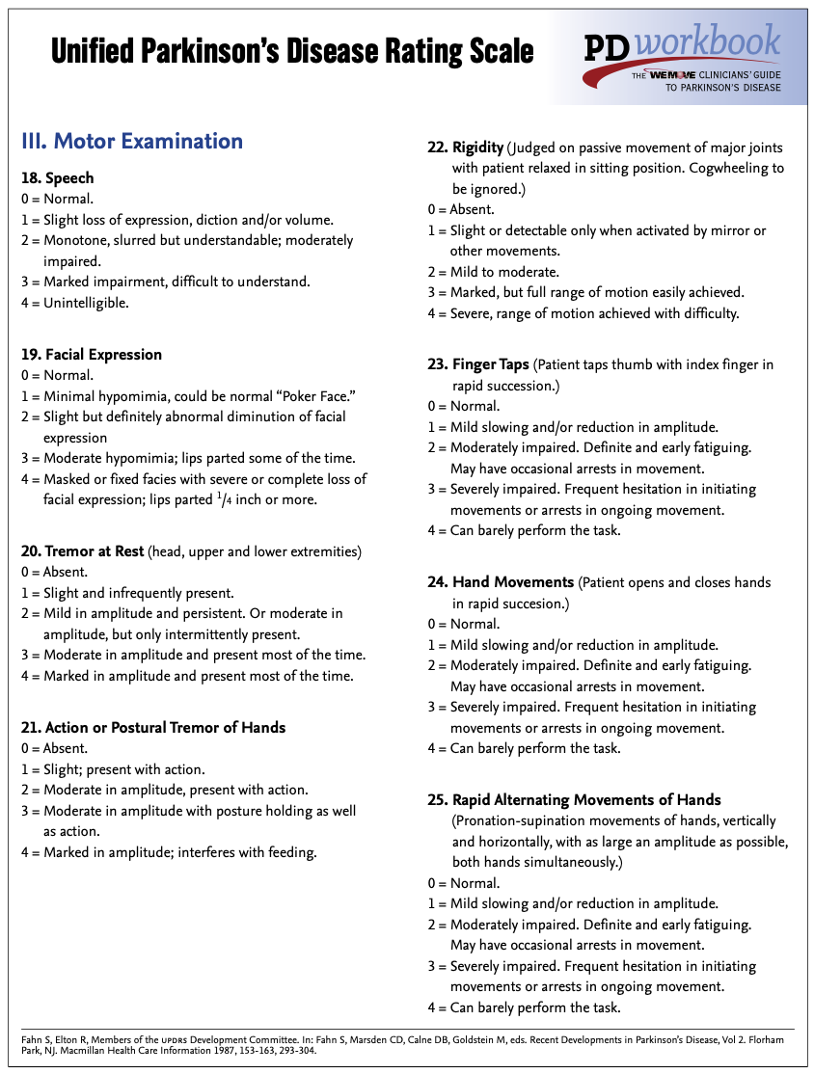
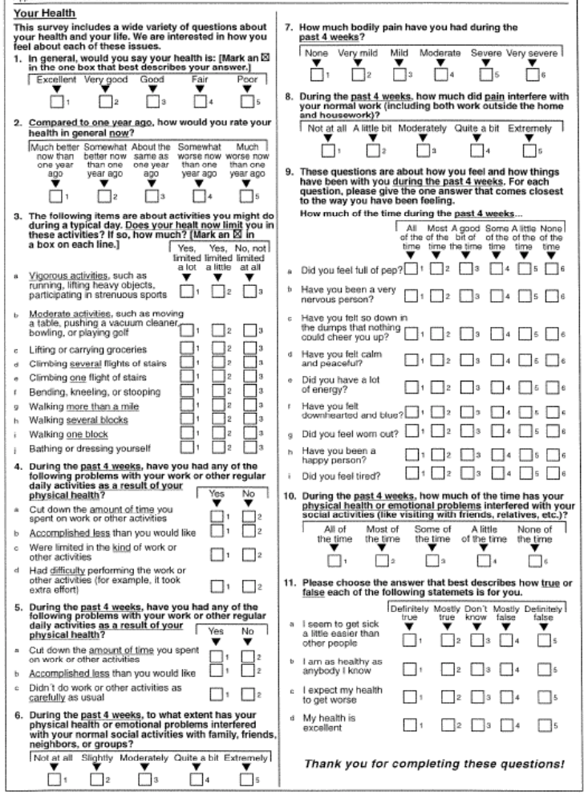
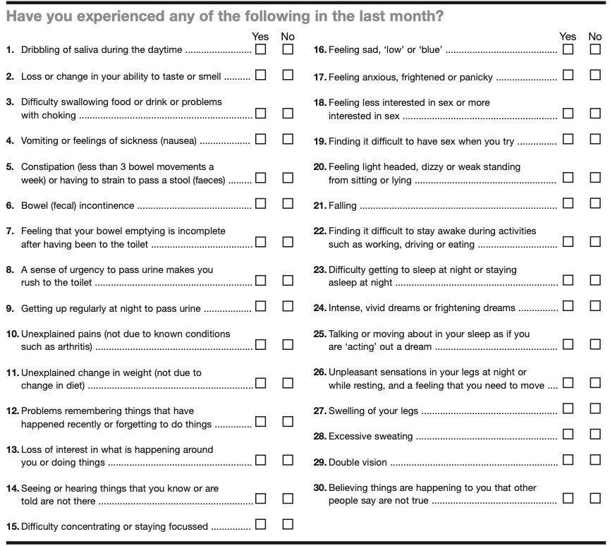
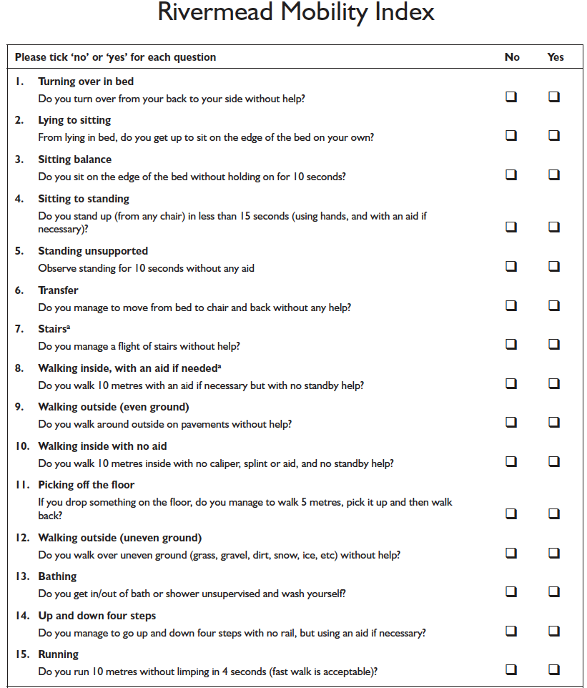
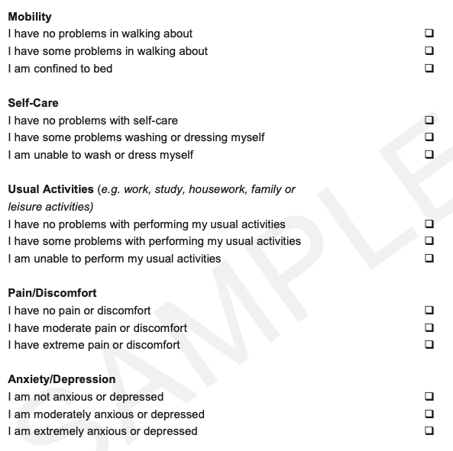
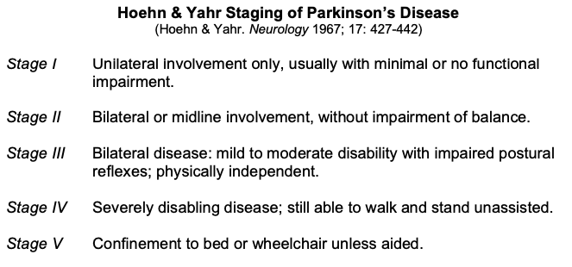
They all look the same – but are they…?

Slide 10
Categorizing instruments according to their use
Patient-reported outcomes (PROs/PROMs)
Patient-reported experience measures (PREMs)
Clinician-reported outcomes (ClinROs)
Observer-reported outcomes (ObsROs)
Performance outcomes (PerfOs)
Intended to produce a score representing the (outcome) variable of interest
Typically developed to be useful for outcome measurement
Checklists
Inventories
Item-level use
Screening tools
Detect a potential problem or risk
Utlilities
Valuation of health states
Classification tools (single-items)
Coarse indicators
Stages of disease, etc.
May be patient-, clinician-, observer- reported, or performance based

Slide 11
Quality testing
Patient-reported outcomes (PROs/PROMs)
Patient-reported experience measures (PREMs)
Clinician-reported outcomes (ClinROs)
Observer-reported outcomes (ObsROs)
Performance outcomes (PerfOs)
Intended to produce measures
Psychometrics
Checklists
Utlilities
Classification tools (single-items)
Wording
Content validity
Test-retest stability
Screening tools
As above +
Sensitivity, specificity, etc.
Not intended to produce measures
Psychometrics largely irrelevant

Slide 12
Some examples
Clinical outcome assessments
Patient-reported outcomes (PROs/PROMs)
PDQ-39
Clinician-reported outcomes (ClinROs)
UPDRS
Observer-reported outcomes (ObsROs)
Performance outcomes (PerfOs)
Patient-reported experience measures (PREMs)
PCCoc
Checklists
NMSQ
Screening tools
MEONF-II
Utlilities
EQ-5D
Classification tools (single-items)
Hoehn & Yahr

Slide 13
Clinical Outcome Assessments

Slide 14
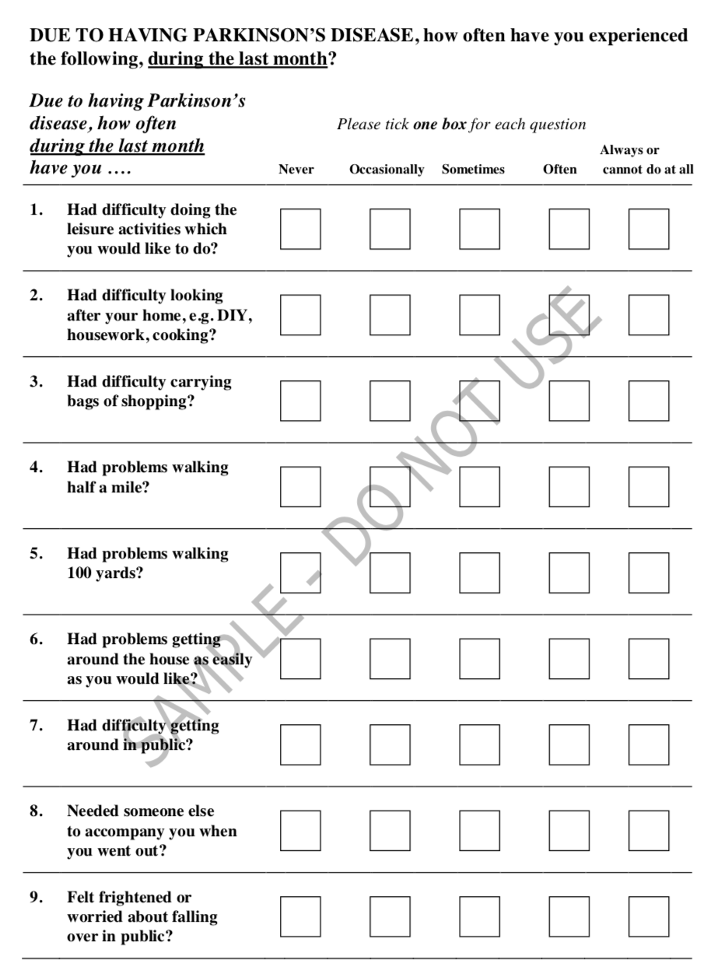
PDQ-39: 39-item Parkinson’s Disease Questionnaire
39 items
5 ordered response categories; problem frequency during the past month
8 subscales (0-100; 0=better):
- Mobility (MOB) - Social support (SOC)
- Activities of Daily Living (ADL) - Cognitions (COG)
- Emotional well-being (EMO) - Communication (COM)
- Stigma (STI) - Bodily discomfort (BOD)
Total score (0-100; 0=better):
PDQ-39 Summary Index (PDQ-39SI)
8-item short form available (PDQ-8)
Intended as a PD-specific PROM for use in research and clinical trials
Unclear what variable(s) it represents (developers have referred to it as a questionnaire regarding functioning and wellbeing, Health-related quality of lite, health status and quality of life)
Peto et al. QLR 1995; 4: 241-8.

Slide 15
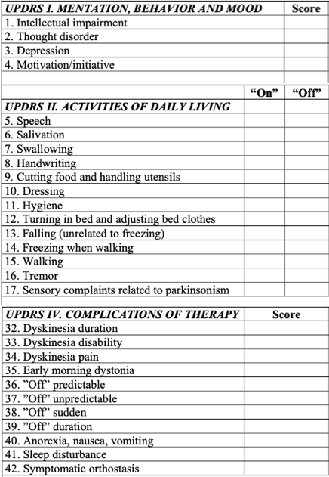
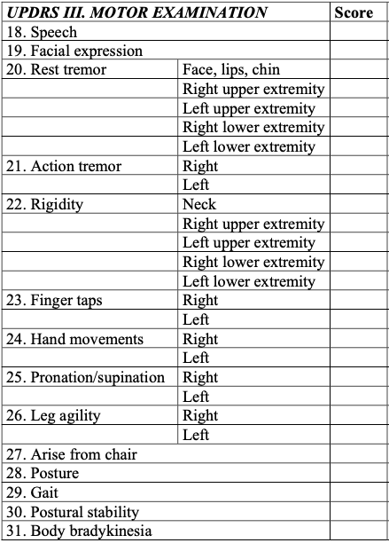
UPDRS: Unified Parkinson’s Disease Rating Scale
Part I. Mentation, Behavior & Mood (4 items)
History, observation
Total score: 0-16 (0=Better)
Part II. Activities of Daily Living (13 items)
History
Total score: 0-52 (0=Better)
Part III. Motor Examination (14/27 items)
Clinical examination
Total score: 0-108 (0=Better)
Part IV. Complications of Therapy (11 items)
History, observation
Total score: 0-23 (0=Better)
Intended to assess symptom severity and outcomes of interventions, as well as a means to standardize clinical assessment
Parts I and IV: Rather characterized as clinical checklists
Part II: Not a coherent ADL assessment

Slide 16
PCCoc: Person-Centered Care instrument for outpatient care
36 items
4 ordered response categories
Total score (0-100; 100=higher degree of perceived person centeredness)
Intended for annual administration as a means to evaluate and develop PCC in outpatient care for persons with long-term conditions (e.g., NDDs)
Gasser et al. JPRO 2023.

Slide 17
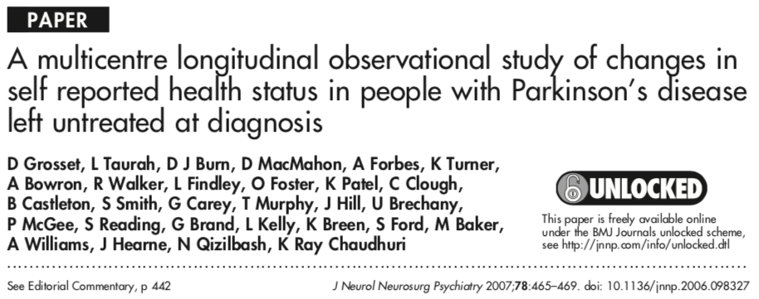
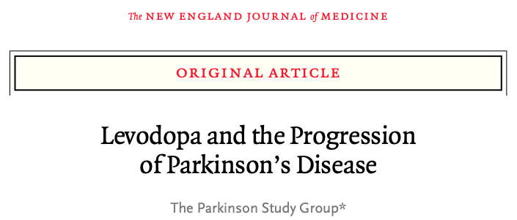
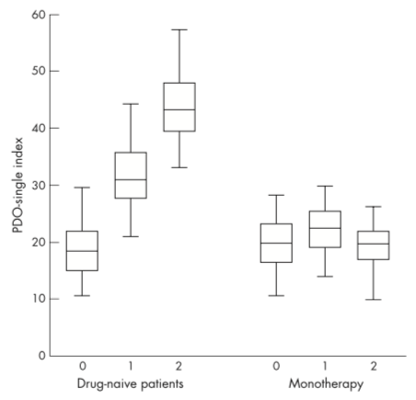
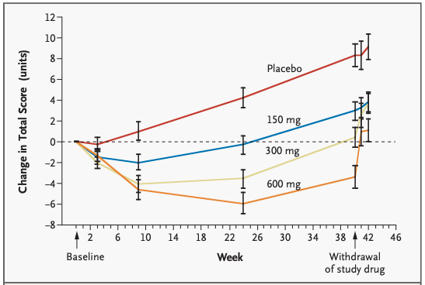
Scientific use of clinical outcome assessments
Gosset et al. JNNP 2007.
PSG NEJM 2004.

Slide 18
Clinical checklist

Slide 19
NMSQ: Non-Motor Symptoms Questionnaire
30 items
2 response categories (Yes/No)
No total score; not meant for assessing symptom severity or effects of interventions
Developed as a clinical patient-/caregiver-reported “screening tool” to be completed before routine clinical consultations (e.g., in the waiting room)
Intended to draw attention to the presence of NMS (i.e., endorsed items) and initiate further investigation
Not a ”screening tool” per definition and not tested as such; rather a checklist
Chaudhuri et al. Mov Disord 2023.

Slide 20
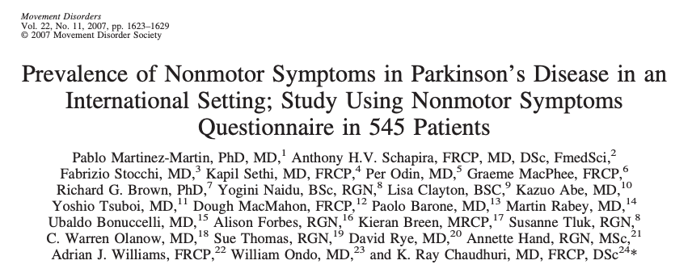
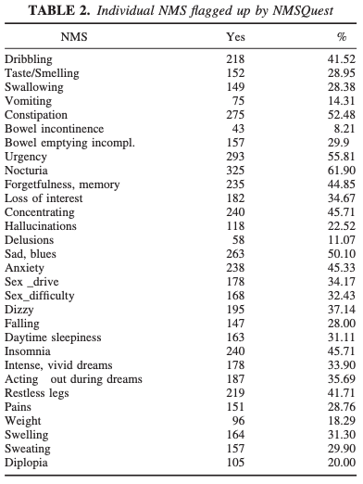
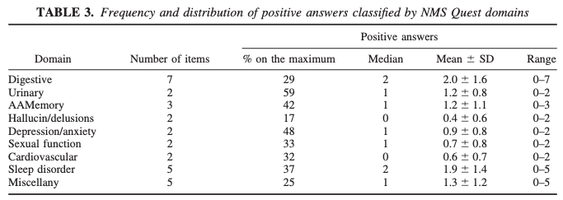
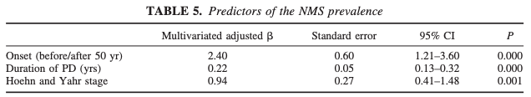
Scientific use of clinical checklists

Slide 21
Screening tools

Slide 22
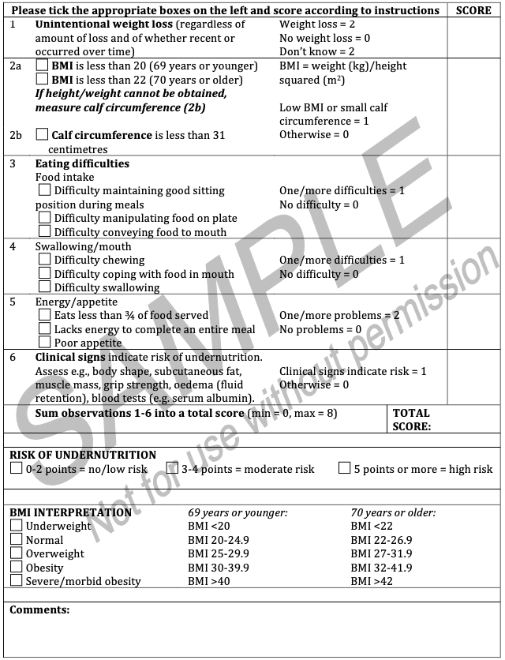
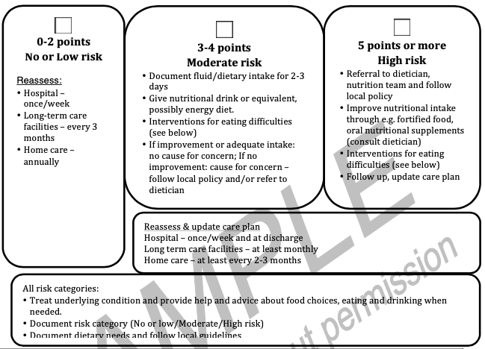
MEONF-II: Minimal Eating Observation and Nutrition Form – version II
6 items
Total score: 0-8 (8=Higher undernutrition risk)
Developed as a clinical observational based screening tool for detecting risk for undernutrition
Cut-off score: ≥3 (3-4=moderate risk; >4=high risk)
Linked to interventions
Vallén et al. FNR 2011.
Westergren et al. FNR 2011.
Smith et al. BJN 2016.

Slide 23

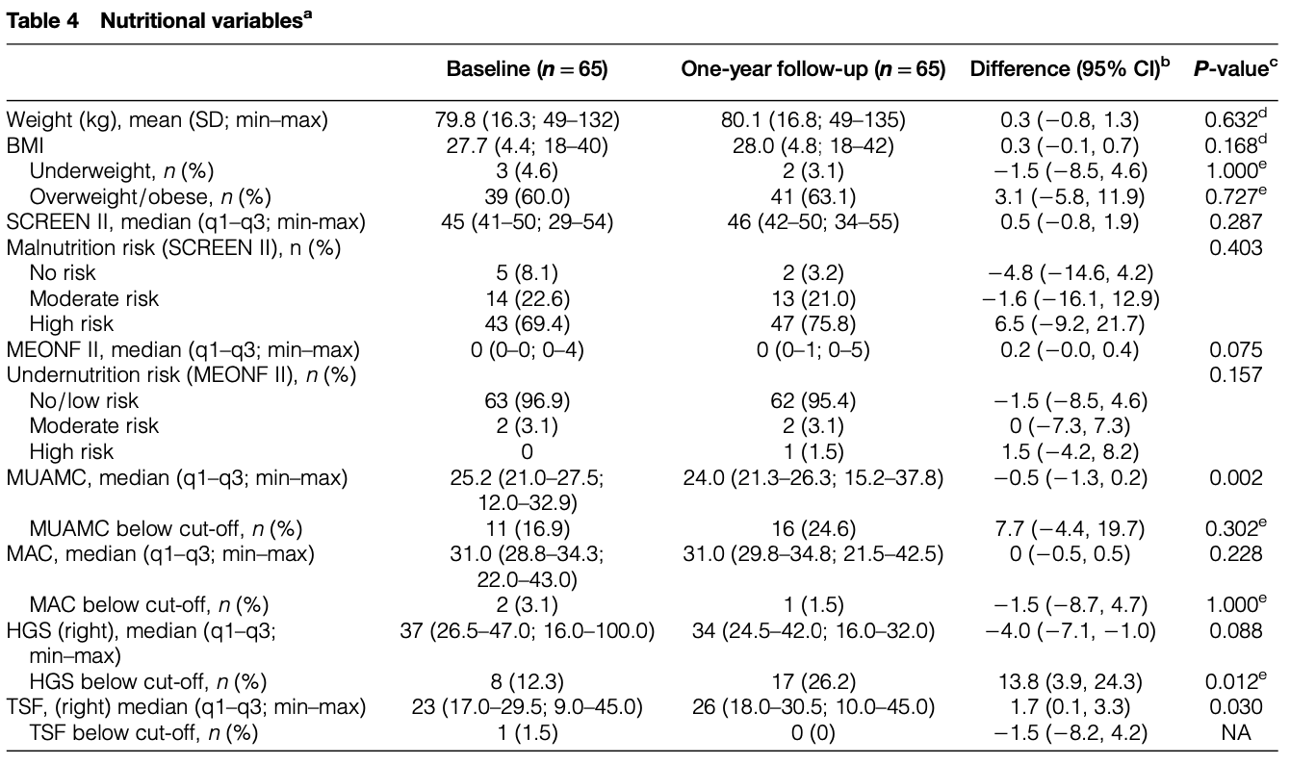
Scientific use of screening tools
Lindskov et al. Nutr Neurosci 2016.

Slide 24
Utilities

Slide 25
EQ-5D
5 items
Patient-reported
Developed as an instrument for valuation of health states in health economic studies
Yields a health utility for the reported health status (combination of the 5 health domains)
Total utility value (“score”): -0.59-100 (<0=Worse than dead; 100=Perfect health)
Overall assessment of current health
VAS “thermometer”
Sparsley used
The EuroQol Group Health Policy 1990.

Slide 26
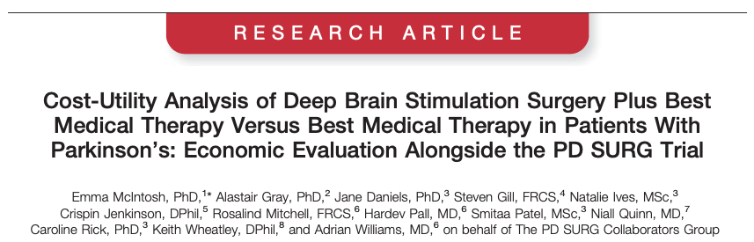
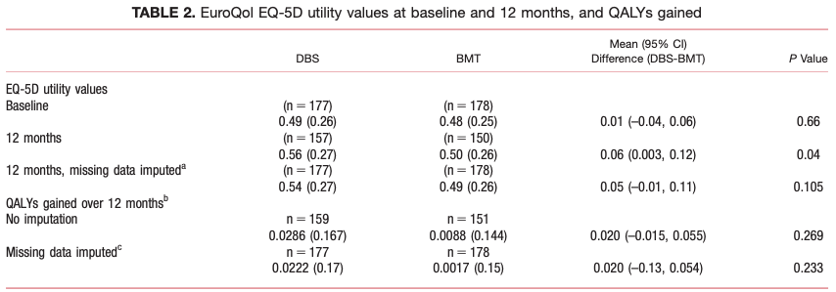
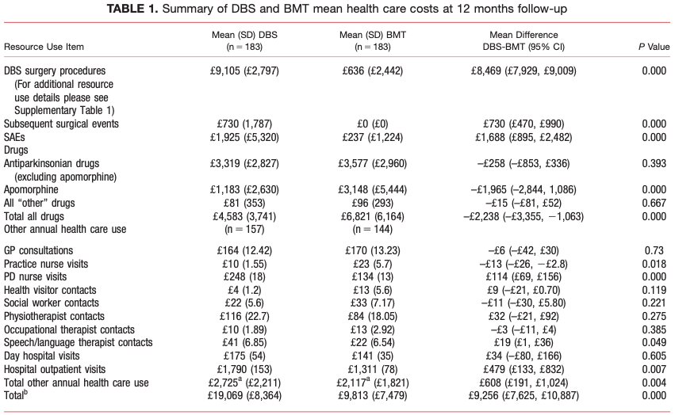
Scientific use of health valuation/utility tools
McIntosh et al. Mov Disord 2016.

Slide 27
Classification tools (single-items)

Slide 28
HY: Hoehn & Yahr stages of Parkinson’s disease
Single-item categorization of disease severity based on clinical examination and observation
5 stages
Developed in the pre-levodopa era based on longitudinal epidemiological observations
Does not take drug complications (e.g., dyskinesias) into consideration
Descriptive of natural history of untreated PD
Intended for classification and broad description, not as an outcome measure
Hoehn & Yahr Neurology 1967.
Goetz et al. Mov Disord 2004

Slide 29
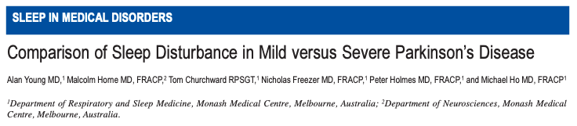
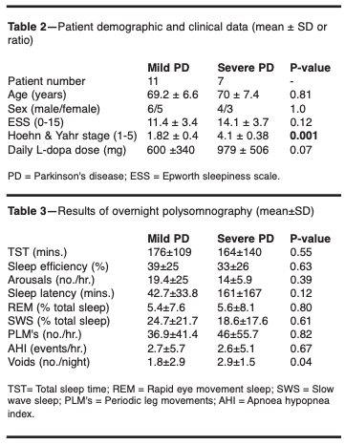
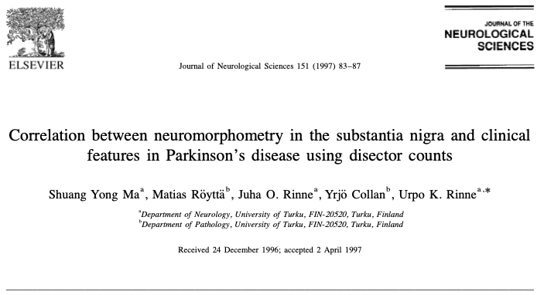
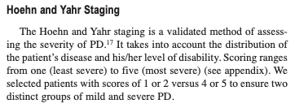
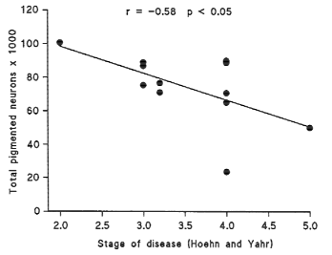
Scientific use of health classification tools (single-items)
Young et al. Sleep 2002.
Ma et al. JNS 1997.

Slide 30
They all look the same – but they are not!

Slide 31
Instruments suitable for outcome assessment may in principle also be used as, e.g., checklists or screening tools (depending on content, context, etc.)
The opposite is rarely the case, since particularly checklists serve a different purpose and typically fail to meet psychometric criteria
An instrument that fails to meet psychometric criteria may still be clinically useful as, e.g., a checklist at the item level
Important implications regarding their use and interpretation

Slide 32
References
Broman JE, Smedje H, Mallon L, Hetta J. The Minimal Insomnia Symptom Scale (MISS): a brief measure of sleeping difficulties. Upsala Journal of Medical Science 2008; 113(2): 131-142. Available from: https://doi.org/10.3109/2000-1967-221
Chaudhuri KR, et al. International multicenter pilot study of the first comprehensive self-completed nonmotor symptoms questionnaire for Parkinson's disease: the NMSQuest study. Movement Disorders 2006; 21(7):916-23. Available from: https://www.movementdisorders.org/MDS-Files1/PDFs/MDS-UPDRS-Rating-Scales/NMSQ.pdf
Gasser F, Bala SV, Westergren A, Ekstrand J, Hagell P. Further development and evaluation of a questionnaire targeting person-centred outpatient care for persons with long-term conditions. Journal of Patient-Reported Outcomes 2023; 7: 85. Available from: https://doi.org/10.1186/s41687-023-00623-6
Goetz CG, et al. Movement Disorder Society Task Force report on the Hoehn and Yahr staging scale: status and recommendations. Movement Disorders 2004; 19(9): 1020-1028. Available from: https://doi.org/10.1002/mds.20213
Gosset D, et al. A multicentre longitudinal observational study of changes in self reported health status in people with Parkinson’s disease left untreated at diagnosis, Journal of Neurology, Neurosurgery & Psychiatry 2007; 78: 465-469. Available from: https://doi.org/10.1136/jnnp.2006.098327
Hagell P, Rouse M, McKenna SP. Measuring the impact of caring for a spouse with Alzheimer's disease: Validation of the Alzheimer’s Patient Partners Life Impact Questionnaire (APPLIQue). Journal of Applied Measurement 2018; 19(3): 271-282. Available from: https://pubmed.ncbi.nlm.nih.gov/30169335/

Slide 33
References
Herman C. What Makes a Screening Exam “Good”? Virtual Mentor 2006; 8(1): 34-37. Available from: https://journalofethics.ama-assn.org/sites/default/files/2018-06/cprl1-0601.pdf
Hobson JP, Edwards NI, Meara RJ. The Parkinson's Disease Activities of Daily Living Scale: a new simple and brief subjective measure of disability in Parkinson's disease. Clinical Rehabilitation 2001; 15(3): 241-246. Available from: https://doi.org/10.1191/026921501666767060
Hoehn MM, Yahr MD. Parkinsonism: onset, progression and mortality. Neurology 1967; 17(5): 427-442. Available from: https://doi.org/10.1212/WNL.17.5.427
Lindskov S, Sjöberg K, Hagell P, Westergren A. Weight stability in Parkinson's disease. Nutritional Neuroscience 2016; 19(1): 11-20. Available from: https://doi.org/10.1179/1476830515Y.0000000044
Loong TW. Understanding sensitivity and specificity with the right side of the brain. BMJ 2003; 327: 716–719. Available from: https://www.ncbi.nlm.nih.gov/pmc/articles/PMC200804/
Ma SY, Röyttä M, Rinne JO, Collan Y, Rinne UK. Correlation between neuromorphometry in the substantia nigra and clinical features in Parkinson's disease using disector counts. Journal of the Neurological Sciences 1997; 151(1): 83-87. Available from: https://doi.org/10.1016/S0022-510X(97)00100-7

Slide 34
References
McIntosh E, et al. Cost-utility analysis of deep brain stimulation surgery plus best medical therapy versus best medical therapy in patients with Parkinson's: Economic evaluation alongside the PD SURG trial. Movement Disorders 2016; 31(8): 1173-82. Available from: https://doi.org/10.1002/mds.26423
Martinez-Martin P, et al. Prevalence of nonmotor symptoms in Parkinson's disease in an international setting; Study using nonmotor symptoms questionnaire in 545 patients. Movement Disorders 2007; 22(11): 1623-1629. Available from: https://doi.org/10.1002/mds.21586
Maxim LD, Niebo R, Utell MJ. Screening tests: a review with examples. Inhalation Toxicology 2014; 26(13): 811–828. Available from: https://www.ncbi.nlm.nih.gov/pmc/articles/PMC4389712/
McKenna SP, Heaney A, Rouse M, Hagell P. International development of the Alzheimer’s Patient Partners Life Impact Questionnaire (APPLIQue). American Journal of Alzheimer's Disease & Other Dementias 2020; 35: 1533317520951690. Available from: https://doi.org/10.1177/1533317520951690
Smith S, Westergren A, Saunders J, Hagell P. Nutritional screening: a user-friendly tool adapted from Sweden. British Journal of Nursing 2016; 25(4): 208-211. Available from: https://doi.org/10.12968/bjon.2016.25.4.208
Substance Abuse and Mental Health Services Administration. Addressing the Specific Behavioral Health Needs of Men. Treatment Improvement Protocol (TIP) Series 56. HHS Publication No. (SMA) 13-4736. Rockville, MD: Substance Abuse and Mental Health Services Administration, 2013. Available from: https://www.ncbi.nlm.nih.gov/books/NBK144289/

Slide 35
References
The EuroQol Group. EuroQol - a new facility for the measurement of health-related quality of life. Health Policy 1990; 16(3): 199-208. Available from: https://doi.org/10.1016/0168-8510(90)90421-9
The Parkinson Study Group. Levodopa and the progression of Parkinson’s disease. New England Journal of Medicine 2004; 351: 2498-508. Available from: https://www.nejm.org/doi/pdf/10.1056/NEJMoa033447
Vallén C, Hagell P, Westergren A. Validity and user-friendliness of the Minimal Eating Observation Form – Version II (MEONF-II) for undernutrition risk screening. Food & Nutrition Research 2011; 55: 5801. Available from: https://doi.org/10.3402/fnr.v55i0.5801
Westergren A, et al. Cut‐off scores for the Minimal Eating Observation and Nutrition Form – version II (MEONF‐II) among hospital inpatients. Food & Nutrition Research 2011; 55: 7289. Available from: https://doi.org/10.3402/fnr.v55i0.7289
Westergren A, Broman JE, Hellström A, Fagerström C, Willman A, Hagell P. Measurement properties of the Minimal Insomnia Symptom Scale as an insomnia screening tool for adults and the elderly. Sleep Medicine 2015; 16(3): 379-384. Available from: https://doi.org/10.1016/j.sleep.2014.10.016
Young A, Horne M, Churchward T, Freezer N, Holmes P, Ho M. Comparison of sleep disturbance in mild versus severe Parkinson's disease. Sleep 2002; 25(5): 573-577. Available from: https://doi.org/10.1093/sleep/25.5.568

