Slide 1

Parkinson`s disease: advanced stage
Pille Taba, Ülle Krikmann

Slide 2
Aims of the lecture
By the end of this lecture the student should be able to understand and explain
Parkinson`s disease advanced stage
Planning the care

Slide 3
Content of lecture
Parkinson`s disease advanced stage
Diagnosis the periood of the disease
Management of the complications of treatment
Nursing interventions

Slide 4
Methods of learning
Lecture 1 hour
Seminar: questions and discussion 1 hour

Slide 5
Literature
Mandatory:
Poewe, W. et al. Parkinson disease. Nat. Rev. Dis. Primers 3,17013 (2017).
Optional:
Herath TB, Withana M, Rodrigo C, Gamage R, Gamage C. Prevalence and associations or symptoms of depression in patients with Parkinson’s disease: a Sri Lankan experience. Int J Ment Health Syst (2016) 10:47. DOI 10.1186/s13033-016-0079-1
.

Slide 6
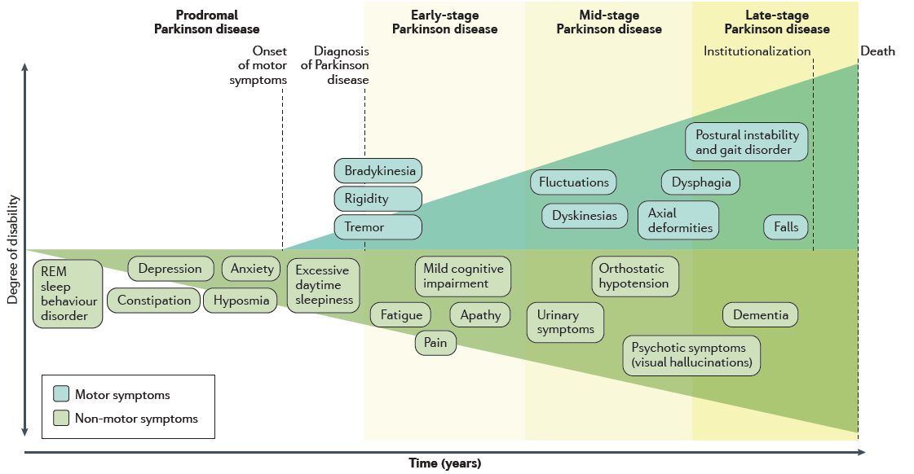
Врем (годы)
Poewe W et al, Nature Rev 2017

Slide 7
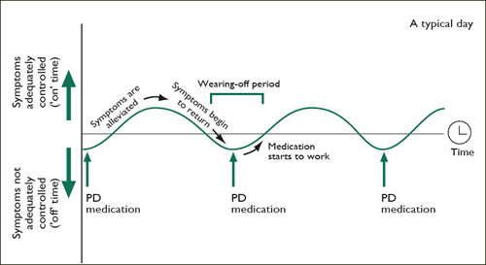
Development of levodopa induced wearing off and dyskinesia

Slide 8
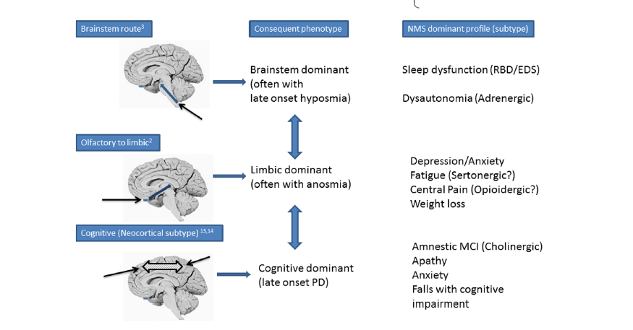
Developing complications
Marras_et_al-2016-Movement_Disorders.pdf

Slide 9
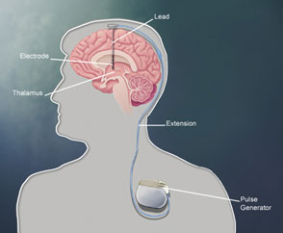
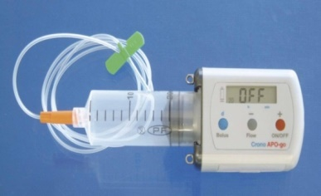
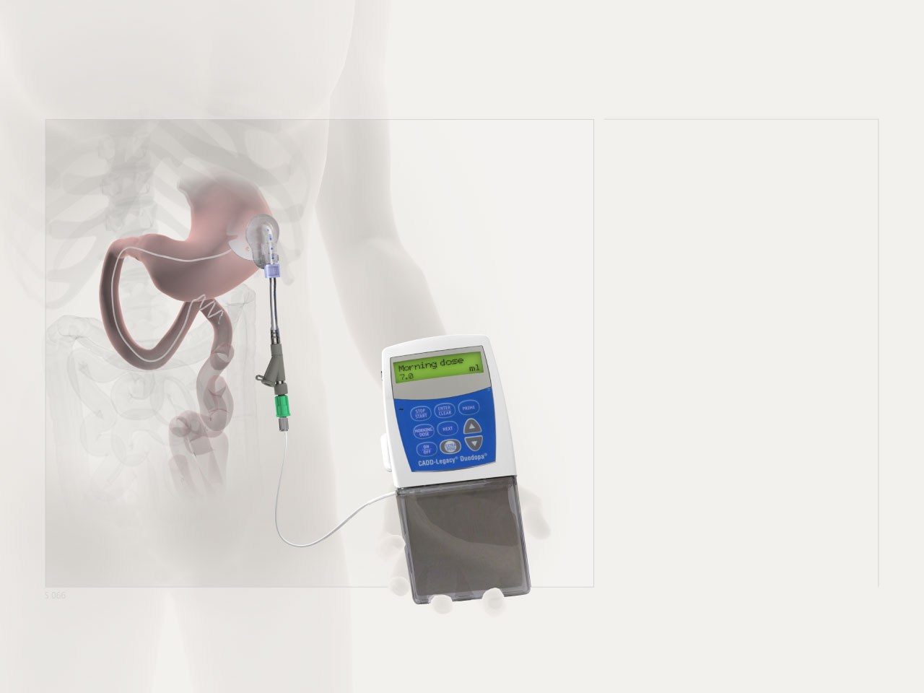
Device-aided treatment – continous dopamine delivery
Normal cognitive status
Younger age
Younger age
Independent
Normal cognitive status
Motor fluctuations, dyskinesis
Older age,
cognitive disorder,
support by family

