Slide 1
Parkinson disease GP-3 section 3.2
Pille Taba
Ülle Krikmann
Tartu University

Slide 2
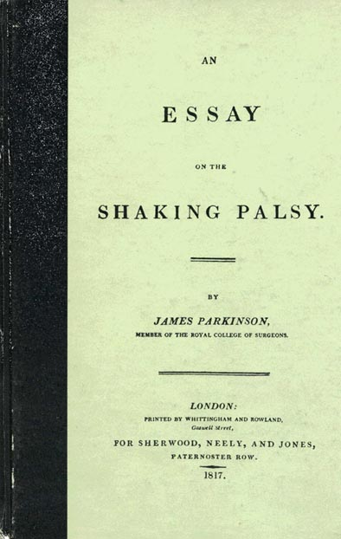
James Parkinson – Parkinson`s disease
1817 a monograph Shaking palsy: involuntary tremoulous motion
1872 Jean-Martin Charcot was particularly decribed bradykinesia, tremor, akinesia as the symptoms and to suggest the use of the term “Parkinson's disease

Slide 3
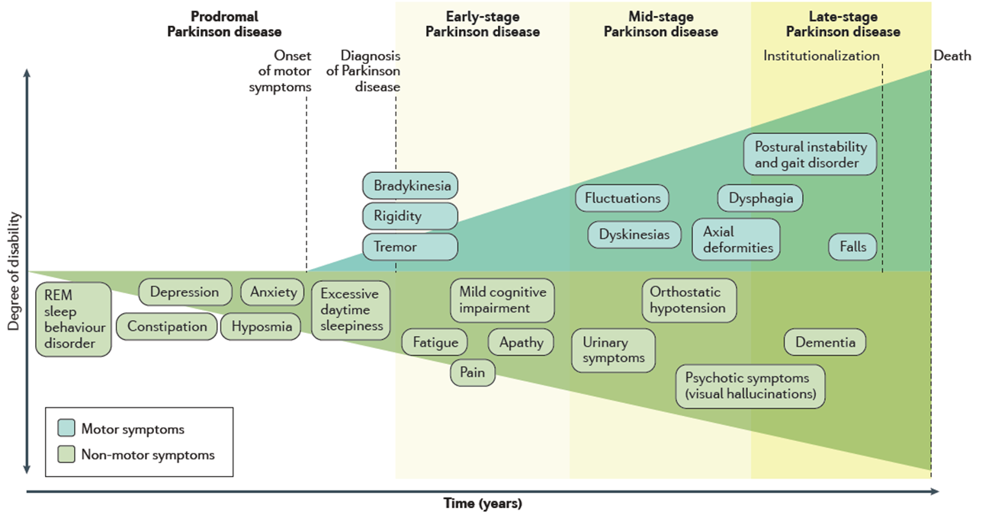
Development of Parkinson´s disease symptoms
Poewe W et al, Nature Rev 2017

Slide 4
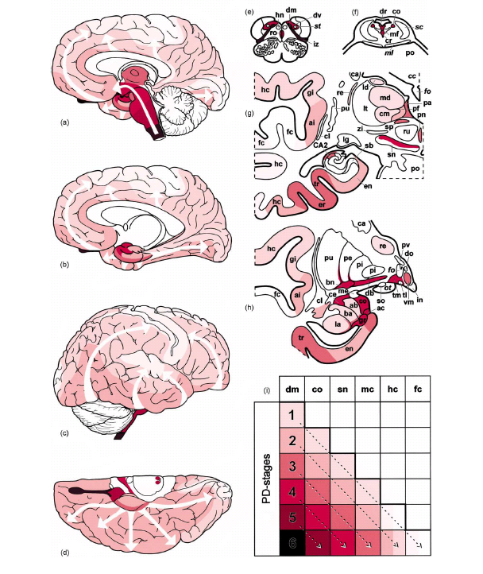
Brain pathology in PD by Braak
Stage 1: dorsal motor nucleus of 10th
intermediate reticular zone
Stage 2: locus coeruleus
raphé, reticular formation
Stage 3: substantia nigra
nucleus basalis of Meynert
Stage 4: amygdaloid complex
temporal mesocortex
CA2 region of hippocampus
Stage 5: cingulate gyrus
frontal cortex
Stage 6: parietal cortex
Braak H, Braak E. J Neurol 2000;247:II/3-10 Hawkes CH, Braak H et al. Park Rel Disord 2010;16:79-84

Slide 5
Parkinson`s disease symptoms
Motor symptoms
Hypokinesia, bradykinesia
Rest tremor
Rigidity
Postural impairment
Gait disturbance
Freezing
Stooped posture
Hypomimia – masked face
Hypophonia
Akinetic dysarthria
Dysphagia
Micrographia
Non-motor symptoms
PSYCHIATRIC | АUTONOMIC | OTHER NON-MOTOR
Depression | Bladder disorder | Fatigue
Anxiety | Sexual dysfunction | Sleep disorder
Apathy, anhedonia | Constipation | Dysphagia
Bradyphrenia | Ortostatic disorder | Hyposmia
Cognitive disorder, dementia | Termoregulation | Pain
Hallucinations, psychosis | Seborrhoea | Weight loss
Impulsive-compulsive behaviours | Hypersalivation

Slide 6
Physiology and pathophysiology of the basal ganglia
The corpus striatum receives afferent input from extensive areas of the cerebral cortex, particularly the motor areas of the frontal lobe
Cortical afferents are glutamatergic, run ipsilaterally, and are topically organized
The substantia nigra sends dopaminergic afferent fibers to the striatum
The striatum also receives a serotonergic input from the raphe nuclei
Major efferent projections of the corpus striatum go to the external and internal segments of the globus pallidus
The cells of origin of the striatal efferent fibers are GABAergic spiny neurons
The major contingent of efferent fibers runs to the thalamus projects to the cerebral cortex, completing a feedback loop.
Dopamine loss is the cause of Parkinson disease

Slide 7
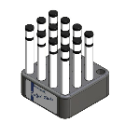
Hyposmia – early sign of PD
Hyposmia – common sign in PD
Sniffin’ Sticks
12 or 16 smells
Extended tests
UPSIT
University of Pennsylvania smell identification test
Doty RL. Nat Rev 2012;8:329-39
Hummel C et al.. Eur Arch Otorhinol 2012;261:871-80

Slide 8
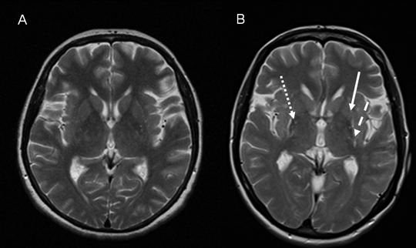
Neuroimaging Magnetic resonance imaging (MRI)
Structural MRI (or CT): normal in PD
Age-associated changes: cortical or subcortical atrophy
Differentiating PD from symptomatic parkinsonism
VBM – voxel based morphometry
VBR – voxel based relaxometry
A – PD with normal MRI;
B – MSA-P: putaminal atrophy and
hypointensity, and hyperintense rim
Strafella AP et al. Mov Disord 2017;32:181-92
Weingarten CP. Neurosci Biobehav Rev 2015:59:16-52

Slide 9
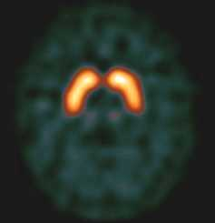
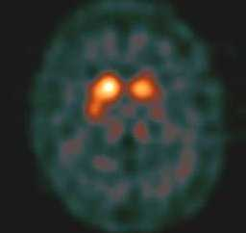
Functional imaging - SPECT
SPECT – single photon emission computed tomography
Estimates function of dopaminergic system, measuring dopamine transporter and receptor binding
Presynaptic: DaTSCAN, β-CIT
Differentiating PD from essential tremor, secondary parkinsonism, psychogenic parkinsonism
Postsynaptic: IBZM, epidepride
SPECT – Normal
SPECT –PD
Brook DJ. Handb Clin Neurol 2016;135:493-505
Perlmutter JS and Norris SA. Ann Neurol 2014; 769-83

Slide 10
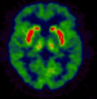

Functional imaging - PET
PET – positron emission tomography
Detection of striatal dopamine deficiency
Reduced putaminal uptake of presynaptic dopaminergic PET-ligand (18F-dopa; DTBZ; 18F-CFT)
Raclopride – striatal D2-receptors
FDG – regional brain metabolic activity
Normal human
Parkinson`s patient

Slide 11
Transcranial doppler-ultrasound
Transcranial doppler-ultrasound midbrain imaging
Hyperechogeneity of substantia nigra
90% in PD
10% in healthy controls
Differentiating PD from atypical and secondary parkinsonism
Does not show progession by current data

Slide 12
Molecular/geneting testingLRRK2
About 5% of PD – caused by known mutations
Testing and counseling:
SNCA (α-synuclein)
In families with multiple affected members
LRRK2 (leucine-rich repeat kinase 2)
Typical PD and a positive family history
GBA (glucocerebrosidase), Gaucher disease
Parkin, PINK1, DJ-1
Typical PD, family history of recessive inheritance
ATP13A2, PLA2G6, FBX07
Very early onset
Locus | Inheritance | Gene
PARK1 | AD | SNCA | α-synuclein
PARK2 | AR | PRKN | parkin
PARK3 | AD | SPR? | sepiapterine reductase
PARK4 | AD | SNCA | α-synuclein (duplications and triplications)
PARK5 | AD | UCHL1 | ubiquitin C-terminal hydrolase L1
PARK6 | AR | PINK1 | PTEN-induced putative kinase 1
PARK7 | AR | DJ-1 | oncogene DJ-1
PARK8 | AD | LRRK2 | leucine-rich repeat kinase 2
PARK9 | AR | ATP13A2 | ATPase, type 13A2
PARK11 | AD | GIGYF2? | GBR-10 interacting GYF-protein
PARK13 | AD? | OMI/HTRA2 | HTRA serine peptidase2
PARK14 | AR | PLA2G6 | Phospholipase A2 group VI
PARK15 | AR | FBOX7 | F-box only protein 7

Slide 13
Diagnostic criteria for PD – Queen Square Brain Bank (QSBB/UK PDSBB)
Diagnosis of Parkinsonian syndrome
Bradykinesia (obligatory) and at least one of the following
Muscular rigidity
4-6 Hz rest tremor
Postural instability
Exclusion criteria for PD
History of possible causes of secondary parkinsonism
Symptoms characteristic for atypical parkinsonian syndromes
More than one affected relative
Sustained remission
Negative response to levodopa
Supportive prospective positive criteria for PD
Three or more required for diagnosis of definite PD
Unilateral onset
Rest tremor present
Progressive disorder
Persistent asymmetry
Excellent response to levodopa
Severe levodopa-induced chorea
Levodopa response for > 5 years
Clinical course of > 10 years
Hyposmia
Visual hallucinations

Slide 14
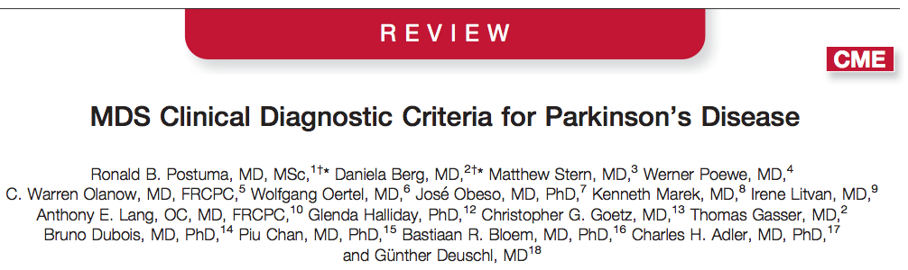
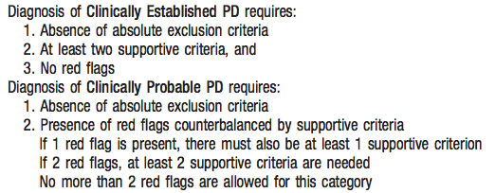


Slide 15
Management of Parkinson’s disease
Pharmacologic
Levodopa
Dopamine agonists
Amantadine
MAO-B inhibitors
COMT-inhibitors
Anticholinergics
Non-pharmacologic
Physiotherapy
Occupational therapy
Speech therapy
Psychotherapy
Diet
Education; group support
Device aided therapy:
Surgical therapy
Pump therapy: levodopa, apomorphin

Slide 16
Aims of management
symptomatic improvement
Motor
Non-motor
Disease modifying
Neuroprotective
Delay of progression
and delay of complications
Improvement of quality of life
Problems
Efficacy
Lack of effect (diagnosis?)
Fluctuating effect
Toxicity
Adverse events

Slide 17
When start?
Immediate start – immediate effect, more benefit
Better quality of life
Risk for adverse events
Neuroprotection?
No treatment – no effect
No adverse events
Delay motor complications ?
Individual basis
Age
Clinical picture
No “cookbook”
Delay motor complications ?

Slide 18
Diagnosis of PD
Decision to treat
No
Yes
Review
Evaluate patient characteristics,
degree of disability
Moderate/ severe disability;
Age 70+;
Comorbidities;
Cognitive impairment
Mild/ moderate motor
disability;
No cognitive impairment
Begin levodopa
Begin dopamine agonist or
MAO-B inhibitor
Schapira, Olanow 2008

Slide 19
Slight symptoms –
MAO-B inhibitor
Algorithm for
Idiopathic PD
Dietrichs and Odin, Acta Neurol Scand 2017
Functional disability
No adverse effects:
Increase dose
Dopamine agonist (<70y)
Levodopa
up tp 400 mg/d
If agonist contraindica-tions: Increase dose
Early combination therapy
Agonist+Levodopa 3-400 mg
Combination therapy
Agonist+Levodopa
Motor fluctuations:
Add COMT-inhibitor
Insufficient effect
(drug resistant tremor)
Disabling dyskinesias:
Try Amantadine
Uncontrollable motor complications
Consider advice-aided therapy

Slide 20
Levodopa – Gold Standard for efficacy
Combined with a dopa-decarboxylase inhibitor
benseraside; carbidopa
Standard and controlled-release formulations
COMT (catechol-O-methyl transpherase) inhibitors increase plasma concentration
entacapone; tolcapone
Adverse events
motor fluctuations and dyskinesias (about 40% in 5 years)
psychiatric: confusion, hallucinations

Slide 21
Advanced Parkinson’s disease: problems
Movement
gait disorder
falls
freezing
Speech, swallowing
Fluctuations (levodopa-induced)
motor
non-motor
Psychiatric symptoms
dementia
depression
hallucinations
Autonomic disorders
bladder
Sleep disorders
Coping in daily life - need for assistance
End of life/ palliative care

Slide 22
Fluctuations induced by levodopa treatment
Motor
Non-motor
Wearing off and on-off fluctuations
Dose failure
Dyskinesias
Peak-dose dyskinesia
Diphasic dyskinesia
Off state dystonias
Freezing
Psychiatric
Depression, anxiety, hallucinations, apathy
Behaviour
Euphoria, agitation
Slowness of thinking
Fatigue
Unpleasant sensations, pain
Excessive sweating
Sphincter disturbanvies
Aquino C and Fox SH, Mov Disord 2015

Slide 23
Levodopa motor complications: Community-based and open studies
Study site | Authors | L-dopa years | Motor fluct % | Dyskinesias %
Tartu, Estonia | Kadastik et al 2017 | 5 | 20 | 21
Norway | Bjornestad et al 2016 | 5 | 43 | 24
Aberdeen, UK | Scott et al 2015 | 5 | 21 | 28
Malaysia | Hashim et al 2014 | 3 | 50 | 44
Madrid, Spain | Lopez et al 2010 | 3 | 23 | 25
 |  | 10 | 94 | 71
Hong Kong | Kum et al 2009 | 5 | 75 | 78
Istanbul, Turkey | Benbir et al 2006 | 6.5 | 46 | 30
Sydney, Australia | Hely et al 2005 | 15 | 96 | 94
London, UK | Schrag and Quinn 2000 | 5 | 40 | 28
Dehli, India | Denny and Behari 1999 | 3 | 50 | 25
Madrid, Spain | Grandas et al 1999 | 4 | 44 | 64
Kansas, USA | Miyawaki et al 1997 | 0-5 | 24 | 13
 |  | >15 | 70 | 72
London, UK | Poewe et al 1986 | 6 | 52 | 54

Slide 24
Higher risk for motor complications
Younger age at onset of PD
Longer duration of PD
Higher dose of levodopa
Longer duration of levodopa
Earlier initiation of levodopa after the first symptom
Tremor dominant subtype of PD
Women (dyskinesia)
Carriers of autosomal dominant recessive PD (Parkin, PINK1, DJ-1)
Aquino C and Fox SH, Mov Disord 2015

Slide 25
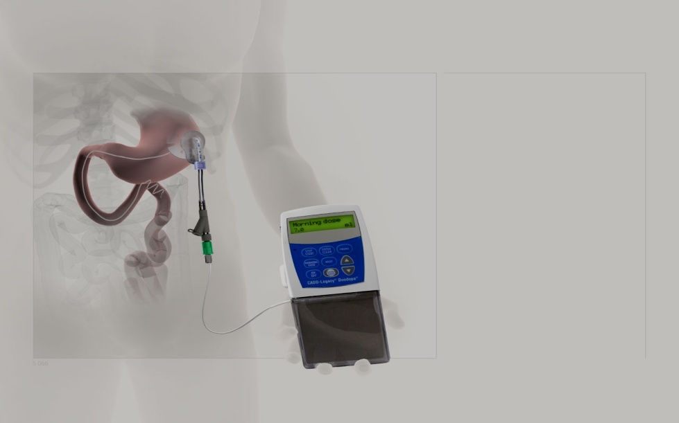
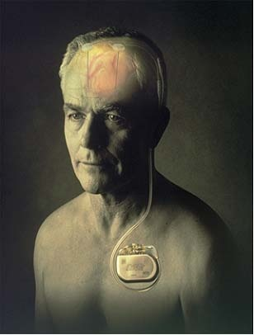
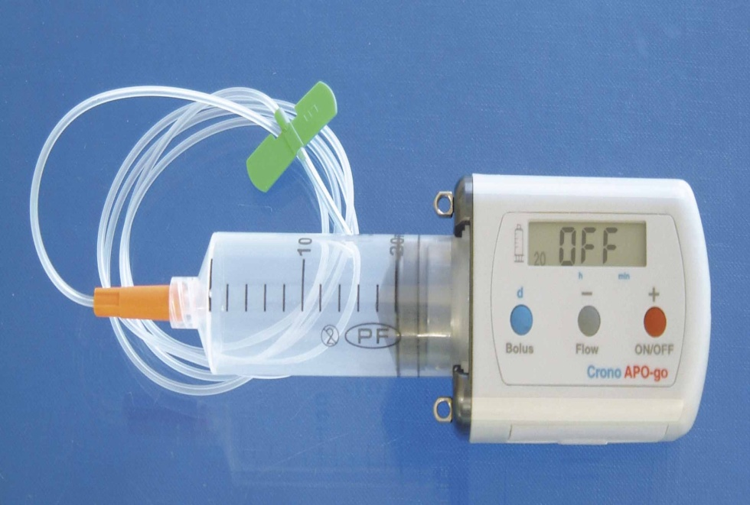
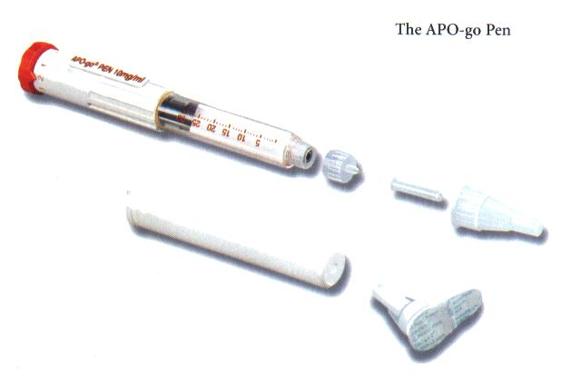
Continuous dopaminergic treatment
Duodenal carbidopa/levodopa gel infusion
Subcutaneous apomorphine infusion
Deep brain stimulation
Odin et al, Park Rel Disord 2015
Antonini et al, Mov Disord 2016
Jenner P and Katzenschlager R, Park Relat Disord 2016
Trenkwalder C et al, Park Rel Disord 2015
Notes:
25

Slide 26
Indications
Apomorphine injections:
„off“ fluctuations in spite of optimized peroral therapy
Duodopa - intestinal gel:
Severe disease
Severe motor fluctuations
Dyskinesias
Nocturnal akinesia
Apomorphine infusion:
Severe disease
Severe motor fluctuations
Dyskinesias
Nocturnal akinesia
STN-DBS:
Severe disease
Severe motor fluctuations
Dyskinesias
Severe tremor, not responding to medication

Slide 27
Contraindications
Apomorphine injections:
Pronounced dementia
Pronounced orthostatism
Pronounced dyskinesias
Duodopa:
Pronounced dementia
Contraindications for abdominal surgery
No compliance, no support
Apomorphine infusion:
Pronounced dementia
Strong tendency to hallucinations
No compliance, no support
STN-DBS:
Age > 70 years
Dementia
Depression, anxiety
Contraindications for brain surgery

Slide 28
New dopaminergic delivery
Levodopa inhalation: CVT-301
Levodopa/carbidopa microtablets
Subcutaneous levodopa
Levodopa-carbidopa intestinal gel with COMT-inhibitor
Malevodopa: short onset
Sublingual Apomorphine
Inhaled Apomorphine
Accordion pill
RYTARY study – levodopa/carbodipa extended release microbeads: shorter ‘off’, no dyskinesias
Senek M et al, Acta Neurol Scand 2017
Dhall M and Kreitzman DL, Neurology 2016
Rascol O. Mov Disord Clin Pract 2016
Hauser RA et al, Mov Disord 2016

Slide 29
New non-dopaminergic medications
Safinamide – MAO-B inhibitor
Opicapone – COMT-inhibitor
Extended release Amantadine
Adenosine A2A receptor antagonists
Istradephylline
Tozadenant
Caffeine
Mavoglurant - glutamatergic antagonist
Exenatide – GLP-1 receptor agonists
Eltoprazine – serotoninergic
Zonisamide - antiepileptic
Tetrabenazine
Simvastatin
Topiramate
Rascol O et al, Mov Disord 2015
Sadeghian M et al, Neuropath Appl Neurobiol 2016
Lees AJ, JAMA Neurology 2017
Foltynie T and Aviles-Olmos I, Alz Dem 2014
Murata M et al, Mov Disord 2014
Paolone G et al, Mov Disord 2015
Vorovemci RJ et al, Exp Rev Neurother 2015
Hauser RA et al, Lancet Neurol 2014

Slide 30
New technologies
Modulating basal ganglia output
Conventional quadripolar electrode
New: directional multipolar electrode: 8-lead
Multitarget stimulation
Restoring brain dopamin cells – gene therapies
ProSavin: lentiviral vector-based gene therapy (injection to putamen)
OXB-102
Stem cells
Alpha-synucleine related immune therapies
Polyphenols
Immunisation: vaccines (peptide; DNA; cell-based)
Small molecules: Nilotinib; glycerol phenybutyrate
Ughratdar I, J Parkinson Dis 2015
Steigerwald F et al, Mov Disord 2016
Hickey P and Stacy M, Front Neurosci 2016
Palfi S et al, Lancet 2014
Brundin P et al, Mov Disord 2015
Schneeberger A et al, Mov Disord 2015

Slide 31
New for non-motor symptoms
Psychosis: Pimavanserin (serotonin agonist); Olanzapine; Donepezil
Depression and anxiety: Cognitive-behavioural therapy; Rasagiline
Apathy: Piribedil; Rivastigmine
Excessive daytime sleepiness: Piribedil; Positive airway pressure; Sodium oxybate
Orthostatic hypotension: Droxidopa; Midodrine; Pyridostigmine, Fludrocortisone
Hyperactive bladder: Solifenacin; Fesoterodine; Transcutaneous n. tibialis stimulation
Chronic constipation: Relamorelin
Pain: Oxycodone/ Naloxone; Rotigotine; STN-DBS
Schrag A et al, Mov Disord 2015
Cummins J et al, Lancet 2014
Elgebaly A et al, Clin Auton Res 2016

Slide 32
New in non-pharmacological therapies: trials
Exercise and physiotherapy: aerobic exercise; strength training; balance; combined innovative strategies; Silverman voice treatment
Dance interventions: tango
Treatments for cognition and behaviour: cognitive behavioural therapies; computer programs
Occupational therapy
Dysphagia: swallowing therapies
Alternative interventions: music therapy; mindfulness
Multidisciplinary care models
Telemedicine
Bloem B et al, Mov Disord 2015
Monticone M et al. Mov Disord 2015

Slide 33
Neuroprotection and disease modification strategies ?
Ongoing clinical trials
Failures
Active or passive immunisation against alpha-synuclein
Caffeine (adenosine receptor antagonist)
AAV2-GDNF (neurotrophic factor)
Isradipine (Ca-channel blocker)
Nicotine (acetylcholine agonist)
GSH intranasal (antioxidant)
N-acetylcysteine (GSH precursor)
Sagramostim (macrophage factor)
Stem cells infusion
Pramipexole (dopamine agonist)
Coenzyme Q10 (antioxidant)
Creatine (bioenergetic)
AAV2-Neuturin putamen injection (neurotrophic)
Pioglitazone (PPAR-gamma-agonist)
Need for the knowledge on biomarkers of disease and progression
No definitive evidence for pharmacological neuroprotection
Espay AJ et al, Mov Disord 2017
Kalia LV et al. Mov Disord 2015

Slide 34
Differential diagnosis of Parkinson’s disease
Secondary
parkinsonism
Dementia:
Lewy body dementia
Alzheimer’s disease
Atypical
parkinsonian
syndromes
Heredodegenerative:
Wilson’s disease
Huntington’s disease
Tremor

Slide 35
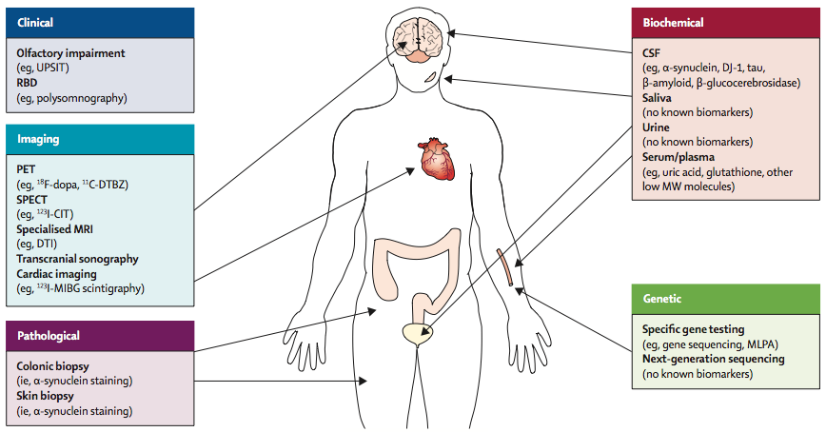
Parkinson disease – whole body problem
Kalis LV and Lang AE. Lancet 2015; online 61393-3
Miller DB and O’Callaghan JP. Metab Clin Exp2015;64:540-6
Notes:
Miller DB and O’Callaghan JP. Metab Clin Exp 2015;64:540-6

Slide 36
Conclusions
Correct diagnosis of PD – a prerequisite for treatment
Confirmation of clinical parkinsonian syndrome
No biomarkers for the premotor stage of PD
Levodopa complications – a major challenge
Need for non-dopaminergic treatments
Team management
No neuroprotection

