Slide 1
Introduction to rating scales and psychometrics
Clinical assessment and outcome measurement
Peter Hagell
Kristianstad university

Slide 2
Learning Objectives
Explain the basic principles of psychometrics
Understand the general principles of rating scale based assessments
Discuss similarities and differences between linear measures and rating scale scores

Slide 3
Clinical assessment and outcome measurement
Used to describe and compare (between individuals and variables, before and after interventions, etc.)
Basis for care and treatment recommendations, priorities, knowledge building, theory development, etc.
Numbers generated by rating scales are often used as measures of the central dependent variable on which clinical decisions are based
Study design and statistical analysis cannot compensate for poor measures
The quality of conclusions from studies depends on the quality of measures

Slide 4
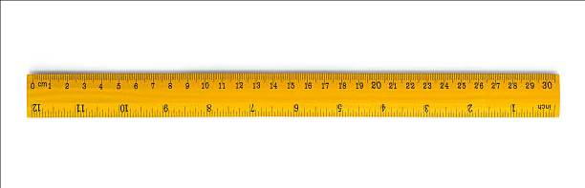
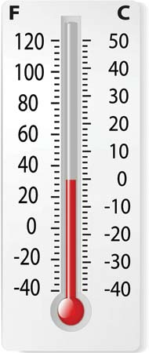
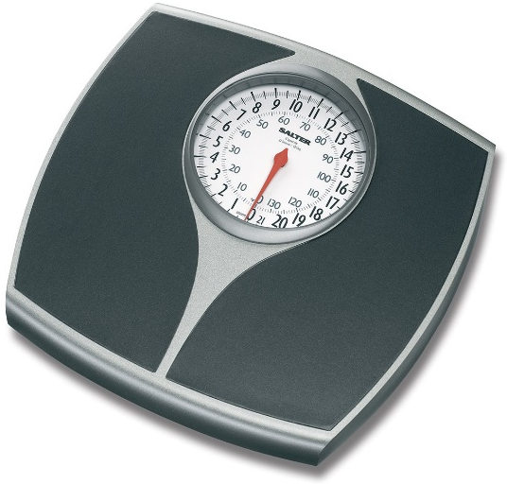


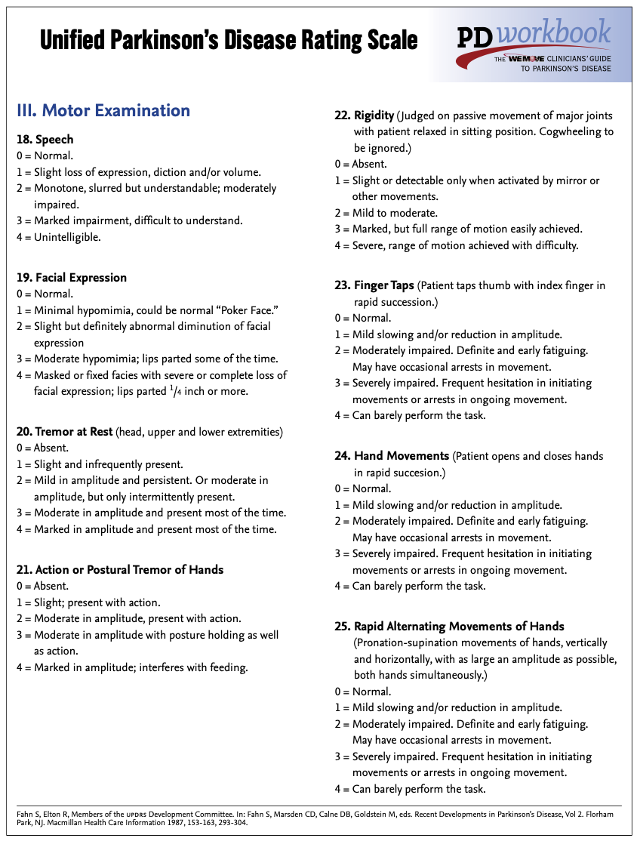
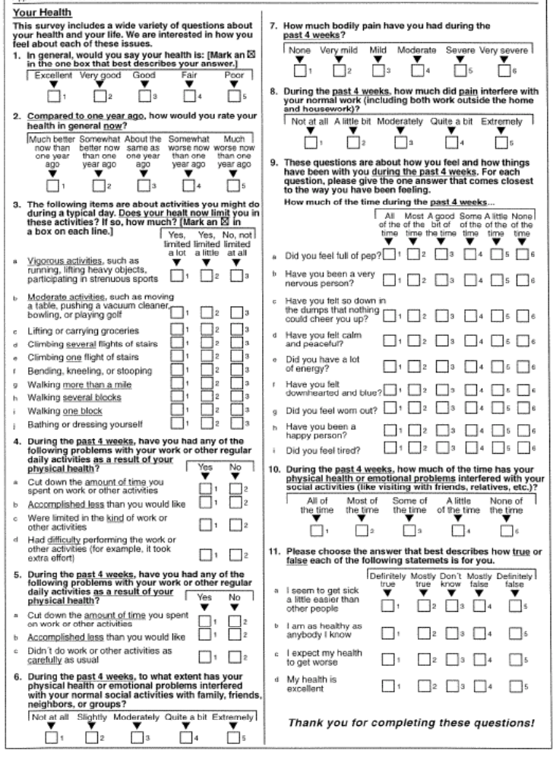
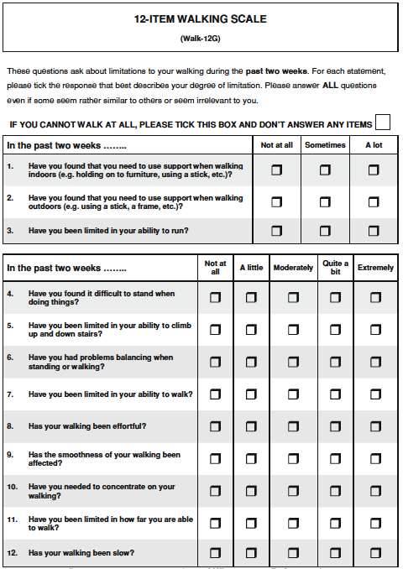
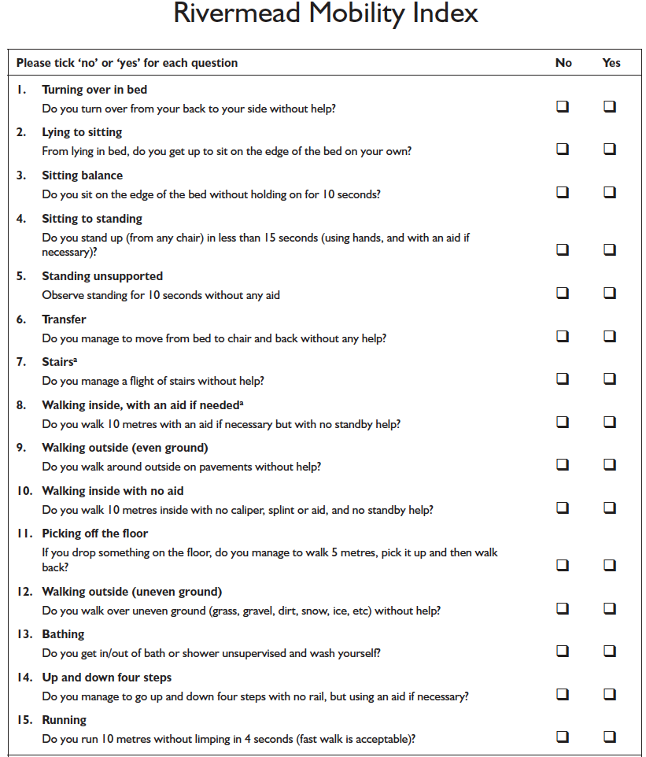
Linear measures
Defined quantities & units
Quality control
Both produce numerical data, but of different kinds
Ordinal observations

Slide 5
Measuring…
Systematic observation
An estimation of the amount, from less to more
Quantification of the quantity

Slide 6
Measuring…
√
Systematic observation
An estimation of the amount, from less to more
Quantification of the quantity
√
Observations
Assessments
QUALITATIVE DATA

Slide 7
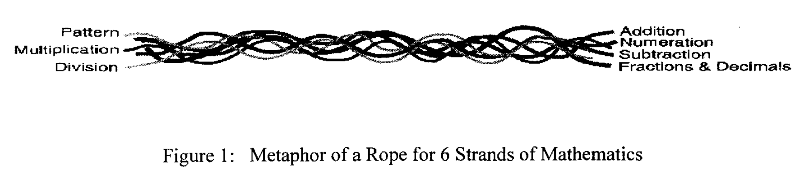
Prerequisites
The phenomenon/variable exists...
The phenomenon/variable can be defined
The phenomenon/variable can be quantified
Unidimensionality
Andrich. Studies in Educational Evaluation 2002; 28: 103-121.

Slide 8
Challenges
Latent variables
Converting qualitative observations into quantitative measures
What do scores represent?
  Validity
  The instrument represents the intended variable
How confident can we be about scores?
  Reliability
  The extent to which scores are free from error
Psychometrics

Slide 9
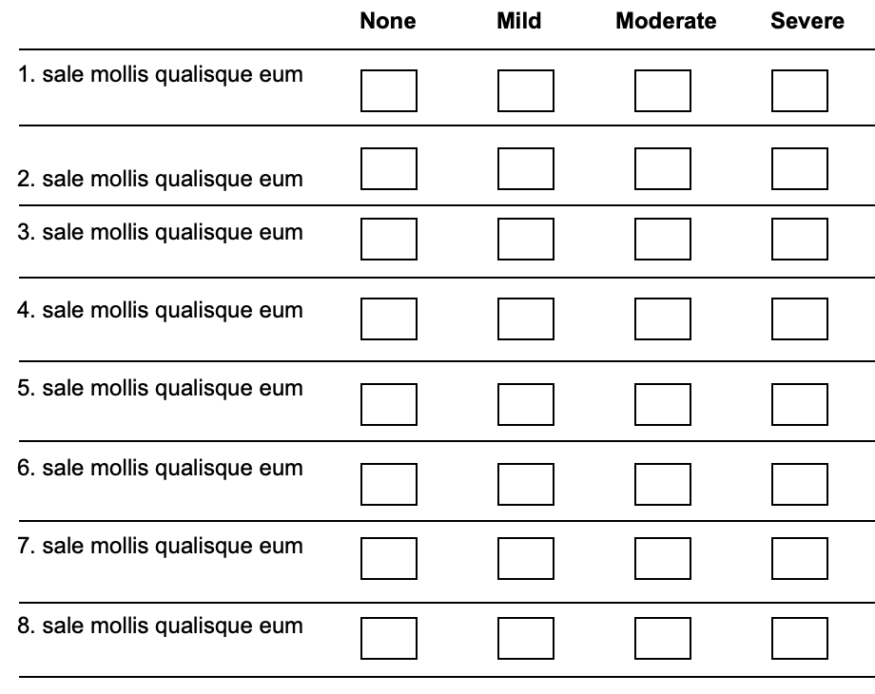
✗
0
1
2
3
0
1
✗
3
2
0
1
✗
2
3
Σ
✗
1
0
2
3
✗
0
1
2
3
0
1
✗
2
3
0
1
✗
3
2
✗
1
0
2
3








Less






More

Slide 10
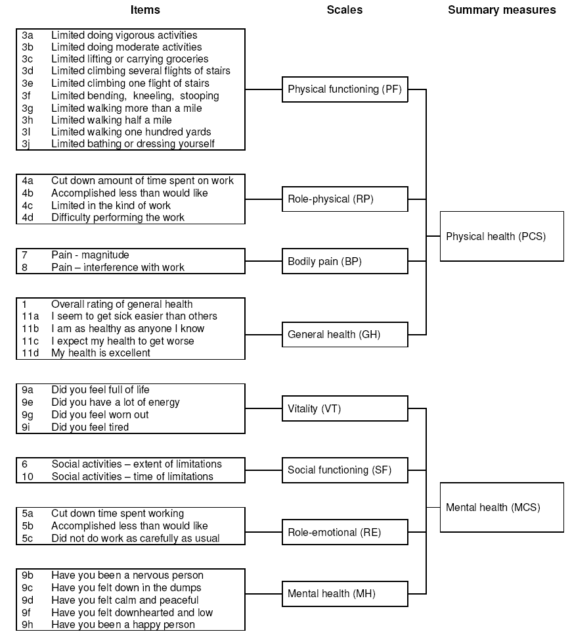
RAND-/SF-36
Health survey
Ware & Sherbourne. Med Care 1992; 30: 473-483.
Hays et al. Health Econ 1993; 2: 217-227.

Slide 11

Rating scale quality aspects
To what extent is the legitimacy of combining items into scales met?
To what extent can scores be interpreted as representations of the intended variable?
To what extent are scores useful for their intended purpose?
To what extent are scores free from measurement error?
To what extent do scores reflect differences and changes?
Can scores serve as a basis for linear measurement?
Meaning?
Measurement?
Action?

Slide 12

A real world example…
A post-marketing phase IV clinical trial of an adjunct (L-dopa add-on) drug for people with Parkinson’s disease
”The present study was designed to investigate the effects of combining levodopa with X on ADL”

Slide 13

People with Parkinson’s
Sample size (n=270) based on earlier studies, with 90% power at P<0.05
Randomization
(n=270)
Inclusion criteria:
PD with wearing-off
Stable levodopa
Exclusion criteria:
Age <35
Dementia, depression, other psychiatric or systemic disorder
Placebo
(Possible score range, 0-52; 0=better)
Active
0: Normal
1: Slow; no help
2: Occasional help
3: Considerable help
4: Helpless
Baseline:
24.7±12.3
Baseline:
23.5±10
Week 13:
-0.7±2.7
Week 13:
-2.3±3.7
Intention-to-treat; analysis of covariance (ANCOVA) for repeated measures controlling for:
Baseline data
Group (active vs. placebo)
Centre
Group x Centre
P<0.0001
”…good efficacy in terms of ADL…”
People with Parkinson’s
Notes:
Depending on your preference, you may disable the animations.

Slide 14
People with Parkinson’s
Randomization
(n=270)
Placebo
(Possible score range, 0-52; 0=better)
Active
Baseline:
24.7±12.3
Baseline:
23.5±10
𝚫1.6?
Week 13:
-0.7±2.7
Week 13:
-2.3±3.7
P<0.0001
”…good efficacy in terms of ADL…”
People with Parkinson’s

Slide 15
People with Parkinson’s
Randomization
(n=270)
Placebo
(Possible score range, 0-52; 0=better)
Active
Baseline:
24.7±12.3
Baseline:
23.5±10
Week 13:
-0.7±2.7
Week 13:
-2.3±3.7
Schwab & England: n.s.
PDQ-39/ADL scale: n.s.
?
”…good efficacy in terms of ADL…”
People with Parkinson’s

Slide 16
WHAT outcome was assessed…?

Slide 17

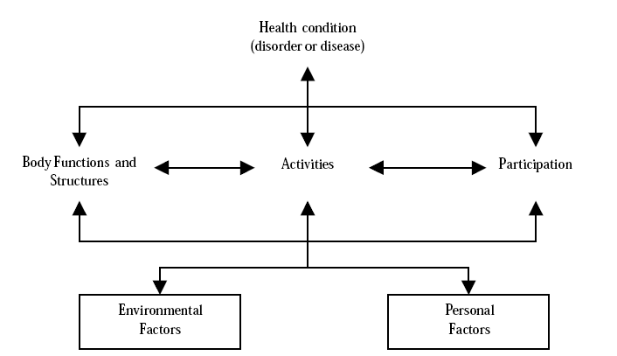
International Classification of Functioning, Disability, and Health
ACTIVITIES
BODY
FUNCTIONS

Slide 18
Are we measuring/assessing the right thing?
Outcome
variable
Objective
Intervention
Requires explicit definition of the outcome variable (e.g., what is meant by "ADL"?) that
is consistent with the objective, intervention and outcome measure
Outcome measure
(instrument)

Slide 19
Measurement
The process of experimentally obtaining one or more quantity values that can reasonably be attributed to a quantity
  (VIM 2012)
Measurement consists of two essential factors:
  (1) a defined standard of reference [the unit]
  (2) the number of times the unit is to be taken to make up the quantity
  (Maxwell, 1873)
The repetition of a unit amount that maintains its size, within an allowable range of error, no matter which instrument is used and no matter who or what relevant person or thing is measured
(Institute of Objective Measurement, 2001)
Estimation of the amount of a unidimensional property relative to a unit
  (Andrich & Marais, 2019)
Assignment of numerals to objects or events according to rules
(Stevens, 1946)

Slide 20
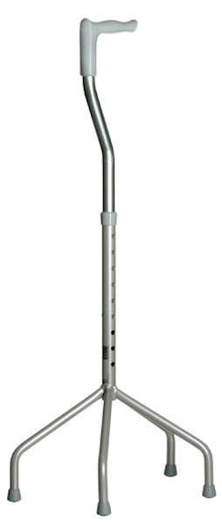
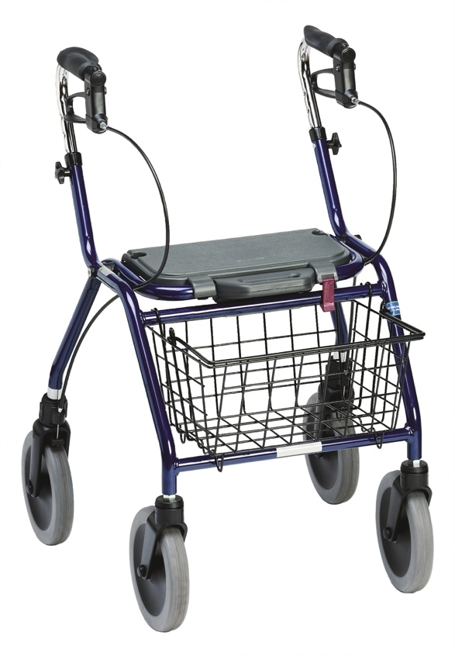
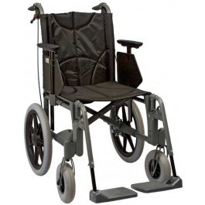
25 kg + 30 kg = 55 kg?
15 m + 10 m = 25 m?
Mild pain (1) + Distressing pain (3) = Horrible pain (4)?
+
=
?
(1) (2) (3)
Blood type A (1) + Blood type B (2) = Blood type AB (3)?
Male (1) + Female (2) = Non-binary (3)?

Slide 21

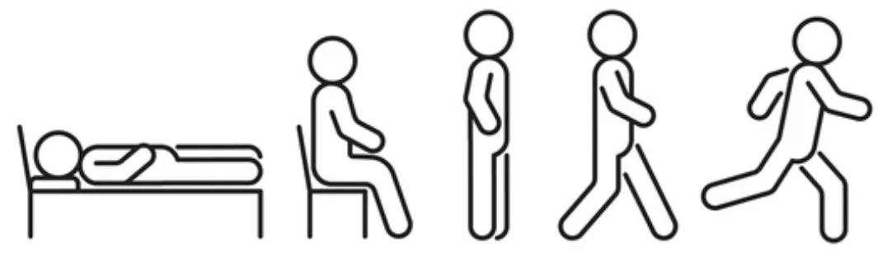
Observations
Requires: Rules
Categorization - Frequency - Order
Nominal - Ordinal - Nonlinear - Qualitative
Measurement
Requires: Theory and quantification
Magnitude - Distance - Equal units
Interval - Ratio - Linear - Quantitative

Slide 22
Need for methods that convert qualitative observations into quantitative measures that are representative of variations in the latent variable
?

Slide 23
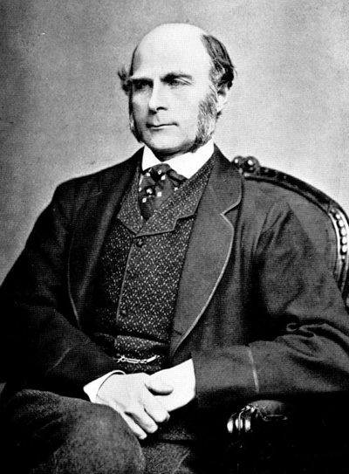

Classical Test Theory (CTT)
About 150 years of history
Rooted in the behavioural sciences
Francis Galton
Charles Spearman

Slide 24
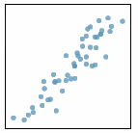
Classical Test Theory (CTT)
O = T + E
Largely correlational
O = Observed score
T = True score
E = Error score
Assumptions
T = mean of repeated simultaneous independent observations of the same person
T and E are uncorrelated
E are uncorrelated
Includes, e.g., reliability estimates, Likert scaling, factor analysis, etc.
Notes:
24

Slide 25
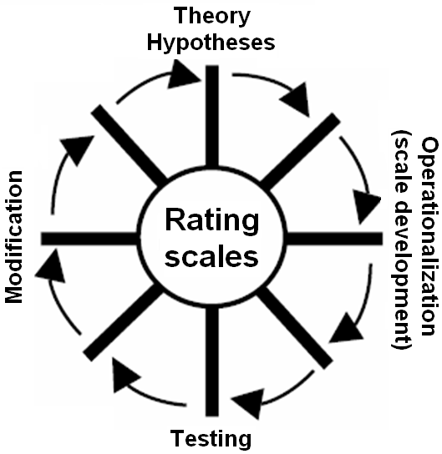
A rating scale can be seen as an hypothesis about a variable and how it can be quantified
Requires variable definition
Requires explicit operationalization - what characterizes the variable as it varies from "less" to "more" and how is this variation expressed in words (i.e., rating scale items and response categories)?
Latent variable
Uncertainty
To what extent and with what precision do empirical observations (responses to items) reflect the variable they intend to represent?
Notes:
25

Slide 26
Unobservable latent variable
(e.g. mobility, fatigue, mental health,
depression, pain, well-being)
Unobservable latent variable
(e.g. mobility, fatigue, mental health,
depression, pain, well-being)
Reflective model Effect indicators
Formative model Causal indicators
Descriptors of observable manifestations
Streiner. JPA; 80(3): 217-222.
Stenner et al. RMT 2009; 22(4): 1176-1177.
Notes:
26

Slide 27
References
Andrich D. Implications and applications of modern test theory in the context of outcomes based education. Studies in Educational Evaluation 2002; 28: 103-121.
Available from: https://doi.org/10.1016/S0191-491X(02)00015-9
Cano SJ, Hobart JC. The problem with health measurement. Patient Preference and Adherence 2011; 5: 279-290.
Available from: https://doi.org/10.2147/PPA.S14399
Hagell P. Measuring Activities of Daily Living in Parkinson's disease: On a road to nowhere and back again? Measurement 2019; 132: 109-124.
Available from: https://doi.org/10.1016/j.measurement.2018.09.050 (https://www.hkr.se/globalassets/transfer/hagell-msrmnt-2019_accepted_ms.pdf)
Hays RD, Sherbourne CD, Mazel RM. The RAND 36-Item Health Survey 1.0. Health Economics 1993; 2(3): 217-227.
Available from: https://www.researchgate.net/publication/14924460
Hobart J. Rating scales for neurologists. Journal of Neurology Neurosurgery & Psychiatry 2003; 74(Suppl 4): iv22-iv26.
Available from: http://dx.doi.org/10.1136/jnnp.74.suppl_4.iv22

Slide 28
References
McGrane JA. Stevens’ forgotten crossroads: the divergent measurement traditions in the physical and psychological sciences from the mid-twentieth century. Frontiers in Psychology 2015; 6: 431.
Available from: https://doi.org/10.3389/fpsyg.2015.00431
Stenner AJ, Stone MH, Burdick DS. Indexing vs. measuring. Rasch Measurement Transactions 2009; 22(4): 1176-1177.
Available from: https://www.rasch.org/rmt/rmt224b.htm
Stevens SS. On the theory of scales of measurement. Science 1946; 103(2684): 677-680.
Available from: https://psychology.okstate.edu/faculty/jgrice/psyc3214/Stevens_FourScales_1946.pdf
Streiner DL. Being inconsistent about consistency: when coefficient alpha does and doesn't matter. Journal of Personality Assessment; 80(3): 217-222.
Available from: https://www.rotman-baycrest.on.ca/files/publicationmodule/@random45f5724eba2f8/JPersAssess03_80_217_222.pdf
Ware JE Jr, Sherbourne CD. The MOS 36-Item Short-Form Health Survey (SF-36): I. Conceptual Framework and Item Selection. Medical Care 1992; 30: 473-483.
Available from: http://www.espalibrary.eu/media/filer_public/f5/31/f531ce0b-0584-476b-b46a-abe3df14d0ec/ware-mc1992.pdf

