Slide 1
Quality assurance of screening tests
Clinical assessment and outcome measurement
Peter Hagell Kristianstad university

Slide 2
Learning Objectives
Understand the principles of sensitivity and specificity
Understand the principles of establishing cut-off scores

Slide 3
Criterion-related validity
How do scores relate to an external criterion?
Prediction of future events based on scores (predictive validity)
Concurrent use of another instrument ("gold standard") that represents the same thing (concurrent validity)

Slide 4
What we expect from screening
Detecting a high proportion of persons who have the condition
Not detecting persons who do not have the condition
Safe to administer
Reasonable in cost
Lead to improved health outcomes
Be widely available (as should interventions following a positive result)

Slide 5
Sensitivity
Specificity
Positive predicitve value
Negative predictive value
Accuracy
Youden index

Slide 6
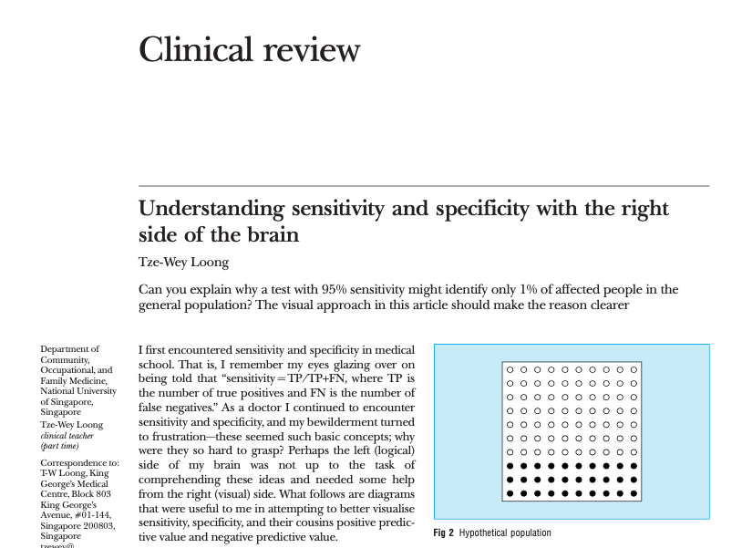
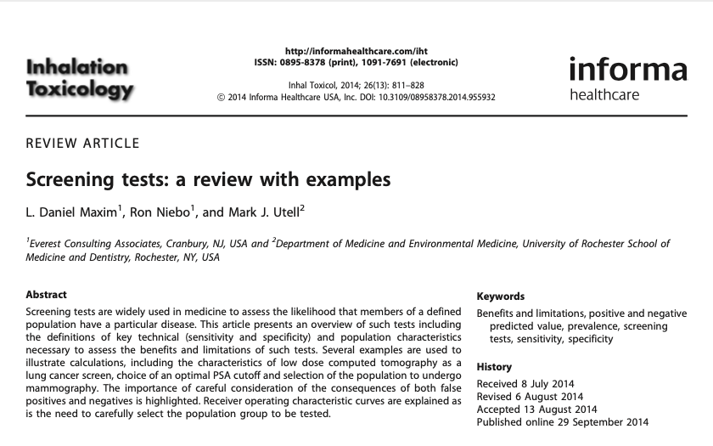
https://www.ncbi.nlm.nih.gov/pmc/articles/PMC4389712/
https://www.ncbi.nlm.nih.gov/pmc/articles/PMC200804/

Slide 7

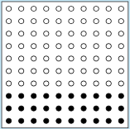
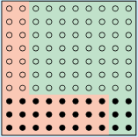
Person without condition
Person with condition
Negative result
Positive result
Incorrectly identified:
False positive
Correctly identified:
True negative
Incorrectly identified:
False negative
30/100 (30%)
with condition (filled dots)
Correctly identified:
True positive
→ Sensitivity (correct identification of cases) Specificity (correct identification of non-cases)

Slide 8
Sensitivity
How well persons with the condition are identified
24 out of the 30 people who have the condition were correctly identified
Sensitivity = 24/30 = 80%

Slide 9
Specificity
How well persons without the condition are identified
56 out of the 70 people who do not have the condition were correctly identified
Specificity = 56/70 = 80%

Slide 10
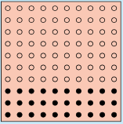
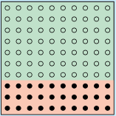
Sensitivity and specificity
High sensitivity can be problematic
Striving towards balance
100% sensitivity
Perfect test

Slide 11
Positive predictive value (PPV)
The chance that a positive result will be correct
24 out of the 38 positive results were correct
PPV = 24/38 = 63%

Slide 12
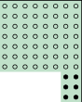
Negative predictive value (NPV)
The chance that a negative result will be correct
56 out of the 62 negative results were correct
NPV = 56/62 = 90%

Slide 13
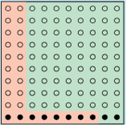
Prevalence of condition
If our prevalence falls to 10% and we use the same screening as before...
Sensitivity = 8/10 = 80%
Specificity = 72/90 = 80%
PPV = 8/26 = 31%
NPV = 72/74 = 97%
PPV falls when the prevalence falls
NPV rises the prevalence falls

Slide 14
PPV
NPV
Sensitivity

Slide 15
Other indices
Accuracy: Overall proportion of correct results
Likelihood: The probability of a person who has the condition testing positive divided by the probability of a person who does not have the condition testing positive

Slide 16
ROC, AUC, Youden…
Identifying the best cut-off

Slide 17
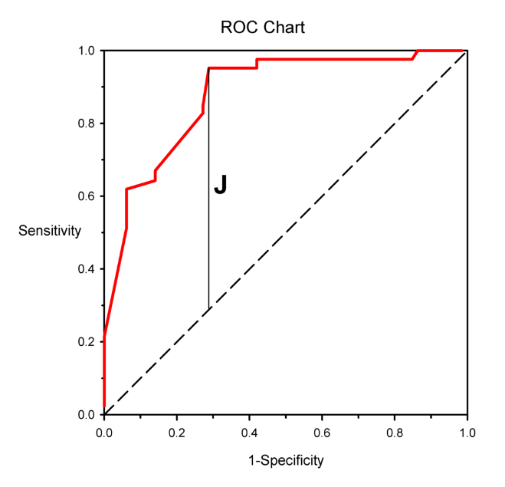
ROC, AUC, Youden…
ROC (Receiver Operating Characteristic) curve
Balancing the proportions of true positives (sensitivity) and false positives (1-specificity)
Area Under the Curve (AUC)
Youden index (J)
Best balance between sensitivity and 1-specificity
AUC
Notes:
1 – specificity = False positive rate. ROC beror på sensitivite och specificitet (prioritering)
ROC anger sambandet mellan ett tests sens och andelen falskt positiva (1-specificiteten)

Slide 18
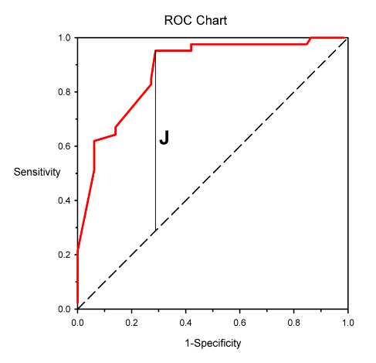
Area Under the Curve (AUC)
AUC | Quality of test
0.9-1 | Excellent
0.8-0.9 | Good
0.7-0.8 | Fair
0.6-0.7 | Poor
0.5-0.6 | Fail
Safari et al. Emergency 2016
Notes:
AUC = Sammantaget mått på testets prestanda = sannolikheten att en slumpmässigt vald person MED sjukdomen har ett högre värde än en slumpmässigt vald person UTAN sjukdomen.

Slide 19

Youden index (J)
J = Sensitivity + Specificity – 1 = True positive + False positive
0: Useless; same results for persons with and without the condition
1: Perfect test; No false positive or false negative results
Used to determine best cut-off (highest J-value)
ROC curve
Dashed line:
50/50
Vertical line (J):
Maximal Youdens index = best cut-off

Slide 20
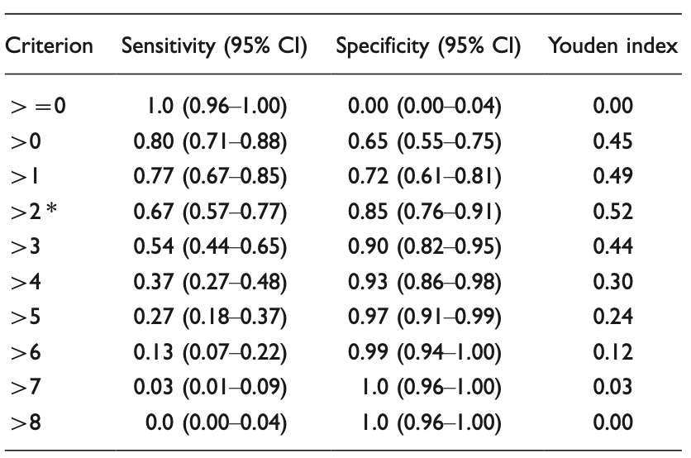
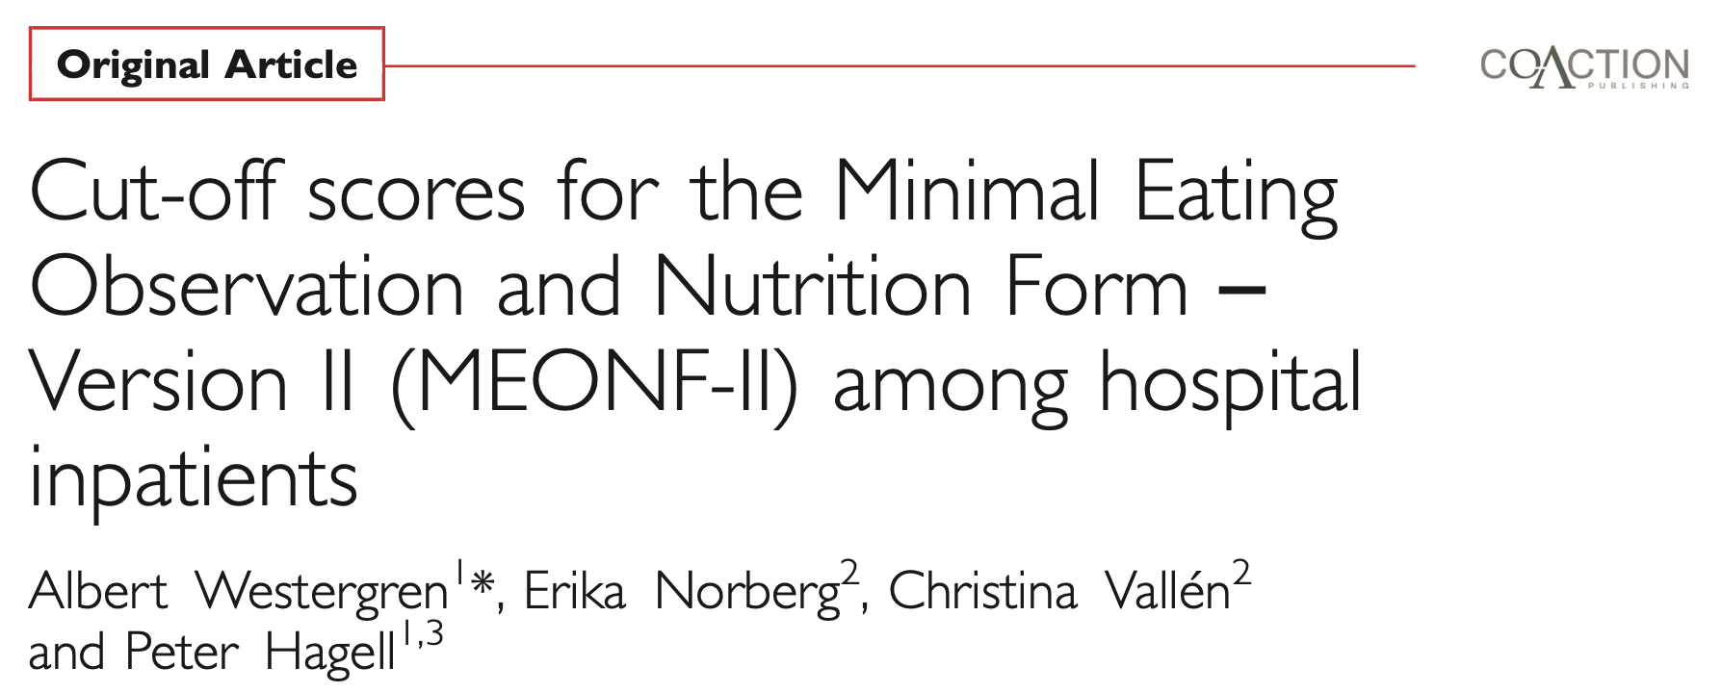
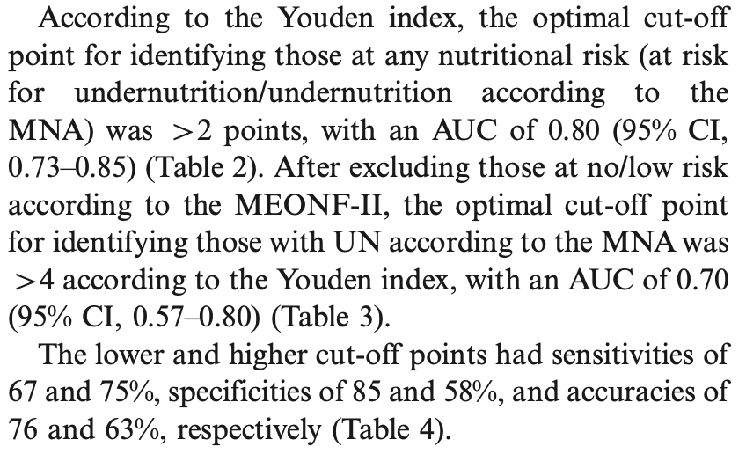
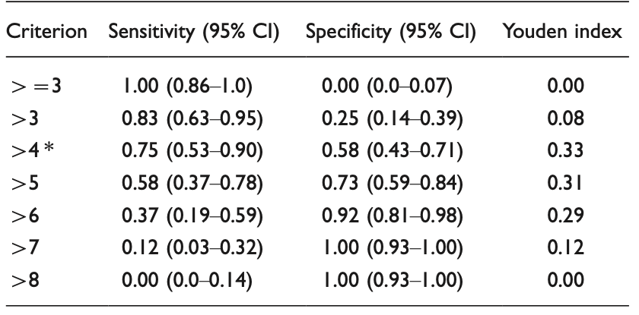
An example:
Screening for undernutrition risk
Westergren et al. FNR 2011.
Notes:
Sensitiviteten (Sant positiva) + Specificiteten-1 (falkst positiva) = 0,67 + 0, 85 = 1,52 – 1 = 0,52

Slide 21
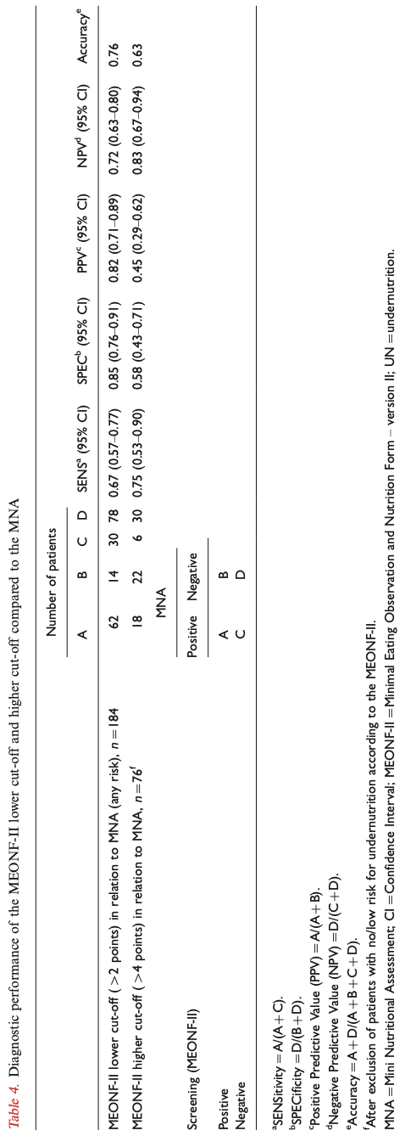
Westergren et al. FNR 2011.

Slide 22
Exercise
Calculate the sensitivity, specificity, PPV and NPV of the screening test based on the data below
 |  | Persons with condition | Persons without condition | Total
Screening | Positive | 62 | 14 | 76
 | Negative | 30 | 78 | 108
 | Total | 92 | 92 | 184

Slide 23
Completion of the exercise

Slide 24
References
Herman C. What Makes a Screening Exam “Good”? Virtual Mentor 2006; 8(1): 34-37. Available from: https://journalofethics.ama-assn.org/sites/default/files/2018-06/cprl1-0601.pdf
Loong TW. Understanding sensitivity and specificity with the right side of the brain. BMJ 2003; 327: 716–719. Available from: https://www.ncbi.nlm.nih.gov/pmc/articles/PMC200804/
Maxim LD, Niebo R, Utell MJ. Screening tests: a review with examples. Inhalation Toxicology 2014; 26(13): 811–828. Available from: https://www.ncbi.nlm.nih.gov/pmc/articles/PMC4389712/
Westergren A, Norberg E, Vallén C, Hagell P. Cut-off scores for the Minimal Eating Observation and Nutrition Form - Version II (MEONF-II) among hospital inpatients. Food & Nutrition Research 2011; 55: 7289. Available from: https://doi.org/10.3402/fnr.v55i0.7289

