Slide 1
Rasch Measurement Theory (RMT) (part 2)
Clinical assessment and outcome measurement
Peter Hagell Kristianstad university

Slide 2
Learning Objectives
Understand the basic principles of Rasch measurement theory
Discuss Rasch measurement theory in relation to traditional psychometric methods and metrology

Slide 3
DIF: Differential Item Functioning
Definition:
”... a difference in item performance between two comparable groups, i.e., groups that are matched with respect to the construct being measured by the test.”
Given that the target variable is unidimensional and that the item represents this variable:
Apart from random variations, responses should ”behave” similarly independent of what subgroup respondents belong to
Holland & Wainer (eds.), Differential Item Functioning, Lawrence Erlbaum,1993.
Notes:
3

Slide 4
DIF with the Rasch model
Different approaches
Residual based:
Group repondents by location on the variable (class intervals)
Group repondents by subgroup (e.g., gender, age)
2-way ANOVA of residuals by class intervals and subgroups
Main effect: class interval (goodness-of-fit)
Main effect: subgroup (uniform DIF)
Interaction effect: class interval x subgroup (non-uniform DIF)

Slide 5
No DIF
(invariance)
Uniform DIF
(group main effect)
Non-uniform DIF
(group x CI interaction effect)

Slide 6
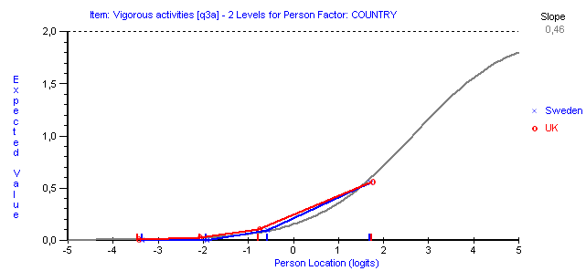
No DIF (invariance)
Physical Functioning (SF-36)

Slide 7
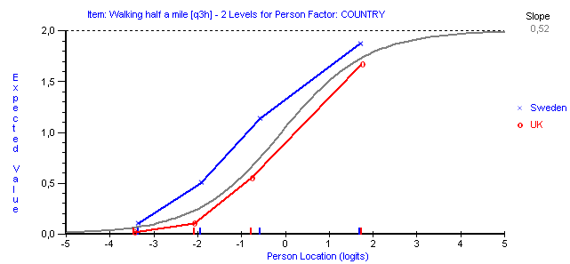
Uniform DIF (group main effect)
Physical Functioning (SF-36)

Slide 8
Uniform DIF (group main effect)
Physical Functioning (SF-36)
(UK) Walking half a mile → (SE) Walking a few hundred metres...

Slide 9
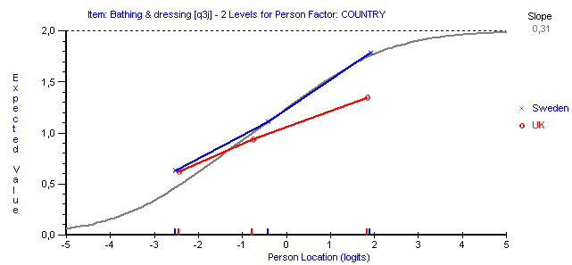
Non-uniform DIF (group x CI interaction effect)
Physical Functioning (SF-36)

Slide 10
Item location DIF (95% CI)

Slide 11
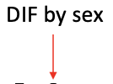
Adjusting for DIF
Sex
Split into 2 group-specific items

Slide 12
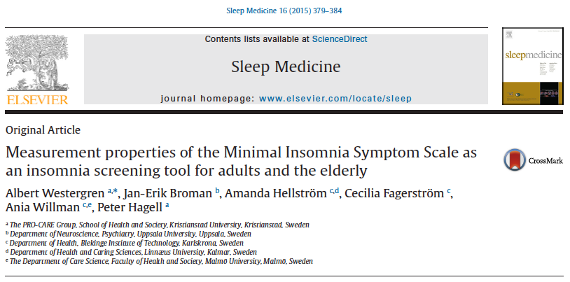

Slide 13

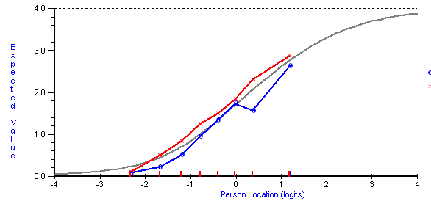
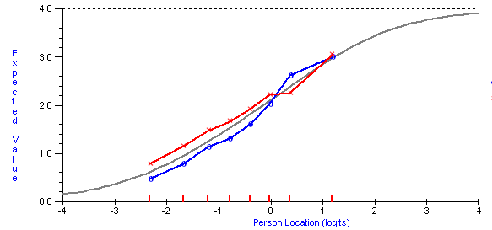
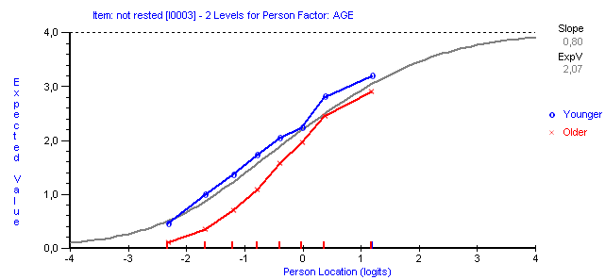
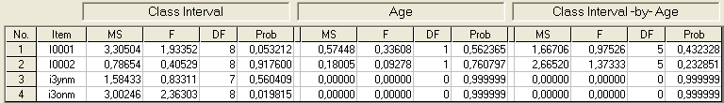
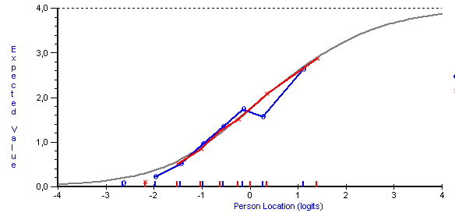
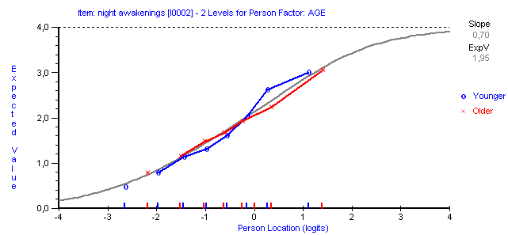
(1)
(2)
(3)
Adjust: 2 age-specific items
(1)
(2)
Artificial DIF

Slide 14
Clinical implication of DIF for age
Do total scores represent the same locations in different subgroups?
→ Rack & stack:
 | i1/a | i2/a | i3/a | i1/e | i2/e | i3/e | i1 | i2 | i3
p1/a | X | X | X |  |  |  | X | X | X
p2/a | X | X | X |  |  |  | X | X | X
p3/a | X | X | X |  |  |  | X | X | X
p…/a | X | X | X |  |  |  | X | X | X
p1/e |  |  |  | X | X | X | X | X | X
p2/e |  |  |  | X | X | X | X | X | X
p3/e |  |  |  | X | X | X | X | X | X
p…/e |  |  |  | X | X | X | X | X | X
Stack
Rack
Wright. RMT 2003; 17: 905-906.
Lundgren-Nilsson et al. HQLO 2006; 4: 55.

Slide 15
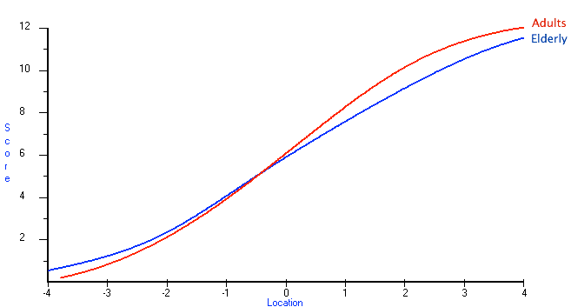
Clinical implication of DIF for age
Do total scores represent the same locations in different subgroups?
Insomnia screening
Different cut-offs
Adults: ≥6
Older: ≥7
Cut-off

Slide 16
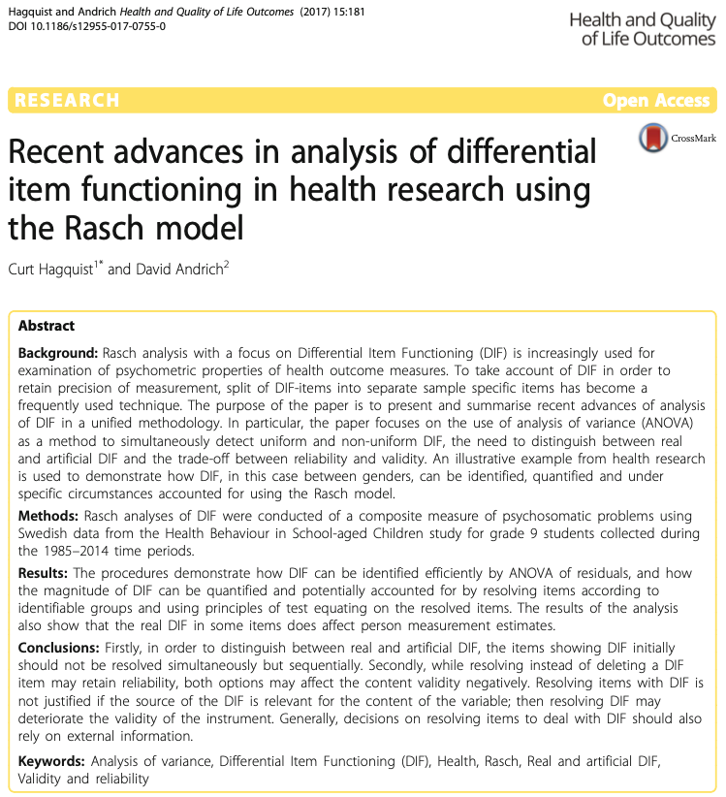
https://doi.org/10.1186/s12955-017-0755-0

Slide 17
The significance of DIF
Aspect of model fit
Items with DIF work differently or have different meanings for each subgroup
Potential threat to validity of group comparisons (bias in total scores)

Slide 18
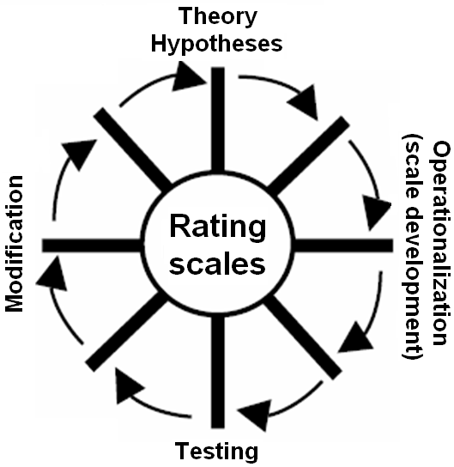
Interpretation and use of goodness-of-fit, DIF, thresholds, etc.
The analysis is effective in identifying anomalies
Anomalies need to be investigated and understood
Avoid over-interpretation of statistical tests
Interpret and try to understand qualitatively in relation to theory, the variable, context, use, etc.
Do not forget the persons…
It's all connected - work sequentially and interactively
Don't throw the baby out with the water...!

Slide 19
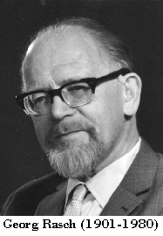
"On the whole we should not overlook that since a model is never true, but only more or less adequate, deficiencies are bound to show, given sufficient data"
Rasch, 1960
Probabilistic models for some intelligence and attainment tests. (p. 92)
Danish Institute for Educational Research, Copenhagen, Denmark, 1960.

Slide 20
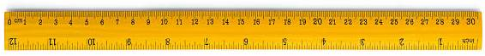
Addressing basic measurement aspects
What does our “ruler” look like?

Slide 21
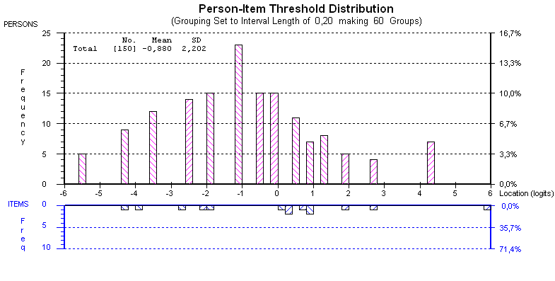
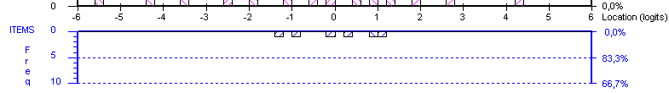
(SF-12/PCS in Parkinson's disease)
Do items represent a quantitative continuum?
Perceived physical health
(worse)
(better)
THRESHOLDS
Hagell & Westergren JPD 2011; 1:185-196.
Notes:
21

Slide 22
(SF-12/PCS in Parkinson's disease)
Is the hierarchical order of items reasonable?
Does it support the validity of the instrument?
Perceived physical health
(worse)
(better)
(better)
(worse)
Hagell & Westergren JPD 2011; 1:185-196.

Slide 24
(SF-12/PCS in Parkinson's disease)
Does the sample represent the items?
THRESHOLDS
Hagell & Westergren JPD 2011; 1:185-196.

Slide 25
(SF-12/PCS in Parkinson's disease)
Do items represent the sample?
THRESHOLDS
Hagell & Westergren JPD 2011; 1:185-196.

Slide 26
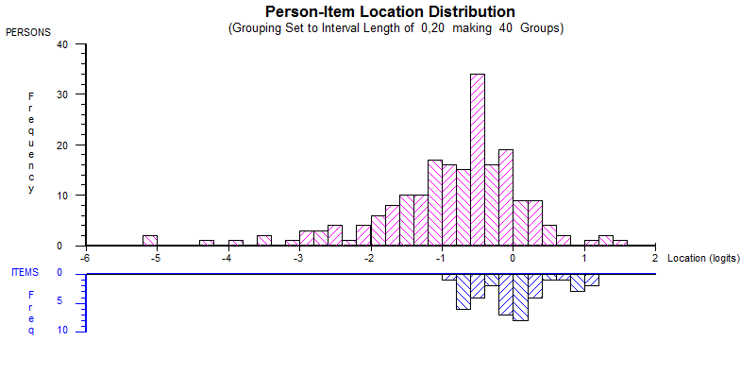
(PDQ-39)

Slide 27
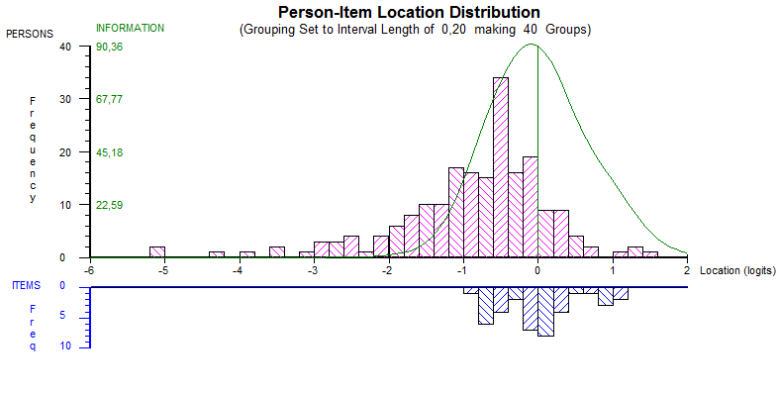
(PDQ-39)

Slide 28
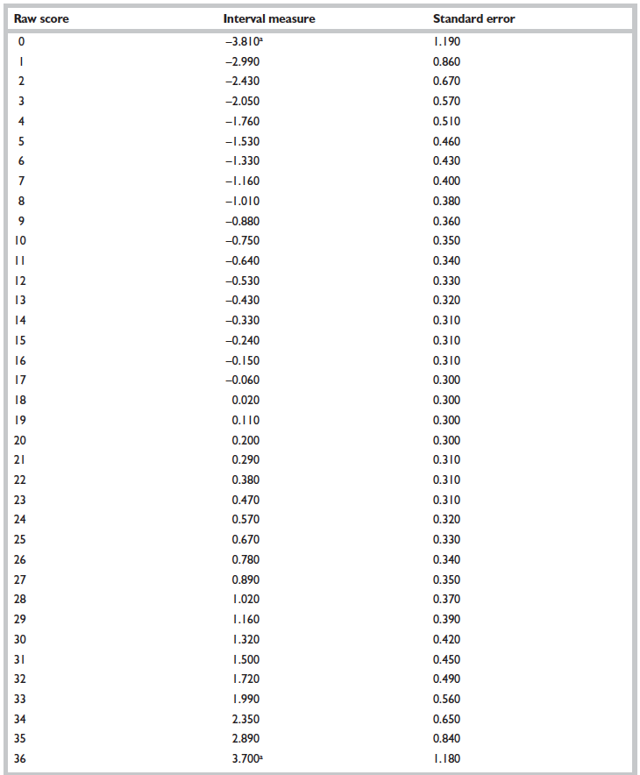
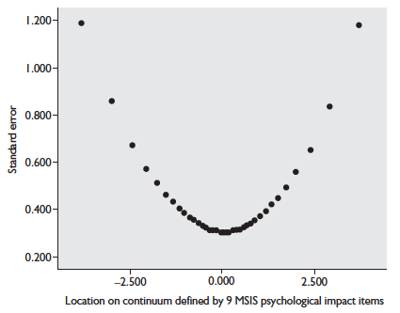
Each possible raw total score converted to linear (interval) measures with known measurement uncertainties (standard errors)
Measurement uncertainty (standard error) is smallest at the middle of the possible score range
Hobart & Cano 2009

Slide 29
Raw scores-to-linear measures

Slide 30
Raw scores-to-linear measures with known uncertainties

Slide 31
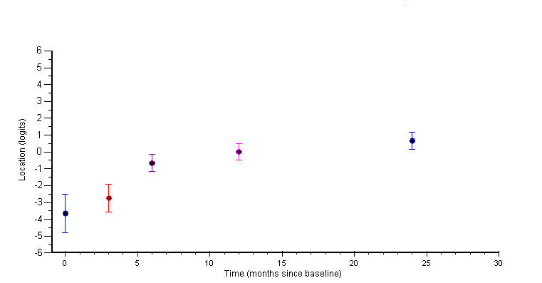
Person-centred measurement: Known measurement uncertainties at the individual person level
1: No change given measurement uncertainty (error)
2: Change beyond measurement uncertainty (error)
2
1

Slide 32
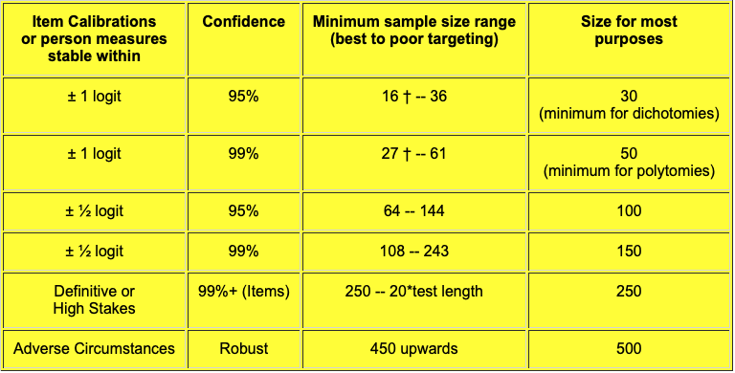
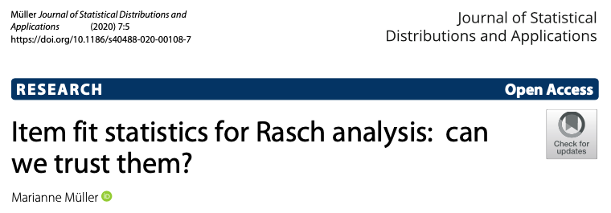
Sample size
Two main aspects
Precision
Stable estimations (locations/measures)
Reasonable measurement uncertainties
More is better…
Number of item parameters x10-15
Goodness of fit
Balanced power
n ~ 250-500
Linacre. RMT 1994
Related to how well person locations match item locations
Context dependent (e.g., prevalence, stage in instrument development)
Small samples provide valuable information
Morel & Cano. Orphanet J Rare Dis 2017; 12(171).
Regnault et al. JPRO 2018; 2(19).

Slide 33
The Rasch model provides a means to test quantitative psychometric measurement properties and to transform qualitative observations into quantitative measures
BUT...
What variable do items represent?

Slide 34
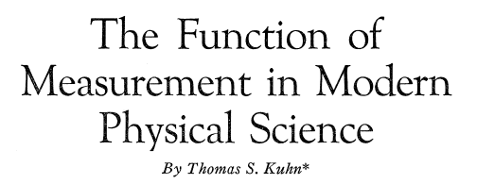
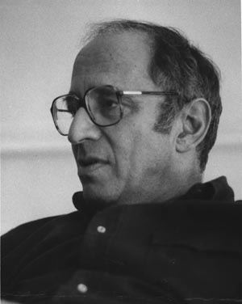
Thomas Kuhn
" ...large amounts of qualitative work have usually been prerequisite to fruitful quantification in the physical sciences."
Kuhn. Isis 1962; 52:161-193.

Slide 35


Thomas Salzberger
(2013)
"The ambitious goals of a Rasch measurement can only be fully met if the substantive theory of the latent variable is sophisticated enough to not only suggest suitable items but also propose at least a theory-driven order of the items"

Slide 36

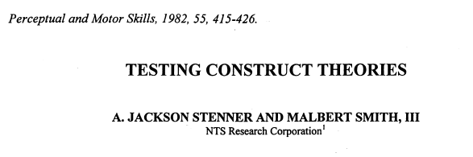
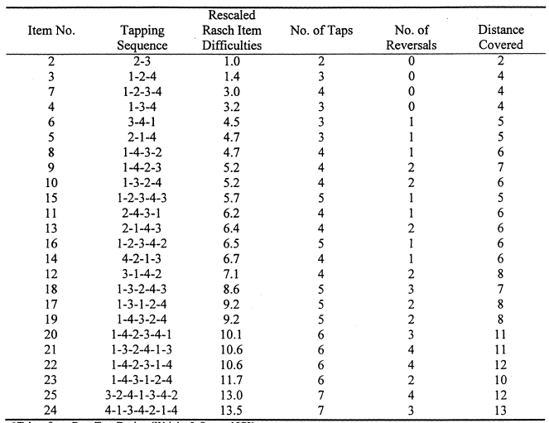
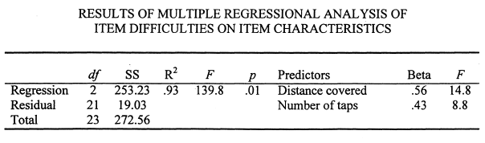
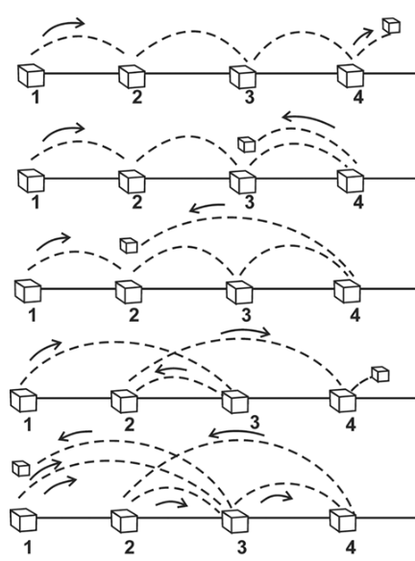
Construct specification equations
Explicit theory and specification regarding which variable-related characteristics that explain item responses, and how these characteristics interact
Knox Cube Test:
→ Construct specification equation:
Difficulty = Distance x #Taps

Slide 37
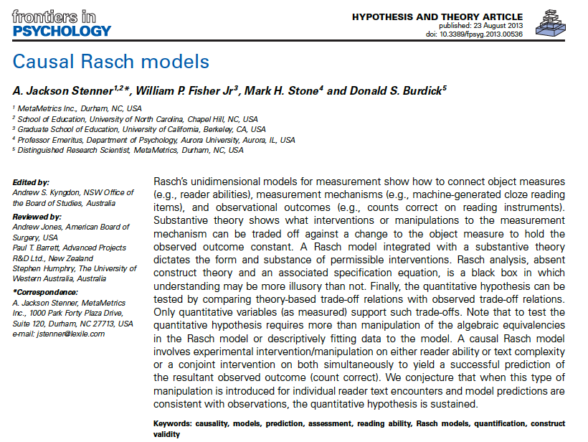
https://doi.org/10.3389/fpsyg.2013.00536

Slide 38
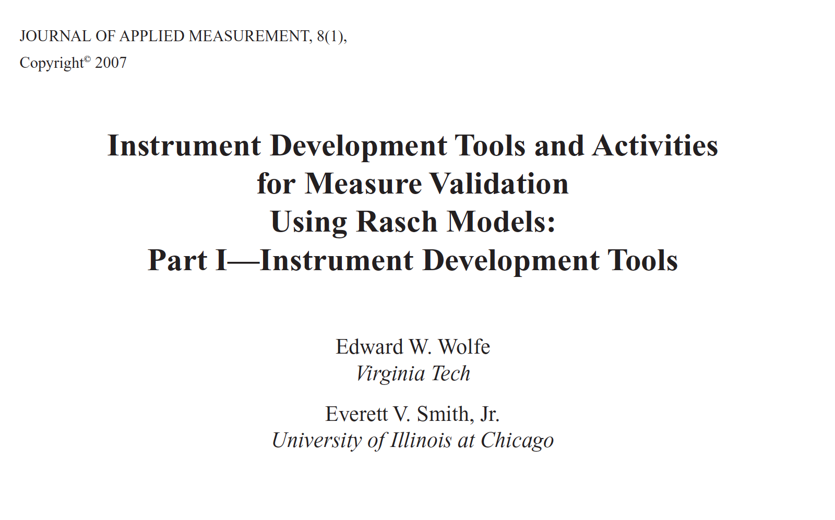
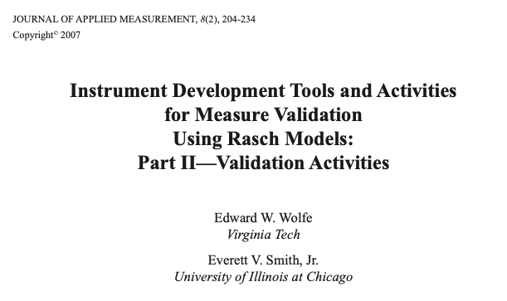
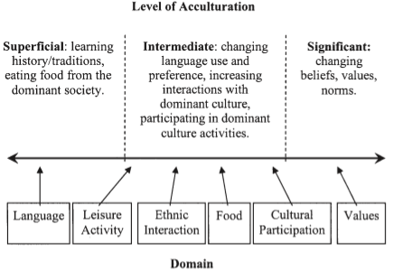
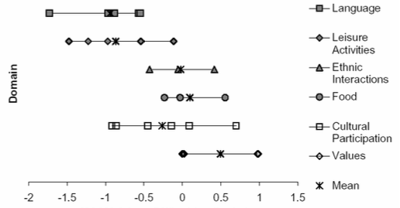
Example: Acculturation to the US culture of Chinese immigrants
Developmental model
Items
Wolfe & Smith. J Appl Meas 2007

Slide 39

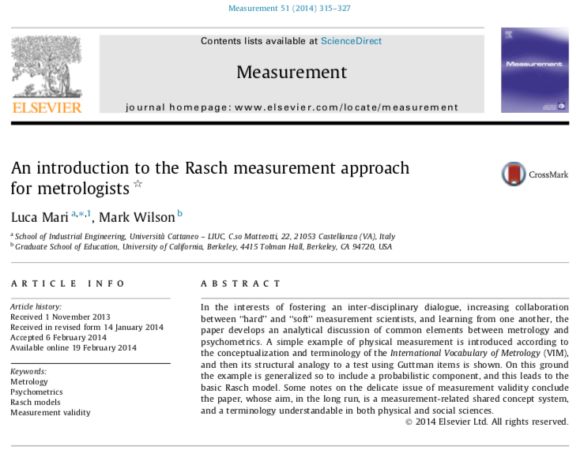
"[RMT] ... is not simply a mathematical or statistical approach, but a specific metrological approach to human-based measurement"
"Rasch models belong to the same class that metrologists consider paradigmatic of measurement"

Slide 40








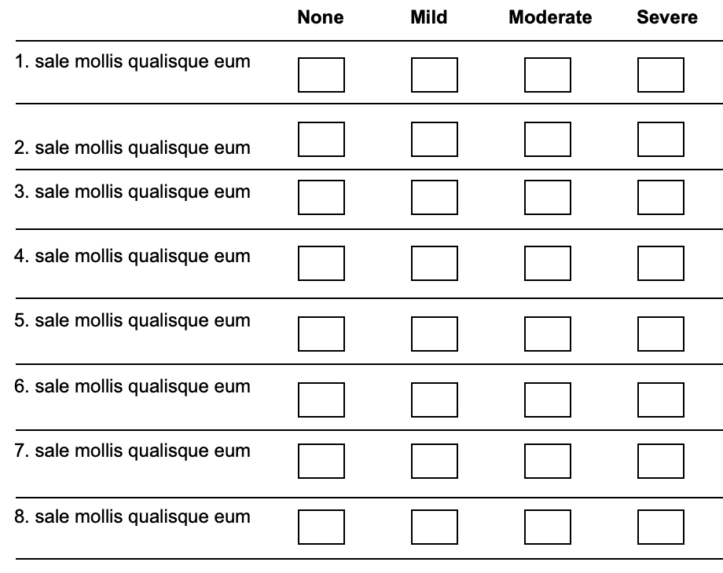
"[RMT] ... is not simply a mathematical or statistical approach, but a specific metrological approach to human-based measurement" (Pendrill 2014)

Slide 41



(2019)
(2021)
(2023)
https://doi.org/10.1007/978-3-031-22448-5
https://doi.org/10.1007/978-3-031-07465-3

Slide 42
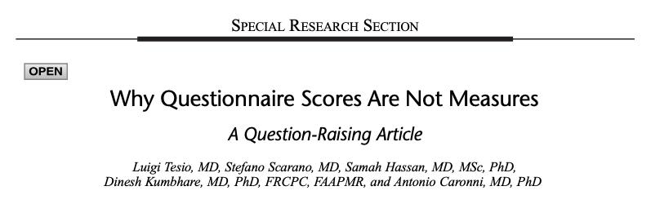
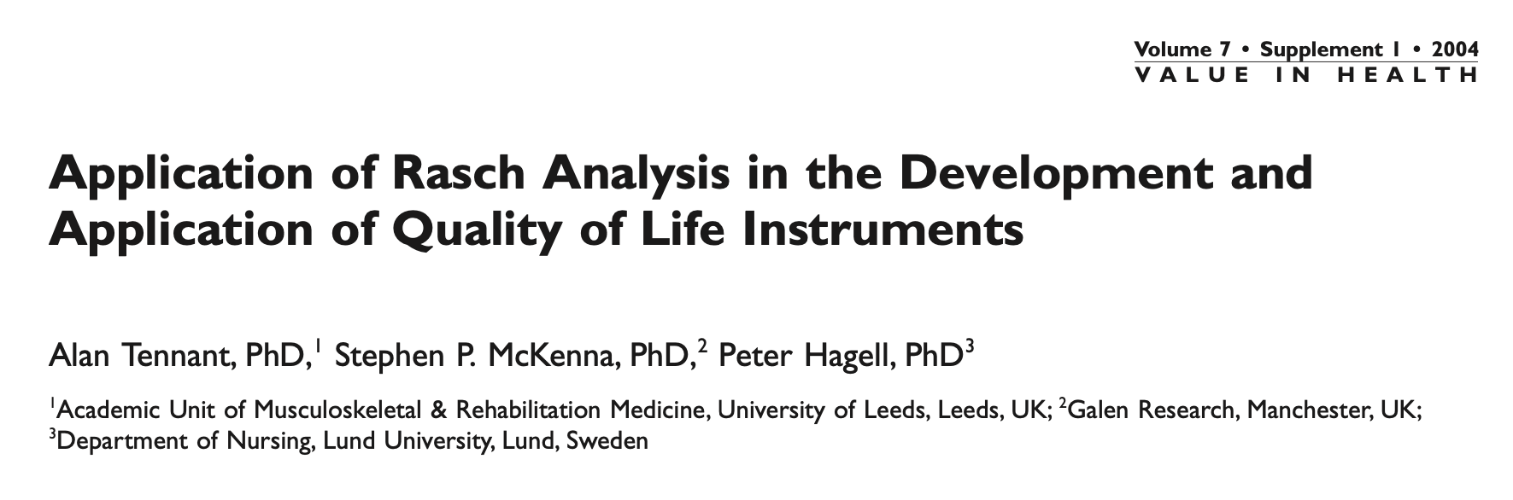
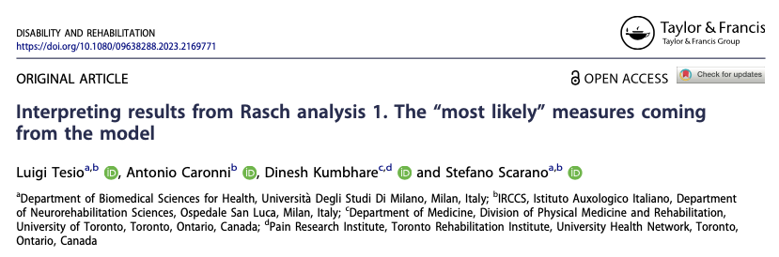
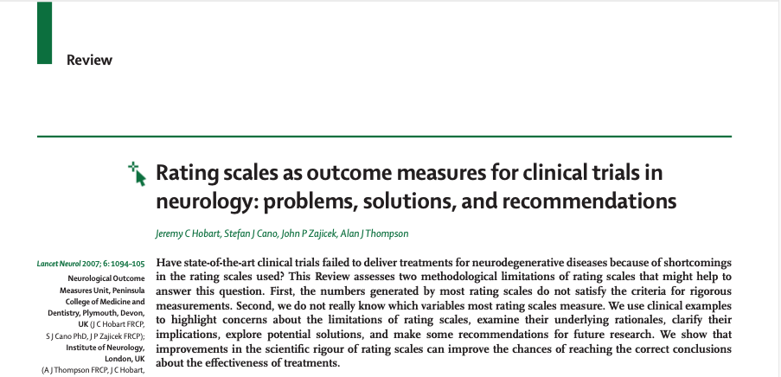
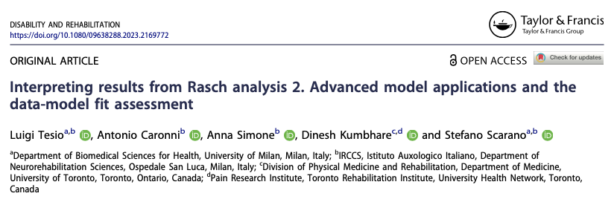
https://doi.org/10.1097/PHM.0000000000002028
https://doi.org/10.1111/j.1524-4733.2004.7s106.x
https://doi.org/10.1080/09638288.2023.2169771
https://www.academia.edu/3504220/Rating_scales_as_outcome_measures_for_clinical_trials_in_neurology_problems_solutions_and_recommendations
https://doi.org/10.1080/09638288.2023.2169772

Slide 43
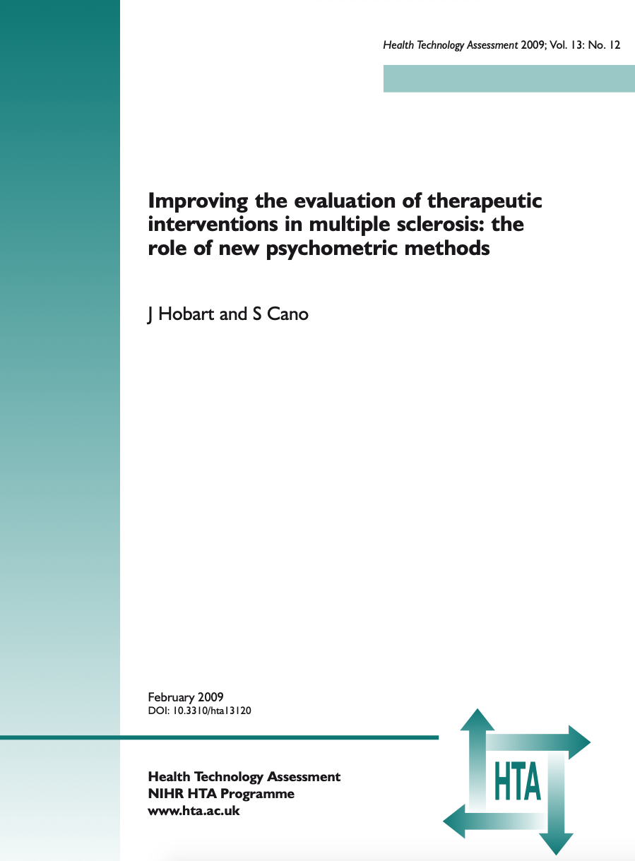
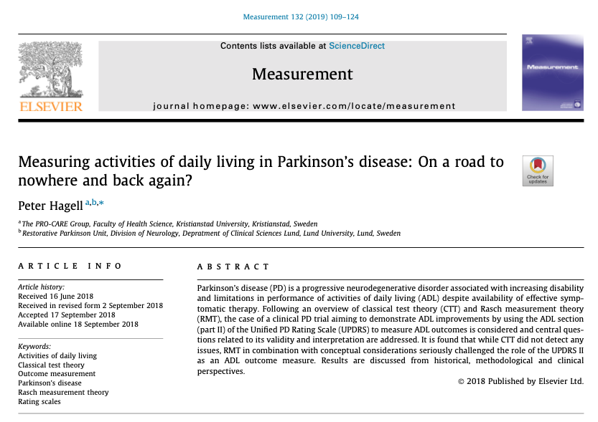
https://doi.org/10.1016/j.measurement.2018.09.050
https://doi.org/10.3310/hta13120

Slide 44

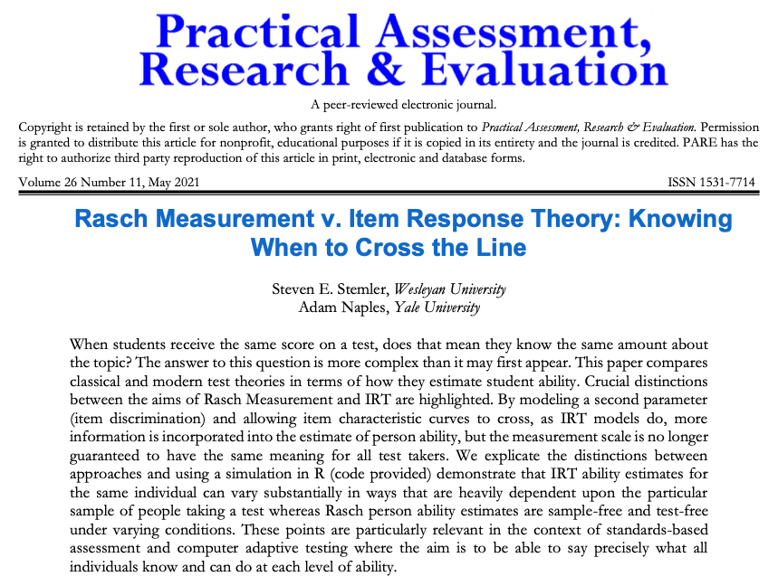
https://doi.org/10.7275/v2gd-4441
https://doi.org/10.3389/fresc.2023.1208670

Slide 45

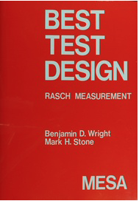
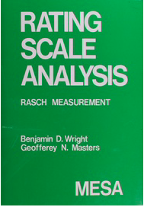
(1979)
www.rasch.org
(1982)

Slide 46
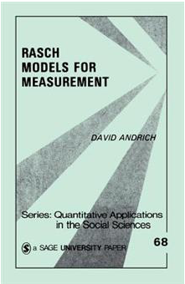
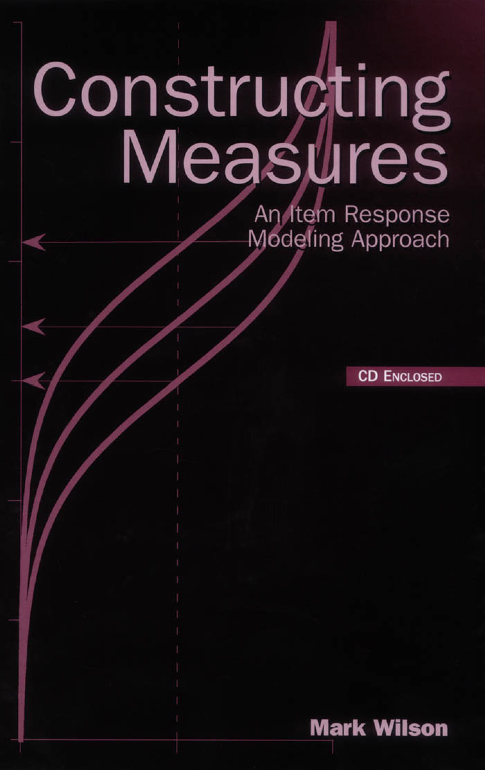


(1988)
(2005)
(2013)
(2019)

Slide 47
References
Fisher WP, Cano SJ (Eds.). Person-centered outcome metrology: Principles and applications for high stakes decision making. Cham: Springer. 2023. Available from: https://doi.org/10.1007/978-3-031-07465-3
Hagell P. Measuring Activities of Daily Living in Parkinson's disease: On a road to nowhere and back again? Measurement 2019; 132: 109-124. Available from: https://doi.org/10.1016/j.measurement.2018.09.050 (https://www.hkr.se/globalassets/transfer/hagell-msrmnt-2019_accepted_ms.pdf)
Hagquist C, Andrich D. Recent advances in analysis of differential item functioning in health research using the Rasch model. Health and Quality of Life Outcomes 2017; 15: 181. Available from: https://doi.org/10.1186/s12955-017-0755-0
Hobart J, Cano S. Improving the evaluation of therapeutic interventions in multiple sclerosis: the role of new psychometric methods. Health Technology Assessment 2009; 13(12). Available from: https://doi.org/10.3310/hta13120
Hobart JC, Cano SJ, Zajicek JP, Thompson AJ. Rating scales as outcome measures for clinical trials in neurology: problems, solutions, and recommendations. Lancet Neurology 2007; 6(12): 1094-1105. Available from: https://www.academia.edu/3504220/Rating_scales_as_outcome_measures_for_clinical_trials_in_neurology_problems_solutions_and_recommendations
Linacre JM. Sample size and item calibration stability. Rasch Measurement Transactions 1994; 7(4): 328. Available from: https://www.rasch.org/rmt/rmt74m.htm

Slide 48
References
Morel T. Cano SJ. Measuring what matters to rare disease patients - reflections on the work by the IRDiRC Taskforce on patient-centered outcome measures. Orphanet Journal of Rare Diseases 2017; 12: 171. Available from: https://doi.org/10.1186/s13023-017-0718-x
Müller M. Item fit statistics for Rasch analysis: can we trust them? Journal of Statistical Distributions and Applications 2020; 7: 5. Available from: https://doi.org/10.1186/s40488-020-00108-7
Pendrill L. Man as a measurement instrument. NCSLI Measure J Meas Sci 2014; 9(4): 24-35. Available from: https://www.researchgate.net/publication/270897373
Stemler SE, Naples A. Rasch measurement v. Item Response Theory: Knowing when to cross the line. Practical Assessment Research & Evaluation 2021; 26: Article 11. Available from: https://doi.org/10.7275/v2gd-4441
Stenner AJ, Smith M. Testing construct theories. Perceptual and Motor Skills 1982; 55(2): 415–426. Available from: https://www.researchgate.net/publication/272907017
Stenner AJ, Smith M, Burdick DS. Toward a theory of construct definition. Journal of Educational Measurement 1983; 20(4): 305-315. Available from: https://cdn.lexile.com/m/resources/materials/Stenner_Smith_Burdick-_Toward_a_theory_of_construct_definition.pdf

Slide 49
References
Stenner AJ, Fisher Jr, WP, Stone MH, Burdick DS. Causal Rasch models. Frontiers in Psychology 2013; 4: 536. Available from: https://doi.org/10.3389/fpsyg.2013.00536
Tennant A, McKenna SP, Hagell P. Application of Rasch analysis in the development and application of quality of life instruments. Value in Health 2004; 7(Suppl 1): S22-26. Available from: https://doi.org/10.1111/j.1524-4733.2004.7s106.x
Tennant A, Küçükdeveci AA. Application of the Rasch measurement model in rehabilitation research and practice: early developments, current practice, and future challenges. Frontiers in Rehabilitation Research 2023; 4:1208670. Available from: https://doi.org/10.3389/fresc.2023.1208670
Tesio L, Caronni A, Hassan S, Kumbhare D, Caronni A. Why Questionnaire Scores Are Not Measures: A Question-Raising Article. American Journal of Physical Medicine & Rehabilitation 2023; 102(1): 75-82. Available from: https://doi.org/10.1097/PHM.0000000000002028
Tesio L, Caronni A, Kumbhare D, Scarano S. Interpreting results from Rasch analysis 1. The “most likely” measures coming from the model. Disability & Rehabilitation 2023. Available from: https://doi.org/10.1080/09638288.2023.2169771

Slide 50
References
Tesio L, Caronni A, Simone A, Kumbhare D, Scarano S. Interpreting results from Rasch analysis 2. Advanced model applications and the data-model fit assessment. Disability & Rehabilitation 2023. Available from: https://doi.org/10.1080/09638288.2023.2169772
Westergren A, Broman JE, Hellström A, Fagerström C, Willman A, Hagell P. Measurement properties of the Minimal Insomnia Symptom Scale as an insomnia screening tool for adults and the elderly. Sleep Medicine 2015; 16(3): 379-384. Available from: https://doi.org/10.1016/j.sleep.2014.10.016
Wright BD, Stone MH. Best test design. Chicago: MESA Press. 1979. Available from: https://www.rasch.org
Wright BD, Masters G. Rating scale analysis. Chicago: MESA Press. 1982. Available from: https://www.rasch.org
Wright BD, Linacre J M. Observations are always ordinal; measurements, however, must be interval. Archives of Physical Medicine & Rehabilitation 1989; 70(12): 857-860. Available from: https://www.rasch.org/memo44.htm

