Slide 1
Rasch Measurement Theory (RMT) (part 1)
Clinical assessment and outcome measurement
Peter Hagell Kristianstad university

Slide 2
Learning Objectives
Understand the basic principles of Rasch measurement theory
Discuss Rasch measurement theory in relation to traditional psychometric methods and metrology

Slide 3
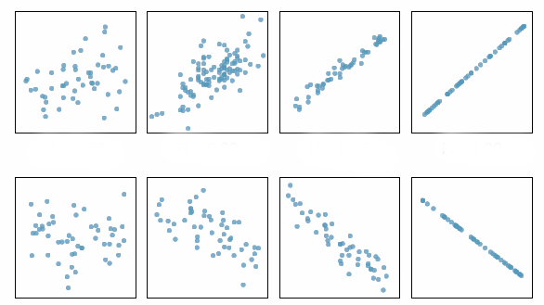
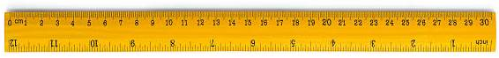
O = T + e
Common CTT methods:
Coefficient alpha
Intra-class correlation
Item-total correlation
Inter-item correlation
External construct validity (multi-trait multi-methods)
Principal component analysis
Factor analysis
Correlations /
Associations
?

Slide 4
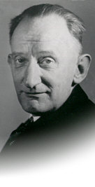
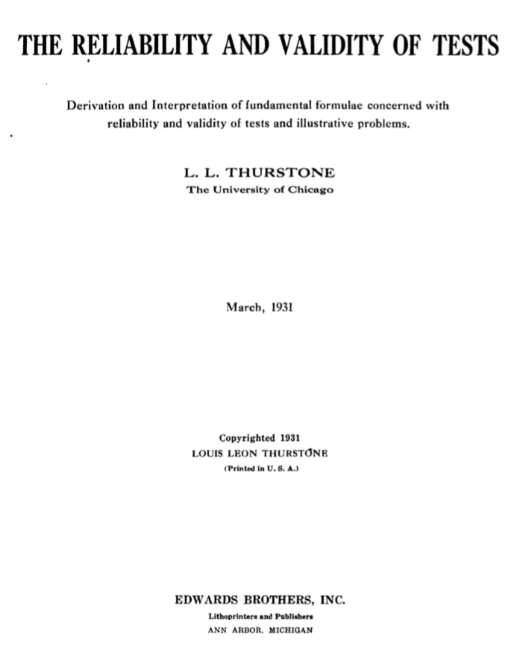
"I do not believe that these correlational methods and particularly the reliability formulae have been responsible for much that can be called fundamental, important, or significant in psychology. On the contrary, the correlational methods have probably stifled scientific imagination as often as they have been of service. As tools in their proper place they are useful but as the central theme of mental measurement they are rather sterile"
?
Thurstone 1931.

Slide 5
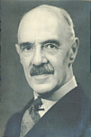
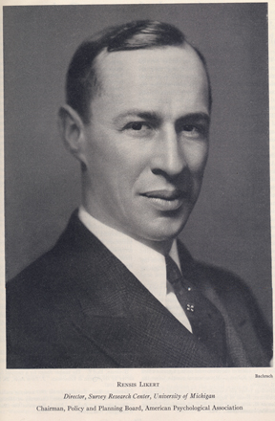
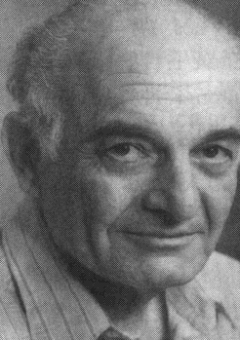
1900s: Spearman
1920s: Thurstone
1930s: Likert
1940s: Guttman
O=T+e
Paired comparisons

Slide 6
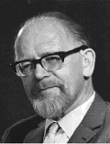
Rasch Measurement Theory
Developed by Danish mathematician Georg Rasch
Georg Rasch (DK)

Slide 7
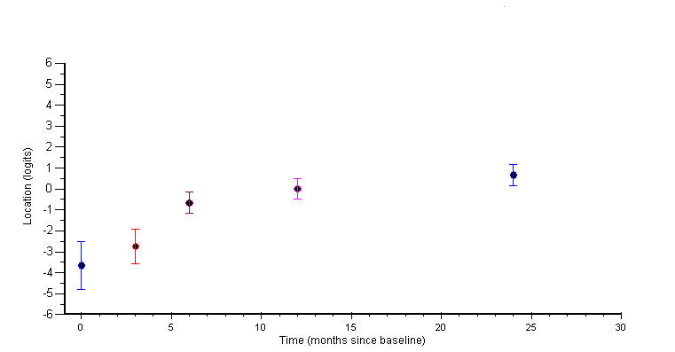
Ordinal raw scores vs. linear measures
Ordinal scores
Data requirements for measurement
Linear measures
(logit)
Individual person monitoring with known measurement uncertainty
Time

Slide 8
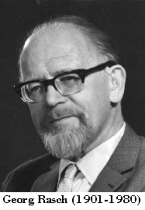
Rasch Measurement Theory
Not correlational
Probabilistic
Based on measurement principles in the physical sciences

Slide 9
Basic logic
”A person having a greater ability than another should have the greater probability of solving any item of the type in question, and similarly, one item being more difficult than another one means that for any person the probability of solving the second item correctly is the greater one”
Rasch, 1960
Probabilistic models for some intelligence and attainment tests. (p. 117)
Danish Institute for Educational Research, Copenhagen, Denmark, 1960.

Slide 10

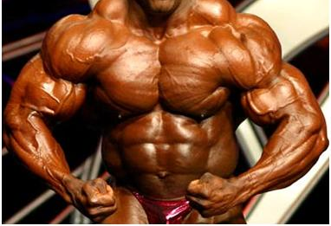


Slide 11
Rasch Measurement Theory
Item (i)
Person (n)
P_{x}
”Ability” (β_{n})
X
”Difficulty” (δ_{i})
X → P_{x} = f(β, δ) → β and δ are estimated

Slide 12
The Rasch model
Probability:
P
Odds:
Log odds:
MODEL:
e = base of the natural
logarithm (~2.7183...)

Slide 13
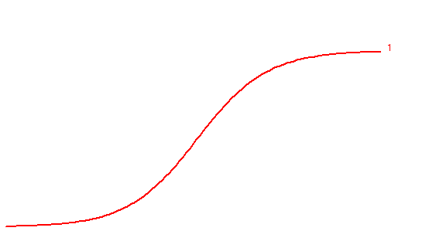
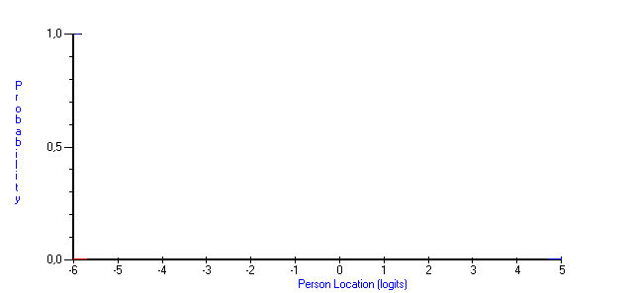
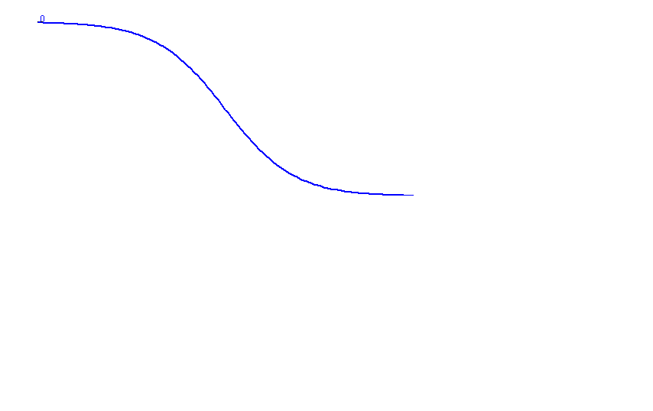
Location (logits)
δ
(-0.485)
(β<δ)
(β=δ)
(β>δ)

Slide 14
Item Characteristic Curves (ICC)

Slide 15
The logit (log-odds unit) scale
Logarithmic scale
Linear at the interval level
Persons and items are located (measured) independently of each other on the same scale, with known measurement uncertainties
Mean item location is set to 0

Slide 16
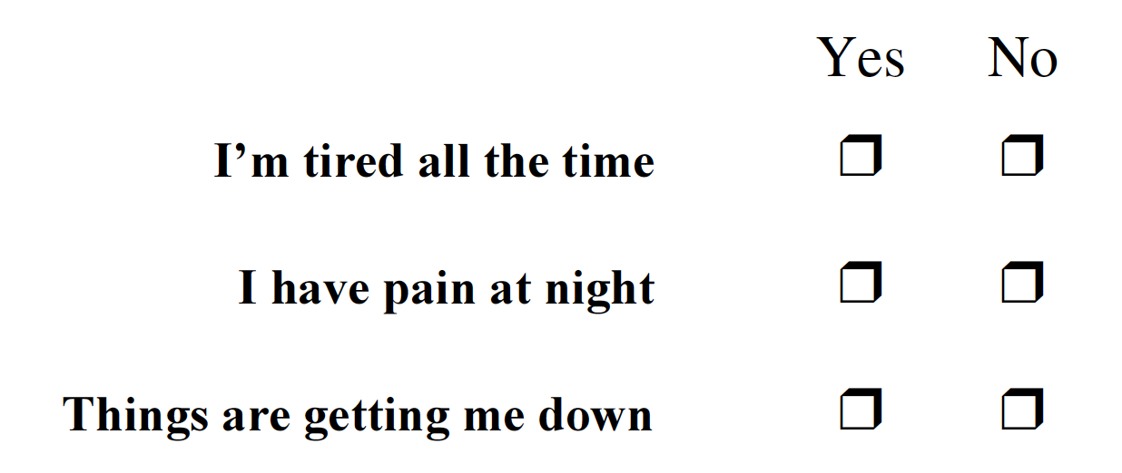
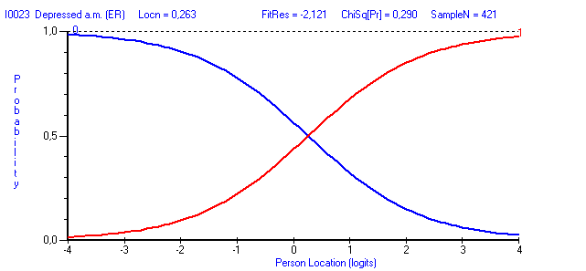
Dichotomous responses
50% 50%
Threshold (P=0.5)
= Item location

Slide 17
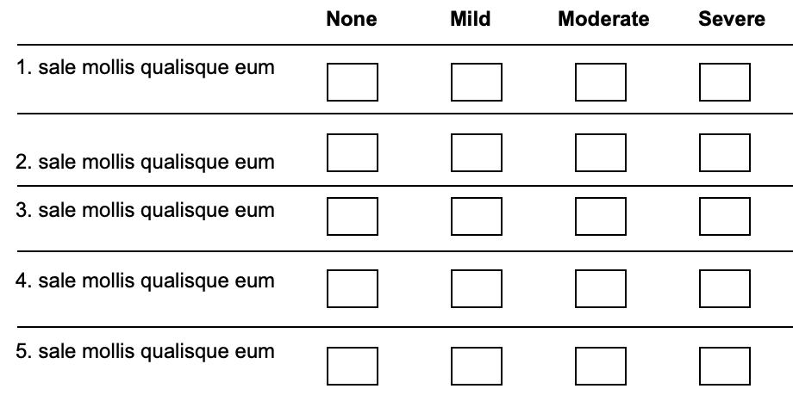
Polytomous responses
50/50
50/50
50/50
Thresholds (m-1)
Assumes ordered categories – from less to more
Empirical test of wheather response categories work as expected

Slide 18
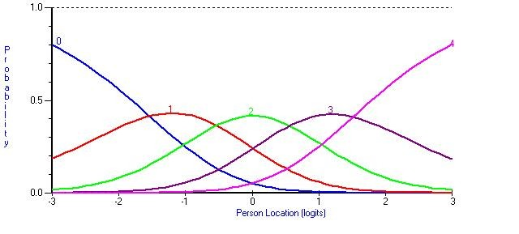
Category Probability Curves
50/50
50/50
50/50
50/50
Thresholds (k-1)

Slide 19
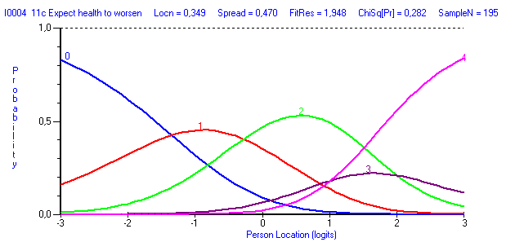
General Health scale (SF-36)
in Parkinson’s disease
3/4
2/3
0 = Definitely true
1 = Mostly true
2 = Don’t know
3 = Mostly false
4 = Definitely false

Slide 20
The Rasch model
Specific objectivity
Parameter separation
Sufficient statistics
[ Measurement uncertainty (SE) ]

Slide 21
Specific objectivity
"Comparisons between individuals become independent of which particular instruments - tests or items or other stimuli - have been used. Symmetrically, it ought to be possible to compare stimuli belonging to the same class - measuring the same thing - independent of which particular individuals, within a class considered, were instrumental for comparison."

Slide 22
Parameter separation: Items locations are independent of person locations - and vice versa
Persons Items
Persons Items
Persons Items
(More)
x
x
xx
xx
xxx
xxxx
xxxxx
xxxxxx
xxxxx
xxxxxx
xxxxx
xxxx
x
xx
xxxx
xxxxx
xxxxxx
xxxxx
xxxxxxxx
xxxxxxxx
xxxxx
xxxxxx
xxxxx
xxx
xx
x
xxxx
xxxxx
xxxxxx
xxxxxxx
xxxxxxxxxx
xxxxxxxxxx
xxxxx
xxxxxx
xxx
xxx
x
x
x
x
A
C H
D
L
F B K
I J
E
G
M
A
C H
D
L
F B K
I J
E
G
M
A
C H
D
L
F B K
I J
E
G
M
(Less)

Slide 23
Parameter separation
i1 i2 i3 ....... Σ
n1 0 0 ?
n2 0 1 ?
n3 1 1 ?
n4 0 0 ?
n5 0 1 ?
Σ 1 3
How much does person A differ from person B?
Item 1:
Total score % (P): 1/5 = 0.2
Odds: P/1-P = 0.2/0.8 = 0.25
ln(0.25) = -1.37 = 𝛅₁
Item 2:
Total score % (P): 3/5 = 0.6
Odds: P/1-P = 0.6/0.4 = 1.5
ln(1.5) = 0.4 = 𝛅₂
How much does item 1 differ from item 2?

Slide 24
Data requirements for measurement

Slide 25
Model fit Are data compatible with model requirements?
Unidimensionality
Do items represent a common variable?
Local independence
Are item responses independent of each other?
Invariance
Do items work the same way under different circumstances?

Slide 26
Model fit
Difference between observed data and the model
i
n
P_{ni}
β_{n}
X_{ni}
δ_{i}
P_{ni} = Expected value (response)
Residual = X_{ni} – P_{ni} → Goodness-of-Fit
Graphical
Residuals
Statistical (chi-2, ANOVA, etc.)

Slide 27
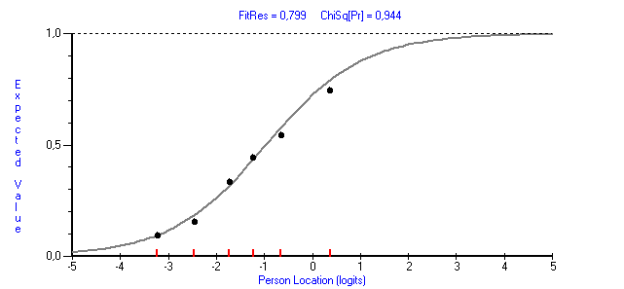
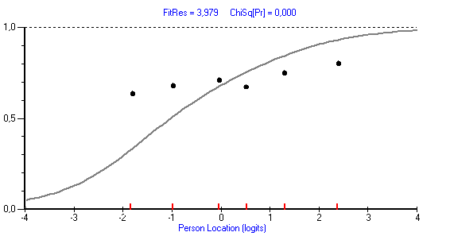
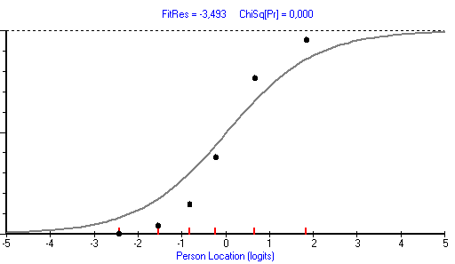
Model fit
Residual close to 0
Good model fit
Large positive residual
Large negative residual
Potential
multidimensionality
Potential
Local dependency

Slide 28
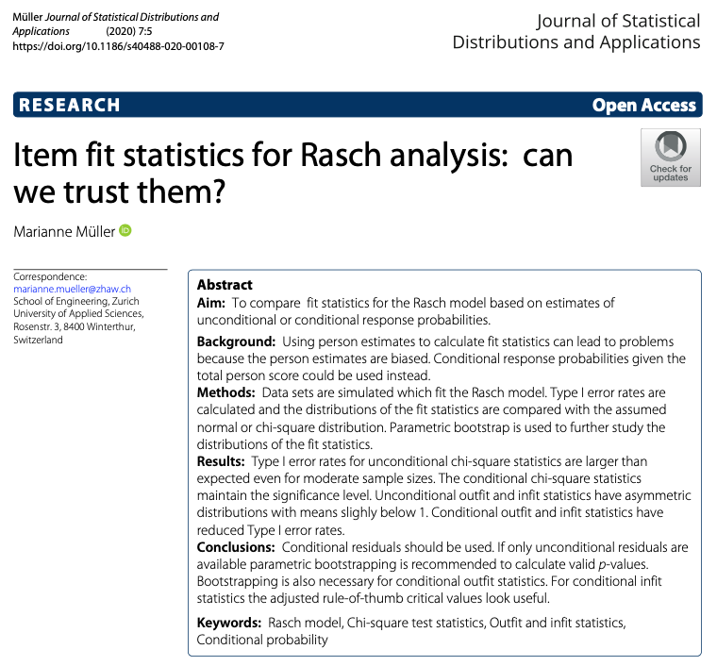
Rules of thumb (residuals): -2.5 to +2.5
Chi-square
Sensitive for sample size
Approximate chi-2 distribution – interpret with caution
Recommended sample size r/t Type I error rate: 200-500

Slide 29
Goodness-of-fit
Interpret Chi-square values as a relative ”order statistic”

Slide 30
Goodness-of-fit: Outfit & Infit
Outfit:
Outlier-sensitive (unweighted) fit statistic
Mean square (MNSQ): Mean of standardized residuals
Standardized (ZSTD): Standardized MNSQ to a normal distribution (approximate t or Z)
Infit:
Information-weighted fit statistic
Mean square (MNSQ): Mean of standardized residuals weighted by their variances
Standardized (ZSTD): Standardized MNSQ to a normal distribution (approximate t or Z)
Outfit often recommended over Infit
MNSQ: Various recommendations, e.g., 0.7-1.3, 0.8-1.2
Sample size adjusted critical values for Outfit: 1±6/√n; Infit: 1±2/√n
ZSTD: ±2, ±2.5
Sensitive for sample size
Recommended sample size r/t Type I error rate: 200-500
Müller. J Stat Distrib Appl 2020; 7(5).

Slide 31
References
Fisher WP, Cano SJ (Eds.). Person-centered outcome metrology: Principles and applications for high stakes decision making. Cham: Springer. 2023. Available from: https://doi.org/10.1007/978-3-031-07465-3
Hagell P. Measuring Activities of Daily Living in Parkinson's disease: On a road to nowhere and back again? Measurement 2019; 132: 109-124. Available from: https://doi.org/10.1016/j.measurement.2018.09.050 (https://www.hkr.se/globalassets/transfer/hagell-msrmnt-2019_accepted_ms.pdf)
Hagquist C, Andrich D. Recent advances in analysis of differential item functioning in health research using the Rasch model. Health and Quality of Life Outcomes 2017; 15: 181. Available from: https://doi.org/10.1186/s12955-017-0755-0
Hobart J, Cano S. Improving the evaluation of therapeutic interventions in multiple sclerosis: the role of new psychometric methods. Health Technology Assessment 2009; 13(12). Available from: https://doi.org/10.3310/hta13120
Hobart JC, Cano SJ, Zajicek JP, Thompson AJ. Rating scales as outcome measures for clinical trials in neurology: problems, solutions, and recommendations. Lancet Neurology 2007; 6(12): 1094-1105. Available from: https://www.academia.edu/3504220/Rating_scales_as_outcome_measures_for_clinical_trials_in_neurology_problems_solutions_and_recommendations
Linacre JM. Sample size and item calibration stability. Rasch Measurement Transactions 1994; 7(4): 328. Available from: https://www.rasch.org/rmt/rmt74m.htm

Slide 32
References
Morel T. Cano SJ. Measuring what matters to rare disease patients - reflections on the work by the IRDiRC Taskforce on patient-centered outcome measures. Orphanet Journal of Rare Diseases 2017; 12: 171. Available from: https://doi.org/10.1186/s13023-017-0718-x
Müller M. Item fit statistics for Rasch analysis: can we trust them? Journal of Statistical Distributions and Applications 2020; 7: 5. Available from: https://doi.org/10.1186/s40488-020-00108-7
Pendrill L. Man as a measurement instrument. NCSLI Measure J Meas Sci 2014; 9(4): 24-35. Available from: https://www.researchgate.net/publication/270897373
Stemler SE, Naples A. Rasch measurement v. Item Response Theory: Knowing when to cross the line. Practical Assessment Research & Evaluation 2021; 26: Article 11. Available from: https://doi.org/10.7275/v2gd-4441
Stenner AJ, Smith M. Testing construct theories. Perceptual and Motor Skills 1982; 55(2): 415–426. Available from: https://www.researchgate.net/publication/272907017
Stenner AJ, Smith M, Burdick DS. Toward a theory of construct definition. Journal of Educational Measurement 1983; 20(4): 305-315. Available from: https://cdn.lexile.com/m/resources/materials/Stenner_Smith_Burdick-_Toward_a_theory_of_construct_definition.pdf

Slide 33
References
Stenner AJ, Fisher Jr, WP, Stone MH, Burdick DS. Causal Rasch models. Frontiers in Psychology 2013; 4: 536. Available from: https://doi.org/10.3389/fpsyg.2013.00536
Tennant A, McKenna SP, Hagell P. Application of Rasch analysis in the development and application of quality of life instruments. Value in Health 2004; 7(Suppl 1): S22-26. Available from: https://doi.org/10.1111/j.1524-4733.2004.7s106.x
Tennant A, Küçükdeveci AA. Application of the Rasch measurement model in rehabilitation research and practice: early developments, current practice, and future challenges. Frontiers in Rehabilitation Research 2023; 4:1208670. Available from: https://doi.org/10.3389/fresc.2023.1208670
Tesio L, Caronni A, Hassan S, Kumbhare D, Caronni A. Why Questionnaire Scores Are Not Measures: A Question-Raising Article. American Journal of Physical Medicine & Rehabilitation 2023; 102(1): 75-82. Available from: https://doi.org/10.1097/PHM.0000000000002028
Tesio L, Caronni A, Kumbhare D, Scarano S. Interpreting results from Rasch analysis 1. The “most likely” measures coming from the model. Disability & Rehabilitation 2023. Available from: https://doi.org/10.1080/09638288.2023.2169771

Slide 34
References
Tesio L, Caronni A, Simone A, Kumbhare D, Scarano S. Interpreting results from Rasch analysis 2. Advanced model applications and the data-model fit assessment. Disability & Rehabilitation 2023. Available from: https://doi.org/10.1080/09638288.2023.2169772
Westergren A, Broman JE, Hellström A, Fagerström C, Willman A, Hagell P. Measurement properties of the Minimal Insomnia Symptom Scale as an insomnia screening tool for adults and the elderly. Sleep Medicine 2015; 16(3): 379-384. Available from: https://doi.org/10.1016/j.sleep.2014.10.016
Wright BD, Stone MH. Best test design. Chicago: MESA Press. 1979. Available from: https://www.rasch.org
Wright BD, Masters G. Rating scale analysis. Chicago: MESA Press. 1982. Available from: https://www.rasch.org
Wright BD, Linacre J M. Observations are always ordinal; measurements, however, must be interval. Archives of Physical Medicine & Rehabilitation 1989; 70(12): 857-860. Available from: https://www.rasch.org/memo44.htm

