Slide 1
Neurobiology of neurodegenerative diseases (NDDs)
„Neurobiological background of Alzheimer‘s dementia related to microbiota“
Neurology and medical care of neurodegenerative disorders
Gorazd Drevenšek
University of Ljubljana

Slide 2
Learning Objectives
Learning objective 1
Students will be able to distinguish between the metabolism of normal aging person and to person with neurodegenerative disorders
Learning objective 2
Students will be able to understand the neurobiology and pathology of NDDs and apply them to the clinical setting
Learning objective 3
Students will be able to describe the pathophysiology of neurodegenerative disorders, discuss the mental health and lifestyle modifications in NDD

Slide 3
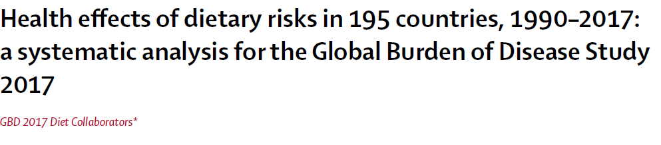

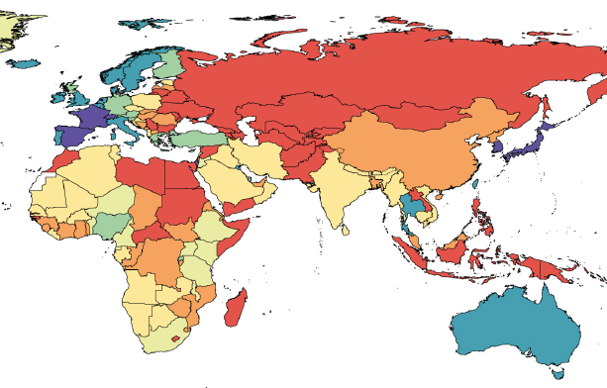
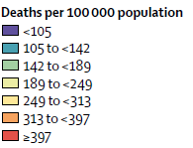
→Keyword: DYSBIOSIS
Background 1

Slide 4
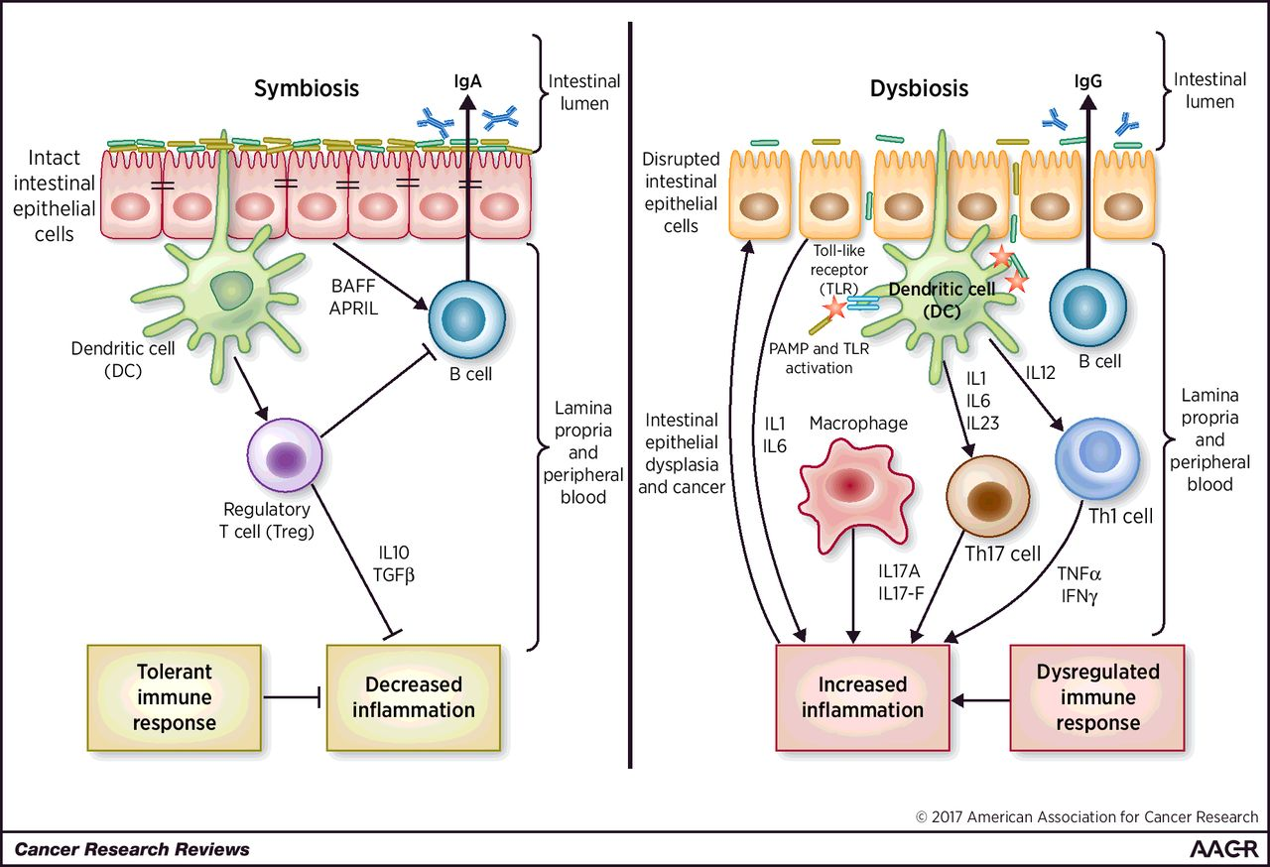

Dysbiosis: Altered immunological status due to pathogen colonization, resulting in excessive inflammation, dysplasia and tumorigenesis
Background 2
Sunil Thomas et al. Cancer Res 2017;77:1783-1812
©2017 by American Association for Cancer Research
Notes:
Dysbiosis: an immunocompromised state characterized by pathobiont colonization that leads to hyperinflammation, dysplasia, and tumorigenesis. Symbiosis (left): a symbiotic gut microbiota operates under a functional intestinal epithelial cell barrier, with steady-state proportions of mucus, pattern recognition receptors, antimicrobial peptides, and secretory IgA, which in turn contain the microbiota in the intestinal lumen. Under tight control by intestinal epithelial cells, the intestinal immune system within the gut lamina propria becomes largely tolerant to the resident commensals. Signaling cascades that occur downstream of TLRs are used by intestinal epithelial cells to detect microbes through pattern recognition receptors. Upon LPS stimulation of TLRs, the MYD88 protein is recruited, activating the NF-κB pathway, leading to production of antimicrobial proteins and proinflammatory cytokines. In a symbiotic gut, intestinal epithelial cells are desensitized by repeated exposure to LPS or are attenuated by LPS-mediated downregulation of the IL1 receptor–associated kinase 1 (IRAK1), an activator of the NF-κB cascade. Exposure to LPS induces epithelial cells to secrete TGFβ, B-cell–activating factor of the TNF family (BAFF), and a proliferation-inducing ligand (APRIL), all of which promote the development of tolerogenic responses to the microbiota. CD103⁺ DCs support the development of Tregs to secrete IL10 and TGFβ, and together, they stimulate the production of commensal-specific IgA. Dysbiosis (right): increased intestinal exposure of diverse PAMPs, proinflammatory cytokines, apoptotic debris, and toxins leads to microbial dysbiosis and overgrowth of “pathobionts,” transformed symbiotic bacteria now under pathologic conditions. Pathobiont overgrowth leads to the loss of barrier integrity and a breach in the intestinal epithelial cell barrier. Translocation of bacteria and bacterial components triggers the intestinal immune system through TLR activation, resulting in potentially harmful effector T-cell responses set to clear invading bacteria. Ultimately, the secretion of IL1 and IL6 from intestinal epithelial cells fuels a Th1 and Th17 response by DCs and macrophages and leads to higher levels of commensal-specific IgG by B cells.

Slide 5
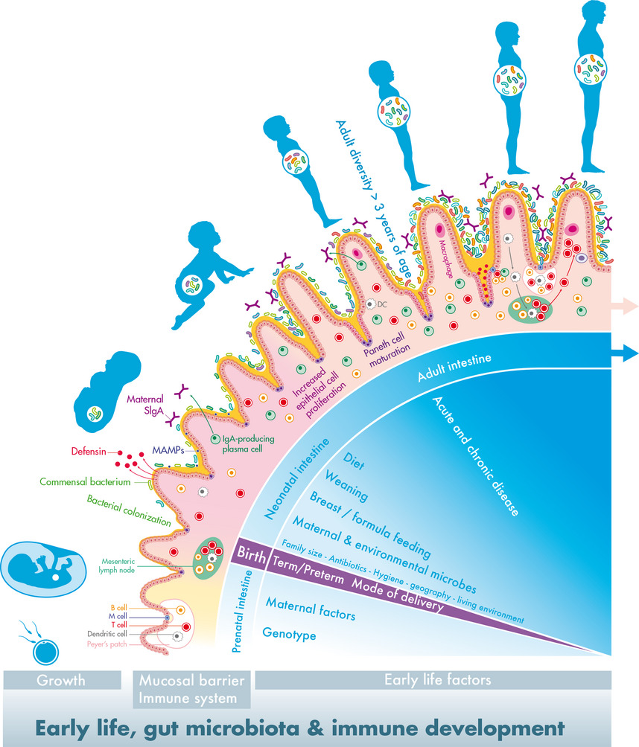
Microbiota development in ontogenesis
The first 1000 days – intestinal microbiology of early life: establishing a symbiosis → primary (personalised) microbiota
Background 3
Pediatric Allergy Immunology, Volume: 25, Issue: 5, Pages: 428-438, First published: 05 June 2014
Notes:
Early life, gut microbiota and immune development – establishing a symbiosis. The establishment of the intestinal host–microbiota symbiosis is driven by both developmental and environmental signals especially in early life, profoundly influencing health throughout life. The prenatal intestine is thought to be sterile, and development depends most importantly on genotype as well as on maternal factors, including nutrition and health status. The cryptopatches and lymphoid tissues (mesenteric lymph nodes and Peyer's patches) with dendritic, T and B cells develop in preparation of the exposure to the extrauterine world. During birth, infants are inoculated with maternal and environmental microbes, and the type and patterns strongly depend on birth mode and gestational age. The gut microbial development in the neonatal period is influenced by several early‐life factors and especially diet (type, composition and timing) drives the further diversification towards an adult complexity, which is reached around 3 years of age. This postnatal colonization process provides several signals, known as microbe‐associated molecular patterns (MAMPs), affecting the maturation of the immune system and the mucosal barrier, accompanied with increased mucus secretion. These signals also result in the proliferation of intestinal epithelial cells in crypts and the cryptlocated Paneth cells, resulting in their increased depth and the production of antimicrobial peptides (defensins), respectively. Specialized epithelial cells (M cells) reside above Peyer's patches and facilitate direct interaction of the luminal content with the underlying lymphoid cells to stimulate mucosal immunity. SIgA is the most abundant immunoglobulin on mucosal surfaces, and maternal SIgA is provided by human milk during the early postnatal period along with the initiation of the infants own SIgA.
IF THIS IMAGE HAS BEEN PROVIDED BY OR IS OWNED BY A THIRD PARTY, AS INDICATED IN THE CAPTION LINE, THEN FURTHER PERMISSION MAY BE NEEDED BEFORE ANY FURTHER USE. PLEASE CONTACT WILEY'S PERMISSIONS DEPARTMENT ON PERMISSIONS@WILEY.COM OR USE THE RIGHTSLINK SERVICE BY CLICKING ON THE 'REQUEST PERMISSIONS' LINK ACCOMPANYING THIS ARTICLE. WILEY OR AUTHOR OWNED IMAGES MAY BE USED FOR NON-COMMERCIAL PURPOSES, SUBJECT TO PROPER CITATION OF THE ARTICLE, AUTHOR, AND PUBLISHER.

Slide 6
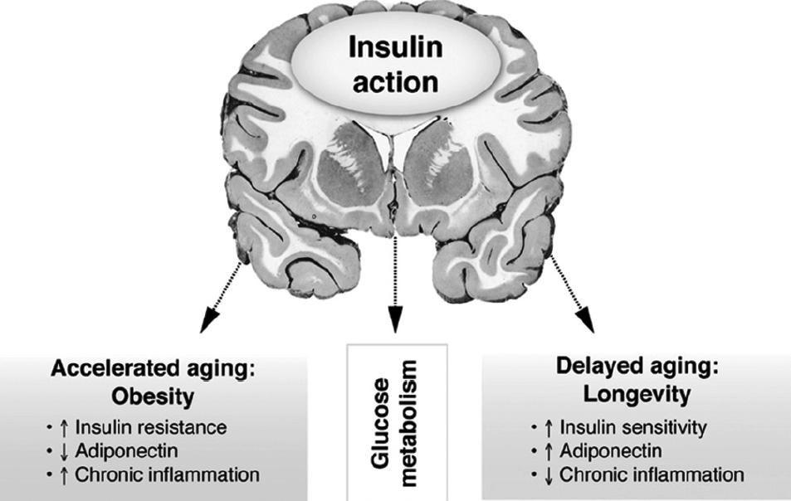
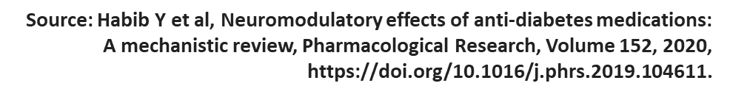
AD and brain glucose
→ „type 3“ diabetes
Metabolic syndrome and AD Aβ/tau pathology may act in a feed-forward mechanism to accelerate AD pathology in the presence of insulin resistence.
80% of people with Alzheimer’s disease have insulin resistance or full-developed type 2 diabetes
AD could be regarded as a brain disorder that has composite features of Type 1 (insulin deficiency) and Type 2 (insulin resistance) diabetes. To consolidate this concept Rivera et al., 2005, Steen et al., 2005 proposed that AD be referred to as, “Type 3 diabetes”.
Key features of “type 3 diabetes ”: brain insulin and IGF resistance and deficiency
Kim B, Feldman EL. Insulin resistance as a key link for the increased risk of cognitive impairment in the metabolic syndrome. Exp Mol Med. 2015. doi: 10.1038/emm
Notes:
Over decades, the dominant hypothesis was that neurodegeneration is caused by one or two of the specific lesions that characterize AD, e.g. AβPP-Aβ accumulation, pTau aggregation, or neuro-inflammation. However, a stream of human and experimental studies has provided convincing evidence that AD is a metabolic disease whereby the brain loses its capacity to efficiently utilize glucose for energy production and respond to critical trophic factor signals due to insulin as well as insulin-like growth factor (IGF) resistance (Baker et al., 2010, Craft, 2007, Hoyer, 2002, Hoyer, 2004b, Krikorian et al., 2010, Luchsinger, 2010, Neumann et al., 2008, Rivera et al., 2005, Schubert et al., 2004, Steen et al., 2005, Talbot et al., 2012, Watson and Craft, 2006). The molecular and biochemical consequences of insulin and IGF resistance in the brain are similar to those in other organs and tissues; however, in brain, insulin signaling impairments compromise neuronal survival, energy production, gene expression, plasticity and white matter integrity (de la Monte, 2011, de la Monte et al., 2009a)
FIGURE: n summary, peripheral MetS induces central IR in the brain. The resulting impaired insulin signaling, which mainly impacts the PI3K/Akt pathway, then increases APP processing/Aβ levels and tau phosphorylation. Finally, increased Aβ further disrupts insulin signaling to exacerbate AD pathology and cognitive decline

Slide 7
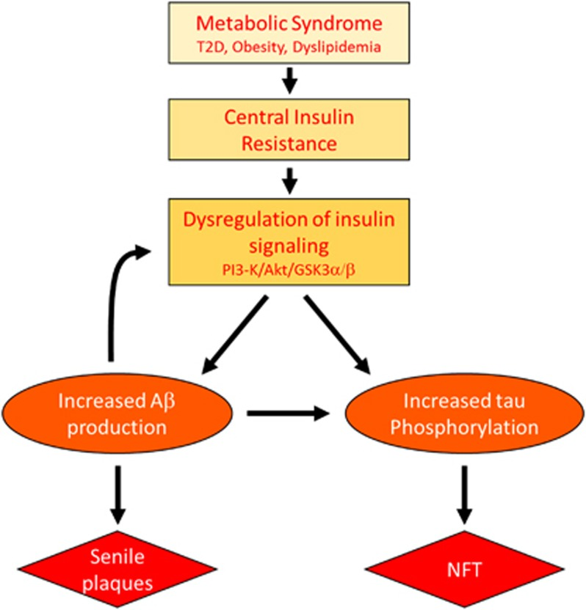
Alzheimer׳s disease (AD) and brain glucose starvation
(The concept of type 3 diabetes – 2)
T2D = Type 2 Diabetes
PI3 = phosphatidylinositol 3 kinase
Akt = serine/threonine kinase
Aβ = amyloid beta
GSK3α/β = Glycogen synthase kinase 3α/β (GSK3α/β), a serine/threonine kinase that plays a critical role in cancer.
NFT =neurofibrillary tangles
Metabolic syndrome and AD Aβ/tau pathology may act in a feed-forward mechanism to accelerate AD pathology in the presence of insulin resistence.
Kim B, Feldman EL. Insulin resistance as a key link for the increased risk of cognitive impairment in the metabolic syndrome. Exp Mol Med. 2015. doi: 10.1038/emm
Notes:
Over decades, the dominant hypothesis was that neurodegeneration is caused by one or two of the specific lesions that characterize AD, e.g. AβPP-Aβ accumulation, pTau aggregation, or neuro-inflammation. However, a stream of human and experimental studies has provided convincing evidence that AD is a metabolic disease whereby the brain loses its capacity to efficiently utilize glucose for energy production and respond to critical trophic factor signals due to insulin as well as insulin-like growth factor (IGF) resistance (Baker et al., 2010, Craft, 2007, Hoyer, 2002, Hoyer, 2004b, Krikorian et al., 2010, Luchsinger, 2010, Neumann et al., 2008, Rivera et al., 2005, Schubert et al., 2004, Steen et al., 2005, Talbot et al., 2012, Watson and Craft, 2006). The molecular and biochemical consequences of insulin and IGF resistance in the brain are similar to those in other organs and tissues; however, in brain, insulin signaling impairments compromise neuronal survival, energy production, gene expression, plasticity and white matter integrity (de la Monte, 2011, de la Monte et al., 2009a)
FIGURE: n summary, peripheral MetS induces central IR in the brain. The resulting impaired insulin signaling, which mainly impacts the PI3K/Akt pathway, then increases APP processing/Aβ levels and tau phosphorylation. Finally, increased Aβ further disrupts insulin signaling to exacerbate AD pathology and cognitive decline

Slide 8
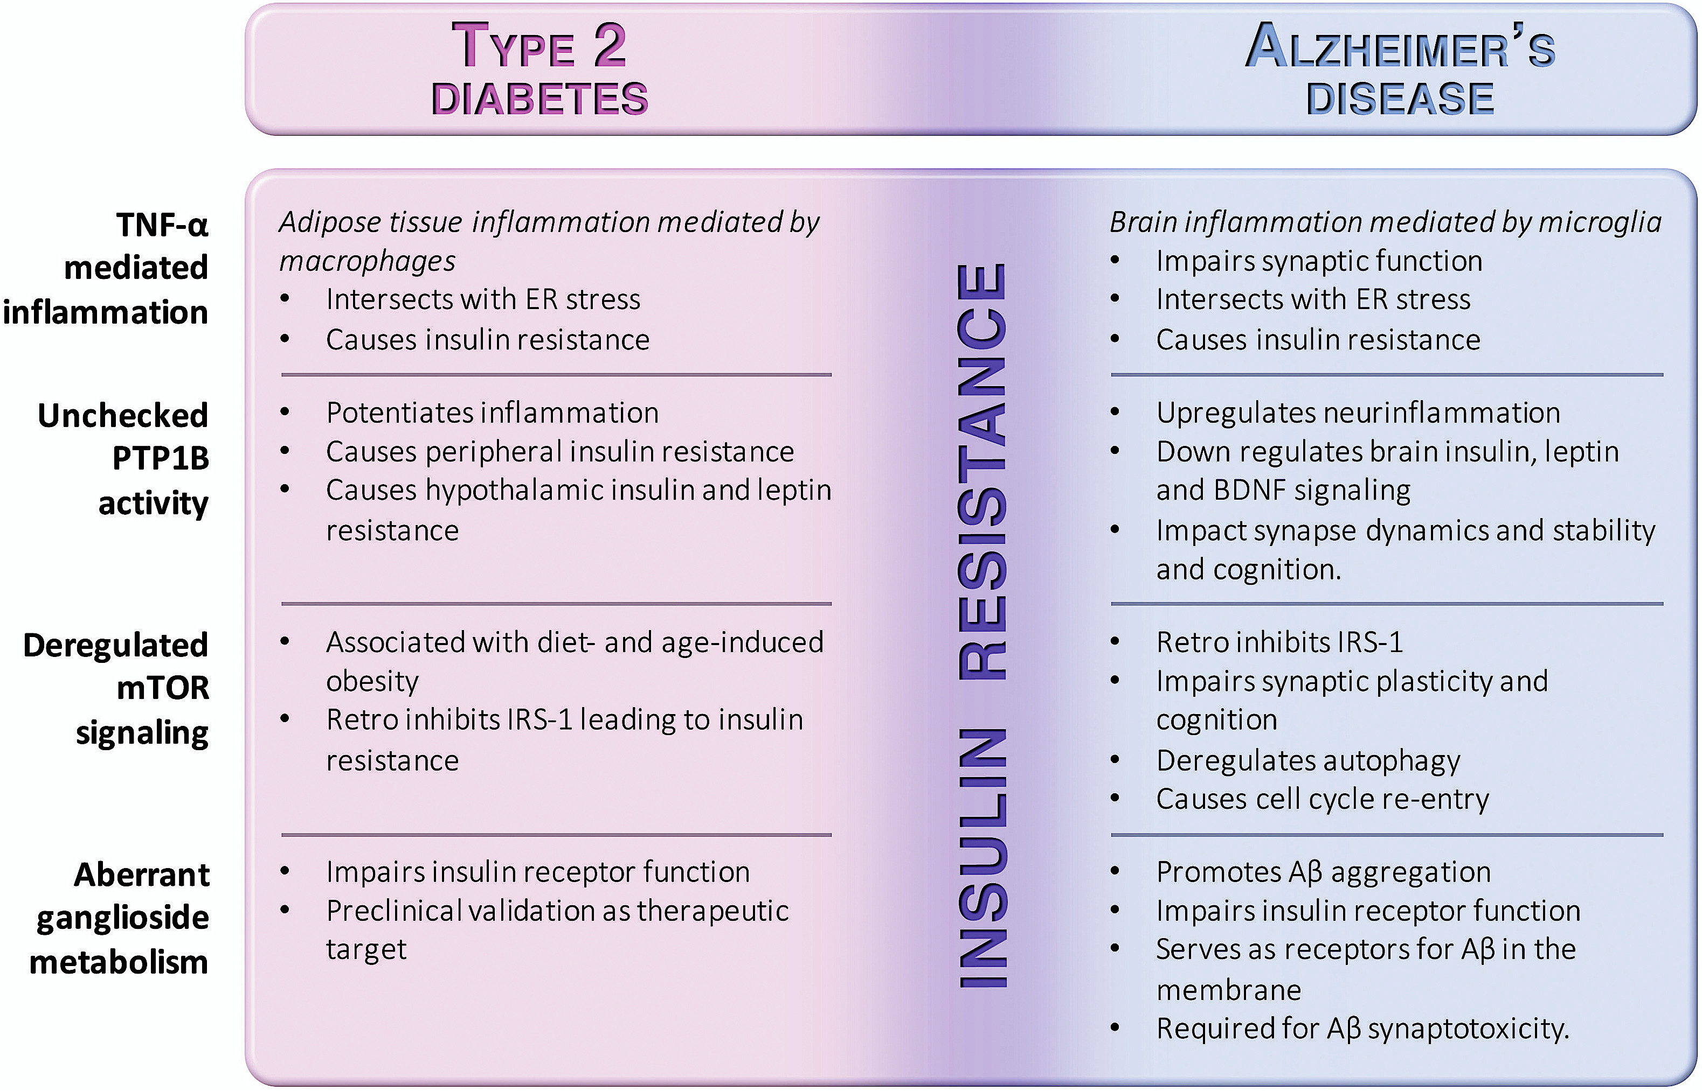
Mechanisms connecting Alzheimer's disease and diabetes
TNF-α = Tumor necrosis factor-alpha
ER = endoplasmic reticulum
PTP1B = protein tyrosine phosphatase 1B
BDNF = brain-derived neurotrophic factor
IRS-1 = insulin receptor substrate 1
mTOR = mammalian target of rapamycin
Aβ = amyloid beta
Source: Marcelo N.N, et al.Connecting Alzheimer's disease to diabetes: Underlying mechanisms and potential therapeutic targets, Neuropharmacology, Volume 136, Part B, 2018, https://doi.org/10.1016/j.neuropharm.2017.11.014.
Notes:
Mechanisms connecting AD and diabetes. The diagram highlights insulin resistance as a major intersection between Alzheimer's disease and type 2 diabetes. The selected mechanisms covered in this review are indicated in the left column. Potential physiopathological and therapeutical implications of those mechanisms to either type 2 diabetes (pink column) or Alzheimer's disease (blue column) are described.

Slide 9
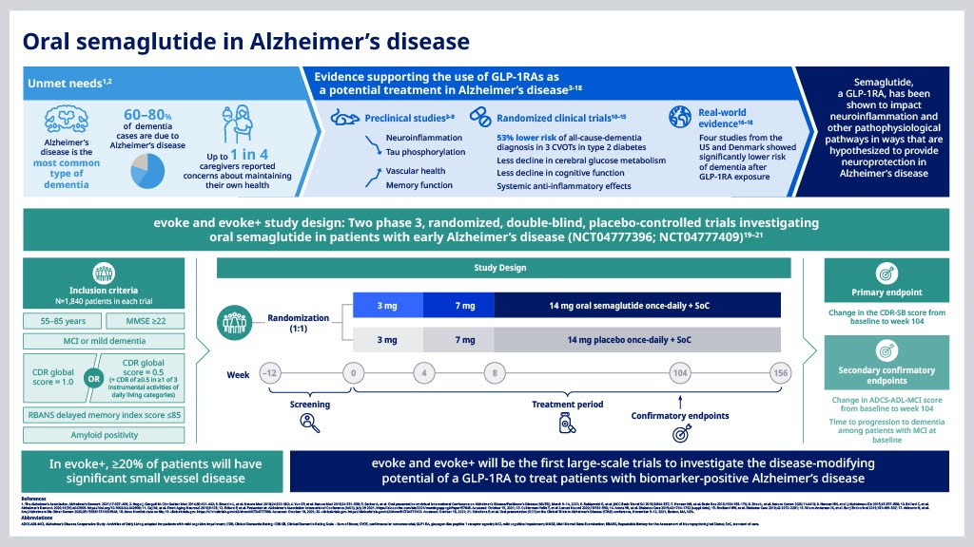
Diabetes and Alzheimer‘s?
GLP-1 and GIP agonists – potential new pharmacotherapy??
Drugs primarily used for treating DM-2 (semaglutide, tirzepatide etc) –research phase
Lancet Diabetes Endocrinol. 2020;8:535-545

Slide 10
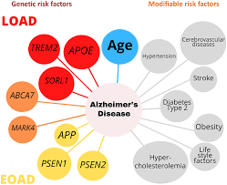
Risk factors for development of AD
Genetic factors, mainly in family AD
  Rare
  Higly related to onset of AD
  APP, PSEN1, PSEN2
Apolipoproteins
  Low frequency, intermediate effectivity
  High correlation
  APOE4
Life style related risks
  Low incidence
  Smaller risk

Slide 11
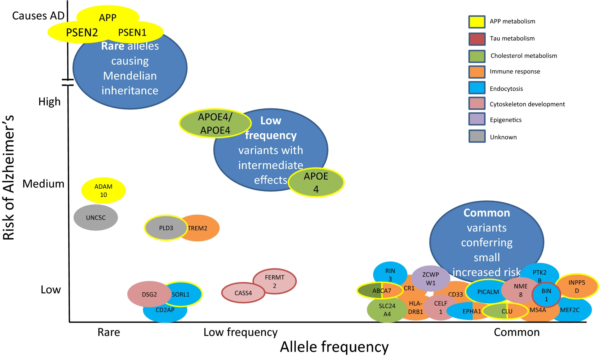

NEWS AND VIEWS
February 2023
The Alzheimer’s risk gene APOE modulates the gut–brain axis

Slide 12
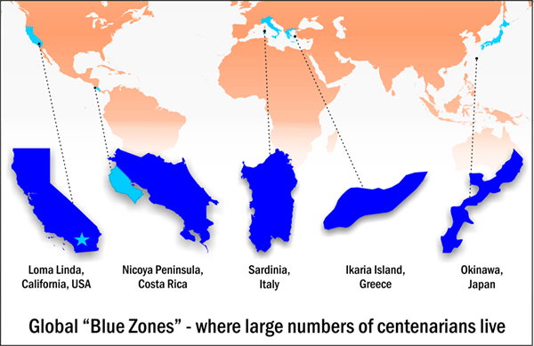
„Blue zones“?
Where are they?
  The highest number of centenials
Regions where over 100 is usual
5 „representative“ regions:
Okinawa (Japan)
Sardinia (Italy);
Nicoya (Costa Rica);
Ikarija (Greece);
Loma Linda (California, USA).

Slide 13
Common to all blue zones?
Social connections, friendship, family
Cultural tradition
Daily obligations
Gardening and field work
  → continous (moderate) physical activity!
Local varied foods

Slide 14
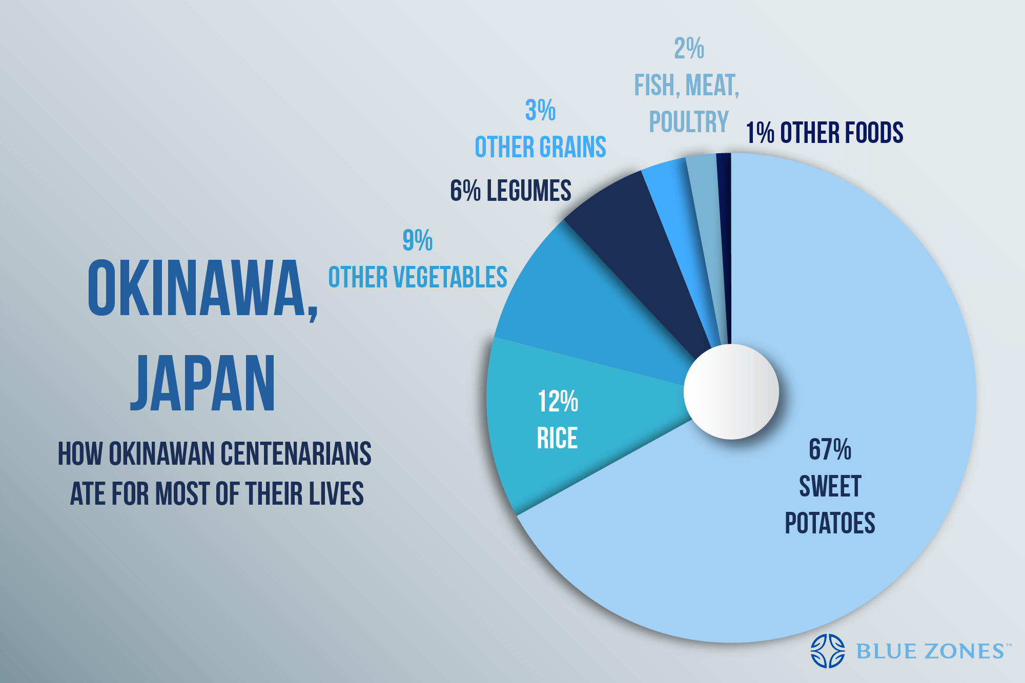
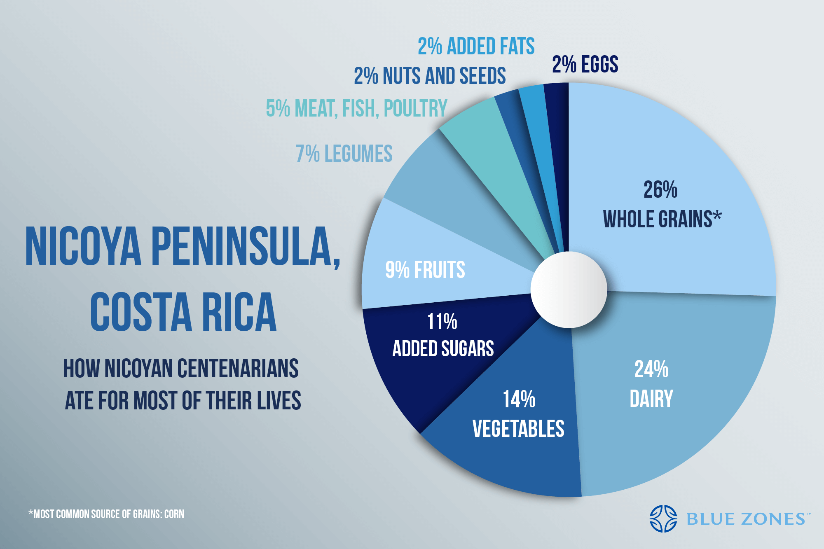
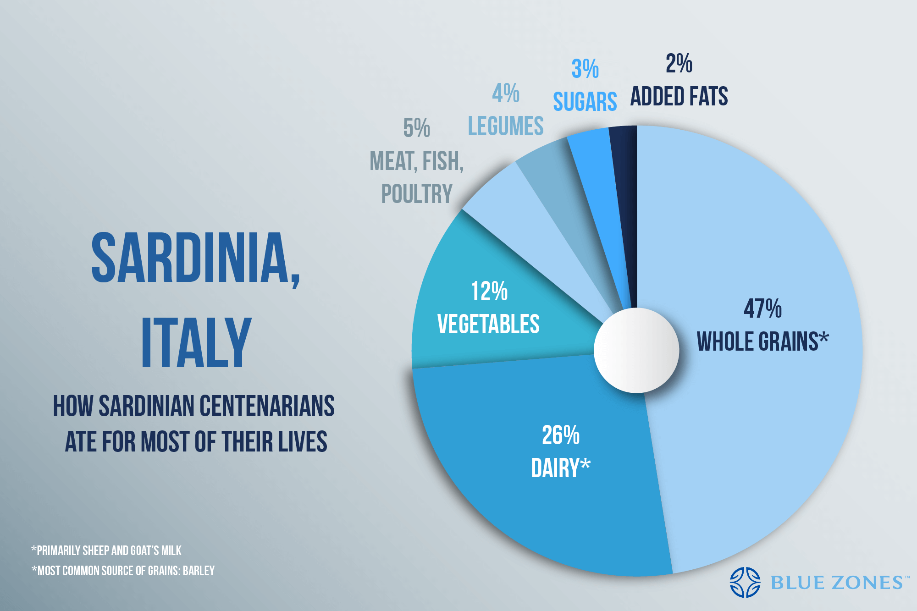
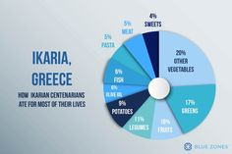
Blue zones food – „nothing special“ but → DIVERSE

Slide 15
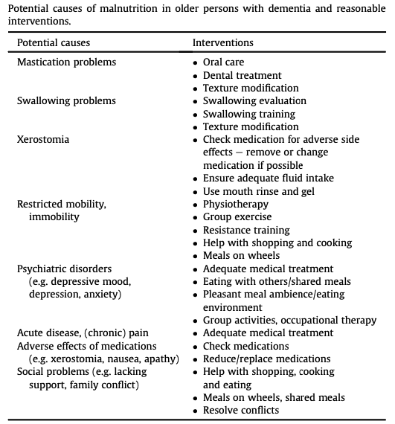
Malnutrition and dementia
Volkert D, et al., ESPEN guidelines on nutrition in dementia, Clinical Nutrition (2015)
Notes:
hus, in a cohort of 414 community-dwelling ambulatory patients with a diagnosis of probable Alzheimer's disease, weight loss of 4% body weight or more during the first year of follow up was independently predictive for rapid cognitive decline (loss of 3 points or more in MMSE over 6 months) during the following 3 years in a multivariate cox-proportional model (HR 1⁄4 1.5, 95%-CI 1.0e2.2) [58].

Slide 16
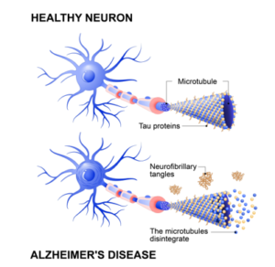
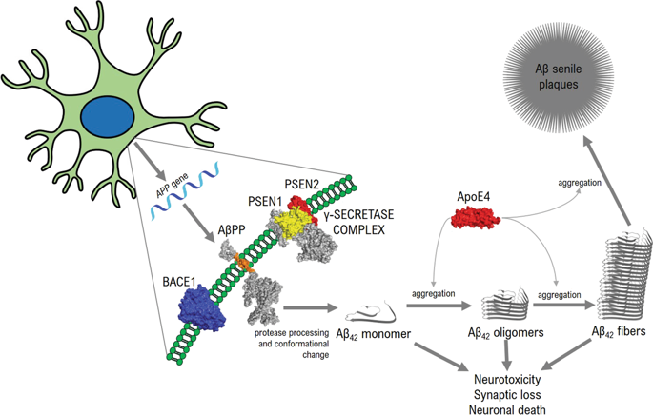
Specific markers in AD: plaques and tangles
AD specific amyloids
Castellani, R.J., Plascencia-Villa, G. & Perry, G. The amyloid cascade and Alzheimer’s disease therapeutics: theory versus observation. Lab Invest 99, 958–970 (2019) doi:10.1038/s41374-019-0231-z

Slide 17
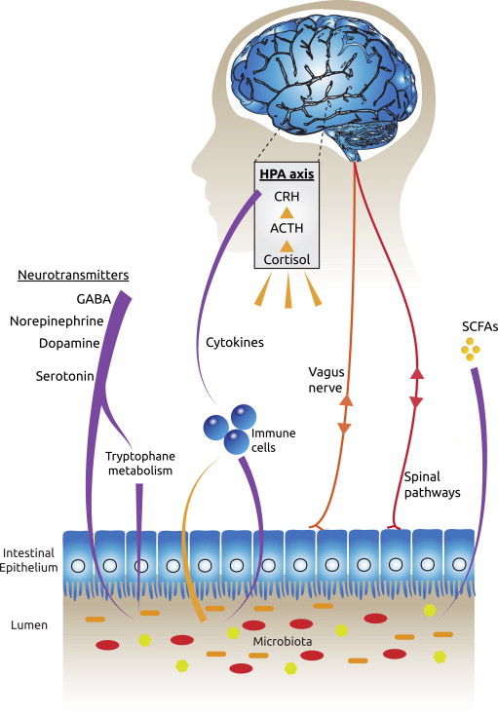
Fecal (microbiota) transplants

Slide 18
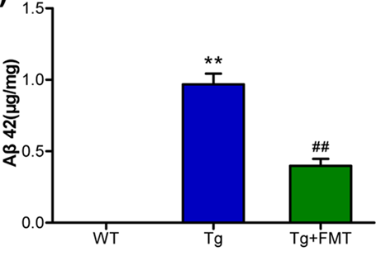
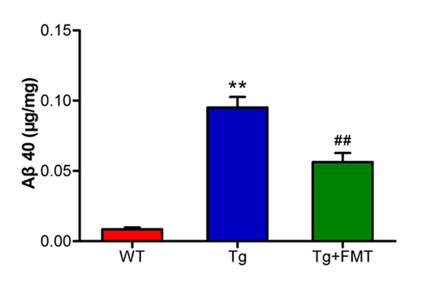
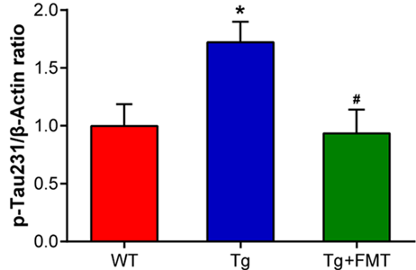
FMT from healthy to AD animals decreased amyloid β42
Sun, J., Xu, J., Ling, Y. et al. Fecal microbiota transplantation alleviated Alzheimer’s disease-like pathogenesis in APP/PS1 transgenic mice. Transl Psychiatry 9, 189 (2019)

Slide 19
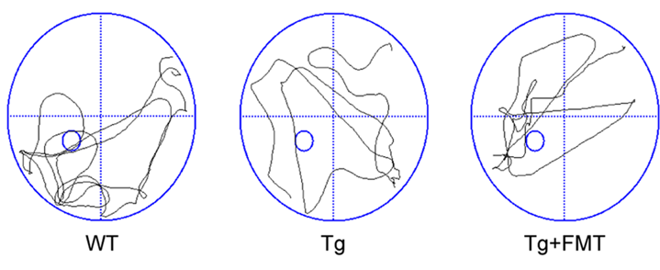
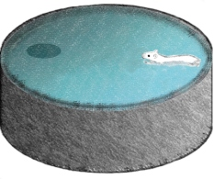
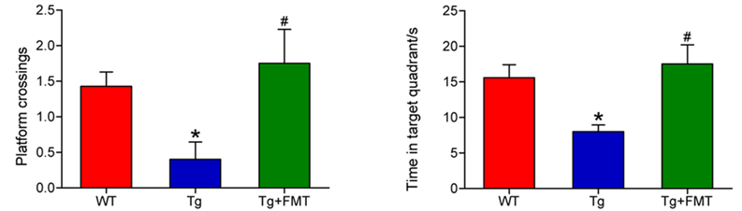
Improved memory after FMT
- Morris water labirinth
Sun et al., 2019

Slide 20
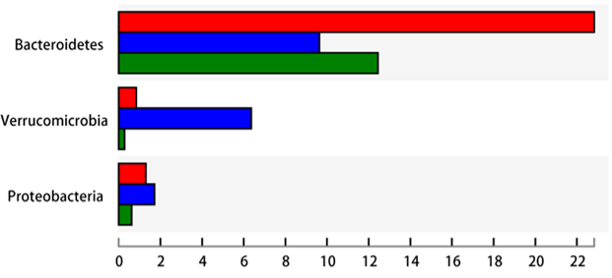
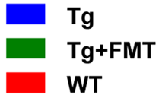
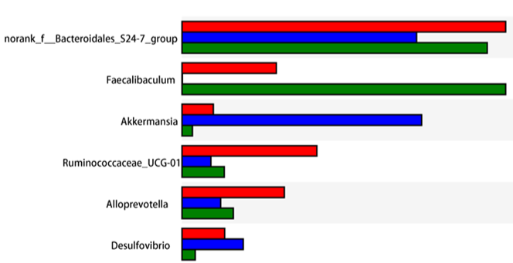
Microbiota composition impoverished in AD
Sun et al., 2019

Slide 21
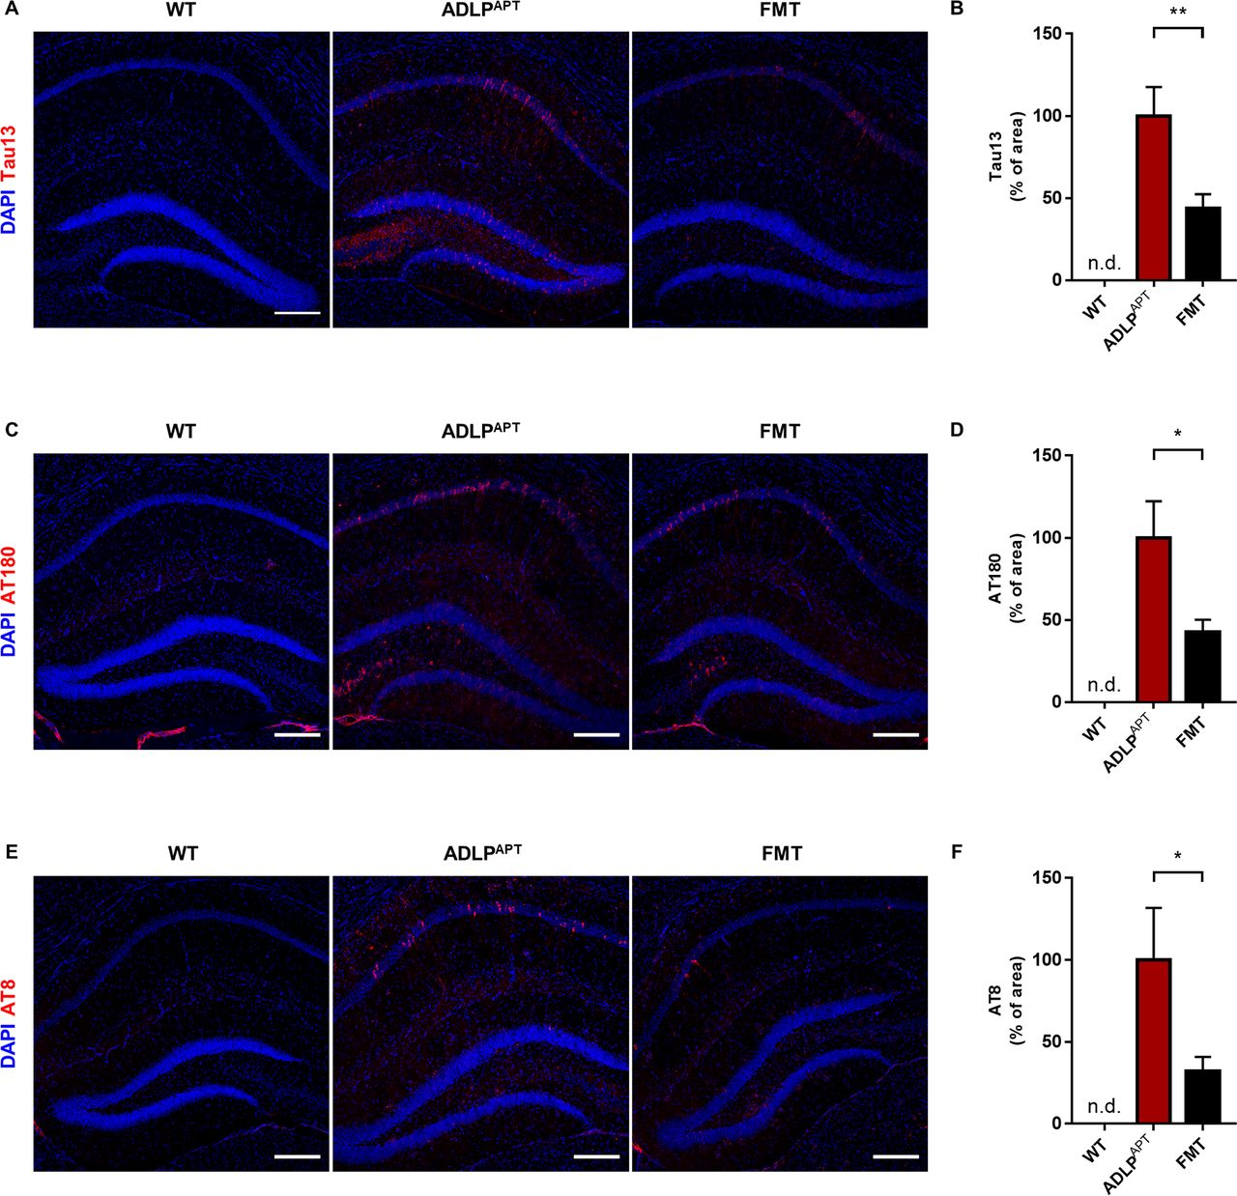

Less aggregation of TAU in hypocampus after FMT.
Min-Soo Kim et al. Gut doi:10.1136/gutjnl-2018-317431
Copyright © BMJ Publishing Group Ltd & British Society of Gastroenterology. All rights reserved.
Notes:
Reduced aggregation of tau in the hippocampus of ADLP^{APT} mice after FMT. Immunostaining for tau pathology in the brain slices from 6-month-old ADLP^{APT} mice after FMT treatment. Representative confocal images of (A) human tau (Tau13) staining and (B) quantification of the Tau13-positive area in the hippocampus of ADLP^{APT} mice (n=14) and FMT mice (n=16). Representative confocal images of (C) PHF-tau (AT180) staining and (D) quantification of the AT180-positive area in the hippocampus of ADLP^{APT} mice (n=14) and FMT mice (n=16). Representative confocal images of (E) PHF-tau (AT8) staining and (F) quantification of AT8-positive area in the hippocampus of ADLP^{APT} mice (n=14) and FMT mice (n=16). Data represent mean±SEM; *p<0.05, **p<0.01, according to two-tailed unpaired t-test. Scale bars in A, C and E: 200 µm. ADLP^{APT}, AD-like pathology with amyloid and neurofibrillarytangles; DAPI, 4',6-Diamidino-2-Phenylindole; FMT, faecal microbiota transfer; n.d., non-detection; PHF, paired helical filament; WT, wild-type.

Slide 22
The role of microbiome RNAs in development of AD
Gastrointestinal disbiosis →
Release of amyloids and lipopolysaharides, pro-inflammatory cytokines
Bacterial lipopolysaharides and amyloids increase gut permeability, interleukins IL-17A and IL-22
Neurodegenerative diseases – bacterial amyloidosis: Aggregation and accumulation of proteins α-synuclein (αSyn),abnormal extracellular accumulation of amyloid-beta peptide (Aβ), senile plaques, dysf. of the SOD1 gene.

Slide 23
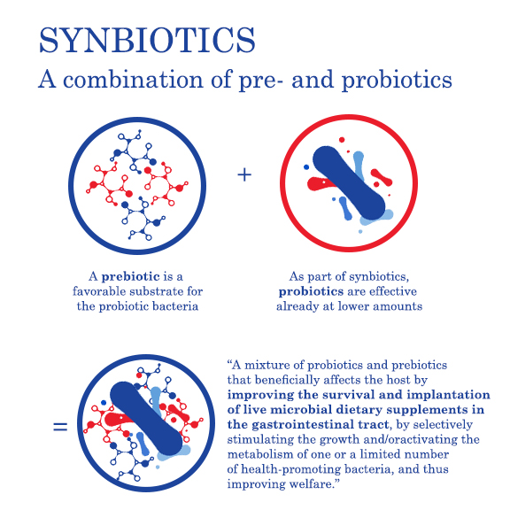
New opportunities to modulate the gut microbiota by nutrition
PROBIOTICS
  live microorganisms that,
  when administrated in adequate
  amounts confer a health benefit on the host
  Based on FAO/WHO definition (2001) and updated ISAPP (2014)
+
SYNBIOTICS
are combination of Pre and Probiotics
  Pandey t al, 2015
  Shamir, 2015
PREBIOTICS
  substrates that are selectively utilized by host microorganisms conferring a health benefit
  The International Scientific Association for Probiotics and Prebiotics (ISAPP) definition for prebiotics as published in a consensus statement from June 2017.
POSTBIOTICS
Are bioactive compounds produces by food-grade microorganisms in a fermentation process
  Aguilar-Toala 2018
  Klemashevish 2014

Slide 24
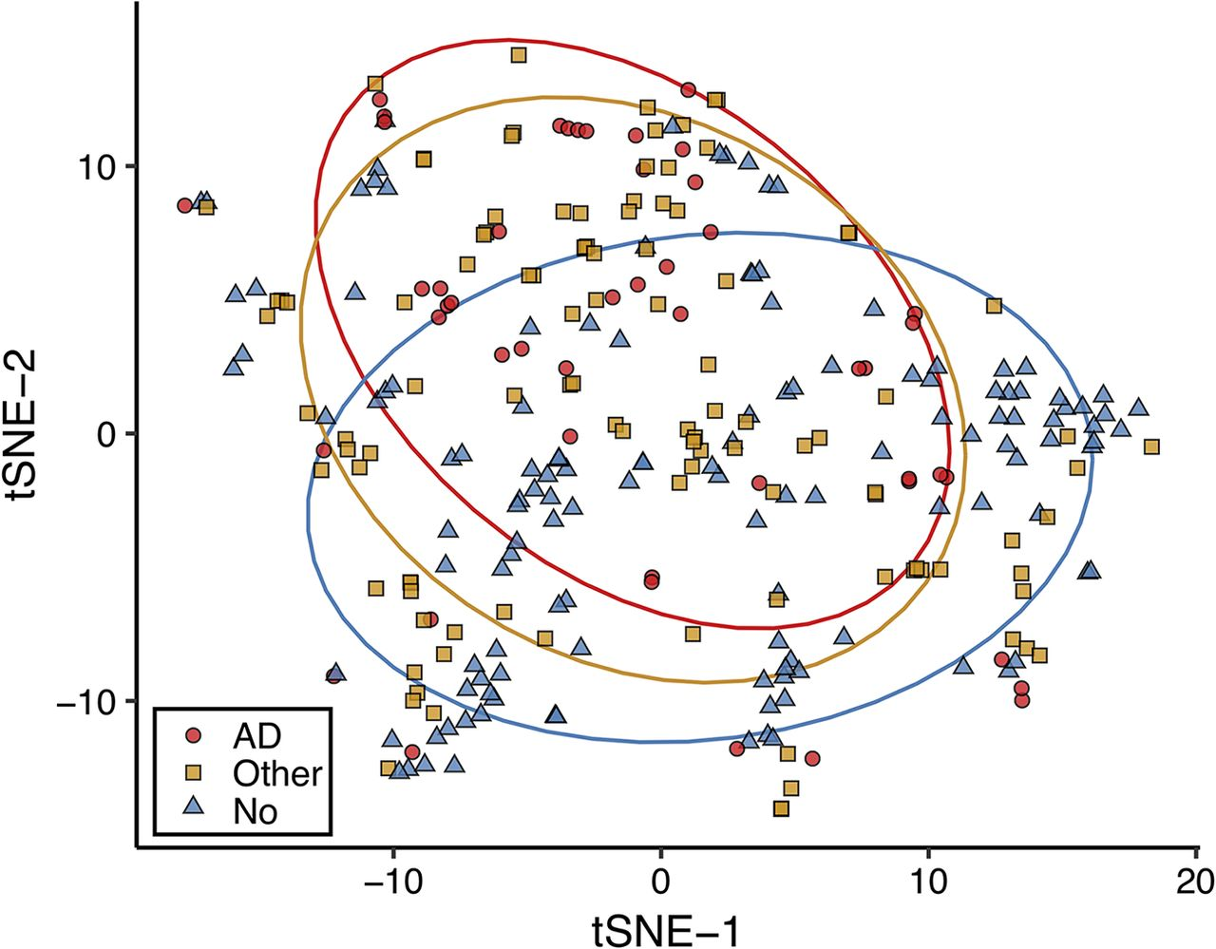
Diversity of microbiome in AD, No AD and Other dementias
John P. Haran et al. mBio 2019; doi:10.1128/mBio.00632-19
Notes:
Microbiome diversity differs between Alzheimer’s disease elders and those with no dementia or other types of dementia. Stool samples from elders were sequenced via shotgun metagenomics. Samples were profiled for microbial species relative abundances by mapping reads to a NCBI bacterial genomes k-mer database with Kraken and by reconstructing the resulting relative abundance profile at the species levels with Bracken. Beta diversity was explored using Jaccard distances by t-distributed stochastic neighbor embedding (tSNE) for a measure of community species dissimilarity among samples collected from individuals without dementia (blue triangles), with Alzheimer’s disease (red circles), and with other dementia types (yellow squares). Each group is displayed with ellipses with a 95% confidence interval.

Slide 25
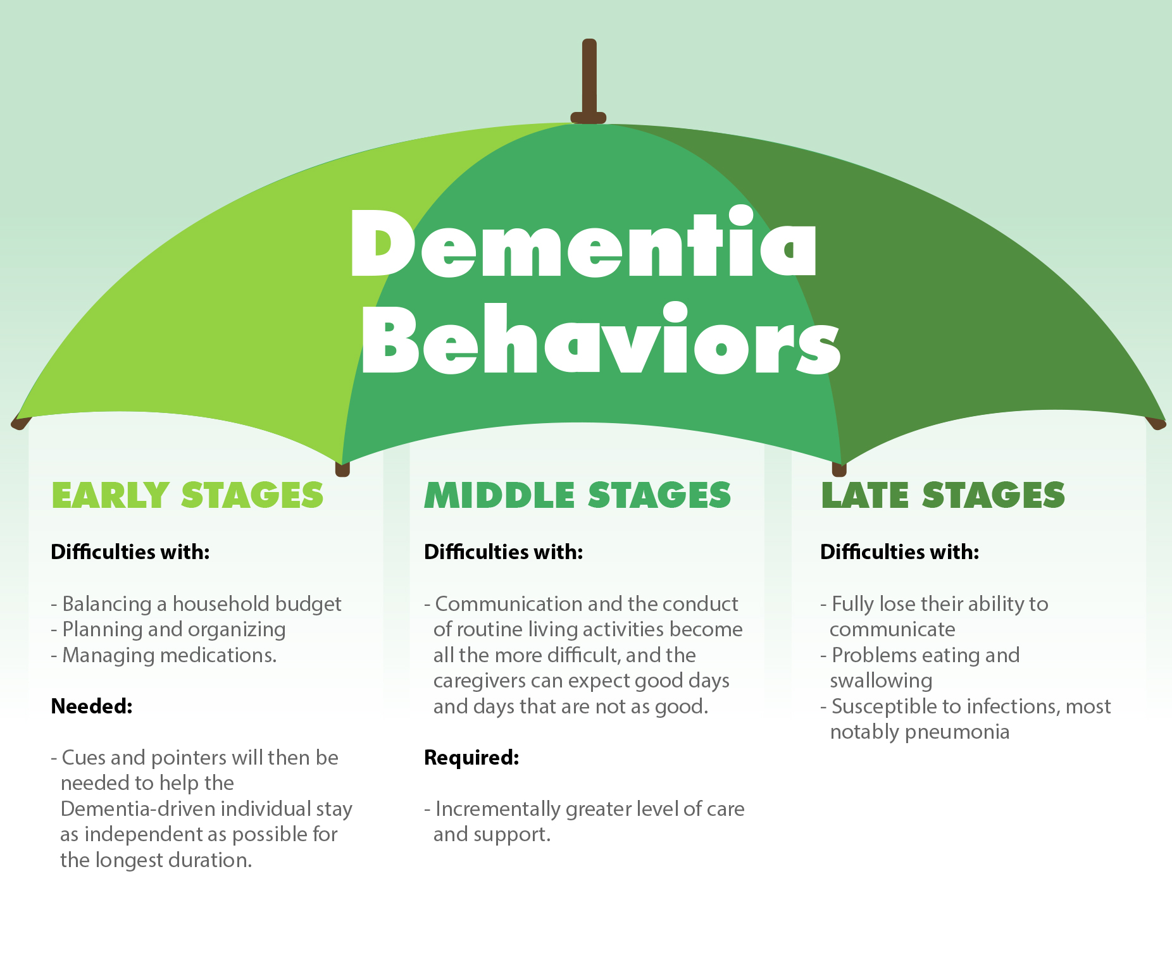
Clinical Dementia Rating (CDR)
NDD as a „moving target“
CDR 1 - 3
  CDR-1 – cca. 2 years
  CDR-2 – cca. 2-4 years
  CDR-3 – cca. 1 -2,5 years
(Analogy to 7 phases – next page)
AD advance: age, comorbidities, → variable!
Support in CDR 1-2 increases quality of life up to 7 years.
https://www.dementiacarecentral.com/aboutdementia/facts/stages/

Slide 26
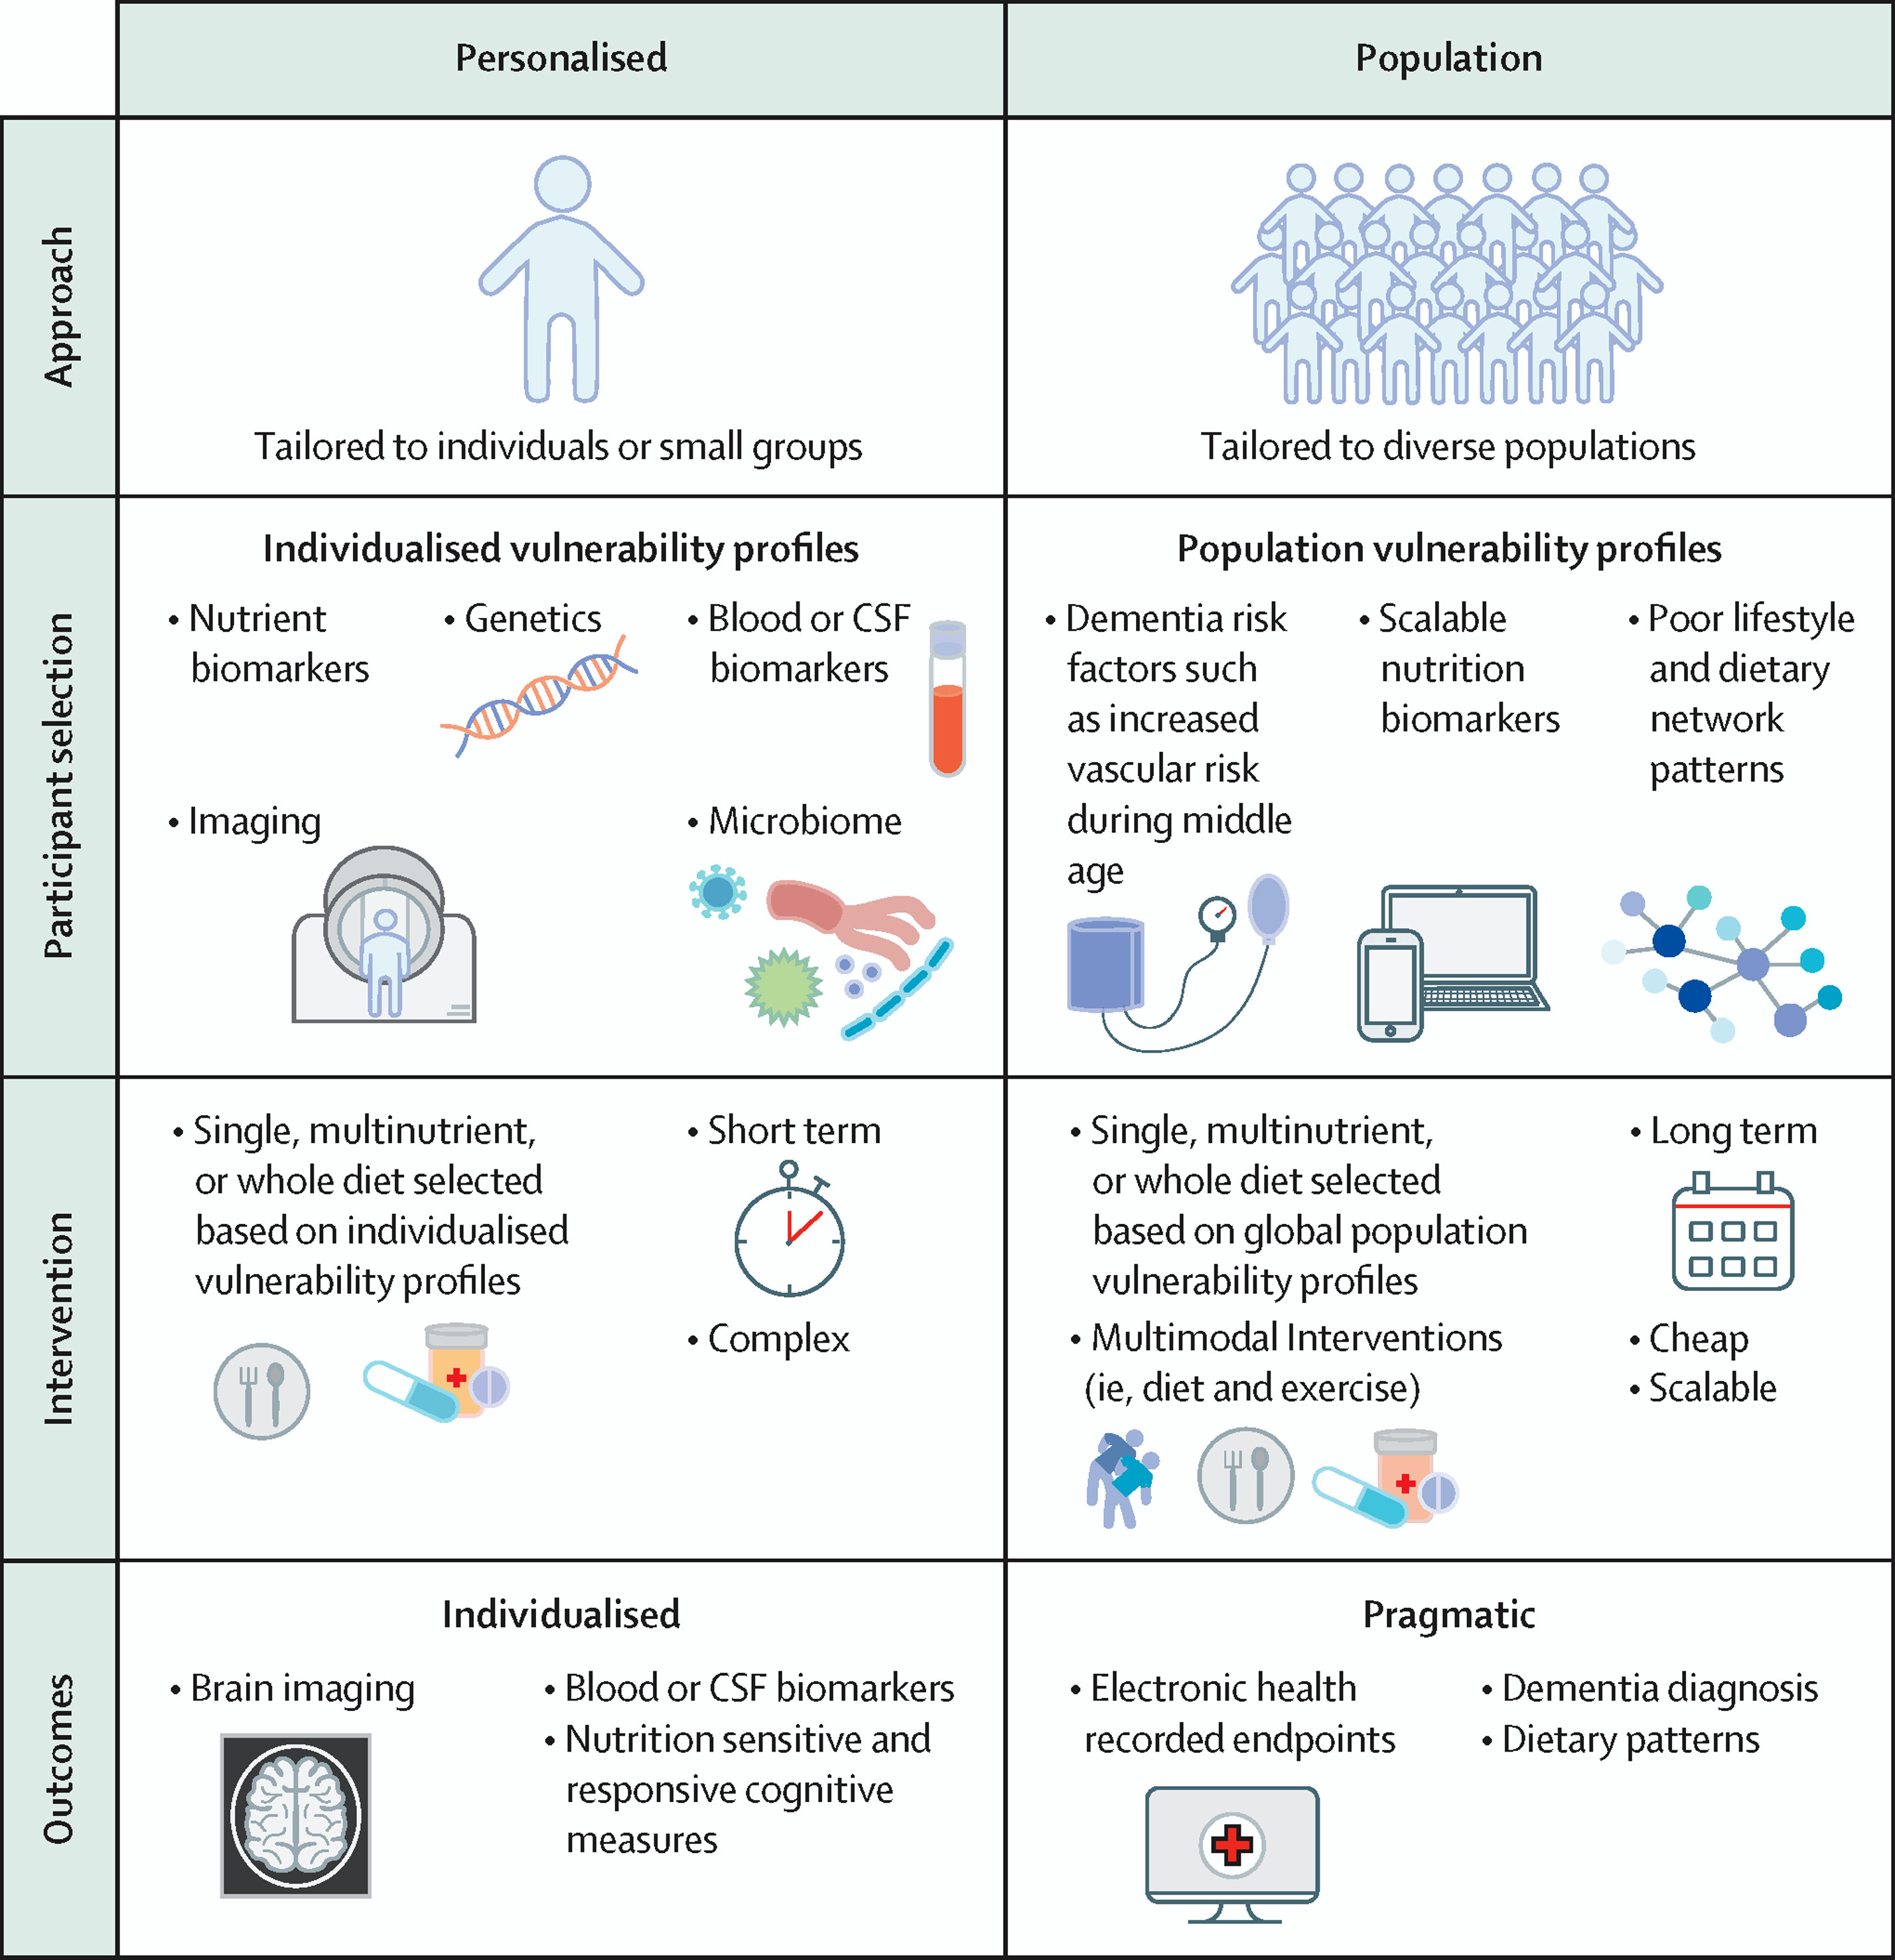
Figure 2
Hussein NY, et al. Nutrition state of science and dementia prevention: recommendations of the Nutrition for Dementia Prevention Working Group. The Lancet Healthy Longevity. 2022
Copyright © 2022 The Author(s). Published by Elsevier Ltd.
Notes:
Two contrasting study designs to nutrition-based interventions for dementia prevention
Two contrasting approaches to nutrition-based clinical trials are shown. The first column shows intensive and personalised interventions guided by biomarkers that capture brain functions. In the second column, interventions are tailored to a population level in groups at risk of dementia and uses pragmatic outcomes. Although certain trials will have to share elements from both approaches, clear study designs that match the intensity of the intervention with the outcome proposed promises to maximise the chances of finding effective therapies.

Slide 27

Preventing dementia
1.) No traumatic events
2.) Alternative to drugs
3.) Daily activity!!!
4.) „First 1000 day“ diets
5.) Les risky (pro-inflammatory) food
6.) Food additives – pro nata
7.) Daily social contacts and cognition
8.) Avoidance to injuries

