Slide 1
Introduction to metrology
Clinical assessment and outcome measurement
Peter Hagell
Kristianstad university

Slide 2
Learning Objectives
Upon completion of this module, participants should be able to
Explain the principles of metrology
Understand the meaning of measurement
Understand the concept of measurement uncertainty

Slide 3
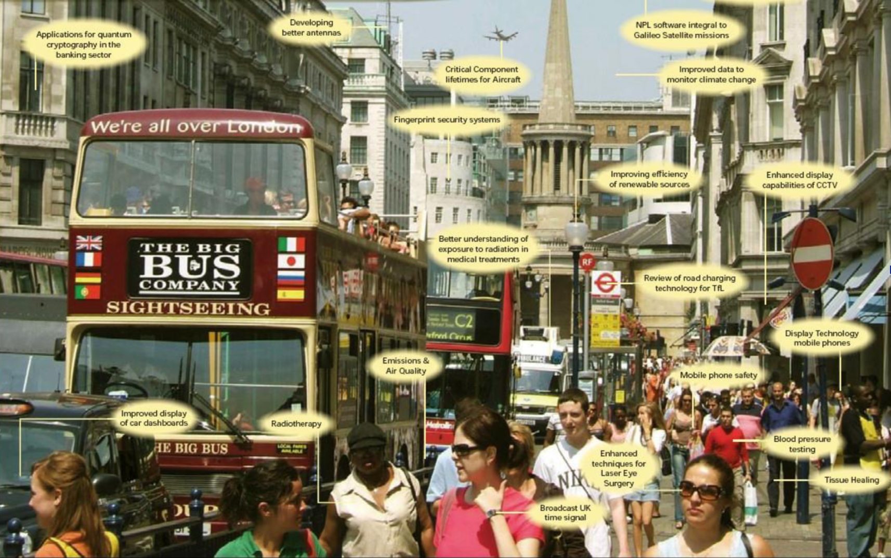

Slide 4

Metrology in daily life
https://www.youtube.com/watch?v=vRnT8hIxjqk

Slide 5
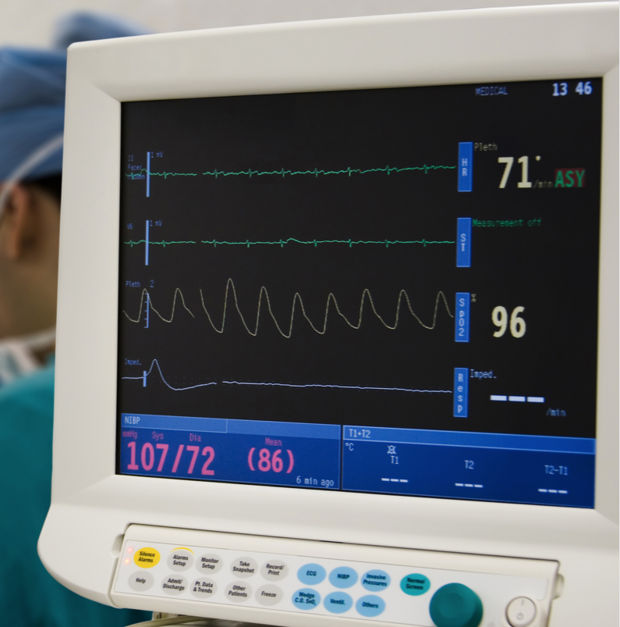
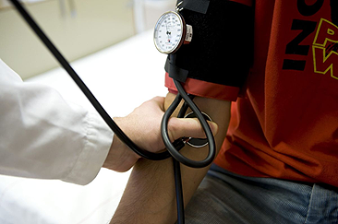
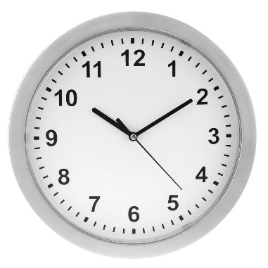
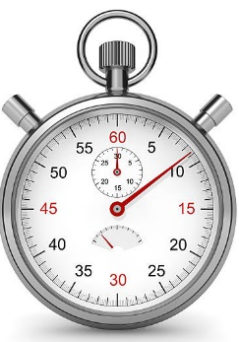
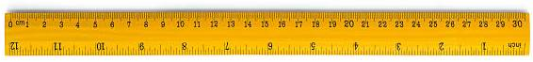
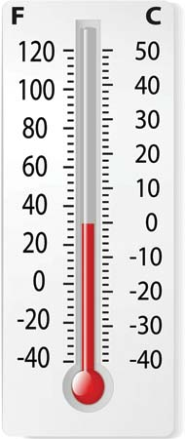
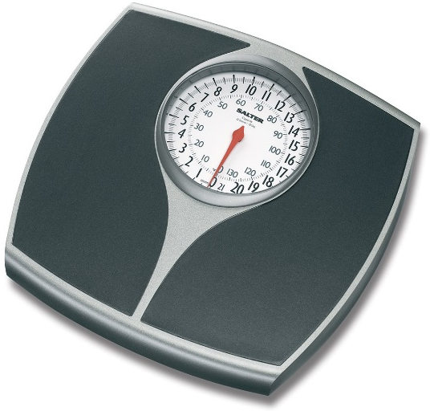
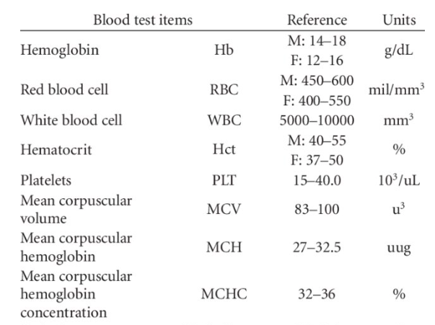
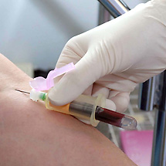

Slide 6

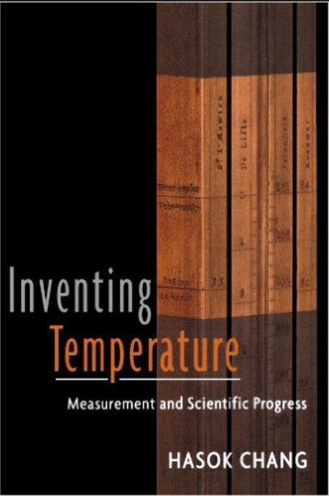
"The trouble with measurement is its seeming simplicity"
Unknown
1592: C. Drebbel von Alkmar and Galileo Galilei simultaneously invented the air thermometer (thermoscope).
1620: C. Drebbel von Alkmar invented the spirit thermometer.
1643: Athanasius Kircher invented the mercury thermometer.
1665: Christian Huygens suggested using the freezing and boiling points of water as standards for scaling temperature.
1714: G.D. Fahrenheit created a mercury thermometer with the Fahrenheit scale.
1730: Rene-Antoine Ferchault de Reaumur created the Reaumur scale.
1742: Anders Celsius created the Celsius scale.

Slide 7
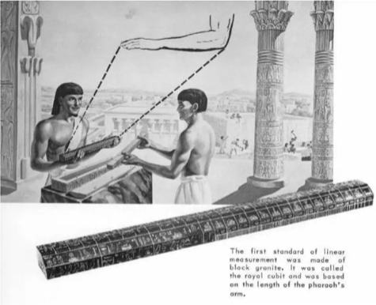
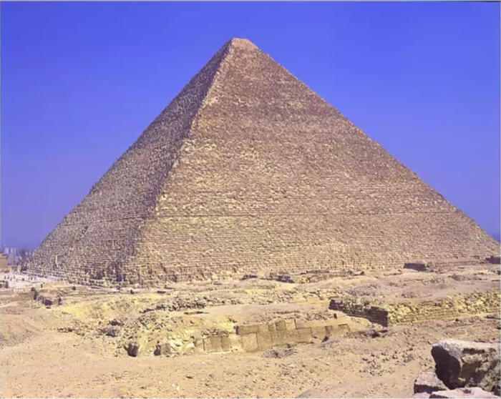
History of measurement: The cubit
The cubit is the earliest known standard measurement unit
Defined by the distance from the tip of the forefinger to the middle of the elbow (of the Pharaoh)
The cubit was used in Egypt for building pyramids (2750 BC)
The mean error of length of the sides of the Khufu Pyramid at Gizeh in Egypt was 1.5 mm

Slide 8
Measurement
The process of experimentally obtaining one or more quantity values that can reasonably be attributed to a quantity
  (VIM 2012)
Measurement consists of two essential factors:
  (1) a defined standard of reference [the unit]
  (2) the number of times the unit is to be taken to make up the quantity
  (Maxwell, 1873)
The repetition of a unit amount that maintains its size, within an allowable range of error, no matter which instrument is used and no matter who or what relevant person or thing is measured
(Institute of Objective Measurement, 2001)
Estimation of the amount of a unidimensional property relative to a unit
(Andrich & Marais, 2019)

Slide 9
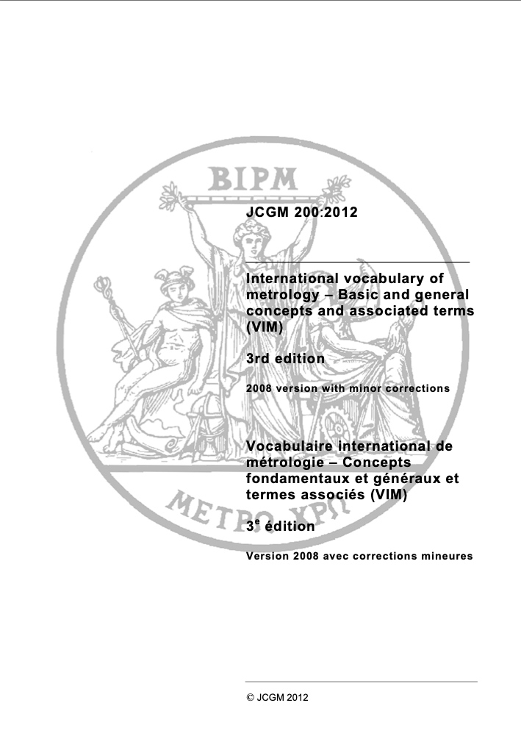
Measurement
International vocabulary of metrology – Basic and general concepts and associated terms (VIM)
https://www.bipm.org/documents/20126/2071204/JCGM_200_2012.pdf/f0e1ad45-d337-bbeb-53a6-15fe649d0ff1
The process of experimentally obtaining one or more quantity values that can reasonably be attributed to a quantity
Measurement does not apply to nominal properties.
Measurement implies comparison of quantities or counting of entities.
Measurement presupposes a description of the quantity commensurate with the intended use of a measurement result, a measurement procedure, and a calibrated measuring system operating according to the specified measurement procedure, including the measurement conditions.
Quantity
The property of a phenomenon, body, or substance, where the property has a magnitude that can be expressed as a number and a reference
A reference can be a measurement unit, a measurement procedure, a reference material, or a combination of such.
Quantity value
The value of a quantity
The number and reference together expressing magnitude of a quantity
According to the type of reference, a quantity value is either
  a product of a number and a measurement unit, or
  a number and a reference to a measurement procedure, or
  a number and a reference material

Slide 10
Metrology:
The Science of Measurement
Fundamental to a functioning society
Three pillars:
  Defined unit of measurement (e.g., metre) for a quantity (e.g., length)
  Operationalization (e.g., of the metre using laser)
  Traceability, i.e., established relationship between different applications (e.g., different methods to measure length) and in relation to definition/standard, including measurement uncertainty

Slide 11
Metrology:
The Science of Measurement
Example: The quantity length:
  The unit metre (m) was initially defined (1791) as one ten-millionth of the distance between the North Pole and the equator along the Paris meridian; nowadays, however, it is defined as the distance travelled by light in a vacuum in 1/299 792 458 s.
  The metre is operationalised using lasers, which are the basis for physical references (yardsticks).
  Traceability is ensured by optical measurement of scales with reference to laser measurements, which provides information on the degree of deviation (measurement uncertainty).

Slide 12
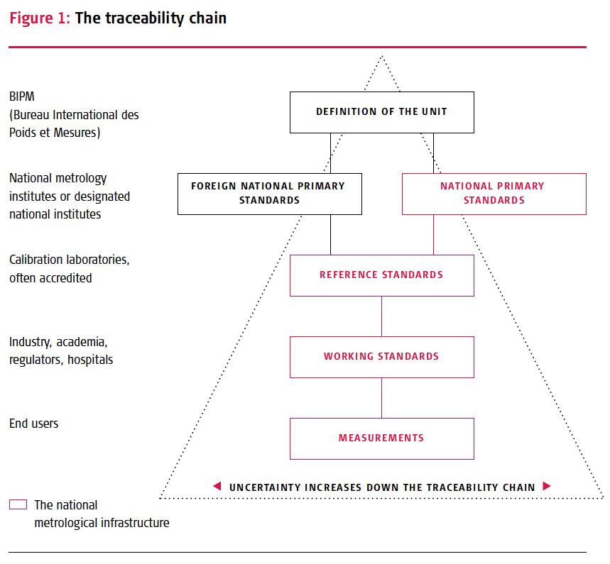
Metrology:
The Science of Measurement
Basic quality aspects:
  Measurement uncertainty:
  Known precision and risk of erroneous results/decisions/inference; allowed to vary to different degrees depending on purpose/context ("fit for purpose")
  Traceability:
  Comparable measures, with known measurement uncertainty

Slide 13


The traceability chain
True value
International standard
National standard
Reference standards (calibration laboratoties)
Working standards (industry, academia, hospitals)
End users
Traceability
Measurement uncertainty

Slide 14
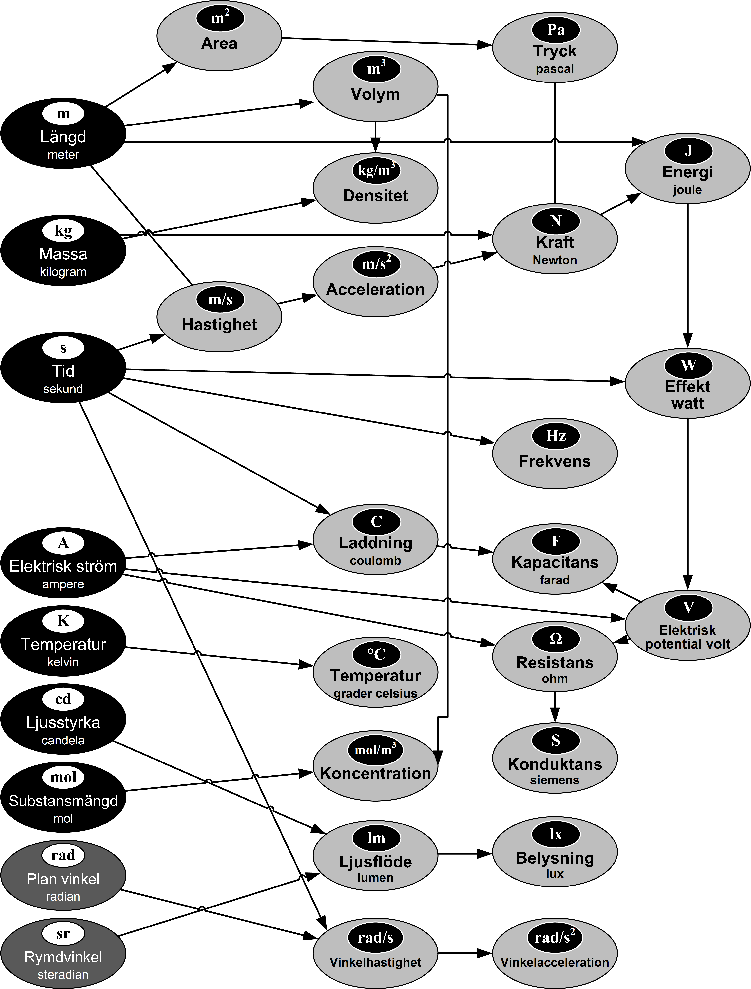
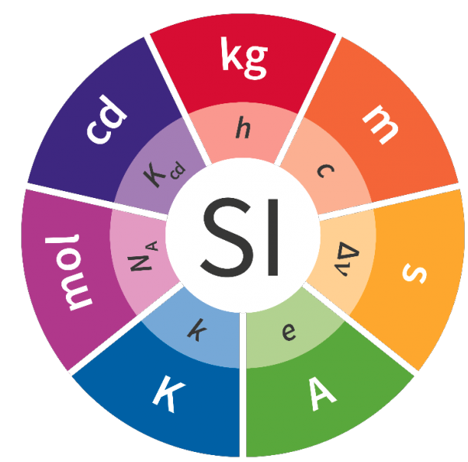
SI: The International System of Units
(Système International d'Unités)
Base units and derived units
Mass:
kilogram
Length:
metre
Luminous intensity:
candela
Amount of substance:
mole
Time:
second
Temperature:
kelvin
Electric current:
ampere

Slide 15
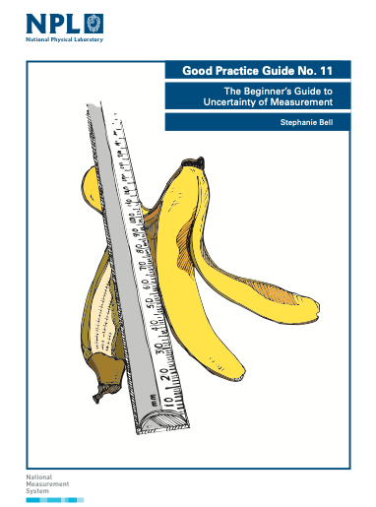
Measurement uncertainty
…the doubt that exists about the result of any measurement
You might think that well-made rulers, clocks and thermometers should be trustworthy, and give the right answers. But for every measurement - even the most careful - there is always a margin of doubt. In everyday speech, this might be expressed as ‘give or take’ ... e.g., a stick might be two metres long ‘give or take a centimetre’.
www.npl.co.uk/gpgs/beginners-guide-measurement-uncertainty-gpg11

Slide 16
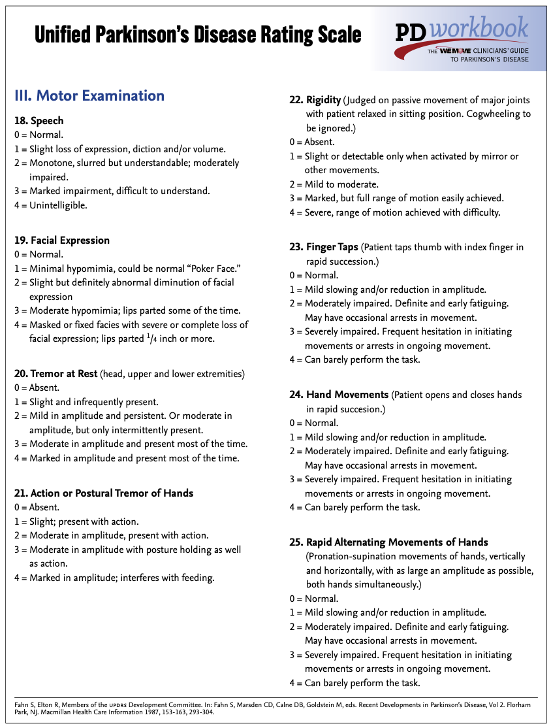
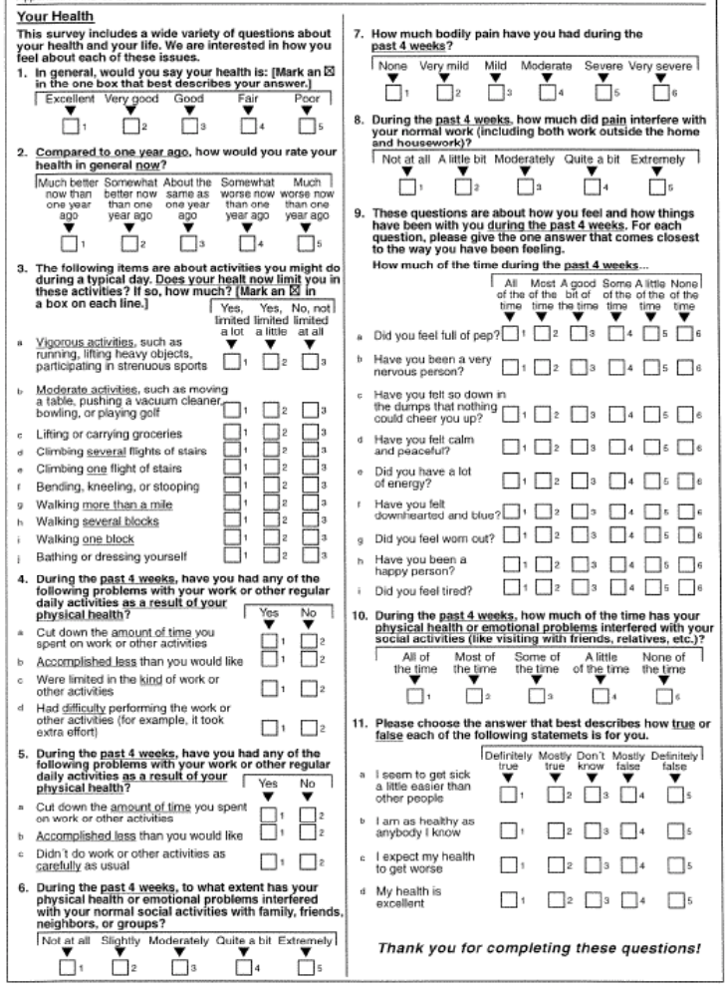
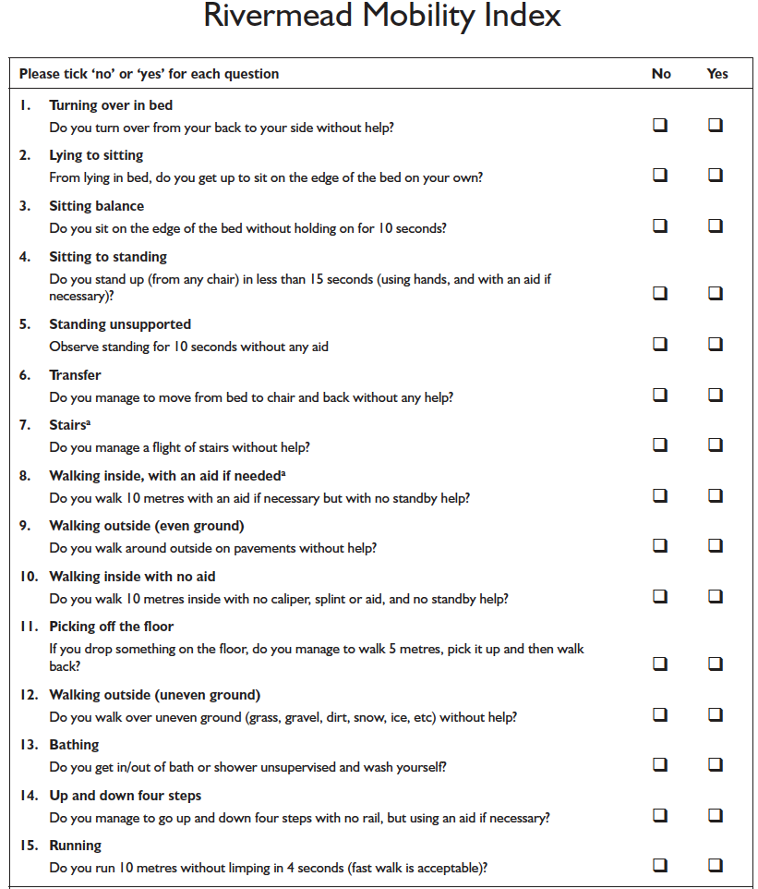
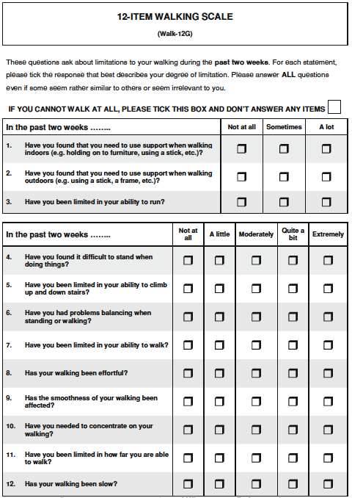

Slide 17
Metrology:
Metrology, "the Science of Measurement"
Basic quality aspects:
  Measurement uncertainty:
  Known precision and risk of erroneous results/decisions/inference; allowed to vary to different degrees depending on purpose/context ("fit for purpose")
  Traceability:
  Comparable measures, with known measurement uncertainty
What about rating scales and questionnaires…?

Slide 18
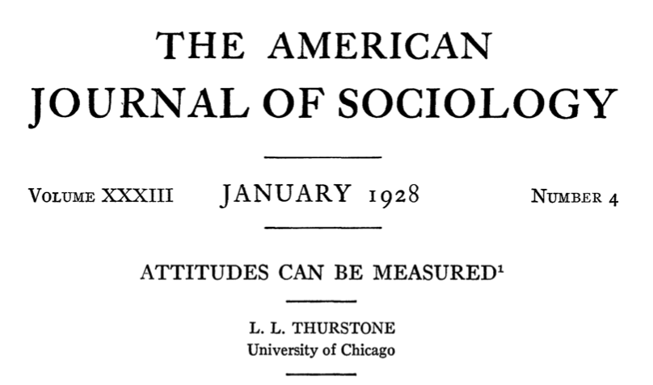
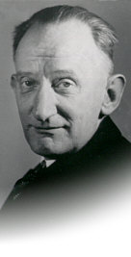
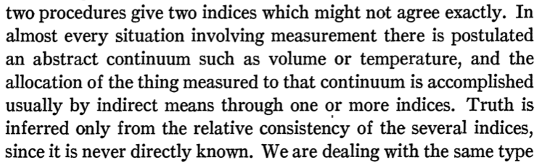
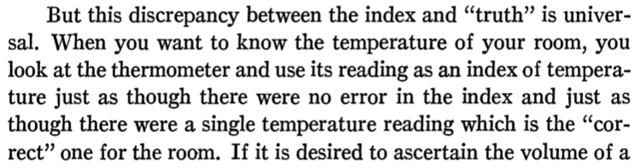
1920s:
Louis Thurstone

Slide 19
Measuring…
Systematic observation
An estimation of the amount, from less to more
Quantification of the quantity

Slide 20
Measuring…
√
Systematic observation
An estimation of the amount, from less to more
Quantification of the quantity
√
Observations
Assessments
QUALITATIVE DATA

Slide 21








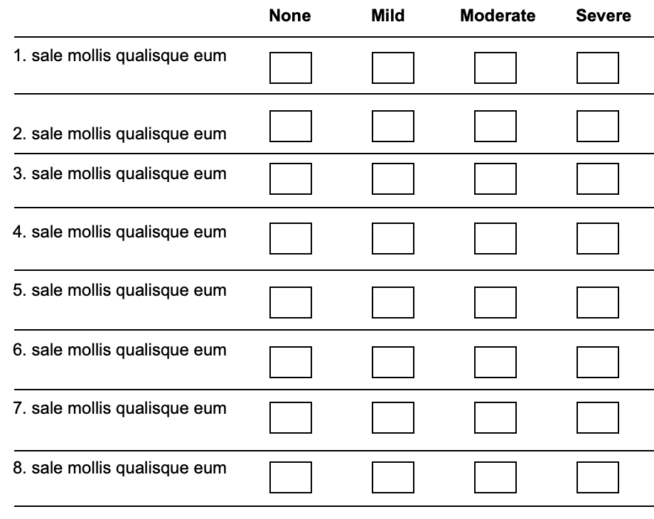
”[RMT] … is not simply a mathematical or statistical approach, but a specific metrological approach to human-based measurement” (Pendrill 2014)

Slide 22

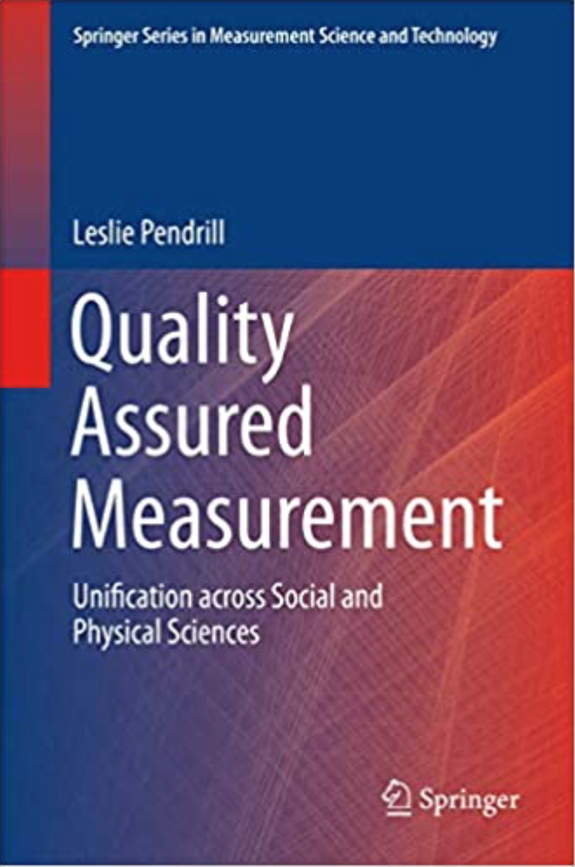
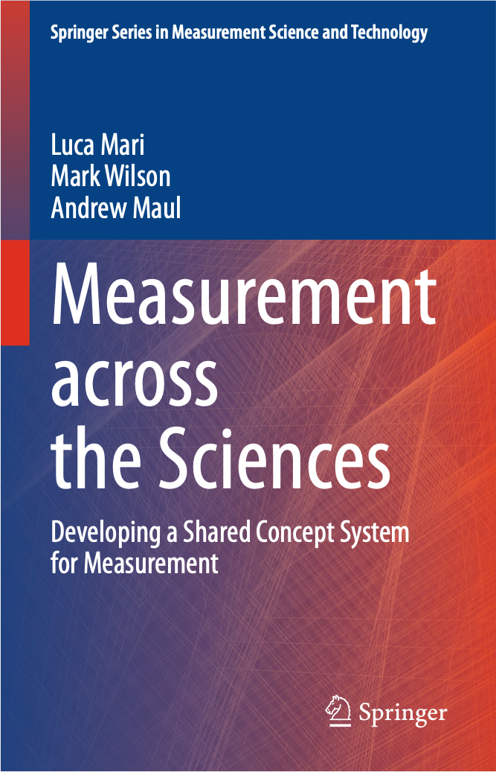
https://doi.org/10.1007/978-3-031-22448-5
https://www.ri.se/en/what-we-do/projects/center-for-category-based-measurements

Slide 23
References
Bell S. The beginner’s guide to uncertainty of measurement. Teddington: National Physical Laboratory, 2001.
Available from: www.npl.co.uk/gpgs/beginners-guide-measurement-uncertainty-gpg11
Brown RJC. Measuring measurement – What is metrology and why does it matter? Measurement 2021; 168: 108408.
Available from: https://doi.org/10.1016/j.measurement.2020.108408
Howarth P, Redgrave F. Metrology - In short, 3rd edition. Albertslund: Euramet, 2008.
Available from: https://www.euramet.org/publications-media-centre/documents/metrology-in-short
Pendrill L. Man as a measurement instrument. NCSLI Measure J Meas Sci 2014; 9(4): 24-35.
Available from: https://www.researchgate.net/profile/Leslie-Pendrill/publication/270897373_Man_as_a_Measurement_Instrument/links/54dc7a590cf2a7769d964450/Man-as-a-Measurement-Instrument.pdf

