Slide 1

Dementia – recognition, evaluation, diagnostic criteria GP-3 section 3.1 Alzheimers
Pille Taba, Ülle Krikmann
Tartu University

Slide 2
Aims of the lecture
By the end of this lecture the student should be able to understand and explain
Dementia syndrome
Recognize person with dementia,
Evaluate and plan the management

Slide 3
Content of lecture
Dementia – recognition,
diagnostic criteria
Diagnosis of dementia syndrome
evaluation,

Slide 4
Methods of learning
Lecture 1 hour
Seminar: questions and discussion 1 hour

Slide 5
Literature
Mandatory:
Rodriguez JJL, Ferri CP, Acosta D, Guerra M, et al. Prevalence of dementia in Latin America, India, and China: a population-based cross-sectional survey. Lancet 2008; 372: 464–74. DOI:10.1016/S0140-6736(08)61002-8
Arvanitakis Z, Shah RC, Bennett DA. Diagnosis and Management of Dementia: A Review. JAMA. 2019 October 22; 322(16): 1589–1599. doi:10.1001/jama.2019.4782
Optional:

Slide 6
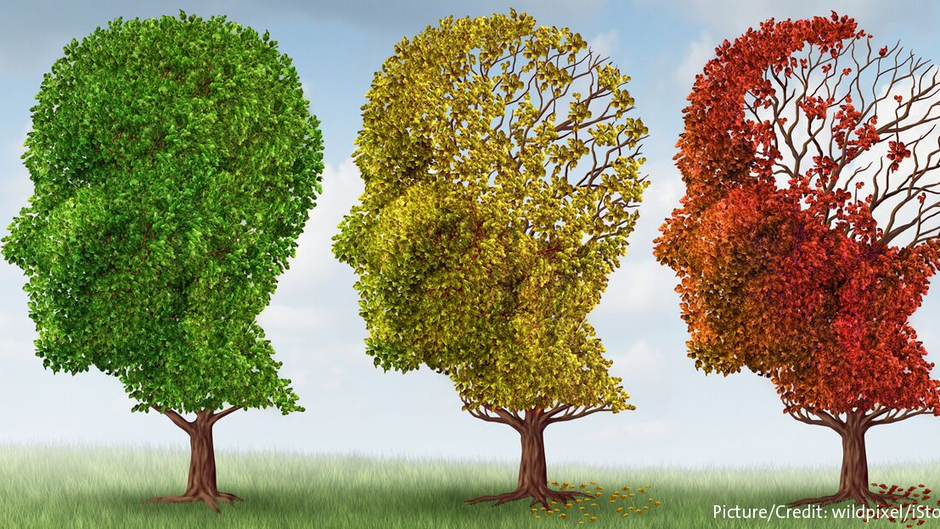
Aging of brain
Neurodegeneration – neural apoptosis
Sructural lesions due to trauma, stroke etc

Slide 7
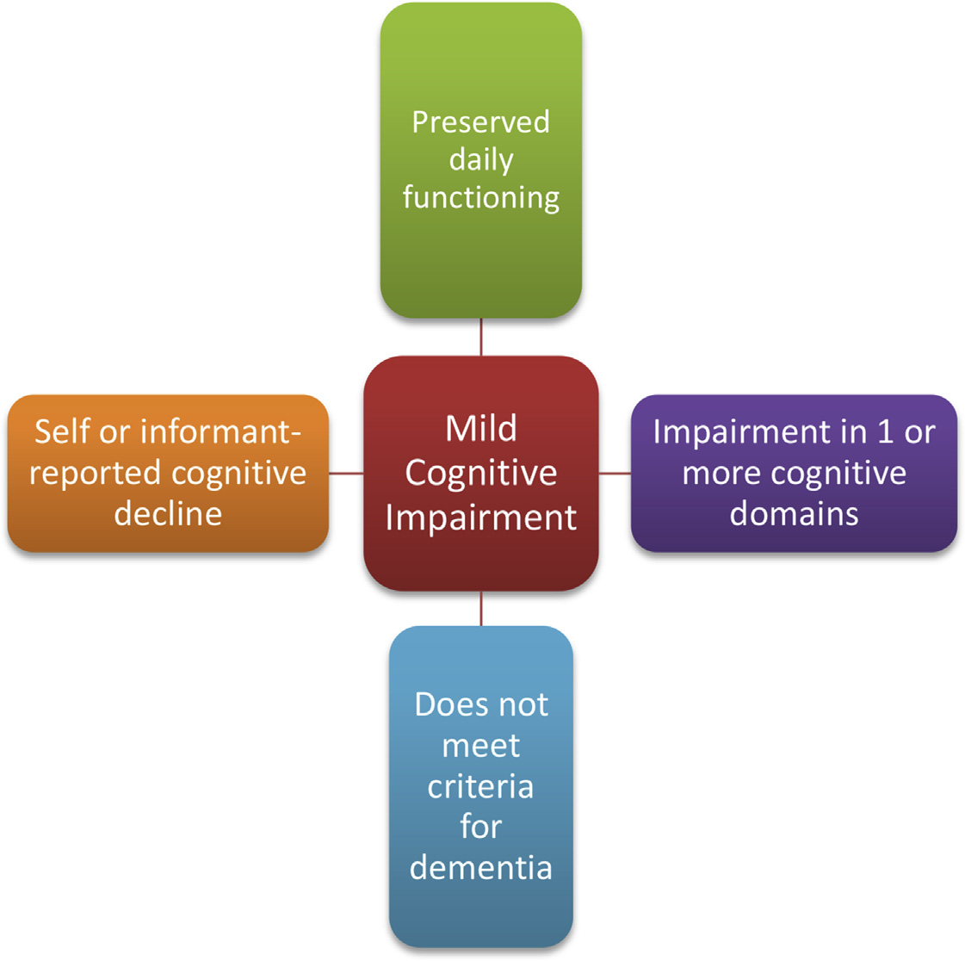
Mild cognitive impairment (MCI)
Sanford AM. Clin Geriatr Med 2017

Slide 8
Progression of mild cognitive impairment ➔ dementia
Amnestic ➔ Alzheimer’s disease (AD)
Multidomain amnestic ➔ Alzheimer’s disease (AD), Frontotemporal dementia (FTD),
Vascular dementia
Non-amnestic ➔Lewy body dementia (LDD), Parkinson disease dementsia (PDD), Frontotemporal dementia (FTD)
Subtypes of MCI
Single domain amnestic
Multidomain amnestic
Single domain nonamnestic
Multidomain nonamnestic
Aerts L et al. Neurology 2017

Slide 9
Dementia
Impairment of cognitive function: amnesia, agnosia, aphasia, apraxia
Syndrome: criteria (DSM IV – DSM V)
Memory disorder + 1 cognitive dysfunction
Personality changes
Decline in professional or social activities
Diseases:
Neurodegenerative; Secondary: progressive; non-progressive;
Neurological; non-neurological (metabolic etc)

Slide 10
DSM -Diagnostic and Statisticalmanual of Mental disorders
DSM-IV criteria | DSM-V criteria
A1. Memory impairment ------------------------------------------------------------------------ A2. At least one of the following: Aphasia Apraxia Agnosia Disturbancein executive functioning | A. Evidence of significant cognitive decline from a previous level of permormance in one or more cognitive domains: Learning memory Language Executive function Complex attention Preceptual-motor Social cognition
B. The cognitive deficits in A1 and A“ each cause significant impairment in social or occupational functioning and represent a significant decline from a previous level of functioning | B. The cognitive deficits interfere with independence in everyday activities. At a minimum, assistance should be required with complex instrumentaal activities of daily living, such as paying bills or managing medications
C.The cognitive deficits do not occur exclusively during the course of delirium | C. The cognitive deficits do not occur exclusively in the context of a delirium
 | D. The cognitive deficits are not better explained by another mental disorder (eg, major depressive disorder, schizophrenia).
For diagnostic criteria of dementia subtypes such as Alzheimer disease or frontotemporal dementia use special criteria

Slide 11
“Subcortical” type of dementia: dysexecutive syndrome
Executive dysfunction:
Strategic planning
Learning and memory
Attention deficit
Information processing:
Bradyphrenia – slow thinking
Apathy
Impaired visual cognition

Slide 12
Biomarkers for cognitive impairment/ dementia
Clinical
Cognitive moduls
Gait
Olfaction
Imaging
Cortical and subcortical atrophy : neuronal loss, axonal degeneration
Reduced cortical metabolism
Neurotransmitter deficiency: cholinergic and dopaminergic function
Increased cortical amyloid load
Cerebrospinal fluid
Proteinopathy
Aβ peptides
Tau protein
α -synuclein
Epidermal growth factor (EGF)
Genetic factors
Apolipoprotein E (APOE)
Catechol-O.methyltransferase gene (COMT)
MAPT and tau haplogroups
Glucocerebrosidase

Slide 13
Pathomorphologic characteristics: AD, LBD, PDD
Mollenhauer B, et al. Mov Disord 2014

Slide 14
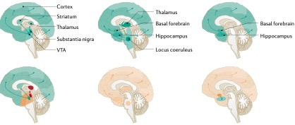

Dopaminergic Noradrenergic Cholinergic
Normal
Neuro-
transmitter
deficits
PD
normal
cognition
PDD
Aarsland D et al, Nature Rev 2021

Slide 15
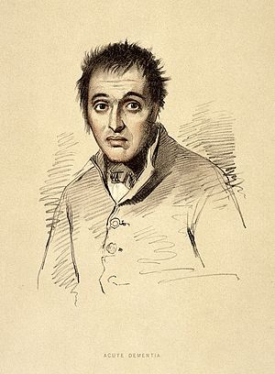
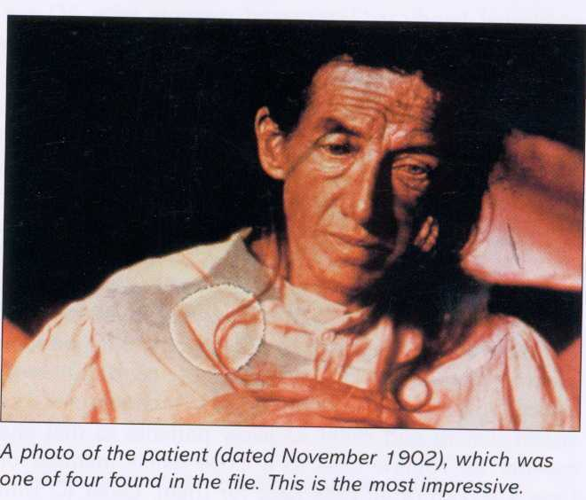
Dementia
an acquired loss of cognition in multiple cognitive domains sufficiently severe to affect social or occupational function
Progressive deterioration of intellect, behaviour and presonality
Disorientation in personal data, time, situation
Amnesia – memory loss
Communication – language ability
Apraxia – loss of handling complex tasks,
Agnosia – orientation in space
Behaviour changes
Notes:
Memory loss, which is usually noticed by someone else
Difficulty communicating or finding words
Difficulty with visual and spatial abilities, such as getting lost while driving
Difficulty reasoning or problem-solving
Difficulty handling complex tasks
Difficulty with planning and organizing
Difficulty with coordination and motor functions
Confusion and disorientation

Slide 16
Development of dementia
The rate of progressioon depends upon underlying cause
Development of symptoms:
Introspective, unsure of šelf
Difficulty in coping with work and ordinary routine
Loss of insight, behavioural changes, loss of inhibition
Long-term care. Cannotbe left unattended
Mutism, incontinence, death
Weeks
Months
Years

Slide 17
History of disease
Acute, fluctuating: transitory global amnesia, transitory epileptic amnesia
Chronic – rapidly progressive or slowly progressive
Other 26,4%: vascular, trauma, etc
FTD 2,6%
ALZ 71%
Leroy, M 2021

Slide 18
Diagnostic algoritm of episodic memory
deficits

Slide 19
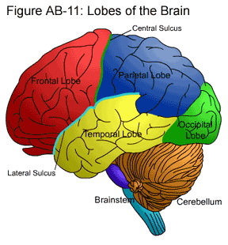
Social behavoir, attention, executive function
Learning tasks
Spatial orietation
Communication,
language
Visual
Memory,
emotion
Coordination

Slide 20
Amnesia – deficit in memory
inability to transfer new information
Inability to learn new info
Amnestic syndromes: retrograde, anterograde – (transitory global amnesia, posttraumatic)
Subcortical dementia - slow, forgetful, poor ability to use knowledge, apathetic, Associated with ohter neurological signs
Exam: MMSE (minimental state examinination), MOCA (Montreali cognitive assessment scale)
Social behavoir, attention
Praxis,
spatial orientation
Memory,
emotions

Slide 21
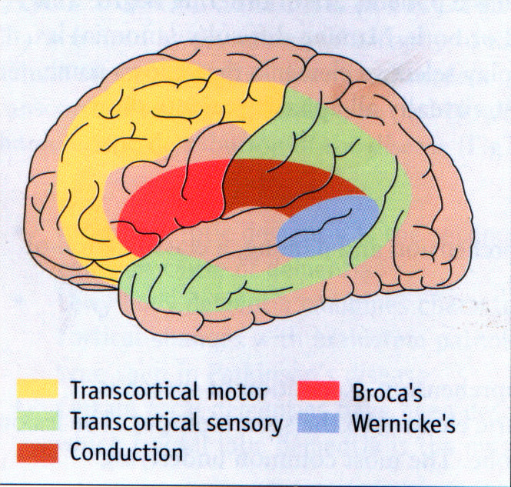
Aphasia: a language disorder
Inability to comprehend language
Wernicke`s aphasia: fluent aphasia: neologisms, , paraphasia (substituting letters, syllables or words),
Broca afaasia e. motor or nonfluent aphasia,understaning of speech is normal, short sentences or only yes/no or no speech

Slide 22
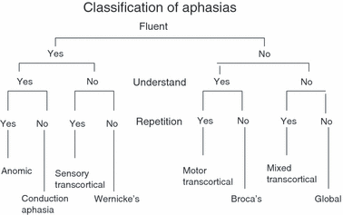
Algoritm of aphasia/dysphasia
Broca´s and Wernicke`s area are in dominant hemisphere in 99% of people
Nondominant hemisphere is related to emotionality and melody of the speech

Slide 23
Assessment of language
Listen to content and fluency of speech
Test comprehension, simple then complex commands
Assess spontaneous speech, naming objects, repetition, reading, writing
Broca`s aphasia: non-fluent,hesitant speech, good comprehension, handwriting is poor.
Wernicke`s aphasia: speech nonsensical but fluent, neologisms – nonexistent words; comprehension is impaired. Patient unware of language problem

Slide 24
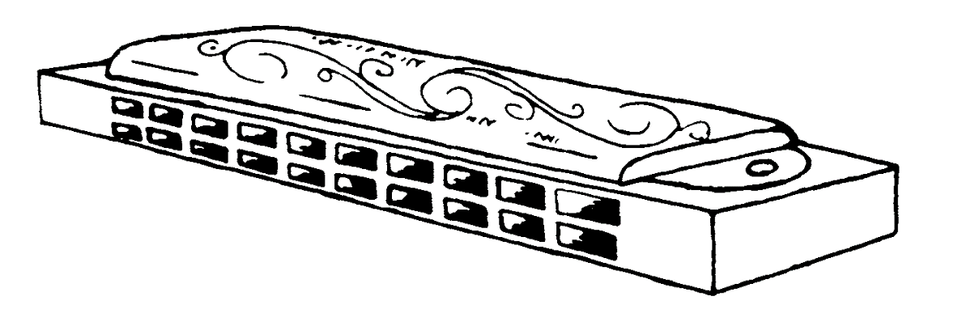
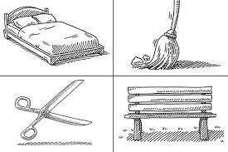
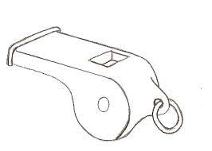
Bostoni naming test –

Slide 25
Memory impairment evaluation
History of memory problems, cognitive decline from the patients and care giver/family members
Disorientation in personal data, orientation in time, place etc
Short memory, longterm memory
Learning skills
Impairment in daily activities
Minimental state examination
Orientation in time (what time is it?) 5 p
Orientation in place (where are you?) 5 p
Recite three ojects now and remember them for later: Apple, table, penny – 3 p
Count backward 100 by seves orspell „world“ backwards – 5 p
Name the three things asked to remember earlier – 3 p
Name objects shown to : watch, pen 2 p
Repeat the phrase 1 p
Follow the instructions: take the paper in your right hand, fold it in half, and put it on the floor 3 p
Read and follow the instructions 1p
Make up a sentence and write it 1 p
Copy this Picture 1 p
Total score 30

Slide 26
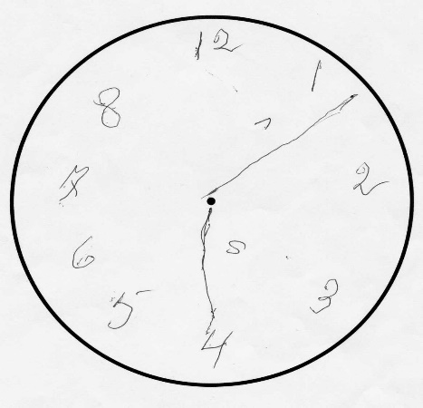
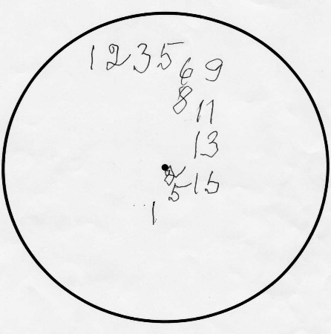
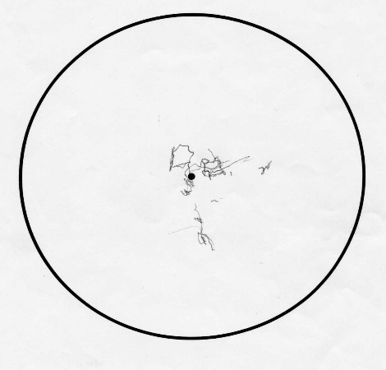
Neuropsychological assessment
Attention test
Trailmaking test
Digit span
Stroop test
Clock drawing
Language
Naming objects
Fluency (phonemic, semantic)

Slide 27
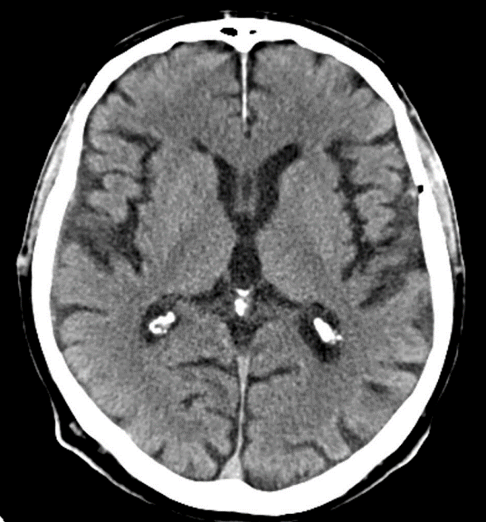
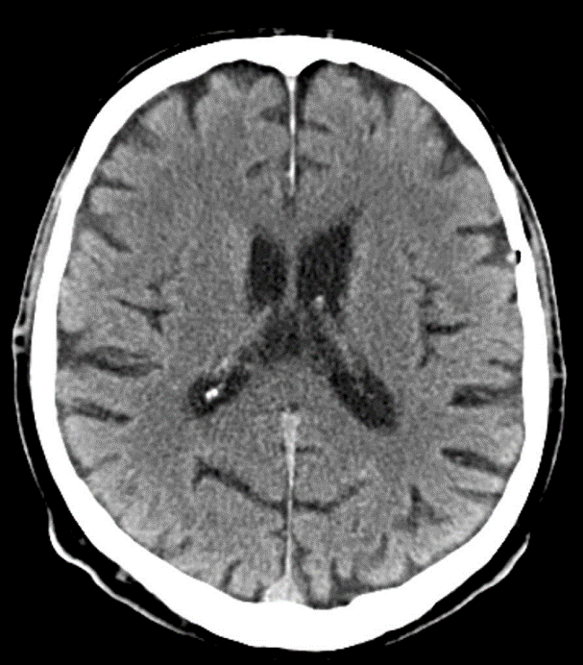

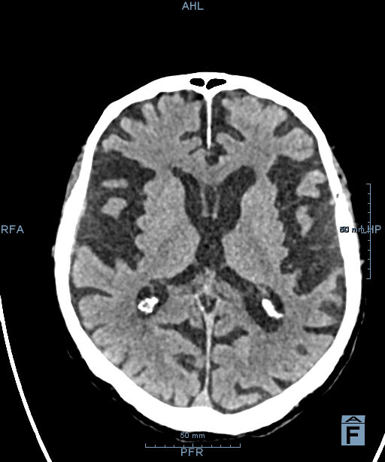
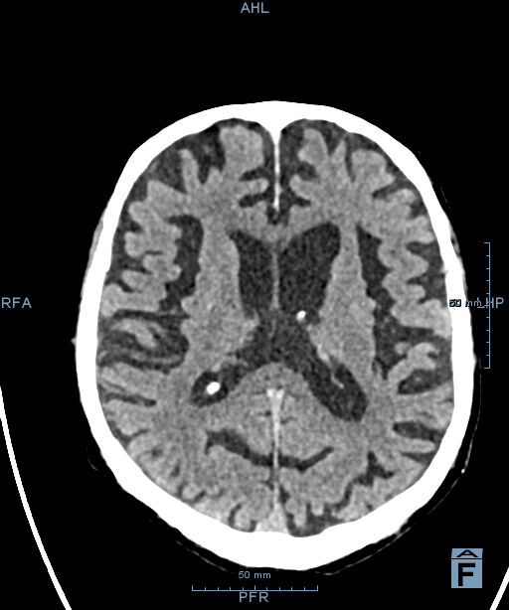
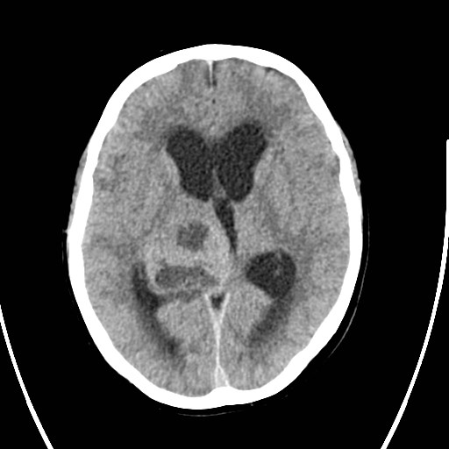
Brain neuroimaging for structural assessment
Chronic subdural haematoma
2006
Tumour
2018
Progressive brain atrophy in CT scan

Slide 28
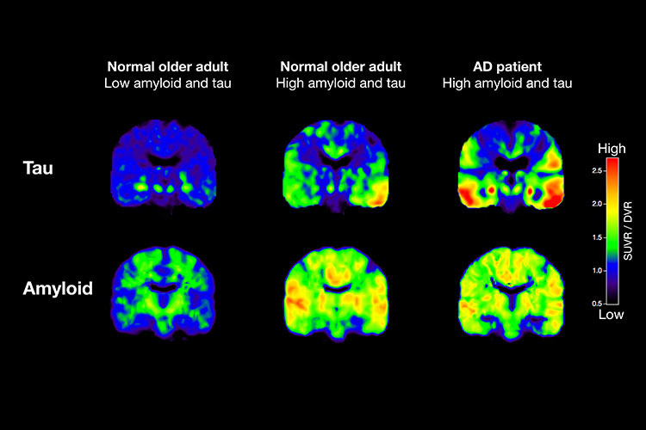
Positron emission tomography: scan of disease specific biomarkers – amyloid and tauprotein

Slide 29
Diagnosis – additional history and exam
Physical examination – neurological syndromes?
Comorbidity?
Medications? Habits?
Cerebrospinal fluid assay
Genetic testing
EEG

Slide 30
Dementia syndromes
Alz
MMSE
Leroy, M 2021

Slide 31
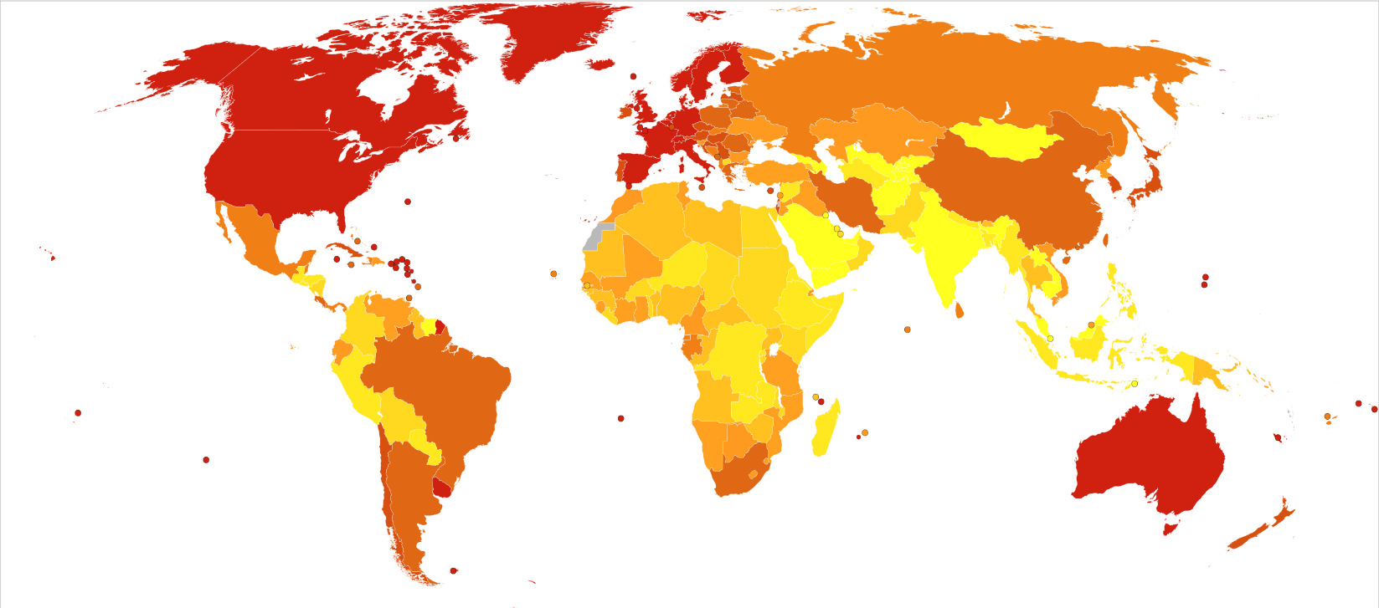
Alzheimer's disease and other dementias world map-deaths per million persons-WHO2012.svg
Deaths from Alzheimer's disease and other dementias in 2012 per million persons.
Statistics from WHO, grouped by deciles
0-4: India, Mongolia, Saudi Arabia
5-8
9-10
11-13
14-17
18-24: Sri Lanka
25-45
46-114
115-375
376-1266: USA, Europe, Australia

