Slide 1

Evaluation methods and data collection
Dr HMP Herath
Senior lecturer
Ph.D. (USJ), RN(SLNC), B.Sc. (Nursing) Hons(UPSL), CTHE (KDU)
Department of Nursing & Midwifery
FAHS, KDU

Slide 2

Learning outcomes
Understand the systematic and consistent nature of evaluation methods and their importance in the evaluation process.
Recognize the significance of proportionate effort and resource allocation, data availability, and timing for decision points in evaluation.
Explain the role of the Theory of Change in guiding the selection and application of evaluation methods.
Recognize that different stakeholders may have diverse needs and priorities and understand the importance of aligning these priorities with the Theory of Change.
Recognize the suitability of theory-based impact evaluation methods for assessing complex interventions or simple interventions in complex environments.
Describe the core principles of experimental and quasi-experimental impact evaluation methods, including the presence of a 'counterfactual' and the comparison of intervention and control groups.
Differentiate between experimental research, where participants are randomly assigned, and quasi-experimental research, which does not use randomization.

Slide 3

Introduction
Evaluation methods are usually made up of processes and protocols that ensure evaluations are done systematically and consistently.
Along with evaluation questions, three other factors are important: proportionate effort and resource, data availability, and timing for decision point.
As mentioned in the previous chapter, iteration will refine what is achievable and practicable.

Slide 4
Selection of appropriate evaluation methods
The process of choosing and applying analytical techniques for assessment should be guided by the theory of change.
It is important to note that various stakeholders may have different needs and prioritize different outcomes.
These outcomes should be reflected in the Theory of Change
Stakeholders should be engaged in the selection of the evaluation methods in order to agree priorities, manage expectations and accept the implications.
There should be alignment between the evaluation questions, the evaluation approach and the methods used.
Notes:
The theory of change and the assumptions and doubts it points out should be used to help choose and use analytical methods for evaluation.
It's important to keep in mind that different stakeholders may have different goals and desires. These results should be included in the Theory of Change, and stakeholders should be involved in choosing the evaluation methods so that they can agree on goals, manage expectations, and deal with the consequences.
The evaluation questions, the way the evaluation is done, and the tools used should all fit together.
In real life, most evaluation designs use a mix of qualitative and quantitative methods to answer questions about effect, process, and value for money.
No single method can answer all questions about evaluation. If time and money are limited, questions and methods will need to be prioritised, and there will need to be trade-offs between methods..

Slide 5

Selection of appropriate evaluation methods
In practice, most evaluation designs involve mixed methods,
  qualitative methods
  quantitative methods
answer the impact, process and value-for-money questions.
No individual method can provide answers to all evaluation questions. If time and resources are limited, questions and methods will have to be prioritized.
Notes:
The theory of change and the assumptions and doubts it points out should be used to help choose and use analytical methods for evaluation.
It's important to keep in mind that different stakeholders may have different goals and desires. These results should be included in the Theory of Change, and stakeholders should be involved in choosing the evaluation methods so that they can agree on goals, manage expectations, and deal with the consequences.
The evaluation questions, the way the evaluation is done, and the tools used should all fit together.
In real life, most evaluation designs use a mix of qualitative and quantitative methods to answer questions about effect, process, and value for money.
No single method can answer all questions about evaluation. If time and money are limited, questions and methods will need to be prioritised, and there will need to be trade-offs between methods..

Slide 6
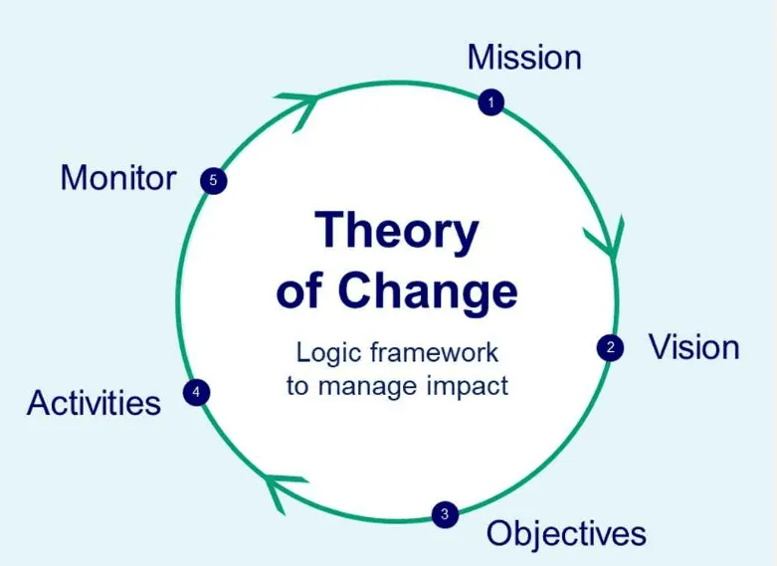
Theory of change is a model
A theory of change is a model that describes how a project or program is expected to function.
In other words, it serves as a roadmap for where the project hopes to go.
Notes:
Monitoring and evaluation tests and refines the road map while communications helps in reaching the destination by helping to bring about change.

Slide 7
Selection of appropriate evaluation methods
It is important to consider both the feasibility and appropriateness of a proposed method.
The cost, timing, respondent burden, ethics, response rate, and the potential effect of the data collection should all be considered.
The populations to be studied and the evaluation questions to be answered should be clear from the scoping stage.
  Clear definitions should be developed around the individuals/groups, places, and time periods associated with the evaluation questions to ensure the most appropriate methods are identified.
  Clear definitions can also help clarify the extent to which the findings can be generalized.

Slide 8
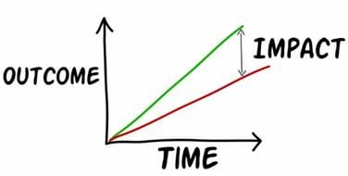
Research methods used in both process and impact evaluations
The research methods summarized in this section are commonly used in process and impact evaluations (and are widely used in non-evaluative research).
When used in impact evaluation, consistent data must also be collected for any control/comparison group.

Slide 9

Research methods commonly used for evaluation

Slide 10

Research methods commonly used for evaluation
Interviews and focus groups
Case studies
Surveys
Output or performance monitoring
Observational studies (including ethnography)

Slide 11
Research methods commonly used for evaluation
1. Interviews and focus groups
Description | Pros and Cons
Interviews enable in-depth exploration of the intervention with participants. Focus groups are useful to elicit views from a group of people rather than an individual. | Can be used to elicit views of individuals involved in an intervention. Can be used to collect in-depth insight about an intervention and shed light on patterns emerging in other pieces of evidence collected. Can be resource intensive; requires time to conduct and analyse; does not provide numerical estimates; there may be risk of bias in the views collected.

Slide 12
Research methods commonly used for evaluation
2. Case studies
Description | Pros and Cons
In-depth investigation of a person, group or event within its real-world context. Subjects are often purposively selected. Often uses multiple sources of evidence and data collection methods. Can be descriptive, exploratory, or explanatory. | Can capture real-life situations in depth and detail and help understand complex phenomena. Works well in combination with or supplementing other methods, such as surveys. Can be helpful for communicating to stakeholders what interventions have worked for particular organizations. It is difficult to generalize findings

Slide 13
Research methods commonly used for evaluation
3. Surveys
Description | Pros and Cons
Commonly used to collect data from a number of individuals, such as beneficiaries, or a large organisation with numerous members of staff. They can be administered face-to-face, by post, online, by telephone or as a handout. | An effective method of obtaining information from a large number of participants. Provides data suitable for statistical analysis that, if properly designed and conducted, can be generalised to the whole population of interest. Less useful for providing in-depth insight into an intervention. There can be response-rate issues that decrease the quality of its findings.

Slide 14
Research methods commonly used for evaluation
4. Output or performance monitoring
Description | Pros and Cons
Continuous measurement and performance review of an intervention. Monitoring plans are developed based on the Theory of Change to allow the tracking of the inputs, outputs and outcomes. To minimise errors in the data collection and burden on staff it is advisable to design monitoring in collaboration with those who will collect data. | Can provide a relatively low-cost and rapid method to identify if an intervention and create outputs as intended. Links well to benefits management. Can feel onerous for both participants and the staff (usually delivering an intervention) who collect

Slide 15
Research methods commonly used for evaluation
5.Observational studies (including ethnography)
Description | Pros and Cons
These involve observing and noting behavior of participants. Often supplemented with interviews of individuals Can support other methods byensuring that other data collected are understood Theories relevant to this context | Can allow for a deeper understanding of individual experience of an intervention. Observation may help improve accuracy of other data by reducing bias arising from self-reporting by participants. However, participants may still act differently if they know they are being observed which can affect the accuracy of the data. Resource-intensive and may have ethical implications, practical barriers and issues with generalizability.

Slide 16

Theory-based impact evaluation methods

Slide 17

Theory-based impact evaluation methods
Theory-based methods can be used to investigate net impacts by exploring the causal chains thought to bring about change by an intervention.
  However, they do not measure effect sizes precisely.
  Theory-based evaluation explicitly considers change extent and cause.
  While implementing the intervention, it often analyses context.
Notes:
Theory-based methods can be used to evaluate net impacts by exploring into the causal chains assumed to cause change as a result of an intervention. They do not, however, provide precise estimates of effect size. Theory-based evaluation is explicitly concerned with both the size of the change and the reasons behind the change. Furthermore, it frequently examines the context when the intervention is being done.

Slide 18
Theory-based impact evaluation methods
Theory-based methods tend to be particularly suited for the evaluation of complex interventions or simple interventions in complex environments.
  Theory-based methods can confirm if an intervention had the desired effect in certain cases, where effect size is difficult to determine.
  Many of these strategies do not try to prove that the intervention caused all measured changes.
  Instead, they investigate whether the intervention caused the measured change. They can also explain why an intervention worked or failed and inform translation to other populations, regions, or periods.
Notes:
Theory-based methods are well suited to evaluating complicated treatments or simple interventions in complex situations. In these cases, where estimating the size of the effect can be challenging, theory-based methods can confirm whether an intervention had the desired effect.
The goal of many of these strategies is not to give definite evidence that the intervention is responsible for the entirety of any measured improvement. Rather, they want to know if the intervention contributed to the observed change. They can also explain why an intervention worked or did not work, and they can help with translation to other populations, locations, or time periods.

Slide 19

Common theory-based impact evaluation methods
Realist evaluation
Contribution analysis
Process tracing
Bayesian updating
Contribution tracing
Qualitative Comparative Analysis
Outcome harvesting
Most significant change
(Please read: Table 3.2 Quick guide to common theory-based impact evaluation methods-HMT_Magenta book)

Slide 20
Experimental and quasi-experimental impact evaluation methods

Slide 21
Experimental and quasi-experimental impact evaluation methods
The core principle of these methods is that there is a ‘counterfactual’: observed outcomes from a ‘control’ group that did not receive the intervention, which can be compared to outcomes from the intervention group.
The groups consist of participants, which might be individual people, or other units, such as schools, businesses, houses, or spatial areas. Mixing between groups should be minimal to limit bias from ‘contamination’.
Quasi-experiments are studies that aim to evaluate interventions but that do not use randomization. Similar to randomized trials, quasi-experiments aim to demonstrate causality between an intervention and an outcome.
Notes:
What two features define a quasi-experimental study?
In a quasi-experimental design, the researcher changes or watches an independent variable, but the participants are not randomly put into groups.
Instead, people are put into groups based on things they already have in common, like their age, gender, or how many times they have seen a certain stimulus.

Slide 22
Experimental and quasi-experimental impact evaluation methods
Collecting and analyzing comparable data from the intervention and control enables evaluators to confidently attribute any measured change to the intervention (subject to assumptions specific to the method).
These impact evaluation methods are favored when we need to know the average additional or net change caused by an intervention or how much of the observed outcome(s) could be attributed to the intervention.
However, the precise method to be used depends on: whether participants in an intervention can be randomised; the expected effect size; the availability of data; and the availability of potential control groups.
A simple, but effective, way to help plan or review experimental methods is the PICOT1framework, which considers the population, intervention, control group, outcome and time period.

Slide 23
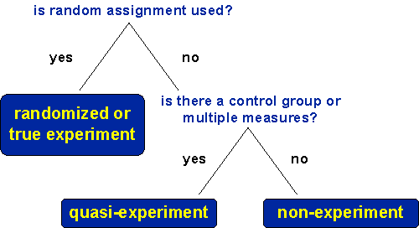
What is the difference between experimental and quasi-experimental research?
With an experimental research study, the participants in both the treatment (product users) and control (product non-users) groups are randomly assigned.
Quasi-experimental research designs do not randomly assign participants to treatment or control groups for comparison.

Slide 24
Randomised Controlled Trials (RCTs)
Randomised Controlled Trials (RCTs) prospectively and randomly allocate participants to either intervention or control groups.
RCTs can robustly evaluate the impact of interventions because they account for both known and unknown factors because allocation to the treatment is random.
Measured differences between groups can, therefore, be considered to be the result of the intervention alone. However, the need to ensure rigid implementation of an intervention (high fidelity with the protocol) can reduce its external validity.

Slide 25
Randomised Controlled Trials (RCTs)
There are a number of variations of RCTs for various needs and situations:
  Factorial RCTs independently randomize participants to multiple interventions;
  Cluster RCTs randomize groups of participants rather than individuals;
  Stepped-wedge RCTs apply an intervention sequentially and at random to groups of participants.
Methods, such as Sequential Multiple Assignment Randomized Trial (SMART) and Multiphase Optimisation Strategy (MOST), have been developed for the optimization of interventions and may be particularly appropriate to develop more potent digital interventions.

Slide 26
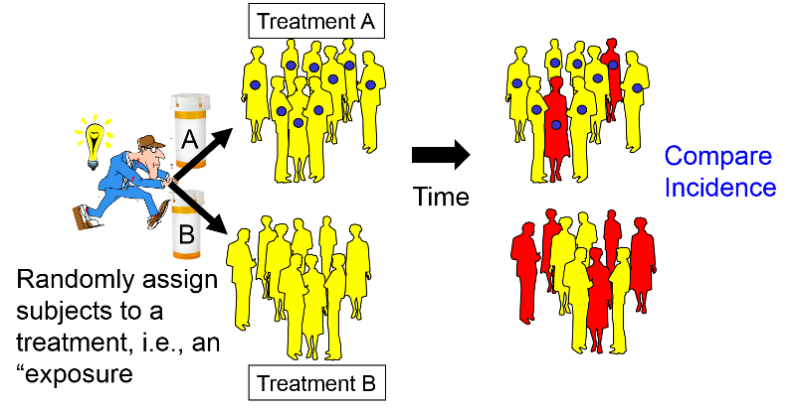
RCT

Slide 27
Selection of a method
Selection of a method usually depends on:
  the nature of the allocation into intervention and control groups (for example, it can be controlled by the evaluator or result from an external shock);
  the nature of the control group (it can be concurrent or historic);
  the format of the available data (such as discrete or trends);
  the volume of the available data (see Figure).

Slide 28
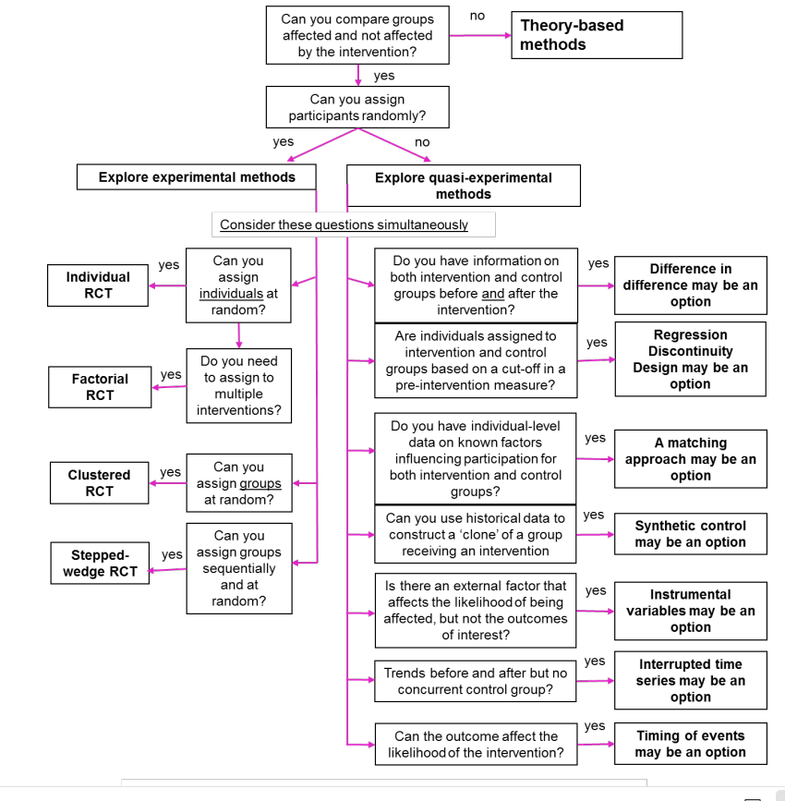
Selection of a method

Slide 29
Common experimental and quasi-experimental impact evaluation methods
Randomised Controlled Trials (RCT)
Interrupted time series analysis and difference-indifference
Regression Discontinuity Design
Propensity Score Matching
Synthetic control methods
Instrumental variables or natural experiments

Slide 30

Value-for-Money evaluation methods

Slide 31

Value-for-Money evaluation methods
Value-for-money evaluation methods compare benefits to the costs of interventions, including adverse and unintended aspects.
Two widely-used methods; both of which allow for comparison of two or more alternative options (interventions).
  social cost-effectiveness analysis and
  social cost-benefit analysis
The primary differences between these two types of evaluations are:
  social cost-effectiveness analysis compares the costs of alternative ways of producing the same or similar outputs.
  social cost-benefit analysis goes further to assess the impact of different interventions on social welfare with all relevant costs and benefits valued in monetary terms (where proportionate and possible).

Slide 32
Value-for-Money evaluation methods
Experimental, quasi-experimental, or synthetic procedures are used to quantify alternative intervention outputs or impacts.
Theory-based methods can estimate the net effect without a quantitative estimate to determine if it will break even.
The expenses of the potential interventions must be examined to determine which will yield the greatest return on investment.
If possible, these expenses should include social value and costs like employment, health, wellbeing, and productivity. Distribution analysis should weigh population group costs and benefits.

Slide 33
Common value-for-money evaluation methods
Evaluation Method | Description | Pros and Cons
Social cost effectiveness analysis | Supports the selection of intervention options that have the same measure of outcome by comparing their costs and effect sizes. | Enables comparison where benefits cannot be converted into monetary units or the cost to do so is prohibitive. Systematically provides comparability of options. The lack of benefits in monetary metrics limits its value compared to cost-benefit analysis.
Social cost benefit analysis | Quantifying and monetising both the costs and benefits of interventions enables comparison between them, even when they have different outcome measures. Can be used to forecast using predicted costs and benefits or used post-intervention in an evaluation using outcome data. | Can capture short- and long-term impacts systematically. Quality of results relies heavily on available data and ability to monetize the impacts.

Slide 34

Synthesis methods

Slide 35
Synthesis methods
Synthesis methods entail combining findings from a range of studies into a common understanding of the impact and/or delivery of a policy.
Post-evaluation synthesis is used to bring together the outputs of the various methods used in the evaluation in a clear and systematic way to answer the original evaluation questions.
The component methods can be quantitative or qualitative or mixed methods and focus on impact or process evaluation questions.
Synthesis methods can also be used prior to initiating the development of an intervention to determine what is already known on a subject.
Notes:
To synthesise, evaluation findings are integrated around each of the questions (rather than simply reporting the findings from each method), typically called ‘triangulation’.
Ideally, this provides a consensus of evidence with greater certainty than each of the component parts. However, if there is conflicting evidence, findings should be examined carefully, explanations considered, and additional evidence sought where appropriate.

Slide 36

Synthesis methods
Meta-evaluation and synthesis
Meta-evaluation and synthesis are formal synthesis methods designed to bring together findings from a number of different studies on the same subject.
Methods of synthesis and meta-analysis bring together existing evaluation evidence in a structured way to produce a coherent narrative.
These "secondary research" procedures start with specific goals and inclusion/exclusion criteria. They then assess source study quality, extract essential findings, and analyze the data to produce an integrated account of the source literature using explicit processes and pre-defined criteria.
The main limitation of evaluation synthesis is its reliance on a sufficient body of previously acquired data.
The quality of the evidence synthesis depends on the quality of the original studies, and validity depends on which original studies are included. Hence, the importance of inclusion criteria and quality assessment in the process.
Notes:
As an example, Systematic Reviews and Rapid Evidence Assessments integrate literature evidence to produce a narrative summary. Systematic reviews often take months and therefore, Rapid Evidence Assessments can be used if less rigour can be tolerated. These methods often focus on quantitative data, but other frameworks

Slide 37
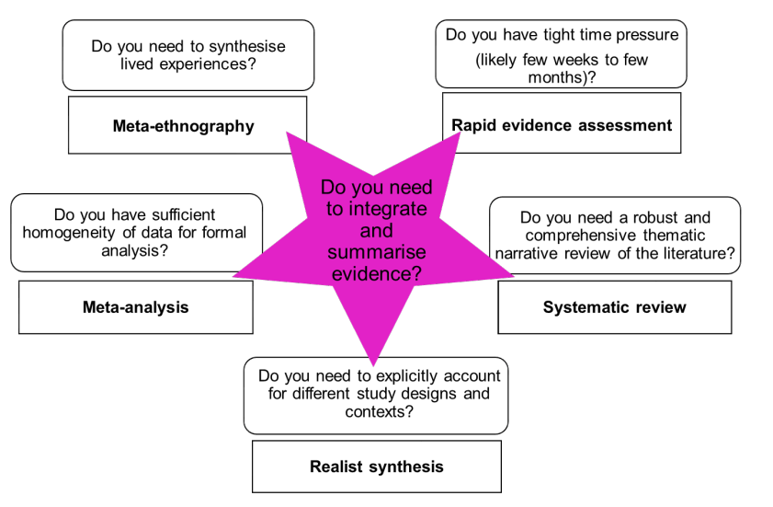
Evidence synthesis methods

Slide 38
Rapid evidence assessment
Description | Pros and Cons
Rapid Evidence Assessments are systematic but pragmatically relatively quick literature reviews. They may use interviews with experts to facilitate targeted searches of the literature. The focus tends to be relatively narrow. | Useful for relatively quick scoping out of existing evidence but require a number of good quality studies to draw from. They are less effective where research questions do not easily map on to the existing body of evidence. Transparency is key. They are subject to greater bias than a systematic review.

Slide 39
Systematic reviews
Description | Pros and Cons
A systematic method of identifying, assessing, extracting and integrating evidence from multiple studies. The focus should provide a methodical approach to reviewing all data to answer a clearly defined research question. The aim is to reduce bias and provide a comprehensive overview of studies through use of five key steps. | Provides a comprehensive assessment of available evidence. Has a rigorous approach to assessing and referencing studies. Can be resource-intensive and take a long time (six months plus). They need a substantial body of evidence to review, so maybe less effective when used in fields with limited evidence.

Slide 40
Meta analysis
Description | Pros and Cons
Rapid Evidence Assessments are systematic but pragmatically relatively quick literature reviews. They may use interviews with experts to facilitate targeted searches of the literature. The focus tends to be relatively narrow. | Useful for relatively quick scoping out of existing evidence but require a number of good quality studies to draw from. They are less effective where research questions do not easily map on to the existing body of evidence. Transparency is key. They are subject to greater bias than a systematic review.

Slide 41
Meta ethnography
Description | Pros and Cons
Meta-ethnography brings together multiple individual lived experiences. Evaluators select, analyse and interpret narrative accounts within studies to identify new concepts and insights across studies. | Allow evaluators to either evolve overall concepts, explain conflicting differences in stories, or build a picture of the study subject from a number of different narrative accounts. Quality depends on quality of original studies and validity depends on inclusion criteria.

Slide 42
Realist synthesis
Description | Pros and Cons
This integrates Systematic Review methods with Realist Evaluation theory to explain outcomes from an intervention through literature review. It is often used to assess complex policies based in complex environments as it is a structured method to understand the underlying Context Mechanism-Outcome relationships in an intervention. | Accounts for differences between study contexts and study designs. The broad concepts to the method are specific to the intervention and context and therefore cannot easily be reproduced or standardized. Requires researcher knowledge of the intervention context and understanding of implementation.

Slide 43

References
HMT Magenta Book: Prudential standards in the Financial Services Bill: Policy statement, 2020. . HM Treasury, United Kingdom.

Slide 44

Thank you

