Slide 1
The role of outcomes research in NDDs: An overview of outcomes research
Clinical assessment and outcome measurement
Peter Hagell Kristianstad university

Slide 2
Learning Objectives
Exemplify various types of outcomes research
Discuss the role of outcomes research in neurodegenerative disorders

Slide 3
What is outcomes research?
Research that investigates the outcomes (results) of health care practices and interventions
Intended to provide scientific evidence relating to decisions made by all who participate in health care

Slide 4

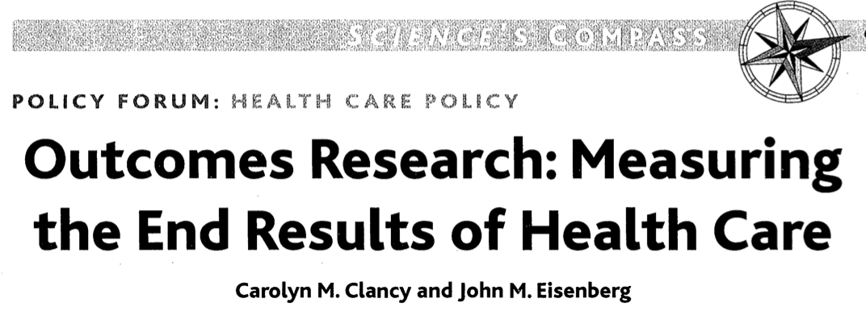
What is outcomes research? Some definitions
the study of the end results of health services that takes patients' experiences, preferences, and values into account
outcomes research seeks to understand the end results of particular health care practices and interventions. End results include effects that people experience and care about, such as change in the ability to function. In particular, for individuals with chronic conditions – where cure is not always possible – end results include quality of life as well as mortality
Clancy & Eisenberg. Science 1998; 282(5387): 245-246.
Jefford et al. Internal Medicine Journal 2003; 33: 110-118.

Slide 5
Outcome assessment (health care)
Medical subject heading (MeSH), The US National Library of Medicine
Research aimed at assessing the quality and effectiveness of health care as measured by the attainment of a specified end result or outcome. Measures include parameters such as improved health, lowered morbidity or mortality, and improvement of abnormal states

Slide 6
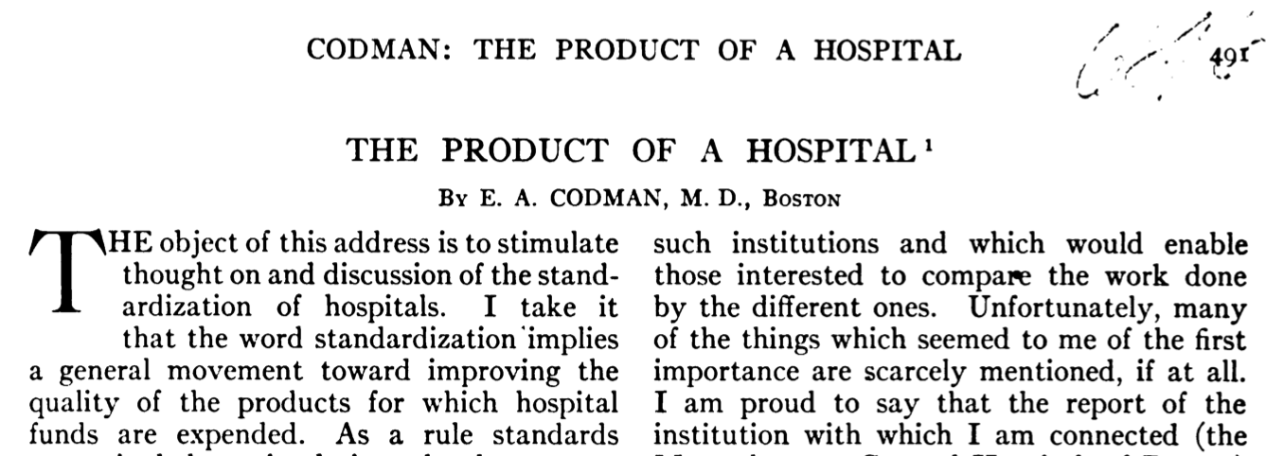

Codman’s 1914 paper is sometimes referred to as the starting point of outcomes research. He argued, e.g., that hospitals
report the number of patients treated, but not whether patients appeared to benefit from treatment
should produce a report of their treatment results, standardized to allow comparison between hospitals
Donabedian (1966) coined the term ‘outcome’. He recognized that,
while some outcomes (such as death) might be easily recognized and assessed, others might be less easily defined and assessed (e.g., patient satisfaction, social restoration and physical disability)
‘outcomes, by and large, remain the ultimate validators of the effectiveness and quality of medical care’
Codman. Surg Gynecol Obstet 1914; 18: 491-496.
Donabedian. Milbank Memorial Fund Quarterly 1966: 44(3): 166-203.

Slide 7
1970s-1980s
Considerable variation in resource input, use and expenditure
Lack of consensus regarding effective medical procedures and techniques, and no clear link between procedures and favourable results
Variation in the use of hospital services without compromised health outcomes → need for research to determine the causes and implications of differences
Studies assessing preferences for treatment, including the trade between improved quality and quantity of life

Slide 8
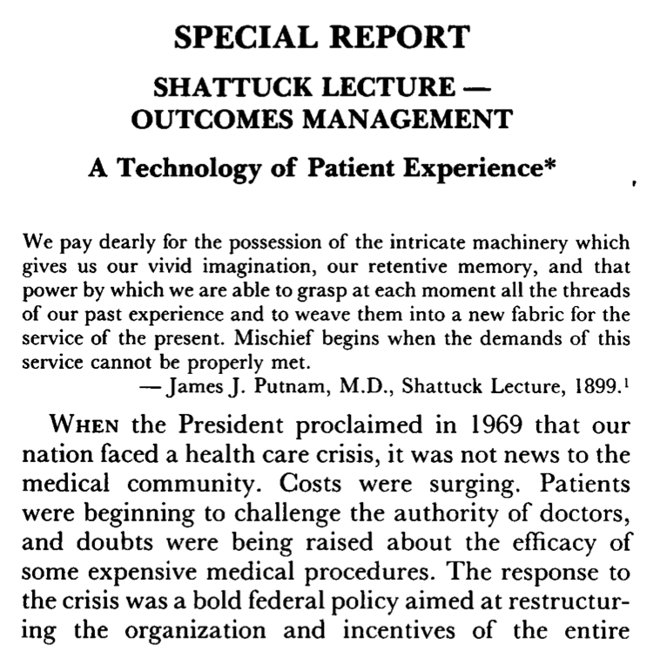
Ellwood PM. N Engl J Med 1988; 318: 1549-1556.

Slide 9








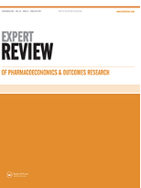

Today
A research field of its own
Specialized journals, scientific societies, conferences, etc.

Slide 10
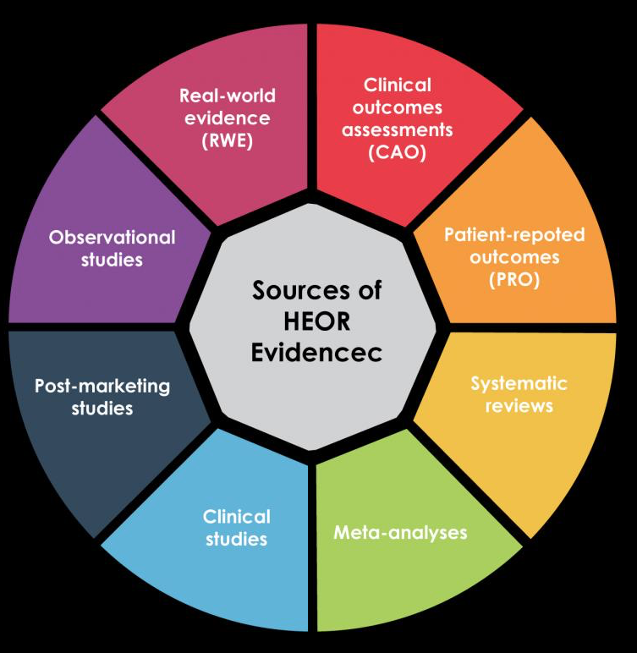
Today
Largely integrated in clinical practice, research and decision making, e.g.,
Quality assurance of rating scales and other similar instruments through psychometrics
Integration of, e.g., patient-reported outcomes and health economics in clinical studies, audits and registries

Slide 11
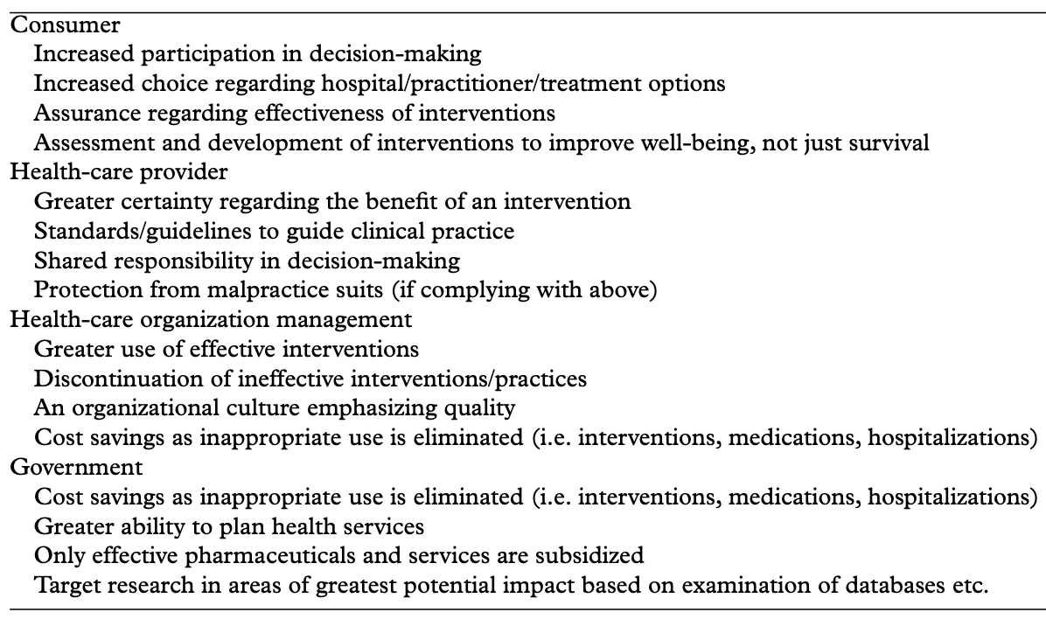
The value of outcomes research
Suggested benefits of outcomes research
Outcomes research complements traditional clinical trials by, e.g.,
provide better information to inform patient decisions
guide health providers
inform health policy decisions
Jefford et al. Internal Medicine Journal 2003; 33: 110-118.

Slide 12
Perspectives and types of outcomes
Perspectives
Patient, family members, informal carers
Health care providers
Health care professionals
Hospitals, clinics
Societal, payers
Outcomes
Humanistic
Clinical
(Health) Economic
Bungay & Sanchez 1996.

Slide 13
Types of outcomes in outcomes research
Humanistic
Patient-reported outcomes (health status, symptoms, well-being, etc.)
Functional status
Satisfaction with and quality of care
Preferences
Clinical
Effectiveness
Symptom/disease severity
Biomarkers
Survival
(Health) Economic
Costs (direct, indirect, intagible)
Utilities (health value; typically based on patient report)

Slide 14
Health economic evaluations
Cost-effectiveness analysis
comparative economic analysis that evaluates two or more alternatives in terms of their relative costs and outcomes, where the outcomes are measured in a single natural unit (e.g., life-years gained)
Cost-utility analysis
a specific type of cost-effectiveness analysis; comparative economic analysis that evaluates two or more alternatives in terms of their relative costs and outcomes, where the outcomes are expressed by a generic measure of health status that considers both the effect on mortality and morbidity (e.g., quality-adjusted life-years (QALYs) and disability-adjusted life-years (DALYs))
Cost-benefit analysis
comparative economic analysis that evaluates two or more alternatives in terms of their relative costs and outcomes, where both the costs and outcomes are expressed in monetary terms. In principle, it should value the interventions relevant costs and outcomes based on the preferences of those affected (i.e., the individuals’ willingness to pay)
Cost-minimization analysis
comparative economic analysis that compares the costs of two or more alternatives that are assumed to have equivalent health effects
Cost of illness
descriptive analysis that identifies direct, indirect and/or intangible costs associated with a particular condition in a specific health system
Turner et al. Frontiers in Public Health 2021

Slide 15
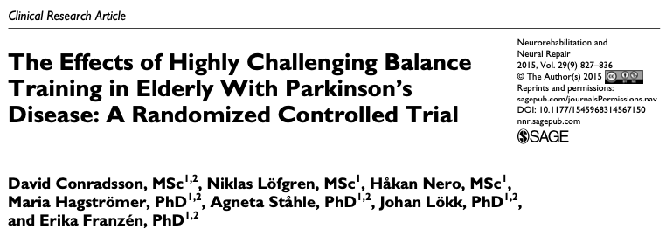
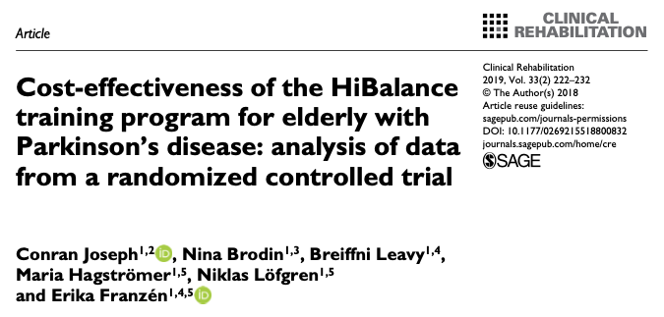
Example RCT with planned subsequent health economic evaluation
Balance training in persons with Parkinson’s disease
https://doi.org/10.1177/1545968314567150
https://doi.org/10.1177/0269215518800832

Slide 16
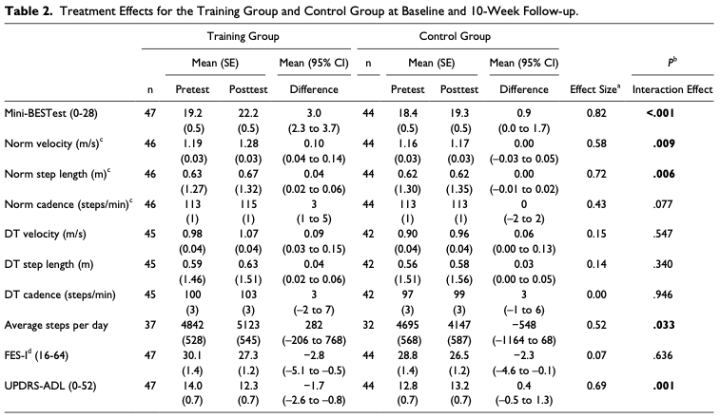
https://doi.org/10.1177/1545968314567150
100 persons with PD randomized either to the 10-week HiBalance program (n=51) or to the control group (n=49)
HiBalance program
4-7 participants/group, 3 times/week, 60 min/session
Sessions led by 2 physiotherapists (n=10) educated in the intervention (8 h)
Primary outcomes:
Balance performance (Mini Balance Evaluation Systems Test, Mini-BESTest; Clinical assessment)
Gait velocity (during normal and dual-task gait; Clinical test)
Concerns about falling (Falls Efficacy Scale – International, FES-I; Patient-reported)
✅
✅

Slide 17
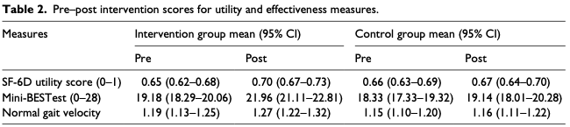
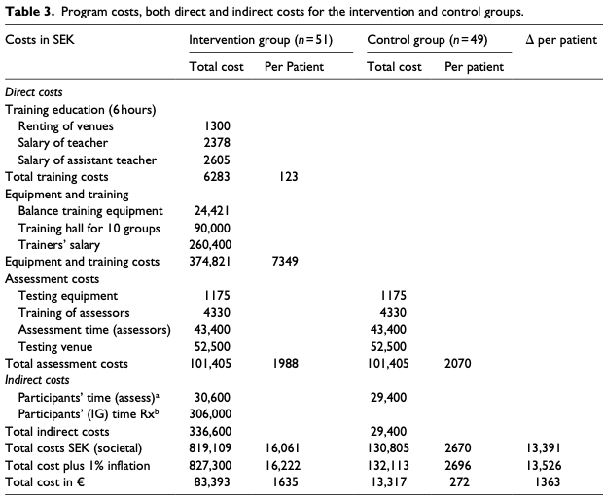
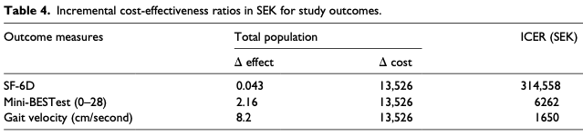
https://doi.org/10.1177/0269215518800832
Cost-effectiveness measures were the Mini-BESTest (range, 0-28) and gait velocity (cm/s)
Cost-utility was evaluated using quality-adjusted life years (QALYs) based on the SF-6D
Health utility 0-1; 1 = perfect health
1 year with health utility 1 = 1 QALY
1 year with health utility 0.5 = 0.5 QALY
3 years with health utility 0.33 = 1 QALY
Incremental Cost-Effectiveness Ratios (ICER)
ICER = (cost_{intervention} – cost_{control}) / (effect_{intervention} – effect_{control})
Relative to a suggested European willingness-to-pay threshold of SEK 500,000
The intervention added an average additional 15 days of perfect health
Cost per QALY: SEK 314,558 (€31,712)
ICER <SEK 500,000

Slide 18

Outcomes research
Purpose
Assist patients, clinicians, purchasers and policy makers in making informed health decisions by advancing quality and relevance of evidence (PCORI)
Provide evidence about benefits, risks, and results of therapies and interventions so clinicians and patients can make more informed decisions (AHRQ)
Process
Identifying, measuring and evaluating effects of care
Results
Can guide health care decision makers* in selecting the most effective treatment and/or procedural strategy or to improve upon current treatments and medical interventions
* including, e.g., patients, health care professionals, payers, health care authorities

Slide 19
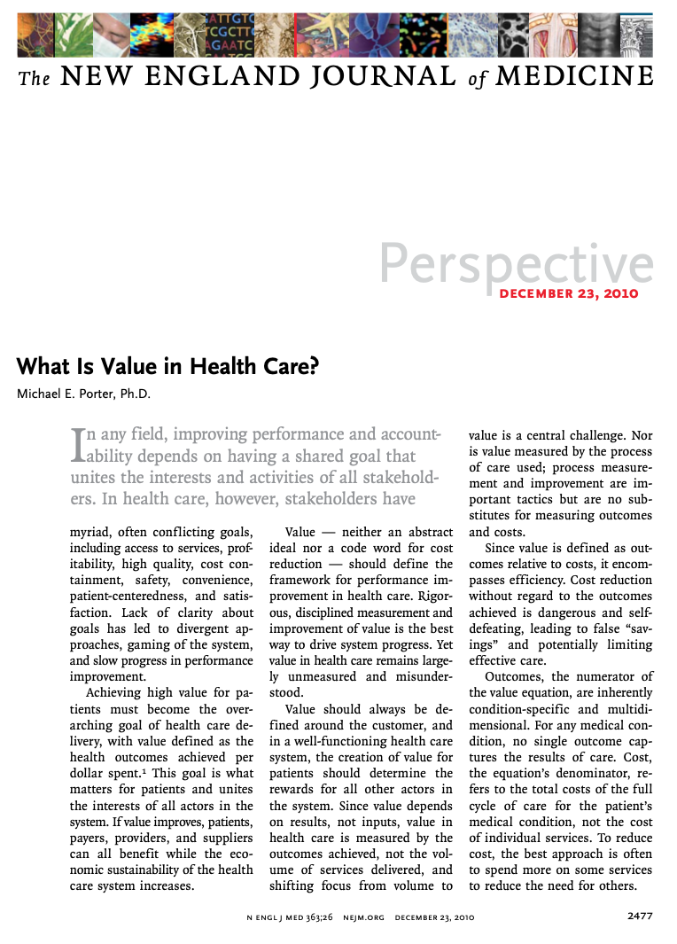
“Value should always be defined around the customer, and in a well-functioning health care system, the creation of value for patients should determine the rewards for all other actors in the system. Since value depends on results, not inputs, value in health care is measured by the outcomes achieved, not the volume of services delivered, and shifting focus from volume to value is a central challenge”
https://doi.org/10.1056/NEJMp1011024

Slide 20


Data sources
Registers
Medical records
Official statistics
Clinical trials
Costs
Rating scales
Questionnaires
Quality assurance of rating scales and questionnaires is a major field of outcomes research (e.g., psychometrics)

Slide 21
Some challenges with rating scales and questionnaires
Latent variables
Converting qualitative observations into quantitative measures
What do scores represent?
Validity
The instrument represents the intended variable
How confident can we be about scores?
Reliability
The extent to which scores are free from error
Psychometrics

Slide 22
Scientific vs. clinical use of rating scales
Scientific use
Standardize assessments and history taking
Represent variables of interest
Use of total scores
Clinical trial end-points
Inform policy and guidelines
Clinical use
Standardize assessments and history taking
Use of individual item responses
Inform day-to-day practice and decisions
Aid patient communication

Slide 23
References
Bungay KM, Sanchez LA. Types of Economic and Humanistic Outcomes Assessments. In: Pharmacoeconomics and Outcomes: Applications for Patient Care (module 1). Kansas City: American College of Clinical Pharmacy, 1996. Available from: https://www.accp.com/docs/products/ppc11/pharmacoeconomics.pdf
Clancy CM, Eisenberg JM. Outcomes research: Measuring the end results of health care. Science 1998; 282(5387): 245–246. Available from: https://doi.org/10.1126/science.282.5387.245
Codman EA. The product of a hospital. Surgery, Gynecology and Obstetrics 1914; 18: 491-496. Available from: https://catalog.hathitrust.org/Record/000680689
Donabedian A. Evaluating the quality of medical care. The Milbank Memorial Fund Quarterly 1966: 44(3, Pt. 2): 166-203. Available from: https://www.ncbi.nlm.nih.gov/pmc/articles/PMC2690293/

Slide 24
References
Jefford M, Stockler MR, Tattersall MHN. Outcomes research: what is it and why does it matter? Internal Medicine Journal 2003; 33: 110-118. Available from: https://www.researchgate.net/publication/10884808_Outcomes_research_What_is_it_and_why_does_it_matter
Lee SJ, Earle CC, Weeks JC. Outcomes research in oncology: history, conceptual framework, and trends in the literature. Journal of the National Cancer Institute 2000; 92: 195-204. Available from: https://doi.org/10.1093/jnci/92.3.195
Turner HC, Archer RA, Downey LE, Isaranuwatchai W, Chalkidou K, Jit M, Teerawattananon Y. An introduction to the main types of economic evaluations used for informing priority setting and resource allocation in healthcare: Key features, uses, and limitations. Frontiers in Public Health 2021; 9:722927. Available from: https://doi.org/10.3389/fpubh.2021.722927

