Slide 1
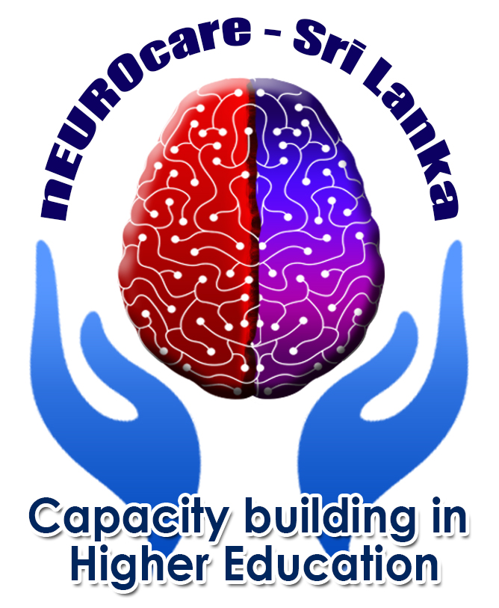
2. Aging
2.2. Neurodegeneration and disease progression
2.2.b. Risk factors -
Epigenetic changes in neurodegeneration
Gorazd Drevenšek

Slide 2
Aim of the lecture
Understand the epigenetic role in neurobiology of NDD
The basics of epigenetics
The main epigenetic impact and degenerative changes
Changes in behavior during NDD development due to epigenetics
Students shall describe and integrate this knowledge into the course of NDD progress

Slide 3
Content of the lecture
Introduction: Epigenetics and Neurodegenerative Diseases
A brief overview of epigenetic mechanisms
2.1 DNA Methylation and Hydroxymethylation
  2.2 Histone Tail Modifications
  2.3 Mechanisms Mediated by Non-coding RNAs
How brain functions are affected due to epigenetic changes
DNA Methylation and Histone Tail Modifications in Alzheimer’s Disease
DNA Methylation and Histone Tail Modifications in Parkinson’s Disease
Non-coding RNAs and neurodegenerative diseases
Behavioural changes of epigenetic origin in NDD, focused on the need for intervention

Slide 4
Methods of learning
Ex-catedra lecture
Group seminar work – examples and cases
Videolectures (individually)
(Max. 1 hour!)

Slide 5
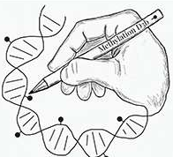
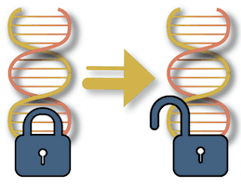
Introduction: Epigenetics and Neurodegenerative Diseases
The concept of epigenetics was first introduced (Waddington, C. H., 1939)
to describe the molecular events that are involved in early embryonic development
“Epigenetics” = the study of changes in gene expression that are not attributed to alterations in the DNA sequence in response to intrinsic and extrinsic stimulations
  different biological traits that are responsible for regulation of gene expression
Neuroepigenetics = ‘epigenetics as it pertains to neurons’
The epigenome is the collection of all of the epigenetic marks on the DNA in a single cell
(Felsenfeld, G. A brief history of epigenetics. Cold Spring Harbor Persp. Biol.2014)
Notes:
Epigenome = chemical compounds that modify, or mark, the genome in a way that tells it what to do, where to do it, and when to do it

Slide 6
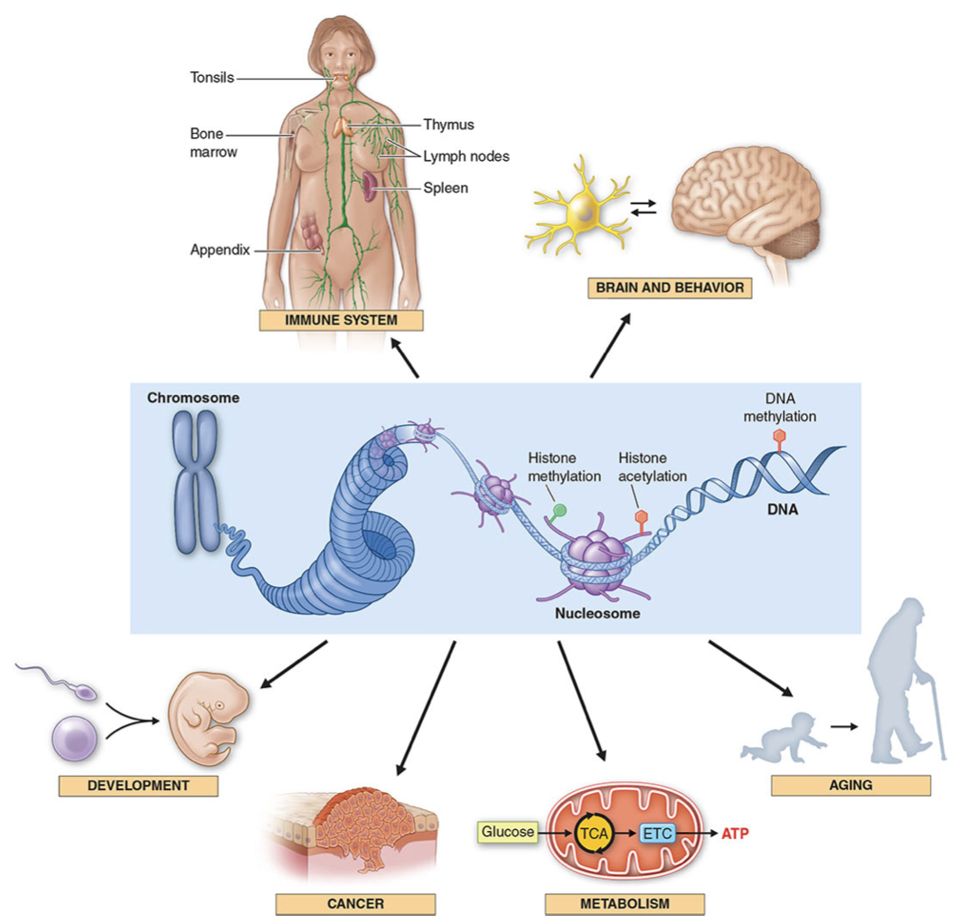
Introduction: Epigenetic pathways influence multiple physiologic and disease pathways
Hauser, Stephen L., et al. Harrison's Principles of Internal Medicine, 21e. 2022 McGraw Hill.
Notes:
s depicted in the center of the illustration, epigenetics refers to the chemical modifications of DNA and histones, which influence chromatin structure, gene expression, and susceptibility to mutations. These molecular pathways, in turn, play important roles in development, cancer, metabolism, aging , neural function, and behavior, and in the immune system. ETC, electron transport chain; TCA, tricarboxylic acid.

Slide 7
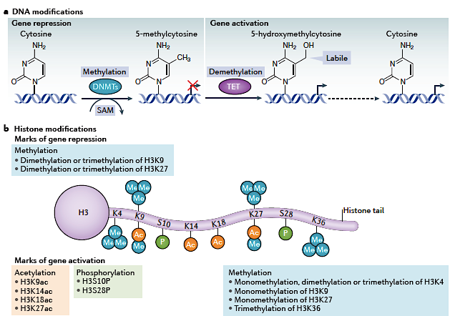
Introduction: Epigenetics and Neurodegenerative Diseases
Epigenetic mechanisms are dynamically regulated in the adult central nervous system in response to experiential stimuli^{1,2,3}
  mediators of neuronal plasticity
  formation, consolidation, and storage of memory,
  impact on behaviour
Epigenetic deregulation of gene expression could contribute to cognitive decline and neurodegeneration⁴
Hwang, JY., Aromolaran, K. & Zukin, R. Nat Rev Neurosci 2017
¹Guo JU, et al. Nat Neurosci, 2011
²Lattal KW, Wood MA. Nat Neurosci, 2013
³Puckett RE, Lubin FD, Epigenomics, 2011
⁴Fabio Coppedè,Epigenetics in Human Disease, 2018

Slide 8
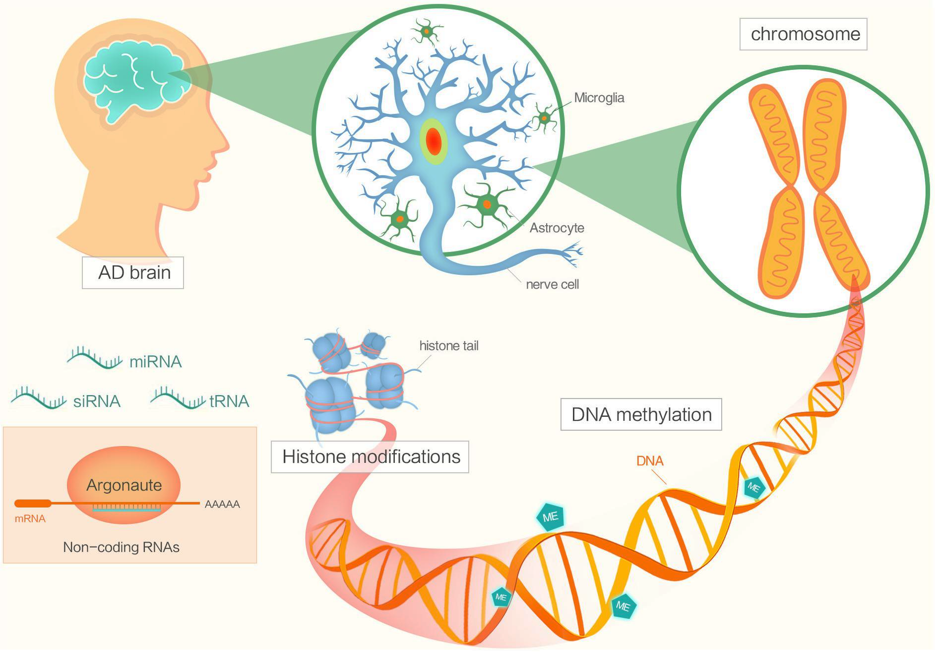
A brief overview of epigenetic mechanisms
Epigenetic mechanisms:
DNA MODIFICATIONS
Post-translational histone modifications
Histone variant exchange
Liu Xiaolei, Frontiers in Genetics, 2018

Slide 9
A brief overview of epigenetic mechanisms
Epigenetic mechanisms:
DNA MODIFICATIONS
  DNA methylation ➔ repressive modification
  DNA demethylation and hydroxymethylation
          ➔ gene activation
DNA methylation thought to be irreversible, recent evidence has revealed that DNA can rapidly and
reversibly undergo undergo demethylation
dioxygenases = ten-eleven translocation (TET) proteins
Hwang, JY., Aromolaran, K. & Zukin, R. Nat Rev Neurosci 2017
Notes:
In the brain, DNA methylation and hydroxymethylation denote gene activation or repression, and their effects extend over
long chromosomal domains, giving rise to ‘memorized’ states of gene expression99. DNA methyltransferases (DNMTs) —
including DNMT1, DNMT3A and DNMT3B — catalyse the transfer of methyl groups from S‑adenosyl-l-methionine (SAM)
to the 5‑position carbon in cytosines within DNA to generate 5‑methylcytosine (see the figure, part a). Although this
methyl group transfer was originally thought to be irreversible, recent evidence has revealed that DNA can rapidly and
reversibly undergo changes in methylation and can undergo demethylation12. A recently discovered family of dioxygenases
known as the ten-eleven translocation (TET) proteins (TET1, TET2 and TET3) can catalyse the conversion of
5‑methylcytosine to 5‑hydroxymethylcytosine16,100. The hydroxymethyl moiety is labile and can rapidly regenerate
unmethylated cytosines (indicated by the dashed arrow), which in turn activate genes.

Slide 10
A brief overview of epigenetic mechanisms
Epigenetic mechanisms:
2. Post-translational histone modifications
  acetylation
  methylation
  phosphorylation
  ubiquitylation
  sumoylation
  deamination
  poly(ADP) ribosylation
Site-specific post-translational modifications of core histone proteins act sequentially or combinatorially to create a ‘histone code’ that is recognized by proteins known as ‘readers’
Readers recognize epigenetic marks on core
histones and are thereby recruited to the promoters of target genes
Hwang, JY., Aromolaran, K. & Zukin, R. Nat Rev Neurosci 2017

Slide 11
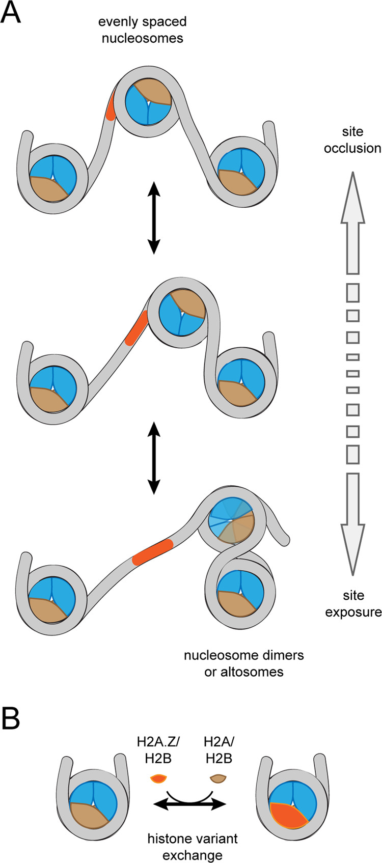
A brief overview of epigenetic mechanisms
Epigenetic mechanisms:
3. Histone variant exchange ➔ The replacement of one histone variant with another
  microRNAs (miRNAs)
  long non-coding RNAs (lncRNAs)
Histone variants
Histone variants undergo replication-independent expression, and they have pronounced effects on nucleosome stability and positioning
Gregory D. Bowman and Michael G. Poirier, Chemical Reviews 2015
Hwang, JY., Aromolaran, K. and Zukin, R. Nat Rev Neurosci 2017
Notes:
Changes in nucleosome organization carried out by chromatin remodelers. (A) Most chromatin remodelers can reposition or “slide” nucleosomes along DNA. Depending on the direction of sliding, this repositioning can bury or expose DNA binding sites. Remodelers like Chd1 and many ISWI-type remodelers are sensitive to DNA flanking the nucleosome and generate evenly spaced nucleosome arrays (top). In contrast, other remodelers such as SWI/SNF and RSC can shift nucleosomes into their neighbors, generating dimeric or altosome structures, which are believed to be intermediates for nucleosome disassembly (bottom). The altosome organization depicted here was adapted from a model of Ulyanova and Schnitzler. (356) (B) Some remodelers specialize in histone variant exchange. Exchange of canonical and variant H2A/H2B dimers, highlighted here, is carried out by SWR1 and INO80.

Slide 12
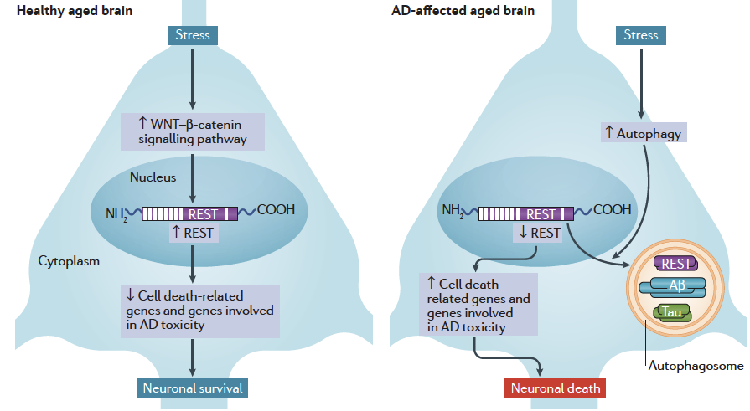
Epigenetics and Alzheimer’s disease (AD)
DNA METHYLATION
Early life environmental exposures, such as B-vitamin restriction or lead exposure ➔ methylation changes of genes required for A𝝱 peptide production
(Fabio Coppedè, Translational Epigenetic, 2018)
Restrictive element 1‑silencing transcription factor
neuroprotective
In AD-affected brains, oxidative stress activates autophagy which than engulf REST, reducing it’s abundance in the nucleus
Hwang, JY., Aromolaran, K. & Zukin, R. Nat Rev Neurosci 2017
oxidative stress and neuronal death
Notes:
Restrictive element 1‑silencing transcription factor in neurodegenerative disease. a | In the healthy aged
brain, stress increases WNT–β‑catenin signalling (specifically that mediated by WNT3A and WNT7A) in the hippocampus
and the frontal cortex. This promotes the nuclear translocation of restrictive element 1‑silencing transcription factor
(REST) and increased binding of REST to the restrictive element 1 (RE1) sites of REST target genes. This induction of REST
nuclear abundance promotes neuroprotection by repressing the transcription of genes that encode proteins involved in
neuronal death (such as BCL‑2‑binding component 3 (BBC3), BAX, death domain-associated protein 6 (DAXX), tumour
necrosis factor receptor type 1‑associated death domain protein (TRADD) and BCL‑2‑like protein 11 (BCL2L11)) and
genes that encode proteins involved in Alzheimer disease (AD) pathology (such as members of the γ‑secretase complex,
which is implicated in amyloid-β (Aβ) generation). In AD-affected brains, oxidative stress activates autophagy129. The
autophagosomes that are generated engulf REST, together with misfolded proteins such as Aβ and tau, which reduces
REST abundance in the nucleus. The loss of REST in the nucleus causes an increase in expression of genes that are involved
in oxidative stress and neuronal death

Slide 13
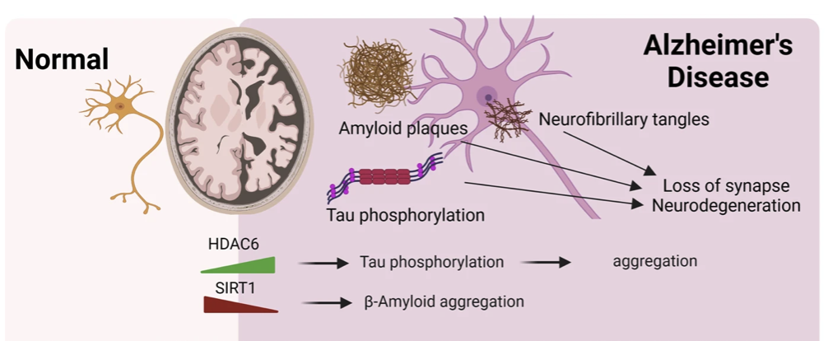
Epigenetics and Alzheimer’s disease (AD)
Dysregulation of histone-modifying enzymes
and histone modifications
Histone deacetylation by histone deacetylases (HDACs) induces a closed chromatin structure ➔ transcriptional repression
HDAC6 increase in AD stimulates tau phosphorylation, thereby facilitating tau aggregation
Sirtuins (i.e. SIRT1) downregulation in AD leads to the elevated Aβ levels and their aggregation.
Park, J., Lee, K., Kim, K. et al. Sig Transduct Target Ther 2022
Notes:
ysregulation of histone-modifying enzymes and histone modifications in Alzheimer’s disease (AD). Histone acetylation such as H3K9ac and H3K27ac is globally increased due to the increase of CBP/p300 expression. In contrast, acetylation of H3K12 is reduced by the increased HDACs (e.g., HDAC2). In AD, HMTs responsible for H3K4me3 and H3K9me2 are overexpressed: SETD1A/1B and MLL3/4 for H3K4me3, GLP/G9a (EHMT1/2) for H3K9me2. These affect the levels of H3K4me3 and H3K9me2 on a global and gene-specific level, thereby altering gene expression. H2A ubiquitination (H2AK119ub by PRC1), H3 lactylation (H3K12la by p300), H2A.X phosphorylation (H2A.XS139p) are increased in AD. SIRT1 downregulation in AD leads to the elevated Aβ levels and their aggregation. HDAC6 increase in AD stimulates tau phosphorylation, thereby facilitating tau aggregation

Slide 14
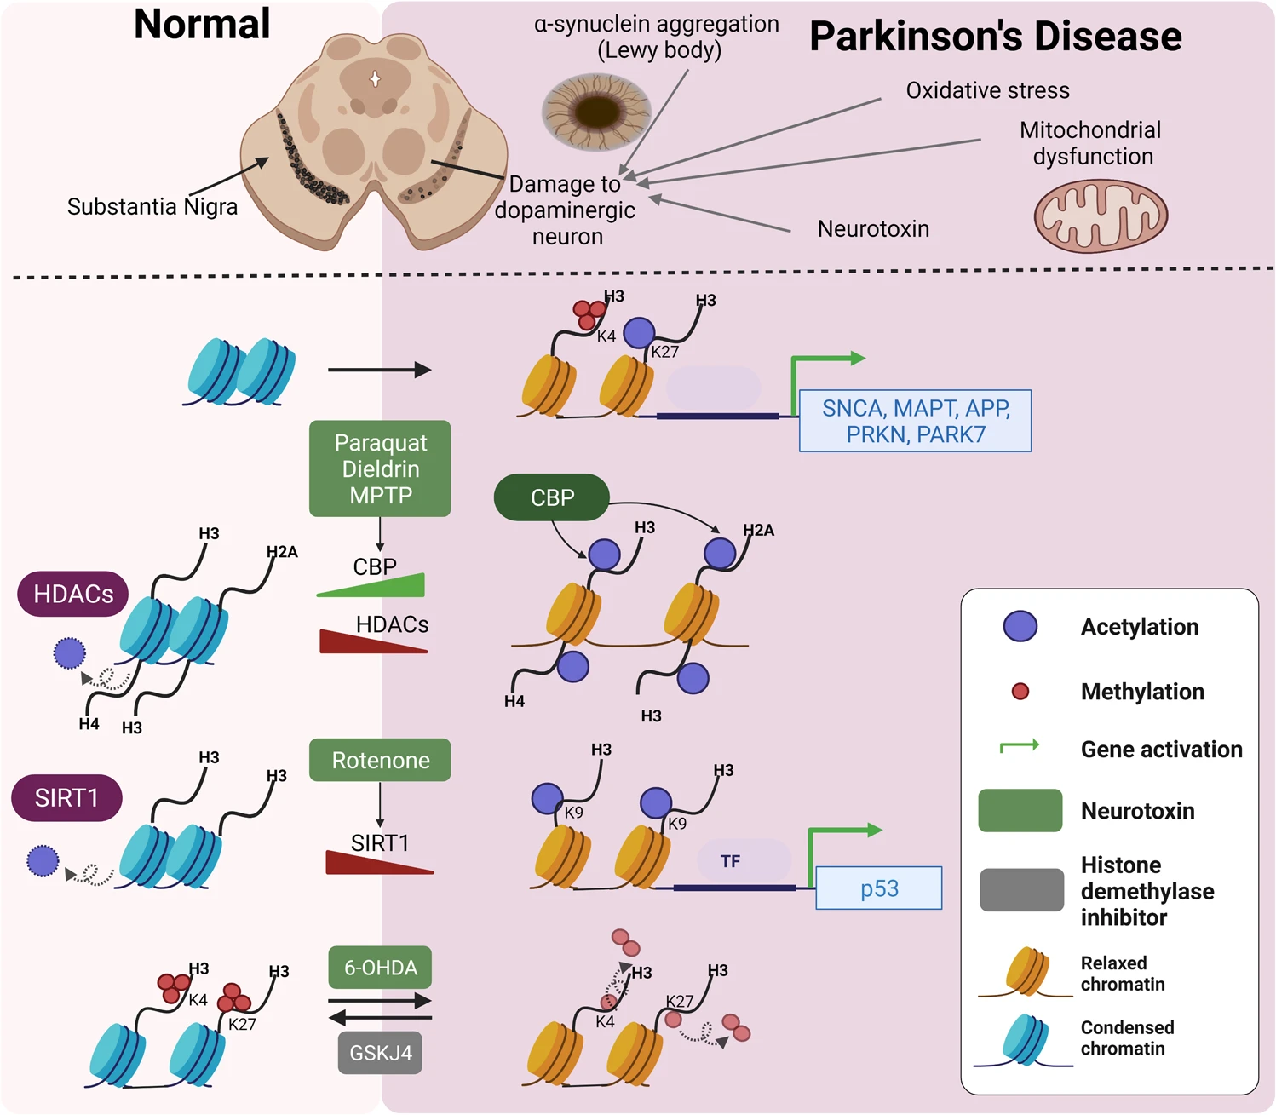
Epigenetics and Parkinson’s disease (PD)
DNA METHYLATION IN PARKINSON’S DISEASE
global DNA hypomethylation in PD and dementia with Lewy bodies
decreased SNCA (disease-related gene) methylation levels increases production of the 𝜶 –synuclein
number of other genes explored
Dysregulation of histone-modifying enzymes
and histone modifications
𝜶-synuclein binds to histones and inhibits histone acetylation (Desplats P. J Biol Chem, 2011)
Notes:
Dysregulation of histone-modifying enzymes and histone modifications in Parkinson’s disease (PD). Several neurotoxins induce H3 and H4 acetylation together with changing the expression of HATs and HDACs. For example, Paraquat and MPTP increase H3 and H4 acetylation. Dieldrin induces H3K14ac by increasing CBP expression. Rotenone reduces SirT1 expression levels, thereby increasing H3K9ac. Histone methylation is also dysregulated in PD. PD-related neurotoxin such as 6-OHDA reduces H3K4me3 and H3K27me3. Furthermore, H3K4me3 at the SNCA promoter is increased in PD patient

Slide 15
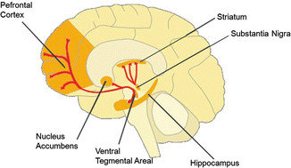
Epigenetic triggers
Brain structures important for the development of addiction, where epigenetics plays an important role:
Nucleus accumbens – Nacc
Ventral tegmental area – VTA
Dorsal striatum - DS

Slide 16
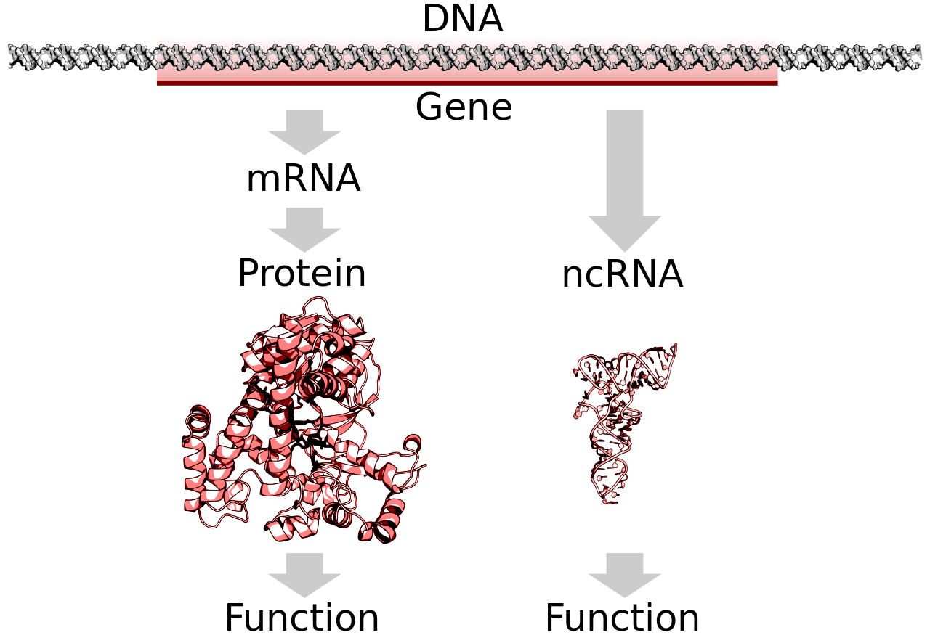
Non-coding RNAs (ncRNAs) and neurodegenerative diseases
miRNAs are a large family of conserved small non-coding RNA that play a central role in the post-transcriptional regulation of gene expression¹
  control about 50% of all protein-coding genes
  discovered in Caenorhabditis elegans² 20 yrs ago
  most extensively studied class of ncRNAs today
largely investigated in both neuronal and peripheral tissues of patients suffering from neurodegenerative disorders, as well as in animal models of these conditions^{3,4,5,6}
¹Bartel D. Cell 2004
²Rosalind C. Cell, 1993
³Evgenia S, The Lancet Neurology, 2012
⁴Moradifard, S. Sci Rep 2018
⁵Fabio C,Epigenetics in Human Disease, 2018
⁶Dobricic, V .Transl Psychiatry 2022

Slide 17
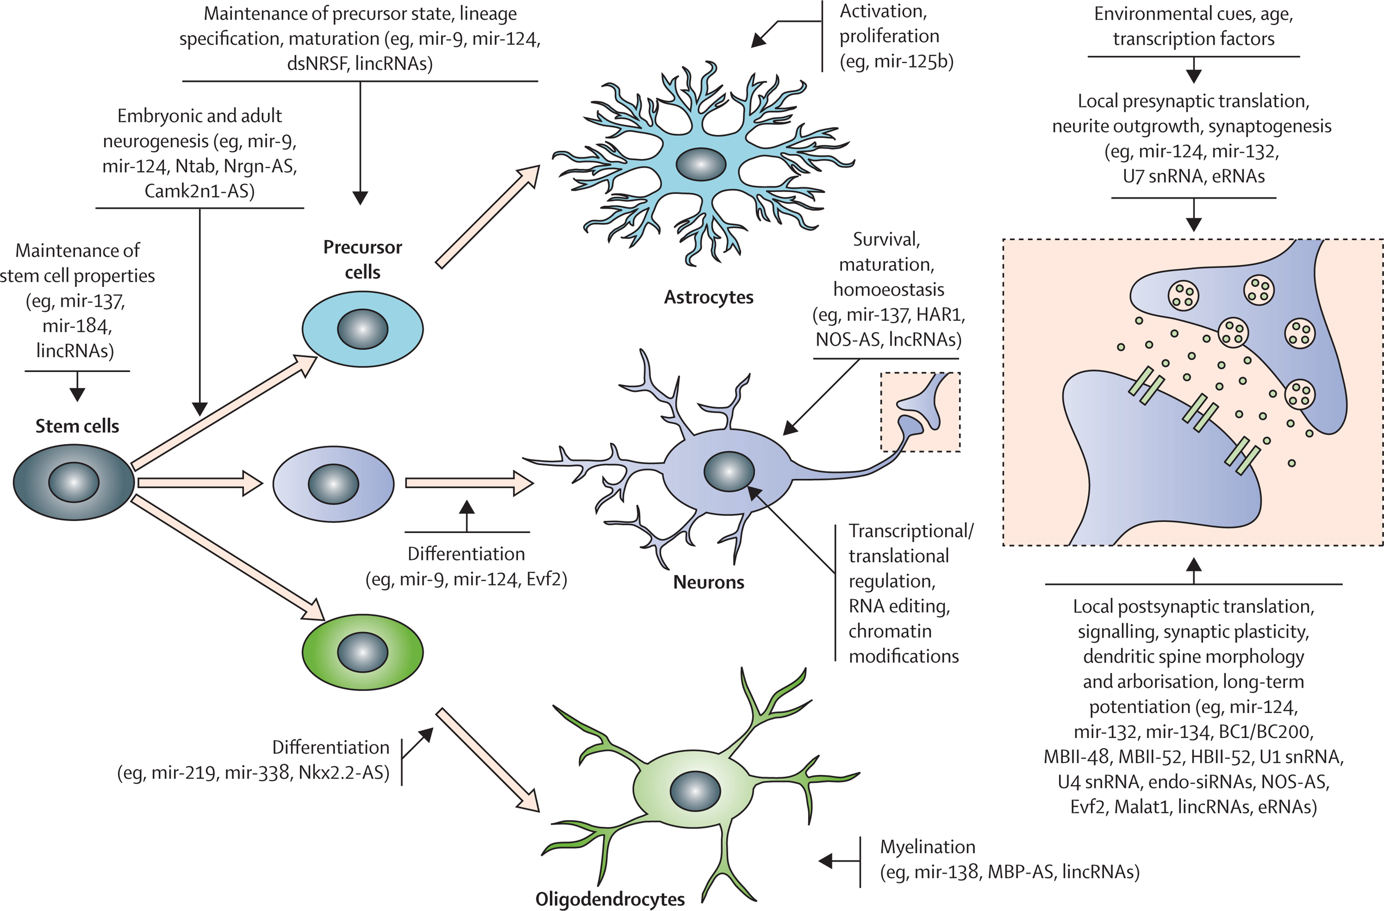
Non-coding RNAs (ncRNAs) and neurodegenerative diseases
Physiological roles of regulatory ncRNAs in the CNS
Evgenia S, The Lancet Neurology, 2012
Notes:
Examples of ncRNAs involved in the physiology of the CNS and affecting processes ranging from neuronal development to maturation. ncRNAs can be involved in the maintenance of the stem cell status of neuronal stem cells and their differentiation into neuronal, astrocytic, or oligodendroglial precursors, and also in the maintenance, lineage specification, maturation, and differentiation of precursor cells into their respective cell types. Additionally, ncRNAs affect processes such as activation and proliferation of astrocytes, survival, maturation, and homoeostasis of neurons, and myelination of mature oligodendrocytes. At the level of the synapse, ncRNAs might regulate local translation, neurite outgrowth, synaptogenesis, neurotransmitter signalling, synaptic plasticity, and long-term potentiation. ncRNA=non-protein-coding RNA. lincRNA=long intergenic non-coding RNA. lncRNA=long non-coding RNA. snRNA=small nuclear RNA. eRNA=enhancer RNA. endo-siRNA=endogenous small interfering RNA. BC1=brain cytoplasmic RNA of 150 nucleotides. BC200=brain cytoplasmic RNA of 200 nucleotides.

Slide 18
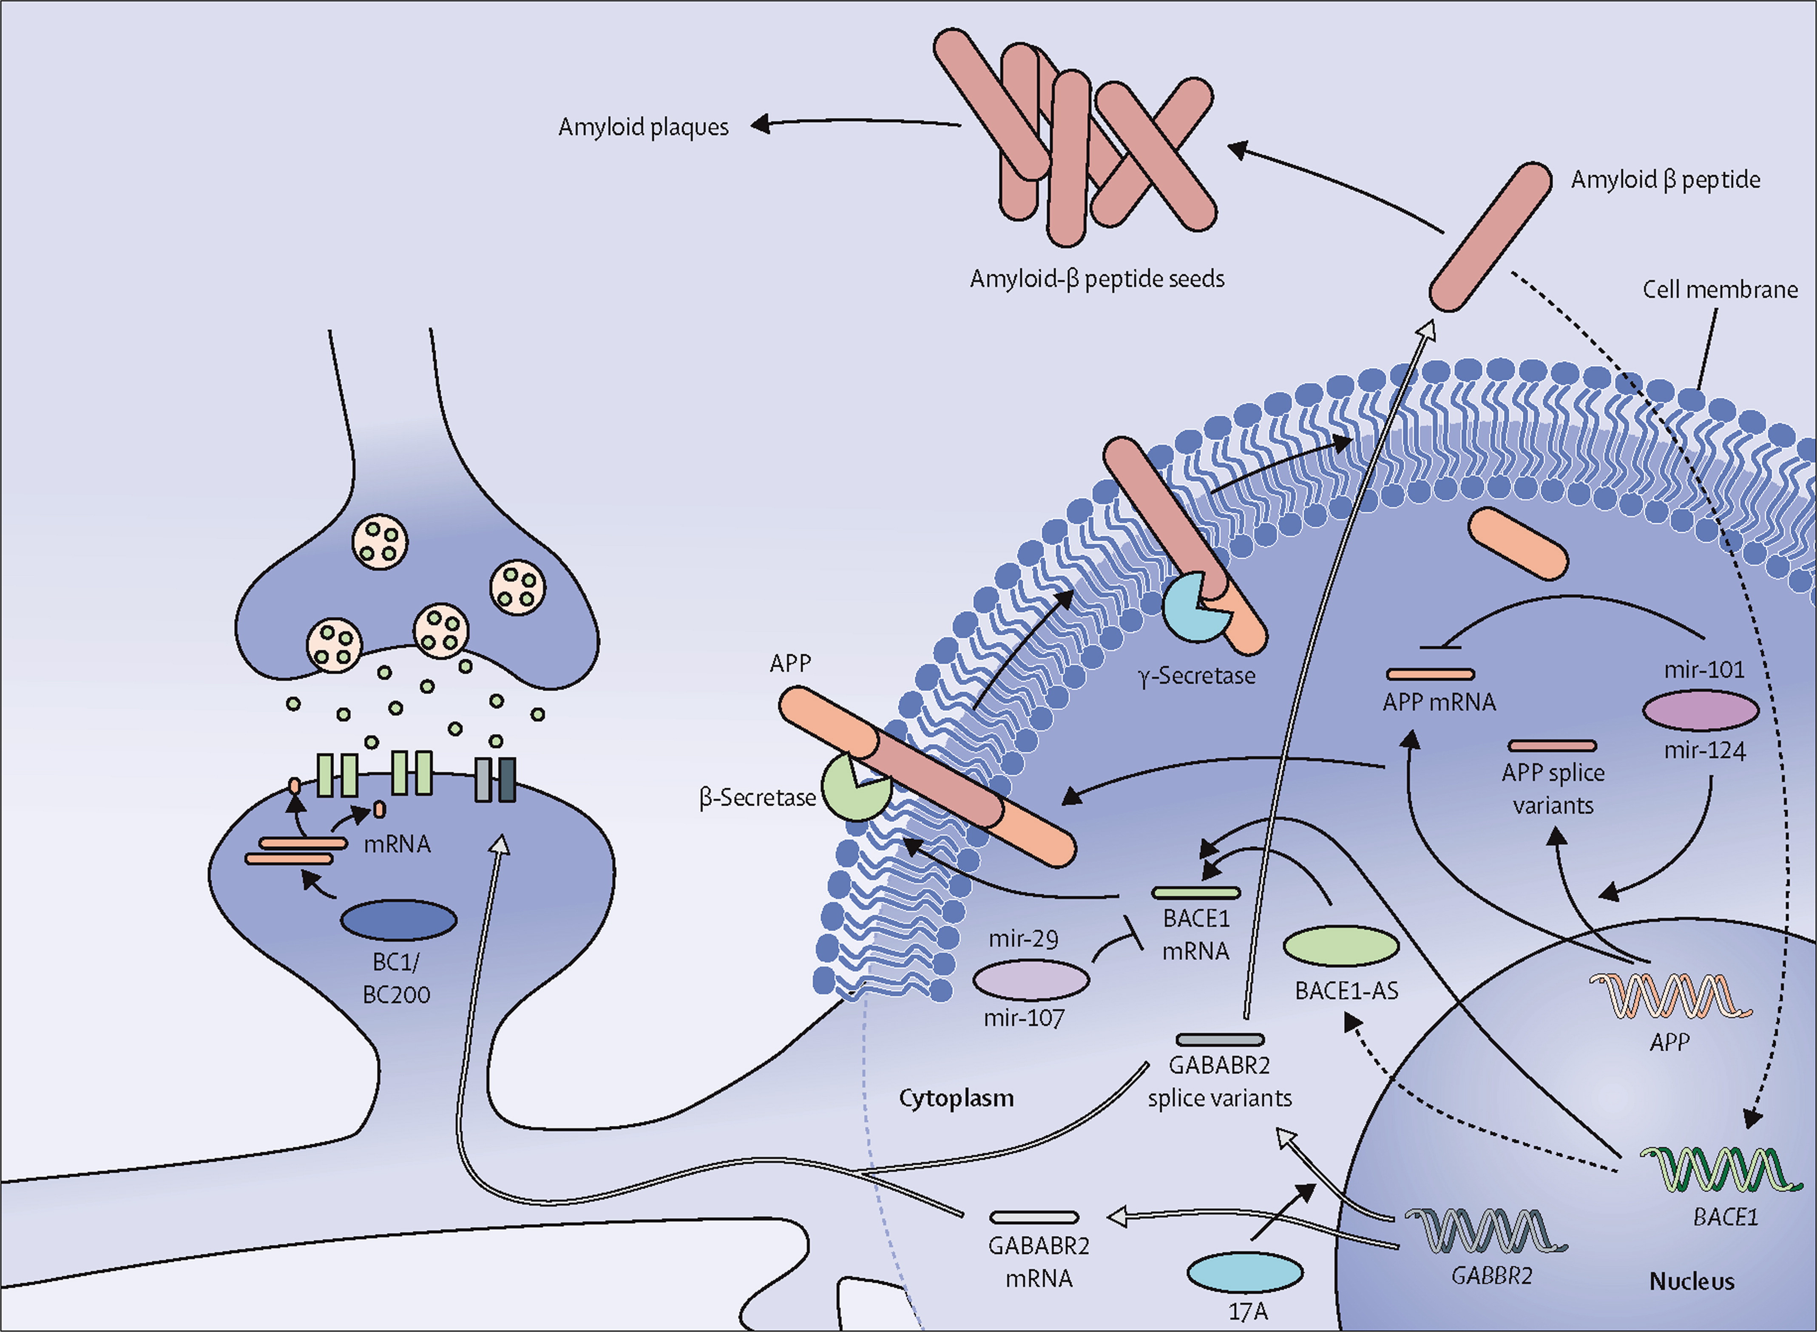
Non-coding RNAs (ncRNAs) and neurodegenerative diseases
Regulatory ncRNAs in Alzheimer's disease
miRNAs were found^{1,2} to be dysregulated in AD targeting genes required for
  the production of the A𝝱 peptide
  coding for protein tau involved in neurofibrillary tangle formation
¹Reddy PH, et al. Biochem Biophys Res Commun 2017
²Basavaraju M, Biomol Concepts 2016
Evgenia S, The Lancet Neurology, 2012
Notes:
Some of the paradigms of ncRNA regulation in the pathogenesis of Alzheimer's disease that involve microRNAs, natural antisense transcripts, and other ncRNAs are shown. More specifically, APP mRNA is regulated by miR-101,^{63,} ⁶⁴miR-106a, miR-520c,⁶⁵ miR-124,⁵³ and let-7,⁶⁶ and BACE1 mRNA is regulated by miR-298, miR-328,⁶⁷ miR-107,⁴⁹ and miR-29a/b-1.⁵⁰ BACE1-AS reacts to deposition of amyloid-β peptide and in turn binds to and stabilises BACE1 mRNA, resulting in increased BACE1 expression and APP processing. BC1 and BC200 reside in synapses, where they are involved in activity-dependent translational regulation. Finally, 17A, an antisense small ncRNA, affects the alternative splicing of the GABABR2 receptor, which leads to aberrant GABA_{B} signalling and increased production of amyloid-β peptide. APP= amyloid precursor protein. ncRNA=non-protein-coding RNA. BC1=brain cytoplasmic RNA of 150 nucleotides. BC200=brain cytoplasmic RNA of 200 nucleotides. BACE1-AS=BACE1 antisense transcript. mRNA=messenger RNA.

Slide 19
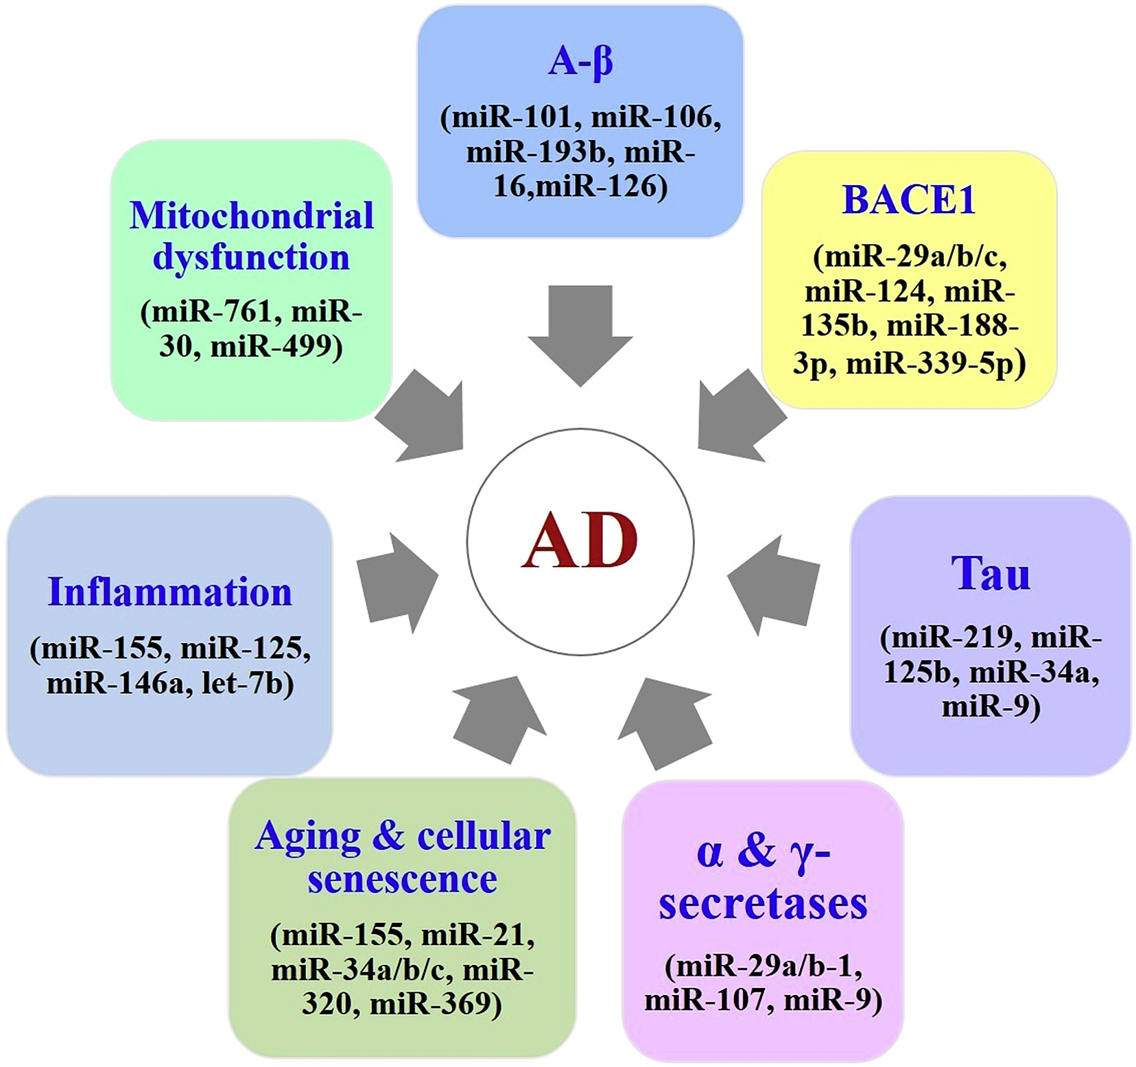
Non-coding RNAs (ncRNAs) and neurodegenerative diseases
AD risk factors and associated miRNAs
miRNAs were found^{1,2} to be dysregulated in AD targeting genes required for
  the production of the A𝝱 peptide
  coding for protein tau involved in neurofibrillary tangle formation
?
AD can be prevented, delayed, or stopped via strategic alterations of miRNA expression
?
Diagnostic tests detecting miRNAs changes for AD onset and progression
P. Hemachandra Reddy, Biochemical and Biophysical Research Communications, 2017
¹Reddy PH, et al. Biochem Biophys Res Commun 2017
²Basavaraju M, Biomol Concepts 2016
Notes:
AD risk factors and associated miRNAs. Deregulation of miRNAs expression modulates the expression of certain key AD related genes and promote disease progression. Beside miRNAs also involved in several cellular process that are critical for AD.

Slide 20
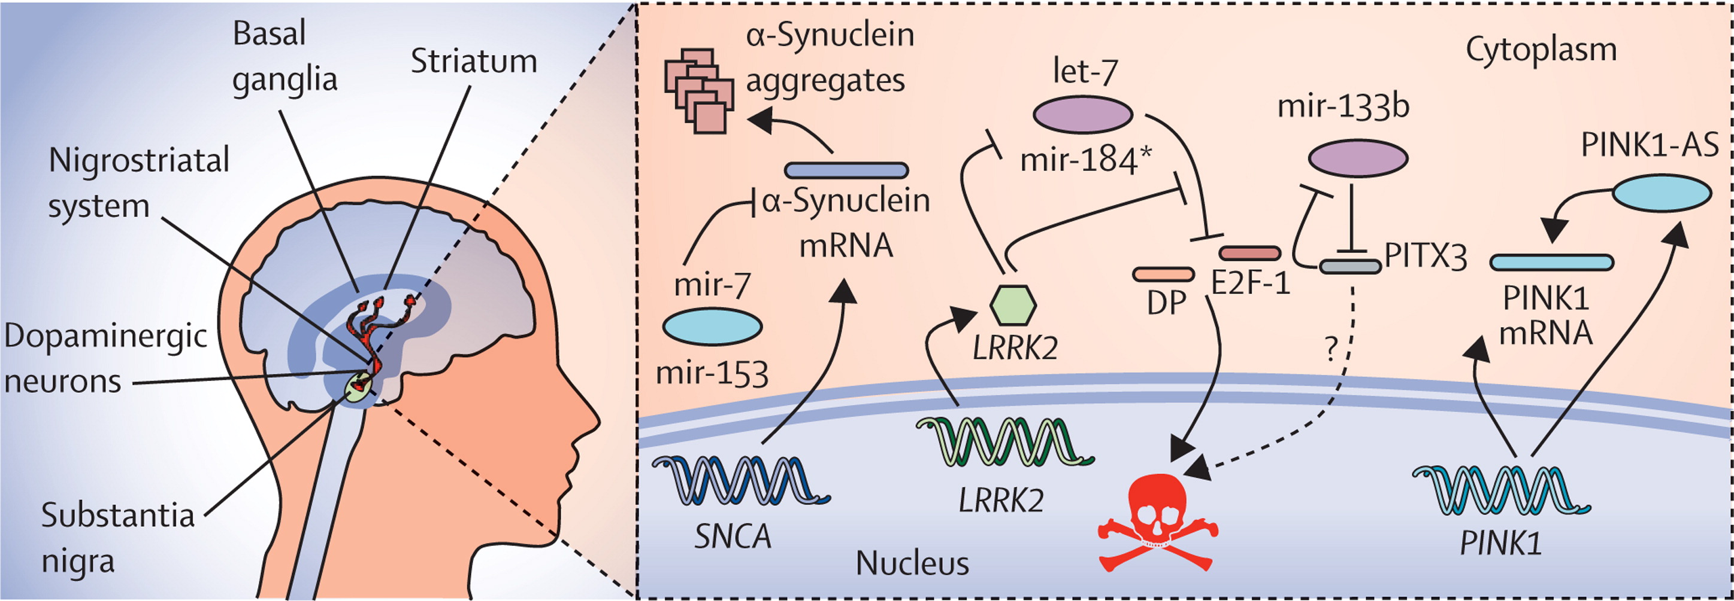
Non-coding RNAs (ncRNAs) and neurodegenerative diseases
Regulatory ncRNAs in Parkinson's disease
Evgenia S, The Lancet Neurology, 2012
Notes:
xamples of ncRNAs possibly directly or indirectly involved in the dopaminergic phenotype of Parkinson's disease. The expression of α-synuclein is fine-tuned by specific microRNAs (eg, mir-7,72, 73 mir-433,⁷⁴ and mir-153⁷²). Under pathogenic conditions LRRK2 mediates a microRNA-dependent transcriptional regulation mechanism in dopaminergic neurons, whereas mir-133b is involved in a negative feedback loop that results in perturbed transcriptional control. Finally, PINK1-AS and PINK1 mRNA levels are co-regulated during mitochondrial biogenesis. ncRNAs=non-protein-coding RNAs. mRNA=messenger RNA.

Slide 21
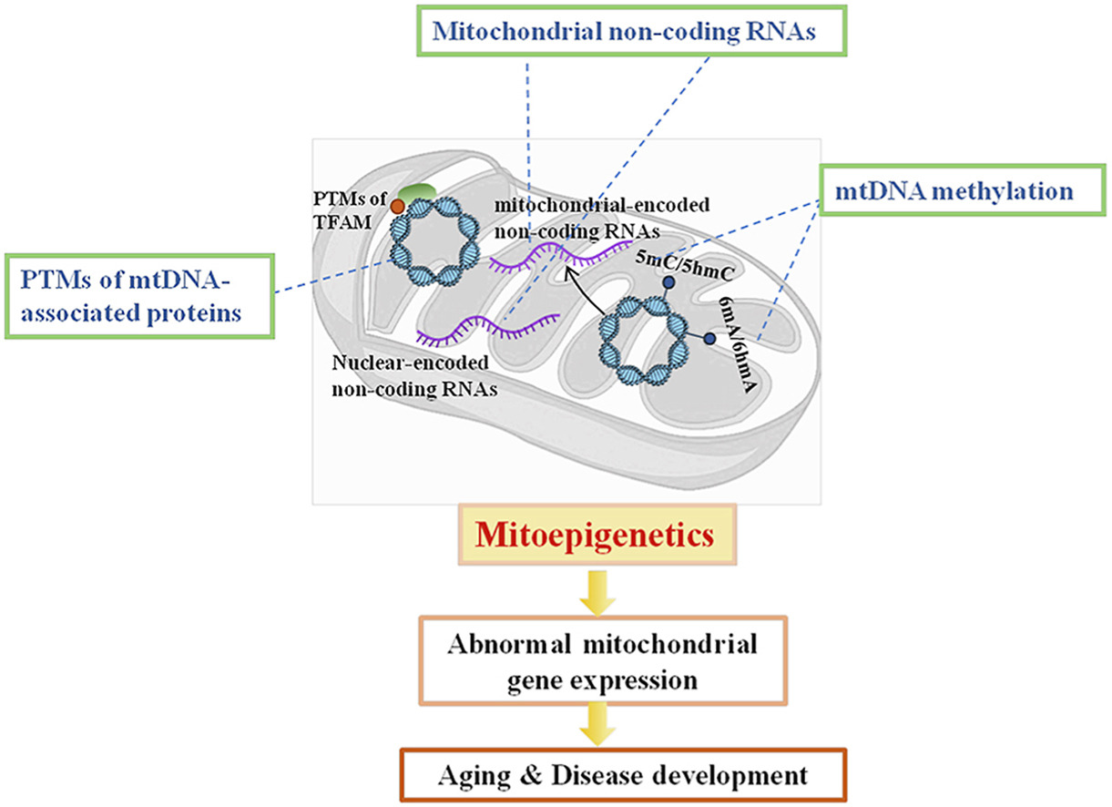
MITOEPIGENETICS AND NEURODEGENERATIVE DISEASES
“mitoepigenetics” = epigenetic modifications of the mitochondrial DNA (mtDNA)^{1,2}
Mitoepigenetics may regulate mitochondrial DNA-encoded gene expression and contribute to mitochondrial dysfunction³
might occur in AD, PD, ALS, and other neurodegenerative conditions
Impact of mtDNA methylation in neurodegenerative diseases pathogenesis?
¹Blanch M,Am J Pathol 2016
²Stoccoro A, J Alzheimers Dis 2017
³ Ke Cao, Free Radical Biology and Medicine, 2021
Notes:
The involvement of the mitochondrial epigenome in neurodegenerative diseases is one of the
current hot topics in neuroepigenetic investigation

Slide 22
Summary: Non-coding RNAs and neurodegenerative diseases
ncRNAs investigated in both, neuronal and peripheral tissues in neurodegenerative disorders, as well as in animal models of these conditions
MicroRNAs interfere with gene regulation and translation.
SLIKA:
https://www.nature.com/articles/nrn.2017.90
Differential expression of MicroRNAs modulate genes related to Alzheimer's disease.
MicroRNAs affect the levels of amyloid beta, phosphorylated tau and synaptic damage.
MicroRNAs affect aging, cellular senescence, inflammation and mitochondrial dysfunction in Alzheimer's disease.

Slide 23
Movie materials: Gene transcription
Transcription of the gene: https://www.youtube.com/watch?v=_Zyb8bpGMR0
Epigenetic changes for gene transcription (39 min)
https://www.youtube.com/watch?v=0dOFztY3VJY
Histon modifications (13 min)
https://www.youtube.com/watch?v=ImcomFPgJO4
Histons posttranslation modification (15 min)
https://www.youtube.com/watch?v=XQ3P7Bq9ld0

Slide 24
Literature
Mandatory:
Park J, Lee K, Kim K, Yi SJ. 2022. The role of histone modifications: from neurodevelopment to neurodiseases. Signal Transduct Target Ther. 2022 Jul 6;7(1):217. doi: 10.1038/s41392-022-01078-9.
Hwang JY, Aromolaran KA, Zukin RS. The emerging field of epigenetics in neurodegeneration and neuroprotection. Nat Rev Neurosci. 2017 May 18;18(6):347-361. doi: 10.1038/nrn.2017.46. Erratum in: Nat Rev Neurosci. 2018 Dec;19(12):771. https://www.ncbi.nlm.nih.gov/pmc/articles/PMC6380351/
Additional:
Genetic and Epigenetic Basis of Neurodegenerative Diseases, 2022, Frontiers in Aging Neuroscience, Research topic: https://www.frontiersin.org/research-topics/24974/genetic-and-epigenetic-basis-of-neurodegenerative-diseases#articles
Fabio Coppedè, Chapter 10 - The Epigenetics of Alzheimer's and Other Neurodegenerative Disorders, In Translational Epigenetics, Epigenetics in Human Disease (Second Edition), 2018, https://doi.org/10.1016/B978-0-12-812215-0.00010-8.
Felsenfeld, G. A brief history of epigenetics. Cold Spring Harbor Persp. Biol, 2014
Advanced
Blanch M,Am J Pathol 2016
Stoccoro A, J Alzheimers Dis 2017
Ke Cao, Free Radical Biology and Medicine, 2021

