Slide 1



Risk Factors in NDD
Mrs. H.M.C.M.Herath
Lecturer
Faculty of Nursing
University of Colombo

Slide 2
Time duration:1 hour
Method: Lecture and tutorial
Sources -open access articles

Slide 3
Intended Learning Outcomes
At the end of this lecture, students will be able to
Outline the risk factors in NDD
Describe the risk factors in NDD

Slide 4
Introduction to the risk factors in NDD
In epidemiology, a risk factor or determinant is a variable associated with an increased risk of disease or infection(Parritz, & Hornik., 2017).
In general, the elderly are most at risk. However, the causes of most neurodegenerative diseases remain unknown.

Slide 5
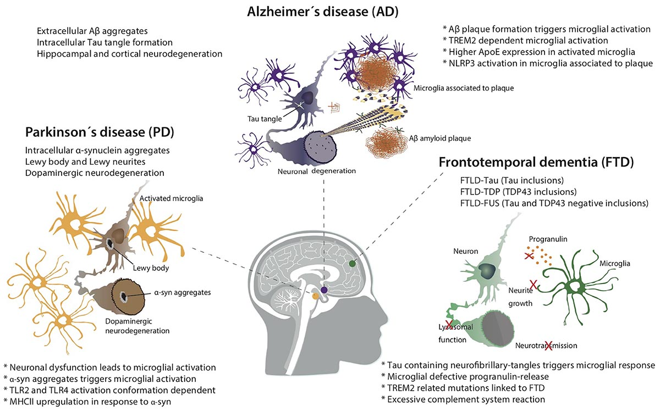
Common neurodegenerative disorders
Basic pathology of some forms of neurodegenerative disease
.Source: https://www.frontiersin.org/articles/10.3389/fncel.2018.00488/full

Slide 6
Risk Factors
Modifiable risk factors
Non-Modifiable risk factors

Slide 7
Modifiable Risk factors
Environmental agents
toxic metal – mercury, aluminum, cadmium, and arsenic
insecticides/pesticides – organophosphate, carbamate
industrial/commercial pollutants
antimicrobials
air pollutants
Infection – virus, bacteria

Slide 8
Ctd………….
Lifestyle
exercises
Oxidative stress
Smoking
Drugs
Obesity

Slide 9
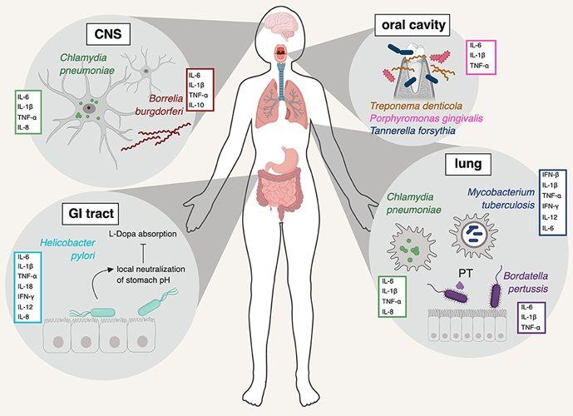
Infection
Different bacterial species that have been implicated in neuroinflammation.Source: https://www.frontiersin.org/articles/10.3389/fcimb.2019.00138/full

Slide 10
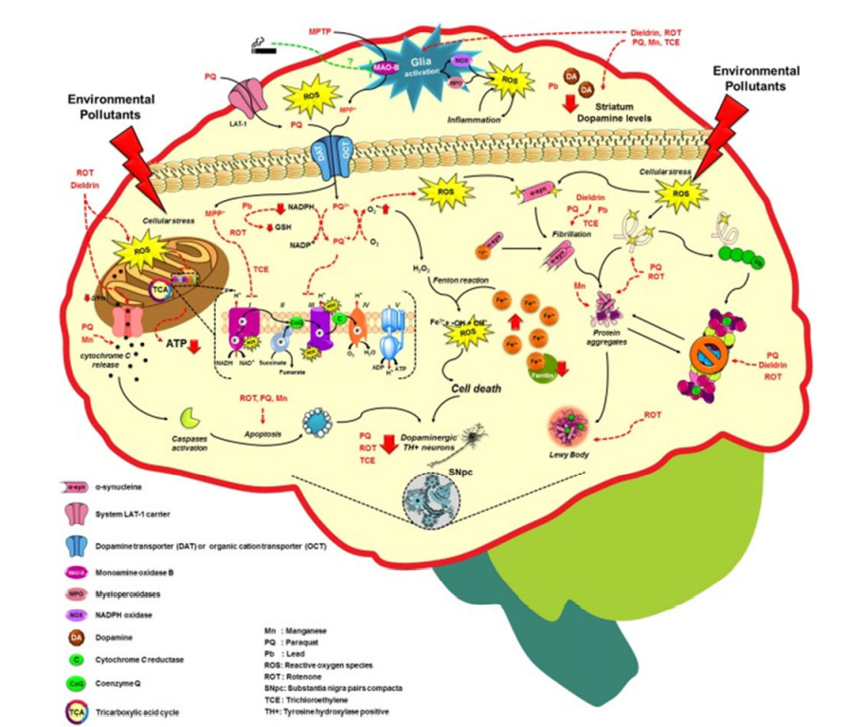
Environmental factors
Molecular mechanisms altered by environmental factors related to increased Parkinson’s disease risk. Exposure to environmental toxicants mainly pesticides, metals, and solvents may lead to the selective loss of dopaminergic neurons on the substantia nigra pars comp acta (SNpc) through the dysregulation/alteration of the molecular mechanisms implicated on PD development such as mitochondrial dysfunction, impairment of protein quality pathways, microglia activation and inflammation, which converge in the production of oxidative stress as the main factor in PD.

Slide 11
ctd
Pollutants are involved in AD due to their ability to increase beta-amyloid (Aβ) peptide and the phosphorylation of Tau protein (P-Tau), causing senile/amyloid plaques and neurofibrillary tangles (NFTs) characteristic of AD
The Exposure to lead, manganese, solvents, and some pesticides has been related to hallmarks of PD such as mitochondrial dysfunction, alterations in metal homeostasis and aggregation of proteins such as α-synuclein (α-syn), which is a key constituent of Lewy bodies (LB), a crucial factor in PD pathogenesis.

Slide 12
Ctd………..
Common mechanisms of environmental pollutants to increase Aβ, P-Tau, α-syn and neuronal death have been reported, including the oxidative stress mainly involved in the increase of Aβ and α-syn, and the reduced activity/protein levels of Aβ degrading enzyme (IDE)s such as neprilysin or insulin IDE.

Slide 13
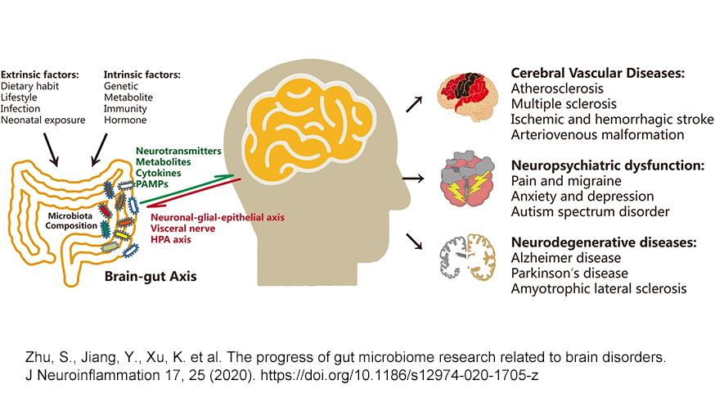
The Microbiota, Lifestyle and Neuroprotection

Slide 14
Potentially risk factors for dementia
Blood pressure
Diabetes mellitus
Stroke
Elevation of serum cholesterol

Slide 15
Non Modifiable risk factors
Genetic factors
Age
Sex
(Patterson, et, al.,2007).

Slide 16
Non-modifiable Risk factors
Aging
Aging is the primary risk factor for most neurodegenerative diseases, including Alzheimer’s disease (AD) and Parkinson’s disease (PD). One in ten individuals aged ≥65 years has AD and its prevalence continues to increase with increasing age.
Sex -approximately two-thirds of Alzheimer’s patients are female.
Men are twice as likely to develop Parkinson’s disease and experience a faster rate of disease progression on average.

Slide 17
Ctd
Genetic factors
White/Black
family history

Slide 18
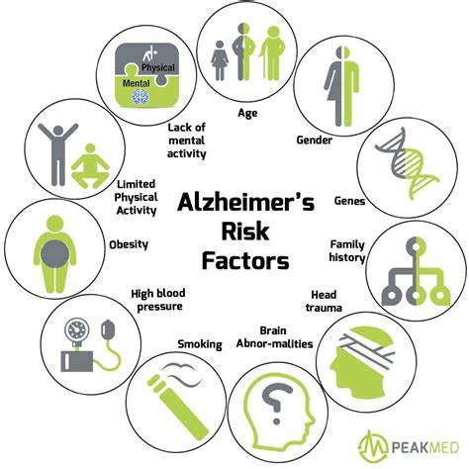
Ctd………

Slide 19


Slide 20
References
Chin-Chan, M., Navarro-Yepes, J., & Quintanilla-Vega, B. (2015). Environmental pollutants as risk factors for neurodegenerative disorders: Alzheimer and Parkinson diseases. Frontiers in Cellular Neuroscience, 9(APR). https://doi.org/10.3389/fncel.2015.00124
Chen, J. H., Lin, K. P., & Chen, Y. C. (2009). Risk factors for dementia. Journal of the Formosan Medical Association, 108(10), 754–764. https://doi.org/10.1016/S0929-6646(09)60402-2
Parritz, Robin Hornik (2017). Disorders of childhood : development and psychopathology. Troy, Michael F. (Michael Francis) (Third ed.). Boston, MA. ISBN 9781337098113. OCLC 960031712.

Slide 21


