Slide 1
Psychological changes in normal ageing

Slide 2
Lesson objectives
At the end of this lecture students should be able to:
  Understand the modern psychological view on ageing
  Understand the main areas of change in psychology and behavior in ageing
  Describe and integrate this knowledge into a whole

Slide 3
Ageing and you
How have you changed with age?
What are the 3 most pronounced changes you have noticed?
What are the changes you are most looking forward to as you age? What are those that you are most afraid of?
Notes:
This slide has the purpose of initial engagement of the students’ attentions. Get them to cooperate with you and start building the setting for a productive lecture. If no one offers an answer in and of themselves, then call out students at random. If comfortable, you can offer your own experience.

Slide 4
The basics
Ageing through the lens of psychology
  Modern psychology; ageing is not merely bad, but also has some advantages
  Widespread changes associated with significant changes in the lives of people
    The children leave the home
    Retirement
    Loss of friends, spouses etc.
    Living on a fixed income
    Issues with physiological decline
Notes:
As we are dealing with psychology and behavior, it is important to understand modern psychological views on ageing. These are marked by a shift away from negativism towards ageing (everything is bad) and acknowledging the positive aspects. Explain, best through analogies and real-life stories, how the different events shown in bullet points above affect the lives of people experiencing them. Discuss various issues and benefits arising from ageing with students’ own experiences. This part is self-explanatory, and I believe everyone can find a personal story to relate to these events, by having seen their parents/grandparents experiencing this.

Slide 5
The basics – the areas of change
Physiological
Cognitive
Affective
Personality
Behavioral
Notes:
Give an example at each area of change. Physiological can be the slowing of reflexes, cognitive the reduction in fluid intelligence, affective the positivity bias, personality the shift to greater neuroticism and behavioral more careful and slow walking. These main areas of change represent the most important/largest parts of what makes us unique and different from one another. This means that ageing will inevitably affect all of our being and transform us into something different than we are now.

Slide 6
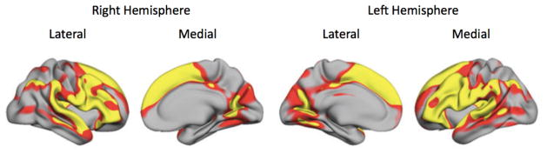
Physiological
Covered in detail elswhere.
Here, we cover only some aspects important for understanding psychological and behavioural changes
Dedifferentiation of the brain
Most pronounced brain areas of decline in ageing
Notes:
This should have been explained in detail elsewhere and can serve as a refresher of knowledge. Discuss the figure in the center, what do the changes in these brain areas mean for the person? Have students try to explain the effects of changes in the (predominantly reduction of) gray matter in these areas with age, what that means for the day to day living of people and have them try to tie this knowledge with the examples know to them (such as their grandparents).
Address the concept of dedifferentiation of the brain with age, meaning that the functional segregation of brain areas starts to disintegrate in age; there are less and less distinct boundaries in various brain areas and activity patterns. If the students are more interested in this topic you can debate how Alzheimer's disease and normal aging differ here, with the AD producing similar, but much more pronounced effects with severely increased neuron and tissue volume loss.

Slide 7
Physiological
Dopaminergic and noradrenergic changes;
  Both decline – implications for motivation, reward-seeking and alertness
Important, vmPFC and amygdala remain relatively intact → the effectivenes of emotional and self-related stimuli for the elderly to elicit better performance on various emotional and cognitive tasks
Notes:
Draw parallels with ADHD when discussing dopaminergic and adrenergic changes in brain signaling. Have the students produce some interventions to improve memory in the elderly using the knowledge of brain physiology and function.

Slide 8
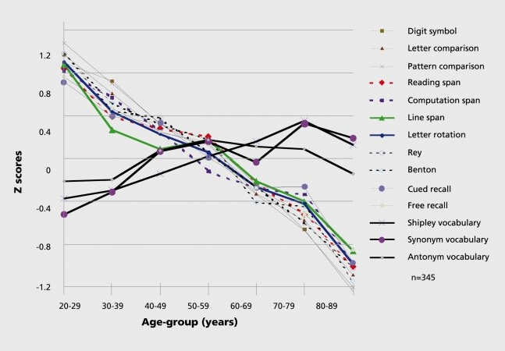
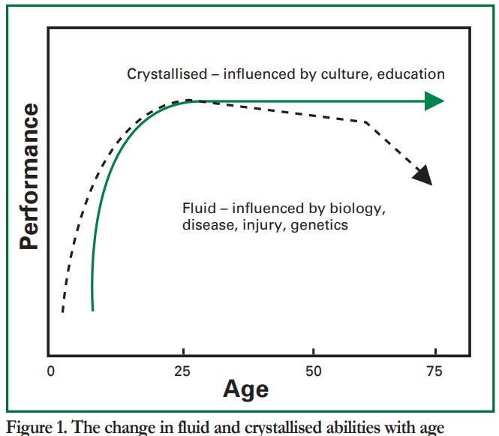
Cognitive
Notes:
Define and explain what is cognition (cognitive is defined as; of, relating to, or being conscious intellectual activity (as thinking, reasoning, remembering, imagining, or learning words), with cognition defined as a cognitive mental process). Next explain the results of the meta-analysis of effects of ageing on cognition shown on the left. All of the tests whose results are depicted in that picture are easily available online, so if you have the time you can go through them with the students.
Also present the concepts of fluid and crystallised intelligence; fluid is the “natural talent” or the “processing speed” of the brain in certain tasks, while crystallised is better represented by the sum of knowledge and experience of one’s life (i.e. the vocabulary is a facet of crystallised intelligence). Ordinary IQ tests are a mix of both.

Slide 9
Cognitive
Decline of memory
Issues with inhibition of irrelevant stimuli (overload sensitivity)
Decline in the senses
Issues with mental flexibility
Issues with contextualization
Less issues with passive environmental support
Notes:
Make a summary of what was learned. Then touch upon issues with inhibition (impulsivity) and tie this to the changes in the brain discussed previously. Paint a picture for the students that these are not separate processes but a part of a bigger whole. Also address each of the bullets and explain them more in-depth;
Decline in the senses pertains to the worsening of vision, hearing, smell, balance etc. and the accommodations one must make to these changes. An interesting point is also the stimuli deprivation arising from this and the possible worsening of conditions like dementia that rely on high brain activation to not progress as rapidly.
Issues with mental flexibility pertains to the mix of a decrease in fluid and an increase of crystallised intelligence. Older people are less likely to see novel solutions/paths, approaches to a problem, while having a lot of life experience to draw upon when trying to solve it and also not much of a reason to seek new knowledge (I have learned what there was to learn in my field of expertise attitude for example).
Issues with contextualization pertain to the difficulty in seeing the big picture.
Passive environmental support pertains to the concept of manipulating the environment in such a way that it elicits better cognitive performance of the people within. This is easier to achieve with elders, due to some of the cognitive effects of ageing as well as emotion processing differences.

Slide 10
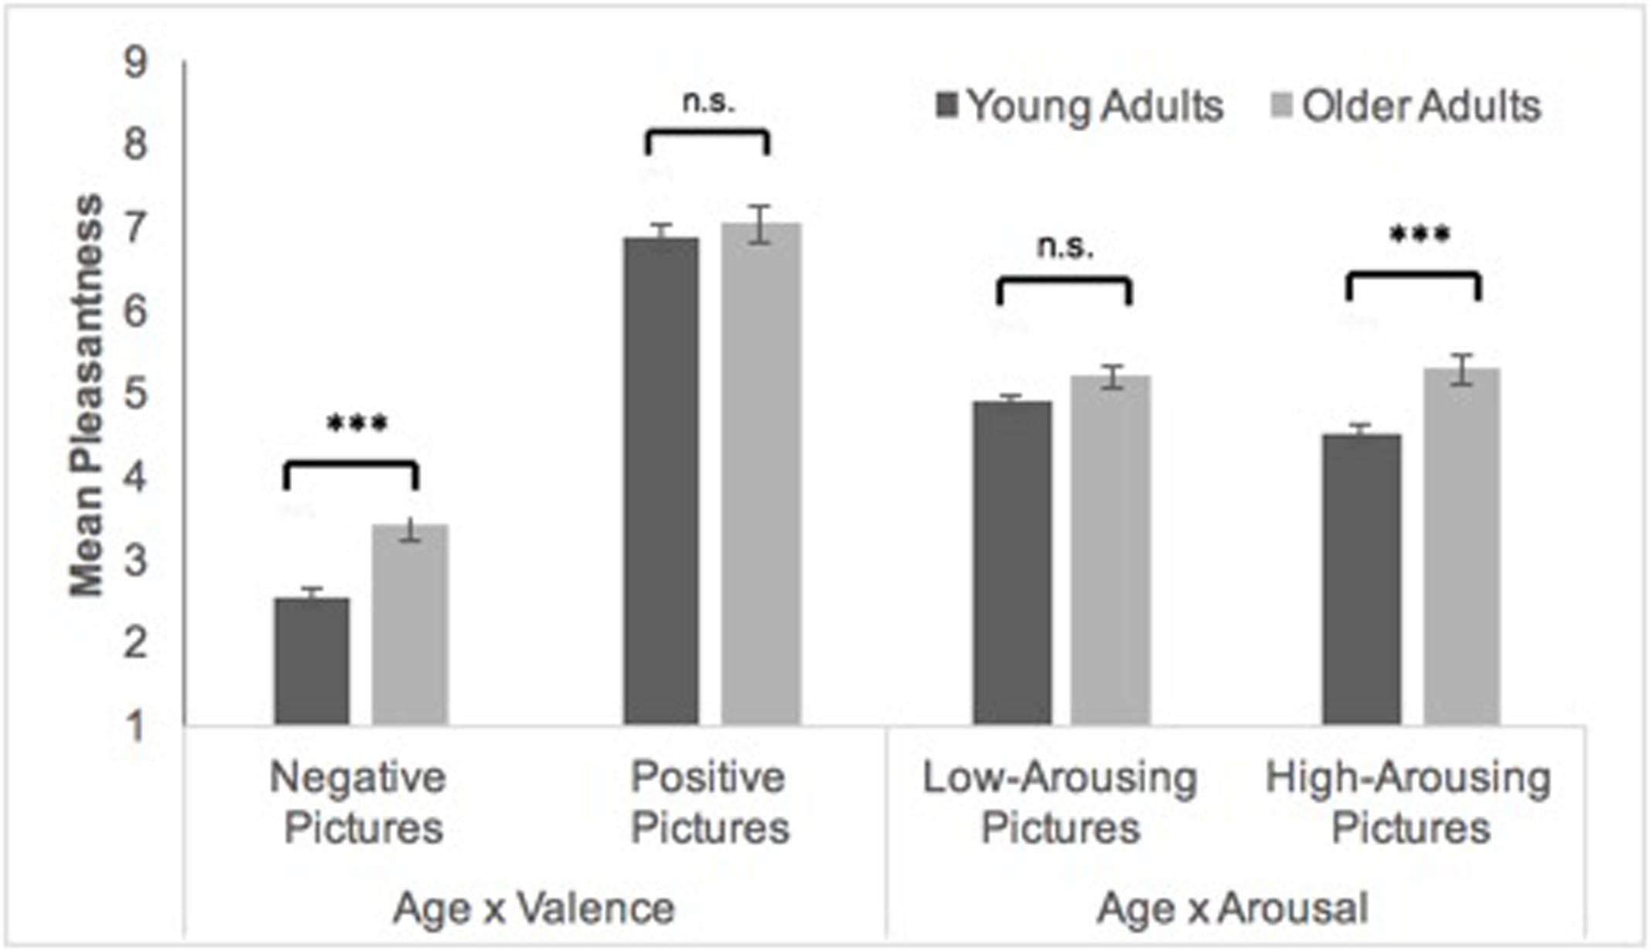
Affective
Positivity effect
Changes in the strategy for emotion regulation (more distraction, less reappraisal)
Worse emotion recognition
Less searching when making decisions, more focused on positive outcomes
Notes:
Discuss what these changes mean for i.e. internet scammers and other everyday life situations. Discuss also what this means for government and public office holders. Discuss all the areas of life where the change in emotion processing can have an effect due to age.

Slide 11
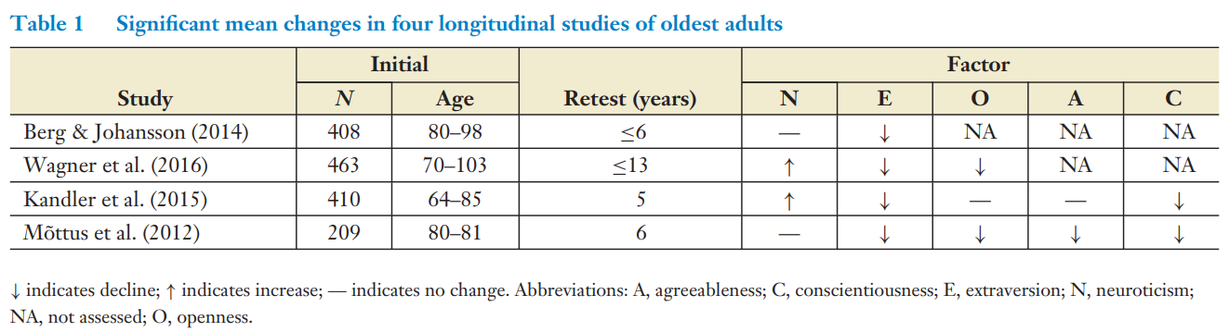
Personality
Notes:
Changes in personality mean that older people are more emotionally unstable (column N – Neuroticism), are less inclined to socialize (column E – Extraversion), are less open to new experience (column O – Openness), less agreeable (column A – Agreeableness) and less conscientious (column C). Discuss with your students if they recognize such changes in their family members.

Slide 12
Behavioral
Less novelty seeking and exploration
More reliance on outside support
The neccessary need to change existing patterns (like going to work)
Slower, more effortful execution of tasks (mostl due to physiological limitations, such as longer reaction times)
Notes:
Tie all the points here to previous changes that were discussed. Again, try to present this as an interconnected system of changes, not separate parts. Illustrate where a change in one system brings about change in the behavior of a person (i.e., less openness to new experience results in the person seeking less and less novel stimuli, which can be seen as the person being averse to novelty and exploration, instead sticking to old routines, living to the outside view, possibly monotonous lives).

Slide 13
Sources and further reading
Mandatory
Anstey, K. J., & Low, L.-F. (2004). Normal cognitive changes in ageing. Australian Family Physician, 33(10). Available from: https://www.racgp.org.au/getattachment/241138d1-7067-49e7-8844-916afdb5ba2c/attachment.aspx
Mather, M. (2016). The Affective Neuroscience of Aging. Annual Review of Psychology, 67, 213. https://doi.org/10.1146/ANNUREV-PSYCH-122414-033540
Costa, P. T., Mccrae, R. R., & Ockenhoff, C. E. L. ¨. (2019). Personality Across the Life Span. Annu. Rev. Psychol, 70, 423–448. https://doi.org/10.1146/annurev-psych-010418
Additional
Park, D. C., Polk, T. A., Mikels, J. A., Taylor, S. F., & Marshuetz, C. (2022). Cerebral aging: integration of brain and behavioral models of cognitive function. Https://Doi.Org/10.31887/DCNS.2001.3.3/Dcpark, 3(3), 151–165. https://doi.org/10.31887/DCNS.2001.3.3/DCPARK
Graham, E. K., Weston, S. J., Gerstorf, D., Yoneda, T. B., Booth, T., Beam, C. R., Petkus, A. J., Drewelies, J., Hall, A. N., Bastarache, E. D., Estabrook, R., Katz, M. J., Turiano, N. A., Lindenberger, U., Smith, J., Wagner, G. G., Piccinin, A. M., Lipton, R. B., Schaie, K. W., … Mroczek, D. K. (2020). Trajectories of Big Five Personality Traits: A Coordinated Analysis of 16 Longitudinal Samples. European Journal of Personality, 10, 301–321. https://doi.org/10.1002/per.2259
Advanced
Bowen, C. E., & Staudinger, U. M. (2011). Aging in the Work Context. In Handbook of the Psychology of Aging (pp. 263–272). https://doi.org/10.1016/B978-0-12-380882-0.00017-6
Kappes, C., Streubel, B., Droste, K. L., & Folta-Schoofs, K. (2017). Linking the positivity effect in attention with affective outcomes: Age group differences and the role of arousal. Frontiers in Psychology, 8(OCT), 1877. https://doi.org/10.3389/FPSYG.2017.01877/BIBTEX

