Slide 1
Aging
& Neuro Degenerative diseases
W.A.Rupa Menike
Faculty of Nursing

Slide 2
Aim of the lecture
At the end of the lessons students will be able to
To describe aging and aging process
To distinguish the effect of processes in normal aging and aging in neurodegenerative disorders

Slide 3
Allocated time (hrs) -02hrs
Teaching learning methods ,
Lecture discussions 30% Small group Discussions 50% Role plays (20%)
Method of assessment
MCQs and SEQs

Slide 4
The content of the lecture in abstract
Normal Aging
Aging associated factors
biological, physiological, environmental, psychological, behavioral, and social factors.
declines in function of the senses and activities of daily life and increased susceptibility to and frequency of disease, frailty, or disability.
The major risk factor for a number of chronic diseases in humans.
Aging is not a homogenous process.

Slide 5
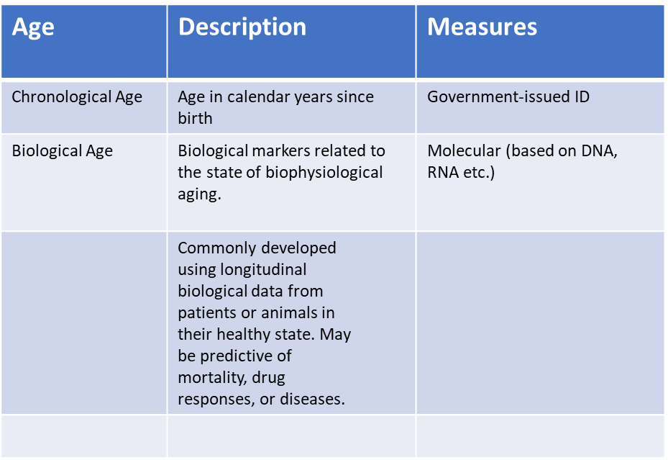
The content of the lecture in abstract
Discuss-Chronological and Biological age

Slide 6
The content of the lecture in abstract
Normal aging process
Age-associated Physiologic Changes
changes in Physiologic rhythms
Cardiac and pulmonary changes
Changes in Hormones
Loss of complexity
Changes in Musculo skeletal changes
Changes in Peripheral nervous system:
Changes in Autonomic nervous system:
Changes in Hormones
Changes in Musculo skeletal changes

Slide 7
The content of the lecture in abstract
Behavioral & Psychological changes in Aging
Discuss
Change and Loss -Aging is a process of adjusting to continual changes. The changes that many older adults experience can affect how they see their lives
Physical complaints, Loneliness, Sense of helplessness,Grief, Depression and anxiety, Rage, Reminiscence, Rigidity/stubbornness, Selective memory, Regression,
Grief & Grief Stages - Acceptance, Bargaining, Depression, Anger, Denial
Signs and Symptoms of Depression
Depressed mood
Feelings of worthlessness, hopelessness, helplessness, and/or inappropriate guilt
Changes in eating habits with significant weight loss or gain
Changes in sleeping habits (sleeping too little; disturbed sleep; or sleeping too much)
Decreased energy or increased fatigue
Inability to concentrate or make decisions
Memory loss, confusion, disorientation
Irritability, short-temper
Persistent sadness or anxiety
Neglect of self care

Slide 8
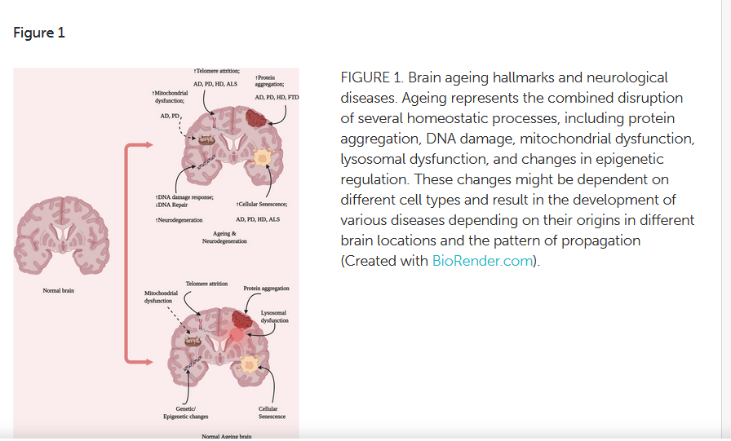
The content of the lecture in abstract
Aging In Neurodegenerative Disorders-Brain aging

Slide 9
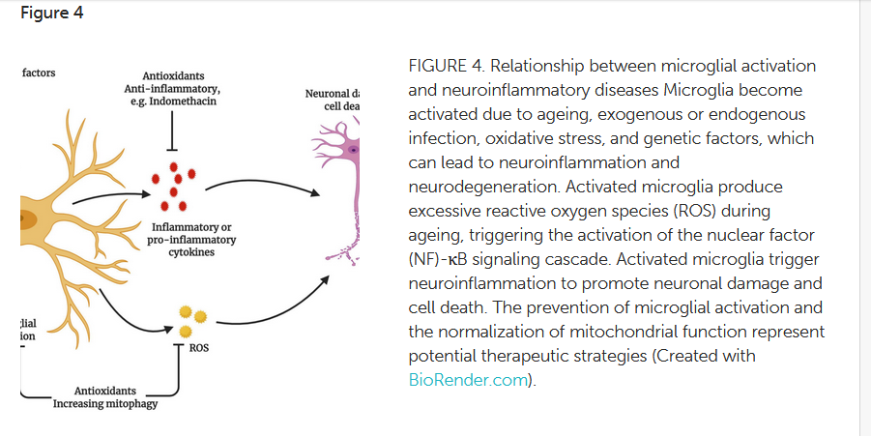
The content of the lecture in abstract
Neuro degeneration

Slide 10
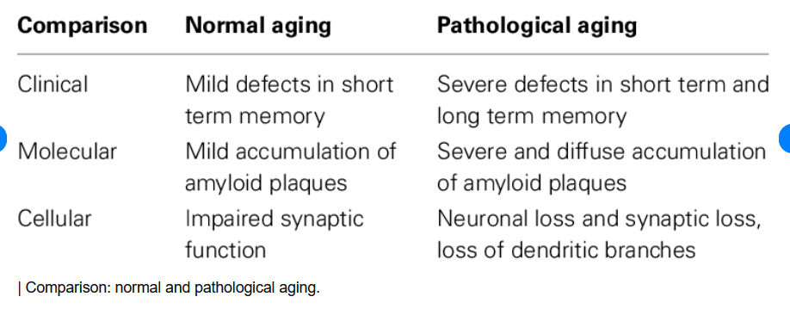
The content of the lecture in abstract
Comparison of Normal Aging &Pathological Aging

Slide 11
Readings
Research studies
Boss, G R.,& Seegmiller, J., E (1981)Age-related physiological changes and their clinical significance West J Med 1981 Dec;135(6):434-40. https://www.ncbi.nlm.nih.gov/pmc/articles/PMC1273316/pdf/westjmed00220-0011.pdf
Amarya, S. & Sabharwal K.,S.,M. (2018)Ageing Process and Physiological Changes (2018) Published: July 4th, 2018 From the Edited Volume Gerontology Edited by Grazia D’Onofrio, Antonio Greco and Daniele Sancarlo
https://www.intechopen.com/chapters/60564
Bourdenx, M., Koulakiotis, N. S., Sanoudou, D., Bezard, E., Dehay, B., and Tsarbopoulos, A. (2017). Protein aggregation and neurodegeneration in prototypical neurodegenerative diseases: examples of amyloidopathies, tauopathies and synucleinopathies. Prog. Neurobiol. 155, 171–193. doi: 10.1016/j.pneurobio.2015.07.003 Google Scholar

