Slide 1
Aging: Normal aging and pathophysiological, behavioural and psychological changes
GP1 - Neurology and medical care of neurodegenerative disorders
Gorazd Drevenšek
University of Ljubljana
and
Manuel Ramanović

Slide 2
Learning Objectives
To learn the processes of normal aging
To learn aging-related pathophysiological, behavioral and pshychological changes
To understand the processes of normal aging in comparison to processes in neurodegeneration

Slide 3
Content of the lecture
Introduction
  What is aging?
  Cellular senescence
Theories of aging
Normal vs. healthy aging
Pathophysiological aging changes
Behavioral and psychological changes in aging
  What cognitive processes change with age
  What cognitive processes do not change with age
Age-related change in physical functions
Aging as a risk factor for neurodegenerative disease
  What cognitive processes change with age
  What cognitive processes do not change with age
Preventive and interventional measures for healthy aging
Effectively caring for the geriatric population - key principles

Slide 4
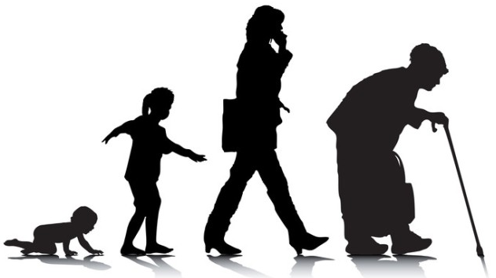
What is aging?
Aging is a complex and multifactorial phenomenon characterized by a gradual decrement in physiological actions and behavioral capacity
Progressive physiological changes in an organism that lead to senescence, or a decline of biological functions and of the organism’s ability to adapt to metabolic stress
The process by which a cell looses its ability to divide, grow, and function. This loss of function ultimately ends in death
Aging happens at molecular, cellular, and histological levels in different organs, particularly at the central nervous system (CNS) and particularly the brain (Zia, A, et al. Behav Brain Funct , 2021)
Guarente, Leonard P. , Simic, Petra and Rogers, Kara. "aging". Encyclopedia Britannica, 2022
Notes:
Gerontology, the study of the aging process, is devoted to the understanding and control of all factors contributing to the finitude of individual life.
Gerontology, therefore, can be defined as the science of the finitude of life as expressed in the three aspects of longevity, aging, and death, examined in both evolutionary and individual (ontogenetic) perspective. Longevity is the span of life of an organism. Aging is the sequential or progressive change in an organism that leads to an increased risk of debility, disease, and death. Senescence consists of these manifestations of the aging process.

Slide 5
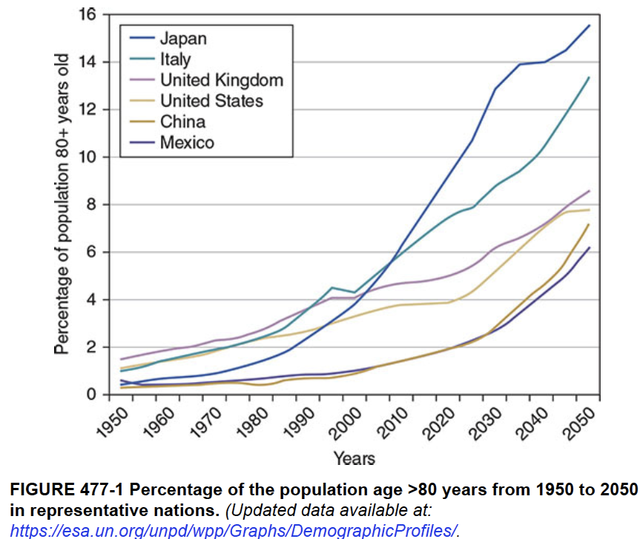
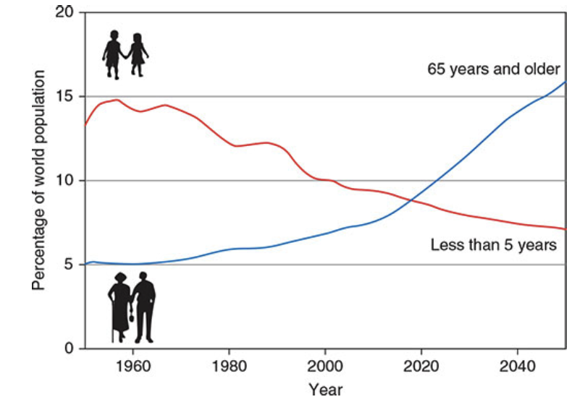
The people over the age of 65 years now exceed children under the age of 5 years
Globally
The dramatic increase in the population of older people is one of the most significant changes in human history
Joseph Loscalzo, et al. Harrison's Principles of Internal Medicine, 21e . McGraw Hill, 2022
Notes:
The dramatic increase in the population of older people is one of the
most significant changes in human history. In the past few years, the
number of people over the age of 65 exceeded that of children under
the age of 5 for the first time, and by 2050, older people will likely
outnumber children under the age of 14

Slide 6
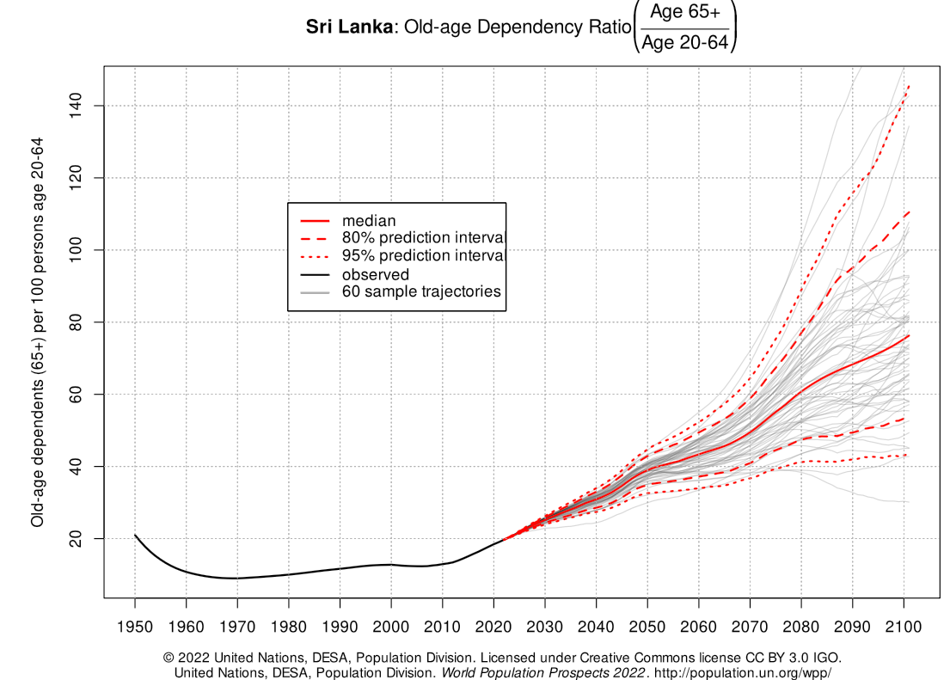
The people over the age of 65 years now exceed children under the age of 5 years
The dramatic increase in the population of older people is one of the most significant changes in human history
Notes:
The dramatic increase in the population of older people is one of the
most significant changes in human history. In the past few years, the
number of people over the age of 65 exceeded that of children under
the age of 5 for the first time, and by 2050, older people will likely
outnumber children under the age of 14

Slide 7
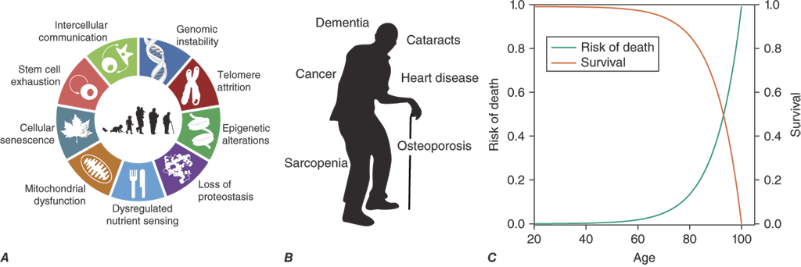
What is aging?
Definitions of aging include
(A) a biological component ➔ nine hallmarks of aging
(B) a phenotypic component ➔ chronic non-communicable diseases, and
(C) a statistical component ➔ exponential increase in the risk of mortality (Gompertz law of mortality)
Joseph Loscalzo, et al. Harrison's Principles of Internal Medicine, 21e . McGraw Hill, 2022,
Notes:
Aging is usually defined as a progressive process associated with
deterioration in structure and function, leading to increased
susceptibility to disease and mortality, and is often associated with
impaired reproductive capacity. There are statistical, biological, and
phenotypic components to aging. From the statistical perspective,
aging in humans is associated with an exponential risk of mortality
with time (Gompertz law of mortality). The biological mechanisms of
aging are encompassed by the “hallmarks of aging,” which describe
the key cellular mechanisms underpinning aging. The phenotypic
components of aging include chronic diseases and age-related
syndromes that are often the target of medical interventions

Slide 8
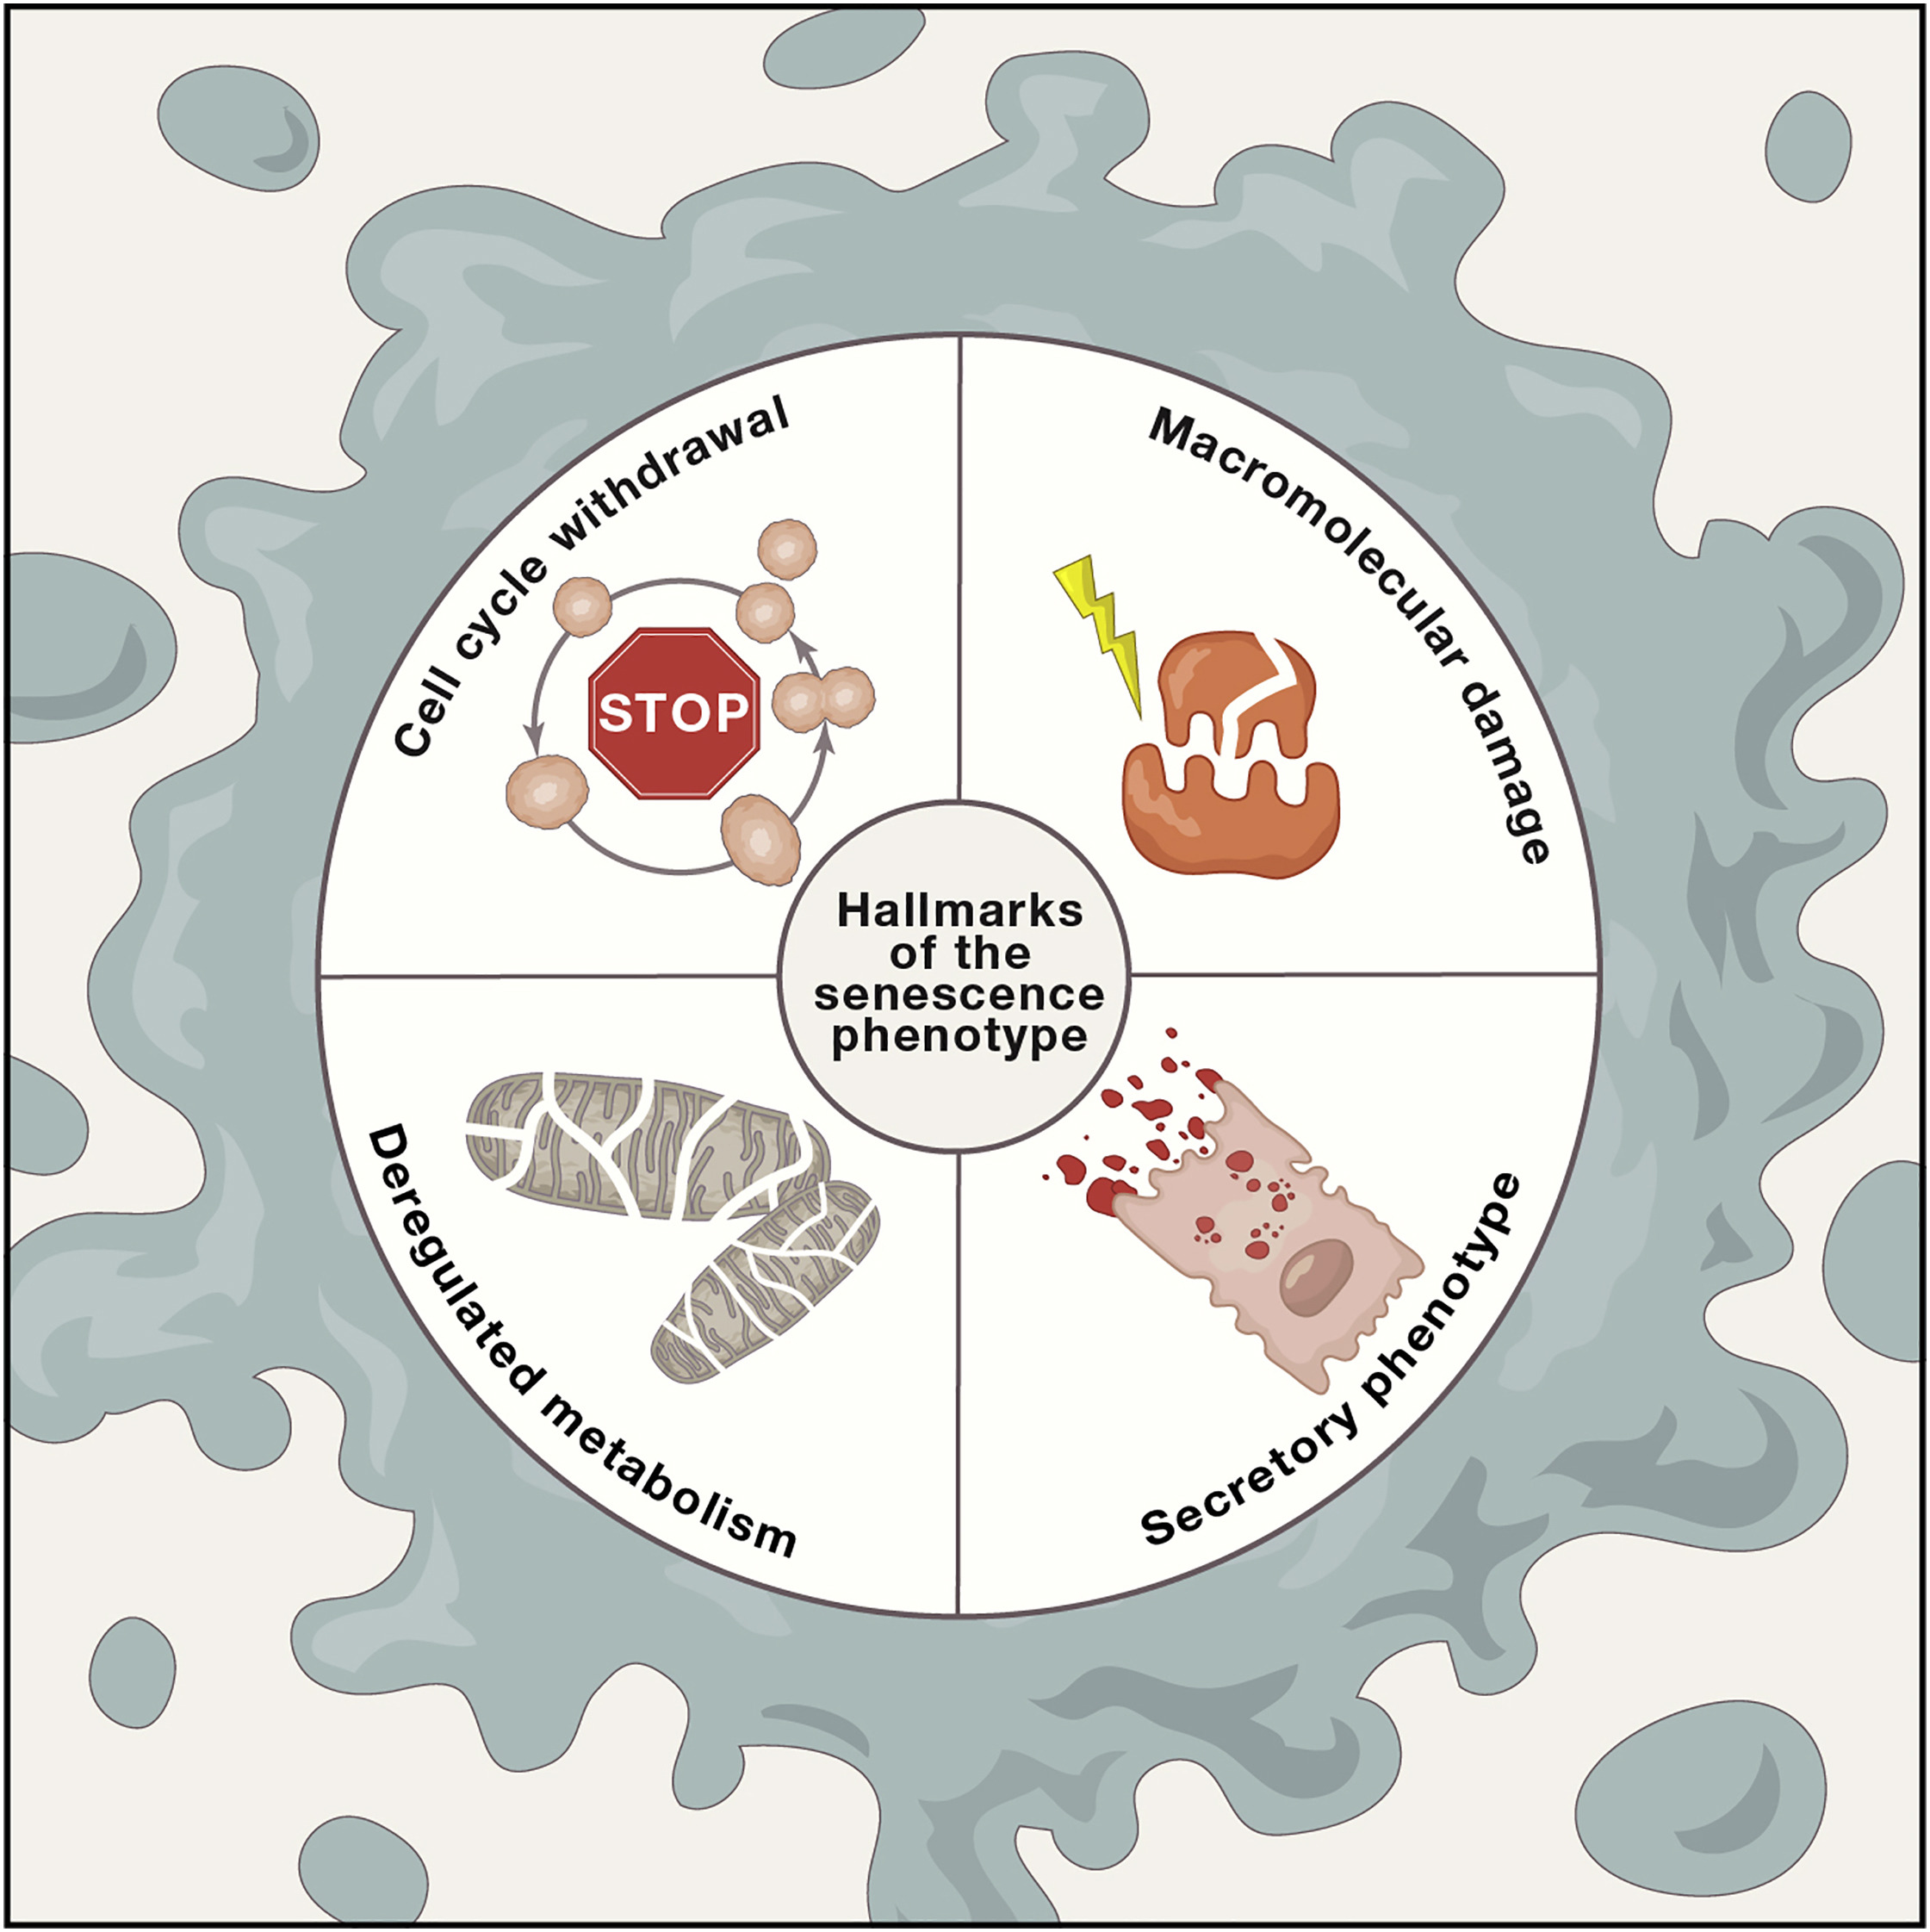
Cellular senescence
The Hallmarks of the Senescence Phenotype
State of growth arrest observed in aging cells
Formally described in 1961 (Hayflick and Moorhead, 1961)
  senex ➔ “old” (Latin)
Response to numerous stressors
  genotoxic agents
  nutrient deprivation
  hypoxia
  mitochondrial dysfunction
  oncogene activation
Vassilis G, et al. Cellular Senescence: Defining a Path Forward, Cell, 2019
Notes:
Formally described in 1961 by Hayflick and colleagues, cellular senescence, derived from the latin word senex meaning “old” (Hayflick and Moorhead, 1961), was originally observed in normal diploid cells that ceased to proliferate after a finite number of divisions (Hayflick limit), later attributed to telomere shortening
Cellular senescence is a cell state triggered by stressful insults and certain physiological processes, characterized by a prolonged and generally irreversible cell-cycle arrest with secretory features, macromolecular damage, and altered metabolism
Figure 1. The Hallmarks of the Senescence Phenotype
Senescent cells exhibit the following four interdependent hallmarks: (1) cell-cycle withdrawal, (2) macromolecular damage, (3) secretory phenotype (SASP), and (4) deregulated metabolism (see also text).
Cellular senescence has since been identified as a response to numerous stressors, including exposure to genotoxic agents, nutrient deprivation, hypoxia, mitochondrial dysfunction, and oncogene activation (Table 1).

Slide 9
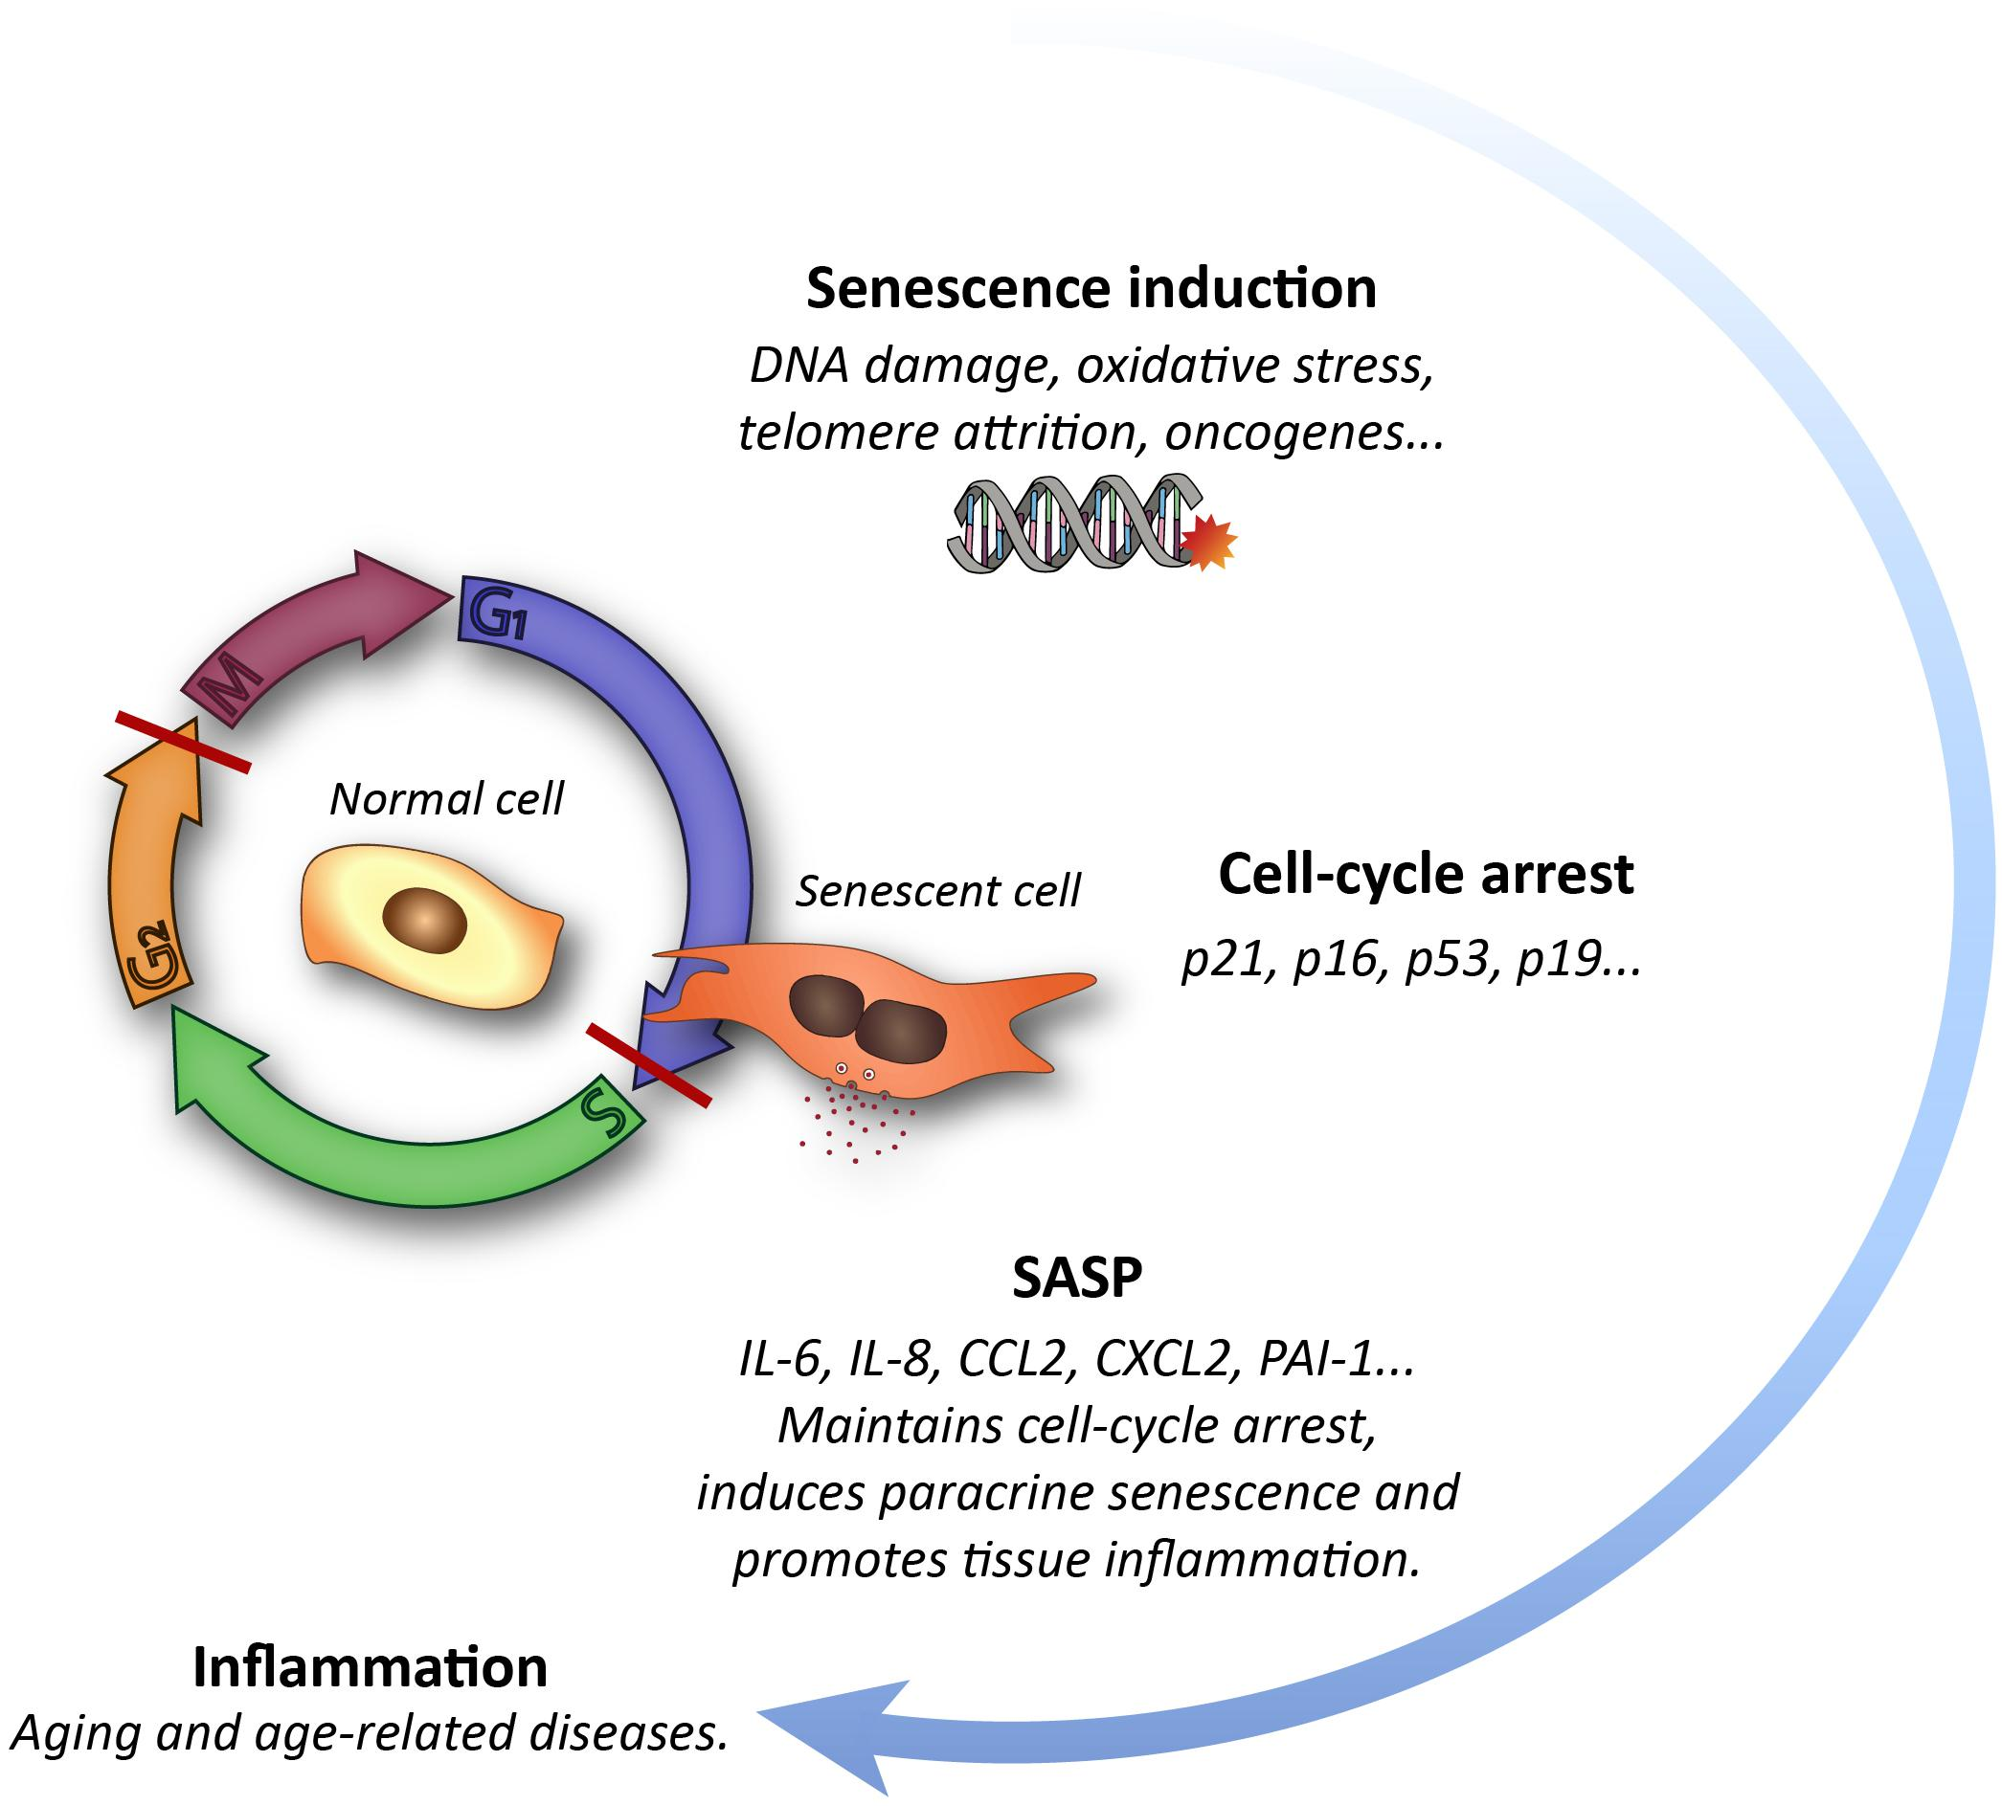
Cellular senescence
State of growth arrest observed in aging cells
Rojas-Vázquez Sara,Frontiers in Neuroscience, 2021
Notes:
Schematic representation of the cellular senescence process and its impact on tissues.

Slide 10
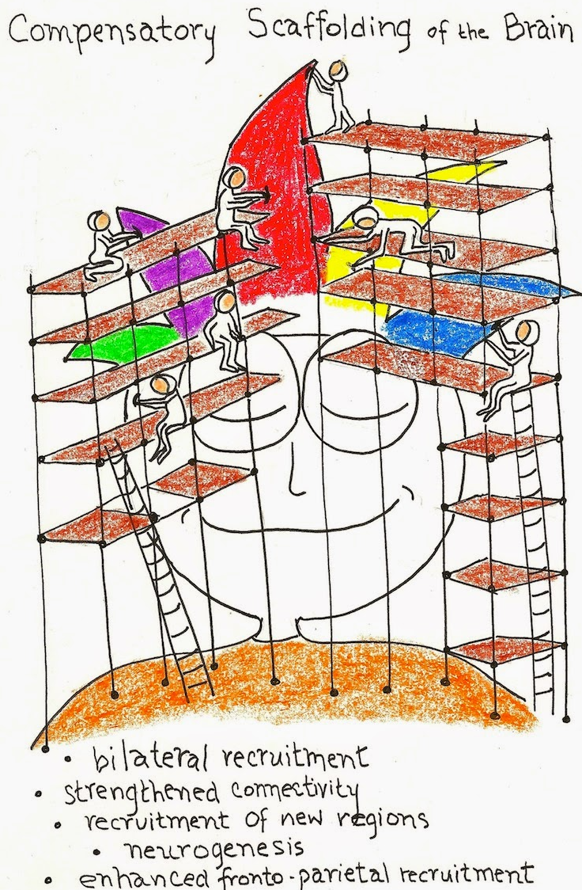
Theories of aging
Kirkwood (Evolution of ageing. Nature. 1977)
  “mortality may be due to an energy-saving strategy of reduced error regulation in somatic cells”
Harman (J Gerontol. 1956)
  theory based on free radical and radiation chemistry
Garaschuck et al, 2018 – age related declines
  Shift in the dynamic equilibrium between the benefits of reactive oxygen (ROS), nitrogen (RNS), and carbonyl (RCS) species RONCS
Park & Bischof, 2009 - Scaffolding theory
  “aging brain can actively change for any number of reasons” - new experiences, behaviors, environments, thoughts, and emotions
  brain remains pliable, even into adulthood.

Slide 11
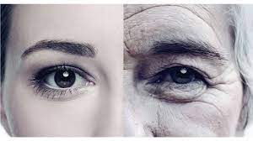
Theories of aging
Biological theories
  “Wear-and-tear”
  Cellular
  Autoimmune
  Genetic mutation
Psychosocial theories
Biopsychosocial theories
Typical changes:
  Skind and hair
  Bones and joints
  Uro-genital tract
  Heart and lungs
  Vision
  Glaucoma
  Macular degeneration
  Hearing
  Sexual characteristics
  Physical ability/performance
Notes:
The wear-and-tear theory states that, like everything else in the world, the human body wears out. Inherent in this theory is the idea that the more you abuse your body, the faster it will wear out.
The cellular theory states that at birth we have only a certain number of usable cells, which are genetically programmed to reproduce a limited number of times. Once cells reach the end of their reproductive cycle, they die, and the organs they make up begin to deteriorate. The rate of deterioration varies from person to person, and its impact depends on the system involved.
The autoimmune theory attributes aging to the decline of the body’s immunological system. Studies indicate that as we age, our immune systems become less effective in fighting disease. Eventually, bodies that are subjected to too much stress, lack of sleep, and so on, show signs of disease and infirmity, especially if these factors are coupled with poor nutrition.
The genetic mutation theory proposes that the number of cells exhibiting unusual or different characteristics in creases with age. Proponents of this theory believe that aging is related to the amount of mutational damage within the genes. The more mutation, the greater the chance that cells will not function properly, which leads to eventual dysfunction of body organs and systems.

Slide 12
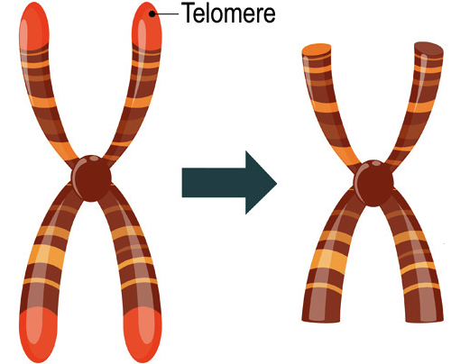
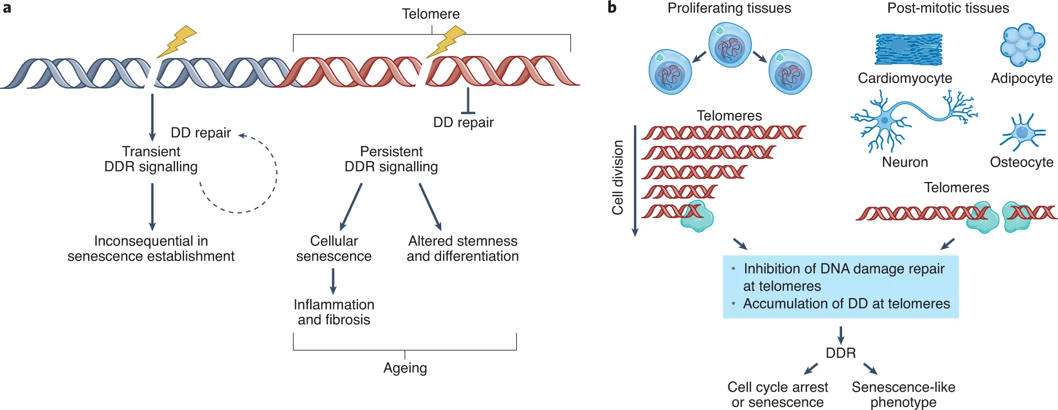
Telomeric Theory
Telomeres are specialized DNA sequences at the end of chromosomes
  shorten with each cell division
  when too short ➔ senescence
Rossiello, F., Jurk, D., Passos, J.F. et al. Telomere dysfunction in ageing and age-related diseases. Nat Cell Biol. 2022
Notes:
a, Genomic DNA damage (DD) triggers a transient DNA damage response (DDR) that may not be sufficient for senescence establishment. Alternatively, an irreparable, therefore persistent, DNA damage at telomeres causes a protracted DDR and cellular senescence that are associated with SASP-mediated inflammation and consequent fibrosis. These events in a stem-cell context impair stem-cell properties and alter differentiation. Overall this contributes to organismal ageing¹⁷. b, In proliferating tissues, telomeres are shortened with cell cycle divisions and, when critically short, they trigger a DDR. In non-proliferating, post-mitotic tissues, telomere dysfunction can be driven by irreparable DNA damage within telomeres. In both cases, the persistent DDR activation sustains a senescent phenotype that is characterized by arrested proliferation and SASP activation.

Slide 13
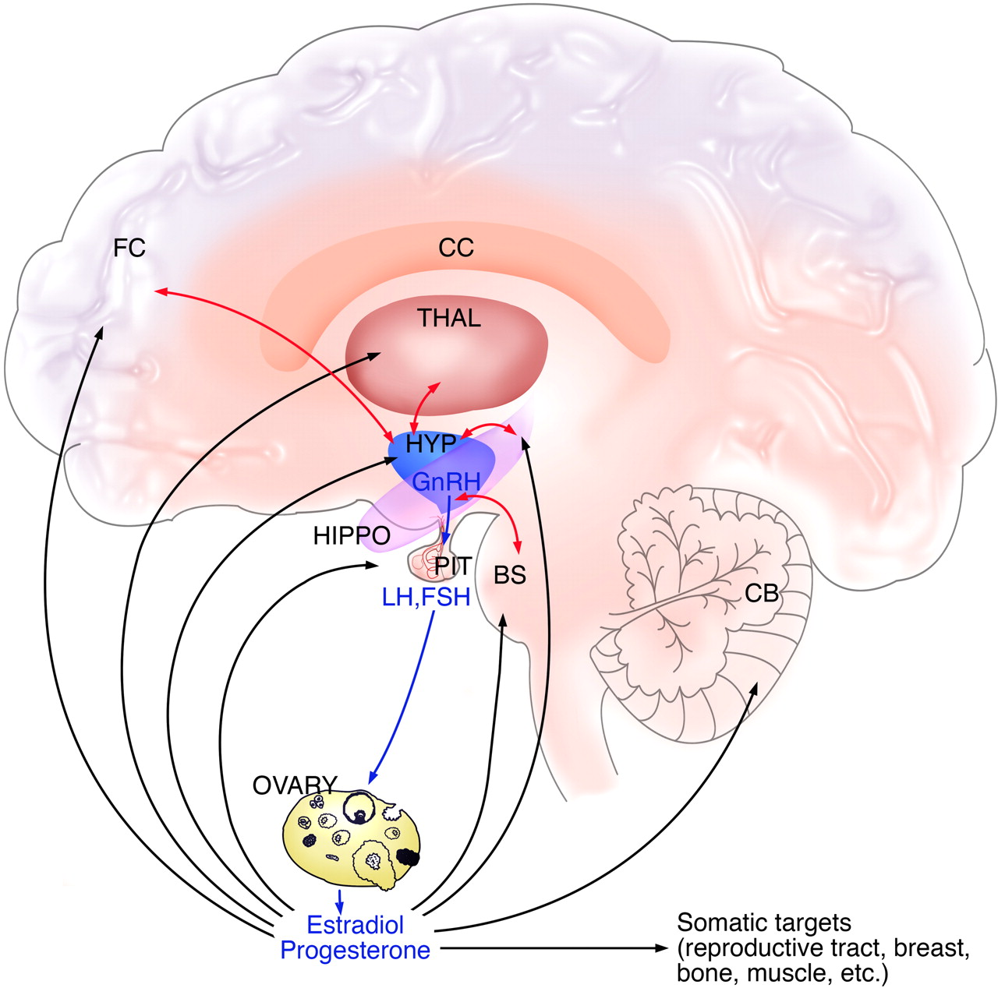
Endokrina teorija
Endocrine Theory
  Biological clock for monitoring the aging rate
    through hormones (melatonin, orexin, etc.)
  Hormones affect growth, metabolism, temperature, inflammation and stress
  Example – menopause:
    Decreased estrogen and progesterone levels
    hot flushes, changes in mood, sweating, and decline in libido , sleeplessness
Horstman AM, et al. J Gerontol A Biol Sci Med Sci. 2012
Somayeh Sahabi, Acta Histochemica, 2022
Sulekha, S.M.P. Curr Pharmacol 2022.
Notes:
Estrogen and cognitive development. BS brainstem, CB cerebellum, CC corpus callosum, FC frontal cortex, HIPPO hippocampus, HYP hypothalamus, PIT pituitary, THAL thalamus

Slide 14
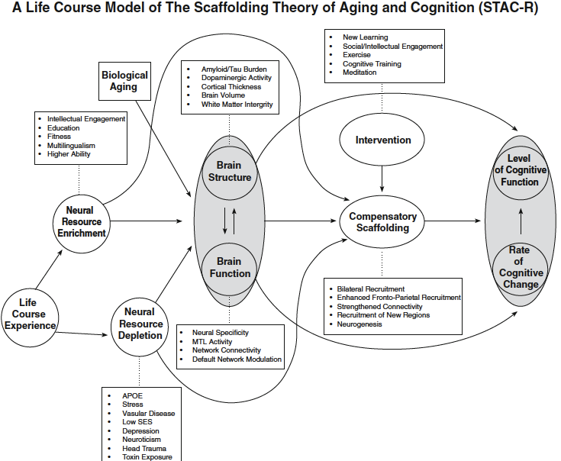
Scaffolding theory
Compensatory and supportive neural mechanisms enable maintenance of cognitive function with age
Park & Bischof, 2014
Notes:
The model indicates that both life-span (aging) and life-course (experience) variables impact
he structure and function of the brain and also directly affect the development of compensatory scaffolding
Older individuals who maintain a youthful neurobiological status, through favorable genetics, environmental factors, lifelong pro-health behaviors and beneficial lifestyle activities will need less compensatory scaffolding and reorganization

Slide 15
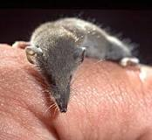
Is longevity determined by genetics?
“The link between genes and lifespan is unquestioned.
The simple observation that some species live longer than others -- humans longer than dogs, tortoises longer than mice -- is one convincing piece of evidence.”
Diseases among elephants(?)
Is that really true?
The National Institute on Aging - https://www.nia.nih.gov/
Suncus etruscus
Weight: 1,8 g → 1500 bits/min (25/s) → heart 1,2% weight;
Consumes up to 2x body weight daily;
When in hibernation, decreases body T by 12°C; during waking-up period up to 3500/min (58/s). Life age duration up to 2 years
Siming Ma, Seminars in Cell & Developmental Biology, 2017

Slide 16


Theories of aging - pessimistic view of gerontologists
Gerontologists have become resigned to the hopelessness of reaching a consensus regarding unified theory of aging which can encompass its evolutionary, biological, and sociological aspects
the large body of descriptive data in gerontology underlines the multifaceted, diverse and complex nature of aging
phenotype and the rate of progression of aging are highly variable
Aging has no universal cause, phenotype, and consequence, except death

Slide 17
Normal vs. Healthy Aging
Normal Aging
Diseases & impairments of elderly
People age differently
Diabetes may be a common disease of adulthood, but is not experienced by all aging adults.
Healthy Aging
Minimize and preserve function
Influenced by lifestyle choices
One may have a healthy life until senescence makes life impossible.

Slide 18
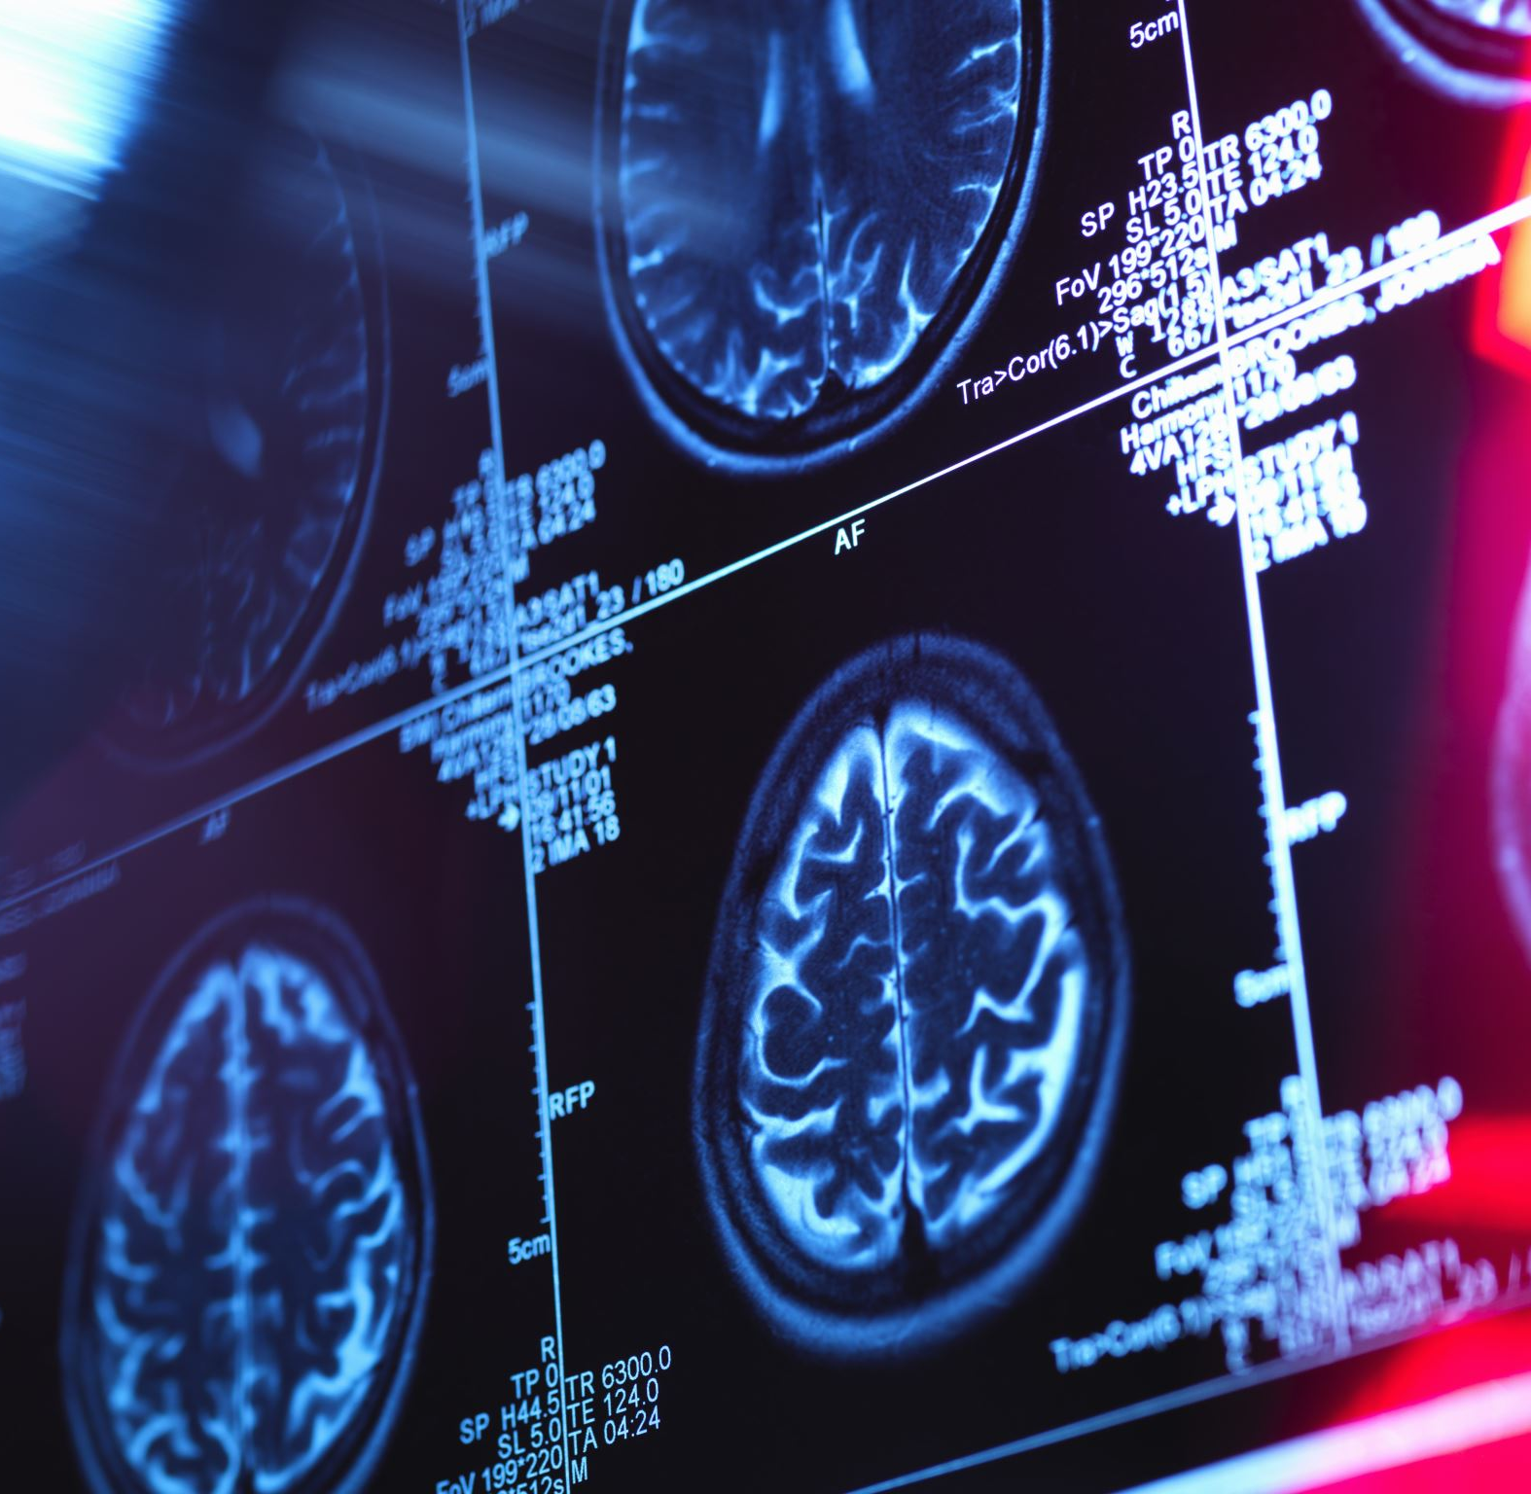
What is ”Healthy” aging?

Slide 19
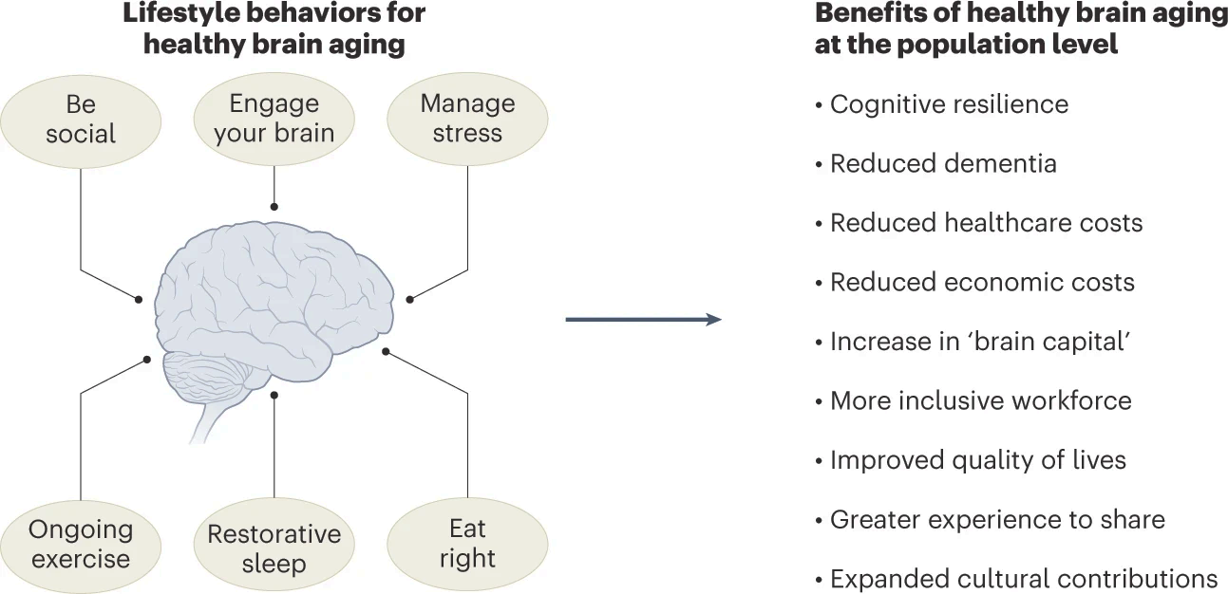
“Healthy” aging
Lock, S.L. The benefits of brain health to our economies. Nat Aging, 2023. https://doi.org/10.1038/s43587-022-00302-z
Notes:
Six pillars to describe key recommendations for individuals from the Global Council on Brain Health on modifiable lifestyle factors that can affect brain health as people age

Slide 20
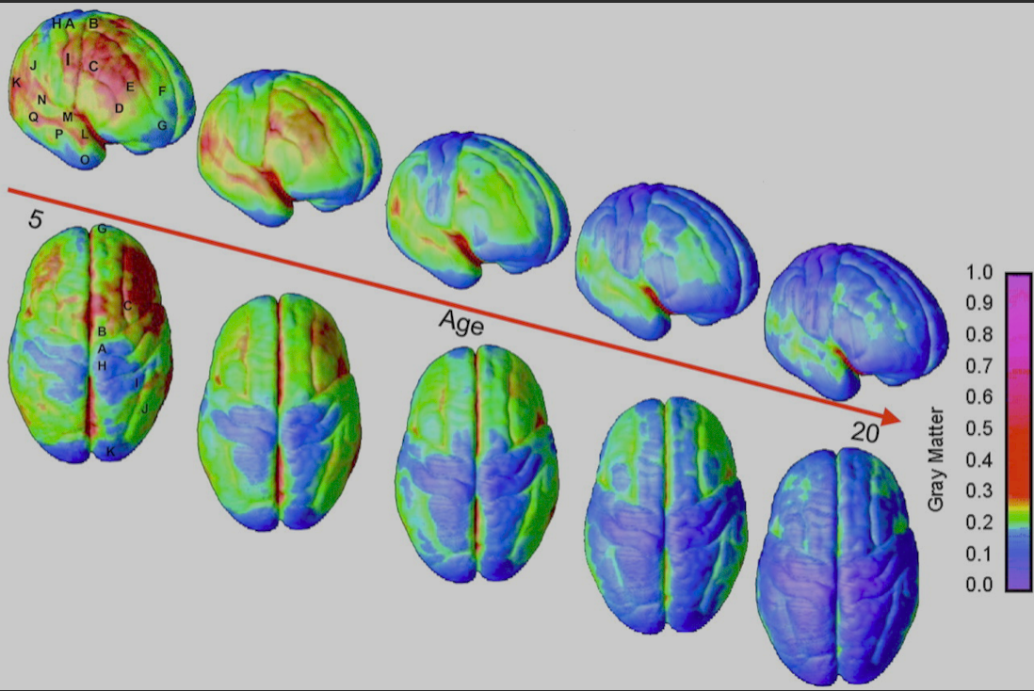
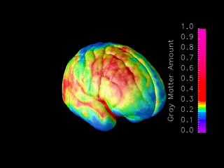
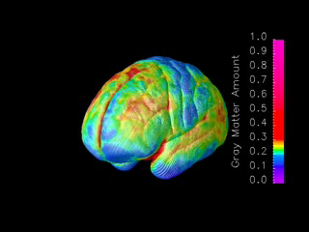
The brain is the only organ that never stops developing
Gray Matter Amount
Gray Matter Amount
https://www.pnas.org/doi/10.1073/pnas.0402680101
Notes:
What we see is that the brain over period of time, form 5yrs of age to age of 20, still may be still maturing. The brain is continually sculpted by environment, by experience.
Within the frontal cortex, the precentral gyrus (Figs. 1A and 3) matures early. GM loss progresses linearly at an early age, whereas more rostral regions of the frontal lobe (along the superior and inferior frontal gyri; Figs. 1 and 3, B–G) mature successively in an anterior progression, as also indicated by the progressively later peaks of nonlinear GM loss (Fig. 1 B–D), with the prefrontal cortex maturing last (Figs. 1, D and E, and 3). In the parietal lobe, the GM loss begins in the postcentral gyrus (Figs. 1H and 3; with a nonlinear early peak), progressing laterally into the angular gyrus (area 40; Figs. 1I and 3), and supramarginal gyrus (area 39; Figs. 1J and 3). The frontal and occipital poles, similar to the pre- and postcentral gyri, mature early (Figs. 1 G and K and 3).

Slide 21
Scaffolding theory
Compensatory and supportive neural mechanisms enable maintenance of cognitive function with age
Park & Bischof, 2014
Notes:
The model indicates that both life-span (aging) and life-course (experience) variables impact
he structure and function of the brain and also directly affect the development of compensatory scaffolding
Older individuals who maintain a youthful neurobiological status, through favorable genetics, environmental factors, lifelong pro-health behaviors and beneficial lifestyle activities will need less compensatory scaffolding and reorganization

Slide 22
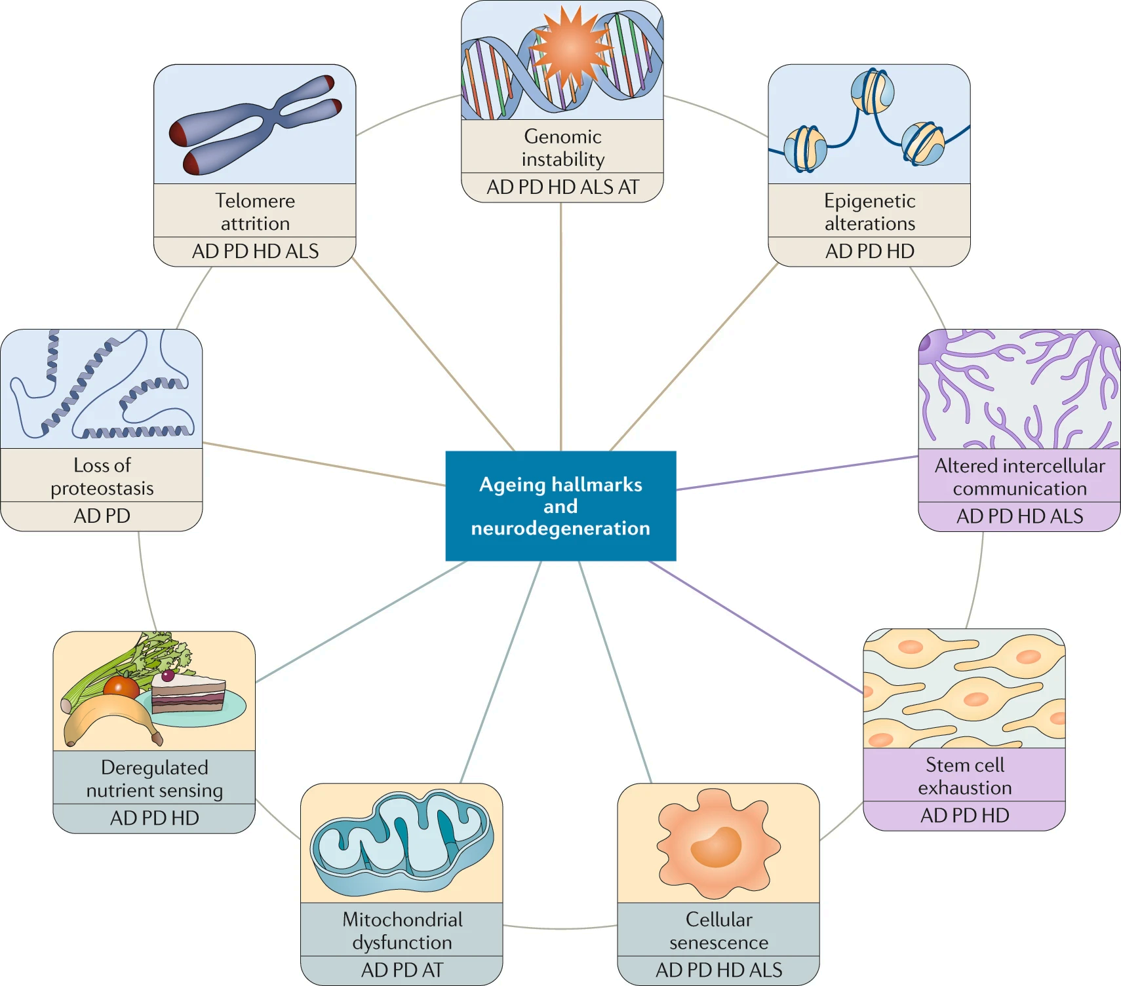
Aging as a risk factor for neurodegenerative disease
Geroscience ➔ the study of the relationship between aging biology and disease
Hou, Y., Dan, X., Babbar, M. et al. Nat Rev Neurol , 2019
Notes:
Nine hallmarks of ageing — genomic instability, telomere attrition, epigenetic alterations, mitochondrial dysfunction, deregulated nutrient sensing, loss of proteostasis, cellular senescence, stem cell exhaustion and altered intercellular communication — seen in the main neurodegenerative diseases. AD, Alzheimer disease; ALS, amyotrophic lateral sclerosis; AT, ataxia telangiectasia; HD, Huntington disease; PD, Parkinson disease.

Slide 23
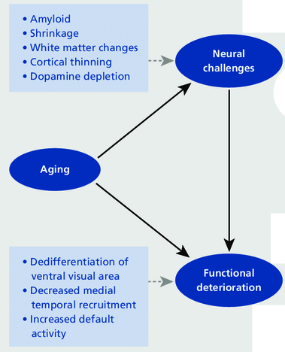
Changes in the brain that occur with age
Park & Bischof, 2014

Slide 24
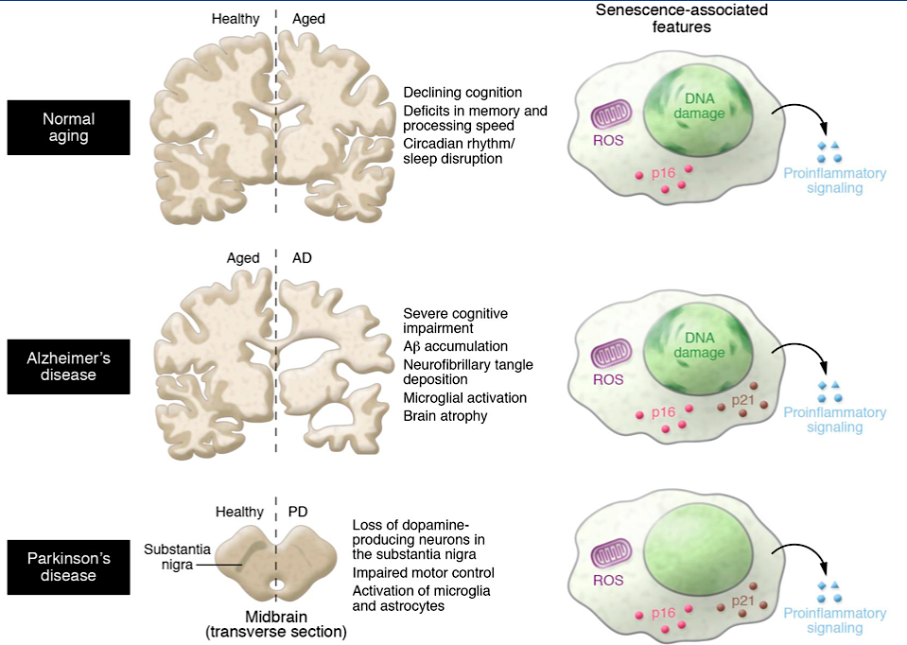
Cellular senescence in brain aging and neurodegenerative diseases
Cell damage accumulation throughout an individual’s life:
  DNA and oxidative damage
  telomere shortening
  impairment of repair mechanisms
  immune system function
Accumulation of senescent cells over time
Inflammatory stress activation
NEURODEGENERATIVE DISEASE
Saez-Atienzar. Nat Rev Neurosci. 2020
Baker DJ, J Clin Invest, 2018
Notes:
he brain ageing process leads to progressive impairment in memory, orientation, attention, and cognition.⁶⁶ In addition, ageing is a major risk factor for the onset of many neurodegenerative disorders, including Alzheimer's disease and Parkinson's disease.⁶⁷
Age-associated cognitive decline has been associated with multiple molecular processes, such as chronic inflammation, altered autophagy, oxidative stress damage, and mitochondrial dysfunction.68, 69 Data have shown that various parts of the brain in patients with neurodegenerative diseases are characterised by increased expression of senescence markers.⁷⁰Clearance of senescent cells has been shown to enhance brain function in healthy aged mice⁷¹ and in various murine models of neurodegenerative diseases, such as Parkinson's disease,⁷² neurodegeneration related to amyloid β,⁴⁰ tau-dependent neurodegenerative iseases,³⁹ and neuropsychiatric disorders.⁷³ In most of these studies, ABT263 (50 mg/kg) or the dasatinib (5–12 mg/kg) and quercetin (50 mg/kg) cocktail were used as the senotherapeutic, with different cycles of treatment and washout over a period of 11 weeks to 6 months. Senotherapy has been shown to ameliorate phenotypes in all of these mouse models, attenuating tau phosphorylation and aggregation,³⁹ reducing neuroinflammation and amyloid β plague load, and improving cognitive deficits.⁴⁰ Collectively, these findings show that senescence has a key role in brain ageing and in related diseases in mice, and that senolytics can improve brain performance.
Ageing is the main risk factor for most neurodegenerative diseases, including Alzheimer disease (AD) and Parkinson disease (PD)

Slide 25
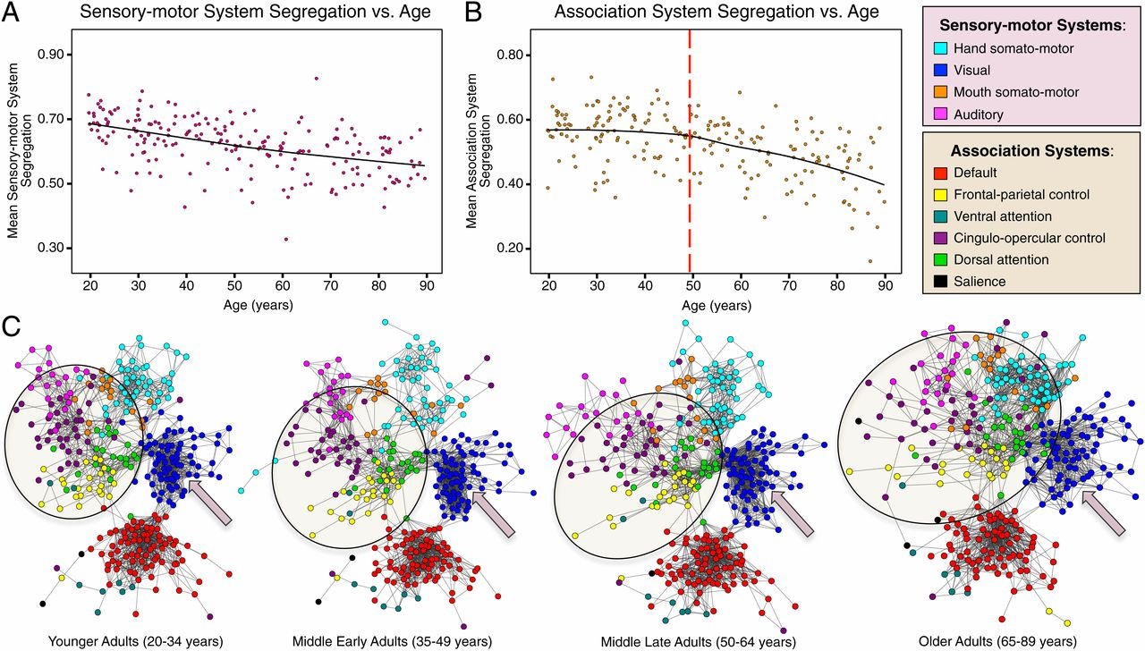
Brain networking over age
Micaela Y. Chan, PNAS, 2014
Notes:
young adults on the left part of the slide have very tightly connected networks that are dense and highly compartmentalized these are different parts of the brain that come into play for specific things like this is the network for using your hand this is the visual network and these are all different parts of the brains that communicate with each other when you’re looking at things and you can see that these networks sort of break down quite a bit should get older and it turns out that the breakdown of these networks or the lack of segregation of the networks does affect memory function
Sensory-motor and association systems exhibit distinct patterns of age-associated differences in segregation. Locally weighted scatterplot smoothing (LOESS) graphs depict (A) the linear association between decreasing sensory-motor system segregation and increasing age and (B) the quadratic association between decreasing association system segregation and increasing age. Decreases in association system segregation exhibit an inflection point reflecting accelerated reductions starting at an approximate age of 50 y (red dotted line). (C) Spring-embedded layouts of the 10 systems (4% edge density) of the four cohorts’ mean correlation matrices (Fig. 2B). Sensory-motor systems exhibit progressive age-accompanied reductions in both within-system correlations and segregation with other systems (e.g., the visual system, highlighted by the arrows). Association systems exhibit prominent and sudden decreases in segregation with other systems starting in middle-late adulthood [e.g., the frontal–parietal control (in yellow) and cingulo-opercular control systems (in purple) exhibit less within-system connectivity and greater between-system connectivity in middle late and older adult cohorts, highlighted by the circle].

Slide 26
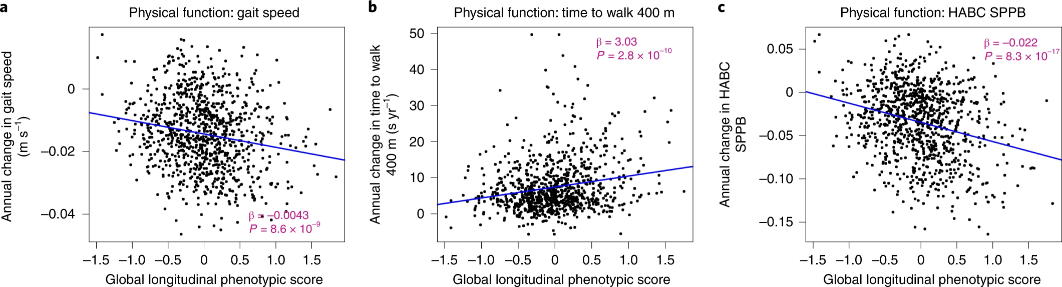
Age-related change in physical functions – mobility tests
Kuo, PL. et al. Longitudinal phenotypic aging metrics in the Baltimore Longitudinal Study of Aging. Nat Aging, 2022
Notes:
Presented are results for physical mobility decrease over life time, as described by global longitudinal phenotypic score. The researchers looked at gait speed, time to walk 400 m and so called Health, Aging and Body Composition short physical performance battery.
Relationship between global longitudinal phenotypic score and change in physical functions for three mobility tests.
Higher global longitudinal phenotypic scores indicate accelerated phenotypic aging trajectories. Higher annual decrease in gait speed (a) and HABC SPPB scores (c), along with higher annual increase in the time to walk 400 m (b), indicate faster decline of physical function. Two-sided tests were used, and the displayed P values were not adjusted for multiple comparisons. Participants with at least two visits, n = 951; usual gait speed, n = 904; time to finish 400-m walk, n = 950 (HABC SPPB); also see Supplementary Table 1b for more details.

Slide 27
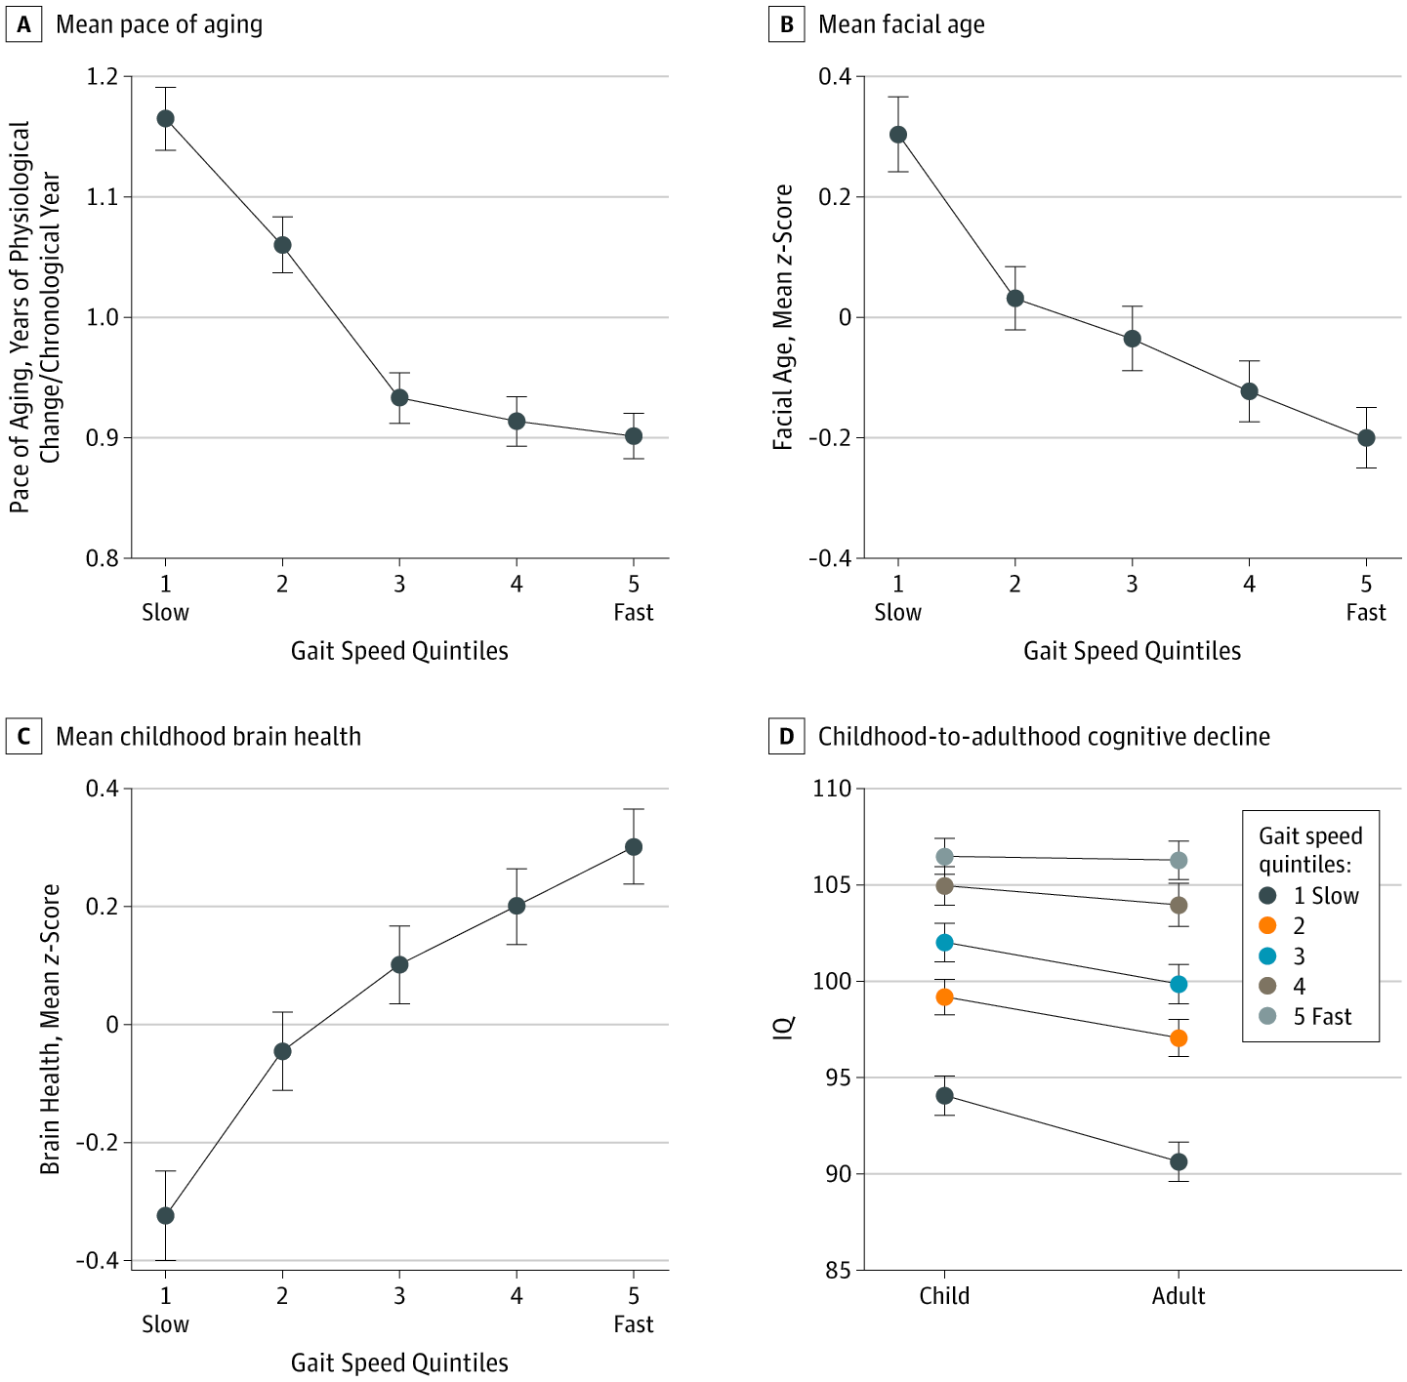
Association of Neurocognitive and Physical Function With Gait Speed in Midlife
The slow gait of a 45-yr-old could be a sing of accelerated aging
  Gait speed - not only an indicator of physical well-being but also an index of the brain health
  slower gait speed showed evidence of accelerated biological aging and greater declines in cognitive functioning from childhood to midlife
Rasmussen, et al. Association of Neurocognitive and Physical Function With Gait Speed in Midlife. JAMA Netw Open. 2019
Notes:
A-C, The mean pace of aging at age 45 years (years of physiological change per chronological year) (A), mean facial age at age 45 years (z score; mean = 0, SD = 1) (B), and mean brain health at age 3 years (z score; mean = 0, SD = 1) (C) by gait speed quintiles at age 45 years are shown. Generalized additive models are shown in eFigure 2 in the Supplement. D,
Gait speed (how fast you walk) is not only an indicator of your physical well-being but also an index of the health of your brain. These findings are based on the Dunedin Study, which has followed a birth cohort of 1,000 children born in the early 1970s to age 45 years. The findings, which appear on October 11 in JAMA Network Open, reveal that midlife adults with slower gait speed showed evidence of accelerated biological aging and greater declines in their cognitive functioning from childhood to midlife. A most remarkable finding was that we could predict how fast they walked at midlife by a childhood assessment of their

Slide 28
What cognitive processes change with age
Behavioral and psychological changes in aging
Type of Memory | Description | Effect on Age | Study
Episodic recall | Accurate memory for past items & events | Decline | Park et al, 1983 to present
Working memory | Online processing resource | Decline | Park et al 1996, 2002
Resistance to Distraction | Controlling & shifting attention | Decline | Park et al 1989
Speed of processing | Rate at which info is processed | Decline | Earles et al 1997
Abstract Reasoning | Integrating multiple dimensions to solve a problem | Decline | Park et al 2002 ,2005

Slide 29
The Dallas Lifespan Brain study
Longitudinal study across the adult lifespan (Age 20-89).
Participants were tested every three to four years over the study period
About 500 subjects from 2008-2012
  Detail measures of cognition and psychosocial functioning
  Measures of brain structure
  Measures of brain activity on four cognitive tasks
  Amyloid imaging (about 70%)

Slide 30
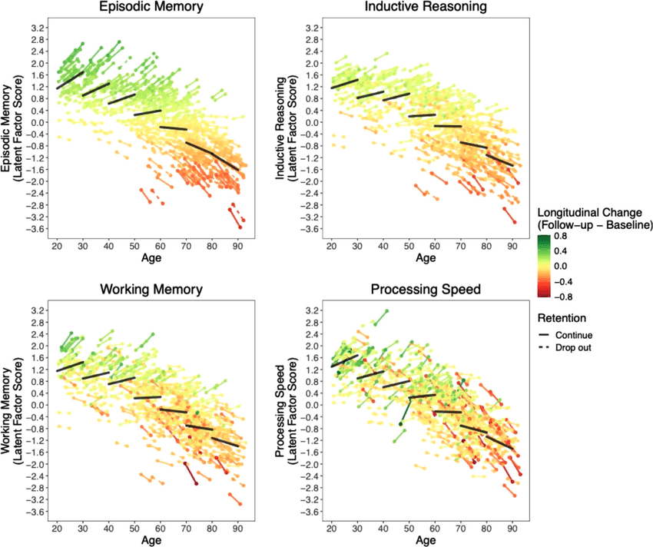
Cognitive decline over years
When does it start?
Dramatically decline:
70 -90 years of age
Xi Chen, et al. NeuroImage, 2022
Notes:
The authors has been looking at how the brain changes over time and also how the changes in the brain affected changes in behavior in order to figure out what brain patterns are important for understanding who is gonna age well and who was not in terms of their cognitive function.
this what these each of these lines represents an individual participant. If the line is red and it goes down it means that person showed a lot of decline from year 1 to year 4. Thw the green lines mean the persons measured brain congnitive performances - speed of processing this is episodic memory, went up. And the yellow showed a little bit of change but not much in either direction.
There is a general picture that the old decline a lot with speed of processing you can see they’ve declined significantly, especillay 70 to 90 year olds and they really show a big drop. from 70 to 90 and the overall pictures for both measures are measures of decline.

Slide 31
Behavioral and psychological changes in aging
What cognitive processes do not decline with age
Type of Memory | Description | Effect on Age | Study
Episodic recognition | Recognizing a past event or item | Varies | Many studies from 1982, 1983,to present
Prospective memory | Remembering to perform a future task or keep an appointment | Some decline | Park et al 1997, Kidder et al 1997
Context Memory for spatial and color features (binding) | Remembering the features or context of items (location, color, modality, frequency of occurrence) | Decline but typically less than four items | Park et al 1980, 1982, 1983 to 2004
Implicit memory | Recollection without awareness | Little Decline | Park & Shaw, 1992
Verbal vs. Pictorial memory | Ease of recall and recognition | Varies | Park et al 1985
Semantic Memory | World knowledge/vocabulary | Increases | Park et al 2002, Hedden et al 2005
Automatic Processes | Cognitive function without awareness | Increases | Chasteen et al 2001, Park et al 1984

Slide 32
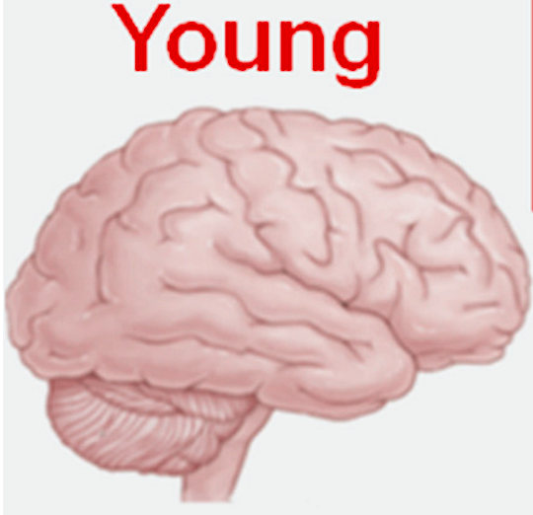
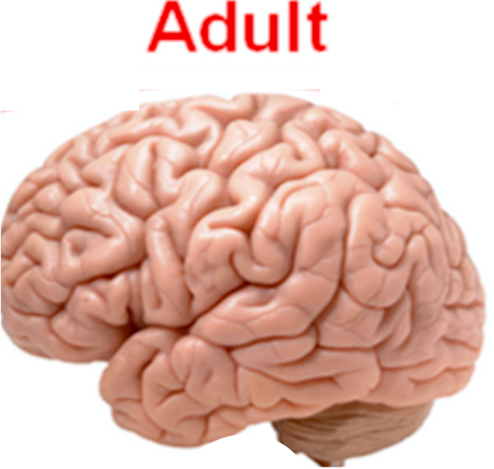
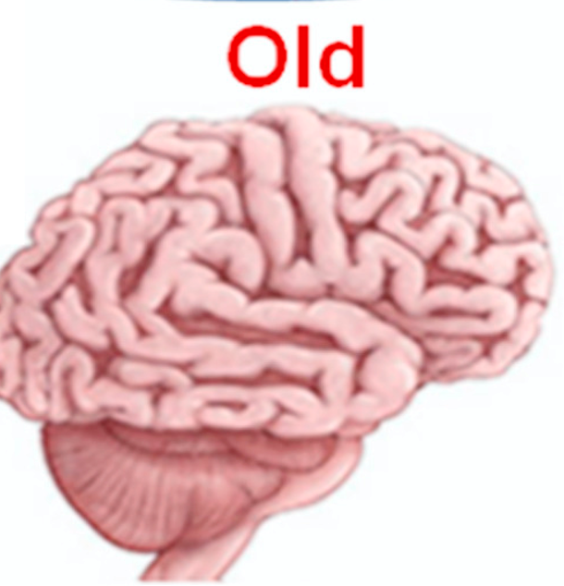
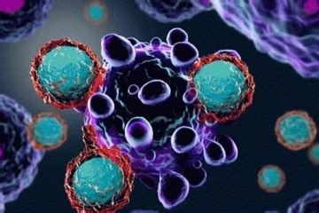
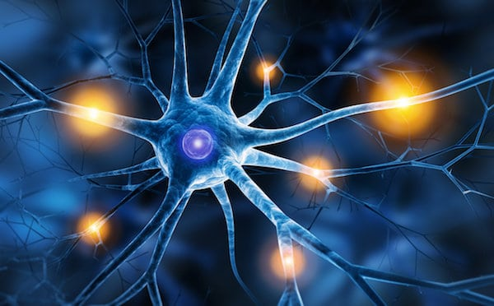
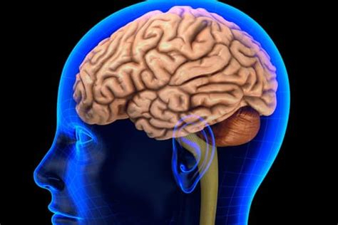

Summary of main changes in brain senescence
Molecular level
  Denatured protein accumulation
  DNA mutation
  ROS overproduction
  Epigenetic changes, Telomere attrition
Cellular level
  Dysregulated apoptosis
  Endothelial dysfunction
  Synaptic degeneration
  Neuroinflammation
Tissue level
  White and gray matter damage
  Vascular damage
  Breach in BBB
  Brain atrophy
Behavioural deviations
  Loss of motor coordination, falls
  Hearing and vision loss
  Hypogeusia, Anorexia, malnutrition
  Aphasia, Anosmia
  Cognitive deficits
TR. Raju,Journal of Chemical Neuroanatomy, 2019.
Notes:
Fig. 1. Schematic diagram depicting changes in brain senescence. Few representative neurological diseases of the young, adult and the aged humans are listed along with changes seen under the categories: (i) tissue level damages, (ii) in behaviours, (iii) molecular level deviations and (iv) cellular level alterations. The most consistent neurological diseases of the aged are stroke, Alzheimer’s disease and Parkinson’s disease, and in the young are certain childhood neuro-disabilities, ASD and ADHD. ROS – reactive oxygen species; RNS - reactive nitrogen species; NSC – neural stem cells; BBB – blood brain barrier; ASD – autism spectrum disorders; ADHD – attention deficit hyperactivity disorders. *As suggested by Centre for Disease Control and Prevention and World Federation of Neurology.

Slide 33
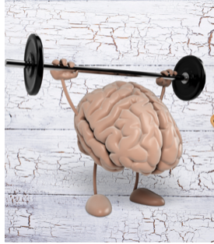
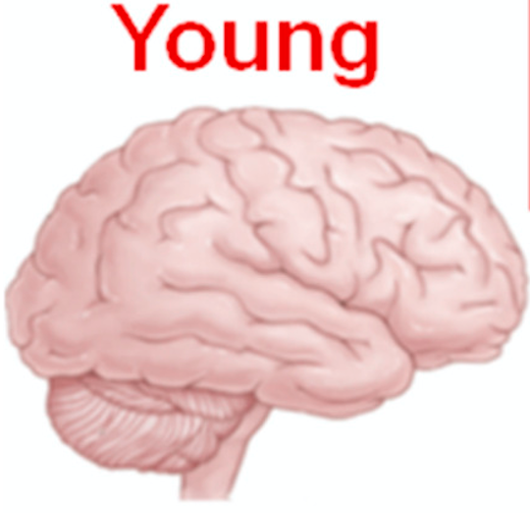
Preventive and interventional measures for healthy aging
✓Counselling
✓ Controlled medication
✓ Control on diet
✓ Inclusive education
✓ Dietary supplements
✓ Vocational training
Lock, S.L. Nat Aging, 2023
TR. Raju, KP. Journal of Chemical Neuroanatomy, 2019

Slide 34


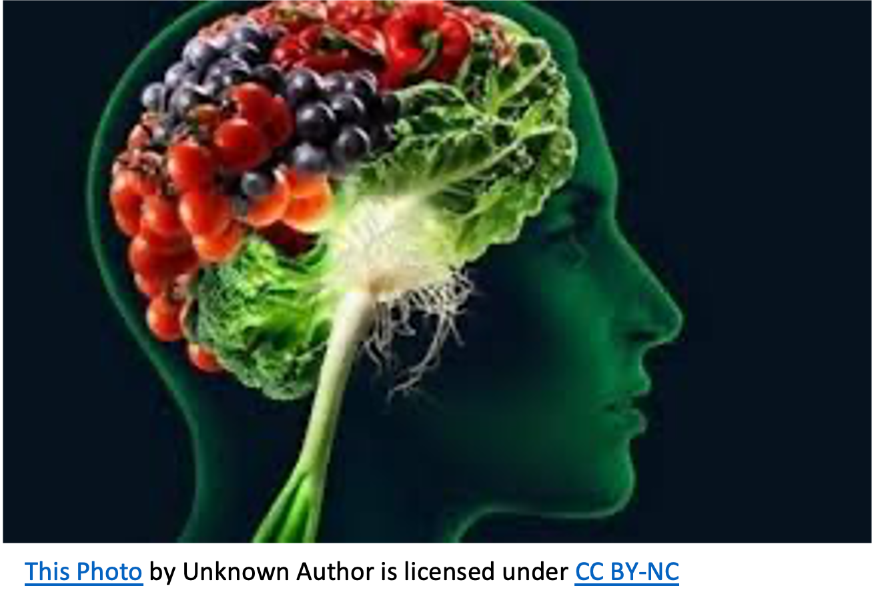



Preventive and interventional measures for healthy aging
✓Stay active:
Physically & mentally
✓Healthy diet
✓ Medication
Control:
✓Sugar level, BP
✓cholesterol
✓stress
✓depression
✓anxiety
✓No tobacco
✓Avoid injury
Lock, S.L. Nat Aging, 2023
TR. Raju, KP. Journal of Chemical Neuroanatomy, 2019

Slide 35
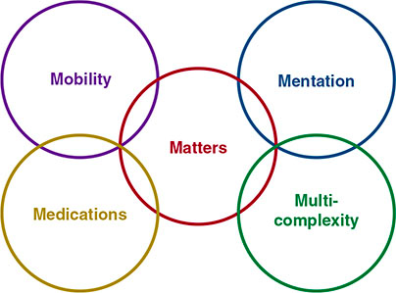
Effectively caring for the geriatric population - key principles
Aging is not a disease
  Have in mind that normal aging do increase susceptibility to many diseases (homeostenosis)
Medical conditions are commonly multiple (“multimorbidity”)
Many potentially reversible and treatable conditions are underdiagnosed and underevaluated
Cognitive and affective disorders are common
  (e.g., mild cognitive impairment, dementia, depression, anxiety)
Iatrogenic illnesses are common
  adverse drug reactions and immobility
5M’s of geriatrics
Joseph Loscalzo, et al. Harrison's Principles of Internal Medicine, 21e . McGraw Hill, 2022
Notes:
Effectively caring for the geriatric population requires
consideration of several key principles
Another way to summarize key concepts is using the “5M’s of
geriatrics” (mentation, medication, mobility, multicomplexity, and
matters most) (Fig. 477-4). This framework organizes care of older
adults in a person-centered manner instead of disease-driven
paradigm. The intention of the 5M’s is to optimize utilization of
existing resources during hospitalization of older adults, as well as to
focus on key geriatric issues in all settings of care. At the core of the
5M’s is what matters most to the patient when considering
diagnostic tests and therapeutic interventions and planning for future
care. Mobility is critical to individual function, quality of life, and fall
risk, and ranges from the ability to move around the community to
walking and transferring from a chair. Because mild cognitive
impairment, dementia, delirium, and depression are all common in
older adults, mentation is a core area for geriatric assessment.
Polypharmacy and prescription of potentially inappropriate and
harmful medications remain common; thus, careful medication
reconciliation and consideration of deprescribing are core aspects of
care for all older adults. Many older adults have complex clinical
issues in more than one of the four M’s just discussed, thus focusing
attention on multiples comorbidities and multicomplexity.

Slide 36
Effectively caring for the geriatric population - key principles
Functional ability and quality of life, as opposed to cure, are key goals of care.
Social history, social support, and patient preferences are critical to treat older people in a safe and person-centered manner.
Effective geriatric care requires interprofessional collaboration
Geriatric care is provided largely outside the hospital (e.g., at home, in skilled nursing and assisted living settings), and attention to care transitions between settings is essential for effective care.
Ethical issues, palliative care, and end-of-life care are critical aspects
5M’s of geriatrics
Joseph Loscalzo, et al. Harrison's Principles of Internal Medicine, 21e . McGraw Hill, 2022
Notes:
Effectively caring for the geriatric population requires
consideration of several key principles:
Effectively caring for the geriatric population requires
consideration of several key principles
Another way to summarize key concepts is using the “5M’s of
geriatrics” (mentation, medication, mobility, multicomplexity, and
matters most) (Fig. 477-4). This framework organizes care of older
adults in a person-centered manner instead of disease-driven
paradigm. The intention of the 5M’s is to optimize utilization of
existing resources during hospitalization of older adults, as well as to
focus on key geriatric issues in all settings of care. At the core of the
5M’s is what matters most to the patient when considering
diagnostic tests and therapeutic interventions and planning for future
care. Mobility is critical to individual function, quality of life, and fall
risk, and ranges from the ability to move around the community to
walking and transferring from a chair. Because mild cognitive
impairment, dementia, delirium, and depression are all common in
older adults, mentation is a core area for geriatric assessment.
Polypharmacy and prescription of potentially inappropriate and
harmful medications remain common; thus, careful medication
reconciliation and consideration of deprescribing are core aspects of
care for all older adults. Many older adults have complex clinical
issues in more than one of the four M’s just discussed, thus focusing
attention on multiples comorbidities and multicomplexity.

Slide 37
Literature
Mandatory:
Hou, Y., Dan, X., Babbar, M. et al. Ageing as a risk factor for neurodegenerative disease.Nat Rev Neurol 15, 565–581 (2019). https://doi.org/10.1038/s41582-019-0244-7
Zia, A., Pourbagher-Shahri, A.M., Farkhondeh, T. et al. Molecular and cellular pathways contributing to brain aging. Behav Brain Funct 17, 6 (2021). https://doi.org/10.1186/s12993-021-00179-9
Guarente, Leonard P. , Simic, Petra and Rogers, Kara. "aging". Encyclopedia Britannica, 15 Dec. 2022, https://www.britannica.com/science/aging-life-process.
Additional:
Joseph Loscalzo, et al. Harrison's Principles of Internal Medicine, 21e . McGraw Hill, 2022
Lock, S.L. The benefits of brain health to our economies. Nat Aging, 2023. https://doi.org/10.1038/s43587-022-00302-z
TR. Raju, KP. Mohanakumar, Neural functions of the aging brain: Daily living, developmental and geriatric disabilities, Journal of Chemical Neuroanatomy, 2019, https://doi.org/10.1016/j.jchemneu.2018.12.004.
Cox, S.R., Harris, M.A., Ritchie, S.J. et al. Three major dimensions of human brain cortical ageing in relation to cognitive decline across the eighth decade of life. Mol Psychiatry. 2021. https://doi.org/10.1038/s41380-020-00975-1
Advanced:
Kuo, PL., Schrack, J.A., Levine, M.E. et al. Longitudinal phenotypic aging metrics in the Baltimore Longitudinal Study of Aging. Nat Aging. 2022. https://doi.org/10.1038/s43587-022-00243-7
Chen X, Rundle MM, Kennedy KM, Moore W, Park DC. Functional activation features of memory in successful agers across the adult lifespan. Neuroimage. 2022. doi: 10.1016/j.neuroimage.2022.119276.
Rasmussen LJH, Caspi A, Ambler A, et al. Association of Neurocognitive and Physical Function With Gait Speed in Midlife. JAMA Netw Open. 2019. doi:10.1001/jamanetworkopen.2019.13123

