Slide 1

1. Nervous system
1.4. Blood supply
Brain Blood Barier (BBB)
Gorazd Drevenšek
University of Ljubljana
Manuel Ramanović

Slide 2
Aim of the lecture
understand the specifity of blood circulation in CNS
Special direct blood-communicating brain areas
The changes of circulation tissues in NDD
The role of glia cells in comunication between blood circulation and signal transmission tissues
Microcirculation, mini strokes and lessions as a centre for protein deposition plaques

Slide 3
Content of the lecture
Description of the blood circulation of CNS tissues, anatomy and specificity, blood brain barrier (BBB)
The difference between body and CNS circulation
Communication by metabolic particles, small microbial RNA, passing BBB as potential risk factor for NDD
The glia cells as metabolic comunication between brain blood circulation and other brain tissues
Vascular dementia and NDD

Slide 4
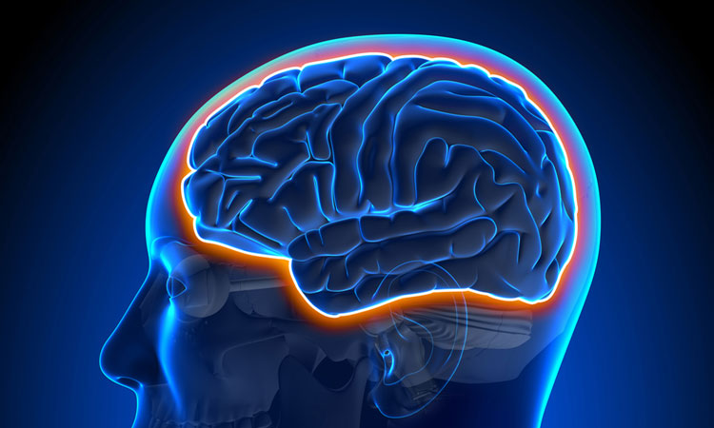
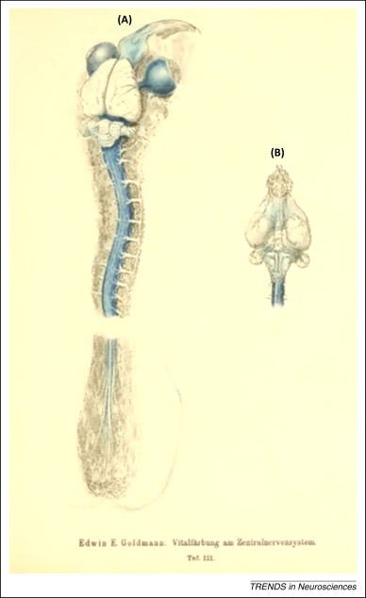
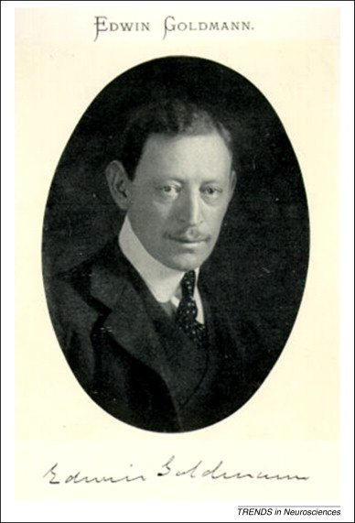
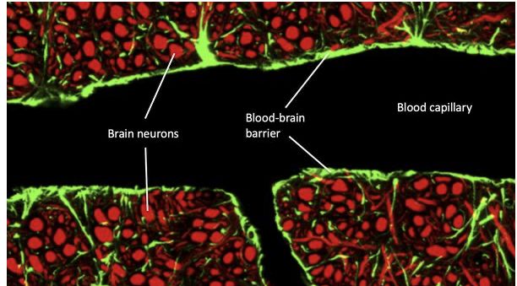
Blood – brain barrier – the discovery
Blood–brain barrier (BBB) = structural and functional barrier which impedes and regulates the influx of most compounds from blood to brain composed of astrocytes and endothelial cells
1885: Paul Ehrlich: intravenous dyes in experimental organisms caused staining of all organs except the brain
Edwin Ellen Goldmann
1913: Edwin Goldmann: cerebral capillaries provide anatomical basis for a physiological barrier between brain and the rest of the body
Marina B, Trends in Neurosciences, 2014
1950s: Electron microscopy demonstrated that the outermost layers of endothelial cells in brain capillaries are fused together
Notes:
Overview of the central nervous system (CNS) of a young rabbit injected with 0.5 ml of a 0.5% trypan blue solution into the lumbar ‘cul-de-sac’.The illustration clearly shows that the lack of trypan blue staining of the CNS following systemic injections of the dye was not due to lack of dye affinity for the CNS, but instead to lack of dye penetration into the brain parenchyma from the blood and choroid plexus, and therefore to a permeability problem, that is, to the existence of a blood–brain and blood–cerebrospinal fluid (CSF) barrier.

Slide 5
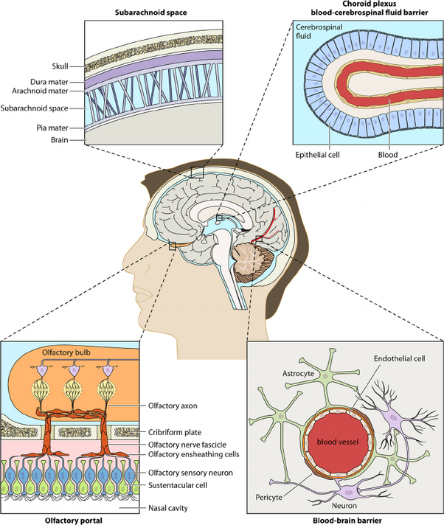
Blood- brain barrier structure
BLOOD - BRAIN BARRIER
blood – CSF barrier
arachnoid barrier
vascular –endothelial barrier
+
+
Epithelial cells of the choroid plexus, joined by tight junctions
Endothelial
cells of blood vessels, joined by tight junctions
Outermost layer of cells of the
arachnoid, joined by tight junctions
The blood-brain barrier acts effectively to protect the brain from circulating pathogens.
Barriers of the brain
Notes:
Barriers of the brain. There are three principal barrier sites between blood and brain. (a) The BBB proper, which is created at the level of the cerebral capillary endothelial cells by tight junction formation. It is by far the largest surface area for exchange and in the adult human is between 12 and 18 m² in surface area. No brain cell is further than about 25 μm from a capillary, so once the BBB is crossed, diffusion distances to neurons and glial cell bodies for solutes and drugs are short. Targeting a drug across the BBB is therefore the favoured route for global delivery of drugs to all brain cells. (b) The blood–CSF barrier (BCSFB) lies at the choroid plexuses in the lateral, third and fourth ventricles of the brain where tight junctions are formed between the epithelial cells at the CSF-facing surface (apical surface) of the epithelium. Some drugs and solutes enter the brain principally across the choroid plexuses into CSF, while others enter via both the BBB and BCSFB. (c) The arachnoid barrier. The brain is enveloped by the arachnoid membrane lying under the dura. The arachnoid is avascular but lies close to the superior sagittal sinus and is separated from it by the dura. The arachnoid is a multi-layered epithelium with tight junctions between cells of the inner layer that form an effective seal. Arachnoid villi project into the sagittal sinus through the dura and a significant amount of CSF drains into the sinus through these valve-like villi which only allow CSF movement out of the brain to blood. Transport across the arachnoid membrane is not an important route for the entry of solutes into brain (adapted from Kandel et al., 2000, with permission).

Slide 6
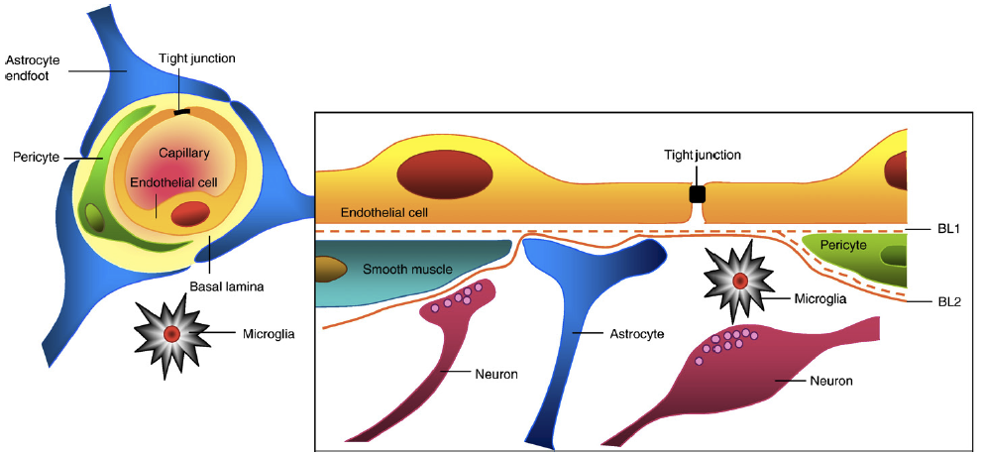
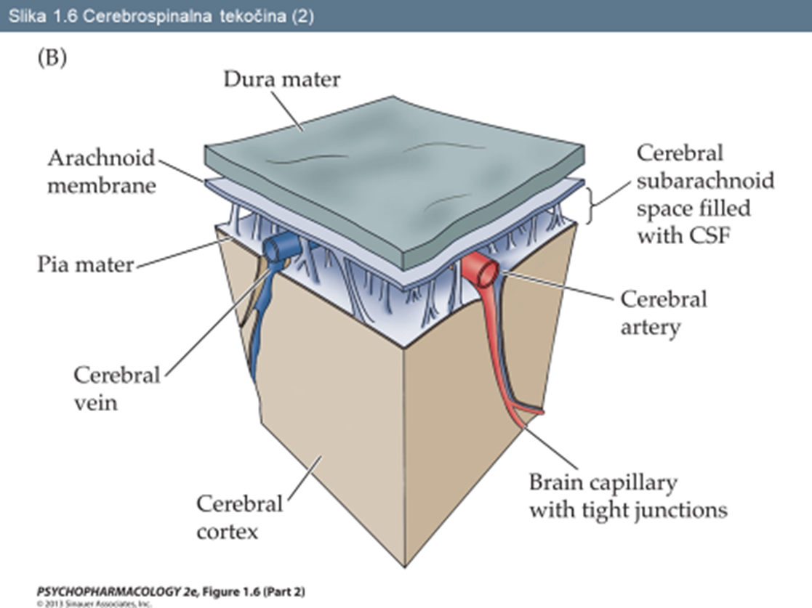
Blood- brain barrier structure
N. Joan Abbott, Neurobiology of Disease, 2010

Slide 7
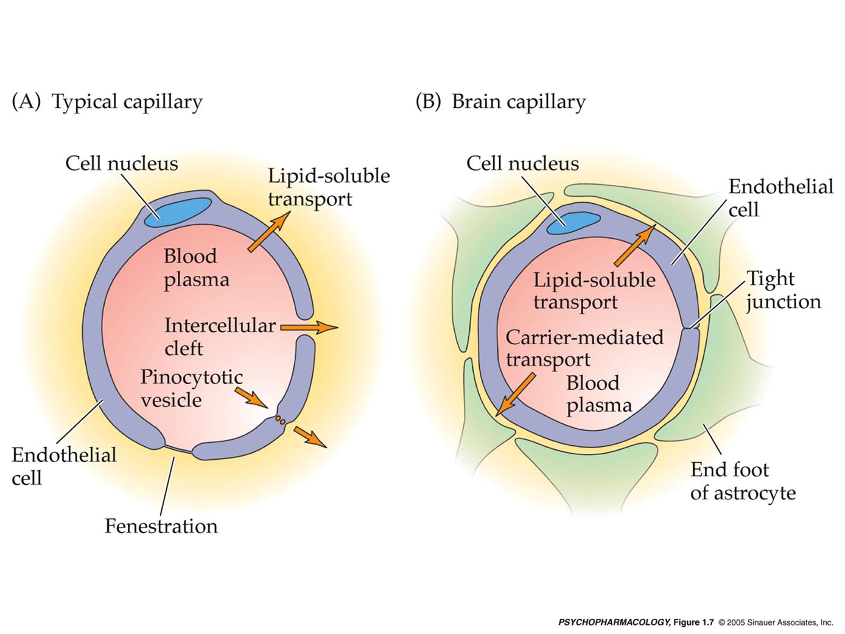
Blood- brain barrier structure
Brain microvascular endothelial cells (BMECs)
BMEC vs. normal endothelial cells
Structural differences:
  Absence of fenestrations
  More extensive tight junctions
Functional differences:
  Impermeable to most substances
  Sparse pinocytic vesicular transport
  Increased expression of transport and carrier proteins
  No gap junctions, only tight junctions
  Limited paracellular and transcellular transport
N. Joan Abbott, Neurobiology of Disease, 2010

Slide 8
Purpose and function of BBB
ENABLE FUNCTIONAL AND STRUCTURAL of the central nervous
Establishing and maintaining the microenvironment of the central nervous system
  maintaining a constant environment within and around the brain so that normal function continues and foreign or harmful substances are kept out
  control of the milieu around the axons and synapses that form
Liebner, S. Acta Neuropathol 2018

Slide 9
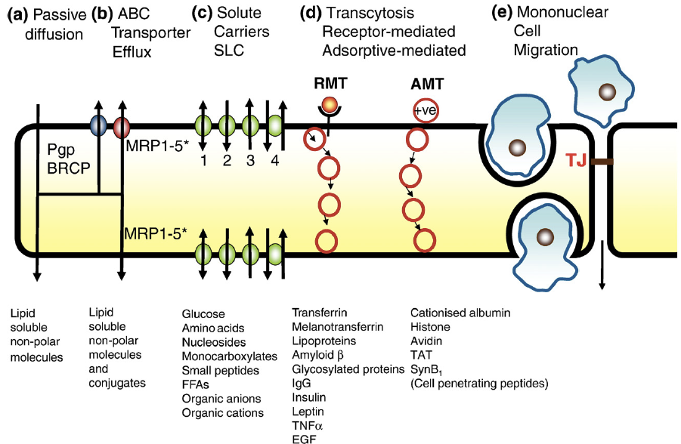
Normal transport across the BBB
Passive diffusion
Facilitated transport by carrier systems - ABC transporters
Receptor mediated endocytosis
Paracellular transfer more common than transcellular transfer
Abbott et al, 2010
(https://www.sciencedirect.com/science/article/pii/S0969996109002083)
Notes:
Routes of transport across the BBB. (a) Solutes may passively diffuse through the cell membrane and cross the endothelium. A higher lipid solubility and several other physico-chemical factors favour this process (see text). (b) Active efflux carriers (ABC transporters) may intercept some of these passively penetrating solutes and pump them out of the endothelial cell either as they diffuse through the cell membrane or from the cytoplasm. Pgp and BCRP are strategically placed in the luminal membrane of the BBB endothelium. MRPs 1–5⁎ are inserted into either luminal or abluminal membranes; there appear to be some species differences in both the polarity and the isoforms of MRPs expressed at the BBB (Begley, 2004a, Begley, 2004b). (c) Carrier-mediated influx via solute carriers (SLCs) may be passive or primarily or secondarily active and can transport many essential polar molecules such as glucose, amino acids and nucleosides into the CNS. The solute carriers may be bi-directional, the direction of net transport being determined by the substrate concentration gradient (1), unidirectional either into or out of the cell (2/3), or involve an exchange of one substrate for another or be driven by an ion gradient (4). In this last case the direction of transport is also reversible depending on electrochemical gradients. (d) RMT requires receptor binding of ligand and can transport a variety of macromolecules such as peptides and proteins across the cerebral endothelium (transcytosis). AMT appears to be induced in a non-specific manner by positively charged macromolecules and can also transport across the endothelium. Both RMT and AMT appear to be vesicular-based systems which carry their macromolecule content across the endothelial cells. (e) Leukocytes cross the BBB either by a process of diapedesis through the endothelial cells (penetrating close to the tight junctional regions), or via modified tight junctions. The junction-associated molecules (JAMs) and the cell surface protein CD99 may interact with the leukocytes to initiate diapedesis. Tight junction modulation can result from signals from cells associated with the brain endothelium or be induced pharmacologically; molecular re-arrangement of the proteins of the tight junctions results in complete or partial opening of the paracellular aqueous diffusional pathway (modified from Begley, 2007).

Slide 10
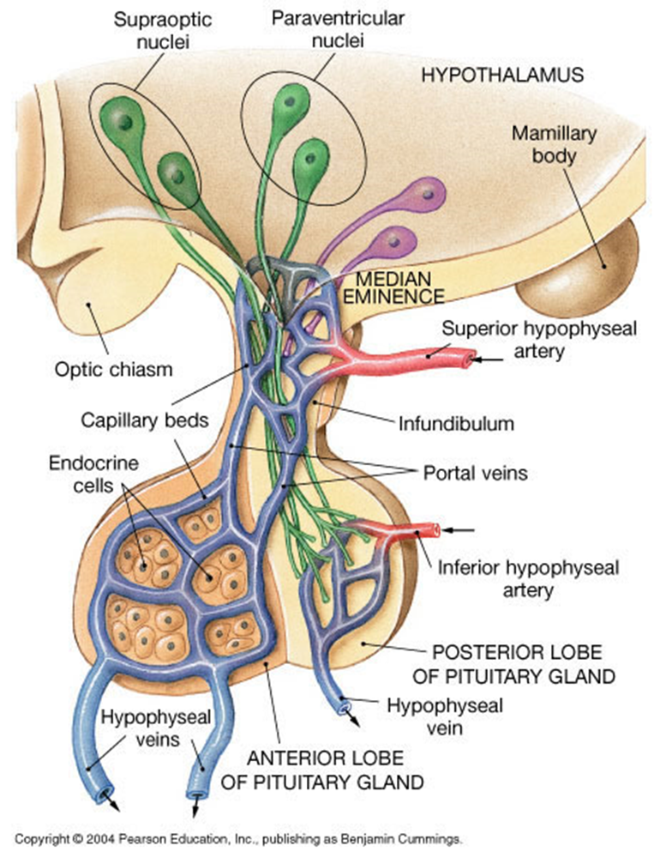
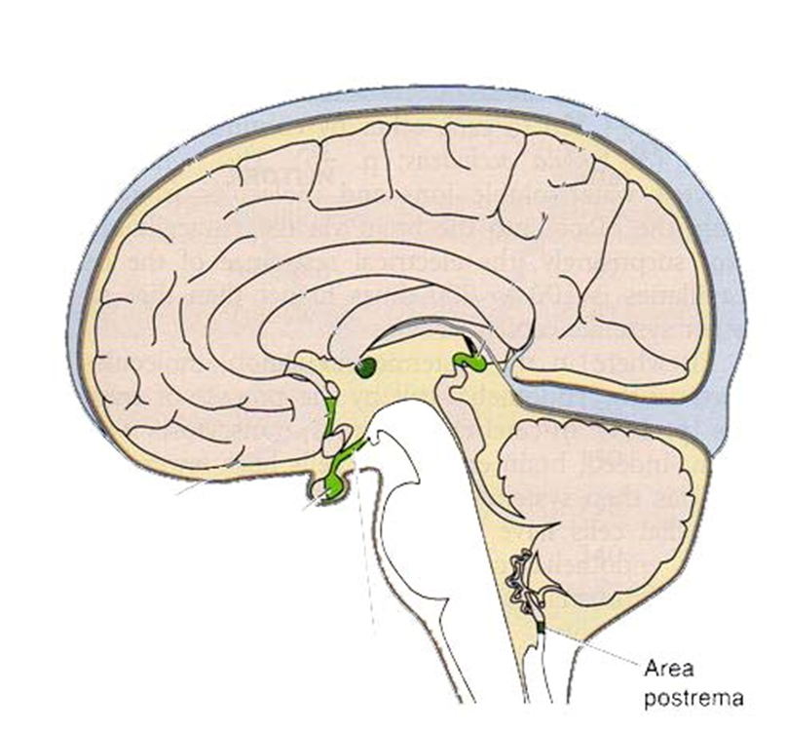
Regions of brain not enclosed by BBB
Circumventricular organs
area postrema,
median eminence,
neurohypophysis,
pineal gland,
subfornical organ and
lamina terminalis
Notes:
These are regions which need to respond to factors present in systemic circulation

Slide 11
Blood–Brain Barrier Dysfunction in Neurodegenerative Diseases
Alzheimer’s Disease (AD)
Accumulation of Aβ and Phosphorylated Tau in Cerebrovasculature¹
  cerebral amyloid angiopathy (CAA)
  Depositions of Aβ ➔ thicken vessel walls, narrow the luminal space ➔ microbleeds and hemorrhages
Pericyte Dysfunction^{1,2}
  numbers of capillary pericytes in the white mass were reduced across all common dementias impairing BBB function
  BBB is damaged in AD, particularly in individuals carrying apolipoprotein E4 (APOE4)
¹Freeze W.M., Stroke. 2019
²Ding R, Brain Pathol. 2020
³Halliday MR,.J Cereb Blood Flow Metab. 2016
Notes:
he BBB is damaged in AD, particularly in individuals carrying apolipoprotein E4 (APOE4) gene, which is a major genetic risk factor for late-onset AD

Slide 12
Blood–Brain Barrier Dysfunction in Neurodegenerative Diseases
Alzheimer’s Disease (AD)
Endothelial Cell Dysfunction^{1,2}
  The activation of Matrix Metalloproteinase-9 (MMP-9) leads to endothelial barrier dysfunction and neuroinflammation
  glucose transport is affected in AD³ leading to neurodegeneration and brain atrophy
  Aβ clearance from the brain, as well as, Aβ depositon (↑RAGE transported) are impaired and accelerates AD progression
¹Weekman E.M. J. Alzheimers Dis.2016
²Brilha S.Sci. Rep. 2017
³Vogelsang P. Brain Res. 2018

Slide 13
Blood–Brain Barrier Dysfunction in Neurodegenerative Diseases
Alzheimer’s Disease (AD)
Astrocyte Dysfunction
  astrocytes are found to produce a detectable amount of Aβ¹, astrogliosis is a common feature in NDDs
  Since astrocytes ensheath the vasculature structure, they may also contribute to the CAA pathology and disrupt BBB integrity in AD
  On the other side, astrocyte degeneration is observed in the AD brain which may disrupt BBB integrity²
¹ Veeraraghavalu K.J. Neurosci. 2014
²Olabarria M. Glia. 2010

Slide 14
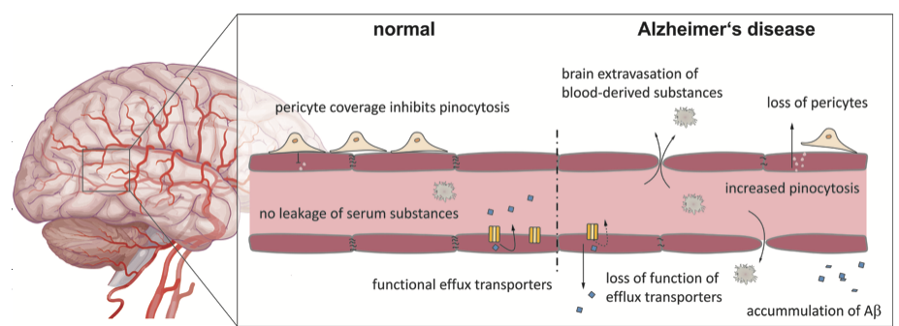
Blood–Brain Barrier Dysfunction in Neurodegenerative Diseases
Alzheimer’s Disease (AD)
Storck, Steffen E. and Pietrzik, Claus U.. "The Blood brain-barrier and its role in Alzheimer’s disease" Neuroforum, 2018
Notes:
The blood brain barrier in Alzheimer’s disease shows alterations to normal conditions. Decreased expression of tight junction proteins and efflux transporters, as well as a loss of function, promote the passive diffusion of blood-borne molecules into brain triggering neurodegeneration and the accumulation of Aβ. The loss and degeneration of pericytes furthermore promotes brain extravasation of plasma substances through the upregulation of transcellular transport processes.

Slide 15
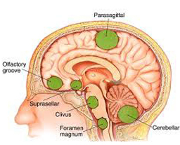
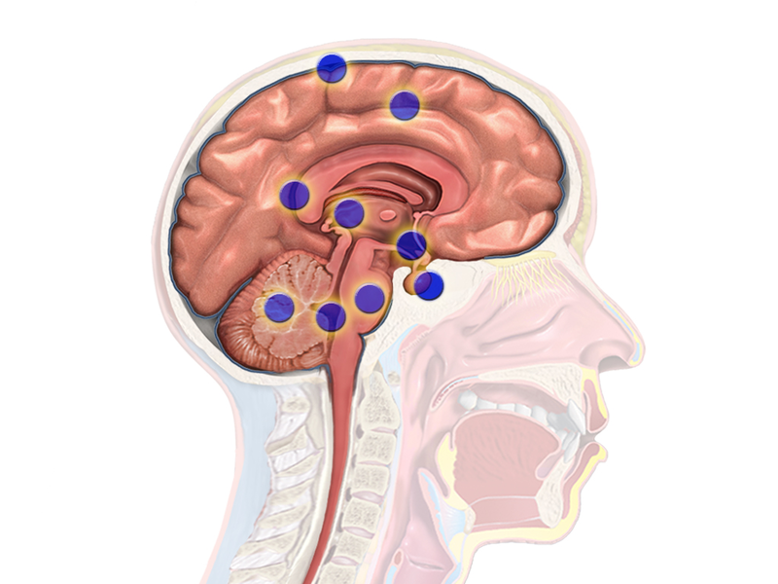
„Risk points“ for AD plaques (stroke related?)

Slide 16
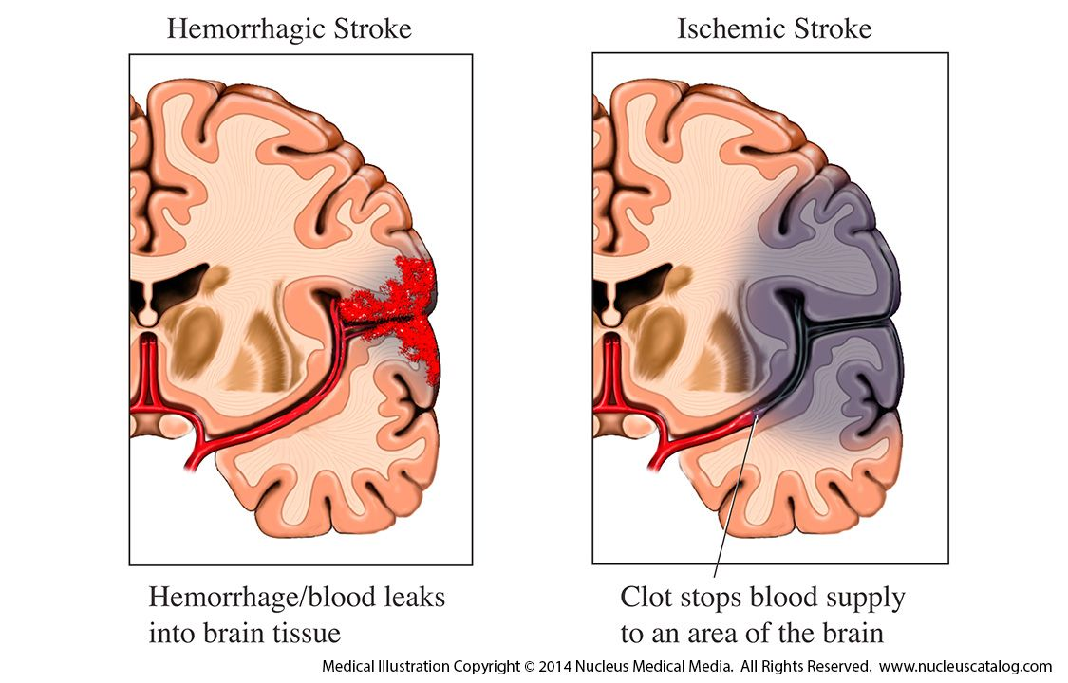
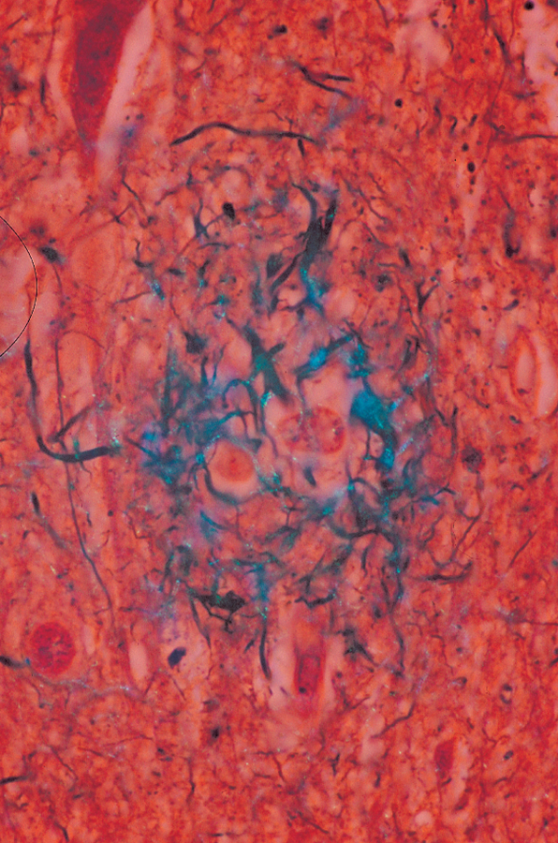
Mini strokes as potential initiation of plaques

Slide 17
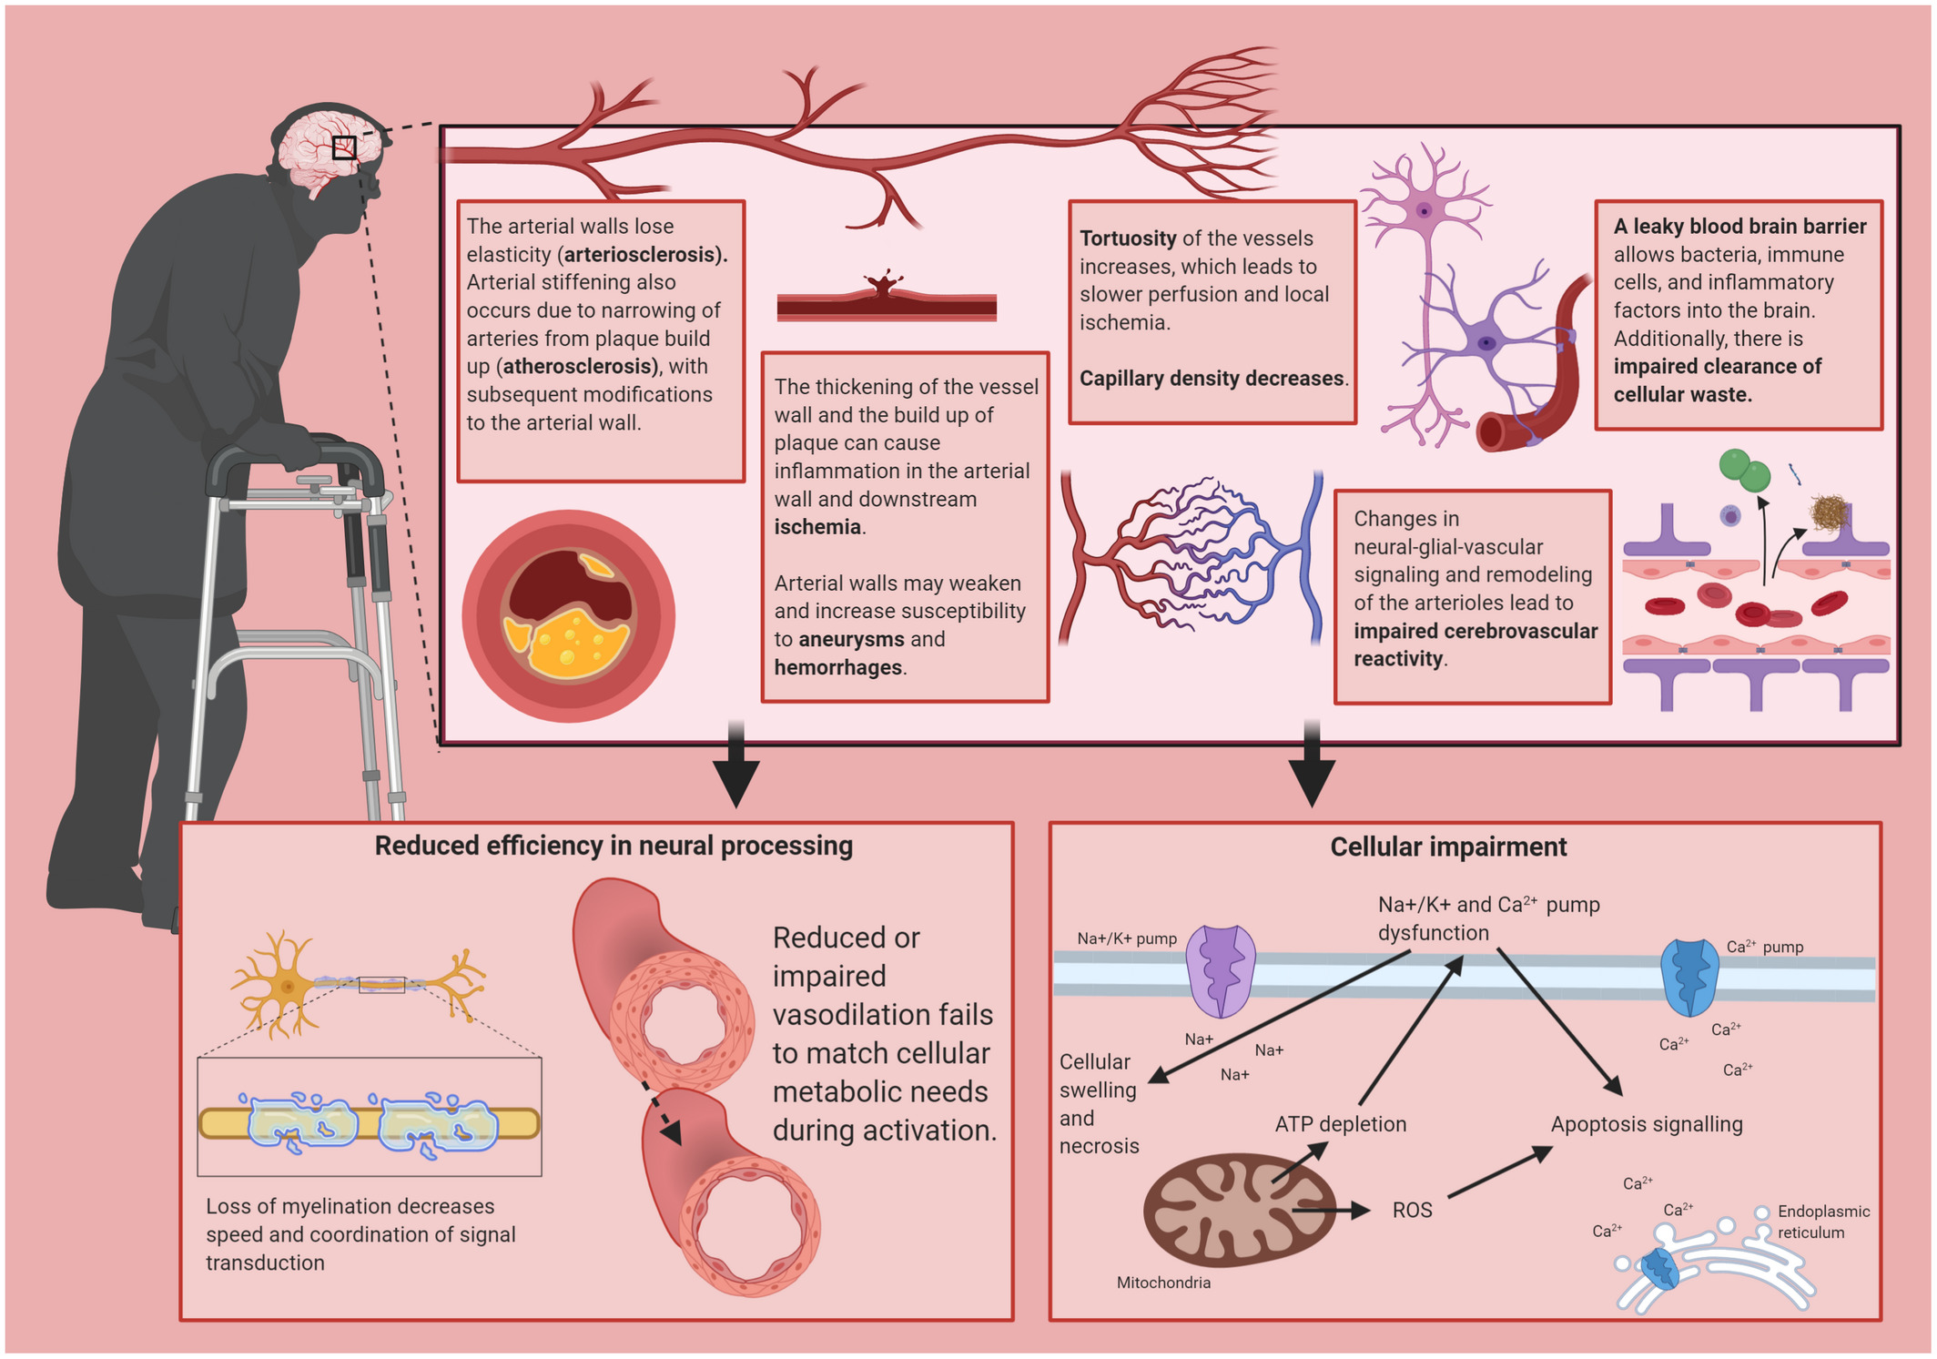
Age-related changes in cerebrovascular health and their effects on neural function and cognition
A leaky blood-brain barrier recognized as part of risk contributing toward neurodegeneration in older age
Zimmerman B, Psychophysiology. 2021
Notes:
Cerebrovascular damage progresses from loss of elasticity in the larger arteries to distal downstream damage to the microvasculature. Impaired cerebrovascular function leads to reduced efficiency in neural processing through damaged myelination and impaired neurovascular coupling mechanisms. Eventually, cerebrovascular dysfunction leads to ischemia, causing cellular impairment or cell death. Together, these effects manifest as reductions in cognitive function

Slide 18
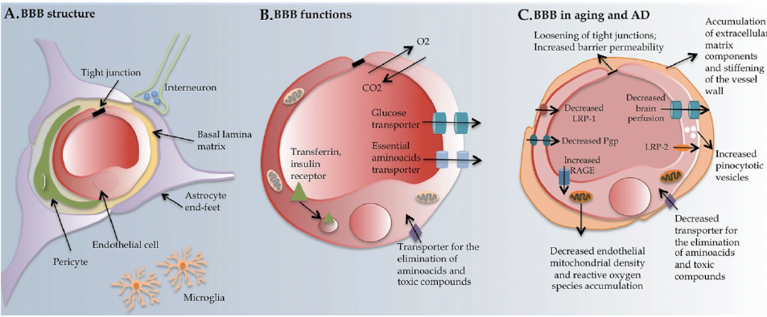
Summary: neurovascular unit composition, function and alterations in aging and in AD
Marques, et al. Mol Neurodegeneration 2013
Notes:
Neurovascular unit composition, function and alterations in aging and in AD. (A) The BBB is formed by the tight junctions that connect the endothelial cells of the brain capillaries. These are surrounded by a basal lamina, pericytes and by astrocytes end-feets, and may as well interact directly or indirectly with neurons. (B) The endothelial cells of the BBB contain in the luminal and abluminal sides transporters and receptors. (C) Several alterations are observed at the endothelial cells of the BBB during aging and in AD.

Slide 19
CONCLUSION
BBB is the functional gatekeeper for brain homeostasis and important for information processing, neuronal connectivity and synaptic functioning
many lines of evidence suggest that vascular impairment precedes neurodegeneration
therapeutic strategies should target BBB breakdown in combination with other approaches in order to prevent, treat and reveres neurodegeneration in AD.

Slide 20
Literature
Mandatory:
N. Joan Abbott, Adjanie A.K. Patabendige, Diana E.M. Dolman, Siti R. Yusof, David J. Begley, Structure and function of the blood–brain barrier, Neurobiology of Disease, Volume 37, Issue 1, 2010,Pages 13-25, https://doi.org/10.1016/j.nbd.2009.07.030.
Ballabh P, Braun A, Nedergaard M. The blood-brain barrier: an overview: structure, regulation, and clinical implications.Neurobiol Dis. 2004 Jun;16(1):1-13. Review.
Additional:
Liebner, S., Dijkhuizen, R.M., Reiss, Y. et al. Functional morphology of the blood–brain barrier in health and disease. Acta Neuropathol 135, 311–336 (2018). https://doi.org/10.1007/s00401-018-1815-1
Advanced
Kim KS. Microbial translocation of the blood-brain barrier.Int J Parasitol. 2006 May 1;36(5):607-14. Epub 2006 Mar 6. Review.

