Slide 1
Functional neuroanatomy: normal nerve conduction process and cellular basis of neural communication
GP1 - Neurology and medical care of neurodegenerative disorders
Gorazd Drevenšek
University of Ljubljana
and
Manuel Ramanović

Slide 2
Learning Objectives
To learn the celluar basis of neural communication
To learn the synaptic transmission process
To learn the main patways of signal transduction in the brain
To disccuss the importance of gene expression and main regulating mechanism of gene expression

Slide 3
Content of the lecture
Introduction
  Overview of neuron structure and function
  Neural communication
Cellular Basis of Communication
  Electric properties of neurons
The Synapse
  Synaptic transmission
  Neurotransmitters
Overview of signal transduction pathways
  G proteins, second messengers, protein phosphorylation
  Neurotrophic factors in protein synthesis cascades
  Signals to the cell nucleus - „on demand“ gene expression
Gene expression profiling

Slide 4
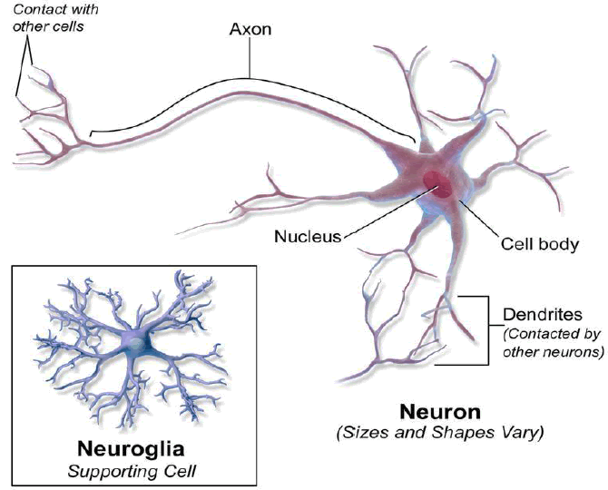
Introduction – neuron structure and function
The nervous system is made up of specialized cells
  nerve cells (or neurons) and
  glial cells (or glia)
Neurons are the basic functional units of the nervous system, and they generate electrical signals called action potentials, which allow them to quickly transmit information over long distances.
Glia are essential to nervous system function - mostly by supporting the neurons and enabling functional cell/tissue homeostasis.
http://www.scientistcindy.com/
Notes:
Short introduction

Slide 5
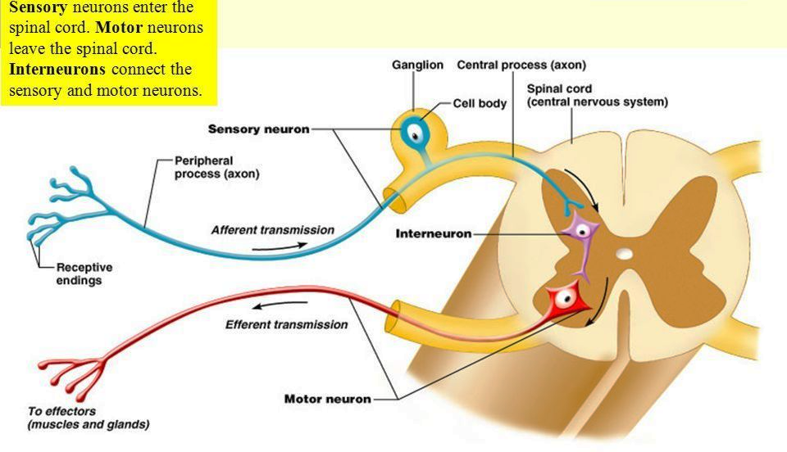
Classes of neurons
Sensory neurons
  get information from outside of the body and bring that information into the CNS so it can be processed
Motor neurons
  get information from other neurons and convey commands to your muscles, organs and glands
Interneurons
  found only in the CNS, connect one neuron to another. They receive information from other neurons (either sensory neurons or interneurons) and transmit information to other neurons

Slide 6
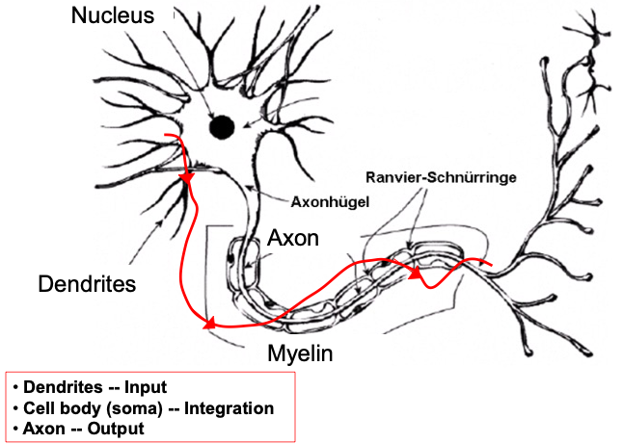
The basic functions of a neuron
3 basic functions:
Receive signals (or information)
Integrate incoming signals (to determine whether or not the information should be passed along)
Communicate signals to target cells (other neurons or muscles or glands)
These neuronal functions are reflected in the anatomy of the neuron
https://thebrain.mcgill.ca
Notes:
If you think about the roles of the three classes of neurons, you can make the generalization that all neurons have three basic functions. These are to:
Receive signals (or information).
Integrate incoming signals (to determine whether or not the information should be passed along).
Communicate signals to target cells (other neurons or muscles or glands).
These neuronal functions are reflected in the anatomy of the neuron.

Slide 7
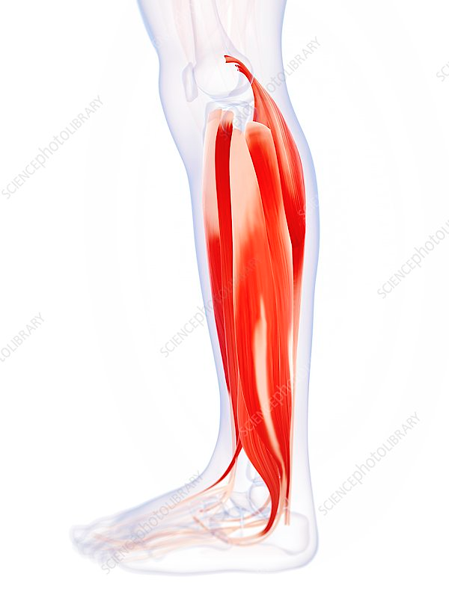
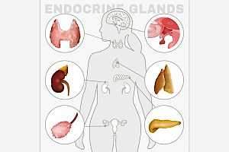
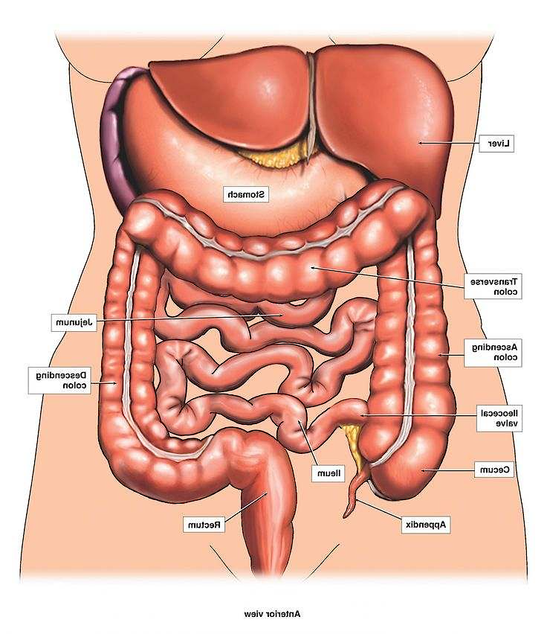
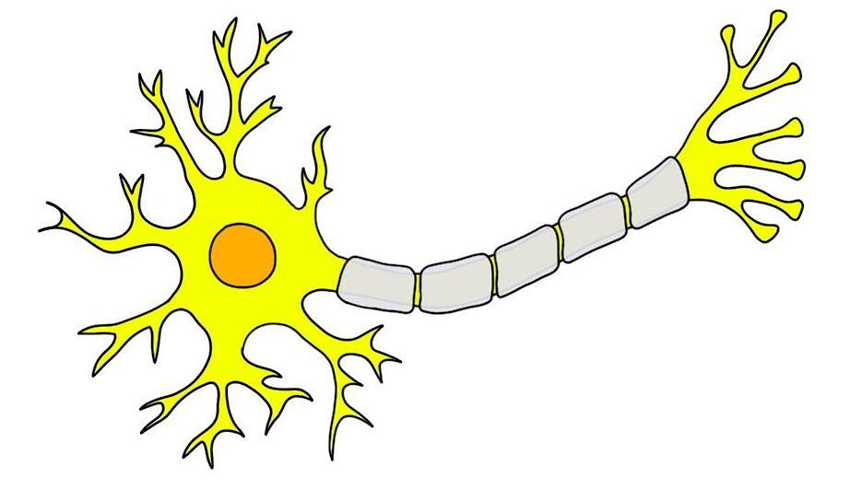
THE ELECTRICAL PROPERTIES OF NEURONS
(human) nervous system receives information from the environment, integrates this information with past experience, and creates a behavioral response that promotes the survival of the organism
EXTERNAL environment
INTERNAL environment
Sensory neuron
Sounds, sights
sensation of hunger or the stretch of a muscle

Slide 8
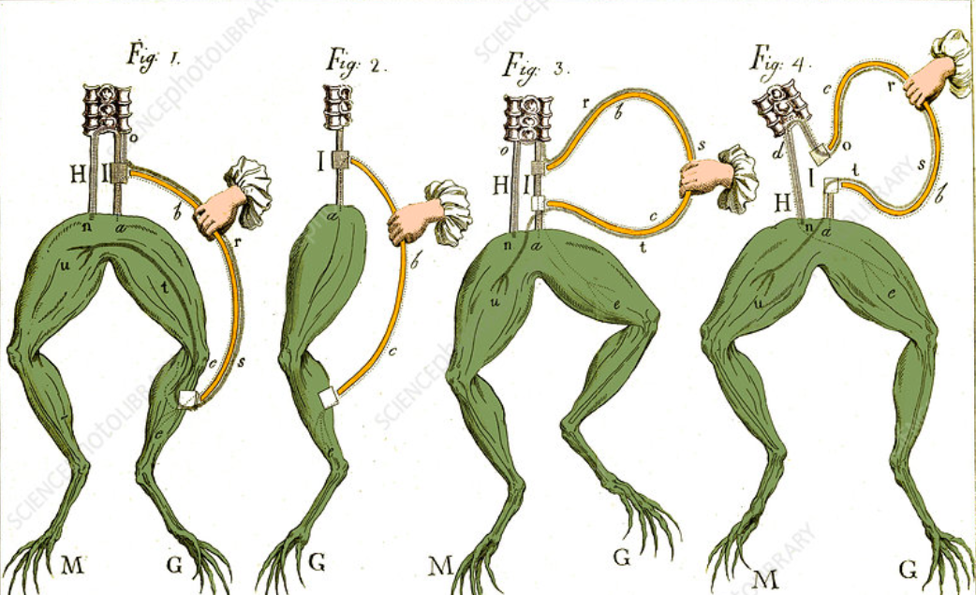
THE ELECTRICAL PROPERTIES OF NEURONS
The Italian scientist Luigi Galvani in 1700s, somewhat by accident during a frog dissection noticed that the muscles of a frog twitched and contracted when two different metals, shaped into arcs, were placed on the frog's spinal cord and leg
He termed it “animal electricity”
In 1939, Hodgkin and Huxley discovered that axons are electrically negative at rest
Today, we know that the frog's leg kicks because neurons carry information via electrical signals
Galvani's Frog Experiments, 1770s
https://www.sciencephoto.com
Notes:
Luigi Galvani (1737-1798), an Italian physician and physicist, began his researches into electrophysiology in the late 1770s. He noticed that the muscles of a frog twitched and contracted when two different metals, shaped into arcs, were placed on the frog's spinal cord and leg. He used similar arcs in his famous frog experiments of 1786 where he claimed that the contraction of the muscle was due to animal electricity. Later disproved, this idea stated that the electrical current was produced by living tissues in the body.
In 1783, according to popular version of the story, Galvani dissected a frog at a table where he had been conducting experiments with static electricity. Galvani's assistant touched an exposed sciatic nerve of the frog with a metal scalpel, which had picked up a charge. At that moment, they saw sparks and the dead frog's leg kick as if in life. The observation made Galvani the first investigator to appreciate the relationship between electricity and animation — or life. This finding provided the basis for the current understanding that electrical energy (carried by ions), and not air or fluid as in earlier balloonist theories, is the impetus behind muscle movement. He is poorly credited with the discovery of bioelectricity.
Galvani called the term animal electricity to describe whatever it was that activated the muscles of his specimens. Along with contemporaries, he regarded their activation as being generated by an electrical fluid that is carried to the muscles by the nerves. The phenomenon was dubbed "galvanism", after Galvani, on the suggestion of his peer and sometime intellectual adversary Alessandro Volta.

Slide 9
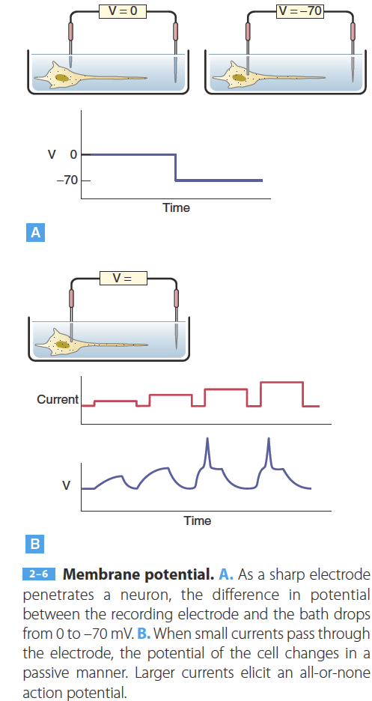
THE ELECTRICAL PROPERTIES OF NEURONS
Electrical Potential in Cells
Neurons convey signals rapidly by alternately maintaining and varying their electrical potentials in relation to the extracellular environment
All neurons maintain a negative electrical potential - “membrane potential” relative to their extracellular environment.
Rapid depolarization (becoming less negative, i.e.from -70 mV to -50 mV) will often stimulate a neuron to release neurotransmitters and thus convey information to other cells through chemical signals
Nestler, Eric J. (Eric Jonathan) et al. Molecular Neuropharmacology : a Foundation for Clinical Neuroscience. Fourth edition. 2020

Slide 10
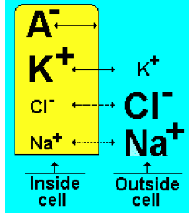
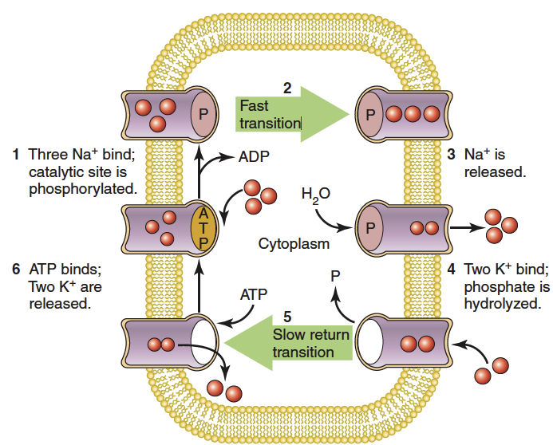
THE ELECTRICAL PROPERTIES OF NEURONS
HOW neurons keep their Electrical Potential
Different types of ions are unequally distributed across the neuronal cell membrane
  neuron’s interior contains a higher concentration of K⁺ and lower concentrations of Na⁺, Ca²⁺, and Cl⁻ than does the extracellular space
  These ionic gradients are maintained through ion-specific pumps that require energy
  Inside cell are located negatively charged, membrane-impermeable proteins
Neuronal cell membrane is differentially permeable to ions
  highly permeable to K⁺
  somewhat permeable to Cl⁻
  very slightly permeable to Na⁺ and Ca²⁺
ATP - dependent Na⁺–K+ pump
Nestler, Eric J. (Eric Jonathan) et al. Molecular Neuropharmacology : a Foundation for Clinical Neuroscience. Fourth edition. 2020

Slide 11
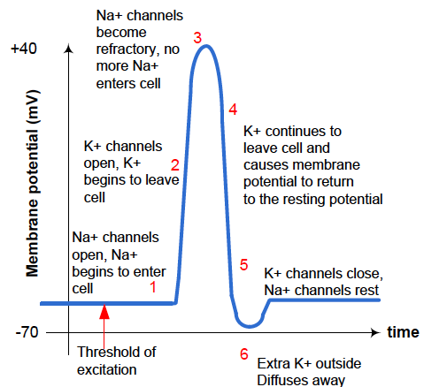
action potential
Typical Nerve Action Potential
A sudden, fast, transitory, and propagating change of the resting membrane potential
Repolarization
Action potentials = nerve signals
An action potential is triggered when the plasma membrane potential rises above its resting value = depolarisation
Neurons generate and propagate these signals along their processes in order to transmit them to the target tissues
Depolarization
Hyperpolarization
Depolarization to threshold
Thanapitak, Surachoke. Bionics Chemical Synapse. 2012

Slide 12
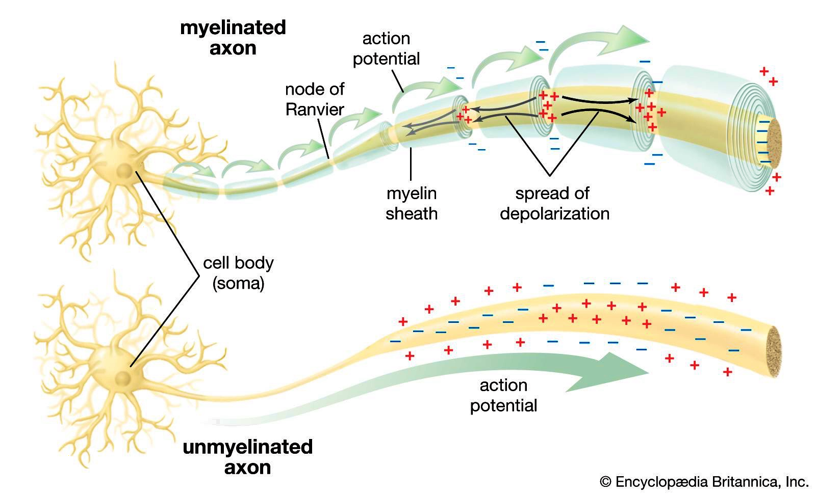
action potential PROPAGATION
An action potential is relayed from one site to another in a series of steps, with the message being repeated at each step propagation
  same events occur repeatedly
  the opening of additional voltage-gated Na⁺ channels is triggered when Na⁺ move into an axon and depolarize adjacent areas
  the reaction spreads across the membrane surface and the action potential is propagated along the length of the axon, eventually reaching the axon terminals
Types of propagation
Continuous propagation - unmyelinated axon
Saltatory propagation - myelinated axon

Slide 13
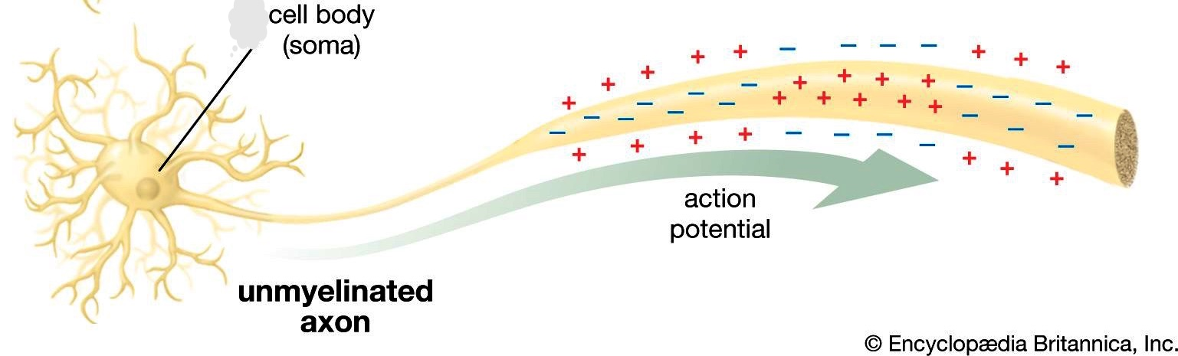
action potential: CONTINUOUS PROPAGATION
The membrane potential briefly becomes positive at the peak of the action potential
The local current spreads out in all directions, depolarizing the nearby membrane areas.
The process continues as if in a chain reaction.
A local current develops as sodium ions begin moving in the cytoplasm and extracellular fluid.
The axon hillock could not to respond with an action potential since it has no voltage-gated sodium ion channels.

Slide 14
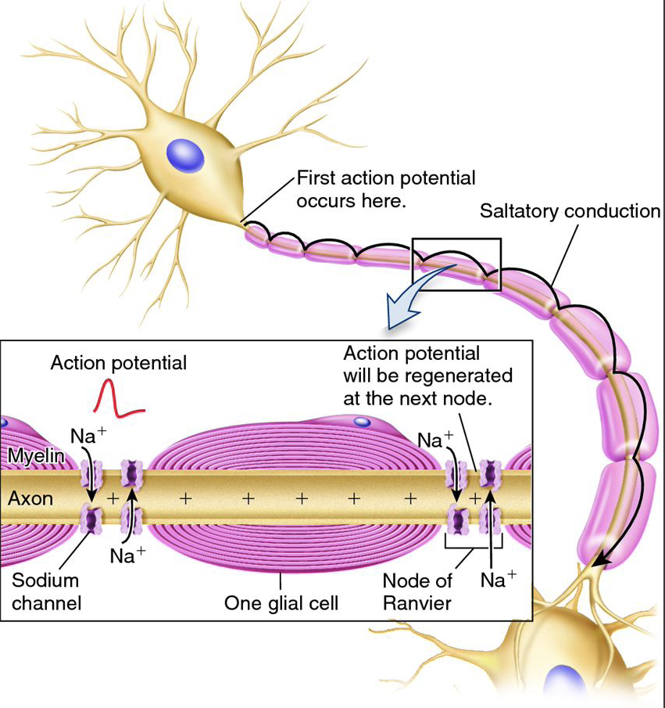
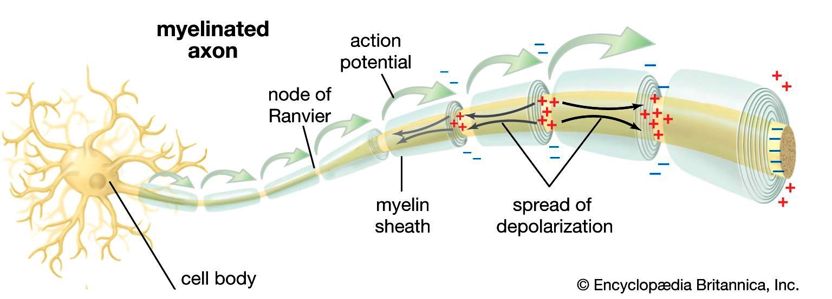
action potential: Saltatory propagation
Much faster than continuous propagation
Uses lower amounts of energy
Fewer Na⁺ must be pumped out of the cytoplasm
The local current jumps over the internodes
Action potential arrives at the initial segment of a myelinated axon
Depolarization of the nearest node to threshold

Slide 15
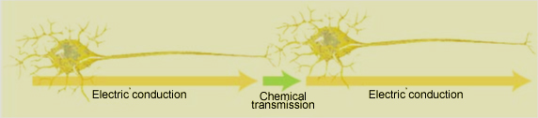
neural communication
sensations, movements, thoughts, and emotions are the result of communication between neurons
2 complementary processes:
a brief electrical fluctuation, down the:
neuron’s dendrites -> cell body -> tip of axon
rapid-response capability that is lacking in the hormonal system
  electrical conduction
synapses between neurons
enabling nerve impulses to be transmitted from one neuron to the next
flexibility that is required for learning
  chemical transmission
https://thebrain.mcgill.ca
Notes:
All of our sensations, movements, thoughts, and emotions are the result of communication between neurons.
This communication is carried out by two complementary processes: electrical conduction and chemical transmission.
Electrical conduction lets nerve impulses travel rapidly within a neuron.
It involves a brief electrical fluctuation that propagates down the neuron’s dendrites, then through its cell body and out to the tip of its axon.
Electrical conduction is what gives the nervous system the rapid-response capability that is lacking in the body’s other major means of communication, the hormonal system.
Chemical transmission takes place in the synapses between neurons, enabling nerve impulses to be transmitted from one neuron to the next.
This process is called “chemical transmission” because the diffusion of chemical molecules from one neuron to the next is what enables the electrical impulse to be reconstituted in that second neuron.
Chemical transmission gives the brain the flexibility that is required for learning.

Slide 16
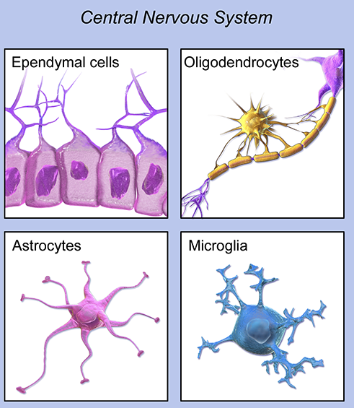
Glial cells – supporting cells in communication
3 major classes of glia:
  ASTROCYTES
  OLIGODENTROCYTES
  MICROGLIA
maintenance of the extracellular milieu
metabolism of certain neurotransmitters
formation of the blood-brain barrier
response to injury
produce myelin sheaths that encase axons and facilitate the conduction of action potentials
cellular components of the brain’s immune system
synaptogenesis
developmental apoptosis
Notes:
Although the neuron is the critical cell type for communication in neural networks, essential supporting roles are played by glial cells. The brain contains three major classes of glia: astrocytes, oligodendrocytes, and microglia. Astrocytes have the most diverse functions, which include maintenance of the extracellular milieu (the composition, including ion concentrations, of extracellular fluid in the brain) for healthy neuronal function, metabolism of certain neurotransmitters, and formation of the blood-brain barrier. Astrocytes also are critical in the CNS response to injury. Oligodendrocytes produce myelin sheaths that encase axons and facilitate the conduction of action potentials. Microglia, together with lymphocytes and macrophages that migrate to the CNS from the periphery, are the cellular components of the brain’s
immune system. All types of glia elaborate soluble factors, including neurotrophic factors and cytokines, which are involved in the maintenance of the nervous
system and in its adaptation to changes in the environment (Chapter 8). Indeed, astrocytes are important in modulating the process of synaptic transmission. Glia
also are key components in guiding the migration of growing neurons during development.

Slide 17
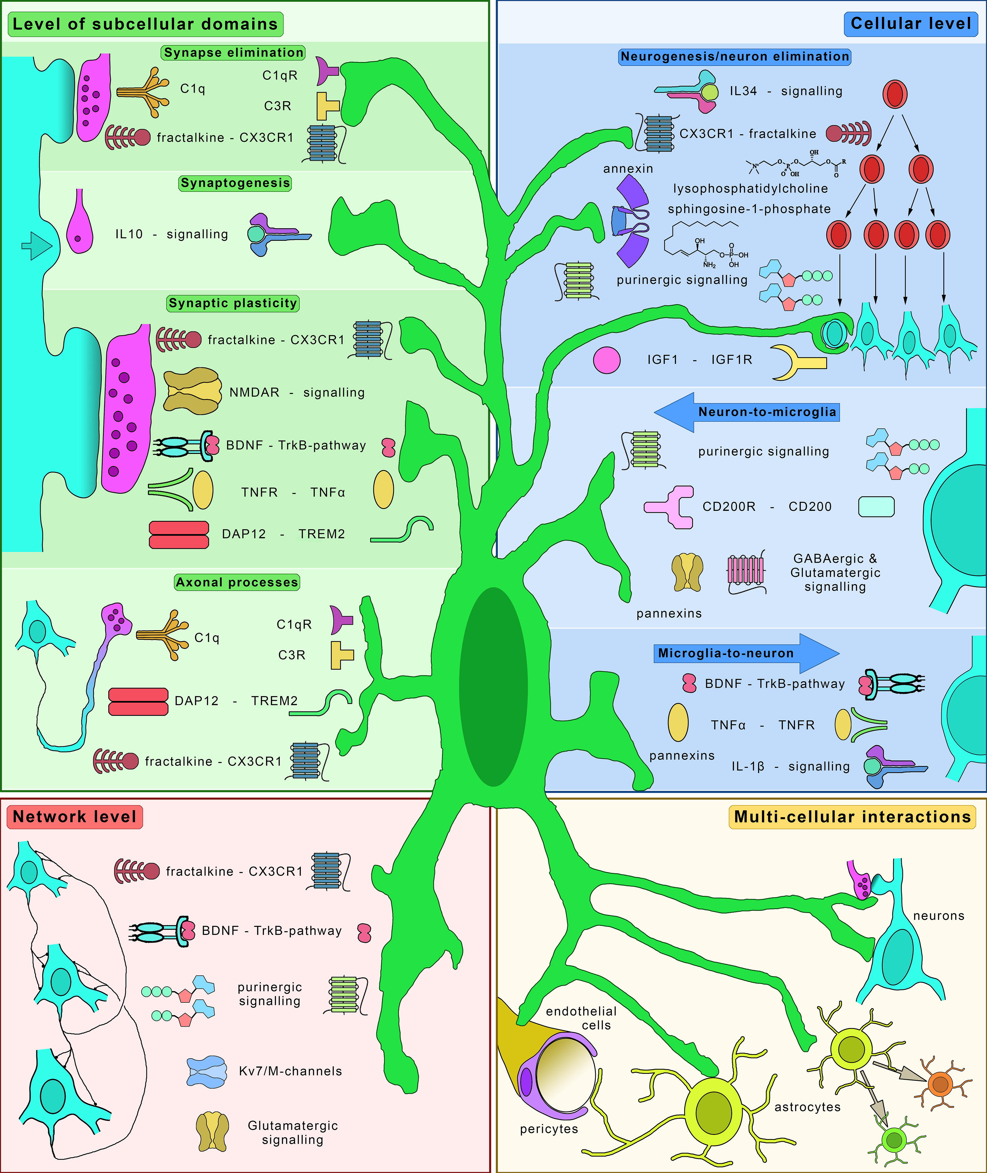
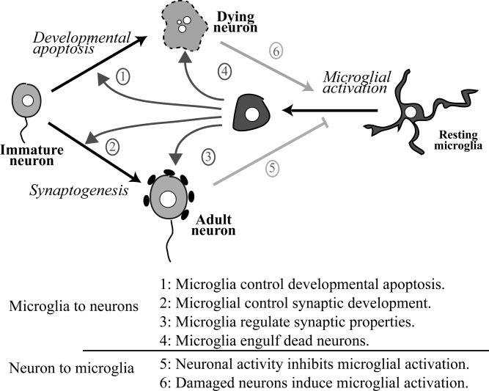
Microglia–Neuron interactions: new insights
Glia, Volume: 55, Issue: 3. DOI: (10.1002/glia.20459)
Balázs Pósfai, et al., New Insights into Microglia–Neuron Interactions: A Neuron’s Perspective, Neuroscience, 2019, https://doi.org/10.1016/j.neuroscience.2018.04.046.
Notes:
Functional crosstalks between microglia and neurons. Microglia are able to regulate several aspects of neuronal functions and neurons can control microglial activation.
Molecular pathways involved in microglia–neuron interactions. The schematic figure shows a simplified view of the main signaling pathways that are implicated in the bidirectional communication between microglia and neurons. The four main levels of interactions (Level of subcellullar domains, Cellular level, Network level and Multi-cellular interactions) follow a bottom-up approach. Please note, that the pathways depicted on the figure are restricted to those discussed in the review (please refer to details in the text). Abbreviations: BDNF – brain-derived neurotrophic factor, C1q – complement component 1q, C1qR – C1q-receptor, C3R – complement receptor 3, CD200 – cluster of differentiation 200, CD200R – CD200 receptor, CX3CR1 – C-X3-C-motif chemokine receptor, DAP12 – DNAX activating protein of 12 kDa, IGF1 – insulin-like growth factor 1, IGF1R – IGF1 receptor, IL-1β – interleukin 1 beta, IL10 – interleukin-10, IL34 – interleukin 34, Kv7/M – M-type potassium channel, NMDAR – N-methyl-d-aspartate receptor, TNFα – tumor necrosis factor alpha, TNFR – TNF receptor, TREM2 – triggering receptor expressed on myeloid cells 2, TrkB – Tropomyosin receptor kinase B.

Slide 18
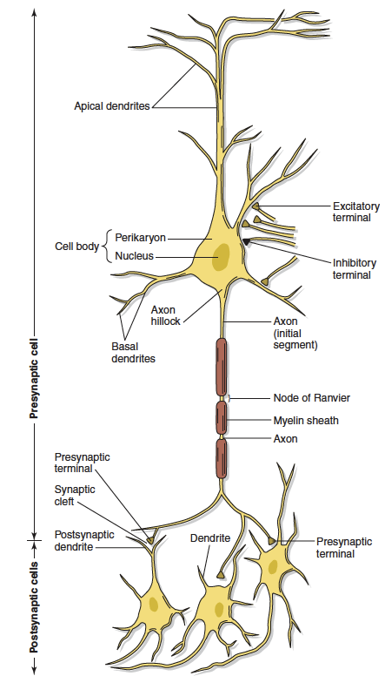
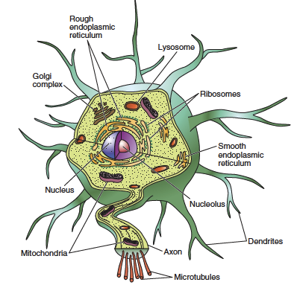
Cellular Basis of Communication
The Neuron
Diagram of intracellular organelles
Kandel ER, Schwartz JH, Jessell TM. Principles of Neuroscience, New York: McGraw-Hill; 2000
Notes:
Principal features of a typical vertebrate neuron. Dendrites, which are the primary sites of synaptic contact, receive most of the incoming synaptic communication. The cell body contains the nucleus and is the site of gene transcription. The axon transmits information and often has multiple branches, the terminals of which form synapses with the dendrites of other neurons.
The nucleus (Nu) is the site of transcription of DNA to RNA. Proteins are synthesized in the endoplasmic reticulum (ER) and subsequently transported to the Golgi apparatus (G) where they undergo further modifications before they are transported to their final destination. Also shown are mitochondria (M), the energy storehouses for the cell, and the plasma membrane (PM).

Slide 19
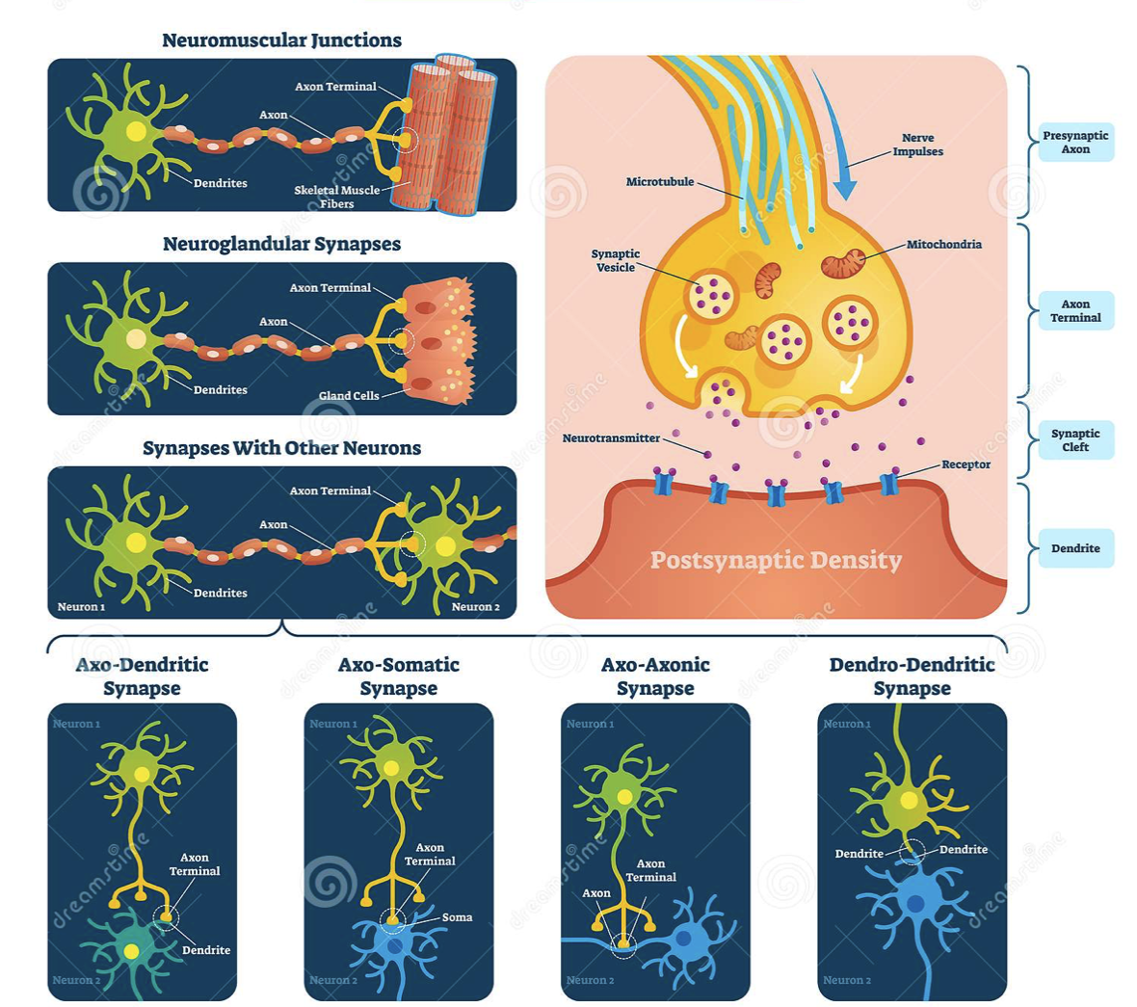
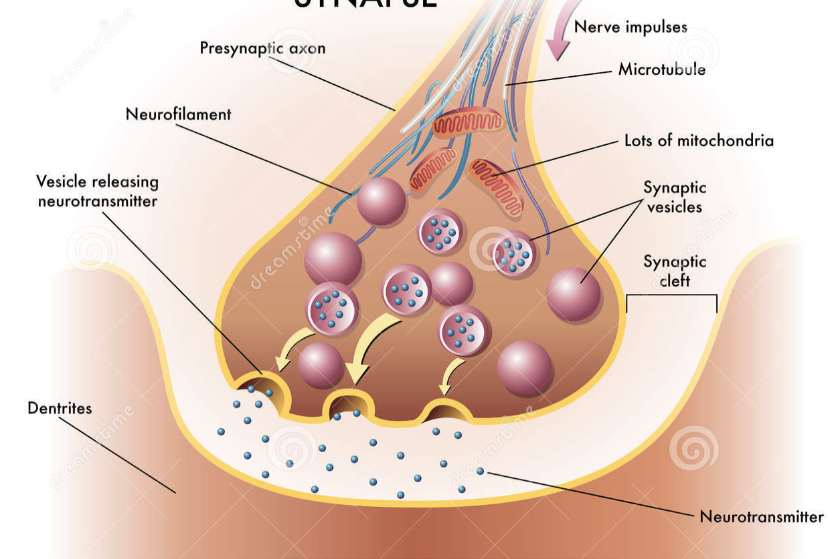
Cellular Basis of Communication
https://www.dreamstime.com
The Synapse
Specialized structure involved in the transmission of information from one neuron to another
  Neurons are not physically connected but are separated by a minute space (20 to 40 nm), called a synapse (the Greek word for clasp)
Chemical Synapse
Typically composed of:
single presynaptic element—the presynaptic terminal or
bouton of an axon
synaptic cleft
a postsynaptic element, which for excitatory synapses is often a dendritic spine

Slide 20
Chemical synapses types
Based on the neurotransmitters they release:
Glutamergic — releases glutamine
  often excitatory
GABAergic — release GABA (gamma-Aminobutyric acid)
  often inhibitory
Cholinergic — release acetylcholine
  found between motor neurons and muscle fibers (the neuromuscular junction)
Adrenergic — release norepinephrine (noradrenaline)

Slide 21
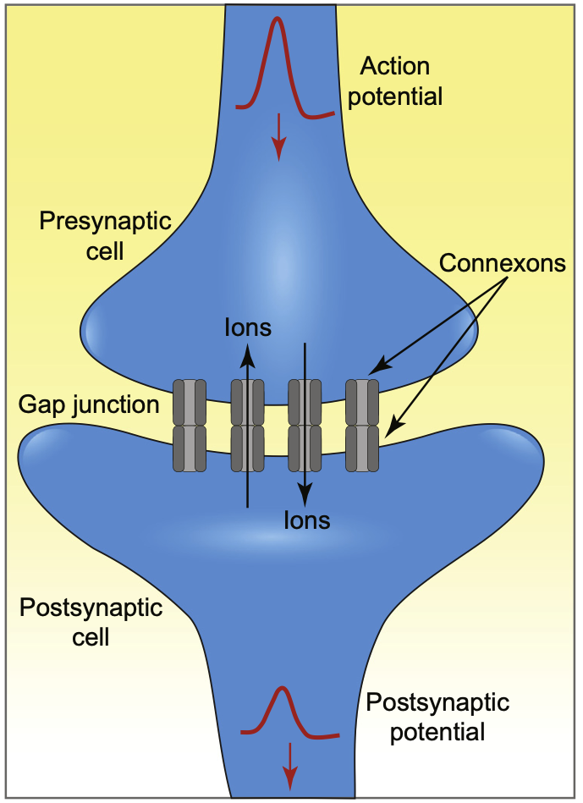
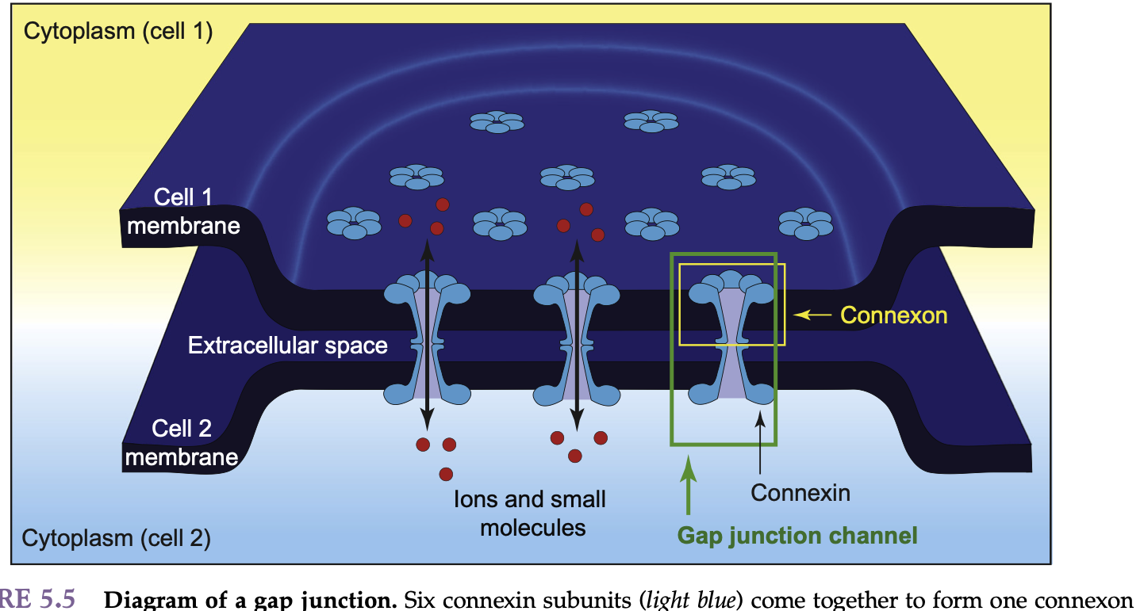
Cellular Basis of Communication
Electrical Synapses
Two neurons connected by specialized channels known as gap junctions
allow electrical signals to travel quickly from the presynaptic cell to the postsynaptic cell rapidly
The special protein channels (connexons) permit electrical currents to flow directly between cells
Synaptic Transmission, 2019 Elsevier Inc. DOI: https://doi.org/10.1016/B978-0-12-815320-8.00005-3

Slide 22
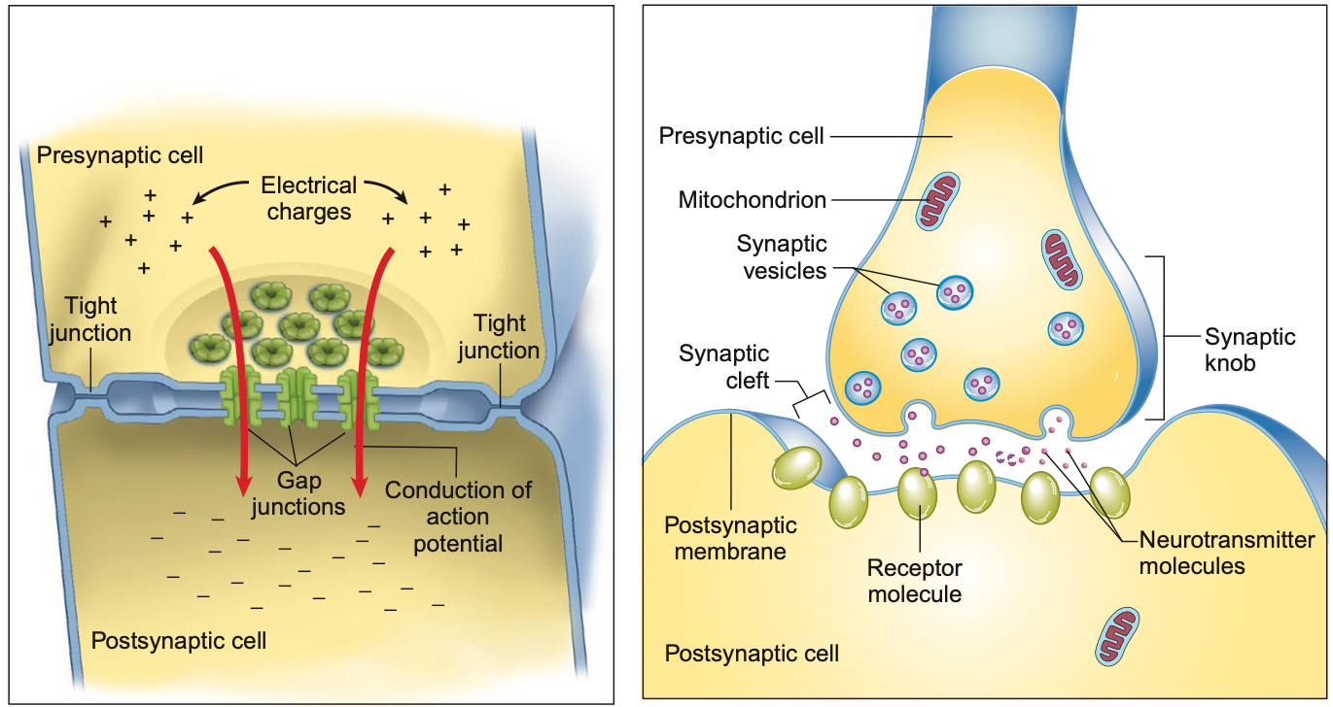
Chemical Synapses
Gap between: 20 nanometers
Speed: Several milliseconds
No loss of signal strength
Excitatory or inhibitory
Electrical Synapses
Gap between: 3.5 nanometers
Speed: Nearly instantaneous
Signal strength diminishes
Excitatory only
Moini, J., & Piran, P. (2020). Histophysiology. Functional and Clinical Neuroanatomy, 1–49.doi:10.1016/b978-0-12-817424-1.00001-x

Slide 23
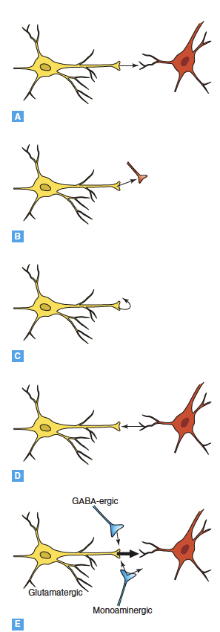
The Many Faces of Synaptic Transmission
Widespread in the CNS and may represent the predominant mode of synaptic transmission involving excitatory and inhibitory amino acids
axodendritic or axosomatic synapse
Neurotransmitters released from one nerve terminal acts on receptors
located on other nearby nerve terminals
B) axoaxonic synapses
C) axoaxonic – autoreceptor function
Neurotransmitters also can act by means of autoreceptors located on the same terminals that release them
Neurotransmitters can be released from cell bodies or dendrites (i.e.nitric oxide, endogenous cannabinoids) and diffuse to act on neighbouring nerve terminals
D) dendroaxonic synapse
E) Coexisting of several types of synaptic relationship
Nestler, Eric J. (Eric Jonathan) et al. Molecular Neuropharmacology : a Foundation for Clinical Neuroscience. Fourth edition. 2020

Slide 24
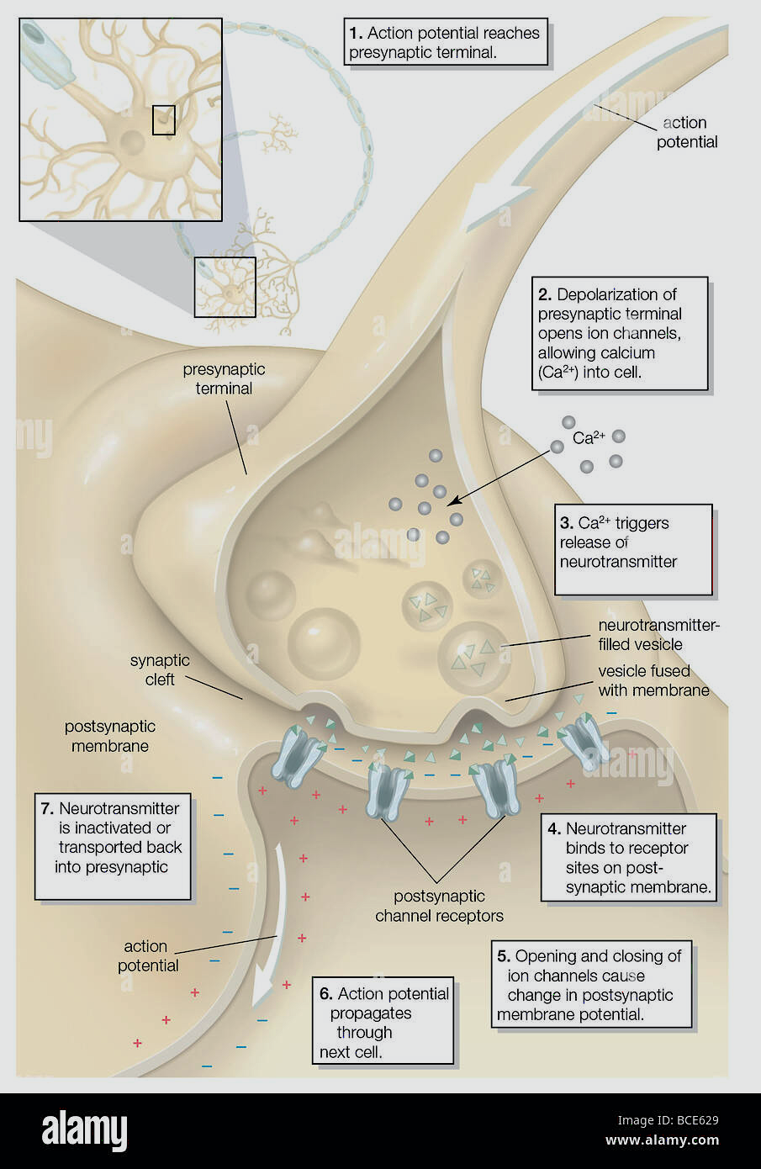
Synaptic transmission
The process that enables a nerve impulse to pass from one neuron to another
This transmission is effected by chemical molecules - neurotransmitters, which bind to receptors
It is through variations in the amount of neurotransmitters released, the receptors available, or the affinity between the two that the synapses undergo changes and enable us to learn
Omnipresent mechanism - source of the brain’s great plasticity
https://www.alamy.com

Slide 25
Synaptic transmission
Synaptic transmission is a result of three types of processes that convert electrical information into a chemical signal and then back again:
electrical information in the axon of a presynaptic neuron is converted to a chemical signal in its nerve terminal,
this chemical signal is transmitted to another cell across a synapse, and
the chemical message received by the postsynaptic cell is converted into an electrical signal
Gap junctions permit the direct flow of electrical current from cell to cell
https://www.alamy.com

Slide 26
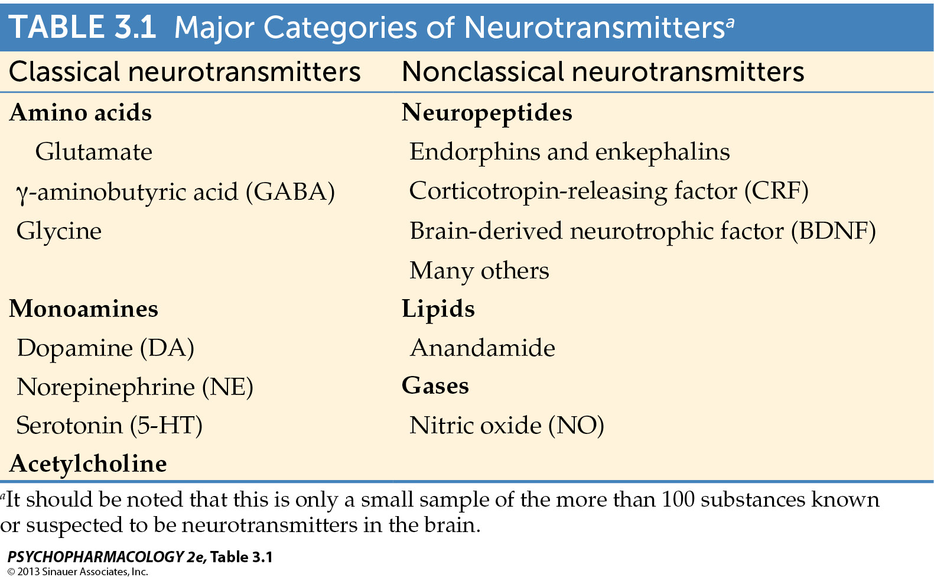
Neurotransmitters
Notes:
Psychopharmacology2e-Table-03-01-0.jpg

Slide 27
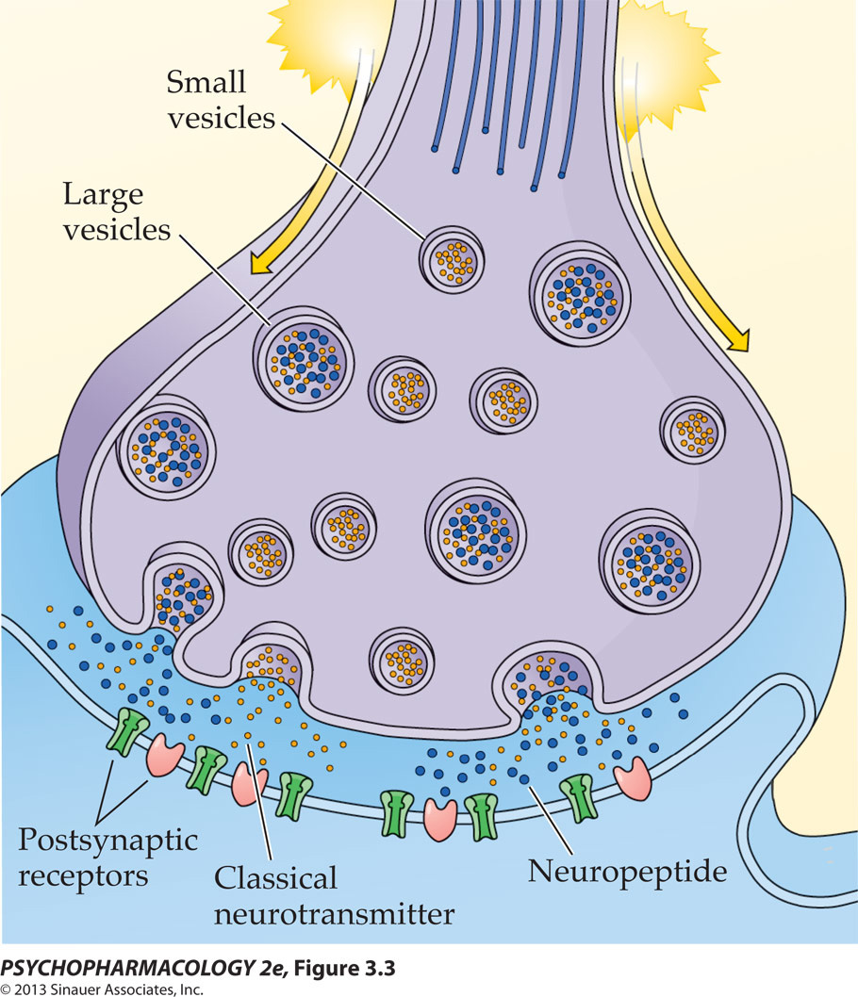
Neurotransmitters: synthesis, storage, release and inactivation
Requirements, for a substance to be neurotransmitter:
  Presynaptic cell 1) synthetize it and can safely 2) store it for 3) release
  Presynaptic cell has mechanisms for 4) inactivation of neurotransmitter
  Neurotransmitter is released form presynaptic terminal in the presence of 5) stimulus
Notes:
27

Slide 28
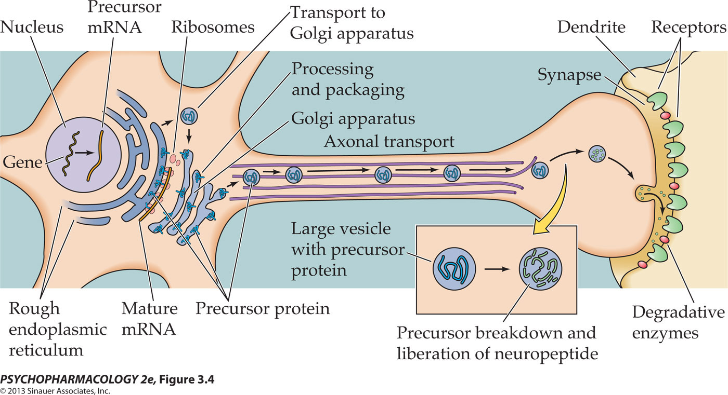
Signal transduction by neuropeptides
Neuromodulators accelerate, reduce or prolong the neurotransmitter’s action
Notes:
Psychopharmacology2e-Fig-03-04-0.jpg

Slide 29
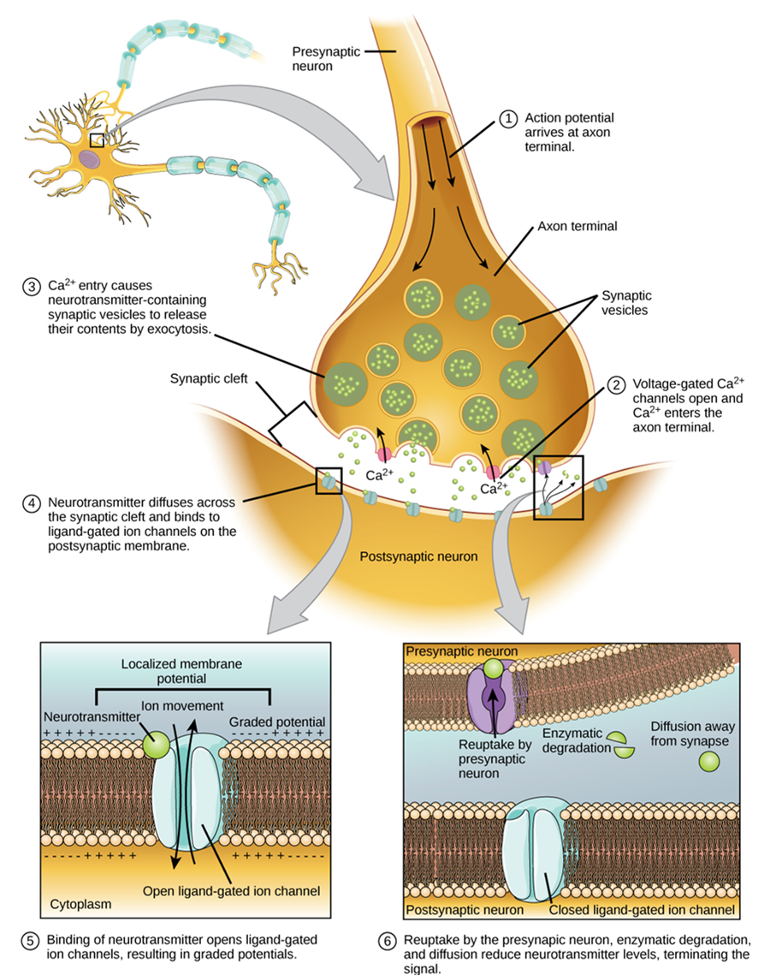
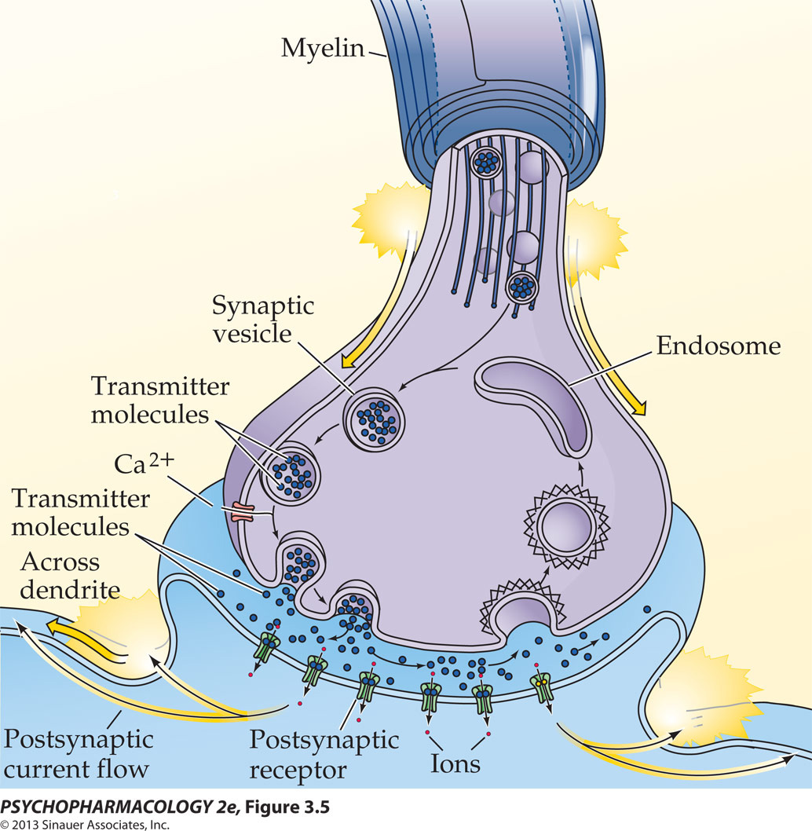
Processes of synaptic neurotransmission
Small synaptic vesicle
(the most abundant form of secretory vesicle in CNS) cluster in the active zone of the nerve terminal
A depolarization dependent influx of Ca²⁺ into the presynaptic terminal causes
  synaptic vesicles to fuse with the plasma membrane (active zone),
  thereby releasing neurotransmitter into the synaptic cleft - exocytosis
Active zone
Synaptic cleft
Postsynaptic density
Notes:
Psychopharmacology2e-Fig-03-05-0R.jpg

Slide 30
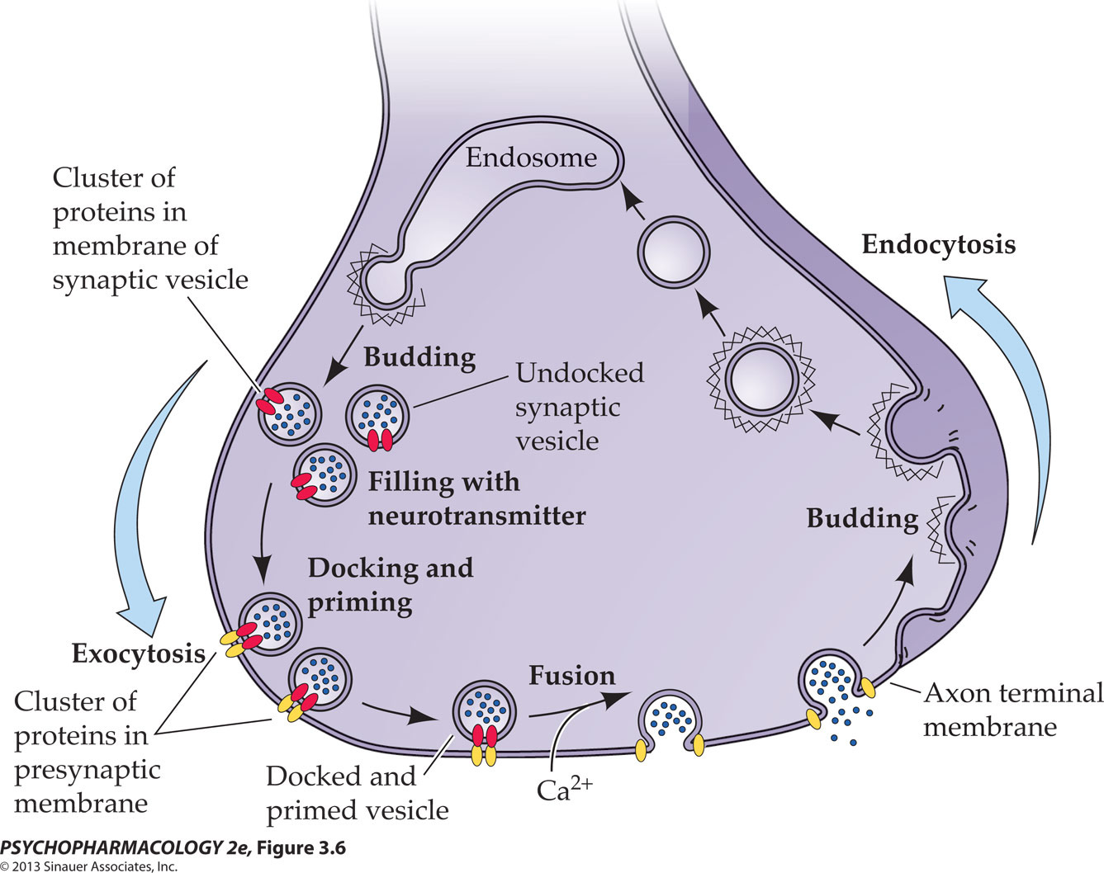
Life cycle of synaptic vesicle
The exocytotic cycle
docking of synaptic vesicles at the plasma membrane of the active zone;
priming, an ATP-dependent step that prepares each vesicle for release;
fusion/exocytosis, the release of neurotransmitter triggered by the influx of Ca²⁺ through voltage-gated channels;
endocytosis, retrieval of vesicle membrane
recycling, whereby vesicles move through an endosome intermediate or invaginations from the plasma membrane.
Notes:
Psychopharmacology2e-Fig-03-06-0R.jpg
1) docking of synaptic vesicles at the plasma membrane of the active zone; (2) priming, an ATP-dependent step that prepares each vesicle for release; (3) fusion/exocytosis, the release of neurotransmitter triggered by the influx of Ca2+ through voltage-gated channels in the plasma membrane; (4) endocytosis, retrieval of vesicle membrane facilitated by a protein coat (dashed line) that subsequently dissociates from each vesicle; and (5) recycling, whereby vesicles move through an endosome intermediate (not shown) or invaginations from the plasma membrane.

Slide 31
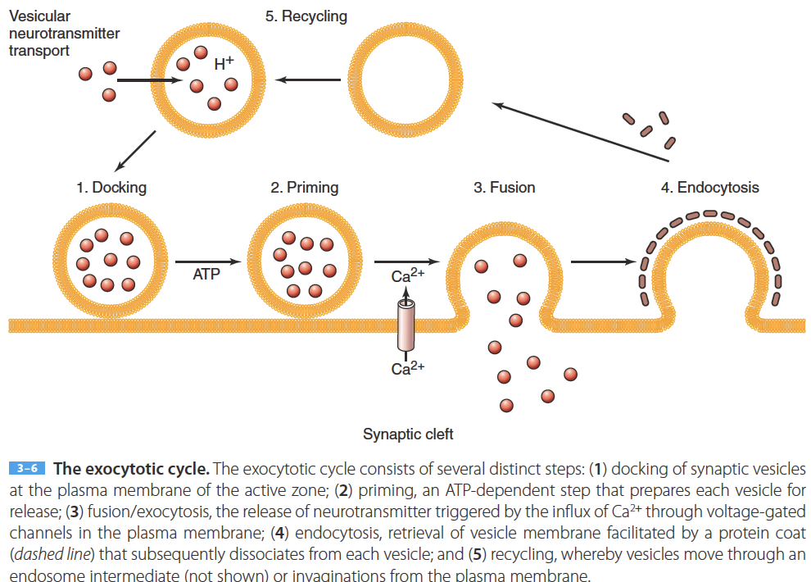
The exocytotic cycle

Slide 32
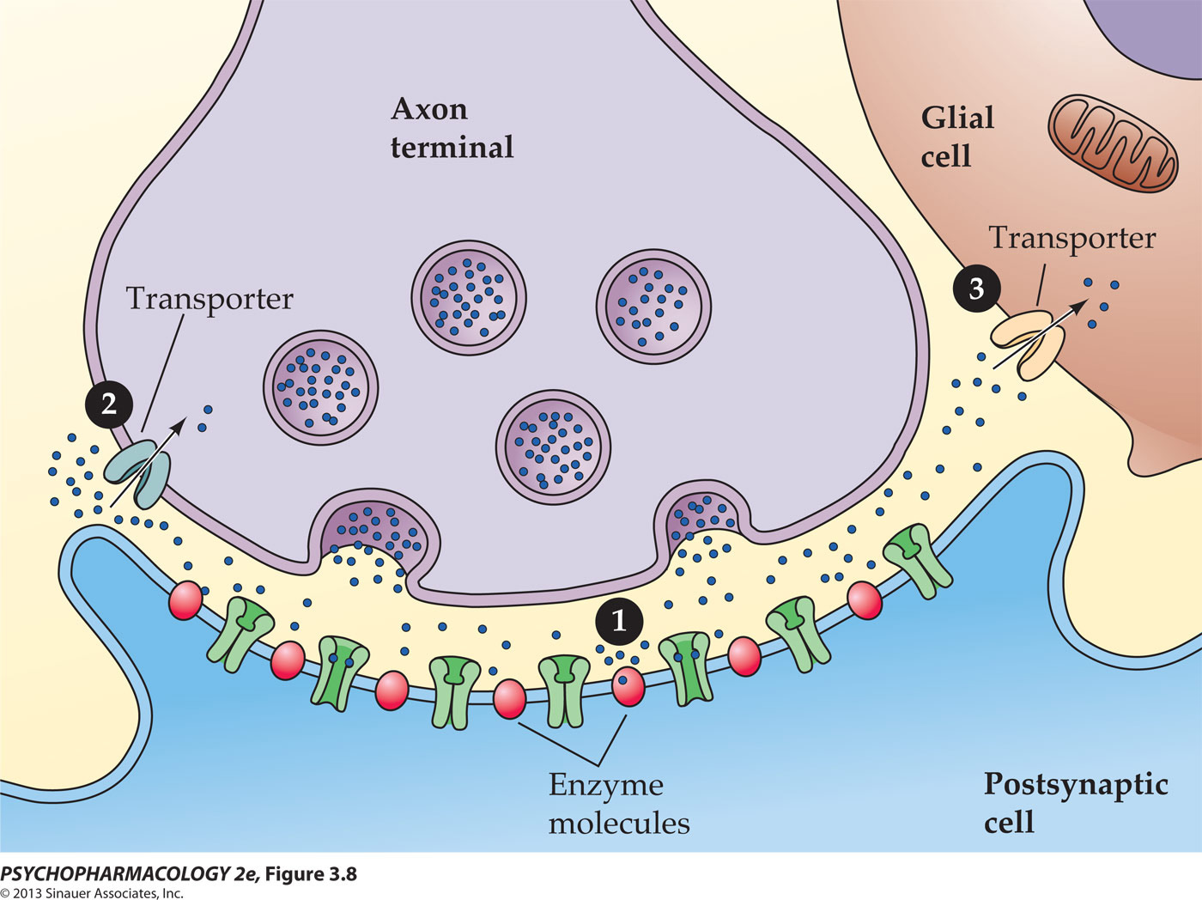
Termination of Neurotransmitter Action
Transmitter fates
enzymatic degradation
transport into the presynaptic terminal
uptake by glia or postsynaptic cells
passive diffusion away from the synapse
Notes:
After exocytosis, neurotransmitter is inactivated, either by enzymatic degradation or by active transport out of the synaptic cleft. The latter process may include transport
across the plasma membrane of the presynaptic terminal, postsynaptic neurons, or neighboring glia. Like vesicular transport, plasma membrane transport requires specific transport proteins. However, unlike vesicular transport, it depends on energy provided by the Na+ gradient across the plasma membrane. These transport activities have been important targets of therapeutic drugs since the early 1960s, when it was discovered that cocaine and many antidepressants act initially by inhibiting the plasma membrane transport of monoamines such as dopamine, norepinephrine, or serotonin

Slide 33
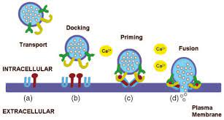
Neurotransmitters synthesis, storage, release and inactivation
The release of transmitters is regulated by:
The frequency of neuron triggering
The frequency of vesicular exocytosis
Autoceptors: receptors for the same transmitter released by the same neuron (self-control of release)
Release of the transmitter (video)
https://www.youtube.com/watch?v=XGINQ7xhPkM
Notes:
33

Slide 34
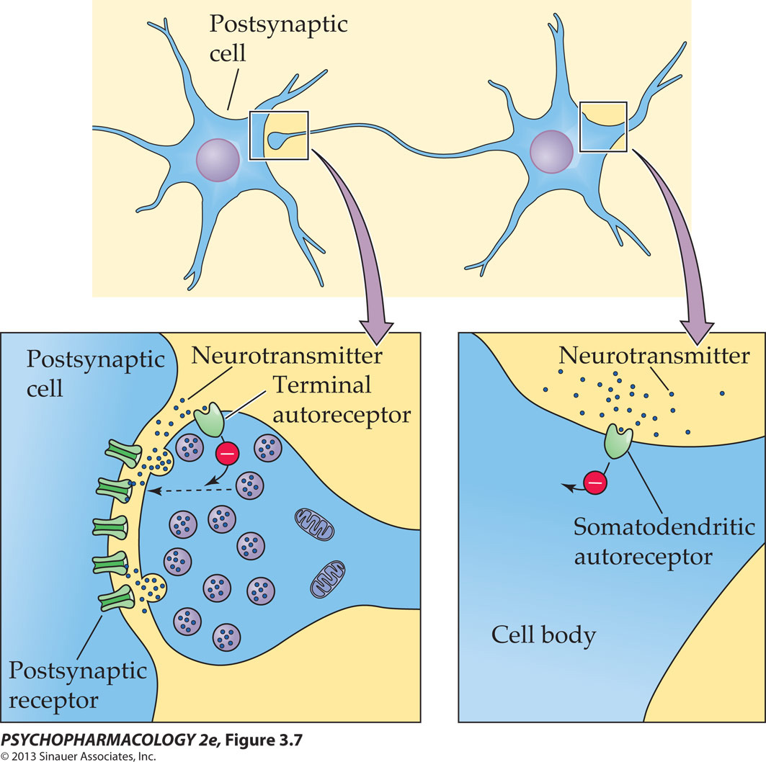
Terminal somatodendritic autoreceptors
Terminal autoreceptors: activated by transmitter; inhibits the release of transmitter in its own cell
Somatodendritic autoreceptors: located in the body of the cells or dendrites and slow the triggering of the neuron, slowing the release of the transmitter
Notes:
Psychopharmacology2e-Fig-03-07-0.jpg

Slide 35
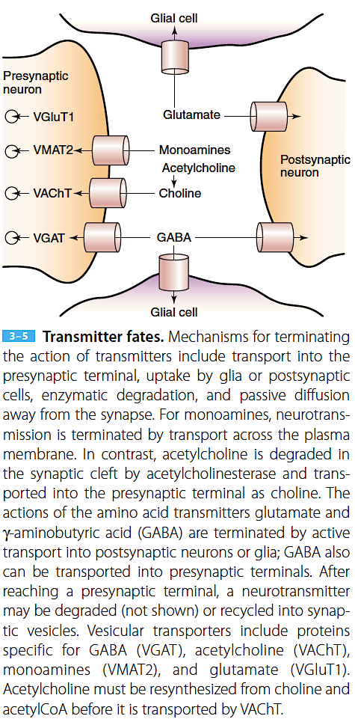
Neurotransmitters synthesis, storage, release and inactivation
To terminate signal transmission, the transmitters must be removed from the synaptic cleft
1) The transmitters is degraded by enzymes – e.g. AChE, lipids, gases, neuropeptides
2) Transporter proteins (vesicular transporters) in the cellular membrane uptake portable molecules
3) Re-uptake: transmitters are re-uptaken by the neuron itself
Uptake: a postsynaptic neuron OR glial cell
Nestler, Eric J. (Eric Jonathan) et al. Molecular Neuropharmacology : a Foundation for Clinical Neuroscience. Fourth edition. 2020
Notes:
35

Slide 36
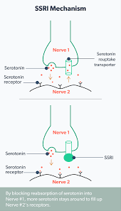
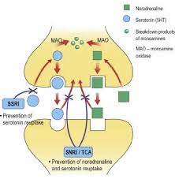
Neurotransmitters synthesis, storage, release and inactivation
Some psychoactive drugs inhibit the activity of vesicular transporters and thus speed up the signal transmission.
Example: SSRI →
Cocaine inhibits transporters for DA, 5-HT, and NA.
Some antidepressants inhibit 5-HT transporters, NA transporters, or both.
Notes:
36

Slide 37
Overview of signal transduction pathways
Signal transduction refers to the processes by which are signals between cells carried by neurotransmitters, hormones, trophic factors, and cytokines are converted into biochemical signals within cells
Signal transduction
Signaling molecule
Receptor of target cell
Most neurotransmitter receptors can be divided into two classes by their signal transduction mechanism:
  1) one class involving activation of an ion channel that is intrinsic to the receptor and
  2) the other involving activation of G proteins
Intracellular molecule
biological effect

Slide 38
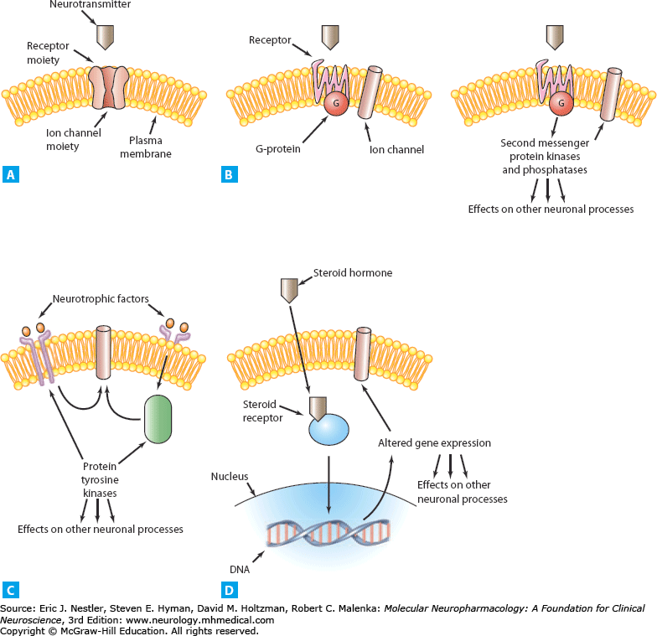
General patterns of signal transduction in the brain
Neurotransmitter activation of a receptor that contains an ion channel
Neurotransmitter activation of a G protein–coupled receptor
Neurotrophic factor activation of a receptor that contains protein tyrosine kinase activity or that activates such a kinase indirectly
Steroid hormone activation of a cytoplasmic receptor
Signal Transduction in the Brain, Nestler EJ, Hyman SE, Holtzman DM, Malenka RC. Molecular Neuropharmacology: A Foundation for Clinical Neuroscience, 3e; 2015. Available at: https://mhmedical.com
Notes:
General patterns of signal transduction in the brain. A. Neurotransmitter activation of a receptor that contains an ion channel. B. Neurotransmitter activation of a G protein–coupled receptor.
After it is activated, the G protein can directly regulate an ion channel (left), or trigger the regulation of second messenger–dependent protein kinases and protein phosphatases, which can in turn regulate other ion channels and many neuronal processes (right). C. Neurotrophic factor activation of a receptor that contains protein tyrosine kinase activity or that activates such a kinase indirectly. D. Steroid hormone activation of a cytoplasmic receptor. After the receptor is bound by hormone, it translocates to the nucleus and regulates gene expression.

Slide 39
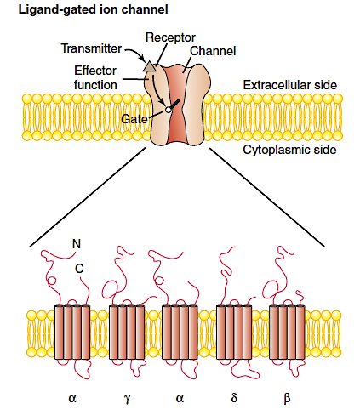
General patterns of signal transduction in the brain
Neurotransmitter activation of a receptor that contains an ion channel
  involves the binding of neurotransmitter to a multimeric plasma membrane receptor complex
used primarily by:
  amino acid neurotransmitters at their ionotropic receptors
  acetylcholine at nicotinic receptors
  serotonin at 5HT₃ receptors
  adenosine triphosphate (ATP) at certain purinergic receptors
  heat at certain vanilloid receptors
Signal Transduction in the Brain, Nestler EJ, Hyman SE, Holtzman DM, Malenka RC. Molecular Neuropharmacology: A Foundation for Clinical Neuroscience, 3e; 2015. Available at: https://mhmedical.com
Notes:
General patterns of signal transduction in the brain. A. Neurotransmitter activation of a receptor that contains an ion channel. B. Neurotransmitter activation of a G protein–coupled receptor.
After it is activated, the G protein can directly regulate an ion channel (left), or trigger the regulation of second messenger–dependent protein kinases and protein phosphatases, which can in turn regulate other ion channels and many neuronal processes (right). C. Neurotrophic factor activation of a receptor that contains protein tyrosine kinase activity or that activates such a kinase indirectly. D. Steroid hormone activation of a cytoplasmic receptor. After the receptor is bound by hormone, it translocates to the nucleus and regulates gene expression.

Slide 40
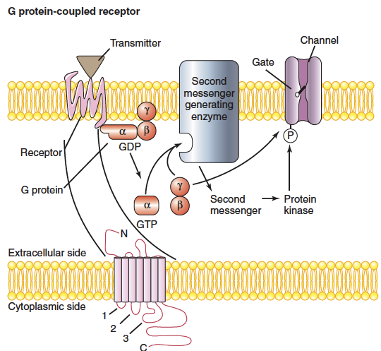
General patterns of signal transduction in the brain
Neurotransmitter activation of a G protein–coupled receptor
  Characterized by the binding of neurotransmitters to plasma membrane receptors that couple with guanine nucleotide–binding proteins or G proteins
  mediate slow synaptic transmission
Signal Transduction in the Brain, Nestler EJ, Hyman SE, Holtzman DM, Malenka RC. Molecular Neuropharmacology: A Foundation for Clinical Neuroscience, 3e; 2015. Available at: https://mhmedical.com
Notes:
G protein–coupled receptors, which mediate slow synaptic transmission, transduce neurotransmitter signals through a different mechanism. These proteins do not form gated pores in the membrane; rather, the binding of transmitter induces a conformational change that allows the receptor to activate a heterotrimeric G protein (Chapter 4). The activated G protein dissociates into a free α subunit bound to GTP and a free βγ subunit dimer. Both can activate enzymes that synthesize second messengers; in addition, βγ dimers directly regulate certain ion channels. Second messengers also regulate ion channels, most often by activating protein kinases, which subsequently phosphorylate such channels (P). 1 2 3, cytoplasmic domains of G protein–coupled receptor.

Slide 41
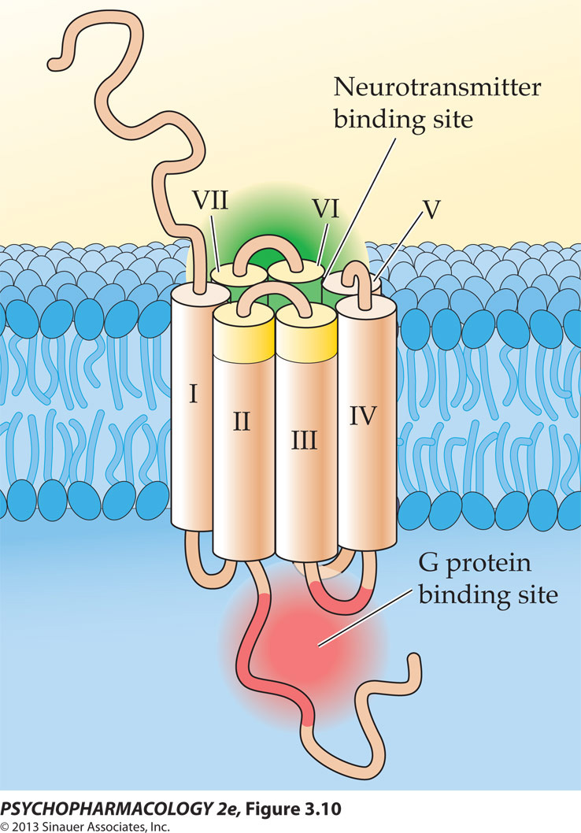
General patterns of signal transduction in the brain
Neurotransmitter activation of a G protein–coupled receptor
G protein structure
Seven-transmembrane domain structure, whose N terminus faces the extracellular space and whose C terminus faces the cytoplasm
Signal Transduction in the Brain, Nestler EJ, Hyman SE, Holtzman DM, Malenka RC. Molecular Neuropharmacology: A Foundation for Clinical Neuroscience, 3e; 2015. Available at: https://mhmedical.com
Notes:
G protein–coupled receptors, which mediate slow synaptic transmission, transduce neurotransmitter signals through a different mechanism. These proteins do not form gated pores in the membrane; rather, the binding of transmitter induces a conformational change that allows the receptor to activate a heterotrimeric G protein (Chapter 4). The activated G protein dissociates into a free α subunit bound to GTP and a free βγ subunit dimer. Both can activate enzymes that synthesize second messengers;
in addition, βγ dimers directly regulate certain ion channels. Second messengers also regulate ion channels, most often by activating protein kinases, which subsequently phosphorylate such channels (P). 1 2 3, cytoplasmic domains of G protein–coupled receptor.

Slide 42
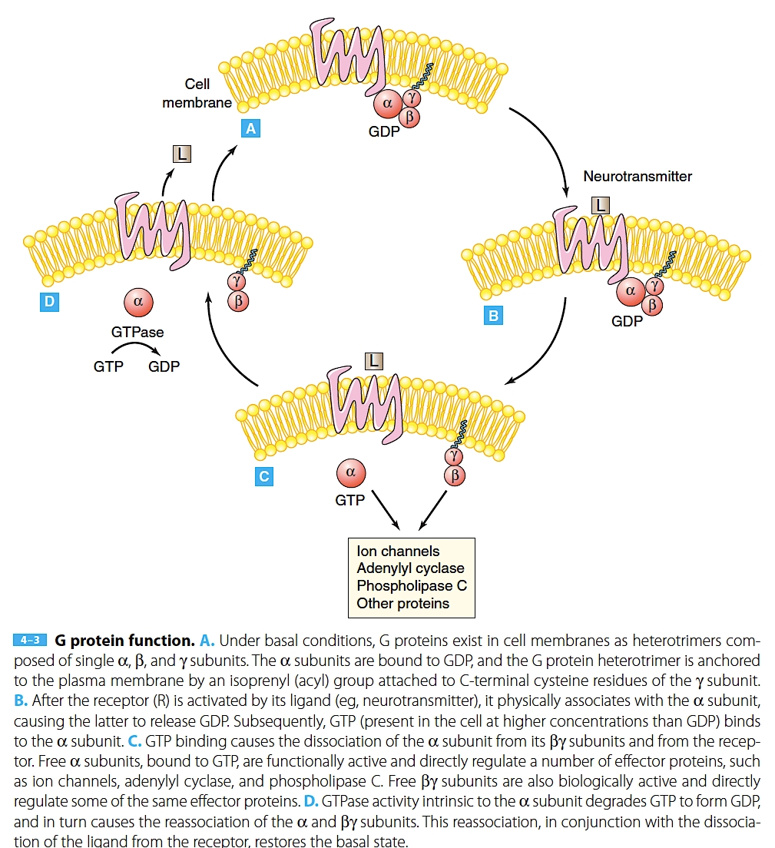
G protein function
Signal Transduction in the Brain, Nestler EJ, Hyman SE, Holtzman DM, Malenka RC. Molecular Neuropharmacology: A Foundation for Clinical Neuroscience, 2015.

Slide 43
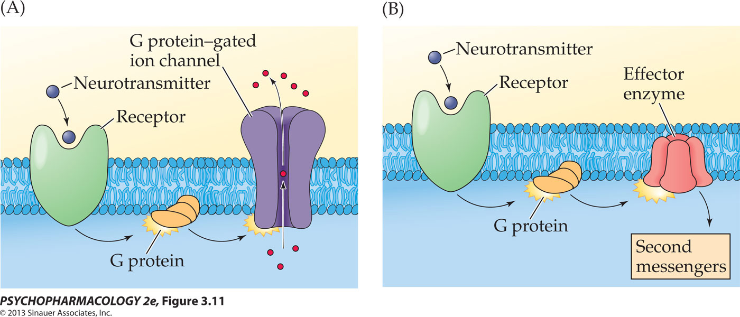
G protein function summary
Inhibit or trigger ionic channels (K+ channels open, K+ exits the cell and hyperpolarization occurs)
Stimulate or inhibit membrane enzymes that synthesize or degrade second-stage transmitters (second messengers)

Slide 44
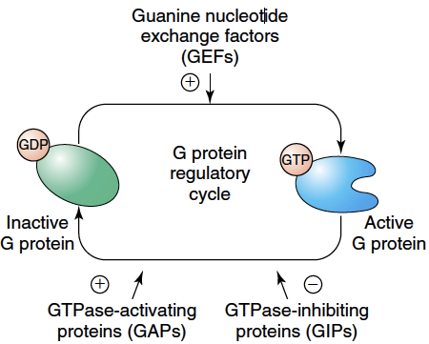
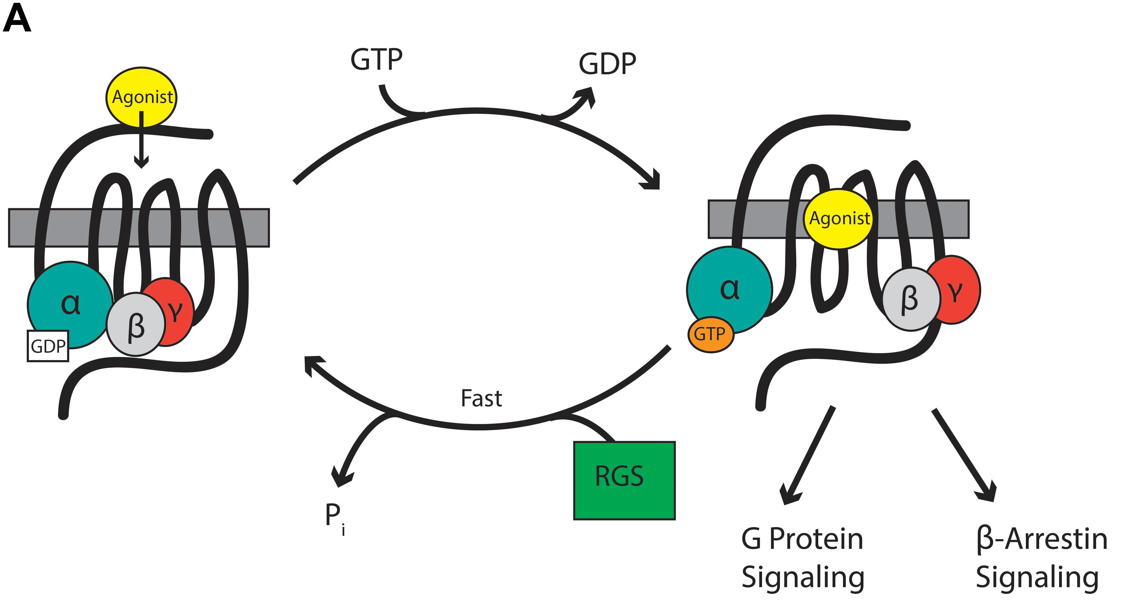
Regulation of G protein function
Several modulatory proteins
Neurotransmitter receptor - guanine nucleotide exchange factor, triggers the release of GDP from the α subunit
Regulators of G protein signalling (RGS proteins) activate the GTPase activity intrinsic to the α subunits of G proteins → inhibit G protein
Phosducin binds to βγ subunits and thereby competes with these subunits for binding to α subunits and possibly to effector proteins
Notes:
G protein function can be regulated by several modulatory proteins. A neurotransmitter receptor may be seen as one type of modulatory protein, specifically a guanine nucleotide exchange factor, because it triggers the release of GDP from the α subunit. Regulators of G protein signaling (RGS proteins) activate the GTPase activity intrinsic to the α subunits of G proteins; thus, these proteins inhibit G protein function by shortening the duration of the signals from both the activated GTP-α subunit and the free βγ subunits. All G protein α subunits, except for Gαs, are known to be regulated in this manner. More than 20 subtypes of RGS proteins, each with a characteristic expression pattern in the brain, have been identified. Phosducin is another modulatory protein that binds to βγ subunits and thereby competes with these subunits for binding to α subunits and possibly to effector proteins.

Slide 45

G Protein Regulation of Ion Channels
Best researched mechanisms
Activation of inwardly rectifying K⁺ channels (GIRKs)
Inhibition of voltage-gated Ca²⁺ channels
A. Kovoor and H. A. Lester Neuron 2002 https://doi.org/10.1016/S0896-6273(01)00572-4
Notes:
In the absence of agonist, the heterotrimeric G protein binds both the receptor and the GIRK channel, and the three proteins together form a macromolecular complex. The exchange of GTP for GDP at the G𝜶 subunit catalyzed by the agonist bound receptor causes the G𝜶 subunit to dissociate from the receptor and also to release the G𝜷𝜸 dimer. The free G 𝜷𝜸 dimer activates GIRK. It is not clear whether G𝜶-GTP also binds GIRK directly. RGS proteins stabilize the transition state conformation of the G𝜶 subunit and may also make contacts with both the receptor and the GIRK channel, thus keeping the complex intact. PDZ domain binding motifs on some GIRK channels may recruit PDZ domain- containing proteins to the complex. PIP2 and Na+ ions, while not structural components of the complex, are important GIRK channel modulators.

Slide 46

Second Messengers
G proteins transduce the activation of neurotransmitter receptors by neurotransmitter binding to altered intracellular levels of second messengers in target neurons
Altered levels of second messengers mediate the effects of receptor activation on many types of ion channels and on numerous physiologic responses
Prominent second messengers in the brain:
  cyclic adenosine monophosphate (cAMP)
  cyclic guanosine monophosphate (cGMP)
  Ca²⁺
  nitric oxide (NO)
  prostaglandins
Signal Transduction in the Brain, Nestler EJ, Hyman SE, Holtzman DM, Malenka RC. Molecular Neuropharmacology: A Foundation for Clinical Neuroscience, 3e; 2015. Available at: https://mhmedical.com

Slide 47

Mechanism of action of Second messengers
The neurotransmitter is first messenger
Second messengers are molecules in a cell that activate protein kinases, which triggers phosphorylation of effector protein
Phosphorylation of protein in nucleus can either initiate or stop gene expression
Signal Transduction in the Brain, Nestler EJ, Hyman SE, Holtzman DM, Malenka RC. Molecular Neuropharmacology: A Foundation for Clinical Neuroscience, 3e; 2015. Available at: https://mhmedical.com

Slide 48


Phosphorylation
Phosphorylation = addition of a phosphate group to one or more sites on the protein
phosphate groups are typically linked to one of the three amino acids that have hydroxyl (-OH) groups in their side chains: tyrosine, threonine, and serine
catalyzed by an enzyme called a kinase
To flip proteins back into their non-phosphorylated state, cells have enzymes called phosphatases - remove a phosphate group from their targets
Image source: www.khanacademy.org

Slide 49

PROTEIN PHOSPHORYLATION: A FINAL COMMON PATHWAY IN THE REGULATION OF NEURONAL FUNCTION
Protein phosphorylation represents a final common pathway in the molecular mechanisms through which neurotransmitters, hormones, and the nerve impulse produce many of their biological effects in target cells.
The activation of individual protein kinases causes the phosphorylation of specific substrate proteins (phosphoproteins) in target cells
Hemmings HC Jr, et al. Role of protein phosphorylation in neuronal signal transduction. FASEB J. 1989
Notes:
Cell membrane receptors for many neurotransmitters and hormones are coupled to the activation of protein kinases, either directly by activating a protein kinase intimately associated with the receptor, or indirectly through changes in the intracellular levels of second messengers. Prominent second messengers involved in the regulation of protein kinases include cAMP, cGMP, Ca2, and 1,2-diacyiglycerol. The nerve impulse is coupled to the regulation of protein kinases by the second messenger Ca2, which enters the cells on activation of voltage-sensitive Ca2 channels. The activation of individual protein kinases causes the phosphorylation of specific substrate proteins (phosphoproteins) in target cells. In some cases these substrate proteins, or third messengers, appear to be the immediate effectors for the biological
response, and in other cases they seem to produce the biological response indirectly, through additional intracellular messengers.
Phosphoprotein phosphatases (protein phosphatases) are also subject to regulation by extracellular signals acting through second messengers. This regulation can occur by second messengers acting on the protein phosphatases (e.g., Ca2 on Ca2/CaM-dependent protein phosphatase-2B) or by the phosphorylation of specific protein
phosphatase modulator proteins (see Figs. 10 and 11 and text). Many, if not all, membrane receptors and ion channels are themselves regulated by phosphorylation/dephosphorylation

Slide 50

PROTEIN PHOSPHORYLATION: PROTEIN KINASES
Best characterized protein kinases in the brain are those activated by the second messengers
  cAMP → protein kinase A or PKA
  cGMP → protein kinase G or PKG
  Ca²⁺
    → Ca²⁺/calmodulin-dependent protein kinase
    → protein kinase C (PKC)
  Diacylglycerol →
Also referred to as protein serine–threonine kinases
Signal Transduction in the Brain, Nestler EJ, Hyman SE, Holtzman DM, Malenka RC. Molecular Neuropharmacology: A Foundation for Clinical Neuroscience, 3e; 2015. Available at: https://mhmedical.com
Notes:
Activation of protein kinases. A. The PKA holoenzyme, which is inactive, is a dimer composed of two regulatory subunits (R) joined by disulfide bonds, each of which is associated with a catalytic subunit (C). Two molecules of cAMP bind to each regulatory subunit, causing it to dissociate from the catalytic subunit, which in turn becomes active. B. PKG is activated in a similar manner, although its regulatory and catalytic domains exist within a single polypeptide chain. Regulatory subunits of PKA and regulatory domains of PKG may be autophosphorylated in response to activation by cAMP or cGMP, respectively; such autophosphorylation promotes further dissociation and activation of the enzymes. C. PKC is a single polypeptide chain that comprises several identifiable domains. C1 binds diacylglycerol (DAG) and phorbol esters, C2 binds Ca2+ and phosphatidylserine (PS), C3 binds ATP, and C4 contains the active, or catalytic, site. The pseudosubstrate site is functionally analogous to the regulatory domain of PKA and PKG in that it inhibits catalytic activity of the enzyme. In response to the binding of Ca2+, PS, and DAG, this inhibition is relieved, and PKC is activated

Slide 51


„Just Say NO“
Increased levels of intracellular Ca²⁺ activates nitric oxide synthase (NOS).
NOS in neurons and endotelial cells (vessels) catalyses formation of NO from arginine.
NO acts differently than other neurotransmitters. Since it is not stored in vesicles, must be syntetised in the site of its actions; crosses the cell membrane; it is often released by postsynaptic cells.
NO modulate vascular tone, insulin secretion, airway tone, and peristalsis, and is involved in angiogenesis and neural development
Notes:
Psychopharmacology2e-Box-03-01-Fig-A-1R.jpg

Slide 52

PROTEIN PHOSPHORYLATION:
Major Classes of Protein Serine–Threonine Kinases
Signal Transduction in the Brain, Nestler EJ, Hyman SE, Holtzman DM, Malenka RC. Molecular Neuropharmacology: A Foundation for Clinical Neuroscience, 3e; 2015. Available at: https://mhmedical.com

Slide 53


PROTEIN KINASE INHIBITORS
Potential therapeutic agents
i.e. peptide inhibitors, directed at the active site of a particular enzyme
protein kinase inhibitor (PKI), is a highly specific inhibitor of PKA that is expressed in many tissues
Small molecule protein kinase inhibitors have been explored in the treatment of many disease remains more hypothetical for neurodegenerative disorders, such as Alzheimer disease
Signal Transduction in the Brain, Nestler EJ, Hyman SE, Holtzman DM, Malenka RC. Molecular Neuropharmacology: A Foundation for Clinical Neuroscience; 2015.
Notes:
Protein kinase inhibitors There has been intense interest in the development of protein kinase inhibitors for use as research tools and as potential therapeutic agents. The most specific of these are peptide inhibitors, which are directed at the active site of a particular enzyme. The prototype, a naturally occurring 17-kDa protein known as protein kinase inhibitor (PKI), is a highly specific inhibitor of PKA that is expressed in many tissues. Small molecule protein kinase inhibitors have been explored in the treatment of numerous diseases. Their development is furthest along for several cancers, and remains more hypothetical for neurodegenerative disorders, such as Alzheimer disease (Chapter 17). Examples of protein kinase inhibitors used experimentally in neuroscience research are listed in 4–5

Slide 54

Protein phosphatases: protein serine–threonine phosphatases
Enzymes that undo the actions of the second messenger–dependent protein kinases
Signal Transduction in the Brain, Nestler EJ, Hyman SE, Holtzman DM, Malenka RC. Molecular Neuropharmacology: A Foundation for Clinical Neuroscience, 3e; 2015. Available at: https://mhmedical.com
Notes:
The brain contains four major types of protein phosphatases that undo the actions of the second messenger–dependent protein kinases. These protein phosphatases, termed protein serine–threonine phosphatases, differ in their regional distribution in the brain and in their regulatory properties. These enzymes, which are summarized
in, are termed protein phosphatases 1, 2A, 2B, and 2C. This terminology is based on the biochemical properties of these enzymes as they were first identified.
Neurotransmitters can regulate protein phosphatases, and in turn influence protein phosphorylation, by means of two known mechanisms.
Phosphatase 2B, also referred to as calcineurin, is activated directly when it is bound to Ca2+/calmodulin. Thus, neurotransmitters that alter cellular Ca2+ levels can influence the phosphorylation of cellular proteins by influencing calcineurin activity. Calcineurin activity is also regulated by immunophilins. This class of proteins, including cyclophilin and FKBP (FK506 binding protein), was originally discovered in lymphocytes and is the target of several important immunosuppressive agents, such as cyclosporin and FK506. Immunophilins are also expressed in the brain, although little is known about their physiologic regulation of neuronal function. However, when
they are bound to FK506 and related drugs, the immunophilins inhibit calcineurin activity. The other mechanism of protein phosphatase regulation is indirect and involves a class of proteins referred to as protein phosphatase inhibitors, examples of which are listed in . Among these, the best known are phosphatase inhibitors 1 and 2 and
dopamine- and cAMP-regulated phosphoprotein of 32 kDa (DARPP-32). DARPP-32 is especially concentrated in neurons of the striatum, which receive dense dopaminergic innervation. These proteins are highly potent inhibitors of protein phosphatase 1, the predominant protein serine–threonine phosphatase in mammalian cells. Phosphorylation of most of these inhibitor proteins by PKA or by other protein kinases greatly enhances their inhibitory activity. In neurons that contain these inhibitors, neurotransmitters that alter cellular cAMP levels can influence the phosphorylation of cellular proteins by altering protein phosphatase 1 activity as well as by
activating PKA. This process is illustrated in studies of the physiologic functions of phosphatases have been facilitated by the identification of natural small molecules that are relatively specific phosphatase inhibitors. Among these, the best known is okadaic acid, which inhibits protein phosphatases 1 and 2A.
The anchoring of protein phosphatases to specific cellular domains by a series of regulatory subunits, which can be tissue-specific, represents another level of regulation. For example, a recently described protein, termed spinophilin, may function as a protein phosphatase 1–anchoring protein that selectively tethers the enzyme to dendritic spines. In contrast, the protein phosphatase 1 nuclear targeting subunit (PNUTS) may target the same phosphatase to the cell nucleus.

Slide 55
General patterns of signal transduction in the brain
Neurotrophin Signaling Pathways
Neurotrophic factor activation of a receptor that contains protein tyrosine kinase activity or that activates such a kinase indirectly
Signal Transduction in the Brain, Nestler EJ, Hyman SE, Holtzman DM, Malenka RC. Molecular Neuropharmacology: A Foundation for Clinical Neuroscience, 3e; 2015. Available at: https://mhmedical.com

Slide 56

Neurotrophin Signaling Pathways
Neurotrophins bind to a plasma membrane receptor, termed Trk, and in turn trigger the dimerization, phosphorylation, and intrinsic protein tyrosine kinase activity of Trk.
Phosphorylation of numerous cell proteins,
mediate the diverse effects of neurotrophins on neuronal function:
regulation of ion channel activity;
neurotransmitter receptor sensitivity;
neurotransmitter synthesis, release, and reuptake;
axoplasmic transport;
the elaboration of dendritic and axonal processes;
the differentiation of neurons
many forms of neural plasticity (learning and memory)
Intracellular pathways of neurotrophins in the brain
Signal Transduction in the Brain, Nestler EJ, Hyman SE, Holtzman DM, Malenka RC. Molecular Neuropharmacology: A Foundation for Clinical Neuroscience, 3e; 2015. Available at: https://mhmedical.com
Notes:
Intracellular pathways of neurotrophins in the brain. The activation of a neurotrophin receptor (Trk) stimulates protein tyrosine kinase activity and results in the autophosphorylation of the receptor. The phosphorylated receptor subsequently associates with other proteins, such as Grb2, Shc, and Sos, to activate the small G protein Ras, which in turn leads to the activation of Raf, a protein serine–threonine kinase. Raf phosphorylates and activates a MAP-kinase kinase (MEK), which subsequently activates a MAP-kinase (ERK) by phosphorylating it on threonine and tyrosine residues. In alternative pathways, Trks (1) attract by means of SH2 domains, phosphorylate, and activate phospholipase C (PLCγ); (2) activate phosphatidylinositol-3-kinase (PI-3-K) by means of insulin receptor substrate (IRS) proteins, which contain SH2 domains and act as linker proteins; or (3) activate other cytoplasmic protein tyrosine kinases that lack a receptor domain. P represents phosphorylation of the indicated proteins on tyrosine residues.

Slide 57

SIGNALING TO THE CELL NUCLEUS: THE DYNAMIC REGULATION OF GENE EXPRESSION
Gene expression is a fundamental life process providing a bridge between information encoded within a gene and a final functional gene product, such as a protein or non-coding RNA (ncRNA)
(Denys V. Volgin, in Animal Biotechnology, 2014)
Importance for cells:
  development
  homeostasis
  adaptation to the environment
Neurotransmitters, growth factors, and drugs change patterns of gene expression affecting many aspects of nervous system functioning, i.e. formation of long-term memories.
https://en.wikipedia.org/wiki/Regulation_of_gene_expression#cite_note-genetics-1
Notes:
All living cells depend on the regulation of gene expression by extracellular signals for their development, homeostasis, and adaptation to the environment. Indeed, many signal transduction pathways function primarily to modify transcription factors that alter the expression of specific genes. Thus, neurotransmitters, growth factors, and drugs change patterns of gene expression in cells and in turn affect many aspects of nervous system functioning, including the formation of long-term memories. Many drugs that require prolonged administration, such as antidepressants and antipsychotics, trigger changes in gene expression that are thought to be therapeutic adaptations to the initial action of the drug.

Slide 58
The mechanisms underlying the control of gene expression
structural changes in chromatin
transcription of DNA into RNA
splicing of RNA into mRNA
editing and other covalent modifications of mRNA
translation of mRNA into protein
posttranslational modification of a protein into its mature, functional form
critical control points for dynamic regulation

Slide 59
REGULATION OF GENE EXPRESSION BY EXTRACELLULAR SIGNALS
gene transcription - by far the best understood step in gene expression
selective expression of common genome (contained in each cell) is required for the formation of distinct cell types during development
  cell identity and function
In adult brain, a subset genes remains accessible for expression and the rate of their expression is under constant control in response to the external environment
  neural and behavioral plasticity
Cramer, P. (2019). Organization and regulation of gene transcription. Nature, doi:10.1038/s41586-019-1517-4
Notes:
All of the steps of gene expression, from RNA transcription to protein translation to posttranslational modifications of proteins, offer critical control points for dynamic regulation. However, by far the best understood is regulation of gene transcription. Each cell in an organism contains a complete copy of that organism’s genome. However, selective expression of this common genome is required for the formation of distinct cell types during development, including the formation of thousands of types of neurons in the brain. In the fully differentiated adult brain, a subset of an organism’s genes remains accessible for expression and the rate of their expression is under constant control in response to the external environment. Indeed, such regulation of gene transcription is now thought to be a key mechanism for neural and behavioral plasticity understood is regulation of gene transcription

Slide 60

Transcription Factors
Key Regulators of Gene Expression
Many genes are inaccessible for transcription in neurons due to their presence in silenced chromatin
Signal Transduction in the Brain, Nestler EJ, Hyman SE, Holtzman DM, Malenka RC. Molecular Neuropharmacology: A Foundation for Clinical Neuroscience, 3e; 2015. Available at: https://mhmedical.com
Notes:
Inhibition of gene expression by the nucleosomal structure of chromatin. To activate the transcription of DNA into RNA, activator proteins (see ) must displace nucleosomes. This permits general transcription factors (collectively called TFIID) and RNA polymerase (pol) II to bind to the transcription initiation site in a gene (start arrow). Still more nucleosomes must be displaced to permit transcription elongation
Many genes are inaccessible for transcription in neurons due to their presence in silenced chromatin

Slide 61



Transcription Factors
Key Regulators of Gene Expression
Many genes are inaccessible for transcription in neurons due to their presence in silenced chromatin
Other genes are available for transcription – permissive
Transcription factors = class of proteins which bind to response elements of permissive genes
The regions of genes where transcription factors bind are often termed promoters or enhancers
Signal Transduction in the Brain, Nestler EJ, Hyman SE, Holtzman DM, Malenka RC. Molecular Neuropharmacology: A Foundation for Clinical Neuroscience, 3e; 2015. Available at: https://mhmedical.com
Notes:
Inhibition of gene expression by the nucleosomal structure of chromatin. To activate the transcription of DNA into RNA, activator proteins (see ) must displace nucleosomes. This permits general transcription factors (collectively called TFIID) and RNA polymerase (pol) II to bind to the transcription initiation site in a gene (start arrow). Still more nucleosomes must be displaced to permit transcription elongation
Many genes are inaccessible for transcription in neurons due to their presence in silenced chromatin
The activation of such permissive genes involves several steps which are only briefly summarized here. The key step is the binding of a class of protein, named transcription factors, to short DNA sequences, called response elements, present along the regulatory regions of genes. The regions of genes where transcription factors bind are often termed promoters or enhancers. Transcription factor binding provides part of the thermodynamic energy to spread nucleosomes apart. The factors also recruit to the gene enzymes that modify histones, such as HATs, which further loosens the nucleosome complex. More than 100 proteins may bind to the vicinity of an activated gene. This basal transcription apparatus contains RNA polymerase (more specifically, RNA polymerase II for virtually all genes that encode mRNAs) and a host of proteins that move nucleosomes along a strand of DNA, allowing for its transcription into RNA.

Slide 62

Intracellular pathways underlying the regulation of gene expression

Slide 63

Gene expression profiling
Gene expression profiling (GEP) is the determination of the pattern of genes expressed in a specific cell at any given moment, showing the pattern of genes expressed by a cell at the transcription level
  global picture of cellular function
  thousands of genes at a time;
  the entire genome at once
GEP provided important insight into mechanisms underlying neurodegenerative disease
Cooper-Knock, et al. Gene expression profiling in human neurodegenerative disease. Nature Reviews Neurology. 2012
Notes:
Summary of the biological pathways that are consistently identified by gene expression profiling of human tissue samples from patients with amyotrophic lateral sclerosis, Alzheimer disease or Parkinson disease. Crossover between findings in the different diseases is also highlighted.

Slide 64

Gene expression profiling
Pan-Neurodegenerative Genes
The top 1000 upregulated and top 1000 downregulated genes for AD, Lewy body dementia, ALS-FTD shows gene signatures, composed of 88 up- and 45 down-regulated genes.
Ayush Noori, et al. Systematic review and meta-analysis of human transcriptomics reveals neuroinflammation, deficient energy metabolism, and proteostasis failure across neurodegeneration,
Neurobiology of Disease, 2021, (https://www.sciencedirect.com/science/article/pii/S0969996120305003)
Notes:
Pan-Neurodegenerative Genes. The top 1000 upregulated and top 1000 downregulated genes by meta-analytic z-score for AD, LBD, and ALS-FTD were intersected to define the pan-neurodegenerative gene signature, which was composed of 88 upregulated and 45 downregulated genes. The color for each gene corresponds to the cell-type with the highest expression for that gene by average FPKM (Zhang et al., 2016).

Slide 65
Literature
Mandatory:
Charles Watson, Matthew Kirkcaldie, George Paxinos. The Brain, Academic Press, 2010, ISBN 9780123738899, https://doi.org/10.1016/B978-0-12-373889-9.50016-4
Krieg Wendell J. S. Functional Neuroanatomy. 2d ed. rev. and augm ed. Blakiston 1953.
Additional:
Jahangir Moini, Pirouz Piran, Functional and Clinical Neuroanatomy, Academic Press, 2020, ISBN 9780128174241, https://doi.org/10.1016/B978-0-12-817424-1.09993-6.
Signal Transduction in the Brain, Nestler EJ, Hyman SE, Holtzman DM, Malenka RC. Molecular Neuropharmacology: A Foundation for Clinical Neuroscience, 3e; 2015. Available at: https://mhmedical.com
Advanced:
Ayush Noori, et al. Systematic review and meta-analysis of human transcriptomics reveals neuroinflammation, deficient energy metabolism, and proteostasis failure across neurodegeneration, Neurobiology of Disease, 2021, (https://www.sciencedirect.com/science/article/pii/S0969996120305003)
Balázs Pósfai, et al., New Insights into Microglia–Neuron Interactions: A Neuron’s Perspective, Neuroscience, 2019, https://doi.org/10.1016/j.neuroscience.2018.04.046.

