Slide 1
Meaning and use of numbers (part 2): Using and analyzing numbers
Clinical assessment and outcome measurement
Peter Hagell Kristianstad university

Slide 2
Learning Objectives
Upon completion of this module, participants should be able to
Interpret and choose appropriate descriptive statistics
Understand when and why to use parametric and nonparametric statistics
Understand common statistical approaches

Slide 3
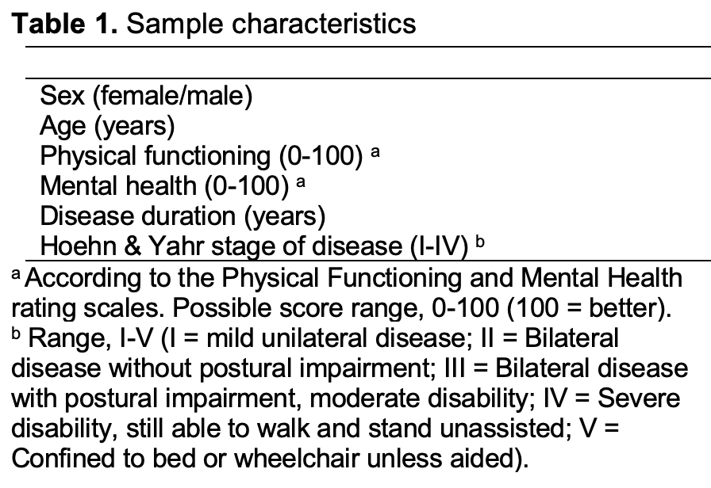
Exercise
This is part of a table from a clinical study in Parkinson’s disease listing a number of participant characteristics but no data
Review the variables and determine for each one whether they are assessments/chategorizations or measures, qualitative or quantitative, as well as their levels (nominal, ordinal, interval or ratio)
Chategorization; Qualitative; Nominal
Measure; Quantitative; Ratio
Assessment; Qualitative; Ordinal
Assessment; Qualitative; Ordinal
Measure; Quantitative; Ratio
Assessment; Qualitative; Ordinal

Slide 4
Implications: Why does it matter?
Description of data
Analyses of data
Interpretation of data
Use of data

Slide 5
Statistical data analysis
Univariate
Analysis of one variable
Descriptive statistics
Bivariate
Analysis of two variables
Comparisons, associations, etc.
Multivariate
Analysis of more than two variables
Multiple regression, etc.
Purpose
Summarize and analyze numerical data
Typically associations (differences, correlations, etc.)
Types of analyses
Univariate
Bivariate
Multivariate

Slide 6
Statistical data analysis
Variable
A characteristic that may vary, e.g., sex, age, blood pressure, anxiety, treatment, well-being
The things that data represent and are collected on
The things that are investigated
Dependent variable (DV)
Outcome variable, the effect
The variable we study
The variable that is being influenced
Independent variable (IV)
Variables that may influence or cause the outcome (effect)
Explanatory variables

Slide 7
Choice of appropriate statistical methods
Governed by
Main types of methods
Data
Level (nominal vs. ordinal vs. interval/ratio)
Distribution (approximately normal?)
Situation
Dependent vs. Independent observations
2 vs. >2 groups/time points
Parametric
Assumes quantitative (interval/ratio) data and normal distribution
Non-parametric
No assumptions regarding data levels or distribution
Based on rank order, frequencies, proportions

Slide 8
Descriptive statistics
Central tendency
The ”average” value to provide a representative summary of individual data
Mean *
Median
Mode
Dispersion
Describes the spread of individual data around the central tendency measure
Variance *
Standard deviation (SD) *
Percentiles: Quartiles (q1-q3), inter-quartile range (IQR)
Min-max
Range
* Parametric

Slide 9
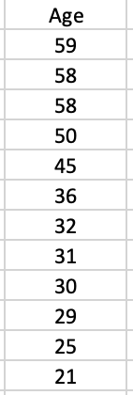
Parametric
Non-parametric
Quartiles (q1-q3):
The values that split the rank ordered data in 4 equally sized parts.
q2 = the median (md)
max
Mode
53.3
q₃ = 54
Mean = ∑ / n
= 474/12 = 39.5
±1 SD
median (q₂) = 34
q₁ = 29.5
25.7
≈ average difference from the mean
min
(Mode = most frequently occurring value)

Slide 10
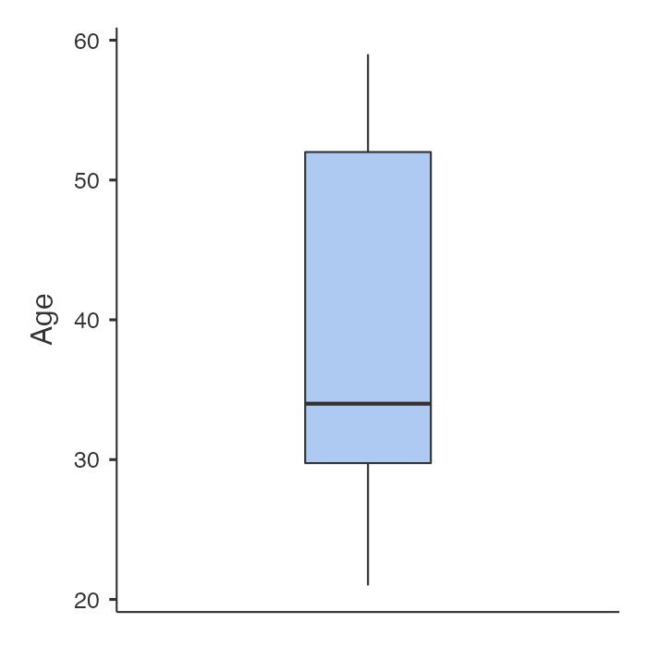
Boxplot
max
q₃ = 54
median (q₂) = 34
q₁ = 29.5
min

Slide 11
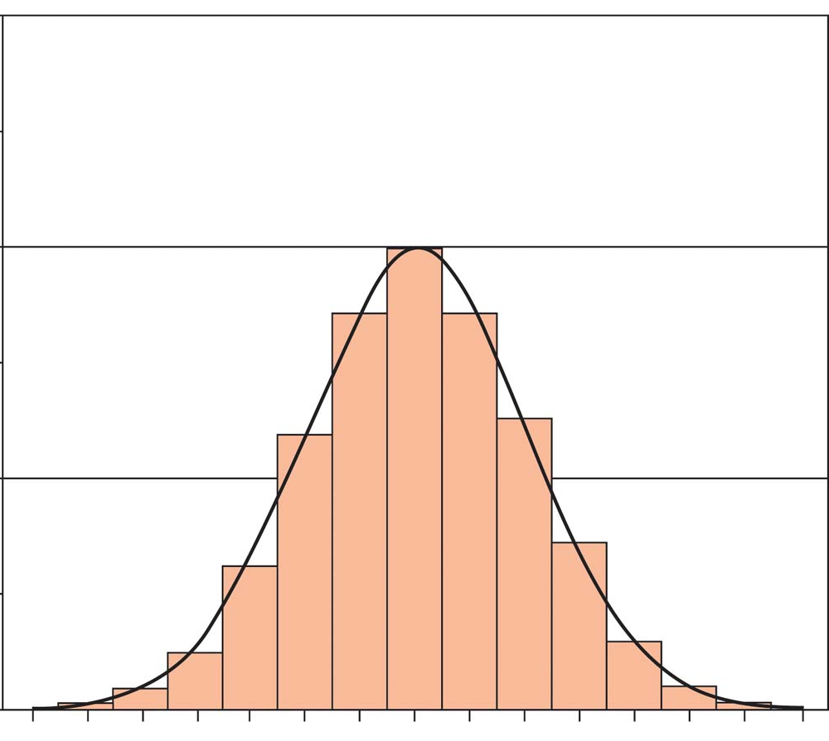
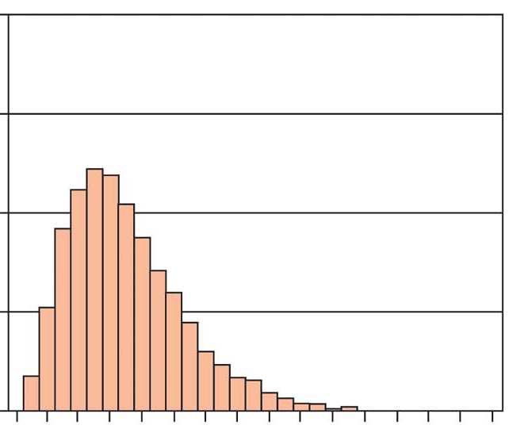
Distribution of data
Normal distribution
(symmetric)
Non-normal distribution
(positive skew)
Frequency
68.3%
Mean
Median
Mode
Mode
95.4%
+/-1.96 = 95%
Median
Mean
Are data normally distributed?
Mean ≈ median
SD ⪅ half the mean value (otherwise non-normal)
Inspect histogram
Formal tests (e.g., Kolmogorov-Smirnov; Shapiro-Wilk; skew & kurtosis ⪅1)

Slide 12
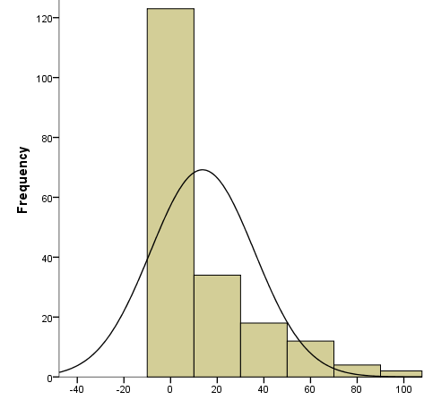
Implications
Possible values: 0-100
n = 193
Mean = 13.7
SD = 22.2
Median = 0
q1-q3 = 0-20
Notes:
Discuss the meaning and interpretation of the descriptive statistics

Slide 13
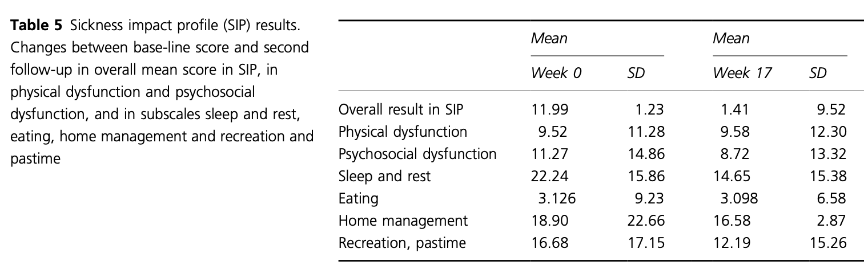
An example
A study on the effects of an educational programme for people with Parkinson’s disease
Assessments
= ordinal data
[The SIP is a patient-reported rating scale regarding the impact of ill health in 6 areas + overall impact.
Possible scores: 0-100 (100=worse)]
Notes:
Do the mean and the SD appear to be appropriate and representative descriptive statistics for the data? – If yes: Why?; If no; Why not?

Slide 14
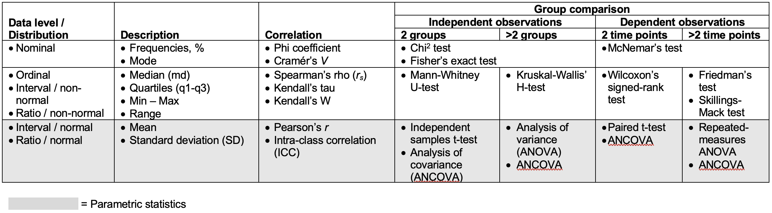
Common statistical methods and their use according to data levels, distribution and situation

Slide 15
Correlation: Degree of linear covariation between two variables
Graphical: Scatterplots
Expressed as the correlation coefficient
Can range between -1 and 1
The extent to which observations (dots in the graph) follow a straight line
Does not represent non-linear (e.g., U-shaped) associations
The value (regardless of direction) indicates the strength of linear association
Close to 1 = strong positive correlation
Close to -1 = strong negative correlation
Positive
Negative

Slide 16
Types of correlation by types of data
Correlation | Data
Pearson’s product-moment | Interval/ratio – Interval/ratio
Spearman’s rank correlation | Ordinal – Ordinal
Kendall’s tau | Ordinal – Ordinal
Kruskal-Goodman’s Gamma | Ordinal – Ordinal
Phi | Nominal – Nominal
Point biserial | Interval/ratio – Dichotomous
Rank biserial | Ordinal – Dichotomous
Tetrachoric | Dichotomous* – Dichotomous*
Polychoric | Ordinal* – Ordinal*
Biserial | Interval/ratio – Dichotomous*
Polyserial | Interval/ratio – Ordinal*
Dichotomous: Two ordered categories
* with underlying latent linearity

Slide 17
Regression
Explain variation in the dependent variable Y
How much does Y change when X increases by one unit?
Determine the straight line that best corresponds with the observations (dots)
Regression coefficient (b): Change in Y when X increases by 1 unit
R²: Proportion of variance in Y that can be accounted for by X
Some variants related to type of dependent variable (DV)
Linear regression: Interval/ratio DV
Logistic regression: Dichotomous (0/1) DV
Ordinal regression: Ordinal DV
Poisson regression: Count DV
Y = a + bX + e
a: Intercept: where the line crosses the y-axis when X=0
b: Regression coefficient: change in Y when X increases by 1 unit
e: Error: unexplained variation in Y

Slide 18
Multivariate statistics
Bivariate associations:
Simultaneous analysis of multiple variables, e.g.,
Regression
Path analysis
Factor analysis
Analysis of covariance (ANCOVA)
Estimation of effects while controlling for other variables
General sample size requirement:
≥10 observations per variable/ estimated parameter
Multivariate
association:
Notes:
Graphics to the right are optional

Slide 19
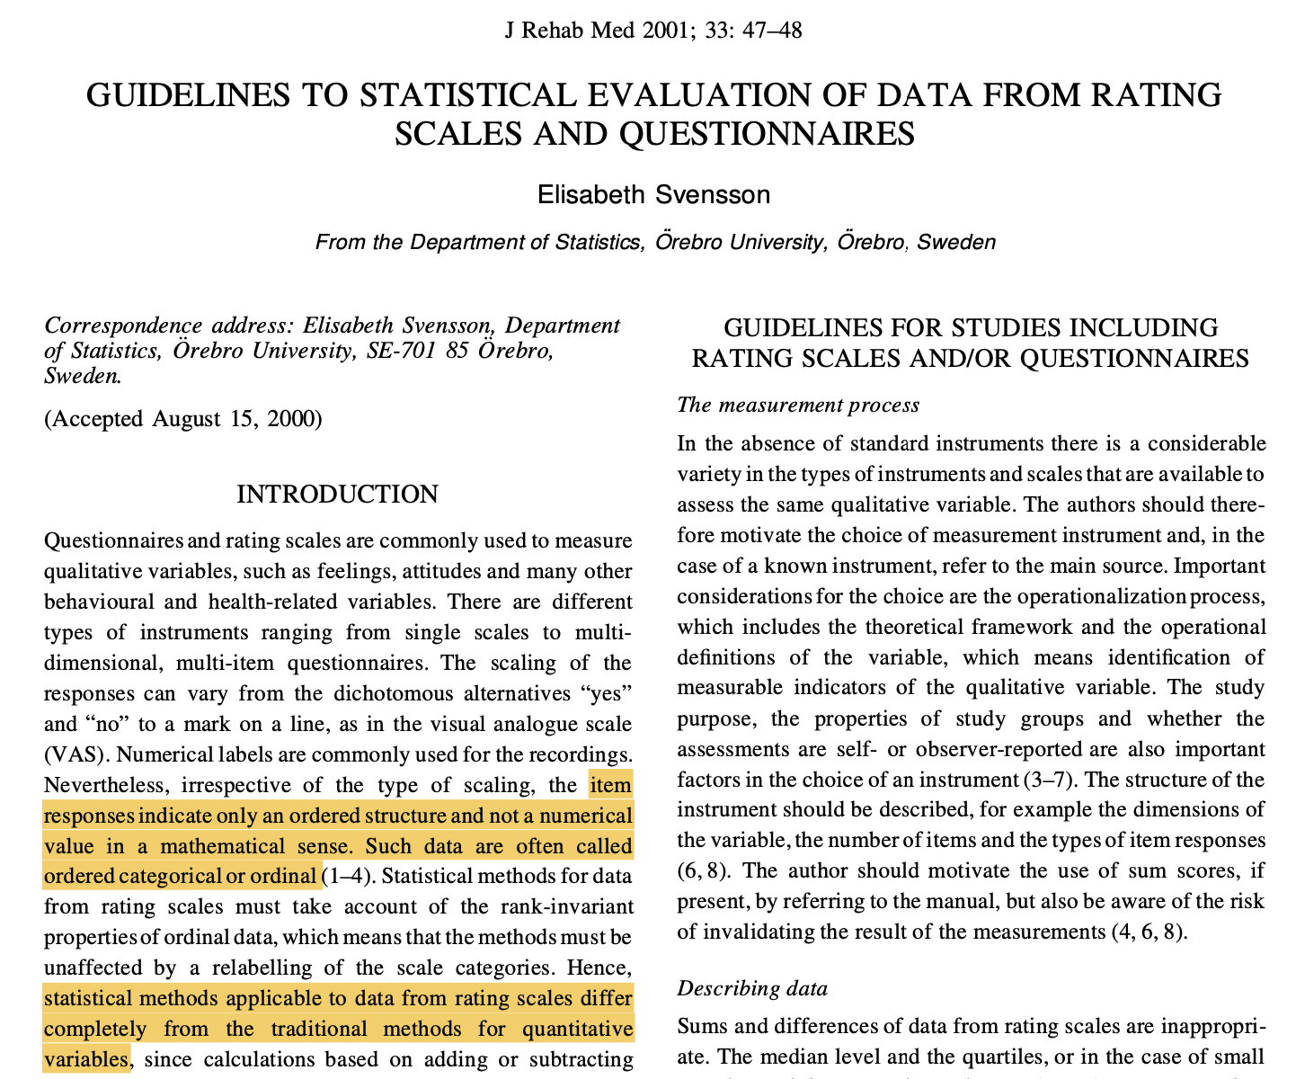
https://doi.org/10.1080/165019701300006542

Slide 20
Hypothesis testing
Null hypothesis (H₀)
The hypothesis that is tested
Usually ”no effect” (e.g., no difference)
Holds unless there is strong enough evidence against it
Alternative hypothesis (H₁)
Negates the null hypothesis
There is an effect (e.g., difference)

Slide 21
The P-value
P = Probability; can vary between 0 and 1
The probability that the observed (or a larger) effect had occurred if the null hypothesis (H₀) is true
General rule of thumb:
P<0.05; i.e., <5% risk to erroneously conclude that there is an effect (e.g., a difference)
Usually lower (e.g., P<0.001) with high stakes analyses or if many hypothesis tests are conducted

Slide 22
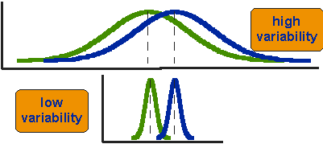
The P-value
Concerns statistical significance – but says nothing about the size of the effect or its clinical significance!
Influenced by sample size: Larger samples → lower P-values
Influenced by dispersion: Smaller dispersion → lower P-values
Sample size/group
Mean difference
Same difference between mean values, different dispersions
Relationship between sample size and mean difference for the difference to be statistically significant (P<0.05) when dispersion is constant (SD=15)

Slide 23
Confidence intervals (CIs)
The range within which the true effect (e.g., group difference) is likely to be
95% CI: The range within which we can be 95% confident that the true effect is
If close to or including what can be considered a trivial or no effect, there is probably reason to question the practical relevance of the findings
Like P-values, CIs are influenced by sample size and dispersion

Slide 24
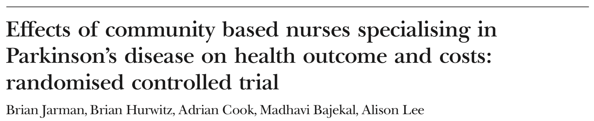
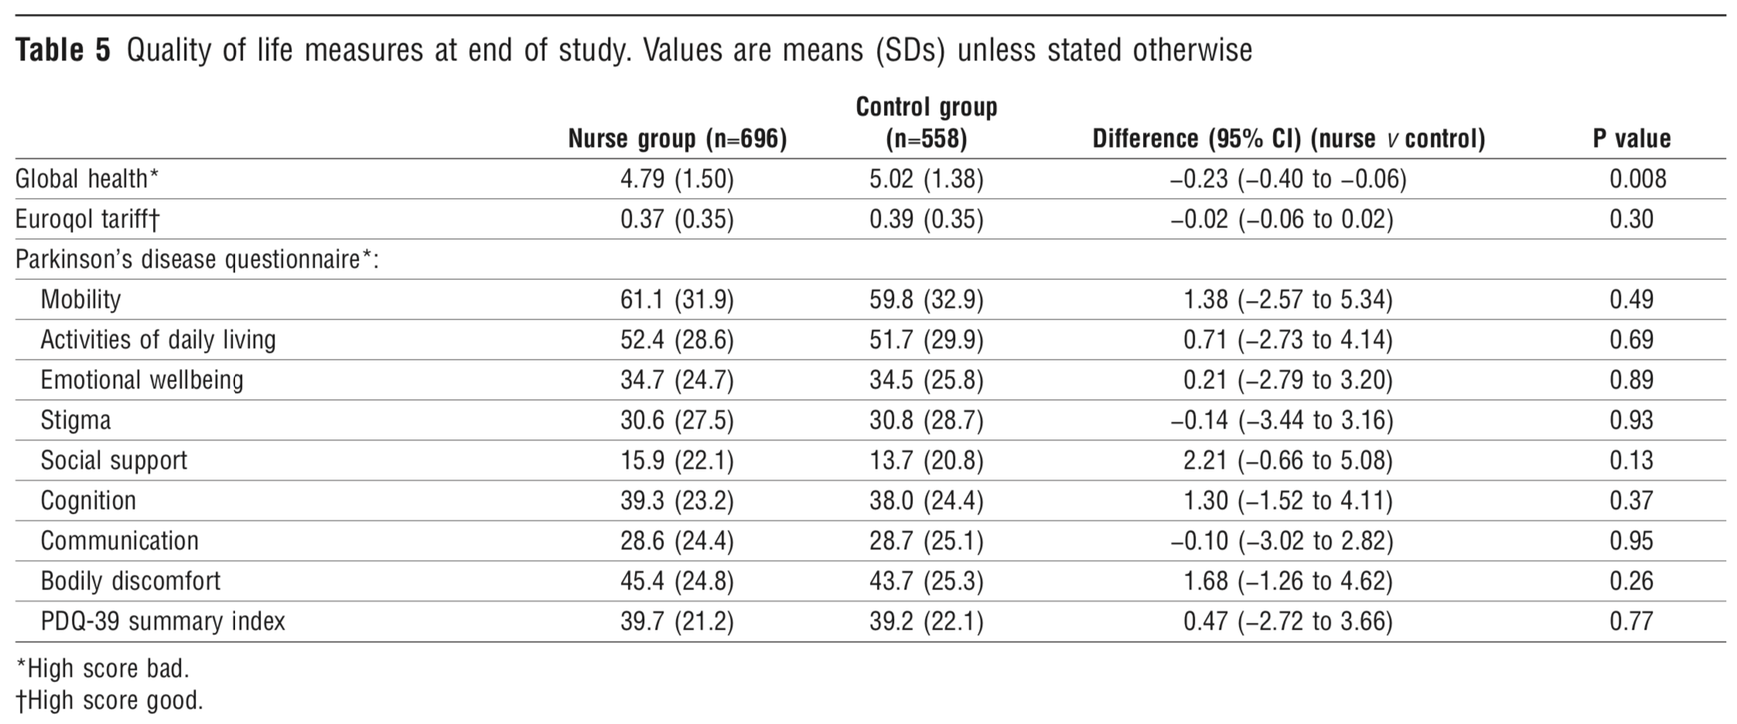
An Example
https://pubmed.ncbi.nlm.nih.gov/11991913/

Slide 25
A Real World Example
A post-marketing (Phase IV) double-blind RCT of an adjunct (levodopa add-on) drug for people with Parkinson’s disease conducted in Northern Europe
”The present study was designed to investigate the effects of combining levodopa with X on ADL”
Notes:
See the ”Putting it all together” section at the end of the Theoretical Report for details on the study, issues to consider and related comments in association with the coming slides.

Slide 26

People with Parkinson’s
Sample size (n=270) based on earlier studies, with 90% power at P<0.05
Randomization
(n=270)
Inclusion criteria:
PD with wearing-off
Stable levodopa
Exclusion criteria:
Age <35
Dementia, depression, other psychiatric or systemic disorder
Placebo
(Possible score range, 0-52; 0=better)
Active
Baseline:
24.7±12.3
0: Normal
1: Slow; no help
2: Occasional help
3: Considerable help
4: Helpless
Baseline:
23.5±10
Week 13:
-0.7±2.7
Week 13:
-2.3±3.7
Intention-to-treat; analysis of covariance (ANCOVA) for repeated measures controlling for:
Baseline data
Group (active vs. placebo)
Centre
Group x Centre
P<0.0001
”…good efficacy in terms of ADL…”
People with Parkinson’s
Notes:
Depending on your preference, you may disable the animations.

Slide 27
Issues to consider
PD with wearing-off
Stable levodopa
Age ≥35
No dementia, depression, other psychiatric or systemic disorder
Was the study sample representative for patients encountered in daily clinical practice?
Is the primary study outcome variable (ADL) clinically relevant?
Was the primary study outcome (ADL) assessed using a reliable and valid tool (UPDRS part II)?
Were data analyses appropriate to meet study objectives and for the data in the study?
Are study results clinically meaningful and interpretable?
Intention-to-treat
Parametric statistics
Analysis of covariance (ANCOVA) for repeated measures

Slide 28
Completion of the exercise

Slide 29
References
Campbell NR. Physics: The Elements. London: Cambridge University Press, 1920. Available from: https://archive.org/details/physicstheelemen029733mbp/page/n7/mode/2up
EuroTEQ Theoretical Report Part I – Research Basics. Available from: https://euroteq.nu/resources
Hobart J. Rating scales for neurologists. Journal of Neurology Neurosurgery & Psychiatry 2003; 74(Suppl 4): iv22-iv26. Available from: http://dx.doi.org/10.1136/jnnp.74.suppl_4.iv22
Merbitz C, Morris J, Grip JC. Ordinal scales and foundations of misinference. Archives of Physical Medicine & Rehabilitation 1989; 70(4); 308-312. Available from: https://www.researchgate.net/profile/Charles-Merbitz/publication/20619750_Ordinal_scale_and_foundations_of_misinference/links/0fcfd50059d8897a5c000000/Ordinal-scale-and-foundations-of-misinference.pdf
Svensson E. Guidelines to statistical evaluation of data from rating scales and questionnaires. Journal of Rehabilitation Medicine 2001; 33(1): 47-8. Available from: https://doi.org/10.1080/165019701300006542

