Slide 1
Meaning and use of numbers (part 1):
Measurement and assessments
Clinical assessment and outcome measurement
Peter Hagell
Kristianstad university

Slide 2
Learning Objectives
Upon completion of this module, participants should be able to
Explain differences between quantitative and qualitative numerical data
Identify nominal, ordinal, interval and ratio level data
Understand the distinction between assessments and measurements

Slide 3
0 1 2 3 4 5 6 7 8 9
Numbers in themselves are abstract and meaningless
  39 – What does it mean?
Meaningful interpretation requires at least
  Defined variable (e.g., time, temperature, distance, etc.)
  Known unit of measurement (e.g., years, degrees C, km, etc.)
  Often also knowledge regarding outcome range, context, etc. (e.g., age, body temperature, distance to GP office, etc.)
Interpretation and meaning come from outside the numbers
  Statistics and other operations are meaningless unless numbers have meaning

Slide 4

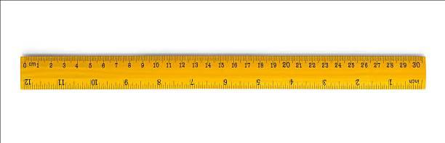

0 1 2 3 4 5 6 7 8 9
Numerical data ≠ quantitative data
  Nominal, ordinal = Qualitative data; categorizations, assessments
  Interval, ratio = Quantitative (linear) data; measurement
Measurement ≠ statistics
  Measurement: Producing numbers that represent the quantity of something
  Statistics: Summarizing and analyzing numerical data

Slide 5
Nominal (qualitative; e.g., gender, etnicity, blood type)
    Categories without quantitative meaning
    Classification 0 = female 1 = male
Ordinal (qualitative; e.g., well-being, symptom severity)
    Unknown intervals between numerals
    Rank order 0 1 2 3 4
Interval (quantitative/linear; e.g., temperature C°/F°)
    Equal intervals but arbitrary zero-point
    Rank order, quantitative difference .… -1 0 1 2 3 4 …
Ratio (quantitative/linear; e.g., length, biomarkers, blood pressure)
    Equal intervals and absolute zero-point
    Rank order, quantitative difference, ratio 0 1 2 3 4 5 …

Slide 6
Meaningful operations & statistics
Frequencies
Mode
Frequencies
Median
Percentiles
Rank order correlation
Addition, subtraction
Mean
SD
Linear correlation
Addition, subtraction
Ratio
Mean
SD
Linear correlation
Nominal (qualitative; e.g., gender, etnicity, blood type)
    Categories without quantitative meaning
    Classification 0 = female 1 = male
Ordinal (qualitative; e.g., well-being, symptom severity)
    Unknown intervals between numerals
    Rank order 0 1 2 3 4
Interval (quantitative/linear; e.g. temperature C°/F°)
    Equal intervals but arbitrary zero-point
    Rank order, quantitative difference .… -1 0 1 2 3 4 …
Ratio (quantitative/linear; e.g., length, biomarkers, blood pressure)
    Equal intervals and absolute zero-point
    Rank order, quantitative difference, ratio 0 1 2 3 4 5 …

Slide 7

Measurement
Systematic observation
Assessment of the amount, from less to more
Quantification of the amount, expressed according to a defined unit

Slide 8
Measurement
Measurement consists of two essential factors:
  (1) a defined standard of reference [the unit]
  (2) the number of times the unit is to be taken to make up the quantity
  (Maxwell, 1873)
The repetition of a unit amount that maintains its size, within an allowable range of error, no matter which instrument is used and no matter who or what relevant person or thing is measured
(Institute of Objective Measurement, 2001)
Estimation of the amount of a unidimensional property relative to a unit
(Andrich & Marais, 2019)

Slide 9
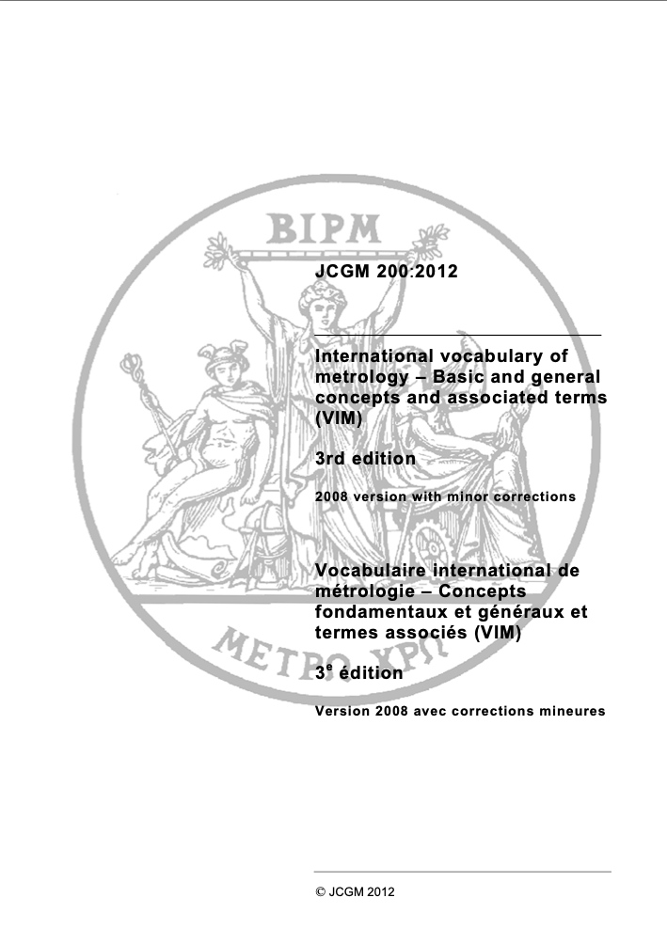
Measurement
The process of experimentally obtaining one or more quantity values that can reasonably be attributed to a quantity
Quantity
The property of a phenomenon, body, or substance, where the property has a magnitude that can be expressed as a number and a reference
A reference can be a measurement unit, a measurement procedure, a reference material, or a combination of such.
Quantity value
The value of a quantity
The number and reference together expressing magnitude of a quantity
According to the type of reference, a quantity value is either
  a product of a number and a measurement unit, or
  a number and a reference to a measurement procedure, or
  a number and a reference material
https://www.bipm.org/documents/20126/2071204/JCGM_200_2012.pdf/f0e1ad45-d337-bbeb-53a6-15fe649d0ff1

Slide 10
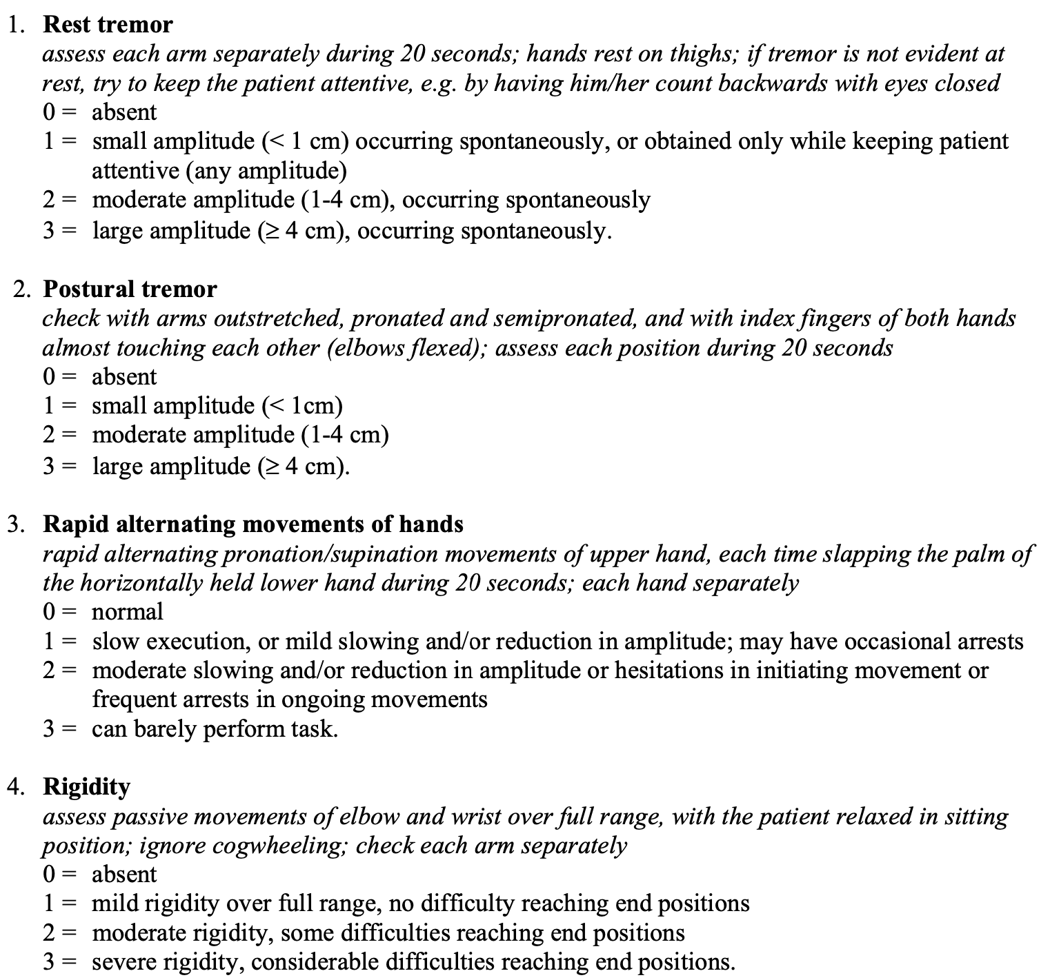
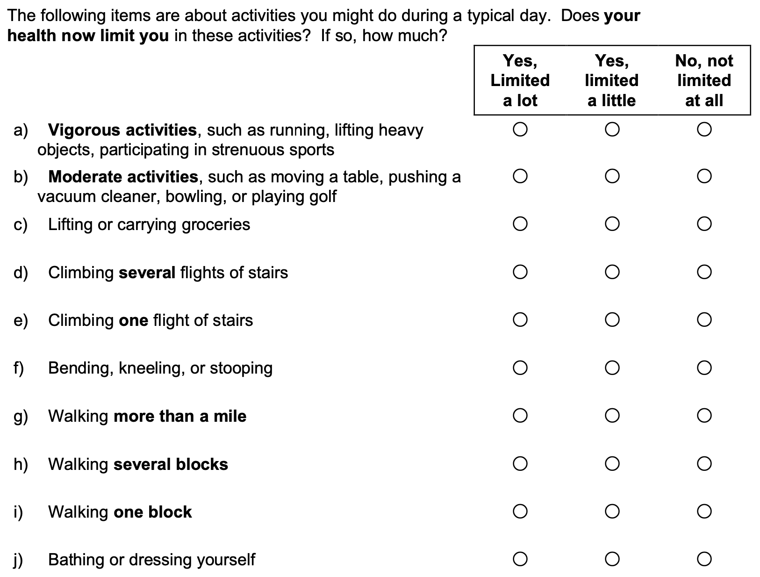
Observations
Assessments

Slide 11
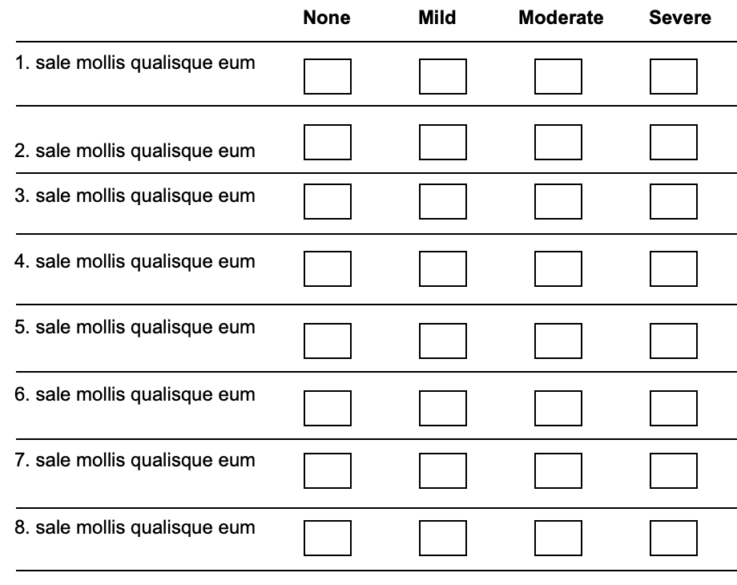
✗
0
1
2
3
0
1
✗
3
2
0
1
✗
2
3
Σ
✗
1
0
2
3
✗
0
1
2
3
0
1
✗
2
3
0
1
✗
3
2
✗
1
0
2
3
TOTAL
SCORE
Ordinal
Non-linear








Less






More

Slide 12
Person A
Ordinal assessments
Person B
Ordinal assessments

Slide 13
Person A
+1
Ordinal assessments
0
1
2
3
4
5
6
7
8
9
10
11
12
13
14
15
0
1
2
3
4
5
6
7
8
9
10
11
12
13
14
15
Linear measures
Person B
+3
Ordinal assessments
0
1
2
3
4
5
6
7
8
9
10
11
12
13
14
15
0
1
2
3
4
5
6
7
8
9
10
11
12
13
14
15
Linear measures

Slide 14
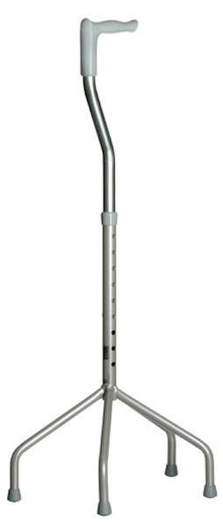
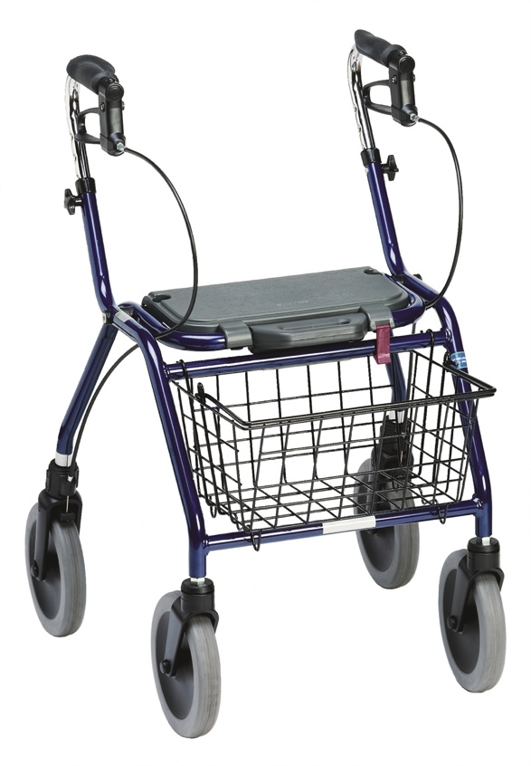
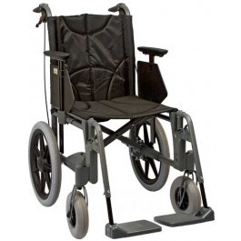
25 kg + 30 kg = 55 kg?
15 m + 10 m = 25 m?
Mild pain (1) + Distressing pain (3) = Horrible pain (4)?
+
=
?
(1) (2) (3)
Blood type A (1) + Blood type B (2) = Blood type AB (3)?
Male (1) + Female (2) = Non-binary (3)?

Slide 16
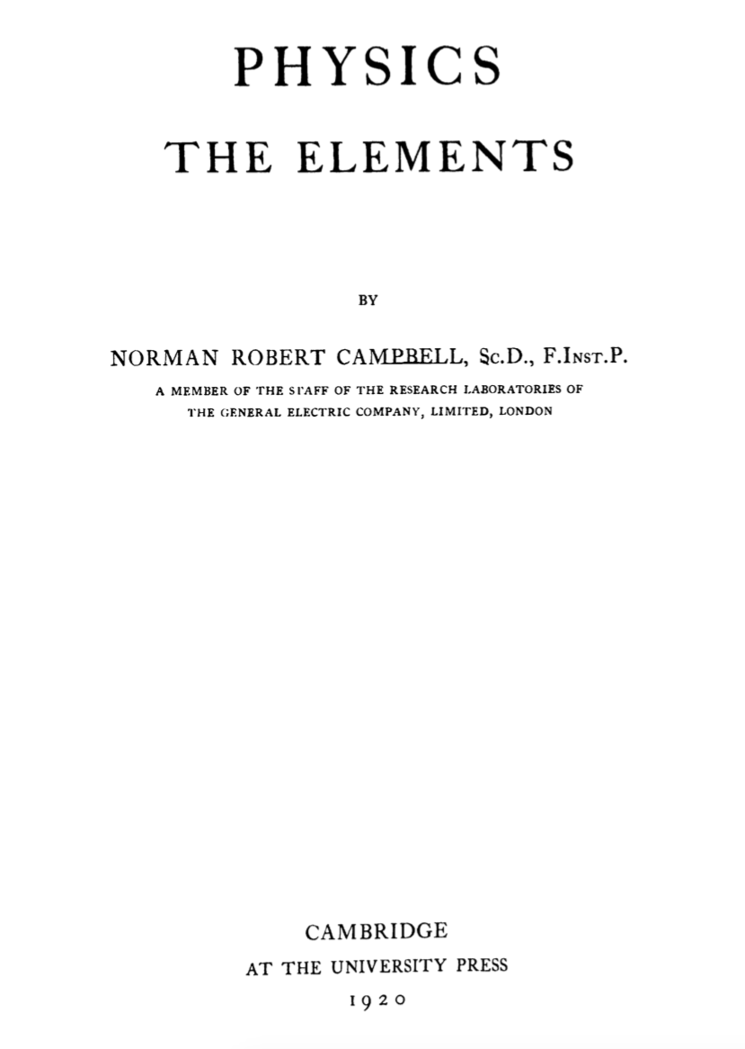
Numerals vs. numbers
”A numeral is a material or quasi-material symbol...
…
The numeral 2 is thus clearly distinguished from the number which is involved in the statement that two and two make four, a pure arithmetical proposition.”
(p. 769)

Slide 17
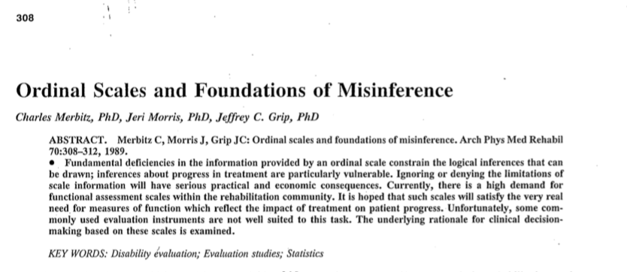

Slide 18
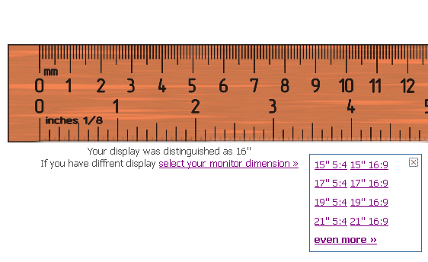
Raw ordinal scores (assessments) vs. linear measures
Rasch Measurement Theory
Ordinal scores
Linear measures

Slide 19
Rating scale quality aspects:
Psychometric properties
Validity:
  The extent to which scores represent the variable they intend to represent
Reliability:
  The extent to which scores are free from error
  Range, 0-1; 1 = perfect reliability
Responsiveness:
  The ability of scores to reflect changes
  A function of validity and reliability

Slide 20
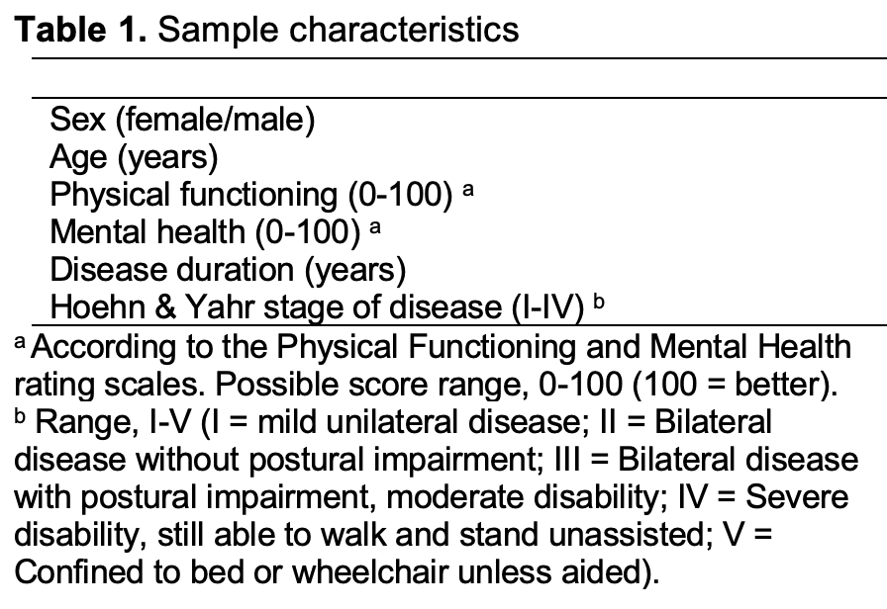
Exercise
This is part of a table from a clinical study in Parkinson’s disease listing a number of participant characteristics but no data
Review the variables and determine for each one whether they are assessments/observations or measures, qualitative or quantitative, as well as their levels (nominal, ordinal, interval or ratio)

Slide 21
Completion of the exercise

Slide 22
References
Campbell NR. Physics: The Elements. London: Cambridge University Press, 1920.
Available from: https://archive.org/details/physicstheelemen029733mbp/page/n7/mode/2up
EuroTEQ Theoretical Report Part I – Research Basics.
Available from: https://euroteq.nu/resources
Hobart J. Rating scales for neurologists. Journal of Neurology Neurosurgery & Psychiatry 2003; 74(Suppl 4): iv22-iv26.
Available from: http://dx.doi.org/10.1136/jnnp.74.suppl_4.iv22
Merbitz C, Morris J, Grip JC. Ordinal scales and foundations of misinference. Archives of Physical Medicine & Rehabilitation 1989; 70(4); 308-312.
Available from: https://www.researchgate.net/profile/Charles-Merbitz/publication/20619750_Ordinal_scale_and_foundations_of_misinference/links/0fcfd50059d8897a5c000000/Ordinal-scale-and-foundations-of-misinference.pdf
Svensson E. Guidelines to statistical evaluation of data from rating scales and questionnaires. Journal of Rehabilitation Medicine 2001; 33(1): 47-8.
Available from: https://doi.org/10.1080/165019701300006542

