Slide 1
Deciphering Metabolic Signatures: Metabolomics in Aging and Neurodegenerative Disorders
GP1 - Neurology and medical care of neurodegenerative disorders
Gorazd Drevenšek University of Ljubljana
and
Manuel Ramanović

Slide 2
Learning Objectives
Understand Basic Concepts: Introduce the basics of metabolomics and its relevance in aging and neurodegenerative diseases.
Identify Metabolomic Changes in Aging: Examine the typical metabolic alterations observed in the elderly.
Distinguish Neurodegenerative Disorders: Highlight the distinct metabolomic profiles in common neurodegenerative disorders like Alzheimer‘s and Parkinson‘s disease.
Clinical Implications: Discuss the implications of these metabolomic changes in diagnosis, treatment, and management.

Slide 3




Contents of the lecture
Section 1: Introduction to Metabolomics
Definition and Scope: Basic understanding of metabolomics
Metabolomics in correlation to other -omics fields
Section 2: Metabolomics in Aging
Metabolic Shifts in Aging: Discuss how aging affects metabolic pathways
Biomarkers of Aging: Identification and role of specific metabolites in aging
Section 3: Metabolomics in Neurodegenerative Disorders
Overview of Neurodegenerative Diseases: Brief description of common neurodegenerative diseases
Disease-specific Metabolic Profiles:
Alzheimer's Disease: Key metabolic changes and their significance
Parkinson's Disease: Metabolomic alterations and their implications
What is microbiota?
The importance of microbiota
Gut – brain axis
Section 4: Clinical Implications and Applications
Personalized Medicine: The role of metabolomics in tailoring treatment plans

Slide 4
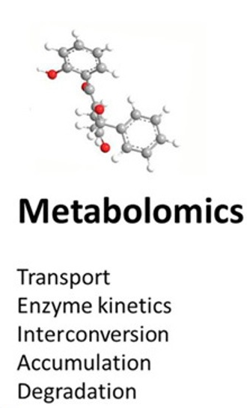
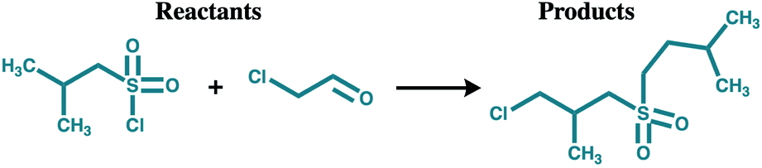

Introduction - definitions
Metabolomics
Newly emerging field of 'omics' research, a holistic, unbiased, analytical approach to detecting metabolic disturbances in human disease
uses High Throughput (HT) technologies to identify and/or characterize all the small molecules or metabolites in a given cell, tissue or organism (i.e. the metabolome).
Metabolome
The complete collection of small molecule metabolites in a cell, organ, tissue or organism
Dynamic
Metabolites
Human (and microbial) intermediates and products of metabolism
e. g. antibiotics, pigments, carbohydrates, fatty acids, amino acids
Primary and secondary metabolites
https://hmdb.ca
Notes:
Metabolomics deals with multiple and complex chemical reactions within living organisms and how these are influenced by external or internal perturbations.

Slide 5
Introduction to Metabolomics
The Pyramid of Life
Metabolome
Metabolomics
Proteome
Environmental Influence
Physiological Influence
Proteomics
Genome
Genomics
Source: bioinformatics.ca
Notes:
Possible representation of interaction between genome, proteome and metabolome.
The base of the pyramid is the genome which includes all of the genes in a given organism or cell or system. Study of the genome is genomics. Genes code for proteins and the study of those proteins is proteomics. Proteins are intended to really either transport or catalyse the transformation of chemicals and so the action of the proteome on those chemicals produces what we call the metabolome. Metabolome is on the top of the pyramid since is profoundly influenced by both the genome and the proteome.
A single base chain that the genome level can lead to a 10,000 fold change in metabolite levels so that makes it exquisitely sensitive to what's going on both at the genome and the protein level
There is increasingly greater influence of the environment going to top of the pyramid, so what's you're eating or have just eaten what you're drinking what you're breathing is actually affecting your metabolites.
Proteome only changes slightly with respect to what your environment.
The fact that the metabolome, sort of, sits between the genome, the environment and physiology makes it a great reporter of the phenotype and this is a value that researchers have seen in metabolomic as a great way of measuring the pheno or the phenotype of systems, other cells, organisms.

Slide 6
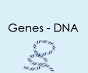

Metabolomics and other “–omics”
Metabolomics
focuses on the relative relationship between metabolites and physiopathological changes
Genomics reflects what can happen
Transcriptomics reflects what is going to happen
Proteomics indicates what is happening
Only truly reflects what has happened and is more time sensitive than other ”omics”
metabolomics
Mutations
Epigenetic modifications
Post-transcriptional modifications
Post-translational modifications
Genomics
Transcriptomics
Proteomics
Metabolomics

Slide 7

Metabolomics is More Time Sensitive Than Other “Omics”
Response
Metabolomics
Response
Proteomics
Response
Genomics
Time
Source: bioinformatics.ca
Notes:
Metabolomics is that it's very time sensitive, far more than other omics. when you eat or drink at the top is the response you would see if you measure things every minute or every two minutes and you'd see things going up and down rapidly: The example is a glucose monitor, you'll find your glucose level goes up and down all the time greatly improved with what you eat. If we were to eat a large meal like spaghetti your proteins would change too your insulin levels might go up your grellin level as well, but only about a half dozen proteins will change at a much slower rate with lower amplitude than what your metabolites will. Likewise if you had your coffee or ate your cereal this morning your genome hopefully didn't change.
It is easier to change the metabolism to fix the metabolome than it is to fix the genome

Slide 8
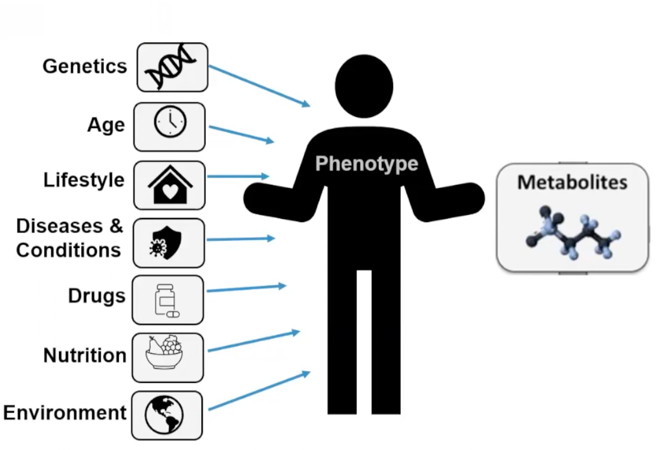

Metabolomics identifies how a person functions
Most diseases result in a specific metabolic pattern or "signature" that reflects its specific cellular activities
• Metabolic Signature
• Metabolic Patterns
• Metabolic Profile
A
B
C
Normal metabolism
A
B
C
Disturbed metabolism
(pathway)
D
https://www.diagnosticsolutionslab.com
Notes:
Metabolomics identifies how well a person functions. Phenotype refers to an individual's observable traits, such as height, eye color and blood type. A person's phenotype is determined by both their genomic makeup (genotype) and environmental factors.
Here is presented all different factors that can affect resulting phenotype, form person’s genetics, age, lifestyle to environmental impact.
Metabolomics can help us also, y identifying underlaying metabolic alterations. Metabolomics is going to define how person function and metabolomic signatures are really looking at that. Research is
finding that most diseases result in a specific metabolic pattern or signature
that's reflective of specific cellular activities. So it's important to know
what area you're looking at, what metabolic pathways and know all those.
Here is an example of how altered metabolism result in different end product that can result in different function of cell or organism as a whole (shematski prikaz, Normal and Disturbed metabolism/metabolic pathway). It can be for example enzyme defect.

Slide 9

Advantages of metabolomics over other traditional omic-techniques
Metabolites are the most reliable indicators of the organism’s phenotype¹
Changes in metabolite concentrations are generally more pronounced than those observed in other biological levels
metabolite profiles = sensitive measure of biological status ²
Metabolic alterations are rapid indicators of abnormalities occurring in the organism due to the high dynamism of metabolite homeostasis ³
Metabolomic data can be directly translated across species⁴
Clinical utility: easily accessible biological⁵
blood, urine or cerebrospinal fluid (CSF)
¹W.B. Dunn, et al. Systems level studies of mammalian metabolomes: the roles of mass spectrometry and nuclear magnetic resonance spectroscopy, Chem. Soc. Rev. 2011
²D.B. Kell, P. Mendes, Snapshots of systems-metabolic control analysis and biotechnology in the post-genomic era, 1999
³C.W.W. Beecher, The human metabolome, Springer, New York, 2003
⁴E. Trushina, M.M. Mielke, Recent advances in the application of metabolomics to Alzheimer’s disease, Biochim. Biophys. Acta, 2014
⁵R. Goodacre, et al. Metabolomics by numbers: acquiring and understanding global metabolite data, Trends Biotechnol. 2004
Notes:
Metabolites are the most reliable indicators of the organism’s phenotype, given that represent the end point of biochemical reactions, directly reflecting the interactions between gene expression, proteins function and the environment ¹
Changes in metabolite concentrations are generally more pronounced than those observed in other biological levels such as the transcriptome or the proteome, making the detection of metabolite profiles a relatively sensitive measure of biological status ²
Metabolomic data can be directly translated across species because most metabolic pathways are highly conserved through evolution, which is crucial in order to interrelate findings from experiments with laboratory animals and human studies ⁴
Metabolomics is applicable to a variety of easily accessible biological samples such as blood, urine or cerebrospinal fluid (CSF), with reduced cost and analysis time, thus highlighting the clinical utility of this approach⁵

Slide 10

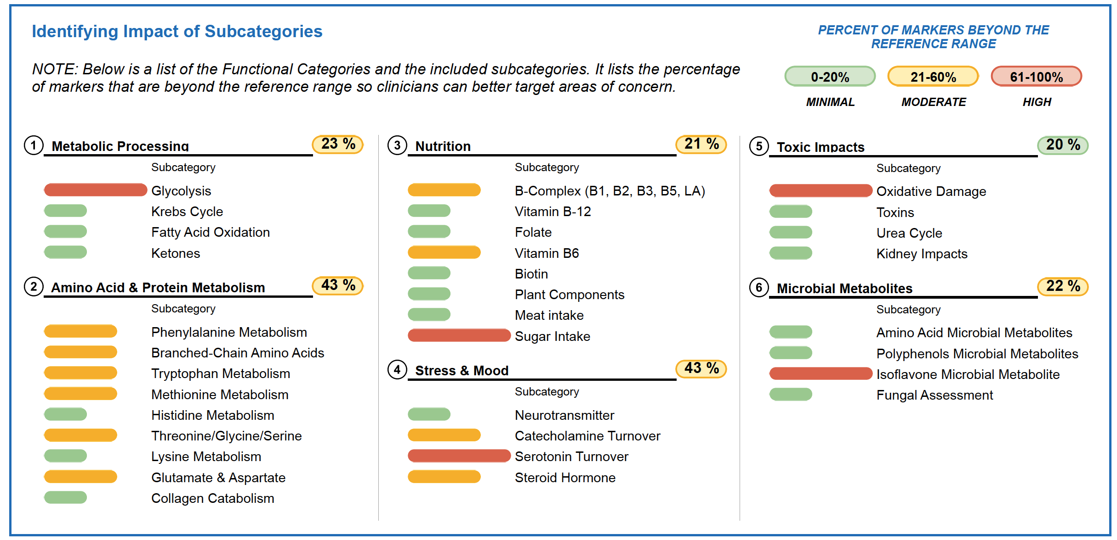
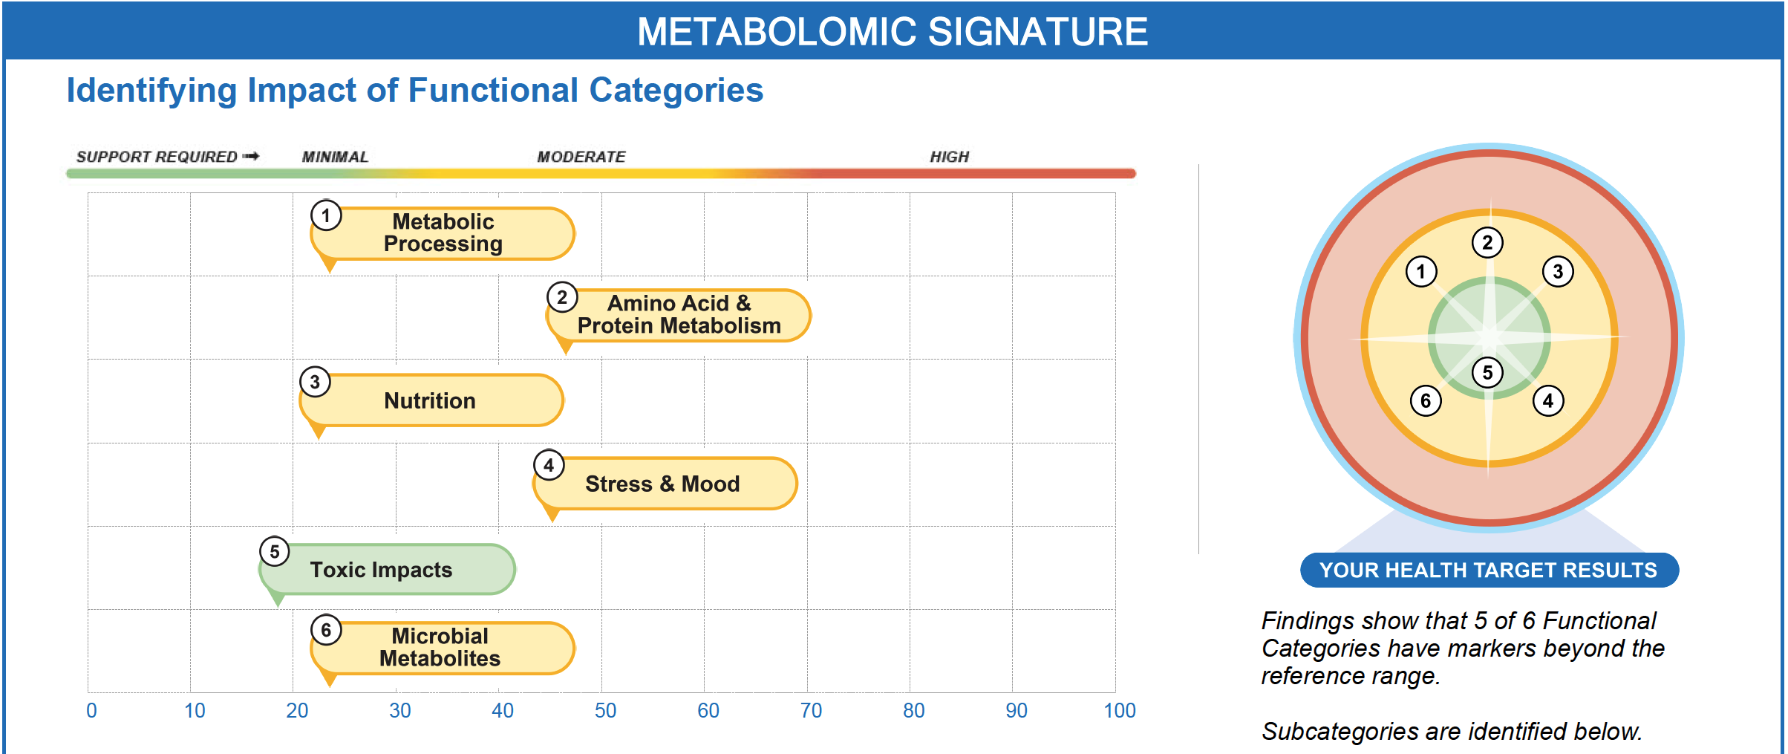
Example of report
https://www.diagnosticsolutionslab.com/tests/omx
Notes:
Generally metabolites include in metabolomics are organic acids, amino acids, steroids, breakdown products, fatty acids.
As presented in the graph, metabolic signature incorporates different functional categories, numbered 1 to 6, and it is conducive with looking at metabolomics research. The categories are shown as health target results, and schematic representation help us visually define metabolic signature and areas where we have to make imrpvement and direct our recommendation towards health improvement. note that it is individual tailored approach. Areas that we look at are:
metabolic processing glycolysis and fatty acids going into Krebs cycle
The pathways with amino acids 3
Nutrient cofactors
Diet stress and mood markers
toxins and then
the impact of microbial metabolites
Th

Slide 11

Metabolomics in aging and neurodegenerative diseases
Biomarker discovery
Metabolomics enables the identification of specific metabolites that may serve as biomarkers for aging and neurodegenerative diseases, offering diagnostic and prognostic value¹
Understanding Pathophysiology
Metabolomics helps in elucidating the complex metabolic pathways implicated in aging and neurodegenerative diseases. This understanding is crucial for unraveling the mechanisms that contribute to disease development and progression²
¹Trushina, E., & Mielke, M. M.. Recent Advances in the Application of Metabolomics to Alzheimer's Disease. Biochimica et Biophysica Acta, 2014
² Maitre, L., Robinson, O., Martinez-Moral, M. P., Stronati, A., Vafeiadi, M., Athersuch, T. J., et al. (2018). Urinary Metabolomic Profiling Reveals the Effect of Prenatal Maternal Stress on Neurodevelopment in Infants. PLoS ONE, 13(4), e0195810. doi:10.1371/journal.pone.0195810

Slide 12




Metabolomics in aging and neurodegenerative diseases
Monitoring disease progression
Metabolomics provides a dynamic view of metabolic changes over time, allowing for the monitoring of disease progression. This temporal information is valuable for developing targeted interventions and assessing treatment efficacy¹
Nutritional intervention
Metabolomics aids in evaluating the impact of nutrition on aging and neurodegenerative diseases. It can identify metabolic changes associated with dietary interventions and help tailor personalized nutritional strategies²
1Bourgognon JM, Steinert JR. The metabolome identity: basis for discovery of biomarkers in neurodegeneration. Neural Regen Res. 2019
2Khodadadi, S., Sobhani, N., Mirshekar, S., Ghiasvand, R., Pourmasoumi, M., & Miraghajani, M. Dietary Fat, and Risk of Alzheimer's Disease: A Systematic Review and Meta-Analysis of 16 Cohort Studies. Aging Clinical and Experimental Research, 2019

Slide 13
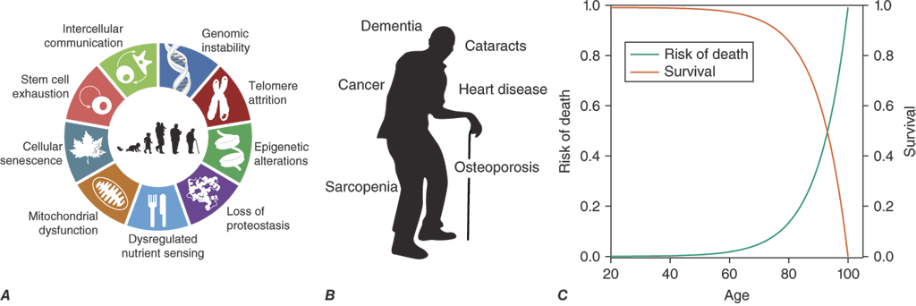
What is aging?
Definitions of aging include
(A) a biological component ➔ nine hallmarks of aging
(B) a phenotypic component ➔ chronic non-communicable diseases, and
(C) a statistical component ➔ exponential increase in the risk of mortality (Gompertz law of mortality)
Joseph Loscalzo, et al. Harrison's Principles of Internal Medicine, 21e . McGraw Hill, 2022,
Notes:
Aging is usually defined as a progressive process associated with
deterioration in structure and function, leading to increased
susceptibility to disease and mortality, and is often associated with
impaired reproductive capacity. There are statistical, biological, and
phenotypic components to aging. From the statistical perspective,
aging in humans is associated with an exponential risk of mortality
with time (Gompertz law of mortality). The biological mechanisms of
aging are encompassed by the “hallmarks of aging,” which describe
the key cellular mechanisms underpinning aging. The phenotypic
components of aging include chronic diseases and age-related
syndromes that are often the target of medical interventions
Nine hallmarks of ageing — genomic instability, telomere attrition, epigenetic alterations, mitochondrial dysfunction, deregulated nutrient sensing, loss of proteostasis, cellular senescence, stem cell exhaustion and altered intercellular communication — seen in the main neurodegenerative diseases. AD, Alzheimer disease; ALS, amyotrophic lateral sclerosis; AT, ataxia telangiectasia; HD, Huntington disease; PD, Parkinson disease.

Slide 14
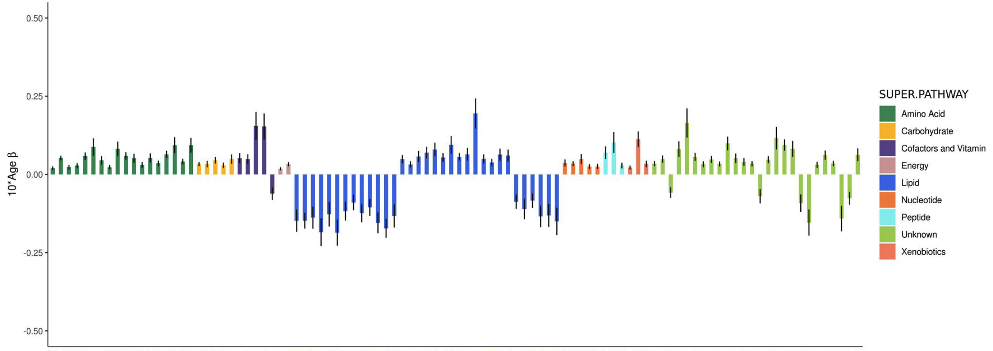
Aging-related metabolic features
Adjusted effects of a 10-year increase in age on the top 100 metabolites most strongly influenced by age²
"Aging biology is intimately associated with dysregulated
metabolism, which is one of the hallmarks of aging.”¹
Most plasma metabolite levels are highly influenced by aging and that aging has a broader effect on metabolites in women than men²
dramatic hormone changes during menopause and loss of ovarian function
¹Sharma R, Ramanathan A. The Aging Metabolome-Biomarkers to Hub Metabolites. Proteomics. 2020
²Darst BF, et al. Longitudinal plasma metabolomics of aging and sex. Aging (Albany NY). 2019
Notes:
Positive values indicate the amount a metabolite increased over 10 years, whereas negative values indicate the amount a metabolite decreased over 10 years. Black vertical lines indicate standard errors.

Slide 15
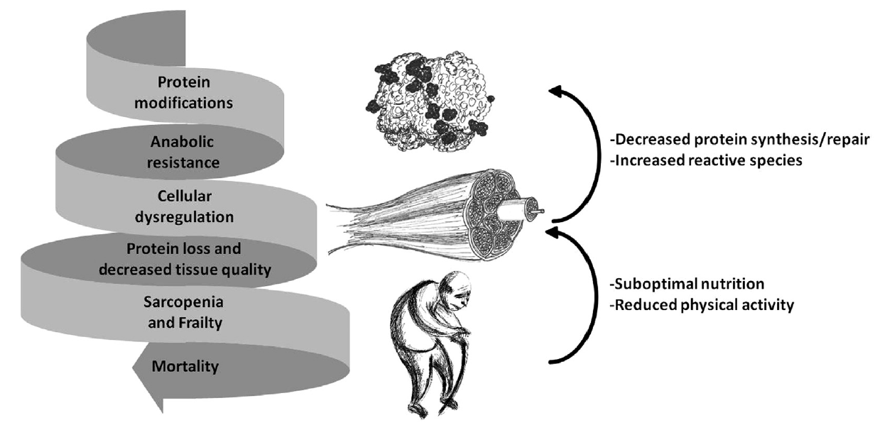
Downward spiral of protein metabolism in aging
E.L. Dillon, Protein Metabolism in the Elderly: Molecular and Cellular Aspects, Academic Press, 2016
Notes:
Downward spiral of protein metabolism in aging. The accumulation of altered proteins contributes to the development of
anabolic resistance and cellular dysfunction. Cellular dysfunction leads to loss in tissue quality, and to the development of sarcopenia, frailty,
and ultimately death. Loss of physical function, suboptimal nutrition, and metabolic dysfunction with aging aggravates the aging process and
contributes further to the accumulation of reactive species and protein damage.

Slide 16
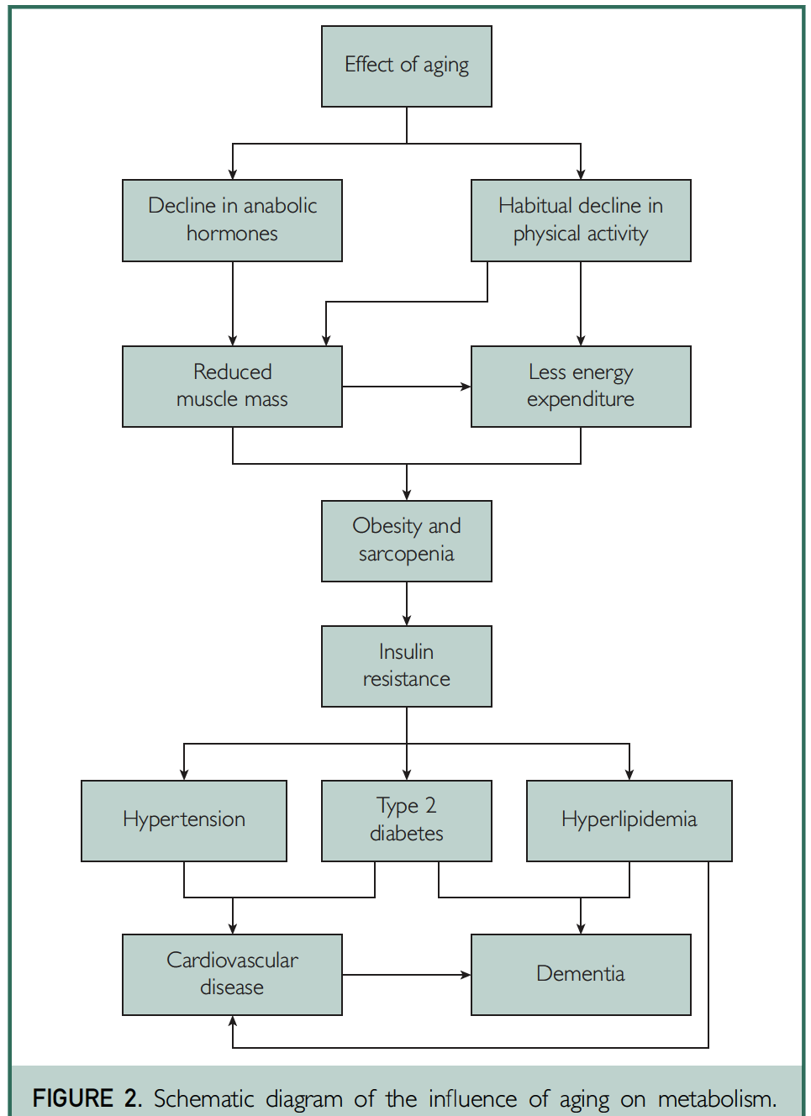
Schematic diagram of the influence of aging on metabolism
Pataky MW, Young WF, Nair KS. Hormonal and Metabolic Changes of Aging and the Influence of Lifestyle Modifications. Mayo Clin Proc. 2021
Notes:
Aging results in a decline in anabolic hormone production and, as is true for a large sum of the older population, a habitual decline in physical activity. This decrease in physical activity results in lower daily energy expenditure, leading to increased rates of obesity in the older population. Moreover, both hormonal dysregulation and reduced physical activity influence the reduction in muscle mass that occurs with age, also known as sarcopenia. The increased rates of obesity in aging combined with the development of sarcopenia can have devastating consequences on metabolism. After the development of insulin resistance, obesity and sarcopenia can result in an increased risk for type 2 diabetes, hypertension, and hyperlipidemia. These metabolic disturbances are known to lead to the development of cardiovascular disease and dementia. Importantly, positive lifestyle modifications such as regular exercise and healthy diet can combat multiple nodes in this process and are critical for healthy aging and the prevention of metabolic disease.

Slide 17
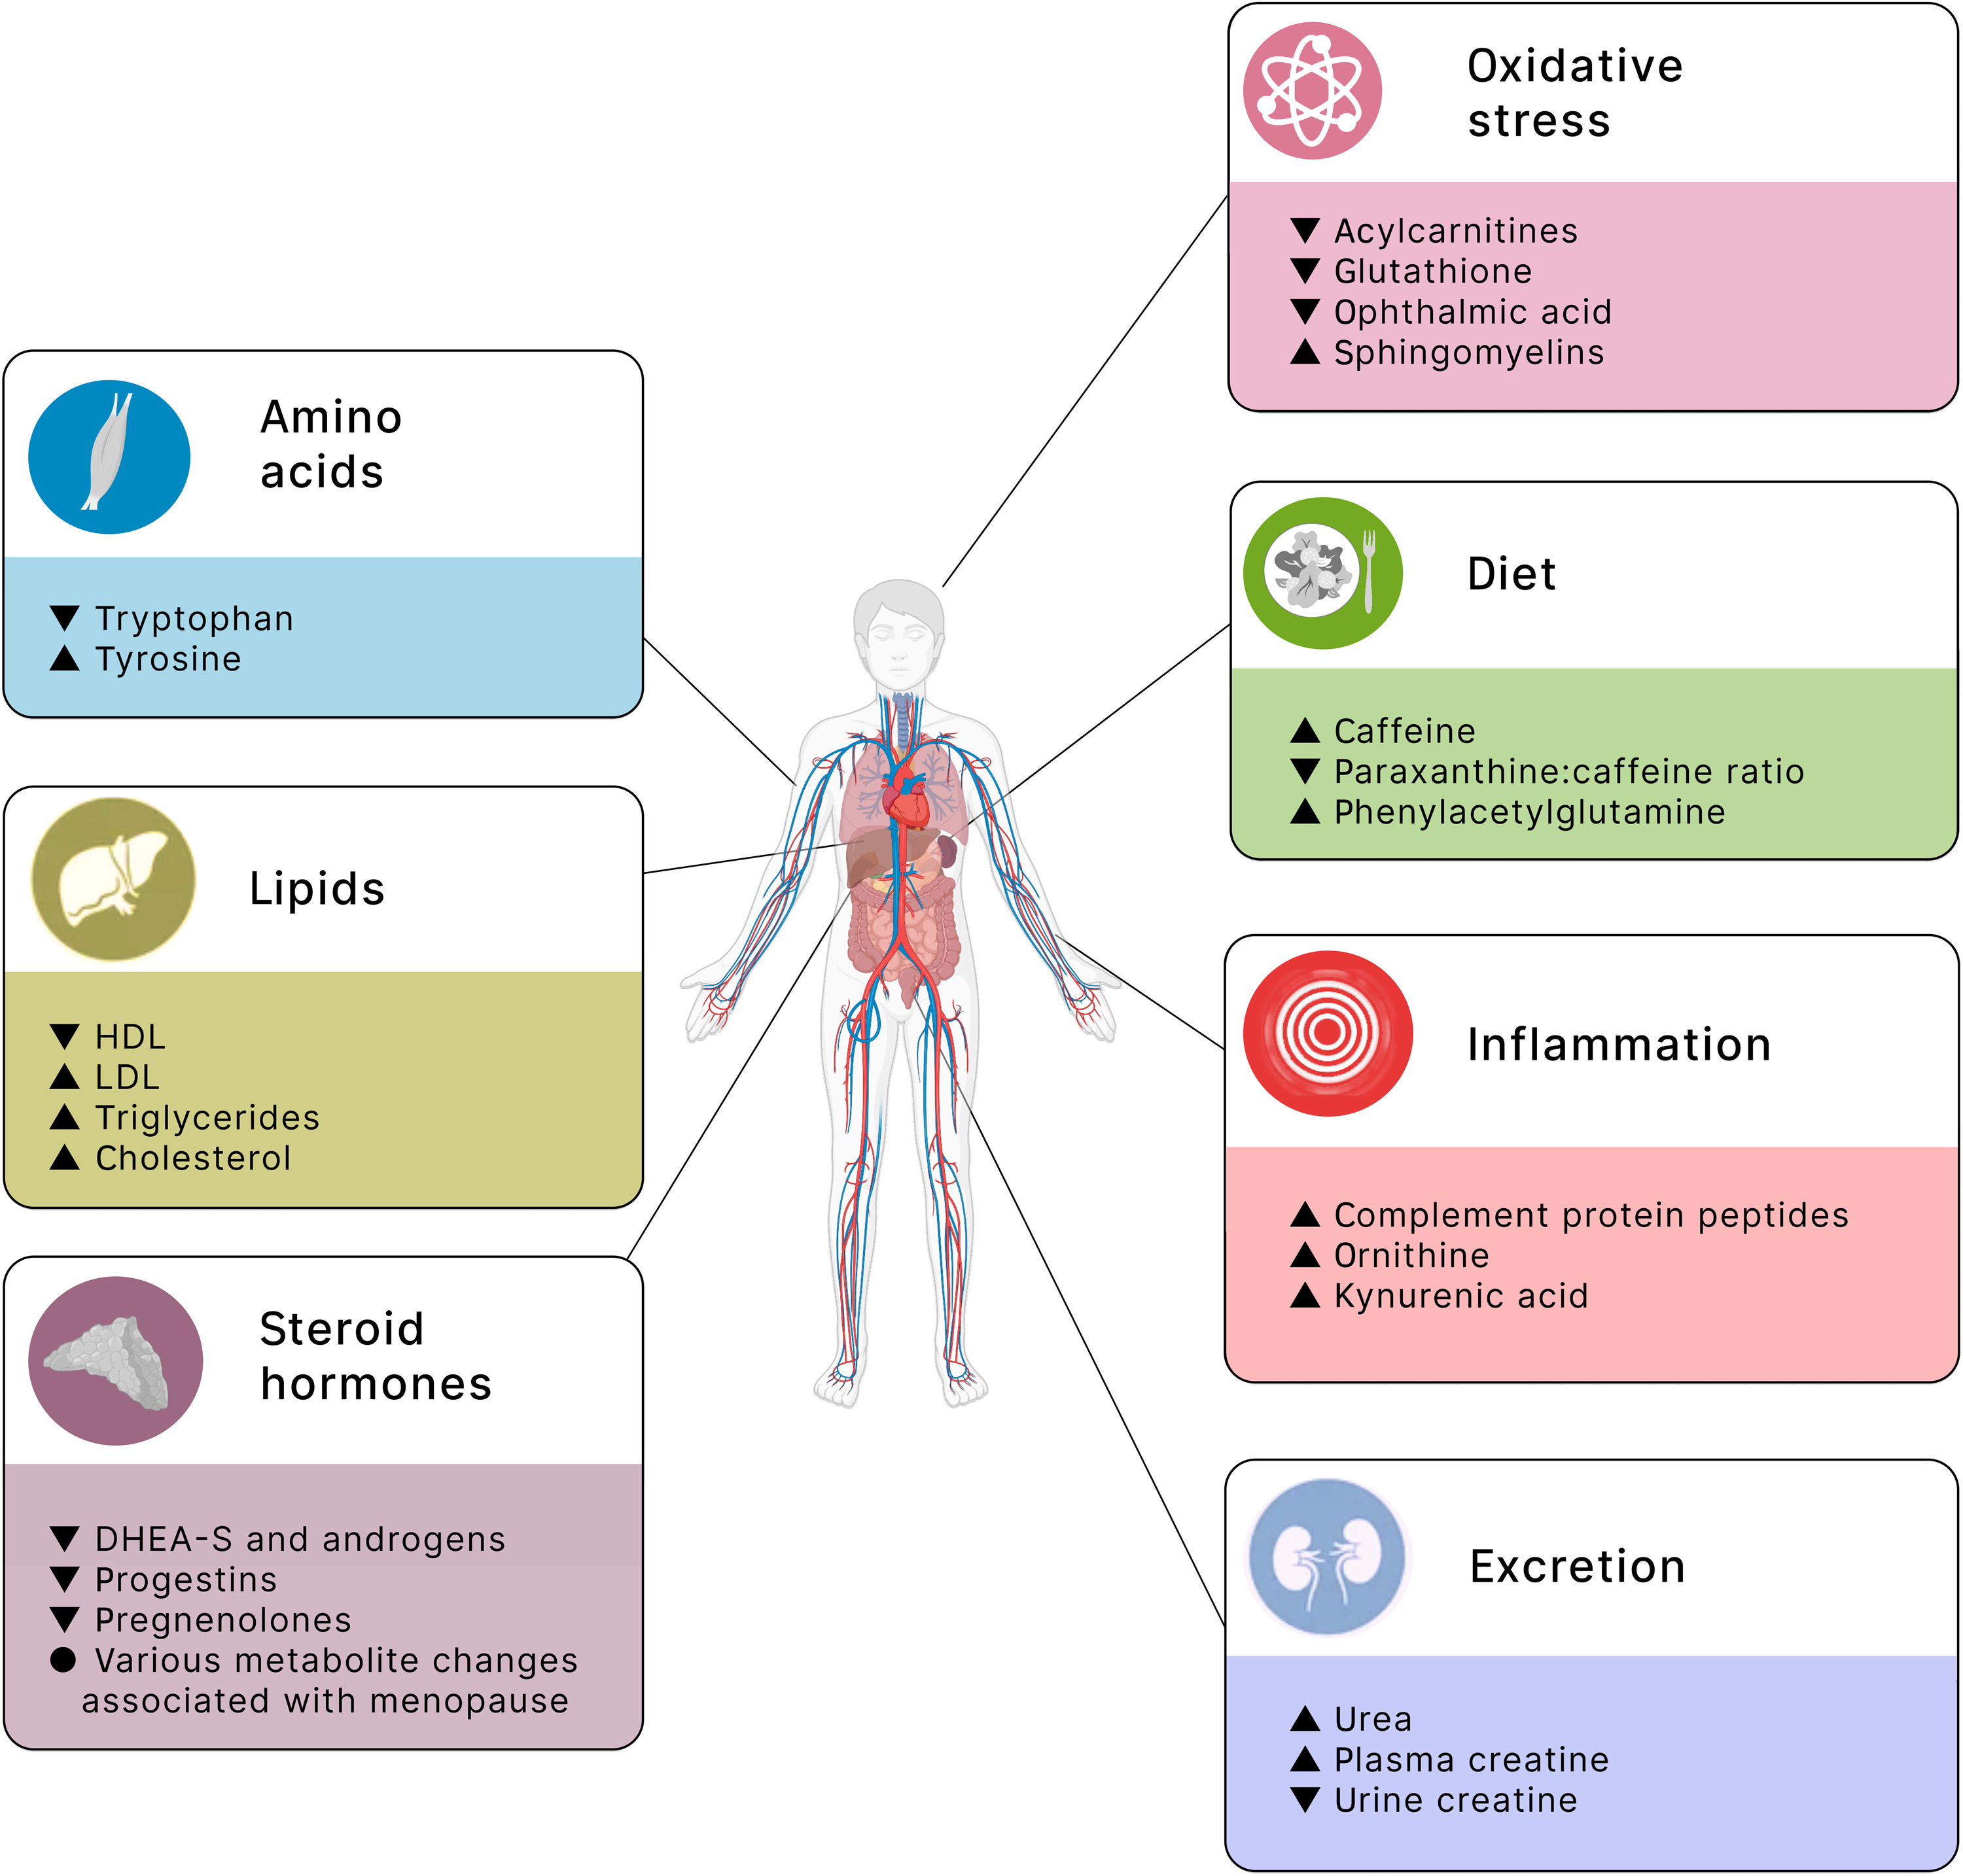
Overview of metabolomic associations with aging
Seven major pathways of metabolomic aging
Source: Panyard DJ, Yu B, Snyder MP. The metabolomics of human aging: Advances, challenges, and opportunities. Sci Adv. 2022
Notes:
Overview of metabolomic associations with aging.
An overview of the major metabolite changes associated with aging in human cohort studies is provided. The changes are grouped into seven major categories: lipids, steroid hormones, excretion, amino acids, diet, oxidative stress, and inflammation. These themes are broadly grouped by chemical structure (themes on the left) and biological pathway (themes on the right). Within each theme are some of the most consistently observed changes, with the change with age noted as an up (increased with older age) or down (decreased with older age) arrowhead.
Despite changes in the scale, technology, and sampling space studied, a number of themes have emerged regarding both the individual metabolites and metabolic pathways associated with aging in human population studies (Fig. 2). Below, we summarize these findings into seven major pathways of metabolomic aging: lipids and lipoproteins, steroid hormones, the renal system and excretion, amino acids and muscle, diet, oxidative stress, and inflammation.

Slide 18
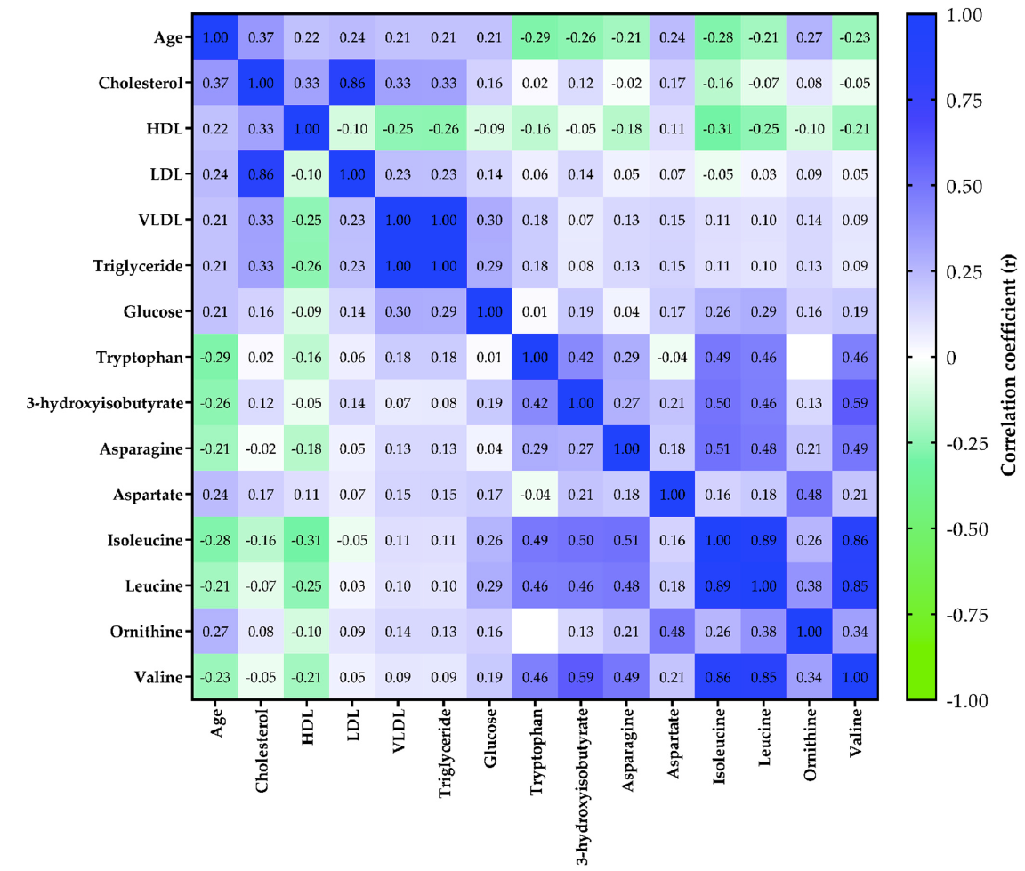
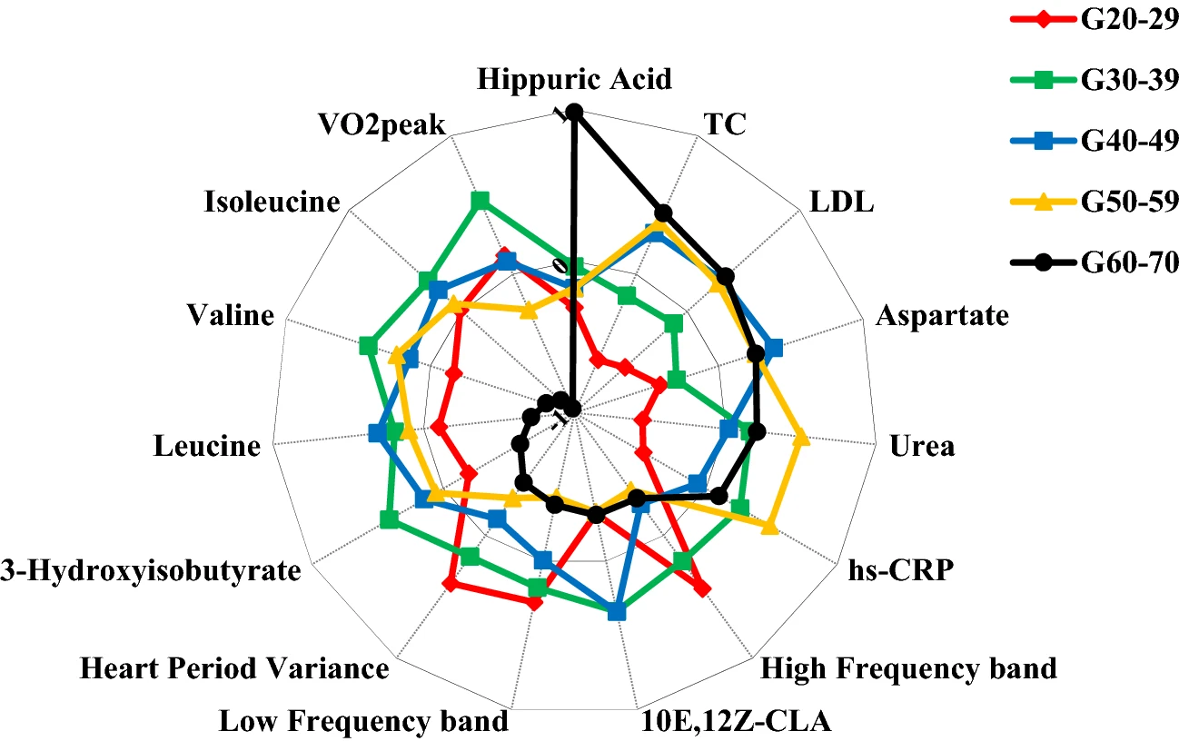
Branch chain amino acids decrease with age
The subjects (n = 118) were divided into five groups according to age (20-29, 30-39, 40-49, 50-59, and 60-70 years old). Serum levels of BCAAs and 3-hydroxyisobutyrate, and VO₂PEAK remained relatively stable until the G50-59 with a significant decrease in the last age group²
Overall correlation heatmap between age, clinical markers, and metabolite levels¹
¹Castro, A, et al. The Aging Process: A Metabolomics Perspective. Molecules, 2022
²De Favari Signini, et al. Integrative perspective of the healthy aging process considering the metabolome, cardiac autonomic modulation and cardiorespiratory fitness evaluated in age groups. Sci Rep, 2022
Notes:
These are two 2022 articles both finding that blood levels of Branch chain amino acids decrease in healthy individuals generally thought to be due to you know sarcopenia or loss of muscle mass. On the left the green is thing are things that are decreased with age so this is the age categories as age so valine, leucine, isoleucine and tryptophan decrease with age. The diagram on the right breaks people up into age groups. In age group above 60 years old, there is a big drop in those branched chain amino acid markers: isoleucine, valine and leucine. So the branch chain amino acid are the most abundant amino acids and proteins they're involved in maintenance of skeletal muscles they help regulate protein synthesis and degradation as well as immune responses telomere length and oxidative stress.

Slide 19
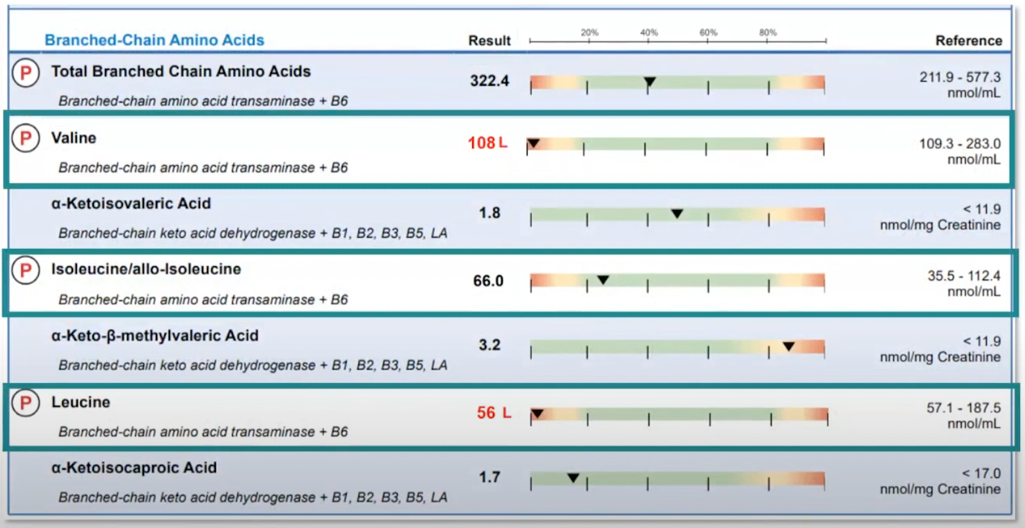
Branch chain amino acids decrease with age
Example report using metabolomics
https://www.diagnosticsolutionslab.com/tests/omx
Notes:
Here is an example of metabolomics report regarding BCAA. Here you can see the valine is low the isoleucine is low and the leucine is low so those are issues. so you'd want to check is this person are they losing muscle mass are they getting enough protein see looking at the other amino acids would be helpful with that

Slide 20
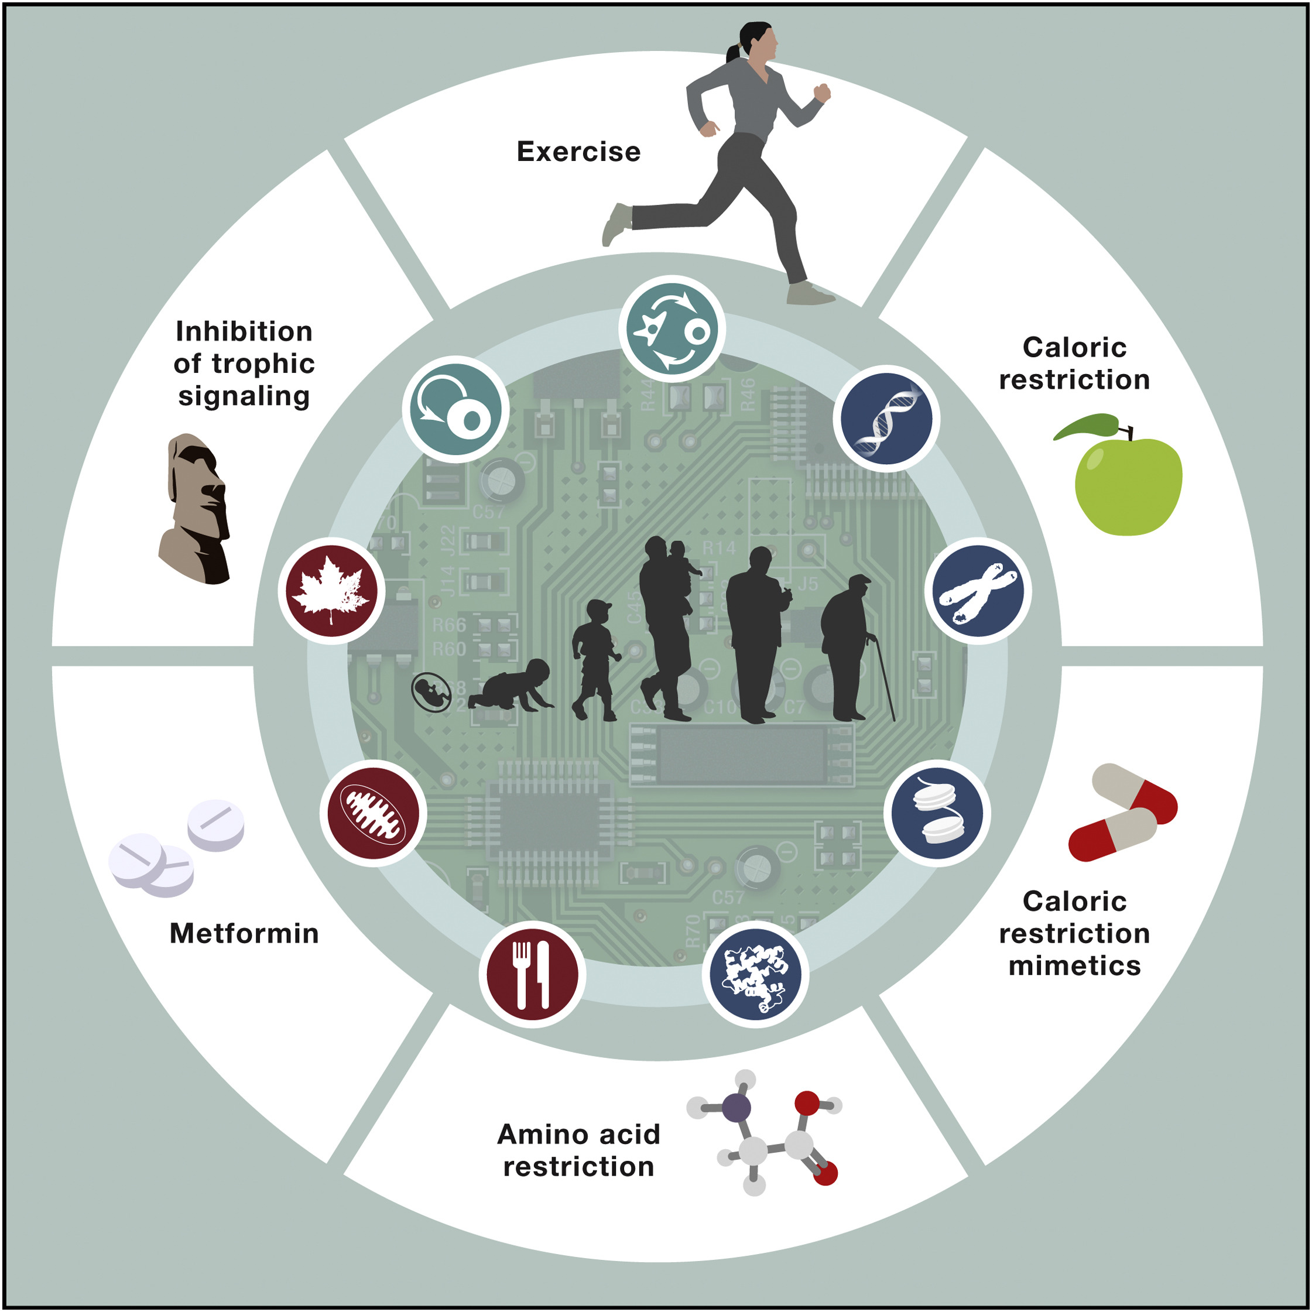

Metabolic Interventions that Improve Longevity
Carlos López-Otín, Lorenzo Galluzzi, José M.P. Freije, Frank Madeo, Guido Kroemer. Metabolic Control of Longevity, Cell, 2016
Notes:
Metabolic Interventions that Improve Longevity
Data from several model organisms indicate that aging and the manifestations of age-associated disorders can be delayed by regular exercise, caloric restriction, small molecules that mimic the effects of fasting but are not associated with a sizeable weight loss (caloric restriction mimetics), limited intake of amino acids, inhibition of trophic signal-transduction cascades (for instance, with rapamycin, originally discovered in Rapa Nui island), and metformin (an antidiabetic drug with pleiotropic metabolic effects). Possibly, these interventions may also extend human lifespan.

Slide 21
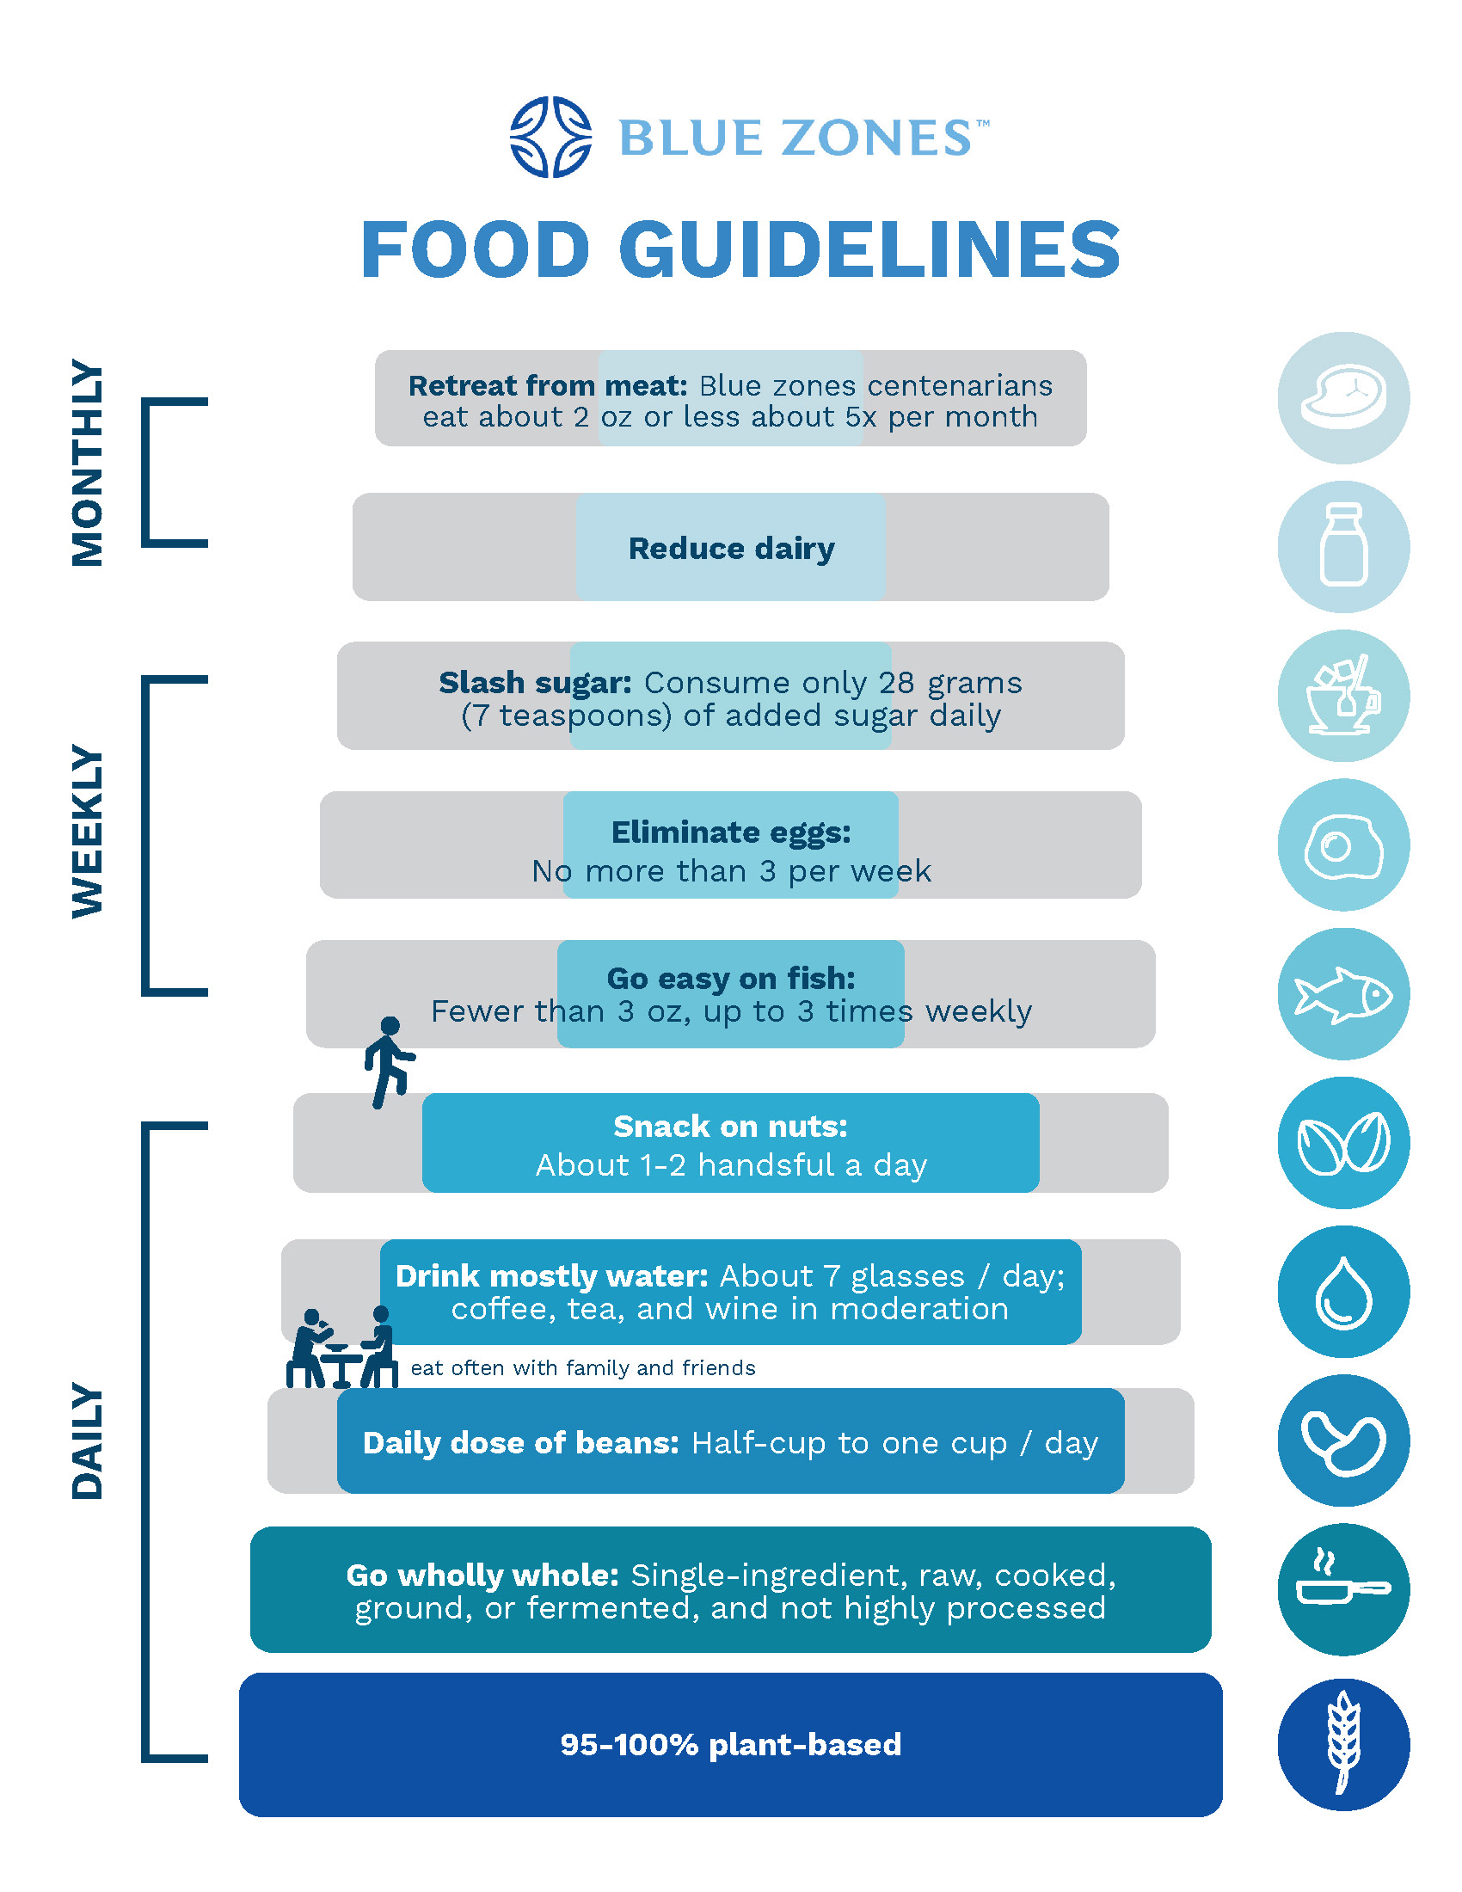


The blue zones are areas of exceptional longevity
https://www.bluezones.com
Notes:
the blue zones are areas of exceptional longevity around the world, these include Sardinia, Ikaria (Greece), Nicoya Peninsula (Costa Rica), Seventh Day Adventists in Loma Linda, (California), Okinawa (Japan)
Named for the color a demographer used in a global “heat map” of mortality around the world.
What lessons can we learn?The blue zones organization distilled findings from more than 150 dietary surveys from the world’s longest-living people to create a set of ten food guidelines.
The foundation of the Blue Zones Food Guidelines, is making your diet at least 95 percent plant-based,
avoiding highly processed foods, emphasizing beans as the healthiest source of protein, water as the best beverage, and nuts as the healthiest snack.
That’s the foundation. The final five guidelines are to “Go easy on fish,” “Eliminate eggs, “Slash sugar,”
“Reduce dairy,” and “Retreat from meat,” noting that blue zones centenarians only eat about two ounces (57 g) of meat or less about five times a month.
They also developed an application, in hich you can get personalized recommendations or recipes for daily menu

Slide 22
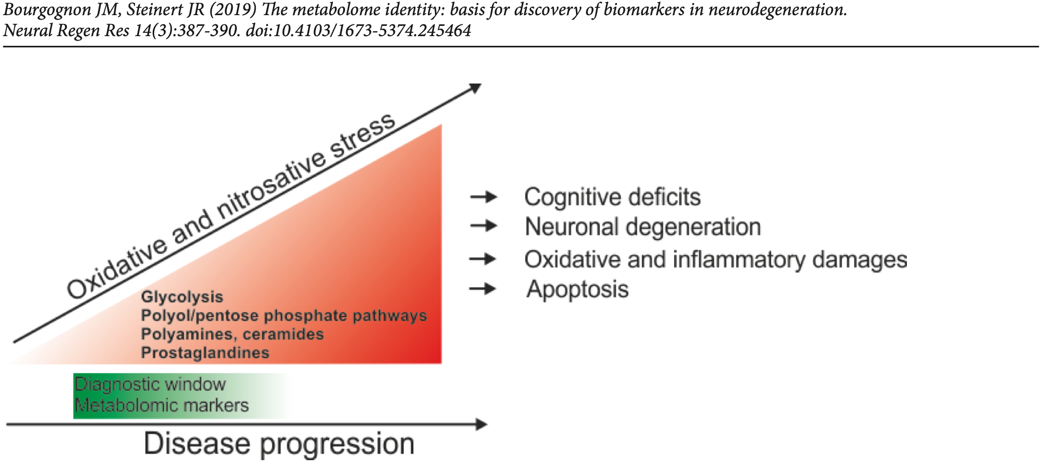
Metabolomics in Neurodegenerative Disorders
Disease relevant alterations in neuronal metabolism
Notes:
Disease relevant alterations in neuronal metabolism with potential for biomarker development.
As neurodegenerative disease progresses, several metabolic pathways are altered and early detection of these changes could provide support for development of diagnostic biomarkers and treatments. Disease progression advances with increasing redox stress which provides a favourable target for treatment strategies.

Slide 23
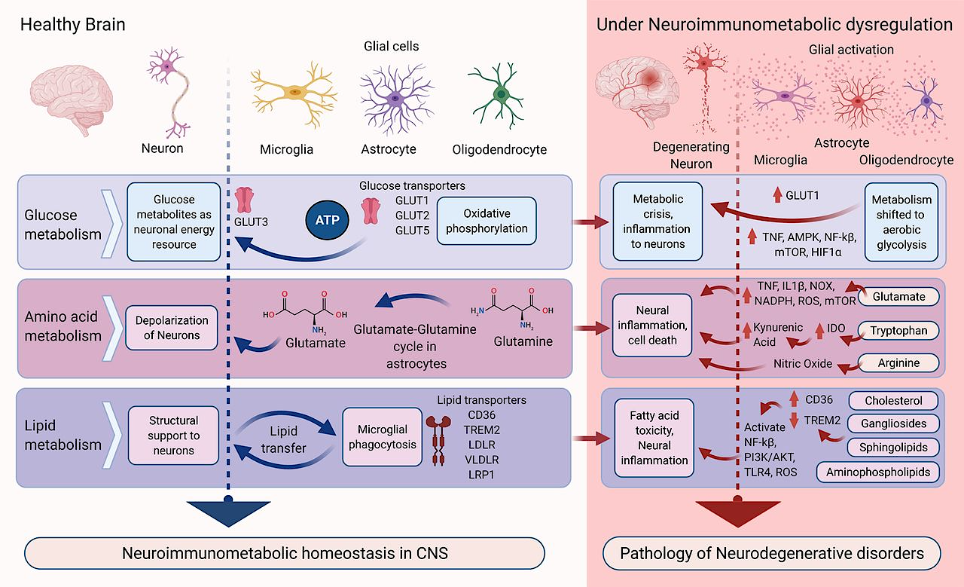
Predominant neuroimmunometabolic homeostasis in the healthy brain and its disruption in neurodegenerative disorders
Swarup Mitra et al. J. Neurosci. 2022;42:1888-1907
Notes:
Predominant neuroimmunometabolic homeostasis in the healthy brain and its disruption in neurodegenerative conditions. In the healthy state (left, blue arrows), glucose, amino acid, and lipid metabolism occur in various cell types. Neuroimmunometabolism disrupts this homeostasis (right, red arrows) contributing to degenerative conditions. IDO, Indoleamine-2,3 dioxygenase; PI3K/AKT, phosphoinositide 3-kinases.

Slide 24
Metabolomics in Neurodegenerative Disorders
Numerous neuropathologies are diagnosed at late stage symptomatic changes which occur in response to these molecular malfunctions and treatment is often too late
Neurodegenerative disorders are often associated with cellular dysfunction caused by underlying protein-misfolding signalling, altered metabolism, malnutrition, aging
Important new strategies to identify early biomarkers with predictive value to intervene with disease progression at stages where cell dysfunction has not progressed irreversibly is of paramount importance
Metabolomics may help

Slide 25
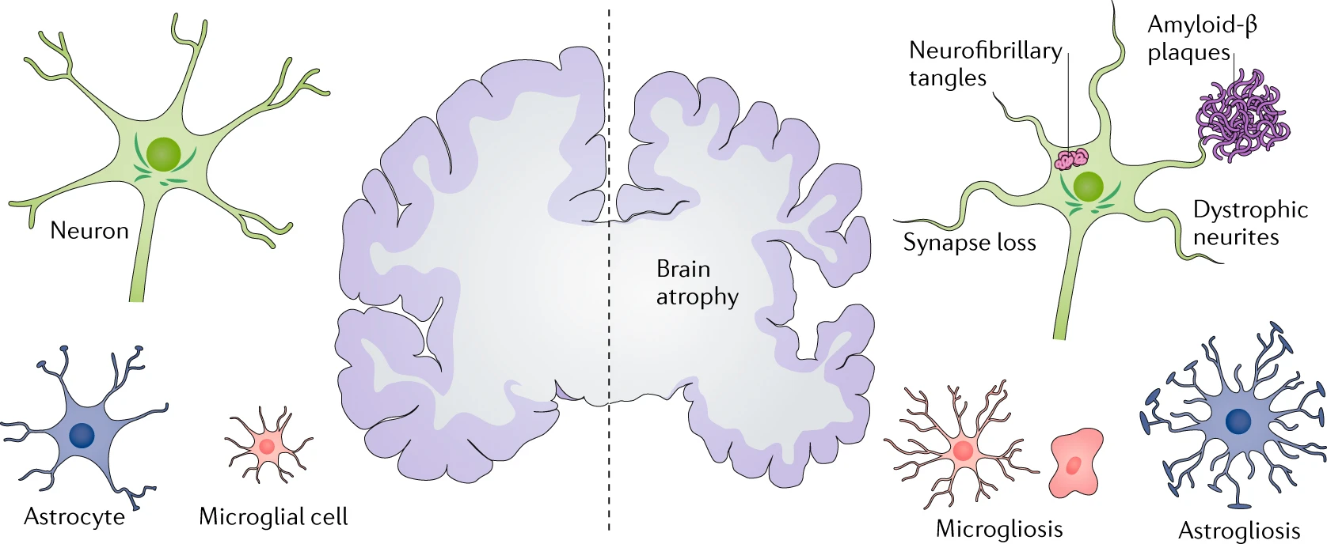
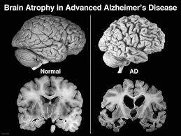
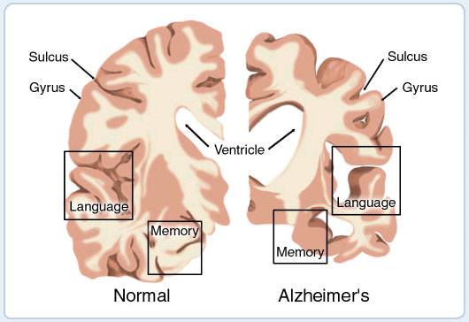
Alzheimer's disease (AD) - Overview
The defining pathological hallmarks of Alzheimer disease
A progressive neurodegenerative disorder in older adults (late-onset, >60 years old)¹
early-onset form (10% of cases) appears around the 30s
Characterized by abnormal amyloid – β and tau proteins
Leads to brain volume loss
Congdon, E.E., Sigurdsson, E.M. Nat Rev Neurol 14, 399–415, 2018
Ultimately and irreversibly degrading memory, behavior and quality of life
The most prevalent form of dementia among elderly people, accounting for 70% of total cases
¹The Society for Neuroscience. Brain facts: A primer on the brain and nervous system. Washington DC, 2002
Notes:
At the gross anatomical level, Alzheimer disease is characterized by brain atrophy associated with loss of synapses and neurons. At the microscopic level, deposition of extracellular amyloid-β plaques and intraneuronal neurofibrillary tangles is observed, in association with dystrophic neurites and loss of synapses, as well as microgliosis and astrogliosis.

Slide 26
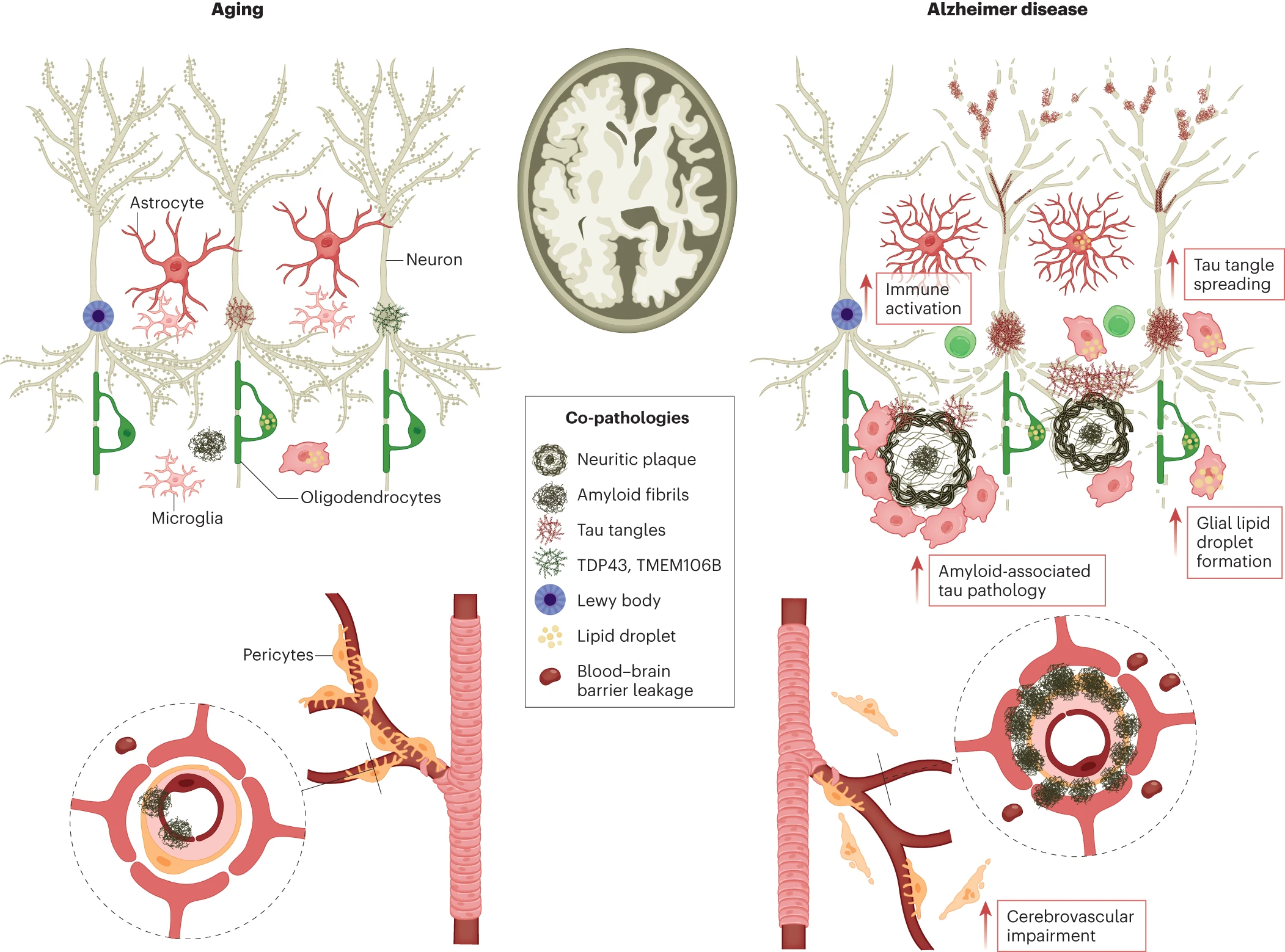
Pathophysiology beyond amyloid and tau
Co-pathologies of the aging brain
protein aggregates within neurons
reductions in synaptic spine density
reactive, pro-inflammatory microglia
lipid droplets accumulation within glia
cerebral amyloid angiopathy
Self, W.K., Holtzman, D.M. Emerging diagnostics and therapeutics for Alzheimer disease. Nat Med, 2023
Notes:
Left, multiple co-pathologies exist in the aged brain, including protein aggregates within neurons, reductions in synaptic spine density, impaired cerebrovascular function, reactive, pro-inflammatory microglia and accumulation of lipid droplets within glia. Amyloid deposition is present in both the brain parenchyma and cerebrovasculature (cerebral amyloid angiopathy). Right, AD brain is uniquely characterized by the degeneration of brain regions in the neocortex, usually along a stereotypical pattern that leads to cognitive decline and dementia. In these regions, the presence of neuritic plaques and tau neurofibrillary tangles are found within the milieu of the co-pathologies of the aging brain. In this neurodegenerative environment, reactive cells of innate immune responses are present, and peripheral immune cells infiltrate the brain. Cerebrovascular integrity is also compromised, with increased blood–brain barrier leakiness and the degeneration of pericytes ensheathing blood vessels.

Slide 27
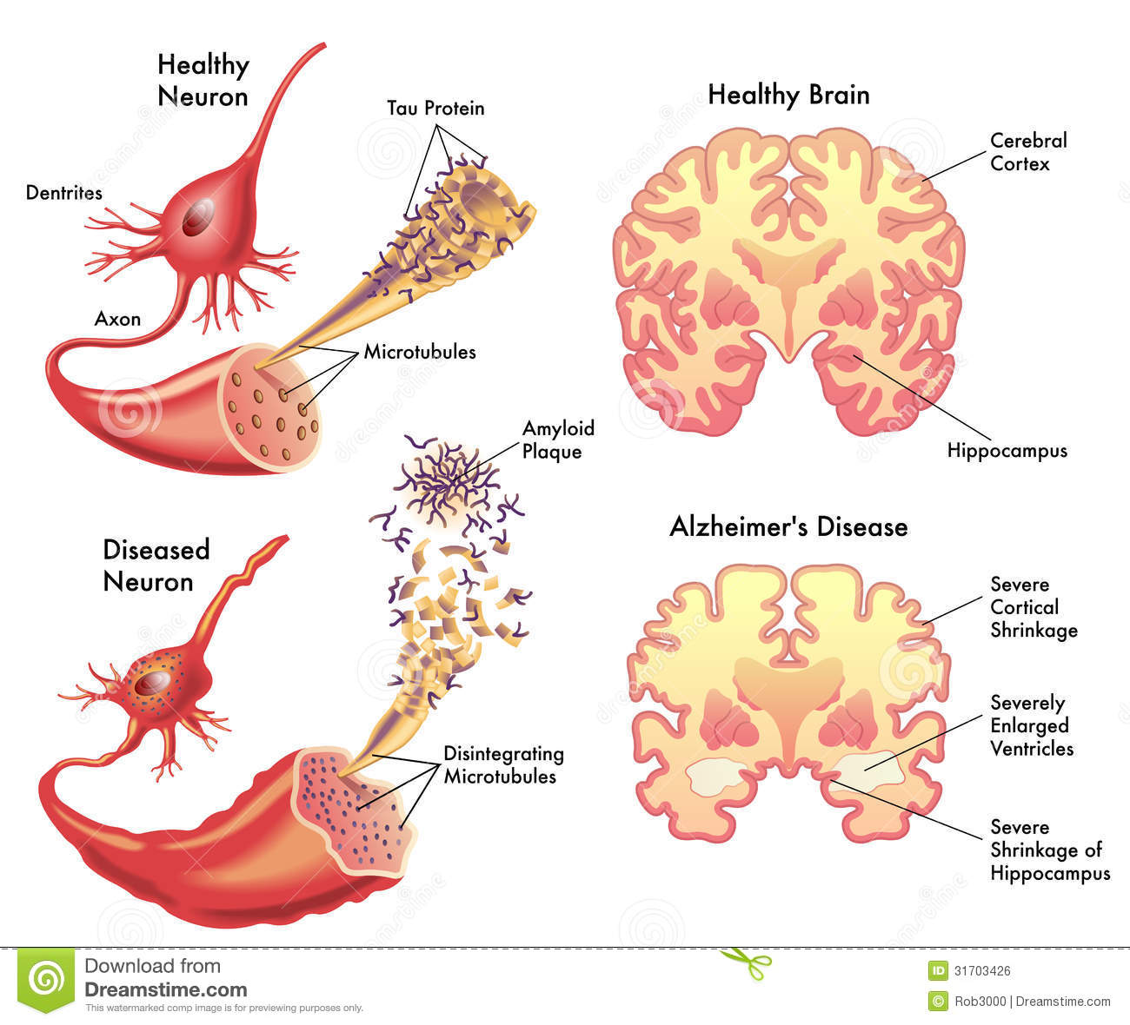
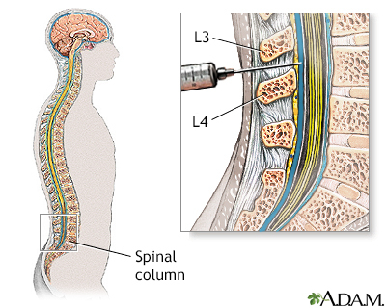
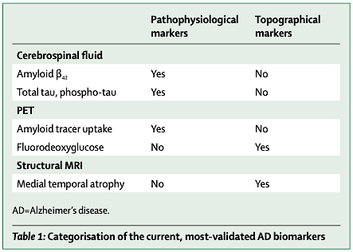
AD diagnosis
Step 1.
Questionnaire and cognitive tests
Step 2.
(CSF)
Diagnosis today in CSF
- invasive
- expensive
- inadequate for pre-clinical or early stage AD
May metabolomics help?
Bruno Dubois, et al. Revising the definition of Alzheimer's disease: a new lexicon, The Lancet Neurology, 2010
Jack CR Jr. A/T/N: An unbiased descriptive classification scheme for Alzheimer disease biomarkers. Neurology. 2016
Notes:
Bruno Dubois, et al. Revising the definition of Alzheimer's disease: a new lexicon,The Lancet Neurology, 2010

Slide 28

AD diagnosis and management clinical challenges
Disease pathology in the form of amyloid deposits starts to accumulate ~20 years before symptom onset, at which point the disease is already quite advanced¹
While removal of amyloid build-up from the brain may be successful achieved, there are not yet effective ways to modify two other major drivers of cognitive decline: tau pathology and the immune response
The older a person is when cognitive decline begins, the more likely it is that other, non-AD pathologies are also contributing to decline
Strategies to diagnose AD before clinical symptoms or treat multiple facets of AD and non-AD pathology
Norman L Foster, The Lancet Neurology, Volume 6, Issue 8, 2007
Prevent the number of people with AD from reaching ~150 million by 2050 worldwide
¹Self, W.K., Holtzman, D.M. Emerging diagnostics and therapeutics for Alzheimer disease. Nat Med, 2023
Notes:
as part of strategies for early detection, metabolomics research can contribute by unveiling underlaying metabolic changes that lead or contribute to progress of cognitive impairment

Slide 29
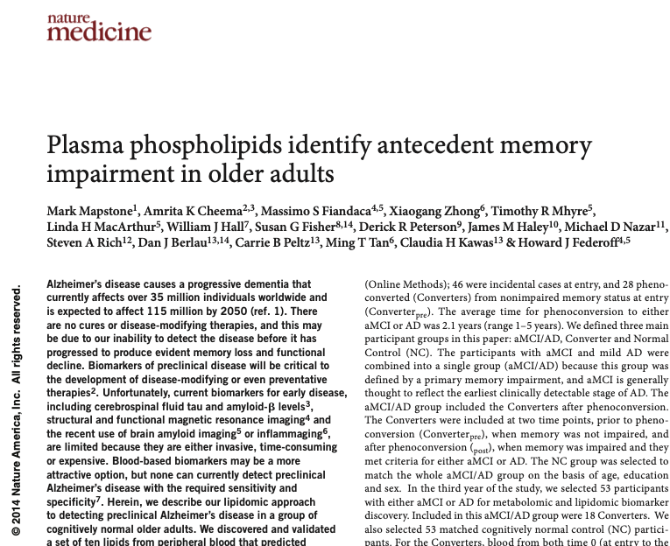
The features of metabolomics in AD
First published report¹ of a blood-based biomarker panel with very high accuracy for detecting preclinical AD
”This metabolic panel robustly identifies (with accuracy above 90%) cognitively normal individuals who, on average, will phenoconvert (develop) to aMCI or AD within 2–3 years”
Differences in 10 blood phospholipids between people with pre-clinical Alzheimer’s and people who will not go on to develop the condition
Patient groups significantly differed in metabolic profile
Mapstone, M., Cheema, A., Fiandaca, M. et al. Plasma phospholipids identify antecedent memory impairment in older adults. Nat Med 20, 2014
Metabolomic signature might reflect early neurodegeneration by disrupted neural cell membrane integrity, and may be utilized as screening marker for the detection of preclinical Alzheimer's
Notes:
Scientists have developed a blood test that uses 10 markers that they say could be used to predict with 90% accuracy whether someone will develop Alzheimer’s disease within three years.
The research, published as a letter in Nature Medicine, shows how there are differences in 10 blood phospholipids between people with pre-clinical Alzheimer’s (before the symptoms appear) and people who will not go on to develop the condition.1 The phospholipids may represent early degenerative changes in neurones within the brain before the onset of dementia. There were 525 enrolled healthy participants aged 70 or over and followed for five years. Midway through the study the researchers analyzed the blood of 53 patients who were already showing signs of cognitive impairment and matched them with 53 cognitively normal controls. When they tracked back they found 10 molecules that could be used to predict, with 90% accuracy, who would go onto have mild cognitive impairment or Alzheimer’s disease.
The authors said that the accuracy of detection was equal to or greater than that obtained from published studies using markers in cerebrospinal fluid.

Slide 30
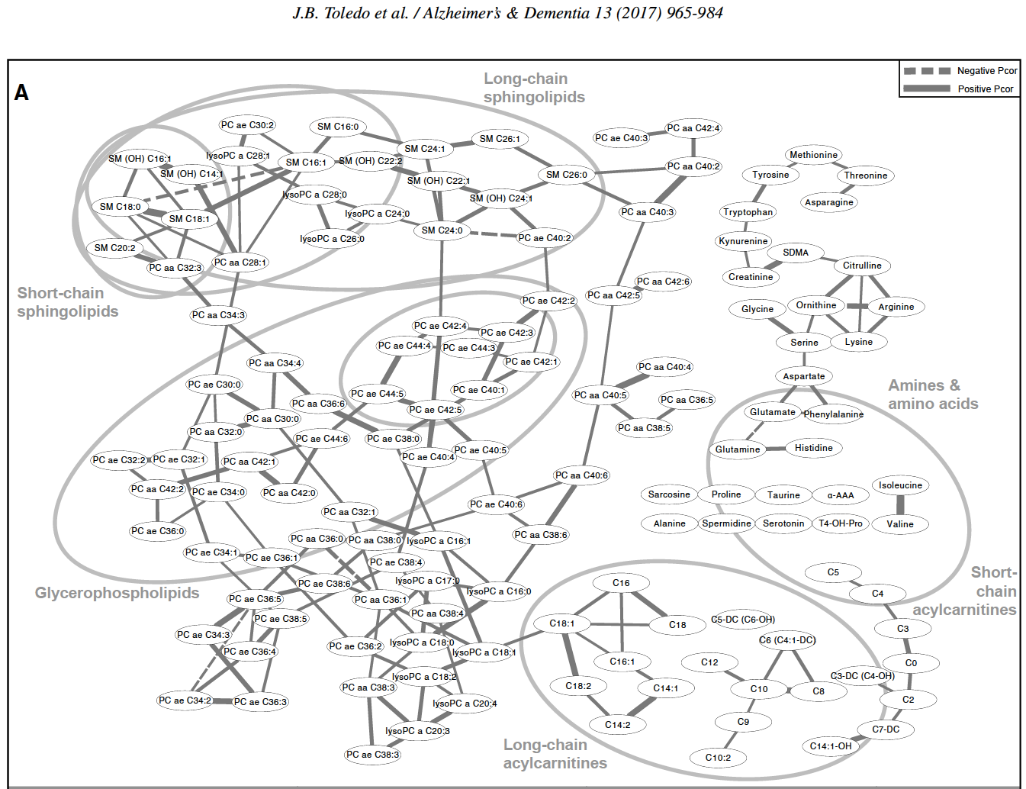
The features of metabolomics in AD
Key findings:
Early AD stages: changes in sphingolipid and phospholipid levels – important for cell membrane integrity and functions
Late AD stages: Changes in mitochondrial energy metabolism (acylcarnitines, BCAAs) – energy utilization, insulin resistance
- interconnected metabolic changes during AD progression
- Stage - specific metabolic alterations reflect pathophysiological processes in AD
Early-stage AD
Late-stage AD
Metabolomics can brighten the dark - specific metabolic alterations may enable early detection and prognosis of AD
Notes:
The importance of selecting disease stages more carefully is highlighted in this paper.
They found that a metabolic profile in serum is specific to disease stage.
In early stages of Alzheimer's disease mainly phospholipids and sphingomyelins are altered whereas in later stages it is primarily amino acids and acylcarnitines that are affected. These alterations also reflect pathophysiological processes
that are specific to disease stage. The changes in sphingomyelins and phospholipids are related to alterations of the cell membrane structure in early stages whereas the changes in amino acids and acylcarnitine may reflect defects in the mitochondrial energy metabolism.
These findings may help to define stages of Alzheimer's disease more exactly
which is required for the successful development of biomarkers and therapies for Alzheimer’s disease
Metabolomics can brighten the dark - specific metabolic alterations may eventually enable early detection and prognosis of Alzheimer’s disease

Slide 31
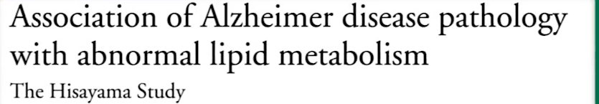
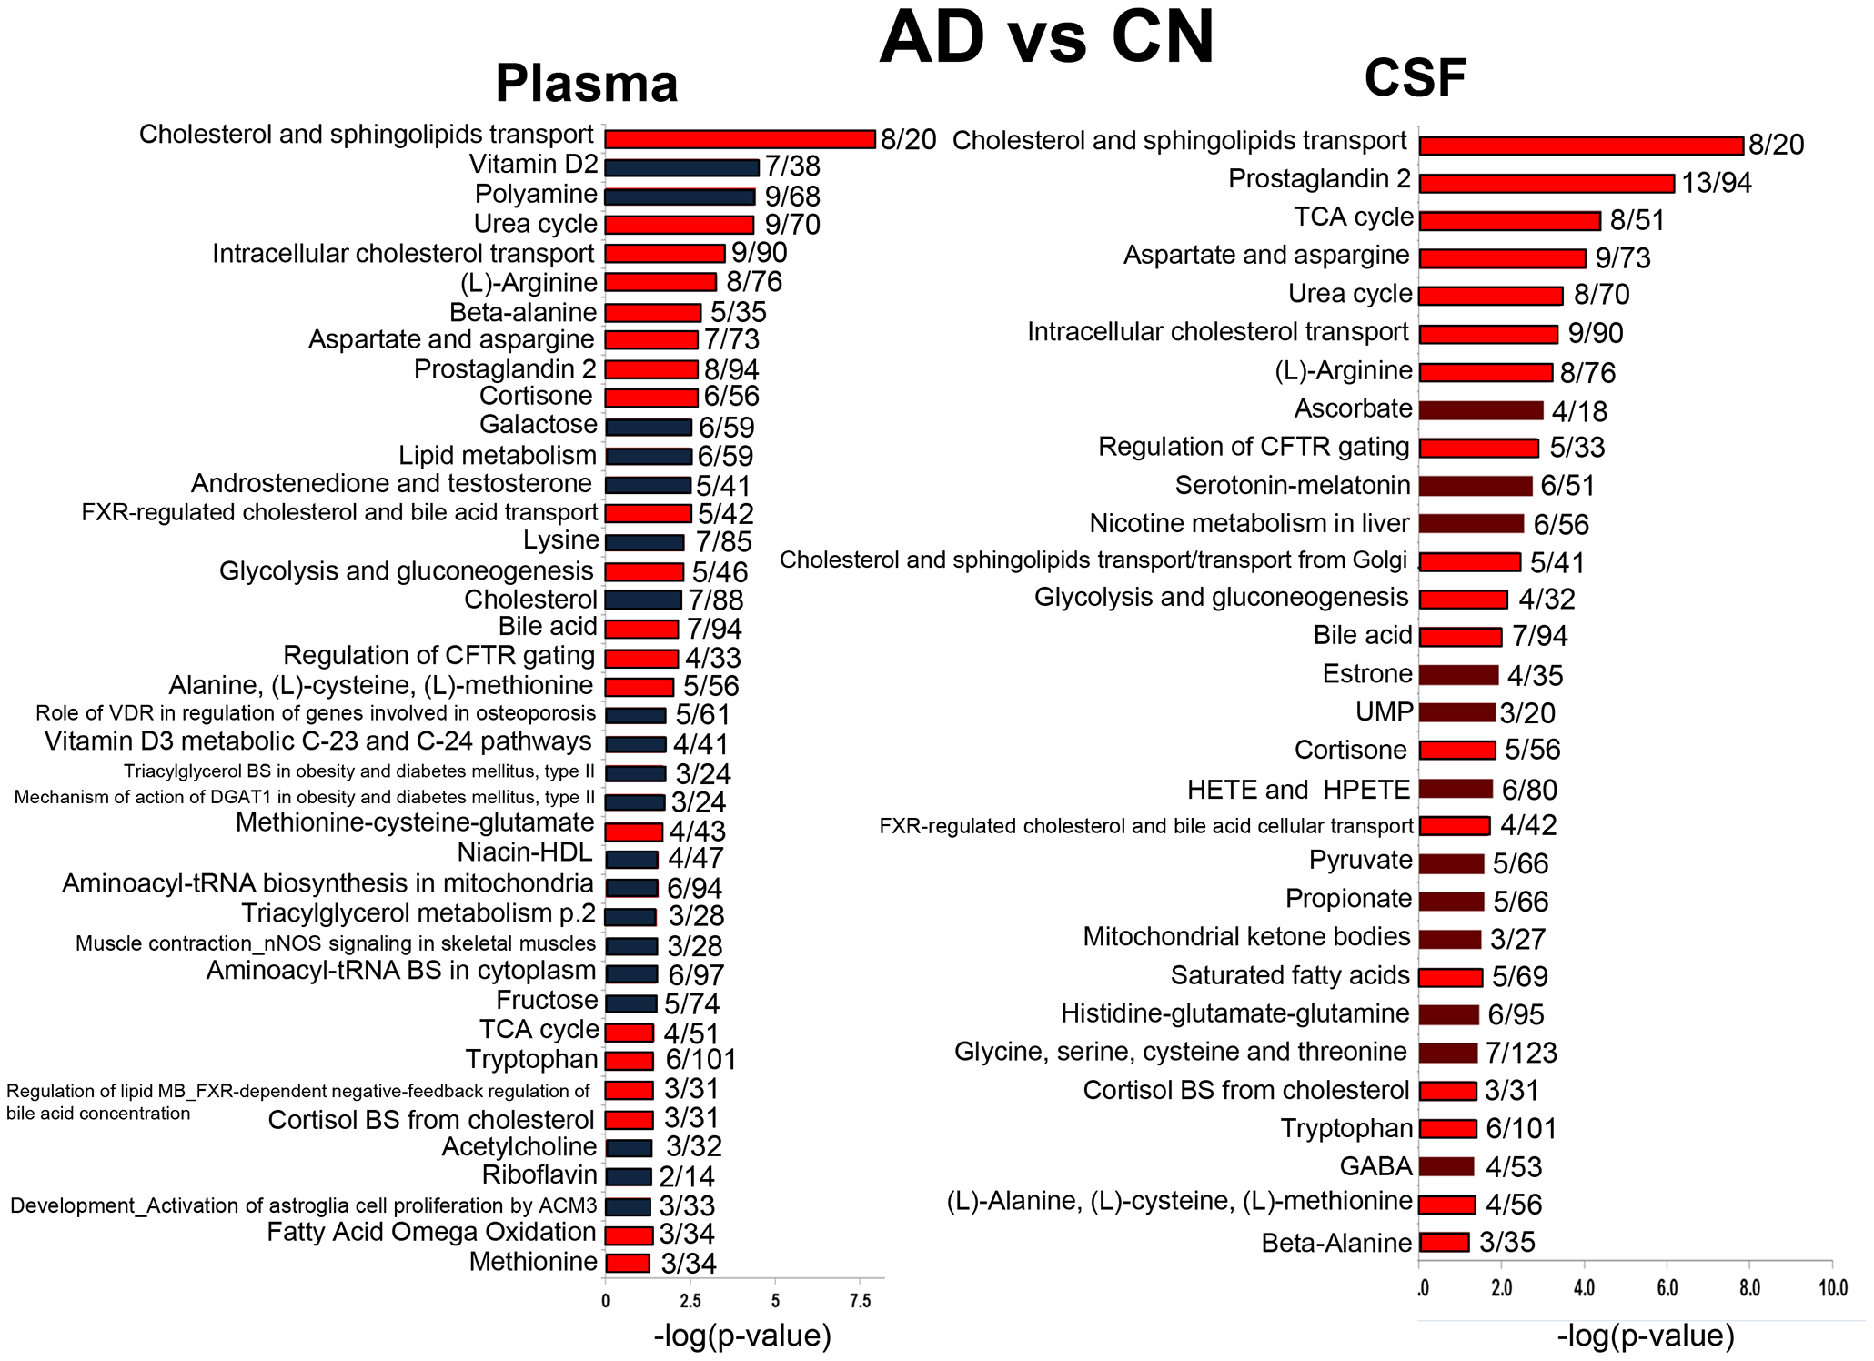
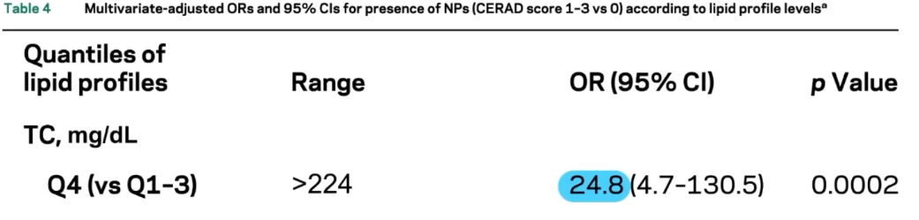
Metabolic pathways altered in AD
Studies using metabolomics and lipidomics
Healthy control
methionine, arginine, and glutamate metabolism,
fatty acid biosynthesis
and mitochondrial bioenergetics
lipid metabolism - the most consistently altered pathway in AD pathogenesis
(Total cholesterol level)
Trushina E, et al. 2013 Identification of Altered Metabolic Pathways in Plasma and CSF in Mild Cognitive Impairment and Alzheimer’s Disease Using Metabolomics. PLOS ONE
Notes:
Recent investigations conducted in human samples have identified changes in a number of metabolites in CSF or plasma that also correlated with AD severity validating metabolomics as a useful tool to study the disease progression. Pathways affected to the highest extent in plasma included cholesterol and sphingolipids transport, vitamin D2 (ergocalciferol) metabolism, polyamine metabolism, and urea cycle. Cholesterol and sphingolipids transport, prostaglandin 2 (PGE2) biosynthesis and metabolism, TCA cycle, and aspartate and asparagine metabolism were among the most affected in CSF of AD subjects. Pathways that were equally affected in CSF and plasma were related to lipid and cortisone biosynthesis and metabolism, mitochondrial function and energy production, urea cycle, bile acid metabolism, and amino acid biosynthesis and metabolism. This study (GRAPH) is another valid prove for usage od plasma as reliable source for metabolomic profiling and suggest that metabolomics is a valuable tool for the identification of molecular mechanisms involved in the etiology of AD and novel therapeutic targets.
Canonical pathways and process networks affected in plasma and CSF of AD vs. CN subjects.
The significance of the pathways was evaluated using P values and false discovery rate <0.05. Pathways that are affected in both fluids are colored in red. The ratio depicts the number of affected metabolites to the total number of metabolites in each pathway. FXR - farnesoid X receptor; CFTR - cystic fibrosis transmembrane conductance regulator; VDR - vitamin D receptor; DGAT1 - diacylglycerol acyltransferase 1; nNOS – neuronal nitric oxide synthase; UMP - Uridine monophosphate; HETE - hydroxyeicosatetraenoic acid; HPETE - hydroperoxyeicosatetraenoic acid; BS – biosynthesis.
The Hisayama study assessed association between lipid profile and accumulation of beta amyloids (AD) and found odds ratio of 24.8 according to total cholesterol level (TC) for ending up with beta amyloid plaques 10/15 years later

Slide 32
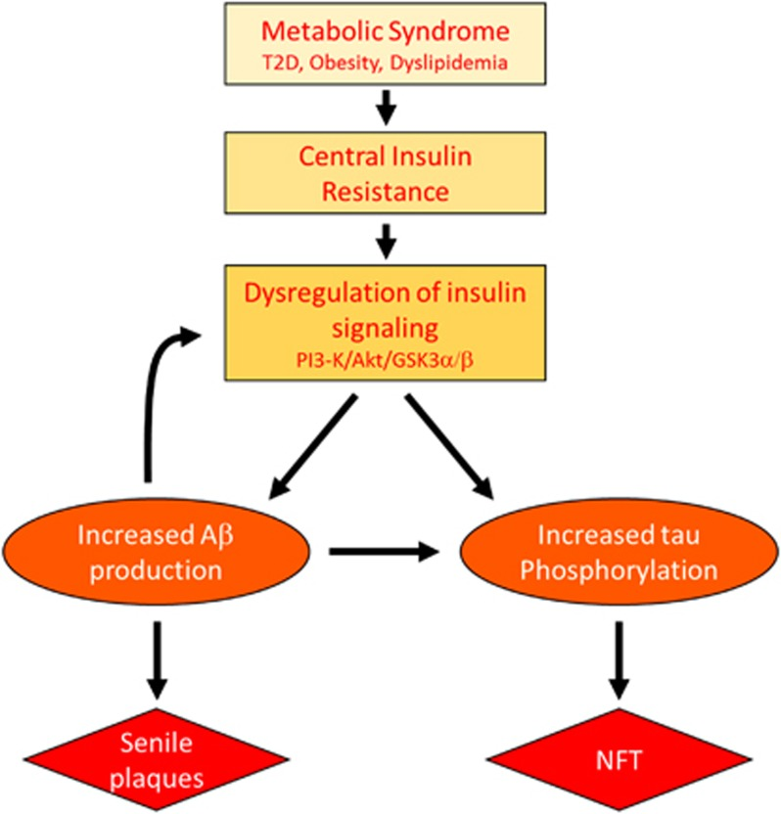
Alzheimer׳s disease (AD) and brain glucose starvation
80% of people with Alzheimer’s disease have insulin resistance or full-developed type 2 diabetes
AD could be regarded as a brain disorder that has composite features of Type 1 (insulin deficiency) and Type 2 (insulin resistance) diabetes.
T2D = Type 2 Diabetes
PI3 = phosphatidylinositol 3 kinase
Akt = serine/threonine kinase
Aβ = amyloid beta
GSK3α/β = Glycogen synthase kinase 3α/β (GSK3α/β), a serine/threonine kinase that plays a critical role in cancer.
NFT =neurofibrillary tangles
Metabolic syndrome and AD Aβ/tau pathology may act in a feed-forward mechanism to accelerate AD pathology in the presence of insulin resistence.
Kim B, Feldman EL. Insulin resistance as a key link for the increased risk of cognitive impairment in the metabolic syndrome. Exp Mol Med. 2015. doi: 10.1038/emm
Notes:
Over decades, the dominant hypothesis was that neurodegeneration is caused by one or two of the specific lesions that characterize AD, e.g. AβPP-Aβ accumulation, pTau aggregation, or neuro-inflammation. However, a stream of human and experimental studies has provided convincing evidence that AD is a metabolic disease whereby the brain loses its capacity to efficiently utilize glucose for energy production and respond to critical trophic factor signals due to insulin as well as insulin-like growth factor (IGF) resistance (Baker et al., 2010, Craft, 2007, Hoyer, 2002, Hoyer, 2004b, Krikorian et al., 2010, Luchsinger, 2010, Neumann et al., 2008, Rivera et al., 2005, Schubert et al., 2004, Steen et al., 2005, Talbot et al., 2012, Watson and Craft, 2006). The molecular and biochemical consequences of insulin and IGF resistance in the brain are similar to those in other organs and tissues; however, in brain, insulin signaling impairments compromise neuronal survival, energy production, gene expression, plasticity and white matter integrity (de la Monte, 2011, de la Monte et al., 2009a)
FIGURE: n summary, peripheral MetS induces central IR in the brain. The resulting impaired insulin signaling, which mainly impacts the PI3K/Akt pathway, then increases APP processing/Aβ levels and tau phosphorylation. Finally, increased Aβ further disrupts insulin signaling to exacerbate AD pathology and cognitive decline

Slide 33
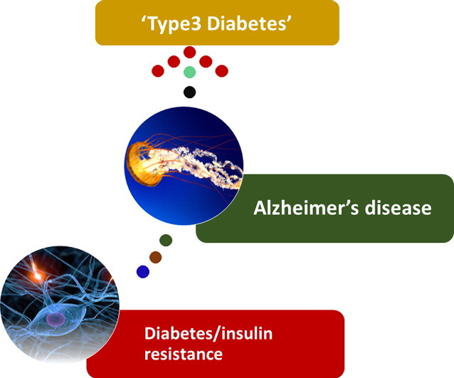
Alzheimer׳s disease (AD) and brain glucose starvation - The concept of type 3 diabetes -
To consolidate the type of glucose impairment in AD patients, Rivera et al., 2005, Steen et al., 2005 proposed that AD be referred to as, “Type 3 diabetes”.
Key features of “type 3 diabetes ”: brain insulin and IGF resistance and deficiency
*Type 3 diabetes is still a concept and not yet incorporated in official medical practice and terminology
Mittal, K. Type 3 Diabetes: Cross Talk between Differentially Regulated Proteins of Type 2 Diabetes Mellitus and Alzheimer’s Disease. Sci Rep 2016.
Kim B, Feldman EL. Insulin resistance as a key link for the increased risk of cognitive impairment in the metabolic syndrome. Exp Mol Med. 2015. doi: 10.1038/emm
Notes:
Over decades, the dominant hypothesis was that neurodegeneration is caused by one or two of the specific lesions that characterize AD, e.g. AβPP-Aβ accumulation, pTau aggregation, or neuro-inflammation. However, a stream of human and experimental studies has provided convincing evidence that AD is a metabolic disease whereby the brain loses its capacity to efficiently utilize glucose for energy production and respond to critical trophic factor signals due to insulin as well as insulin-like growth factor (IGF) resistance (Baker et al., 2010, Craft, 2007, Hoyer, 2002, Hoyer, 2004b, Krikorian et al., 2010, Luchsinger, 2010, Neumann et al., 2008, Rivera et al., 2005, Schubert et al., 2004, Steen et al., 2005, Talbot et al., 2012, Watson and Craft, 2006). The molecular and biochemical consequences of insulin and IGF resistance in the brain are similar to those in other organs and tissues; however, in brain, insulin signaling impairments compromise neuronal survival, energy production, gene expression, plasticity and white matter integrity (de la Monte, 2011, de la Monte et al., 2009a)
FIGURE: n summary, peripheral MetS induces central IR in the brain. The resulting impaired insulin signaling, which mainly impacts the PI3K/Akt pathway, then increases APP processing/Aβ levels and tau phosphorylation. Finally, increased Aβ further disrupts insulin signaling to exacerbate AD pathology and cognitive decline

Slide 34
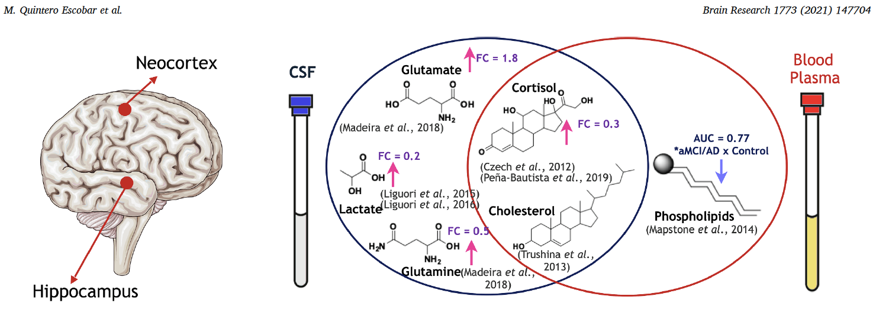
Metabolites associated with AD
The detailed list of metabolites can be found at: Omics-based biomarkers discovery for Alzheimer's disease (2022)
M Quintero Escobar,et al. Metabolomics in degenerative brain diseases, Brain Research, 2021
Notes:
Shows the alterations in brain regions caused by AD and the changes in the concentrations of some metabolites in CSF and blood plasma samples
The neocortex and hippocampus can lose contact because of the increase of neurofibrillary tangles and amyloid-containing senile plaques (Scheff et al., 2006), which point to AD. In this process, the prolonged increase of cortisol levels in basal metabolism has been indicated as a biomarker of defects of the hippocampus, because it releases glucocorticoid as a regulation mechanism during stress such as lesions (Lupien et al., 1998). Furthermore, specific phospholipids levels were decreased in the hippocampus (Haughey et al., 2010), as well as, in the blood plasma of AD patients. Phospholipids may be used to monitor the cell membrane integrity of neurodegeneration and to evaluate cognitive effects (Mapstone et al., 2014).
Brain area affected by AD, and some metabolites identified in CSF samples, blood plasma samples, or both. The arrows next to the chemical structures indicate an increase (pink arrow) or decrease (blue arrow) in the concentration of metabolites in the sample about the respective control samples
These metabolites are associated with number of pathological processes, such as: Tau phosphorylation, Aβ metabolism, dysfunction in mitochondrial activities, lipid metabolism, , Brain blood barrier damage, energy deficiencies, oxidative stress..

Slide 35
Potential Dietary Factors Leading to the Development of Alzheimer’s Disease
Insufficient antioxidants consumption^{1,2,3}: vitamins E and C
Antioxidant vitamins reduce β-amyloid-induced lipid peroxidation and oxidative stress and suppress inflammation signalling cascades ^{4,5}
Involved in DNA methylation and are essential cofactors for homocysteine metabolism. Their deficiency may contribute to Alzheimer’s disease through increased homocysteine levels and subsequent oxidative damage ⁴
Insufficient consumption of folates, vitamins B₆ and B₁₂
Moderate to severe cognitive impairment correlates positively with an increased risk of energy malnutrition⁶
Failure to meet energy demands
Loss of appetite, decrease in taste function, forgetting about the need to eat a meal
¹ Mielech A. Nutrients. 2020;12:3458
² An Y. Clin. Epigenet. 2019;11:139
³ Mecocci P. Biochim. Biophys. Acta (BBA) Mol. Basis Dis. 2012
⁴ Luchsinger J.A. Lancet Neurol. 2004;3:579–587.
⁵ Allan Butterfield D. Nutr. Neurosci. 2002;5:229–239.
⁶Martín I.S.M. Am. J. Alzheimers Dis. Other Demen. 2018;33:508–515

Slide 36
Potential Dietary Factors Leading to the Development of Alzheimer’s Disease
A high fat diet and excess saturated fatty acids (SFA)
High cholesterol levels
In animal model studies, a high fat and high cholesterol diet: ↑Tau hyperphosphorylation, ↓memory performance, ↑ hippocampal p-tau levels in old age
The role of heavy metals is speculated (especially lead and cadmium), current results are very inconclusive
Related to hyper-insulinemia, which is associated with a higher risk of Alzheimer’s disease^{1,2}
Contribute to oxysterols accumulating in the brain in AD
Positive correlation between cholesterol levels in the brain and the severity of dementia in Alzheimer’s disease patients⁴
Promotes the development of hypercholesterolemia³
¹ Luchsinger J.A. Lancet Neurol. 2004;3:579–587
² Luchsinger J.A. Neurology. 2004;63:1187–1192
³Maffeis C. Eur. J. Clin. Nutr. 2021;75:1109–1117
⁴Cutler R.G.Proc. Natl. Acad. Sci. 2004;101:2070–2075

Slide 37
The influence of nutritional factors on the prevention of AD
Positive Dietary Factors | Negative Dietary Factors
Foods rich in antioxidative and anti-inflammatory compounds:
Vitamin E (e.g., cold pressed vegetable oils) | Highly processed products- fast food, ready-to-eat meals
Vitamin C (e.g., citrus fruits, berries, acerola, peppers, broccoli) | Saturated fatty acid (e.g., animal fats, palm oil, highly processed food)
B-vitamins (e.g., nuts, seeds, beans, whole grain product) | Trans fatty acids (e.g., partially hydrogenated fats in foods, meat)
Polyunsaturated fatty acid (e.g., fish and seafood, nuts, camelina oil, linseed oil) | Simple sugar (e.g., sweets and sugar)
Polyphenols (e.g., grapes, berry fruit, green tee, red wine) | Poor quality food—risk of excess consumption of pollution and toxins, e.g., heavy metal
Stefaniak O. Nutrients. 2022;14(21):4564
Notes:
Based on previously mentioned dietary factors that may lead to development of AD, here is the the evidence based list of potential nutritional elements as preventive factors for AD

Slide 38

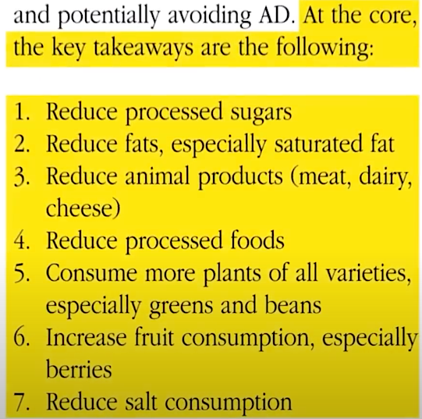
The influence of nutritional factors on the prevention of AD
Notes:
HERE IS ANOTHER reccomendation from leading scientific group for AD

Slide 39
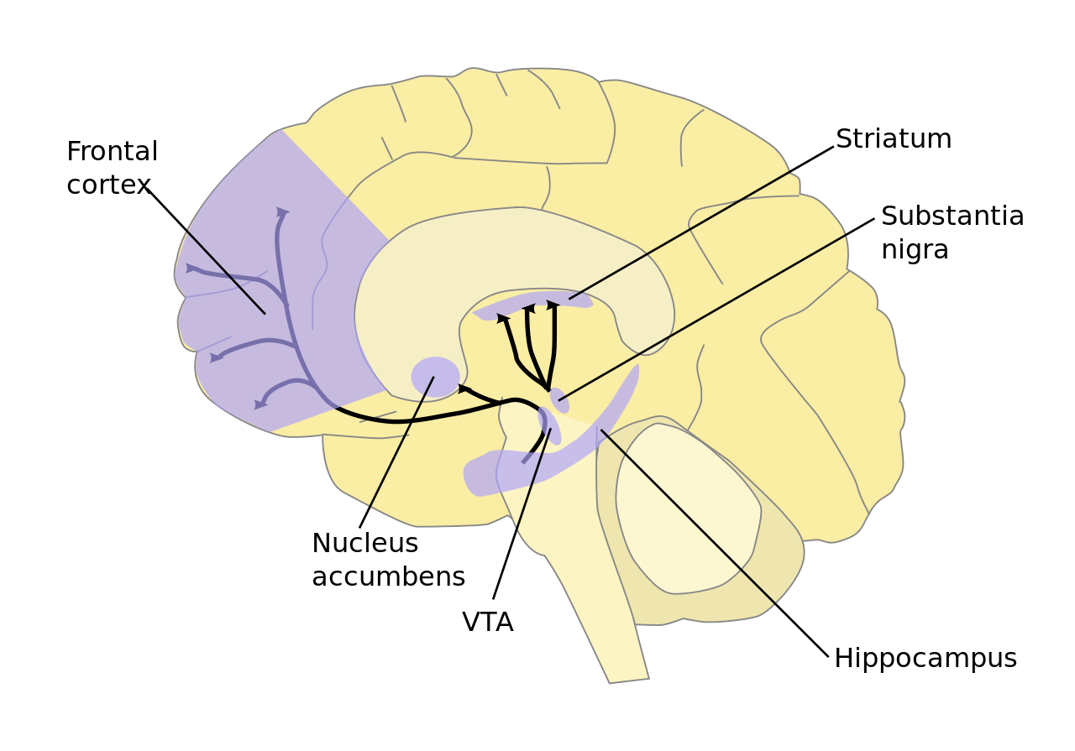
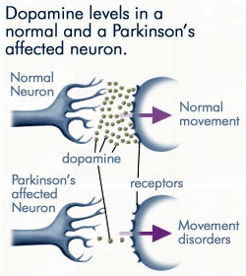
Parkinson’s disease - Overview
Progressive neurodegenerative disease
Movement (motor) disorder
2nd most common neurodegenerative disease to Alzheimer's
Prevalence thought to increase due to industrialization
Characterized by the degeneration of dopaminergic neurons in the substantia nigra pars compacta (SNpc)¹
Reduced dopamine signalling & release
other types of neurons are also affected
Aggregates of α-synuclein called Lewy bodies
¹Dickson DW. Parkinson's disease and parkinsonism: neuropathology. Cold Spring Harb Perspect Med. 2012

Slide 40
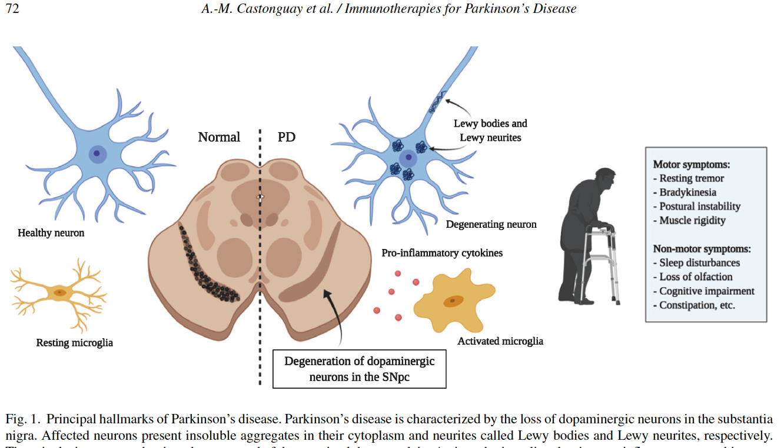
Parkinson’s disease - Overview
The current diagnosis of PD essentially relies on evaluation of clinical signs
Diagnosis and staging of using neuroimaging
An effort to define specific disease-related biomarkers → metabolomics is such and approach
- labor intensive
- expensive
A.M. Castonguay, et al. Treating Parkinson’s Disease with Antibodies: Previous Studies and Future Directions. J Parkinsons Dis. 2021
Notes:
Principal hallmarks of Parkinson’s disease. Parkinson’s disease is characterized by the loss of dopaminergic neurons in the substantia nigra. Affected neurons present insoluble aggregates in their cytoplasm and neurites called Lewy bodies and Lewy neurites, respectively. The current diagnosis relies on evaluation of clinical signs: motor symptoms and non-motor. Since diagnosis and staging using neuroimaging techniques (CT, MRI) is labor intensive and expensive, there is an effort to define specific disease-related biomarkers → metabolomics is such and approach

Slide 41
Metabolomics - novel insight into PD pathogenesis
Oxidative stress
Dyshomeostasis in metabolism^{1,2,3}:
catecholamine (↑vanillylmandelic acid)
tryptophan (↑3-hydroxykynurenine)
caffeine (↓concentrations of caffeine metabolites)
bile acid (BA) metabolism⁷
Several potential biomarkers^{4,5,6}:
acylcarnitines
quinolinic acid (QA)/kynurenic acid (KA) ratio
N8-acetyl spermidine
lipids
¹ Hatano T. J Neurol Neurosurg Psychiatry. 2016;87:295–301.
² Han W. Mov Disord. 2017;32:1720–8
³ Masato A. Mol Neurodegener. 2019;14:35.
⁴ Saiki S. Sci Rep. 2017;7:7328
⁵ Chang KH. Mol Neurobiol. 2018;55:6319–28
⁶ Schulte EC. PLoS One. 2016;11:e0147129.
⁷ MahmoudianDehkordi S. Alzheimers Dement. 2019;15:76–92
Notes:
A previous metabolomics study on cerebrospinal fluid (CSF) detected an increase in concentration of 3-hydroxykynurenine and decrease in concentration of glutathione in PD patients, suggesting the involvement of neurotoxicity and oxidative stress in PD pathogenesis
Vanillylmandelic acid (VMA), which is the end product of the catecholamine pathway, was retained as a significantly changed metabolite.
The fold change of VMA between the PD group and the control group was as large as 3.80, suggesting a significant metabolic change caused by PD
Although the concentrations of tryptophan and kynurenine did not change greatly, increased relative concentration of 3-hydroxykynurenine in the PD group was observed
The concentrations of caffeine metabolites were lower. It has been widely reported that coffee and tea consumption could protect against the risk of PD.
Metabolomics studies have revealed alterations in various metabolites associated with PD, including changes in amino acids, lipids, and energy-related metabolites. Here is the suumary of novel insights into PD pathogenesis, using metabolomics.
Metabolomics has the potential to identify biomarkers for early diagnosis and prognosis of PD. Specific metabolite profiles in biofluids (e.g., blood or cerebrospinal fluid) may serve as indicators of disease status: acylcarnitines, quinolinic acid (QA)/kynurenic acid (KA) ratio N8-acetyl spermidine, lipids

Slide 42
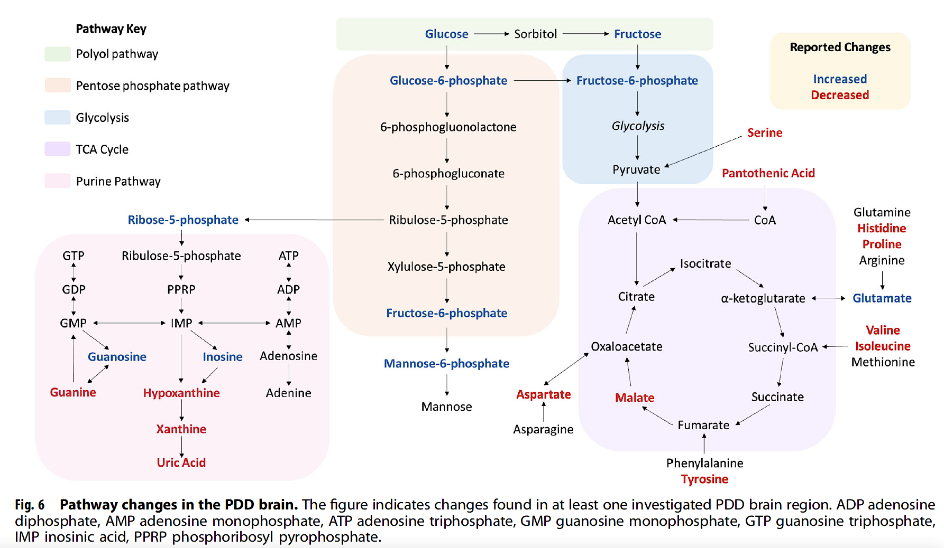
Metabolic pathway changes in the Parkinson's Disease Dementia (PDD) brain
Scholefield, M, et al. Multi-regional alterations in glucose and purine metabolic pathways in the Parkinson’s disease dementia brain. npj Parkinsons Dis. 2023
Notes:
The figure indicates changes found in at least one investigated PDD brain region. ADP adenosine diphosphate, AMP adenosine monophosphate, ATP adenosine triphosphate, GMP guanosine monophosphate, GTP guanosine triphosphate, IMP inosinic acid, PPRP phosphoribosyl pyrophosphate. These complex, interconnected metabolic pathways can help provide metabolic signature and profile, allowing us to better recognise, diagnose, screen and make personalized nutritional intervention towards preventing progression of PD disease. Overall, this report represents a comprehensive systematic, multi-regional, semi-targeted metabolic investigation of the PDD brain—highlighting several metabolic pathways for future targeted studies and potential therapeutic targets, including glucose and purine metabolism, among others. The number of these alterations reflected the α-synuclein Braak stage in which these brain regions are first affected by Lewy body deposition in traditional PD Braak staging, indicating that metabolic changes may reflect the temporal spread of PD neuropathology rather than the degree of neuronal loss in PDD.
Glucose metabolism: Evidence for impaired glucose metabolism has been reported extensively in the PD and PDD brain^{21,22,23}, with some previous reports of increased glucose and decreased glucose-6-phosphate⁵ levels in the PD cortex. Fructose showed increases of up to 2.8-fold in all investigated regions and fructose-6-phosphate also showed large increases of up to 9.9-fold. Fructose elevations, in combination with widespread elevations in ribose-5-phosphate, and more limited increases in glucose-6-phosphate and fructose-6-phosphate, may indicate increased activity of the polyol pathway and pentose phosphate pathway and decreased glycolytic activity in PDD. The relative changes in these different glucose metabolism pathways may contribute to mitochondrial dysfunction, glucose hypometabolism and energy production deficits in the PDD brain
Purines are essential components of the DNA and RNA nucleobase backbone and also function as components of other metabolic molecules that are involved in a great number of metabolic pathways, such as adenosine triphosphate (ATP), cyclic adenosine monophosphate (cAMP), reduced nicotinamide adenine dinucleotide (NADH) and coenzyme A (CoA); disruptions in the purine metabolic pathway, may lead to insufficient pools of purine components for these pathways
Multiple amino acids were observed to be altered in the PDD brain(we presented previously similar changes with aging) with widespread decreases in serine and proline affecting every investigated region (except for the SN in the case of serine), as well as region-specific decreases in isoleucine, valine and histidine, among others. MTG-specific increases in leucine and isoleucine were also present. Amino acids provide substrates to multiple metabolic pathways, including the TCA cycle (see Fig. 6); diminished amino acid levels may prevent the proper functioning of these pathways. Indeed, some alterations in the TCA cycle have previously been observed in the PD brain, including decreases in the activity of the rate-limiting enzyme α-ketoglutarate dehydrogenase in the PD CB⁸; however, most studies report only peripheral levels²⁵. Amino acids may influence neurotransmitter synthesis and functioning, as many are precursor molecules of different neurotransmitters, such as tyrosine and glutamate.
Pantothenic acid was observed to be decreased. Pantothenic acid is essential to the formation of CoA, which is involved in almost all metabolic pathways, including the TCA cycle and glycolysis . Decreased pantothenic acid levels may lead to insufficient levels of CoA being produced, as has been previously observed in the PD brain⁸, with potential downstream effects on the metabolic pathways in which it is involved.

Slide 43
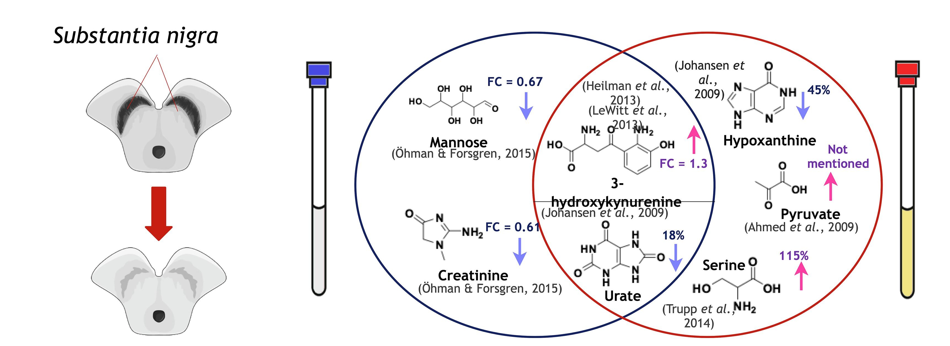
Metabolites associated with PD
M Quintero Escobar,et al. Metabolomics in degenerative brain diseases, Brain Research, 2021
Notes:
shows the alterations in brain regions caused by PD and the changes in the concentrations of some metabolites in CSF and blood plasma samples.
In PD, the substantia nigra neurons are degenerated due to the low concentration of dopamine. These neurons are responsible for a complex network of communications with basal ganglia neurons, which release dopamine that is biochemically associated with fine adjustment of movement (Triarhou, 2013). The increased levels of 3-hydroxykynurenine (Fig. 3) in substantia nigra may point to alterations in the kynurenine pathway and nicotinamide adenine dinucleotide (NADH) reduction (Wuolikainen et al., 2016), and the reduced concentration of glutathione may cause oxidative stress (Pearce et al., 1997).
The arrows next to the chemical structures indicate an increase (pink arrow) or decrease (blue arrow) in the concentration of metabolites in the sample about the respective control samples.

Slide 44



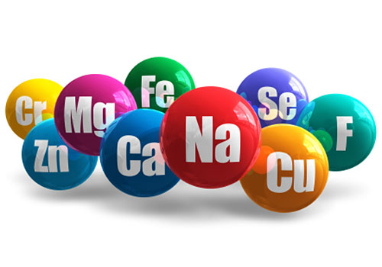

Parkinson disease
Diet and Parkinson disease (PD) risk and progression¹
Dietary component | Summary of evidence
Macronutrients
Carbohydrate, protein and fat | Beneficial effects of polyunsaturated fatty acids, which have a key role in inflammatory processes and can inhibit Toll-like receptor signalling and intestinal inflammation
Micronutrients
Dietary antioxidants (vitamins C and E and carotenoids) | In two large Swedish cohort studies^{2,3}, dietary vitamin E intake was associated with reduced PD risk. Evidence regarding dietary vitamin C and carotenoids is discrepant; no association with PD risk was seen in two meta-analyses
Vitamin B and folate | Reduced PD risk has been linked to vitamin B₆ intake, but not vitamin B₁₂ or folate. Higher homocysteine levels (low vit. B₆ intake) - worse motoric function and cognitive decline
Minerals and trace elements | Limited study result; a meta-analysis found no association between iron, zinc or copper intake and PD risk⁴
Overall dietary pattern
Mediterranean diet | Mediterranean diet adherence was associated with reduced risk of PD in large US and Swedish cohort studies ^{5,6} and reduced risk of prodromal PD among older adults in Greece⁷
¹Tan, A.H., Lim, S.Y. & Lang, A.E. Nat Rev Neurol, 2022;
²Hantikainen, E. et al. Neurology 96, 2021
³Yang, F., et al. Mov. Disord. 32, 2017
⁴Cheng, P. et al. Neurol. Sci. 36, 2015
⁵Gao, X. et al. Am. J. Clin. Nutr. 86, 2007
⁶Yin, W., et al. Mov. Disord.36, 2021
⁷Maraki, M. I. et al. Mov. Disord. 34, 2019

Slide 45





Parkinson disease
Diet and Parkinson disease (PD) risk and progression¹
Dietary component |  |  | Summary of evidence
Specific foods and compounds
Coffee and other caffeinated beverages |  | caffeine – main molecular component driving neuroprotection (possibly via adenosine A2A receptor antagonism)² Caffeine and polyphenols modulate the gut microbiome and promote gut mobility³ Reduced risk of levodopa-induced dyskinesia² | caffeine – main molecular component driving neuroprotection (possibly via adenosine A2A receptor antagonism)² Caffeine and polyphenols modulate the gut microbiome and promote gut mobility³ Reduced risk of levodopa-induced dyskinesia²
Flavonoids |  | Limited evidence suggests that dietary flavonoids in berry fruits, apples, oranges, fruit juices and red wine are associated with reduced PD risk^{4,5} | Limited evidence suggests that dietary flavonoids in berry fruits, apples, oranges, fruit juices and red wine are associated with reduced PD risk^{4,5}
Urate (diets rich in purine) |  | Higher plasma urate levels have been linked to reduced risk and slower progression of PD in several prospective studies^{6,7}- neuroprotection Sex difference: women but not men showing benefits | Higher plasma urate levels have been linked to reduced risk and slower progression of PD in several prospective studies^{6,7}- neuroprotection Sex difference: women but not men showing benefits
Dairy products |  | Higher (low-fat) milk consumption seems to be associated with higher risk of PD⁸ - urate-lowering effects | Higher (low-fat) milk consumption seems to be associated with higher risk of PD⁸ - urate-lowering effects
Alcohol |  | Evidence regarding the link between alcohol consumption and PD risk remains inconclusive Two European cohort studies found no association, whereas cohort studies from South Korea and the UK linked alcohol consumption with reduced PD risk; antioxidant effects, i.e. via urate-elevating effects of beer or polyphenols in wine⁴ (see reference 1 for more details) | Evidence regarding the link between alcohol consumption and PD risk remains inconclusive Two European cohort studies found no association, whereas cohort studies from South Korea and the UK linked alcohol consumption with reduced PD risk; antioxidant effects, i.e. via urate-elevating effects of beer or polyphenols in wine⁴ (see reference 1 for more details)
1Tan, A.H., Lim, S.Y. & Lang, A.E. Nat Rev Neurol, 2022
2Chen, J. F. & Schwarzschild, M. A. Parkinonism Relat. Disord. 80, 2020
3Iriondo-DeHond, A., Uranga, J. A., Del Castillo, M. D. & Abalo, R. Nutrients 13, 2020
4Boulos, C., Yaghi, N., El Hayeck, R., Heraoui, G. N. & Fakhoury-Sayegh, N. Nutrients 11, 2019
5Gao, X., Cassidy, A., Schwarzschild, M. A., Rimm, E. B. & Ascherio. Neurology 78, 2012
6leeman, I. et al. J. Parkinsons Dis. 9, 2019
7Gao, X., O’ Reilly, É. J., Schwarzschild, M. A. & Ascherio, Neurology 86, 2016
Notes:
Several studies showed no association between total dairy product consumption and dietary calcium and PD risk²²⁷. Among specific dairy products, higher milk consumption (in particular, low-fat milk) seemed to be associated with a higher risk of PD²²⁸. This association is posited to be due to the urate-lowering effects of milk consumption, although pesticide contamination might be a factor^{200,227,228}. No consistent association was found with other dairy products, such as yogurt, cheese, ice cream or butter^{200,227}

Slide 46
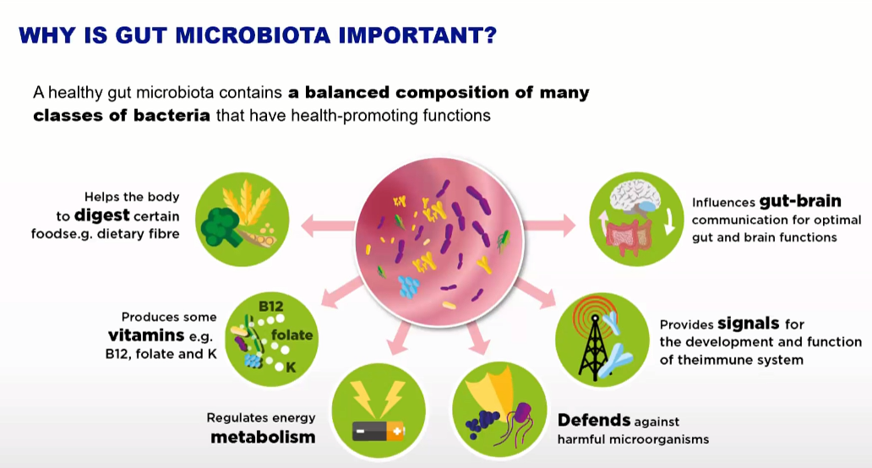
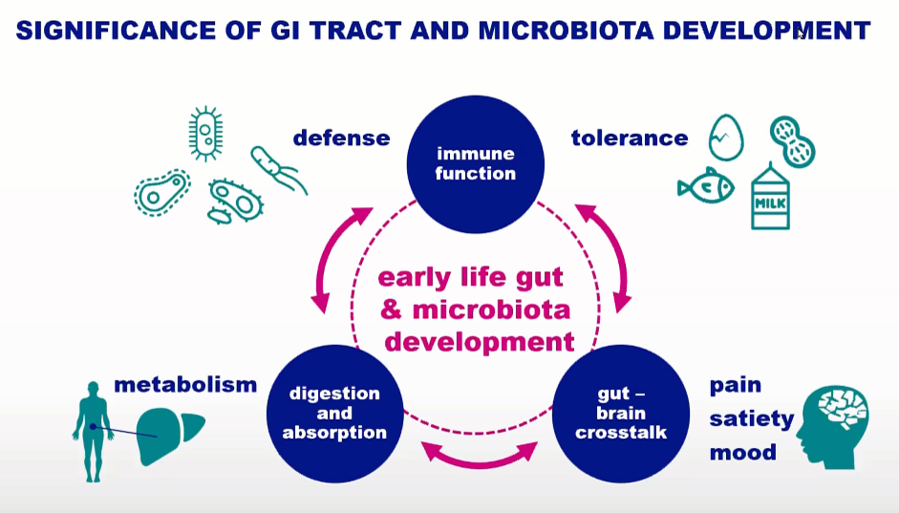
The importance of microbiota
Source: https://www.nutriciaresearch.com
Notes:
In this slide, lets remind of importance of microbiome and then we will describe the importance for pathophysiology of PD and AD
Microbiota are all microorganisms that normally inhabit an environment, such as the soil or a body of water, i.e.gut microbiota: bacteries, archaebacteria, viruses in single-cell Eukaryota.
A microbiome is the genomic composition of the entire microbiota in the host.
Gut microbiome and gut microbiota describe either the collective genomes of
the microorganisms that resides in the gut, or the microorganisms themselves
The microbiota is mostly present in the colon and less in the beginning of the digestive tube!

Slide 47
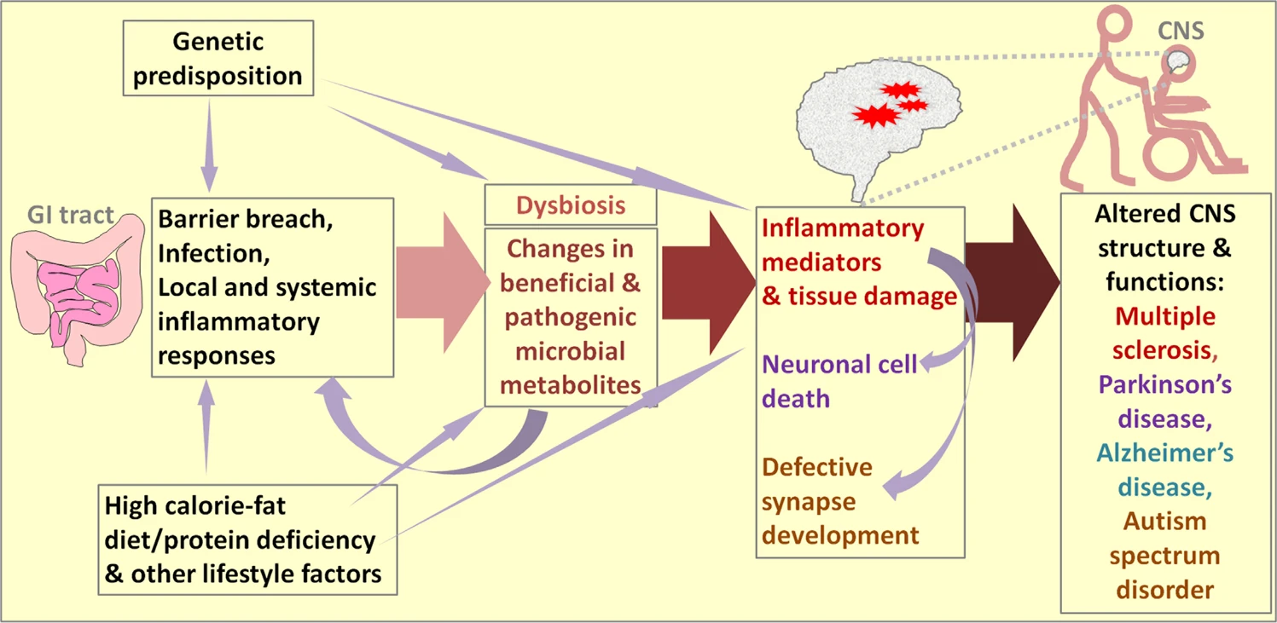
The common regulatory network of microbial metabolites, inflammatory diseases and CNS disorders
long-chain fatty acids
bile acid metabolites
toxic microbial metabolites
Park, J., Kim, C.H. Regulation of common neurological disorders by gut microbial metabolites. Exp Mol Med, 2021
Notes:
he common initiating factors for the four neurological diseases are genetic predisposition and environmental factors, which include diet and lifestyle. Under pathogenic conditions, the intestinal barrier can be breached, and systemic inflammatory responses can occur. These changes can be followed by dysbiosis (i.e., decreased gut microbial diversity leading to decreased levels of beneficial microbes). For example, consumption of a diet high in calories and fat but low in dietary fiber can accelerate pathogenic dysbiosis. As a result, decreased levels of beneficial gut microbial metabolites such as SCFAs, Trp metabolites and phytochemicals are produced, and simultaneously, the production of harmful metabolites such as long-chain fatty acids (LCFAs), certain bile acid metabolites, and toxic microbial metabolites increases, thereby affecting immune and tissue cells in both the intestine and CNS. These changes can decrease immune tolerance, which is important for preventing autoimmune diseases, and exacerbate pathogenic immune responses mediated by inflammatory cells such as Th17 and Th1 cells. These pathogenic inflammatory responses can contribute to tissue damage (demyelination in MS), neuronal cell death (PD and AD), and neuronal synapse development (ASD). Moreover, certain microbial metabolites regulate neurotransmission and, therefore, can directly affect neurological activity.

Slide 48
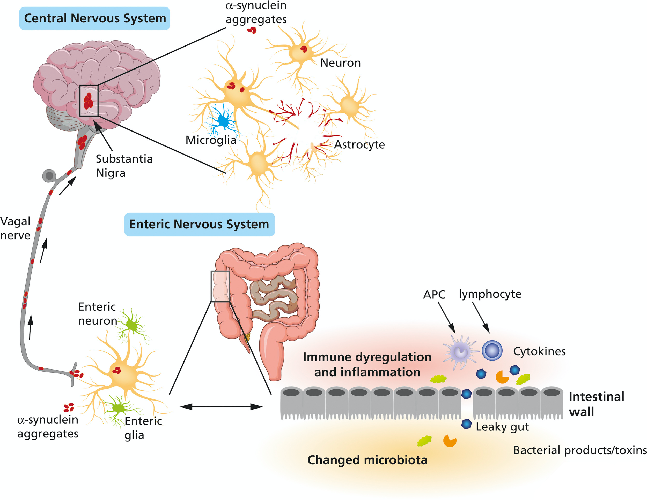
Gut Microbiota and Metabolome Alterations in PD
The gut-brain axis
PD patients show an increased gastrointestinal (GI) permeability, also known as leaky gut(Forsyth et al., 2011)
translocation of bacteria and inflammatory bacterial products (e.g., lipopolysaccharide, LPS)
inflammation and oxidative stress in the GI, alpha-synuclein accumulation in the ENS
(Forsyth et al., 2011, Glass et al., 2010, Quigley and Quera, 2006)
gut-derived LPS can promote the disruption of the blood brain barrier (Banks et al., 2008, Banks and Erickson, 2010)
Neuroinflammation and injury in the supstantia nigra
Possibilities for food-based therapies
Perez-Pardo P, et al. European Journal of Pharmacology, 2017
Notes:
Dietary phospholipid precursors and cofactors can increase neuronal membrane formation and function, and reduce inflammation, affecting both the ENS and CNS and reducing motor and non-motor abnormalities in PD. Probiotics, prebiotics and/or synbiotics might impact the gut microbiota composition, enhance intestinal epithelial integrity and reduce the pro-inflammatory response, impacting initiation or progression of the neurodegenerative process.

Slide 49
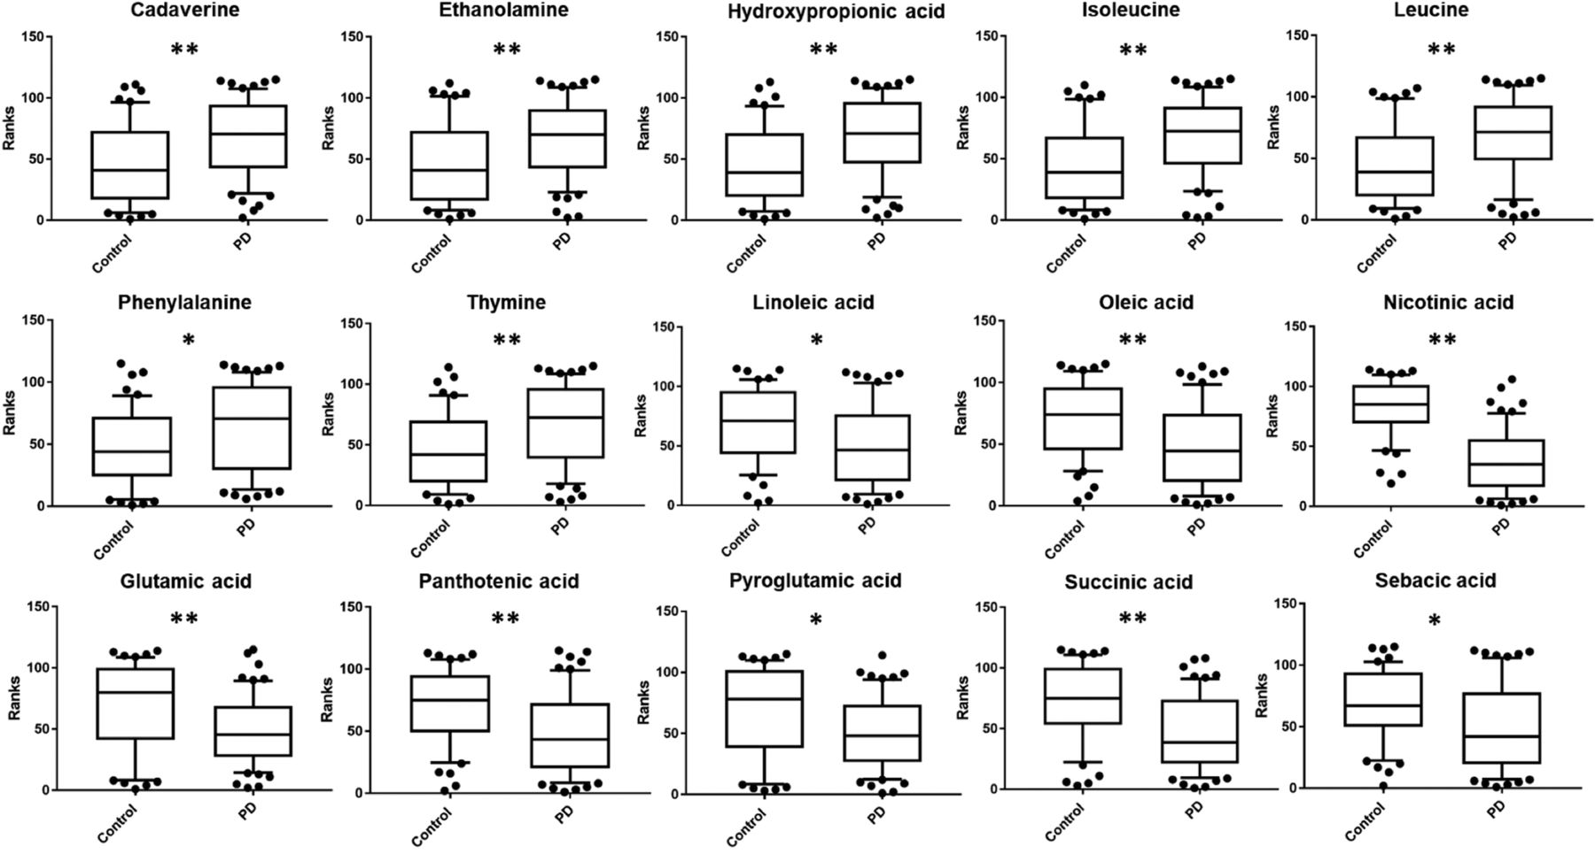
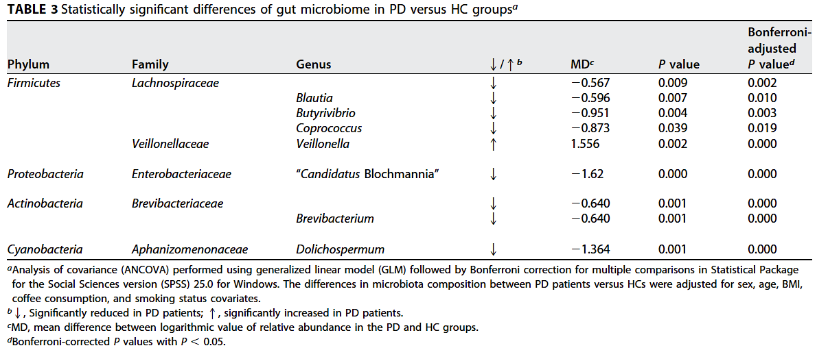
Composition of the gut microbiota and Parkinson’s disease
Evaluation of fecal metabolites reveals alterations in the gut metabolome in PD patient (57) compared to the heathy group
Alterations of metabolites:
Upregulation of metabolites:
cadaverine
ethanolamine,
hydroxypropionic acid,
isoleucine and leucine,
phenylalanineand thymine
Downregulation of metabolites:
pantothenic acid
pyroglutamic acid
succinic acid
sebacic acid
linoleic acid
oleic acid
nicotinic acid
glutamic acid
Statistically significant metabolites in fecal samples of PD patients versus control subjects comparison
Vascellari S, et al. Gut Microbiota and Metabolome Alterations Associated with Parkinson’s Disease, ASM Journals, 2020
Notes:
This is one of the few studies thus far that correlates the composition of the gut microbiota with the direct analysis of fecal metabolites in patients with Parkinson’s disease. Overall, data highlight microbiota modifications correlated with numerous fecal metabolites. This suggests that Parkinson’s disease is associated with gut dysregulation that involves a synergistic relationship between gut microbes and several bacterial metabolites favoring altered homeostasis. Interestingly, a reduction of short-chain fatty acid (SCFA)-producing bacteria influenced the shape of the metabolomics profile, affecting several metabolites with potential protective effects in the Parkinson group. On the other hand, the extensive impact that intestinal dysbiosis has at the level of numerous metabolic pathways could encourage the identification of specific biomarkers for the diagnosis and treatment of Parkinson’s disease, also in light of the effect that specific drugs have on the composition of the intestinal microbiota.

Slide 50
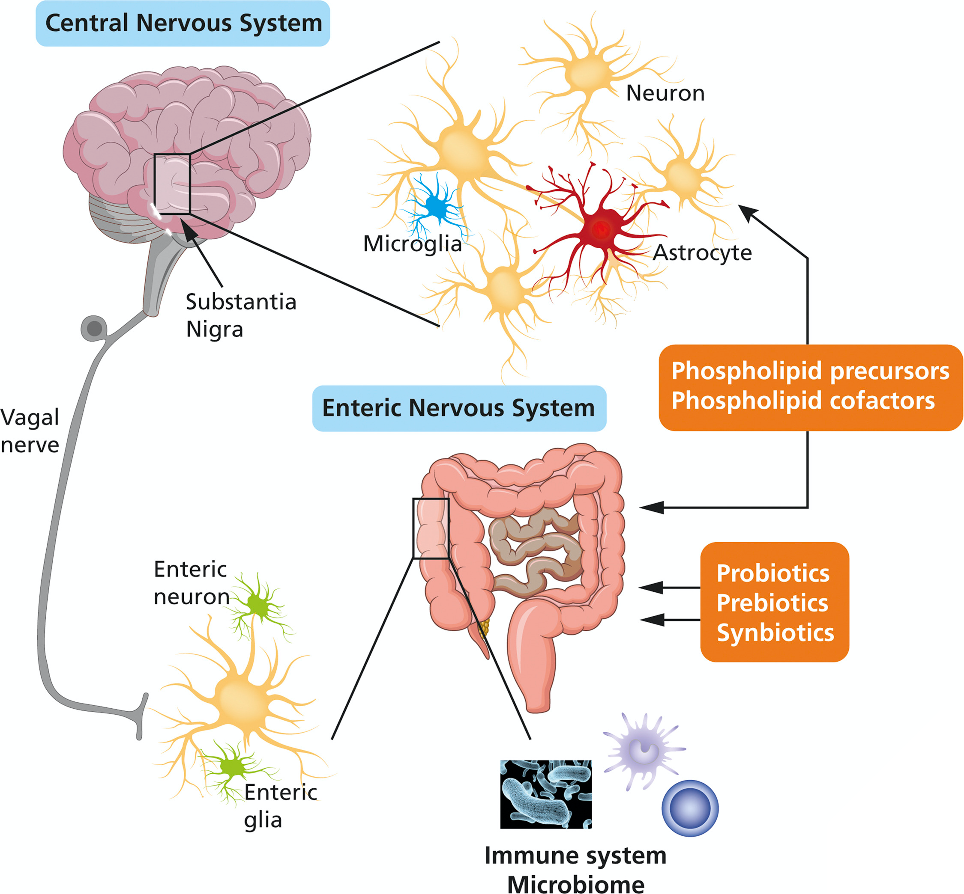
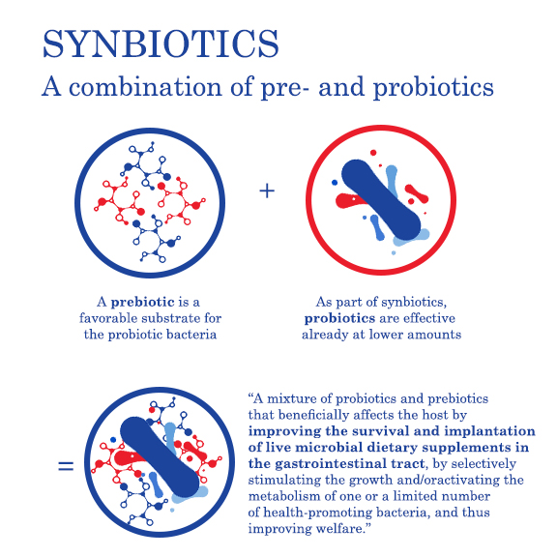
Gut Microbiota and Metabolome Alterations in PD
Possibilities for food-based therapies
PROBIOTICS
live microorganisms that,
when administrated in adequate
amounts confer a health benefit on the host
Based on FAO/WHO definition (2001) and updated ISAPP (2014)
PREBIOTICS
substrates that are selectively utilized by host microorganisms conferring a health benefit
The International Scientific Association for Probiotics and Prebiotics (ISAPP) definition for prebiotics as published in a consensus statement from June 2017.
SYNBIOTICS
are combination of Pre and Probiotics
Pandey t al, 2015
Shamir, 2015
POSTBIOTICS
bioactive compounds produces by food-grade microorganisms in a fermentation process
Aguilar-Toala 2018
Klemashevish 2014
Perez-Pardo P, et al. European Journal of Pharmacology, 2017
Notes:
The emerging field of research on the gut-brain axis has shed light on potential connections between gut microbiota and neurodegenerative diseases, including Parkinson's disease (PD). Among the various interventions studied, probiotics, prebiotics, and postbiotics have garnered attention for their potential impact on the gut microbiota and, consequently, on neurological health.
Probiotics, defined as live microorganisms, primarily bacteria, that confer health benefits when consumed in sufficient amounts, have been investigated for their potential effects in PD. Research suggests that probiotics may influence the composition of the gut microbiota, which is often altered in PD patients. By restoring a healthy microbial balance, probiotics could potentially mitigate gut dysbiosis observed in PD. Moreover, certain probiotics have been found to produce neurotransmitters such as gamma-aminobutyric acid (GABA) and serotonin, suggesting a potential link between gut microbial activity and brain function.
Prebiotics, non-digestible fibers that serve as a food source for beneficial gut bacteria, offer another avenue for exploring interventions in PD. By nourishing the growth of beneficial bacteria in the gut, prebiotics contribute to the maintenance of a healthy gut microbiota. The fermentation of prebiotics by gut bacteria produces short-chain fatty acids (SCFAs), including butyrate, which exhibits anti-inflammatory and neuroprotective properties. This raises the possibility that prebiotics may influence gut-brain communication through their effects on microbial metabolites.
Postbiotics, the metabolic byproducts of probiotic bacteria, encompass substances such as organic acids, peptides, and cell surface proteins. These byproducts may exert direct anti-inflammatory effects in the gut and contribute to the maintenance of gut barrier function. The exploration of postbiotics in PD is a relatively recent avenue of research, and further studies are needed to elucidate their specific roles and mechanisms of action.

Slide 51
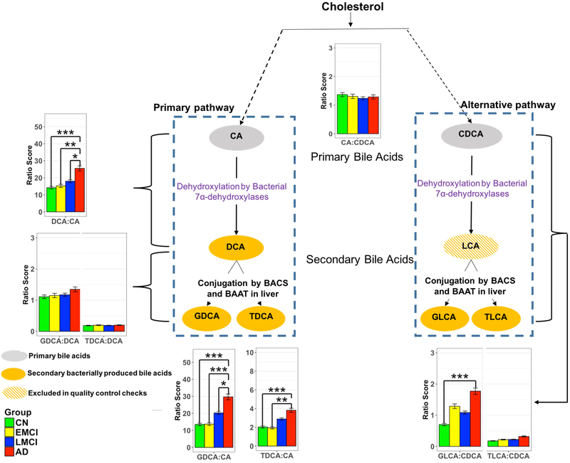
Gut Microbiome and Alzheimer’s disease (AD)
Bile acid (BA) profiles are altered in Mild cognitive impairment (MCI) and AD patients and are related to cognitive decline¹
In Alzheimer’s disease
decreased cholic acid (CA)
increased deoxycholic acid (DCA)
increased DCA:CA ration ➔ dysbiosis ➔ cognitive decline
Bile acid signature was associated with A/T/N biomarker for AD pathophysiology
Ratios of bile acids reflective of liver and gut microbiome enzymatic activities in CN, Early MCI, Late MCI and AD patients.
¹ MahmoudianDehkordi S. Alzheimers Dement. 2019;15:76–92
Notes:
The study Investigated if bile acid profiles are altered in Mild cognitive impairement (MCI) and AD patients and if these differences are related to cognitive decline¹
1464 subjects included, 370 CN, 284 early MCI, 5050 late MCI, 305 AD
Studies have reported alterations in the composition of the gut microbiome in individuals with Alzheimer's disease. These changes include variations in the abundance and diversity of specific microbial species. (Reference: Cattaneo, A., et al. (2017).
Metabolites produced by gut bacteria, such as short-chain fatty acids (SCFAs), may have immunomodulatory effects. Disturbances in the production of these metabolites could contribute to neuroinflammation, a hallmark of Alzheimer's disease. Reference: Vogt, N. M., et al. (2017).
Amyloid beta, a protein associated with Alzheimer's pathology, may be influenced by the gut microbiome. Some studies suggest that certain microbes can modulate amyloid beta production and clearance. Reference: Harach, T., et al. (2017).

Slide 52

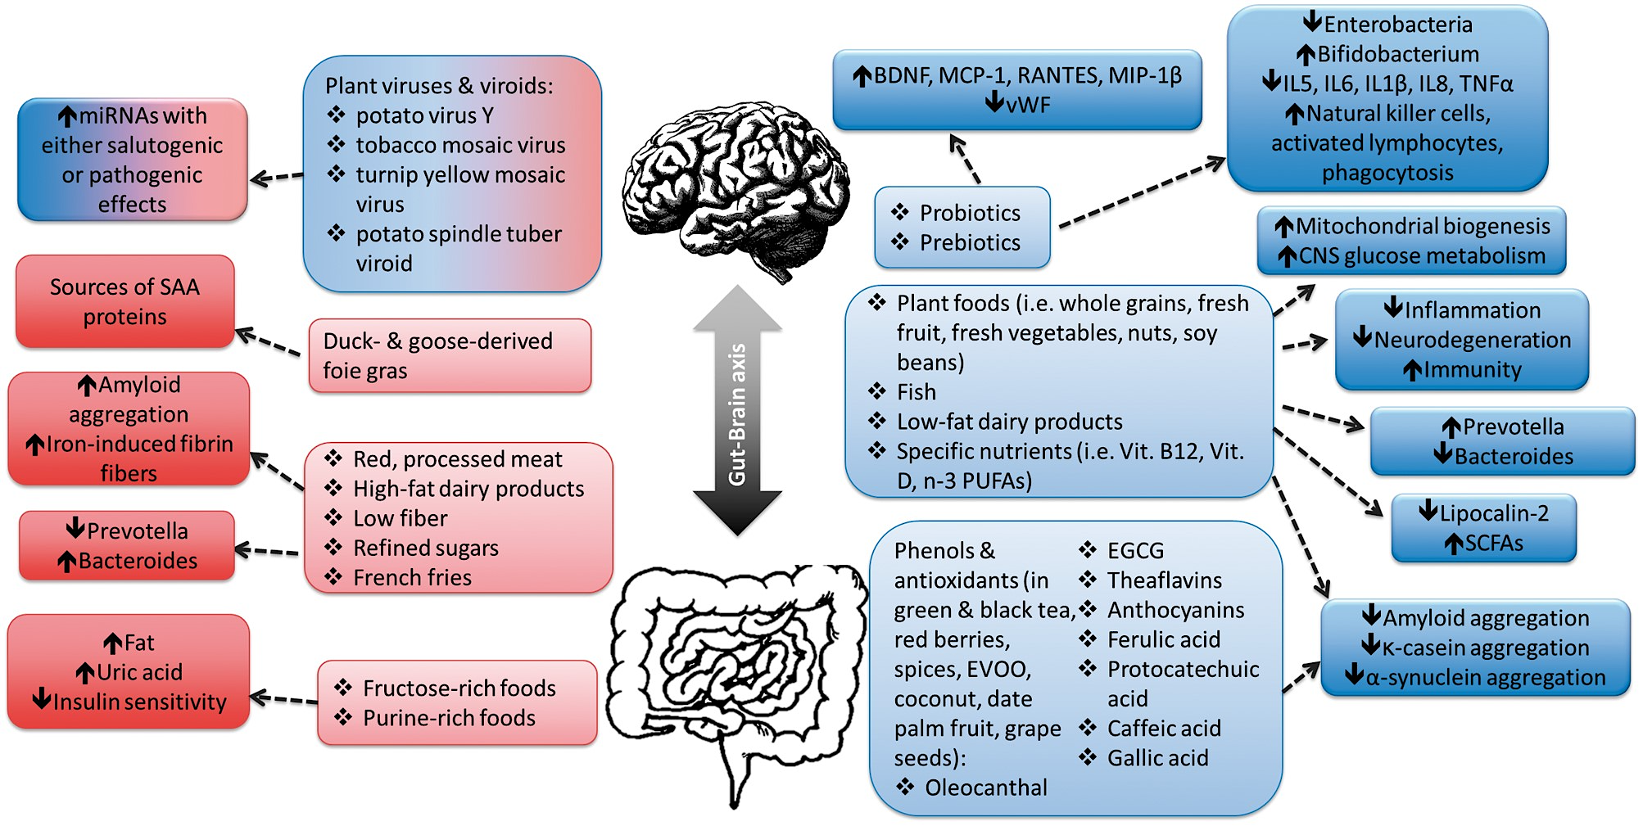
Effects elicited by nutrients and foods on either gut microbiota composition or amyloid formation
Gut Microbiome and Alzheimer’s disease (AD)
Potential Therapeutic Strategies
Understanding the early causes of gut microbiota dysbiosis and the correlations between gut microbiota and brain physiology might help prevent or reduce sequelae related to chronic gut and brain inflammation.
Notes:
Figure 2 Effects elicited by nutrients and foods on either gut microbiota composition or amyloid formation. Protective, antiamyloidogenic foods and nutrients and their salutogenic effects are shown on the right side of the figure; proamyloidogenic foods and nutrients and their pathogenic effects are indicated on the left side. Plant viruses and viroids can increase the levels of miRNAs with either salutogenic or pathogenic effects. Abbreviations : CNS, central nervous system; BDNF, brain-derived neurotrophic factor; EGCG, (−)-epi-gallocatechin gallate; EVOO, extra virgin olive oil; IL, interleukin; MCP-1, monocyte chemotactic protein-1; MIP-1β, macrophage inflammatory protein-1β; miRNA, micro RNA; PUFAs, polyunsaturated fatty acids; RANTES, regulated on activation, normal T cell expressed and secreted; SAA, serum amyloid A; SCFAs, short-chain fatty acids; TNFα, tumor necrosis factor α; Vit B12, vitamin B 12 ; vWF, Von Willebrand factor.
Potential Therapeutic Strategies:
Modulating the gut microbiome through dietary interventions, probiotics, and fecal microbiota transplantation (FMT) is being explored as a potential therapeutic strategy for Alzheimer's disease.
Studies have reported alterations in the composition of the gut microbiome in individuals with Alzheimer's disease. These changes include variations in the abundance and diversity of specific microbial species. (Reference: Cattaneo, A., et al. (2017).
Metabolites produced by gut bacteria, such as short-chain fatty acids (SCFAs), may have immunomodulatory effects. Disturbances in the production of these metabolites could contribute to neuroinflammation, a hallmark of Alzheimer's disease. Reference: Vogt, N. M., et al. (2017).
Amyloid beta, a protein associated with Alzheimer's pathology, may be influenced by the gut microbiome. Some studies suggest that certain microbes can modulate amyloid beta production and clearance. Reference: Harach, T., et al. (2017).

Slide 53


Future perspectives – precision nutrition
Role of metabotyping in the development of targeted dietary advise. Metabotypes are subgroups of metabolically similar individuals.
Predicting response to dietary interventions. The development of metabotyes, and predictive models encompassing metabolomic profiles, can be used to predict which individuals respond to specific dietary interventions
Lorraine Brennan, Baukje de Roos, Role of metabolomics in the delivery of precision nutrition, Redox Biology, 2023
Notes:
The area of precision nutrition, and the concepts underpinning it's research, have only recently started to attract a lot more attention. The opportunities that omics technologies offer, especially metabolomics, to broaden our understanding of dietary intake and how this links to disease development, as well as to evaluate individual responsiveness based on metabotypes, and/or other factors including someone's genetics, their gut microbiome, body composition, and metabolites indicative of glucose or protein metabolism, offer important improvements on how we can provide personalised and more precise dietary advice. Advanced statistical and AI approaches play an increasingly important role in this development, especially in relation to the integration of multi-omics datasets to define metabotypes and predict individual response

Slide 54

We are what we eat
A sustained change from a typical Western diet to the optimal diet
from age 20
increase life expectancy (LE) by more than a decade for women 10.7 and men 13 years
more legumes
more whole grains
more nuts
and less red meat
less processed meat
from age 60
increase LE by 8 years for women and 8.8 years for men
80-year-olds
gain 3.4 years
Fadnes LT, et al. Estimating impact of food choices on life expectancy: A modeling study. PLoS Med. 2022
Notes:
We are what we eat. Which is good news, because it means we have the power. Changing from a more typical diet to a more optimized diet starting at age twenty would be expected to increase the lifespan of women by about eleven years and men by thirteen years.
The largest gains would be made by eating more legumes, whole grains and nuts, and less red and processed meat.

Slide 55


Summary
Metabolomics is a Promising Tool:
Integral in unraveling complexities of aging and neurodegenerative diseases.
Potential for personalized medicine and targeted therapeutic interventions.
Metabolomics not only illuminates the subtle shifts in the aging process but also holds the promise of early detection and diagnosis in neurodegenerative diseases
Deciphering the metabolic pathways implicated in neurodegenerative disorders, enables a profound understanding of their pathophysiology
The integration of metabolomics with other 'omics' disciplines, such as genomics and proteomics, is an essential step forward
Gut-organ axes: microbiome communicates to distant organs via metabolites
Microbiome-induced malnutrition of the brain could induce AD
Neurodegeneration as a metabolic disease can be prevented by adhering to healthy lifestyle satisfying your microbiome
This Photo by Unknown Author is licensed under CC BY-NC
Notes:
n the intricate tapestry of aging and neurodegenerative diseases, metabolomics emerges as a powerful lens, revealing the molecular nuances that underlie these complex processes. As we navigate the vast landscape of biological molecules, metabolomics stands out as a beacon of hope, offering profound insights and transformative potential.

Slide 56
Literature
Mandatory:
Bourgognon JM, Steinert JR. The metabolome identity: basis for discovery of biomarkers in neurodegeneration. Neural Regen Res. 2019
M Quintero Escobar, et al. Metabolomics in degenerative brain diseases, Brain Research, 2021
Hou, Y., Dan, X., Babbar, M. et al. Ageing as a risk factor for neurodegenerative disease. Nat Rev Neurol, 2019
Pataky MW, Young WF, Nair KS. Hormonal and Metabolic Changes of Aging and the Influence of Lifestyle Modifications. Mayo Clin Proc, 2021
Self, W.K., Holtzman, D.M. Emerging diagnostics and therapeutics for Alzheimer disease. Nat Med, 2023
Park, J., Kim, C.H. Regulation of common neurological disorders by gut microbial metabolites. Exp Mol Med, 2021
Bruno Dubois, et al. Clinical diagnosis of Alzheimer's disease: recommendations of the International Working Group, The Lancet Neurology, 2021
Vascellari S, et al. Gut Microbiota and Metabolome Alterations Associated with Parkinson’s Disease, ASM Journals, 2020
Additional:
E.L. Dillon, Protein Metabolism in the Elderly: Molecular and Cellular Aspects, Academic Press, 2016
Castro, A, et al. The Aging Process: A Metabolomics Perspective. Molecules, 2022
Mapstone, M., Cheema, A., Fiandaca, M. et al. Plasma phospholipids identify antecedent memory impairment in older adults. Nat Med, 2014
Jack CR Jr. A/T/N: An unbiased descriptive classification scheme for Alzheimer disease biomarkers. Neurology, 2016
Sharma R, Ramanathan A. The Aging Metabolome-Biomarkers to Hub Metabolites. Proteomics, 2020
Perez-Pardo P, Kliest T, Dodiya HB, Broersen LM, Garssen J, Keshavarzian A, Kraneveld AD. The gut-brain axis in Parkinson's disease: Possibilities for food-based therapies. Eur J Pharmacol, 2017
https://www.diagnosticsolutionslab.com
https://www.bluezones.com
MahmoudianDehkordi S. Altered bile acid profile associates with cognitive impairment in Alzheimer's disease-An emerging role for gut microbiome.. Alzheimers Dement, 2019
Advanced:
The Human Metabolome Database - https://hmdb.ca
https://www.bioinformatics.ca
Self, W.K., Holtzman, D.M. Emerging diagnostics and therapeutics for Alzheimer disease. Nat Med, 2023
Jack CR Jr. A/T/N: An unbiased descriptive classification scheme for Alzheimer disease biomarkers. Neurology, 2016
Lorraine Brennan, Baukje de Roos, Role of metabolomics in the delivery of precision nutrition, Redox Biology, 2023

